Slide 1
8. TOPIC Groups and teams in the organization group formation
Ing. Pavel Adámek, Ph.D.
adamek@opf.slu.cz

Slide 2
Content
Group formation – key terms and learning outcomes
The key characteristics of a group
Different types of group tasks
Formal and an informal group
Group formation and group development

Slide 3
How the lecture will be conducted?
The lecture is divided into two blocks, where each block introduces an issue associated with:
Group formation
The key characteristics of a group
Different types of group tasks
Formal and Informal group
We use MS Teams, a shared whiteboard for your engagement and reactions, brainstorming ideas and for sharing answers.
The lecture is completed by quizzes in Vevox, the link is always in the presentation.

Slide 4
Contents
PART (45 min.)
Group formation
The key characteristics of a group
Different types of group tasks
2. PART (45 min.)
Definitions and distinctions formal and Informal group

Slide 5
Learning objectives
After studying this topic, you should be able to:
Have knowledge of group formation and group building, you will be able to recognise the key characteristics of groups.
To distinguish between typologies and types of groups according to formality and degree of development, which can then be applied in practical team creation/development.

Slide 6
Key readings
You can find support in the following sources:
Book – Huczynski, A. (2013). Organizational Behaviour. Chapter 10., p. 322

Slide 7
PART 2
Group formation
The key characteristics of a group
Different types of group tasks
Work groups and teams have become a nearly ubiquitous part of contemporary management practice in the majority of prominent organizations in the world.

Slide 8
Why study groups?
Groups embody many important cultural values of Western society: teamwork, cooperation, a collective that is greater than the sum of its parts, informality, egalitarianism and even the indispensability of the individual member.
Groups are seen as having a motivating, inspiring influence on the individual, drawing the best out of him or her, enabling him or her to perform feats that would be beyond him or herself as a detached individual.
Groups can have a healing effect on individuals, bolstering their self-esteem and filling their lives with meaning.

Slide 9
Why study groups?
According to the European Foundation:
60 per cent of EU workers perform all or part of their work in teams;
most teamworking is to be found in the UK and Estonia (81 per cent) and the least in Lithuania (38 per cent) and Italy (41 per cent);
most teamwork occurs in industrial rather than service industries;
teamwork is most often found in larger organizations.

Slide 10
Why study groups?
McGrath’s circumplex model shown reflects the four major activities performed by groups, and classifies eight different group tasks.
Groups generate plans and ideas (e.g. solutions, strategies);
They execute tasks (e.g. surgical operations, military missions);
They engage in negotiations (e.g. in labour–management conflicts and company–government disputes); and
They choose between options (e.g. appointment decisions, investment decisions).

Slide 11
McGrath’s circumplex model of group tasks

Slide 12
Definitions of groups
The term group is thus reserved for people who consider themselves to be part of an identifiable unit, who relate to each other in a meaningful fashion, and who share dispositions through their shared sense of collective identity.
Researchers often refer to these as psychological groups.
Group two or more people, in face-to-face interaction, each aware of their group membership and interdependence, as they strive to achieve their goals.
Group dynamics the forces operating within groups that affect their performance and their members’ satisfaction.

Slide 13
Definitions of groups

Slide 14
STOP AND THINK
Why would only one of the following be considered to be a group? In what circumstances could one of the other aggregates become a group?
(a) people riding on a bus
(b) blonde women between 20 and 30 years of age
(c) members of a football team
(d) audience in a theatre
(e) people sheltering in a shop doorway from the rain

Slide 15
Definitions of groups
Groups differ in the degree to which they possess the five characteristics listed below.
A minimum membership of two people. Groups can range from two people to over 30. However, the greater the number of group members, the higher the number of possible relationships between them, the greater the level of communication that is required, and the more complex the structure needed to operate the group successfully.
A communication network. Each group member must be capable of communicating with every other member. In this communication process, the aims and purposes of the group are exchanged. The mere process of interaction satisfies some of our social needs, and it is used to set and enforce standards of group behaviour.
A shared sense of collective identity. Each member must identify with the other members of their group, and not see themselves as an individual acting independently. They must all believe themselves to be participants in the group which itself is distinct from other groups.

Slide 16
Definitions of groups
Groups differ in the degree to which they possess the five characteristics listed below.
Complementary goals. Members have individual objectives which can only be met through membership of and participation in the group. Their goals may differ but are sufficiently complementary that members feel able to achieve them through participation in the group. They recognize the need to work collectively and not as individuals.
Group structure. Individuals in the group will have different roles, e.g. initiator/ideas person, suggestion-provider, compromiser. These roles, which tend to become fixed, indicate what members expect of each other. Norms or rules exist which indicate which behaviours are acceptable in the group and which are not (e.g. smoking, swearing, late arrival).

Slide 17
Issues facing any work group

Slide 18
Definitions of groups
There are many benefits of group working:
Groups allow organizations to develop and deliver products and services quickly and cost-effectively while maintaining quality.
They enable organizations to learn, and to retain learning, more effectively.
Cross-functional groups promote improved quality management.
Cross-functional design groups can undertake effective process re-engineering.
Production time can be reduced if tasks currently performed consecutively by individuals are performed concurrently by people in groups.

Slide 19
Types of group tasks
Borrill and West (2005) reported research estimating that 88% of the variation in a group’s
performance could be explained with reference to the task that it was asked to perform.
Steiner (1972) classified group tasks on the basis of the type of interdependence that they required between their members.
With an additive task, all group members do basically the same job, and the final group product or outcome (group performance) is the sum of all their individual contributions.
The final outcome is roughly proportional to the number of individuals contributing. There is low interdependency between these people.
A group working together will normally perform better than the same number of individuals working alone, provided that all group members make their contribution.

Slide 20
Types of group tasks
Steiner (1972) classified group tasks on the basis of the type of interdependence that they required between their members.
In a disjunctive task, one member’s performance depends on another’s. Again there is high interdependency. However, this time, the group’s most capable member determines its performance.
Groups perform better than their average member on disjunctive tasks, since even the best performer will not know all the answers, and working with others helps to improve overall group performance.
Examples of disjunctive task performers are quiz teams (University Challenge, pub quiz) and a maintenance team in a nuclear power generating plant.

Slide 21
Group-oriented view of organizations
Another famous psychologist, Rensis Likert (1903–1981) , echoed the idea that organizations should be viewed and managed as a collection of groups rather than individuals.
He argued that:
work groups are important sources of individuals’ need satisfaction;
groups in organizations that fulfil this psychological function are also more productive;
management’s task is therefore to create effective work groups by developing ‘supportive relationships’;
an effective organizational structure consists of democratic-participative work groups, each linked to the organization as a whole through overlapping memberships;
coordination is achieved by individuals who carry out ‘linking functions’.

Slide 22
Group-oriented view of organizations
Organizational design based around groups rather than individuals:
improves communications;
increases co-operation;
provides more team member commitment;
produces faster decision-making.
Rensis Likert’s linking pin model

Slide 23
STOP AND THINK
You have accepted a job and your new employer tells you that you will become ‘part of the team’, and a ‘member of one big happy family here’.
• How do you feel about the organization as your ‘psychological home’ in this respect?
• When managers say that they want you ‘to belong’ what do they really mean?
• Why do you think teamworking has been so consistently popular with managers interested in improving employees’ performance?

Slide 24
Vevox questions
https://silesianuniversity.vevox.com/#/meeting/450463/polls

Slide 25
PART 2
Formal and Informal groups
Workplace behaviour can be considered as varying along a continuum from formally to informally organized.

Slide 26
Formal and informal groups
Formal group a group that has been consciously created by management to accomplish a defined task that contributes to the organization’s goal.
All have certain common characteristics:
They are task-orientated.
They tend to be permanent.
They have a formal structure.
They are consciously organized by management to achieve organizational goals.
Their activities contribute directly to the organization’s collective purpose.

Slide 27
Formal and informal groups
Informal group a collection of individuals who become a group when they develop interdependencies, influence one another’s behaviour, and contribute to mutual need satisfaction.
Self-interest and self-identity interact and reciprocate. These processes have implications for the behaviour of the groups concerned. This phenomenon is termed group self-organization.
Group self-organization refers to the tendency of groups to
form interests,
develop autonomy, and
establish identities.

Slide 28
A social network in an organization

Slide 29
Group formation
Groups do not suddenly appear out of nowhere.
Before being able and willing to contribute as part of a collective, individuals who were previously strangers have to become familiar with each other in order to establish how best to work together to achieve the common task.

Slide 30
Group formation
Group environment is created by management’s decisions in three areas:
Physical. These are the actual surroundings within which a group functions. It includes the spatial arrangement of physical objects and location of human activities, e.g. office architecture and work furniture; placement of workers on an assembly line.
Technological. This includes both material technology (the tools, machinery, and equipment that can be seen, touched, and heard) that group members use to do their jobs, and social technology (the methods which order their behaviour and relationships).
Social. This encompasses the norms and values of the group itself; of its managers (e.g. employees as motivated solely by money) and of the organization culture (stressing mutual support and collaboration or competition, distrust and backstabbing).

Slide 31
Group formation
External system broadly compares to the concept of the formal organization.
They require individuals to perform certain activities; to have certain interactions with others; and to have certain sentiments or feelings towards their work.
For example, in a supermarket, the physical/technological/social environment is represented by the design and positioning of the checkout stations, the choice of scanning equipment, and the company’s ‘the customer is always right’ policy. The supermarket management wants its checkout operators to scan customers’ purchases (activities); greet them, offer to pack their bags, and say goodbye to them (interactions). They are also expected to have positive attitudes and feelings towards their customers and their employer (sentiments).
Each of these elements with the term ‘required’ (required activities, required interactions, and required sentiments) and referred to them collectively as the external system.

Slide 32
Group development

Slide 33
Groups and teams

Slide 34
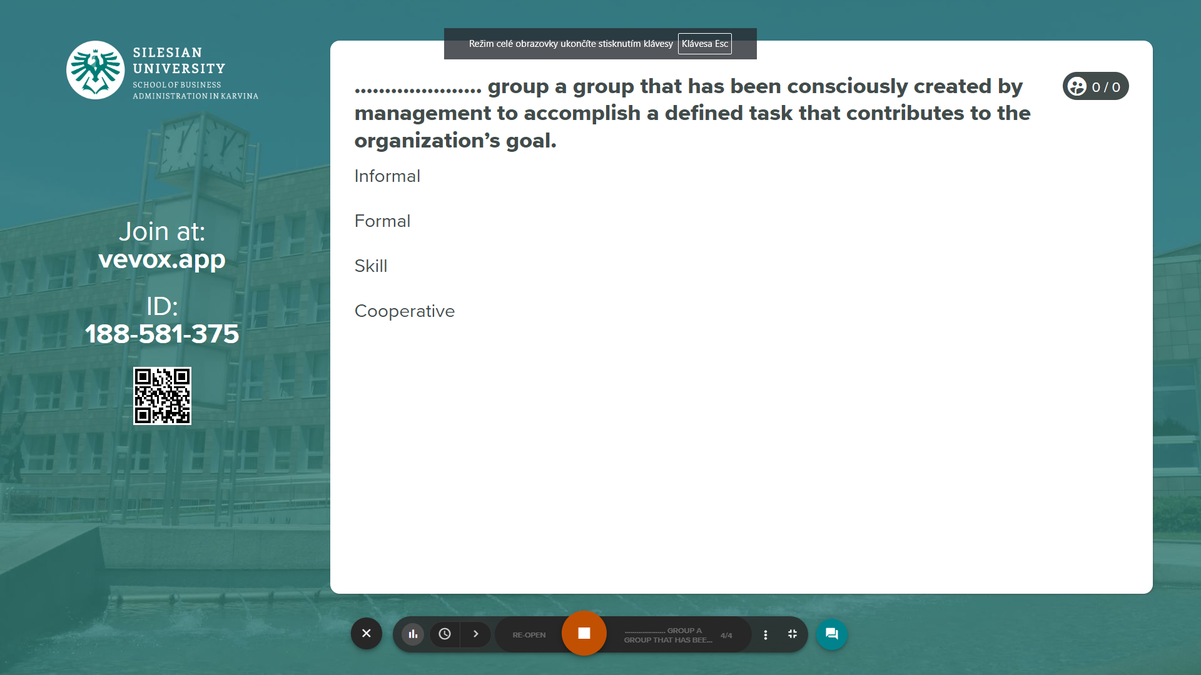
Vevox questions
https://silesianuniversity.vevox.com/#/meeting/450463/polls

Slide 35
RECAP
A group consists of two or more people, in face-toface interaction, each aware of his or her membership in the group, each aware of the others who belong to the group, and each aware of their positive interdependence as they strive to achieve mutual goals.
Groups can be assigned many different tasks, many of which can be categorized under the headings of additive, conjunctive, and disjunctive.
Formal groups can be distinguished from informal groups in terms of who creates them and the purposes that they serve.
George Homans’s theory of group formation distinguishes between background factors and required and emergent activities, interactions, and sentiments, to explain how individuals come to form groups.
We can distinguish five stages through which groups typically proceed, which they name forming, storming, norming, performing, and adjourning.
Contrast a team with a single-leader working group on the dimensions of: who runs it; who sets the goals; performance evaluation; work style; business context; speed and efficiency; primary end products; and accountability.

Slide 36
We can share our thoughts and ask questions ☺
Pavel Adámek
adamek@opf.slu.cz

