Slide 1

Logistika
Přeprava
Ing. et Ing. Michal Halaška, Ph.D.
Katedra podnikové ekonomiky a managementu

Slide 2
Cíl přednášky a její obsah
Cíl přednášky
Obsah přednášky
Cílem přednášky je seznámit se s jednotlivými druhy přepravy a jejich charakteristikami
Představení typů přepravy
Výhody a nevýhody různých typů přepravy
Kritéria výběru typu přepravy
Náklady spojené s přepravou
Logistika – přeprava
2/30
Notes:
csvukrs

Slide 3
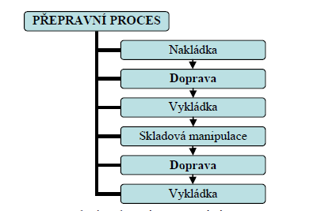
Přepravní proces
Logistika – přeprava
3/30

Slide 4

Samostatný úkol č. 1
Rozdělte se do týmů a popište kroky SCM k výrobě papíru
Logistika – přeprava
4/30

Slide 5
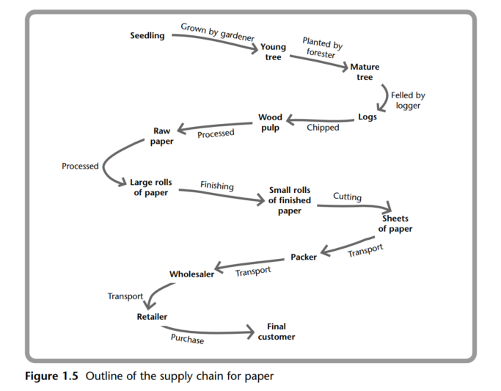
Příklad SCM pro výrobu papíru
Logistika – přeprava
5/30

Slide 6

Přeprava
Propojuje jednotlivé části logistického procesu
Zajišťuje fyzický přesun výrobků
Přispívá k vyšší úrovni zákaznického servisu
Přínos místa
Přínos času
Logistika – přeprava
6/30

Slide 7
Samostatný úkol č. 2
Rozdělte se do týmu a zamyslete se nad cíli přepravy.
Logistika – přeprava
7/30

Slide 8
Cíle přepravy
Jedná se o efektivní a cenově dostupnou přepravu zboží z jednoho místa na druhé. Patří sem volba nejefektivnějšího způsobu přepravy - například letecká, železniční, nákladní nebo lodní doprava - a také nejekonomičtější trasy a záruka, že zboží dorazí na místo určení včas. Dalším aspektem přepravy je řízení nákladů na přepravu, včetně nákladů na pohonné hmoty, pojištění a dalších souvisejících výdajů.
Logistika – přeprava
8/30

Slide 9
Klasifikace přepravy
Podle místa působení
  Mimopodniková doprava
  Vnitropodniková doprava
    Kontinuální dopravní prostředky
    Nekontinuální dopravní prostředky
    Meziobjektová vs mezioperační vs operační
Podle předmětu přepravy
  Osobní
  Nákladní
Podle přepravních cest
  Silniční, kolejová, letecká, lodní, potrubní
Logistika – přeprava
9/30

Slide 10
Faktory ovlivňující výběr přepravy – operativní - externí
Základní infrastruktura v zemi (dopravní infrastruktura)
Překážky obchodu (cla, dovozní tarify, kvóty)
Kontroly vývozu a licence (množství vývozu v daném období)
Právo a daně (silniční doprava a životní prostředí – velikost vozidla, velikost nákladu, časové restrikce)
Finanční instituce, služby a ekonomické podmínky (stabilita měnného kurzu, inflace)
Komunikační systémy (podpůrné procesy a dokumenty při přepravě zboží)
Kultura (volba způsobu dopravy může záviset více na vlastnictví než na nákladové efektivitě)
Klima (extrémní počasí, teploty a vlhkost)
Logistika – přeprava
10/30
Notes:
Encompassing the many operational factors that may need to be considered are those that are external to direct distribution-related factors. These are particularly relevant when contemplating the international context of modal choice, because from country to country these factors can vary significantly. They include: • The basic infrastructure in the country. In particular, the transport infrastructure is likely to be important. For example, opportunities to use rail will be significantly affected by the rail network that exists within a country. Many countries have limited track availability, while others may have mainline track but an insufficient number of railheads, or railheads in inappropriate locations for industrial or commercial use. • Trade barriers. These might include, for example, customs duty, import tariffs or quota payments. These can have a big impact on the overall cost of a product, and this may affect the decision concerning the most appropriate mode of transport for cost reasons. • Export controls and licences. With these, there may be implications for the quantity of product that can be shipped in given periods of time. • Law and taxation. Clearly, legal requirements in both a general and a specific context are likely to differ from one country to another. There is, for example, some very different road transport and environmental legislation that can affect the use of vehicles in terms of size restrictions, load restrictions and time restrictions. • Financial institutions and services, and economic conditions. Elements such as exchange rate stability and inflation, for example, can influence modal choice. Where financial changes occur at a dramatic rate in a country then speed of delivery may be important. • Communications systems. These can have an impact, for example, on the supporting processes and paperwork of freight movements. Delays can be more likely with some modes of transport. For example, sea-freight can have particularly lengthy and onerous procedures. Culture. Differing cultural aspects may influence how trade and commerce are undertaken. For example, the choice of transport mode may rest on ownership rather than cost-effectiveness. • Climate. Extremes of weather, temperature and humidity can have a major impact on some products. Thus, modes of transport must be selected carefully to ensure that prevailing climatic conditions do not badly affect freight while it is in transit. Suitable protection must be guaranteed. This list can be a long one, and the relevant inclusions will vary according to the country under consideration.

Slide 11
Faktory ovlivňující výběr přepravy – operativní - zákaznické
Požadavky na úroveň služby (časová omezení – nespolehlivé druhy přepravy)
Omezení místa dodání (umístění místa dodání, omezení velikosti vozidla, požadavky na vykládku)
Hodnocení zákazníka (požadavky na platbu předem)
Podmínky prodeje (požadované zákazníkem – platba při dodání)
Preference velikosti dodávky zákazníkem
Důležitost zákazníka (dodávka pro nejdůležitější zákazníky nesmí selhat)
Znalost produktu (předání znalostí o produktu zákazníkovi – sestavení, používání)
Logistika – přeprava
11/30
Notes:
The particular customer characteristics may also have a significant effect on the choice of transport mode. Most of the characteristics will need to be considered for both national and international modal choice, that is, they are not specific to overseas distribution. The main characteristics to take into account are:
• Service level requirements. Some service level requirements can have a significant
impact on choice of transport mode. Delivery time constraints can mean that certain
relatively unreliable modes cannot be considered. This may occur when there is a need
for delivery to be at a certain time or on a certain date, or when a specific time delivery
window is stipulated. This is very common in retail delivery operations.
• Delivery point constraints. This factor is a very important one. It refers particularly to the
physical aspects of delivery, including the location of the delivery point, any access constraints concerning the size of vehicle that can make the delivery and any equipment
requirements for unloading. Once again, these are common problems in retail delivery.
• Credit rating. The credit rating of a customer may help to impose a limit on route
selection and modal choice. New customers and existing customers with a poor credit
rating mean that a company will want to be sure that payment is confirmed before
delivery is made. Thus, commercial arrangements may override any logistical preference for a particular transport method. It should be noted, however, that for shipments
by sea the bill of lading can be held through a Letter of Credit until payment is made at
a bank, although the situation is different for air freight owing to the speed of transit
and the fact that an air waybill (AWB) is not a document of title to the goods.
• Terms of sale preference. There are a number of different terms of sale that can be used,
ranging from ex works (at the supplier factory) to delivered duty paid (at the customer’s
delivery point). The terms of sale preferred by a customer therefore have a very large
implication for the choice of transport mode – and, of course, who makes that choice,
the supplier or the customer.
• Order size preference. The physical size of an order clearly has an impact on modal choice,
as some modes are more suitable for small orders and others for large ones. There may
be significant cost implications here.
• Customer importance. Most suppliers have ‘A’ rated customers who are deemed to be
their most important and who really must be given a delivery service that does not fail.
For these customers, service reliability is essential and so certain routes and transport
modes will be preferred.
• Product knowledge. Some products or orders may necessitate some knowledge transfer
to the customer at the time of delivery. This may relate to the need to assemble the
product in some way, or information on how to use the product. It is not likely to be an
element that affects many orders, but would be important to both route and modal
choice where it does.

Slide 12
Faktory ovlivňující výběr přepravy – operativní – další
Zásobovací místa (umístění dodavatelů má dopad na volbu trasy a způsob přepravy)
Výrobní závod (umístění výrobních a produkčních závodů ovlivní volbu trasy a způsob přepravy)
Sklady a skladovací prostory (nemusí být nutně v místě výrobních a produkčních závodů)
Depa (umístění dep v podobě vzdálenosti a geografie má dopad na způsob přepravy)
Marketingové plány a zásady (různé plány a politiky vyžadují různé reakce – např. rychlost u nových výrobků)
Filozofie zásobování (JIT a jiné skladovací politiky)
Stávající systém dodávek (náklady v existující přepravní flotile)
Logistika – přeprava
12/30
Notes:
• Supply points. The location of raw material or component suppliers will clearly impact
on route and modal choice. This applies particularly where supply is sourced from
abroad. Modal choice issues will be key where a raw material or component is vital to
a manufacturing process or where inventory levels are relatively low at the point of
production.
• Production plants. The location of manufacturing and production plants will impact
on route and modal choice. This applies particularly where supply is sourced from
abroad, as shipment delays may be unacceptable.
• Warehouses and storage facilities. Finished goods warehouses are often located adjacent
to production points and factories, but they may be some distance away and thus
involve regular movement of finished product from factory to warehouse.
• Depots. Inventory and stockholding policy will usually determine where depots are
located. The location of depots with respect to their supply points (usually production
or warehouse facilities) in terms of distance and geography will have an impact on the
choice of transport mode.
• Marketing plans and policies. These may affect transport choice because some plans
and policies call for a very fast response time to customer orders, so, depending
on depot location, a fast method of transport is essential. A good example is where
new products are marketed or where there is a promotion of a particular product.
Fast transport may often be required to support any marketing-related surges in
demand.
• Supply philosophy. The use of just-in-time and other supply policies that are based
on minimum stockholding levels will have an impact on transport modal choice as
delivery reliability is key for these approaches in order to avoid costly stockouts.
• Existing delivery system. There may be elements of the existing delivery operation that
need to be retained. This often applies where there are sunk costs in a transport fleet,
which means that it is a cost imperative to keep all or some of the vehicles.

Slide 13

Samostatný úkol č. 3
Rozdělte se do týmu a zamyslete se nad charakteristikami různých typů přepravy (letecká, silniční, železniční a námořní)
Logistika – přeprava
13/30

Slide 14
Charakteristiky přepravy – typy přepravy I
Letecká přeprava
  Nejrychlejší a nejefektivnější pro dlouhé vzdálenosti
  Omezená povětrnostními podmínkami
  Nejdražší možnost
  Může být velmi výhodní díky „lead-time economy“
  Letecká doprava je typicky velmi šetrná k nákladu
Logistika – přeprava
14/30
Notes:
The use of air freight as an alternative transport mode has grown rapidly in recent years. Major developments in the areas of integrated unit loads, improved handling systems and additional cargo space, together with the proliferation of scheduled cargo flights, have increased the
competitiveness and service capability of air freight (see Chapter 25). The major attributes of air freight are as follows:
• Air freight compares very well with other transport modes in terms of speed over longer
international movements. This is because it has very rapid airport-to-airport transit
times over these longer distances.
• Although air freight is very quick from airport to airport, there can be occasions when
this speed factor is diminished because time can be lost due to airport congestion and
handling, paperwork and customs delays.
• One particular advantage of air freight is known as ‘lead-time economy’. The ability to
move goods very quickly over long distances means that it is unnecessary to hold
stocks of these items in the countries in question (spare parts, etc). The short lead time
required between the ordering and receiving of goods, and the resultant saving in
inventory holding costs give this benefit its name of ‘lead-time economy’.
• The air freighting of products allows for a great deal of market flexibility, because
any number of countries and markets can be reached very quickly and easily. This is
particularly advantageous for a company that wishes either to test a product in a given
area or to launch a new product. The flexibility of air freight means that a company
need not necessarily set up extensive stockholding networks in these areas.
• The movement of goods by air freight can result in a marked reduction in packaging requirements. As a general rule, the air freight mode is not one that experiences
severe physical conditions, and so its consignments are not prone to damage and
breakages.
• Air freight transport is very advantageous for certain ranges of goods, compared to
many of the alternative modes. This includes those commodities with high value to
weight ratios (a lot of money is tied up, therefore an expensive freight on-cost is
not significant), perishables (where speed is vital), fashion goods (which tend both to be expensive and to have a short ‘shelf life’), emergency supplies (speed again is vital) and finally spare parts (the lack of which may be holding up the operation of a multimillion-pound project).
• For the vast majority of products, air freight is a very expensive form of transport.
This is by far its greatest disadvantage. In some instances, and for some products,
cost is of very little consequence, and it is for these types of goods that air freight tends
to be used.
• Air freight has suffered to a certain extent due to security concerns. This is one reason
for the increasing trend towards all-freighter aircraft, rather than freight being carried
in the belly hold of passenger aircraft (which has generally been the predominant
means of air freight).

Slide 15
Charakteristiky přepravy – typy přepravy I
Železniční přeprava
  Dostupnější než letecká doprava
  Pomalejší než letecká (ale i obecně), ale spolehlivější (povětrnostní podmínky)
  Relativně levná
  Vhodná pro různé vzdálenosti
  Většinou potřeba dvojí manipulace (přímá cesta z místa původu do místa určení velmi vzácná)
  Nekompatibilita napříč Evropou (různé země mají různé předpisy)
  Nižší flexibilita (plánování vlaků na trati)
Logistika – přeprava
15/30
Notes:
There have been many recent developments in rail freight systems, especially the development of intermodal containerized systems using ISO containers as the basic unit load and the introduction of the swap-body concept of transferable road–rail units. These are described in Chapter 26. More conventional rail freight systems have the major benefit of being a relatively cheap form of transport. This is particularly true for bulky and heavy consignments that require movement over medium to long distances and where speed is not vital. The principal disadvantages of conventional rail freight are as follows:
• Rail wagons are prone to some very severe shocks as they are shunted around goods
yards. Shunting shocks can cause damage to products. To overcome this, costly packaging needs to be used.
• There is a need to double-handle many loads because the first and last leg of a ‘through’
journey often needs to be by road transport.
• There are a limited number of railheads available at factories and depots, making direct
origin-to-destination journeys very rare. Few companies now have railway sidings on
their premises due to their high cost of upkeep and operation.
• In general, rail transport is a very slow means of carriage – particularly when the
whole journey is taken into account. Many freight trains have to fit their schedules
around passenger trains, which take priority. This can cause significant time delays to
the rail freight.
• Rail freight transport can be very unreliable. Batches of wagons may arrive at irregular
intervals. This can cause further delays for international traffic if a complete shipment
is on a single customs document.
• For international movements, there are significant compatibility issues (especially
across Europe). These include variations in track gauge sizes, bridge heights and (lack
of) electrification.

Slide 16
Charakteristiky přepravy – typy přepravy II
Silniční přeprava
  Ve většině zemí se jedná o nejvýznamnější typ přepravy
  Patří mezi rychlejší druhy přepravy
  Relativně dostupná a rychlá pro krátké vzdálenosti
  Nabízí flexibilitu v trasování a plánování
  Cenově výhodnější pro náklady s jediným výchozím a koncovým bodem
  Často odpadá dvojité manipulování
  Silniční nákladní přeprava může ztratit výhodu rychlosti, pokud se používá pro přepravu nákladů menších než nákladní automobily (dvojité manipulace a dodatečné balení)
Logistika – přeprava
16/30
Notes:
As already indicated, road freight transport is the most important mode for national movements within most individual countries. In the context of international distribution, road freight transport is also important, even where there are fairly significant geographic constraints such as sea crossings. In the UK for example, road freight is viable via the use of roll-on roll-off (RORO) ferry services and the Channel Tunnel route. These allow for the through transport of goods from factory or warehouse direct to customers’ premises abroad.
Compared with the other forms of international freight transport, the major advantages and disadvantages of road freight transport services are as follows:
• They can provide a very quick service (ferry and tunnel schedules can be carefully
timed into route plans if they are a necessary part of the journey).
• For complete unit loads with single origin and destination points, they can be very
competitive from the cost viewpoint.
• There is a greatly reduced need to double-handle and trans-ship goods and packages,
and for direct, full-load deliveries this is completely eliminated. This saves time and
minimizes the likelihood of damage.
• Packaging cost can be kept to a minimum because loads are less susceptible to the
extreme transit ‘shocks’ that other modes can cause.
• The system can provide regular, scheduled services due to the flexibility of road-vehicle
scheduling.
• Road freight transport can lose its speed advantage when used for less than lorry-sized
loads. These entail groupage and so involve double-handling (at both ends of the
journey), additional packaging and time delay.

Slide 17
Charakteristiky přepravy – typy přepravy II
Námořní přeprava
  Nejpomalejší způsob dopravy (otáčení lodí atd.)
  Nejekonomičtější volba pro dlouhé vzdálenosti (vhodné zejména když doba přepravy nehraje významnou roli)
  Nabízí velkou kapacitu pro velkoobjemové zboží a zboží balené ve velkém množství
  Zboží musí být často dvakrát manipulováno (ztráta času, větší riziko poškození)
  Jedná se o zpoždění před odesláním, zpoždění v přístavu vykládky, neočekávaná zpoždění způsobená špatným počasím, zmeškáním přílivu a odlivu atd.
Logistika – přeprava
17/30
Notes:
Of the main alternative types of sea-freight, both the conventional load and the unit load are relevant. The unit load (container) is considered later. For conventional sea-freight, the main points to note are:
• Cost economies. For some products, the most economic means of carriage remains that
of conventional sea-freight. This particularly applies to bulk goods and to large packaged consignments that are going long distances. Where speed of service is completely
unimportant, then the cheapness of sea-freight makes it very competitive.
• Availability. Services are widely available, and most types of cargo can be accommodated.
• Speed. Sea-freight tends to be very slow for several reasons. These include the fact that the
turnaround time in port is still quite slow, as is the actual voyage time.
• Need for double-handling. Conventional sea-freight is disadvantaged by the slow handling
methods still used. This is especially true when compared with the more competitive
‘through transport’ systems with which sea-freight must compete. The problem is
particularly apparent on some of the short sea routes.
• Delay problems. There are three major delay factors that can lead to bad and irregular
services, as well as helping to slow up the transport time itself. These are over and
above the journey time. They are pre-shipment delays, delays at the discharge port and
unexpected delays due to bad weather, missed tides, etc.
• Damage. The need to double-handle cargo on conventional ships tends to make this
mode more prone to damage for both products and packaging.

Slide 18
Charakteristiky přepravy – náklady a životní prostředí
Náklady
  Cena je klíčovým faktorem
  Náklady závisí na způsobu přepravy, vzdálenosti, cenách paliva a daních, zpoždění dodávek, poškození zboží
Životní prostředí
  Letecká doprava: Nejvyšší negativní dopad s významnými emisemi.
  Železniční doprava: Menší dopad než letecká doprava, ale stále produkuje významné emise.
  Silniční doprava: Menší dopad než železnice nebo letecká doprava, ale stále přispívá k emisím z dopravního provozu a výfuků vozidel.
  Námořní doprava: Má nejmenší negativní dopad na životní prostředí mezi způsoby dopravy kvůli nižším emisím.
Logistika – přeprava
18/30

Slide 19
Samostatný úkol č. 4
Velikost dodávky | 100 tun
 | 20 tun
 | Paleta
 | Zásilka
 |  | Krátká | Střední | Dlouhá | Velmi dlouhá
 |  | Délka dodání
Logistika – přeprava
19/30
Notes:
Economic order quantity model
Model přechodného neuspokojení poptávky
Produkční model

Slide 20
Samostatný úkol č. 4
Velikost dodávky | 100 tun | Silniční | Silniční/železniční | Železniční/námořní | Námořní
 | 20 tun | Silniční | Silniční | Silniční/železniční | Železniční/námořní
 | Paleta | Silniční | Silniční | Silniční/železniční | Letecká/námořní
 | Zásilka | Pošta/Silniční | Pošta/Silniční/letecká | Pošta/Silniční/letecká | Poštovní/letecká
 |  | Krátká | Střední | Dlouhá | Velmi dlouhá
 |  | Délka dodání
Logistika – přeprava
20/30

Slide 21
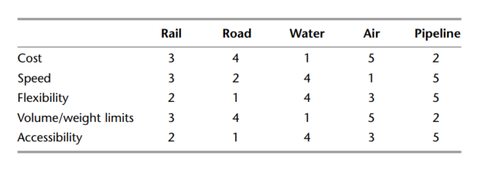
Samostatný úkol č. 4
Logistika – přeprava
21/30

Slide 22
Metody pro analýzu nákladů přepravy I
Cost-Benefit analysis - Tato metoda zahrnuje vážení výhod použití konkrétní trasy nebo způsobu dopravy vůči nákladům s tím spojeným. Tato data mohou firmy využít k rozhodnutí, které trasy nebo techniky jsou nejekonomičtější a nejefektivnější.
Activity-based costing - Tato technika zkoumá náklady související s každou aktivitou procesu dodavatelského řetězce. Zahrnuje to úkoly jako nakládání, vykládání a přesun objektů. Firmy mohou hledáním těchto nákladů najít oblasti, kde mohou snížit náklady a zvýšit efektivitu.
Logistika – přeprava
22/30
Notes:
csvukrs

Slide 23
Metody pro analýzu nákladů přepravy II
Time-Distance analysis - V této technice jsou zkoumány čas a vzdálenost potřebné pro konkrétní trasu nebo způsob dopravy. Tato data mohou firmy využít k rozhodnutí, které trasy nebo techniky jsou nejefektivnější a nejekonomičtější.
Risk analysis - Tato technika zahrnuje hodnocení rizik spojených s konkrétní trasou nebo způsobem dopravy. Tato data mohou firmy využít k rozhodnutí, které trasy nebo techniky jsou pro přepravu zboží nejspolehlivější a nejbezpečnější.
Logistika – přeprava
23/30
Notes:
csvukrs

Slide 24
Intermodální přeprava
Přepravní proces realizovaný s využitím minimálně dvou různých druhů dopravy a současně zachováním jedné integrované manipulační jednotky na celé přepravní trase, organizovaný pouze jedním operátorem.
I přes vyšší náklady na manipulaci (překládku) s přepravními prostředky (např. kontejnery), celkovým výsledkem je úspora nákladů a vyšší úroveň ZS.
Logistika – přeprava
24/30
Notes:
csvukrs

Slide 25
Mýtní systémy I
Zpoplatnění užívání pozemních komunikací pomocí elektronického sledování pohybu vozidel
Nutnost vybavit sledovaná vozidla palubní jednotkou – pro každý stát samostatná
Platba za skutečně ujeté kilometry – diferencováno dle ročního období a dle ekologické zátěže vozidel
Logistika – přeprava
25/30

Slide 26
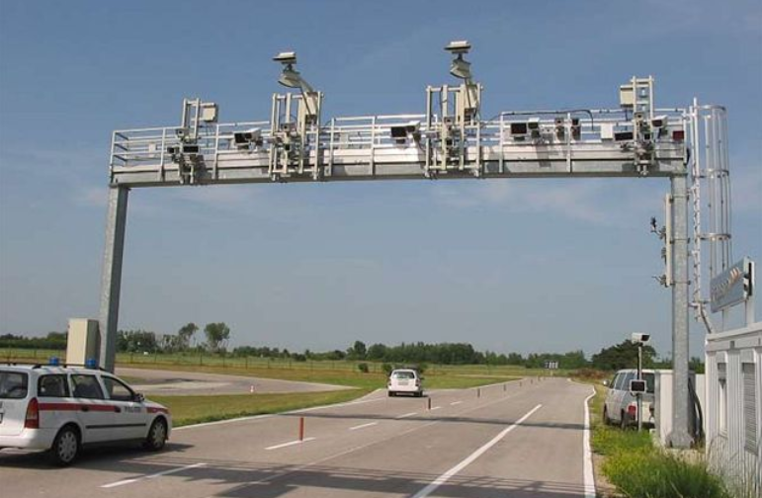
Mýtní systémy II
Dva základní typy systémů
  Mikrovlnný systém – sledování pomocí mýtných bran se snímači mikrovlnného signálu a kamerami pro detekci pohybu vozidel.
  Satelitní systém – umožňuje celoplošné sledování vozidel nejen na speciálně vybavených komunikacích, ale v celém terénu.
V Evropě dominují mikrovlnné systémy
Logistika – přeprava
26/30

Slide 27
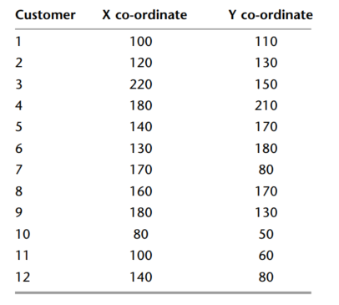
Samostatný úkol č. 5
Depo je na souřadnicích (120, 90). Vaším úkolem je najít nejkratší cestu mezi všemi 12 zákazníky včetně cesty z depa a zpět do depa.
Logistika – přeprava
27/30

Slide 28
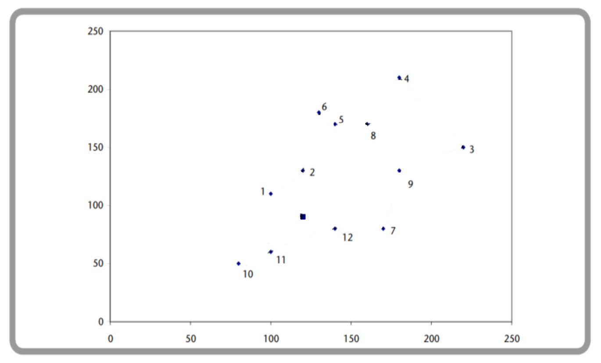
Samostatný úkol č. 5
Logistika – logistické náklady a jejich řízení
28/29

Slide 29
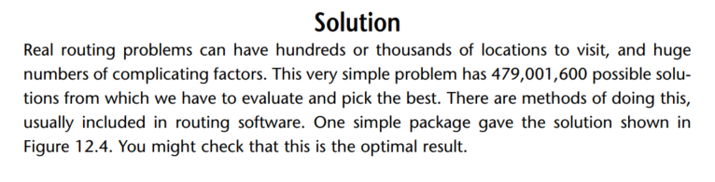
Samostatný úkol č. 5
Logistika – přeprava
29/30

Slide 30
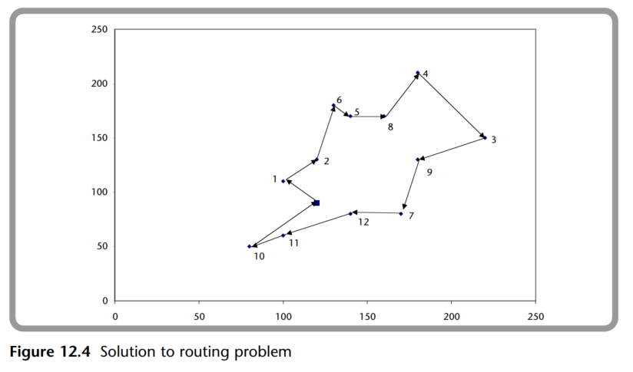
Samostatný úkol č. 5
Logistika – přeprava
30/30

Slide 31
Děkuji za pozornost
Logistika – přeprava

