Slide 1
HUMAN RESOURCE MANAGEMENT
Lesson 10
Rewarding system. Performance management and motivation
Ing. Helena Marková, Ph.D.

Slide 2
Content
PERSONALISTIKA PEM SU OPF
reward, rewarding system
purpose of rewarding strategies
performace management
developement

Slide 3
Rewarding systems
HRM PEM SU OPF
Compensation X Reward
Purpose of reward
Different forms
Rewarding systems
Rewarding Strategies
Motivation

Slide 4
Significance of pay policy
HRM PEM SU OPF
In manufacturing sector
20 to 30 percent of operational costs
In service sector
50 to 70 percent of operational costs
Employers and their quality are the source of competitive advantage
Balance of fixed and variable pay based on the evaluation of performance (individual or team) – it also transfers some of the financial risk to the firm from employers onto the employees.

Slide 5
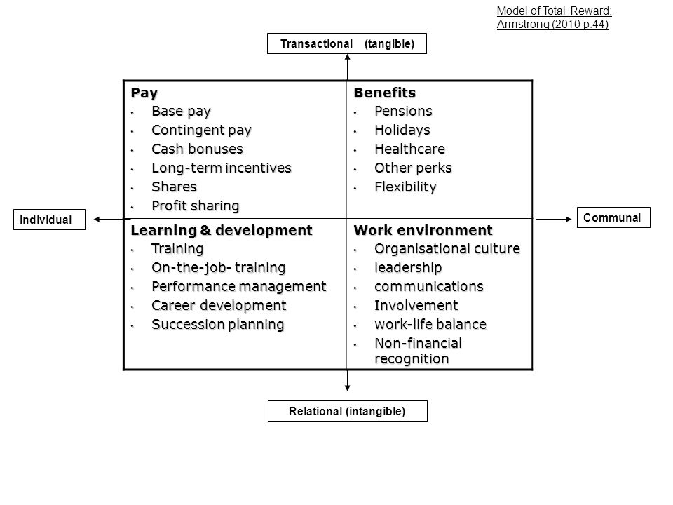
Total reward by Armstrong
HRM PEM SU OPF

Slide 6
Compensation X Reward
HRM PEM SU OPF
Compensation refers to the total package of financial and non-financial benefits that an employee receives in exchange for their work, including base salary, bonuses, benefits, and other forms of pay. Compensation is typically structured according to the job market and the value of the employee's skills and experience.
Rewards are incentives or recognition that are given to employees for their performance or contributions. Rewards can take many forms, including bonuses, promotions, recognition programs, and other non-financial incentives.

Slide 7
Compensation X Reward
HRM PEM SU OPF
Compensation is a key part of the overall employee package, but rewards are a way to motivate and appreciate employees for their contributions over and above their normal duties.
Reward programs are often used to increase employee engagement, encourage high performance, and retain top talent.
While compensation is a fixed package of pay and benefits that an employee receives as part of their job, rewards are additional encouragements that are used to motivate and recognize employees for their performance and contributions.

Slide 8
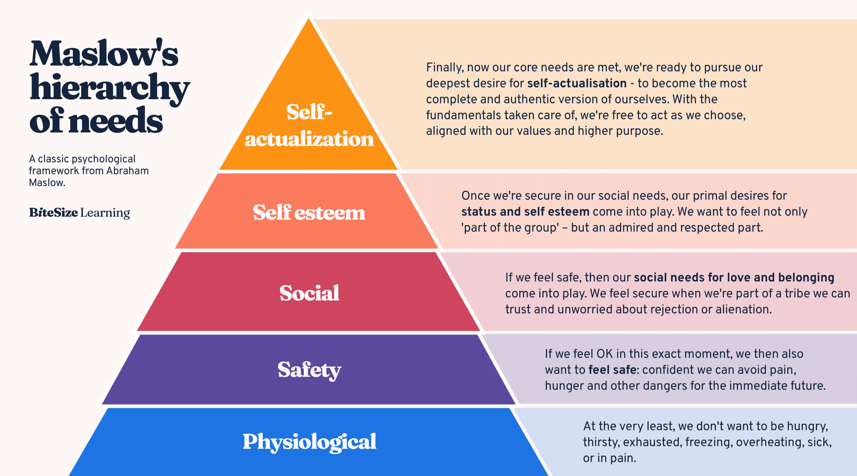
Purpose of reward
HRM PEM SU OPF
Purpose of whom? Different stakeholders have an interest, but their interest vary.
For employers
For society
Customers
For employees

Slide 9
Purpose of reward
HRM PEM SU OPF
Atraction
Ŕetention
Motiovation
Fairness in reward (CEO / employees, sportstars, popstars, men x women)

Slide 10
Equality in rewarding systems
HRM PEM SU OPF
Equality in rewarding systems refers to the principle of providing equal rewards for equal contributions within an organization. This concept is based on the idea of fairness and impartiality in recognizing and compensating employees.
Features of equal rewarding systém:
1. Fairness: Reward systems are considered equal when they are fair, meaning that they are free from bias, favoritism, or discrimination. Rewards should be based on objective criteria such as performance, effort, skills, or responsibilities rather than on subjective preferences or personal characteristics.
2. Transparency: Equal rewarding systems operate transparently, with clear criteria for what is rewarded and how. Employees should understand what is expected of them and how these expectations tie to the rewards they can receive.
3. Consistency: There should be consistency in the way rewards are distributed. Employees in similar roles with similar achievements and levels of contribution should receive similar rewards.

Slide 11
Equality in rewarding systems
HRM PEM SU OPF
4. Merit-based: Rewards should be based on merit, reflecting the contributions and performance of the employees. The idea is to reward employees proportionately to the value they bring to the organization.
5. Non-Discriminatory: Equality in rewarding systems ensures that all employees, regardless of gender, race, age, disability, or any other personal characteristic, have equal access to rewards for comparable work.
6. Compliance with Laws and Standards: The system should comply with all relevant laws and ethical standards, including equal pay for equal work and other labor and anti-discrimination laws.
7. Aligned with Organizational Goals: Reward systems should align with the overall goals and values of the organization. This means that the rewards should support the organization's strategy by incentivizing behaviors and outcomes that advance its objectives.

Slide 12
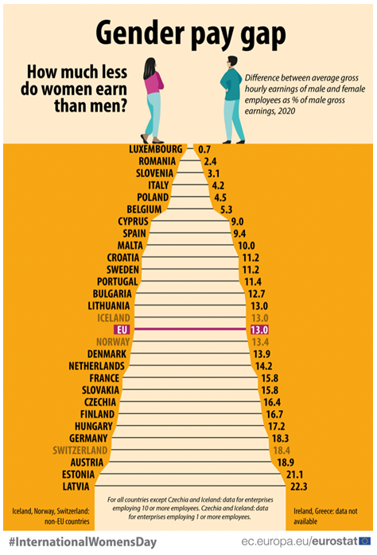
Fairness
HRM PEM SU OPF

Slide 13
Rewarding forms
HRM PEM SU OPF
Financial Rewards X Non-Financial Rewards
Extrinsic Rewards X Intrinsic Rewards
external resources - internal(sense of accomp., perso-
physical items nal satisfaction

Slide 14
Componenets of rewarding forms
HRM PEM SU OPF
Monetary Rewards:
Salary: The basic compensation an employee receives for their work.
Bonuses: Additional compensation awarded for meeting or exceeding certain goals or for exceptional performance.
Commissions: Earnings linked directly to the amount of sales or revenue an employee generates.
Profit Sharing: A system where employees receive a share of the company's profits, usually distributed annually or quarterly.

Slide 15
Componenets of rewarding forms
HRM PEM SU OPF
Benefits:
Health Insurance: Medical, dental, and vision plans.
Retirement Plans: Such as 401(k) plans in the U.S. or pension schemes.
paid Time Off: Including vacation days, personal days, and sick leave.
Life and Disability Insurance: Coverage for unforeseen life events impacting the employee’s ability to work.

Slide 16
Componenets of rewarding forms
HRM PEM SU OPF
Non-Monetary Rewards:
Recognition Programs: Employee of the month, service awards, or public acknowledgments.
Professional Development: Training, courses, workshops, and seminars that enhance an employee’s skills and value.
Career Advancement Opportunities: Promotions or internal mobility options that provide a path for growth within the company.
Work-Life Balance: Flexible working hours, remote work options, and sabbaticals.

Slide 17
Componenets of rewarding forms
HRM PEM SU OPF
Performance Management:
Appraisals: Regular reviews of employee performance to discuss achievements and areas for improvement.
Feedback Mechanisms: Ongoing communication channels for providing immediate recognition and constructive criticism.
Incentive Plans:
Short-term Incentive Plans: Rewards based on the achievement of specific short-term performance targets.
Long-term Incentive Plans: Rewards such as stock options or deferred compensation plans designed to align employees’ interests with long-term company success.

Slide 18
Componenets of rewarding forms
HRM PEM SU OPF
Perquisites (Perks):
Company Car: Often provided to high-level executives or employees in roles that require extensive travel.
Gym Memberships: To promote health and wellness among employees.
Childcare Assistance: On-site childcare facilities or assistance programs.
Employee Discounts: Special pricing on company products or services.
Social Recognition:
Peer Recognition Programs: Allowing employees to recognize each other's efforts and achievements.
Team-Building Events: Company retreats, holiday parties, or team outings that encourage bonding and morale.
Job Design:
Job Enrichment: Adding variety and more complex tasks to a role to increase job satisfaction.
Job Empowerment: Giving employees more autonomy and control over their work.

Slide 19
Strategic and total reward
HRM PEM SU OPF
There is a range of purposes thet a reward system serves and many aspects of work tha can be considered rewarding.
Priorities of reward policy coresponds with HR strategy.
Total reward
All of the tools available to teh employer that may be used to attract, motivate and retain employees perceives to be a value resulting from the employment relationship.

Slide 20
Effectiveness of a reward system
HRM PEM SU OPF
Combintion of quantitative and qualitative metrics
Aim of measure: how well the reward system is influencing job satisfaction, performance, and turnover rates, among other factors
Job satisfaction (surveys and questionnaires, exit interviews)
Performance (performance metrics, 360-degree feedback, KPI)
Turnover rates (turnover rate analysis, voluntary turnover)
Additional tools and metrics (cost-benefit analysis, engagement scores)

Slide 21
TASK 1 – REWARDS THROUGHT THE GENERATIONS
HRM PEM SU OPF
Case study
Team work
Theory + practise

Slide 22
Performance management
HRM PEM SU OPF
Performance management is a processthrough which organisations can ensure that individual employees are working towards organisational goals, by monitoring and guiding their performance.
Critical components:
job assignment
goal setting
establishing performance standards
providing feedback
performance appraisal (including documentation)

Slide 23
Job assignment
HRM PEM SU OPF
The process of mathing individual competencies with jo requirements, so as to achieve the best fit.
Testing and identifing the best fit of employee, starting in the process of recruitment and hiring.

Slide 24
Goal setting
HRM PEM SU OPF
The process of asingning work tasks to individuals so that they are clear on what is expected of them.
to be effective, the goals should be speciffick, measurable, attainable, realistic and time-bound. = SMART

Slide 25
Performance standards
HRM PEM SU OPF
Specific performance expectations and levels against which an employee´s performance will judged – thus, it should be clear to the employee what levels of performance would be deemed enacceptable, acceptable and surpassing expectations.

Slide 26
Feedback
HRM PEM SU OPF
The process by which individuals are informed of the degree to which they are meeting desired or expected levels of performance.

Slide 27
Performance appraisal
HRM PEM SU OPF
The process of evaluating an individual´s past performance for a specific period, usually one year.
Important features:
The evaluation process (role of appraisee and appraiser, record of achievement)
Scheduling the evaluation
The appraiser
Evaluating performance – What will be evaluated (traits, behaviours, outcomes)?

Slide 28
Performance evaluating methods
HRM PEM SU OPF
Here are some performance evaluation methods commonly used in organizations to assess employee competency:
360-Degree Feedback: This method involves collecting feedback from multiple sources, including supervisors, peers, subordinates, and even external stakeholders, to provide a comprehensive assessment of an employee's performance. It provides a well-rounded view of an employee's competencies, strengths, and areas for improvement.
Key Performance Indicators (KPIs): Establishing measurable KPIs aligned with job re-sponsibilities and desired competencies allows for objective evaluation of employee per-formance. KPIs can include quantitative metrics such as sales targets, productivity levels, customer satisfaction ratings, or qualitative indicators like problem-solving ability, communication skills, or teamwork effectiveness.

Slide 29
Performance evaluating methods
HRM PEM SU OPF
Management by Objectives (MBO): MBO involves setting specific, measurable, achie-vable, relevant, and time-bound (SMART) objectives collaboratively between managers and employees. Regular performance evaluations are conducted to assess how well employees are meeting these objectives, providing insights into their competency development.
Behavioral Observation Scales (BOS): BOS involves assessing employees' competencies based on observed behaviors during their job performance. Evaluators use predetermined scales to rate employees' behaviors, such as decision-making, communication, leadership, or problem-solving skills.
Self-Assessment: Employees are given the opportunity to evaluate their own performance against predefined competency frameworks or criteria. This method encourages employees to reflect on their strengths and areas for improvement, fostering self-awareness and perso-nal development.

Slide 30
Performance evaluating methods
HRM PEM SU OPF
Performance Ranking and Rating: This method involves ranking or rating employees' per-formance against each other based on their competencies and achievements. It can be done using a numerical scale or performance categories (e.g., outstanding, proficient, needs im-provement), providing a comparative assessment of employees' competency levels.
Performance Appraisal Interviews: Conducting structured performance appraisal inter-views allows managers to have one-on-one discussions with employees to evaluate their performance and competencies. These interviews can provide an opportunity to address concerns, set development goals, and provide feedback on competency strengths and areas for improvement.

Slide 31
TASK 2
HRM PEM SU OPF
Discuss the positives and negatives of the above mentioned evaluating methods.

Slide 32
PERSONALISTIKA PEM SU OPF
Thank you
for your attention.
Děkuji vám za pozornost, přeji příjemný den.

