Slide 1
HUMAN RESOURCE MANAGEMENT
Lesson 10
Rewarding system. Performance management and motivation
Ing. Helena Marková, Ph.D.

Slide 2
Next lessons
PERSONALISTIKA PEM SU OPF
today – terms of presentation, dates
6.5. 14,45 Kostas Zervas, Kyndryl Senior Lead, Customer Technology Advisor – CONFLICT RESOLVING
13.5. 14,45 INTERNATIONAL HRM

Slide 3
Content
PERSONALISTIKA PEM SU OPF
repetition of the last lesson
University rewarding system
different preferences of the generations = various benefits
Challenges of implementation
pilot programme, survey, participation of employees (KION example), role of corporate culture
Alignment with values
Why do we want to support: communication, competencies, cooperation. In all the instruments you can project the corporate values!

Slide 4
Firemní kultura
HR procesy

Slide 5
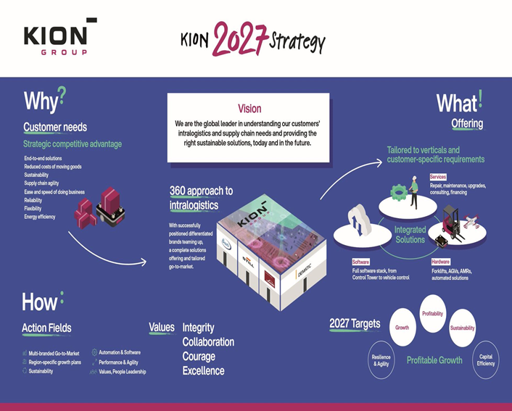
KION example
HRM PEM SU OPF
Corporate values:
integrity
collaboration
courage
excellence

Slide 6
Process of implementation of new rewarding system
HRM PEM SU OPF
Analyse current system
Define objectives – what do you want to support
Engage all relevant stakeholders early in the process
Design the new remuneration structure, which may include base pay, bonuses, benefits, and other incentives
Conduct a pilot test to see how it works in practice and to identify any issues or adjustments needed
Provide training for HR staff and managers on how to implement and manage the new system
Roll out the new system across the organization
Monitoring and evaluation
Regularly review and Continuous Improvement

Slide 7
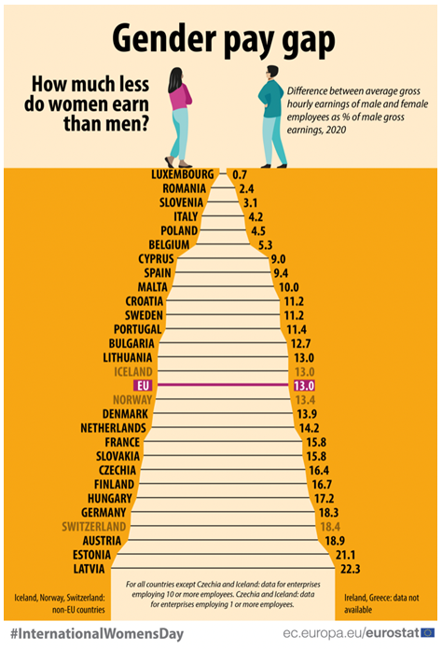
Fairness
HRM PEM SU OPF

Slide 8
Fairness in rewarding
HRM PEM SU OPF
Define fairness
Diversity x Fairness
Attitude to pay inequality through generations
Examples of unequal pay (sport, art, between professions, countries…)

Slide 9
TASK - Fairness in rewarding
HRM PEM SU OPF
How much are they worth?
Find examples of pay inequality in different fields of human activity.
Discuss the causes, give arguments pros and cons.
Examples:
sports (football, tennis, athletics…)
film industry
music (popstars)
IT sector
medicine
universities and science

Slide 10
Performance management
HRM PEM SU OPF
Performance management is a process through which organisations can ensure that individual employees are working towards organisational goals, by monitoring and guiding their performance.
Critical components:
job assignment
goal setting
establishing performance standards
providing feedback
performance appraisal (including documentation)

Slide 11
Job assignment
HRM PEM SU OPF
The process of mathing individual competencies with job requirements, so as to achieve the best fit.
Testing and identifing the best fit of employee, starting in the process of recruitment and hiring.

Slide 12
Goal setting
HRM PEM SU OPF
The process of asingning work tasks to individuals so that they are clear on what is expected of them.
to be effective, the goals should be speciffick, measurable, attainable, realistic and time-bound. = SMART

Slide 13
Performance standards
HRM PEM SU OPF
Specific performance expectations and levels against which an employee´s performance will judged – thus, it should be clear to the employee what levels of performance would be deemed enacceptable, acceptable and surpassing expectations.

Slide 14
Feedback
HRM PEM SU OPF
The process by which individuals are informed of the degree to which they are meeting desired or expected levels of performance.

Slide 15
Performance appraisal
HRM PEM SU OPF
The process of evaluating an individual´s past performance for a specific period, usually one year.
Important features:
The evaluation process (role of appraisee and appraiser, record of achievement)
Scheduling the evaluation
The appraiser
Evaluating performance – What will be evaluated (traits, behaviours, outcomes)?

Slide 16
Performance management and employee motivation
HRM PEM SU OPF
The process of evaluating an individual´s past performance for a specific period, usually one year.
Important features:
The evaluation process (role of appraisee and appraiser, record of achievement)
Scheduling the evaluation
The appraiser
Evaluating performance – What will be evaluated (traits, behaviours, outcomes)?

Slide 17
TASK - Performance-related reward
HRM PEM SU OPF
Performance-related reward systems require that we can identify appropriate performance and recognise its achievement through the reward system.
For the following jobs, what performance would you want to reward and what form would that PRR take?
A univesity teacher
A used car salesperson
An emergency room nurse
An expatriate production manager working to set up a new joint venture plant in Malaysia
Work in groups, discuss

Slide 18
Performance evaluating methods
HRM PEM SU OPF
Here are some performance evaluation methods commonly used in organizations to assess employee competency:
360-Degree Feedback: This method involves collecting feedback from multiple sources, including supervisors, peers, subordinates, and even external stakeholders, to provide a comprehensive assessment of an employee's performance. It provides a well-rounded view of an employee's competencies, strengths, and areas for improvement.
Key Performance Indicators (KPIs): Establishing measurable KPIs aligned with job re-sponsibilities and desired competencies allows for objective evaluation of employee per-formance. KPIs can include quantitative metrics such as sales targets, productivity levels, customer satisfaction ratings, or qualitative indicators like problem-solving ability, communication skills, or teamwork effectiveness.

Slide 19
Performance evaluating methods
HRM PEM SU OPF
Management by Objectives (MBO): MBO involves setting specific, measurable, achie-vable, relevant, and time-bound (SMART) objectives collaboratively between managers and employees. Regular performance evaluations are conducted to assess how well employees are meeting these objectives, providing insights into their competency development.
Behavioral Observation Scales (BOS): BOS involves assessing employees' competencies based on observed behaviors during their job performance. Evaluators use predetermined scales to rate employees' behaviors, such as decision-making, communication, leadership, or problem-solving skills.
Self-Assessment: Employees are given the opportunity to evaluate their own performance against predefined competency frameworks or criteria. This method encourages employees to reflect on their strengths and areas for improvement, fostering self-awareness and perso-nal development.

Slide 20
Performance evaluating methods
HRM PEM SU OPF
Performance Ranking and Rating: This method involves ranking or rating employees' per-formance against each other based on their competencies and achievements. It can be done using a numerical scale or performance categories (e.g., outstanding, proficient, needs im-provement), providing a comparative assessment of employees' competency levels.
Performance Appraisal Interviews: Conducting structured performance appraisal inter-views allows managers to have one-on-one discussions with employees to evaluate their performance and competencies. These interviews can provide an opportunity to address concerns, set development goals, and provide feedback on competency strengths and areas for improvement.

Slide 21
TASK – positives and negatives
HRM PEM SU OPF
Discuss the positives and negatives of the above mentioned evaluating methods.

Slide 22
PERSONALISTIKA PEM SU OPF
Thank you
for your attention.
Děkuji vám za pozornost, přeji příjemný den.

