Slide 1

HUMAN RESOURCE MANAGEMENT
Lesson 4
Context and stakeholders.
Leadership.
Ing. Helena Marková, Ph.D.

Slide 2
Content
PERSONALISTIKA PEM SU OPF
leadership
leadership x management
personality of leader
sustainability

Slide 3
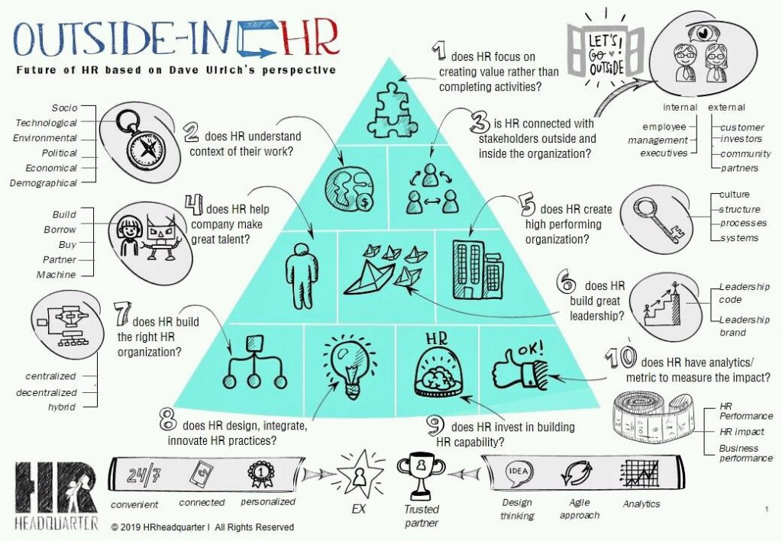
PERSONALISTIKA PEM SU OPF
leadership
leadership x management
personality of leader
multigenerational leadership
sustainability

Slide 4
Context of HR
HRM PEM SU OPF
S – sociological
T – technological
E – economical
P – political
E – environmental
D – demographic
All the conditions influence HRM in companies.
Discuss, what are the most important chalenges in the each part of external context.

Slide 5
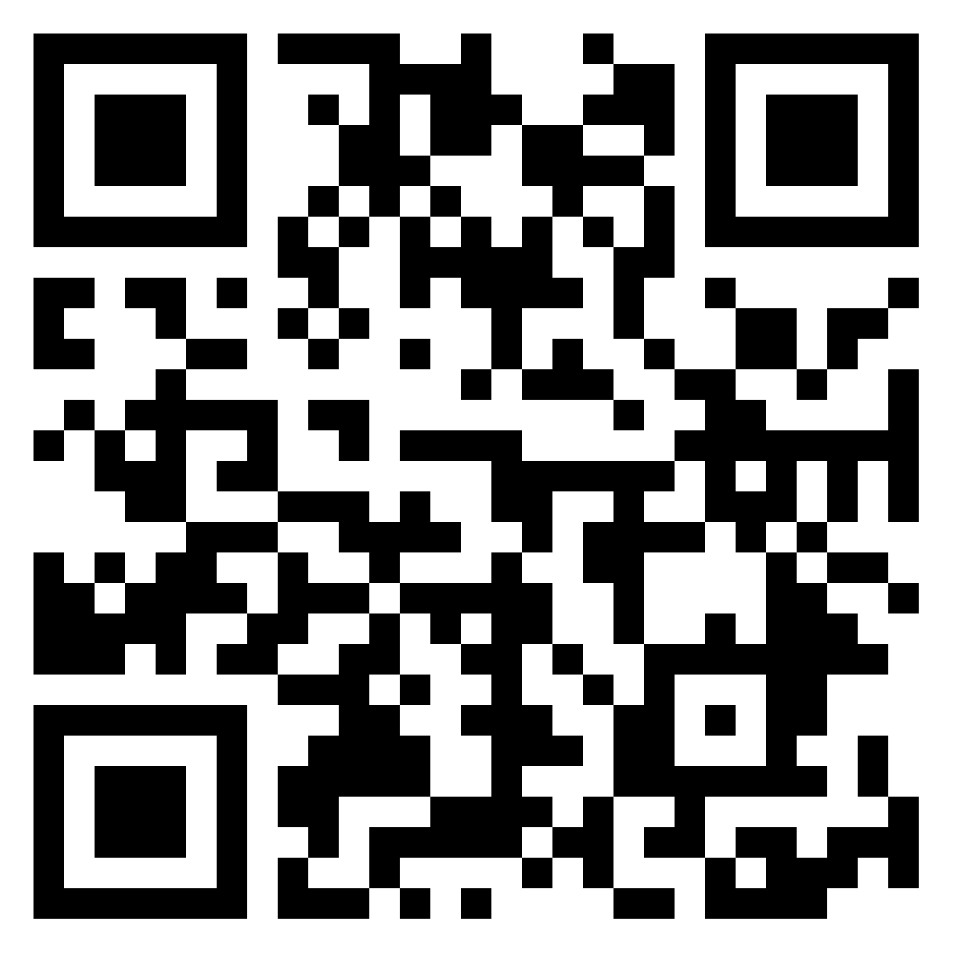
Discuss
HRM PEM SU OPF
Discuss, what are the most important challenges in the each part of external context.

Slide 6
Stakeholders
HRM PEM SU OPF
All the internal systems in companies are not good only for solving internal problems.
They influence the relations with stakeholders.
Examples:
rewarding system
work-life balance
agemanagement
talentmanagement…

Slide 7
What is leadership?
HRM PEM SU OPF
refers to the ability to inspire, motivate, and influence people to achieve a common goal.
Leaders are often visionary and have a strong sense of purpose.
They inspire others to follow them by setting an example, sharing their vision, and empowering others to achieve their full potential.
Leaders often challenge the status quo and seek to bring about positive change (Can they bring negative change?).

Slide 8
Corporate culture and leadership
HRM PEM SU OPF
corporate culture is closely connected with the style of leadership within an organization. A company´s culture can be defined as the shared values, beliefs, behaviors, and practices that shape the organization's identity and guide the behavior of its employees.
Do you remember: symbols, values, rituals… and HEROS.
The style of leadership in an organization plays a crucial role in shaping its culture.

Slide 9
Leadership styles
HRM PEM SU OPF
Autocratic: This style involves a leader who makes decisions without consulting others. They typically have full control over their team and dictate tasks and processes. While this style can be efficient in certain situations, it can also stifle creativity and motivation among team members.
Democratic: Democratic leaders involve their team members in decision-making processes. They encourage participation, seek input from team members, and consider their opinions before making decisions. This approach fosters a sense of ownership and collaboration among team members.

Slide 10
Leadership styles
HRM PEM SU OPF
Laissez-Faire: Laissez-faire leaders are hands-off and give their team members a high degree of autonomy. They provide minimal guidance and allow individuals to make their own decisions and manage their own tasks. While this style can empower skilled and self-motivated team members, it may lead to confusion or lack of direction in some cases.
Transformational: Transformational leaders inspire and motivate their team members by articulating a compelling vision and setting high standards. They encourage innovation, foster a positive organizational culture. They empower their team members to reach their full potential and achieve collective goals.

Slide 11
Leadership styles
HRM PEM SU OPF
Transactional: Transactional leaders focus on the exchange of rewards and punishments to motivate their team members. They establish clear expectations, set goals, and provide feedback based on performance. Transactional leaders often use incentives to reward achievement and corrective action to address underperformance.
Servant: Servant leaders prioritize the needs of their team members above their own. They focus on serving others, fostering a supportive environment, and facilitating personal and professional growth. Servant leaders often emphasize empathy, humility, and collaboration.

Slide 12
Leadership styles
HRM PEM SU OPF
Charismatic: Charismatic leaders possess strong personalities and inspire devotion and loyalty among their followers through their charm, confidence, and persuasion skills. They often articulate a compelling vision and use their charisma to motivate others to achieve shared goals..
Situational: Situational leaders adapt their leadership style to suit the specific needs of a situation or individual team members. They assess the readiness and capabilities of their team members and adjust their approach accordingly, whether it involves providing guidance and direction or delegating authority.

Slide 13
Is a leadership style important?
HRM PEM SU OPF
The leadership style also determines the level of employee engagement, motivation, and job satisfaction.
Leaders who promote a positive and supportive culture tend to have a more engaged and motivated workforce, while leaders who promote a negative or toxic culture tend to have a disengaged and unhappy workforce.
Appreciated leaders from history:
widely regarded as effective and inspirational include Nelson Mandela, Mahatma Gandhi, Martin Luther King Jr., Mother Teresa, and Winston Churchill…
Why? exceptional qualities such as vision, courage, empathy, and the ability to inspire and unite people towards a common goal.

Slide 14
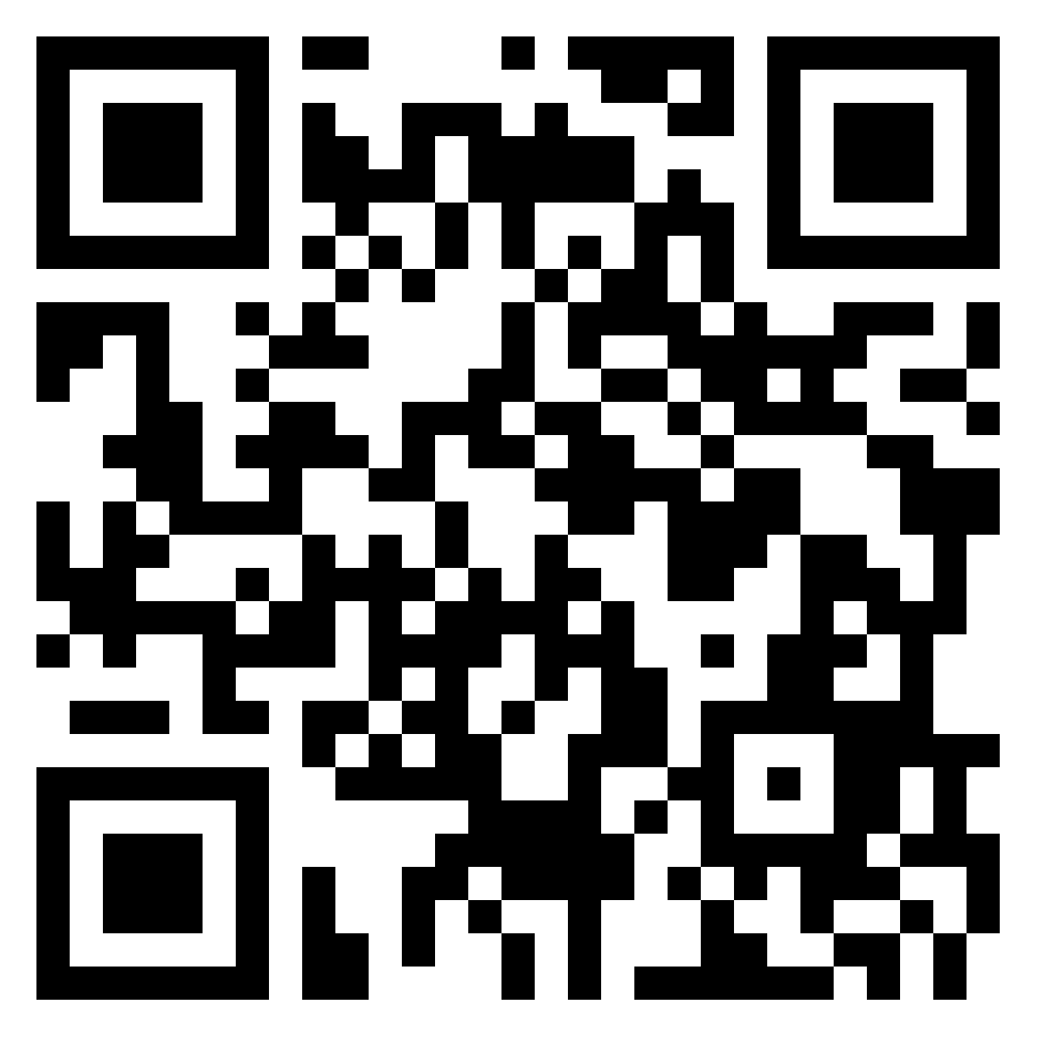
TASK 1 - Leaders
HRM PEM SU OPF
Find the leader:
Find examples of the leader in different categories
What are their
common features?

Slide 15
Who is the leader - features
HRM PEM SU OPF
effective leadership requires a combination of skills, traits, and behaviors that allow leaders to inspire and motivate their team to achieve their best.
Visionary: Effective leaders have a clear vision for the future of their organization and can articulate this vision to their team in a way that inspires and motivates them.
Communicative: Effective leaders are skilled communicators who can convey their ideas and thoughts clearly and persuasively to their team.
Empathetic: Effective leaders are empathetic and understand the needs and concerns of their team members. They listen actively to their team's feedback and ideas, and seek to understand their perspectives.

Slide 16
Who is the leader - features
HRM PEM SU OPF
Decisive: Effective leaders are decisive and able to make sound decisions based on available information and data. They can weigh the pros and cons of different options and choose the best course of action.
Collaborative: Effective leaders recognize the importance of collaboration and seek input from their team members when making decisions. They encourage open communication and create an environment that fosters teamwork and mutual respect.
Adaptable: Effective leaders are adaptable and able to pivot quickly in response to changing circumstances or unexpected challenges. They are open to new ideas and approaches and can adjust their strategy as needed.
Inspirational: Effective leaders inspire their team members to work towards a common goal and achieve their full potential. They lead by example and set a high standard of excellence for themselves and their team.

Slide 17
Identifying personality of leader
HRM PEM SU OPF
the personality of a leader can be done by observing their behavior, communication style, decision-making approach, and overall leadership style.
Some ways to identify a leader's personality include:
Look at how the leader interacts with their team and others.
Do they seem calm, assertive, or outgoing?
Do they inspire others, or do they come across as distant or authoritarian?

Slide 18
Identifying personality of leader
HRM PEM SU OPF
How does the leader communicate with others?
Do they speak clearly and effectively, or are they vague and unresponsive?
Do they listen actively and empathetically, or do they dominate conversations and interrupt others?
How does the leader make decisions?
What is the leader's overall approach to leadership?
Do they lead by example and inspire others, or do they rely on rules and authority to maintain control?

Slide 19
Methods of selection
HRM PEM SU OPF
There are many tests and assessments available to help identify and evaluate leadership skills and potential. Some of the most widely used tests for leaders include:
Myers-Briggs Type Indicator (MBTI): four key areas of personality: extraversion vs. introversion, sensing vs. intuition, thinking vs. feeling, and judging vs. perceiving
Strengths Finder: This test identifies an individual's top strengths and talents, 34 different strengths, such as strategic thinking, empathy, and positivity
360-Degree Feedback: This assessment involves gathering feedback from multiple sources, including peers, managers, direct reports
Assesment centre!

Slide 20
What must leaders know?
HRM PEM SU OPF
The organization's vision, mission, and values: Leaders must have a clear understanding of the organization's goals and values, and be able to communicate these to their team in a way that inspires and motivates them.
The strengths and weaknesses of their team: Leaders must be aware of the skills and abilities of their team members, as well as their areas for improvement.
The needs of their stakeholders: Leaders must know the needs and expectations of their stakeholders, including customers, employees, shareholders, and community members – better decision-making.

Slide 21
What must leaders know?
HRM PEM SU OPF
How to communicate effectively: clearly, both verbally and in writing, be good listeners and able to provide feedback.
How to manage conflict: in their team and between stakeholders. This involves: listen to different perspectives, find common ground, and facilitate problem-solving.
How to lead through change: to adapt to changing circumstances, flexible, responsive, and able to communicate a clear vision for the future.

Slide 22
Is there a difference between leadership and management?
HRM PEM SU OPF
Leadership
Management
Refers to the ability to inspire, motivate, and influence people to achieve a common goal.
Leaders are often visionary and have a strong sense of purpose. They inspire others to follow them by setting an example, sharing their vision, and empowering others to achieve their full potential.
Leaders often challenge the status quo and seek to bring about positive change.
Refers to the process of planning, organizing, directing, and controlling resources (e.g., people, finances, materials) to achieve organizational goals. Managers are responsible for efficiently and effectively completed processes.
They focus on maintaining order and stability within an organization, and often work within established procedures and guidelines.

Slide 23

Sustainability – a new challenge
(team work)
HRM PEM SU OPF
It is not only environmental, but social and economic = 3 pillars.
„Sustainability is a concept that emphasizes meeting the needs of the present without compromising the ability of future generations to meet their own needs.“
Role of corporate culture and leaders, CSR

Slide 24
Economic sustainability
HRM PEM SU OPF
Economic sustainability involves managing resources and finances in a way that supports long-term prosperity without depleting natural resources or causing social harm. It includes practices such as investing in renewable energy, promoting fair trade, reducing waste and inefficiency, and fostering economic stability and resilience.
Example:
economic benefits of renewable energy, recycling
brand
corporate values

Slide 25
Social sustainability
HRM PEM SU OPF
Social sustainability concerns the well-being of people and communities, both now and in the future. It involves promoting equity, justice, and inclusivity, ensuring access to basic needs such as education, healthcare, and housing, and fostering strong social connections and cultural diversity.
Example:
work-life balance
working conditions
equity rewarding system
fair trade
role of HRM

Slide 26
Environmental sustainability
HRM PEM SU OPF
This aspect of sustainability focuses on ensuring that natural resources are managed responsibly to minimize harm to ecosystems and biodiversity. It involves practices such as reducing pollution, conserving energy and water, protecting habitats, and mitigating climate change.
Example:
recycling
renewable energy
sustainable agriculture
new technologies, digitization

Slide 27
TASK 3
HRM PEM SU OPF
Work in teams for your seminar paper.
Prepare theoretical explanation.
Chose the company and find the legal framework that addresses sustainability in a specific economy.
Do not forget about References!

Slide 28
Next lesson content
HRM PEM SU OPF
Multigenerational leadreship
Talent management
Branding
Diversity management
Role of social network

Slide 29

PERSONALISTIKA PEM SU OPF
Thank you
for your attention.
Děkuji vám za pozornost, přeji příjemný den.

