Slide 1
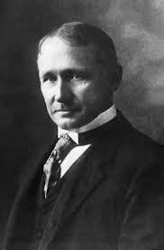
FREDRICK W. Taylor
American mechanical engineer

Slide 2
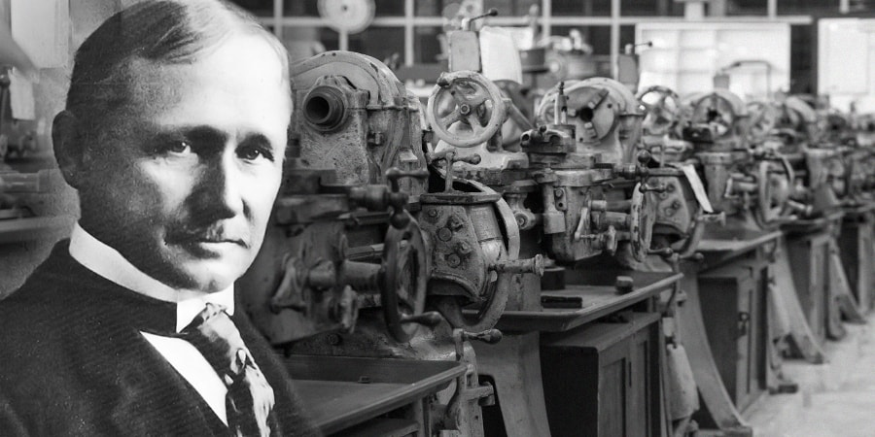
The Biography :-
Born:- March 20, 1856 in Pennsylvania, United States
He is an American mechanical engineering
He is widely know for his methods to improve industrial efficiency
He is the father of Scientific management theory
He finished his bachelor's degree in mechanical engineering from Stevens Institute of Technology in 1883
He also wrote the books such as :
  Notes on Belting (1894) ,
  A Piece-Rate System (1895)
  Shop Management (1903)
  The Principles of Scientific Management (1911).

Slide 3
The benefit in the management
Taylor Motivation Theory - Key takeaways :
1) Scientific methods are used to discover the most efficient way to perform a task
2) Clear division of responsibilities
3) Performance-based pay
4) Rigid hierarchy and strict surveillance of employees.
The key advantages of Taylor’s theory are:
Increased production
Managers being in control of their workforce
The cost of production is reduced
The performance-based payment system being introduced and reduced inaccuracy.

Slide 4
What is relevant today :-
Taylor’s ideas had a widespread impact on the business world, which is still visible today. Scientific management principles continue to influence productivity strategies in areas preoccupied with efficiency, such as manufacturing processes, mass production, and mechanical engineering.
Frederick Winslow Taylor's scientific management principles, like time and motion studies for efficiency, are still relevant in HRM. Concepts such as performance measurement, goal setting, and standardization can be applied to enhance productivity and employee performance. However, it's crucial to balance these principles with modern approaches that emphasize employee motivation, empowerment, and a more holistic view of human resources.

Slide 5
The Conclusion :
His main focus was on how to increase productivity.
His theories have helped many business organization to grow.
His theories was very good for the business but not for the workers because of the control of the employees.
Deskilling is also a big issue in his theories.

