Slide 1
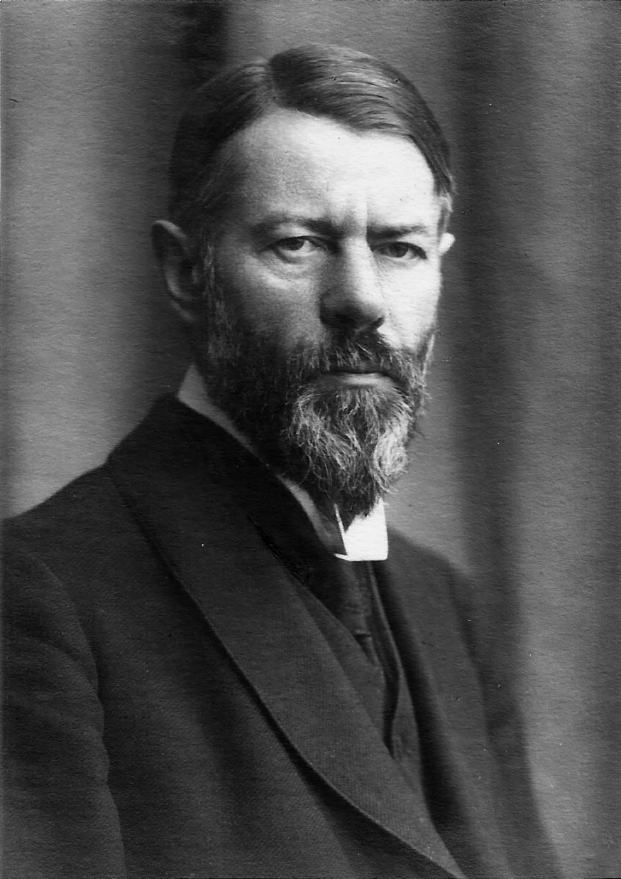
MAX WEBER
1864-1920
PRESENTED BY
ASHIK GANESAN
AROMAL OTTATHIL JIJI
VIMAL KUMAR
ASHIQ KOLKALATHIL
LIMA RAJEEV
ARABHI GOPAL RANI
MOHAMMED JAMNAS
SUDHEESH C
SABITH THANGAL

Slide 2
Max Weber (1864–1920) was a German sociologist, philosopher, and political economist known for his contributions to social theory, economic sociology, and bureaucracy studies.
Education: Studied law, economics.
Academic Career: Started as a lecturer, teaching economics at the University of Freiburg, later becoming a professor at the University of Heidelberg and the University of Munich.
Methodology: Advocated for verstehen, or understanding, as a sociological method, stressing interpretation within cultural and historical contexts.
Later Life and Legacy: Continued writing and teaching until his death on June 14, 1920, in Munich, leaving a profound impact on sociology, economics, and political science, and considered a founding figure of modern sociology.
BIOGRAPHY

Slide 3
BENEFITS IN MANAGEMENT
Specialization: Weber advocated for division of labor, allowing individuals to focus on specific tasks they excel at. In HRM, this translates to specialized roles such as recruitment specialists, training coordinators, and compensation analysts, leading to expertise and efficiency.
Formal Rules and Procedures: Weber stressed the importance of standardized rules and procedures to ensure consistency and fairness. In HRM, this involves establishing policies and guidelines for recruitment, performance evaluation, disciplinary actions, etc., fostering transparency and equity.
Impersonality: Weber proposed that decisions should be based on objective criteria rather than personal biases or preferences. In HRM, this principle supports fair treatment of employees regardless of personal relationships, promoting equal opportunities and reducing favoritism.

Slide 4
CONCLUSION
Max Weber's ideas on bureaucracy, the Protestant work ethic, and the concept of the "ideal type" remain relevant today. His insights into the complexities of modern organizations and the influence of cultural factors on economic development continue to be studied and applied in various fields like sociology, political science, and management.

Slide 5
THANKYOU

