Slide 1
Conflict Management Konstantinos Zervas

Slide 2
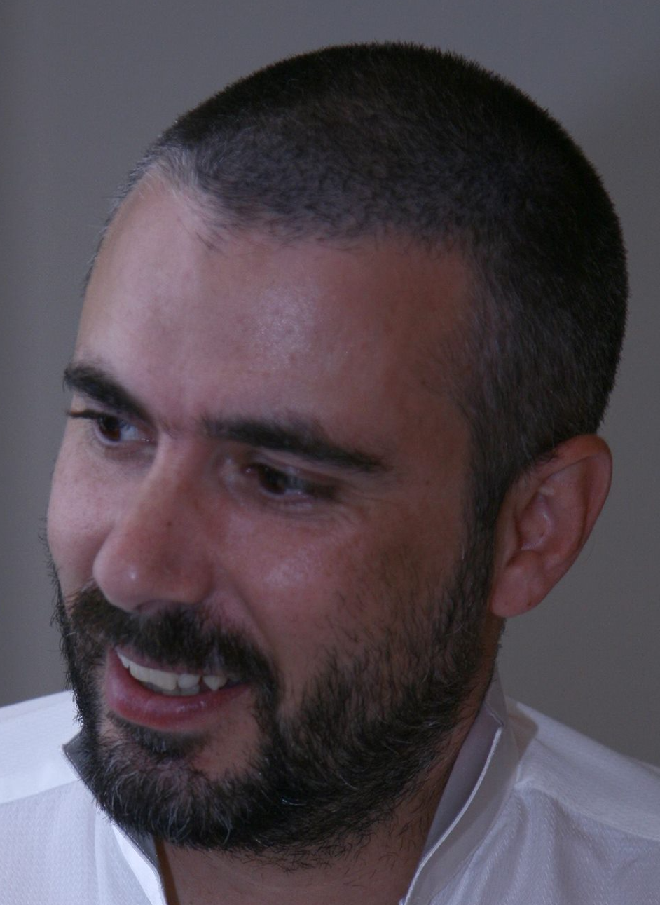
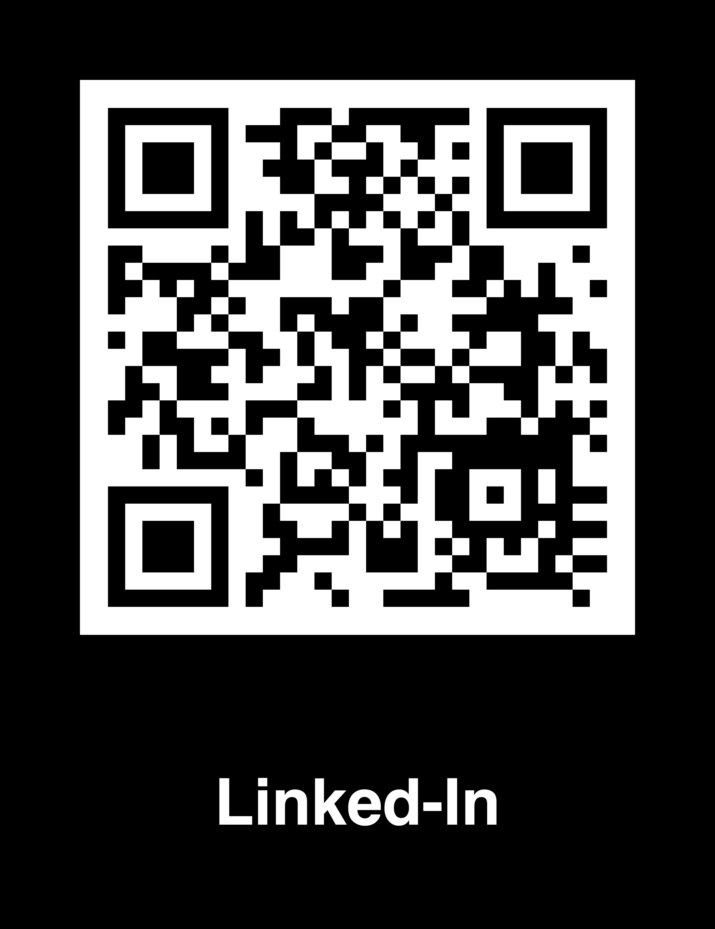
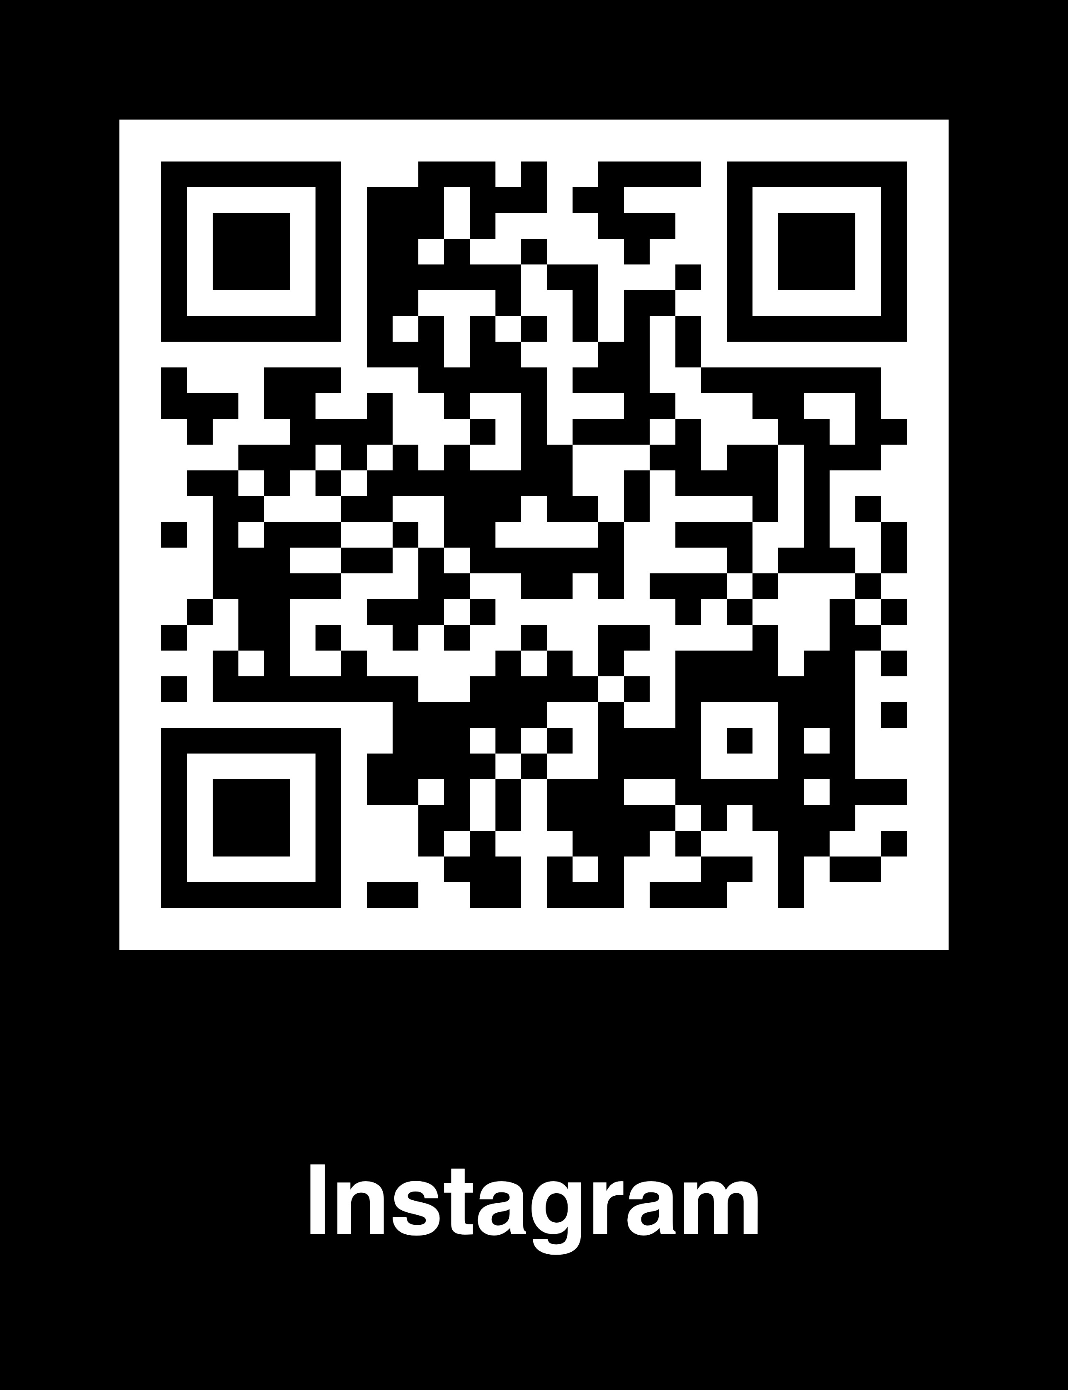
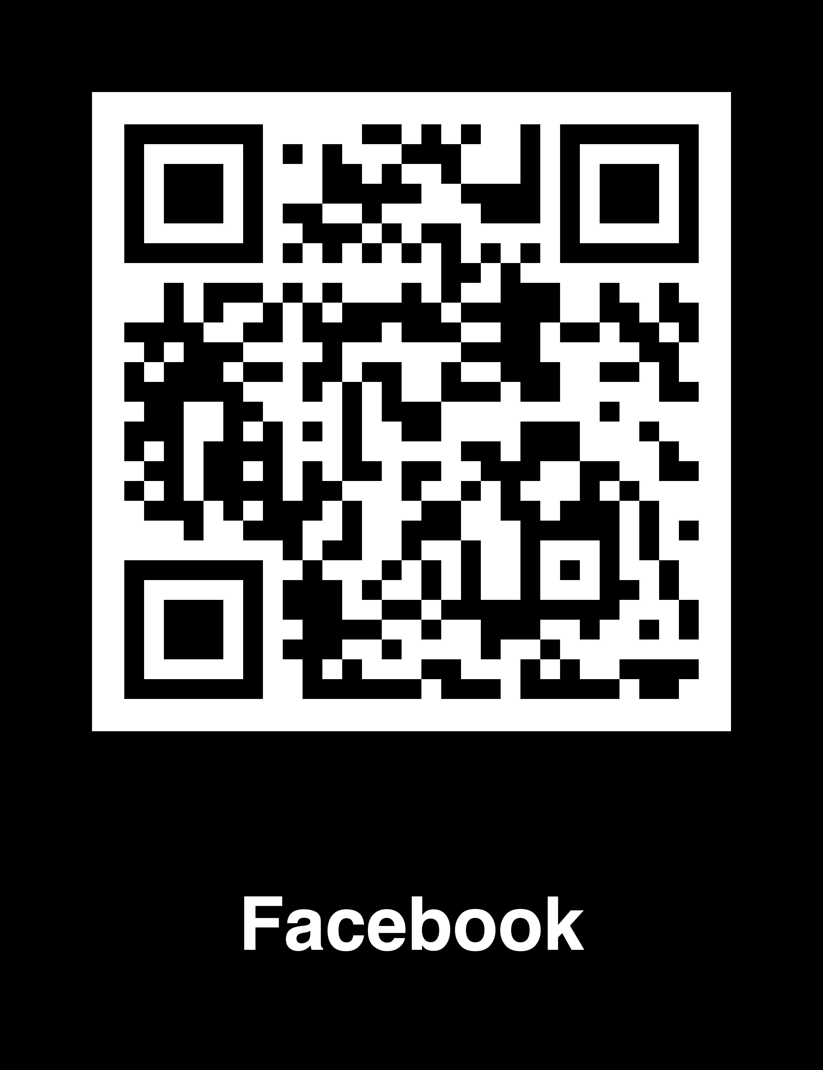
Who am I and… Why am I here?
Name: Costas
Age: Need to know basis only and you don’t need to know
10 x Years in Lecturing
17+ Years in IT Leadership positions
Lived in: Greece, UK, Ireland, UAE, Cyprus, Czechia
Speaking: Greek, English, German
Thinking I speak: Italian, Spanish, Russian, Czech
Love: Star Wars, Team sports, Drums, Heavy Metal, my gaming consoles
Not a fan: gym, running (unless hunted),biking (unless car is damaged)
Feel free to follow me :
Related Credentials:
2 x Years as Service Integration Leader for ALD Automotive
2 X Years as Squad Leader for IT-Ergo Financial Institute
2 X Years as Delivery Partner Executive for EFS Bank.
2 x Years as Major Incident commander with Global ISAT Team
4 x Years in Delivery Leadership Account Management (DACH Banking Industry)
8 x Years in Commercial Leadership Account Management in EMEA Region (Retail, Banking)
1 x Wedding planned
1 x Divorce agreed
1 x 11 year old son

Slide 4
Video

Slide 5
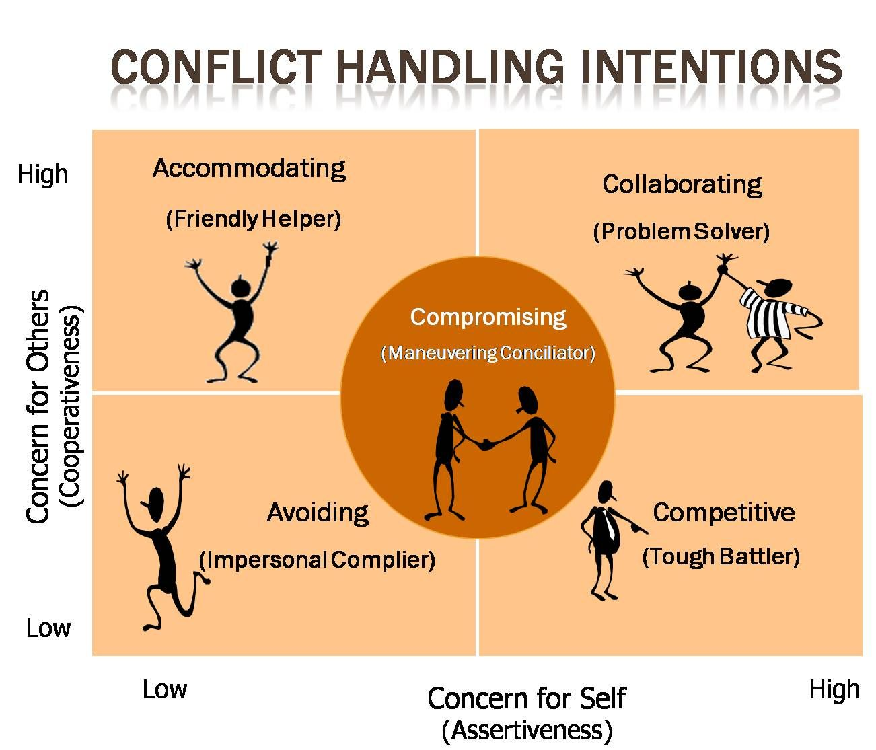
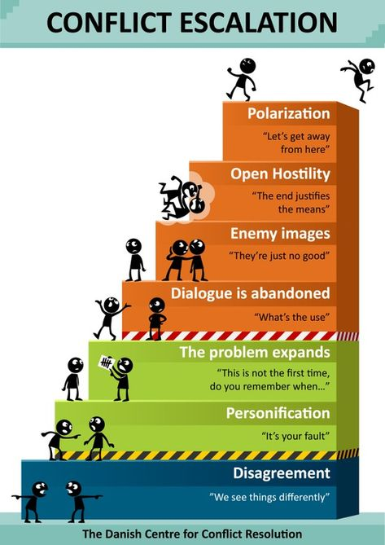

Slide 6
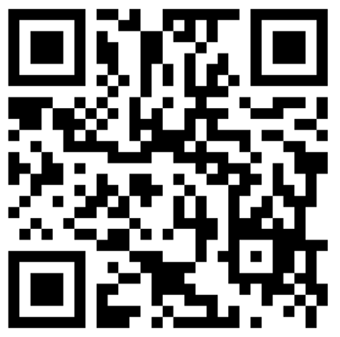
We value your feedback.

