Slide 1

Factors impacting innovation
Ing. A K M Zakara
zakaria@opf.slu.cz

Slide 2
Introduction
Innovation is simply the act of creating something new or improving something that already exists. It can be a new product, a new service, a new process, or a new technology that adds value to people's lives. In other words, innovation is all about introducing new and better ways of doing things that help individuals, businesses, and society as a whole.
Example: Tesla Inc.
Tesla's electric cars offer superior performance, longer ranges, reduce carbon emissions and innovative features such as Autopilot, which can assist with driving tasks.

Slide 3
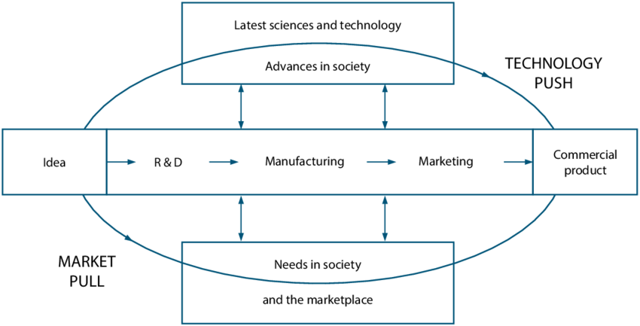
The interactive model of innovation

Slide 4
Importance of innovation
In today's world, innovation is essential for several reasons:
Staying competitive: Innovation helps businesses and organizations to stay ahead of their competitors by creating new products, services, or processes that offer greater value to customers.
Meeting changing customer needs: Customer needs and preferences are constantly evolving, and innovation enables organizations to develop products and services that better meet those needs.
Increasing productivity: Innovation can help organizations to increase their productivity by improving processes and workflows, reducing waste, and automating tasks.

Slide 5
Importance of innovation
Creating new markets: Innovation can open up new markets and revenue streams for businesses by creating products and services that meet unmet customer needs.
Addressing social and environmental challenges: Innovation can be used to address social and environmental challenges such as climate change, resource depletion, and social inequality, which are becoming increasingly urgent issues in today's world.
In short, innovation is essential for businesses and organizations that want to survive in today's rapidly changing and competitive marketplace, and to contribute to a better world for all.

Slide 6



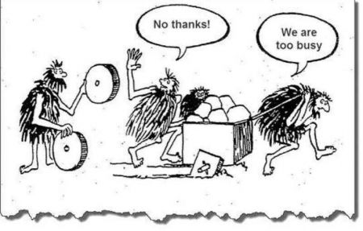
Innovation

Slide 7
Factors impacting innovation
There are two set of factors
1. Exogenous Factors (External Factors)
2. Endogenous Factors (Internal Factors)

Slide 8
Exogenous Factors
Exogenous factors are external factors that affect innovation and those are the out of control of an organization or individual. Exogenous factors can have both positive and negative impacts on innovation, and organizations must be able to adapt to these external changes to remain competitive and innovative.

Slide 9
Exogenous Factors
Political and economic conditions are some of the most significant exogenous factors that impact innovation. Changes in government policies and regulations, shifts in market demand, and fluctuations in the global economy can all have a significant impact on the innovation ecosystem. For example, changes in government funding policies for research and development can either stimulate or restrict innovation. Economic conditions can affect the availability of financing, access to resources, and the willingness of consumers to adopt new products and services.

Slide 10
Exogenous Factors
Cultural values and social trends can impact a company's ability to innovate by influencing the types of products and services that are in demand by consumers. For example, social trends such as the growing interest in health and wellness has led to an increase in demand for healthy food products, which has led to innovation in the food industry to develop healthier alternatives. Similarly, cultural values around sustainability have driven companies to develop more environmentally friendly products and services.

Slide 11
Exogenous Factors
Technological advancements are another important exogenous factor that impacts innovation. Advances in technology can enable new forms of innovation and disrupt existing markets. For example, the rise of cloud computing, artificial intelligence, and blockchain technology have enabled new forms of innovation in various industries, such as finance, healthcare, and logistics.
Globalization: Globalization has had a big impact on innovation. On the one hand, it has created new opportunities for businesses to develop innovative products and services, and collaborate with others from around the world. On the other hand, it has also increased competition, raised intellectual property issues, and presented challenges related to cultural differences.

Slide 12
Exogenous Factors
Environmental factors: Climate change, natural disasters, and other environmental factors can impact innovation by creating new market opportunities for sustainable products and services, increasing demand for green technologies, and driving innovation in areas such as renewable energy and resource efficiency.
Demographic changes: Changes in population size, age, and diversity can shape innovation opportunities and create new markets for products and services. For example, an aging population can drive innovation in healthcare, while demographic shifts towards urbanization can create opportunities for innovation in transportation and infrastructure.

Slide 13
Exogenous Factors
Competition: Apple and Samsung are in fierce competition in the smartphone market, which has led to the development of new features such as facial recognition and foldable screens.
Market Opportunity: Tesla identified a market opportunity for electric cars and developed innovative battery technology to meet customer needs.

Slide 14
Exogenous Factors
Funding: Funding can be considered an exogenous factor in the sense that it is influenced by external factors that a company may not have direct control over. For example, the availability of funding sources such as venture capital, angel investors or public grants can be influenced by market conditions, economic policies, and investor sentiment, which are all factors outside the company's control.

Slide 15
Endogenous Factors
Endogenous factors are internal factors that impact innovation and are within the control of an organization or individual. These factors can include organizational culture, leadership, resources, capabilities, and the ability to collaborate and share knowledge within a team. Endogenous factors are often influenced by an organization's strategies, goals, and objectives, and can have a significant impact on the ability to innovate and develop new products, services, or processes.
Successful organizations understand the importance of managing endogenous factors effectively to create a culture of innovation and stay ahead of the competition.

Slide 16
Endogenous Factors
Technology: A company's ability to adopt new technologies and adapt to changing technological trends can also be an endogenous factor of innovation. Companies that are quick to adopt new technologies and integrate them into their operations can gain a competitive advantage by improving efficiency and reducing costs.
Resources: Resources such as funding, talent, and equipment can impact innovation. Companies with sufficient resources are more likely to invest in research and development and explore new market opportunities.

Slide 17
Endogenous Factors
Leadership: Leadership is important for innovation because good leaders can inspire their teams to come up with new ideas and take risks. By creating a culture of innovation, leaders can encourage their team to think creatively and develop new solutions to challenges, which can help the company stay competitive and successful.
Culture: Company culture can impact innovation by either promoting or blocking creativity and experimentation. Companies with a culture that values innovation and encourages employees to share new ideas are more likely to foster a culture of innovation.

Slide 18
Endogenous Factors
Vision: A clear vision and strategy for innovation provides direction and focus for innovation efforts. It helps to ensure that innovation aligns with overall business goals and motivates employees to contribute their ideas.
Team: Innovation is a team effort, and a diverse and skilled team brings different viewpoints and knowledge to the innovation process. Effective team leadership encourages open communication, collaboration, and risk-taking to foster creativity within the team.

Slide 19
Endogenous Factors
Experimentation: Experimentation can impact innovation by allowing companies to test and refine new ideas. Companies that encourage experimentation and provide a safe space for employees to try new things are more likely to drive innovation.
Feedback: Gathering feedback from customers, employees, and other stakeholders can impact innovation by providing valuable insights into customer needs and preferences. Companies that prioritize gathering and including feedback into their innovation process are more likely to develop products or services that meet customer needs.

Slide 20
Endogenous Factors
Adaptability: Adaptability can impact innovation by allowing companies to respond quickly to changing market conditions and customer needs. Companies that are adaptable are more likely to develop innovative solutions that meet increasing market demands.
Collaborative partnerships: Nike's collaboration with Apple to create the Nike+ running app is an example of a collaborative partnership. The two companies worked together to combine their respective expertise in sportswear and technology to create a new product that enhanced the running experience for users.

Slide 21
Endogenous Factors
Risk taking: Risk taking is a critical factor in driving innovation. Companies must be willing to take risks in order to develop new products and services and enter new markets.
Investment in Research and Development: Companies that invest heavily in R&D are often more successful at driving innovation and staying ahead of their competitors. For example, Apple invests heavily in R&D, which has led to the development of innovative products such as the iPhone and the Apple Watch.

Slide 22
Similarities and Differences
Similarities:
Both exogenous and endogenous factors can impact an organization's ability to innovate and stay competitive in the marketplace.
Both types of factors can be interdependent and interact in complex ways.
Organizations can manage and respond to both types of factors to foster innovation.

Slide 23
Similarities and Differences
Differences:
Exogenous factors are external to the organization and outside of its control, while endogenous factors are internal and within the organization's control.
Exogenous factors are typically macro-level factors that affect the industry or environment, while endogenous factors are more micro-level factors that affect the organization itself.
Exogenous factors can be difficult or impossible to predict or control, while endogenous factors can be managed and controlled by the organization through strategic decisions and actions.

Slide 24
Example
Airbnb
Founded 2008
Identify a gap - lack of affordable, high-quality accommodation
Online platform => travelers + homeowners => short-term rentals
COVID-19 => longer-term rentals (work remotely or relocate temporarily)
Invested heavily to develop dynamic pricing algorithm
Launched new products and services, such as Airbnb Experiences

Slide 25

Example
Samsung
Research and Development (R&D)
  dedicated team of researchers and engineers
  large, high-resolution displays
  curved display technology
Competition
  facial recognition technology and foldable displays
Global Trends
  environmentally-friendly products
  EcoBubble washing machines

Slide 26
Summary
Factors impacting managing innovation can be categorized into exogenous and endogenous factors. Exogenous factors include market and customer needs, competition, regulatory environment, funding, and economic conditions. Endogenous factors include company culture, investment in research and development, people, resources and capabilities, and leadership and management. It's important to understand and manage these factors to drive successful innovation within a company, as they can interact with each other in complex ways.

Slide 27
Thank You and Good Luck
Email: zakaria@opf.slu.cz

