Slide 1

International Business Law
Organizational forms of entering foreign markets
Mgr. Tomáš Gongol, Ph.D.
International Business Law PEM/NPPMO

Slide 2
Organizational forms
  More extensive prospectus
    Advantage:
      More accurate operating and controling of company activities – unlike operating of contract partners
      First-hand contact with customer
    Disadvantage:
      High cost for maintantance
      Impact of foreign revenue tax measure
      Foreign jurisdiction – czech company can be sued abroad
      Possibility to highly protect empoyees by labour-law provisions
      Plenty of formalities – foundation, during operating

Slide 3
Organizational forms of entering foreign markets
  joint venture
  Subsidiary company establishment
    Establishment of organizational branch abroad
    Establishment of foreign form of corporation abroad
  Establishment of community interest company
  Acquisition
  Merger

Slide 4
Joint ventures
Form of business or production agreement between subjects from at least two countries, co-venturers share revenues, expenses and assets and also losts
  Corporate ventures
  Creates incorporate person
  (most commonly corporate enterprise and single-person corporation)
  Advantages: stableness, often bigger capital
  Disadvantages: long time and expensive founding of a company, rigidity and time-intensive concerning changes and liquidation

Slide 5
Joint ventures
  Contractual ventures
  Doesn´t create incorporate person
  investors just signed up to cooperate and their discretions and duties are regulated
  Advantages: elasticity and less financial costingness
  Disadvantages: some of field of international business can be are reserved only for incorporate person

Slide 6

Joint ventures examples
Partners who take benefit from their the other partner
Foreign company can offer e.g. Financial capital, well-known brand...
  Domestic company puts in knowledge of local market – very often in the area of electrotechnics
  KONE – TELC (institutional joint venture)
    Finnish KONE and Japanese Toshiba Elevator and Building Systems Corporation (TELC)
    Establishment of independent corporation „Joint-venture“ in China
      Kone - production line
      TELC - technology
    KONE has 70 % and TELC 30% of shares
    Toshiba lets KONE produce high-speed double-floor lifts with technoloy based on proven brand of Toshiba and Toshiba gets access to new markets
  Škoda - Volkswagen

Slide 7
Establishing of subdivision abroad
  Non-independent subdivision - branch (organisation unit)
    Legal entity identical with the exporter
    Contractual relations with foreign business partners are concluded through an organisational unit. The contractual party is always the czech exporter.
    Subdivision which is driven by a leader represented the parent company is “only” a mediator in closing deals (concluding, mediate)

Slide 8
Establishing of subdivision abroad
  Independent subdivision (local business company)
    Independent foreign legal entity - „daughter company“
    Not only negotiating but also entering into contracts on its behalf and on its own responsibility
    Subdivision doesn’t have to be established only by one czech founder but also can be established in cooperation with other entities. They will be participating on its activity finacially or otherwise

Slide 9
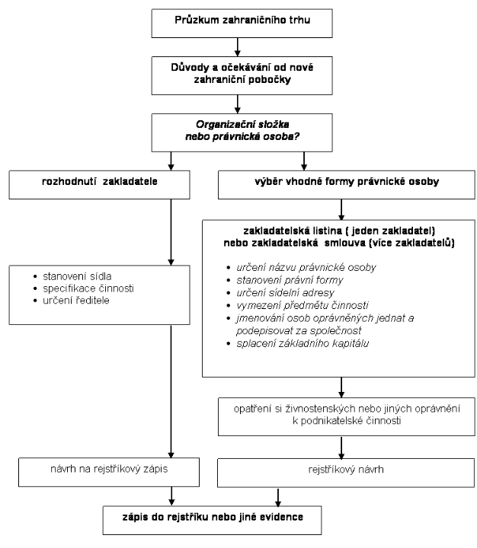

Slide 10
Widespread legal forms of business companies in Europe
  Favorite versions of Czech „s.r.o.“
    German „GmbH“,
      Minimal basic capital 25 000 EUR
    British „Ltd.“
      Minimal basic capital 1 GBP
    Dutch „B.V.“
      Basic capital 18 000 EUR
  Favorite versions of czech „a.s.“
    German „AG“
      Minimal basic capital 50 000 EUR
    British „Plc“
      Minimal basic capital 50 000 GBP
    Dutch „N.V.“
      Minimal basic capital 45 000 EUR
Notes:
Tady jsem jen zlehka upravila sjednoceni. Zaprve nejdriv cislice pak menu a zadruhe jsem anglicky prelozila jako British ne English, z duvodu ze Anglie neni Britanie a tak by vyraz English mohl byt zavadejici. Stejne jako Dutch – Holland.

Slide 11
Current situation of corporate law in EU
  The EU single market:
    Guarantee for all companies which are established under the law of EU member states, so called “national treatment”
      Enterpreneurs have the same rights as national entities
  Legal regulations of member states are harmonised (european standards)
    E.g. publicity of index data, cunsumer protection, protection of minority shareholders

Slide 12
Enterprise of foreigners in accordance to Trade and Commercial Code (national treatment )
  Enterpreneurship – Trade Code (§5/2)
    Foreign person can do business under the same conditions as citizen of the Czech republic
      te. Has to obtain business license in Czech
      If the person is not from EU: there is need to document a proof of visa or residence permit
      Enterpreneurship - Commercial Code (§ 21/4)
    Anthorisation of foreign person to enterpreuting in territory of the Czech republic is created at the day of registration the person (or organisation unit) to the Commercial Register
      exception.: doesn’t apply to natural person which is citizen of EU member states or EC or Switzerland.

Slide 13
Cross border services providing
  Act. No. 222/2009 Coll., on the free movement of services
  The cross border services principle
    Allows provider to provide services temporarily and occasionally on territory of another member state (using business license from home country)
  Providing services by entrepreneru which has not been settled in country where the service is provided
    E.g. interpreter, who gets an offer from spanish company to interpret for czech visitor in their spanish branch; or czech carpenter who is supposed to manufacture beams in the construction of church in Slovakia

Slide 14
Cross border services providing
  Self-employed persons do not have to apply for qualification recognition if they want to provide cross-border service
    It’s enough is they have permission to provide those services from home country
    Some services were excluded (permanently)
      E.g. postal, transport and financial services, providing of health care
  Law has a system of approving documents and meeting the critirie
  Land also principle of silent partnership
    If trade license office won’t respond within the deadline, it’s understood that the permission is approved

Slide 15
Participation of foreign subject in legal entity
  § 24/1 Comercial Code: A foreign person can for business purposes:
    Participate in formation of Czech legal entity or
    Participate as partner or member in czech legal entity already established
    Also can establish czech legal entity by itself
  In practise it’s the most common form of contributing foreign capital to Czech republic

Slide 16

Place of business relocation
  Favorable tax conditions
  Better position of majority partner towards minority one
  Less strict liability of partners
  Weaker or no participation of employees in Supervisory Board
  Higher quality of workforce
  Lower labour costs
  Financial suport from local agencies
  Providing better access to local market
  More flexible and quality legal system

Slide 17
Possibility of place of business relocation within the EU area ?
  The question of harmony with Community law – i.e. freedom
  of establishment
  Addressed to the European Court of Justice (ECJ) several times
  Daily Mail case 1988
    It was about the possibility to relocate the place of business because of tax reasons. From United Kingdom to Netherlands. European Court of Justine excluded this possibility. The primary freedom of establishment belongs only to individuals.
  Centros case 1998
    It’s not possible impose a ban on registration of a brand with justifying that the company was established according to legal order of country (in this case UK) where has no activity
  Inspire Art case 2003
    Member state of EU where the branch of the company is cannot change or regulate any law concerning minimum capital of partners of that company

Slide 18
Competition of legal order in EU
Conclusion of ECJ decisions:
Relocation of settlement abroad is not possible
Establish a company abroad is possible
Locate a branch of a company abroad is possible =>
  Decision of ECJ allowed so called competition of legal orders
    entrepreneur chooses a legal order which suits him the best for the establishing (e.g. requires the lowest minimal capital, etc.)
    Entrepreneur moves his activity to other country by establishing there a branch which performs subject of business.
      E.g. Czech entrepreneur formally established company in UK. Also establish one brand in Germany where will be actually operating the business.

Slide 19
How to proceed with “relocating settlement” according to valid Czech legal order?
  Fundamental for establishing new business company according to legal order of member state which suits the entrepreneur the best:
    Relocate the place of business of the company is not possible, i.e. it’s necessary to cancel the company in Czech and establish a new one in another country
  Putting in of a company (assets) into national company to capital of new company
  Establishing some of supranational companies (Societas Europaea)

Slide 20
European supranational companies
  Advantage: possibility to move the settlement within EU
  Forms of European supranational companies
    European Economic Interest Grouping
    Societas Europaea
    European Cooperative Society
  In future: European Private Company

Slide 21
European Economic Interest Grouping
  Legally
    EEC Council Regulation No. 2137/1985 on the European Economic Interest Grouping
    Act No. 360/2004 Coll. On the European Interest Grouping
  The purpose of this grouping is to make easier or develop economic activity of its members
    Its purpose is not to make profit for use of the grouping
      Any profits arising from grouping activity is considered as profit of its members
      EIG cannot:
        Perform directly or infirectly controlling or managing authority over activities of its memebrs or activities in different company
        Hold shares or stocks of any kind of form in member company
        To employ more than five hundred people
        To be used by company for provide loans to CEO or any person connected with CEO, if those loans are limited or anyhow controlled by legal acts of member states relating to companies
        Be member of another European Economic Interest Grouping

Slide 22
Establishing and settlement of EEIG
  Establishing by contract on grouping
  Created by the day of notation to certain registration list in country where is the settlement (member state of EU)
  In Czech it’s Commercial Register
  Prerequisite for creation of EEIG is that it consists of two members (individual and legal entity) from different countries of EU
  Settlement of the grouping can be replaced within the EU area

Slide 23



Example
Inter Pool Cover Team, European economic interest grouping
  The IPC Team is a European Economic Interest Grouping (EEIG), an alliance of 15 European Companies which have agreed to act in partnership to secure and fulfil contracts throughout Europe. Offers telescopic, rotated and fixed enclosures, 25 shapes, super flat and safe ground rails, the World novelties 3Seasons, Universe T, Neo Line - dome-shape & oval spa enclosures from IPC Team.
  The IPC Team is a European Economic Interest Grouping (EEIG), an alliance of 15 European Companies which have agreed to act in partnership to secure and fulfil contracts throughout Europe.
Notes:
Tyto informace jsem vzala z oficialnich stranek: www.poolcove-ipc.com

Slide 24
Societas Europaea
  Legislation of Societas Europea (SE)
    EU Council Regulation no. 2157/2001 – 8th of October 2001 on the European Company Statute (hereinafter only “SE Regulation”)
    Act No. 627/2004 Coll., on European companies
  Cannot be so-called “Greenfield project”
  European company prerequisite is already built business structure exceeding borders of one member state.
    E.g. cross-border mergers – min. 2 joint-stock companies, establishing cross-border mother holding company, transformation of joint-stock company which has a daughter company at least for two years on the territory of another country
  Registration takes place in the country of settlement
  SE can relocate to another member state of EU

Slide 25
The most used types in practice
MERGER
HOLDING
Cyprian joint-stock company
Czech joint-stock company
Slovakian joint-stock company
Mother SE
Slovakian joint-stock company
Czech join-stock company
Newly established SE
Creation of merger by integration or incorporation
CHANGE OF LEGAL FORM
Czech joint-stock company
Slovakian joint-stock company
Czech SE
Slovakian joint-stock company
100% daughter company
100% daughter company

Slide 26
Less used types in practice
CREATING
OF DAUGHTER COMPANY
DAUGHTER COMPANY
OF OTHER SE
Daughter company
Slovakian company
Czech company
Czech SE
Daughter SE No.1
Daughter SE No.2
Daughter SE No.3
Newly established daughter company

Slide 27
Conditions for SE
  Capital in amount of 120 000 EUR
  Liability in the amount of subscribed capital
  Possibility of choosing internal bodies of SE
    Monistic model – Management Board with authority of Board of Directors and Supervisory Board headed by Chairman
    Dualistic model (Board of Directors and Supervisory Board)
      In both is minimum required member one person
  Among the biggest European companies are:
  Allianz, BASF, Strabag or Porsche Automobil Holding

Slide 28
European Cooperative Society (ECS)
  Council regulation No. 1435/2003 on European Cooperative Society Statute
  Act No. 307/2006 Sb., on European Cooperative Society
  Main purpose:
    Meeting the need of its members and developing their activities abroad, esp. by concluding contracts with members to deliver goods or provide services
  Minimal capital is 30 000€
  It is possible to relocate the settlement without liquidation

Slide 29

Other forms of entering new markets
  Acquisition
    Take over a fully operating business or part of it
      Buying a company (e.g. buying shares) or majority of shares enough to control
    Acquisitions of competitive companies or service organisations are quite often
  Merger
    Can be by integration
      or incorporation

Slide 30
Ex. 1 / chap. 2
Partner of domestic Ltd. (seller) Mr. Adam signed 26.1.1994 during meeting with foreign partner in Dijon, FR a contract. It was about delivering goods in fourth quarter of the year 1994. Buyer urged this deliver in January 1995 by phone and fax. After what buyer claimed his right to compensation of loss, Mr. Adam who was supposed to deliver the goods rejected it with reasoning that the contract was not legally concluded, because partner exceeded the limit of own authority while signing the contract. Buyer insisted on proceeding and when even after other negotiations the Mr.Adam’s opinion didn’t change, he turned to the Regional Court in České Budějovice. The Court recognized the contract as valid. Executive Director then lodged a claim to Mr. Adam for loss compensation as a result of his unlawful behavior towards the buyer.
Answer these questions:
How and under what legal standards would you judge this case?
How and under what legal standards would you decide the dispute between domestic Ltd. And acting partner – Mr.Adam?

