Slide 1

International Business Law
Commercial terms INCOTERMS
International Transport Contracts
Doc. Mgr. Tomáš Gongol, Ph.D.
International Business Law PEM/NPPMO

Slide 2
INCOTERMS Origin :in practice of the trade
(a part of lex mercatoria)
  Application is possible only by using a reference in the contract!
  Made by International Chamber of Commerce in Paris (ICC)
    First version of INCOTERMS was published in 1936 (then in 1953, 1967, 1976, 1980, 1990, 2000, 2010)
    The newest: INCOTERMS 2015
  INCOTERMS connects a purchase contract with a transportation contract
    it regulates obligations of the parties about transporation of goods or its insurance

Slide 3
Content of INCOTERMS
  Rights and obligations of parties in relation to supply of goods
  If it’s used then it replaced Vienna convention
  (and sometimes even goes beyond it) in the following issues:
    Place of delivery
    Packaging
    Goods checking
    Obligations related to import and export
    Moment of transition of danger
    Moment of transition of costs
    Insurance (only CIF and CIP clauses)
CIF: Cost, Insurance and Freight; CIP: Carriage and Insurance Paid
Notes:
Tady tim prekladem: okamzit prechodu nakladu si nejsem moc jista

Slide 4
Types of clauses
  INCOTERMS contains 11 clauses (previously 13) which can be further divided into several groups:
  According to rights and obligations of the parties
    Minimum seller’s obligations: E clauses
    Split responsibilities: F and C clauses
    Minimum buyer’s obligations: D clauses
Notes:
Tady k tem zkratkam jsem vzdy radeji dopnila I jejich jmena

Slide 5
Structure of particular INCOTERMS 2000 clauses
  The seller’s obligations
A1 Provision of goods in conformity with the contract
A2 Licences, authorisations and formalities
A3 Contracts of
a) carriage and
b) insurance
A4 Delivery
A5 Transfer of risks
A6 Division of costs
A7 Notice to the buyer
A8 Proof of delivery, transport document or equivalent electronic message
A9 Checking – packaging – marking
A10 Other obligations
  The buyer’s obligations
B1 Payment of the price
B2 See A2
B3 See A3
B4 Taking delivery
B5 See A5
B6 See A6
B7 Notice to the seller (determine the time within an agreed period + place of taking delivery)
B8 Proof of delivery, transport document or equivalent electronic message
B9 Inspection of goods
B10 See A10

Slide 6
Incoterm 2010 | Loading at origin | Export customs declaration | Carriage to port of export | Unloading of truck in port of export | Loading on vessel/airplane in port of export | Carriage (sea/air) to port of import | Insurance | Unloading in port of import | Loading on truck in port of import | Carriage to place of destination | Import customs clearance | Import duties and taxes | Unloading at destination
EXW | Buyer | Buyer | Buyer | Buyer | Buyer | Buyer | Buyer | Buyer | Buyer | Buyer | Buyer | Buyer | Buyer
FCA | Seller | Seller | Seller | Buyer | Buyer | Buyer | Buyer | Buyer | Buyer | Buyer | Buyer | Buyer | Buyer
FAS | Seller | Seller | Seller | Seller | Buyer | Buyer | Buyer | Buyer | Buyer | Buyer | Buyer | Buyer | Buyer
FOB | Seller | Seller | Seller | Seller | Seller | Buyer | Buyer | Buyer | Buyer | Buyer | Buyer | Buyer | Buyer
CPT | Seller | Seller | Seller | Seller | Seller | Seller | Buyer | Buyer | Buyer | Buyer | Buyer | Buyer | Buyer
CFR | Seller | Seller | Seller | Seller | Seller | Seller | Buyer | Buyer | Buyer | Buyer | Buyer | Buyer | Buyer
CIF | Seller | Seller | Seller | Seller | Seller | Seller | Seller | Buyer | Buyer | Buyer | Buyer | Buyer | Buyer
CIP | Seller | Seller | Seller | Seller | Seller | Seller | Seller | Buyer/Seller | Buyer/Seller | Seller | Buyer | Buyer | Buyer
DAT | Seller | Seller | Seller | Seller | Seller | Seller | Seller | Seller | Buyer | Buyer | Buyer | Buyer | Buyer
DAP | Seller | Seller | Seller | Seller | Seller | Seller | Seller | Seller | Seller | Seller | Buyer | Buyer | Buyer
DDP | Seller | Seller | Seller | Seller | Seller | Seller | Seller | Seller | Seller | Seller | Seller | Seller | Buyer

Slide 7
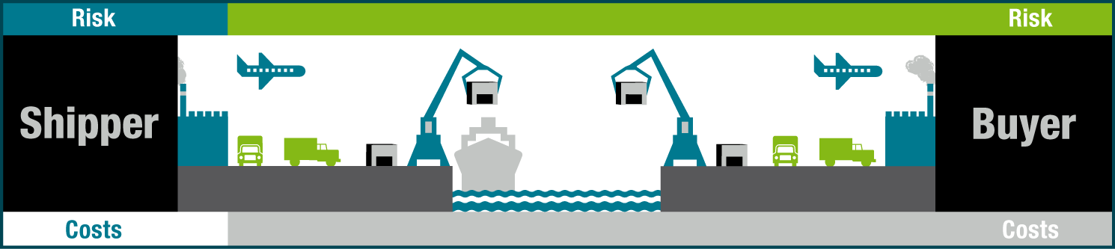
Ex works (EXW)
  Used for all modes of transportation. Transfer of risks takes place when the seller places the goods at the disposal of the buyer at the named place (e.g. factory, warehouse, etc.)

Slide 8
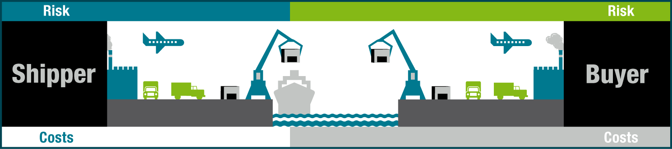
FREE ON BOARD (FOB)
  Used ONLY for vessels.
  Transfer of risks takes place successively once the goods have been placed on board the vessel nominated by the buyer at the named port of shipment.

Slide 9
CASE
In the agreement between the Ethiopian company (seller) and czech joint-stock company (buyer) for the supply of flax seed worth 15,500 EURO, Incoterms FOB Assab – Djibouti, had not been agreed the crusual (applicable) law. To solve eventual disputes arising from this agreement the parties have chosen, as arbitration body, Arbitration Court of the Economic Chamber and Agricultural Chamber of the Czech Republic in Prague.
QUESTIONS:
1. What law will be applicable?
2. Who is responsible for loss or damage of goods during transport across the Germany?
3. What is most comfortable INCOTERMS condition to use for the seller?

Slide 10

FREE ALONGSIDE SHIP (FAS)
Used ONLY for vessels.
Transfer of risks takes place when the seller places the goods alongside the vessel on the quay nominated by the buyer at the named port of shipment.

Slide 11
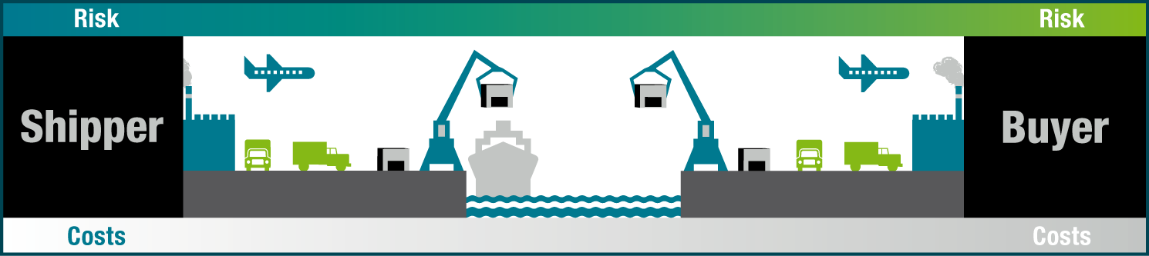
FREE CARRIER (FCA)
Used for all modes of transportation.
Transfer of risks takes place when the seller delivers the goods to the carrier nominated by the buyer at the named place.

Slide 12
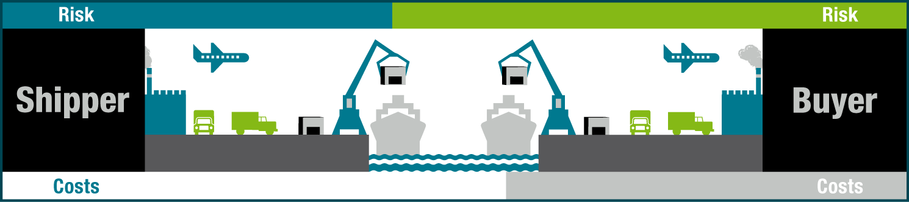
COST AND FREIGHT (CFR)
Used ONLY for vessels.
Transfer of risks is similar to FOB.

Slide 13
COST, INSURANCE AND FREIGHT (CIF)
Used ONLY for vessels.
Transfer of risks is similar to FOB. Marine and transport insurance shall be taken out by the seller for coverage of the buyer’s risks from the place of transfer of risks to unloading at the port of destination on conditions that minimum match Institute Cargo Clauses C or similar.

Slide 14
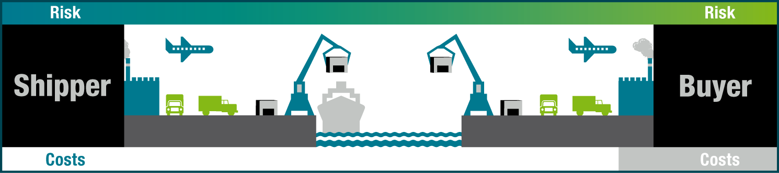
CARRIAGE PAID TO (CPT)
Used for all modes of transportation.
Transfer of risks takes place when the seller delivers the goods to the first carrier.

Slide 15
CARRIAGE AND INSURANCE PAID TO (CIP)
Used for all modes of transportation.
Transfer of risks is similar to CPT, i.e. when the seller delivers the goods to the first carrier. Marine and transport insurance shall be taken out by the seller for coverage of the buyer’s risks from the place of transfer of risks to the point of destination on conditions that minimum match Institute Cargo Clauses C or similar.

Slide 16
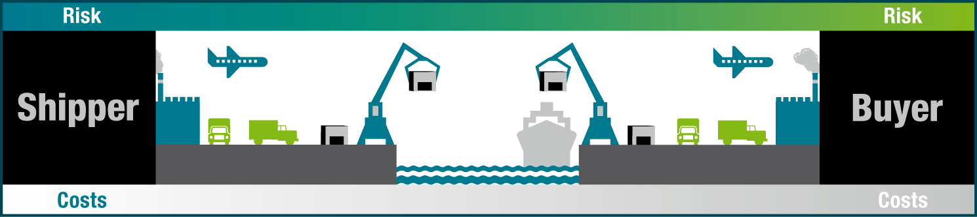
DELIVERED AT TERMINAL (DAT)
Used for all modes of transportation.
Transfer of risks takes place when the goods have been unloaded from the arriving means of transport and placed at the disposal of the buyer at a named terminal at the named port of destination/point of destination, not cleared for import.

Slide 17
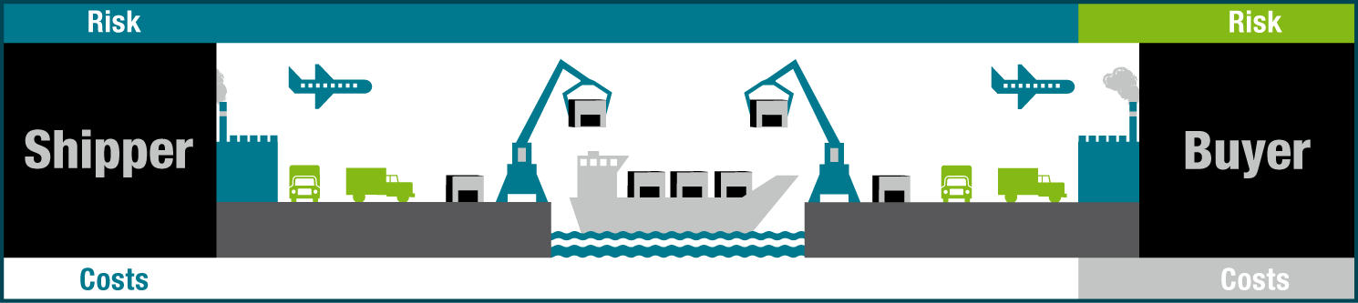
DELIVERED AT PLACE (DAP)
Used for all modes of transportation.
Transfer of risks takes place when the goods have been placed at the disposal of the buyer at the named point of destination, cleared for import.

Slide 18
DELIVERED DUTY PAID (DDP)
Used for all modes of transportation.
Transfer of risks takes place when the goods have been placed at the disposal of the buyer at the named point of destination, cleared for import

Slide 19
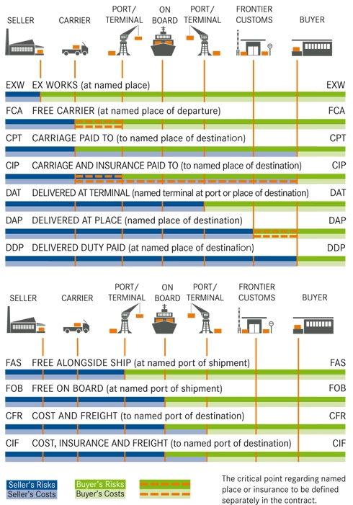

Slide 20
International Transport Contract
  Importance for international business
    Transport of goods – seems as complementary service to the purchase contract
      Covering the transport by contractual party is not very common
  Definition of international transport
    Transportation is international when the place of departure (sending) and the destination place are in different countries
      Sometimes those places are in the same country but part of the transport is take place someplace else.

Slide 21

Legislation
  Unified
    Esp.. Transportation contracts (contained in international contracts)
      Key point: shipping document, liability of the carrier, dispute solving
  Conflict
    When unified type doesn’t exist
    E.g. forward contract
    Applicable law: legislation of the place (country) where the carrier or shipper is established in
  Form contracts
    In practise: the carrier presents it to customer

Slide 22
International contracts in international transportation of goods
  CMR: Convention on the Contractor the International Carriage of Goods by Road – Reg. No. 11/1975 Coll.
  COTIF: Convention Concerning International Carriage by Rail – Reg. No. 8/1985 Coll. as amended
  United Nations Convention on the Carriage of Goods by Sea (The Hamburg Rules) 1978, Ministry of Foreign Affairs No. 193/1996 Coll.
  Convention for the Unification of Certain Rules for International Carriage by Air (The Montreal Convention) 1999 – Ministry of Foreign Affairs, No. 123/2003 Coll.

Slide 23
International sources of technical issues
    Convention on International Regime of Maritime Ports – Reg. No. 64/1932 Coll.
    Convention on International Civil Aviatory – Reg. No. 147/1947 Coll. as amended of Reg. No. 29/1957 Coll.
    European Convention on Road Signs – Reg. No. 175/1960 Coll.
    Agreement on adopting particular homologation conditions (verification of conformity) and mutual recognition of equipment homologation and other parts of motor vehicles – Reg. No. 176/1960 Coll.
    Custom Convention on International Agreement on Safe Containers – Reg. No. 62/1986 Coll.

Slide 24

International railway transport
  9 May 1980 – Convention concerning International Carriage by Rail (COTIF)
  3 parts
    Text of Convention = statute Intergovernmental Organisation for International Carriage by Rail (OTIF)
      Purpose: to create uniform legal order for international carriage of passengers, luggage and goods

Slide 25
  Appendix A – Uniform rules concerning the Contract for International Carriage of Passengers and Luggage by Rail (CIV)
    Transport document = ticket and luggage ticket (must contain the abbr. “CIV“)
    Railroad liability
      For death, injury during operation or entering or exiting (statute of limitations: 3 years)
      For damages caused by losing or damaging things that passengers having on themselves and for damage of hand luggage (statute of limitations: 1 year)
      For damages on luggage which was transported (statute of limitations: 1 year)
Notes:
Nejsem si jista, ale podle zneni COTIF, ktere jsem nasla na strankach jsem Pripojek A I B prelozila jako Appendix

Slide 26
  Appendix B – Uniform Rules concerning the Contract for International Carriage of Goods by Rail (CIM)
    Uniform legislation CIM is complemented by 4 Annexes which regulate more specific issues:
      International Carriage of Dangerous Goods by Rail (RID)
      International Haulage of Private Owners’ Wagons by Rail (RIP)
      International Carriage of Containers by Rail (RiCo)
      International Carriage of Express Parcels by Rail (RIEx)

Slide 27
CIM
  CIM applies to: all shipments of goods transported with consignment note issued for the route:
  On territory of at least two countries
  On railway lines registered in the list administered by Central office for international carriage by rail.
  CIM regulations are binding for countries which agreed with COTIF Convention as well as for transportation contract countries
    It is possible to deviate but only if CIM regulations itself allow it!
  If CIM regulations or international tariffs don’t regulate some issues then the applicable law shall be the national law of the country in which the party make a claim

Slide 28

  Transport document = consignment note
    Transportation contract shall be enter into consignment note
    Carrier is responsible for:
    Total or partial loss of goods
    Damage of goods to the moment of delivery
    Damage caused by delay
  Carrier is relieved of this liability:
    If the loss, damage or delay was authorised
    person’s fault or an order by authorised
    person which was not caused by the carrier,
    specific defects (such as inherent one,
    draining away, etc) or
    Circumstances which the carrier couldn’t
    stop and its consequences couldn't avoid.

Slide 29
International Road Freight Transport
  19 May 1956 – Convention on the Contract for the International Carriage of Goods by Road (CMR)
  Conditions of application
    Applies to every contract for the carriage of goods by road in vehicles (motor vehicles, trailers, semi-trailers)
    When the place of taking over of the goods and the place designated for delivery, as specified in the contract, are situated in two different countries, of which at least one is a contracting country
    It is done for reward
  Mandatory nature of the Convention
    Variance can be done but only if the contract allows it.
Other (consignment note, liability, atd.) see COTIF

Slide 30

International Air Transport
  28th May 1999 – Convention for the Unification of Certain Rules for International Carriage by Air (Montreal Convention)
      Replaces so-called Vienna Convention (1929)
  Application
    Applies to international carriage of passengers, baggage and cargo performed by aircraft for reward
    The place of departure and the place
    of destination are situated within
    the territories of two State Parties
    It has a mandatory nature.

Slide 31
  Transport of goods– air waybill
  Liability of Carrier
    Exceptions: inherent defect, quality or vice of that cargo; defective packing; an act of war; an act of public authority
    In practice: Airlines provide higher compensations than is required by the Convention
    Complaints:
      Damaged cargo: within 14 days, baggage: 7 days from the date of receipt
      Delay: within 21 days from the date on which the baggage or cargo have been placed at disposal
      If no complaint is made within the times aforesaid, no action shall lie against the carrier, save in the case of fraud on its part.
Notes:
Tady jsem pouzila americky vyraz waybill protoze si nejsem jista, jestli consignment note je take pouzivane u letecke dopravy.

Slide 32
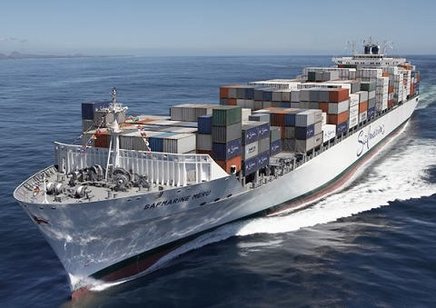
Maritime transport
  30th March 1978 United Nations Conventio on the Carriage of Goods by Sea (The Hamburg Rules)
  Convention is applicable to all contracts of carriage by sea between two different Countries if:
    The port of loading as provided for in the contract of carriage by sea is located in a Contracting Country or
    The bill of lading or other document
    evidencing the contract of carriage by
    sea is issued in a Contracting Country
  It has a mandatory nature.

Slide 33
Joint contractual type :
Carriage of goods contract
  Despite minor differences in the contracts of good carriage there are common rules in contracts.
  International nature of transport
    Is not given by the place of business or seat of contractual parties but by the fact that the transport path goes across a border as least one country.
      Due to that the carriage of goods agreed between two domestic entrepreneurs shall follow the international convention if the goods is transported to another country or from abroad.

Slide 34
Transport document
  Transportation contract is created by an agreement between the consignor and the carrier.
  Along with handing over the goods there have to be also transport documents - bill of lading, consignment note, air waybill
    It’s a proof of existence of contract and
    Security that gives the right to dispose with the consignment
    Requirements are specified in certain conventions

Slide 35
The essential elements of a transportation contract
The essential elements:
  Contractual parties (carrier, consignor)
  Recipient
  Type of goods (items), including data on weight, number of pieces, etc.
  Destination of goods
Other:
  Reward (e.g. setting fares)
  Value of the goods
  List of documents necessary for performing the tranport
    e.g. required by customs or other public authorities and danded to the carrier

Slide 36
Rights and Responsibilities
  Consignor’s responsibilities
    Hand over the shipment
    Inform about its character
    Hand over all documents
    Pay a fee (freight)
  Carrier’s Responsibilities
    Transport the goods on time and properly
Consignor’s R&R
  Consignor’s rights
    To get the goods for submitted transport documents
  Consignor’s responsibilities
    Cover those costs which weren’t pay by the carrier

Slide 37
Carrier’s responsibilities
  Responsibility for delay and damages
  It’s limited kind of responsibility
    Liberisation reasons (e.g. defective goods, defected packing, etc.)
    Limits the compensation for actual damages (e.g. price of the package) and don’t acknowledge the right for compensation for loss profit
Notes:
U tech liberizacnich duvodu byl jeste jeden priklad a to: zavinění škody oprávněným
Coz jsem uplne presne nepochopila a tak jsem to tam nezahrnula

Slide 38
Freight Forwarding contract in international business
  Definition:
  The seller (=forwarder) agrees to arrange storage and shipping from one place to another of merchandise on behalf of its shippers. It usually provides a full range of services including: tracking inland transportation, preparation of documents, warehousing, booking cargo spaces, negotiation, etc. The buyer agrees to pay a reward to a seller.
  Specialised type brokerage contract
    The seller covers also so-called forwarding activities
  Forwarder is liable for damages caused during transport unless he couldn’t avoid damaging it by performing professional care.
    If the contracts says so, the forwarder is obliged to insure the goods.
  Forwarder can perform the transport unless it contradicts the contract
  Forwarder has a lien on the consignment to ensure claims
  Legal regime:
    If there’s no choice of law then the applicable one is the law of the country where the forwarder has a seat or domicile
    Influence has been made by NGO FIATA

