Slide 1

HUMAN RESOURCE MANAGEMENT
Lesson 2
HRM – significance, developement, functions
Ing. Helena Marková, Ph.D.

Slide 2
Experts from practice - topics
PERSONALISTIKA PEM SU OPF
25.3. 14.45 Branding. Social media.
Presenters: Daria Wojtkowska, Global Talent Marketing Lead - Early Careers & Social, together with Kavya Kundalia, Social Media Marketing Senior Lead.
6.5. 14.45 Resolving conflicts
13.5. 14.45. International HR management
Cooperation with Kyndryl, IBM division.
on-line during the HRM lesson

Slide 3
Content
PERSONALISTIKA PEM SU OPF
personnel management,
human resource management,
personalities of management and personnel management history – TASK (team work)
diffencies of personal and human resource management
geographical differencies of the developement ant their reasons

Slide 4
Developement of HRM
HRM PEM SU OPF
The emergence of industrial relations and personnel management
Late 19th century to 1920
Connected with the need of improvement of working condition and need of higher efficiency
Labour movements across the newly indistrualized world
Typical conditions: working hours, child labour, improved health and safety at work.

Slide 5
Developement of HRM
HRM PEM SU OPF
How to achieve efficiency?
(notions of bureaucracy, division of labour, Principles of Scientific Management)
Efficiency may be attained through:
The increasing mechanisation of the workplace.
The simplification and routinisation of work.
The extrinsic, out-put related, reward-based motiovation of employees.

Slide 6
Developement of HRM
HRM PEM SU OPF
1st stage - people care (care about employees)
1920 - 30
technical aspect of hiring, evaluating, training, compensating
Taylorism, often referred to as Scientific Management, was the first theory of management to focus specifically on analyzing and optimizing workflows.
conflict of managers and employees – motivation/only money
a human was a part of technological process.

Slide 7
Developement of HRM
HRM PEM SU OPF
2nd stage
Personnel administration
explosion of academic research in psychology, anthropology and sociology
human realtions movement
rise of behaviourial, psychological and emotional perspective
divided into processes, technical background is still important

Slide 8
Developement of HRM
HRM PEM SU OPF
3rd stage (1940s – 50s)
Personnel management – developement
specific social needs of a person
comprehensive plans for personal and social development
personnel management (not just administration )
corporate management was both operational and tactical

Slide 9
Developement of HRM
HRM PEM SU OPF
4th stage (1960s – 70s)
Personnel management – maturity
specific social needs of a person
comprehensive plans for personal and social development
personnel management
corporate management was both operational and tactical
employees as a part of the system, increasing role of education, HR generally

Slide 10
Developement of HRM
HRM PEM SU OPF
5th stage (1980s - )
Human resource managment
more strategies
learning and developing people – learning organization
man was seen as a highly individualized
organised and pro-social system
systems are interconnected and processes build on each other
more oriented towards the external environment of the company

Slide 11
TASK 1
HRM PEM SU OPF
Trip to history (2-point activity)
4 group of students
Search for information about 4 historical personalities of management:
Henri Fayol Frederick W. Taylor
Peter F. Drucker Max Weber
Basic biography
What is their benefit in management, especially HRM?
What is relevant today?
Present it to your co-students.

Slide 12
Developement of HRM
HRM PEM SU OPF
It developed differently in the world.
It differes geographically.
Discuss:
What are the reasons of geogr. differencies of the HRM developement?
Find some examples.

Slide 13
Key differencies
HRM PEM SU OPF
Personnel Management Human Resource Manag.
employee focused business partner
operational, administrative strategic
reactive proactive
fragmental,ad hoc integrated, coordinated
policies and practises policies and practises
focus on performance focus on added value measurment

Slide 14
Hard x soft HRM
HRM PEM SU OPF
Hard HRM
emphasises on the efficient utilisation of the workforce
employees are the source to achieve organisational goals
Soft HRM
people management practises and activities to gain commitment of employees „emotionaly“ – you want to do that because you believe it…

Slide 15
Hard x soft HRM
HRM PEM SU OPF
Hard HRM Soft HRM
Employees are a resource …they are a source of
utilized competitive advantage
Deployment Developement
Control Commitment
Direction Involvement
Rigidity Flexibility
Performance measurement Performance enabling

Slide 16
Common HR activities
HRM PEM SU OPF

Slide 17
The pillars of HRM
HRM PEM SU OPF
Company culture
Philosophy
HRM Strategy
Policies and procedures

Slide 18
Company culture
HRM PEM SU OPF
Company culture is about the climate in the company, about relationships, behaviour towards employees and clients, respect to each other.
It goes throught strategies and policies.
It is based on philosophy (usually of the founder or owner).
Main values of the company.
CSR – what is it? Is it important? Is it what can company culture be built on? Name some rules…

Slide 19
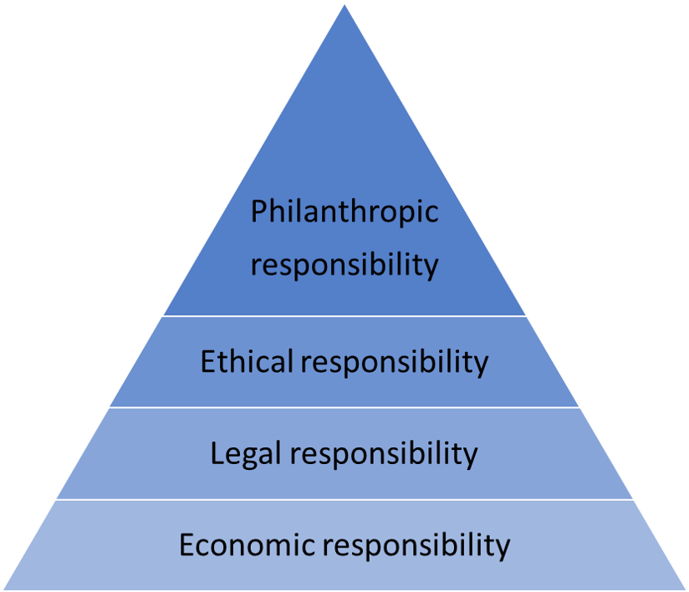
CSR pyramid
HRM PEM SU OPF

Slide 20
CSR in the social area
HRM PEM SU OPF
Social activities of a socially responsible company may include:
philanthropy
communication with stakeholders
strict respect for human rights (holidays, overtime, sick days, benefits, not trying to set a minimum wage saying there are 20 more people waiting outside)
compliance with labour standards
https://digitalmarketinginstitute.com/blog/corporate-16-brands-doing-corporate-social-responsibility-successfully

Slide 21

PERSONALISTIKA PEM SU OPF
Thank you
for your attention.
Děkuji vám za pozornost, přeji příjemný den.

