Slide 1

Accounting policy as a basis for budgeting at the enterprise
Lecture of Corporate Budgeting
Mgr. Tetiana Konieva, Ph.D

Slide 2
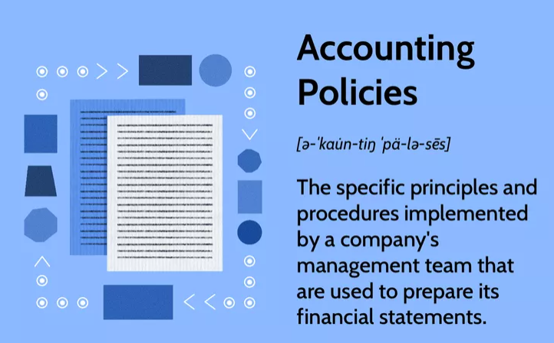
ACCOUNTING POLICY
Notes:
Nechci

Slide 3

ACCOUNTING POLICY
All accounting policies are required to conform to generally accepted accounting principles (GAAP) and/or international financial reporting standards (IFRS), International accounting standards (IAS).
International accounting standard (IAS) 8: Accounting Policies, Changes in Accounting Estimates and Errors
Accounting policies are the specific principles, bases, conventions, rules and practices applied by an entity in preparing and presenting financial statements; a set of principles, methods, procedures for accounting and financial reporting, which gives the enterprise independence and which is the internal law of the enterprise
A corresponding order about the accounting policy is issued, which is obligatory for all the department
An entity shall select and apply its accounting policies consistently for similar transactions, other events and conditions, unless a Standard or an Interpretation specifically requires or permits categorisation of items for which different policies may be appropriate
An entity is permitted to change an accounting policy only if the change: is required by a standard or interpretation; or results in the financial statements providing reliable and more relevant information about the effects of transactions, other events or conditions on the entity's financial position, financial performance, or cash flows.
Notes:
Nechci

Slide 4
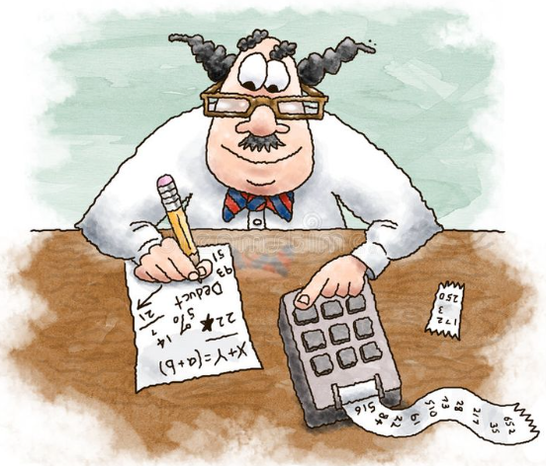
ACCOUNTING POLICY IS RELATED TO:
Accounting period: from January to December or from March to February or …..
Valuation of inventory:
Specific identification method - assessment of the value of each individual unit of inventory.
First-in First-out FIFO – inventories, that are the first to arrive and are released into production are valued at first-in cost
Last-in First-out LIFO - inventories are used in the reverse sequence of their arrival at the enterprise. That is, the inventories that are the first to be released into production are valued at the cost price of the last ones at the time of receipt.
Weighted average method
3. The structure of the costs of production: the list of direct material costs, direct labour costs, other direct costs, general production costs….
4. Depreciation methods: Straight-line; Sum-of-the-years’ digits; Double declining balance; Units of production
5. Criteria for low-valued non-current material assets
6. Salvage value for depreciation of fixed assets
7. Methods of depreciation of intangible fixed assets
Notes:
Nechci

Slide 5

ACCOUNTING POLICY IS RELATED TO:
8. Duration of the normal production and operating cycle of the enterprise in days
9. Periodicity of checking the property at the enterprise.
10. The list of officials who are granted the right to permit economic operations (operations with inventories and other property, access to banking account, responsible for cash payments…..). Samples of their signatures are approved and brought to the attention of the relevant structural subdivisions.
11. Rules and schedule of document circulation
12. Approved software, used for accounting
13. Classification of accounts receivable by duration
14. Methods of evaluating the doubtful and hopeless debts
15. The structure of provisions (provisions for future losses and payments; fund of guaranteed payments; funds of the corporate pension fund)
……….
Notes:
Nechci

