Slide 1
Sales budget
Lecture of Corporate Budgeting
Mgr. Tetiana Konieva, Ph.D

Slide 2
INCOMES AND EXPENSES: TYPES OF ACTIVITY
Income – growing of economic benefits in the form of assets increasing or liabilities decreasing, that leads to increasing in equity, other than increasing relating to contributions from owners
Expenses (costs, expenditures) – reducing of economic benefits in the form of assets decreasing or liabilities increasing, that leads to decreasing in equity, other than decreasing because of repurchasing stocks or reducing the quantity of owners
Profit = Incomes – Costs
Loss = Incomes – Costs (in case Costs > incomes)
According to International Accounting Standard 7 — Statement of Cash Flows incomes and costs are generated by:
operating activities are the main revenue-producing activities of the entity that are not investing or financing activities. Operating activity = basic activity (main goal of the firm; business, that generates majority of the incomes) + other operating activity (incomes from rent of the property, exchange rate difference, doubtful debts, sale of raw materials and other property).
investing activities are the acquisition and disposal of long-term assets and other investments that are not considered to be cash equivalents. Examples of investing activities are cash outflow for the purchase of fixed assets and financial investments, securities issued by other entities; cash inflow from the sale of the fixed assets, financial investments, received dividends, interest rate
financing activities are activities that alter the equity capital and borrowing structure of the entity. Examples are: cash inflows (the sale of company shares, bonds, getting loans) and cash outflows (the repurchase of shares, bonds, returning the credit, interest rate and dividend payments). Financing activity generates only financial costs, never incomes.

Slide 3
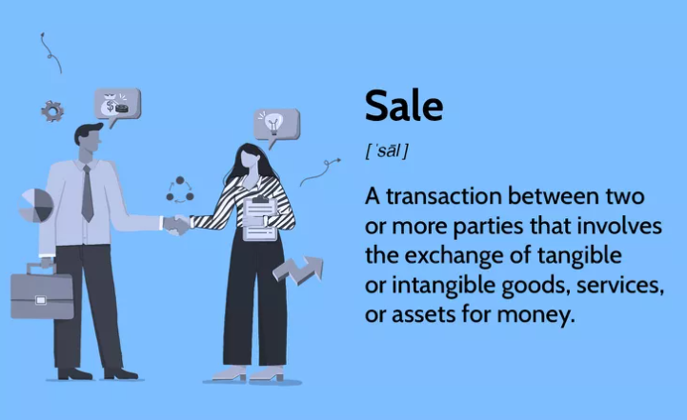
INCOMES BUDGET
The income budget reflects all incomes of the firm from every type of activities
Index | I | II | III | IV | Annual
1. Incomes from operating activity:
1.1 revenue (sales) from production, services
1.2 income from sale of property
1.3 income from sale of raw material
1.4 income from exchange rate
1.5 income from rent
2. Incomes from investing activity:
2.1 financial income (received % from deposit, from bonds, dividends)
2.2 other income from sale of financial investments (shares, bonds, other securities)
3. Total income

Slide 4
SALES (REVENUE) AS A PART OF INCOMES
Sales (revenue) is a part of incomes from operating activity
Sales (revenue) = Quantity of units of production sold *
Price per unit
Or
Sales (revenue) = Ʃ Quantity of units of production sold *
Price per unit, if there is an assortment of goods
Net revenue from sales of production (goods, works, services) = Net sales = Ʃ Quantity of units of production sold *
Price per unit – Value Added Tax – Excise – Custom Duty – Discounts – Allowances – Returns
https://www.investopedia.com/terms/r/revenue.asp

Slide 5
INCOMES AND EXPENSES: ACCRUAL BASIS OF ACCOUNTING
Accrual basis of accounting: Under the accrual basis of accounting, revenues are reported on the income statement when they are earned. When the revenues are earned but cash is not received, the asset accounts receivable will be recorded.
Recognition of revenue (International Accounting Standard 18 – Revenue):
the seller has transferred to the buyer the significant risks and rewards of ownership
the seller retains neither continuing managerial involvement to the degree usually associated with ownership nor effective control over the goods sold
the amount of revenue can be measured reliably
it is probable that the economic benefits associated with the transaction will flow to the seller, and
the costs incurred or to be incurred in respect of the transaction can be measured reliably
Expenses are reported on the income statement when they match up with the revenues being reported, or when a cost has no future benefit that can be measured. When an expense occurs and cash has not yet been paid, a liability account will also be recorded.

Slide 6
INCOMES AND EXPENSES: ACCRUAL BASIS OF ACCOUNTING
The accrual method records accounts receivables and payables and, as a result, can provide a more accurate picture of the profitability of a company, particularly in the long term.
For example, a company might have sales in the current quarter that wouldn't be recorded under the cash method. The related revenue is expected in the following quarter. An investor might think the company is unprofitable when, in reality, the company is doing well.
The accrual method doesn't track cash flow. A company might look profitable in the long term but actually have a challenging, major cash shortage in the short term.
Another disadvantage of the accrual method is that it can be more complicated to use since it's necessary to account for items like unearned revenue and prepaid expenses. It also may require added staff.
The accrual method typically is required for companies that file audited financial statements and is accepted under the generally accepted accounting principles (GAAP) issued by the Financial Accounting Standards Boards (FASB).

Slide 7
INCOMES AND EXPENSES: CASH BASIS ACCOUNTING
Cash Basis Accounting provides an immediate recognition of revenue and expenses when cash related to those transactions actually is received or paid.
The cash basis method typically is used by sole proprietors and smaller businesses.
The key advantage of the cash method is its simplicity – it only accounts for cash paid or received. Tracking the cash flow of a company is also easier.
It's beneficial to sole proprietorships and small businesses because, most likely, it won't require added staff (and related expenses) to use.
However, the cash basis method might overstate the health of a company that is cash-rich. That's because it doesn't record accounts payables that might exceed the cash on the books and the company's current revenue stream.
As a result, an investor might conclude the company is making a profit when, in reality, the company might be facing financial difficulties. The cash basis method is not acceptable under GAAP.

Slide 8
ACCRUAL BASIS OF ACCOUNTING
Transaction | Revenue, income | Cash inflow
1. Delivered production to buyers and received cash from them 20000
2. Delivered production to buyers with payment delay 20000
3. Received prepayment 20000 from the buyers for production, that have not been delivered yet
4. Received bank credit 30000
5. Company issued shares and sold them at exchange market 15000
6. Company received cash dividends from financial investments on the declaration date 1400
7. Company is declared cash dividends 1400 from financial investments in September, that will be paid in October

Slide 9
ACCRUAL BASIS OF ACCOUNTING
Transaction | Revenue, income | Cash inflow
1. Delivered production to buyers and received cash from them 20000 | 20000 | 20000
2. Delivered production to buyers with payment delay 20000 | 20000 | -
3. Received prepayment 20000 from the buyers for production, that have not been delivered yet | - | 20000
4. Received bank credit 30000 | - | 30000
5. Company issued shares and sold them at exchange market 15000 | - | 15000
6. Company received cash dividends from financial investments on the declaration date 1400 | 1400 | 1400
7. Company is declared cash dividends 1400 from financial investments in September, that will be paid in October | 1400 (September) - (October) | - 1400 (October)

Slide 10
ACCRUAL BASIS OF ACCOUNTING
Transaction | Expenses | Cash outflow
1. Company paid in advance for inventories 23000
2. Returning bank credit 30000
3. Salary is calculated for September 42000, it will be paid at the beginning of October
4. Made prepayment for annual rent 56000
5. Company paid dividend for owners 4000
6. Company calculated depreciation of equipment 1200

Slide 11
ACCRUAL BASIS OF ACCOUNTING
Transaction | Expenses | Cash outflow
1. Company paid in advance for inventories 23000 | - (the price of bought inventories will be expenses after the manufacturing the production from them and its selling) | 23000
2. Returning bank credit 30000 | - | 30000
3. Salary is calculated for September 42000, it will be paid at the beginning of October | 42000 | - 42000 (in October)
4. Made prepayment for annual rent 56000 | - (56000/12 – will be cost at the end of every month of the year ) | 56000
5. Company paid dividend for owners 4000 | - (dividends are not expenses, because they are paid from net profit after all expenses) | 4000
6. Company calculated depreciation of equipment 1200 | 1200 | -

Slide 12
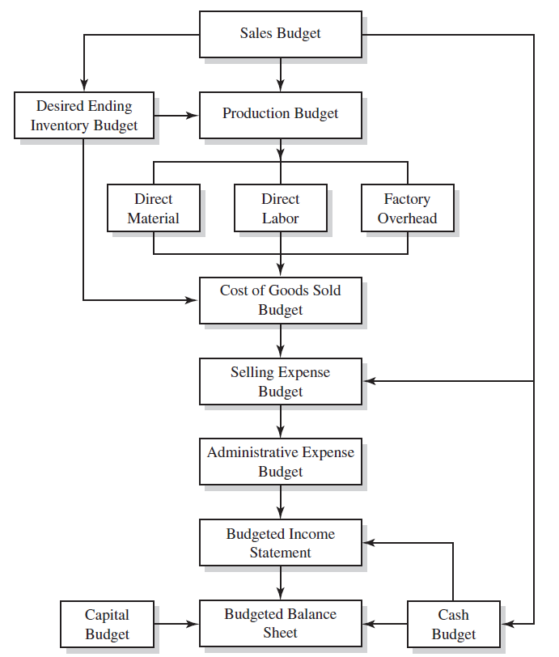
LOGICAL SCHEME OF BUDGETING PROCESS

Slide 13
SALES BUDGET
The sales budget is an operating budget, the starting point in preparing the manufacturing budget, because estimated sales volume influences nearly all other items appearing throughout all the entire budgets.
The sales budget should show total sales in quantity and value.
The sales budget is prepared for each product separately
The budget can be analysed further by product, territory, customer, and seasonal pattern of expected sales.
Indicator | Quarters |  |  |  | Annual sale | Quarters
 | І | ІІ | ІІІ | ІV |  | І | ІІ
1. Sale of finished products, units
2. Sale price, CZK.
3. Revenue (row 1 * row 2), CZK.

Slide 14
WAYS TO ANALYSE THE SALES BUDGET
Indexes | Domestic market | Foreign market
Product А:
_demand, units
_price per unit
_revenue = demand * price
_cost of units sold
profit = revenue – cost of units sold
Profitability = profit/cost of units sold
Product В:
demand, units
…….
Product | Demand (sales) | Inventories | Volume, needed to be produced = demand - inventories | Level of sales providing: -volume of production/sales or - inventories/sales
A
B

Slide 15
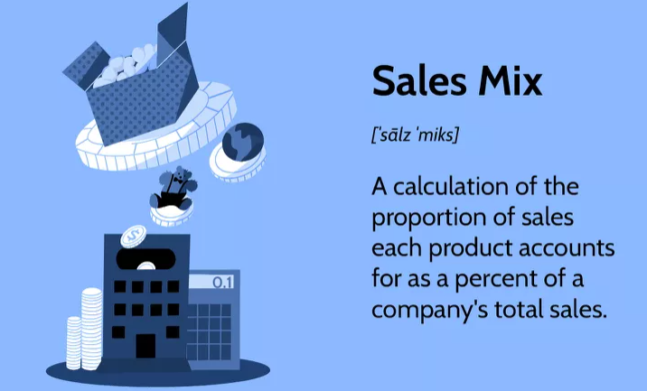
WAYS TO ANALYSE THE SALES BUDGET
Product | Sales |  | Deviation, %
 | Planned | Actually
A
B
C
Product | Volume of sales, units | Structure, % | Sales, CZK | Structure, % | Profit | Structure, %
A
B
C
Total |  | 100% |  | 100% |  | 100%

Slide 16
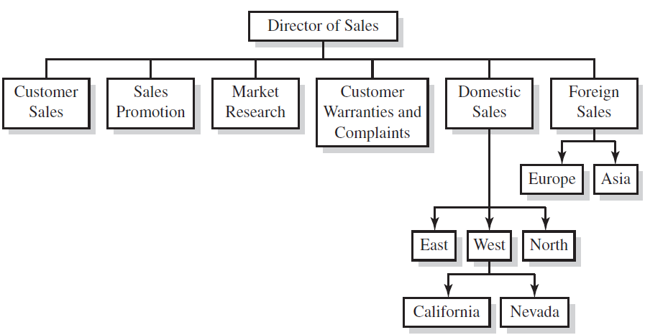
STRUCTURE OF A SALES DIVISION

Slide 17
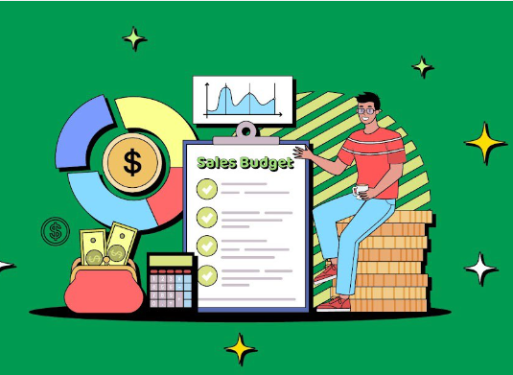
FACTORS, INFLUENCING THE SALES BUDGET
Macroeconomic factors: political stability, economic growth, exchange rate, inflation, unemployment….
Type of the market: perfect competition, monopoly, monopolistic competition, oligopoly, monopsony
Type of the product
Quality of product
Price of the product
Demand, elasticity of demand
Life cycle of the product
Fashion
Provided assortment
Customers’ segment
Seasonality
Marketing policy (advertising, special promotion methods, postproduction services), marketing mix: product, price, placement, promotion
Package
Pricing policy
Existing of substitute products and complementary products
Production capacity of the enterprise, inventories at the storehouses
State regulation of prices, volume of sales

Slide 18
TYPES OF MARKET STRUCTURES
1. Perfect Competition: large number of small companies competing against each other. They sell similar products (homogeneous), lack price influence over the commodities, and are free to enter or exit the market.
Consumers in this type of market have full knowledge of the goods being sold. They are aware of the prices charged on them and the product branding. No incentive for innovation: In the real world, if competition exists and a company holds a dominant market share, there is a tendency to increase innovation to beat the competitors and maintain the status quo. However, in a perfectly competitive market, the profit margin is fixed, and sellers cannot increase prices, or they will lose their customers.
There are very few barriers to entry: Any company can enter the market and start selling the product. Therefore, incumbents must stay proactive to maintain market share.
2. Monopolistic Competition - imperfectly competitive market with the traits of both the monopoly and competitive market. Sellers compete among themselves and can differentiate their goods in terms of quality and branding to look different. In this type of competition, sellers consider the price charged by their competitors and ignore the impact of their own prices on their competition.
3. Oligopoly market consists of a small number of large companies that sell differentiated or identical products. Since there are few players in the market, their competitive strategies are dependent on each other. For example, if one of the actors decides to reduce the price of its products, the action will trigger other actors to lower their prices, too. On the other hand, a price increase may influence others not to take any action in the anticipation consumers will opt for their products. Therefore, strategic planning by these types of players is a must.

Slide 19
TYPES OF MARKET STRUCTURES
4. Monopoly - a single company represents the whole industry. It has no competitor, and it is the sole seller of products in the entire market. This type of market is characterized by factors such as the sole claim to ownership of resources, patent and copyright, licenses issued by the government, or high initial setup costs. All the above characteristics associated with monopoly restrict other companies from entering the market. The company, therefore, remains a single seller because it has the power to control the market and set prices for its goods.
5. A monopsony is a market condition in which there is only one buyer, the monopsonist. Like a monopoly, a monopsony also has imperfect market conditions. The difference between a monopoly and a monopsony is primarily in the difference between the controlling entities. A single buyer dominates a monopsonized market while an individual seller controls a monopolized market. Monopsonists are common in areas where they supply most or all of the region's jobs.
A monopsony refers to a market dominated by a single buyer.
In a monopsony, a single buyer generally has a controlling advantage that drives its consumption price levels down.
A monopsony can arise due to geographical constraints, government regulation, or unique consumer demands.
Monopsonies commonly experience low prices from wholesalers and an advantage in paid wages.
Whereas a monopoly results in only one seller of a good that creates upward pricing pressure, a monopsony is a market condition with only one buyer who may be able to cause downward pricing pressure.

Slide 20
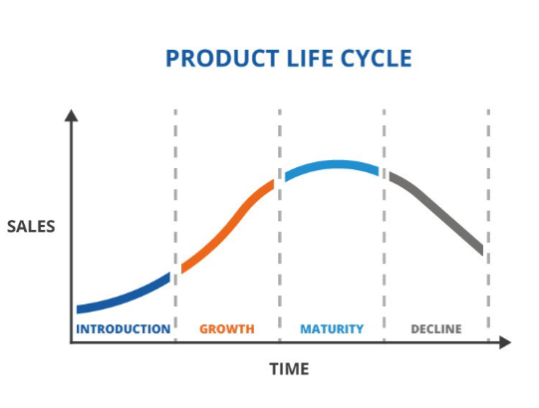
PRODUCT LIFE CYCLE
1. Market development. This is where your market research journey begins. Before your product hits the marketplace, you will be refining your concept, testing your product, and creating a launch strategy. Concept testing with real potential users is an important part of this step. With concept testing, you’ll know your target market’s reaction to your concept and make changes according to their feedback—before you’ve even begun to create.
During this initial phase, you’ll encounter a lot of costs without producing any income from this new product. You may be funding this stage yourself or you may be seeking investors.
2. Market introduction. When your product launches, you’ve entered the introduction stage of the life cycle. Your marketing team will be focused on building product awareness and reaching your target market. Typically, all content marketing and inbound marketing are based on promoting the product.
3. Market growth - consumers have embraced your product and are buying into your marketing. Demand and profits are growing, and the competition is looking to interrupt your success. Marketing in this stage moves from getting attention from consumers to establishing a brand presence. Show them why they should choose you over the competition. As your company grows, you may add new features to your product, beef up your support services, and open new distribution channels. All of these efforts will feature solidly in your marketing.
4. When sales begin to level off from rapid growth, you’re entering the maturity stage. You may have to reduce prices to stay competitive. Now, your marketing campaigns focus on differentiation instead of awareness, pointing out your superior product features. During this stage, production costs decline and sales are steady. It’s tempting to sit back and enjoy the steady sales, but you must make ongoing improvements to your product and let consumers know that it’s continuing to get better.

Slide 21
PRODUCT LIFE CYCLE
5. Market decline: If your brand isn’t a marketplace favourite, you’ll start to experience the last stage. You’ll be facing more competition, and they’ll be taking a share of the market. Sales will typically decrease in the face of rising competition.
Market decline may be related to:
Too much competition from products with similar features. If you can’t differentiate your product, you won’t be able to stand out in the crowd.
Outdated or replaced product
Loss of customer interest
Damaged brand image
Ways to survive during decline:
Extending the product line.
Repackaging the product
Trying new pricing strategies
Launching new versions of the product
Moving into new product categories would mean moving back to the beginning of the product life cycle—and sometimes that’s what it takes to survive.

Slide 22
OVERCOMING THE SEASONALITY
1. Do a trend analysis. This will assist you with seasonal forecasting and complying with the surges.
2. Plan ahead. It is difficult to predict when fluctuations will take place. However, by staying current with market trends, you can respond quickly. By planning, you can stagger the delivery of your inventory and more accurately determine staffing levels.
3. Keep an eye on financial changes.
4. Maintain records. Make sure you retain all your POS (point of sale) records. Review them for historical data and react accordingly.
5. Establish reorder points. Set up a schedule for ordering based on your POS review and any seasonal aspects associated with your product or service.
6. Do not order at the last minute. This will lead to you having a vast influx of inventory and will generate the need for extra staff and overtime. Both of these will impact your profit margin.
7. Reduce surplus stock. Don't forget to consider how to get rid of surplus seasonal stock. Plan for markdowns and clearance sales without losing money.
8. Leverage your industry contacts. Communicate with people in your niche. They may give you insights into how to manage the demand.

Slide 23
OVERCOMING THE SEASONALITY
9. Train your staff. Make sure your staff members are well-trained to cope with the increased demand.
10. Diversify. If you only sell Christmas trees, you will only be busy in December. If you sell other plants as well, it will bring in customers year-round.
11. Advertise. A good marketing plan can help overcome seasonal lows, for example.
12. Maximize your sales during peak seasons. This will help you stay on top when sales slow. This might mean staying open later or working more days a week.
13. Outsource. If possible, outsource work instead of hiring new staff to save on any extra seasonal expenses.
14. Don’t forget about quality control. Ensure the quality of your product or service doesn't suffer because of high demand.
15. Be cognizant of the weather. It can impact the demand for specific merchandise depending on the season.
16. Make the reserves
17. Requalification and training the personnel during dead season
18. Repair and reconstruction during dead season
19. Guaranteed sales with suppliers
20. Payment delay with suppliers during dead season

Slide 24
STRUCTURE OF THE PRICE:
1. cost of production (direct material costs (materials, energy, gas, water, spent for the manufacturing of the production) + direct labor costs (salary of employees, that manufacture the production) + Cost of spoiled production + depreciation of equipment, that takes part in manufacturing process + general production costs (for maintaining the workshop, where production manufactured; salary of the workshop director, workshop cleaners; heating and lightening of the workshop)
+
2. profit (administrative costs (salary of the director, financial services departments, HR department, supply department, depreciation of the administrative fixed assets, representative expenses, audit, etc.), sales costs (packaging, advertising, transportation of products, depreciation of refrigerators, storage of finished products, salary of sales department), profit, tax profit, dividends)
+
3. Excise
+
4. custom duty
+
5. Mark-up
+
6. VAT value added tax

Slide 25
TYPES OF THE PRICES
1. Fixed - set administratively by the state for essential services, manufactured and provided by the state (gas, transport, heat, water, electricity supply).
2. Regulated - regulated by the state relating to the level of profitability of private producers of essential goods (salt, bread, sugar, flour).
3. Indicative - min and max price level set by the state.
4. Free prices (wholesale, retail - for consumers).

Slide 26
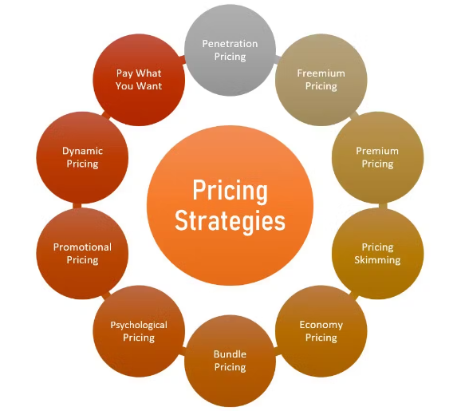
TYPES OF PRICING STRATEGIES
1. Premium pricing - the process of establishing higher prices than most of the competitors in the market. It helps create perceived value, luxury and quality. Companies that sell exclusive high-tech products often use this pricing strategy, as customers pay a premium price if they have a positive brand perception. When a company implements this market strategy, it may charge more than its production costs to get a high-profit margin. It is essential to note that this strategy works mostly when users perceive the product as a premium one.
2. Penetration pricing - process of establishing comparatively low prices to draw customers' attention from high-priced competitors and earn sales. New businesses often use this marketing strategy while entering the market. Initially, the company may charge low prices to reach new customers. They may raise the prices once the new customers become loyal followers of the brand. This strategy makes it easier to gain a market share. It can help increase market share and sales volume, leading to lower production costs and faster inventory turnover. Penetration pricing is often helpful for achieving short-term business goals, but, depending on the business, it may not be sustainable for the long term as it can attract bargain hunters and those with low customer loyalty.
3. Skimming pricing
Skimming pricing involves charging maximum prices for new products and reducing them gradually to maximise profit and make up for production costs. The strategy can work well if you sell products with varying life cycle lengths. Products often go out of trend after a period, so you have limited time to gain your profit in the initial stage of the product life cycle. Price skimming allows businesses to retain customer interest in the long term, but may not always be an ideal strategy for populous markets.

Slide 27
TYPES OF PRICING STRATEGIES
4. Psychological pricing
Psychological pricing is the process of studying consumer buying patterns to influence buyer decisions and make higher value sales. These methods work well when you have an intimate understanding of the target market. Some psychological pricing techniques include promoting offers such as buy-one-get-one-free or setting the price to an odd figure instead of a round number. Psychological pricing simplifies the decision-making process for customers and can increase sales as it allows you to get direct customer attention. It is essential to maintain transparency while using this method to ensure retaining loyal customers.
5. Bundle pricing
Bundle pricing is when you sell two or more products or services at a single price. It is a great way to market products to customers who may want to pay extra for multiple products. Beauty salons, cosmetics brands, restaurants and retail stores often use this pricing strategy to increase sales as customers discover more products with this strategy and end up purchasing additional products.
6. High-low pricing
High-low pricing can help you increase revenue by attracting new customers by advertising low-pricing products and later displaying high-cost products. To implement this strategy, you can evaluate the prices and popularity of your products and leverage low or high pricing to increase sales during a slow period. For example, if a certain product is in high demand, you can charge a high price while introducing it. Subsequently, as the demand decreases, you can reduce the price in the lower-selling months through discounts and clearance sales. This strategy typically relies heavily on sale promotions and often requires significant marketing efforts.

Slide 28
TYPES OF PRICING STRATEGIES
7. Competitive pricing
In competitive pricing, you set the product prices on par with all the other competitor products available in the market. The prices may differ slightly from the market rate but are ultimately within the range of prices set by the other companies. This strategy can help you stay competitive if the company you work for is in a saturated market . Customers often compare the market prices, so charging competitive or slightly low prices can give you a chance to gain more customers.
8. Cost-plus pricing
Some businesses use a cost-plus pricing strategy when their focus is to recover the production cost of the product. This strategy involves taking the amount invested and increasing it by adding a fixed percentage.
The advantage of this type of pricing strategy is that as you set the market price to a fixed rate for the products, the profits are more predictable.
9. Dynamic pricing
Dynamic pricing, also known as demand or surge pricing, matches the current market demand. It is a flexible strategy, used when the prices keep fluctuating daily or even hourly. Industries like airlines, hotels, utility companies and event management companies may use dynamic pricing based on market trends. It helps companies to shift prices to match the customers' willingness to pay. You can charge varying prices for different user intents, to reduce challenges at the time of purchase and develop customer loyalty.

Slide 29
TYPES OF PRICING STRATEGIES
10. Captive-product pricing
This is a pricing strategy that considers captive or secondary products along with core or main products while determining the price. For example, if a printer is the core product, printer ink is a captive product. Companies put higher prices on captive products, increasing the revenue margin as compared to core products. Captive-product pricing can increase traffic flow from a core product and can increase customer loyalty for a specific brand. It is crucial to ensure that customers see the value offered by the captive product and find its quality satisfactory.
11. Geographical pricing
Geographical pricing is the process of charging product prices depending on geographical location or market. With geographical pricing, you can set prices according to local consumer interests, requirements and preferences. While executing this strategy, it is important to conduct extensive research about local region-specific taxation laws and have a streamlined accounting process to ensure its success.

Slide 30
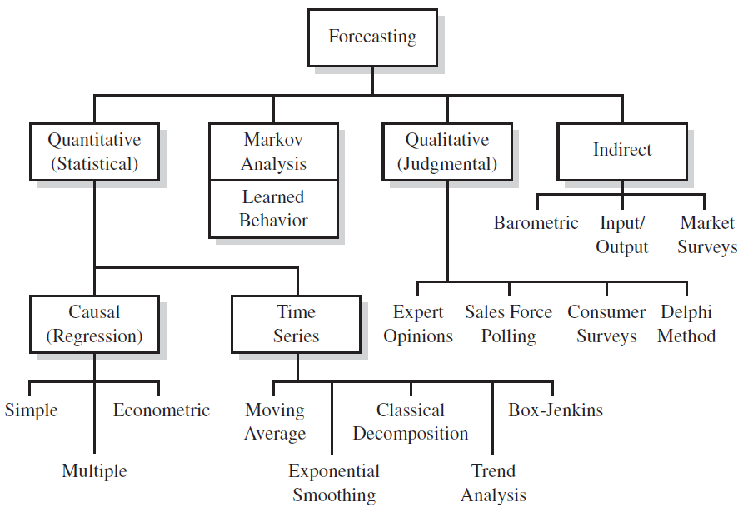
SALES FORECASTING METHODS
Notes:
Nechci

Slide 31
SALES FORECASTING METHODS
The company may choose from a wide range of forecasting techniques. There are
basically two approaches to forecasting, qualitative and quantitative:
1. Qualitative approach - forecasts based on judgment and opinion
Executive opinions
Delphi technique
Sales force polling
Consumer surveys
2. Quantitative approach
a. Forecasts based on historical data
Naive methods
Moving average
Exponential smoothing
Trend analysis
Decomposition of time series
b. Associative (causal) forecasts
Simple regression
Multiple regression
Econometric modelling
Notes:
Nechci

Slide 32
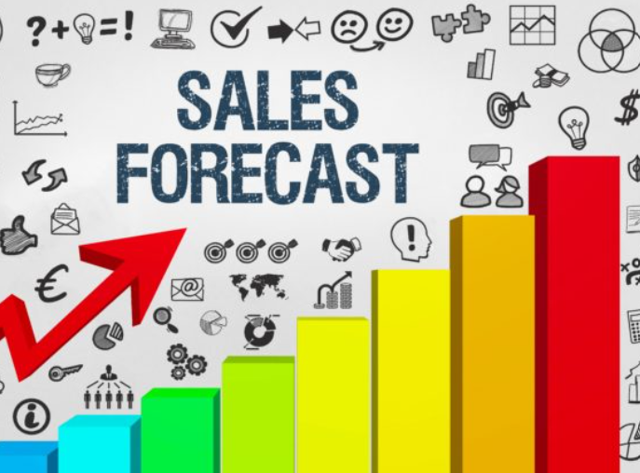
SELECTION OF FORECASTING METHOD
The choice of a forecasting technique is influenced significantly by the stage of the product life cycle and sometimes by the firm or industry for which a decision is being made.
In the beginning of the product life cycle, relatively small expenditures are made for research and market investigation. During the first phase of product introduction, these expenditures start to increase. In the rapid growth stage, considerable amounts of money are involved in the decisions, so a high level of accuracy is desirable.
After the product has entered the maturity stage, the decisions are more routine, involving marketing and manufacturing. These are important considerations when determining the appropriate sales forecast technique.
After evaluating the particular stages of the product and firm and industry life cycles, a further probe is necessary. Instead of selecting a forecasting technique by using whatever seems applicable, decision makers should determine what is appropriate.
Some of the techniques are quite simple and rather inexpensive to develop and use. Others are extremely complex, require significant amounts of time to develop, and may be quite expensive. Some are best suited for short-term projections, others for intermediate- or long-term forecasts.
Notes:
Nechci

Slide 33
SELECTION OF FORECASTING METHOD
What technique or techniques to select depends on six criteria:
1. What is the cost associated with developing the forecasting model, compared with potential gains resulting from its use? The choice is one of benefit-cost trade-off.
2. How complicated are the relationships that are being forecasted?
3. Is it for short-run or long-run purposes?
4. How much accuracy is desired?
5. Is there a minimum tolerance level of errors?
6. How much data are available? Techniques vary in the amount of data they require.
Notes:
Nechci

Slide 34
QUALITATIVE APPROACH
The qualitative (or judgmental) approach can be useful in formulating short-term forecasts and can also supplement the projections based on the use of any of the quantitative methods.
Four of the better-known qualitative forecasting methods are executive opinions, the Delphi method, sales-force polling, and consumer surveys.
1. Executive Opinions: The subjective views of executives or experts from sales, production, finance, purchasing, and administration are averaged to generate a forecast about future sales. Usually this method is used in conjunction with some quantitative method, such as trend extrapolation. The management team modifies the resulting forecast, based on their expectations.
The advantage of this approach is that the forecasting is done quickly and easily, without need of elaborate statistics. Also, the jury of executive opinions may be the only means of forecasting feasible in the absence of adequate data.
The disadvantage, however, is that of “group think.” This is a set of problems inherent to those who meet as a group. Foremost among these are high cohesiveness, strong leadership, and insulation of the group. With high cohesiveness, the group becomes increasingly conforming through group pressure that helps stifle dissension and critical thought. Strong leadership fosters group pressure for unanimous opinion. Insulation of the group tends to separate the group from outside opinions, if given.
Notes:
Nechci

Slide 35
QUALITATIVE APPROACH
2. Delphi Method
This is a group technique in which a panel of experts are questioned individually about their perceptions of future events. The experts do not meet as a group, in order to reduce the possibility that consensus is reached because of dominant personality factors. Instead, the forecasts and accompanying arguments are summarized by an outside party and returned to the experts along with further questions. This continues until a consensus is reached.
This type of method is useful and quite effective for long-range forecasting.
The technique is done by questionnaire format and eliminates the disadvantages of group think. There is no committee or debate. The experts are not influenced by peer pressure to forecast a certain way, as the answer is not intended to be reached by consensus or unanimity.
Low reliability is cited as the main disadvantage of the Delphi method, as well as lack of consensus from the returns.
Notes:
Nechci

Slide 36
QUALITATIVE APPROACH
3. Sales Force Polling
Some companies use as a forecast source salespeople who have continual contacts with customers. They believe that the salespeople who are closest to the ultimate customers may have significant insights regarding the state of the future market.
Forecasts based on sales force polling may be averaged to develop a future forecast. Or they may be used to modify other quantitative and/or qualitative forecasts that have been generated internally in the company.
The advantages of this forecast are: It is simple to use and understand; It uses the specialized knowledge of those closest to the action; It can place responsibility for attaining the forecast in the hands of those who most affect the actual results; The information can be broken down easily by territory, product, customer, or salesperson.
The disadvantages include salespeople’s being overly optimistic or pessimistic regarding their predictions and inaccuracies due to broader economic events that are largely beyond their control.
Notes:
Nechci

Slide 37
QUALITATIVE APPROACH
4. Consumer Surveys: Some companies conduct their own market surveys regarding specific consumer purchases. Surveys may consist of telephone contacts, personal interviews, or questionnaires as a means of obtaining data. Extensive statistical analysis usually is applied to survey results in order to test hypotheses regarding consumer behaviour.
Notes:
Nechci

Slide 38
STEPS IN THE FORECASTING PROCESS
There are six basic steps in the forecasting process. They are:
1. Determine the what and why of the forecast and what will be needed. This will indicate the level of detail required in the forecast (e.g., forecast by region, by product), the amount of resources (e.g., computer hardware and software, manpower) that can be justified, and the level of accuracy desired.
2. Establish a time horizon, short term or long term. More specifically, project for the next year or next five years.
3. Select a forecasting technique. Refer to the criteria discussed before.
4. Gather the data and develop a forecast.
5. Identify any assumptions that had to be made in preparing the forecast and using it.
6. Monitor the forecast to see if it is performing in a manner desired. Develop an evaluation system for this purpose. If not, go back to Step 1.
Notes:
Nechci

Slide 39
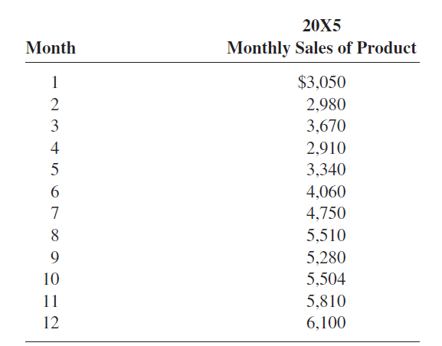
QUANTITATIVE FORECASTING
Naive forecasting models are based exclusively on historical observation of sales or other variables, such as earning and cash flows. They do not attempt to explain the underlying causal relationships that produce the variable being forecast
The advantage is that it is inexpensive to develop, store data, and operate.
The disadvantage is that it does not consider any possible causal relationships that underly the forecasted variable.
A simple example of a naive type:
1. Use the actual sales of the current period as the forecast for the next period.
Let us the symbol Y¢t+1 as the forecast value and the symbol Yt as the
actual value. Then
2. If you consider trends, then
3. If you want to incorporate the rate of change rather than the absolute
amount, then
The naive models can be applied, with little need of a computer, to develop
forecasts for sales, earnings, and cash flows. They must be compared with more
sophisticated models, such as the regression method, for forecasting efficiency.
Notes:
Nechci

Slide 40
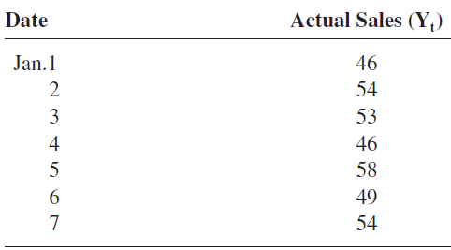
QUANTITATIVE FORECASTING
4. Moving Averages
Moving averages are averages that are updated as new information is received.
With the moving average, a manager simply employs the most recent observations
to calculate an average, which is used as the forecast for the next period.
Advantages and Disadvantages
The moving average is simple to use and easy to understand. However, there are two shortcomings:
1. It requires users to retain a great deal of data and carry it along with them from forecast period to forecast period.
2. All data in the sample are weighted equally. If more recent data are more valid than older data, why not give them greater weight?
Notes:
Nechci

Slide 41
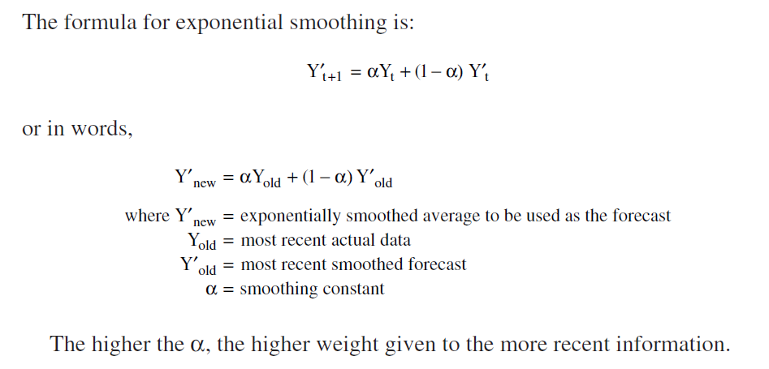
QUANTITATIVE FORECASTING
5. Exponential Smoothing
Exponential smoothing is a popular technique for short-run forecasting by managers.
It uses a weighted average of past data as the basis for a forecast. The procedure gives heaviest weight to more recent information and smaller weight to observations in the more distant past.
The reason is that the future is more dependent on the recent past than on the distant past.
The method is known to be effective when there is randomness and no seasonal fluctuations in the data.
One disadvantage of the method, however, is that it does not include industrial or economic factors such as market conditions, prices, or the effects of competitors’ actions.
Notes:
Nechci

Slide 42
THANK YOU FOR ATTENTION!

