Slide 1

Production budget
Lecture of Corporate Budgeting
Mgr. Tetiana Konieva, Ph.D

Slide 2
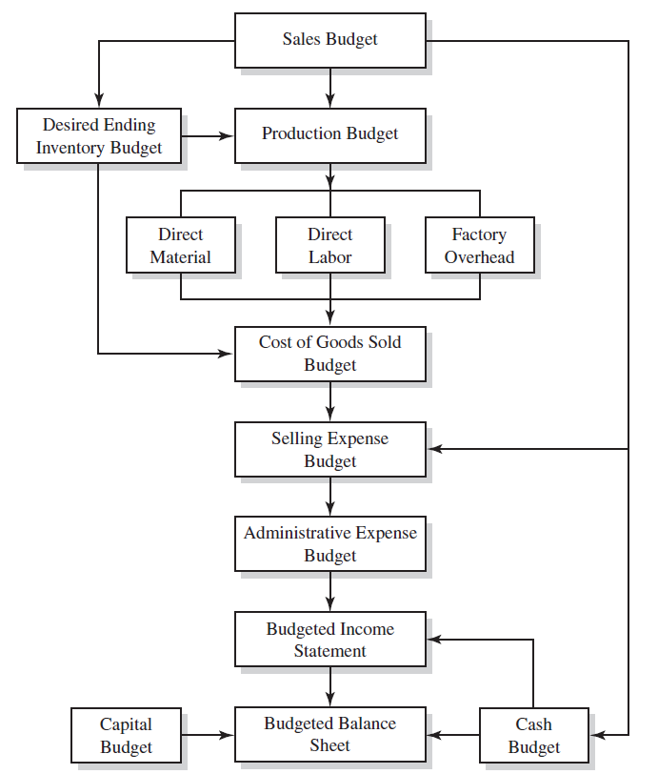

LOGICAL SCHEME OF BUDGETING PROCESS

Slide 3

PRODUCTION BUDGET: DEFINITION
Production budget is one of the operating budgets along with Sales budget, Direct materials budget, Direct labour budget, Budget of other direct and general production costs and Selling and administrative expense budget
A production budget is a calculation of how many units of a specific product a company can make within a budgetary time period. The production or manufacturing manager usually prepares this budget by collaborating with other team members, other managers, to obtain information and properly implement the information gained from the budget
A production budget is a document that expresses the number of units of a specific product that an organization must produce to match its estimated sales quantity. Companies typically create quarterly or monthly production budgets, and they're a part of the overall operating budget.
The production budget is a statement of the output by product and is generally expressed in units. It should take into account the sales budget, plant capacity, whether stocks are to be increased or decreased, and outside purchases.
The number of units expected to be manufactured to meet budgeted sales and inventory requirements is set forth in the production budget.
The expected volume of production is determined by subtracting the estimated inventory at the beginning of the period from the sum of the units expected to be sold and the desired inventory at the end of the period.

Slide 4
PRODUCTION BUDGET
Indicator | Quarters |  |  |  | For the year | Quarters of next year
 | І | ІІ | ІІІ | ІV |  | І | ІІ
1. Sale of finished products, units* | 470 | 440 | 450 | 460 | 1820 | 470 | 480
2. Finished products inventories at the end of the period, units** | 57.20 | 58.50 | 59.80 | 61.10 | - | 62.40 | -
3. Total need for the finished products, units (row 1+ row 2) | 527.20 | 498.50 | 509.80 | 521.10 | 2056.60 | 532.40
4. Finished products inventories at the beginning of the period, units**** | ^{59.78***} | 57.20 | 58.50 | 59.80 | - | 61.10 | 62.40
5. The required output of finished products, units (row 3 – row 4) | 467.42 | 441.30 | 451.30 | 461.30 | 1821.32 | 471.30
*from sales budget
**as % (for example 13%) from sales of next quarter
***finished product at the end of previous year in units = finished product at the end of previous year in units/cost of production per unit
**** Finished products inventories at the beginning of second quarter = Finished products inventories at the end of first quarter……and so on
Row 5 = The required output of finished products, units = Planning sales + Desired ending inventory - Beginning inventory

Slide 5
COMPONENTS OF PRODUCTION BUDGET
Indicator | Quarters |  |  |  | For the year | Quarters of next year
 | І | ІІ | ІІІ | ІV |  | І | ІІ
1. Sale of finished products, units* | 470 | 440 | 450 | 460 | 1820 | 470 | 480
2. Finished products inventories at the end of the period, units** | 57.20 | 58.50 | 59.80 | 61.10 | - | 62.40 | -
3. Total need for the finished products, units (row 1+ row 2) | 527.20 | 498.50 | 509.80 | 521.10 | 2056.60 | 532.40
4. Finished products inventories at the beginning of the period, units**** | ^{59.78***} | 57.20 | 58.50 | 59.80 | - | 61.10 | 62.40
5. The required output of finished products, units (row 3 – row 4) | 467.42 | 441.30 | 451.30 | 461.30 | 1821.32 | 471.30
The exact components for calculating the production budget for a specific product depend on its characteristics. These are some components usually included in production budgets:
Specified time frame: The time interval used to calculate the production budget (days, months, quarters)
Forecasted sales: The projected sales figures within the specified time frame based on previous sales information and trends (row 1)
Current inventory: The leftover inventory from previous production cycles (row 4)
Planned inventory: The number of items the organization plans on having in its inventory at the end of the specified time frame (row 2)
Required production: The number of units an organization must produce within a specified time frame to achieve profitability (row 5)

Slide 6

HOW TO CALCULATE A PRODUCTION BUDGET
1. Set the time frame and product
The first step when calculating your production budget is determining the time frame it applies to and selecting the product. The time frame depends on the product characteristics and the estimated number of sold units. Production budgets that cover smaller time frames are usually more accurate than those covering longer ones.
2. Perform beginning inventory
The next step in calculating the production budget is assessing the respective product's inventory at the beginning of the specified time frame. The appropriate amount of inventory depends on the product and the selling company's overall strategy. Keeping a large inventory can be helpful in situations of sudden increases in demand but can be unfavorable if the overall demand decreases for various reasons.
3. Operate the sales forecasting
Forecasting the estimated sales for the selected time period can help the organization anticipate the number of items it must produce to meet the demand for the respective product. When forecasting sales, you can use previous sales records and current market trends as references. A sales forecast may also include the estimated profit, which you can obtain by subtracting the total cost of production from the total sales figures.
4. Determine planned inventory
The planned inventory, or ending inventory, represents the number of product items that are still in inventory at the end of the selected time period. Depending on various factors, like the product and demand predictions, you may plan for having a specific number of items in inventory at the end of the time frame. The remaining stock at the end of a time period is the safety stock.
5. Calculate the required production
After determining the number of items in inventory at the beginning and end of the selected time period and forecasting sales numbers, you can use this information to determine your production budget. The formula for determining the required production is as follows:
Required production units = expected unit sales + units in your safety stock - units in the beginning inventory

Slide 7

FACTORS, AFFECTING A PRODUCTION BUDGET
Production budget = The sales budget or forecast + Planned inventory to be maintained in the end – Inventory in the beginning.
The above three factors are internal to any organization. Too much inventory balance, in the end, will result in the blocking of capital as well as storage space. Also, there is a risk of products getting obsolete or out of fashion, and the company may have to sell at a steep discount or loss. On the other hand, maintaining fewer inventories may result in stock-outs and loss of sales opportunities in case of a sudden surge in demand. Therefore, it is an uphill task to decide the amount of inventory to maintain in the end.
There are some critical external factors too that affect the production budget. These factors are the prevailing economic conditions, competition in the market, availability of substitutes, etc. A change in any of these external factors may directly affect the sales of the company, which in turn will affect the production budget. Therefore, these are important factors for consideration while preparing or analysing a budget.

Slide 8
IMPORTANCE AND LIMITATIONS OF PRODUCTION BUDGET
Importance of Production budget:
Basis for Planning of Future Production Process - A well-conceived production budget forms the basis for planning in any organization. The budget indicates the number of units to make. Hence, it does not take into account the cost of production. Thus, it helps to streamline the production process, machinery utilization, and proper scheduling of the same.
Helps in Taking Key Managerial Decisions - The production budget is the key to the purchase budget for the management. The purchasing of raw materials and consumables depends entirely on the production budget. Also, many other key decisions, like the recruitment of new personnel, depend upon how much production the company will do.
Production budget is a basis for direct material budget, direct labour budget, factory overhead budget (general production costs)
Limitations of Production Budget
Based on Estimates - This budget is based entirely on estimated values of sales. Also, maintaining inventory is subjective, with the possibility of a lot of variation. These figures are based on the management’s judgment. It can go wrong in unforeseen circumstances such as fluctuation in demand for the product or the supply of raw materials, changes in the economic situation, recession, or even due to competition.
Time-consuming Process - Preparing this budget is a lengthy process. Hence, It can consume a lot of time. In case estimates go wrong, it will result in the wastage of precious working hours.
Though there are some limitations with the budgets, budgets are still the guiding force for future action. Moreover, all budgets reflect the estimation or plan for the period and are based on certain assumptions.

Slide 9

THANK YOU FOR ATTENTION!

