Slide 1

Inventory management
Lecture of Corporate Budgeting
Mgr. Tetiana Konieva, Ph.D

Slide 2
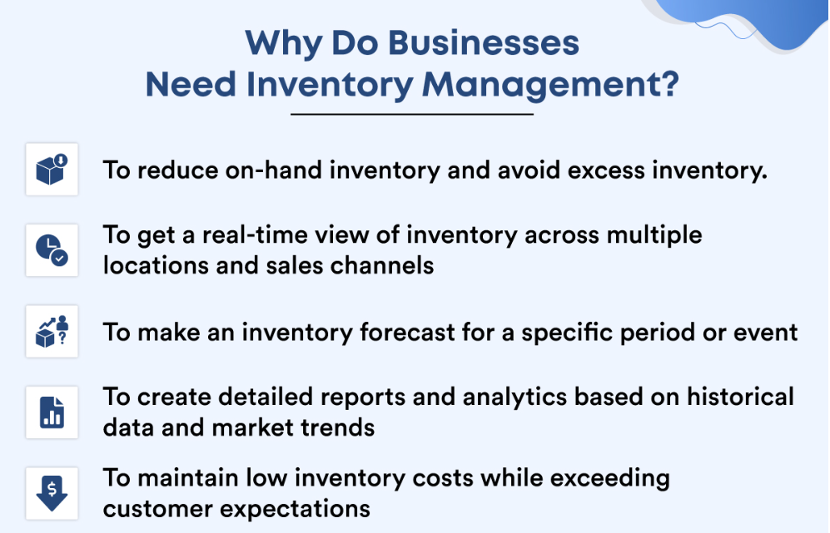
IMPORTANCE OF INVENTORY MANAGEMENT
Inventory management is a process that monitors the flow of goods from manufacturers to warehouses to points of sale. It employs a variety of data to track goods as they move through the process.
Keeping a detailed record of each supply is critical for any company for various reasons, including preventing fraudulent activities, navigating demand fluctuation, and providing better customer service.
Inventory management plays a more critical role or becomes necessary when the organization is large or handles a wide and complex range of items. In such a scenario, an advanced inventory management system that can be integrated with accounting software.
For several reasons, inventory management is crucial, especially in medium- and large-sized organizations. Firstly, it gives you a thorough understanding of the stocks or items you currently have, what needs to be ordered or refilled, what products are in high demand, what products are merely taking up shelf space, and so forth.
In general, successful inventory management assists companies in efficiently controlling supply and demand.
Another factor that manifests the need for inventory management is to maintain the company’s financial health. By analyzing data analytics and market trends, you can improve demand forecasting and supply planning, thereby avoiding unnecessary investment or capital blockages.

Slide 3
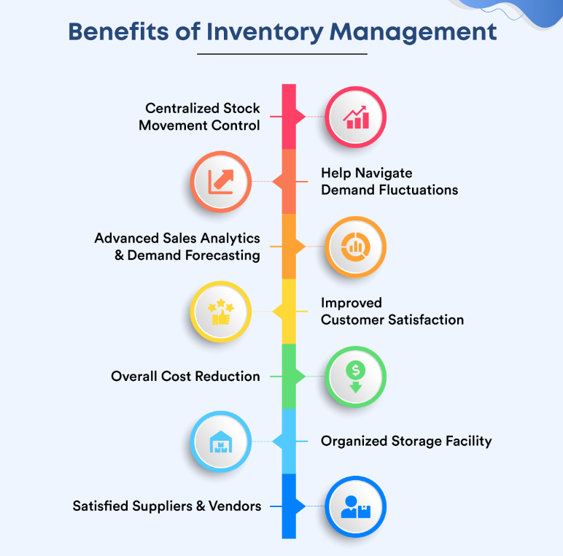
BENEFITS OF INVENTORY MANAGEMENT
1. Centralized stock movement control
with the help of an effective inventory management system for business, you can gain centralized control over all items, regardless of whether you manage one warehouse or multiple.
2. Help navigate demand fluctuations
When you have real-time stock updates and other information about market trends and future demand, you can better plan your strategy, procure the necessary raw materials, and successfully manage seasonal or fluctuating demands.
By maintaining consistent market supply, you can not only strengthen your brand’s reputation but also enhance the customer experience.
3. Advanced sales analytics and demand forecasting
Inventory forecasting is a practice that involves forecasting necessary inventory levels for a future period using historical data, market trends, and known upcoming events. When you have an accurate demand forecast for a specific product during a specific period, you can plan its manufacturing and material procurement. Demand forecasting eventually assists you in fulfilling customer orders while avoiding tying up cash flow in unnecessary inventory.
4. Improved customer satisfaction
When you have accurate demand projections and never fail to supply the necessary products in the market or to the customers, you will develop a strong brand reputation for your business among the customers. These customers will eventually become cult customers who will always prefer you over your competitors.

Slide 4
BENEFITS OF INVENTORY MANAGEMENT
5. Overall cost reduction. With real-time updates on stock movements across all sales channels, you can avoid overstocking, get rid of deadstock, and manufacture the necessary products. Besides that, the system allows you to generate granular reports on sales performance and determine the next best step to generate more revenue.
6. Organized storage facility. It is understandable that managing a warehouse manually is a difficult task, especially when there are multiple warehouses located in different locations. The implementation of transport management software can help you streamline warehouse operations by optimizing transportation routes for inbound and outbound goods, reducing congestion, and enhancing overall warehouse efficiency. However, advanced stock inventory management software can help you manage the flow and movement of raw materials and finished products more efficiently. A well-organized warehouse eventually eliminates waste, prevents health and safety issues, reduces maintenance costs, and represents the professionalism of the company.
7. Satisfied suppliers and vendors
Leveraging the insights provided by inventory management software about which products sell and in what volume, you can negotiate better prices and terms with suppliers. You can also keep suppliers and vendors informed about stock status, which allows them to pass the same information to their customers as soon as possible. This gives customers enough time to find an alternative solution for the time being. If there is no such communication between you and your suppliers, end users are likely to suffer and lose trust in your brand.
To summarize, detailed inventory management mitigates every potential threat to the company’s stock and supply.

Slide 5
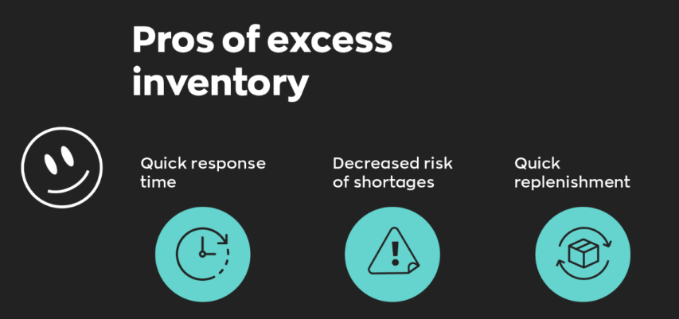
PROS TO HOLDING EXCESS INVENTORY
Quicker response time. You can quickly fill all customer orders as soon as they arrive—no need to worry about waiting for your stock to arrive. If you can’t ship an order quickly, you’ll lose those valued customers.
Decreased risk of shortages. By keeping stock on hand, you can guarantee that you will always have a particular item. You’ll also have less to worry about if you discontinue a product. If there is a shift in demand for a product, you’ll be able to meet (or even beat) the competition, which means you’ll be able to sell your excess inventory at an excellent price.
Quick replenishment. By keeping excess inventory, you can work to make sure that your shelves are always full. It’ll ensure your store always has a neat and tidy appearance.

Slide 6
DISADVANTAGES OF INVENTORY MANAGEMENT
1. Initial higher cost
The first disadvantage of inventory management is that you will need to purchase a battery of resources in order to upgrade your entire inventory infrastructure. Additionally, you may need to rent or purchase new space to store the inventory in an organized fashion. This initial or setup cost may be a challenging factor for small businesses or startups operating on a tight budget.
2. Require skilled human resources
Another disadvantage of inventory management is that it necessitates skilled labor to operate tools and technologies, monitor performance, and perform other necessary operations. All your investment in infrastructure and technology stack will be wasted if you don’t have the right people to manage the inventory.
3. Recurring administrative costs
The third significant disadvantage of inventory management is that it comes with recurring costs. For example, when erecting a modern inventory infrastructure, you will certainly require to purchase an inventory management software subscription. Also, you will need to hire a dedicated team of employees to manage the inventory department. These recurring expenses can eat up a sizable portion of your budget.

Slide 7
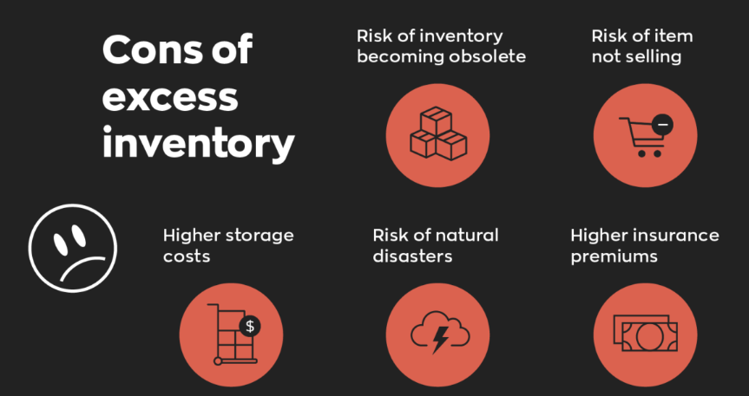
CONS OF HOLDING EXCESS INVENTORY
Tying up Cash flow. The more inventory you have on hand, the greater the amount of the business’ capital is tied up. You will risk slowing down your business’ cash flow.
Risk of inventory becoming obsolete. The value and quality of your product decrease the longer you keep it in stock. You have to make it a priority to sell your inventory while it’s new to the market. Smartphones, for example, are updated almost every six months. So, you have to sell your stock before new versions arrive. Otherwise, you might end up having to sell them at a discounted price because it has become outdated or obsolete. Similarly, if you are selling perishable goods, you would have to sell them at a lower price as it gets closer to the expiration date. You could lose money on an item if you were forced to sell it below cost to clear it out.
Risk of an item not selling. You may have decided to keep excess inventory but then realized you misjudged what will and will not sell. In doing so, you could end up with a large quantity of items that people don’t want to purchase. Again, you might have to sell at a steep discount or below cost to move the inventory out of your warehouse.
Higher storage costs. Excess inventory means extra space needed for storage. Additional space also means extra costs, and since you have to include those extra costs in your price, you might end up losing to competition with other sellers because your price is too high. Even if you have your own warehouse, you would still have extra maintenance costs and risk needing more space for new items.

Slide 8
CONS OF HOLDING EXCESS INVENTORY
Risk of natural disasters. Any type of stock is always at risk of being destroyed or damaged by fires, floods, or other natural disasters. However, having less of it in excess would incur more minor losses should these natural disasters happen.
Higher insurance premiums. The insurance you will pay for items will be directly related to the capital cost of the products you store. The more inventory you keep and the longer you keep it, the more insurance you pay.
temporarily free (excessively formed) current assets practically do not generate profit (except for investments of monetary assets in short-term financial investments),
moreover, excess inventories do not generate profit, but also cause additional operating costs for their storage
• significant part of current assets has a risk of loss due to dishonesty of partners or own personnel
The opportunity cost of capital on the invested amount

Slide 9

ORIGINAL VALUE OF INVENTORIES
Original value of inventories =
Price of purchase without Value Added Tax +
cost of services of middlemen +
Freight charges (cost of transportation) +
Loading (unloading)+
Insurance +
Custom duties + Excise +
Registration fees +
Cost of preparation of inventories for production process

Slide 10
INVENTORY VALUATION METHODS:
Specific identification method - assessment of the value of each individual unit of inventory. This method applies to inventory that is released for special orders and projects, as well as inventory that is not interchangeable. The disadvantage of this method is its high labor intensity, especially in the conditions of a wide nomenclature of stocks
Weighted average method
First-in First-out FIFO – inventories, that are the first to arrive and are released into production are valued at first-in cost
Last-in First-out LIFO - inventories are used in the reverse sequence of their arrival at the enterprise. That is, the inventories that are the first to be released into production are valued at the cost price of the last ones at the time of receipt.

Slide 11
SPECIFIC IDENTIFICATION METHOD
Specific identification method - assessment of the value of each individual unit of inventory. This method applies to inventory that is released for special orders and projects, as well as inventory that is not interchangeable. The disadvantage of this method is its high labor intensity, especially in the conditions of a wide nomenclature of stocks
Example: calculate the cost of production outflows and ending inventory by specific identification method, if
Date of purchase | Amount of purchase | Production process, outflow | Ending inventory
16.01 | 20 units*$3 | 3units*$3
20.01 | 18*$3.5 | 10*$3.5
1.02 | 16*$3.8 | 4*$3.8
15.03 | 14*$3.6 | 2*$3.6
Date of purchase | Amount of purchase | Production process, outflow | Ending inventory
16.01 | 20 units*$3 | 3units*$3 | (20-3)* $3
20.01 | 18*$3.5 | 10*$3.5 | (18-10)* $3.5
1.02 | 16*$3.8 | 4*$3.8 | (16-4)* $3.8
15.03 | 14*$3.6 | 2*$3.6 | (14-2) *$3.6

Slide 12
WEIGHTED AVERAGE METHOD :
calculate the cost of production outflows and ending inventory by weighted average method:
Date of purchase of inventories | Amount of purchase | Production process, outflow | Ending inventory
16.01 | 20units*$3 | 3*$3.44
20.01 | 18units*$3.5 | 10*$3.44
1.02 | 16*$3.8 | 4*$3.44
15.03 | 14*$3.6 | 2*$3.44
Date of purchase of inventories | Amount of purchase | Production process, outflow | Ending inventory
16.01 | 20units*$3 | 3*$3.44 | (20+18+16+14-3-10-4-2)*$3.44=
20.01 | 18units*$3.5 | 10*$3.44
1.02 | 16*$3.8 | 4*$3.44
15.03 | 14*$3.6 | 2*$3.44
weighted average price = (20units*$3+18units*$3.5+16*$3.8+14*$3.6)/(20+18+16+14) = $3.44

Slide 13
FIRST-IN FIRST-OUT FIFO METHOD:
First-in First-out FIFO – inventories, that are the first to arrive and are released into production are valued at first-in cost
calculate the cost of production outflows and ending inventory by FIFO method:
Date of purchase | Amount of purchase | Production process, outflow | Ending inventory
16.01 | 20*$3 | 3 units*$3
20.01 | 18*$3.5 | 10*$3
1.02 | 16*$3.8 | 4*$3
15.03 | 14*$3.6 | 2*$3
Date of purchase | Amount of purchase | Production process, outflow | Ending inventory
16.01 | 20*$3 | 3 units*$3 | (20-3-10-4-2)* $3
20.01 | 18*$3.5 | 10*$3 | 18*$3.5
1.02 | 16*$3.8 | 4*$3 | 16*$3.8
15.03 | 14*$3.6 | 2*$3 | 14*$3.6

Slide 14
LAST-IN FIRST-OUT LIFO METHOD:
Last-in First-out LIFO - inventories are used in the reverse sequence of their arrival at the enterprise. That is, the inventories that are the first to be released into production are valued at the cost price of the last ones at the time of receipt.
calculate the cost of production outflows and ending inventory by LIFO method
Date of purchase | Amount of purchase | Production outflow | Ending inventory
16.01 | 20*$3 | 3*$3.6
20.01 | 18*$3.5 | 10*$3.6
1.02 | 16*$3.8 | 1*$3.6 3*$3.8
15.03 | 14*$3.6 | 2*$3.8
Date of purchase | Amount of purchase | Production outflow | Ending inventory
16.01 | 20*$3 | 3*$3.6 | 20*$3
20.01 | 18*$3.5 | 10*$3.6 | 18*$3.5
1.02 | 16*$3.8 | 1*$3.6 3*$3.8 | (16-3-2)* $3.8
15.03 | 14*$3.6 | 2*$3.8 | 0

Slide 15

TRANSPORTATION (SHIPPING, FREIGHT ) COSTS
FOB – free on board:
FOB destination – seller (supplier) delivers production free of any freight charges; destination specified by the buyer; items in transit do not belong to buyer yet, until items reach buyer; items in transit are included in seller’s (supplier) balance sheet
FOB shipping point – buyer must pay transportation charges; items in transit already belong to buyer; items in transit are included in buyer’s balance sheet

Slide 16
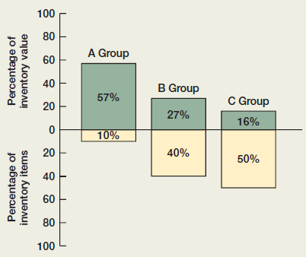
OPTIMAL INVENTORIES: THE ABC APPROACH
A Group constitutes only 10 percent of inventory by item count, but it represents over half of the value of inventory. The A Group items are thus monitored closely, and inventory levels are kept relatively low.
At the other end, basic inventory items, such as nuts and bolts, also exist; but, because these are crucial and inexpensive, large quantities are ordered and kept on hand. These would be C Group items.
The B Group is made up of in-between items.

Slide 17
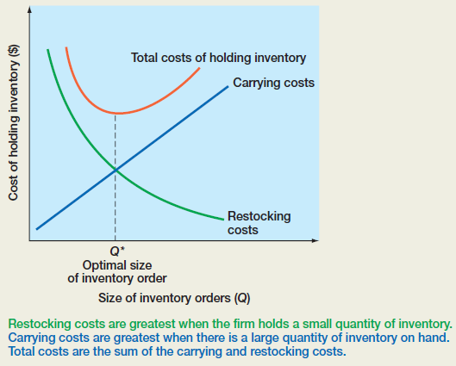
OPTIMAL INVENTORIES: THE ECONOMIC ORDER QUANTITY
(EOQ) MODEL
Q* - the restocking quantity that minimizes the total inventory costs

Slide 18
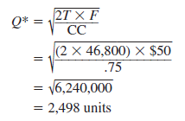
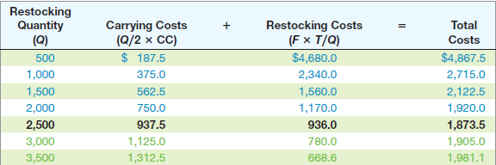
OPTIMAL INVENTORIES: THE ECONOMIC ORDER QUANTITY (EOQ) MODEL
T - total annual sales are 46,800 units
carrying costs (CC) of $0.75 per unit per year,
fixed costs ( F ) of $50 per order,
The restocking quantity Q*, that minimizes the total inventory costs =

Slide 19

THANK YOU FOR ATTENTION!

