Slide 1

Direct labor budget
Lecture of Corporate Budgeting
Mgr. Tetiana Konieva, Ph.D

Slide 2
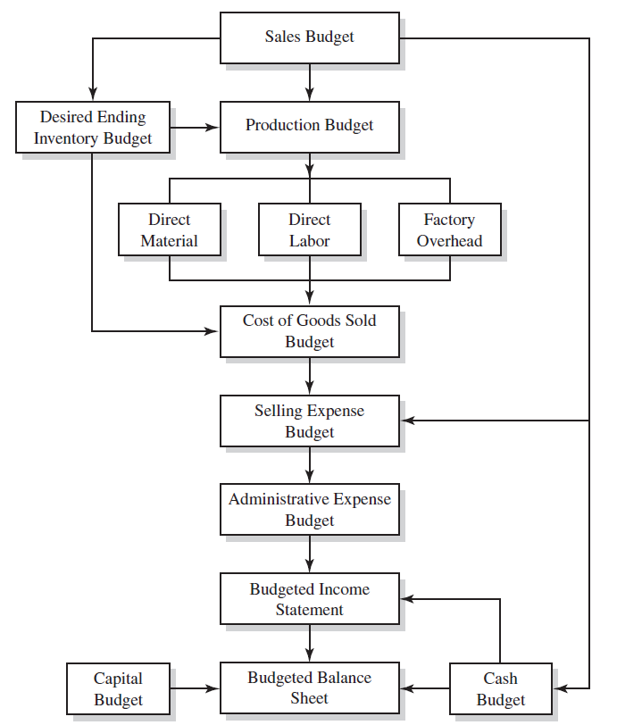

LOGICAL SCHEME OF BUDGETING PROCESS

Slide 3

DIRECT LABOR BUDGET: DEFINITION
Direct labour budget is one of the operating budgets along with Sales budget, Production budget, Direct materials budget, Budget of other direct and general production costs and Selling and administrative expense budget
Direct labour budget - schedule for expected labor cost. Expected labor cost is dependent on expected production volume (production budget). Labor requirements are based on production volume multiplied by direct labor hours per unit. Direct labor hours needed for production are then multiplied by direct labor cost per hour to derive budgeted direct labor costs.
Direct Labor Budget relates to the cost of direct labor involved in production/assembly or service. Specifically, this budget shows the cost and hours of direct labor that a company requires for production/extending service.
Direct laborers are the employees that work on the factory floor to produce a product.
To compute direct labor requirements, expected production volume for each period is multiplied by the number of direct labor hours required to produce a single unit.
The direct labor hours to meet production requirements is then multiplied by the (standard) direct labor cost per hour to obtain budgeted total direct labor costs.

Slide 4
DIRECT LABOR BUDGET
Indicator | Quarters |  |  |  | For the year
 | І | ІІ | ІІІ | ІV
1. The required output of finished products*, units | 467.42 | 441.30 | 451.30 | 461.30 | 1821.32
2. Direct labour costs per unit of finished goods**, hours | 5 | 5 | 5 | 5 | 5
3. Total number of hours required for the finished products output, hours (row 1*row 2) | 2337.09 | 2206.5 | 2256.5 | 2306.5 | 9106.59
4. The cost per hour of direct labour costs***, CZK. | 7 | 7 | 7 | 7 | 7
5. Single social contribution (37%)****, CZK. | 6053.06 | 5714.84 | 5844.34 | 5973.84 | 23586.06
6. Total direct labour costs, CZK. (row 3* row 4+ row 5) | 22412.66 | 21160.34 | 21639.84 | 22119.3 | 87332.17
*from production budget
**according technology
***according to labor contract, legislation, other conditions
****according legislation

Slide 5

BENEFITS AND DRAWBACKS OF DIRECT LABOR BUDGET
Benefits:
It helps management to identify labor shortages and make necessary adjustments in time to avoid any production disruption.
The budget also helps management schedule plant shutdowns for maintenance purposes.
It helps the management to schedule delivery of the products to the customers.
It also helps in determining the selling price of the product.
Drawbacks:
One issue with the calculation is regarding cash requirements. Generally, we don’t take cash requirements to calculate such a budget. Instead, the cash requirements are part of the master budget.
If there are many categories of direct labor, then preparing a budget takes too much time and becomes a complex process.
The actual payment to the labor would depend upon many current macros and micro factors in the real world. This results in a big variance in the budget and the actual numbers.
In some cases, the direct labor cost could be more or less fixed (like a fixed cost). In such cases, preparing a budget with full details might be a waste of time.

Slide 6
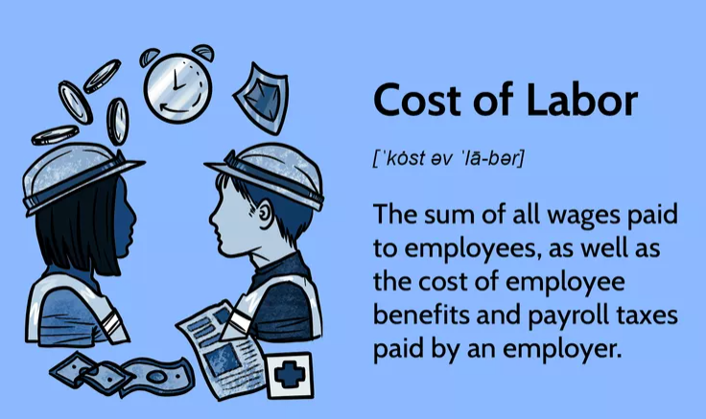
LABOR COSTS
Costs of labor can be categorized into two main categories, direct (production) and indirect (non-production) cost of labor.
Direct costs include wages for the employees that produce a product, including workers on an assembly line, while indirect costs are associated with support labor, such as employees who maintain factory equipment.
If the cost of labor is improperly allocated or evaluated, it can cause the price of goods or services to shift away from their true cost and damage profits.
Direct labor costs are usually variable cost, which varies with the firm's level of production. A firm can easily increase or decrease variable labor cost by increasing or decreasing production.

Slide 7
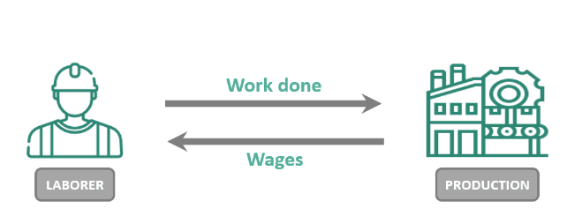
TYPE OF WAGES
Professionals receive monetary compensation for their work hours, referred to as wages. The amount and distribution method of wages depends on the employer's payroll policies and other factors, such as legal restrictions. Wages are generally paid bi-weekly or monthly, depending on the employer and employee's agreement.
Here are the different types of wages and examples of jobs that usually offer them:
1) Salary. A salary refers to a predetermined amount of money an employer pays to an employee annually. The payments are usually spread throughout the year, according to the employment contract. Jobs typically offer salaries include IT specialists, HR generalists, marketing managers, accountants, business development coordinators, physicians, registered nurses, and retail store buyers.
2) Hourly Wage. Hourly wages are a type of wage where employers pay employees for each hour worked. This type of wage is common for part-time employment and sometimes full-time employment. Jobs that offer hourly wages include retail, healthcare assistance, sales, and construction.
3) Commissions. Commissions are typically offered to sales professionals by their employers in addition to hourly pay or salaries. Employees earn a percentage of money from each sale they make. Examples of jobs typically offering commissions include sales representatives, retail store associates, talent acquisition specialists, and wholesale agents.
4) Fair Wage. A fair wage is a wage that employers offer their employees. It considers factors like the cost of living in a particular area and typical wages for a job position. Fair wages usually act as a midway point between minimum wage and a living wage. Jobs typically receive fair wages, including housekeepers, virtual assistants, retail sales managers, home health aides, and tech support specialists.

Slide 8
TYPE OF WAGES
5) Overtime wages are paid to employees for any work they complete that exceeds 40 hours per week. Typically, overtime pay includes double an employee's average earnings during a 40-hour work week. Examples of jobs that usually offer overtime include registered nurses, truck drivers, construction workers, tradespeople, EMTs, and IT specialists.
6) Severance Pay refers to the type of wage employers pay to employees they have to let go. The severance pay an employee receives usually coincides with the years they've worked at the company. For instance, an employee who worked for a company for three years would likely get three weeks of severance pay to help their transition.
7) Prevailing Wage is typically used in government contracting between agencies and outside businesses. The U.S. Department of Labor provides various data to help determine recommended payments for contractual workers. Prevailing wage may differ depending on the state where a professional works contractually with the government. Jobs that may receive prevailing wages include civil engineers, urban planners, mechanics, construction workers, and construction supervisors.
8) Living Wage refers to the minimum amount of money an employer can offer an employee. Living wage is different from minimum wage because employers don't have to follow legal guidelines like they would if they offered minimum wage to employees. Examples of jobs that may receive living wages include receptionists, mail carriers, hair stylists, nannies, and waiters.

Slide 9
TYPE OF WAGES
9) Minimum Wage refers to the set hourly rate, established by the government. This figure varies depending on the state the individual works in. Jobs that offer minimum wage include cashiers, grocery store clerks, dishwashers, and daycare assistants.
10) Bonuses are cash compensation that employers provide to employees for producing good work. Bonuses don't factor into salaried or hourly earnings and aren't guaranteed to employees. This type of wage usually acts as an incentive for employees to reach a certain level of productivity. Jobs that may offer bonuses include salespersons, marketing specialists, recruitment specialists, and general managers.
11) Vacation Pay is the money employers compensate employees for when they take time off from work. This type of wage may vary depending on the employee's job position. For example, a nurse might receive more vacation pay than someone in retail. Employees eligible to receive vacation pay typically get two weeks of paid leave each year.
12) Paid time off refers to the money employers pay employees for taking days off from work when needed. This type of wage is usually provided as an additional benefit to employees and is paid out in addition to their regular salary or hourly wage. Jobs that may offer paid time off include nurses, customer service representatives, legal assistants, teachers, and librarians.

Slide 10

SOCIAL STANDARDS IN CZECH REPUBLIC
Minimal salary in Czech Republic 17300 CZK (2023), 18900 CZK (2024).
Current minimum wage in the U.S. is $7.25 an hour and has not been raised since 2009
Average salary 40324 CZK (2023), 43967 CZK (2024)
The cost of living is the cost needed to maintain a certain standard of living by a consumer in a specific geographic location. This includes housing, food, transportation, entertainment, etc. The cost of living without housing 4860 (2023, 2024)
Employee pays from his/her salary for social (pension) insurance – 6.5% and health insurance – 4.5%. From 2024 employee will pay for insurance of temporary incapacity due to illness 0.6% from salary
Employer pays above total salary fund of its employees for social insurance – 24.8% (including pension insurance 21.5%, insurance of temporary incapacity due to illness 2,1%, state policy of employment 1.2%) and health insurance – 9%.
So, in case of Czech Republic in Direct labor budget single social contribution (row 5) will be 33.8%.
The Employee will pay his/her contributions from Row 4 - The cost per hour of direct labour costs

Slide 11

FACTORS, AFFECTING LABOR COSTS
Bonuses
Cost of hiring and onboarding
Holidays and time off
Human resources
Insurance
Overtime
Payroll taxes
Performance
Sick days
Stipends or reimbursements
Supplies
Training
Wages

Slide 12

WAYS TO REDUCE LABOR COSTS
1. Avoid overtime
Consider keeping track of the hours your team members work in a week to help you avoid unnecessary overtime. Avoiding overtime can be a short-term method for reducing labor expenses.
2. Improve your efficiency
If a workplace operates efficiently, it reduces the time your team takes to complete their duties. When you or your team completes tasks faster, this can reduce the time you're at work, which can lower labor costs. It may also mean you can do the same task with fewer people. Review your duties periodically and see if there are ways you can improve your team's efficiency.
3. Offer benefits
Benefits are additional advantages you get from performing a job. When hiring team members, you may offer additional benefits instead of a higher salary. If providing these benefits can cost less than raising their salary, it may encourage cost reduction.
4. Reduce turnover
Reducing turnover rates can affect labor costs because training individuals may require more money than keeping an existing team member. Experienced people usually make fewer mistakes and are more efficient at their job, which can help costs in other areas. You can reduce turnover by rewarding top performers, hiring people who fit the company culture and offering growth opportunities.
5. Cross-train staff
Cross training is when you teach your team members how to perform tasks that are the responsibility of other positions. When a team is cross trained, every member can carry out most of the company's tasks, allowing you more flexibility when scheduling. It can also help you avoid relying on a single person for particular tasks, which may increase the need for overtime.
6. Allow flexible working conditions
Allowing people to choose when they work can reduce the number of hours they work, which may help to lower labor costs. Sometimes, a person may complete their duties before their shift is officially over. Flexible hours allow that person to stop working after they completed their tasks. Many people also enjoy flexible hours, so you may retain employees longer.

Slide 13
WAYS TO REDUCE LABOR COSTS
7. Consider commissions
Commissions are a form of non-guaranteed payment you can give to team members when they meet a particular sales goal. They may receive a partial commission if they don't meet their sales goal. If a company offers someone a commission, you can usually offer a lower salary, which may reduce your cost of labor. If you work at a sales company, you may consider introducing commissions to your new employees.
8. Develop your company culture
Having a strong company culture can motivate your team and may increase their chances of staying with the company. Retaining employees can help lower labor costs because it takes money and other resources to hire and train new individuals. Consider improving the company culture by listening to the team's feedback, helping create social connections and offering your team special perks or promotions.
9. Automate some tasks
Automation is assigning a particular task to a machine or software program instead of a person. If you automate smaller or less essential duties, your team can focus on larger tasks and have less to do overall. This allows you to schedule fewer people at a time to lower labor expenses.
10. Review your procedures
As a company grows, its labor policies and procedures may change. Consider reviewing company procedures to see if they're affecting labor costs. If they are, speak with your supervisor about changing them to a more cost-efficient alternative.
11. Consider part-time labor
Part-time employees are those who work at your company for 30 hours or fewer each week. One advantage of hiring part-time employees is you don't need to offer benefits like paid holidays. Consider offering more part-time positions than full-time positions to help lower labor expenses.

Slide 14
WAYS TO REDUCE LABOR COSTS
12. Plan your rosters
Adjusting your rosters so your team has more members during periods of high activity and fewer during periods of low activity can help lower labor costs. If you plan your rosters, you can avoid scheduling too many people, which may influence your labor costs.
For example, if you work at a movie theater that teenagers visit frequently, you may schedule fewer people during school hours and more on evenings and weekends.
13. Follow safety standards
If someone gets injured while working, the company is usually legally obligated to pay for their care and recovery time, increasing labor costs. Ensuring the workplace is safe for everyone is a long-term solution and reduces injuries, which lowers labor expenses and encourages your team to stay with the company longer.
14. Offer a reduced working schedule
A reduced work schedule means full-time employees work less than 40 hours per week. Rather than paying an individual for a full eight-hour workday, they can work four, five or six-hour days once or a couple times per week. This way, they're still completing all their work, but during reduced hours so the company doesn't have to pay the standard eight-hour day or 40-hour week.
15. Make part of employees' fixed pay variable
When businesses make part of employees' fixed salary variable, it means the amount a company pays employees can vary each pay period. This can help an organization save money during specific parts of the year or month while compensating its team appropriately. For example, retail or restaurant employees may experience variable pay based on customer service scores and sales revenue.
16. Work with freelancers
Working with freelance employees means you can outsource work with less overhead cost. For example, if a company requires a freelance writer, they can collaborate on a task, pay the writer for their work and part ways. This way, the company isn't required to pay them a fixed salary every week because they can pick and choose when they wish to work with a freelancer. Additionally, like part-time employees, companies aren't obligated to offer freelance individuals benefits.

Slide 15

THANK YOU FOR ATTENTION!

