Slide 1

Factory overhead budget
Lecture of Corporate Budgeting
Mgr. Tetiana Konieva, Ph.D

Slide 2
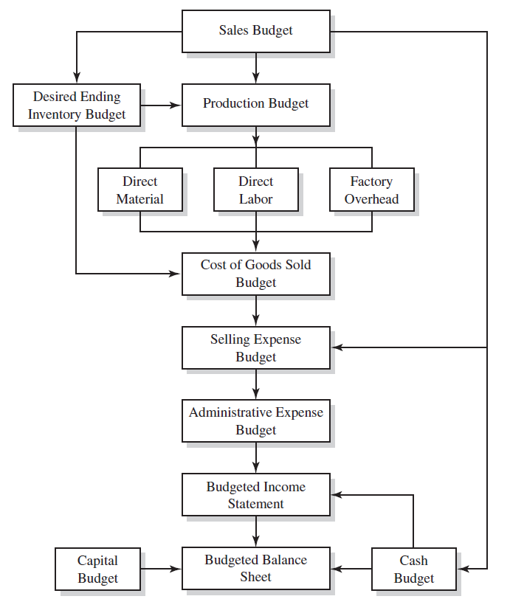
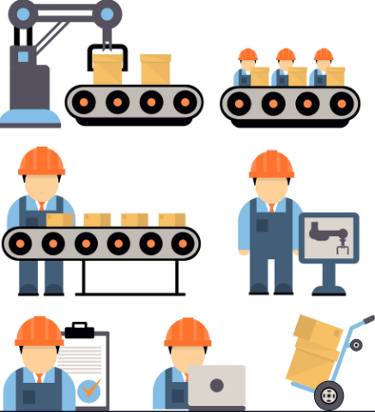
LOGICAL SCHEME OF BUDGETING PROCESS
Manufacturing overhead costs
Non-manufacturing overhead costs

Slide 3
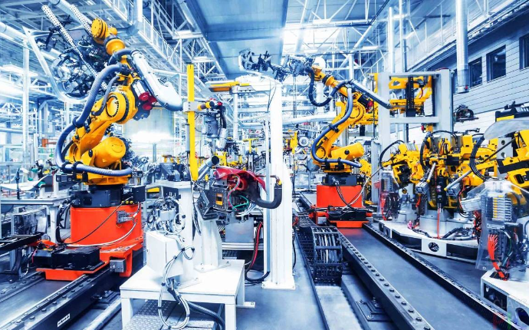
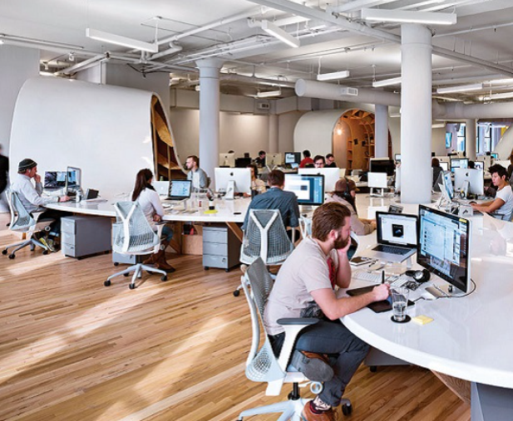
MANUFACTURING AND NON-MANUFACTORING OVERHEAD
Manufacturing overhead: This is the indirect cost associated with the production process and includes all expenses that do not attribute directly to a specific product, such as:
Factory rent
Utilities
Depreciation of equipment
Wages of indirect labor
Manufacturing overhead are parts of the Cost of production manufactured
Non-manufacturing overhead: This is the indirect cost associated with the general operation of a business and includes all of the expenses unrelated to the production process, such as:
Administrative salaries
Marketing and advertising expenses
Office rent and utilities
Legal and accounting fees
Insurance
Non-manufacturing overhead are not included into the Cost of production manufactured, but are parts of the Price of production sold

Slide 4
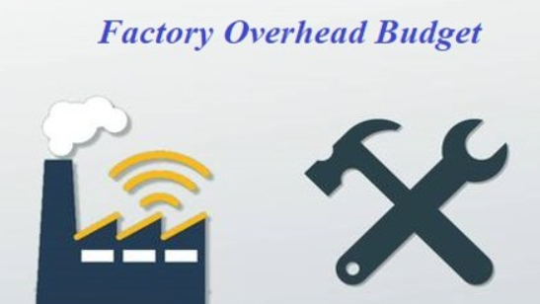
FACTORY OVERHEAD BUDGET
Factory Overhead Budget – schedule of all expected manufacturing costs except for direct material and direct labor. Factory overhead items include indirect material, indirect labor, factory rent, and factory insurance.
Factory Overhead Budget can be considered as budget of the other direct costs and general production costs

Slide 5
FACTORY OVERHEAD BUDGET
Indicator | Quarters |  |  |  | For the year
 | І | ІІ | ІІІ | ІV
1. Other direct costs:
1.1. Spoilage costs* | 104.05 | 105.91 | 108.31 | 110.71 | 428.99
1.2. Depreciation of equipment** | 819.00 | 819.00 | 819.00 | 819.00 | 3276.00
2. General production costs*** | 10014.93 | 10194.03 | 10425.03 | 10656.03 | 41290.02
3. Total (row 1+ row 2) | 10937.98 | 11118.94 | 11352.34 | 11585.74 | 44995.01
4. Depreciation of equipment | 819.00 | 819.00 | 819.00 | 819.00 | 3276.00
5. Cash outflow for the other direct and general production costs (row 3- row 4)**** | 10118.98 | 10299.94 | 10533.34 | 10766.74 | 41719.01
*spoilage is wastage or loss of material that occurs during the manufacturing process
** depreciation of equipment, that takes part in manufacturing process
***general production costs (for maintaining the workshop, where production manufactured; salary of the workshop director, workshop cleaner managers; heating and lightening of the workshop, depreciation of workshop and other equipment, that supports but does participate in production process)
****all calculated budgets will be reflected in Cash plan. As far as depreciation does not entail a cash outflow, it must be deducted from the total factory overhead budget in computing cash disbursement for factory overhead.

Slide 6
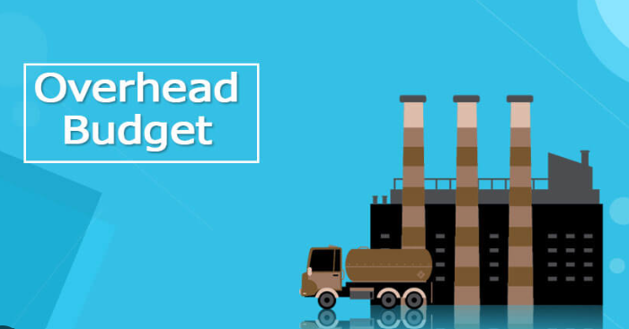
CLASSIFICATION OF FACTORY OVERHEAD COSTS
1. Facility Costs: These include rent, property taxes, insurance, and maintenance necessary to run the manufacturing facility.
2. Utilities: These include electricity, water, and gas used in manufacturing.
3. Supervision and Management: These include salaries, benefits, and other costs associated with supervisory and management personnel responsible for overseeing the manufacturing process.
4. Equipment Costs: These include depreciation, maintenance, and repair costs for machinery and equipment used in manufacturing.
5. Quality Control: These include costs associated with ensuring the quality of the manufactured products, such as inspection, testing, and auditing costs.
6. Materials Handling and Storage: These include costs for moving and storing materials used in the manufacturing process, such as forklift operation, pallets, and warehouse space.
7. Quality Control: These costs include the cost of inspection, testing, and quality assurance of the finished product before its shipment to the customer.
8. Research and Development: These include costs associated with researching and developing new products or improving existing ones.
9. Taxes and Licenses: These include taxes and licenses required to operate a manufacturing facility, such as property taxes, business licenses, and environmental permits.
Factory overhead costs can be classified as direct, indirect, variable, fixed and mixed

Slide 7
TYPES OF COSTS
Fixed costs
Costs independent of the quantity produced
Variable costs
Costs dependent on the quantity produced
Marginal costs
The cost of the last produced unit
Opportunity costs
The cost of sacrificing opportunities
Indirect costs
Costs that can not be assigned directly to a particular performance
An increase in the total cost of producing one extra product
It is necessary to budget them in a certain way

Slide 8
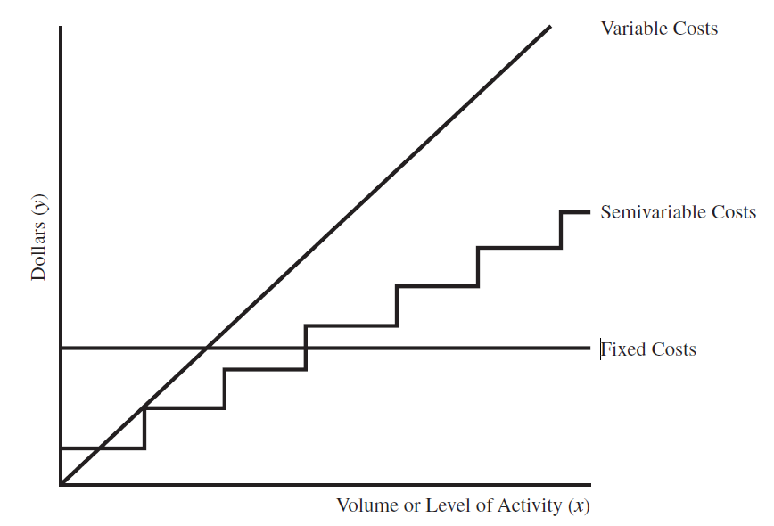
COST BEHAVIOR PATTERNS
Variable Factory Overhead vary in total with changes in volume or level of activity: Supplies, Receiving costs, Fuel and power, Overtime premium, Spoilage and defective work
Fixed costs do not change in total regardless of the volume or level of activity: Property taxes, Rent on factory building, Depreciation, Indirect labor, Insurance, Patent amortization
Mixed (Semivariable) Costs contain both a fixed element and a variable one: Supervision Maintenance and repairs,
Inspection Compensation insurance, Service department costs, Employer’s payroll taxes, Utilities Rental of delivery truck,
Fringe benefits

Slide 9
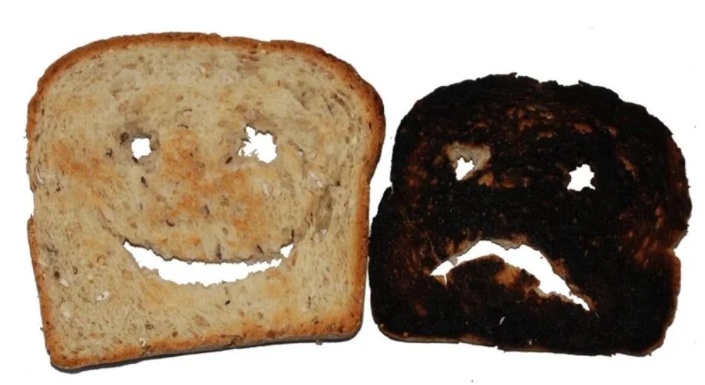

SPOILAGE COSTS
Spoilage is wastage or loss of material that occurs during the manufacturing process. It can also be used to classify badly damaged material that is used for processing a product.
Spoilage is used to refer most commonly to raw materials whose lifespan is very short.
In accounting, spoilage is classified into two types – normal spoilage and abnormal spoilage.
Normal spoilage is the kind of spoilage that happens during the production process that business owners can say is normal and acceptable.
Abnormal spoilage, on the other hand, is spoilage that is beyond the normal point, wherein the level is unexpectedly high. It may be due to defective machinery, sub-standard quality of materials, and even incompetent operators.
For example, a fruit importer understands that transporting fruits by sea or ground will definitely incur spoilage for various reasons. One reason is that some fruits age faster than the rest, making them rot faster. Some fruits might become spoiled because of the way they were handled as they were moved from one vehicle to the next. The importer then may consider a pound of rotten fruits to be normal spoilage when it arrives at his shop and may charge it to the “cost of goods sold.”

Slide 10
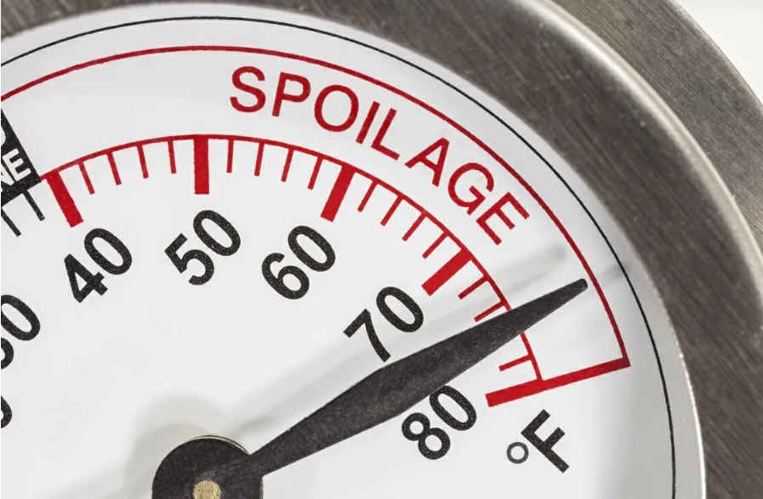
SPOILAGE COSTS
Spoilage, especially normal spoilage, is always part of the production process, as it is unavoidable and expected. However, it is important to take notice of it and do something about it before it becomes abnormal spoilage. Here are some reasons why:
It can signal a need to evaluate the production process. A part of the production process can be responsible for the spoilage. For example, a conveyor belt in a cookie manufacturing plant that is too loose and makes erratic movements can cause the cookies to break.
Spoilage can indicate a mistake that is continuously and unknowingly made by an operator. When evaluated, the operators may be required to undergo re-training or training in a new process.
The main difference between spoilage and by-products is that spoilage is considered scrap or trash that cannot be used anymore for any other purpose. By-products, on the other hand, are products that can still be of use or may be sold as a product other than what was originally created.
For example, a restaurant that serves chicken barbecue can consider chicken barbecue as its main product while the excess barbecue sauce it makes may be sold as an entirely different product to customers. It can now be considered a by-product. Meanwhile, spoilage will be the parts of the chicken that cannot be used anymore, such as the feet and the head.

Slide 11
DEPRECIATION - DISTRIBUTION THE VALUE OF FIXED ASSETS
Original (beginning) value of fixed assets = Price of purchase without Value Added Tax + Freight (transportation) charges + Installation, testing + Insurance + Custom duties +Registration fees……..
Original value (for example, equipment = $100000; Useful life = 5 years (period, during which the assets serve)
$100000 = cash outflow from investing activity ≠ costs at once;
it is distributed during useful life; monthly part ($1667) will be depreciation cost
First year | Second year | Third year | Forth year | Fifth year
$100000/5 years/12 months=$1667= costs per month | $100000/5 years/12 months=$1667= costs per month | $100000/5 years/12 months=$1667= costs per month | $100000/5 years/12 months=$1667= costs per month | $100000/5 years/12 months=$1667= costs per month

Slide 12
DEPRECIATION COSTS
Depreciation (amortization) as cost can be included into the:
cost of production (direct material costs (materials, energy, gas, water, spent for the manufacturing of the production) + direct labor costs (salary of employees, that manufacture the production) + Cost of spoiled production + depreciation of equipment, that takes part in manufacturing process + general production costs (for maintaining the workshop, where production manufactured; salary of the workshop director, workshop cleaners; heating and lightening of the workshop) +
administrative costs (salary of the director, financial services departments, HR department, supply department, depreciation of the administrative fixed assets, representative expenses, audit, etc.),
sales costs (packaging, advertising, transportation of products, depreciation of refrigerators, storage of finished products, salary of sales department)

Slide 13
TERMS OF DEPRECIATION
Original value= Price of purchase without Value Added Tax + Freight charges + Installation, testing + Insurance + Custom duties +Registration fees
Depreciation – distribution of original value of tangible assets during their useful life
Amortization – distribution of original value of intangible assets during their useful life
Useful life – period, during which the assets serve
Book value = original value – accumulated depreciation
Salvage (residual) value – price of asset’s selling at the end of useful life (0, >0……)
Depreciated value = original value – salvage value

Slide 14
THE FOUR BASIC METHODS OF DEPRECIATION
Straight-line
Sum-of-the-years’ digits
Double declining balance
Units of production

Slide 15
THE FOUR BASIC METHODS OF DEPRECIATION
Straight-line method:
Annual depreciation = (original value – salvage value)
useful life
Double declining balance:
Annual depreciation = Book value *2
useful life
Depreciation per month = Annual depreciation/12

Slide 16
THE FOUR BASIC METHODS OF DEPRECIATION
Sum-of-the-years’ digits:
Annual depreciation =
(original value – salvage value) * quantity of years up to the end of useful life
1+2+3+4+5+6+……+10useful life
Units of production:
Annual depreciation = Annual amount of production from asset * (original value – salvage value)
total amount of production from asset
Depreciation per month = Annual depreciation/12

Slide 17
DEPRECIATION FUND: EXAMPLE
Price of the unit of production $1000=
1.cost of production (direct material costs (materials, energy, gas, water, spent for the manufacturing of the production) + direct labor costs (salary of employees, that manufacture the production) + Cost of spoiled production + depreciation of equipment, that takes part in manufacturing process + general production costs (for maintaining the workshop, where production manufactured; salary of the workshop director, workshop cleaners; heating and lightening of the workshop)
+
2.profit (administrative costs (salary of the director, financial services departments, HR department, supply department, depreciation of the administrative fixed assets, representative expenses, audit, etc.), sales costs (packaging, advertising, transportation of products, depreciation of refrigerators, storage of finished products, salary of sales department), profit, tax profit, dividends)
+
3.Excise + 4.custom duty + 5.VAT value added tax
In case of purchase, the buyer pays $1000 to the company. From this amount company covers all the costs, mentioned above, except profit and depreciation. Profit belongs to shareholders and received money as depreciation should be accumulated into the depreciation fund for repairing, reconstruction, modernization, buying (building) new fixed assets
So, this fund is formed by byers, that is why original value should be calculated properly, including all costs, connected with fixed assets. This original value will be distributed as depreciation and included into the price.
The only task of the company is selling the production, collecting money from buyers and forming the depreciation fund

Slide 18
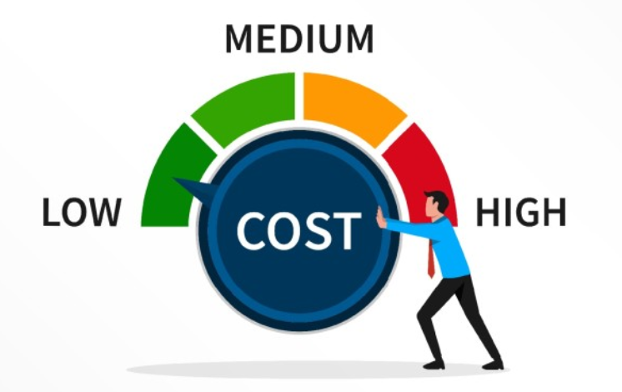
WAYS TO REDUCE OVERHEAD COSTS
Increase efficiency through equipment upgrades and trained employees. By upgrading older equipment to better new ones, you can produce more for the same amount of resources. Training your employees can also increase their efficiency, giving you better results per person instead of simply hiring more.
Decrease excess inventory and idle equipment. Storing extra products or mothballed equipment “just in case” costs tens of thousands in factory overhead. Consolidate those areas to both decrease overhead and increase alternative revenue streams.
Reuse equipment and supplies from other factories. Ask other facilities if they have extra equipment or materials that they’re not using – and if it could be “redeployed” to your factory. Redeployment would save time and money in searching for and installing brand-new equipment while decreasing your overhead costs.
Bild strong relationships with vendors in order to get discounts and special contracts with favourable conditions
Preventative maintenance of the equipment
Brainstorming among the employees, connected with the problem of costs reducing.
Motivation of the employees, who propose rational decision
Automation of manufacturing processes
Accurate inventory management
Outsourcing of the personal, that can help in some additional operations

Slide 19
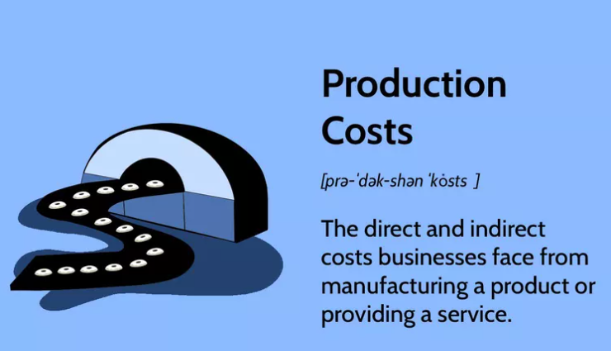
TOTAL COSTS OF PRODUCTION MANUFACTURED
Production costs refer to the costs a company incurs from manufacturing a product or providing a service that generates revenue for the company.
Production costs can include a variety of expenses, such as labor, raw materials, consumable manufacturing supplies, and general overhead.
Total product costs can be determined by adding together the total direct materials and labor costs as well as the total manufacturing overhead costs.
Budget of total cost of production:
Indicator | Quarters |  |  |  | For the year
 | І | ІІ | ІІІ | ІV
1. Total direct costs for materials | 6503.20 | 6619.5 | 6769.5 | 6919.5 | 26811.70
2. Total direct labour costs | 20788.57 | 21160.33 | 21639.84 | 22119.33 | 85708.07
3. Other direct costs:
3.1. Spoilage costs | 104.05 | 105.91 | 108.31 | 110.71 | 428.99
3.2. Depreciation of equipment | 819 | 819 | 819 | 819 | 3276
4. General production costs | 10014.93 | 10194.03 | 10425.03 | 10656.03 | 41290.02
5. Cost of finished products (row 1+ row 2+ row 3.1+ row 3.2+ row 4) | 38229.76 | 38898.78 | 39761.68 | 40624.58 | 157514.79
Cost of production per unit = total costs of production/total units produced

Slide 20

THANK YOU FOR ATTENTION!

