Slide 1
Cost of goods manufactured and cost of goods sold
Lecture of Corporate Budgeting
Mgr. Tetiana Konieva, Ph.D

Slide 2
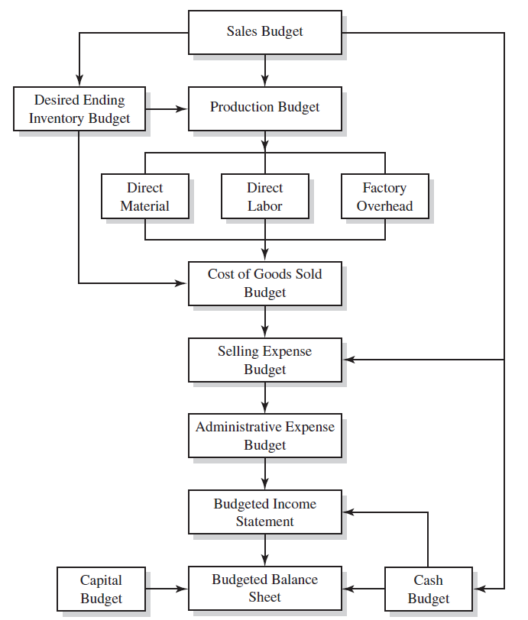
LOGICAL SCHEME OF BUDGETING PROCESS

Slide 3
TOTAL COSTS OF PRODUCTION MANUFACTURED
Production costs refer to the costs a company incurs from manufacturing a product or providing a service that generates revenue for the company.
Production costs can include a variety of expenses, such as labor, raw materials, consumable manufacturing supplies, and general overhead.
Total product costs can be determined by adding together the total direct materials and labor costs as well as the total manufacturing overhead costs.
Budget of total cost of production:
Indicator | Quarters |  |  |  | For the year
 | І | ІІ | ІІІ | ІV
1. Total direct costs for materials | 6503.20 | 6619.5 | 6769.5 | 6919.5 | 26811.70
2. Total direct labour costs | 20788.57 | 21160.33 | 21639.84 | 22119.33 | 85708.07
3. Other direct costs:
3.1. Spoilage costs | 104.05 | 105.91 | 108.31 | 110.71 | 428.99
3.2. Depreciation of equipment | 819 | 819 | 819 | 819 | 3276
4. General production costs | 10014.93 | 10194.03 | 10425.03 | 10656.03 | 41290.02
5. Cost of finished products (row 1+ row 2+ row 3.1+ row 3.2+ row 4) | 38229.76 | 38898.78 | 39761.68 | 40624.58 | 157514.79
Cost of production per unit = total costs of production/total units produced

Slide 4
COST OF PRODUCTION AS PART OF THE PRICE
Price of the unit of production =
1.cost of production per unit (direct material costs (materials, energy, gas, water, spent for the manufacturing of the production) + direct labor costs (salary of employees, that manufacture the production) + Cost of spoiled production + depreciation of equipment, that takes part in manufacturing process + general production costs (for maintaining the workshop, where production manufactured; salary of the workshop director, workshop cleaners; heating and lightening of the workshop)
+
2.profit (administrative costs (salary of the director, financial services departments, HR department, supply department, depreciation of the administrative fixed assets, representative expenses, audit, etc.), sales costs (packaging, advertising, transportation of products, depreciation of refrigerators, storage of finished products, salary of sales department), profit, tax profit, dividends)
+
3.Excise + 4.custom duty + 5.VAT value added tax

Slide 5
COST OF PRODUCTION SOLD
https://www.investopedia.com/terms/c/cogs.asp
Cost of goods sold is also referred to as "cost of sales.“
Cost of goods sold (COGS) refers to the direct costs of producing the goods sold by a company. This amount includes the cost of the materials and labor directly used to create the good. It excludes indirect expenses, such as distribution costs and sales force costs.
Cost of goods sold (COGS) includes all of the costs and expenses directly related to the production of goods.
COGS excludes indirect costs such as overhead, administrative and sales and marketing.
COGS is a part of Income statement
COGS is deducted from revenues (sales) in order to calculate gross profit and gross margin. Higher COGS results in lower margins. Gross profit = net revenue – cost of goods sold
The value of COGS will change depending on the accounting standards used in the calculation.
COGS differs from operating expenses (OPEX) in that OPEX includes expenditures that are not directly tied to the production of goods or services.

Slide 6
COST OF GOODS MANUFACTURED & COST OF GOODS SOLD
Cost of goods (production) manufactured per unit = 100 CZK
1 variant: Company manufactured and sold 500 units
Company manufactured 500 units, cost of goods manufactured 500 units * 100 CZK = 50000 CZK | Company sold 500 units, cost of goods sold 500 units * 100 CZK = 50000 CZK
2 variant: Company manufactured 500 units, but sold 0 units
Company manufactured 500 units, cost of goods manufactured 500 units * 100 CZK = 50000 CZK | Company sold 0 units, cost of goods sold 0 units * 100 CZK = 0 CZK
3 variant: Company manufactured 500 units, but sold 200 units
Company manufactured 500 units, cost of goods manufactured 500 units * 100 CZK = 50000 CZK | Company sold 200 units, cost of goods sold 200 units * 100 CZK = 20000 CZK
4 variant: Company manufactured 500 units, but sold 800 units (using the inventories of units, left in warehouse from previous year)
Company manufactured 500 units, cost of goods manufactured 500 units * 100 CZK = 50000 CZK | Company sold 800 units, cost of goods sold 800 units * 100 CZK = 80000 CZK
5 variant: Company manufactured 0 units, but sold 400 units (using the inventories of units, left in warehouse from previous year)
Company manufactured 0 units, cost of goods manufactured 0 units * 100 CZK = 0 CZK | Company sold 400 units, cost of goods sold 400 units * 100 CZK = 40000 CZK

Slide 7
WAYS TO CALCULATE THE COST OF GOODS SOLD
Units of goods sold * cost of production per unit
Beginning Inventory + Purchases during period − Ending Inventory
3. Finished production at the end of previous year + (units of production sold this year - Finished production at the end of previous year/cost of production per unit of previous year)* cost of production per unit this year

Slide 8
THANK YOU FOR ATTENTION!

