Slide 1

Cash budget
Lecture of Corporate Budgeting
Mgr. Tetiana Konieva, Ph.D

Slide 2
ACCRUAL BASIS OF ACCOUNTING:
INCOME CAN BE =, >, < THAN CASH INFLOW
Transaction | Revenue, income | Cash inflow
1. Delivered production to buyers and received cash from them 20000 | 20000 | 20000
2. Delivered production to buyers with payment delay 20000 | 20000 | -
3. Received prepayment 20000 from the buyers for production, that have not been delivered yet | - | 20000
4. Received bank credit 30000 | - | 30000
5. Company issued shares and sold them at exchange market 15000 | - | 15000
6. Company received cash dividends from financial investments on the declaration date 1400 | 1400 | 1400
7. Company is declared cash dividends 1400 from financial investments in September, that will be paid in October | 1400 (September) - (October) | - 1400 (October)

Slide 3
ACCRUAL BASIS OF ACCOUNTING:
EXPENSES CAN BE =, >, < THAN CASH OUTFLOW
Transaction | Expenses | Cash outflow
1. Company paid in advance for inventories 23000 | - (the price of bought inventories will be expenses after the manufacturing the production from them and its selling) | 23000
2. Returning bank credit 30000 | - | 30000
3. Salary is calculated for September 42000, it will be paid at the beginning of October | 42000 | - 42000 (in October)
4. Made prepayment for annual rent 56000 | - (56000/12 – will be cost at the end of every month of the year ) | 56000
5. Company paid dividend for owners 4000 | - (dividends are not expenses, because they are paid from net profit after all expenses) | 4000
6. Company calculated depreciation of equipment 1200 | 1200 | -

Slide 4
BUDGET OF CASH INFLOW FROM SALE OF FINISHED PRODUCTS
In order to attract customers company can provide payment delay or partial payment, for example 68% from delivered production at once, and the rest – next quarter.
Every client can be provided specific conditions, which can vary from each other. That is why payment of every client should be calculated and controlled separately.
Example of calculating the Budget of cash inflow from sale of finished products
Sales budget
Indicator | Quarters |  |  |  | Annual sale
 | І | ІІ | ІІІ | ІV
1. Sale of finished products, units | 470 | 440 | 450 | 460 | 1820
2. Sale price, CZK. | 138 | 138 | 138 | 138 | 138
3. Revenue = row 1 * row 2, CZK. | 64860 | 60720 | 62100 | 63480 | 251160
Budget of cash inflow from sale of finished products
Indicator | Quarters |  |  |  | For the year
 | І | ІІ | ІІІ | ІV
1. Repayment of accounts receivable for the previous year | ^{4500.00} |  |  |  | 4500.00
2. Quarterly payments of finished products:
І quarter | 44104.80 | 19458.00 |  |  | 63562.80
ІІ quarter |  | 41289.60 | 18216.00 |  | 59505.60
ІІІ quarter |  |  | 42228.00 | 18630.00 | 60858.00
ІV quarter |  |  |  | 43166.40 | 43166.40
3. The total amount of cash inflows (row 1+ row 2) | 48604.80 | 60747.60 | 60444.00 | 61796.40 | 231592.80
4. Accounts receivable at the end of the year |  |  |  | 19044.00 | 19044.00
68%
30%
68%
68%
68%
30%
30%
30%

Slide 5
BUDGET OF DOUBTFUL DEBTS
In order to attract customers company can provide payment delay or partial payment, for example 68% from delivered production at once, and the rest – next quarter.
Sometimes the payment of this left part can be problematic because of different reasons.
This can lead to doubtful debts. In the example the company received 68% at once, 30% next quarter, and 2% left as doubtful debts
Sales budget
Indicator | Quarters |  |  |  | Annual sale
 | І | ІІ | ІІІ | ІV
1. Sale of finished products, units | 470 | 440 | 450 | 460 | 1820
2. Sale price, CZK. | 138 | 138 | 138 | 138 | 138
3. Revenue = row 1 * row 2, CZK. | 64860 | 60720 | 62100 | 63480 | 251160
Budget of doubtful debts
2%
2%
2%
2%
Indicator | Quarters |  |  |  | For the year
 | І | ІІ | ІІІ | ІV
Doubtful debts | 1297.20 | 1214.40 | 1242.00 | 1269.60 | 5023.20

Slide 6
BUDGET OF CASH OUTFLOW FOR THE RAW MATERIALS PURCHASE
So far as company provides favorable credit policy of the clients, giving them payment delay or partial payment, it has a right to demand same conditions from suppliers.
In this case it is important to maintain the balance between credit policy provided and credit policy from vendors in order to avoid cash deficit. In our case the credit policy conditions from suppliers are not favorable: 75% at once, 25% next quarter
Example of calculating the Budget of cash outflow for the raw materials purchase
Budget of the direct costs for materials
Indicator | Quarters |  |  |  | Annual sale
 | І | ІІ | ІІІ | ІV
1. …… | …. | …. | …. | …. | ….
…. | …. | …. | …. | …. | ….
Costs of the raw materials purchase, CZK | 6578.74 | 6639.00 | 6789.00 | 6939.00 | 26945.74
Budget of cash outflow for the raw materials purchase
75%
Indicator | Quarters |  |  |  | For the year
 | І | ІІ | ІІІ | ІV
1. Repayment of accounts payable for the previous year | ^{4350.00} |  |  |  | ^{4350.00}
2. Quarterly payments of raw material:
І quarter | 4934.05 | 1644.68 |  |  | 6578.74
ІІ quarter |  | 4979.25 | 1659.75 |  | 6639.00
ІІІ quarter |  |  | 5091.75 | 1697.25 | 6789.00
ІV quarter |  |  |  | 5204.25 | 5204.25
3. The total amount of cash outflows (row 1+ row 2) | 9284.05 | 6623.93 | 6751.50 | 5204.25 | 27863.74
4. Accounts payable at the end of the year |  |  |  | 1734.75 | 1734.75
75%
25%
75%
75%
25%
25%
25%

Slide 7
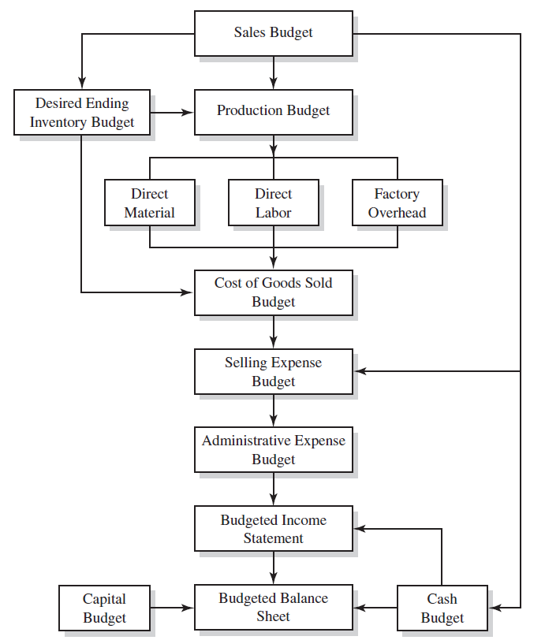
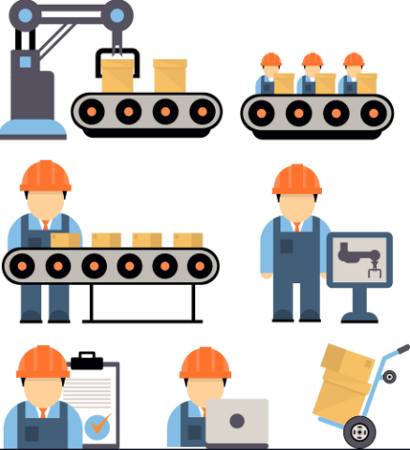
LOGICAL SCHEME OF BUDGETING PROCESS

Slide 8
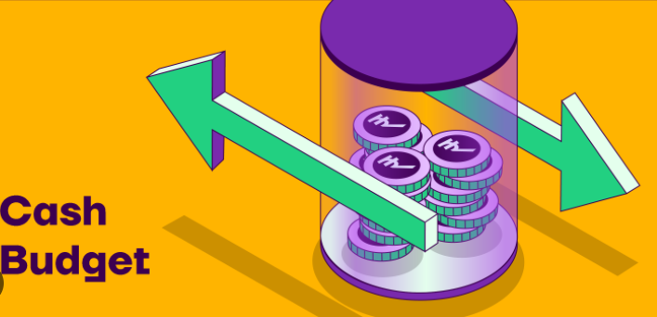
CASH PLAN
The budget preparation process normally begins with the sales budget and continues through the preparation of pro forma financial statements.
The last schedule prepared before the financial statements is the cash budget. The cash budget is a schedule of estimated cash collections and payments. The various operating budgets and the capital budget are inputs to the cash budgeting process.
The cash budget is prepared for the purpose of cash planning and control.
It presents the expected cash inflow and outflow for a designated time period.
The cash budget helps management keep cash balances in reasonable relationship to its needs. It aids in avoiding unnecessary idle cash and possible cash shortages.
The cash budget also allows for review of future cash receipts and cash payments to uncover possible patterns of cash flows. In this way, collection and disbursement efforts can be studied to ascertain if net cash flows are being maximized.
In addition, the cash budget reveals when and how much to borrow and when users will be able to pay the money back. For example, if a cash budget indicates that a significant cash outlay will be needed to buy assets (e.g., store equipment), the user may have to borrow money and determine a debt repayment schedule.
In order to obtain a line of credit, lenders typically require borrowers to submit the cash budget along with financial statements.

Slide 9
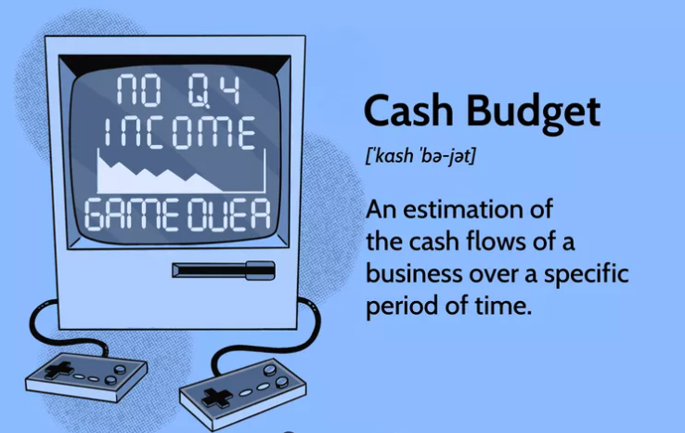
CASH PLAN
https://www.investopedia.com/terms/c/cashbudget.asp#:~:text=A%20cash%20budget%20is%20an,over%20the%20given%20time%20frame
A cash budget is a company's estimation of cash inflows and outflows over a specific period of time, which can be weekly, monthly, quarterly, or annually.
A company will use a cash budget to determine whether it has sufficient cash to continue operating over the given time frame.
A cash budget will also provide a company with insight into its cash needs and any surpluses, which help it determine if the business is using cash effectively.
Cash budgets can be viewed as short-term cash budgets, usually, a time frame of weeks to months, or long-term cash budgets, which are viewed as years.
A company must manage its sales and expenses to reach optimal cash flow.
Cash budgets are usually viewed in either the short-term or the long-term. Short-term cash budgets focus on the cash requirements needed for the next week or months whereas long-term cash budget focuses on cash needs for the next year to several years.
Short-term cash budgets will look at items such as utility bills, rent, payroll, payments to suppliers, other operating expenses, and investments. Long-term cash budgets focus on quarterly and annual tax payments, capital expenditure projects, and long-term investments. Long-term cash budgets usually require more strategic planning and detailed analysis as they require cash to be tied up for a longer period of time.

Slide 10
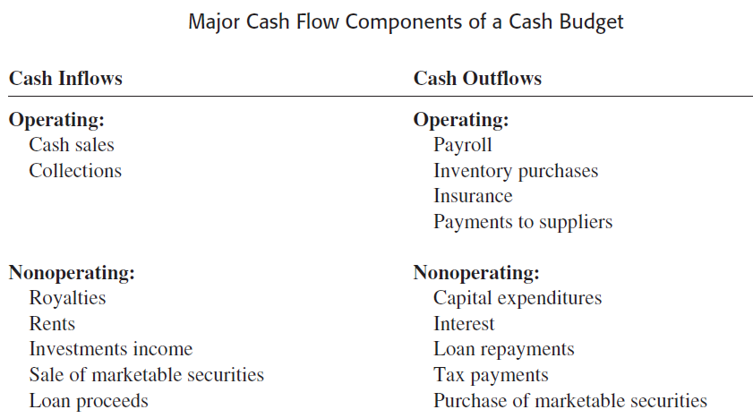
CASH PLAN
The cash budget typically consists of four major sections:
1. The cash receipts section, which is cash collections from customers and other cash receipts, such as royalty income and investment income
2. The cash disbursements section, which comprises all cash payments made by purpose
3. The cash surplus or deficit section, which simply shows the difference between the total cash available and the total cash needed including a minimum cash balance if required. If there is surplus cash, loans may be repaid or temporary
investments made.
4. The financing section, which provides a detailed account of the borrowings, repayments, and interest payments expected during the budgeting period
Cash budgets often are prepared monthly, quarterly, annually, but there are no strict rules for determining
the length of the budget period.

Slide 11
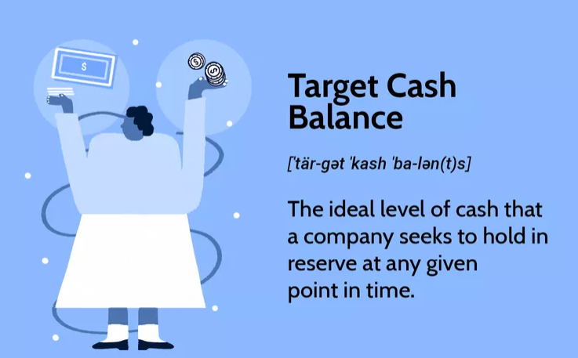
TARGET (MINIMUM) CASH BALANCE
A target cash balance is the optimal level of cash that a firm or investor should have on hand or in their portfolio at the end of the period (month, quarter, year).
It is something like norm of cash balance, applied at the enterprise
Too much cash can be a drag on overall investment performance and cash not invested may be subject to opportunity costs.
Too little cash means that certain opportunities cannot be seized when they arise and can lead to undesirable liquidity problems causing the forced sales of assets.
A cash position represents the amount of cash that a company, investment fund, or bank has on its books at a specific point in time. The cash position can be a sign of financial strength and liquidity. In addition to cash itself, this position often takes into consideration highly liquid assets, such as certificates of deposit, short-term government debt, and other cash equivalents. However, too large of a cash position can often signal waste, as the funds are generating very little return.
"Cash drag" is a common source of performance drag in a portfolio. It refers to holding a portion of a portfolio in cash rather than investing this portion in the market. Because cash typically has very low or even negative real returns after considering the effects of inflation, most portfolios would earn a better return by investing all cash in the market. However, some investors decide to hold cash to pay for account fees and commissions, as an emergency fund or as a diversifier of other portfolio investments.

Slide 12
TARGET (MINIMUM) CASH BALANCE
A minimum cash balance is a cash reserve kept on hand to offset any unplanned cash outflows. Without this safety buffer, a business might find itself unable to pay its bills. The use of a minimum cash balance means that a certain amount of cash is maintained in a bank account, rather than being invested elsewhere, used to pay down debt, or returned to investors as a dividend.
A minimum cash balance is most necessary in environments where there are large differences between the timing and amount of cash inflows and cash outflows.
The best way to derive your minimum cash balance is to create a detailed monthly budget, which includes all expected expenditures for fixed assets, as well as cash inflows from the expected sale of assets. This budget will reveal any projected cash shortfalls over the budget period. The minimum cash balance should offset the largest of these shortfalls.
Or target cash balance can be established as particular % from sales

Slide 13
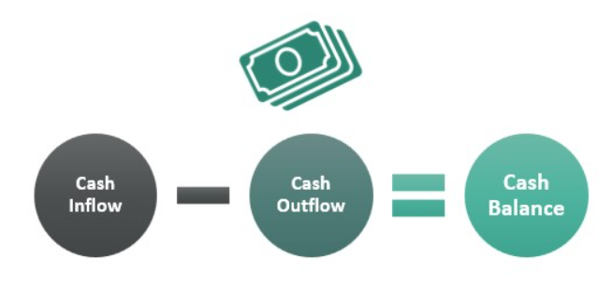
WAYS TO IMPROVE CASH FLOWS
1. Lease, Don’t Buy
Since leasing supplies, equipment, and real estate usually ends up being more expensive than buying, doing so may seem counterintuitive to someone who is only paying attention to the bottom line, or your income after expenses are paid off. But unless your company is flush with cash, you’re going to want to maintain a cash stream for day-to-day operations. By leasing, you pay in small increments, which helps improve cash flow. An added bonus is that lease payments are a business expense, and thereby can be written off on your taxes.
2. Offer Discounts for Early Payment
Everyone loves an incentive, and if you offer customers a discount if they pay their bills ahead of time, you’re creating a win/win situation for both of you. Getting the cash in early helps your cash flow, of course.
3. Conduct Customer Credit Checks
If a customer doesn't want to pay you in cash, then be sure to conduct a credit check—especially before you sign them up. If the client has poor credit, you can safely assume that you won’t be receiving payments on time.
As badly as you might want to make the sale, the late payments will hurt your business’s cash flow. If you opt for a sale despite any questionable credit, be sure to set it up with a high interest rate.
4. Form a Buying Cooperative. Think power in numbers, and find other like-minded companies willing to pool their cash in order to haggle lower prices with suppliers, who usually give big discounts to large firms who buy in bulk.
5. Improve Your Inventory. Take an inventory check. Make a list of those goods you buy that aren't moving at the same pace as your other products. They tie up a lot of cash and could hurt your cash flow.
Instead of buying more of what doesn’t sell, get rid of it—even if you need to sell it at a discount. It's hard to walk away from products you fall in love with, hoping that someday you'll magically see heightened demand, but that almost never happens. Be objective, not emotional

Slide 14
WAYS TO IMPROVE CASH FLOWS
6. Send Invoices Out Immediately
You'll see receivables come in more quickly this way. Make sure you understand the basics of how to put together a good invoice. You'll want your invoices to be easy to read and the terms clearly stated. Have the due date stated in a few places (preferably in bold), including at the top of the invoice and on the payment slip at the bottom. Include clear instructions regarding payment types accepted. If you charge late payment fees, make sure you include this information as well.5
7. Use Electronic Payments
If you pay electronically, you can wait until the morning of the day a bill is due to make payment. This buying of time improves your cash flow. You can also use a business credit card as some offer a grace period as long as 21 days, which can do a lot to increase your cash flow. You might even get cash back. But don't pile up too much debt
8. Pay Suppliers Less
If you maintain friendly, regular communication with suppliers, you will have a better chance of landing better terms with them. Offer suppliers early payments if they're willing to give you a discount in return. Learning to master the art of negotiation is an essential part of doing business and could help you convince your suppliers to offer you a better deal.7
9. Use High-Interest Savings Accounts
This will provide you with liquidity while growing your cash position. The best high-yield savings accounts offer interest rates more than 17 times higher than the national average, meaning you'll earn more on the money you've stashed away.89
10. Increase Pricing
Increasing your prices is a concept that scares many business owners. They're worried it will lead to reduced sales. But it's OK to experiment with pricing to find the perfect number—how high are customers willing to go? There's no way to know unless you take a chance.

Slide 15
WAYS TO IMPROVE CASH FLOWS
11. Consider invoice factoring
Invoice factoring allows businesses to free up ready cash by “selling” an outstanding invoice to a third party company. Typically, the third-party factor will buy an invoice for 70-90% of its total value, and then take control of the credit control process to chase the client for payment. Once the factor has received the payment from the client, they will pay the vendor the final outstanding invoice value, minus their fee.
For businesses that have high-value invoices – which could impact cash flow if they go unpaid – invoice financing can be a low risk way to release working capital.
12. Consider Borrowing Options
Cash flow shortages occur when more money flows out of your company than into your company. One way to solve the problem is to find a way to bring money into the business. You can do this with a business loan or a credit card advance. Before you take on business debt, however, be sure you understand the interest rates and have considered all other options. Be sure you are not making a decision that will simply kick the problem down the road to be addressed at a later date.
If your business has an intrinsic problem causing your cash flow crisis, then taking on debt will only put a band-aid on the problem and make the problem worse in the future.
13. Raise Investor Capital
Another way to quickly increase your business's working capital (and also to bring in a new business partner) is to sell equity. Like taking on debt, however, be sure you truly want or need to sell a piece of ownership in your business to solve a cash flow crisis.
Also, be careful regarding the type of investors to whom you decide to sell and with whom you choose to partner. Do not let the pressure of a cash flow crisis lead you to make poor decisions for the future of your business.

Slide 16
WAYS TO IMPROVE CASH FLOWS
14. Slash Expenses
As a rule of thumb in business, you should always scrutinize every single penny that leaves your bank account, but you will need to be especially critical of spending during a cash flow crisis. During a cash flow shortage, you must prioritize your company's expenses. Eliminate all unnecessary expenses and only spend on the costs that keep you operational and generate revenue.
15. Sell Non-Essential Assets
In addition to cutting non-essential expenses, in a cash flow crisis you can also off-load non-essential business assets. Although this is a temporary fix, as you can only sell an unnecessary item once, it is an effective and quick way to raise some cash when you are in a bind.

Slide 17

THANK YOU FOR ATTENTION!

