Slide 1
Statistics
Lecture 1
Introduction
David Bartl
Statistics
INM/BASTA

Slide 2
Reading list
What is statistics?
Why statistics “lie”
Some history of statistics in ancient times
Why statistics is useful in business
How to use a computer in statistics

Slide 3
Reading list
Compulsory:
KELLER, Gerald: Statistics for Management and Economics. 11th Edition. Cengage Learning, 2017. ISBN 978-1-337-09345-3
SIEGEL, Andrew: Practical Business Statistics. 7th Edition.
Academic Press, 2016. ISBN 978-0-12-804250-2
Recommended:
www.statsoft.com/textbook
http://onlinestatbook.com/

Slide 4
Reading list
Free Online Textbooks:
Many textbooks on statistics and other disciplines can be found at
https://freetextbook.org/
Online Statistics Education: An Interactive Multimedia Course of Study
http://onlinestatbook.com/
The Electronic Statistics Textbook by StatSoft, Inc. (2013)
www.statsoft.com/textbook
The printed version of the latter textbook:
HILL, T. & LEWICKI, P. (2007). STATISTICS: Methods and Applications. StatSoft, Tulsa, OK.

Slide 5
Reading list
Recommended:
ÖZDEMIR, Durmuş: Applied Statistics for Economics and Business.
2nd Edition. Springer, 2016.
ISBN 978-3-319-26495-0 (hardcover). ISBN 978-3-319-79962-9 (softcover).
UBØE, Jan: Introductory Statistics for Business and Economics:
Theory, Exercises and Solutions. 1st Edition. Springer, 2017.
ISBN 978-3-319-70935-2 (hardcover). ISBN 978-3-319-89016-6 (softcover).
QUIRK, Thomas: Excel 2016 for Business Statistics:
A Guide to Solving Practical Problems. 1st Edition. Springer, 2016.
ISBN 978-3-319-38958-5 (softcover).
HERKENHOFF, Linda, FOGLI, John:
Applied Statistics for Business and Management using Microsoft Excel.
1st Edition. Springer, 2013. ISBN 978-1-4614-8422-6 (softcover).

Slide 6
Reading list
Optional:
ANDERSON, D. R., SWEENEY, D. J., WILLIAMS, Th. A., FREEMAN, J., SHOESMITH, E.: Statistics for Business and Economics.
Cengage Learning, 2017. ISBN 978-1-4737-2656-7
DANIEL, W. W., TERREL, J.: Business Statistics for Management and Economics. Houghton Mifflin, 1995. ISBN 0-395-73717-6
WOOLDRIDGE, J. M.: Introductory Econometrics: A Modern Approach.
Mason, OH: Thomson/South-Western, 2006. ISBN 0-324-28978-2
VAN MATRE, J. G., GILBREATH, G. H.: Statistics for Business and Economics. BPI/IRWIN, Homewood, 1997. ISBN 0-256-03719-1

Slide 7
What is statistics?
The word “statistics” has two meanings:
Statistics is a table, graph, or any numerical information
Statistics is a collection of methods and procedures dealing
with information, and with numerical information in particular
The word “statistic” has a special meaning
Statistic is a random variable:
— a function of the random sample
— a formula or an algebraic expression

Slide 8
What is statistics for us?
The statistics is a collection, or a system, of methods and procedures dealing with numerical (quantitative) and non-numerical (qualitative) information. In particular, statistics deals with:
collection of the information (census, poll, questionnaires, interviews)
description of the information (structuration, storage in the computer)
analysis of the information (by using statistical methods)
evaluation of the information (explanation, interpretation and presentation)

Slide 9
Statistics lie…
“Statistics is a particularly cunning form of a lie.”
— an unknown English lord
“There are three kinds of lies: lies, damned lies, and statistics.”
— of unknown origin / Mark Twain (?)
“The only statistics you can trust are the ones you have falsified yourself.”
“I only believe in statistics that I doctored myself.”
— Sir Winston Churchill
“The statistics is boring, but provides valuable information.”
— a song by Zdeněk Svěrák and Jaroslav Uhlíř

Slide 10
Example: The number of crimes in the City of XYZ
Bad news: The number of crimes increased by 300 % and by 400 %
Good news: The crime growth rate decreased by 50 %
5000
4000
4000
3000
3000
2000
1000
1000
0
2001
2002
2003
year

Slide 11
Median salaries in various professions
profession median salary (in CZK per month)
physicians 43 174
lawyers 41 725
programmers 41 164
scientists 34 342
teachers 26 168

Slide 12
Some history of statistics in ancient times
“Statistics” in ancient Egypt, Mesopotamia, China
The oldest “statistics” – the description of a state – the depiction of the given geographical, economic, and political state (situation)
One of the first works on the theory of the state:
Francesco Sansovino:
„del Governo et Administratione di diversi Regni, et Republichi“
Italy, 1583

Slide 13
Some modern history of statistics
Adolphe Quételet (1796–1874), a Belgian astronomer, mathematician, statistician, and sociologist:
introduced the concept of “homme moyen”, an average man, a prototype the Nature strives for, but is unreal
the foundation of modern statistics: the concept of the normal distribution,
mean and variance

Slide 14
Some modern history of statistics
18th and 19th century – foundations for further development of statistics:
Italians (three brothers)
— Jacob Bernoulli
— Daniel Bernoulli
— Nicolas Bernoulli
the French
— Joseph-Louis Lagrange, comte de l’Empire
— Pierre-Simon de Laplace

Slide 15
Some modern history of statistics
18th and 19th century – foundations for further development of statistics:
Swiss
— Leonhard Euler
German
— Carl Friedrich Gauss (Johann Carl Friedrich Gauß)
The catchword of statistics:
POPULATION = the collection of everything

Slide 16
Some modern history of statistics
The beginning of the 20th and 19th century – inductive statistics:
earlier: a description of every detail
now: conclusions about the population based on the sample
The catchword of modern statistics:
SAMPLE

Slide 17
Some modern history of statistics
Founders of modern statistics:
Russians
— Pafnuty Lvovich Chebyshev
— Aleksandr Mikhailovich Lyapunov
— Andrey Andreyevich Markov
British / English
— Ronald Fisher
— Karl Pearson
Polish
— Jerzy Neyman

Slide 18
Historical conclusion
Correct understanding of statistical concepts and methods
is a prerequisite for successful work of any specialist in economy.

Slide 19
Statistics and computers
Czech Statistical Office
→ https://www.czso.cz/
Eurostat
→ https://ec.europa.eu/eurostat/
Electronic textbooks of statistics
→ www.statsoft.com/textbook → http://onlinestatbook.com/
→ https://freetextbook.org/
Software: Specialized statistical software:
— Excel — SPSS — gretl = Gnu Regression,
— Statgraphics Econometrics and
— Statistica Time-series Library

Slide 20
Statistics
The purpose of statistics is to present data in a comprehensive form.
The goal is to analyse the information and reveal relations hidden in the data.
There are two approaches:
— Descriptive statistics (categorization, characteristics)
– we shall deal with it now
— Inductive statistics (assumptions about the origin of the data,
probability distributions)
– we shall deal with it later

Slide 21
Data — Data unit — Data item — Observation — Dataset
Data — (plural) — measurements and observations
Data unit — one entity (e.g. a person) in the population, under study,
about which the data are collected
Data item — a characteristics (an attribute) of a data unit
(e.g. the date of birth, gender, income, …), also called a variable
Observation — an occurrence of a specific data item recorded about a data unit,
also called a datum (singular of “data”)
Dataset — a complete collection of all observations

Slide 22
Statistical unit
Examples of statistical units:
inhabitants of a country
houses in a country
flats in a country
customers of a supermarket
employers
employees of a company
organizations of a given type (such as supermarkets)
students of a university
electors
products
events (accidents, coin tosses, rolling a dice)

Slide 23
Statistical unit
A statistical unit is determined from three points of view at least:
merit viewpoint (e.g. a male university student)
spatial viewpoint (e.g. a university student in Karviná)
time viewpoint (e.g. this year a first-year student)

Slide 24
Statistical unit
A census example:
merit viewpoint: all persons
spatial viewpoint: who are present in the territory of the Czech republic
time viewpoint: at the crucial moment
(the midnight between
Friday 25th March 2011 and
Saturday 26th March 2011)

Slide 25
Population — Sample — Data item
Population — a collection of all data units of the same (merit, spatial and time) specification
Sample — a selected subset of the population
Data item — a property or an attribute of a data unit of the population
Data items – statistical variables – are:
— qualitative (categorical), such as the gender, colour, taste, satisfaction
— quantitative (numerical), such as the revenue, price, number of customers

Slide 26
Qualitative data items
Qualitative (categorical) data items – qualitative statistical variables – are:
— nominal – only the name, such as:
— gender (male, female)
— colour (blue, red, yellow, green, white, black, …)
— ordinal – the values can be compared and ordered, such as
— satisfaction:
terrible < poor < not bad < good < excellent
— knowledge:
basic < advanced < expert

Slide 27
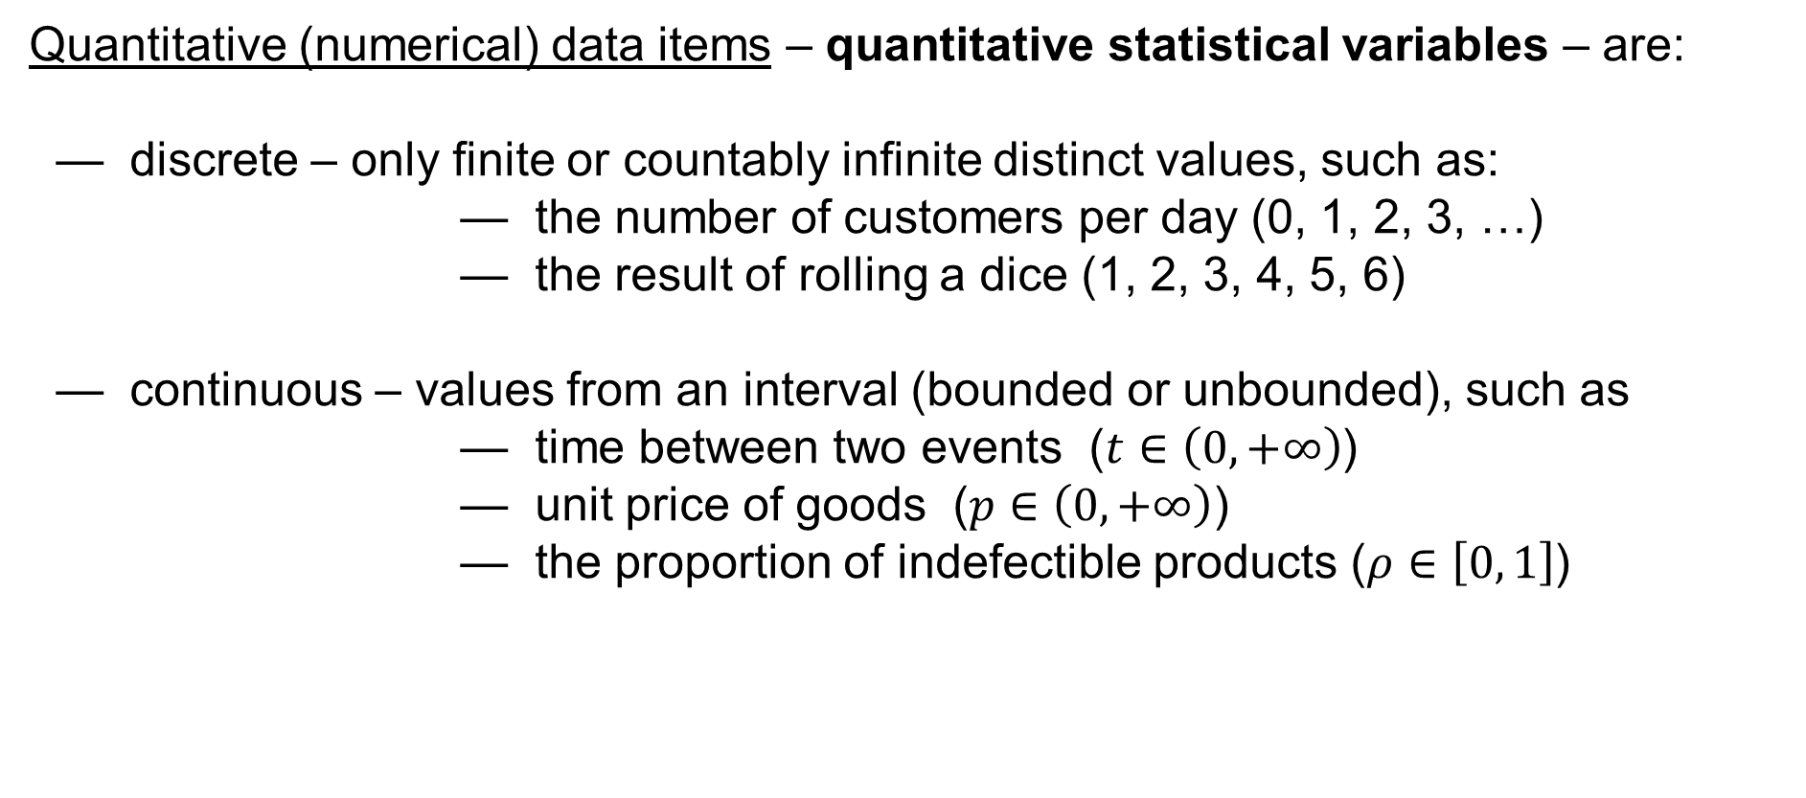
Quantitative data items
Quantitative (numerical) data items – quantitative statistical variables – are:
— discrete – only finite or countably infinite distinct values, such as:
— the number of customers per day (0, 1, 2, 3, …)
— the result of rolling a dice (1, 2, 3, 4, 5, 6)
— continuous – values from an interval (bounded or unbounded), such as
— time between two events ($t∈\left(0,+∞\right)$)
— unit price of goods ($p∈\left(0,+∞\right)$)
— the proportion of indefectible products ($ρ∈\left[0, 1\right]$)

Slide 28
Data items = Variables
Variable = data item
Qualitative = categorical
Quantitative = numerical
Ordinal
Nominal
Discrete
Continuous

Slide 29
Example: a Dataset where Statistical units = employees
ID | Gender | Age | Marital Status | Education | Position | Salary per Year | Evaluation
5060 | M | 65 | divorced | secondary | worker | 258800 | 4
1030 | M | 60 | divorced | university | manager | 630000 | 2
3049 | M | 60 | married | primary | operator | 436600 | 5
5047 | M | 60 | widowed | primary+vocational | worker | 240600 | 3
5061 | M | 60 | widowed | primary+vocational | worker | 241800 | 1
5087 | M | 60 | widowed | secondary | worker | 239500 | —
5133 | F | 60 | married | secondary | worker | 241100 | 4
5177 | F | 60 | widowed | secondary | worker | 239600 | 4
3030 | F | 58 | widowed | primary | operator | 422600 | 1
3014 | F | 56 | widowed | university | operator | 303600 | 3
5012 | F | 56 | widowed | primary+vocational | worker | 223100 | 4
5056 | M | 56 | divorced | primary | worker | 225200 | 5
5101 | M | 56 | unmarried | primary+vocational | worker | 224600 | 4
5106 | M | 56 | married | primary+vocational | worker | 226100 | 7
5146 | F | 56 | married | primary+vocational | worker | 224900 | 3
5153 | M | 56 | divorced | secondary | worker | 224500 | 4
5189 | M | 56 | married | primary+vocational | worker | 224600 | 1
5196 | M | 56 | widowed | primary+vocational | worker | 222800 | 3
1031 | M | 55 | married | university | manager | 429000 | —
5016 | M | 55 | divorced | secondary | administrative officer | 259000 | 5
5021 | F | 55 | married | primary+vocational | worker | 220200 | —
5062 | F | 55 | widowed | primary+vocational | worker | 221400 | 5
5107 | M | 55 | divorced | primary+vocational | worker | 220500 | 4
5154 | F | 55 | widowed | primary+vocational | worker | 219200 | 5
5195 | M | 55 | married | primary+vocational | worker | 219400 | 6

