Slide 1
Statistics
Lecture 4 & 5
Random variable
David Bartl
Statistics
INM/BASTA

Slide 2
The concept of probability
Random variable
Measures of central tendency (mean, mode, median)
Measures of dispersion (variance)
Measures of shape (skewness, kurtosis)
Functions of random variables (sample mean, sample variance)

Slide 3
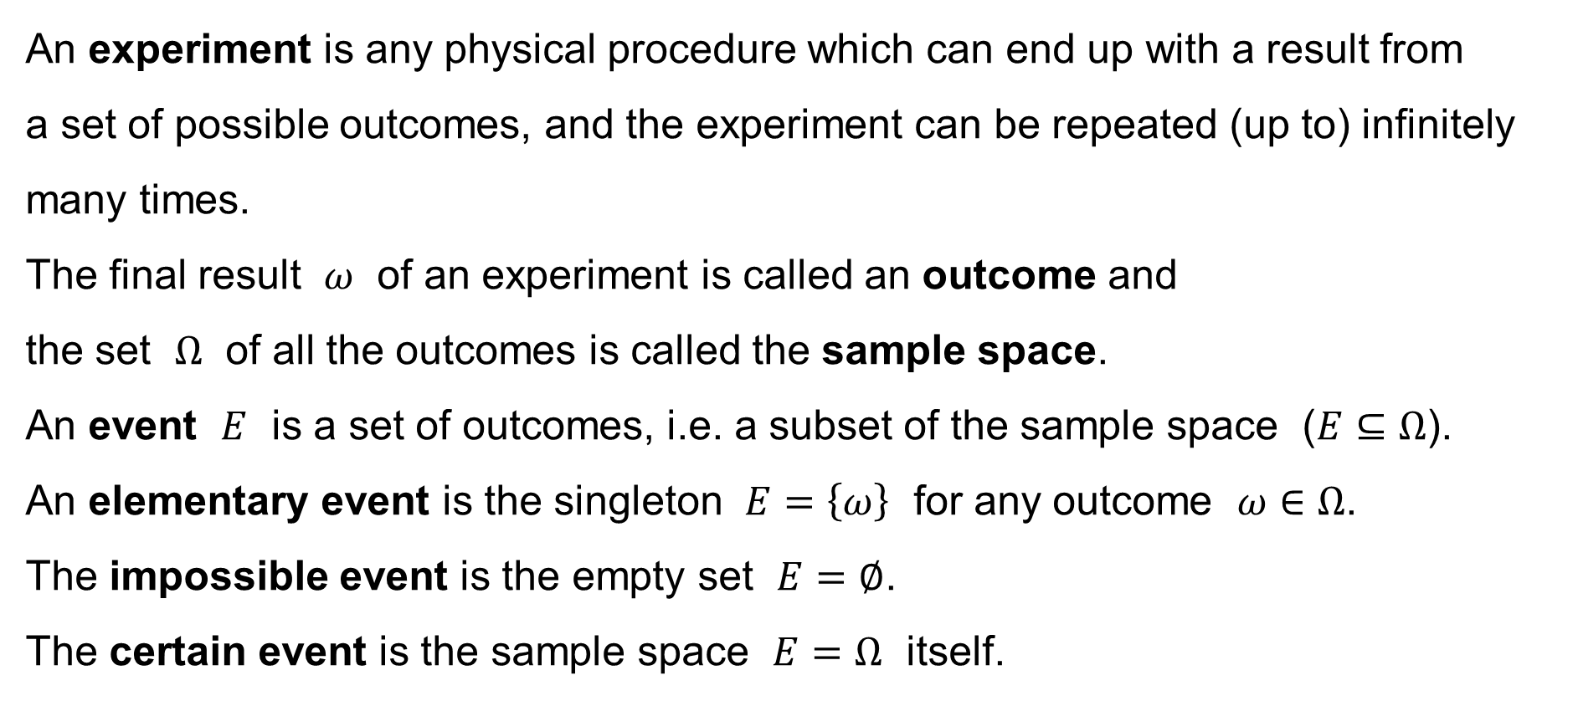
The concept of probability
An experiment is any physical procedure which can end up with a result from
a set of possible outcomes, and the experiment can be repeated (up to) infinitely many times.
The final result $ω$ of an experiment is called an outcome and
the set $Ω$ of all the outcomes is called the sample space.
An event $E$ is a set of outcomes, i.e. a subset of the sample space ($E⊆Ω$).
An elementary event is the singleton $E=\left\{ω\right\}$ for any outcome $ω∈Ω$.
The impossible event is the empty set $E=∅$.
The certain event is the sample space $E=Ω$ itself.

Slide 4
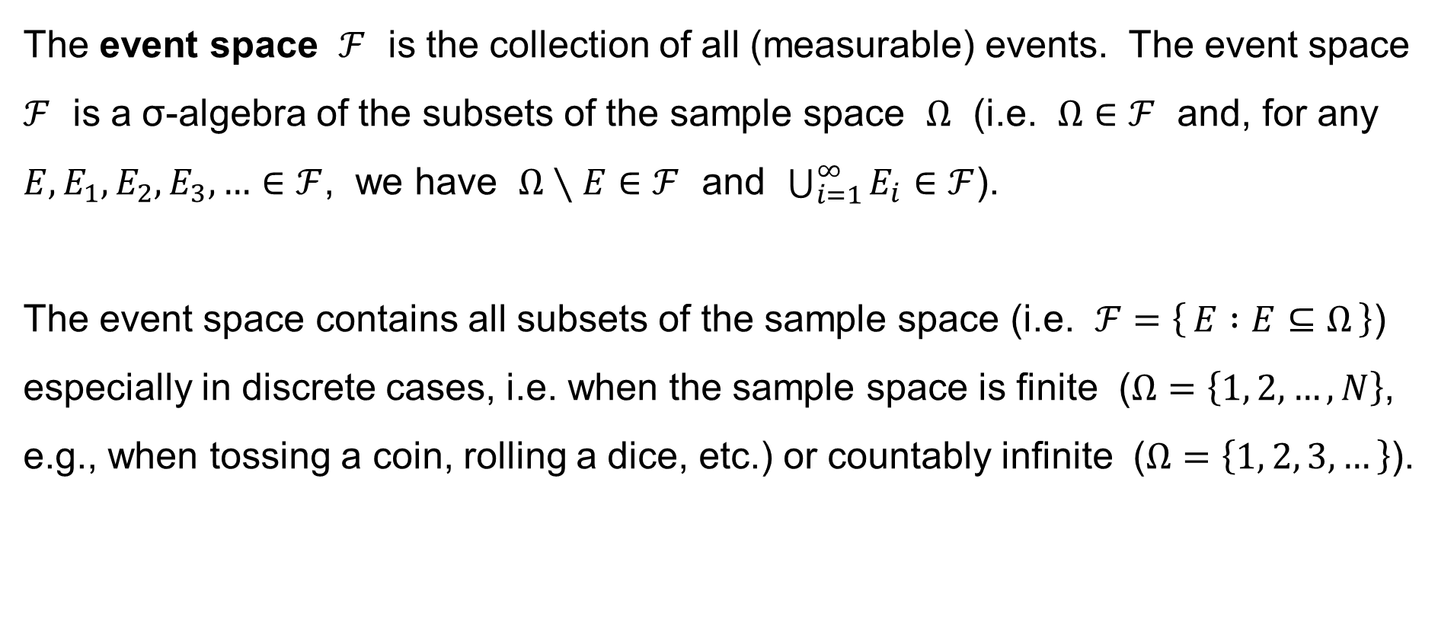
The concept of probability
The event space $ℱ$ is the collection of all (measurable) events. The event space $ℱ$ is a σ-algebra of the subsets of the sample space $Ω$ (i.e. $Ω∈ℱ$ and, for any $E,E_{1},E_{2},E_{3},…∈ℱ$, we have $Ω∖E∈ℱ$ and $\bigcup_{i=1}^{∞}{E_{i}}∈ℱ$).
The event space contains all subsets of the sample space (i.e. $ℱ=\left\{ E :E⊆Ω \right\}$) especially in discrete cases, i.e. when the sample space is finite ($Ω=\left\{1, 2,…,N\right\}$, e.g., when tossing a coin, rolling a dice, etc.) or countably infinite ($Ω=\left\{1, 2, 3,…\right\}$).

Slide 5
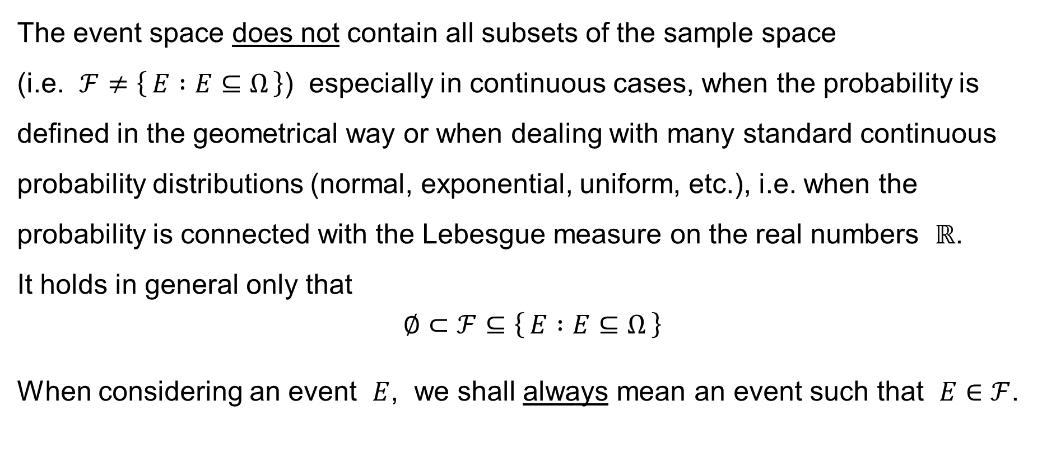
The concept of probability
The event space does not contain all subsets of the sample space
(i.e. $ℱ≠\left\{ E :E⊆Ω \right\}$) especially in continuous cases, when the probability is defined in the geometrical way or when dealing with many standard continuous probability distributions (normal, exponential, uniform, etc.), i.e. when the probability is connected with the Lebesgue measure on the real numbers $ℝ$.
It holds in general only that
$$∅⊂ℱ⊆\left\{ E :E⊆Ω \right\}$$
When considering an event $E$, we shall always mean an event such that $E∈ℱ$.

Slide 6
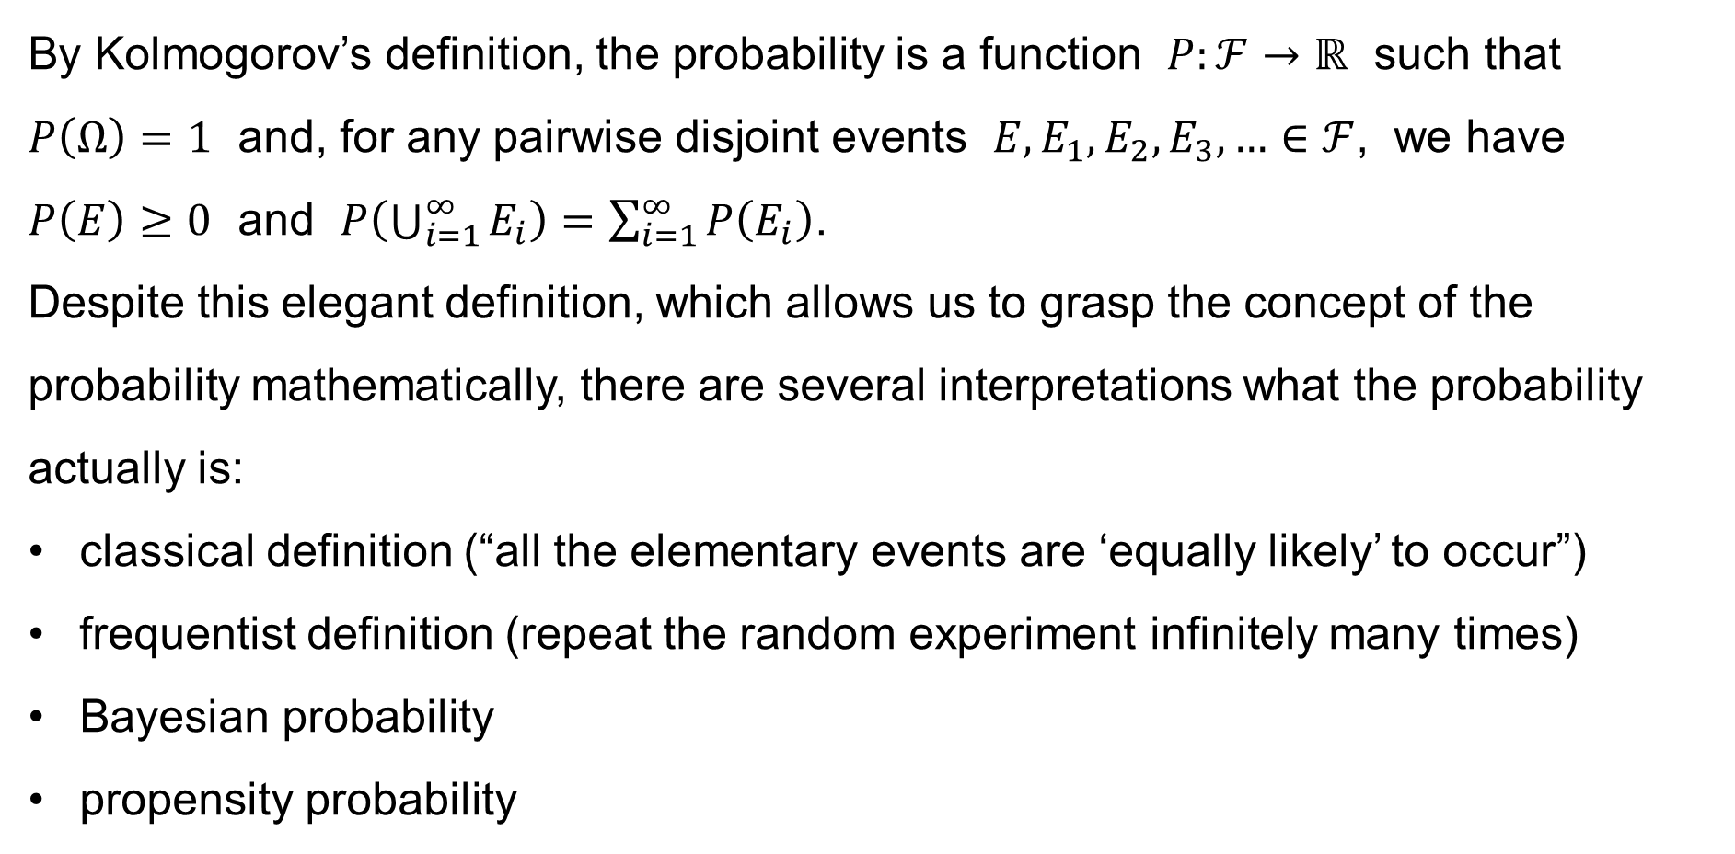
The concept of probability
By Kolmogorov’s definition, the probability is a function $P:ℱ→ℝ$ such that $P\left(Ω\right)=1$ and, for any pairwise disjoint events $E,E_{1},E_{2},E_{3},…∈ℱ$, we have $P\left(E\right)≥0$ and $P\left(\bigcup_{i=1}^{∞}{E_{i}}\right)=\sum_{i=1}^{∞}{P\left(E_{i}\right)}$.
Despite this elegant definition, which allows us to grasp the concept of the probability mathematically, there are several interpretations what the probability actually is:
classical definition (“all the elementary events are ‘equally likely’ to occur”)
frequentist definition (repeat the random experiment infinitely many times)
Bayesian probability
propensity probability

Slide 7
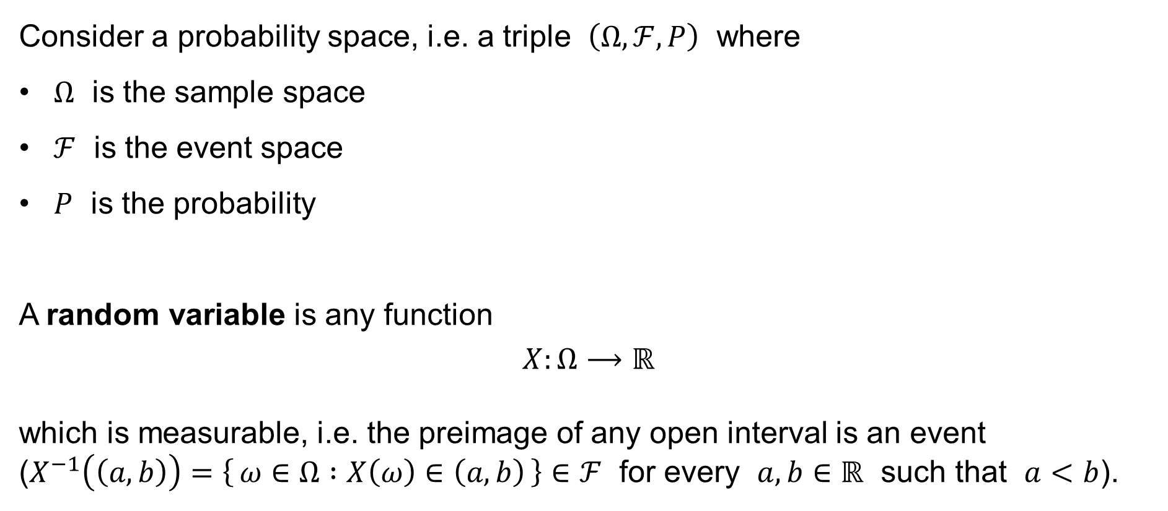
Random variable
Consider a probability space, i.e. a triple $\left(Ω,ℱ,P\right)$ where
$Ω$ is the sample space
$ℱ$ is the event space
$P$ is the probability
A random variable is any function
$$X:Ω⟶ℝ$$
which is measurable, i.e. the preimage of any open interval is an event
($X^{−1}\left(\left(a,b\right)\right)=\left\{ ω∈Ω :X\left(ω\right)∈\left(a,b\right) \right\}∈ℱ$ for every $a,b∈ℝ$ such that $a<b$).
(the set of all possible outcomes of a random experiment)
(the collection of all measurable events)
(a non-negative σ-additive function $P:ℱ→ℝ$ such that $P\left(Ω\right)=1$)

Slide 8
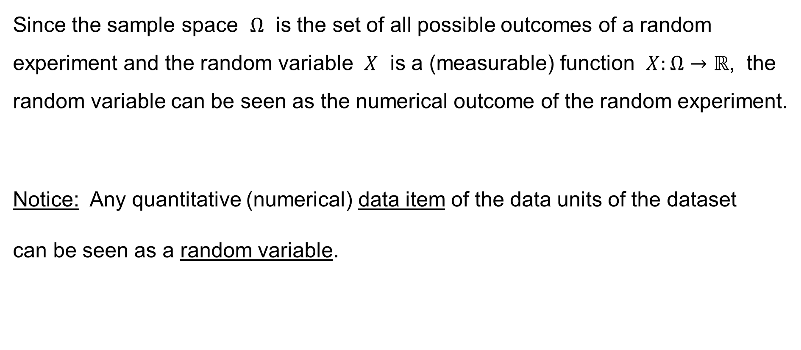
Random variable
Since the sample space $Ω$ is the set of all possible outcomes of a random experiment and the random variable $X$ is a (measurable) function $X:Ω→ℝ$, the random variable can be seen as the numerical outcome of the random experiment.
Notice: Any quantitative (numerical) data item of the data units of the dataset
can be seen as a random variable.

Slide 9
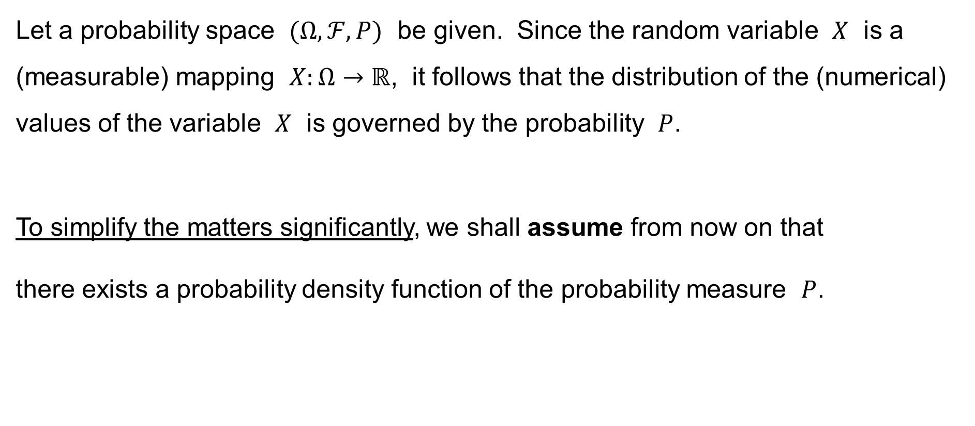
Random variable
Let a probability space $(Ω,ℱ,P)$ be given. Since the random variable $X$ is a (measurable) mapping $X:Ω→ℝ$, it follows that the distribution of the (numerical) values of the variable $X$ is governed by the probability $P$.
To simplify the matters significantly, we shall assume from now on that
there exists a probability density function of the probability measure $P$.

Slide 10
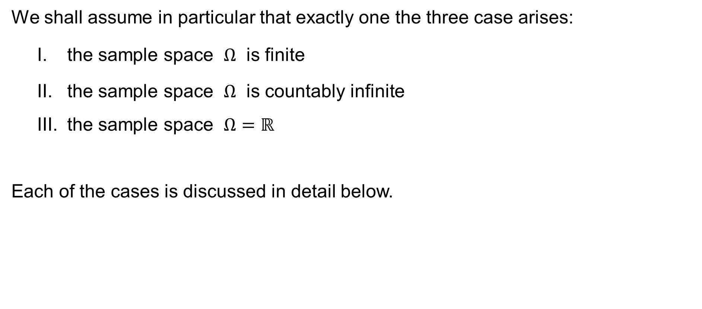
Assumptions to simplify the matters
We shall assume in particular that exactly one the three case arises:
I. the sample space $Ω$ is finite
II. the sample space $Ω$ is countably infinite
III. the sample space $Ω=ℝ$
Each of the cases is discussed in detail below.

Slide 11
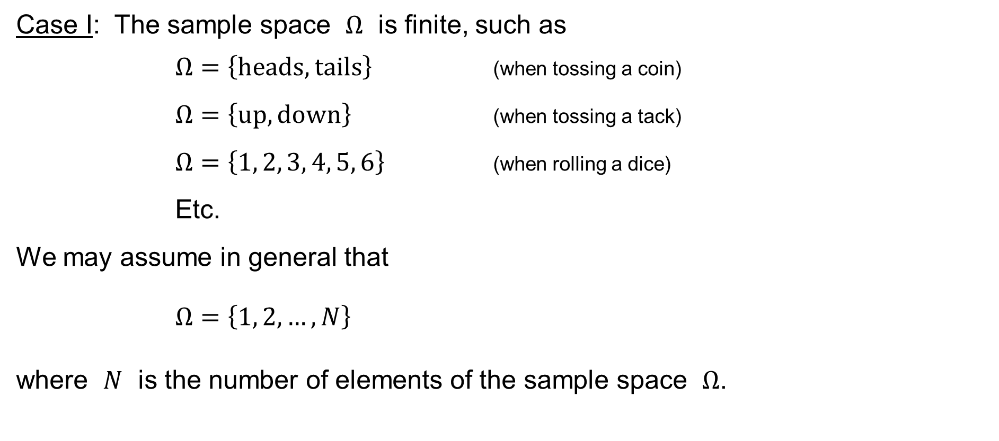
Assumptions to simplify the matters
Case I: The sample space $Ω$ is finite, such as
$Ω=\left\{\text{heads},\text{tails}\right\}$ (when tossing a coin)
$Ω=\left\{\text{up},\text{down}\right\}$ (when tossing a tack)
$Ω=\left\{1, 2, 3, 4, 5, 6\right\}$ (when rolling a dice)
Etc.
We may assume in general that
$Ω=\left\{1, 2,…,N\right\}$
where $N$ is the number of elements of the sample space $Ω$.

Slide 12
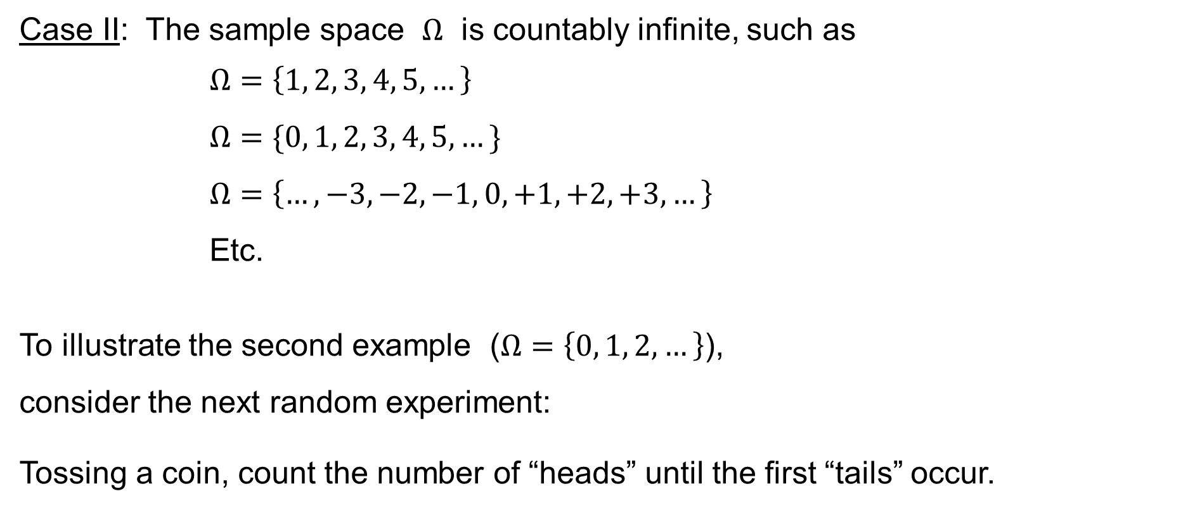
Assumptions to simplify the matters
Case II: The sample space $Ω$ is countably infinite, such as
$Ω=\left\{1, 2, 3, 4, 5,…\right\}$
$Ω=\{0, 1, 2, 3, 4, 5,…\}$
$Ω=\left\{…,−3,−2,−1, 0,+1,+2,+3,…\right\}$
Etc.
To illustrate the second example ($Ω=\left\{0, 1, 2,…\right\}$),
consider the next random experiment:
Tossing a coin, count the number of “heads” until the first “tails” occur.

Slide 13
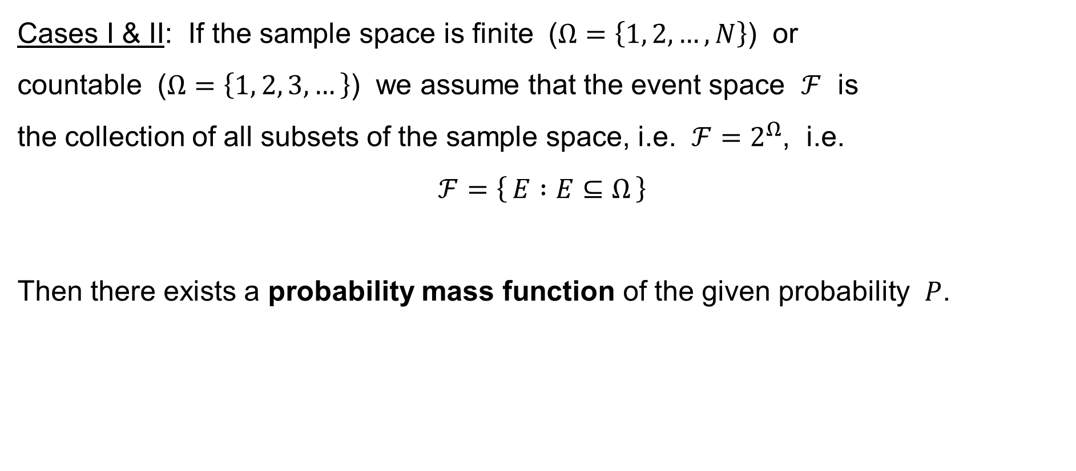
Assumptions to simplify the matters
Cases I & II: If the sample space is finite ($Ω=\left\{1, 2,…,N\right\}$) or
countable ($Ω=\left\{1, 2, 3,…\right\}$) we assume that the event space $ℱ$ is
the collection of all subsets of the sample space, i.e. $ℱ=2^{Ω}$, i.e.
$$ℱ=\left\{ E :E⊆Ω \right\}$$
Then there exists a probability mass function of the given probability $P$.

Slide 14
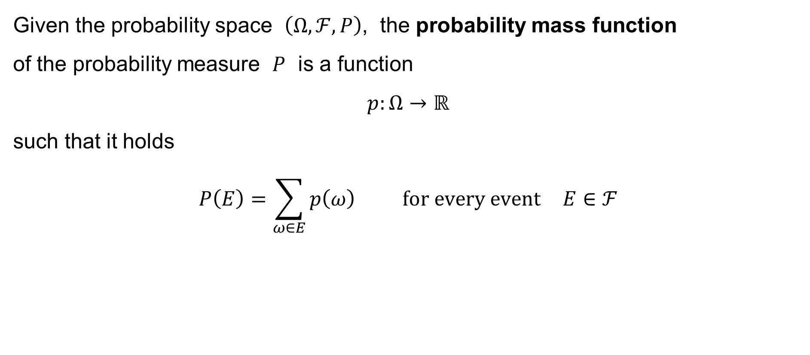
Probability mass function
Given the probability space $\left(Ω,ℱ,P\right)$, the probability mass function
of the probability measure $P$ is a function
$$p:Ω→ℝ$$
such that it holds
$$P\left(E\right)=\sum_{ω∈E}{p\left(ω\right)} \text{for} \text{every} \text{event} E∈ℱ$$

Slide 15
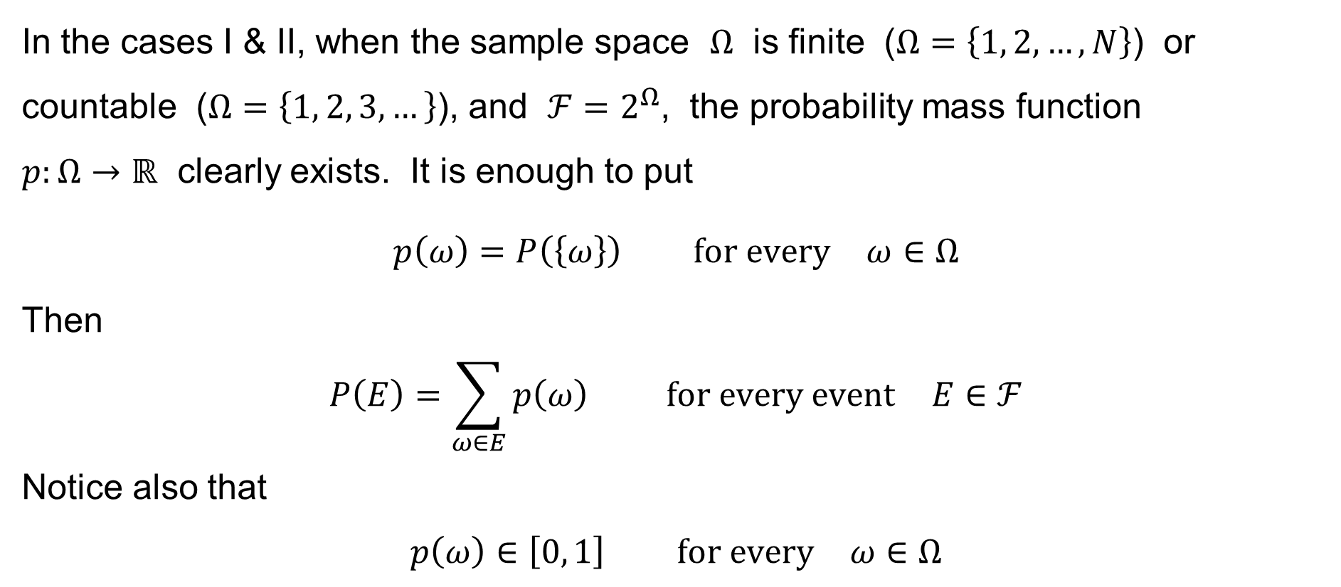
Probability mass function
In the cases I & II, when the sample space $Ω$ is finite ($Ω=\left\{1, 2,…,N\right\}$) or
countable ($Ω=\left\{1, 2, 3,…\right\}$), and $ℱ=2^{Ω}$, the probability mass function
$p:Ω→ℝ$ clearly exists. It is enough to put
$$p\left(ω\right)=P\left(\left\{ω\right\}\right) \text{for} \text{every} ω∈Ω$$
Then
$$P\left(E\right)=\sum_{ω∈E}{p\left(ω\right)} \text{for} \text{every} \text{event} E∈ℱ$$
Notice also that
$$p\left(ω\right)∈\left[0, 1\right] \text{for} \text{every} ω∈Ω$$

Slide 16
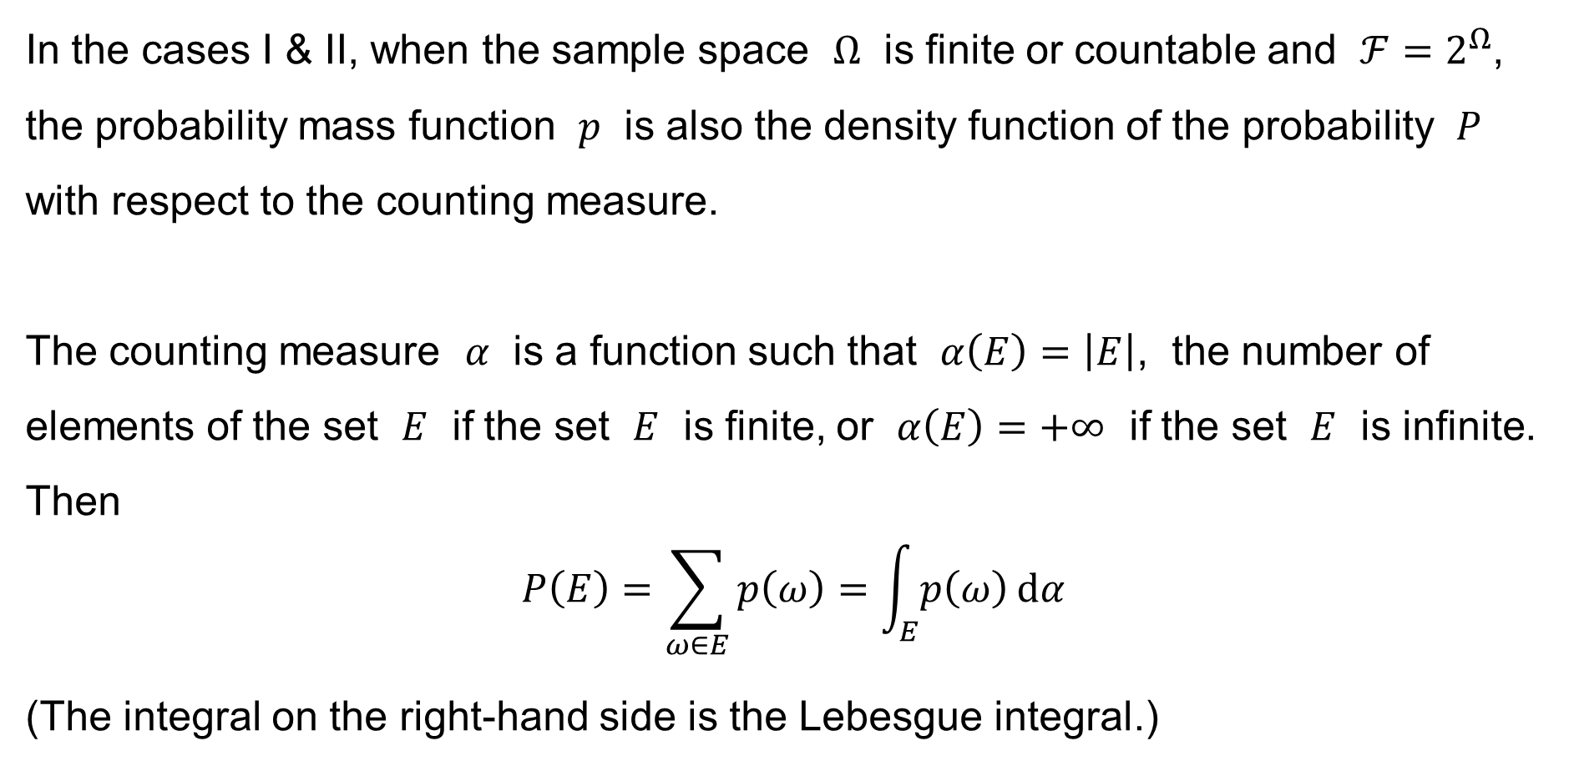
Assumptions to simplify the matters
In the cases I & II, when the sample space $Ω$ is finite or countable and $ℱ=2^{Ω}$, the probability mass function $p$ is also the density function of the probability $P$ with respect to the counting measure.
The counting measure $α$ is a function such that $α\left(E\right)=\left|E\right|$, the number of elements of the set $E$ if the set $E$ is finite, or $α\left(E\right)=+∞$ if the set $E$ is infinite.
Then
$$P\left(E\right)=\sum_{ω∈E}{p\left(ω\right)}=\int_{E}{p\left(ω\right) dα}$$
(The integral on the right-hand side is the Lebesgue integral.)

Slide 17
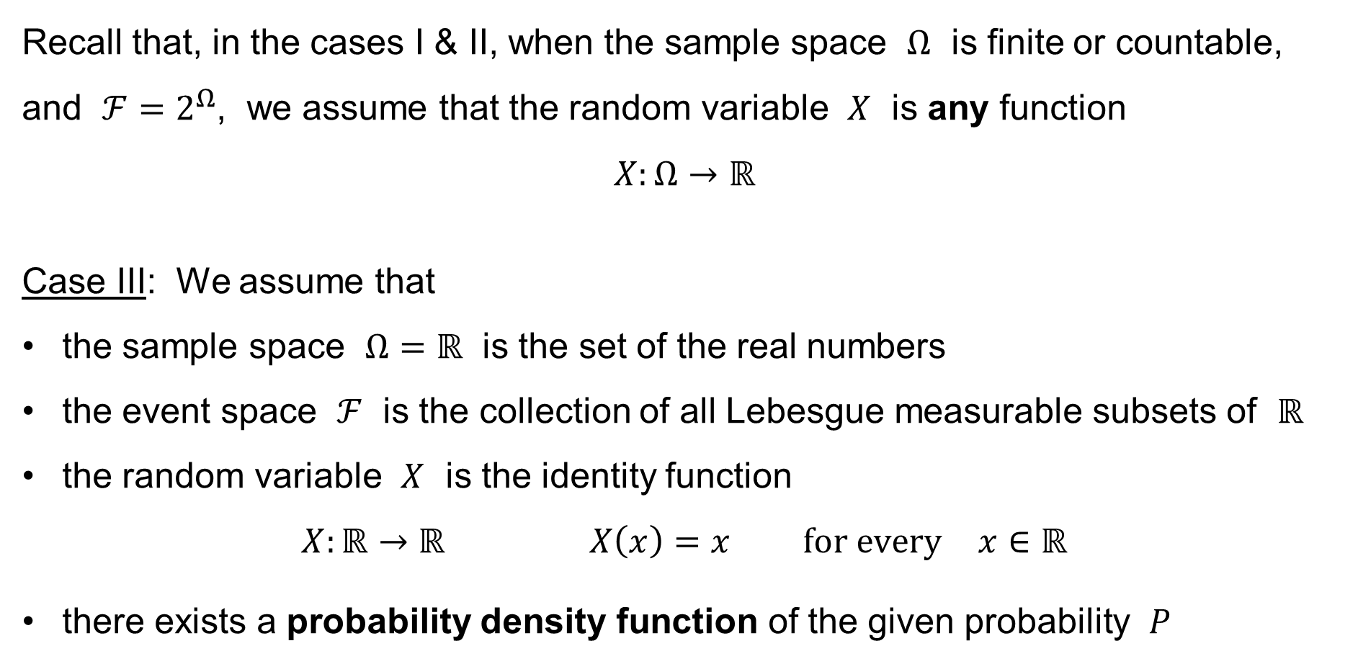
Assumptions to simplify the matters
Recall that, in the cases I & II, when the sample space $Ω$ is finite or countable,
and $ℱ=2^{Ω}$, we assume that the random variable $X$ is any function
$$X:Ω→ℝ$$
Case III: We assume that
the sample space $Ω=ℝ$ is the set of the real numbers
the event space $ℱ$ is the collection of all Lebesgue measurable subsets of $ℝ$
the random variable $X$ is the identity function
$X:ℝ→ℝ X\left(x\right)=x \text{for} \text{every} x∈ℝ$
there exists a probability density function of the given probability $P$

Slide 18
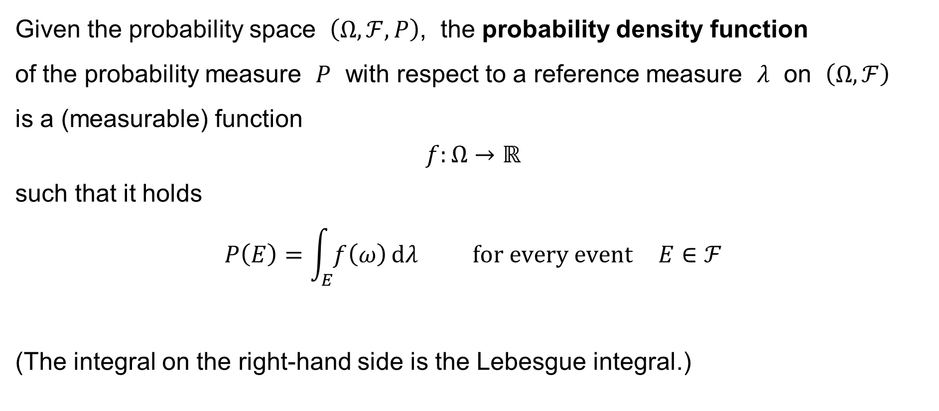
Probability density function
Given the probability space $\left(Ω,ℱ,P\right)$, the probability density function
of the probability measure $P$ with respect to a reference measure $λ$ on $\left(Ω,ℱ\right)$
is a (measurable) function
$$f:Ω→ℝ$$
such that it holds
$$P\left(E\right)=\int_{E}{f\left(ω\right) dλ} \text{for} \text{every} \text{event} E∈ℱ$$
(The integral on the right-hand side is the Lebesgue integral.)

Slide 19
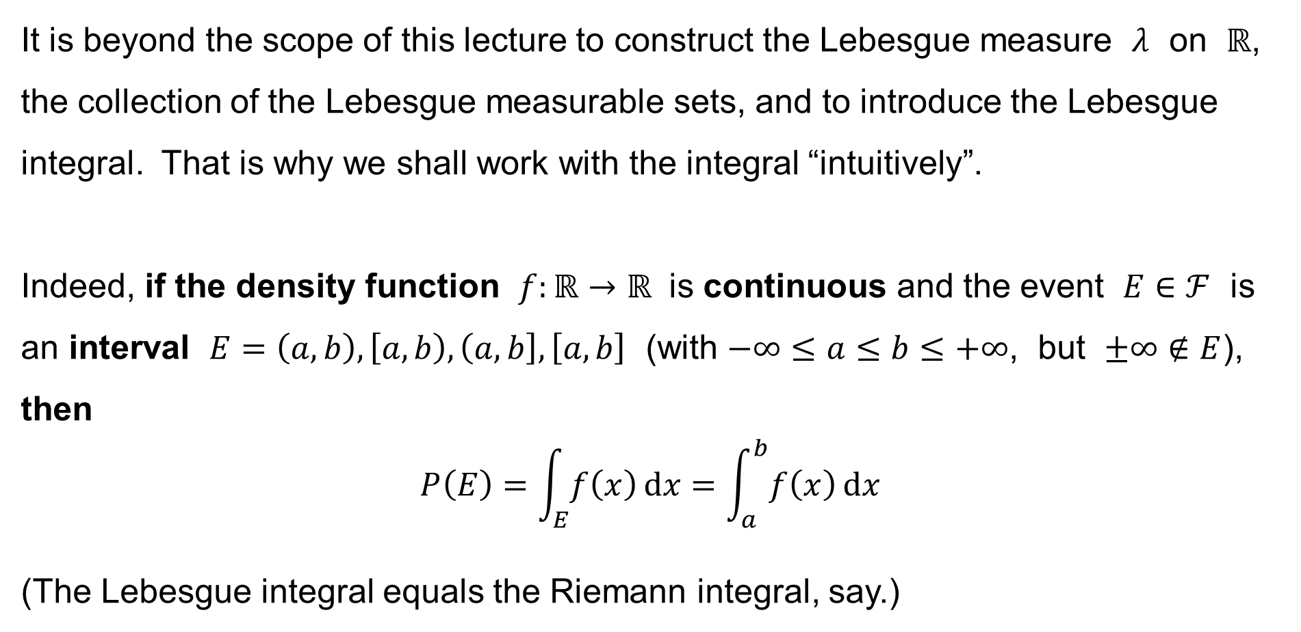
Lebesgue measure and Lebesgue integral
It is beyond the scope of this lecture to construct the Lebesgue measure $λ$ on $ℝ$,
the collection of the Lebesgue measurable sets, and to introduce the Lebesgue integral. That is why we shall work with the integral “intuitively”.
Indeed, if the density function $f:ℝ→ℝ$ is continuous and the event $E∈ℱ$ is
an interval $E=\left(a,b\right), \left[a,b\right),\left(a,b\right],\left[a,b\right]$ (with $−∞≤a≤b≤+∞$, but $±∞∉E$),
then
$$P\left(E\right)=\int_{E}{f\left(x\right) dx}=\int_{a}^{b}{f\left(x\right) dx}$$
(The Lebesgue integral equals the Riemann integral, say.)

Slide 20
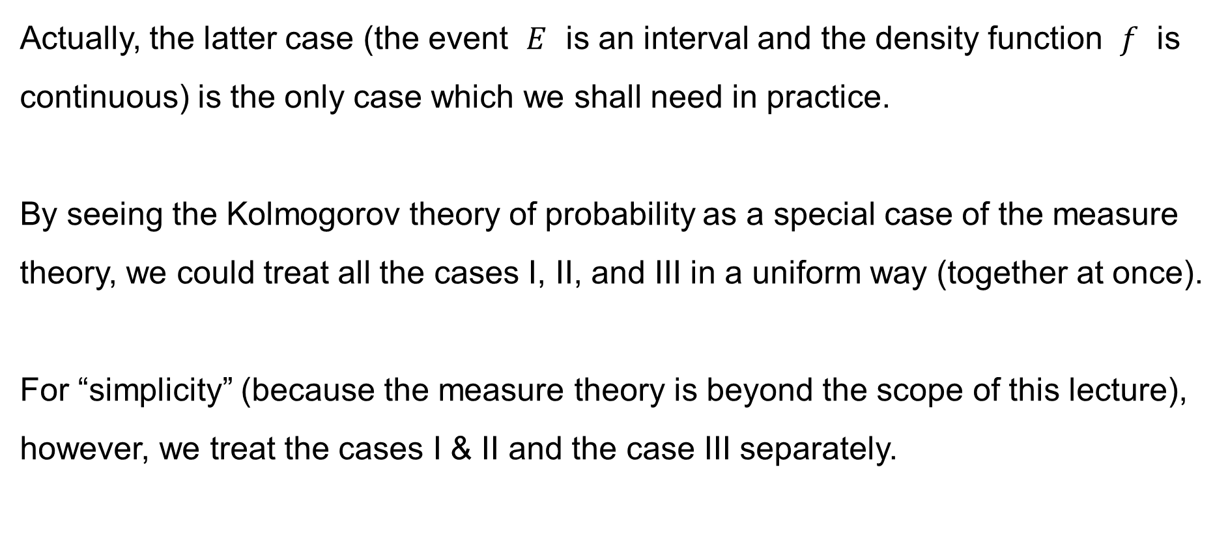
Lebesgue measure and Lebesgue integral
Actually, the latter case (the event $E$ is an interval and the density function $f$ is continuous) is the only case which we shall need in practice.
By seeing the Kolmogorov theory of probability as a special case of the measure theory, we could treat all the cases I, II, and III in a uniform way (together at once).
For “simplicity” (because the measure theory is beyond the scope of this lecture), however, we treat the cases I & II and the case III separately.

Slide 21
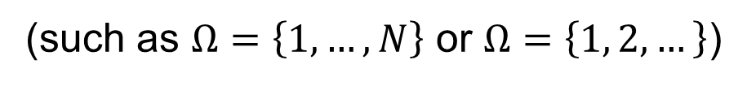
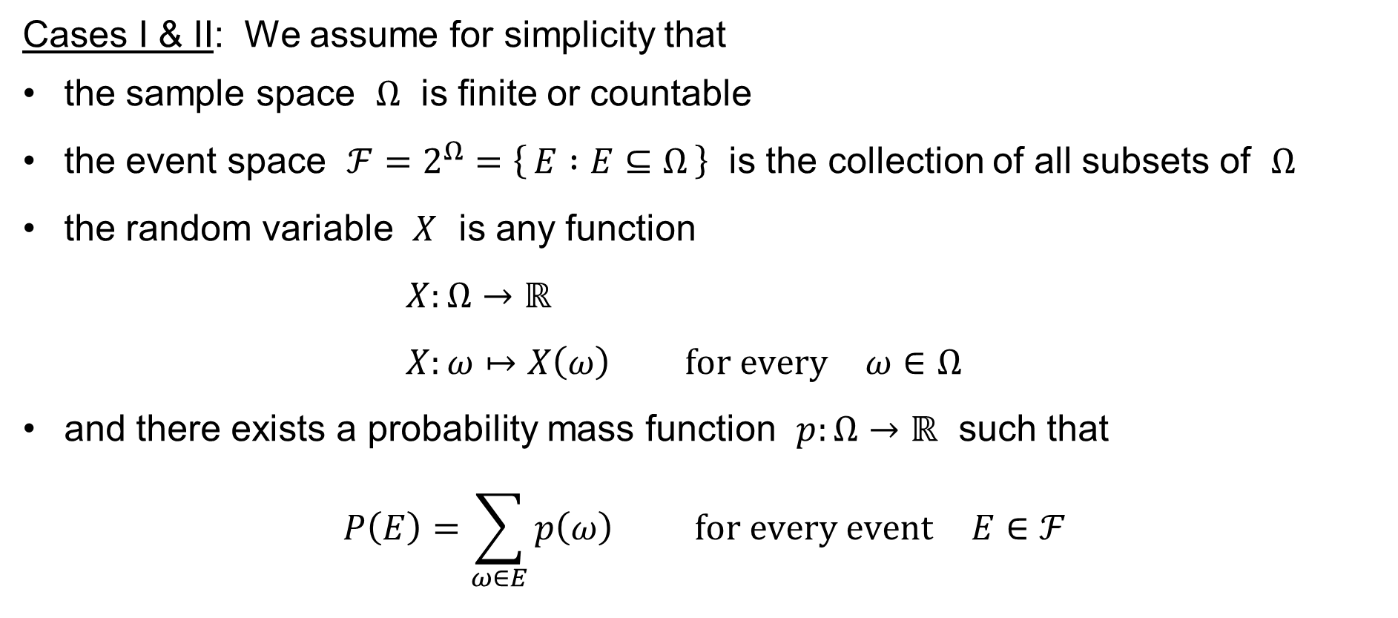
Assumptions to simplify the matters
Cases I & II: We assume for simplicity that
the sample space $Ω$ is finite or countable
the event space $ℱ=2^{Ω}=\left\{ E :E⊆Ω \right\}$ is the collection of all subsets of $Ω$
the random variable $X$ is any function
$X:Ω→ℝ$
$X:ω↦X\left(ω\right) \text{for} \text{every} ω∈Ω$
and there exists a probability mass function $p:Ω→ℝ$ such that
$$P\left(E\right)=\sum_{ω∈E}{p\left(ω\right)} \text{for} \text{every} \text{event} E∈ℱ$$
(such as $Ω=\left\{1, …,N\right\}$ or $Ω=\left\{1, 2, …\right\}$)

Slide 22
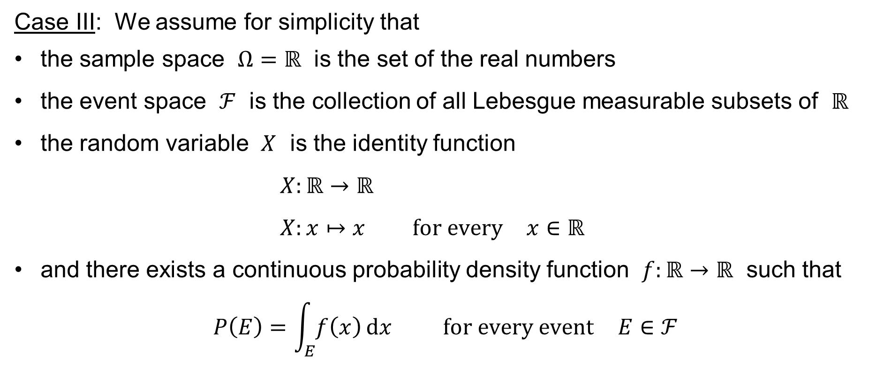
Assumptions to simplify the matters
Case III: We assume for simplicity that
the sample space $Ω=ℝ$ is the set of the real numbers
the event space $ℱ$ is the collection of all Lebesgue measurable subsets of $ℝ$
the random variable $X$ is the identity function
$X:ℝ→ℝ$
$X:x↦x \text{for} \text{every} x∈ℝ$
and there exists a continuous probability density function $f:ℝ→ℝ$ such that
$$P\left(E\right)=\int_{E}{f\left(x\right) dx} \text{for} \text{every} \text{event} E∈ℱ$$

Slide 23

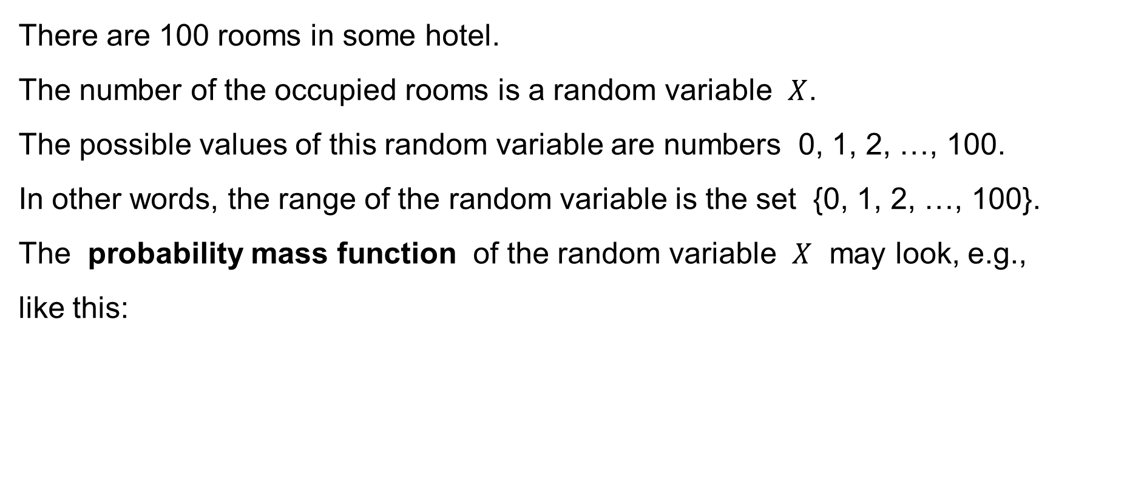

Examples of random variables
There are 100 rooms in some hotel.
The number of the occupied rooms is a random variable $X$.
The possible values of this random variable are numbers 0, 1, 2, …, 100.
In other words, the range of the random variable is the set {0, 1, 2, …, 100}.
The probability mass function of the random variable $X$ may look, e.g.,
like this:
$$p\left(n\right)$$
$$\sum_{n=0}^{100}{p\left(n\right)}=1$$
0
10
20
30
40
50
60
70
80
90
100

Slide 24

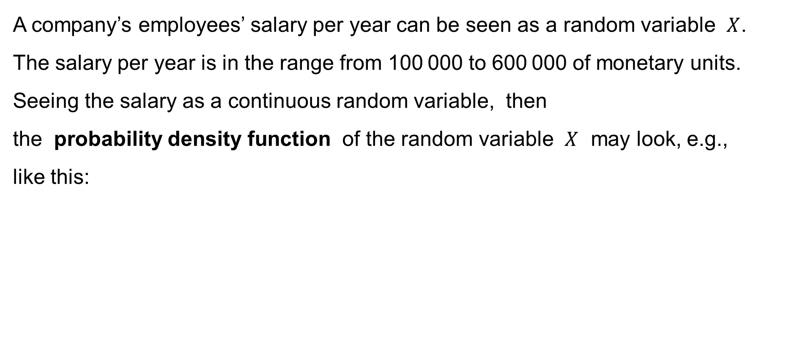
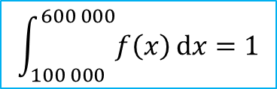
Examples of random variables
A company’s employees’ salary per year can be seen as a random variable $X$.
The salary per year is in the range from 100 000 to 600 000 of monetary units.
Seeing the salary as a continuous random variable, then
the probability density function of the random variable $X$ may look, e.g.,
like this:
$$\int_{100 000}^{600 000}{f\left(x\right) dx}=1$$
$$f\left(x\right)$$
100 000
600 000

Slide 25




Examples of random variables
The lifetime of a product (such as a bulb) is a continuous random variable $X$.
This random variable can attain any non-negative value.
The probability density function of the random variable $X$ may look, e.g.,
like this:
$$\int_{0}^{+∞}{f\left(x\right) dx}=1$$
$$f\left(x\right)$$
$$0$$
time

Slide 26

Examples of random variables
The “wheel of fortune”.
The customer rotates the wheel and, depending upon the final position, the discount of the price is deduced.

Slide 27
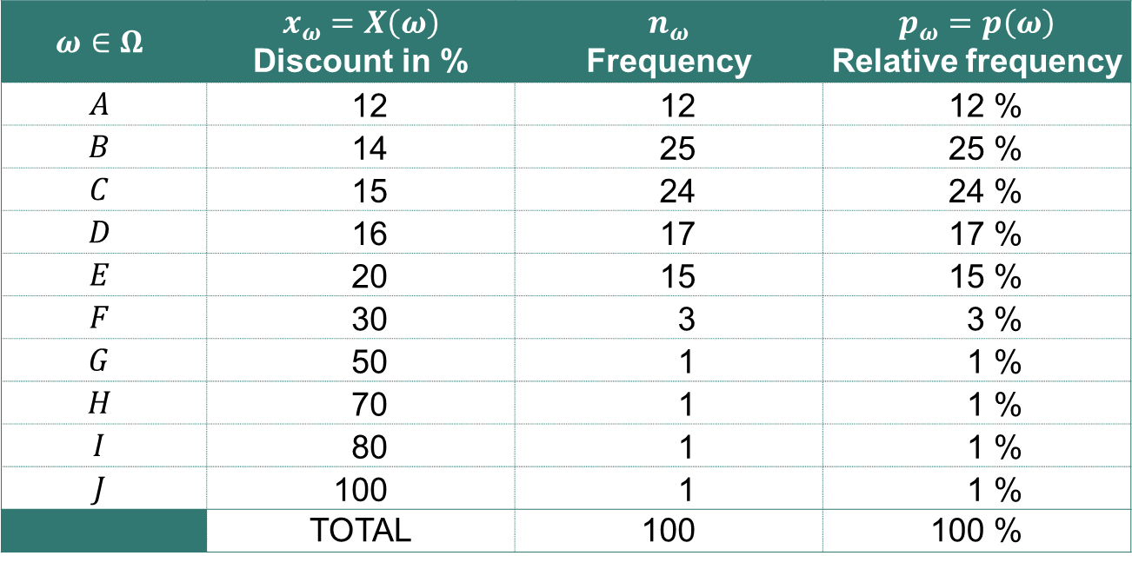

Examples of random variables
Example: The “wheel of fortune”.
The sample space: $Ω=\left\{A,B,C,D,E,F,G,H,I,J\right\}$
Table:
$$ω∈Ω$$ | $$x_{ω}=X\left(ω\right)$$ Discount in % | $$n_{ω}$$ Frequency | $$p_{ω}=p\left(ω\right)$$ Relative frequency
$$A$$ | 12 | 12 | 12 %
$$B$$ | 14 | 25 | 25 %
$$C$$ | 15 | 24 | 24 %
$$D$$ | 16 | 17 | 17 %
$$E$$ | 20 | 15 | 15 %
$$F$$ | 30 | 3 | 3 %
$$G$$ | 50 | 1 | 1 %
$$H$$ | 70 | 1 | 1 %
$$I$$ | 80 | 1 | 1 %
$$J$$ | 100 | 1 | 1 %
 | TOTAL | 100 | 100 %

Slide 28
Examples of random variables
Bar chart – the frequencies (numbers) of the ordinal data item “Discount”:
Frequency
25
25
24
20
17
15
15
12
10
5
3
1
1
1
1
0
12
14
15
16
20
30
50
70
80
100
Discount

Slide 29


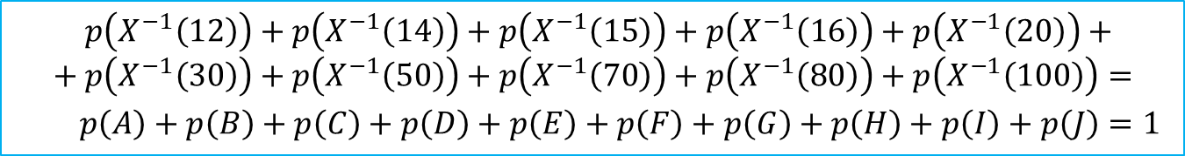
Examples of random variables
The graph of the probability mass function of the random variable $X$:
$$p\left(X^{−1}\left(12\right)\right)+p\left(X^{−1}\left(14\right)\right)+p\left(X^{−1}\left(15\right)\right)+p\left(X^{−1}\left(16\right)\right)+p\left(X^{−1}\left(20\right)\right)+ \\ + p\left(X^{−1}\left(30\right)\right)+p\left(X^{−1}\left(50\right)\right)+p\left(X^{−1}\left(70\right)\right)+p\left(X^{−1}\left(80\right)\right)+p\left(X^{−1}\left(100\right)\right)=$$
$$p\left(A\right)+p\left(B\right)+p\left(C\right)+p\left(D\right)+p\left(E\right)+p\left(F\right)+p\left(G\right)+p\left(H\right)+p\left(I\right)+p\left(J\right)=1$$
0.25
0.20
0.15
$$p\left(X^{−1}\left(d\right)\right)$$
0.10
0.05
0
Discount
0
10
20
30
40
50
60
70
80
90
100

Slide 30
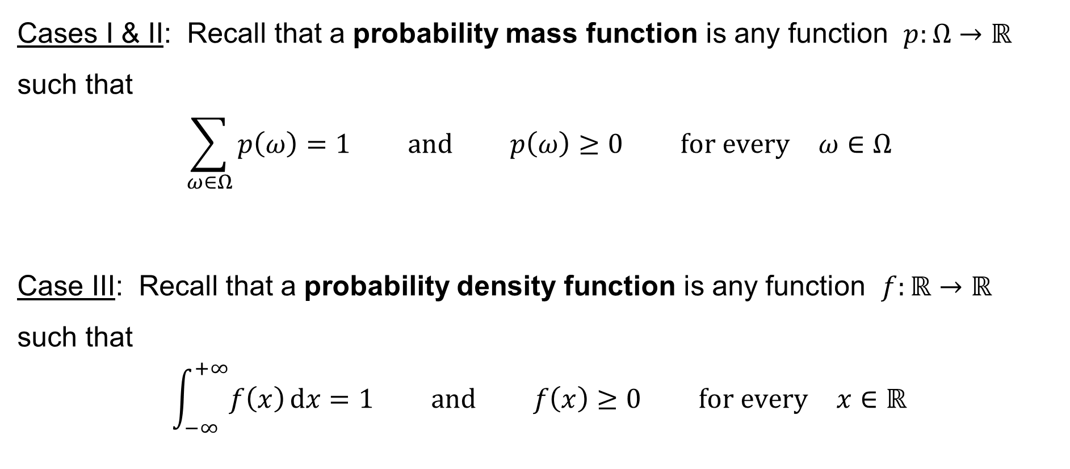
Probability mass function & Probability density function
Cases I & II: Recall that a probability mass function is any function $p:Ω→ℝ$ such that
$$\sum_{ω∈Ω}{p\left(ω\right)}=1 \text{and} p\left(ω\right)≥0 \text{for} \text{every} ω∈Ω$$
Case III: Recall that a probability density function is any function $f:ℝ→ℝ$
such that
$$\int_{−∞}^{+∞}{f\left(x\right) dx}=1 \text{and} f\left(x\right)≥0 \text{for} \text{every} x∈ℝ$$

Slide 31
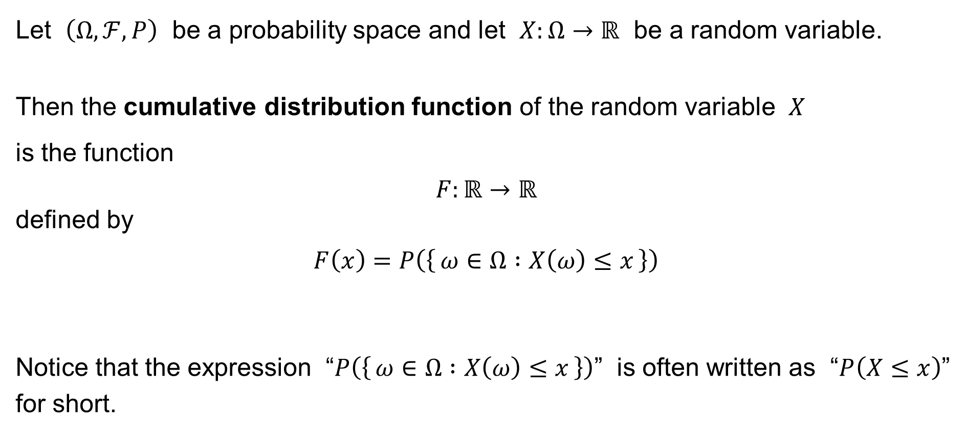
Cumulative distribution function
Let $\left(Ω,ℱ,P\right)$ be a probability space and let $X:Ω→ℝ$ be a random variable.
Then the cumulative distribution function of the random variable $X$
is the function
$$F:ℝ→ℝ$$
defined by
$$F\left(x\right)=P\left(\left\{ ω∈Ω :X\left(ω\right)≤x \right\}\right)$$
Notice that the expression “$P\left(\left\{ ω∈Ω :X\left(ω\right)≤x \right\}\right)$” is often written as “$P\left(X≤x\right)$”
for short.

Slide 32
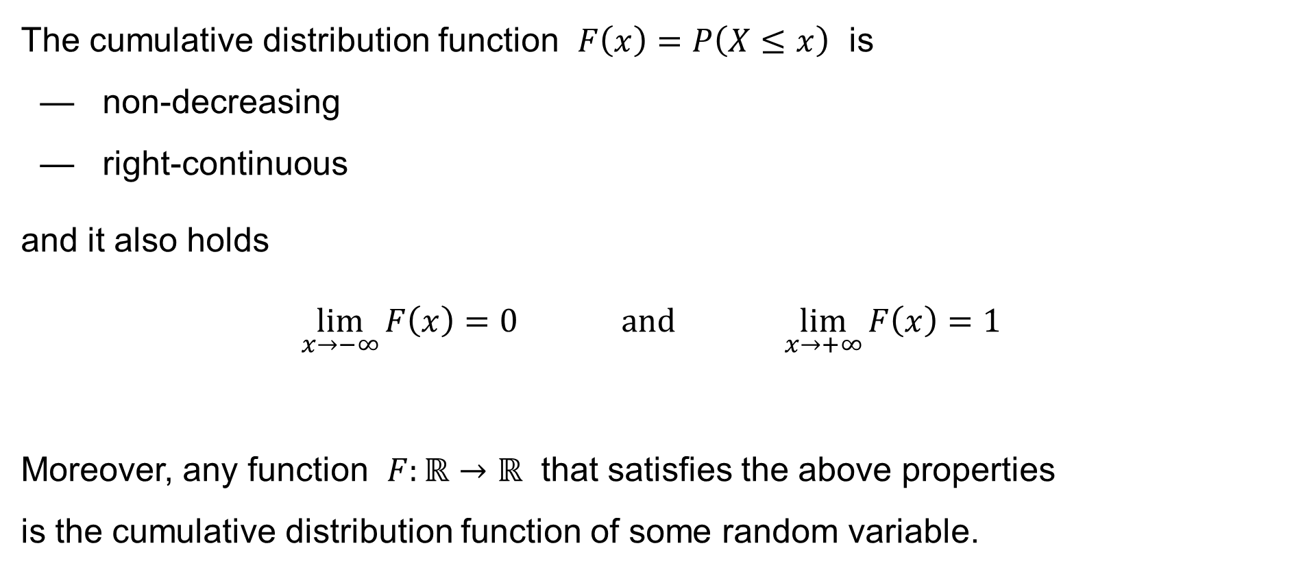
Cumulative distribution function
The cumulative distribution function $F\left(x\right)=P\left(X≤x\right)$ is
— non-decreasing
— right-continuous
and it also holds
$$\lim_{x→−∞}{F\left(x\right)}=0 \text{and} \lim_{x→+∞}{F\left(x\right)}=1$$
Moreover, any function $F:ℝ→ℝ$ that satisfies the above properties
is the cumulative distribution function of some random variable.

Slide 33

Cumulative distribution function
By the definition
$$F\left(x\right)=P\left(X≤x\right) \\ =P\left(\left\{ ω∈Ω :X\left(ω\right)≤x \right\}\right)$$
of the cumulative distribution function, it follows that
$$P\left(a<X≤b\right)= \\ P\left(\left\{ ω∈Ω :a<X\left(ω\right)≤b \right\}\right)=F\left(b\right)−F\left(a\right) \text{for} \text{every} a,b∈ℝ$$

Slide 34

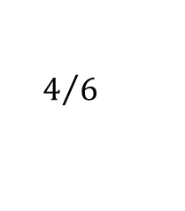


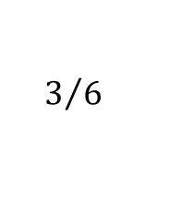




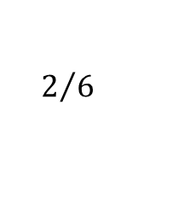


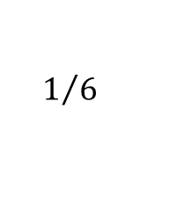


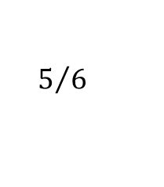
Examples of cumulative distribution functions
Example: Rolling a dice. The random variable: $X\left(x\right)=x$
The sample space: $Ω=\left\{1, 2, 3, 4, 5, 6\right\}$ The probability mass function: $p\left(x\right)=\frac{1}{6}$
The graph of the cumulative distribution function of the random variable $X$:
$$1$$
$$F\left(x\right)$$
$$5/6$$
$$4/6$$
$$3/6$$
$$2/6$$
$$1/6$$
$$0$$
$$x$$
$$1$$
$$2$$
$$3$$
$$4$$
$$5$$
$$6$$

Slide 35
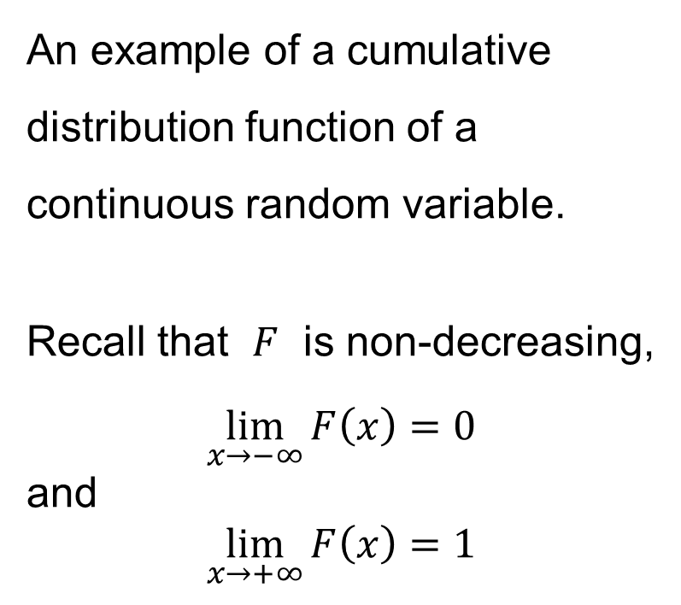
Examples of cumulative distribution functions
An example of a cumulative distribution function of a continuous random variable.
Recall that $F$ is non-decreasing,
$$\lim_{x→−∞}{F\left(x\right)}=0$$
and
$$\lim_{x→+∞}{F\left(x\right)}=1$$

Slide 36
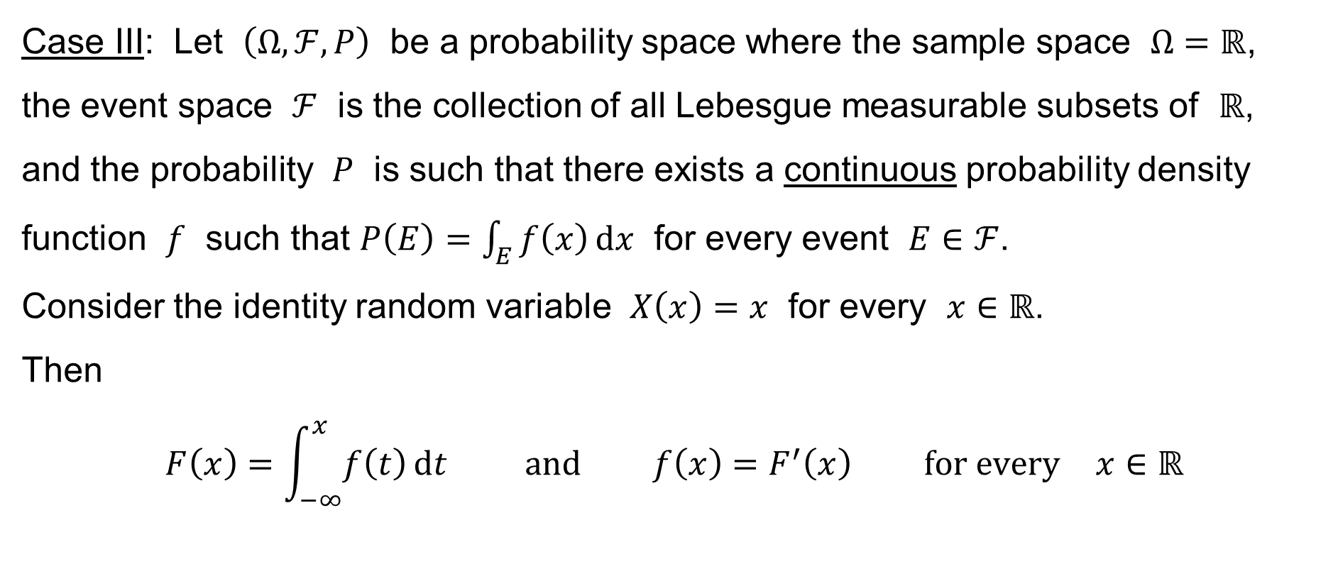
The cumulative distribution & the density function
Case III: Let $\left(Ω,ℱ,P\right)$ be a probability space where the sample space $Ω=ℝ$,
the event space $ℱ$ is the collection of all Lebesgue measurable subsets of $ℝ$, and the probability $P$ is such that there exists a continuous probability density function $f$ such that $P\left(E\right)=\int_{E}{f\left(x\right) dx}$ for every event $E∈ℱ$.
Consider the identity random variable $X\left(x\right)=x$ for every $x∈ℝ$.
Then
$$F\left(x\right)=\int_{−∞}^{x}{f\left(t\right) dt} \text{and} f\left(x\right)=F^{′}\left(x\right) \text{for} \text{every} x∈ℝ$$

Slide 37
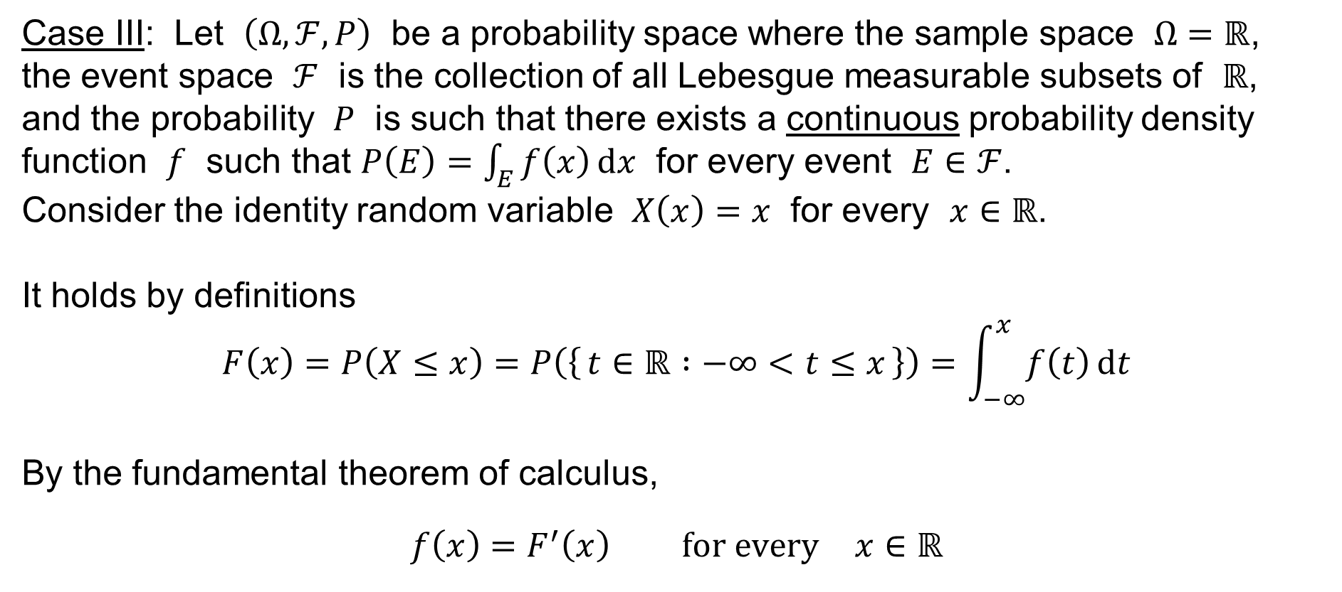
The cumulative distribution & the density function
Case III: Let $\left(Ω,ℱ,P\right)$ be a probability space where the sample space $Ω=ℝ$,
the event space $ℱ$ is the collection of all Lebesgue measurable subsets of $ℝ$, and the probability $P$ is such that there exists a continuous probability density function $f$ such that $P\left(E\right)=\int_{E}{f\left(x\right) dx}$ for every event $E∈ℱ$.
Consider the identity random variable $X\left(x\right)=x$ for every $x∈ℝ$.
It holds by definitions
$$F\left(x\right)=P\left(X≤x\right)=P\left(\left\{ t∈ℝ :−∞<t≤x \right\}\right)=\int_{−∞}^{x}{f\left(t\right) dt}$$
By the fundamental theorem of calculus,
$$f\left(x\right)=F^{′}\left(x\right) \text{for} \text{every} x∈ℝ$$

Slide 38
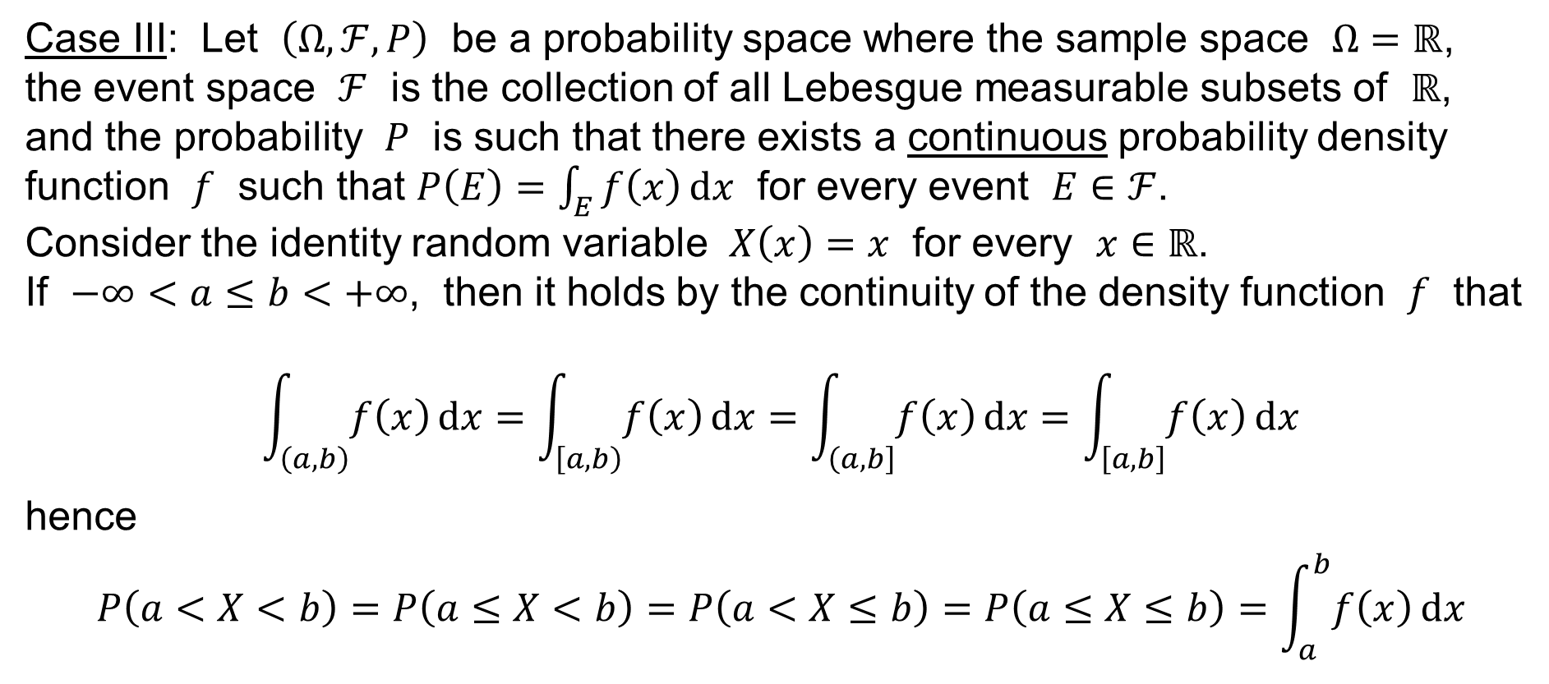
The cumulative distribution & the density function
Case III: Let $\left(Ω,ℱ,P\right)$ be a probability space where the sample space $Ω=ℝ$,
the event space $ℱ$ is the collection of all Lebesgue measurable subsets of $ℝ$, and the probability $P$ is such that there exists a continuous probability density function $f$ such that $P\left(E\right)=\int_{E}{f\left(x\right) dx}$ for every event $E∈ℱ$.
Consider the identity random variable $X\left(x\right)=x$ for every $x∈ℝ$.
If $−∞<a≤b<+∞$, then it holds by the continuity of the density function $f$ that
$$\int_{\left(a,b\right)}{f\left(x\right) dx}=\int_{\left[a,b\right)}{f\left(x\right) dx}=\int_{\left(a,b\right]}{f\left(x\right) dx}=\int_{\left[a,b\right]}{f\left(x\right) dx}$$
hence
$$P\left(a<X<b\right)=P\left(a≤X<b\right)=P\left(a<X≤b\right)=P\left(a≤X≤b\right)=\int_{a}^{b}{f\left(x\right) dx}$$

Slide 39


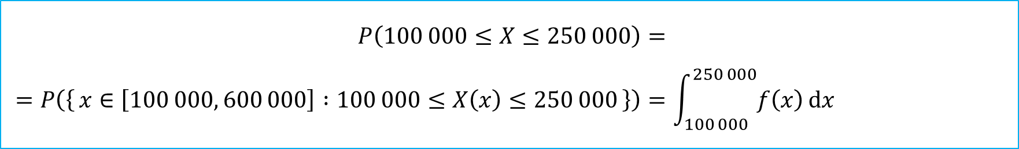
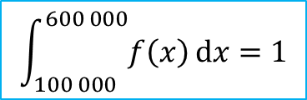
The probability of an event
Let the probability density function of a random variable $X$
(the employees’ salary per year) look like this:
$$\int_{100 000}^{600 000}{f\left(x\right) dx}=1$$
$$f\left(x\right)$$
100 000
250 000
600 000
Then the probability the salary of an employee is in the range from 100000 to 250 000, say, is:
$$P\left(100 000≤X≤250 000\right)= \\ =P\left(\left\{ x∈\left[100 000, 600 000\right] :100 000≤X\left(x\right)≤250 000 \right\}\right)=\int_{100 000}^{250 000}{f\left(x\right) dx}$$

Slide 40
Measures of central tendency
Mean / Expected value
Mode
Quantile
Median
Quartiles
Deciles
Centiles

Slide 41

The mean / expected value
The expected value (or the mean value) of the random variable $X$ is denoted by
$$μ \text{or} E\left[X\right]$$
Cases I & II:
$$μ=E\left[X\right]=\sum_{ω∈Ω}{X\left(ω\right)p\left(ω\right)}$$
Case III:
$$μ=E\left[X\right]=\int_{−∞}^{+∞}{xf\left(x\right) dx}$$

Slide 42
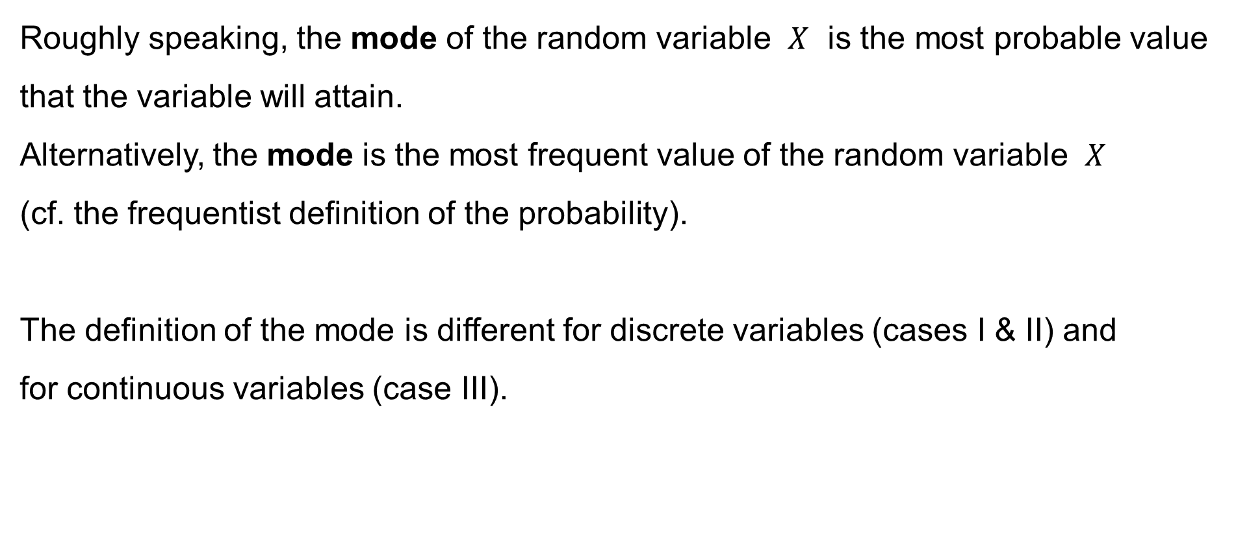
The mode
Roughly speaking, the mode of the random variable $X$ is the most probable value that the variable will attain.
Alternatively, the mode is the most frequent value of the random variable $X$
(cf. the frequentist definition of the probability).
The definition of the mode is different for discrete variables (cases I & II) and
for continuous variables (case III).

Slide 43
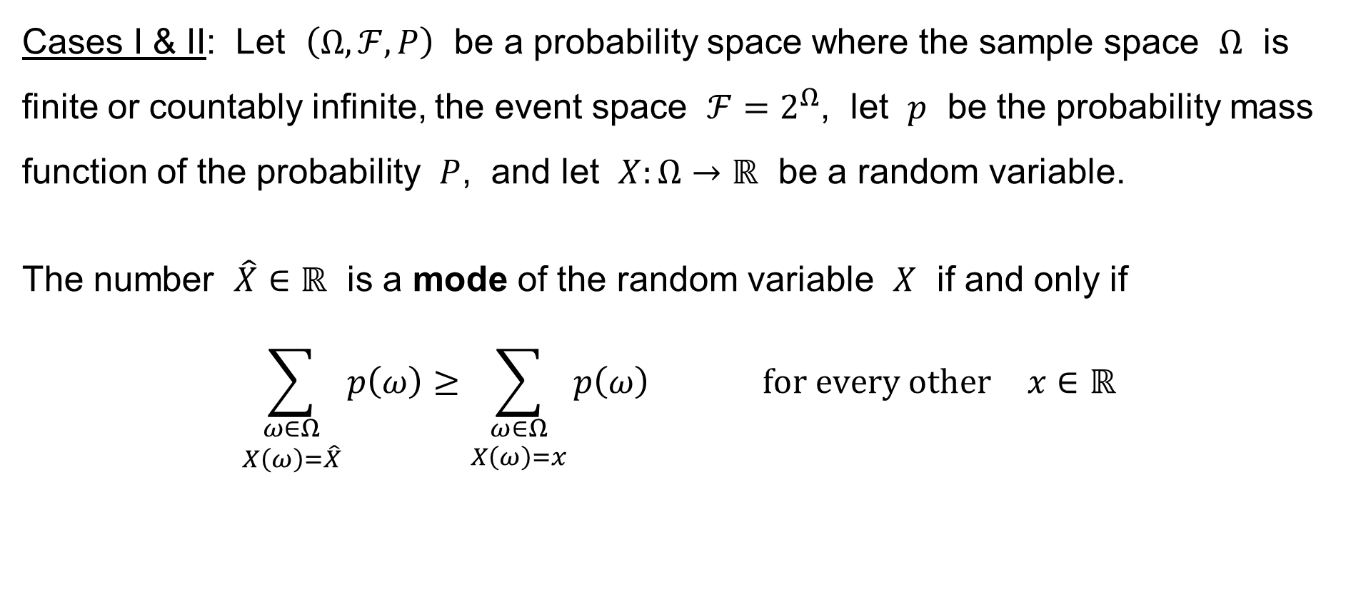
The mode
Cases I & II: Let $\left(Ω,ℱ,P\right)$ be a probability space where the sample space $Ω$ is finite or countably infinite, the event space $ℱ=2^{Ω}$, let $p$ be the probability mass function of the probability $P$, and let $X:Ω→ℝ$ be a random variable.
The number $\hat{X}∈ℝ$ is a mode of the random variable $X$ if and only if
$$\sum_{\begin{aligned}ω∈Ω \\ X\left(ω\right)=\hat{X}\end{aligned}}{p\left(ω\right)}≥\sum_{\begin{aligned}ω∈Ω \\ X\left(ω\right)=x\end{aligned}}{p\left(ω\right)} \text{for} \text{every} \text{other} x∈ℝ$$

Slide 44

The mode
The graph of the probability mass function of the random variable $X$:
0.25
Mode: $\hat{X}=14$
0.20
0.15
$$p\left(X^{−1}\left(d\right)\right)$$
0.10
0.05
0
Discount
0
10
14
20
30
40
50
60
70
80
90
100

Slide 45



The mode
Example: Some example with some probability mass function.
The sample space: $Ω=\left\{1, 2, 3, 4, 5, 6\right\}$ The random variable: $X\left(x\right)=x$
Mode: $\hat{X}=4$
$$p\left(n\right)$$
0
1
2
3
4
5
6
7
8
9
10

Slide 46

The mode
Example: Some example with some probability mass function.
The sample space: $Ω=\left\{1, 2, 3, 4, 5, 6\right\}$ The random variable: $X\left(x\right)=x$
Modes: $\hat{X}=1, 4, 6$
$$p\left(n\right)$$
0
1
2
3
4
5
6
7
8
9
10

Slide 47


The mode
Example: Rolling a dice. The random variable: $X\left(x\right)=x$
The sample space: $Ω=\left\{1, 2, 3, 4, 5, 6\right\}$ The probability mass function: $p\left(x\right)=\frac{1}{6}$
Modes: $\hat{X}=1, 2, 3, 4, 5, 6$
$$p\left(n\right)$$
0
1
2
3
4
5
6
7
8
9
10

Slide 48

The mode
Case III: Let $\left(Ω,ℱ,P\right)$ be a probability space where the sample space $Ω=ℝ$,
the event space $ℱ$ is the collection of all Lebesgue measurable subsets of $ℝ$,
let $f$ be the probability density function of the probability $P$, assume that $f$ is continuous, and let $X\left(x\right)=x$ for every $x∈ℝ$.
The number $\hat{X}∈ℝ$ is a mode of the random variable $X$ if and only if
there is a local maximum of the density function $f$ at the point $\hat{X}$

Slide 49

The mode
The mode is any point at which the density function $f\left(x\right)$ attains its local maximum.

Slide 50

The mode
If the random variable is discrete (i.e. there is a probability mass function of the given probability measure $P$) or the random variable is continuous and there is
a continuous probability density function of the given probability $P$, then there exists at least one mode of the random variable $X$.
In other words, under our assumptions (cases I & II or III), at least one mode
of the random variable $X$ exists.

Slide 51

The mode
Remarks:
If the random variable is continuous, but the probability density function of the given probability $P$ is not continuous, then the mode of the random variable may not exist.
If the random variable is continuous and there exists no probability density function of the given probability $P$, then the mode of the random variable can not be defined at all !

Slide 52
The mode
Remarks:
There may exist more than one mode.
The probability distribution is termed:
— unimodal, if there is exactly one mode
— bimodal, if there are exactly two modes
— etc.
— multimodal, if there are several modes

Slide 53

Quantile
Let $\left(Ω,ℱ,P\right)$ be any probability space and let $X:Ω→ℝ$ be any random variable.
Then the quantile corresponding to a given probability $p∈\left[0, 1\right]$ with respect to the cumulative distribution function $F\left(x\right)=P\left(X≤x\right)$ of the random variable $X$
is the value $x_{p}∈ℝ$ such that
$$P\left(X<x_{p}\right)≤p≤P\left(X≤x_{p}\right)$$
Since the cumulative distribution function $F\left(x\right)=P\left(X≤x\right)$ of the random
variable $X$ is right-continuous, it is equivalent to say that the quantile is
the least value $x_{p}∈ℝ$ such that
$$p≤P\left(X≤x_{p}\right)$$

Slide 54

Quantile
Let $\left(Ω,ℱ,P\right)$ be any probability space and let $X:Ω→ℝ$ be any random variable.
If the cumulative distribution function $F\left(x\right)=P\left(X≤x\right)$ of the random variable $X$
is continuous and strictly monotonically increasing, then the quantile is the value $x_{p}∈ℝ$ such that
$$P\left(X≤x_{p}\right)=p$$
i.e.
$$x_{p}=F^{−1}\left(p\right)$$
where $F^{−1}$ is the function inverse to the cumulative distribution function $F$.

Slide 55






Quantile
$$1$$
$$F\left(x\right)$$
$$p$$
$$0$$
$$x_{p}=F^{−1}\left(p\right)$$
$$x$$

Slide 56

Median
Let $\left(Ω,ℱ,P\right)$ be any probability space and let $X:Ω→ℝ$ be any random variable.
Then the median with respect to the cumulative distribution function
$F\left(x\right)=P\left(X≤x\right)$ of the random variable $X$ is the quantile corresponding
to the probability $p=0.5$, i.e. the value $\tilde{X}=x_{0.5}∈ℝ$ such that
$$P\left(X<x_{0.5}\right)≤\frac{1}{2}≤P\left(X≤x_{0.5}\right)$$

Slide 57

Quartiles
Let $\left(Ω,ℱ,P\right)$ be any probability space and let $X:Ω→ℝ$ be any random variable.
There are three quartiles with respect to the cumulative distribution function
$F\left(x\right)=P\left(X≤x\right)$ of the random variable $X$. The quartiles are:
$Q_{1}=x_{0.25}$ … the first quartile or the lower quartile
… it is the quantile corresponding to the probability $p=0.25$
$Q_{2}=x_{0.5}$ … the second quartile or the median
… it is the quantile corresponding to the probability $p=0.5$
$Q_{1}=x_{0.75}$ … the third quartile or the upper quartile
… it is the quantile corresponding to the probability $p=0.75$

Slide 58

Quartiles
Notice that the difference
$$IQR=Q_{3}−Q_{1}$$
is also called the interquartile range, the “midspread” or the “middle fifty”.

Slide 59
Median & Quartiles
lower quartile
upper quartile

Slide 60

Deciles
Let $\left(Ω,ℱ,P\right)$ be any probability space and let $X:Ω→ℝ$ be any random variable.
There are nine deciles with respect to the cumulative distribution function
$F\left(x\right)=P\left(X≤x\right)$ of the random variable $X$. The deciles are:
$D_{1}=x_{0.1}$ $D_{4}=x_{0.4}$ $D_{7}=x_{0.7}$
$D_{2}=x_{0.2}$ $D_{5}=x_{0.5}$ $D_{8}=x_{0.8}$
$D_{3}=x_{0.3}$ $D_{6}=x_{0.6}$ $D_{9}=x_{0.9}$
The fifth decile ($D_{5}=x_{0.5}$) is the median.

Slide 61

Centiles
Let $\left(Ω,ℱ,P\right)$ be any probability space and let $X:Ω→ℝ$ be any random variable.
There are ninety nine centiles with respect to the cumulative distribution function
$F\left(x\right)=P\left(X≤x\right)$ of the random variable $X$. The centiles are:
$C_{1}=x_{0.01}$ $…$ $C_{97}=x_{0.97}$
$C_{2}=x_{0.02}$ $C_{50}=x_{0.5}$ $C_{98}=x_{0.98}$
$C_{3}=x_{0.03}$ $…$ $C_{99}=x_{0.99}$
The fiftieth centile ($C_{50}=x_{0.5}$) is the median. The twenty fifth centile and
the seventy fifth centile ($C_{25}=x_{0.25}$ and $C_{75}=x_{0.75}$) is the lower quartile
and the upper quartile, respectively.

Slide 62

Mode & Mean & Median may differ
Example: The probability density function of a random variable is
$$f\left(x\right)=\left\{\begin{aligned}\frac{3}{x^{4}}&, x≥1 \\ 0&, x<1\end{aligned}\right.$$
Observe that $\int_{−∞}^{+∞}{f\left(x\right) dx}={\left[−\frac{1}{x^{3}}\right]}_{1}^{+∞}=0+1=1$
Mode: $\hat{X}=1$
Median: $\int_{−∞}^{\tilde{X}}{f\left(x\right) dx}={\left[−\frac{1}{x^{3}}\right]}_{1}^{\tilde{X}}=−\frac{1}{{\tilde{X}}^{3}}+1=\frac{1}{2}$ $⟶$ $\tilde{X}=\sqrt[3]{2}$
Expected value: $E\left[X\right]=\int_{−∞}^{+∞}{xf\left(x\right) dx}={\left[−\frac{3}{2x^{2}}\right]}_{1}^{+∞}=0+\frac{3}{2}=\frac{3}{2}=1.5$
Mod(X)=
E(X)
Med(X)

Slide 63
Measures of dispersion
Variance
Standard deviation

Slide 64

Variance
Let $\left(Ω,ℱ,P\right)$ be any probability space and let $X:Ω→ℝ$ be any random variable.
Assume that the expected value $E\left[X\right]$ of the random variable $X$ exists.
Notice that the sum $E\left[X\right]=\sum_{ω∈Ω}{X\left(ω\right)p\left(ω\right)}$ (in the case II) or the integral
$E\left[X\right]=\int_{−∞}^{+∞}{xf\left(x\right) dx}$ (in the case III) may diverge, i.e. either not exist at all or
exist but diverge to the value $+∞$ or $−∞$.

Slide 65

Variance
Let $\left(Ω,ℱ,P\right)$ be any probability space and let $X:Ω→ℝ$ be any random variable.
Assuming that the expected value $E\left[X\right]$ exists and is finite,
the variance $Var\left(X\right)$ of the random variable $X$ is
$$Var\left(X\right)=E\left[{\left(X−E\left[X\right]\right)}^{2}\right]$$

Slide 66

Variance
Cases I & II:
$$σ^{2}=Var\left(X\right)=\sum_{ω∈Ω}{{\left(X\left(ω\right)−E\left[X\right]\right)}^{2}p\left(ω\right)}$$
Case III:
$$σ^{2}=Var\left(X\right)=\int_{−∞}^{+∞}{{\left(x−E\left[X\right]\right)}^{2}f\left(x\right) dx}$$
Notice that (even if we assume that $E\left[X\right]$ exists and is finite),
the variance may be infinite ($Var\left(X\right)=+∞$) sometimes.

Slide 67

Variance
Let $\left(Ω,ℱ,P\right)$ be any probability space.
Let $X:Ω→ℝ$ and $Y:Ω→ℝ$ be two random variables.
Considering the definition of the expected value (see above) and
by the properties of the sum or the integral, the following equations
are easy to see under the assumption that both $E\left[X\right]$ and $E\left[Y\right]$ are finite:
$$E\left[X+Y\right]=E\left[X\right]+E\left[Y\right] \\ E\left[cX\right]=cE\left[X\right] \text{for} \text{every} c∈ℝ$$

Slide 68

Variance
The next formula holds if $E\left[X\right]$ exists and is finite:
$$Var\left(X\right)=E\left[{\left(X−E\left[X\right]\right)}^{2}\right] \\ =E\left[X^{2}−2XE\left[X\right]+{\left(E\left[X\right]\right)}^{2}\right] \\ =E\left[X^{2}\right]−E\left[2XE\left[X\right]\right]+{\left(E\left[X\right]\right)}^{2} \\ =E\left[X^{2}\right]−2\left(E\left[X\right]\right)\left(E\left[X\right]\right)+{\left(E\left[X\right]\right)}^{2} \\ =E\left[X^{2}\right]−{\left(E\left[X\right]\right)}^{2}$$
Remark: The formula may be useful in the case I to compute the variance efficiently: $Var\left(X\right)=\sum_{ω∈Ω}{X^{2}\left(ω\right)p\left(ω\right)}−{\left(\sum_{ω∈Ω}{X\left(ω\right)p\left(ω\right)}\right)}^{2}$.
¡¡¡ When doing it, beware of the catastrophic cancellation !!!

Slide 69

Standard deviation
The standard deviation is the square root of the variance:
$$σ=\sqrt{Var\left(X\right)}=\sqrt{σ^{2}}$$

Slide 70
Measures of shape
Skewness
Kurtosis

Slide 71

Skewness & Kurtosis
Let $\left(Ω,ℱ,P\right)$ be any probability space and let $X:Ω→ℝ$ be any random variable.
Assume that the expected value $E\left[X\right]$ of the random variable $X$ exists.
Pearson’s moment coefficient of skewness is
$$\text{Skew}\left(X\right)=E\left[{\left(\frac{X−E\left[X\right]}{\sqrt{Var\left(X\right)} }\right)}^{3}\right]$$
Pearson’s moment coefficient of kurtosis is
$$\text{Kurt}\left(X\right)=E\left[{\left(\frac{X−E\left[X\right]}{\sqrt{Var\left(X\right)} }\right)}^{4}\right]$$

Slide 72

Skewness: Properties and interpretation
Pearson’s moment coefficient of skewness
$$\text{Skew}\left(X\right)=E\left[{\left(\frac{X−E\left[X\right]}{\sqrt{Var\left(X\right)} }\right)}^{3}\right]$$
can be positive or zero or negative.
— $Skew\left(X\right)<0$ — the majority of the values is left to the mean
— $Skew\left(X\right)=0$ — the values are distributed ≈ symmetrically around the mean
— $Skew\left(X\right)>0$ — the majority of the values is right to the mean
Large positive or negative value — there are “outliers”, i.e.
values far away from the mean

Slide 73

Kurtosis: Properties and interpretation
Pearson’s moment coefficient of kurtosis
$$\text{Kurt}\left(X\right)=E\left[{\left(\frac{X−E\left[X\right]}{\sqrt{Var\left(X\right)} }\right)}^{4}\right]$$
can be positive or zero.
— $Kurt\left(X\right)≥0$ is small — the values are concentrated ≈ around the mean
— $Kurt\left(X\right)>0$ is large — there are “outliers”, i.e.
values far away from the mean
The Skewness & Kurtosis describe the shape of the distribution of the values.

Slide 74
Functions of random variables
Sample mean
Sample variance
Sample standard deviation

Slide 75

Statistic
Let $\left(Ω,ℱ,P\right)$ be a probability space and let $X_{1},X_{2},…,X_{n}:Ω→ℝ$ be
random variables. A statistic is any function (a formula or an algebraic expression) of the random variables:
$$Y=f\left(X_{1},X_{2},…,X_{n}\right)$$
Notice that the statistic is a new random variable.

Slide 76

Sample mean & Sample variance
The most frequently used statistics are:
Sample mean:
$$\overline{X}=\frac{1}{n}\sum_{i=1}^{n}{X_{i}}$$
Sample variance:
$$s^{2}=\frac{1}{n−1}\sum_{i=1}^{n}{{\left(X_{i}−\overline{X}\right)}^{2}}$$

Slide 77

Sample variance & Sample standard deviation
Notice that the sample variance satisfies the next equation:
$$s^{2}=\frac{1}{n−1}\sum_{i=1}^{n}{{\left(X_{i}−\overline{X}\right)}^{2}} = \frac{1}{2n\left(n−1\right)}\sum_{i=1}^{n}{\sum_{j=1}^{n}{{\left(X_{i}−X_{j}\right)}^{2}}}$$
Once the sample variance $s^{2}$ is known,
the sample standard deviation is
$$s=\sqrt{s^{2}}=\sqrt{\frac{1}{n−1}\sum_{i=1}^{n}{{\left(X_{i}−\overline{X}\right)}^{2}}}$$

Slide 78

The measures of the statistics
The sample mean:
$$E\left[\overline{X}\right]=μ$$
$$Var\left(\overline{X}\right)=\frac{σ^{2}}{n}$$
The sample variance:
$$E\left[s^{2}\right]=σ^{2}$$
The sample standard deviation:
$$E\left[s\right]=σ$$

Slide 79
The expected values of the functions of random variables
The expected value of the sample mean
Independent events
Independent random variables
The variance of the sample mean
The expected value
of the sample variance

Slide 80

The expected value of the sample mean
Assume that the expected values $E\left[X_{1}\right]=E\left[X_{2}\right]=…=E\left[X_{n}\right]=μ$.
Then
$$E\left[\overline{X}\right]=E\left[\frac{1}{n}\sum_{i=1}^{n}{X_{i}}\right]=\frac{1}{n}E\left[\sum_{i=1}^{n}{X_{i}}\right]=\frac{1}{n}\sum_{i=1}^{n}{E\left[X_{i}\right]}=\frac{1}{n}\sum_{i=1}^{n}{μ}=μ$$

Slide 81



Independent events
Let $\left(Ω,ℱ,P\right)$ be a probability space.
We say that events $A,B∈ℱ$ are independent if and only if
$$P\left(A∩B\right)=P\left(A\right)×P\left(B\right)$$
so that
$$P\left(A | B\right)=\frac{P\left(A∩B\right)}{P\left(B\right)}=\frac{P\left(A\right)P\left(B\right)}{P\left(B\right)}=P\left(A\right) \text{and} P\left(B | A\right)=\frac{P\left(A∩B\right)}{P\left(A\right)}=\frac{P\left(A\right)P\left(B\right)}{P\left(A\right)}=P\left(B\right)$$
$$P\left(B\right)≠0$$
$$P\left(A\right)≠0$$

Slide 82

Independent random variables
Let $\left(Ω,ℱ,P\right)$ be a probability space.
We say that random variables $X,Y:Ω→ℝ$ are independent if and only if
$$P\left(\left\{ ω∈Ω :X\left(ω\right)≤a \right\}∩\left\{ ω∈Ω :Y\left(ω\right)≤b \right\}\right)= \\ =P\left(\left\{ ω∈Ω :X\left(ω\right)≤a \right\}\right)×P\left(\left\{ ω∈Ω :Y\left(ω\right)≤b \right\}\right) \text{for} \text{every} a,b∈ℝ$$
in short:
$$P\left(\left\{X≤a\right\}∩\left\{Y≤b\right\}\right)=P\left(\left\{X≤a\right\}\right)×P\left(\left\{Y≤b\right\}\right) \text{for} \text{every} a,b∈ℝ$$

Slide 83

Independent random variables: Theorem
Let $\left(Ω,ℱ,P\right)$ be a probability space and let $X,Y:Ω→ℝ$ be independent
random variables such that the expected values $E\left[ \left|X\right| \right]$ and $E\left[ \left|Y\right| \right]$ are finite.
Then
$$E\left[X×Y\right]=E\left[X\right]×E\left[Y\right]$$
We prove this statement in the case I, when the sample space $Ω$ is finite
($Ω=\left\{1, 2,…,N\right\}$). The proof uses limiting steps and some advanced results
(Levi’s Theorem) of the theory of measures and the Lebesgue integral.

Slide 84

Independent random variables: E[XY] = E[X] E[Y]
Proof (in the case I): Let
$$\left\{x_{1},x_{2},…,x_{m}\right\}=\left\{ X\left(ω\right) :ω∈Ω \right\} \text{and} \left\{y_{1},y_{2},…,y_{n}\right\}=\left\{ Y\left(ω\right) :ω∈Ω \right\}$$
be the ranges of the random variables $X$ and $Y$, and let the ranges be finite.
(If the sample space $Ω$ is finite [the case I], then so are the ranges.) Then
$$E\left[X×Y\right]=\sum_{i=1}^{m}{\sum_{j=1}^{n}{x_{i}×y_{j}×P\left(\left\{X=x_{i}\right\}∩\left\{Y=y_{j}\right\}\right)}}$$

Slide 85

Independent random variables: E[XY] = E[X] E[Y]
$$E\left[X×Y\right]=\sum_{i=1}^{m}{\sum_{j=1}^{n}{x_{i}×y_{j}×P\left(\left\{X=x_{i}\right\}∩\left\{Y=y_{j}\right\}\right)}}= \\ =\sum_{i=1}^{m}{\sum_{j=1}^{n}{x_{i}×y_{j}×P\left(\left\{X=x_{i}\right\}\right)×P\left(\left\{Y=y_{j}\right\}\right)}}= \\ =\sum_{i=1}^{m}{x_{i}×P\left(\left\{X=x_{i}\right\}\right)}×\sum_{j=1}^{n}{y_{j}×P\left(\left\{Y=y_{j}\right\}\right)}=E\left[X\right]×E\left[Y\right]$$
(The proof is more elaborate in the general case.)

Slide 86

Independent random variables: Theorem II
Let $\left(Ω,ℱ,P\right)$ be a probability space and let $X^{′},X^{′′}:Ω→ℝ$ be independent
random variables such that the expected values $μ^{′}=E\left(\left|X^{′}\right|\right)$ and $μ^{′′}=E\left(\left|X^{′′}\right|\right)$ are finite. Then
$$E\left[\left(X^{′}−μ^{′}\right)\left(X^{′′}−μ^{′′}\right)\right]=0$$
Proof:
$$E\left[\left(X^{′}−μ^{′}\right)\left(X^{′′}−μ^{′′}\right)\right]=E\left[X^{′}X^{′′}−X^{′}μ^{′′}−μ^{′}X^{′′}+μ^{′}μ^{′′}\right]= \\ =E\left[X^{′}X^{′′}\right]−E\left[X^{′}μ^{′′}\right]−E \left[μ^{′}X^{′′}\right]+E\left[μ^{′}μ^{′′}\right]= \\ =E\left[X^{′}\right]E\left[X^{′′}\right]−E\left[X^{′}\right]μ^{′′}−μ^{′}E\left[X^{′′}\right]+μ^{′}μ^{′′}= \\ =μ^{′}μ^{′′}−μ^{′}μ^{′′}−μ^{′}μ^{′′}+μ^{′}μ^{′′}=0$$

Slide 87

The variance of the sample mean
Assume that the variances $Var\left(X_{1}\right)=Var\left(X_{2}\right)=…=Var\left(X_{n}\right)=σ^{2}$
and that the random variables $X_{1},X_{2},…,X_{n}$ are pairwise independent.
Then
$$Var\left(\overline{X}\right)=E\left[{\left(\overline{X}−E\left[\overline{X}\right]\right)}^{2}\right]=E\left[{\left(\frac{1}{n}\sum_{i=1}^{n}{X_{i}}−μ\right)}^{2}\right]=E\left[\frac{{\left(\sum_{i=1}^{n}{\left(X_{i}−μ\right)}\right)}^{2}}{n^{2}}\right] \\ =\frac{1}{n^{2}}E\left[\sum_{i=1}^{n}{{\left(X_{i}−μ\right)}^{2}}+\sum_{i=1}^{n}{\sum_{\begin{aligned}j=1 \\ i≠j\end{aligned}}^{n}{\left(X_{i}−μ\right)\left(X_{j}−μ\right)}}\right]=$$

Slide 88

The variance of the sample mean
$$Var\left(\overline{X}\right)=\frac{1}{n^{2}}E\left[\sum_{i=1}^{n}{{\left(X_{i}−μ\right)}^{2}}+\sum_{i=1}^{n}{\sum_{\begin{aligned}j=1 \\ i≠j\end{aligned}}^{n}{\left(X_{i}−μ\right)\left(X_{j}−μ\right)}}\right]= \\ =\frac{1}{n^{2}}\left(\sum_{i=1}^{n}{E\left[{\left(X_{i}−μ\right)}^{2}\right]}+\sum_{i=1}^{n}{\sum_{\begin{aligned}j=1 \\ i≠j\end{aligned}}^{n}{E\left[\left(X_{i}−μ\right)\left(X_{j}−μ\right)\right]}}\right)=$$

Slide 89

The variance of the sample mean
If $X_{i}$ and $X_{j}$ are independent, then $E\left[\left(X_{i}−μ\right)\left(X_{j}−μ\right)\right]=0$
$$Var\left(\overline{X}\right)=\frac{1}{n^{2}}\left(\sum_{i=1}^{n}{E\left[{\left(X_{i}−μ\right)}^{2}\right]}+\sum_{i=1}^{n}{\sum_{\begin{aligned}j=1 \\ i≠j\end{aligned}}^{n}{E\left[\left(X_{i}−μ\right)\left(X_{j}−μ\right)\right]}}\right)= \\ =\frac{1}{n^{2}}\left(\sum_{i=1}^{n}{E\left[{\left(X_{i}−μ\right)}^{2}\right]}\right)= \\ =\frac{1}{n^{2}}\sum_{i=1}^{n}{σ^{2}}=\frac{σ^{2}}{n}$$

Slide 90

The expected value of the sample variance
Assume that the expected values $E\left[X_{1}\right]=E\left[X_{2}\right]=…=E\left[X_{n}\right]=μ$,
that the variances $Var\left(X_{1}\right)=Var\left(X_{2}\right)=…=Var\left(X_{n}\right)=σ^{2}$,
and that the random variables $X_{1},X_{2},…,X_{n}$ are pairwise independent.
Then
$$E\left[s^{2}\right]=E\left[\frac{1}{n−1}\sum_{i=1}^{n}{{\left(X_{i}−\overline{X}\right)}^{2}}\right]=E\left[\frac{1}{n−1}\sum_{i=1}^{n}{{\left(X_{i}−\frac{1}{n}\sum_{j=1}^{n}{X_{j}}\right)}^{2}}\right]= \\ =\frac{1}{n−1}\sum_{i=1}^{n}{E\left[{\left(X_{i}−\frac{1}{n}\sum_{j=1}^{n}{X_{j}}\right)}^{2}\right]}=$$

Slide 91

The expected value of the sample variance
$$E\left[s^{2}\right]=\frac{1}{n−1}\sum_{i=1}^{n}{E\left[{\left(X_{i}−\frac{1}{n}\sum_{j=1}^{n}{X_{j}}\right)}^{2}\right]}= \\ =\frac{1}{n−1}\sum_{i=1}^{n}{E\left[X_{i}^{2}−\frac{2}{n}X_{i}\sum_{j=1}^{n}{X_{j}}+\frac{1}{n^{2}}\sum_{j=1}^{n}{X_{j}}\sum_{k=1}^{n}{X_{k}}\right]}= \\ =\frac{1}{n−1}\sum_{i=1}^{n}{E\left[X_{i}^{2}−\frac{2}{n}X_{i}^{2}−\frac{2}{n}\sum_{\begin{aligned}j=1 \\ i≠j\end{aligned}}^{n}{X_{i}X_{j}}+\frac{1}{n^{2}}\sum_{j=1}^{n}{\sum_{\begin{aligned}k=1 \\ j≠k\end{aligned}}^{n}{X_{j}X_{k}}}+\frac{1}{n^{2}}\sum_{j=1}^{n}{X_{j}^{2}}\right]}=$$

Slide 92


The expected value of the sample variance
$$=\frac{1}{n−1}\sum_{i=1}^{n}{E\left[X_{i}^{2}−\frac{2}{n}X_{i}^{2}−\frac{2}{n}\sum_{\begin{aligned}j=1 \\ i≠j\end{aligned}}^{n}{X_{i}X_{j}}+\frac{1}{n^{2}}\sum_{j=1}^{n}{\sum_{\begin{aligned}k=1 \\ j≠k\end{aligned}}^{n}{X_{j}X_{k}}}+\frac{1}{n^{2}}\sum_{j=1}^{n}{X_{j}^{2}}\right]}= \\ =\frac{1}{n−1}\sum_{i=1}^{n}{\left(\frac{n−2}{n}E\left[X_{i}^{2}\right]−\frac{2}{n}\sum_{\begin{aligned}j=1 \\ i≠j\end{aligned}}^{n}{E\left[X_{i}X_{j}\right]}+\frac{1}{n^{2}}\sum_{j=1}^{n}{\sum_{\begin{aligned}k=1 \\ j≠k\end{aligned}}^{n}{E\left[X_{j}X_{k}\right]}}+\frac{1}{n^{2}}\sum_{j=1}^{n}{E\left[X_{j}^{2}\right]}\right)}=$$
$$E\left[s^{2}\right]$$

Slide 93


The expected value of the sample variance
Recall that $E\left[X_{1}\right]=…=E\left[X_{n}\right]=μ$ and $Var\left(X_{1}\right)=…=Var\left(X_{n}\right)=σ^{2}$,
and $σ^{2}=Var\left(X_{i}\right)=E\left[X_{i}^{2}\right]−{\left(E\left[X_{i}\right]\right)}^{2}=E\left[X_{i}^{2}\right]−μ^{2}$ in general. Hence
$E\left[X_{i}^{2}\right]=μ^{2}+σ^{2}$ for every $i=1,…,n$. Since $X_{i}$ and $X_{j}$ are independent, we have $E\left[X_{i}X_{j}\right]=E\left[X_{i}\right]E\left[X_{j}\right]=μ^{2}$ for every $i,j=1,…,n$ when $i≠j$. Therefore
$$=\frac{1}{n−1}\sum_{i=1}^{n}{\left(\frac{n−2}{n}E\left[X_{i}^{2}\right]−\frac{2}{n}\sum_{\begin{aligned}j=1 \\ i≠j\end{aligned}}^{n}{E\left[X_{i}X_{j}\right]}+\frac{1}{n^{2}}\sum_{j=1}^{n}{\sum_{\begin{aligned}k=1 \\ j≠k\end{aligned}}^{n}{E\left[X_{j}X_{k}\right]}}+\frac{1}{n^{2}}\sum_{j=1}^{n}{E\left[X_{j}^{2}\right]}\right)}= \\ =\frac{1}{n−1}\sum_{i=1}^{n}{\left(\frac{n−2}{n}\left(μ^{2}+σ^{2}\right)−2\frac{n−1}{n}μ^{2}+\frac{n\left(n−1\right)}{n^{2}}μ^{2}+\frac{n^{2}}{n^{2}}\left(μ^{2}+σ^{2}\right)\right)}=$$
$$E\left[s^{2}\right]$$

Slide 94

The expected value of the sample variance
$$E\left[s^{2}\right]=\frac{1}{n−1}\sum_{i=1}^{n}{\left(\frac{n−2}{n}\left(μ^{2}+σ^{2}\right)−2\frac{n−1}{n}μ^{2}+\frac{n\left(n−1\right)}{n^{2}}μ^{2}+\frac{n^{2}}{n^{2}}\left(μ^{2}+σ^{2}\right)\right)}= \\ =\frac{1}{n−1}\sum_{i=1}^{n}{\left(\frac{n−1}{n}\left(μ^{2}+σ^{2}\right)−\frac{n−1}{n}μ^{2}\right)}= \\ =\frac{1}{n−1}\sum_{i=1}^{n}{\left(\frac{n−1}{n}σ^{2}\right)}=σ^{2}$$

Slide 95

An alternative formula for the sample variance
We have noticed that the sample variance satisfies the next equation:
$$s^{2}=\frac{1}{n−1}\sum_{i=1}^{n}{{\left(X_{i}−\overline{X}\right)}^{2}} = \frac{1}{2n\left(n−1\right)}\sum_{i=1}^{n}{\sum_{j=1}^{n}{{\left(X_{i}−X_{j}\right)}^{2}}}$$
To see the equation, note that:
$$\sum_{i=1}^{n}{{\left(X_{i}−\overline{X}\right)}^{2}}=\sum_{i=1}^{n}{{\left(X_{i}−\frac{1}{n}\sum_{j=1}^{n}{X_{j}}\right)}^{2}}=\sum_{i=1}^{n}{\left(X_{i}^{2}−\frac{2}{n}X_{i}\sum_{j=1}^{n}{X_{j}}+\frac{1}{n^{2}}\sum_{j=1}^{n}{X_{j}}\sum_{k=1}^{n}{X_{k}}\right)}= \\ =\sum_{i=1}^{n}{X_{i}^{2}}−\frac{2}{n}\sum_{i=1}^{n}{\sum_{j=1}^{n}{X_{i}X_{j}}}+\frac{1}{n^{2}}\sum_{i=1}^{n}{\sum_{j=1}^{n}{\sum_{k=1}^{n}{X_{j}X_{k}}}}=$$

Slide 96

An alternative formula for the sample variance
$$\sum_{i=1}^{n}{{\left(X_{i}−\overline{X}\right)}^{2}}=\sum_{i=1}^{n}{X_{i}^{2}}−\frac{2}{n}\sum_{i=1}^{n}{\sum_{j=1}^{n}{X_{i}X_{j}}}+\frac{1}{n^{2}}\sum_{i=1}^{n}{\sum_{j=1}^{n}{\sum_{k=1}^{n}{X_{j}X_{k}}}}= \\ =\sum_{i=1}^{n}{X_{i}^{2}}−\frac{2}{n}\sum_{i=1}^{n}{\sum_{j=1}^{n}{X_{i}X_{j}}}+\frac{1}{n}\sum_{j=1}^{n}{\sum_{k=1}^{n}{X_{j}X_{k}}}= \\ =\sum_{i=1}^{n}{X_{i}^{2}}−\frac{1}{n}\sum_{i=1}^{n}{\sum_{j=1}^{n}{X_{i}X_{j}}}= \\ =\frac{1}{2n}\left(\sum_{i=1}^{n}{\sum_{j=1}^{n}{X_{i}^{2}}}−2\sum_{i=1}^{n}{\sum_{j=1}^{n}{X_{i}X_{j}}}+\sum_{i=1}^{n}{\sum_{j=1}^{n}{X_{j}^{2}}}\right)=\frac{1}{2n}\sum_{i=1}^{n}{\sum_{j=1}^{n}{{\left(X_{i}−X_{j}\right)}^{2}}}$$

