Slide 1
Statistics
Lecture 7
Continuous probability distributions
David Bartl
Statistics
INM/BASTA

Slide 2
Continuous probability distributions
Continuous uniform distribution
Gaussian normal distribution
Exponential distribution
Some other continuous probability distributions

Slide 3
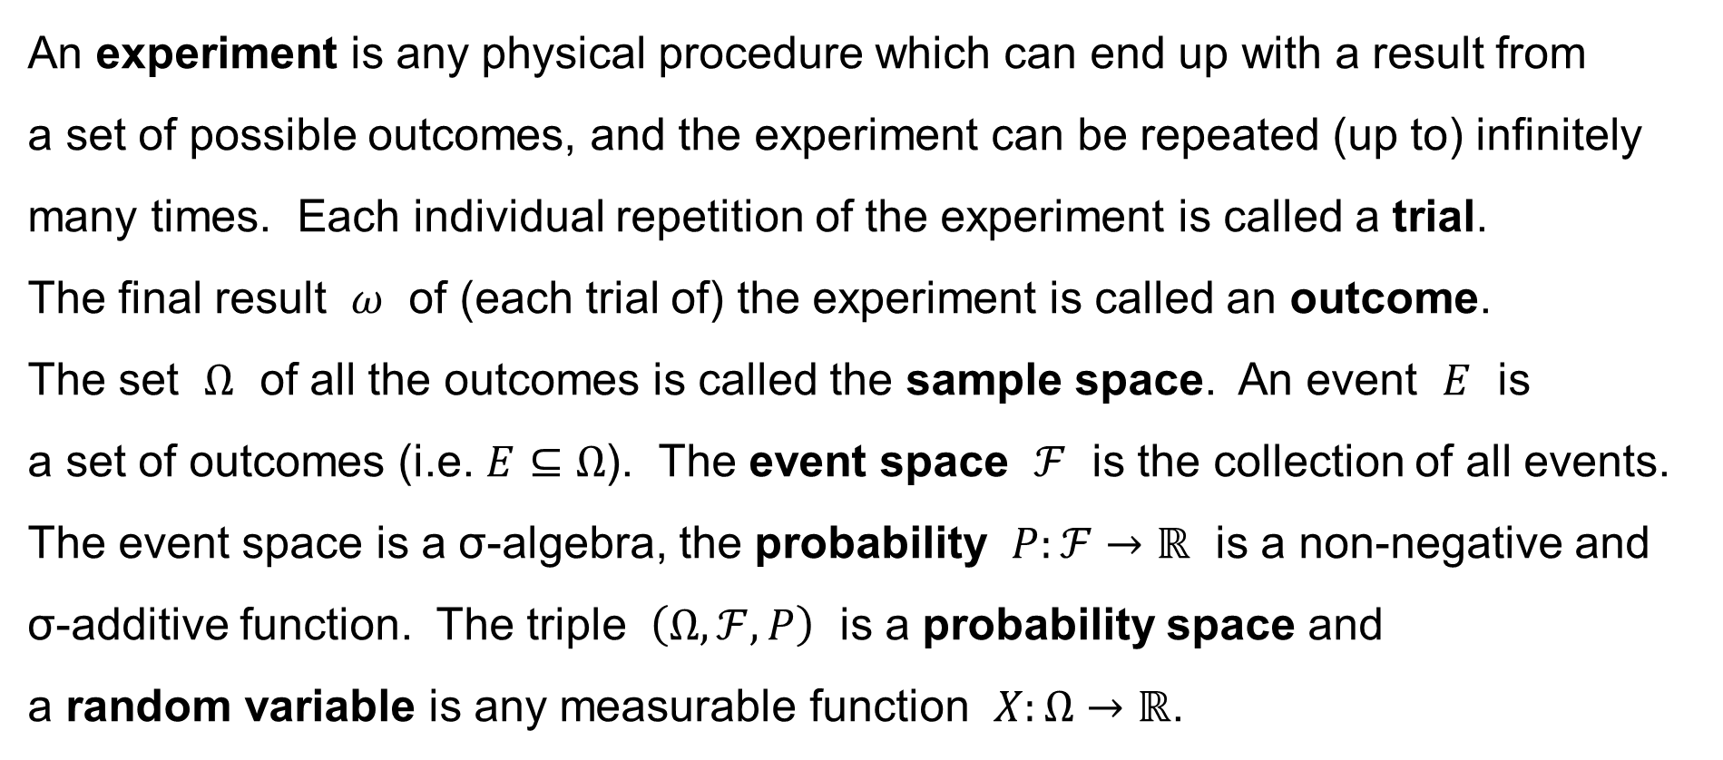
Experiment — Trial — Random variable
An experiment is any physical procedure which can end up with a result from
a set of possible outcomes, and the experiment can be repeated (up to) infinitely many times. Each individual repetition of the experiment is called a trial.
The final result $ω$ of (each trial of) the experiment is called an outcome.
The set $Ω$ of all the outcomes is called the sample space. An event $E$ is
a set of outcomes (i.e. $E⊆Ω$). The event space $ℱ$ is the collection of all events. The event space is a σ-algebra, the probability $P:ℱ→ℝ$ is a non-negative and
σ-additive function. The triple $\left(Ω,ℱ,P\right)$ is a probability space and
a random variable is any measurable function $X:Ω→ℝ$.

Slide 4
Random variable — Dataset
To conclude, the random variable assigns a numerical value to each outcome of the random experiment.
Now, a dataset is a collection of measurements and observations, i.e.
it is a collection of data. A data unit is an entity of the population under study,
and a data item or a variable is a characteristics of each data unit.
We are considering numerical (quantitative) variables now.
We assume the hypothesis that the data items in the dataset are realizations
of the random variable, i.e. the random variable (via the trials of the random experiment) generates the data.

Slide 5
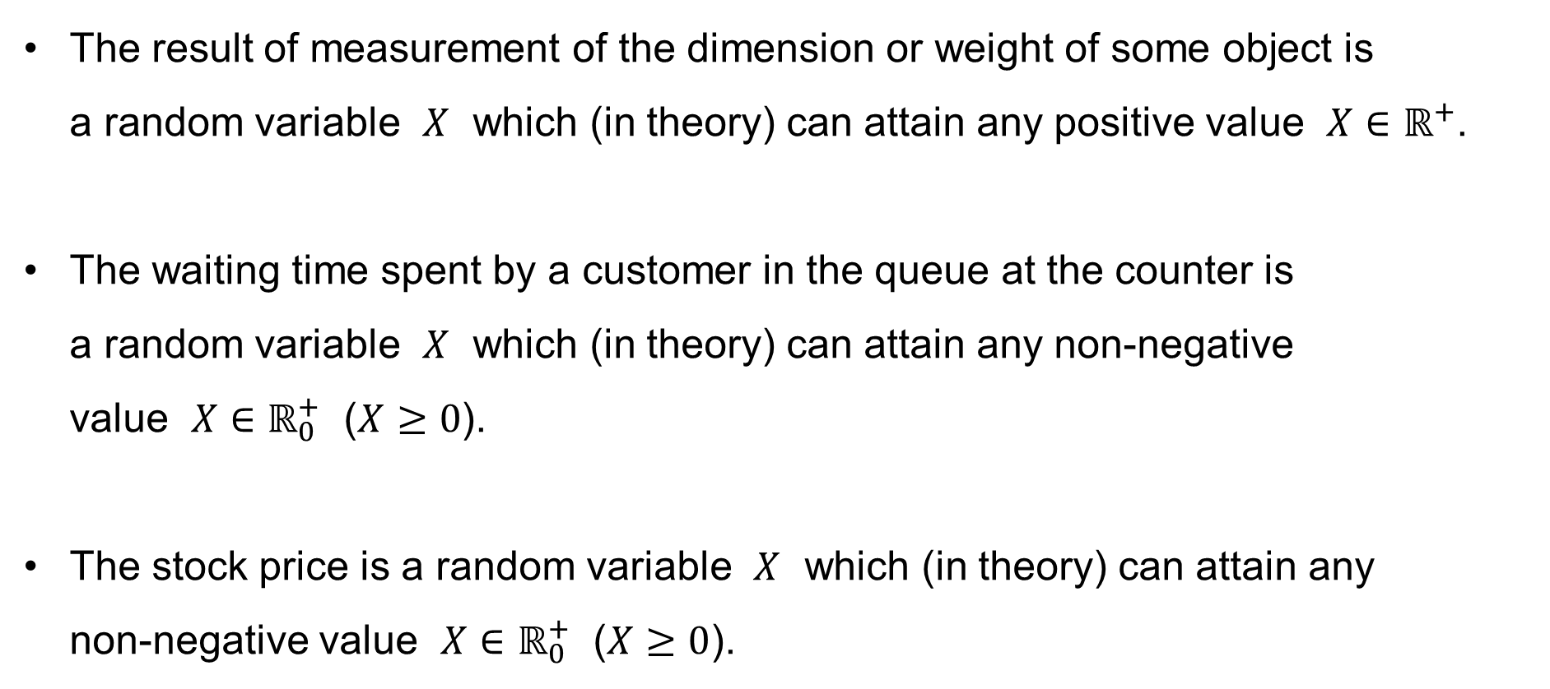
Examples of continuous random variables
The result of measurement of the dimension or weight of some object is
a random variable $X$ which (in theory) can attain any positive value $X∈ℝ^{+}$.
The waiting time spent by a customer in the queue at the counter is
a random variable $X$ which (in theory) can attain any non-negative
value $X∈ℝ_{0}^{+}$ ($X≥0$).
The stock price is a random variable $X$ which (in theory) can attain any
non-negative value $X∈ℝ_{0}^{+}$ ($X≥0$).

Slide 6
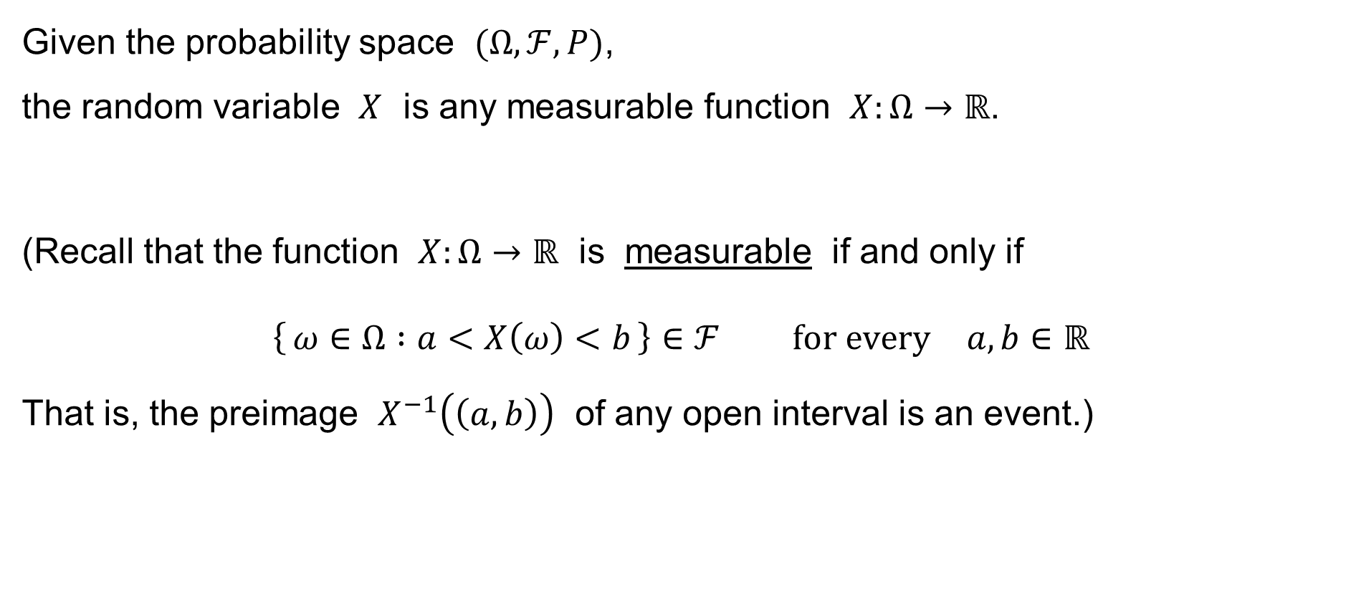
Random variable
Given the probability space $(Ω,ℱ,P)$,
the random variable $X$ is any measurable function $X:Ω→ℝ$.
(Recall that the function $X:Ω→ℝ$ is measurable if and only if
$$\left\{ ω∈Ω :a<X\left(ω\right)<b \right\}∈ℱ \text{for} \text{every} a,b∈ℝ$$
That is, the preimage $X^{−1}\left(\left(a,b\right)\right)$ of any open interval is an event.)

Slide 7
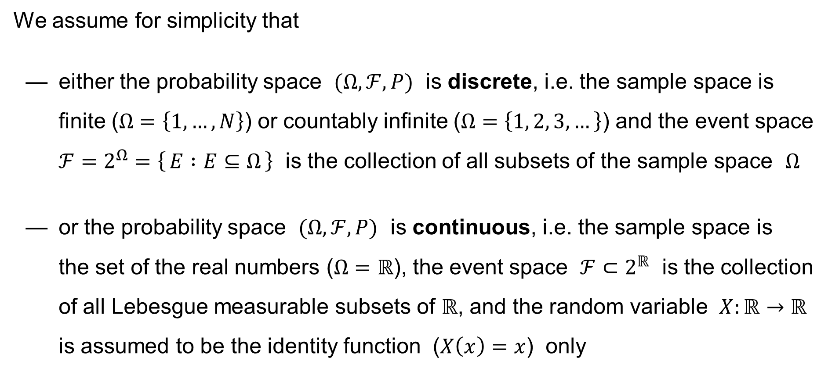
Assumptions to simplify the matters
We assume for simplicity that
— either the probability space $(Ω,ℱ,P)$ is discrete, i.e. the sample space is finite ($Ω=\left\{1,…,N\right\}$) or countably infinite ($Ω=\left\{1, 2, 3,…\right\}$) and the event space $ℱ=2^{Ω}=\left\{ E :E⊆Ω \right\}$ is the collection of all subsets of the sample space $Ω$
— or the probability space $(Ω,ℱ,P)$ is continuous, i.e. the sample space is
the set of the real numbers ($Ω=ℝ$), the event space $ℱ⊂2^{ℝ}$ is the collection of all Lebesgue measurable subsets of $ℝ$, and the random variable $X:ℝ→ℝ$ is assumed to be the identity function ($X\left(x\right)=x$) only

Slide 8
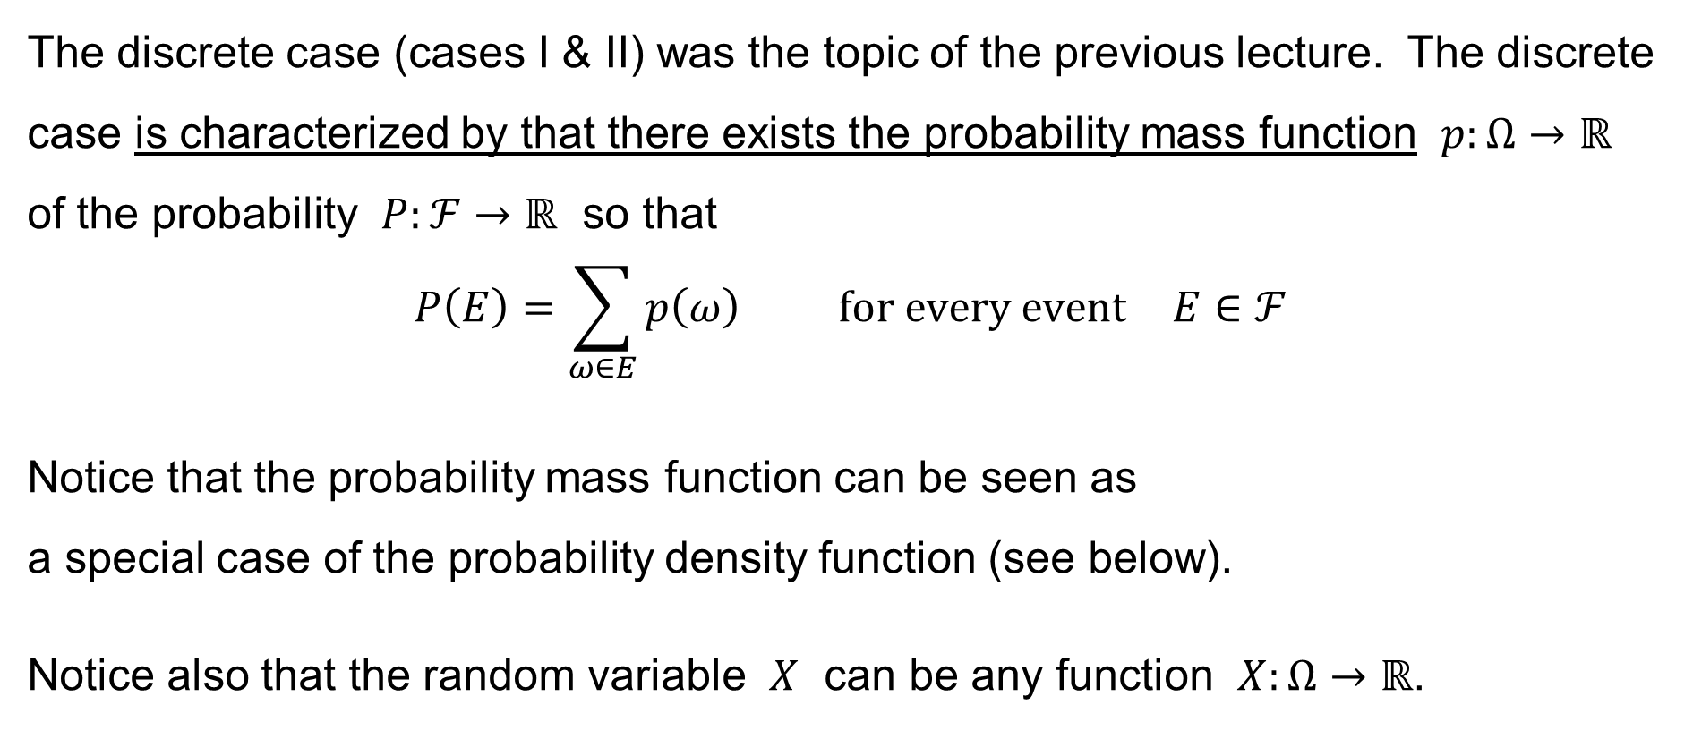
Probability mass function
The discrete case (cases I & II) was the topic of the previous lecture. The discrete case is characterized by that there exists the probability mass function $p:Ω→ℝ$
of the probability $P:ℱ→ℝ$ so that
$$P\left(E\right)=\sum_{ω∈E}{p\left(ω\right)} \text{for} \text{every} \text{event} E∈ℱ$$
Notice that the probability mass function can be seen as
a special case of the probability density function (see below).
Notice also that the random variable $X$ can be any function $X:Ω→ℝ$.

Slide 9
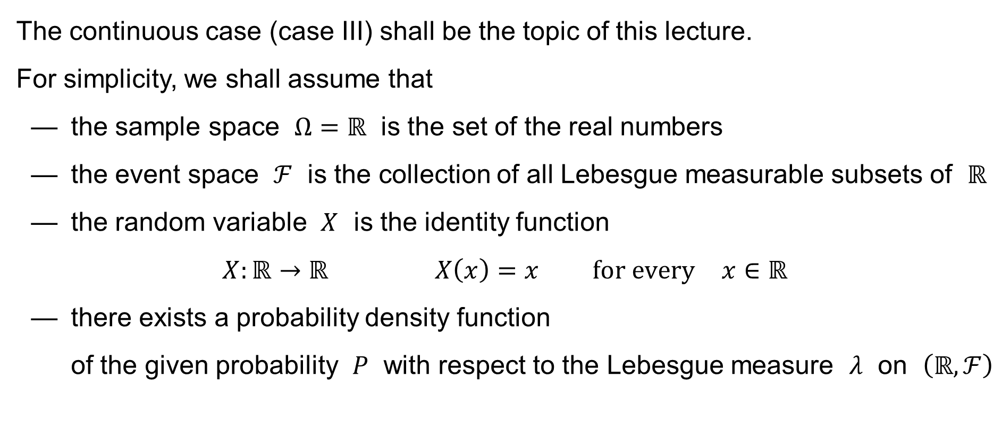
Assumptions to simplify the matters
The continuous case (case III) shall be the topic of this lecture.
For simplicity, we shall assume that
— the sample space $Ω=ℝ$ is the set of the real numbers
— the event space $ℱ$ is the collection of all Lebesgue measurable subsets of $ℝ$
— the random variable $X$ is the identity function
$$X:ℝ→ℝ X\left(x\right)=x \text{for} \text{every} x∈ℝ$$
— there exists a probability density function
of the given probability $P$ with respect to the Lebesgue measure $λ$ on $\left(ℝ,ℱ\right)$

Slide 10
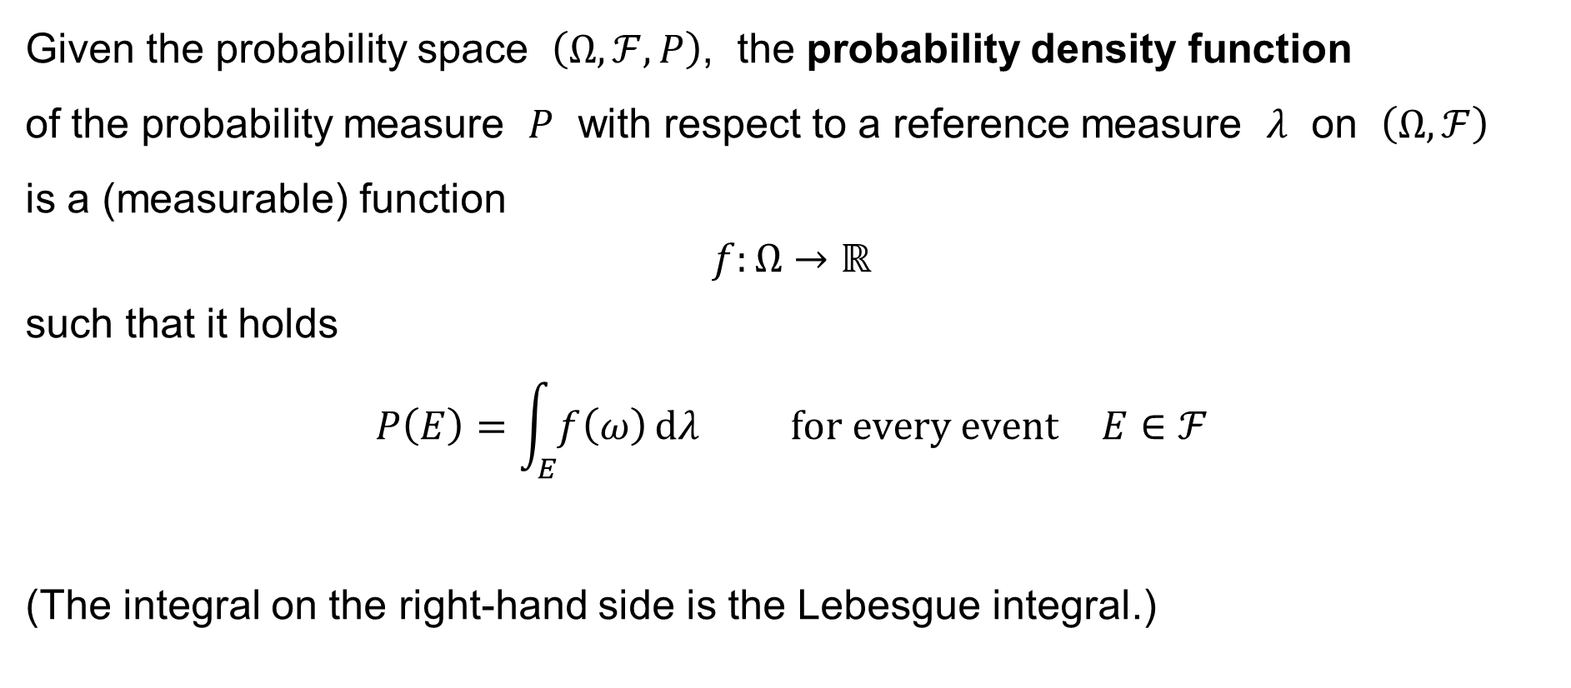
Probability density function
Given the probability space $\left(Ω,ℱ,P\right)$, the probability density function
of the probability measure $P$ with respect to a reference measure $λ$ on $\left(Ω,ℱ\right)$
is a (measurable) function
$$f:Ω→ℝ$$
such that it holds
$$P\left(E\right)=\int_{E}{f\left(ω\right) dλ} \text{for} \text{every} \text{event} E∈ℱ$$
(The integral on the right-hand side is the Lebesgue integral.)

Slide 11
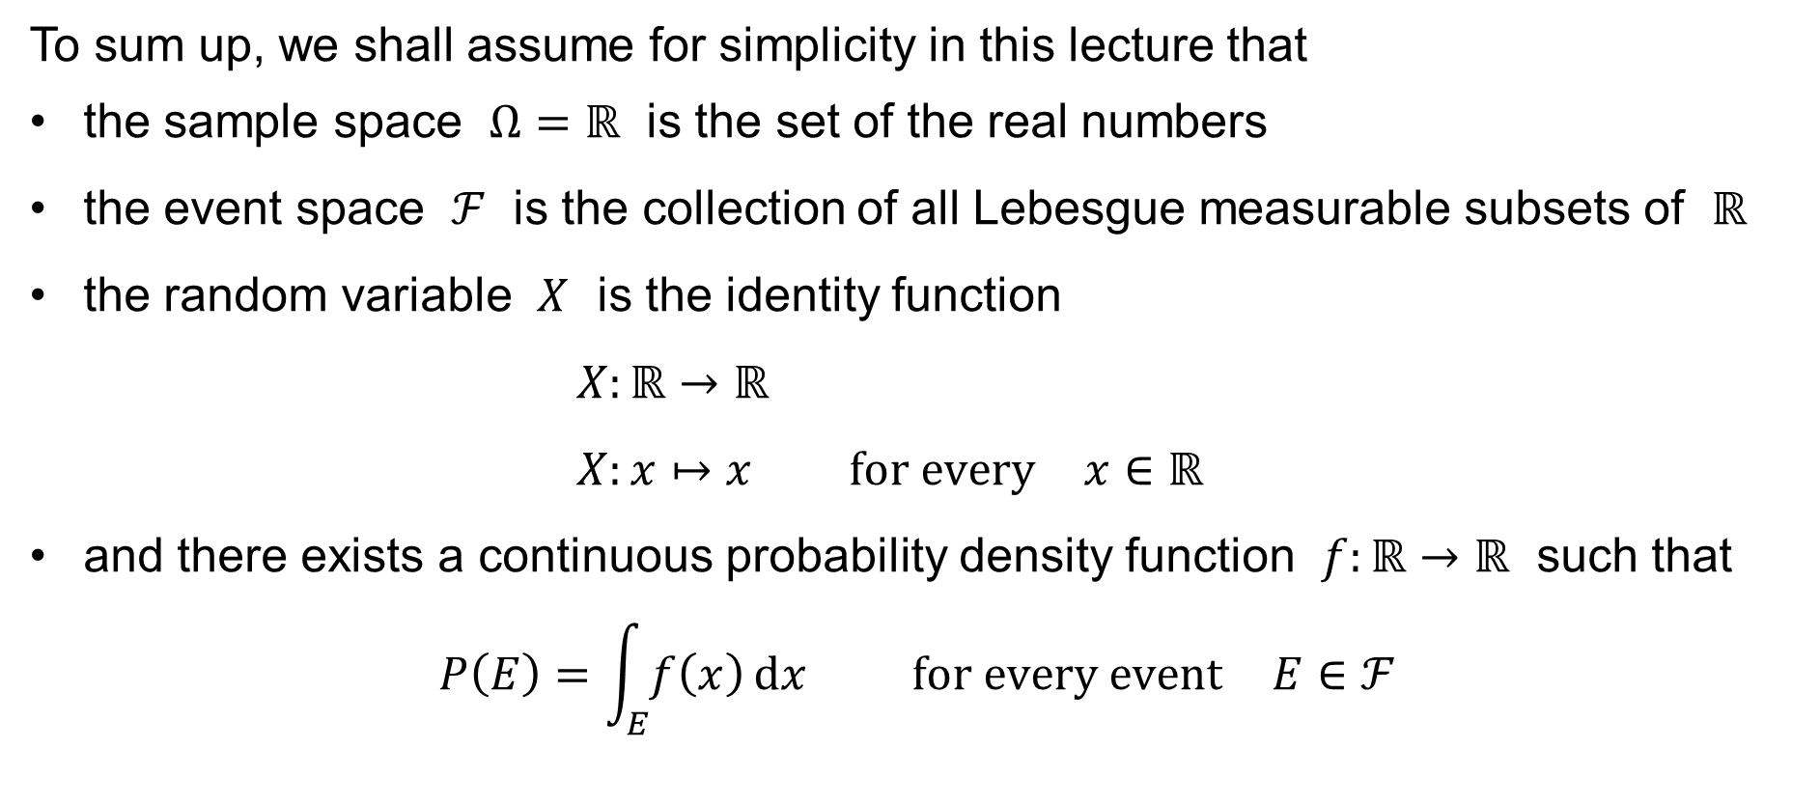
Assumptions to simplify the matters
To sum up, we shall assume for simplicity in this lecture that
the sample space $Ω=ℝ$ is the set of the real numbers
the event space $ℱ$ is the collection of all Lebesgue measurable subsets of $ℝ$
the random variable $X$ is the identity function
$X:ℝ→ℝ$
$X:x↦x \text{for} \text{every} x∈ℝ$
and there exists a continuous probability density function $f:ℝ→ℝ$ such that
$$P\left(E\right)=\int_{E}{f\left(x\right) dx} \text{for} \text{every} \text{event} E∈ℱ$$

Slide 12
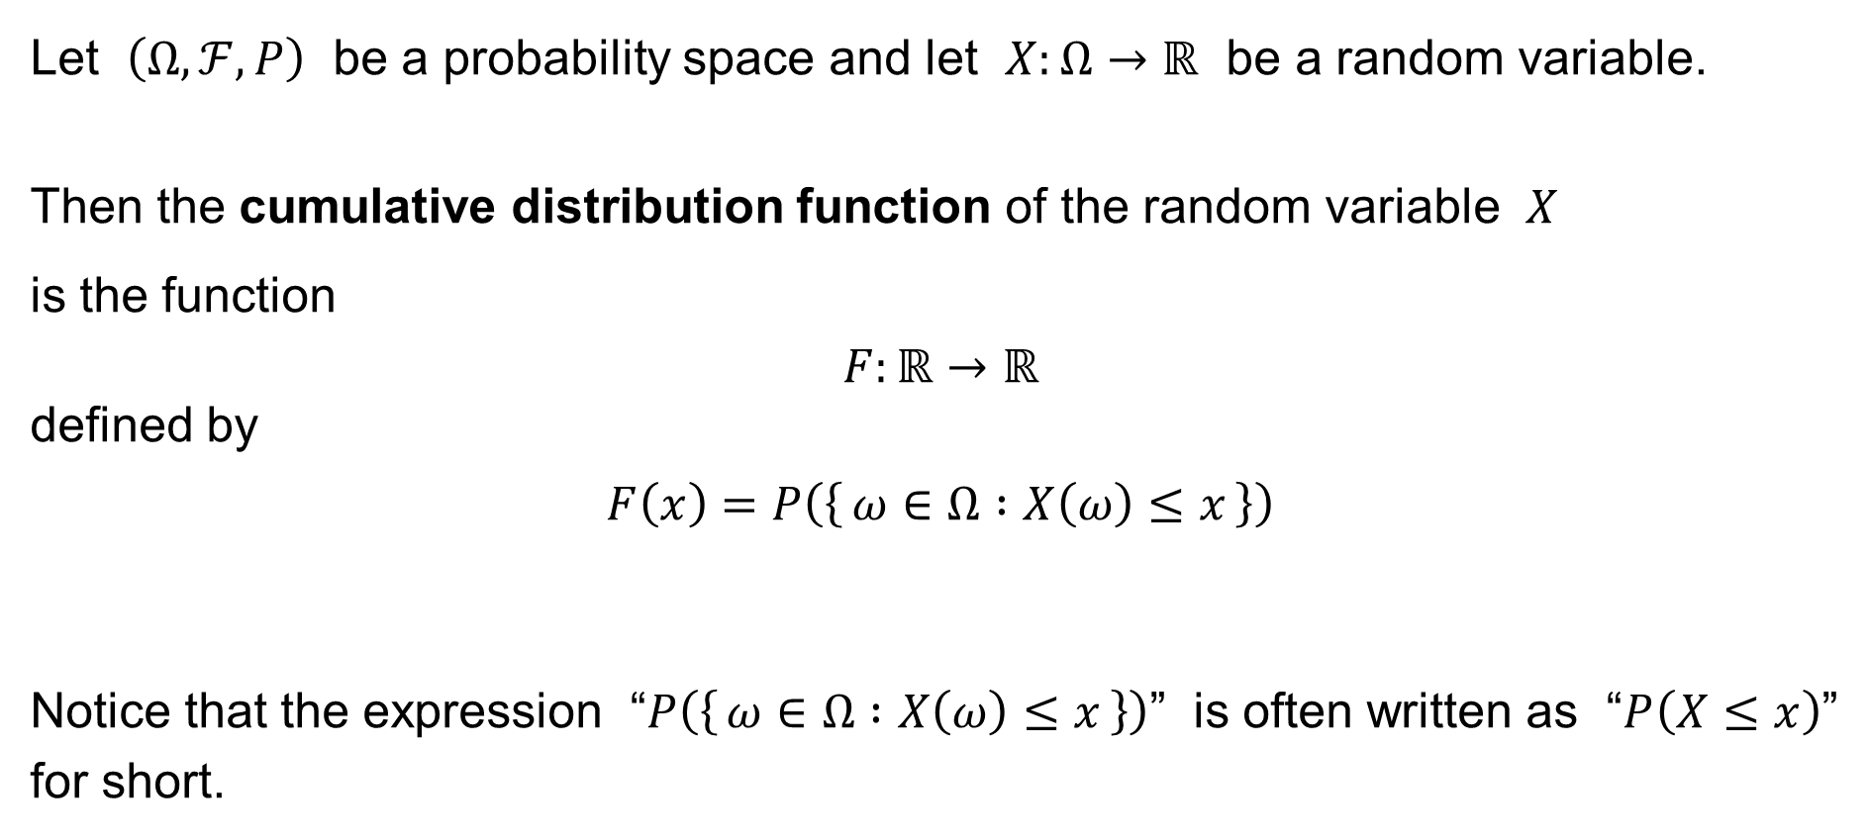
Cumulative distribution function
Let $\left(Ω,ℱ,P\right)$ be a probability space and let $X:Ω→ℝ$ be a random variable.
Then the cumulative distribution function of the random variable $X$
is the function
$$F:ℝ→ℝ$$
defined by
$$F\left(x\right)=P\left(\left\{ ω∈Ω :X\left(ω\right)≤x \right\}\right)$$
Notice that the expression “$P\left(\left\{ ω∈Ω :X\left(ω\right)≤x \right\}\right)$” is often written as “$P\left(X≤x\right)$”
for short.

Slide 13
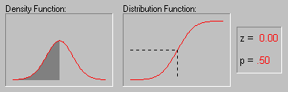

The density & the cumulative distribution function
It holds:
$$P\left(a<X≤b\right)=\int_{a}^{b}{f\left(x\right) dx}=F\left(b\right)−F\left(a\right)$$
1
p=0,62
p=0,5
p=0,62
p=0,5
z=0
z=0
z=0,7

Slide 14
Continuous uniform distribution

Slide 15




Uniform distribution (continuous)
The continuous uniform distribution is another one which relates closely
to the classical definition of probability: Considering a bounded interval $\left[a,b\right]$
to be the set of the outcomes of a random experiment, each point $x∈\left[a,b\right]$
of the interval is equally likely to occur.
$$a$$
$$b$$
$$ℝ$$

Slide 16
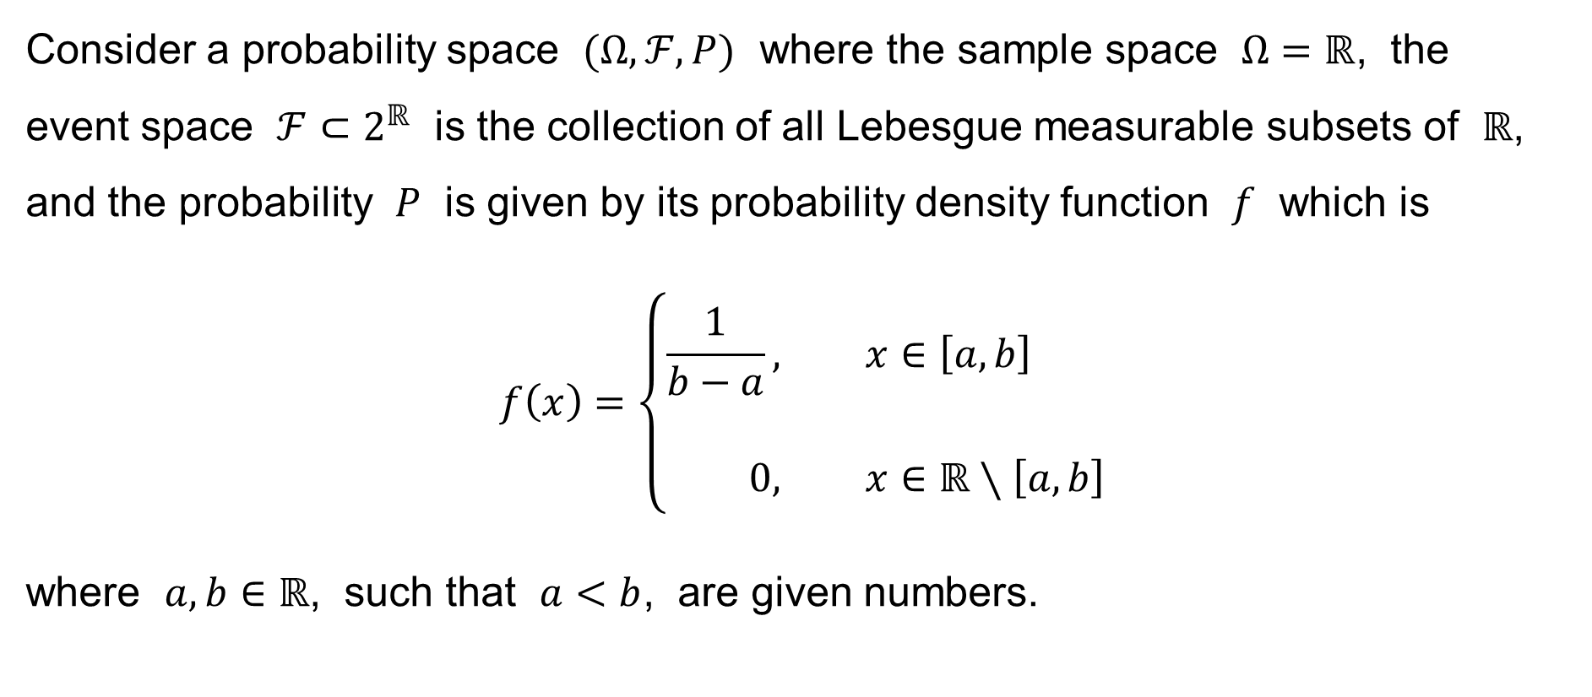
Uniform distribution (continuous)
Consider a probability space $(Ω,ℱ,P)$ where the sample space $Ω=ℝ$, the
event space $ℱ⊂2^{ℝ}$ is the collection of all Lebesgue measurable subsets of $ℝ$, and the probability $P$ is given by its probability density function $f$ which is
$$f\left(x\right)=\left\{\begin{aligned}\frac{1}{b−a}&, x∈\left[a,b\right] \\ \\ 0&, x∈ℝ∖\left[a,b\right]\end{aligned}\right.$$
where $a,b∈ℝ$, such that $a<b$, are given numbers.

Slide 17
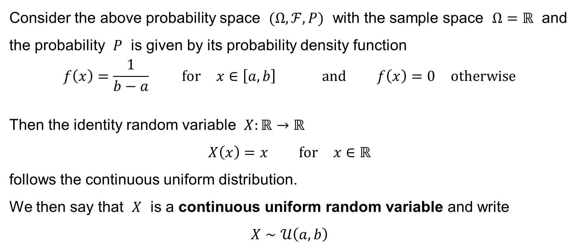
Uniform distribution (continuous)
Consider the above probability space $(Ω,ℱ,P)$ with the sample space $Ω=ℝ$ and the probability $P$ is given by its probability density function
$$f\left(x\right)=\frac{1}{b−a} \text{for} x∈\left[a,b\right] \text{and} f\left(x\right)=0 \text{otherwise}$$
Then the identity random variable $X:ℝ→ℝ$
$$X\left(x\right)=x \text{for} x∈ℝ$$
follows the continuous uniform distribution.
We then say that $X$ is a continuous uniform random variable and write
$$X∼𝒰\left(a,b\right)$$

Slide 18







Uniform distribution (continuous)
The graph of the probability density function
of a continuous uniform random variable $X∼𝒰\left(a,b\right)$:
$$\frac{1}{b−a}$$
$$f\left(x\right)$$
$$0$$
$$x$$
$$a$$
$$b$$

Slide 19



Uniform distribution (continuous)
The graph of the cumulative distribution function
of a continuous uniform random variable $X∼𝒰\left(a,b\right)$:
$$1$$
$$F\left(x\right)$$
$$0$$
$$x$$
$$a$$
$$b$$

Slide 20
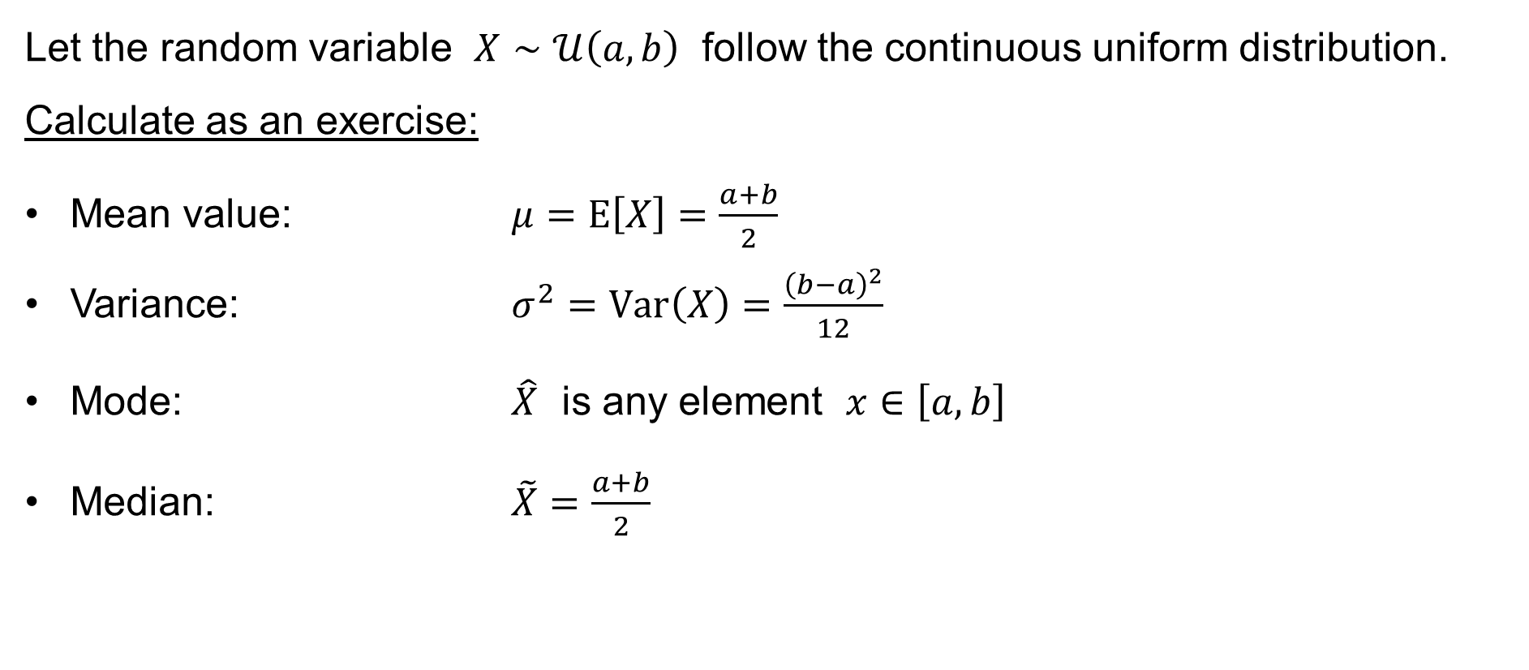
Uniform distribution (continuous)
Let the random variable $X∼𝒰\left(a,b\right)$ follow the continuous uniform distribution.
Calculate as an exercise:
Mean value: $μ=E\left[X\right]=\frac{a+b}{2}$
Variance: $σ^{2}=Var\left(X\right)=\frac{{\left(b−a\right)}^{2}}{12}$
Mode: $\hat{X}$ is any element $x∈\left[a,b\right]$
Median: $\tilde{X}=\frac{a+b}{2}$

Slide 21
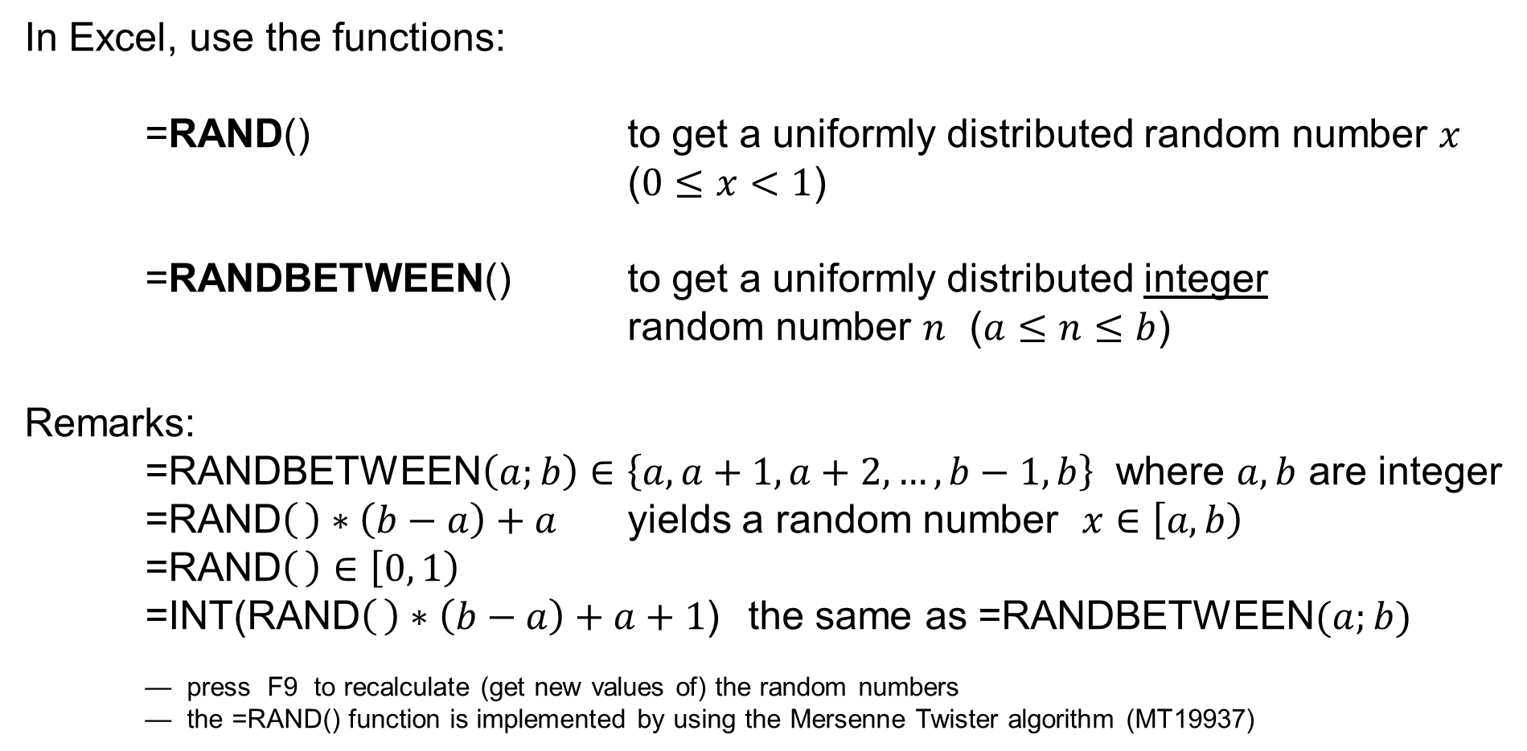
Uniform distribution (continuous) in Excel
In Excel, use the functions:
=RAND() to get a uniformly distributed random number $x$
($0≤x<1$)
=RANDBETWEEN() to get a uniformly distributed integer
random number $n$ ($a≤n≤b$)
Remarks:
=RANDBETWEEN$\left(a;b\right)∈\left\{a,a+1,a+2,…,b−1,b\right\}$ where $a,b$ are integer
=RAND$\left( \right)∗\left(b−a\right)+a$ yields a random number $x∈\left[a,b\right)$
=RAND$\left( \right)∈\left[0, 1\right)$
=INT(RAND$\left( \right)∗\left(b−a\right)+a+1$) the same as =RANDBETWEEN$(a;b)$
— press F9 to recalculate (get new values of) the random numbers
— the =RAND() function is implemented by using the Mersenne Twister algorithm (MT19937)

Slide 22
Uniform distribution (continuous): Example
The bus operates every 15 minutes. A passenger (who does not know
the timetable of the bus) comes to the bus stop at a random time.
The operator comes to the telephone set every 15 minutes. A customer makes a telephone call at a random time and waits as long as the operator comes.
Notice the difference:
— we have just one request here
— when applying the discrete Poisson distribution or the continuous exponential distribution, we have a series of requests coming at a constant rate

Slide 23
Gaussian normal distribution
Normal distribution
Normalized normal distribution
Central Limit Theorem

Slide 24
Normal distribution
It has been observed in practice that the distribution of many real phenomena yields the typical “bell curve”, i.e. the phenomena can be approximated by the classical Gaussian normal distribution. These phenomena include:
— the results of repeated measurements of lengths, distances, weights, etc.
— the results of various tests and examinations (exams)
We explain these practical observations by hypothesizing that many random quantities present in the experiment sum up together, cancel one another, and
(by the Central Limit Theorem) yield the normal distribution approximately.

Slide 25
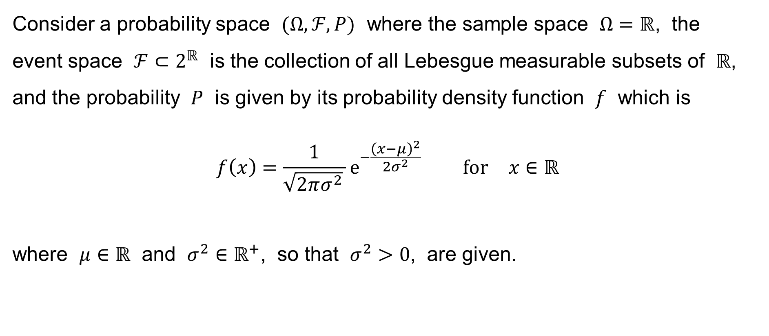
Normal distribution
Consider a probability space $(Ω,ℱ,P)$ where the sample space $Ω=ℝ$, the
event space $ℱ⊂2^{ℝ}$ is the collection of all Lebesgue measurable subsets of $ℝ$, and the probability $P$ is given by its probability density function $f$ which is
$$f\left(x\right)=\frac{1}{\sqrt{2πσ^{2}} }e^{−\frac{{\left(x−μ\right)}^{2}}{2σ^{2}}} \text{for} x∈ℝ$$
where $μ∈ℝ$ and $σ^{2}∈ℝ^{+}$, so that $σ^{2}>0$, are given.

Slide 26
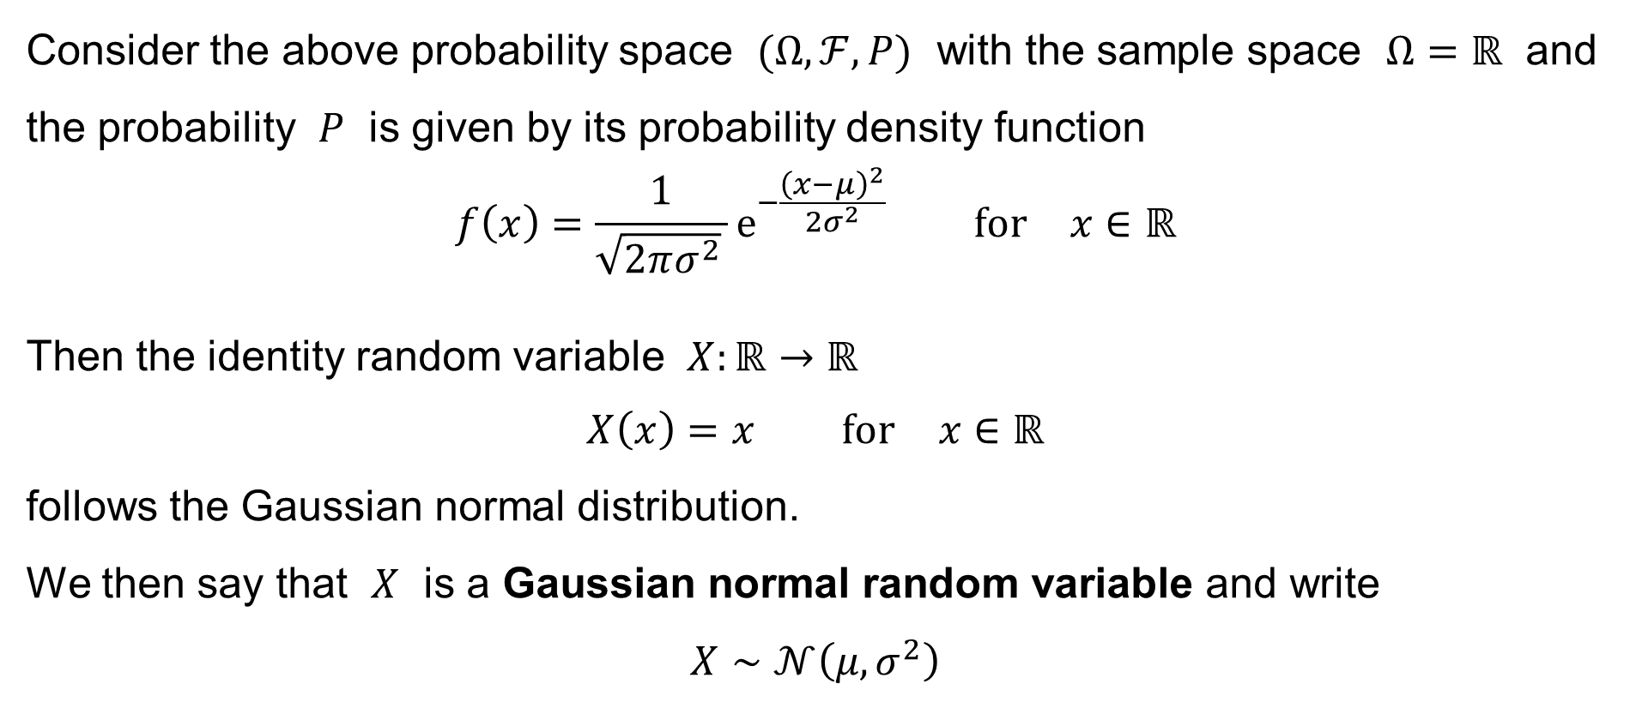
Normal distribution
Consider the above probability space $(Ω,ℱ,P)$ with the sample space $Ω=ℝ$ and the probability $P$ is given by its probability density function
$$f\left(x\right)=\frac{1}{\sqrt{2πσ^{2}} }e^{−\frac{{\left(x−μ\right)}^{2}}{2σ^{2}}} \text{for} x∈ℝ$$
Then the identity random variable $X:ℝ→ℝ$
$$X\left(x\right)=x \text{for} x∈ℝ$$
follows the Gaussian normal distribution.
We then say that $X$ is a Gaussian normal random variable and write
$$X∼𝒩\left(μ,σ^{2}\right)$$

Slide 27
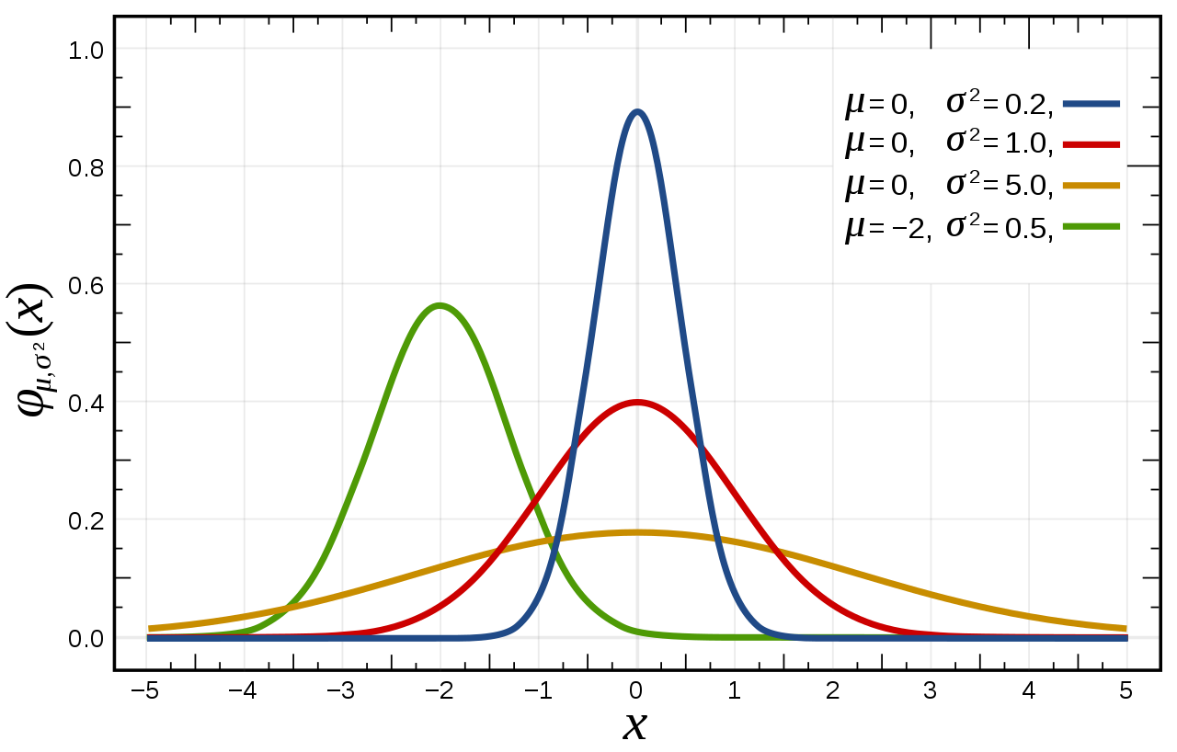

Normal distribution
The graph of the probability density function
of a normal random variable $X∼𝒩\left(μ,σ^{2}\right)$ for various parameters:
source: Wikipedia

Slide 28
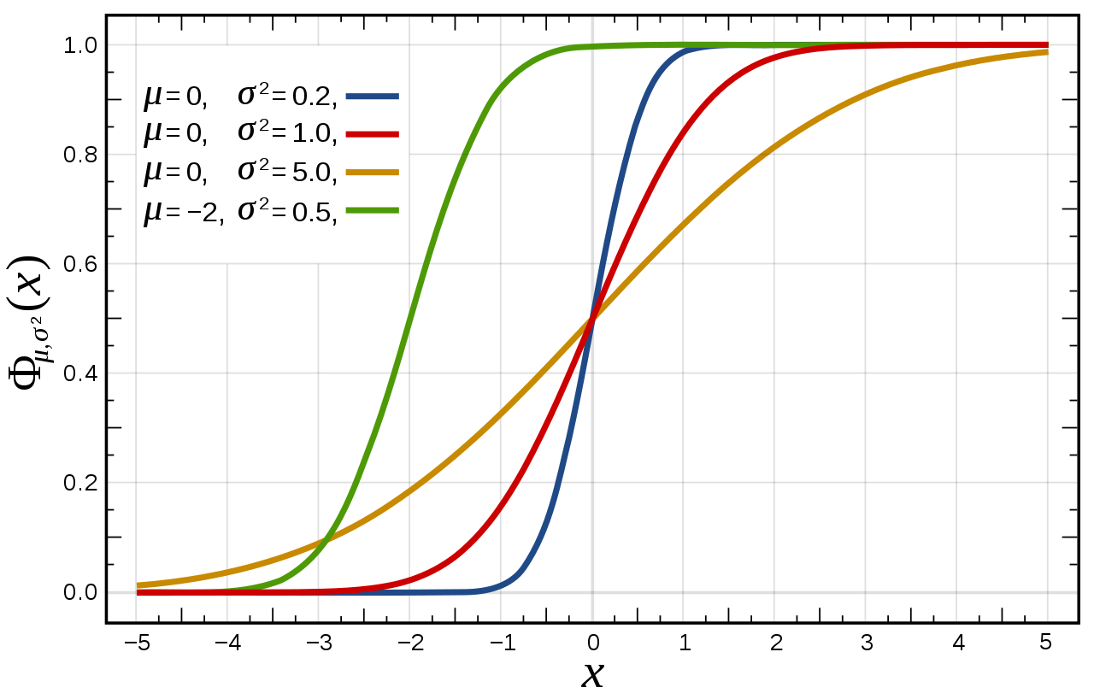

Normal distribution
The graph of the cumulative distribution function
of a normal random variable $X∼𝒩\left(μ,σ^{2}\right)$ for various parameters:
source: Wikipedia

Slide 29

Normal distribution
The graph of the probability density function & cumulative distribution function
of a normal random variable $X∼𝒩\left(μ,σ^{2}\right)$ with $μ=0$:
1
p=0,5
p=0,5
z=0
z=0

Slide 30
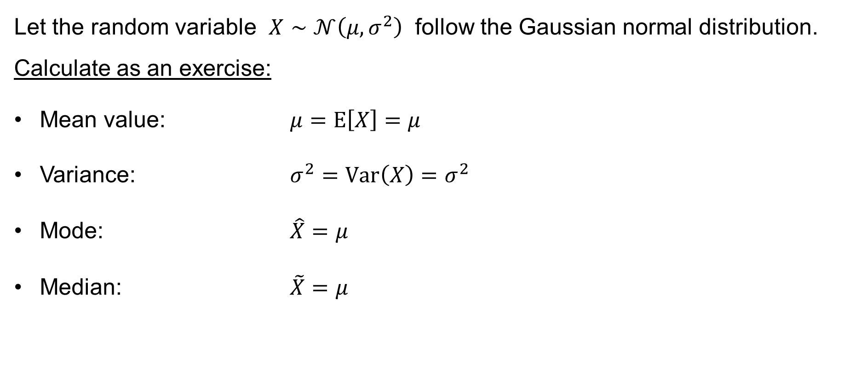
Normal distribution
Let the random variable $X∼𝒩\left(μ,σ^{2}\right)$ follow the Gaussian normal distribution.
Calculate as an exercise:
Mean value: $μ=E\left[X\right]=μ$
Variance: $σ^{2}=Var\left(X\right)=σ^{2}$
Mode: $\hat{X}=μ$
Median: $\tilde{X}=μ$

Slide 31

Normal distribution
Recall: Let $X∼𝒩\left(μ,σ^{2}\right)$. Then
$$P\left(a<X≤b\right)=P\left(a≤X≤b\right)=P\left(a≤X<b\right)=P\left(a<x<b\right)= \\ =\int_{a}^{b}{f\left(x\right) dx}=\frac{1}{\sqrt{2πσ^{2}} }\int_{a}^{b}{e^{−\frac{{\left(x−μ\right)}^{2}}{2σ^{2}}} dx}$$

Slide 32

Normal distribution: The 68–95–99.7 rule
The 68–95–99.7 rule / The three-sigma (3σ) rule
source: Wikipedia

Slide 33
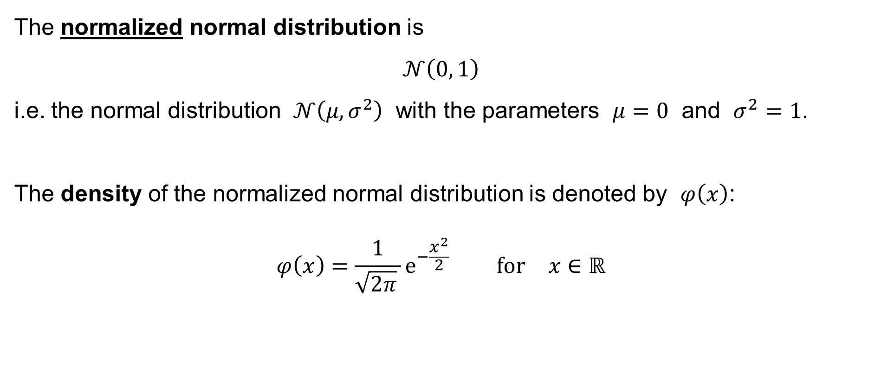
Normalized normal distribution
The normalized normal distribution is
$$𝒩\left(0, 1\right)$$
i.e. the normal distribution $𝒩\left(μ,σ^{2}\right)$ with the parameters $μ=0$ and $σ^{2}=1$.
The density of the normalized normal distribution is denoted by $φ\left(x\right)$:
$$φ\left(x\right)=\frac{1}{\sqrt{2π} }e^{−\frac{x^{2}}{2}} \text{for} x∈ℝ$$

Slide 34

Normalized normal distribution
The cumulative distribution function of the normalized normal distribution
is called the Laplace function and is denoted by $Φ\left(x\right)$:
$$Φ\left(x\right)=\int_{−∞}^{x}{φ\left(t\right) dt}=\frac{1}{\sqrt{2π} }\int_{−∞}^{x}{e^{−\frac{t^{2}}{2}} dt} \text{for} x∈ℝ$$

Slide 35
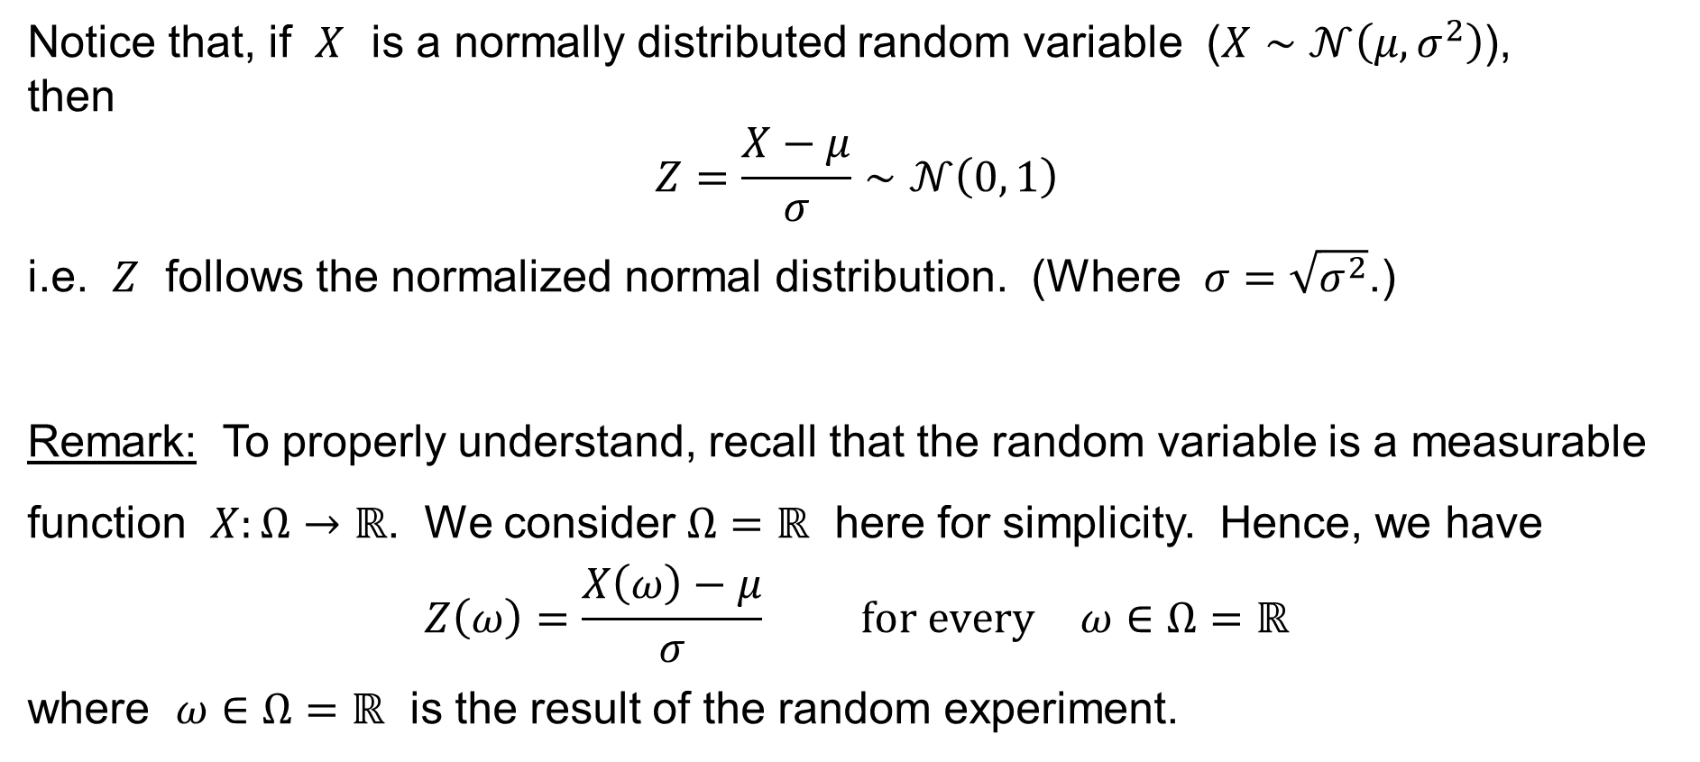
Normalized normal distribution
Notice that, if $X$ is a normally distributed random variable ($X∼𝒩\left(μ,σ^{2}\right)$),
then
$$Z=\frac{X−μ}{σ}∼𝒩\left(0, 1\right)$$
i.e. $Z$ follows the normalized normal distribution. (Where $σ=\sqrt{σ^{2}}$.)
Remark: To properly understand, recall that the random variable is a measurable function $X:Ω→ℝ$. We consider $Ω=ℝ$ here for simplicity. Hence, we have
$$Z\left(ω\right)=\frac{X\left(ω\right)−μ}{σ} \text{for} \text{every} ω∈Ω=ℝ$$
where $ω∈Ω=ℝ$ is the result of the random experiment.

Slide 36
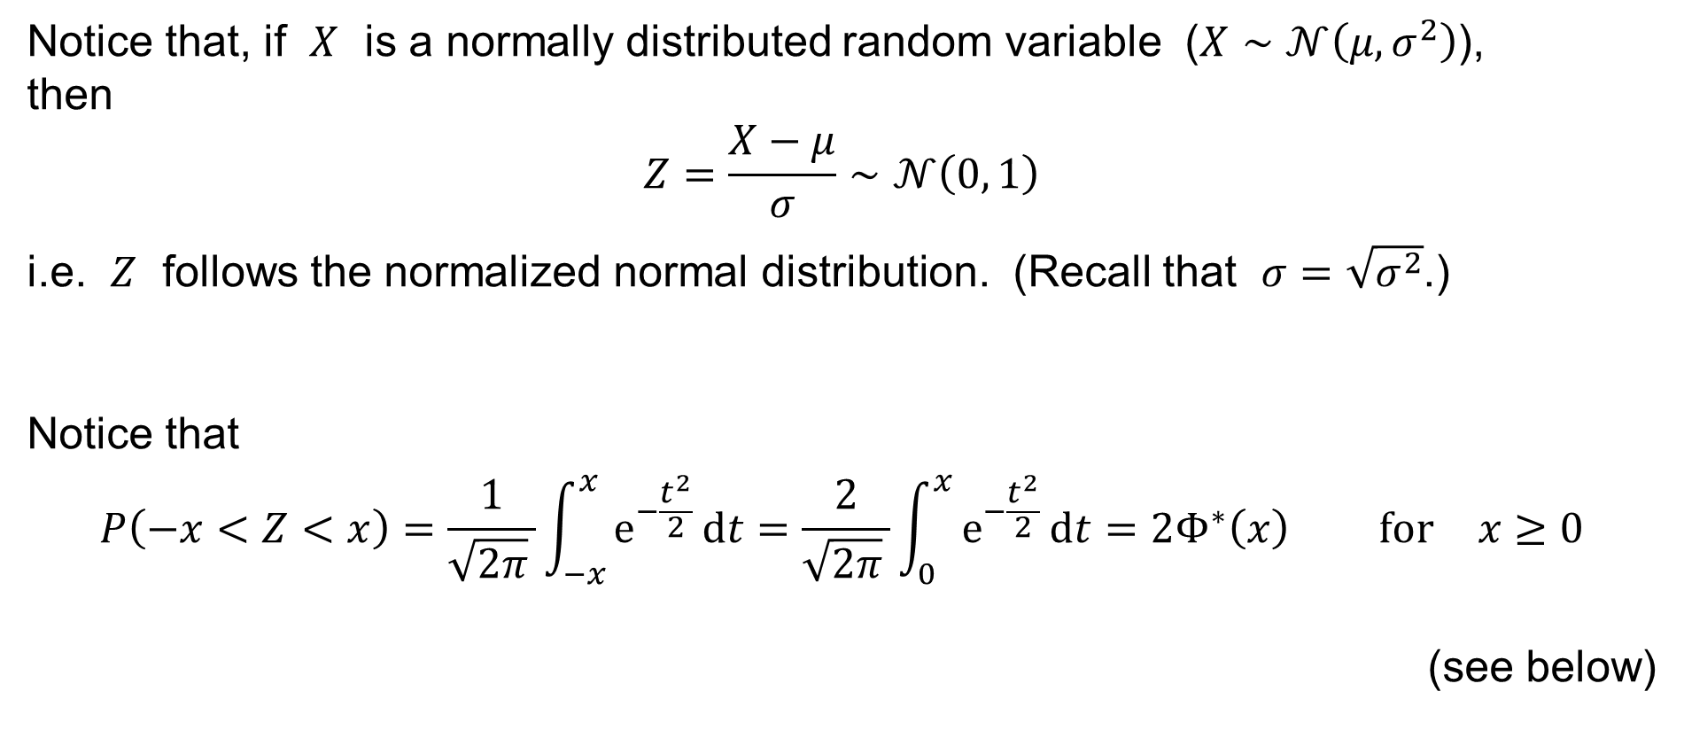
Normalized normal distribution
Notice that, if $X$ is a normally distributed random variable ($X∼𝒩\left(μ,σ^{2}\right)$),
then
$$Z=\frac{X−μ}{σ}∼𝒩\left(0, 1\right)$$
i.e. $Z$ follows the normalized normal distribution. (Recall that $σ=\sqrt{σ^{2}}$.)
Notice that
$$P\left(−x<Z<x\right)=\frac{1}{\sqrt{2π} }\int_{−x}^{x}{e^{−\frac{t^{2}}{2}} dt}=\frac{2}{\sqrt{2π} }\int_{0}^{x}{e^{−\frac{t^{2}}{2}} dt}=2Φ^{∗}\left(x\right) \text{for} x≥0$$
(see below)

Slide 37
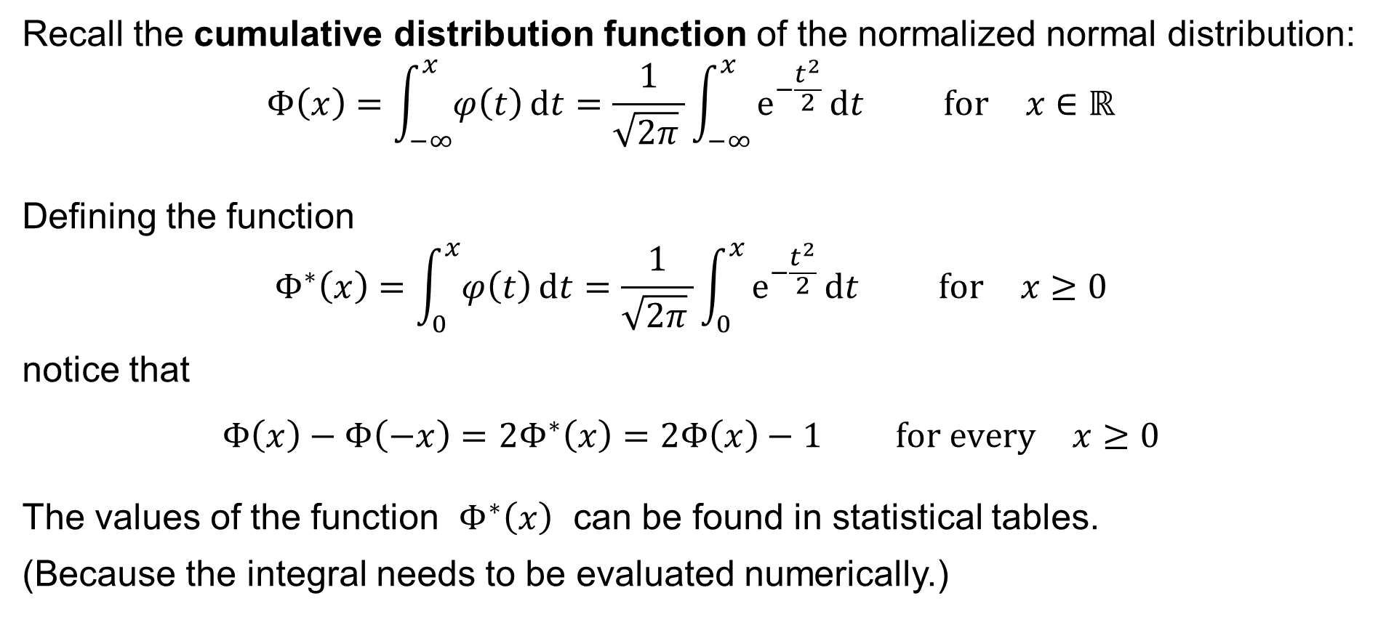
Normalized normal distribution
Recall the cumulative distribution function of the normalized normal distribution:
$$Φ\left(x\right)=\int_{−∞}^{x}{φ\left(t\right) dt}=\frac{1}{\sqrt{2π} }\int_{−∞}^{x}{e^{−\frac{t^{2}}{2}} dt} \text{for} x∈ℝ$$
Defining the function
$$Φ^{∗}\left(x\right)=\int_{0}^{x}{φ\left(t\right) dt}=\frac{1}{\sqrt{2π} }\int_{0}^{x}{e^{−\frac{t^{2}}{2}} dt} \text{for} x≥0$$
notice that
$$Φ\left(x\right)−Φ\left(−x\right)=2Φ^{∗}\left(x\right)=2Φ\left(x\right)−1 \text{for} \text{every} x≥0$$
The values of the function $Φ^{∗}\left(x\right)$ can be found in statistical tables.
(Because the integral needs to be evaluated numerically.)

Slide 38
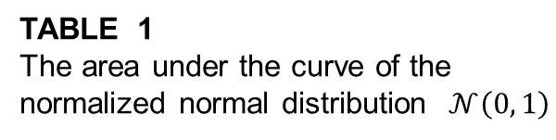
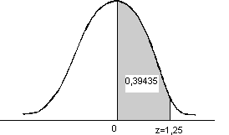
TABLE 1
The area under the curve of the
normalized normal distribution $𝒩\left(0, 1\right)$
 | 0.00 | 0.01 | 0.02 | 0.03 | 0.04 | 0.05 | 0.06 | 0.07 | 0.08 | 0.09
0.0 | 0.00000 | 0.00399 | 0.00798 | 0.01197 | 0.01595 | 0.01994 | 0.02392 | 0.02790 | 0.03188 | 0.03586
0.1 | 0.03983 | 0.04380 | 0.04776 | 0.05172 | 0.05567 | 0.05962 | 0.06356 | 0.06749 | 0.07142 | 0.07535
0.2 | 0.07926 | 0.08317 | 0.08706 | 0.09095 | 0.09483 | 0.09871 | 0.10257 | 0.10642 | 0.10260 | 0.11409
0.3 | 0.11791 | 0.12172 | 0.12552 | 0.12930 | 0.13307 | 0.13683 | 0.14058 | 0.14431 | 0.14803 | 0.15173
0.4 | 0.15542 | 0.15910 | 0.16276 | 0.16640 | 0.17003 | 0.17364 | 0.18824 | 0.18082 | 0.18439 | 0.18793
0.5 | 0.19146 | 0.19497 | 0.19847 | 0.20194 | 0.20540 | 0.20884 | 0.21226 | 0.21566 | 0.21904 | 0.22240
0.6 | 0.22575 | 0.22907 | 0.23237 | 0.23565 | 0.23891 | 0.24215 | 0.24537 | 0.24857 | 0.25175 | 0.25490
0.7 | 0.25804 | 0.26115 | 0.26424 | 0.26730 | 0.27035 | 0.27337 | 0.27637 | 0.27935 | 0.28230 | 0.28524
0.8 | 0.28814 | 0.29103 | 0.29389 | 0.29673 | 0.29955 | 0.30234 | 0.30511 | 0.30785 | 0.31057 | 0.31327
0.9 | 0.31594 | 0.31859 | 0.32121 | 0.32381 | 0.32639 | 0.32894 | 0.33147 | 0.33398 | 0.36460 | 0.33891
1.0 | 0.34134 | 0.34375 | 0.34614 | 0.34850 | 0.35083 | 0.35314 | 0.35543 | 0.35769 | 0.35993 | 0.36214
1.1 | 0.36433 | 0.36650 | 0.36864 | 0.37076 | 0.37286 | 0.37493 | 0.37698 | 0.37900 | 0.38100 | 0.38298
1.2 | 0.38493 | 0.38686 | 0.38877 | 0.39065 | 0.39251 | 0.39435 | 0.39617 | 0.39796 | 0.39973 | 0.40147
1.3 | 0.40320 | 0.40490 | 0.40658 | 0.40824 | 0.40988 | 0.41149 | 0.41309 | 0.41466 | 0.41621 | 0.41774
1.4 | 0.41924 | 0.42073 | 0.42220 | 0.42364 | 0.42507 | 0.42647 | 0.42786 | 0.42922 | 0.43056 | 0.43189
1.5 | 0.43319 | 0.43448 | 0.43574 | 0.43699 | 0.43822 | 0.43943 | 0.44062 | 0.44179 | 0.44295 | 0.44408

Slide 39
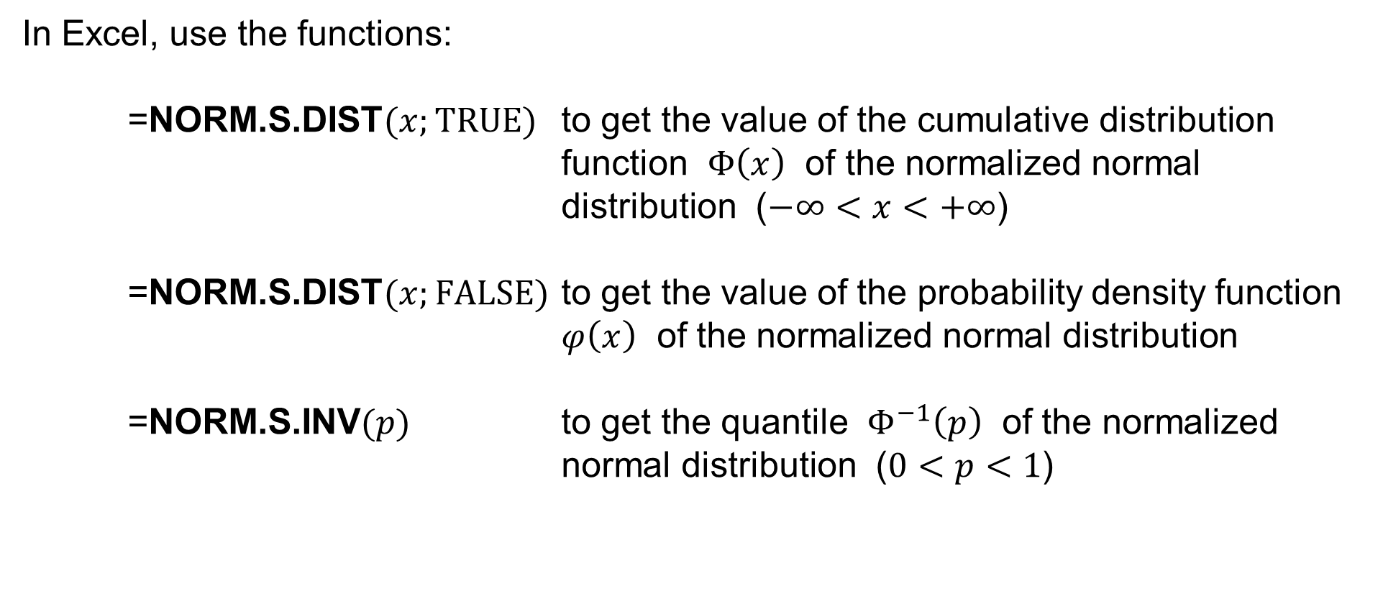
Normal distribution in Excel
In Excel, use the functions:
=NORM.S.DIST$(x;TRUE)$ to get the value of the cumulative distribution function $Φ\left(x\right)$ of the normalized normal distribution ($−∞<x<+∞$)
=NORM.S.DIST$(x;FALSE)$ to get the value of the probability density function $φ\left(x\right)$ of the normalized normal distribution
=NORM.S.INV$(p)$ to get the quantile $Φ^{−1}\left(p\right)$ of the normalized normal distribution ($0<p<1$)

Slide 40
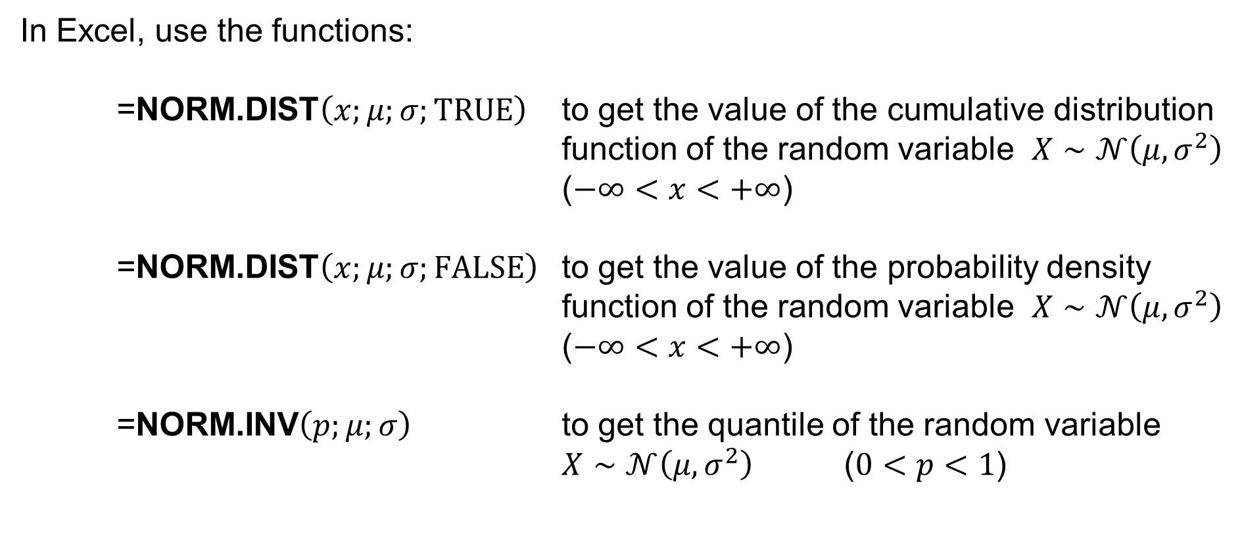
Normal distribution in Excel
In Excel, use the functions:
=NORM.DIST$\left(x;μ;σ;TRUE\right)$ to get the value of the cumulative distribution function of the random variable $X∼𝒩\left(μ,σ^{2}\right)$ ($−∞<x<+∞$)
=NORM.DIST$\left(x;μ;σ;FALSE\right)$ to get the value of the probability density function of the random variable $X∼𝒩\left(μ,σ^{2}\right)$ ($−∞<x<+∞$)
=NORM.INV$\left(p;μ;σ\right)$ to get the quantile of the random variable $X∼𝒩\left(μ,σ^{2}\right)$ ($0<p<1$)

Slide 41
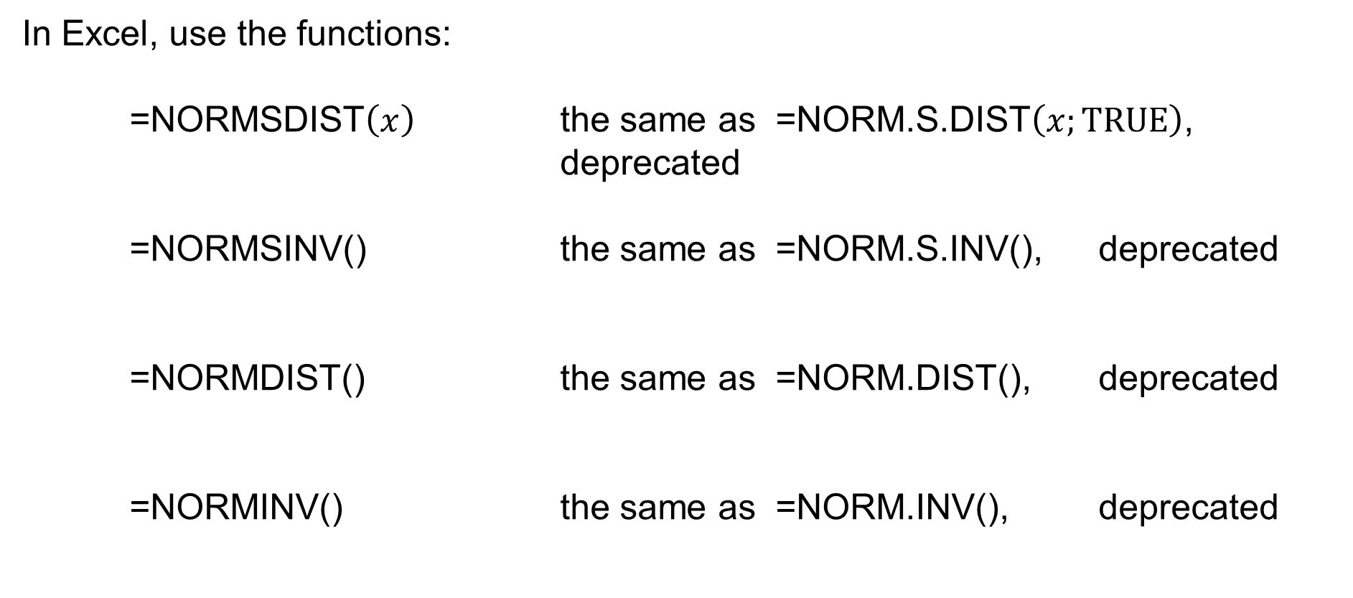
Normal distribution in Excel
In Excel, use the functions:
=NORMSDIST$\left(x\right)$ the same as =NORM.S.DIST$\left(x;TRUE\right)$,
deprecated
=NORMSINV() the same as =NORM.S.INV(), deprecated
=NORMDIST() the same as =NORM.DIST(), deprecated
=NORMINV() the same as =NORM.INV(), deprecated

Slide 42
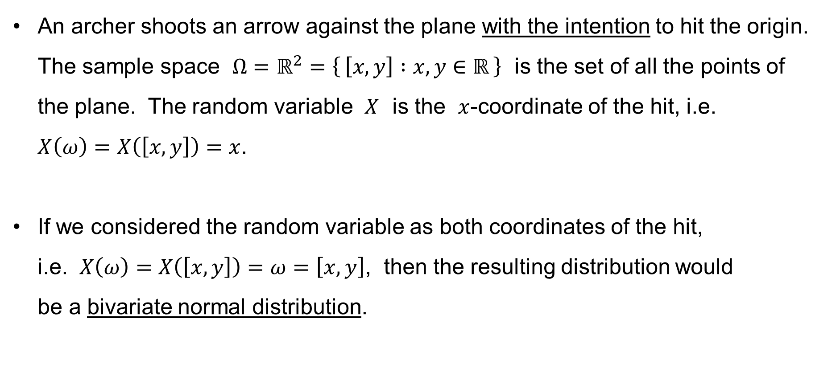
Normal distribution: Example
An archer shoots an arrow against the plane with the intention to hit the origin. The sample space $Ω=ℝ^{2}=\left\{ \left[x,y\right] :x,y∈ℝ \right\}$ is the set of all the points of
the plane. The random variable $X$ is the $x$-coordinate of the hit, i.e.
$X\left(ω\right)=X\left(\left[x,y\right]\right)=x$.
If we considered the random variable as both coordinates of the hit,
i.e. $X\left(ω\right)=X\left(\left[x,y\right]\right)=ω=\left[x,y\right]$, then the resulting distribution would
be a bivariate normal distribution.

Slide 43
Central Limit Theorem (CLT)
There are several versions or variants of the Central Limit Theorem.
Its earlies version is now known as the de Moivre-Laplace Theorem. It states that the normal distribution is an approximation of the discrete binomial distribution.
We shall then mention the Lindeberg-Lévy Theorem, which is a comprehensible variant of the Central Limit Theorem.

Slide 44
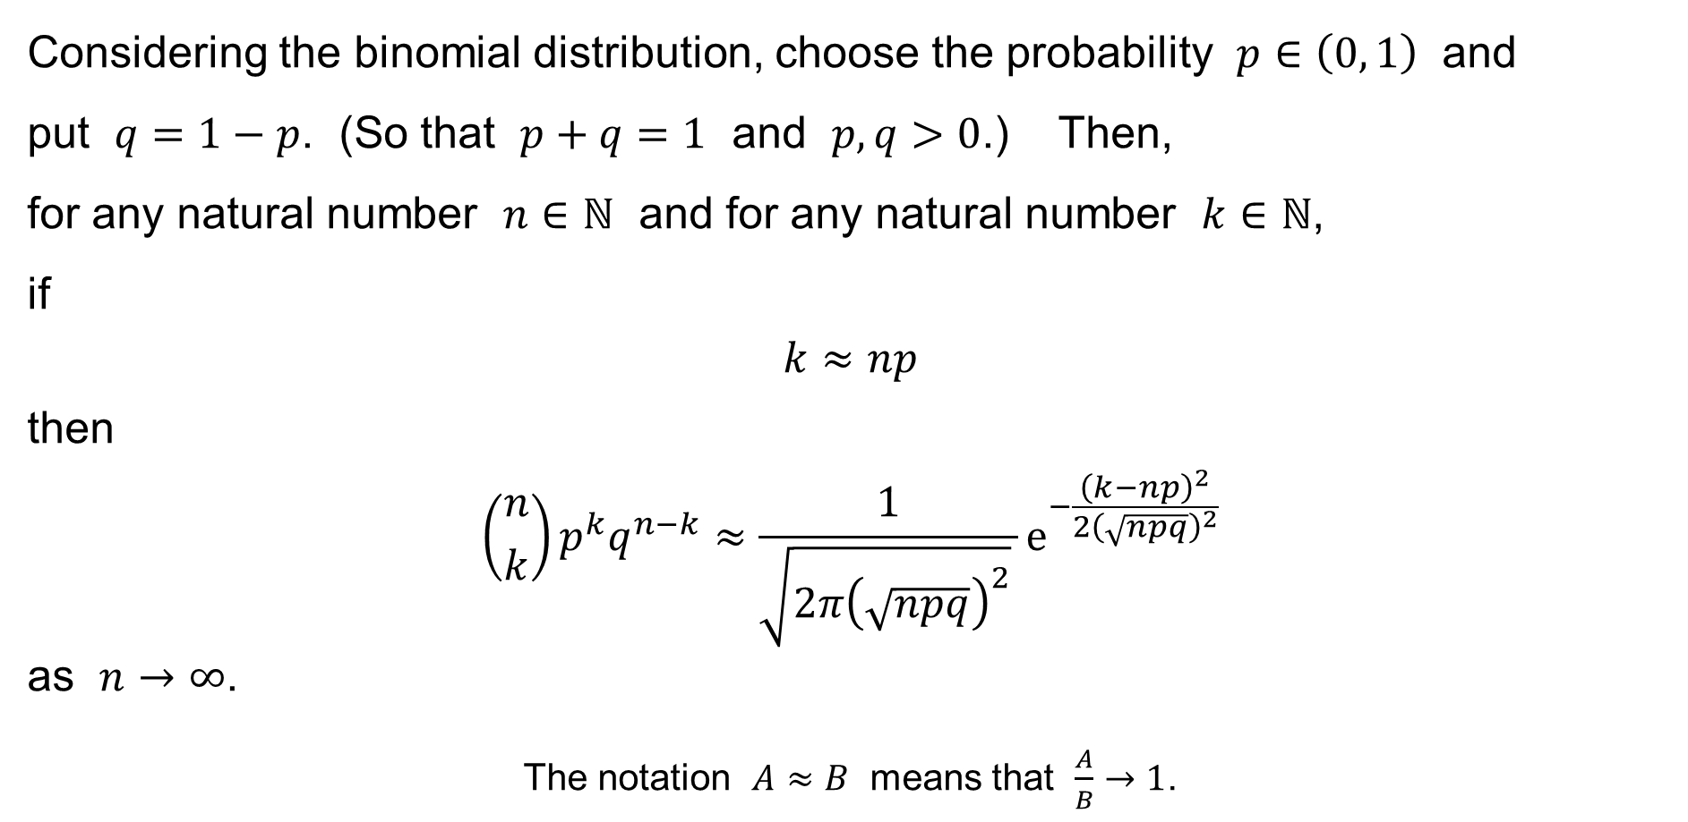
CLT: de Moivre-Laplace Theorem (local form)
Considering the binomial distribution, choose the probability $p∈\left(0, 1\right)$ and
put $q=1−p$. (So that $p+q=1$ and $p,q>0$.) Then,
for any natural number $n∈ℕ$ and for any natural number $k∈ℕ$,
if
$$k≈np$$
then
$$\left({n \atop k}\right)p^{k}q^{n−k}≈\frac{1}{\sqrt{2π{\left(\sqrt{npq}\right)}^{2}} }e^{−\frac{{\left(k−np\right)}^{2}}{2{\left(\sqrt{npq}\right)}^{2}}}$$
as $n→∞$.
The notation $A≈B$ means that $\frac{A}{B}→1$.

Slide 45
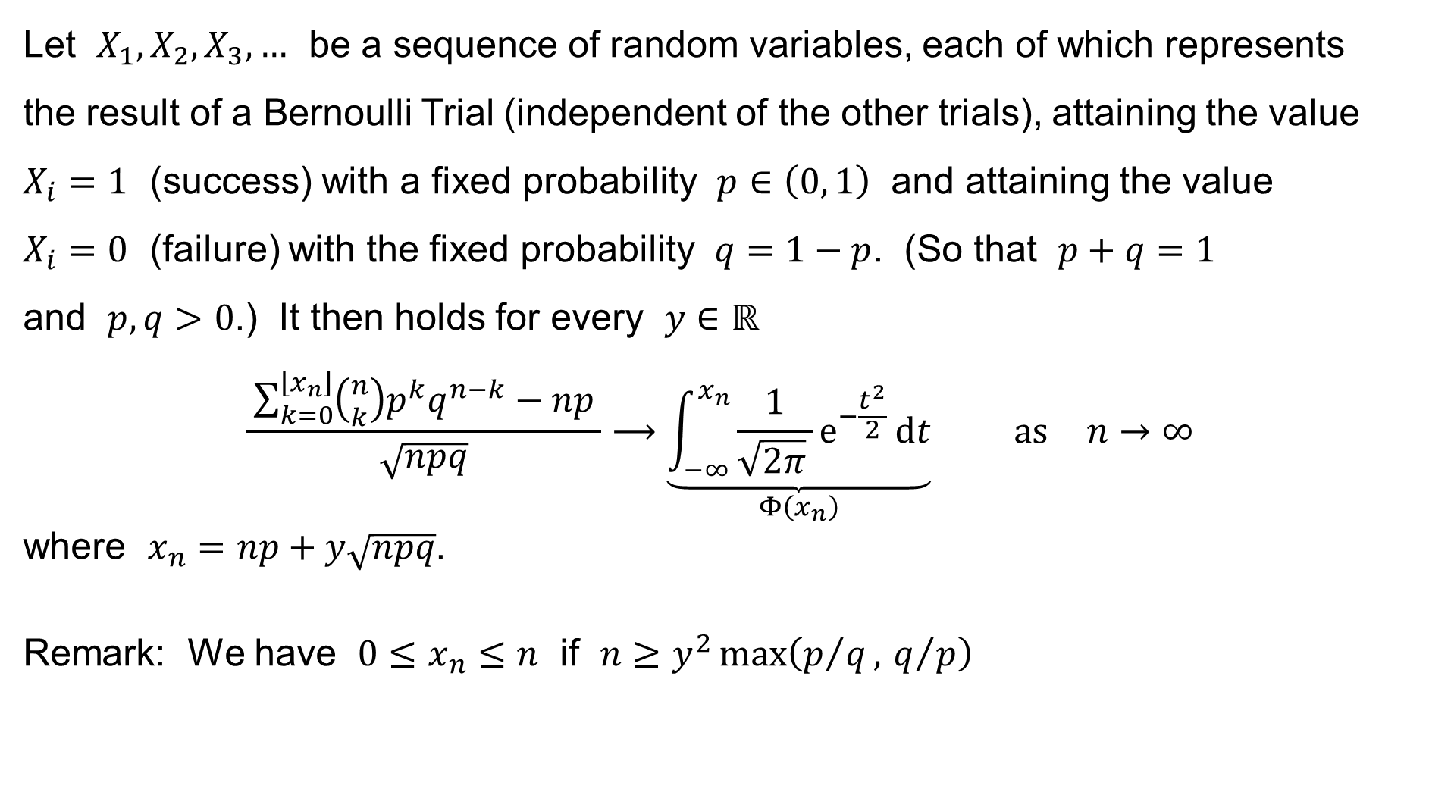
CLT: de Moivre-Laplace Theorem (integral form)
Let $X_{1},X_{2},X_{3},…$ be a sequence of random variables, each of which represents
the result of a Bernoulli Trial (independent of the other trials), attaining the value $X_{i}=1$ (success) with a fixed probability $p∈\left(0, 1\right)$ and attaining the value
$X_{i}=0$ (failure) with the fixed probability $q=1−p$. (So that $p+q=1$
and $p,q>0$.) It then holds for every $y∈ℝ$
$$\frac{ \sum_{\begin{aligned}k=0\end{aligned}}^{\left\lfloor x_{n}\right\rfloor }{\left({n \atop k}\right)p^{k}q^{n−k}}−np }{\sqrt{npq}}⟶\underset{Φ\left(x_{n}\right)}{\underbrace{\int_{−∞}^{x_{n}}{\frac{1}{\sqrt{2π} }e^{−\frac{t^{2}}{2}} dt}}} \text{as} n→∞$$
where $x_{n}=np+y\sqrt{npq}$.
Remark: We have $0≤x_{n}≤n$ if $n≥y^{2}\max\left(p/q, q/p\right)$

Slide 46
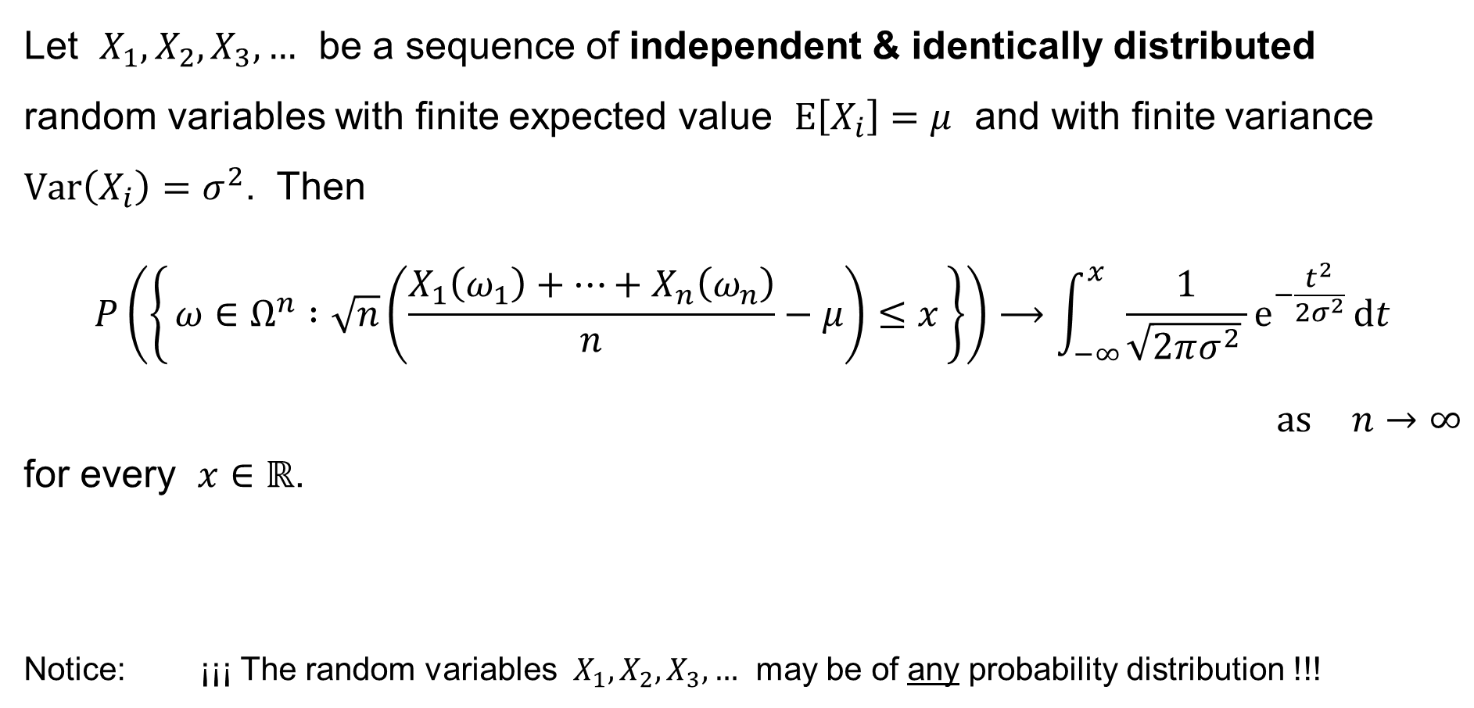
CLT: Lindeberg-Lévy Theorem
Let $X_{1},X_{2},X_{3},…$ be a sequence of independent & identically distributed
random variables with finite expected value $E\left[X_{i}\right]=μ$ and with finite variance $Var\left(X_{i}\right)=σ^{2}$. Then
$$P\left(\left\{ ω∈Ω^{n} :\sqrt{n}\left(\frac{X_{1}\left(ω_{1}\right)+⋯+X_{n}\left(ω_{n}\right)}{n}−μ\right)≤x \right\}\right)⟶\int_{−∞}^{x}{\frac{1}{\sqrt{2πσ^{2}} }e^{−\frac{t^{2}}{2σ^{2}}} dt}$$
$\text{as} n→∞$
for every $x∈ℝ$.
Notice: ¡¡¡ The random variables $X_{1},X_{2},X_{3},…$ may be of any probability distribution !!!

Slide 47
Exponential distribution

Slide 48
Exponential distribution
There are some events, such as
— customers coming to a shop during one hour (between 10:00 and 11:00, say)
— telephone calls incoming during one hour (between 10:00 and 11:00, say)
— requests incoming to a server during one minute (between 10:00 and 10:01)
— meteorites of diameter ≥ 1 meter hitting the Earth during a year
— decay events from a radioactive source
that (as we suppose) have some properties in common.

Slide 49
Exponential distribution
Suppose that a random event occurs repeatedly and satisfies
the following assumptions:
the event can occur at any time
the average number of occurrences of the event during an interval of time
of a fixed length is constant; the number does not depend on the beginning
of the interval, and does not depend on the number of occurrences of the event before the beginning of the time interval
the average number of occurrences of the event during an interval of time is proportional to the length of the interval
…

Slide 50
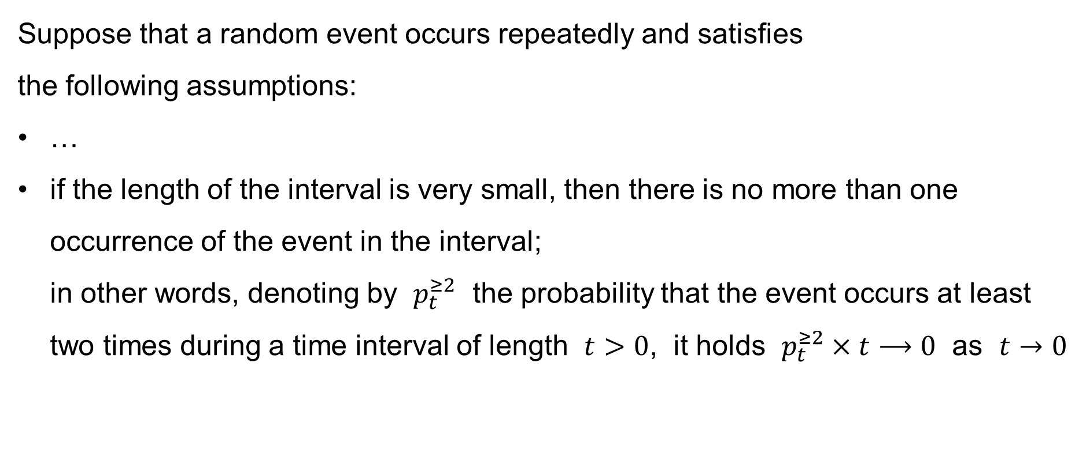
Exponential distribution
Suppose that a random event occurs repeatedly and satisfies
the following assumptions:
…
if the length of the interval is very small, then there is no more than one occurrence of the event in the interval;
in other words, denoting by $p_{t}^{≥2}$ the probability that the event occurs at least two times during a time interval of length $t>0$, it holds $p_{t}^{≥2}×t⟶0$ as $t→0$

Slide 51
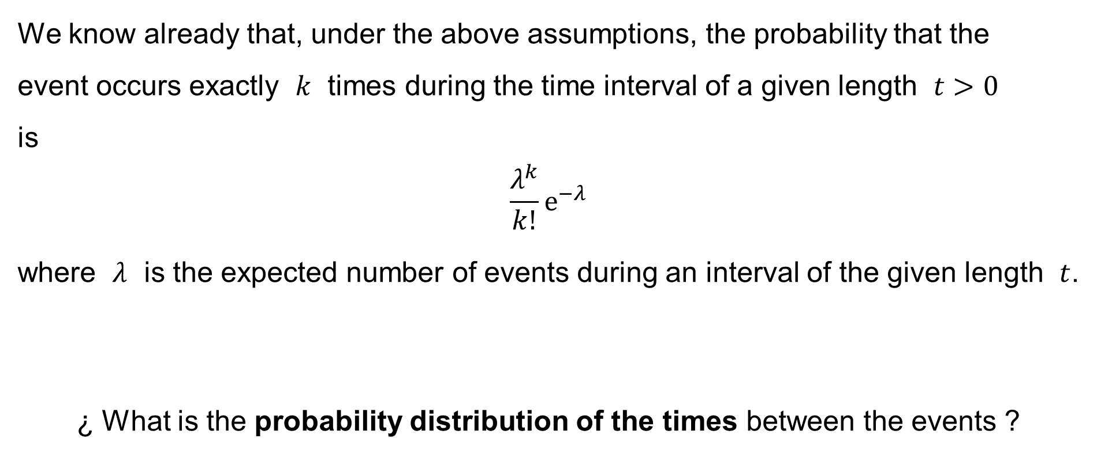
Exponential distribution
We know already that, under the above assumptions, the probability that the
event occurs exactly $k$ times during the time interval of a given length $t>0$
is
$$\frac{λ^{k}}{k!}e^{−λ}$$
where $λ$ is the expected number of events during an interval of the given length $t$.
¿ What is the probability distribution of the times between the events ?

Slide 52
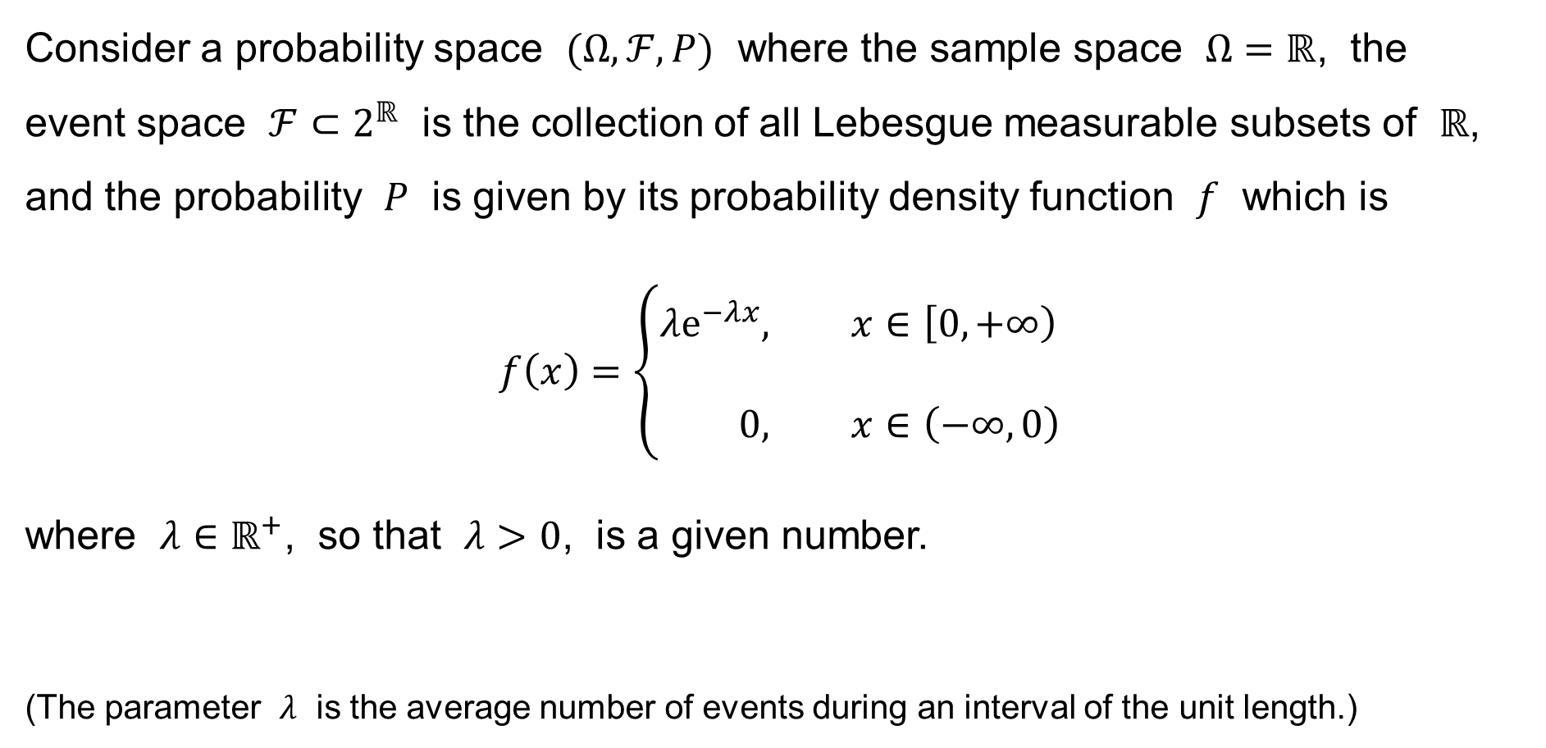
Exponential distribution
Consider a probability space $(Ω,ℱ,P)$ where the sample space $Ω=ℝ$, the
event space $ℱ⊂2^{ℝ}$ is the collection of all Lebesgue measurable subsets of $ℝ$, and the probability $P$ is given by its probability density function $f$ which is
$$f\left(x\right)=\left\{\begin{aligned}λe^{−λx}&, x∈\left[0,+∞\right) \\ \\ 0&, x∈\left(−∞,0\right)\end{aligned}\right.$$
where $λ∈ℝ^{+}$, so that $λ>0$, is a given number.
(The parameter $λ$ is the average number of events during an interval of the unit length.)

Slide 53
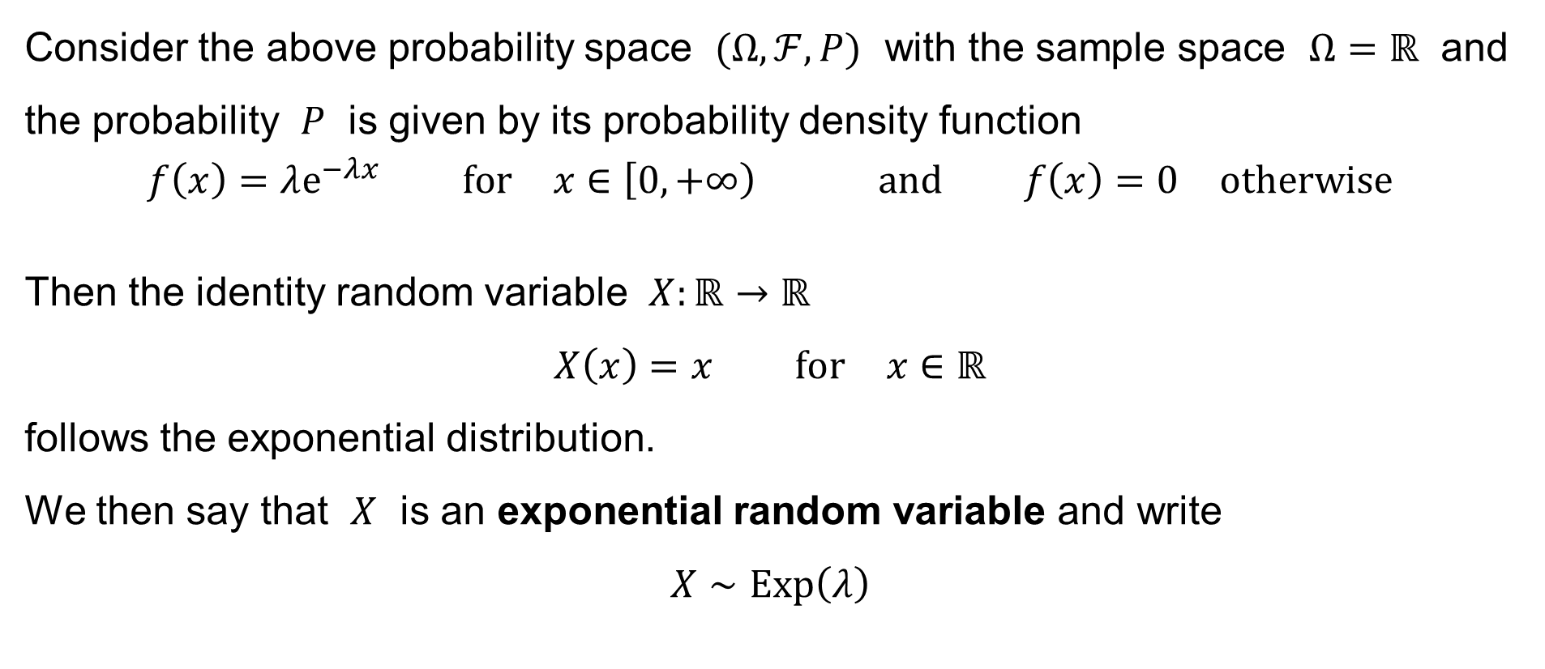
Exponential distribution
Consider the above probability space $(Ω,ℱ,P)$ with the sample space $Ω=ℝ$ and the probability $P$ is given by its probability density function
$$f\left(x\right)=λe^{−λx} \text{for} x∈\left[0,+∞\right) \text{and} f\left(x\right)=0 \text{otherwise}$$
Then the identity random variable $X:ℝ→ℝ$
$$X\left(x\right)=x \text{for} x∈ℝ$$
follows the exponential distribution.
We then say that $X$ is an exponential random variable and write
$$X∼Exp\left(λ\right)$$

Slide 54
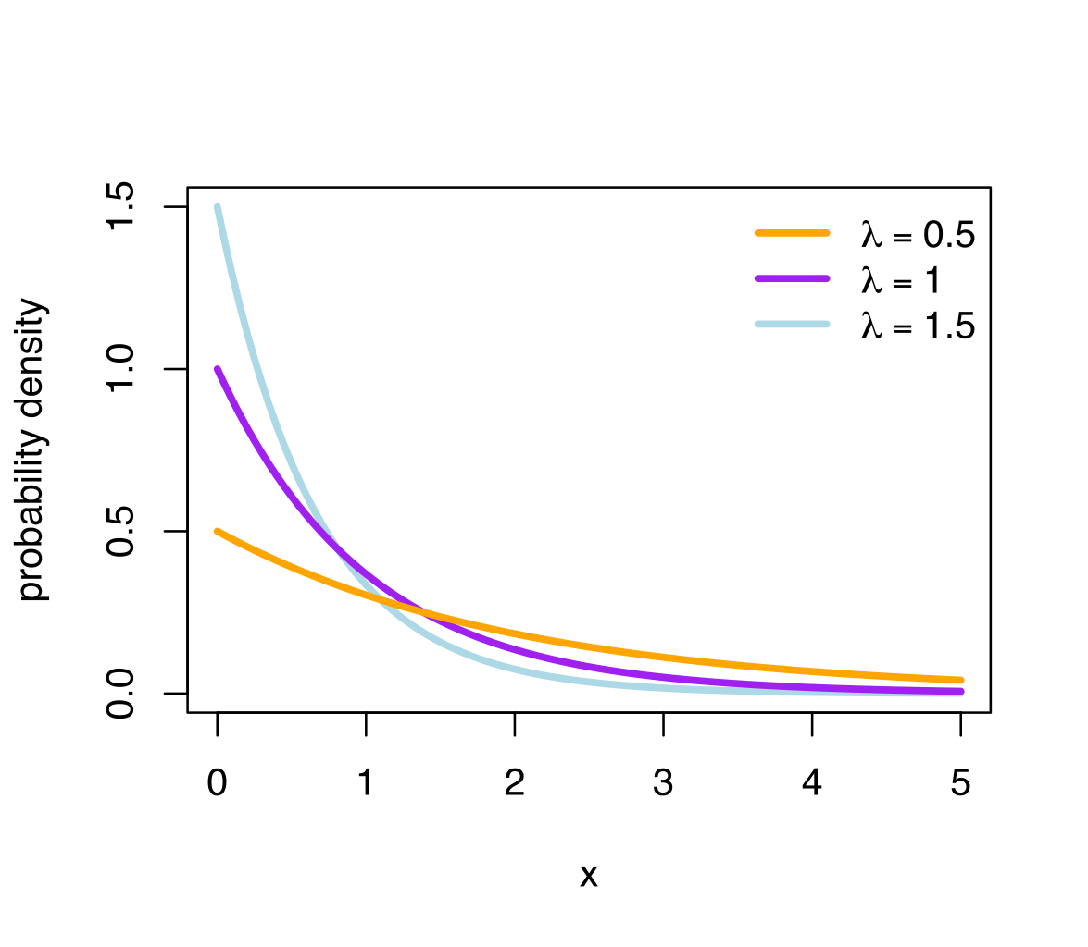

Exponential distribution
The graph of the probability density function of
an exponential random variable $X∼Exp\left(λ\right)$ for various values of the parameter:
source: Wikipedia

Slide 55
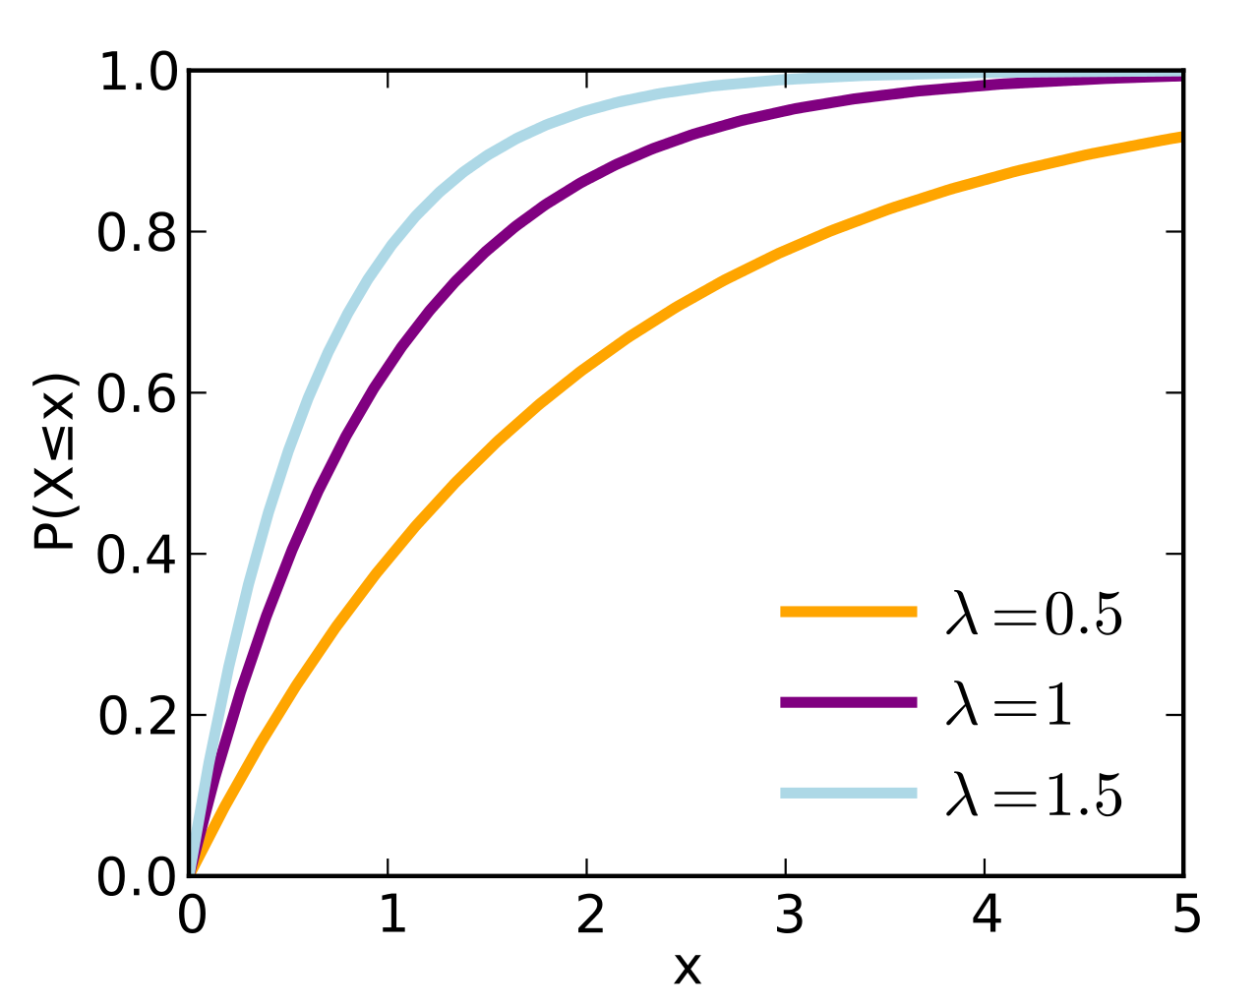

Exponential distribution
The graph of the cumulative distribution function of
an exponential random variable $X∼Exp\left(λ\right)$ for various values of the parameter:
source: Wikipedia

Slide 56
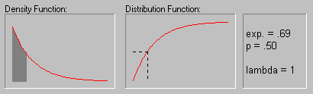

Exponential distribution
The graph of the probability density function & cumulative distribution function
of an exponential random variable $X∼Exp\left(λ\right)$ with $λ=1$:
F(x)
p=0,5
F(x)=0,5
f(x)
x=0,69
x=0,69

Slide 57

Exponential distribution
Let the random variable $X∼Exp\left(λ\right)$ follow the exponential distribution.
Calculate as an exercise:
Mean value: $μ=E\left[X\right]=\frac{1}{λ}$
Variance: $σ^{2}=Var\left(X\right)=\frac{1}{λ^{2}}$
Mode: $\hat{X}=0$
Median: $\tilde{X}=\frac{\ln{2}}{λ}$

Slide 58
Exponential distribution: Examples
The time till the next telephone call.
The time until a radioactive particle decays.
The time between clicks of a Geiger-Müller counter.
The time until the next default in risk modelling.
The time till the next failure / accident / …

Slide 59
Some continuous probability distributions derived from the normal distribution
Pearson’s χ² distribution
Student’s t distribution
Fisher-Snedecor F distribution

Slide 60

Pearson’s χ² distribution
Let
$$Z_{1},Z_{2},…,Z_{k}∼𝒩\left(0, 1\right)$$
be independent & normalized normal random variables. Then the random variable
$$X=Z_{1}^{2}+Z_{2}^{2}+⋯+Z_{k}^{2}$$
i.e. the sum of the squares of the random variables,
follows the chi-squared distribution with $k$ degrees of freedom and we write
$$X∼χ^{2}\left(k\right) \text{or} X∼χ_{k}^{2}$$

Slide 61


chi-squared distribution
The graph of the probability density function of an $X∼χ_{k}^{2}$ for various $k$:
source: Wikipedia

Slide 62


chi-squared distribution
The graph of the cumulative distribution function of an $X∼χ_{k}^{2}$ for various $k$:
source: Wikipedia

Slide 63

chi-squared distribution
The probability density function:
$$f\left(x\right)=\left\{\begin{aligned}\frac{x^{\frac{k}{2}−1}e^{−\frac{x}{2}}}{Γ\left(\frac{k}{2}\right)2^{\frac{k}{2}}}&, x∈\left(0,+∞\right) \\ \\ 0&, x∈\left(−∞,0\right]\end{aligned}\right.$$
Mean value: $μ=E\left[X\right]=k$ Mode: $\hat{X}=\max\left(k−2, 0\right)$
Variance: $σ^{2}=Var\left(x\right)=2k$

Slide 64

The gamma function
$$Γ\left(z\right)=\int_{0}^{+∞}{x^{z}e^{−x} dx} \text{for} z∈ℂ \text{such} \text{that} \operatorname{Re}\left(z\right)>0$$
It is easy to calculate:
$$Γ\left(1\right)=1 \\ Γ\left(z+1\right)=zΓ\left(z\right)$$
Therefore:
$$Γ\left(n+1\right)=n! \text{for} n=0, 1, 2, 3,…$$

Slide 65

The gamma function – another definition (due to Euler)
$$Γ\left(z\right) = \frac{1}{z}\prod_{n=1}^{∞}{\frac{{\left(1+\frac{1}{n}\right)}^{z}}{1+\frac{z}{n}}} \text{for} z∈ℂ∖\left\{0,−1,−2,−3,…\right\}$$

Slide 66

chi-squared distribution in Excel
In Excel, use the functions:
=CHISQ.DIST$\left(x;k;TRUE\right)$ to get the value of the cumulative distribution function of the random variable $X∼χ_{k}^{2}$ ($−∞<x<+∞$)
=CHISQ.DIST$\left(x;k;FALSE\right)$ to get the value of the probability density function of the random variable $X∼χ_{k}^{2}$ ($−∞<x<+∞$)
=CHISQ.INV$\left(p;k\right)$ to get the quantile of the random variable $X∼χ_{k}^{2}$ ($0<p<1$)

Slide 67

chi-squared distribution in Excel
In Excel, use the functions:
=CHISQ.DIST.RT$\left(x;k\right)$ the same as =1-CHISQ.DIST$\left(x;k;TRUE\right)$
=CHISQ.INV.RT$\left(p;k\right)$ the same as =CHISQ.INV$\left(1−p;k\right)$
That is, these functions calculate the cumulative distribution function from the right. This is useful when one needs to calculate the critical value of some χ²-test.

Slide 68

chi-squared distribution in Excel
In Excel, use the functions:
=CHIDIST() the same as =CHISQ.DIST.RT(),
deprecated
=CHIINV() the same as =CHISQ.INV.RT,
deprecated

Slide 69

Student’s t distribution
Let
$$Z,Z_{1},Z_{2},…,Z_{k}∼𝒩\left(0, 1\right)$$
be independent & normalized normal random variables. Then the random variable
$$X= \frac{Z}{\sqrt{\frac{Z_{1}^{2}+Z_{2}^{2}+⋯+Z_{k}^{2}}{k} } } = \frac{Z}{\sqrt{Z_{1}^{2}+Z_{2}^{2}+⋯+Z_{k}^{2} } } \sqrt{k }$$
follows the t-distribution with $k$ degrees of freedom and we write
$$X∼t\left(k\right) \text{or} X∼t_{k}$$

Slide 70

Student’s t distribution
Equivalently, let
$$Z∼𝒩\left(0, 1\right) \text{and} Y∼χ_{k}^{2}$$
be independent random variables. Then the random variable
$$X= \frac{Z}{\sqrt{Y/k } } = \frac{Z}{\sqrt{Y } } \sqrt{k }$$
follows the t-distribution with $k$ degrees of freedom and we write
$$X∼t\left(k\right) \text{or} X∼t_{k}$$

Slide 71


t-distribution
The graph of the probability density function of an $X∼t_{k}$ for various $k$:
source: Wikipedia

Slide 72


t-distribution
The graph of the cumulative distribution function of an $X∼t_{k}$ for various $k$:
source: Wikipedia

Slide 73

t-distribution
The probability density function:
$$f\left(x\right)=\frac{Γ\left(\frac{k+1}{2}\right)}{Γ\left(\frac{k}{2}\right)\sqrt{πk } }{\left(1+\frac{x^{2}}{k}\right)}^{−\frac{k+1}{2}} \text{for} x∈ℝ$$
Mean value: $μ=E\left[X\right]=\left\{\begin{aligned}0&, k=2, 3, 4,… \\ \text{not} \text{exists}&, k=1\end{aligned}\right.$ Mode: $\hat{X}=0$
Variance: $σ^{2}=Var\left(x\right)=\left\{\begin{aligned}\frac{k}{k−2}&, k=3, 4, 5,… \\ +∞&, k=2 \\ \text{not} \text{exists}&, k=1\end{aligned}\right.$ Median: $\tilde{X}=0$

Slide 74

t-distribution in Excel
In Excel, use the functions:
=T.DIST$\left(x;k;TRUE\right)$ to get the value of the cumulative distribution function of the random variable $X∼t_{k}$ ($−∞<x<+∞$)
=T.DIST$\left(x;k;FALSE\right)$ to get the value of the probability density function of the random variable $X∼t_{k}$ ($−∞<x<+∞$)
=T.INV$\left(p;k\right)$ to get the quantile of the random variable $X∼t_{k}$ ($0<p<1$)

Slide 75

t-distribution in Excel
In Excel, use the functions:
=T.DIST.RT$\left(x;k\right)$ the same as =1-T.DIST$\left(x;k;TRUE\right)$
=T.DIST.2T$\left(x;k\right)$ the same as =2*T.DIST.RT$\left(x;k\right)$
=T.INV.2T$\left(p;k\right)$ the same as =T.INV$\left(1−p/2;k\right)$
That is, the functions calculate the cumulative distribution function from the right. This is useful when one needs to calculate the critical value of some t-test.

Slide 76

t-distribution in Excel
In Excel, use the functions:
=TDIST$\left(x;k;tails\right)$ $tails=1$:
the same as =T.DIST.RT$\left(x;k\right)$, deprecated
$tails=2$:
the same as =T.DIST.2T$\left(x;k\right)$, deprecated
=TINV() the same as =T.INV.2T, deprecated

Slide 77

Fisher-Snedecor F distribution
Let
$$Z_{1}^{′},Z_{2}^{′},…,Z_{k_{1}}^{′}∼𝒩\left(0, 1\right) \text{and} Z_{1}^{′′},Z_{2}^{′′},…,Z_{k_{2}}^{′′}∼𝒩\left(0, 1\right)$$
be independent & normalized normal random variables. Then the random variable
$$X= \frac{\frac{{Z_{1}^{′}}^{2}+{Z_{2}^{′}}^{2}+⋯+{Z_{k_{1}}^{′}}^{2}}{k_{1}}}{ \frac{{Z_{1}^{′′}}^{2}+{Z_{2}^{′′}}^{2}+⋯+{Z_{k_{2}}^{′′}}^{2}}{k_{2}} } = {\frac{{Z_{1}^{′}}^{2}+{Z_{2}^{′}}^{2}+⋯+{Z_{k_{1}}^{′}}^{2}}{ {Z_{1}^{′′}}^{2}+{Z_{2}^{′′}}^{2}+⋯+{Z_{k_{2}}^{′′}}^{2} } }/{ \frac{k_{1}}{k_{2}}}$$
follows the F-distribution with $k_{1}$ and $k_{2}$ degrees of freedom and we write
$$X∼F\left(k_{1},k_{2}\right) \text{or} X∼F_{k_{1},k_{2}}$$

Slide 78

Fisher-Snedecor F distribution
Equivalently, let
$$Y_{1}∼χ_{k_{1}}^{2} \text{and} Y_{2}∼χ_{k_{2}}^{2}$$
be independent random variables. Then the random variable
$$X= \frac{ \frac{Y_{1}}{k_{1}} }{ \frac{Y_{2}}{k_{2}} } = {\frac{Y_{1}}{Y_{2}} }/{ \frac{k_{1}}{k_{2}}}$$
follows the F-distribution with $k_{1}$ and $k_{2}$ degrees of freedom and we write
$$X∼F\left(k_{1},k_{2}\right) \text{or} X∼F_{k_{1},k_{2}}$$

Slide 79


F-distribution
The graph of the probability density function of an $X∼F_{k_{1},k_{2}}$ for
various $k_{1},k_{2}$:
source: Wikipedia

Slide 80


F-distribution
The graph of the cumulative distribution function of an $X∼F_{k_{1},k_{2}}$ for
various $k_{1},k_{2}$:
source: Wikipedia

Slide 81

F-distribution
The probability density function:
$$f\left(x\right)=\left\{\begin{aligned}\frac{Γ\left(\frac{k_{1}+k_{2}}{2}\right)}{Γ\left(\frac{k_{1}}{2}\right)Γ\left(\frac{k_{2}}{2}\right)}{\left(\frac{k_{1}}{k_{2}}\right)}^{\frac{k_{1}}{2}}x^{\frac{k_{1}}{2}−1}{\left(1+\frac{k_{1}}{k_{2}}x\right)}^{−\frac{k_{1}+k_{2}}{2}}&, x∈\left(0,+∞\right) \\ \\ 0&, x∈\left(−∞,0\right]\end{aligned}\right.$$

Slide 82

F-distribution
Mean value (for $k_{2}=3, 4, 5,…$):
$$μ=E\left[X\right]=\frac{k_{2}}{k_{2}−2}$$
Variance (for $k_{2}=5, 6, 7,…$):
$$σ^{2}=Var\left(X\right)=\frac{2k_{2}^{2}\left(k_{1}+k_{2}−2\right)}{k_{1}{\left(k_{2}−2\right)}^{2}\left(k_{2}−4\right)}$$
Mode (for $k_{1}=3, 4, 5,…$):
$$\hat{X}=\frac{k_{1}−2}{k_{1}}\frac{k_{2}}{k_{2}+2}$$

Slide 83

F-distribution in Excel
In Excel, use the functions:
=F.DIST$\left(x;k_{1};k_{2};TRUE\right)$ to get the value of the cumulative distribution function of the random variable $X∼F_{k_{1}k_{2}}$ ($−∞<x<+∞$)
=F.DIST$\left(x;k_{1};k_{2};FALSE\right)$ to get the value of the probability density function of the random variable $X∼F_{k_{1},k_{2}}$ ($−∞<x<+∞$)
=F.INV$\left(p;k_{1};k_{2}\right)$ to get the quantile of the random variable $X∼F_{k_{1},k_{2}}$ ($0<p<1$)

Slide 84

F-distribution in Excel
In Excel, use the functions:
=F.DIST.RT$\left(x;k_{1};k_{2}\right)$ the same as =1-F.DIST$\left(x;k_{1};k_{2};TRUE\right)$
=F.INV.RT$\left(p;k_{1};k_{2}\right)$ the same as =F.INV$\left(1−p;k_{1};k_{2}\right)$
That is, these functions calculate the cumulative distribution function from the right. This is useful when one needs to calculate the critical value of some F-test.

Slide 85

F-distribution in Excel
In Excel, use the functions:
=FDIST() the same as =F.DIST.RT(),
deprecated
=FINV() the same as =F.INV.RT,
deprecated

