Slide 1
Statistics
Lecture 8
Point and interval estimates
David Bartl
Statistics
INM/BASTA

Slide 2
Central Limit Theorem: the Lindenberg-Lévy Theorem
Sampling and survey data collection
— sampling with replacement
— sampling without replacement
Point estimates
— point estimates for the population mean and for the population variance
Interval estimates
— interval estimates for the population mean and for the population variance

Slide 3
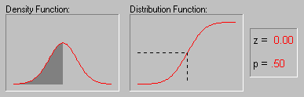

Normal distribution
The graph of the probability density function & cumulative distribution function
of a normal random variable $X∼𝒩\left(μ,σ^{2}\right)$ with $μ=0$:
1
p=0,5
p=0,5
z=0
z=0

Slide 4
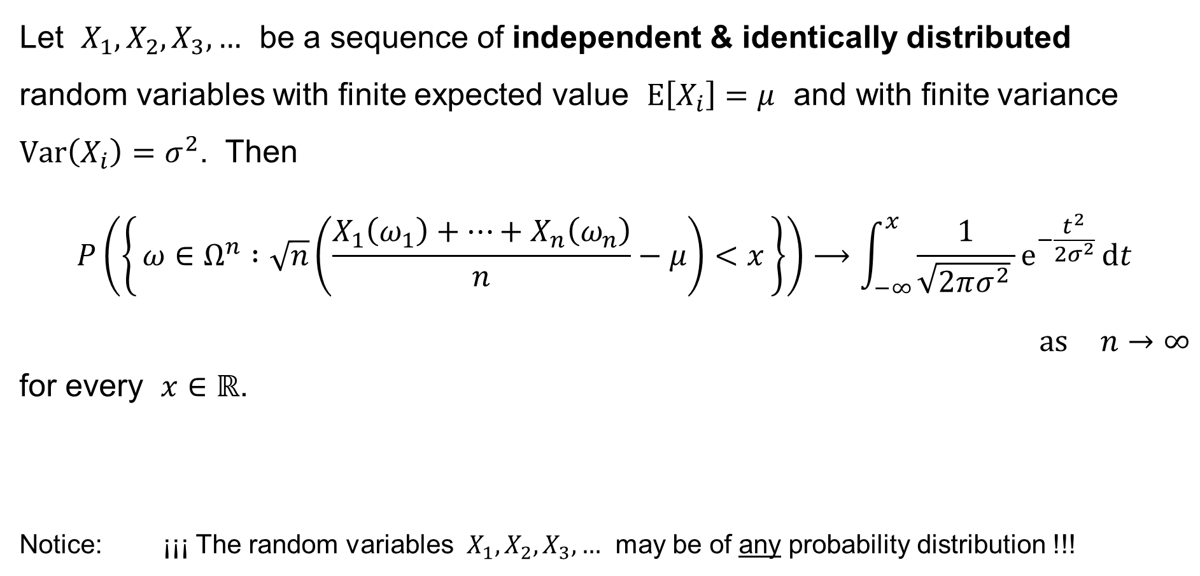
CLT: Lindeberg-Lévy Theorem
Let $X_{1},X_{2},X_{3},…$ be a sequence of independent & identically distributed
random variables with finite expected value $E\left[X_{i}\right]=μ$ and with finite variance $Var\left(X_{i}\right)=σ^{2}$. Then
$$P\left(\left\{ ω∈Ω^{n} :\sqrt{n}\left(\frac{X_{1}\left(ω_{1}\right)+⋯+X_{n}\left(ω_{n}\right)}{n}−μ\right)<x \right\}\right)⟶\int_{−∞}^{x}{\frac{1}{\sqrt{2πσ^{2}} }e^{−\frac{t^{2}}{2σ^{2}}} dt}$$
$\text{as} n→∞$
for every $x∈ℝ$.
Notice: ¡¡¡ The random variables $X_{1},X_{2},X_{3},…$ may be of any probability distribution !!!

Slide 5
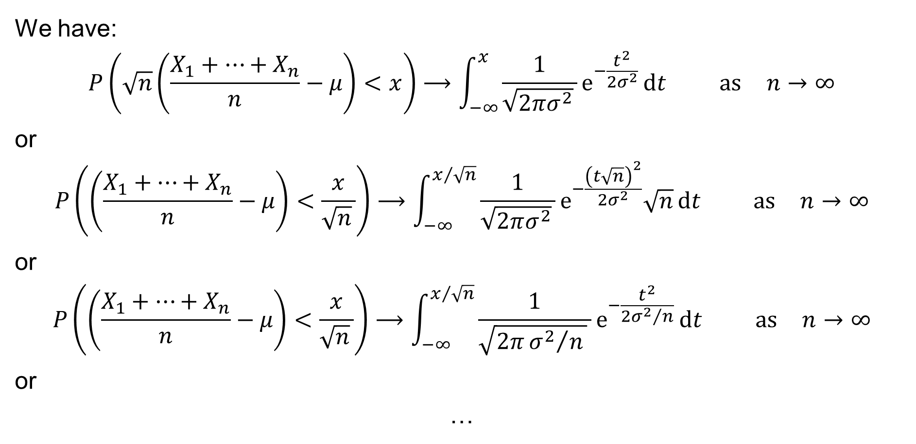
CLT: Lindeberg-Lévy Theorem in brief
We have:
$$P\left(\sqrt{n}\left(\frac{X_{1}+⋯+X_{n}}{n}−μ\right)<x\right)⟶\int_{−∞}^{x}{\frac{1}{\sqrt{2πσ^{2}} }e^{−\frac{t^{2}}{2σ^{2}}} dt} \text{as} n→∞$$
or
$$P\left(\left(\frac{X_{1}+⋯+X_{n}}{n}−μ\right)<\frac{x}{\sqrt{n} }\right)⟶\int_{−∞}^{x/{\sqrt{n}}}{\frac{1}{\sqrt{2πσ^{2}} }e^{−\frac{{\left(t\sqrt{n}\right)}^{2}}{2σ^{2}}}\sqrt{n} dt} \text{as} n→∞$$
or
$$P\left(\left(\frac{X_{1}+⋯+X_{n}}{n}−μ\right)<\frac{x}{\sqrt{n} }\right)⟶\int_{−∞}^{x/{\sqrt{n}}}{\frac{1}{\sqrt{2π{σ^{2}}/n } }e^{−\frac{t^{2}}{2{σ^{2}}/n}} dt} \text{as} n→∞$$
or
…

Slide 6
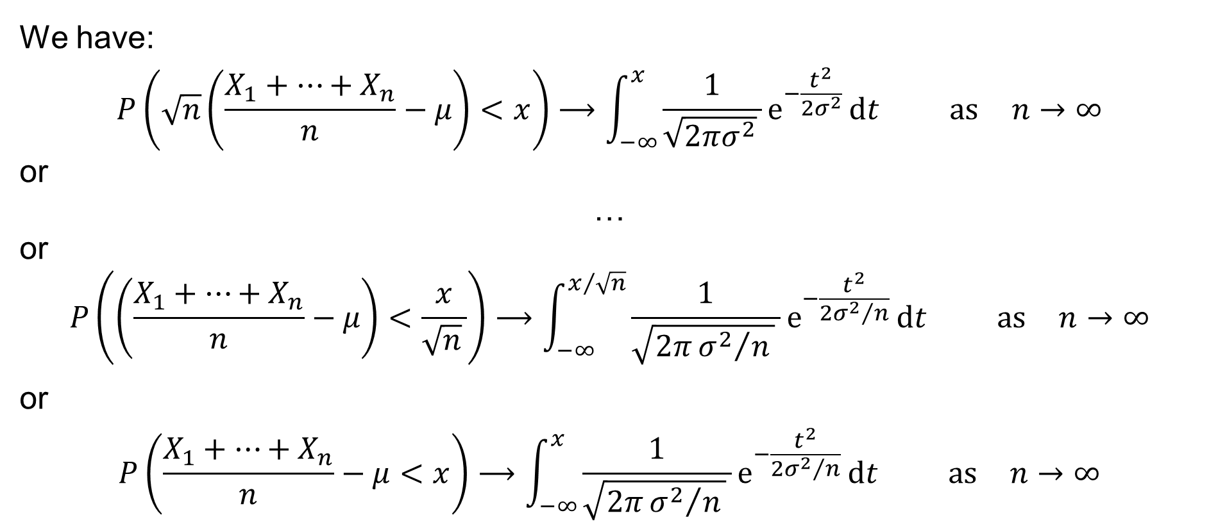
CLT: Lindeberg-Lévy Theorem in brief
We have:
$$P\left(\sqrt{n}\left(\frac{X_{1}+⋯+X_{n}}{n}−μ\right)<x\right)⟶\int_{−∞}^{x}{\frac{1}{\sqrt{2πσ^{2}} }e^{−\frac{t^{2}}{2σ^{2}}} dt} \text{as} n→∞$$
or
…
or
$$P\left(\left(\frac{X_{1}+⋯+X_{n}}{n}−μ\right)<\frac{x}{\sqrt{n} }\right)⟶\int_{−∞}^{x/{\sqrt{n}}}{\frac{1}{\sqrt{2π{σ^{2}}/n } }e^{−\frac{t^{2}}{2{σ^{2}}/n}} dt} \text{as} n→∞$$
or
$$P\left(\frac{X_{1}+⋯+X_{n}}{n}−μ<x\right)⟶\int_{−∞}^{x}{\frac{1}{\sqrt{2π{σ^{2}}/n } }e^{−\frac{t^{2}}{2{σ^{2}}/n}} dt} \text{as} n→∞$$

Slide 7

CLT: Lindeberg-Lévy Theorem in in other words
In other words, we approximately have:
$$\underset{\overline{X}}{\underbrace{\frac{X_{1}+X_{2}+⋯+X_{n}}{n}}}−μ∼𝒩\left(0,\frac{σ^{2}}{n}\right) \text{as} n→∞$$
or
$$\overline{X}∼𝒩\left(μ,\frac{σ^{2}}{n}\right) \text{as} n→∞$$

Slide 8
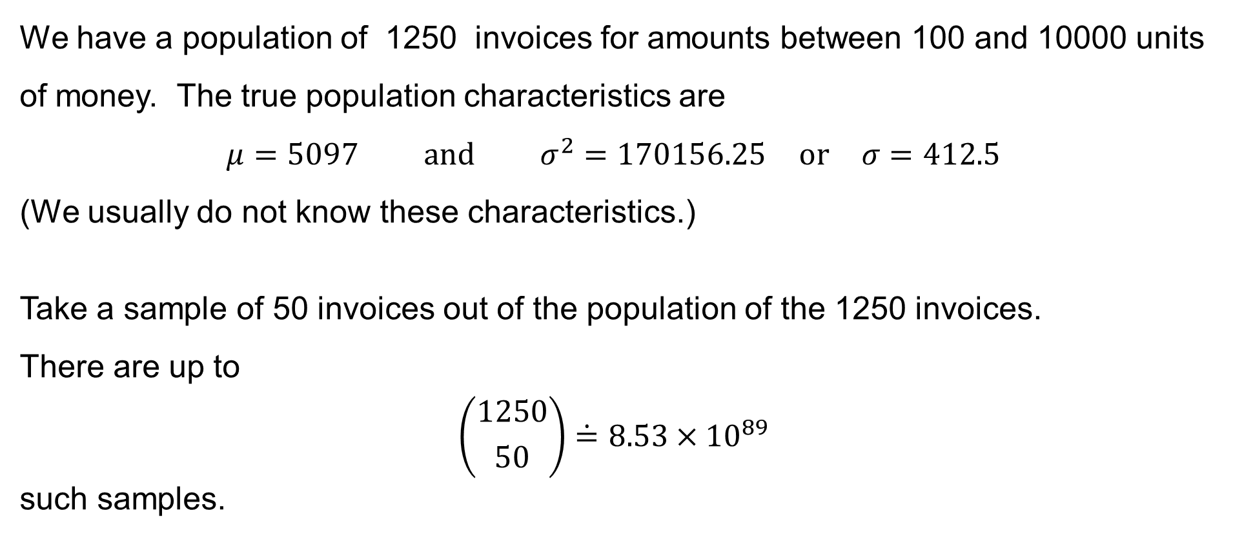
Example: Invoices
We have a population of 1250 invoices for amounts between 100 and 10000 units of money. The true population characteristics are
$$μ=5097 \text{and} σ^{2}=170156.25 \text{or} σ=412.5$$
(We usually do not know these characteristics.)
Take a sample of 50 invoices out of the population of the 1250 invoices.
There are up to
$$\left({1250 \atop 50}\right)\dot{=}8.53×{10}^{89}$$
such samples.

Slide 9
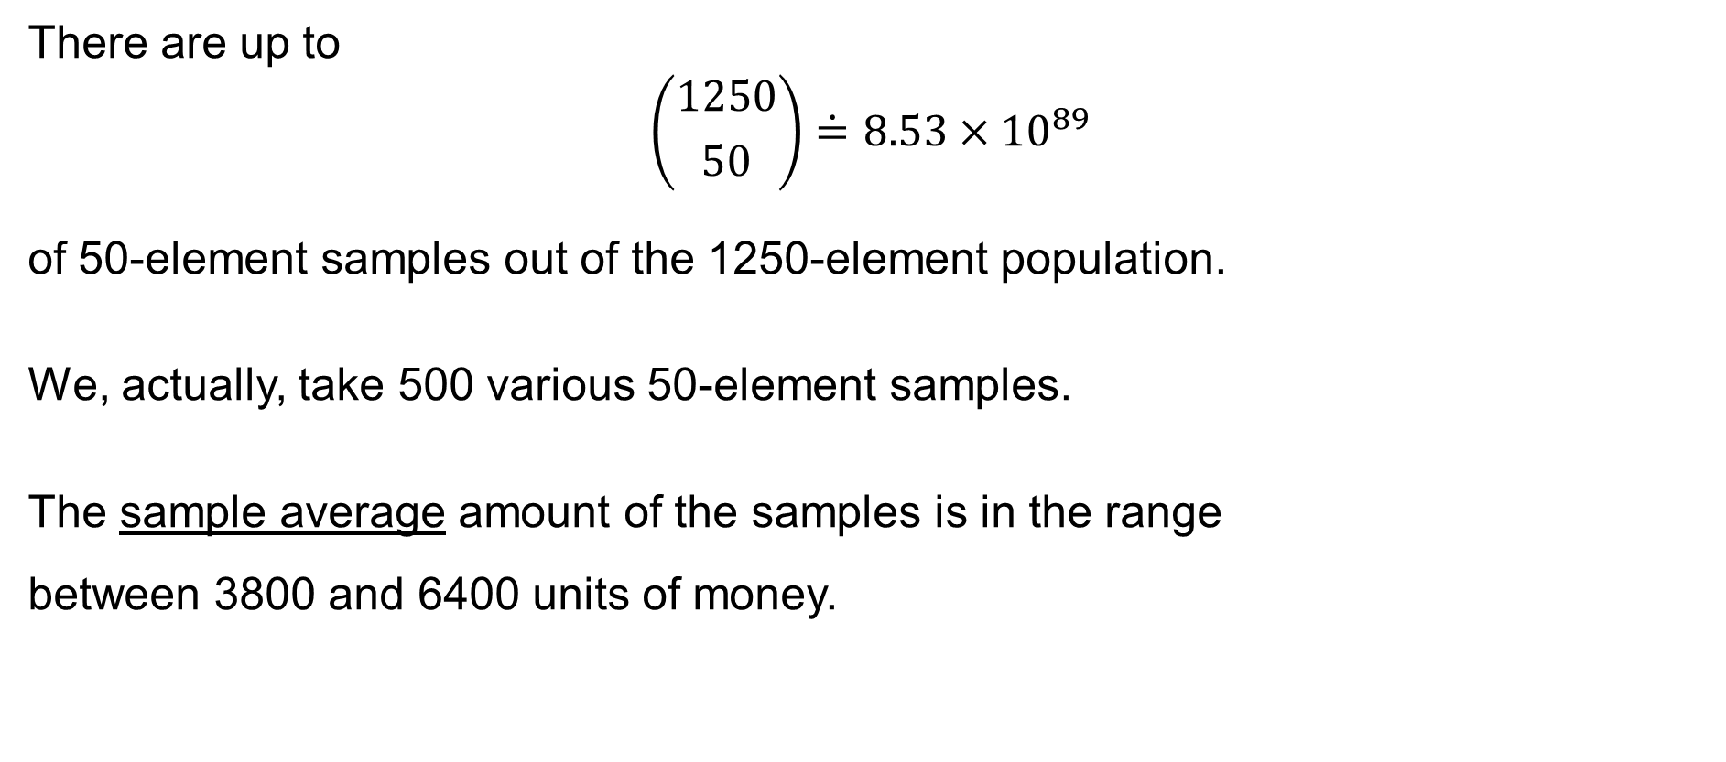
Example: Invoices
There are up to
$$\left({1250 \atop 50}\right)\dot{=}8.53×{10}^{89}$$
of 50-element samples out of the 1250-element population.
We, actually, take 500 various 50-element samples.
The sample average amount of the samples is in the range
between 3800 and 6400 units of money.

Slide 10
Example: Invoices
The table
of the frequencies
for the sample mean
of the 50-element
samples:
Interval of the sample mean | Frequency (number) | Relative frequency
3800 ≤ x¯ < 4000 | 1 | 0.2 %
4000 ≤ x¯ < 4200 | 2 | 0.4 %
4200 ≤ x¯ < 4400 | 17 | 3.4 %
4400 ≤ x¯ < 4600 | 39 | 7.8 %
4600 ≤ x¯ < 4800 | 52 | 10.4 %
4800 ≤ x¯ < 5000 | 85 | 17.0 %
5000 ≤ x¯ < 5200 | 110 | 22.0 %
5200 ≤ x¯ < 5400 | 77 | 15.4 %
5400 ≤ x¯ < 5600 | 64 | 12.8 %
5600 ≤ x < 5800 | 37 | 7.4 %
5800 ≤ x¯ < 6000 | 10 | 2.0 %
6000 ≤ x¯ < 6200 | 4 | 0.8 %
6200 ≤ x¯ < 6400 | 2 | 0.4 %
TOTAL: | 500 | 100.0 %

Slide 11
Example: Invoices
Histogram – the relative frequencies of the sample mean – 500-element sample:
Relative frequency
25 %
22.0
20 %
17.0
15.4
15 %
12.8
10.4
10 %
7.8
7.4
5 %
3.4
2.0
0.2
0.4
0.8
0.4
0 %
3800
4000
4200
4400
4600
4800
5000
5200
5400
5600
5800
5400
5600
5800
Amount of money

Slide 12


Example: Invoices
Histogram – the relative frequencies of the sample mean – 5000-element sample:
$$μ=5097$$
$$10000$$

Slide 13
Sampling and survey data collection
The population is often very large, or the population may not be clearly specified in practice.
Sampling is a method to obtain a relevant sample of the entire population.
The sample should be representative, i.e. its structure should follow the structure of the entire population.
Sampling plan (random sample, etc.) – see below.
The methods of collecting the data:
— [opinion] poll, survey
— questionnaire
— on-line / telephone / mail / face-to-face / …

Slide 14
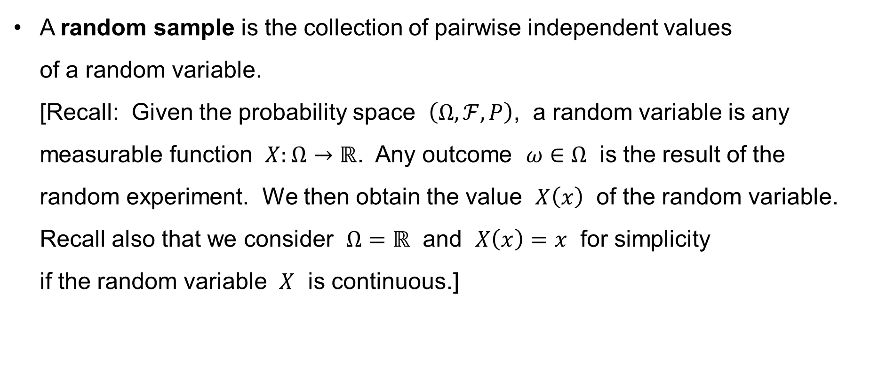
Sampling and survey data collection
A random sample is the collection of pairwise independent values
of a random variable.
[Recall: Given the probability space $\left(Ω,ℱ,P\right)$, a random variable is any measurable function $X:Ω→ℝ$. Any outcome $ω∈Ω$ is the result of the
random experiment. We then obtain the value $X\left(x\right)$ of the random variable. Recall also that we consider $Ω=ℝ$ and $X\left(x\right)=x$ for simplicity
if the random variable $X$ is continuous.]

Slide 15
Sampling and survey data collection
Simple random sampling – each element has equal chance of being selected.
Systematic sampling.
Stratified sampling.
Cluster sampling.
Accidental sampling.
…

Slide 16
Sampling with and without replacement
Replacement of selected units:
sampling without replacement:
— an element can appear no more than once in the sample
sampling with replacement:
— an element can appear several times in the sample
Note that sampling without replacement is often the case in practice.

Slide 17
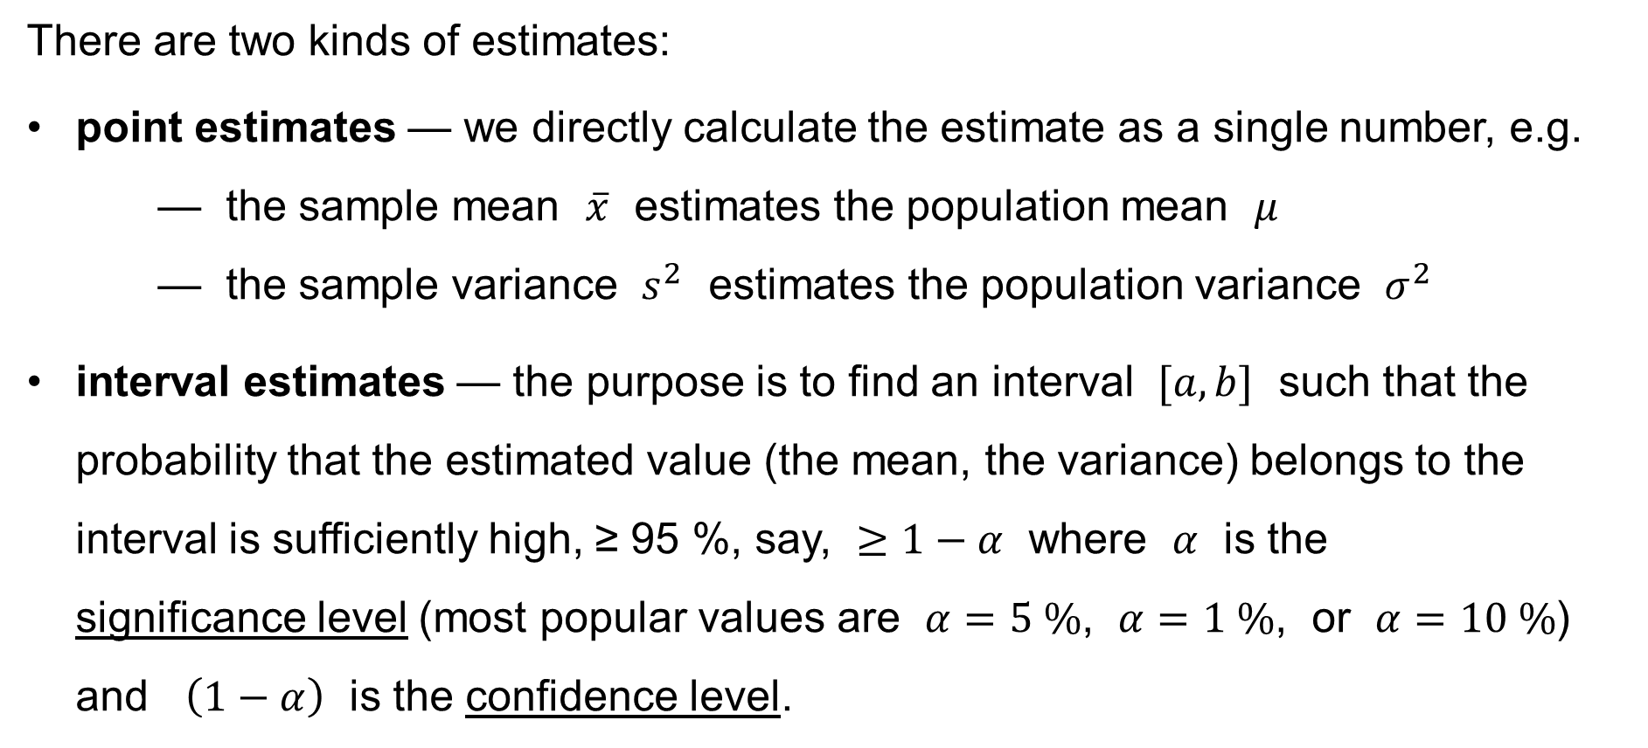
Point estimates & Interval estimates
There are two kinds of estimates:
point estimates — we directly calculate the estimate as a single number, e.g.
— the sample mean $\overline{x}$ estimates the population mean $μ$
— the sample variance $s^{2}$ estimates the population variance $σ^{2}$
interval estimates — the purpose is to find an interval $[a,b]$ such that the probability that the estimated value (the mean, the variance) belongs to the interval is sufficiently high, ≥ 95 %, say, $≥1−α$ where $α$ is the
significance level (most popular values are $α=5 \%$, $α=1 \%$, or $α=10 \%$) and $\left(1−α\right)$ is the confidence level.

Slide 18
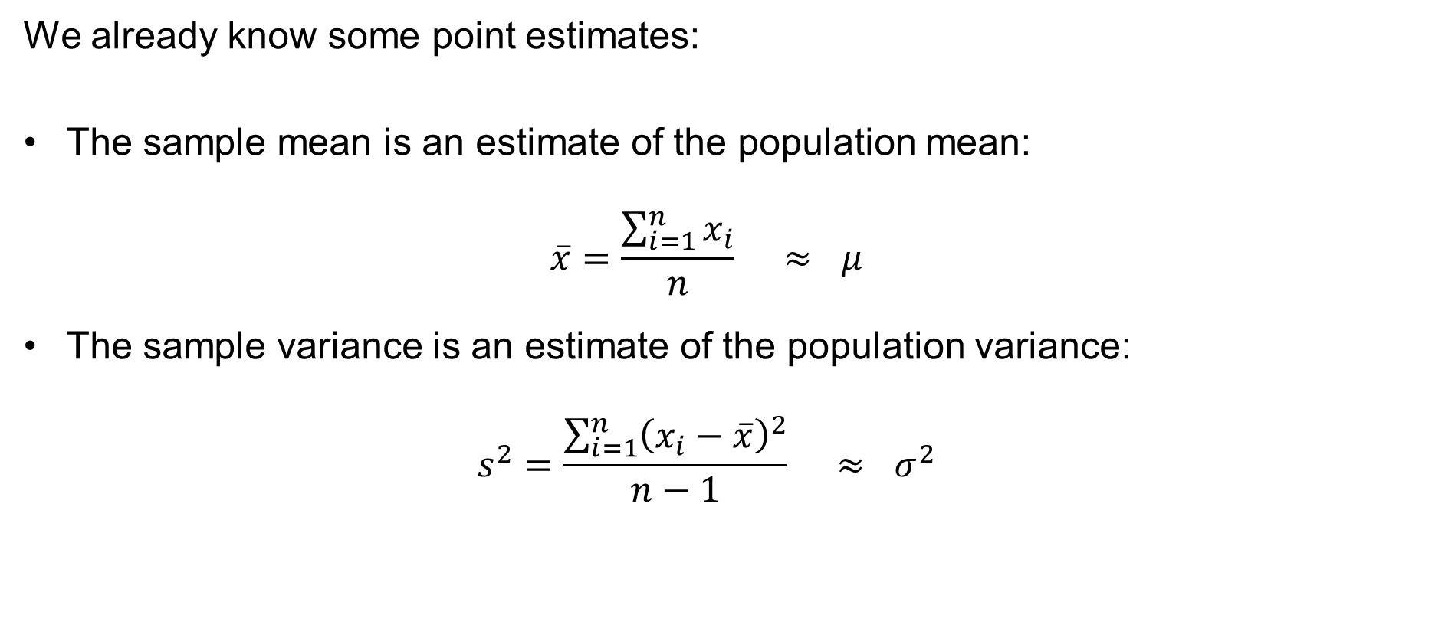
Point estimates
We already know some point estimates:
The sample mean is an estimate of the population mean:
$\overline{x}=\frac{\sum_{i=1}^{n}{x_{i}}}{n} ≈ μ$
The sample variance is an estimate of the population variance:
$s^{2}=\frac{\sum_{i=1}^{n}{{\left(x_{i}−\overline{x}\right)}^{2}}}{n−1} ≈ σ^{2}$

Slide 19
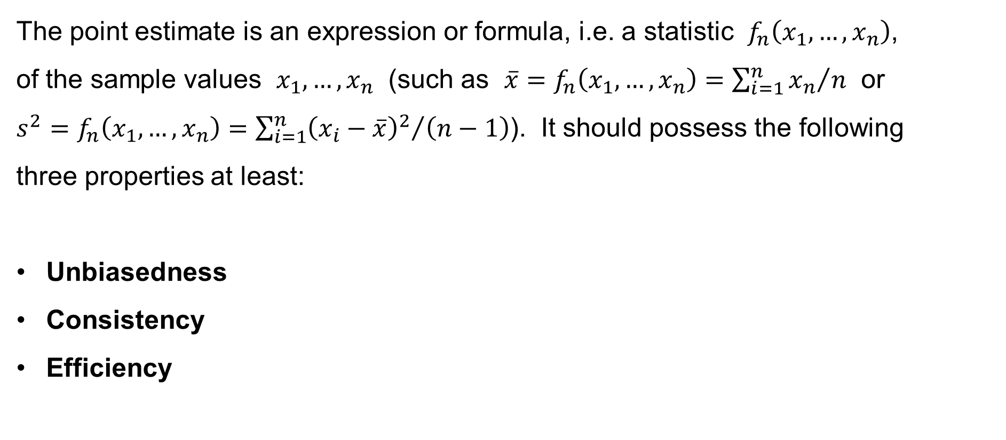
Point estimates
The point estimate is an expression or formula, i.e. a statistic $f_{n}\left(x_{1},…,x_{n}\right)$,
of the sample values $x_{1},…,x_{n}$ (such as $\overline{x}=f_{n}\left(x_{1},…,x_{n}\right)={\sum_{i=1}^{n}{x_{n}}}/n$ or
$s^{2}=f_{n}\left(x_{1},…,x_{n}\right)={\sum_{i=1}^{n}{{\left(x_{i}−\overline{x}\right)}^{2}}}/{\left(n−1\right)}$). It should possess the following
three properties at least:
Unbiasedness
Consistency
Efficiency

Slide 20
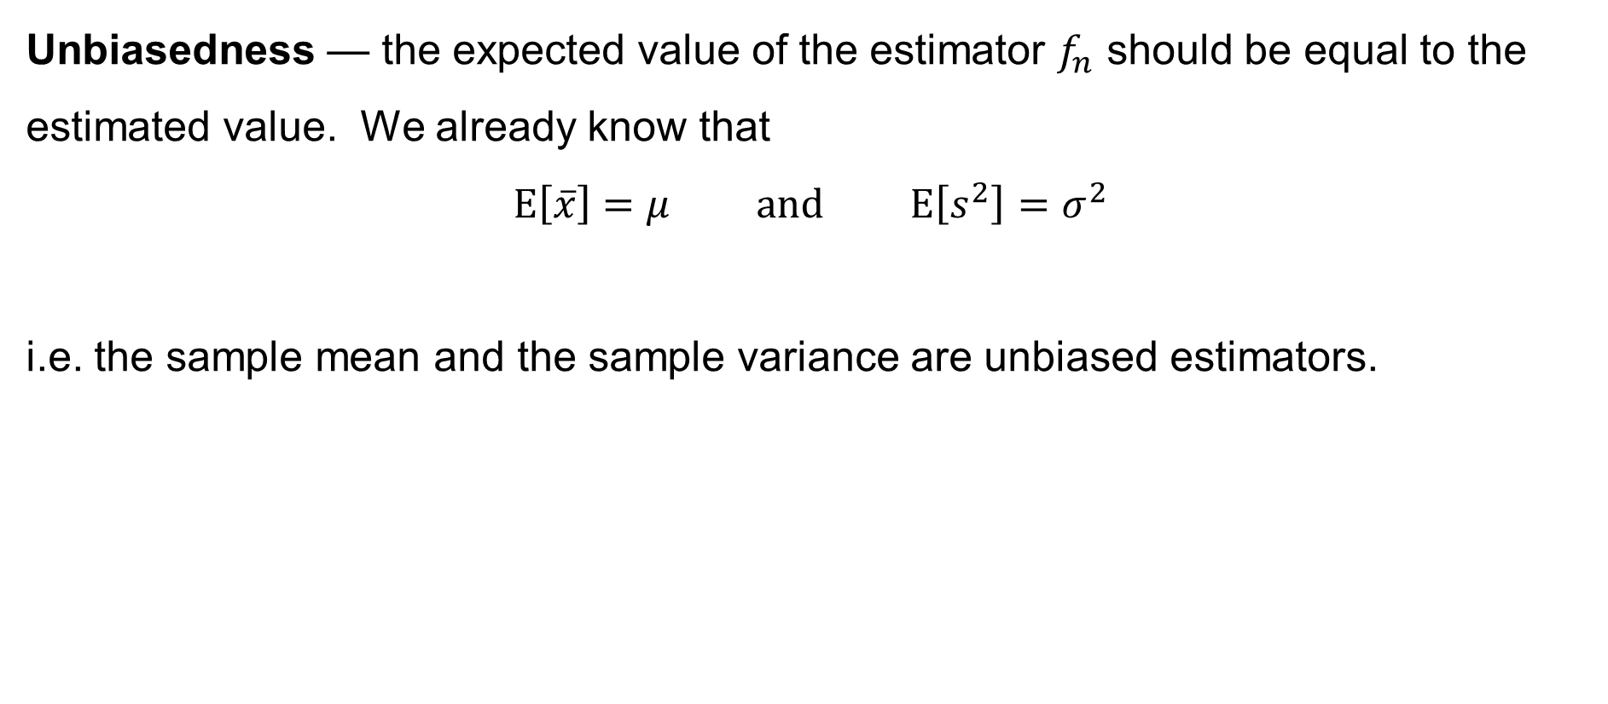
Point estimates
Unbiasedness — the expected value of the estimator $f_{n}$ should be equal to the estimated value. We already know that
$$E\left[\overline{x}\right]=μ \text{and} E\left[s^{2}\right]=σ^{2}$$
i.e. the sample mean and the sample variance are unbiased estimators.

Slide 21
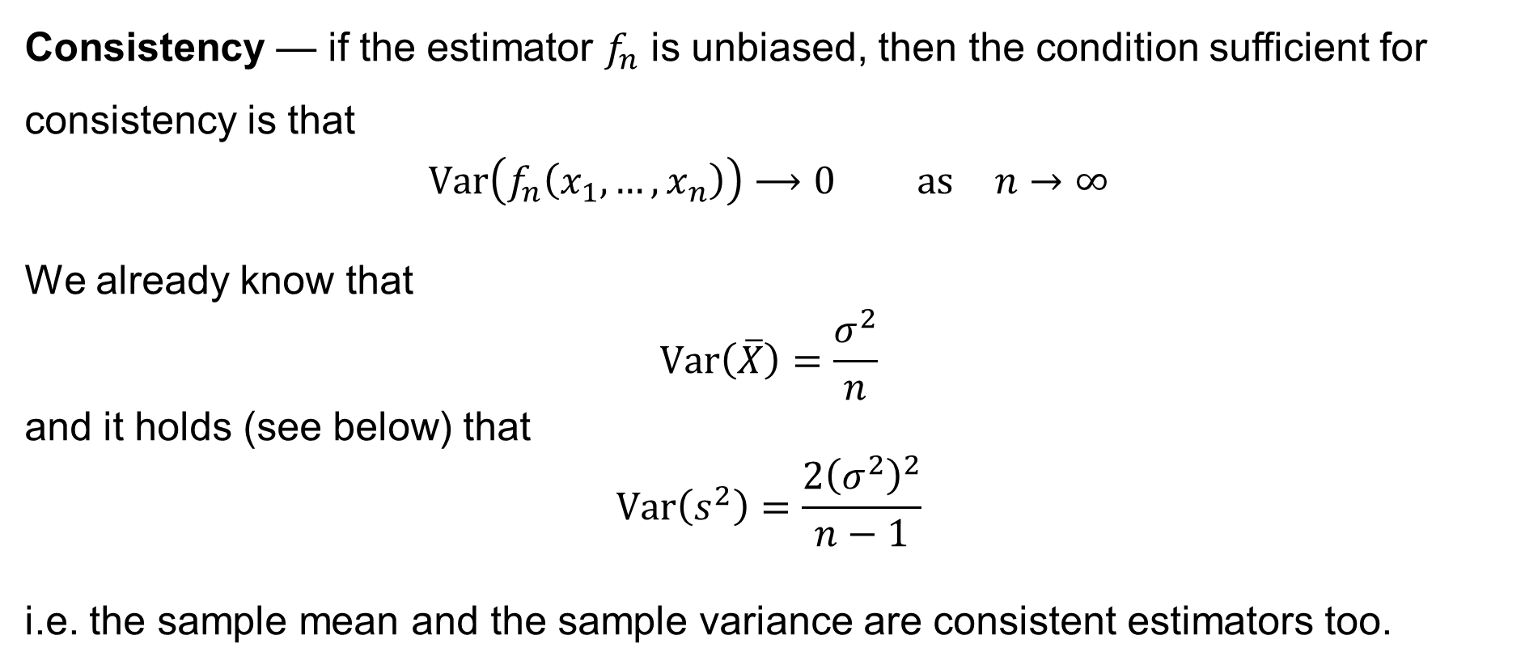
Point estimates
Consistency — if the estimator $f_{n}$ is unbiased, then the condition sufficient for consistency is that
$$Var\left(f_{n}\left(x_{1},…,x_{n}\right)\right)⟶0 \text{as} n→∞$$
We already know that
$$Var\left(\overline{X}\right)=\frac{σ^{2}}{n}$$
and it holds (see below) that
$$Var\left(s^{2}\right)=\frac{2{\left(σ^{2}\right)}^{2}}{n−1}$$
i.e. the sample mean and the sample variance are consistent estimators too.
(always)
(if the sampled variables are normal)

Slide 22
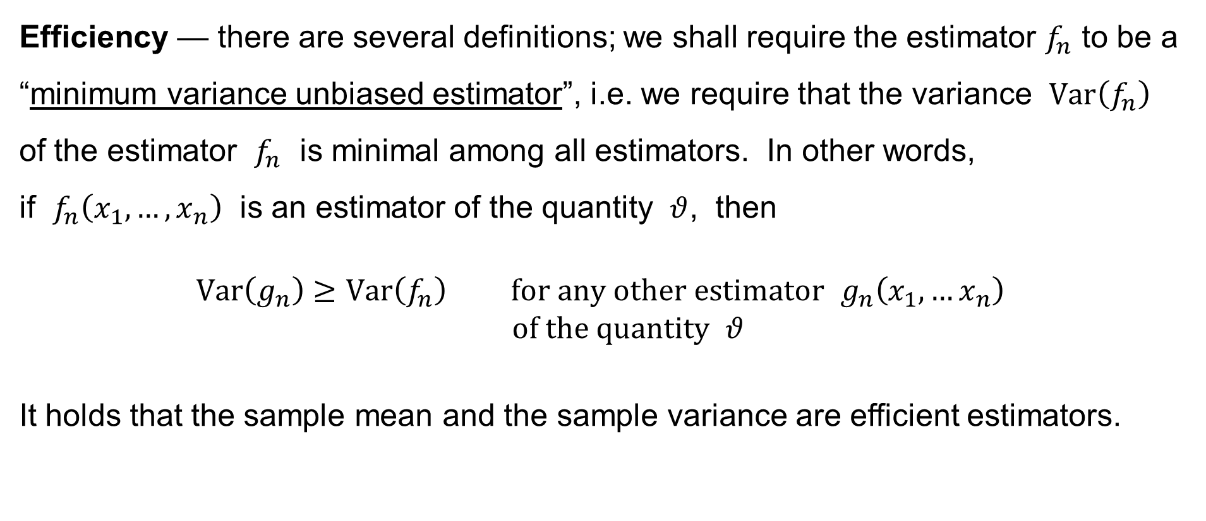
Point estimates
Efficiency — there are several definitions; we shall require the estimator $f_{n}$ to be a “minimum variance unbiased estimator”, i.e. we require that the variance $Var\left(f_{n}\right)$ of the estimator $f_{n}$ is minimal among all estimators. In other words,
if $f_{n}\left(x_{1},…,x_{n}\right)$ is an estimator of the quantity $θ$, then
$$Var\left(g_{n}\right)≥Var\left(f_{n}\right) \text{for} \text{any} \text{other} \text{estimator} g_{n}\left(x_{1},…x_{n}\right) \\ \text{of} \text{the} \text{quantity} θ$$
It holds that the sample mean and the sample variance are efficient estimators.

Slide 23
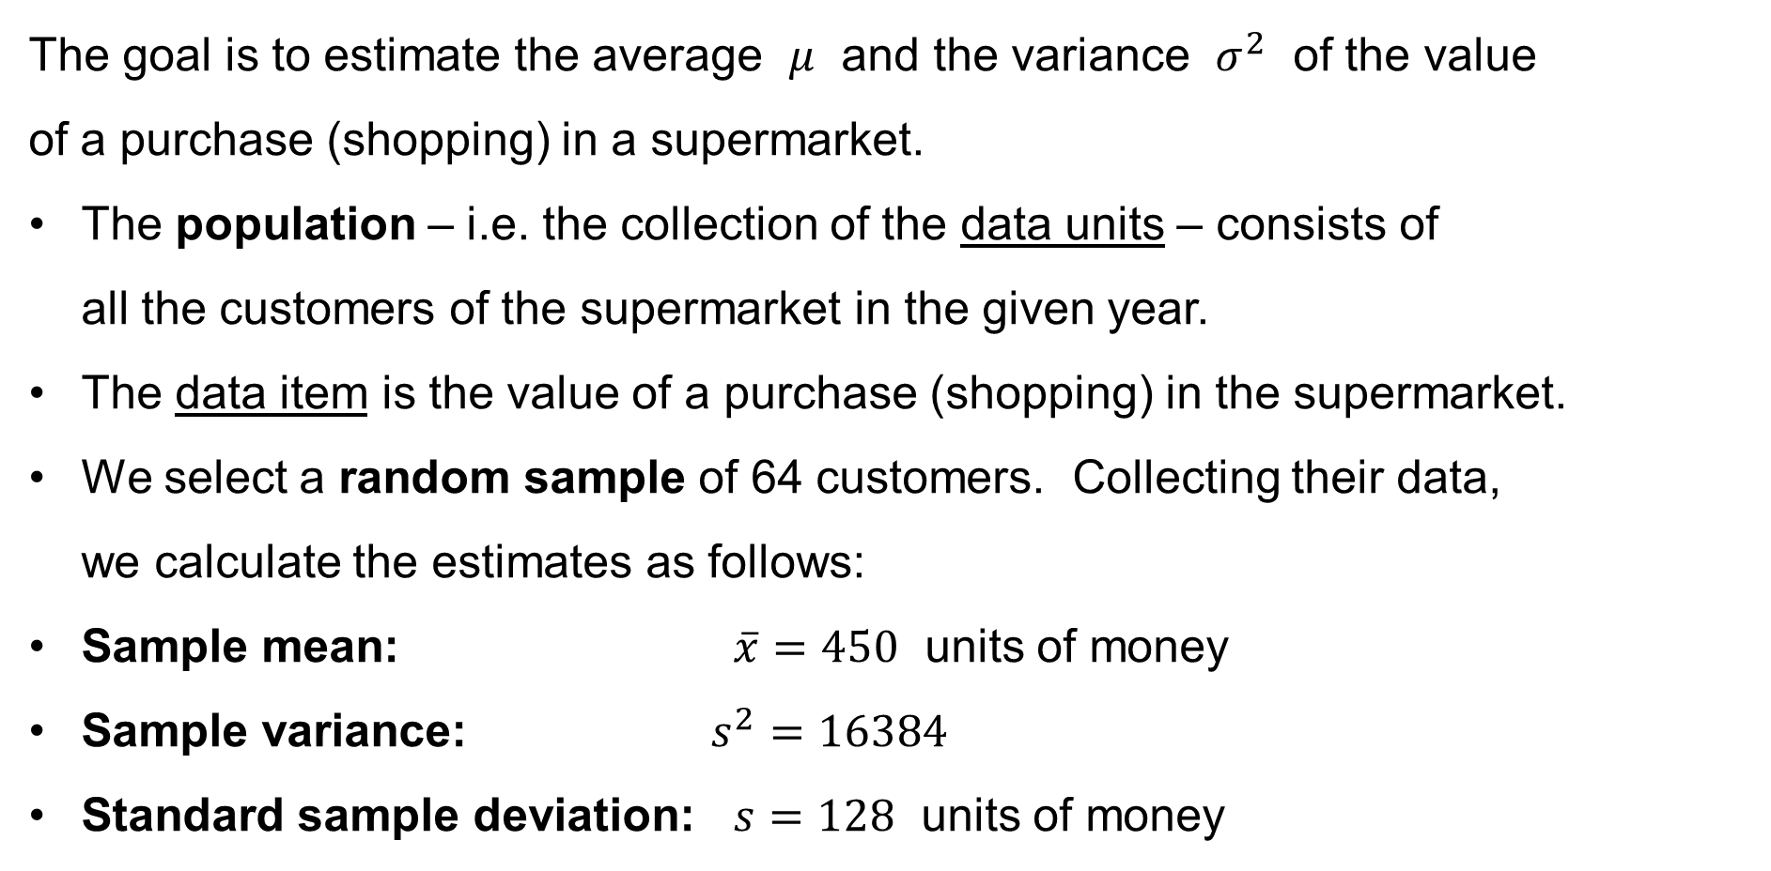
An illustrative example
The goal is to estimate the average $μ$ and the variance $σ^{2}$ of the value
of a purchase (shopping) in a supermarket.
The population – i.e. the collection of the data units – consists of
all the customers of the supermarket in the given year.
The data item is the value of a purchase (shopping) in the supermarket.
We select a random sample of 64 customers. Collecting their data,
we calculate the estimates as follows:
Sample mean: $\overline{x}=450$ units of money
Sample variance: $s^{2}=16384$
Standard sample deviation: $s=128$ units of money

Slide 24

Interval estimates for the mean $μ$

Slide 25
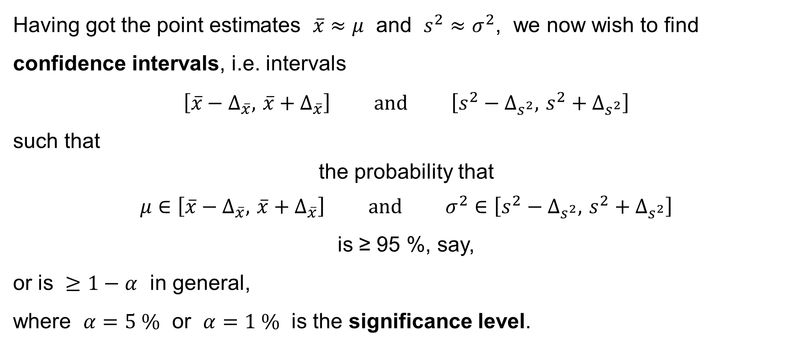
Interval estimates
Having got the point estimates $\overline{x}≈μ$ and $s^{2}≈σ^{2}$, we now wish to find confidence intervals, i.e. intervals
$$\left[\overline{x}−Δ_{\overline{x}}, \overline{x}+Δ_{\overline{x}}\right] \text{and} \left[s^{2}−Δ_{s^{2}}, s^{2}+Δ_{s^{2}}\right]$$
such that
the probability that
$$μ∈\left[\overline{x}−Δ_{\overline{x}}, \overline{x}+Δ_{\overline{x}}\right] \text{and} σ^{2}∈\left[s^{2}−Δ_{s^{2}}, s^{2}+Δ_{s^{2}}\right]$$
is ≥ 95 %, say,
or is $≥1−α$ in general,
where $α=5 \%$ or $α=1 \%$ is the significance level.

Slide 26
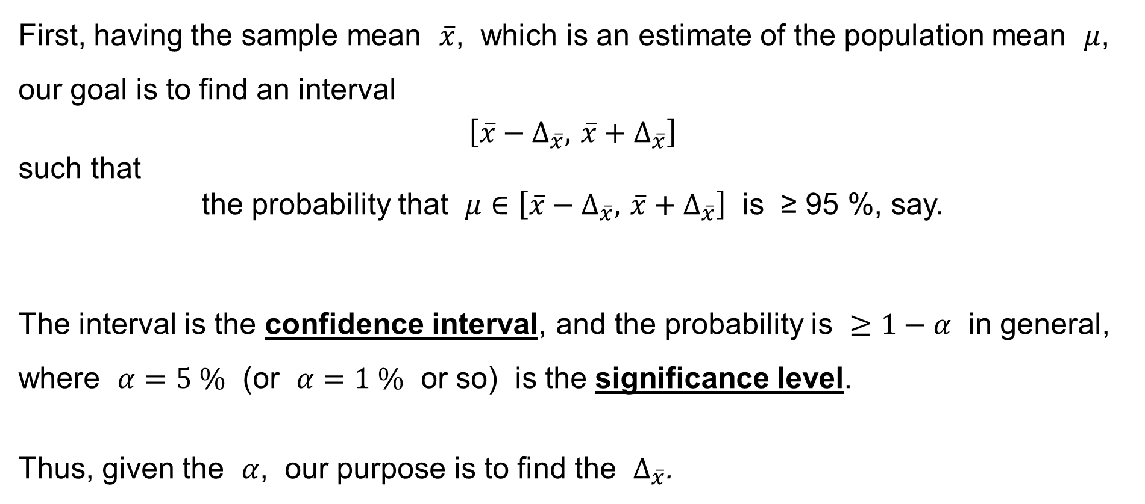
Interval estimates
First, having the sample mean $\overline{x}$, which is an estimate of the population mean $μ$, our goal is to find an interval
$$\left[\overline{x}−Δ_{\overline{x}}, \overline{x}+Δ_{\overline{x}}\right]$$
such that
the probability that $μ∈\left[\overline{x}−Δ_{\overline{x}}, \overline{x}+Δ_{\overline{x}}\right]$ is ≥ 95 %, say.
The interval is the confidence interval, and the probability is $≥1−α$ in general, where $α=5 \%$ (or $α=1 \%$ or so) is the significance level.
Thus, given the $α$, our purpose is to find the $Δ_{\overline{x}}$.

Slide 27
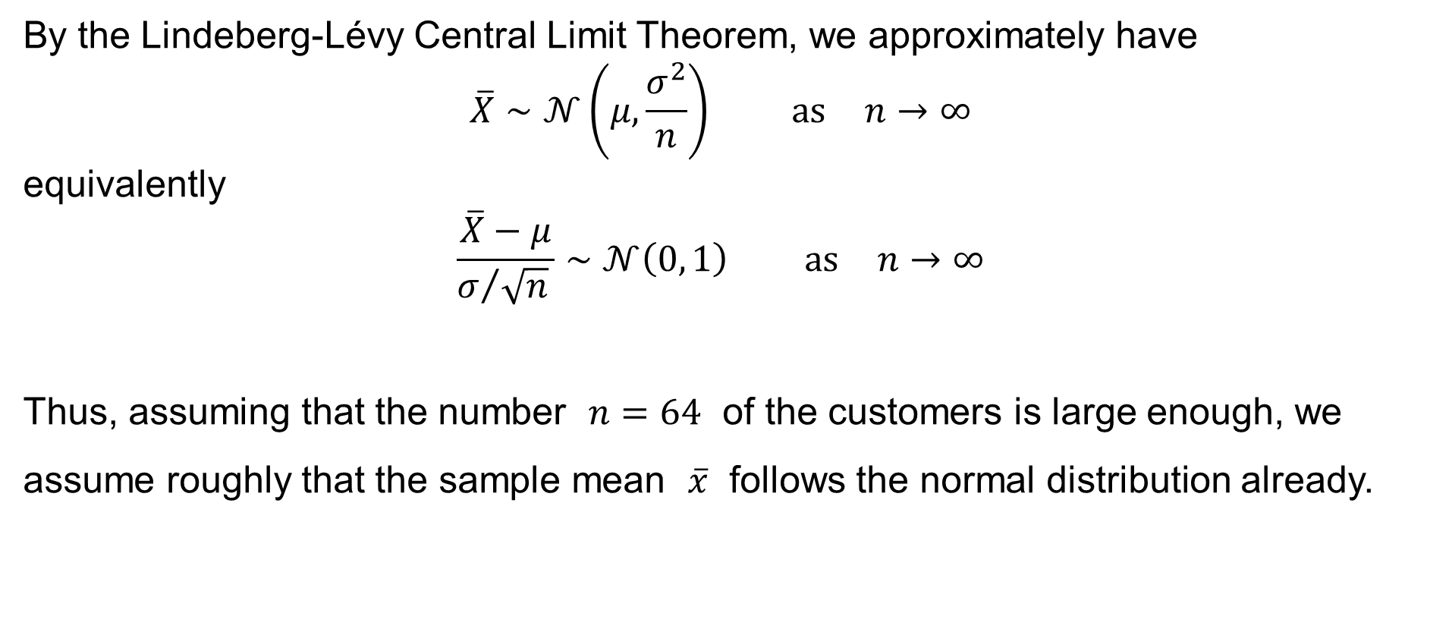
An illustrative example
By the Lindeberg-Lévy Central Limit Theorem, we approximately have
$$\overline{X}∼𝒩\left(μ,\frac{σ^{2}}{n}\right) \text{as} n→∞$$
equivalently
$$\frac{\overline{X}−μ}{σ/{\sqrt{n}} }∼𝒩\left(0, 1\right) \text{as} n→∞$$
Thus, assuming that the number $n=64$ of the customers is large enough, we assume roughly that the sample mean $\overline{x}$ follows the normal distribution already.

Slide 28
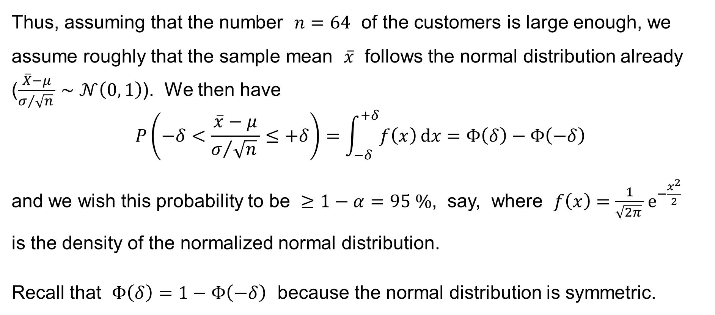
An illustrative example
Thus, assuming that the number $n=64$ of the customers is large enough, we assume roughly that the sample mean $\overline{x}$ follows the normal distribution already
($\frac{\overline{X}−μ}{σ/{\sqrt{n}} }∼𝒩\left(0, 1\right)$). We then have
$$P\left(−δ<\frac{\overline{x}−μ}{σ/{\sqrt{n}} }≤+δ\right)=\int_{−δ}^{+δ}{f\left(x\right) dx}=Φ\left(δ\right)−Φ\left(−δ\right)$$
and we wish this probability to be $≥1−α=95 \%$, say, where $f\left(x\right)=\frac{1}{\sqrt{2π} }e^{−\frac{x^{2}}{2}}$
is the density of the normalized normal distribution.
Recall that $Φ\left(δ\right)=1−Φ\left(−δ\right)$ because the normal distribution is symmetric.

Slide 29
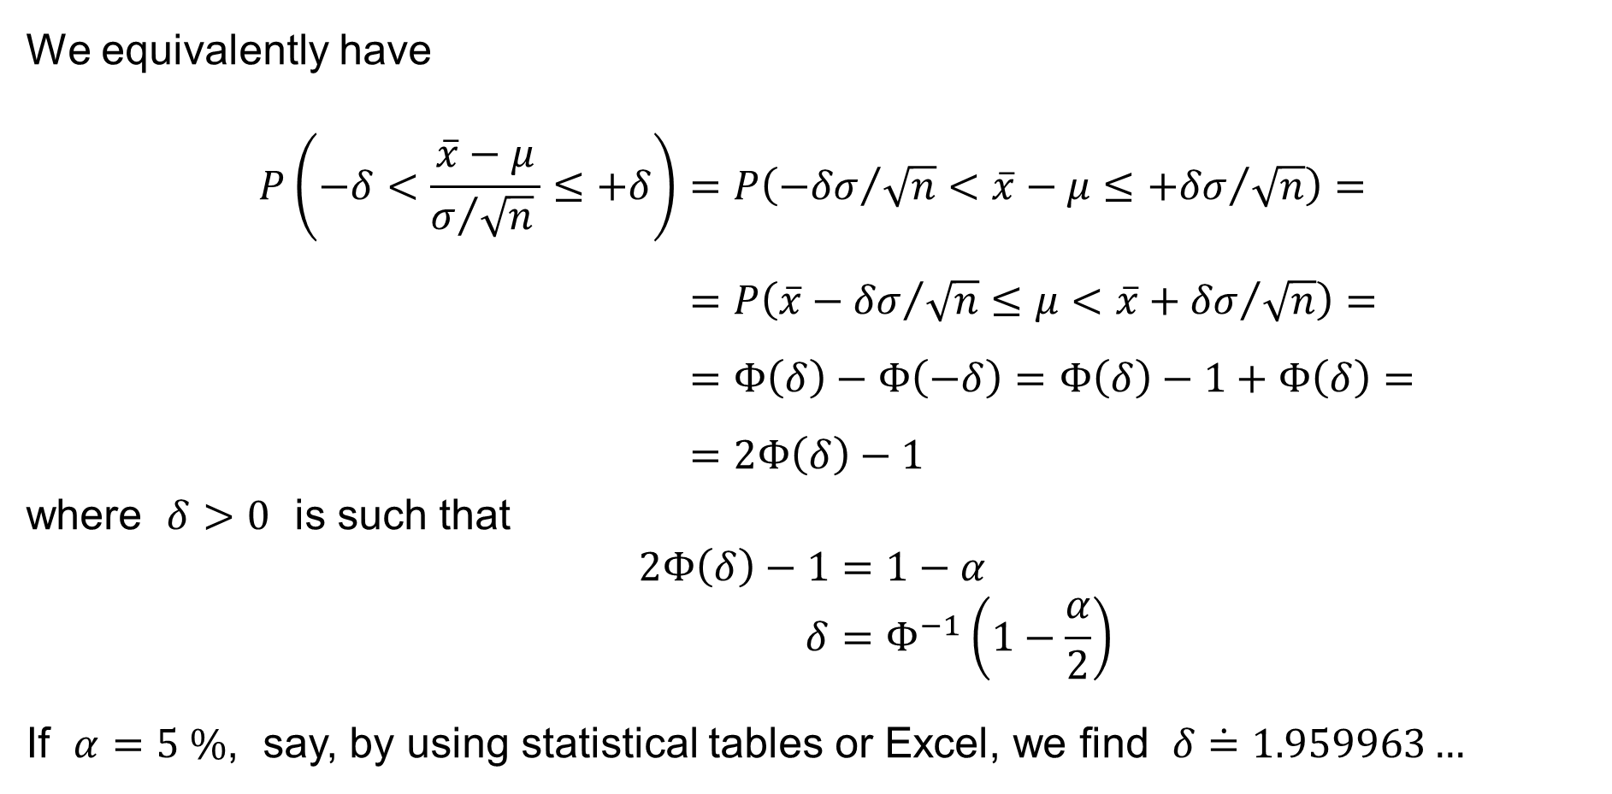
An illustrative example
We equivalently have
$$P\left(−δ<\frac{\overline{x}−μ}{σ/{\sqrt{n}} }≤+δ\right)=P\left({−δσ}/{\sqrt{n}}<\overline{x}−μ≤{+δσ}/{\sqrt{n}}\right)= \\ =P\left(\overline{x}−{δσ}/{\sqrt{n}}≤μ<\overline{x}+{δσ}/{\sqrt{n}}\right)= \\ =Φ\left(δ\right)−Φ\left(−δ\right)=Φ\left(δ\right)−1+Φ\left(δ\right)= \\ =2Φ\left(δ\right)−1$$
where $δ>0$ is such that
$$2Φ\left(δ\right)−1=1−α \\ δ=Φ^{−1}\left(1−\frac{α}{2}\right)$$
If $α=5 \%$, say, by using statistical tables or Excel, we find $δ\dot{=}1.959963…$

Slide 30
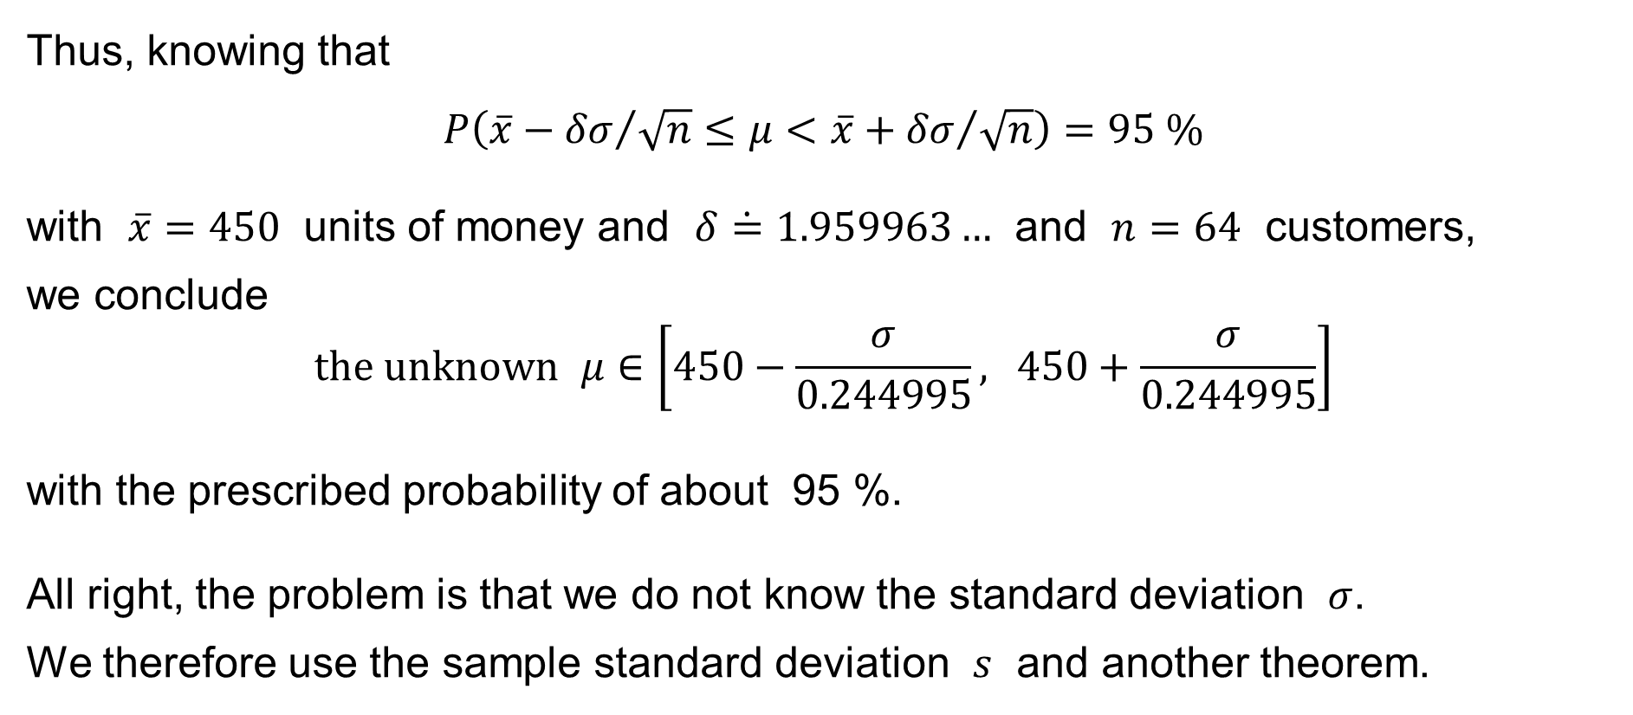
An illustrative example
Thus, knowing that
$$P\left(\overline{x}−{δσ}/{\sqrt{n}}≤μ<\overline{x}+{δσ}/{\sqrt{n}}\right)=95 \%$$
with $\overline{x}=450$ units of money and $δ\dot{=}1.959963…$ and $n=64$ customers,
we conclude
$$\text{the} \text{unknown} μ∈\left[450−\frac{σ}{0.244995}, 450+\frac{σ}{0.244995}\right]$$
with the prescribed probability of about 95 %.
All right, the problem is that we do not know the standard deviation $σ$.
We therefore use the sample standard deviation $s$ and another theorem.

Slide 31
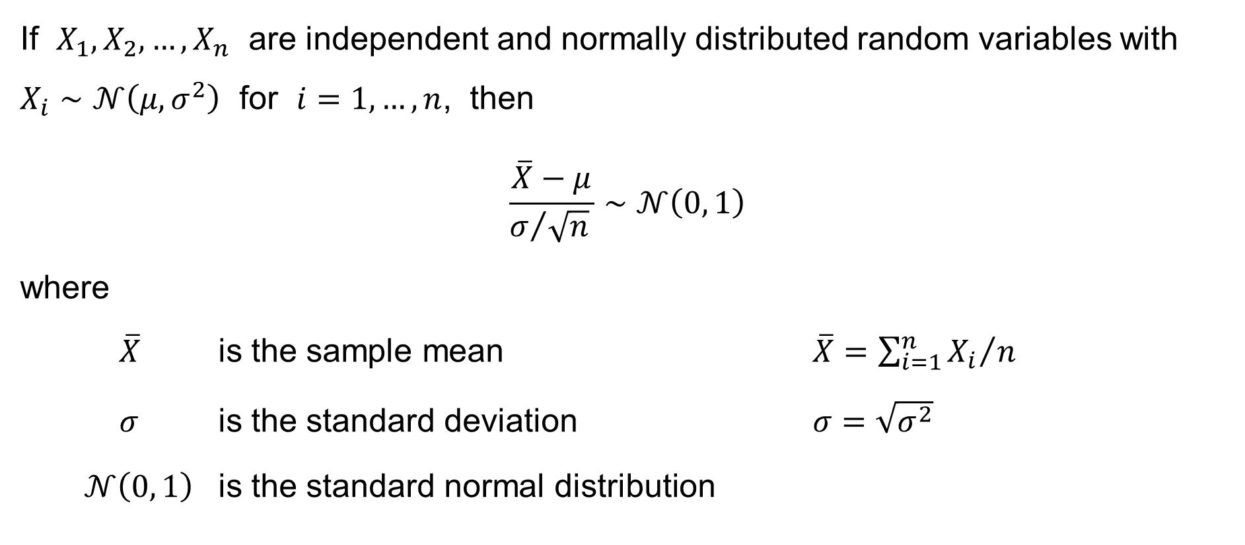
Theorem
If $X_{1},X_{2},…,X_{n}$ are independent and normally distributed random variables with $X_{i}∼𝒩\left(μ,σ^{2}\right)$ for $i=1,…,n$, then
$$\frac{\overline{X}−μ}{σ/{\sqrt{n}} }∼𝒩\left(0, 1\right)$$
where
$\overline{X}$ is the sample mean $\overline{X}={\sum_{i=1}^{n}{X_{i}}}/n$
$σ$ is the standard deviation $σ=\sqrt{σ^{2}}$
$𝒩\left(0, 1\right)$ is the standard normal distribution

Slide 32
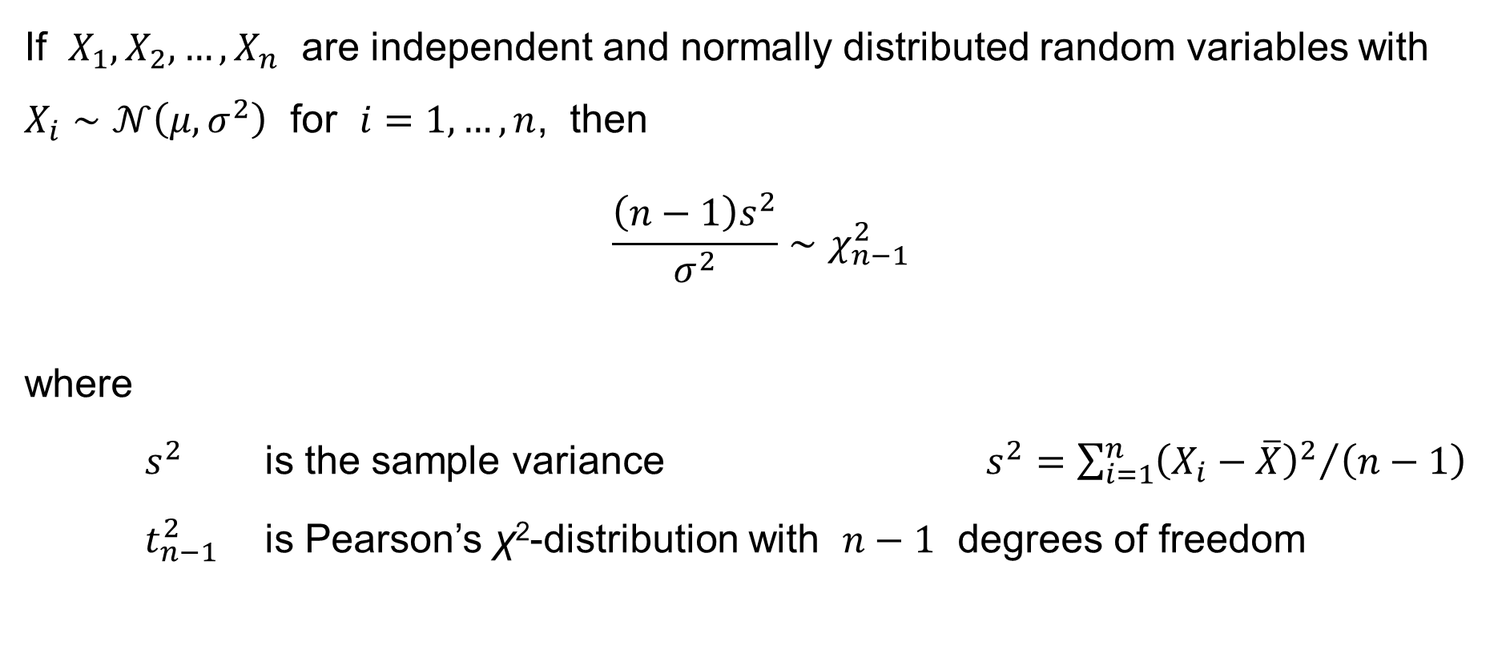
Theorem
If $X_{1},X_{2},…,X_{n}$ are independent and normally distributed random variables with $X_{i}∼𝒩\left(μ,σ^{2}\right)$ for $i=1,…,n$, then
$$\frac{\left(n−1\right)s^{2}}{σ^{2}}∼χ_{n−1}^{2}$$
where
$s^{2}$ is the sample variance $s^{2}={\sum_{i=1}^{n}{{\left(X_{i}−\overline{X}\right)}^{2}}}/{\left(n−1\right)}$
$t_{n−1}^{2}$ is Pearson’s χ²-distribution with $n−1$ degrees of freedom

Slide 33
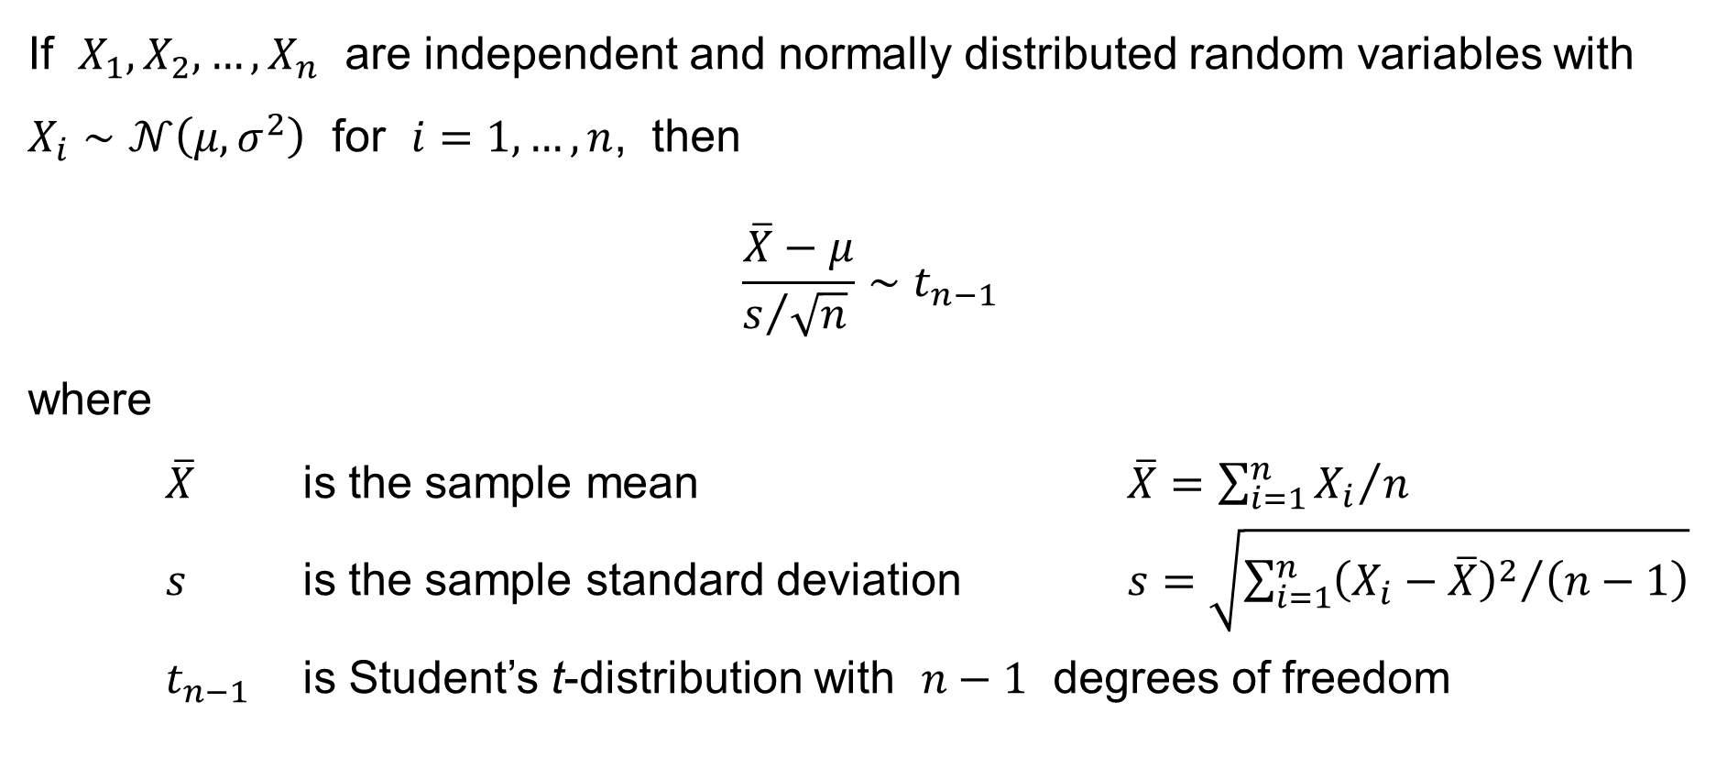
Theorem – Corollary
If $X_{1},X_{2},…,X_{n}$ are independent and normally distributed random variables with $X_{i}∼𝒩\left(μ,σ^{2}\right)$ for $i=1,…,n$, then
$$\frac{\overline{X}−μ}{s/{\sqrt{n}} }∼t_{n−1}$$
where
$\overline{X}$ is the sample mean $\overline{X}={\sum_{i=1}^{n}{X_{i}}}/n$
$s$ is the sample standard deviation $s=\sqrt{{\sum_{i=1}^{n}{{\left(X_{i}−\overline{X}\right)}^{2}}}/{\left(n−1\right)}}$
$t_{n−1}$ is Student’s t-distribution with $n−1$ degrees of freedom

Slide 34
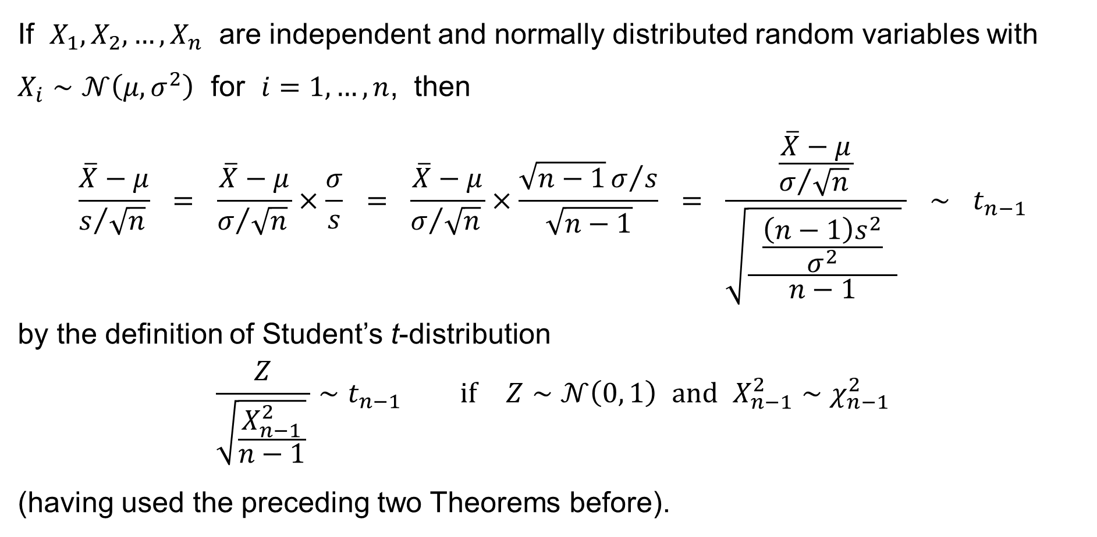
Theorem – Corollary – Proof:
If $X_{1},X_{2},…,X_{n}$ are independent and normally distributed random variables with $X_{i}∼𝒩\left(μ,σ^{2}\right)$ for $i=1,…,n$, then
$$\frac{\overline{X}−μ}{s/{\sqrt{n}} } = \frac{\overline{X}−μ}{σ/{\sqrt{n}} }×\frac{σ}{s} = \frac{\overline{X}−μ}{σ/{\sqrt{n}} }×\frac{\sqrt{n−1}σ/s}{\sqrt{n−1}} = \frac{\frac{\overline{X}−μ}{σ/{\sqrt{n}} }}{\sqrt{\frac{ \frac{\left(n−1\right)s^{2}}{σ^{2}} }{n−1} } } ∼ t_{n−1}$$
by the definition of Student’s t-distribution
$$\frac{Z}{\sqrt{\frac{X_{n−1}^{2}}{n−1}} }∼t_{n−1} \text{if} Z∼𝒩\left(0, 1\right) \text{and} X_{n−1}^{2}∼χ_{n−1}^{2}$$
(having used the preceding two Theorems before).

Slide 35
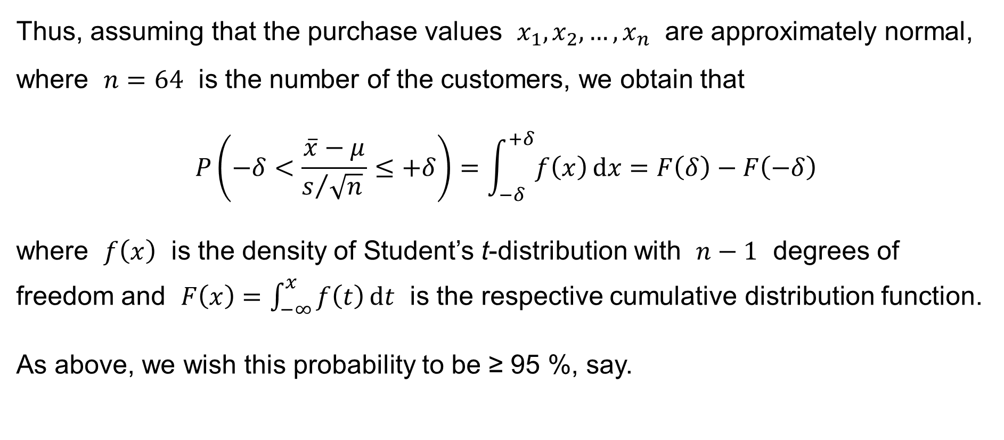
An illustrative example
Thus, assuming that the purchase values $x_{1},x_{2},…,x_{n}$ are approximately normal, where $n=64$ is the number of the customers, we obtain that
$$P\left(−δ<\frac{\overline{x}−μ}{s/{\sqrt{n}} }≤+δ\right)=\int_{−δ}^{+δ}{f\left(x\right) dx}=F\left(δ\right)−F\left(−δ\right)$$
where $f\left(x\right)$ is the density of Student’s t-distribution with $n−1$ degrees of
freedom and $F\left(x\right)=\int_{−∞}^{x}{f\left(t\right) dt}$ is the respective cumulative distribution function.
As above, we wish this probability to be ≥ 95 %, say.

Slide 36
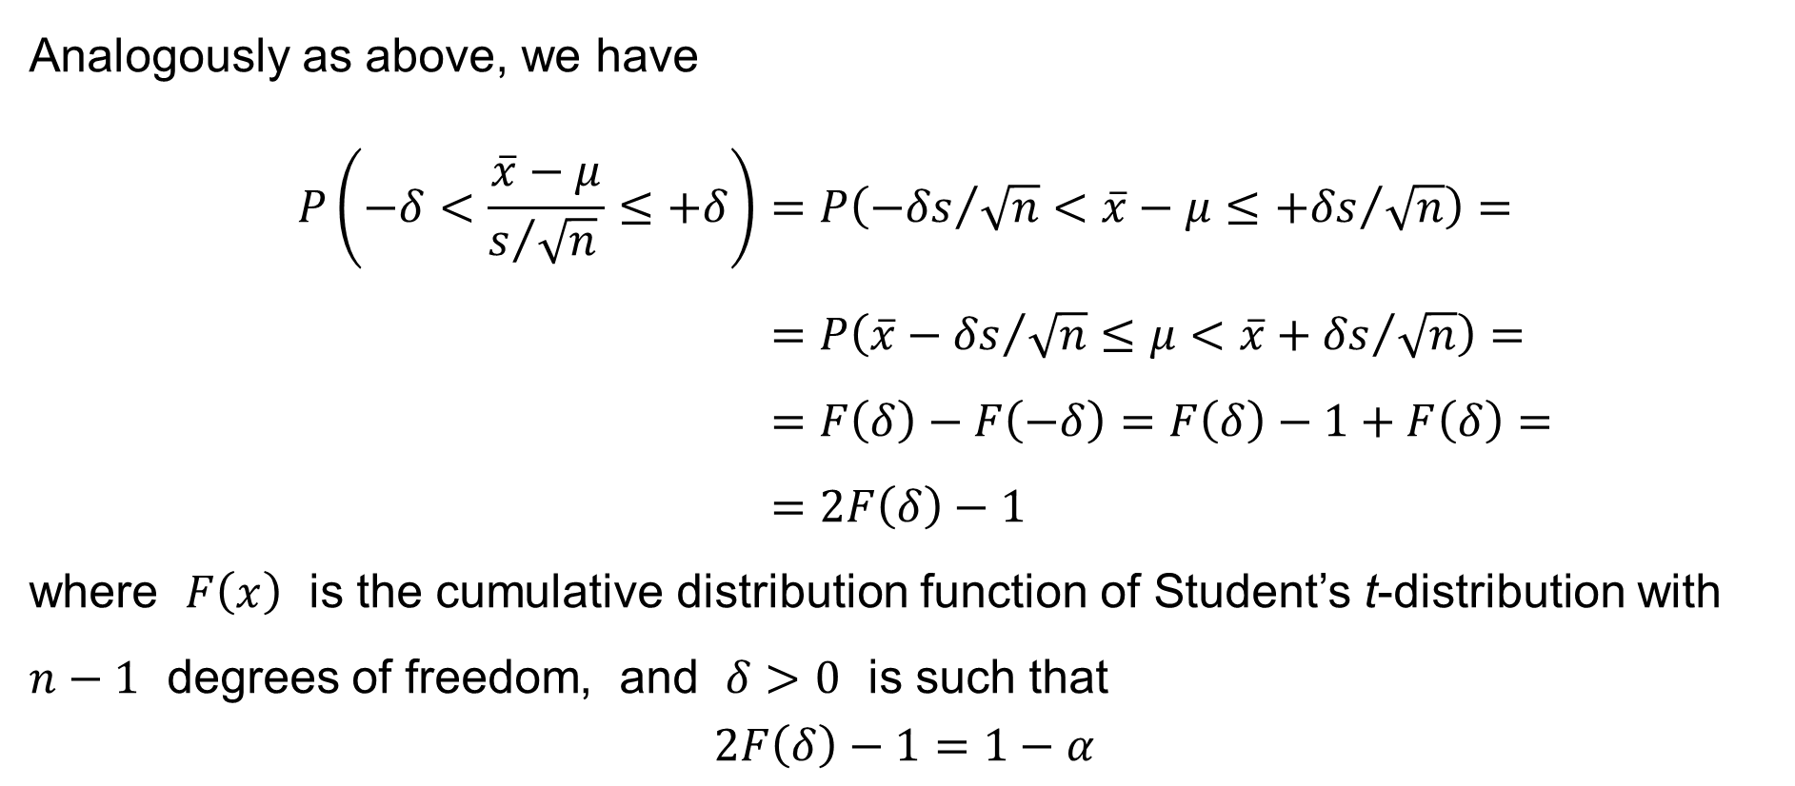
An illustrative example
Analogously as above, we have
$$P\left(−δ<\frac{\overline{x}−μ}{s/{\sqrt{n}} }≤+δ\right)=P\left({−δs}/{\sqrt{n}}<\overline{x}−μ≤{+δs}/{\sqrt{n}}\right)= \\ =P\left(\overline{x}−{δs}/{\sqrt{n}}≤μ<\overline{x}+{δs}/{\sqrt{n}}\right)= \\ =F\left(δ\right)−F\left(−δ\right)=F\left(δ\right)−1+F\left(δ\right)= \\ =2F\left(δ\right)−1$$
where $F\left(x\right)$ is the cumulative distribution function of Student’s t-distribution with $n−1$ degrees of freedom, and $δ>0$ is such that
$$2F\left(δ\right)−1=1−α$$

Slide 37
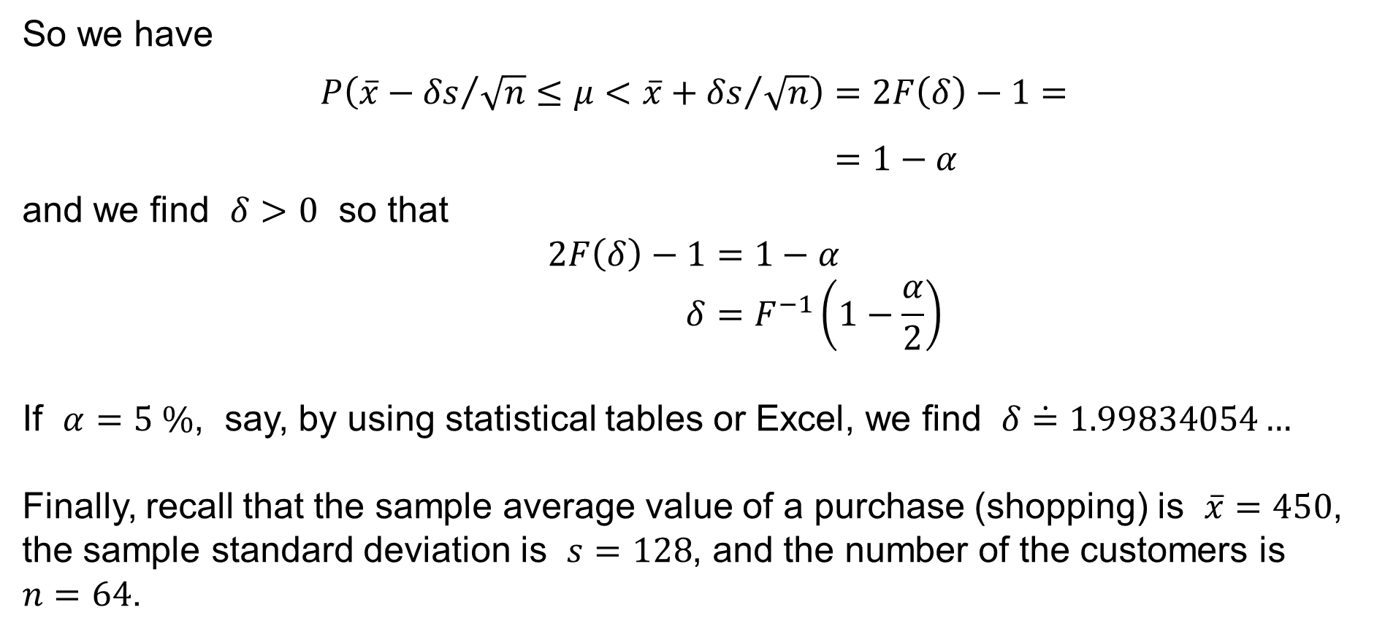
An illustrative example
So we have
$$P\left(\overline{x}−{δs}/{\sqrt{n}}≤μ<\overline{x}+{δs}/{\sqrt{n}}\right)=2F\left(δ\right)−1= \\ =1−α$$
and we find $δ>0$ so that
$$2F\left(δ\right)−1=1−α \\ δ=F^{−1}\left(1−\frac{α}{2}\right)$$
If $α=5 \%$, say, by using statistical tables or Excel, we find $δ\dot{=}1.99834054…$
Finally, recall that the sample average value of a purchase (shopping) is $\overline{x}=450$,
the sample standard deviation is $s=128$, and the number of the customers is
$n=64$.

Slide 38
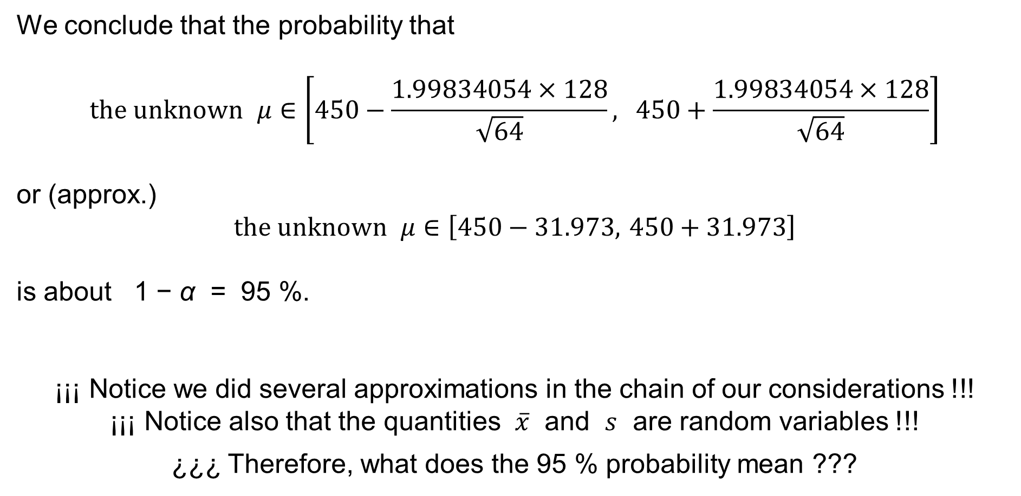
An illustrative example
We conclude that the probability that
$$\text{the} \text{unknown} μ∈\left[450−\frac{1.99834054×128}{\sqrt{64}}, 450+\frac{1.99834054×128}{\sqrt{64}}\right]$$
or (approx.)
$$\text{the} \text{unknown} μ∈\left[450−31.973, 450+31.973\right]$$
is about 1 − α = 95 %.
¡¡¡ Notice we did several approximations in the chain of our considerations !!!
¡¡¡ Notice also that the quantities $\overline{x}$ and $s$ are random variables !!!
¿¿¿ Therefore, what does the 95 % probability mean ???

Slide 39
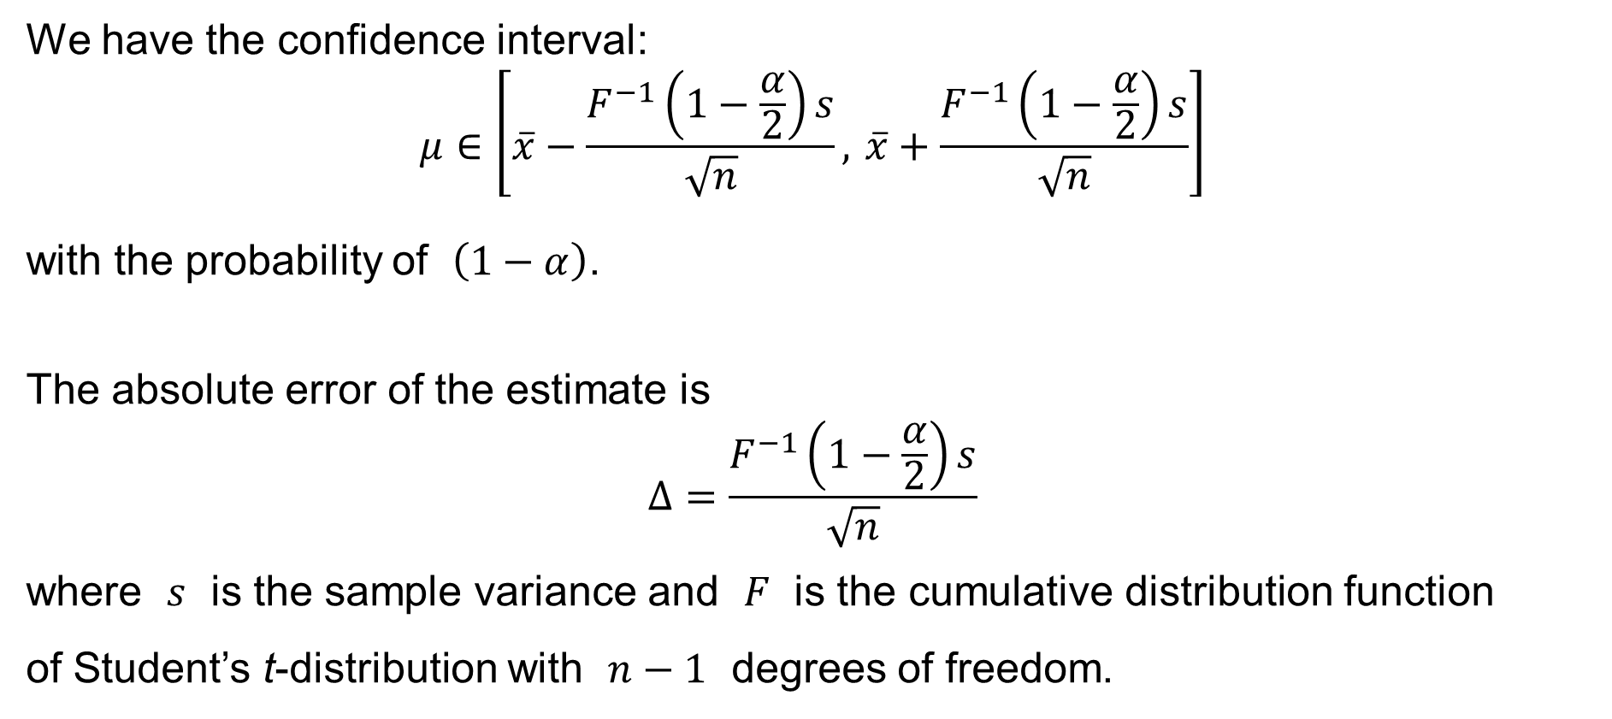
The sample size for the confidence interval
We have the confidence interval:
$$μ∈\left[\overline{x}−\frac{F^{−1}\left(1−\frac{α}{2}\right)s}{\sqrt{n}}, \overline{x}+\frac{F^{−1}\left(1−\frac{α}{2}\right)s}{\sqrt{n}}\right]$$
with the probability of $\left(1−α\right)$.
The absolute error of the estimate is
$$Δ=\frac{F^{−1}\left(1−\frac{α}{2}\right)s}{\sqrt{n}}$$
where $s$ is the sample variance and $F$ is the cumulative distribution function
of Student’s t-distribution with $n−1$ degrees of freedom.

Slide 40
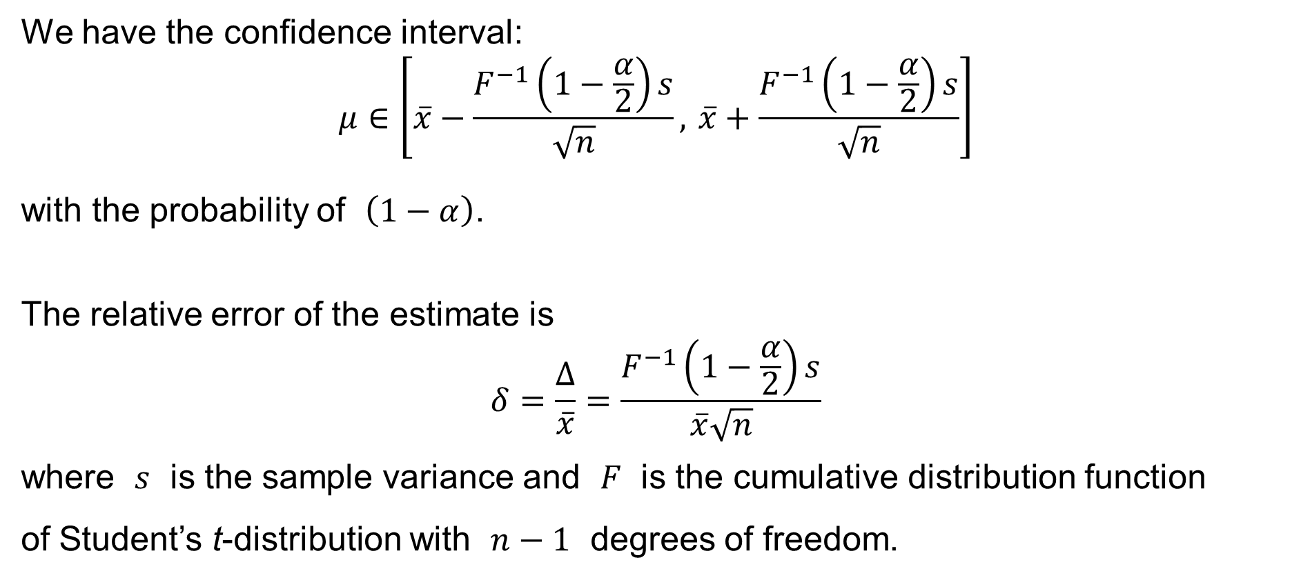
The sample size for the confidence interval
We have the confidence interval:
$$μ∈\left[\overline{x}−\frac{F^{−1}\left(1−\frac{α}{2}\right)s}{\sqrt{n}}, \overline{x}+\frac{F^{−1}\left(1−\frac{α}{2}\right)s}{\sqrt{n}}\right]$$
with the probability of $\left(1−α\right)$.
The relative error of the estimate is
$$δ=\frac{Δ}{\overline{x}}=\frac{F^{−1}\left(1−\frac{α}{2}\right)s}{\overline{x}\sqrt{n}}$$
where $s$ is the sample variance and $F$ is the cumulative distribution function
of Student’s t-distribution with $n−1$ degrees of freedom.

Slide 41
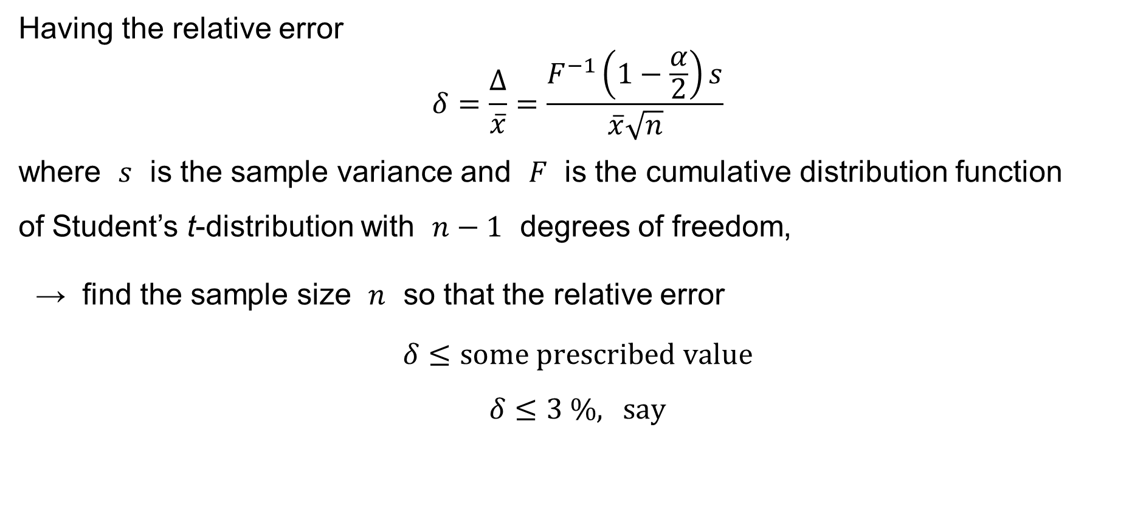
The sample size for the confidence interval
Having the relative error
$$δ=\frac{Δ}{\overline{x}}=\frac{F^{−1}\left(1−\frac{α}{2}\right)s}{\overline{x}\sqrt{n}}$$
where $s$ is the sample variance and $F$ is the cumulative distribution function
of Student’s t-distribution with $n−1$ degrees of freedom,
→ find the sample size $n$ so that the relative error
$$δ≤\text{some} \text{prescribed} \text{value}$$
$$δ≤3 \%, \text{say}$$

Slide 42
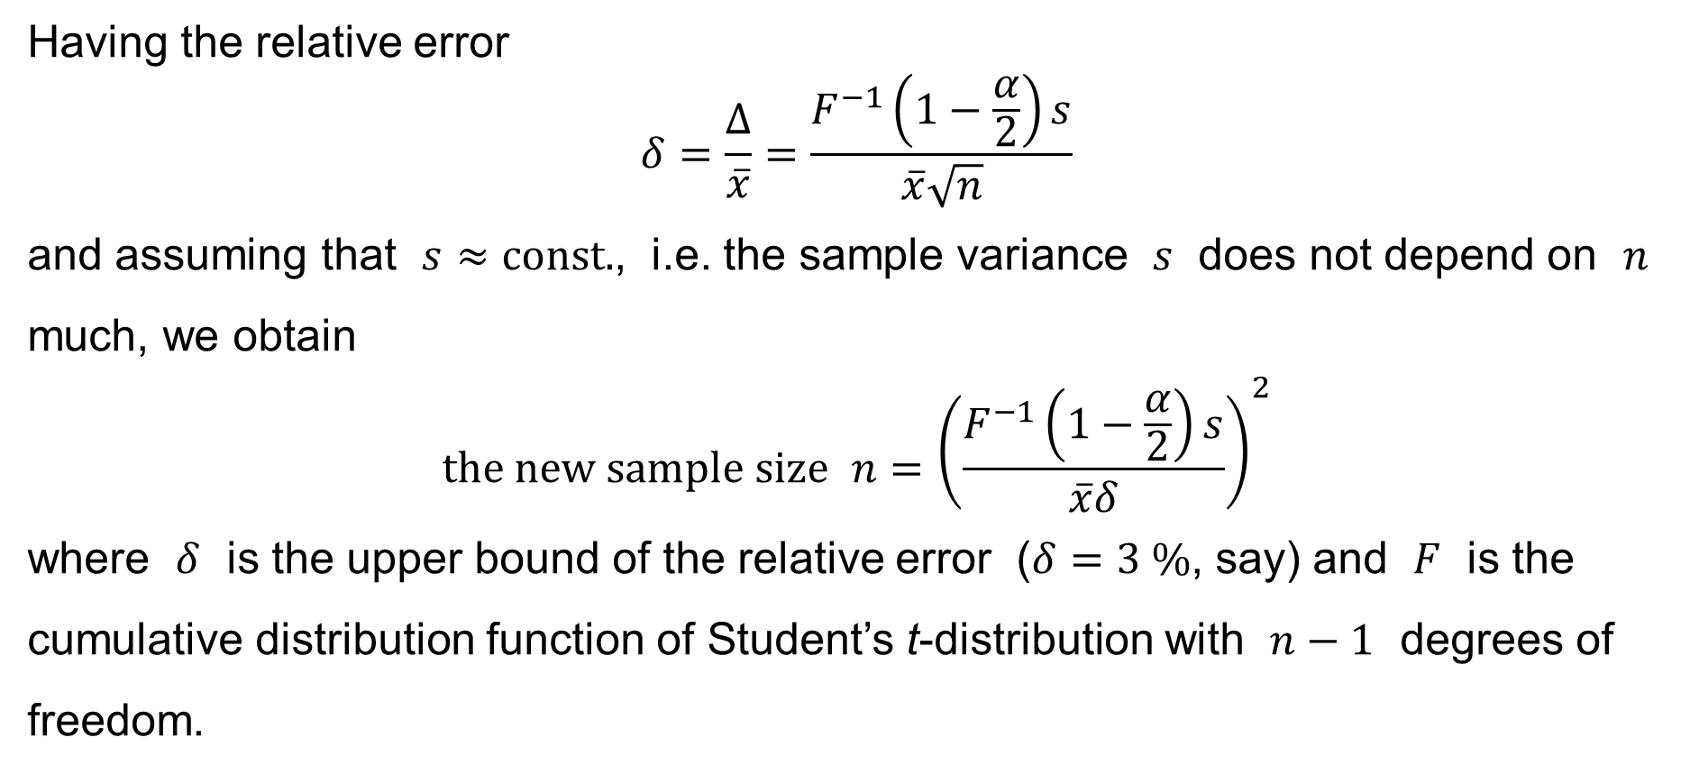
The sample size for the confidence interval
Having the relative error
$$δ=\frac{Δ}{\overline{x}}=\frac{F^{−1}\left(1−\frac{α}{2}\right)s}{\overline{x}\sqrt{n}}$$
and assuming that $s≈\text{const}\text{.}$, i.e. the sample variance $s$ does not depend on $n$ much, we obtain
$$\text{the} \text{new} \text{sample} \text{size} n={\left(\frac{F^{−1}\left(1−\frac{α}{2}\right)s}{\overline{x}δ}\right)}^{2}$$
where $δ$ is the upper bound of the relative error ($δ=3 \%$, say) and $F$ is the cumulative distribution function of Student’s t-distribution with $n−1$ degrees of freedom.

Slide 43

Interval estimate for the variance $σ^{2}$

Slide 44
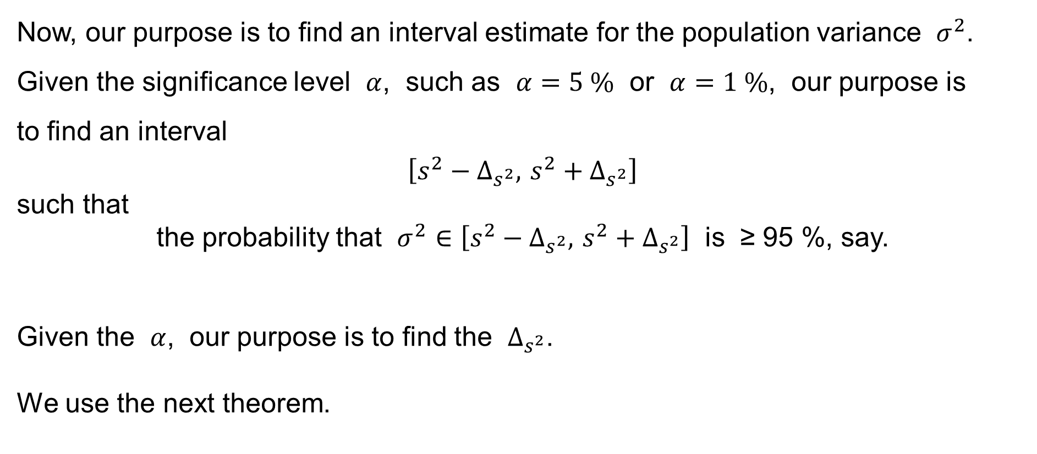
Interval estimate for the variance
Now, our purpose is to find an interval estimate for the population variance $σ^{2}$. Given the significance level $α$, such as $α=5 \%$ or $α=1 \%$, our purpose is
to find an interval
$$\left[s^{2}−Δ_{s^{2}}, s^{2}+Δ_{s^{2}}\right]$$
such that
the probability that $σ^{2}∈\left[s^{2}−Δ_{s^{2}}, s^{2}+Δ_{s^{2}}\right]$ is ≥ 95 %, say.
Given the $α$, our purpose is to find the $Δ_{s^{2}}$.
We use the next theorem.

Slide 45
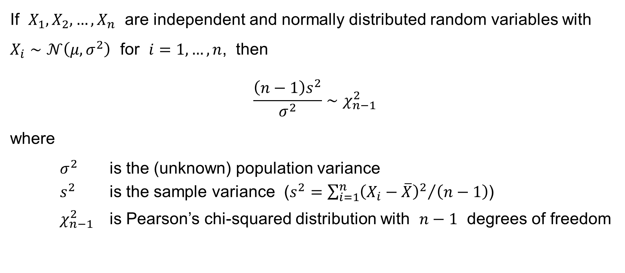
Theorem
If $X_{1},X_{2},…,X_{n}$ are independent and normally distributed random variables with $X_{i}∼𝒩\left(μ,σ^{2}\right)$ for $i=1,…,n$, then
$$\frac{\left(n−1\right)s^{2}}{σ^{2}}∼χ_{n−1}^{2}$$
where
$σ^{2}$ is the (unknown) population variance
$s^{2}$ is the sample variance ($s^{2}={\sum_{i=1}^{n}{{\left(X_{i}−\overline{X}\right)}^{2}}}/{\left(n−1\right)}$)
$χ_{n−1}^{2}$ is Pearson’s chi-squared distribution with $n−1$ degrees of freedom

Slide 46
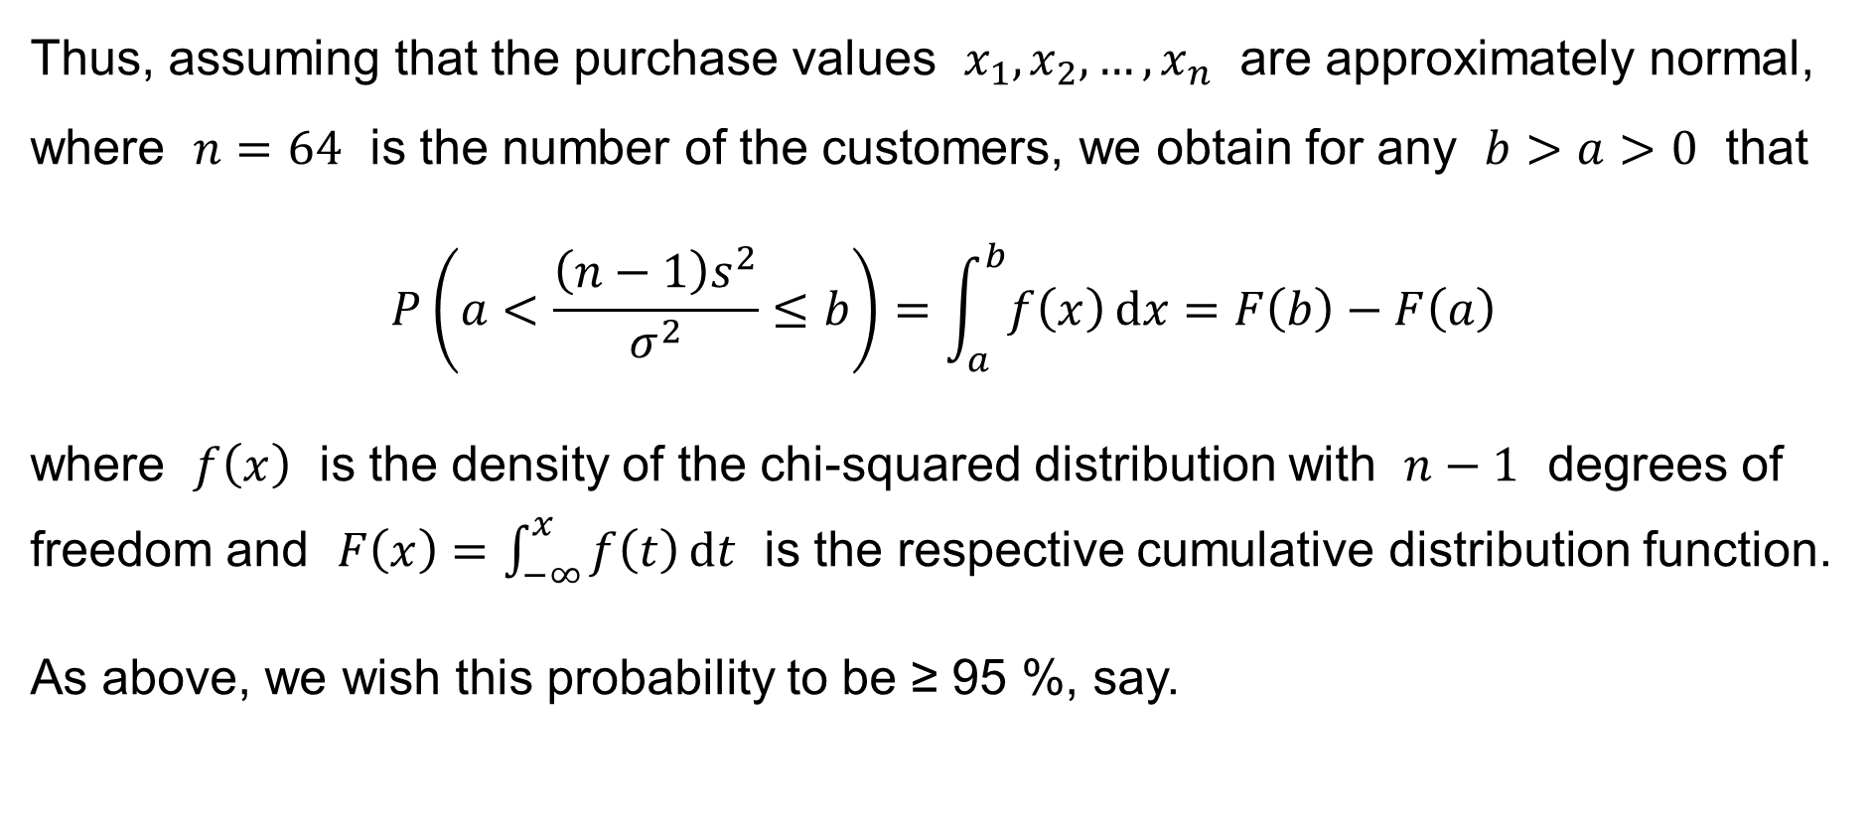
An illustrative example
Thus, assuming that the purchase values $x_{1},x_{2},…,x_{n}$ are approximately normal, where $n=64$ is the number of the customers, we obtain for any $b>a>0$ that
$$P\left(a<\frac{\left(n−1\right)s^{2}}{σ^{2}}≤b\right)=\int_{a}^{b}{f\left(x\right) dx}=F\left(b\right)−F\left(a\right)$$
where $f\left(x\right)$ is the density of the chi-squared distribution with $n−1$ degrees of
freedom and $F\left(x\right)=\int_{−∞}^{x}{f\left(t\right) dt}$ is the respective cumulative distribution function.
As above, we wish this probability to be ≥ 95 %, say.

Slide 47
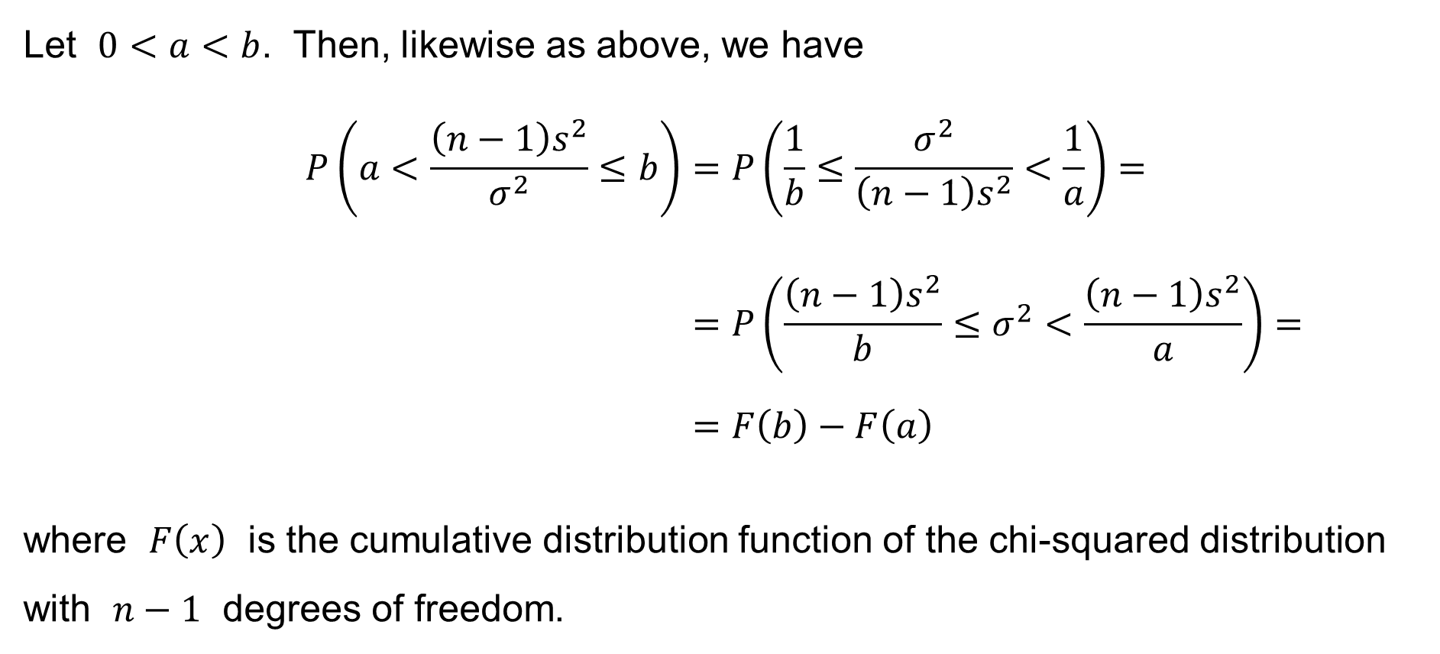
An illustrative example
Let $0<a<b$. Then, likewise as above, we have
$$P\left(a<\frac{\left(n−1\right)s^{2}}{σ^{2}}≤b\right)=P\left(\frac{1}{b}≤\frac{σ^{2}}{\left(n−1\right)s^{2}}<\frac{1}{a}\right)= \\ =P\left(\frac{\left(n−1\right)s^{2}}{b}≤σ^{2}<\frac{\left(n−1\right)s^{2}}{a}\right)= \\ =F\left(b\right)−F\left(a\right)$$
where $F\left(x\right)$ is the cumulative distribution function of the chi-squared distribution with $n−1$ degrees of freedom.

Slide 48
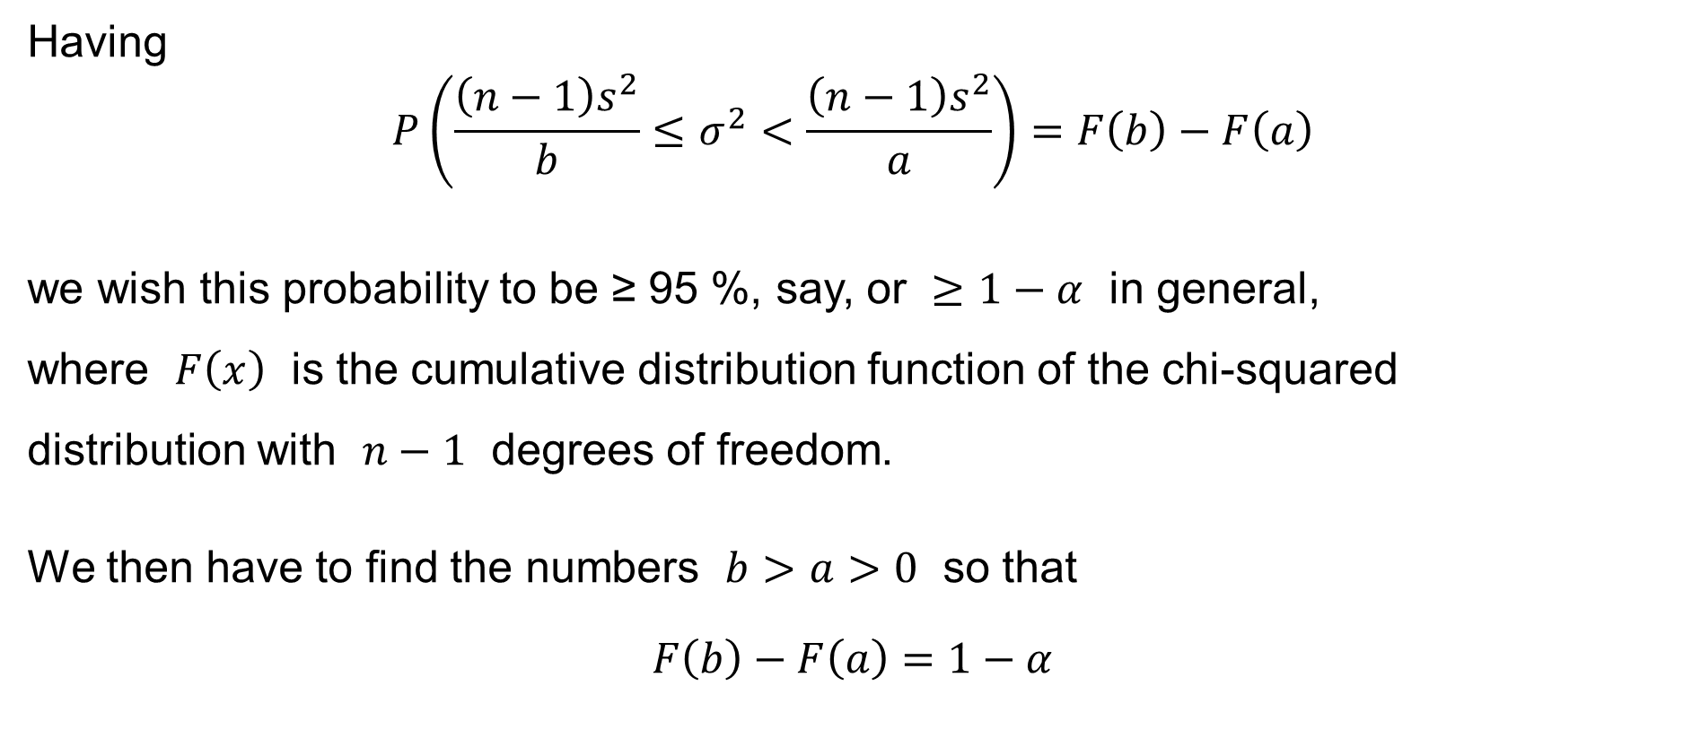
An illustrative example
Having
$$P\left(\frac{\left(n−1\right)s^{2}}{b}≤σ^{2}<\frac{\left(n−1\right)s^{2}}{a}\right)=F\left(b\right)−F\left(a\right)$$
we wish this probability to be ≥ 95 %, say, or $≥1−α$ in general,
where $F\left(x\right)$ is the cumulative distribution function of the chi-squared
distribution with $n−1$ degrees of freedom.
We then have to find the numbers $b>a>0$ so that
$$F\left(b\right)−F\left(a\right)=1−α$$

Slide 49
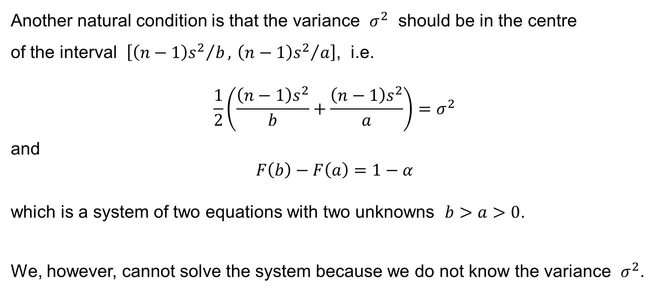
An illustrative example
Another natural condition is that the variance $σ^{2}$ should be in the centre
of the interval $\left[{\left(n−1\right)s^{2}}/b, {\left(n−1\right)s^{2}}/a\right]$, i.e.
$$\frac{1}{2}\left(\frac{\left(n−1\right)s^{2}}{b}+\frac{\left(n−1\right)s^{2}}{a}\right)=σ^{2}$$
and
$$F\left(b\right)−F\left(a\right)=1−α$$
which is a system of two equations with two unknowns $b>a>0$.
We, however, cannot solve the system because we do not know the variance $σ^{2}$.

Slide 50
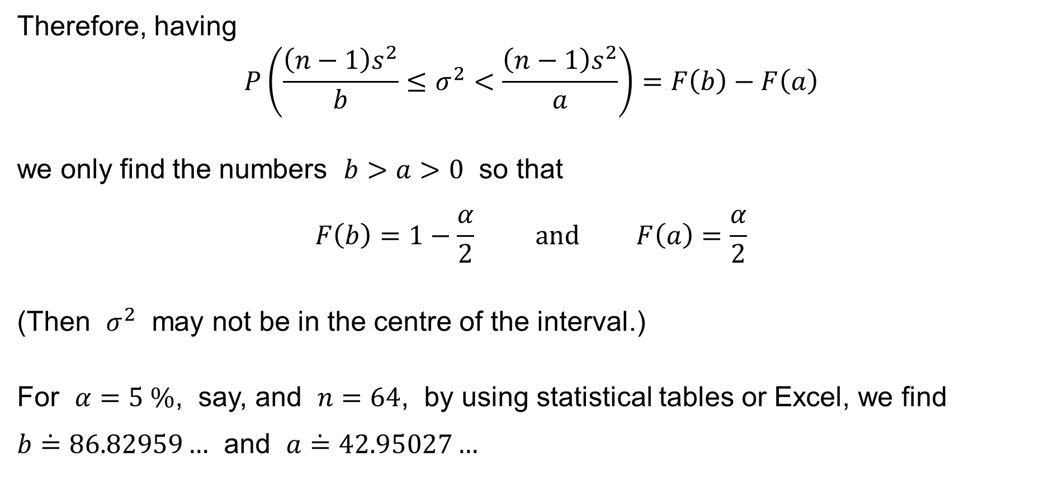
An illustrative example
Therefore, having
$$P\left(\frac{\left(n−1\right)s^{2}}{b}≤σ^{2}<\frac{\left(n−1\right)s^{2}}{a}\right)=F\left(b\right)−F\left(a\right)$$
we only find the numbers $b>a>0$ so that
$$F\left(b\right)=1−\frac{α}{2} \text{and} F\left(a\right)=\frac{α}{2}$$
(Then $σ^{2}$ may not be in the centre of the interval.)
For $α=5 \%$, say, and $n=64$, by using statistical tables or Excel, we find $b\dot{=}86.82959…$ and $a\dot{=}42.95027…$

Slide 51
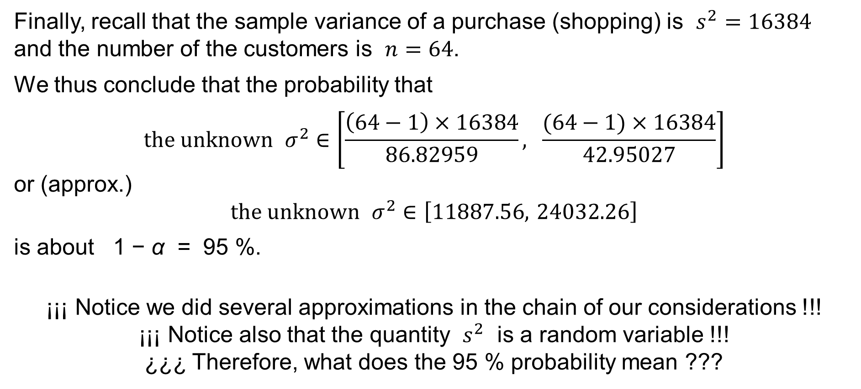
An illustrative example
Finally, recall that the sample variance of a purchase (shopping) is $s^{2}=16384$ and the number of the customers is $n=64$.
We thus conclude that the probability that
$$\text{the} \text{unknown} σ^{2}∈\left[\frac{\left(64−1\right)×16384}{86.82959}, \frac{(64−1)×16384}{42.95027}\right]$$
or (approx.)
$$\text{the} \text{unknown} σ^{2}∈\left[11887.56, 24032.26\right]$$
is about 1 − α = 95 %.
¡¡¡ Notice we did several approximations in the chain of our considerations !!!
¡¡¡ Notice also that the quantity $s^{2}$ is a random variable !!!
¿¿¿ Therefore, what does the 95 % probability mean ???

Slide 52
The variance of the sample variance
The variance of the sample variance
for normal distribution

Slide 53
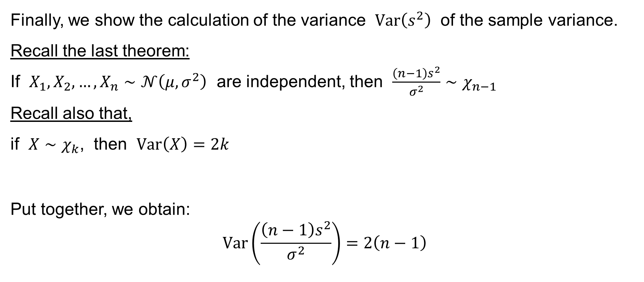
The variance of the sample variance
Finally, we show the calculation of the variance $Var\left(s^{2}\right)$ of the sample variance. Recall the last theorem:
If $X_{1},X_{2},…,X_{n}∼𝒩\left(μ,σ^{2}\right)$ are independent, then $\frac{\left(n−1\right)s^{2}}{σ^{2}}∼χ_{n−1}$
Recall also that,
if $X∼χ_{k}$, then $Var\left(X\right)=2k$
Put together, we obtain:
$$Var\left(\frac{\left(n−1\right)s^{2}}{σ^{2}}\right)=2\left(n−1\right)$$

Slide 54

The variance of the sample variance
Having
$$Var\left(\frac{\left(n−1\right)s^{2}}{σ^{2}}\right)=\frac{{\left(n−1\right)}^{2}}{{\left(σ^{2}\right)}^{2}}Var\left(s^{2}\right)=2\left(n−1\right)$$
we obtain
$$Var\left(s^{2}\right)=\frac{{2\left(σ^{2}\right)}^{2}}{n−1}$$

