Slide 1
Statistical Methods for Economists
Lecture (7 & 8)b
Two-Way Analysis of Variance
(ANOVA)
David Bartl
Statistical Methods for Economists
INM/BASTE

Slide 2
Introduction
Two-way ANOVA without interactions
Two-way ANOVA with interactions

Slide 3
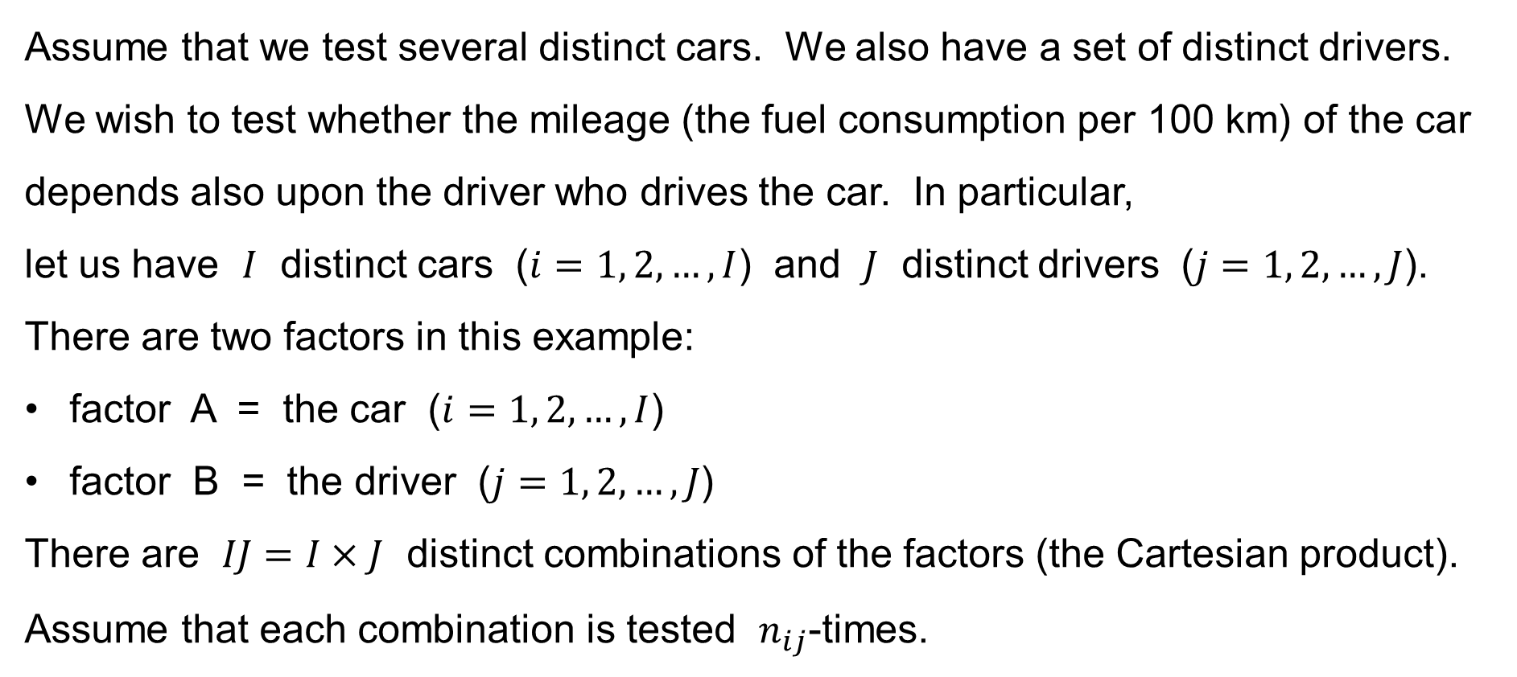
Two-factor ANOVA: Motivation: Example
Assume that we test several distinct cars. We also have a set of distinct drivers. We wish to test whether the mileage (the fuel consumption per 100 km) of the car depends also upon the driver who drives the car. In particular,
let us have $I$ distinct cars ($i=1, 2,…,I$) and $J$ distinct drivers ($j=1, 2,…,J$).
There are two factors in this example:
factor A = the car ($i=1, 2,…,I$)
factor B = the driver ($j=1, 2,…,J$)
There are $IJ=I×J$ distinct combinations of the factors (the Cartesian product).
Assume that each combination is tested $n_{ij}$-times.

Slide 4
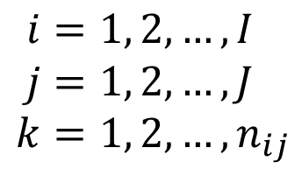
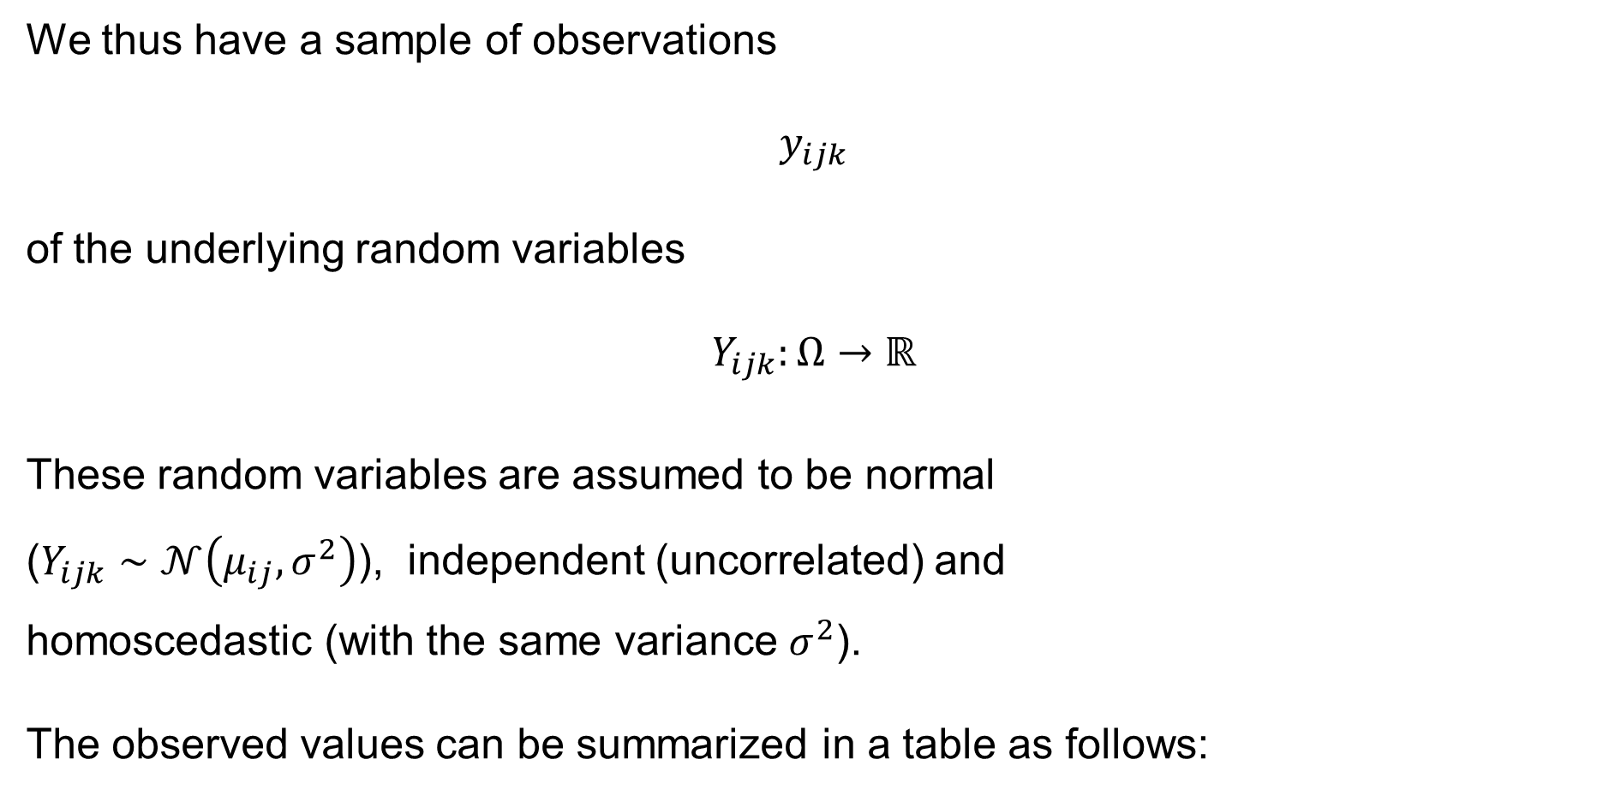


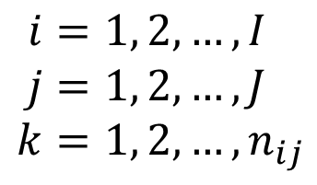
Two-factor ANOVA: Motivation & Introduction
We thus have a sample of observations
$$y_{ijk}$$
of the underlying random variables
$$Y_{ijk}:Ω→ℝ$$
These random variables are assumed to be normal
($Y_{ijk}∼𝒩\left(μ_{ij},σ^{2}\right)$), independent (uncorrelated) and
homoscedastic (with the same variance $σ^{2}$).
The observed values can be summarized in a table as follows:
$$i=1, 2,…,I \\ j=1, 2,…,J \\ k=1, 2,…,n_{ij}$$
$$\text{for}$$
$$i=1, 2,…,I \\ j=1, 2,…,J \\ k=1, 2,…,n_{ij}$$
$$\text{for}$$

Slide 5
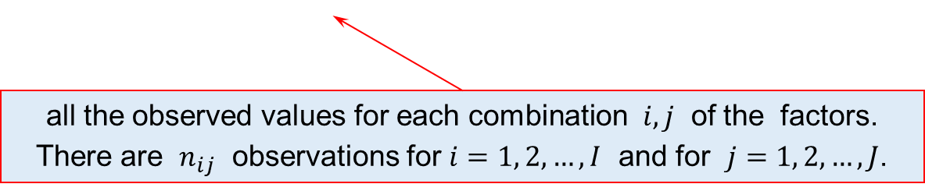
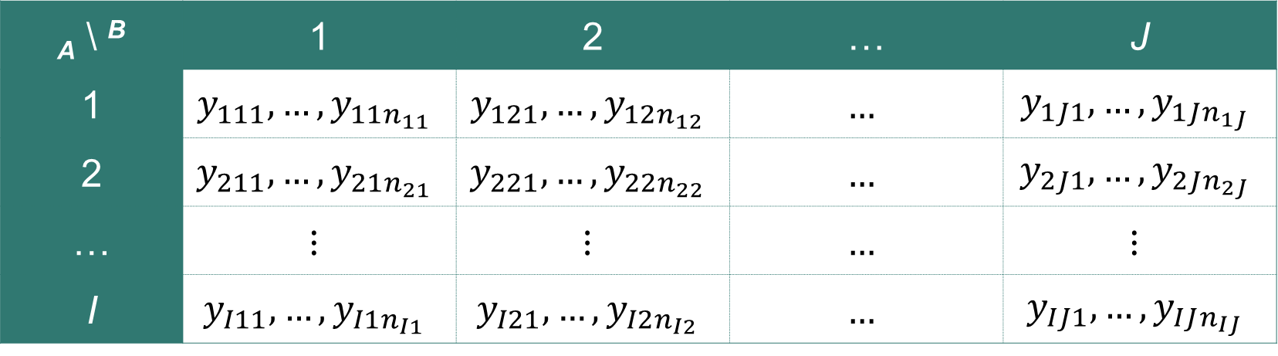
Two-factor ANOVA: Motivation & Introduction
the levels of the factor A (groups)
the levels of the factor B (blocks)
_{A} \ ^{B} | 1 | 2 | … | J
1 | $$y_{111},…,y_{11n_{11}}$$ | $$y_{121},…,y_{12n_{12}}$$ | $$…$$ | $$y_{1J1},…,y_{1Jn_{1J}}$$
2 | $$y_{211},…,y_{21n_{21}}$$ | $$y_{221},…,y_{22n_{22}}$$ | $$…$$ | $$y_{2J1},…,y_{2Jn_{2J}}$$
… | $$⋮$$ | $$⋮$$ | $$…$$ | $$⋮$$
I | $$y_{I11},…,y_{I1n_{I1}}$$ | $$y_{I21},…,y_{I2n_{I2}}$$ | $$…$$ | $$y_{IJ1},…,y_{IJn_{IJ}}$$
all the observed values for each combination $i,j$ of the factors.
There are $n_{ij}$ observations for $i=1, 2,…,I$ and for $j=1, 2,…,J$.

Slide 6
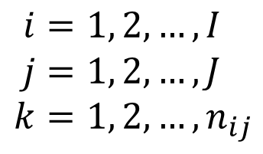
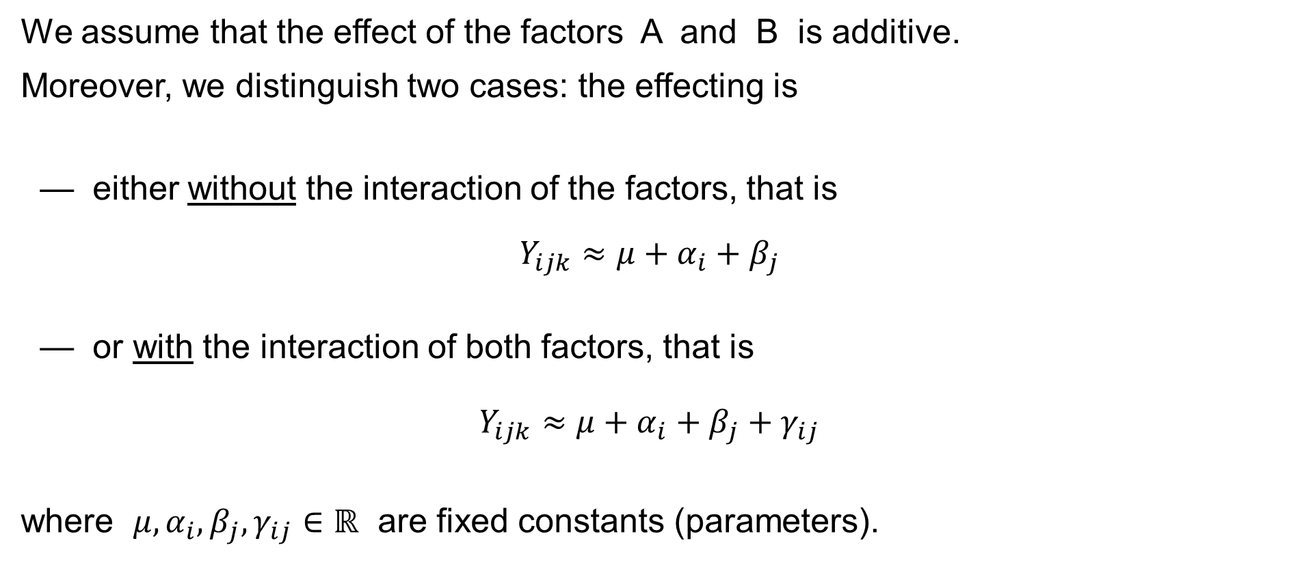


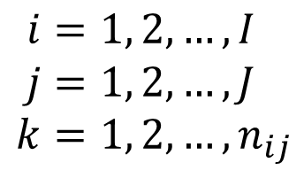
Two-factor ANOVA: Introduction: Assumptions
We assume that the effect of the factors A and B is additive.
Moreover, we distinguish two cases: the effecting is
— either without the interaction of the factors, that is
$$Y_{ijk}≈μ+α_{i}+β_{j}$$
— or with the interaction of both factors, that is
$$Y_{ijk}≈μ+α_{i}+β_{j}+γ_{ij}$$
where $μ,α_{i},β_{j},γ_{ij}∈ℝ$ are fixed constants (parameters).
$$i=1, 2,…,I \\ j=1, 2,…,J \\ k=1, 2,…,n_{ij}$$
$$\text{for}$$
$$i=1, 2,…,I \\ j=1, 2,…,J \\ k=1, 2,…,n_{ij}$$
$$\text{for}$$

Slide 7
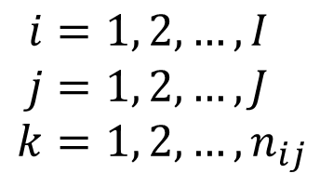
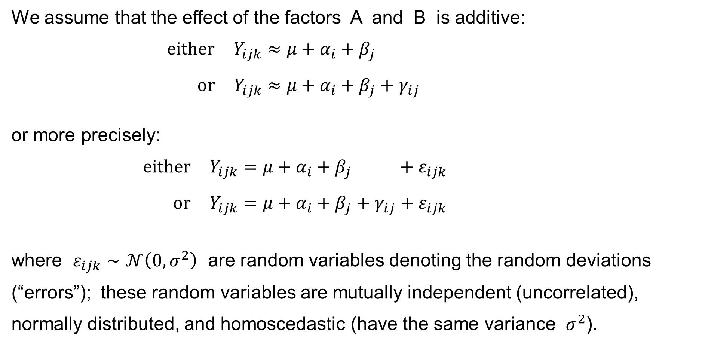

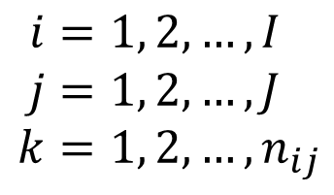

Two-factor ANOVA: Introduction: Assumptions
We assume that the effect of the factors A and B is additive:
$$\text{either} Y_{ijk}≈μ+α_{i}+β_{j} \\ \text{or} Y_{ijk}≈μ+α_{i}+β_{j}+γ_{ij}$$
or more precisely:
$$\text{either} Y_{ijk}=μ+α_{i}+β_{j} +ε_{ijk} \\ \text{or} Y_{ijk}=μ+α_{i}+β_{j}+γ_{ij}+ε_{ijk}$$
where $ε_{ijk}∼𝒩\left(0,σ^{2}\right)$ are random variables denoting the random deviations (“errors”); these random variables are mutually independent (uncorrelated), normally distributed, and homoscedastic (have the same variance $σ^{2}$).
$$i=1, 2,…,I \\ j=1, 2,…,J \\ k=1, 2,…,n_{ij}$$
$$\text{for}$$
$$i=1, 2,…,I \\ j=1, 2,…,J \\ k=1, 2,…,n_{ij}$$
$$\text{for}$$

Slide 8
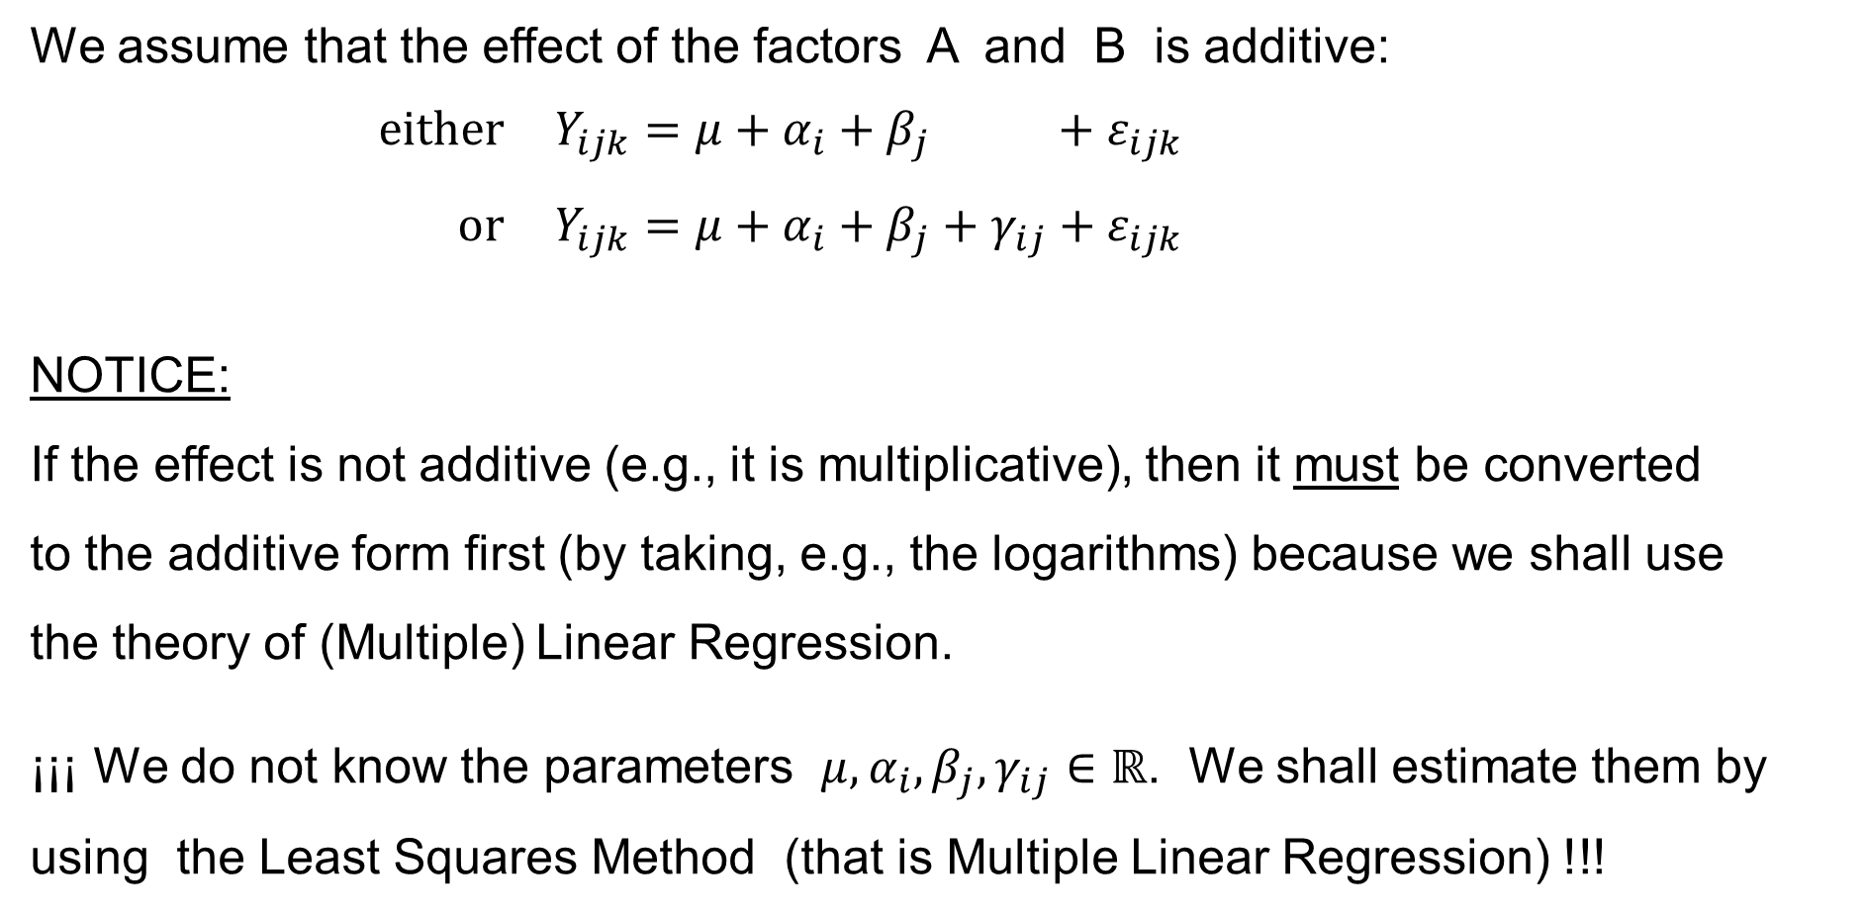
Two-factor ANOVA: Introduction: Assumptions
We assume that the effect of the factors A and B is additive:
$$\text{either} Y_{ijk}=μ+α_{i}+β_{j} +ε_{ijk} \\ \text{or} Y_{ijk}=μ+α_{i}+β_{j}+γ_{ij}+ε_{ijk}$$
NOTICE:
If the effect is not additive (e.g., it is multiplicative), then it must be converted
to the additive form first (by taking, e.g., the logarithms) because we shall use
the theory of (Multiple) Linear Regression.
¡¡¡ We do not know the parameters $μ,α_{i},β_{j},γ_{ij}∈ℝ$. We shall estimate them by using the Least Squares Method (that is Multiple Linear Regression) !!!
$$i=1, 2,…,I \\ j=1, 2,…,J \\ k=1, 2,…,n_{ij}$$
$$\text{for}$$

Slide 9
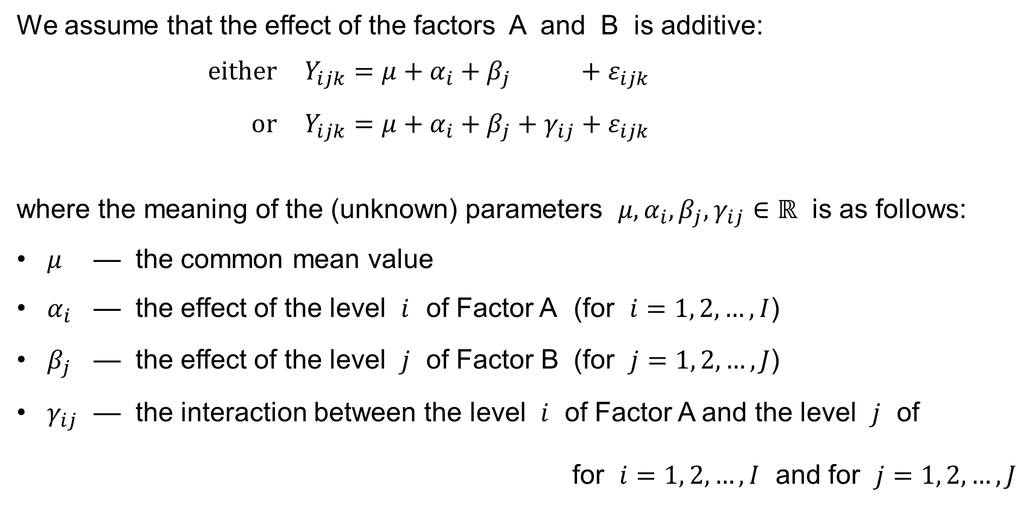
Two-factor ANOVA: Introduction: Assumptions
We assume that the effect of the factors A and B is additive:
$$\text{either} Y_{ijk}=μ+α_{i}+β_{j} +ε_{ijk} \\ \text{or} Y_{ijk}=μ+α_{i}+β_{j}+γ_{ij}+ε_{ijk}$$
where the meaning of the (unknown) parameters $μ,α_{i},β_{j},γ_{ij}∈ℝ$ is as follows:
$μ$ — the common mean value
$α_{i}$ — the effect of the level $i$ of Factor A (for $i=1, 2,…,I$)
$β_{j}$ — the effect of the level $j$ of Factor B (for $j=1, 2,…,J$)
$γ_{ij}$ — the interaction between the level $i$ of Factor A and the level $j$ of
for $i=1, 2,…,I$ and for $j=1, 2,…,J$
$$i=1, 2,…,I \\ j=1, 2,…,J \\ k=1, 2,…,n_{ij}$$
$$\text{for}$$
Factor B

Slide 10
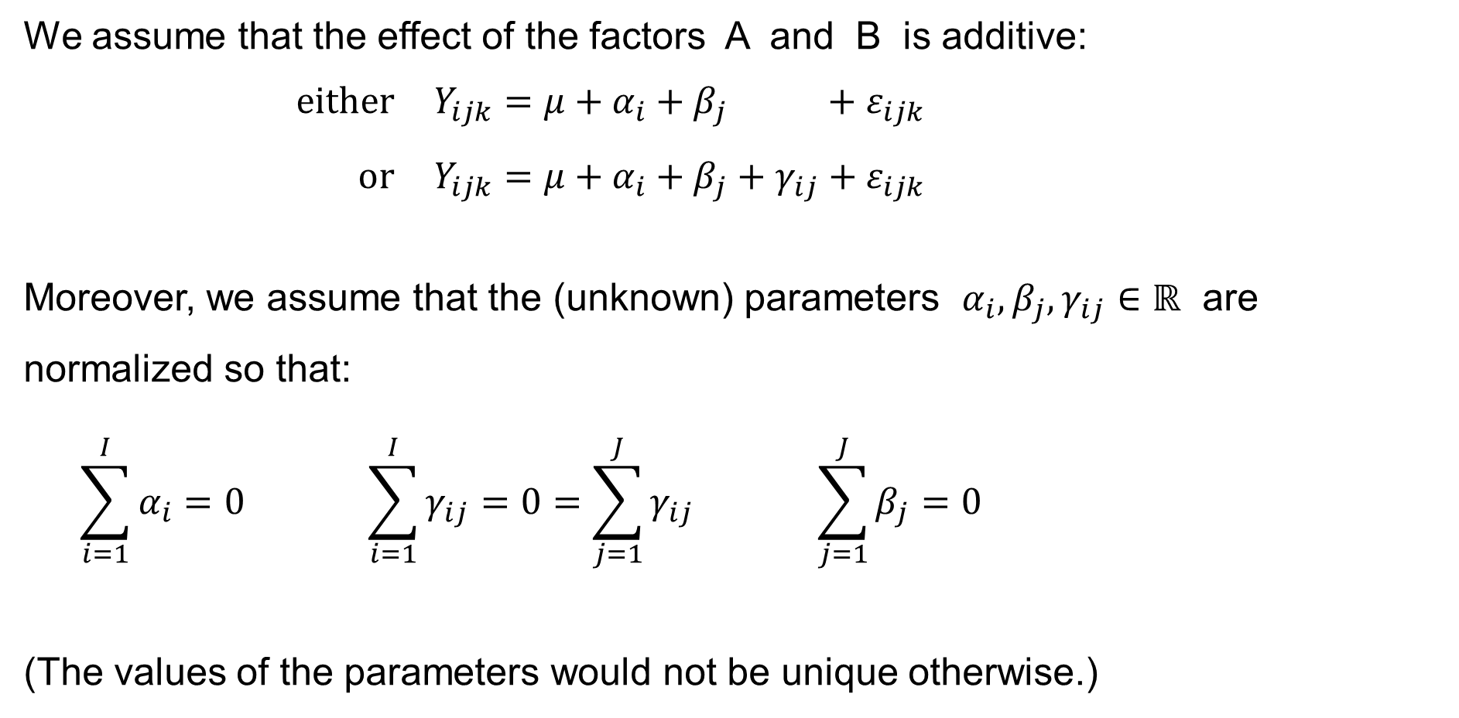

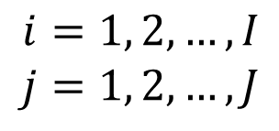
Two-factor ANOVA: Introduction: Assumptions
We assume that the effect of the factors A and B is additive:
$$\text{either} Y_{ijk}=μ+α_{i}+β_{j} +ε_{ijk} \\ \text{or} Y_{ijk}=μ+α_{i}+β_{j}+γ_{ij}+ε_{ijk}$$
Moreover, we assume that the (unknown) parameters $α_{i},β_{j},γ_{ij}∈ℝ$ are normalized so that:
$$\sum_{i=1}^{I}{α_{i}}=0 \sum_{i=1}^{I}{γ_{ij}}=0=\sum_{j=1}^{J}{γ_{ij}} \sum_{j=1}^{J}{β_{j}}=0$$
(The values of the parameters would not be unique otherwise.)
$$i=1, 2,…,I \\ j=1, 2,…,J \\ k=1, 2,…,n_{ij}$$
$$\text{for}$$
$$i=1, 2,…,I \\ j=1, 2,…,J$$
$$\text{for}$$

Slide 11
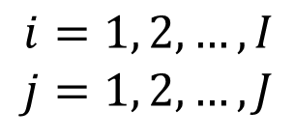
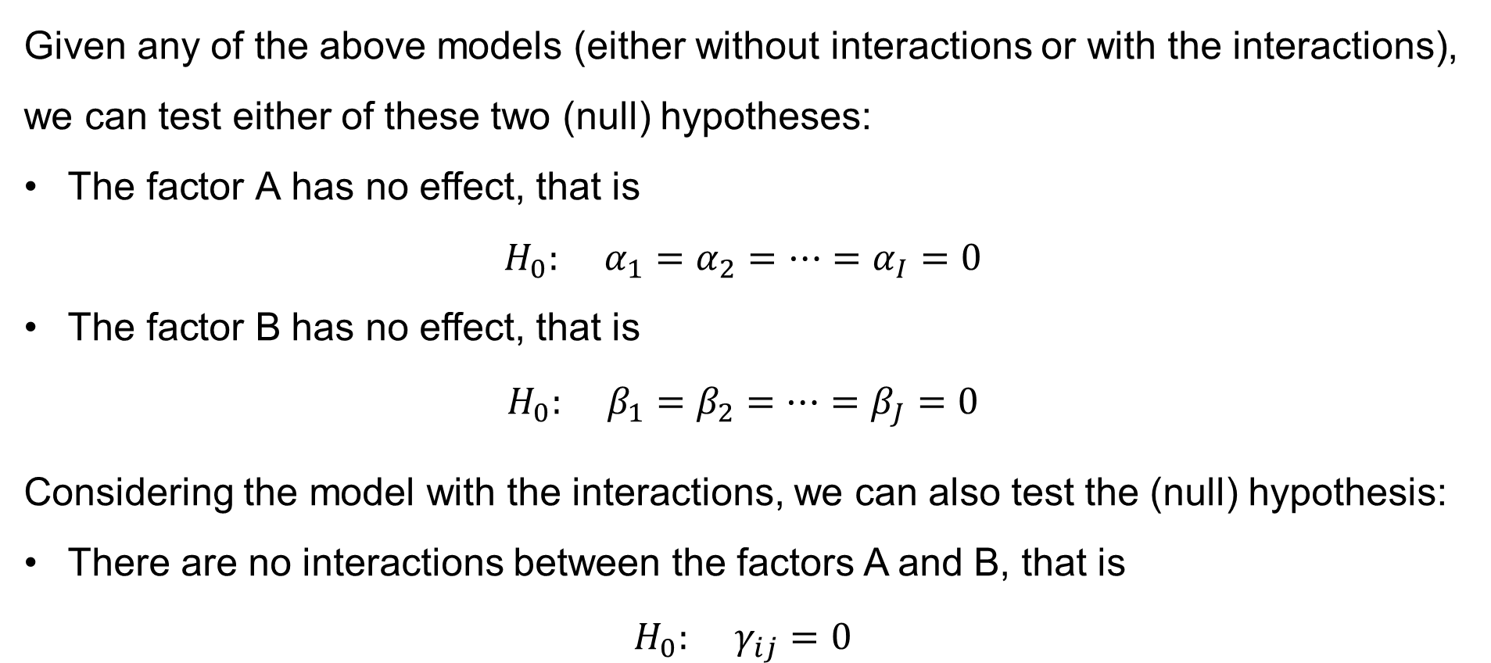

Two-factor ANOVA: Introduction: The Goal
Given any of the above models (either without interactions or with the interactions), we can test either of these two (null) hypotheses:
The factor A has no effect, that is
$H_{0}: α_{1}=α_{2}=⋯=α_{I}=0$
The factor B has no effect, that is
$H_{0}: β_{1}=β_{2}=⋯=β_{J}=0$
Considering the model with the interactions, we can also test the (null) hypothesis:
There are no interactions between the factors A and B, that is
$H_{0}: γ_{ij}=0$
$$i=1, 2,…,I \\ j=1, 2,…,J$$
$$\text{for}$$

Slide 12
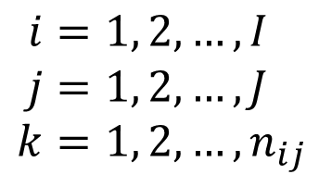
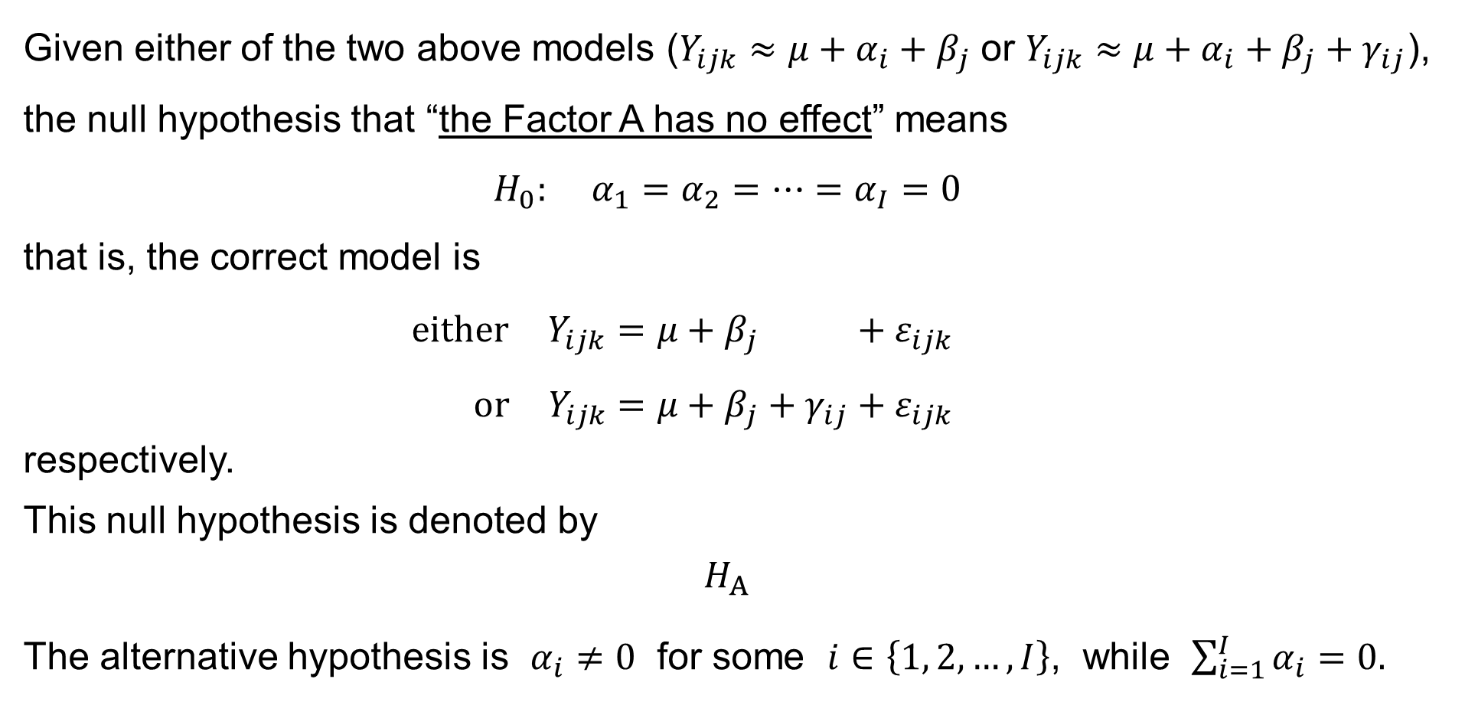

Two-factor ANOVA: Hypothesis H_{A}
Given either of the two above models ($Y_{ijk}≈μ+α_{i}+β_{j}$ or $Y_{ijk}≈μ+α_{i}+β_{j}+γ_{ij}$), the null hypothesis that “the Factor A has no effect” means
$$H_{0}: α_{1}=α_{2}=⋯=α_{I}=0$$
that is, the correct model is
$$\text{either} Y_{ijk}=μ+β_{j} +ε_{ijk} \\ \text{or} Y_{ijk}=μ+β_{j}+γ_{ij}+ε_{ijk}$$
respectively.
This null hypothesis is denoted by
$$H_{A}$$
The alternative hypothesis is $α_{i}≠0$ for some $i∈\left\{1, 2,…,I\right\}$, while $\sum_{i=1}^{I}{α_{i}}=0.$
$$i=1, 2,…,I \\ j=1, 2,…,J \\ k=1, 2,…,n_{ij}$$
$$\text{for}$$

Slide 13
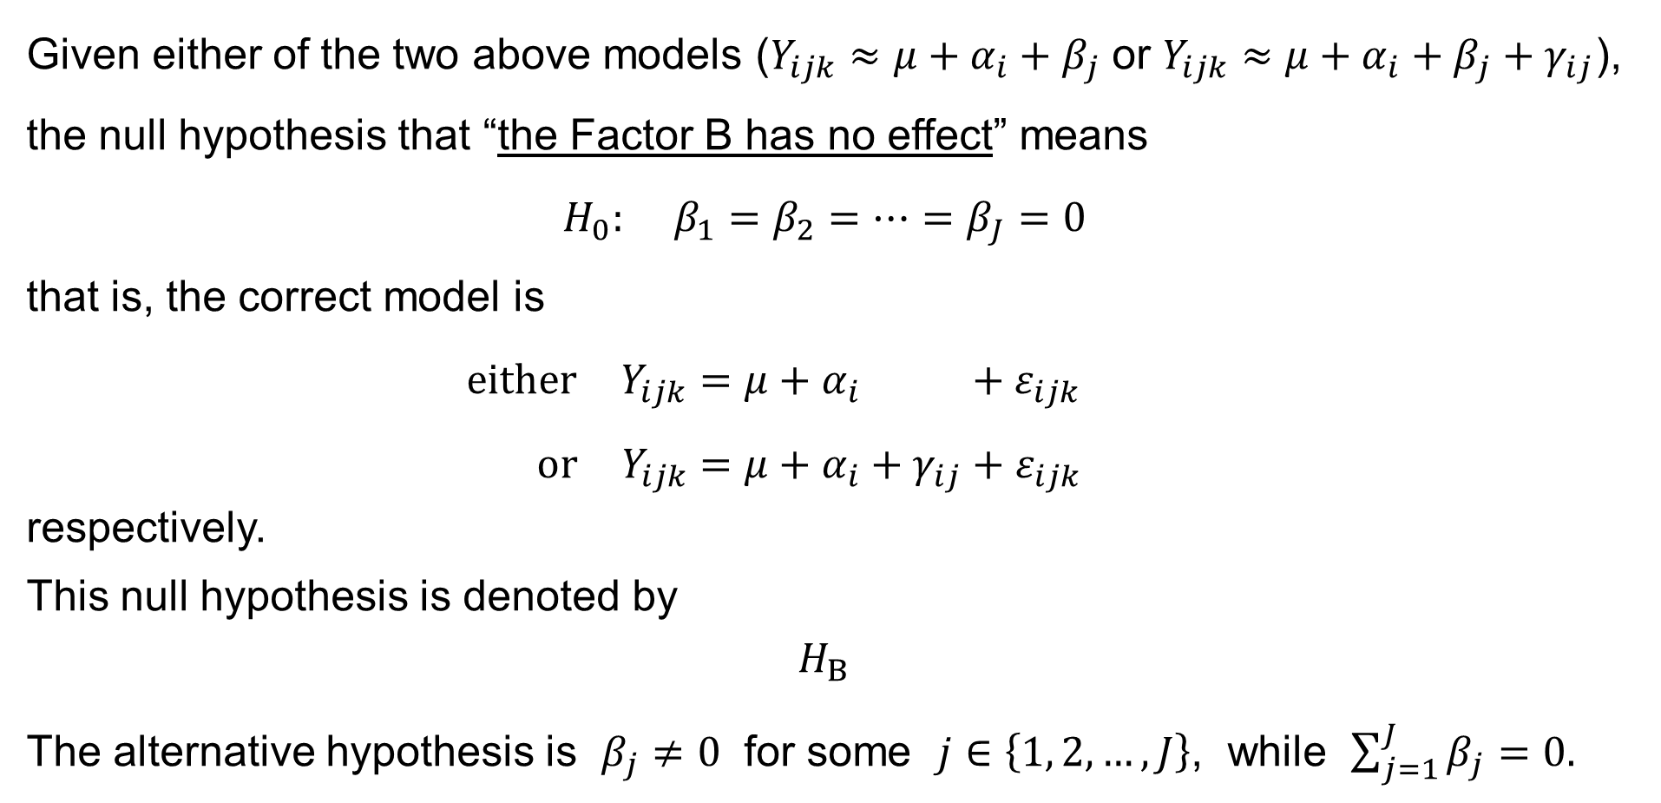
Two-factor ANOVA: Hypothesis H_{B}
Given either of the two above models ($Y_{ijk}≈μ+α_{i}+β_{j}$ or $Y_{ijk}≈μ+α_{i}+β_{j}+γ_{ij}$), the null hypothesis that “the Factor B has no effect” means
$$H_{0}: β_{1}=β_{2}=⋯=β_{J}=0$$
that is, the correct model is
$$\text{either} Y_{ijk}=μ+α_{i} +ε_{ijk} \\ \text{or} Y_{ijk}=μ+α_{i}+γ_{ij}+ε_{ijk}$$
respectively.
This null hypothesis is denoted by
$$H_{B}$$
The alternative hypothesis is $β_{j}≠0$ for some $j∈\left\{1, 2,…,J\right\}$, while $\sum_{j=1}^{J}{β_{j}}=0.$
$$i=1, 2,…,I \\ j=1, 2,…,J \\ k=1, 2,…,n_{ij}$$
$$\text{for}$$

Slide 14
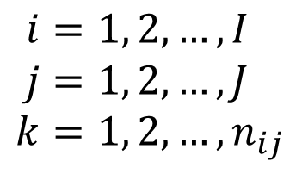
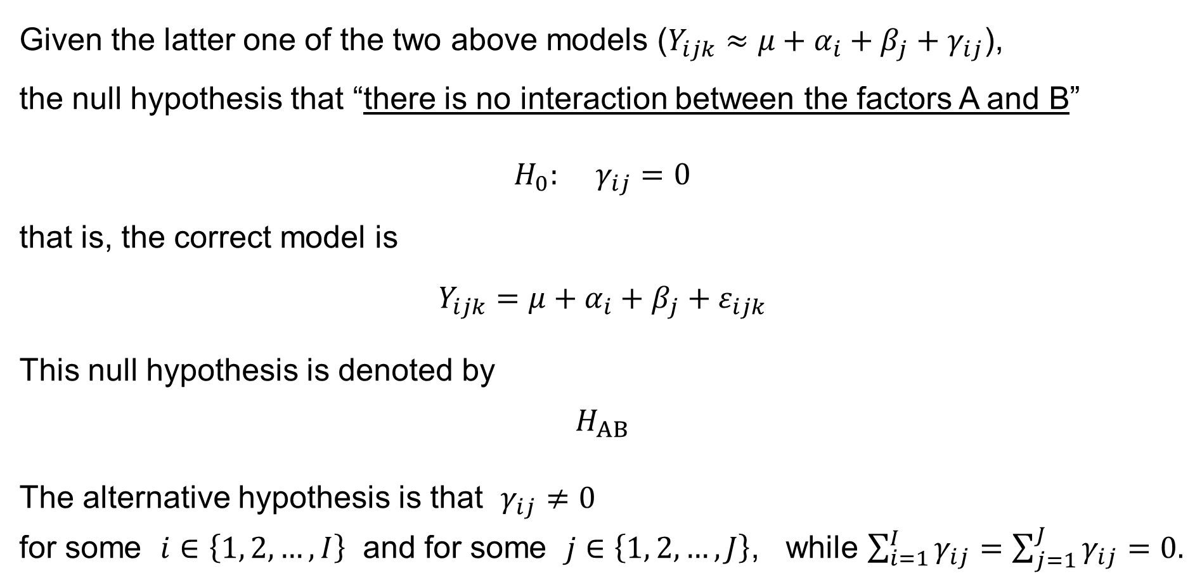

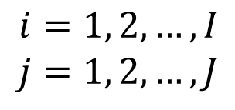

Two-factor ANOVA: Hypothesis H_{AB}
Given the latter one of the two above models ($Y_{ijk}≈μ+α_{i}+β_{j}+γ_{ij}$),
the null hypothesis that “there is no interaction between the factors A and B”
$$H_{0}: γ_{ij}=0$$
that is, the correct model is
$$Y_{ijk}=μ+α_{i}+β_{j}+ε_{ijk}$$
This null hypothesis is denoted by
$$H_{AB}$$
The alternative hypothesis is that $γ_{ij}≠0$
for some $i∈\left\{1, 2,…,I\right\}$ and for some $j∈\left\{1, 2,…,J\right\}$, while $\sum_{i=1}^{I}{γ_{ij}}=\sum_{j=1}^{J}{γ_{ij}}=0.$
means
$$i=1, 2,…,I \\ j=1, 2,…,J$$
$$\text{for}$$
$$i=1, 2,…,I \\ j=1, 2,…,J \\ k=1, 2,…,n_{ij}$$
$$\text{for}$$

Slide 15
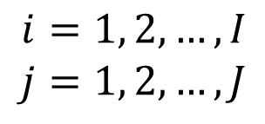
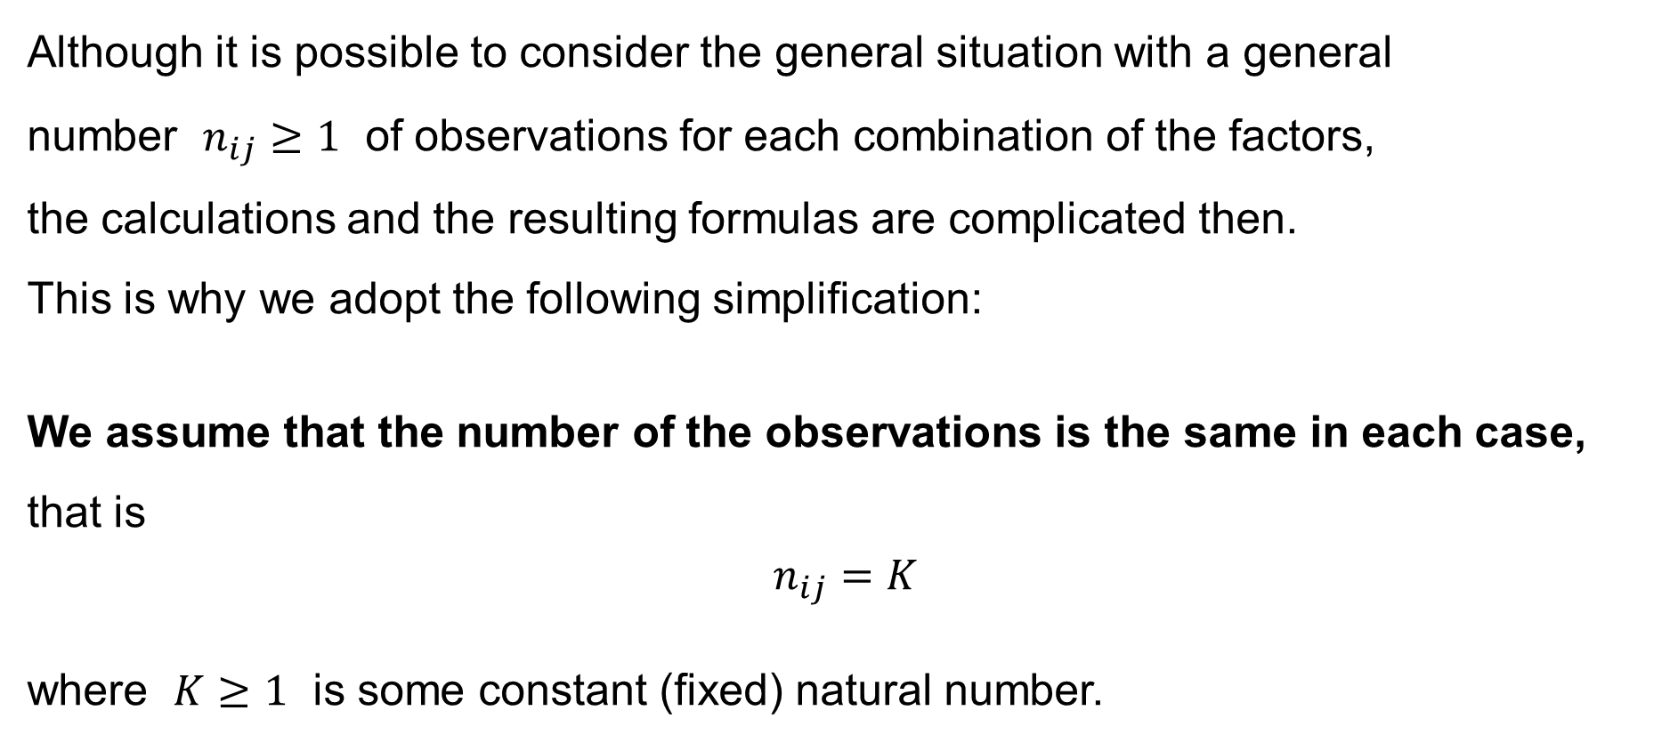
Two-factor ANOVA: Simplification
Although it is possible to consider the general situation with a general
number $n_{ij}≥1$ of observations for each combination of the factors,
the calculations and the resulting formulas are complicated then.
This is why we adopt the following simplification:
We assume that the number of the observations is the same in each case,
that is
$$n_{ij}=K$$
where $K≥1$ is some constant (fixed) natural number.
$$i=1, 2,…,I \\ j=1, 2,…,J$$
$$\text{for}$$

Slide 16
Two-Way ANOVA without interactions
Y_{ijk}=μ+α_{i}+β_{j}+ε_{ijk}

Slide 17

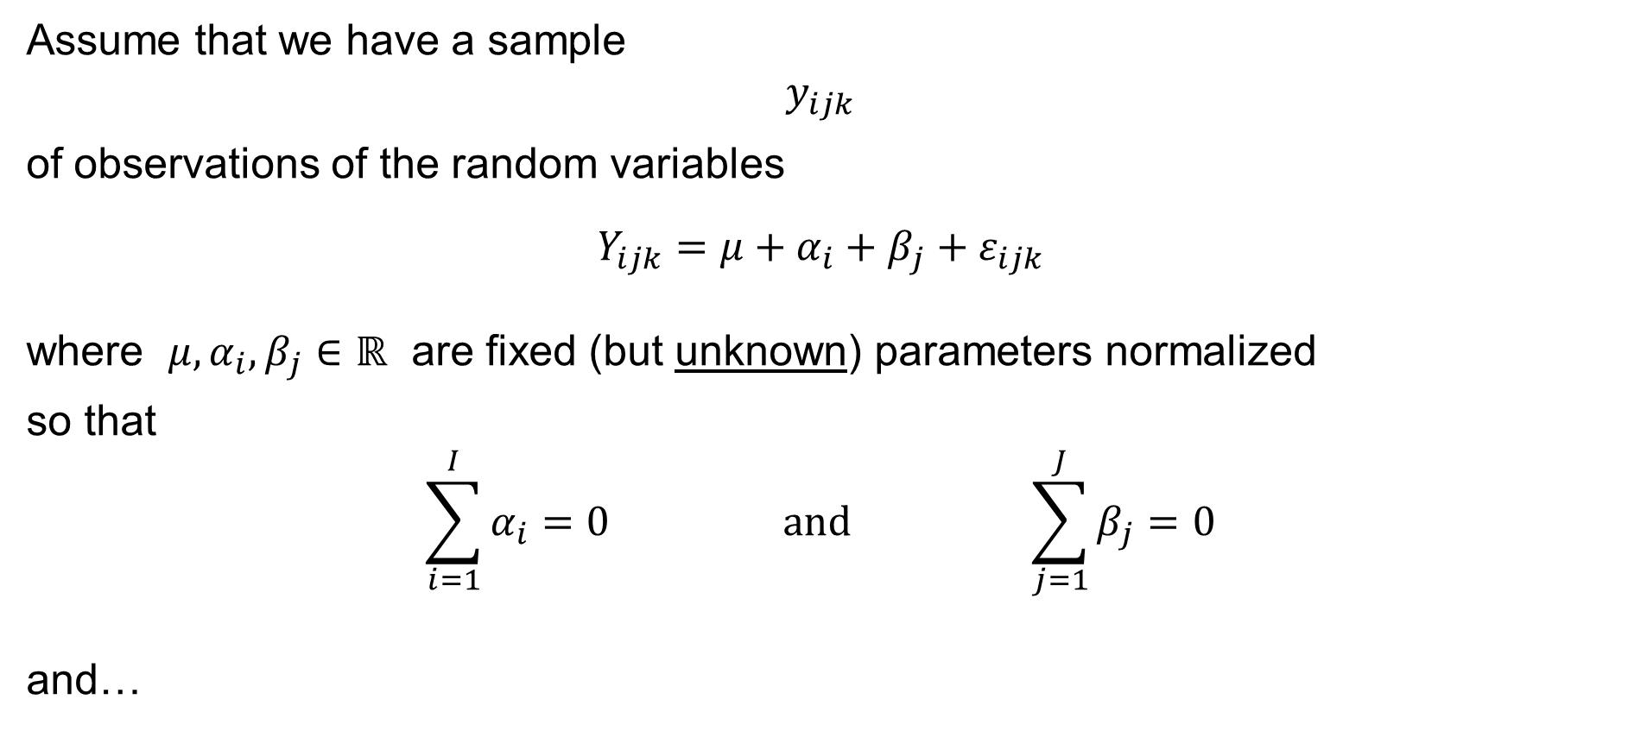

Two-way ANOVA with no interactions
Assume that we have a sample
$$y_{ijk}$$
of observations of the random variables
$$Y_{ijk}=μ+α_{i}+β_{j}+ε_{ijk}$$
where $μ,α_{i},β_{j}∈ℝ$ are fixed (but unknown) parameters normalized
so that
$$\sum_{i=1}^{I}{α_{i}}=0 \text{and} \sum_{j=1}^{J}{β_{j}}=0$$
and…
$$i=1, 2,…,I \\ j=1, 2,…,J \\ k=1, 2,…,K$$
$$\text{for}$$

Slide 18
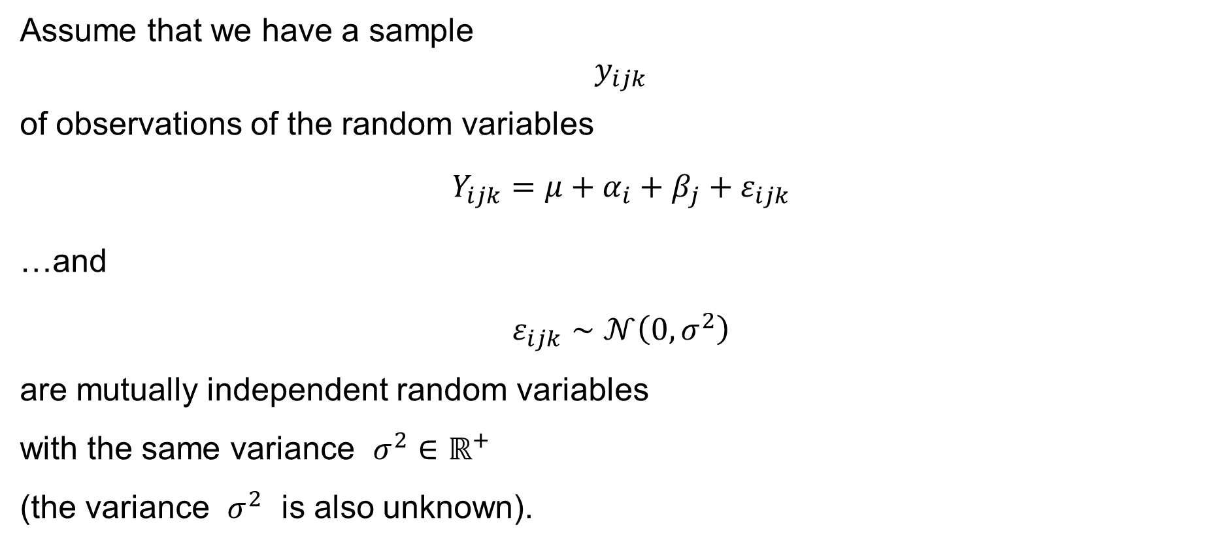


Two-way ANOVA with no interactions
Assume that we have a sample
$$y_{ijk}$$
of observations of the random variables
$$Y_{ijk}=μ+α_{i}+β_{j}+ε_{ijk}$$
…and
$$ε_{ijk}∼𝒩\left(0,σ^{2}\right)$$
are mutually independent random variables
with the same variance $σ^{2}∈ℝ^{+}$
(the variance $σ^{2}$ is also unknown).
$$i=1, 2,…,I \\ j=1, 2,…,J \\ k=1, 2,…,K$$
$$\text{for}$$
$$i=1, 2,…,I \\ j=1, 2,…,J \\ k=1, 2,…,K$$
$$\text{for}$$

Slide 19
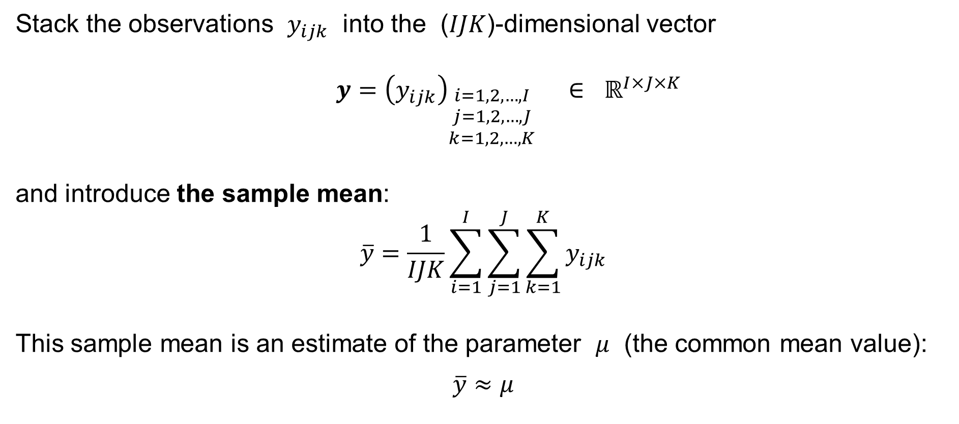
Two-way ANOVA with no interactions: Notation
Stack the observations $y_{ijk}$ into the ($IJK$)-dimensional vector
$$y={\left(y_{ijk}\right)}_{\begin{aligned}i=1,2,…,I \\ j=1,2,…,J \\ k=1,2,…,K\end{aligned}} ∈ ℝ^{I×J×K}$$
and introduce the sample mean:
$$\overline{y}=\frac{1}{IJK}\sum_{i=1}^{I}{\sum_{j=1}^{J}{\sum_{k=1}^{K}{y_{ijk}}}}$$
This sample mean is an estimate of the parameter $μ$ (the common mean value):
$$\overline{y}≈μ$$

Slide 20

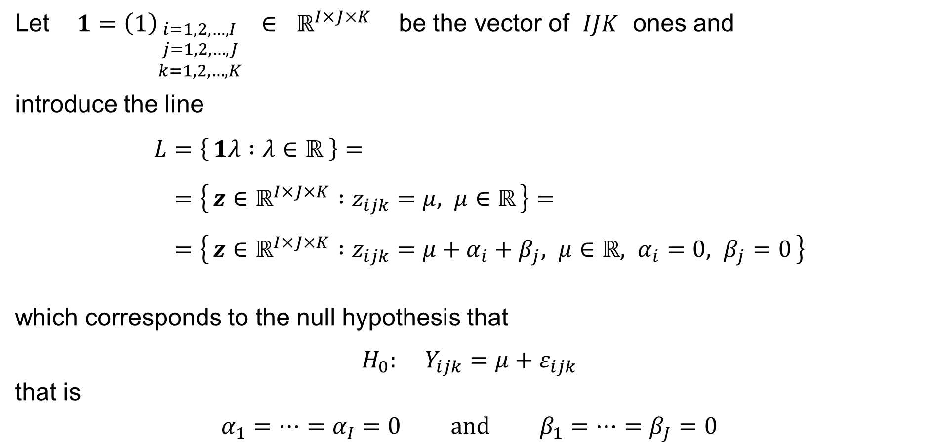

Two-way ANOVA with no interactions: Notation
Let $1={\left(1\right)}_{\begin{aligned}i=1,2,…,I \\ j=1,2,…,J \\ k=1,2,…,K\end{aligned}} ∈ ℝ^{I×J×K}$ be the vector of $IJK$ ones and
introduce the line
$$L=\left\{ 1λ :λ∈ℝ \right\}= \\ =\left\{ z∈ℝ^{I×J×K} :z_{ijk}=μ, μ∈ℝ \right\}= \\ =\left\{ z∈ℝ^{I×J×K} :z_{ijk}=μ+α_{i}+β_{j}, μ∈ℝ, α_{i}=0, β_{j}=0 \right\}$$
which corresponds to the null hypothesis that
$$H_{0}: Y_{ijk}=μ+ε_{ijk}$$
that is
$$α_{1}=⋯=α_{I}=0 \text{and} β_{1}=⋯=β_{J}=0$$
$$i=1, 2,…,I \\ j=1, 2,…,J \\ k=1, 2,…,K$$
$$\text{for}$$
(cf. one-way ANOVA)

Slide 21

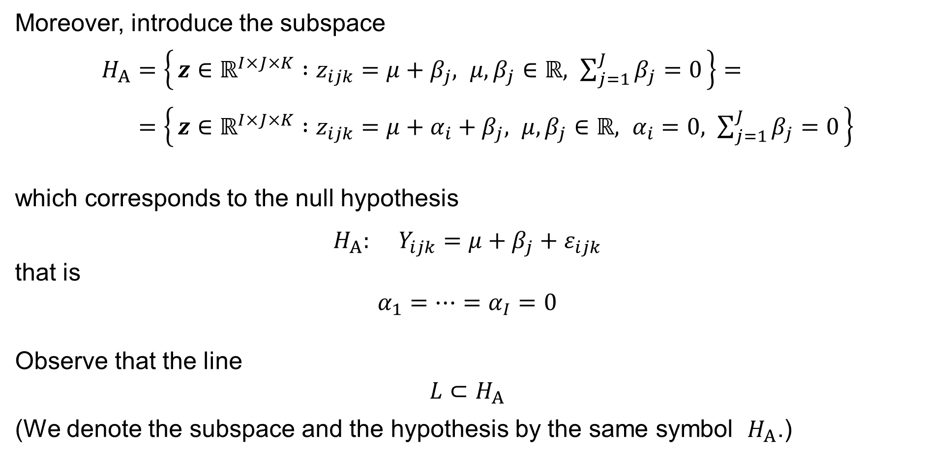

Two-way ANOVA with no interactions: Notation
Moreover, introduce the subspace
$H_{A}=\left\{ z∈ℝ^{I×J×K} :z_{ijk}=μ+β_{j}, μ,β_{j}∈ℝ, \sum_{j=1}^{J}{β_{j}}=0 \right\}=$
$H_{A}=\left\{ z∈ℝ^{I×J×K} :z_{ijk}=μ+α_{i}+β_{j}, μ,β_{j}∈ℝ, α_{i}=0, \sum_{j=1}^{J}{β_{j}}=0 \right\}$
which corresponds to the null hypothesis
$$H_{A}: Y_{ijk}=μ+β_{j}+ε_{ijk}$$
that is
$$α_{1}=⋯=α_{I}=0$$
Observe that the line
$$L⊂H_{A}$$
(We denote the subspace and the hypothesis by the same symbol $H_{A}$.)
$$i=1, 2,…,I \\ j=1, 2,…,J \\ k=1, 2,…,K$$
$$\text{for}$$

Slide 22

Two-way ANOVA with no interactions: Notation
Introduce also the subspace
$H_{B}=\left\{ z∈ℝ^{I×J×K} :z_{ijk}=μ+α_{i}, μ,α_{i}∈ℝ, \sum_{i=1}^{I}{α_{i}}=0 \right\}=$
$H_{B}=\left\{ z∈ℝ^{I×J×K} :z_{ijk}=μ+α_{i}+β_{j}, μ,α_{i}∈ℝ, β_{j}=0, \sum_{i=1}^{I}{α_{i}}=0 \right\}$
which corresponds to the null hypothesis
$$H_{B}: Y_{ijk}=μ+α_{i}+ε_{ijk}$$
that is
$$β_{1}=⋯=β_{J}=0$$
Observe that the line
$$L⊂H_{B}$$
(We denote the subspace and the hypothesis by the same symbol $H_{B}$.)
$$i=1, 2,…,I \\ j=1, 2,…,J \\ k=1, 2,…,K$$
$$\text{for}$$

Slide 23



Two-way ANOVA with no interactions: Notation
Finally, introduce the subspace
$M=\left\{ z∈ℝ^{I×J×K} :z_{ijk}=μ+α_{i}+β_{j}, μ,α_{i},β_{j}∈ℝ, \sum_{i=1}^{I}{α_{i}}=\sum_{j=1}^{J}{β_{j}}=0 \right\}$
which corresponds to the model under consideration:
$$Y_{ijk}=μ+α_{i}+β_{j}+ε_{ijk}$$
$$i=1, 2,…,I \\ j=1, 2,…,J \\ k=1, 2,…,K$$
$$\text{for}$$

Slide 24

Two-way ANOVA with no interactions: Dimensions
Notice that the dimension of
— the line
$$L=\left\{ 1λ :λ∈ℝ \right\}=\left\{ z∈ℝ^{I×J×K} :z_{ijk}=μ, μ∈ℝ \right\}$$
is
$$1$$
— the subspace
$H_{A}=\left\{ z∈ℝ^{I×J×K} :z_{ijk}=μ+β_{j}, μ,β_{j}∈ℝ, \sum_{j=1}^{J}{β_{j}}=0 \right\}$
is
$$\left(1+J\right)−1= J$$

Slide 25
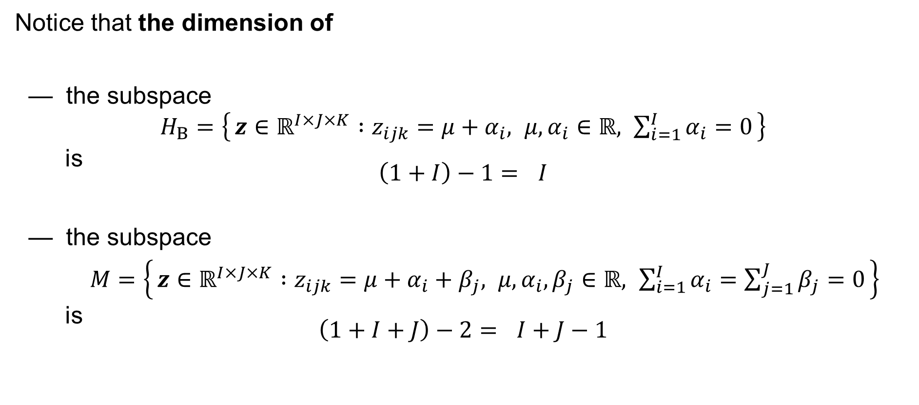
Two-way ANOVA with no interactions: Dimensions
Notice that the dimension of
— the subspace
$H_{B}=\left\{ z∈ℝ^{I×J×K} :z_{ijk}=μ+α_{i}, μ,α_{i}∈ℝ, \sum_{i=1}^{I}{α_{i}}=0 \right\}$
is
$$\left(1+I\right)−1= I$$
— the subspace
$M=\left\{ z∈ℝ^{I×J×K} :z_{ijk}=μ+α_{i}+β_{j}, μ,α_{i},β_{j}∈ℝ, \sum_{i=1}^{I}{α_{i}}=\sum_{j=1}^{J}{β_{j}}=0 \right\}$
is
$$\left(1+I+J\right)−2= I+J−1$$

Slide 26

Two-way ANOVA with no interactions
Solve the Least Squares Problem:
$$\sum_{i=1}^{I}{\sum_{j=1}^{J}{\sum_{k=1}^{K}{{\left(y_{ijk}−μ−α_{i}−β_{j}\right)}^{2}}}}⟶min$$
subject to
$$\sum_{i=1}^{I}{α_{i}}=0 \text{and} \sum_{j=1}^{J}{β_{j}}=0$$
and
$$μ, α_{1},…,α_{I}, β_{1},…,β_{J}∈ℝ$$

Slide 27

Two-way ANOVA with no interactions
Letting ${\hat{y}}_{ijk}=μ−α_{i}−β_{j}$, it is equivalent to solve the problem:
$$\min_{\hat{y}∈M}{\sum_{i=1}^{I}{\sum_{j=1}^{J}{\sum_{k=1}^{K}{{\left(y_{ijk}−μ−α_{i}−β_{j}\right)}^{2}}}}} = \min_{\hat{y}∈M}{{\left\|y−\hat{y}\right\|}^{2}} = RSS$$

Slide 28






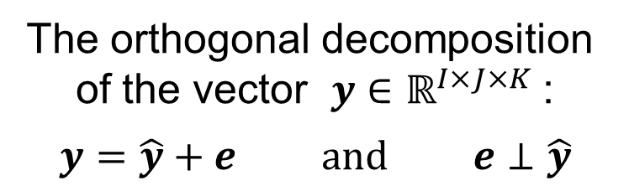


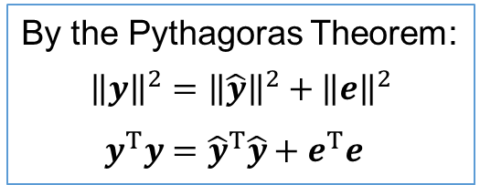
Two-way ANOVA with no interactions
The orthogonal decomposition
of the vector $y∈ℝ^{I×J×K}$ :
$$y=\hat{y}+e \text{and} e⊥\hat{y}$$
$$M^{⊥}$$
(the orthogonal
complement =
= the space of
the residuals)
the vector of the numerical
outcomes
of the random experiment
$$y$$
$$y−\hat{y}=e$$
By the Pythagoras Theorem:
$${\left\|y\right\|}^{2}={\left\|\hat{y}\right\|}^{2}+{\left\|e\right\|}^{2} \\ y^{T}y={\hat{y}}^{T}\hat{y}+e^{T}e$$
0
$$\hat{y}$$
$$\dim{M}=I+J−1$$
$$M$$
$$\dim{M^{⊥}}=\left(I−1\right)\left(J−1\right)+IJ\left(K−1\right)$$
$$\dim{M^{⊥}}+\dim{M}=IJK$$
(the subspace corresponding to the model)
Residual Sum of Squares: $RSS=\sum_{i=1}^{n}{{\left(y_{i}−{\hat{y}}_{i}\right)}^{2}}=\sum_{i=1}^{n}{e_{i}^{2}}=e^{T}e={\left\|e\right\|}^{2}$

Slide 29

Two-way ANOVA with no interactions
Solve also:
$$\sum_{i=1}^{I}{\sum_{j=1}^{J}{\sum_{k=1}^{K}{{\left(y_{ijk}−μ−β_{j}\right)}^{2}}}}⟶min \text{and} \sum_{i=1}^{I}{\sum_{j=1}^{J}{\sum_{k=1}^{K}{{\left(y_{ijk}−μ−α_{i}\right)}^{2}}}}⟶min$$
subject to
$$\sum_{j=1}^{J}{β_{j}}=0 \text{and} \sum_{i=1}^{I}{α_{i}}=0$$
and
$$μ, α_{1},…,α_{I}∈ℝ \text{and} μ, β_{1},…,β_{J}∈ℝ$$

Slide 30
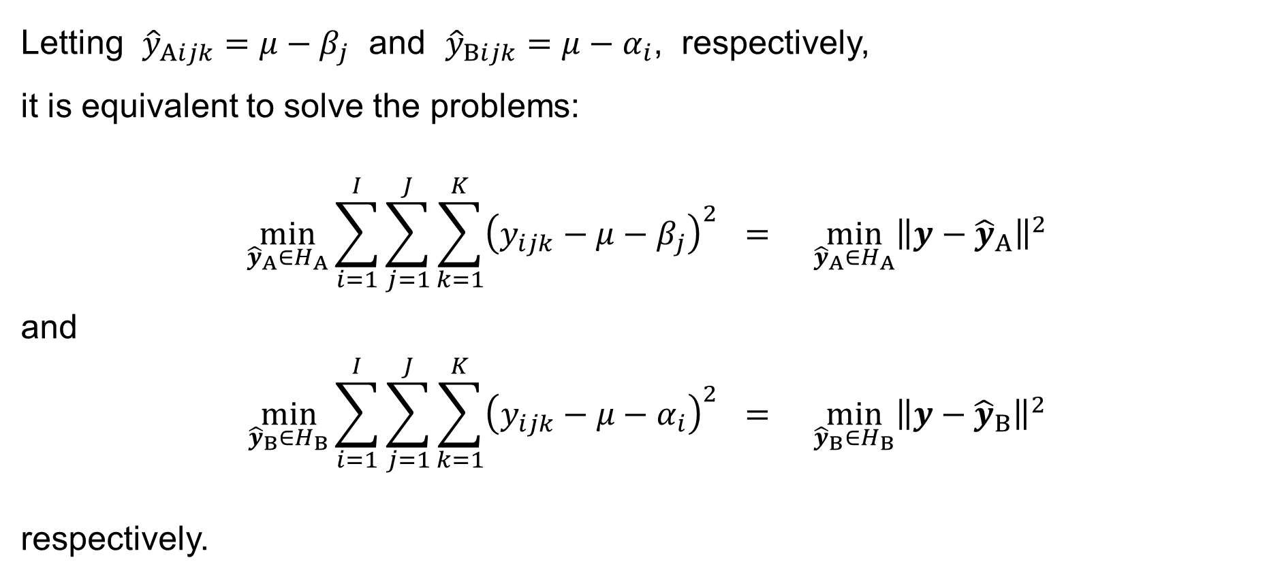
Two-way ANOVA with no interactions
Letting ${\hat{y}}_{Aijk}=μ−β_{j}$ and ${\hat{y}}_{Bijk}=μ−α_{i}$, respectively,
it is equivalent to solve the problems:
$$\min_{{\hat{y}}_{A}∈H_{A}}{\sum_{i=1}^{I}{\sum_{j=1}^{J}{\sum_{k=1}^{K}{{\left(y_{ijk}−μ−β_{j}\right)}^{2}}}}} = \min_{{\hat{y}}_{A}∈H_{A}}{{\left\|y−{\hat{y}}_{A}\right\|}^{2}}$$
and
$$\min_{{\hat{y}}_{B}∈H_{B}}{\sum_{i=1}^{I}{\sum_{j=1}^{J}{\sum_{k=1}^{K}{{\left(y_{ijk}−μ−α_{i}\right)}^{2}}}}} = \min_{{\hat{y}}_{B}∈H_{B}}{{\left\|y−{\hat{y}}_{B}\right\|}^{2}}$$
respectively.

Slide 31

Two-way ANOVA with no interactions
Lastly, solve:
$$\sum_{i=1}^{I}{\sum_{j=1}^{J}{\sum_{k=1}^{K}{{\left(y_{ijk}−μ\right)}^{2}}}}⟶min$$
subject to
$$μ∈ℝ$$
By letting $\overline{y}=μ$, equivalently:
$$\min_{1\overline{y}∈L}{\sum_{i=1}^{I}{\sum_{j=1}^{J}{\sum_{k=1}^{K}{{\left(y_{ijk}−μ\right)}^{2}}}}} = \min_{1\overline{y}∈L}{{\left\|y−1\overline{y}\right\|}^{2}}$$

Slide 32



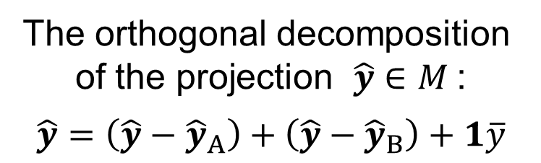


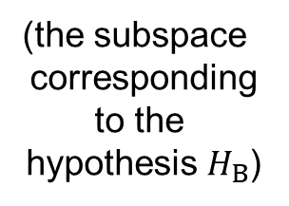

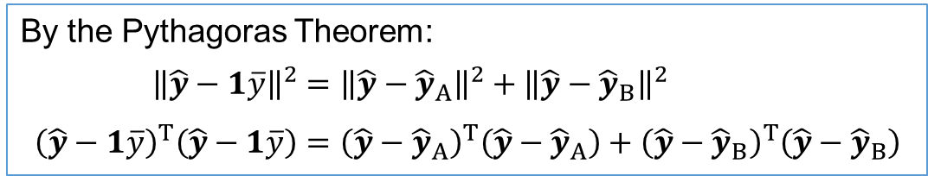



Two-way ANOVA with no interactions
The orthogonal decomposition
of the projection $\hat{y}∈M$ :
$$\hat{y}=\left(\hat{y}−{\hat{y}}_{A}\right)+\left(\hat{y}−{\hat{y}}_{B}\right)+1\overline{y}$$
$$H_{B}$$
$$\dim{M}=I+J−1$$
(the subspace
corresponding
to the
hypothesis $H_{B}$)
By the Pythagoras Theorem:
$${\left\|\hat{y}−1\overline{y}\right\|}^{2}={\left\|\hat{y}−{\hat{y}}_{A}\right\|}^{2}+{\left\|\hat{y}−{\hat{y}}_{B}\right\|}^{2} \\ {\left(\hat{y}−1\overline{y}\right)}^{T}\left(\hat{y}−1\overline{y}\right)={\left(\hat{y}−{\hat{y}}_{A}\right)}^{T}\left(\hat{y}−{\hat{y}}_{A}\right)+{\left(\hat{y}−{\hat{y}}_{B}\right)}^{T}\left(\hat{y}−{\hat{y}}_{B}\right)$$
$$\hat{y}$$
$${\hat{y}}_{B}$$
the line $L$
$$1\overline{y}$$
$${\hat{y}}_{A}$$
$$H_{A}$$
(the subspace corresponding to the hypothesis $H_{A}$)
the line $L=H_{A}∩H_{B}$

Slide 33
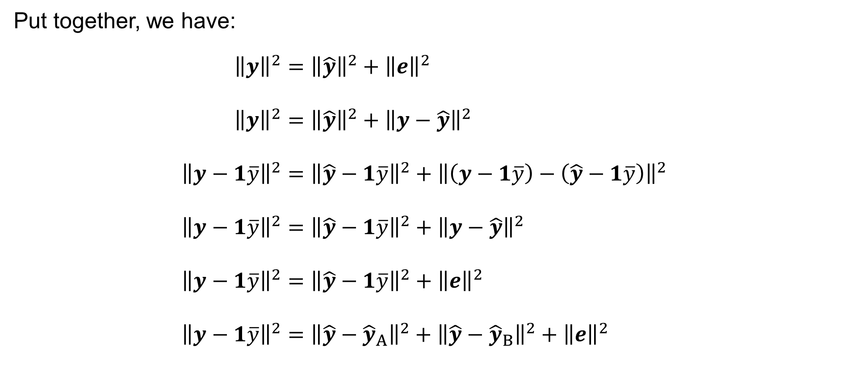
Two-way ANOVA with no interactions
Put together, we have:
$${\left\|y\right\|}^{2}={\left\|\hat{y}\right\|}^{2}+{\left\|e\right\|}^{2} \\ {\left\|y\right\|}^{2}={\left\|\hat{y}\right\|}^{2}+{\left\|y−\hat{y}\right\|}^{2} \\ {\left\|y−1\overline{y}\right\|}^{2}={\left\|\hat{y}−1\overline{y}\right\|}^{2}+{\left\|\left(y−1\overline{y}\right)−\left(\hat{y}−1\overline{y}\right)\right\|}^{2} \\ {\left\|y−1\overline{y}\right\|}^{2}={\left\|\hat{y}−1\overline{y}\right\|}^{2}+{\left\|y−\hat{y}\right\|}^{2} \\ {\left\|y−1\overline{y}\right\|}^{2}={\left\|\hat{y}−1\overline{y}\right\|}^{2}+{\left\|e\right\|}^{2} \\ {\left\|y−1\overline{y}\right\|}^{2}={\left\|\hat{y}−{\hat{y}}_{A}\right\|}^{2}+{\left\|\hat{y}−{\hat{y}}_{B}\right\|}^{2}+{\left\|e\right\|}^{2}$$

Slide 34

Two-way ANOVA with no interactions
We have and denote:
$$\underset{{SS}_{TOTAL}}{\underbrace{{\left\|y−1\overline{y}\right\|}^{2}}} = \underset{{SS}_{A}}{\underbrace{{\left\|\hat{y}−{\hat{y}}_{A}\right\|}^{2}}} + \underset{{SS}_{B}}{\underbrace{{\left\|\hat{y}−{\hat{y}}_{B}\right\|}^{2}}} + \underset{RSS}{\underbrace{{\left\|e\right\|}^{2}}}$$
where, recall, we have:
$${\hat{y}}_{ijk}=μ+α_{i}+β_{j}$$
$${\hat{y}}_{Aijk}=μ+β_{j} {\hat{y}}_{Bijk}=μ+α_{i}$$
$$\overline{y}=μ$$

Slide 35

Two-way ANOVA with no interactions
We thus have:
$${SS}_{TOTAL}={\left\|y−1\overline{y}\right\|}^{2}=\sum_{i=1}^{I}{\sum_{j=1}^{J}{\sum_{k=1}^{K}{{\left(y_{ijk}−\overline{y}\right)}^{2}}}}=\sum_{i=1}^{I}{\sum_{j=1}^{J}{\sum_{k=1}^{K}{{\left(y_{ijk}−μ\right)}^{2}}}}$$
$$RSS={\left\|e\right\|}^{2}={\left\|y−\hat{y}\right\|}^{2}=\sum_{i=1}^{I}{\sum_{j=1}^{J}{\sum_{k=1}^{K}{{\left(y_{ijk}−{\hat{y}}_{ijk}\right)}^{2}}}}=\sum_{i=1}^{I}{\sum_{j=1}^{J}{\sum_{k=1}^{K}{{\left(y_{ijk}−μ−α_{i}−β_{j}\right)}^{2}}}}$$

Slide 36

Two-way ANOVA with no interactions
We thus have:
$${SS}_{A}={\left\|\hat{y}−{\hat{y}}_{A}\right\|}^{2}=\sum_{i=1}^{I}{\sum_{j=1}^{J}{\sum_{k=1}^{K}{{\left({\hat{y}}_{ijk}−{\hat{y}}_{Aijk}\right)}^{2}}}}=\sum_{i=1}^{I}{\sum_{j=1}^{J}{\sum_{k=1}^{K}{{\left(μ+α_{i}+β_{j}−μ−β_{j}\right)}^{2}}}}= \\ =\sum_{i=1}^{I}{\sum_{j=1}^{J}{\sum_{k=1}^{K}{α_{i}^{2}}}} = JK\sum_{i=1}^{I}{α_{i}^{2}}$$

Slide 37

Two-way ANOVA with no interactions
We thus have:
$${SS}_{B}={\left\|\hat{y}−{\hat{y}}_{B}\right\|}^{2}=\sum_{i=1}^{I}{\sum_{j=1}^{J}{\sum_{k=1}^{K}{{\left({\hat{y}}_{ijk}−{\hat{y}}_{Bijk}\right)}^{2}}}}=\sum_{i=1}^{I}{\sum_{j=1}^{J}{\sum_{k=1}^{K}{{\left(μ+α_{i}+β_{j}−μ−α_{i}\right)}^{2}}}}= \\ =\sum_{i=1}^{I}{\sum_{j=1}^{J}{\sum_{k=1}^{K}{β_{j}^{2}}}} = IK\sum_{j=1}^{J}{β_{j}^{2}}$$

Slide 38

Two-way ANOVA with no interactions
By solving the above Least Squares Problems (${∂F}/{∂μ}={∂F}/{∂α_{i}}={∂F}/{∂β_{j}}=0$ etc.;
do it as an exercise), we obtain:
$$\hat{μ} = \frac{1}{IJK}\sum_{i=1}^{I}{\sum_{j=1}^{J}{\sum_{k=1}^{K}{y_{ijk}}}} = \overline{y}$$
$${\hat{α}}_{i} = \frac{1}{JK}\sum_{j=1}^{J}{\sum_{k=1}^{K}{y_{ijk}}}−\hat{μ} = {\overline{y}}_{i∙∙}−\overline{y} \text{for} i=1, 2,…,I$$
$${\hat{β}}_{j} = \frac{1}{IK}\sum_{i=1}^{I}{\sum_{k=1}^{K}{y_{ijk}}}−\hat{μ} = {\overline{y}}_{∙j∙}−\overline{y} \text{for} j=1, 2,…,J$$

Slide 39

Two-way ANOVA with no interactions
Put together, we have:
$${SS}_{TOTAL} =\sum_{i=1}^{I}{\sum_{j=1}^{J}{\sum_{k=1}^{K}{{\left(y_{ijk}−\hat{μ}\right)}^{2}}}} = \sum_{i=1}^{I}{\sum_{j=1}^{J}{\sum_{k=1}^{K}{{\left(y_{ijk}−\overline{y}\right)}^{2}}}}$$
$${SS}_{A} =JK\sum_{i=1}^{I}{{\hat{α}}_{i}^{2}} = JK\sum_{i=1}^{I}{{\left({\overline{y}}_{i∙∙}−\overline{y}\right)}^{2}}$$
$${SS}_{B} =IK\sum_{j=1}^{J}{{\hat{β}}_{j}^{2}} = IK\sum_{j=1}^{J}{{\left({\overline{y}}_{∙j∙}−\overline{y}\right)}^{2}}$$

Slide 40

Two-way ANOVA with no interactions
Put together, we have:
$$RSS=\sum_{i=1}^{I}{\sum_{j=1}^{J}{\sum_{k=1}^{K}{{\left(y_{ijk}−\hat{μ}−{\hat{α}}_{i}−{\hat{β}}_{j}\right)}^{2}}}}=\sum_{i=1}^{I}{\sum_{j=1}^{J}{\sum_{k=1}^{K}{{\left(y_{ijk}−\overline{y}−{\overline{y}}_{i∙∙}+\overline{y}−{\overline{y}}_{∙j∙}+\overline{y}\right)}^{2}}}}= \\ =\sum_{i=1}^{I}{\sum_{j=1}^{J}{\sum_{k=1}^{K}{{\left(y_{ijk}−{\overline{y}}_{i∙∙}−{\overline{y}}_{∙j∙}+\overline{y}\right)}^{2}}}}$$
Remark: The quantity
$$s^{2}=\frac{RSS}{\left(I−1\right)\left(J−1\right)+IJ\left(K−1\right)}$$
is an estimate of the unknown $σ^{2}$, that is $s^{2}≈σ^{2}$. We have $E\left[s^{2}\right]=σ^{2}$.

Slide 41

Two-way ANOVA with no interactions
Recall that it holds:
$${SS}_{TOTAL}={SS}_{A}+{SS}_{B}+RSS$$
$$\sum_{i=1}^{I}{\sum_{j=1}^{J}{\sum_{k=1}^{K}{{\left(y_{ijk}−\overline{y}\right)}^{2}}}} = JK\sum_{i=1}^{I}{{\left({\overline{y}}_{i∙∙}−\overline{y}\right)}^{2}}+IK\sum_{j=1}^{J}{{\left({\overline{y}}_{∙j∙}−\overline{y}\right)}^{2}}+ \\ +\sum_{i=1}^{I}{\sum_{j=1}^{J}{\sum_{k=1}^{K}{{\left(y_{ijk}−{\overline{y}}_{i∙∙}−{\overline{y}}_{∙j∙}+\overline{y}\right)}^{2}}}}$$

Slide 42

Two-way ANOVA with no interactions: Test for H_{A}
We use the theory of Linear Regression (Theorem 8) to test Hypothesis $H_{A}$:
If the null hypothesis
$$H_{A}: α_{1}=α_{2}=⋯=α_{I}=0$$
holds true, then
$${\frac{{SS}_{A}}{ RSS }}/{\frac{I−1}{\left(I−1\right)\left(J−1\right)+IJ\left(K−1\right)}} ∼ F_{I−1, \left(I−1\right)\left(J−1\right)+IJ\left(K−1\right)}$$
that is
$${\frac{JK\sum_{i=1}^{I}{{\left({\overline{y}}_{i∙∙}−\overline{y}\right)}^{2}}}{\sum_{i=1}^{I}{\sum_{j=1}^{J}{\sum_{k=1}^{K}{{\left(y_{ijk}−{\overline{y}}_{i∙∙}−{\overline{y}}_{∙j∙}+\overline{y}\right)}^{2}}}}}}/{\frac{I−1}{\left(I−1\right)\left(J−1\right)+IJ\left(K−1\right)}} ∼$$
$$∼ F_{I−1, \left(I−1\right)\left(J−1\right)+IJ\left(K−1\right)}$$

Slide 43















Two-way ANOVA with no interactions: Test for H_{A}
It holds:
$$M^{⊥}$$
$${cotan}^{2}{φ}=\frac{{\left(\hat{y}−{\hat{y}}_{A}\right)}^{T}\left(\hat{y}−{\hat{y}}_{A}\right)}{RSS}$$
(the orthogonal
complement =
= the space of
the residuals)
subspace
of dimension
$$y$$
$$e=y−\hat{y}$$
$${{\left(\operatorname{cotan}{φ}\right)}^{2}}/{\frac{I−1}{IJK−I−J+1}}∼F_{I−1, IJK−I−J+1}$$
$$IJK−\left(I+J−1\right)$$
$${\hat{y}}_{A}$$
$$φ$$
$$\hat{y}$$
$$M$$
0
subspace of dimension
$$I+J−1$$
$$H_{A}$$
subspace of dimension
the dimension of its complement within
the subspace of dimension $I+J−1$ is
$$J$$
$$I−1$$

Slide 44

Two-way ANOVA with no interactions: Test for H_{A}
Given the sample $y_{ijk}$ of the random variables $Y_{ijk}=μ+α_{i}+β_{j}+ε_{ijk}$ where $μ,α_{i},β_{j}∈ℝ$ are (unknown) parameters such that $\sum_{i=1}^{I}{α_{i}}=\sum_{j=1}^{J}{β_{j}}=0$ and
$ε_{ijk}∼𝒩\left(0,σ^{2}\right)$ are mutually independent random variables for $i=1, 2,…,I$, $j=1, 2,…,J$, and $k=1, 2,…,K$, formulate the null hypothesis:
$H_{A}: α_{1}=α_{2}=⋯=α_{I}=0$
The alternative hypothesis is $H_{A1}≡¬H_{A}$, i.e. $α_{i}≠0$ for some $i∈\left\{1, 2,…,I\right\}$

Slide 45

Two-way ANOVA with no interactions: Test for H_{A}
Calculate the statistic
$$F={\frac{{SS}_{A}}{ RSS }}/{\frac{{DF}_{A}}{DF_{RSS}}}={\frac{JK\sum_{i=1}^{I}{{\left({\overline{y}}_{i∙∙}−\overline{y}\right)}^{2}}}{\sum_{i=1}^{I}{\sum_{j=1}^{J}{\sum_{k=1}^{K}{{\left(y_{ijk}−{\overline{y}}_{i∙∙}−{\overline{y}}_{∙j∙}+\overline{y}\right)}^{2}}}}}}/{\frac{I−1}{\left(I−1\right)\left(J−1\right)+IJ\left(K−1\right)}}$$
If the null hypothesis is true, then we have by the Theorem
$F∼F_{I−1, \left(I−1\right)\left(J−1\right)+IJ\left(K−1\right)}$
Choose the level of significance, a small number $α>0$, such as $α=5 \%$, other popular values are $α=10 \%$ or $α=1 \%$ or $α=0.1 \%$ etc.

Slide 46

Two-way ANOVA with no interactions: Test for H_{A}
find the critical value
$c = F_{I−1, \left(I−1\right)\left(J−1\right)+IJ\left(K−1\right)} \left(1−α\right)$
so that $\int_{c}^{+∞}{f\left(x\right) dx}=α$ where $f$ is the density of the F-distribution with
$I−1$ and $\left(I−1\right)\left(J−1\right)+IJ\left(K−1\right)$ degrees of freedom
if $F∈\left[c,+∞\right)$, the critical region, then reject the null hypothesis
if $F∈\left[0,c\right)$, then do not reject (or fail to reject) the null hypothesis

Slide 47

Two-way ANOVA with no interactions: Test for H_{B}
We can test Hypothesis $H_{B}$ analogously:
If the null hypothesis
$$H_{B}: β_{1}=β_{2}=⋯=β_{J}=0$$
holds true, then
$${\frac{{SS}_{B}}{ RSS }}/{\frac{J−1}{\left(I−1\right)\left(J−1\right)+IJ\left(K−1\right)}} ∼ F_{J−1, \left(I−1\right)\left(J−1\right)+IJ\left(K−1\right)}$$
that is
$${\frac{IK\sum_{j=1}^{J}{{\left({\overline{y}}_{∙j∙}−\overline{y}\right)}^{2}}}{\sum_{i=1}^{I}{\sum_{j=1}^{J}{\sum_{k=1}^{K}{{\left(y_{ijk}−{\overline{y}}_{i∙∙}−{\overline{y}}_{∙j∙}+\overline{y}\right)}^{2}}}}}}/{\frac{J−1}{\left(I−1\right)\left(J−1\right)+IJ\left(K−1\right)}} ∼$$
Details = Exercise. $∼ F_{J−1, \left(I−1\right)\left(J−1\right)+IJ\left(K−1\right)}$

Slide 48
Two-Way ANOVA with interactions
Y_{ijk}=μ+α_{i}+β_{j}+γ_{ij}+ε_{ijk}

Slide 49



Two-way ANOVA with interactions
Assume that we have a sample
$$y_{ijk}$$
of observations of the random variables
$$Y_{ijk}=μ+α_{i}+β_{j}+γ_{ij}+ε_{ijk}$$
where $μ,α_{i},β_{j},γ_{ij}∈ℝ$ are fixed (but unknown) parameters normalized
so that
$$\sum_{i=1}^{I}{α_{i}}=0 \sum_{i=1}^{I}{γ_{ij}}=0=\sum_{j=1}^{J}{γ_{ij}} \sum_{j=1}^{J}{β_{j}}=0$$
and…
$$i=1, 2,…,I \\ j=1, 2,…,J \\ k=1, 2,…,K$$
$$\text{for}$$
$$i=1, 2,…,I \\ j=1, 2,…,J$$
$$\text{for}$$

Slide 50

Two-way ANOVA with interactions
Assume that we have a sample
$$y_{ijk}$$
of observations of the random variables
$$Y_{ijk}=μ+α_{i}+β_{j}+γ_{ij}+ε_{ijk}$$
…and
$$ε_{ijk}∼𝒩\left(0,σ^{2}\right)$$
are mutually independent random variables
with the same variance $σ^{2}∈ℝ^{+}$
(the variance $σ^{2}$ is also unknown).
$$i=1, 2,…,I \\ j=1, 2,…,J \\ k=1, 2,…,K$$
$$\text{for}$$
$$i=1, 2,…,I \\ j=1, 2,…,J \\ k=1, 2,…,K$$
$$\text{for}$$

Slide 51
Two-way ANOVA with interactions: Notation
Stack the observations $y_{ijk}$ into the ($IJK$)-dimensional vector
$$y={\left(y_{ijk}\right)}_{\begin{aligned}i=1,2,…,I \\ j=1,2,…,J \\ k=1,2,…,K\end{aligned}} ∈ ℝ^{I×J×K}$$
and introduce the sample mean:
$$\overline{y}=\frac{1}{IJK}\sum_{i=1}^{I}{\sum_{j=1}^{J}{\sum_{k=1}^{K}{y_{ijk}}}}$$
This sample mean is an estimate of the parameter $μ$ (the common mean value):
$$\overline{y}≈μ$$

Slide 52

Two-way ANOVA with interactions: Notation
Let $1={\left(1\right)}_{\begin{aligned}i=1,2,…,I \\ j=1,2,…,J \\ k=1,2,…,K\end{aligned}} ∈ ℝ^{I×J×K}$ be the vector of $IJK$ ones and
introduce the line
$$L=\left\{ 1λ :λ∈ℝ \right\}= \\ =\left\{ z∈ℝ^{I×J×K} :z_{ijk}=μ, μ∈ℝ \right\}= \\ =\left\{ z∈ℝ^{I×J×K} :z_{ijk}=μ+α_{i}+β_{j}+γ_{ij}, μ∈ℝ, α_{i}=0, β_{j}=0, γ_{ij}=0 \right\}$$
which corresponds to the null hypothesis that
$$H_{0}: Y_{ijk}=μ+ε_{ijk}$$
that is
$$α_{i}=0 γ_{ij}=0 β_{j}=0$$
$$i=1, 2,…,I \\ j=1, 2,…,J \\ k=1, 2,…,K$$
$$\text{for}$$
(cf. one-way ANOVA)

Slide 53

Two-way ANOVA with interactions: Notation
Moreover, introduce the subspace
$H_{A}=\left\{\begin{aligned} z∈ℝ^{I×J×K} :z_{ijk}=μ+α_{i}+β_{j}+γ_{ij}, μ,β_{j},γ_{ij}∈ℝ, α_{i}=0, \\ \sum_{j=1}^{J}{β_{j}}=0, \sum_{i=1}^{I}{γ_{ij}}=0, \sum_{j=1}^{J}{γ_{ij}}=0\end{aligned}\right\}$
which corresponds to the null hypothesis
$$H_{A}: Y_{ijk}=μ+β_{j}+γ_{ij}+ε_{ijk}$$
that is
$$α_{1}=⋯=α_{I}=0$$
Observe that the line
$$L⊂H_{A}$$
(We denote the subspace and the hypothesis by the same symbol $H_{A}$.)
$$i=1, 2,…,I \\ j=1, 2,…,J \\ k=1, 2,…,K$$
$$\text{for}$$

Slide 54

Two-way ANOVA with interactions: Notation
Introduce also the subspace
$H_{B}=\left\{\begin{aligned} z∈ℝ^{I×J×K} :z_{ijk}=μ+α_{i}+β_{j}+γ_{ij}, μ,α_{i},γ_{ij}∈ℝ, β_{j}=0, \\ \sum_{i=1}^{I}{α_{i}}=0, \sum_{i=1}^{I}{γ_{ij}}=0, \sum_{j=1}^{J}{γ_{ij}}=0\end{aligned}\right\}$
which corresponds to the null hypothesis
$$H_{B}: Y_{ijk}=μ+α_{i}+γ_{ij}+ε_{ijk}$$
that is
$$β_{1}=⋯=β_{J}=0$$
Observe that the line
$$L⊂H_{B}$$
(We denote the subspace and the hypothesis by the same symbol $H_{B}$.)
$$i=1, 2,…,I \\ j=1, 2,…,J \\ k=1, 2,…,K$$
$$\text{for}$$

Slide 55





Two-way ANOVA with interactions: Notation
And introduce the subspace
$H_{AB}=\left\{\begin{aligned} z∈ℝ^{I×J×K} :z_{ijk}=μ+α_{i}+β_{j}+γ_{ij}, μ,α_{i},β_{j}∈ℝ, γ_{ij}=0, \\ \sum_{i=1}^{I}{α_{i}}=0, \sum_{j=1}^{J}{β_{j}}=0 \end{aligned}\right\}$
which corresponds to the null hypothesis
$$H_{AB}: Y_{ijk}=μ+α_{i}+β_{j}+ε_{ijk}$$
that is
$$γ_{ij}=0$$
Observe that the line
$$L⊂H_{AB}$$
(We denote the subspace and the hypothesis by the same symbol $H_{AB}$.)
$$i=1, 2,…,I \\ j=1, 2,…,J \\ k=1, 2,…,K$$
$$\text{for}$$
$$i=1, 2,…,I \\ j=1, 2,…,J$$
$$\text{for}$$

Slide 56



Two-way ANOVA with interactions: Notation
Finally, introduce the subspace
$M=\left\{\begin{aligned} z∈ℝ^{I×J×K} :z_{ijk}=μ+α_{i}+β_{j}+γ_{ij}, μ,α_{i},β_{j},γ_{ij}∈ℝ, \\ \sum_{i=1}^{I}{α_{i}}=0, \sum_{j=1}^{J}{β_{j}}=0, \sum_{i=1}^{I}{γ_{ij}}=0, \sum_{j=1}^{J}{γ_{ij}}=0 \end{aligned}\right\}$
which corresponds to the model under consideration:
$$Y_{ijk}=μ+α_{i}+β_{j}+γ_{ijk}+ε_{ijk}$$
$$i=1, 2,…,I \\ j=1, 2,…,J \\ k=1, 2,…,K$$
$$\text{for}$$

Slide 57

Two-way ANOVA with interactions: Dimensions
Notice that the dimension of
— the line
$$L=\left\{ 1λ :λ∈ℝ \right\}=\left\{ z∈ℝ^{I×J×K} :z_{ijk}=μ, μ∈ℝ \right\}$$
is
$$1$$
— the subspace
$M=\left\{\begin{aligned} z∈ℝ^{I×J×K} :z_{ijk}=μ+α_{i}+β_{j}+γ_{ij}, μ,α_{i},β_{j},γ_{ij}∈ℝ, \\ \sum_{i=1}^{I}{α_{i}}=0, \sum_{j=1}^{J}{β_{j}}=0, \sum_{i=1}^{I}{γ_{ij}}=0, \sum_{j=1}^{J}{γ_{ij}}=0 \end{aligned}\right\}$
is
$$\left(1+I+J+IJ\right)−1−1−J−I+1= IJ$$

Slide 58

Two-way ANOVA with interactions: Dimensions
Notice that the dimension of
— the subspace
$H_{A}=\left\{\begin{aligned} z∈ℝ^{I×J×K} :z_{ijk}=μ+α_{i}+β_{j}+γ_{ij}, μ,β_{j},γ_{ij}∈ℝ, α_{i}=0, \\ \sum_{j=1}^{J}{β_{j}}=0, \sum_{i=1}^{I}{γ_{ij}}=0, \sum_{j=1}^{J}{γ_{ij}}=0\end{aligned}\right\}$
is
$$\left(1+J+IJ\right)−1−J−I+1= IJ−I+1 = I\left(J−1\right)+1$$
— the subspace
$H_{B}=\left\{\begin{aligned} z∈ℝ^{I×J×K} :z_{ijk}=μ+α_{i}+β_{j}+γ_{ij}, μ,α_{i},γ_{ij}∈ℝ, β_{j}=0, \\ \sum_{i=1}^{I}{α_{i}}=0, \sum_{i=1}^{I}{γ_{ij}}=0, \sum_{j=1}^{J}{γ_{ij}}=0\end{aligned}\right\}$
is
$$\left(1+J+IJ\right)−1−J−I+1= IJ−I+1 = I\left(J−1\right)+1$$

Slide 59

Two-way ANOVA with interactions: Dimensions
Notice that the dimension of
— the subspace
$H_{AB}=\left\{\begin{aligned} z∈ℝ^{I×J×K} :z_{ijk}=μ+α_{i}+β_{j}+γ_{ij}, μ,α_{i},β_{j}∈ℝ, γ_{ij}=0, \\ \sum_{i=1}^{I}{α_{i}}=0, \sum_{j=1}^{J}{β_{j}}=0 \end{aligned}\right\}$
is
$$\left(1+I+J\right)−1−1= I+J−1$$

Slide 60

Two-way ANOVA with interactions
Solve the Least Squares Problem:
$$\sum_{i=1}^{I}{\sum_{j=1}^{J}{\sum_{k=1}^{K}{{\left(y_{ijk}−μ−α_{i}−β_{j}−γ_{ij}\right)}^{2}}}}⟶min$$
subject to
$$\sum_{i=1}^{I}{α_{i}}=0 \sum_{i=1}^{I}{γ_{ij}}=0=\sum_{j=1}^{J}{γ_{ij}} \sum_{j=1}^{J}{β_{j}}=0$$
and
$$μ, α_{i}, β_{j}, γ_{ij}∈ℝ$$

Slide 61

Two-way ANOVA with interactions
Letting ${\hat{y}}_{ijk}=μ−α_{i}−β_{j}−γ_{ij}$, it is equivalent to solve the problem:
$$\min_{\hat{y}∈M}{\sum_{i=1}^{I}{\sum_{j=1}^{J}{\sum_{k=1}^{K}{{\left(y_{ijk}−μ−α_{i}−β_{j}−γ_{ij}\right)}^{2}}}}} = \min_{\hat{y}∈M}{{\left\|y−\hat{y}\right\|}^{2}} = RSS$$

Slide 62



Two-way ANOVA with interactions
The orthogonal decomposition
of the vector $y∈ℝ^{I×J×K}$ :
$$y=\hat{y}+e \text{and} e⊥\hat{y}$$
$$M^{⊥}$$
(the orthogonal
complement =
= the space of
the residuals)
the vector of the numerical
outcomes
of the random experiment
$$y$$
$$y−\hat{y}=e$$
By the Pythagoras Theorem:
$${\left\|y\right\|}^{2}={\left\|\hat{y}\right\|}^{2}+{\left\|e\right\|}^{2} \\ y^{T}y={\hat{y}}^{T}\hat{y}+e^{T}e$$
0
$$\hat{y}$$
$$\dim{M}=I×J$$
$$M$$
$$\dim{M^{⊥}}=IJ\left(K−1\right)$$
$$\dim{M^{⊥}}+\dim{M}=IJK$$
(the subspace corresponding to the model)
Residual Sum of Squares: $RSS=\sum_{i=1}^{n}{{\left(y_{i}−{\hat{y}}_{i}\right)}^{2}}=\sum_{i=1}^{n}{e_{i}^{2}}=e^{T}e={\left\|e\right\|}^{2}$

Slide 63

Two-way ANOVA with interactions
Solve also:
$$\sum_{i=1}^{I}{\sum_{j=1}^{J}{\sum_{k=1}^{K}{{\left(y_{ijk}−μ−β_{j}−γ_{ij}\right)}^{2}}}}⟶min$$
subject to
$$\sum_{j=1}^{J}{β_{j}}=0 \text{and} \sum_{i=1}^{I}{γ_{ij}}=0=\sum_{j=1}^{J}{γ_{ij}}$$
and
$$μ, β_{j}, γ_{ij}∈ℝ$$

Slide 64

Two-way ANOVA with interactions
Solve also:
$$\sum_{i=1}^{I}{\sum_{j=1}^{J}{\sum_{k=1}^{K}{{\left(y_{ijk}−μ−α_{i}−γ_{ij}\right)}^{2}}}}⟶min$$
subject to
$$\sum_{i=1}^{I}{α_{i}}=0 \text{and} \sum_{i=1}^{I}{γ_{ij}}=0=\sum_{j=1}^{J}{γ_{ij}}$$
and
$$μ, α_{i}, γ_{ij}∈ℝ$$

Slide 65

Two-way ANOVA with interactions
Letting ${\hat{y}}_{Aijk}=μ−β_{j}$ and ${\hat{y}}_{Bijk}=μ−α_{i}$, respectively,
it is equivalent to solve the problems:
$$\min_{{\hat{y}}_{A}∈H_{A}}{\sum_{i=1}^{I}{\sum_{j=1}^{J}{\sum_{k=1}^{K}{{\left(y_{ijk}−μ−β_{j}−γ_{ij}\right)}^{2}}}}} = \min_{{\hat{y}}_{A}∈H_{A}}{{\left\|y−{\hat{y}}_{A}\right\|}^{2}}$$
and
$$\min_{{\hat{y}}_{B}∈H_{B}}{\sum_{i=1}^{I}{\sum_{j=1}^{J}{\sum_{k=1}^{K}{{\left(y_{ijk}−μ−α_{i}−γ_{ij}\right)}^{2}}}}} = \min_{{\hat{y}}_{B}∈H_{B}}{{\left\|y−{\hat{y}}_{B}\right\|}^{2}}$$
respectively.

Slide 66

Two-way ANOVA with interactions
Solve also the Least Squares Problem:
$$\sum_{i=1}^{I}{\sum_{j=1}^{J}{\sum_{k=1}^{K}{{\left(y_{ijk}−μ−α_{i}−β_{j}\right)}^{2}}}}⟶min$$
subject to
$$\sum_{i=1}^{I}{α_{i}}=0 \text{and} \sum_{j=1}^{J}{β_{j}}=0$$
and
$$μ, α_{1},…,α_{I}, β_{1},…,β_{J}∈ℝ$$

Slide 67

Two-way ANOVA with interactions
Letting ${\hat{y}}_{ABijk}=μ−α_{i}−β_{j}$, it is equivalent to solve the problem:
$$\min_{{\hat{y}}_{AB}∈H_{AB}}{\sum_{i=1}^{I}{\sum_{j=1}^{J}{\sum_{k=1}^{K}{{\left(y_{ijk}−μ−α_{i}−β_{j}\right)}^{2}}}}} = \min_{{\hat{y}}_{AB}∈H_{AB}}{{\left\|y−{\hat{y}}_{AB}\right\|}^{2}}$$

Slide 68
Two-way ANOVA with interactions
Lastly, solve:
$$\sum_{i=1}^{I}{\sum_{j=1}^{J}{\sum_{k=1}^{K}{{\left(y_{ijk}−μ\right)}^{2}}}}⟶min$$
subject to
$$μ∈ℝ$$
By letting $\overline{y}=μ$, equivalently:
$$\min_{1\overline{y}∈L}{\sum_{i=1}^{I}{\sum_{j=1}^{J}{\sum_{k=1}^{K}{{\left(y_{ijk}−μ\right)}^{2}}}}} = \min_{1\overline{y}∈L}{{\left\|y−1\overline{y}\right\|}^{2}}$$

Slide 69















Two-way ANOVA with interactions
$$H_{AB}$$
(the subspace
corresponding
to the hypothesis $H_{AB}$)
$${\hat{y}}_{AB}$$
The orthogonal decomposition
of the projection $\hat{y}∈M$ :
$$\hat{y}=\left(\hat{y}−{\hat{y}}_{A}\right)+\left(\hat{y}−{\hat{y}}_{B}\right)+\left(\hat{y}−{\hat{y}}_{AB}\right)+1\overline{y}$$
$$\dim{M}=IJ−1$$
the line
$$L=H_{A}∩H_{B}∩H_{AB}$$
By the Pythagoras Theorem:
$${\left\|\hat{y}−1\overline{y}\right\|}^{2}={\left\|\hat{y}−{\hat{y}}_{A}\right\|}^{2}+{\left\|\hat{y}−{\hat{y}}_{B}\right\|}^{2}+{\left\|\hat{y}−{\hat{y}}_{AB}\right\|}^{2}$$
$$1\overline{y}$$
$$L$$
$$\hat{y}$$
$${\hat{y}}_{A}$$
$${\hat{y}}_{B}$$
(the subspace
corresponding
to the hypothesis $H_{A}$)
$$H_{A}$$
$$H_{B}$$
(the subspace corresponding to the hypothesis $H_{B}$)

Slide 70

Two-way ANOVA with interactions
Put together, we have:
$${\left\|y\right\|}^{2}={\left\|\hat{y}\right\|}^{2}+{\left\|e\right\|}^{2} \\ {\left\|y\right\|}^{2}={\left\|\hat{y}\right\|}^{2}+{\left\|y−\hat{y}\right\|}^{2} \\ {\left\|y−1\overline{y}\right\|}^{2}={\left\|\hat{y}−1\overline{y}\right\|}^{2}+{\left\|\left(y−1\overline{y}\right)−\left(\hat{y}−1\overline{y}\right)\right\|}^{2} \\ {\left\|y−1\overline{y}\right\|}^{2}={\left\|\hat{y}−1\overline{y}\right\|}^{2}+{\left\|y−\hat{y}\right\|}^{2} \\ {\left\|y−1\overline{y}\right\|}^{2}={\left\|\hat{y}−1\overline{y}\right\|}^{2}+{\left\|e\right\|}^{2} \\ {\left\|y−1\overline{y}\right\|}^{2}={\left\|\hat{y}−{\hat{y}}_{A}\right\|}^{2}+{\left\|\hat{y}−{\hat{y}}_{B}\right\|}^{2}+{\left\|\hat{y}−{\hat{y}}_{AB}\right\|}^{2}+{\left\|e\right\|}^{2}$$

Slide 71

Two-way ANOVA with interactions
We have and denote:
$$\underset{{SS}_{TOTAL}}{\underbrace{{\left\|y−1\overline{y}\right\|}^{2}}} = \underset{{SS}_{A}}{\underbrace{{\left\|\hat{y}−{\hat{y}}_{A}\right\|}^{2}}} + \underset{{SS}_{B}}{\underbrace{{\left\|\hat{y}−{\hat{y}}_{B}\right\|}^{2}}} + \underset{{SS}_{AB}}{\underbrace{{\left\|\hat{y}−{\hat{y}}_{AB}\right\|}^{2}}} + \underset{RSS}{\underbrace{{\left\|e\right\|}^{2}}}$$
where, recall, we have:
$${\hat{y}}_{ijk}=μ+α_{i}+β_{j}+γ_{ij}$$
$${\hat{y}}_{Aijk}=μ+β_{j} {\hat{y}}_{ABijk}=μ+γ_{ij} {\hat{y}}_{Bijk}=μ+α_{i}$$
$$\overline{y}=μ$$

Slide 72

Two-way ANOVA with interactions
We thus have:
$${SS}_{TOTAL}={\left\|y−1\overline{y}\right\|}^{2}=\sum_{i=1}^{I}{\sum_{j=1}^{J}{\sum_{k=1}^{K}{{\left(y_{ijk}−\overline{y}\right)}^{2}}}}=\sum_{i=1}^{I}{\sum_{j=1}^{J}{\sum_{k=1}^{K}{{\left(y_{ijk}−μ\right)}^{2}}}}$$
$$RSS={\left\|e\right\|}^{2}={\left\|y−\hat{y}\right\|}^{2}=\sum_{i=1}^{I}{\sum_{j=1}^{J}{\sum_{k=1}^{K}{{\left(y_{ijk}−{\hat{y}}_{ijk}\right)}^{2}}}}= \\ =\sum_{i=1}^{I}{\sum_{j=1}^{J}{\sum_{k=1}^{K}{{\left(y_{ijk}−μ−α_{i}−β_{j}−γ_{ij}\right)}^{2}}}}$$

Slide 73

Two-way ANOVA with interactions
We thus have:
$${SS}_{A}={\left\|\hat{y}−{\hat{y}}_{A}\right\|}^{2}=\sum_{i=1}^{I}{\sum_{j=1}^{J}{\sum_{k=1}^{K}{{\left({\hat{y}}_{ijk}−{\hat{y}}_{Aijk}\right)}^{2}}}}= \\ =\sum_{i=1}^{I}{\sum_{j=1}^{J}{\sum_{k=1}^{K}{{\left(μ+α_{i}+β_{j}+γ_{ij}−μ−β_{j}−γ_{ij}\right)}^{2}}}}= \\ =\sum_{i=1}^{I}{\sum_{j=1}^{J}{\sum_{k=1}^{K}{α_{i}^{2}}}} = JK\sum_{i=1}^{I}{α_{i}^{2}}$$

Slide 74

Two-way ANOVA with interactions
We thus have:
$${SS}_{B}={\left\|\hat{y}−{\hat{y}}_{B}\right\|}^{2}=\sum_{i=1}^{I}{\sum_{j=1}^{J}{\sum_{k=1}^{K}{{\left({\hat{y}}_{ijk}−{\hat{y}}_{Bijk}\right)}^{2}}}}= \\ =\sum_{i=1}^{I}{\sum_{j=1}^{J}{\sum_{k=1}^{K}{{\left(μ+α_{i}+β_{j}+γ_{ij}−μ−α_{i}−γ_{ij}\right)}^{2}}}}= \\ =\sum_{i=1}^{I}{\sum_{j=1}^{J}{\sum_{k=1}^{K}{β_{j}^{2}}}} = IK\sum_{i=1}^{I}{β_{j}^{2}}$$

Slide 75

Two-way ANOVA with interactions
We thus have:
$${SS}_{AB}={\left\|\hat{y}−{\hat{y}}_{AB}\right\|}^{2}=\sum_{i=1}^{I}{\sum_{j=1}^{J}{\sum_{k=1}^{K}{{\left({\hat{y}}_{ijk}−{\hat{y}}_{ABijk}\right)}^{2}}}}= \\ =\sum_{i=1}^{I}{\sum_{j=1}^{J}{\sum_{k=1}^{K}{{\left(μ+α_{i}+β_{j}+γ_{ij}−μ−α_{i}−β_{j}\right)}^{2}}}}= \\ =\sum_{i=1}^{I}{\sum_{j=1}^{J}{\sum_{k=1}^{K}{γ_{ij}^{2}}}} = K\sum_{i=1}^{I}{\sum_{j=1}^{J}{γ_{ij}^{2}}}$$

Slide 76

Two-way ANOVA with interactions
By solving the above Least Squares Problems
(${∂F}/{∂μ}={∂F}/{∂α_{i}}={∂F}/{∂β_{j}}={∂F}/{∂γ_{ij}}=0$ etc.; do it as an exercise), we obtain:
$$\hat{μ} = \frac{1}{IJK}\sum_{i=1}^{I}{\sum_{j=1}^{J}{\sum_{k=1}^{K}{y_{ijk}}}} = \overline{y} = {\overline{y}}_{∙∙∙}$$

Slide 77

Two-way ANOVA with interactions
By solving the above Least Squares Problems
(${∂F}/{∂μ}={∂F}/{∂α_{i}}={∂F}/{∂β_{j}}={∂F}/{∂γ_{ij}}=0$ etc.; do it as an exercise), we obtain:
$${\hat{α}}_{i} = \frac{1}{JK}\sum_{j=1}^{J}{\sum_{k=1}^{K}{y_{ijk}}}−\hat{μ} = {\overline{y}}_{i∙∙}−\overline{y} \text{for} i=1, 2,…,I$$
$${\hat{β}}_{j} = \frac{1}{IK}\sum_{i=1}^{I}{\sum_{k=1}^{K}{y_{ijk}}}−\hat{μ} = {\overline{y}}_{∙j∙}−\overline{y} \text{for} j=1, 2,…,J$$

Slide 78

Two-way ANOVA with interactions
By solving the above Least Squares Problems
(${∂F}/{∂μ}={∂F}/{∂α_{i}}={∂F}/{∂β_{j}}={∂F}/{∂γ_{ij}}=0$ etc.; do it as an exercise), we obtain:
$${\hat{γ}}_{ij} = \frac{1}{K}\sum_{k=1}^{K}{y_{ijk}}−\hat{μ}−{\hat{α}}_{i}−{\hat{β}}_{j} = {\overline{y}}_{ij∙}−{\overline{y}}_{i∙∙}−{\overline{y}}_{∙j∙}+\overline{y} = \\ = {\overline{y}}_{ij∙}−{\overline{y}}_{i∙∙}−{\overline{y}}_{∙j∙}+{\overline{y}}_{∙∙∙}$$
$$\text{for} i=1, 2,…,I \text{and} \text{for} j=1, 2,…,J$$

Slide 79

Two-way ANOVA with interactions
Put together, we have:
$${SS}_{TOTAL} =\sum_{i=1}^{I}{\sum_{j=1}^{J}{\sum_{k=1}^{K}{{\left(y_{ijk}−\hat{μ}\right)}^{2}}}} = \sum_{i=1}^{I}{\sum_{j=1}^{J}{\sum_{k=1}^{K}{{\left(y_{ijk}−\overline{y}\right)}^{2}}}}$$
$${SS}_{A} =JK\sum_{i=1}^{I}{{\hat{α}}_{i}^{2}} = JK\sum_{i=1}^{I}{{\left({\overline{y}}_{i∙∙}−\overline{y}\right)}^{2}}$$
$${SS}_{B} =IK\sum_{j=1}^{J}{{\hat{β}}_{j}^{2}} = IK\sum_{j=1}^{J}{{\left({\overline{y}}_{∙j∙}−\overline{y}\right)}^{2}}$$
$${SS}_{AB} =K\sum_{i=1}^{I}{\sum_{j=1}^{J}{{\hat{γ}}_{ij}^{2}}} = K\sum_{i=1}^{I}{\sum_{j=1}^{J}{{\left({\overline{y}}_{ij∙}−{\overline{y}}_{i∙∙}−{\overline{y}}_{∙j∙}+{\overline{y}}_{∙∙∙}\right)}^{2}}}$$

Slide 80

Two-way ANOVA with interactions
Put together, we have:
$$RSS=\sum_{i=1}^{I}{\sum_{j=1}^{J}{\sum_{k=1}^{K}{{\left(y_{ijk}−\hat{μ}−{\hat{α}}_{i}−{\hat{β}}_{j}−{\hat{γ}}_{ij}\right)}^{2}}}}=\sum_{i=1}^{I}{\sum_{j=1}^{J}{\sum_{k=1}^{K}{{\left(y_{ijk}−{\overline{y}}_{ij∙}\right)}^{2}}}}$$
Remark: The quantity
$$s^{2}=\frac{RSS}{ IJ\left(K−1\right) }$$
is an estimate of the unknown $σ^{2}$, that is $s^{2}≈σ^{2}$. We have $E\left[s^{2}\right]=σ^{2}$.

Slide 81

Two-way ANOVA with interactions
Recall that it holds:
$${SS}_{TOTAL}={SS}_{A}+{SS}_{B}+{SS}_{AB}+RSS$$
$$\sum_{i=1}^{I}{\sum_{j=1}^{J}{\sum_{k=1}^{K}{{\left(y_{ijk}−\overline{y}\right)}^{2}}}} = JK\sum_{i=1}^{I}{{\left({\overline{y}}_{i∙∙}−\overline{y}\right)}^{2}}+IK\sum_{j=1}^{J}{{\left({\overline{y}}_{∙j∙}−\overline{y}\right)}^{2}}+ \\ + K\sum_{i=1}^{I}{\sum_{j=1}^{J}{{\left({\overline{y}}_{ij∙}−{\overline{y}}_{i∙∙}−{\overline{y}}_{∙j∙}+{\overline{y}}_{∙∙∙}\right)}^{2}}}+\sum_{i=1}^{I}{\sum_{j=1}^{J}{\sum_{k=1}^{K}{{\left(y_{ijk}−{\overline{y}}_{ij∙}\right)}^{2}}}}$$

Slide 82

Two-way ANOVA with interactions: Test for H_{A}
We use the theory of Linear Regression (Theorem 8) to test Hypothesis $H_{A}$:
If the null hypothesis
$$H_{A}: α_{1}=α_{2}=⋯=α_{I}=0$$
holds true, then
$${\frac{{SS}_{A}}{ RSS }}/{\frac{ \dim{M}−\dim{H_{A}} }{IJK−\dim{M}}} = {\frac{{SS}_{A}}{ RSS }}/{\frac{I−1}{ IJ\left(K−1\right) }} ∼ F_{I−1, IJ\left(K−1\right)}$$
that is
$${\frac{JK\sum_{i=1}^{I}{{\left({\overline{y}}_{i∙∙}−\overline{y}\right)}^{2}}}{\sum_{i=1}^{I}{\sum_{j=1}^{J}{\sum_{k=1}^{K}{{\left(y_{ijk}−{\overline{y}}_{ij∙}\right)}^{2}}}}}}/{\frac{I−1}{ IJ\left(K−1\right) }} ∼ F_{I−1, IJ\left(K−1\right)}$$

Slide 83






Two-way ANOVA with interactions: Test for H_{A}
It holds:
$$M^{⊥}$$
$${cotan}^{2}{φ}=\frac{{\left(\hat{y}−{\hat{y}}_{A}\right)}^{T}\left(\hat{y}−{\hat{y}}_{A}\right)}{RSS}$$
(the orthogonal
complement =
= the space of
the residuals)
subspace
of dimension
$$y$$
$$e=y−\hat{y}$$
$${{\left(\operatorname{cotan}{φ}\right)}^{2}}/{\frac{I−1}{ IJK−IJ }}∼F_{I−1, IJK−IJ}$$
$$IJK−IJ$$
$${\hat{y}}_{A}$$
$$φ$$
$$\hat{y}$$
$$M$$
0
subspace of dimension
$$IJ$$
$$H_{A}$$
subspace of dimension
the dimension of its complement within
the subspace of dimension $IJ$ is
$$I\left(J−1\right)+1$$
$$I−1$$

Slide 84

Two-way ANOVA with interactions: Test for H_{A}
Given the sample $y_{ijk}$ of the random variables $Y_{ijk}=μ+α_{i}+β_{j}+γ_{ij}+ε_{ijk}$ where $μ,α_{i},β_{j},γ_{ij}∈ℝ$ are (unknown) parameters such that
$\sum_{i=1}^{I}{α_{i}}=\sum_{j=1}^{J}{β_{j}}=\sum_{i=1}^{I}{γ_{ij}}=\sum_{j=1}^{J}{γ_{ij}}=0$ and $ε_{ijk}∼𝒩\left(0,σ^{2}\right)$ are
mutually independent random variables for $i=1, 2,…,I$, $j=1, 2,…,J$,
and $k=1, 2,…,K$, formulate the null hypothesis:
$H_{A}: α_{1}=α_{2}=⋯=α_{I}=0$
The alternative hypothesis is $H_{A1}≡¬H_{A}$, i.e. $α_{i}≠0$ for some $i∈\left\{1, 2,…,I\right\}$

Slide 85

Two-way ANOVA with interactions: Test for H_{A}
Calculate the statistic
$$F={\frac{{SS}_{A}}{ RSS }}/{\frac{{DF}_{A}}{DF_{RSS}}}={\frac{JK\sum_{i=1}^{I}{{\left({\overline{y}}_{i∙∙}−\overline{y}\right)}^{2}}}{\sum_{i=1}^{I}{\sum_{j=1}^{J}{\sum_{k=1}^{K}{{\left(y_{ijk}−{\overline{y}}_{ij∙}\right)}^{2}}}}}}/{\frac{I−1}{ IJ\left(K−1\right) }}$$
If the null hypothesis is true, then we have by the Theorem
$F∼F_{I−1, IJ\left(K−1\right)}$
Choose the level of significance, a small number $α>0$, such as $α=5 \%$, other popular values are $α=10 \%$ or $α=1 \%$ or $α=0.1 \%$ etc.

Slide 86

Two-way ANOVA with interactions: Test for H_{A}
find the critical value
$c = F_{I−1, IJ\left(K−1\right)} \left(1−α\right)$
so that $\int_{c}^{+∞}{f\left(x\right) dx}=α$ where $f$ is the density of the F-distribution with
$I−1$ and $IJ\left(K−1\right)$ degrees of freedom
if $F∈\left[c,+∞\right)$, the critical region, then reject the null hypothesis
if $F∈\left[0,c\right)$, then do not reject (or fail to reject) the null hypothesis

Slide 87

Two-way ANOVA with interactions: Test for H_{B}
We can test Hypothesis $H_{B}$ analogously:
If the null hypothesis
$$H_{B}: β_{1}=β_{2}=⋯=β_{J}=0$$
holds true, then
$${{\frac{{SS}_{B}}{ RSS }}/{\frac{ \dim{M}−\dim{H_{B}} }{IJK−\dim{M}}} = \frac{{SS}_{B}}{ RSS }}/{\frac{J−1}{ IJ\left(K−1\right) }} ∼ F_{J−1, IJ\left(K−1\right)}$$
that is
$${\frac{IK\sum_{j=1}^{J}{{\left({\overline{y}}_{∙j∙}−\overline{y}\right)}^{2}}}{\sum_{i=1}^{I}{\sum_{j=1}^{J}{\sum_{k=1}^{K}{{\left(y_{ijk}−{\overline{y}}_{ij∙}\right)}^{2}}}}}}/{\frac{J−1}{ IJ\left(K−1\right) }} ∼ F_{J−1, IJ\left(K−1\right)}$$
Details = Exercise.

Slide 88



Two-way ANOVA with interactions: Test for H_{AB}
We use the theory of Linear Regression (Theorem 8) to test Hypothesis $H_{AB}$:
If the null hypothesis
$$H_{AB}: γ_{ij}=0$$
holds true, then
$${\frac{{SS}_{AB}}{ RSS }}/{\frac{ \dim{M}−\dim{H_{AB}} }{IJK−\dim{M}}} = {\frac{{SS}_{AB}}{ RSS }}/{\frac{ \left(I−1\right)\left(J−1\right) }{IJ\left(K−1\right)}} ∼ F_{\left(I−1\right)\left(J−1\right), IJ\left(K−1\right)}$$
that is
$${\frac{K\sum_{i=1}^{I}{\sum_{j=1}^{J}{{\left({\overline{y}}_{ij∙}−{\overline{y}}_{i∙∙}−{\overline{y}}_{∙j∙}+{\overline{y}}_{∙∙∙}\right)}^{2}}}}{\sum_{i=1}^{I}{\sum_{j=1}^{J}{\sum_{k=1}^{K}{{\left(y_{ijk}−{\overline{y}}_{ij∙}\right)}^{2}}}}}}/{\frac{ \left(I−1\right)\left(J−1\right) }{ IJ\left(K−1\right) }} ∼ F_{\left(I−1\right)\left(J−1\right), IJ\left(K−1\right)}$$
$$i=1, 2,…,I \\ j=1, 2,…,J$$
$$\text{for}$$

Slide 89






Two-way ANOVA with interactions: Test for H_{AB}
It holds:
$$M^{⊥}$$
$${cotan}^{2}{φ}=\frac{{\left(\hat{y}−{\hat{y}}_{AB}\right)}^{T}\left(\hat{y}−{\hat{y}}_{AB}\right)}{RSS}$$
(the orthogonal
complement =
= the space of
the residuals)
subspace
of dimension
$$y$$
$$e=y−\hat{y}$$
$${{\left(\operatorname{cotan}{φ}\right)}^{2}}/{\frac{ \left(I−1\right)\left(J−1\right) }{ IJK−IJ }}∼F_{\left(I−1\right)\left(J−1\right), IJK−IJ}$$
$$IJK−IJ$$
$${\hat{y}}_{AB}$$
$$φ$$
$$\hat{y}$$
$$M$$
0
subspace of dimension
$$IJ$$
$$H_{AB}$$
subspace of dimension
the dimension of its complement within
the subspace of dimension $IJ$ is
$$I+J−1$$
$$IJ−I−J+1$$

Slide 90



Two-way ANOVA with interactions: Test for H_{AB}
Given the sample $y_{ijk}$ of the random variables $Y_{ijk}=μ+α_{i}+β_{j}+γ_{ij}+ε_{ijk}$ where $μ,α_{i},β_{j},γ_{ij}∈ℝ$ are (unknown) parameters such that
$\sum_{i=1}^{I}{α_{i}}=\sum_{j=1}^{J}{β_{j}}=\sum_{i=1}^{I}{γ_{ij}}=\sum_{j=1}^{J}{γ_{ij}}=0$ and $ε_{ijk}∼𝒩\left(0,σ^{2}\right)$ are
mutually independent random variables for $i=1, 2,…,I$, $j=1, 2,…,J$,
and $k=1, 2,…,K$, formulate the null hypothesis:
$H_{AB}: γ_{ij}=0$
The alternative hypothesis is $H_{AB1}≡¬H_{AB}$,
i.e. $γ_{ij}≠0$ for some $i∈\left\{1, 2,…,I\right\}$ and for some $j∈\left\{1, 2,…,J\right\}$
$$i=1, 2,…,I \\ j=1, 2,…,J$$
$$\text{for}$$

Slide 91

Two-way ANOVA with interactions: Test for H_{AB}
Calculate the statistic
$$F={\frac{{SS}_{AB}}{ RSS }}/{\frac{{DF}_{AB}}{DF_{RSS}}}={\frac{K\sum_{i=1}^{I}{\sum_{j=1}^{J}{{\left({\overline{y}}_{ij∙}−{\overline{y}}_{i∙∙}−{\overline{y}}_{∙j∙}+{\overline{y}}_{∙∙∙}\right)}^{2}}}}{\sum_{i=1}^{I}{\sum_{j=1}^{J}{\sum_{k=1}^{K}{{\left(y_{ijk}−{\overline{y}}_{ij∙}\right)}^{2}}}}}}/{\frac{ \left(I−1\right)\left(J−1\right) }{ IJ\left(K−1\right) }}$$
If the null hypothesis is true, then we have by the Theorem
$F∼F_{\left(I−1\right)\left(J−1\right), IJ\left(K−1\right)}$
Choose the level of significance, a small number $α>0$, such as $α=5 \%$, other popular values are $α=10 \%$ or $α=1 \%$ or $α=0.1 \%$ etc.

Slide 92

Two-way ANOVA with interactions: Test for H_{AB}
find the critical value
$c = F_{\left(I−1\right)\left(J−1\right), IJ\left(K−1\right)} \left(1−α\right)$
so that $\int_{c}^{+∞}{f\left(x\right) dx}=α$ where $f$ is the density of the F-distribution with
$\left(I−1\right)\left(J−1\right)$ and $IJ\left(K−1\right)$ degrees of freedom
if $F∈\left[c,+∞\right)$, the critical region, then reject the null hypothesis
if $F∈\left[0,c\right)$, then do not reject (or fail to reject) the null hypothesis

