Slide 1
Statistical Methods for Economists
Lecture (7 & 8)d
Four-Way Analysis of Variance
(ANOVA)
— Græco-Latin Squares
David Bartl
Statistical Methods for Economists
INM/BASTE
[ Graeco / Greco ]

Slide 2
Four-way ANOVA: Introduction
Græco-Latin squares
Four-way ANOVA simplified by using Græco-Latin squares

Slide 3
Four-factor ANOVA: Motivation: Example
We have:
a set of distinct cars
a set of distinct drivers
several types of car-fuel (e.g. fuel with various additives)
several types of tyres
We wish to test whether the mileage (the fuel consumption per 100 km) of the car depends also upon the driver who drives the car, the type of the fuel, and on the type of the tyres.

Slide 4

Four-factor ANOVA: Motivation: Example
In particular, we have:
$I$ distinct cars ($i=1, 2,…,I$)
$J$ distinct drivers ($j=1, 2,…,J$)
$K$ distinct types of fuel ($k=1, 2,…,K$)
$L$ distinct types of tyres ($l=1, 2,…,L$)

Slide 5
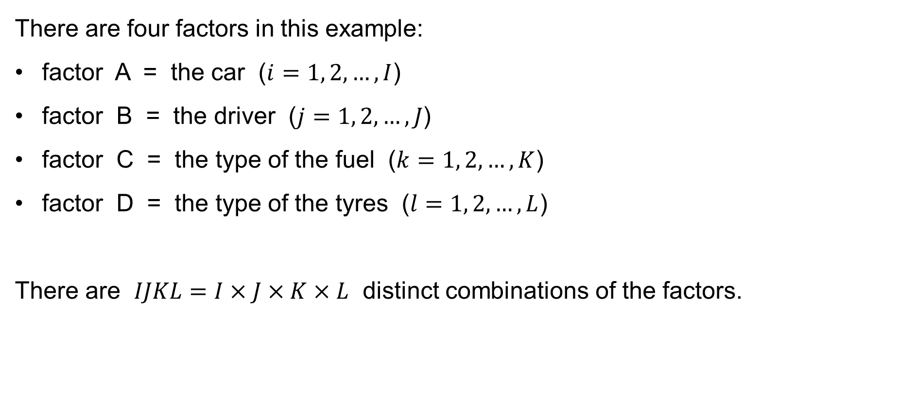
Four-factor ANOVA: Motivation: Example
There are four factors in this example:
factor A = the car ($i=1, 2,…,I$)
factor B = the driver ($j=1, 2,…,J$)
factor C = the type of the fuel ($k=1, 2,…,K$)
factor D = the type of the tyres ($l=1, 2,…,L$)
There are $IJKL=I×J×K×L$ distinct combinations of the factors.

Slide 6

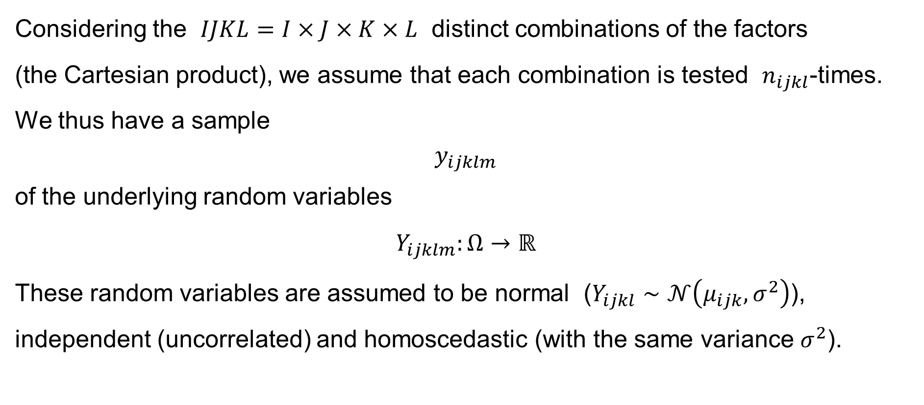

Four-factor ANOVA: Motivation & Introduction
Considering the $IJKL=I×J×K×L$ distinct combinations of the factors
(the Cartesian product), we assume that each combination is tested $n_{ijkl}$-times.
We thus have a sample
$$y_{ijklm}$$
of the underlying random variables
$$Y_{ijklm}:Ω→ℝ$$
These random variables are assumed to be normal ($Y_{ijkl}∼𝒩\left(μ_{ijk},σ^{2}\right)$), independent (uncorrelated) and homoscedastic (with the same variance $σ^{2}$).
$$i=1, 2,…,I \\ j=1, 2,…,J \\ k=1, 2,…,K \\ l=1, 2,…,L \\ m=1,2,…,n_{ijkl}$$
$$\text{for}$$

Slide 7

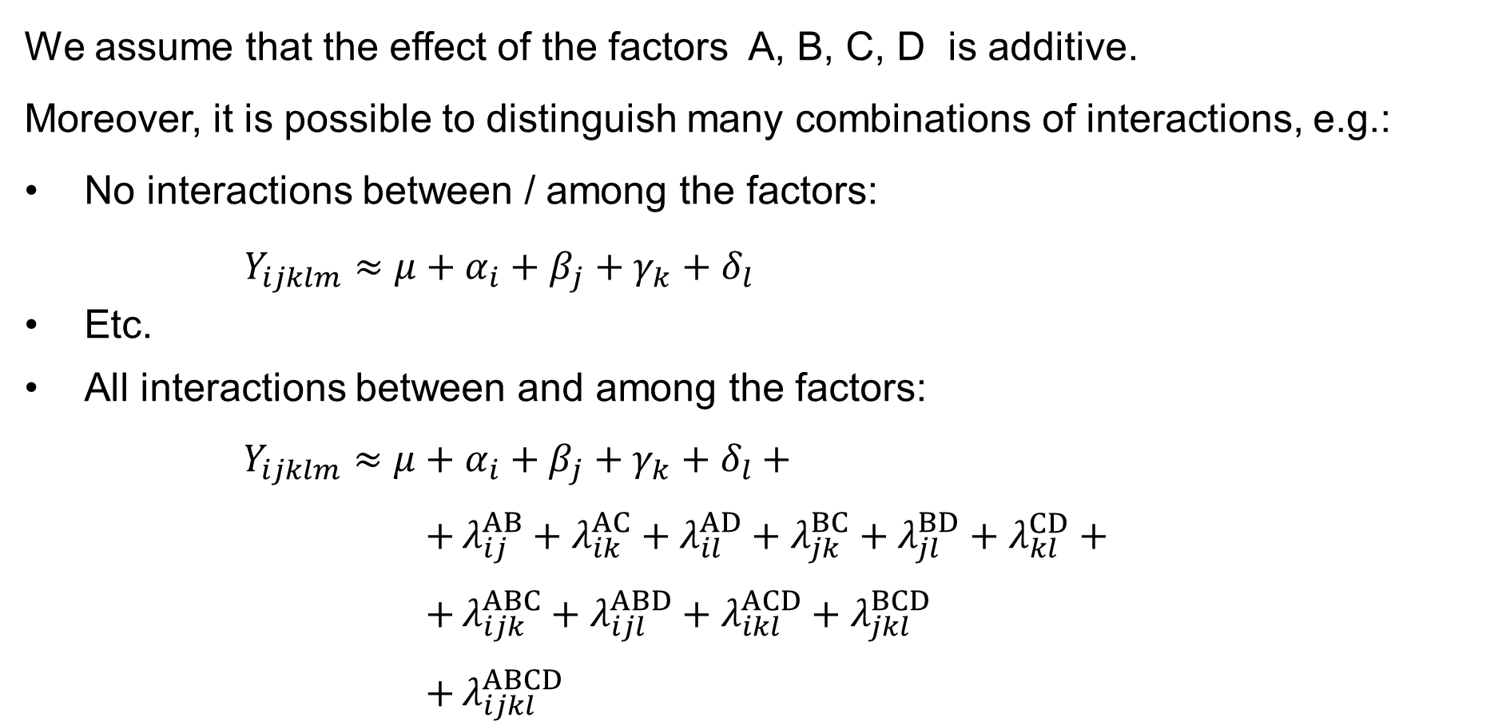

Four-factor ANOVA: Introduction: Assumptions
We assume that the effect of the factors A, B, C, D is additive.
Moreover, it is possible to distinguish many combinations of interactions, e.g.:
No interactions between / among the factors:
$Y_{ijklm}≈μ+α_{i}+β_{j}+γ_{k}+δ_{l}$
Etc.
All interactions between and among the factors:
$$Y_{ijklm}≈μ+α_{i}+β_{j}+γ_{k}+δ_{l}+ \\ + λ_{ij}^{AB}+λ_{ik}^{AC}+λ_{il}^{AD}+λ_{jk}^{BC}+λ_{jl}^{BD}+λ_{kl}^{CD}+ \\ + λ_{ijk}^{ABC}+λ_{ijl}^{ABD}+λ_{ikl}^{ACD}+λ_{jkl}^{BCD} \\ + λ_{ijkl}^{ABCD}$$
$$i=1, 2,…,I \\ j=1, 2,…,J \\ k=1, 2,…,K \\ l=1, 2,…,L \\ m=1,2,…,n_{ijkl}$$
$$\text{for}$$

Slide 8
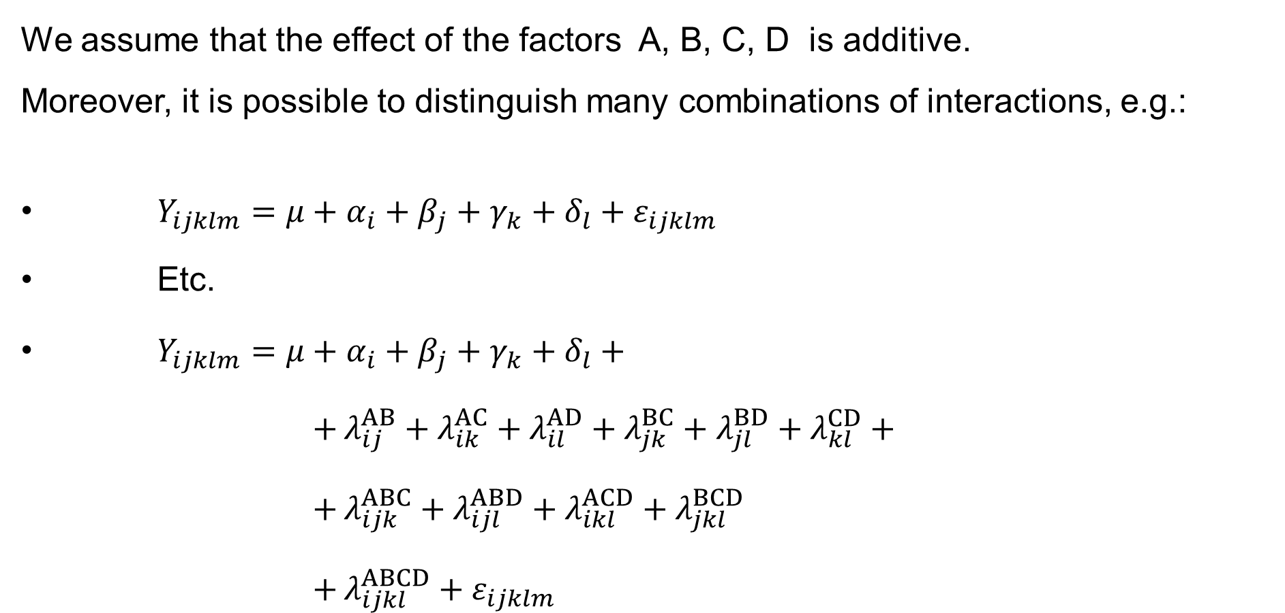
Four-factor ANOVA: Introduction: Assumptions
We assume that the effect of the factors A, B, C, D is additive.
Moreover, it is possible to distinguish many combinations of interactions, e.g.:
$Y_{ijklm}=μ+α_{i}+β_{j}+γ_{k}+δ_{l}+ε_{ijklm}$
Etc.
$Y_{ijklm}=μ+α_{i}+β_{j}+γ_{k}+δ_{l}+$
$+ λ_{ij}^{AB}+λ_{ik}^{AC}+λ_{il}^{AD}+λ_{jk}^{BC}+λ_{jl}^{BD}+λ_{kl}^{CD}+$
$+ λ_{ijk}^{ABC}+λ_{ijl}^{ABD}+λ_{ikl}^{ACD}+λ_{jkl}^{BCD}$
$+ λ_{ijkl}^{ABCD}+ε_{ijklm}$
$$i=1, 2,…,I \\ j=1, 2,…,J \\ k=1, 2,…,K \\ l=1, 2,…,L \\ m=1,2,…,n_{ijkl}$$
$$\text{for}$$

Slide 9
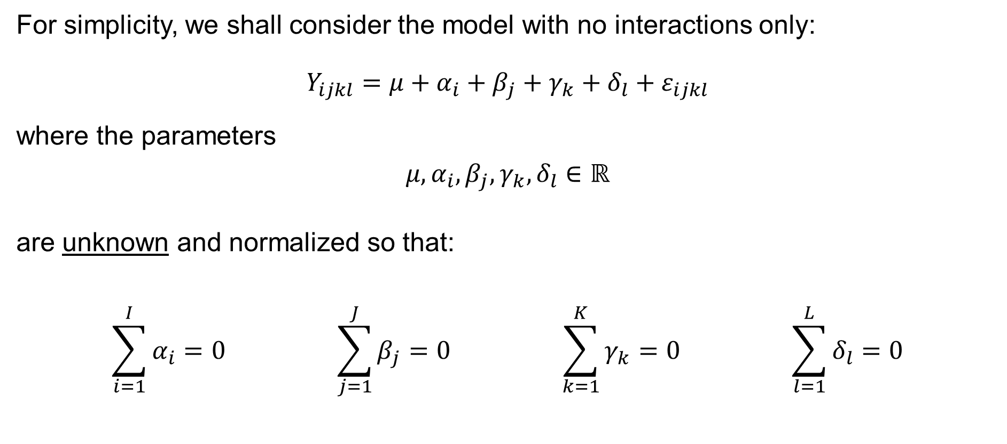
Four-factor ANOVA: Introduction: Assumptions
For simplicity, we shall consider the model with no interactions only:
$$Y_{ijkl}=μ+α_{i}+β_{j}+γ_{k}+δ_{l}+ε_{ijkl}$$
where the parameters
$$μ,α_{i},β_{j},γ_{k},δ_{l}∈ℝ$$
are unknown and normalized so that:
$$\sum_{i=1}^{I}{α_{i}}=0 \sum_{j=1}^{J}{β_{j}}=0 \sum_{k=1}^{K}{γ_{k}}=0 \sum_{l=1}^{L}{δ_{l}}=0$$

Slide 10
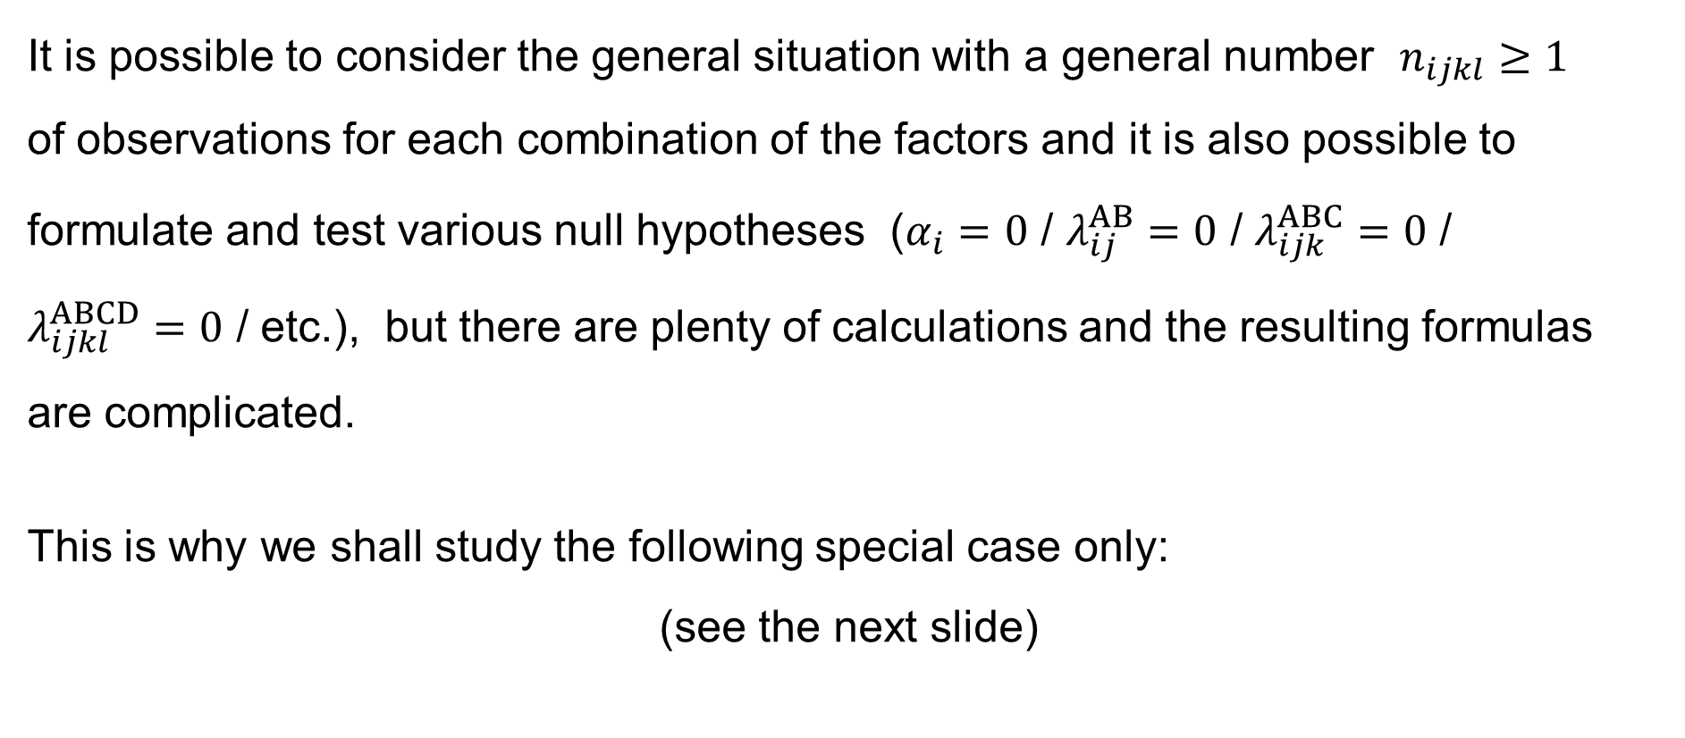
Four-factor ANOVA: Simplification
It is possible to consider the general situation with a general number $n_{ijkl}≥1$
of observations for each combination of the factors and it is also possible to formulate and test various null hypotheses ($α_{i}=0$ / $λ_{ij}^{AB}=0$ / $λ_{ijk}^{ABC}=0$ /
$λ_{ijkl}^{ABCD}=0$ / etc.), but there are plenty of calculations and the resulting formulas
are complicated.
This is why we shall study the following special case only:
(see the next slide)

Slide 11
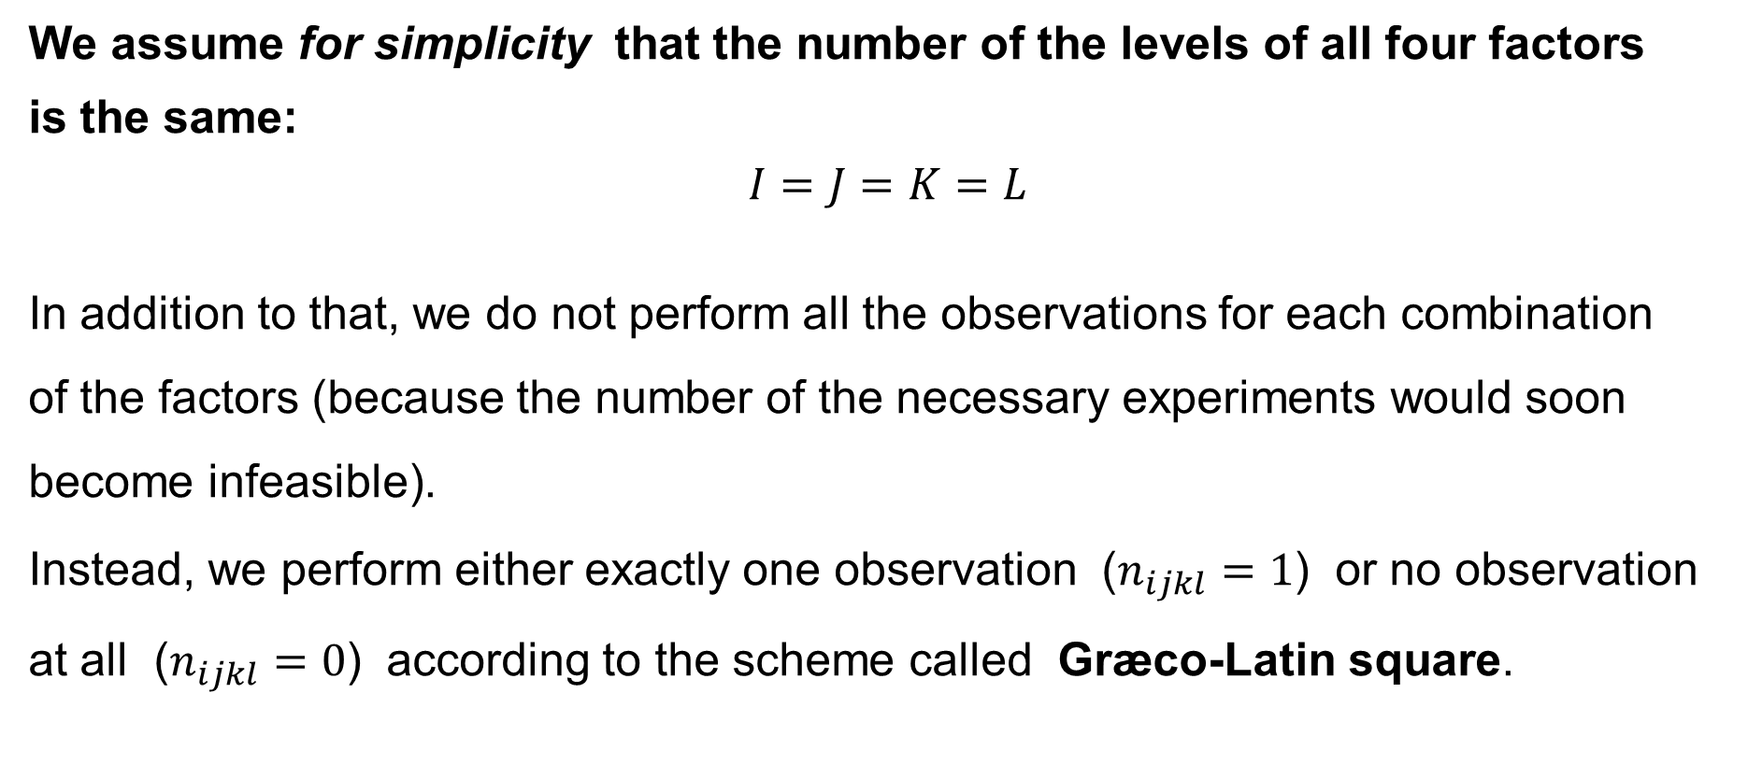
Four-factor ANOVA: Simplification
We assume for simplicity that the number of the levels of all four factors
is the same:
$$I=J=K=L$$
In addition to that, we do not perform all the observations for each combination
of the factors (because the number of the necessary experiments would soon become infeasible).
Instead, we perform either exactly one observation ($n_{ijkl}=1$) or no observation
at all ($n_{ijkl}=0$) according to the scheme called Græco-Latin square.

Slide 12
Græco-Latin squares in
Four-way ANOVA

Slide 13
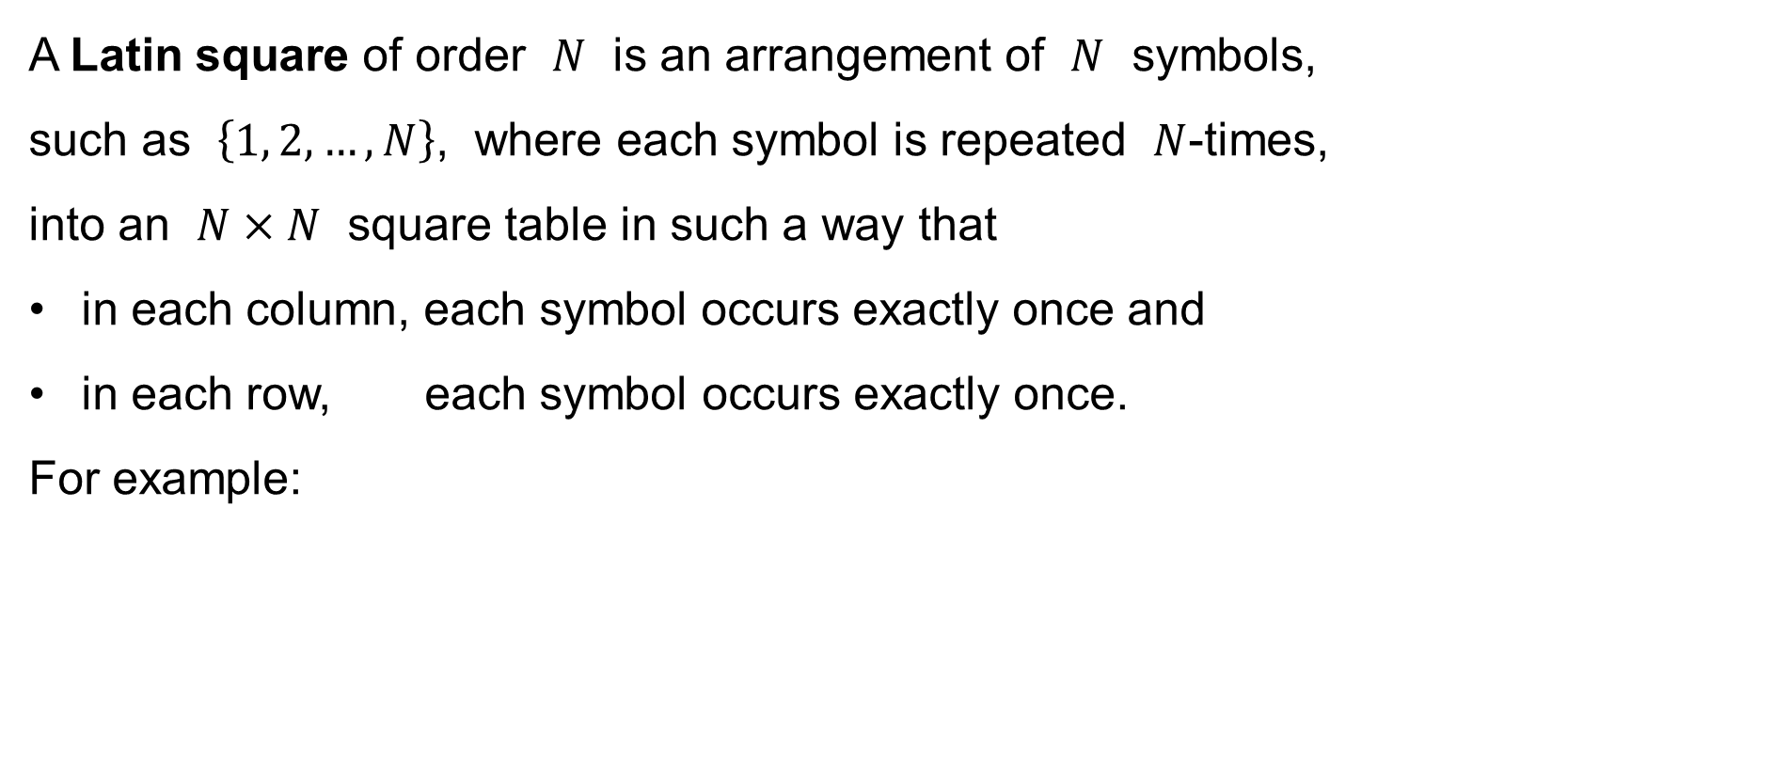
Latin square
A Latin square of order $N$ is an arrangement of $N$ symbols,
such as $\left\{1, 2,…,N\right\}$, where each symbol is repeated $N$-times,
into an $N×N$ square table in such a way that
in each column, each symbol occurs exactly once and
in each row, each symbol occurs exactly once.
For example:
1 | 2 | 3 | 4 | 5
2 | 3 | 4 | 5 | 1
3 | 4 | 5 | 1 | 2
4 | 5 | 1 | 2 | 3
5 | 1 | 2 | 3 | 4
1 | 2 | 3 | 4
2 | 3 | 4 | 1
3 | 4 | 1 | 2
4 | 1 | 2 | 3
1 | 2 | 3 | 4
3 | 4 | 1 | 2
4 | 3 | 2 | 1
2 | 1 | 4 | 3
1 | 2 | 3
2 | 3 | 1
3 | 1 | 2
1 | 2 | 3
3 | 1 | 2
2 | 3 | 1

Slide 14
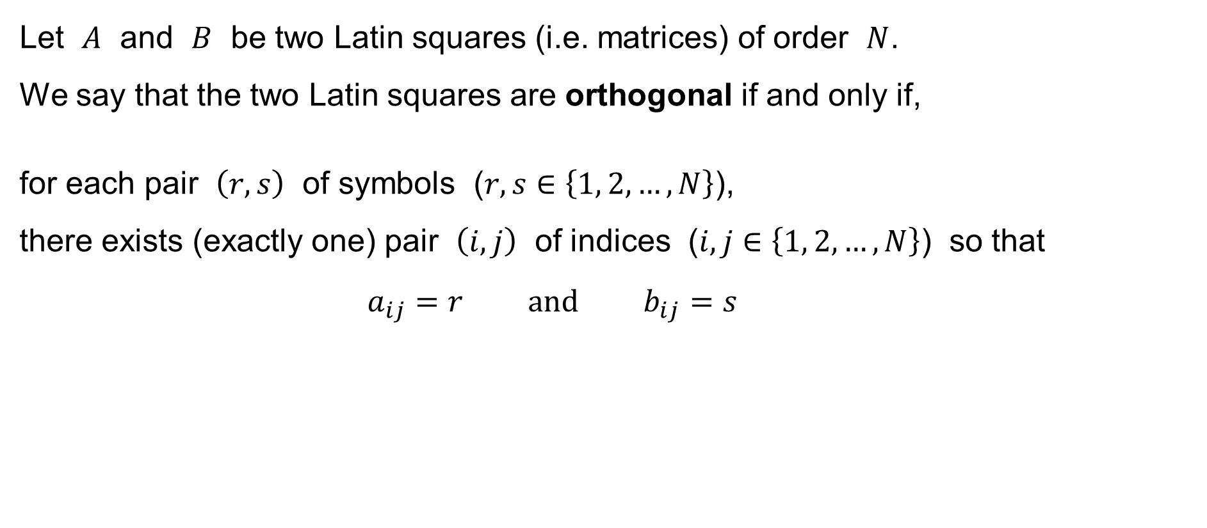
Orthogonal Latin squares
Let $A$ and $B$ be two Latin squares (i.e. matrices) of order $N$.
We say that the two Latin squares are orthogonal if and only if,
for each pair $\left(r,s\right)$ of symbols ($r,s∈\left\{1, 2,…,N\right\}$),
there exists (exactly one) pair $\left(i,j\right)$ of indices ($i,j∈\left\{1, 2,…,N\right\}$) so that
$$a_{ij}=r \text{and} b_{ij}=s$$
1 | 2 | 3
2 | 3 | 1
3 | 1 | 2
1 | 2 | 3
3 | 1 | 2
2 | 3 | 1
1, 1 | 2, 2 | 3, 3
2, 3 | 3, 1 | 1, 2
3, 2 | 1, 3 | 2, 1
&
=

Slide 15
Orthogonal Latin squares
Let $A$ and $B$ be two Latin squares (i.e. matrices) of order $N$.
We say that the two Latin squares are orthogonal if and only if,
for each pair $\left(r,s\right)$ of symbols ($r,s∈\left\{1, 2,…,N\right\}$),
there exists (exactly one) pair $\left(i,j\right)$ of indices ($i,j∈\left\{1, 2,…,N\right\}$) so that
$$a_{ij}=r \text{and} b_{ij}=s$$
1 | 2 | 3 | 4
2 | 1 | 4 | 3
3 | 4 | 1 | 2
4 | 3 | 2 | 1
1 | 2 | 3 | 4
3 | 4 | 1 | 2
4 | 3 | 2 | 1
2 | 1 | 4 | 3
1, 1 | 2, 2 | 3, 3 | 4, 4
2, 3 | 1, 4 | 4, 1 | 3, 2
3, 4 | 4, 3 | 1, 2 | 2, 1
4, 2 | 3, 1 | 2, 4 | 1, 3
&
=

Slide 16
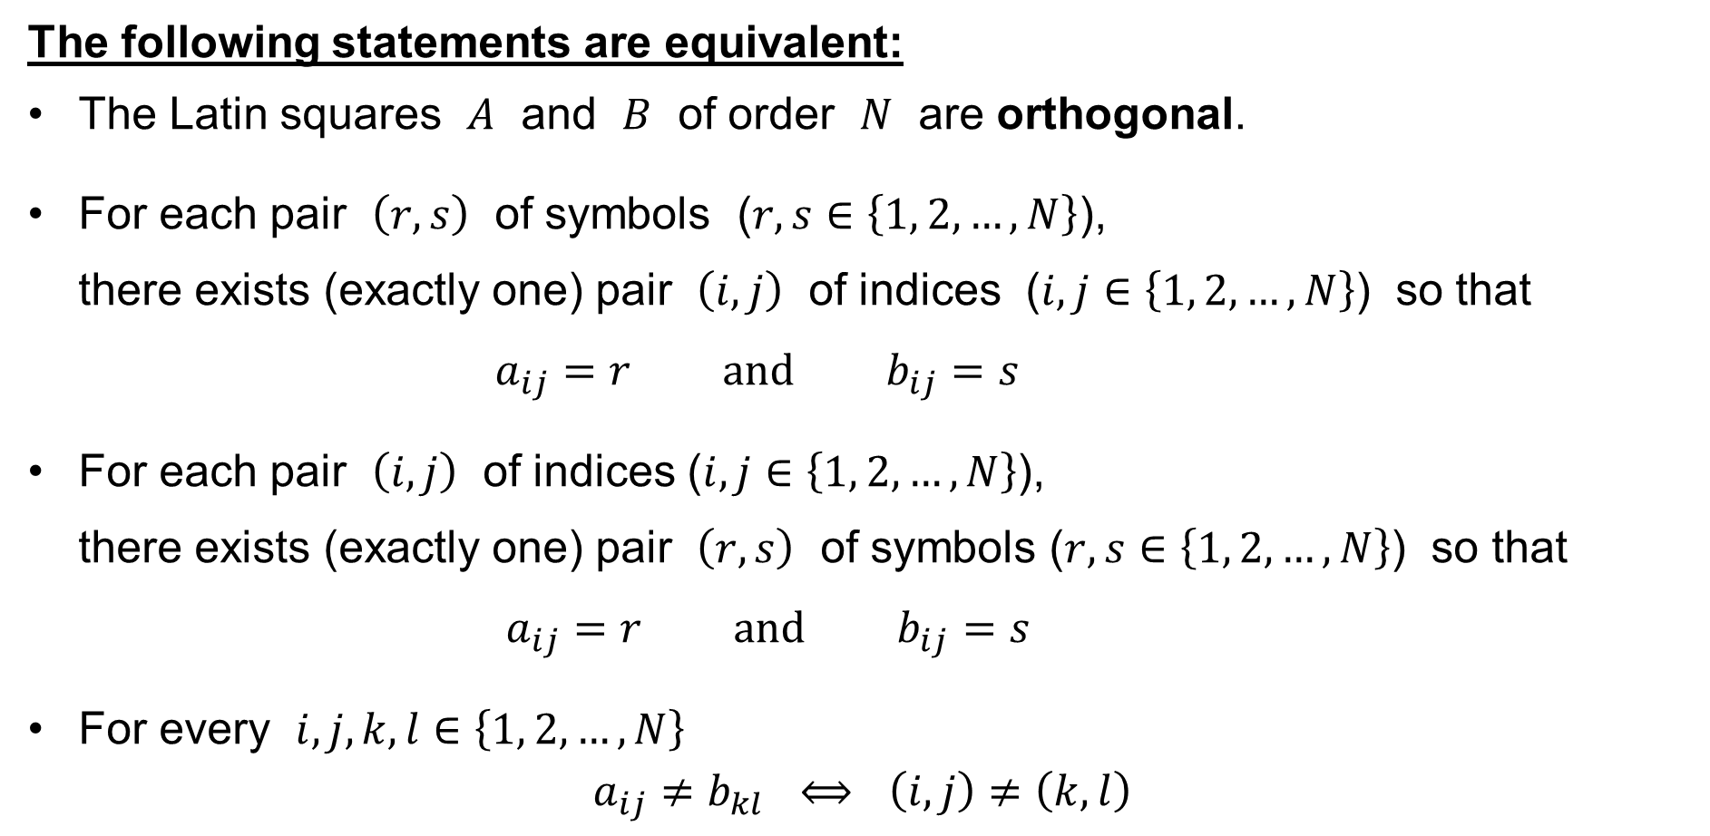
Orthogonal Latin squares
The following statements are equivalent:
The Latin squares $A$ and $B$ of order $N$ are orthogonal.
For each pair $\left(r,s\right)$ of symbols ($r,s∈\left\{1, 2,…,N\right\}$),
there exists (exactly one) pair $\left(i,j\right)$ of indices ($i,j∈\left\{1, 2,…,N\right\}$) so that
$a_{ij}=r \text{and} b_{ij}=s$
For each pair $\left(i,j\right)$ of indices ($i,j∈\left\{1, 2,…,N\right\}$),
there exists (exactly one) pair $\left(r,s\right)$ of symbols ($r,s∈\left\{1, 2,…,N\right\}$) so that
$a_{ij}=r \text{and} b_{ij}=s$
For every $i,j,k,l∈\left\{1, 2,…,N\right\}$
$$a_{ij}≠b_{kl} ⟺ \left(i,j\right)≠\left(k,l\right)$$

Slide 17
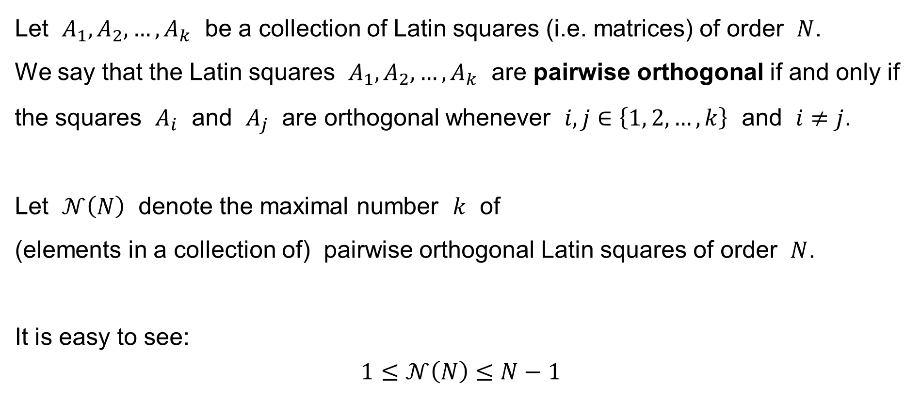
Orthogonal Latin squares
Let $A_{1},A_{2},…,A_{k}$ be a collection of Latin squares (i.e. matrices) of order $N$.
We say that the Latin squares $A_{1},A_{2},…,A_{k}$ are pairwise orthogonal if and only if the squares $A_{i}$ and $A_{j}$ are orthogonal whenever $i,j∈\left\{1, 2,…,k\right\}$ and $i≠j$.
Let $𝒩\left(N\right)$ denote the maximal number $k$ of
(elements in a collection of) pairwise orthogonal Latin squares of order $N$.
It is easy to see:
$$1≤𝒩\left(N\right)≤N−1$$

Slide 18
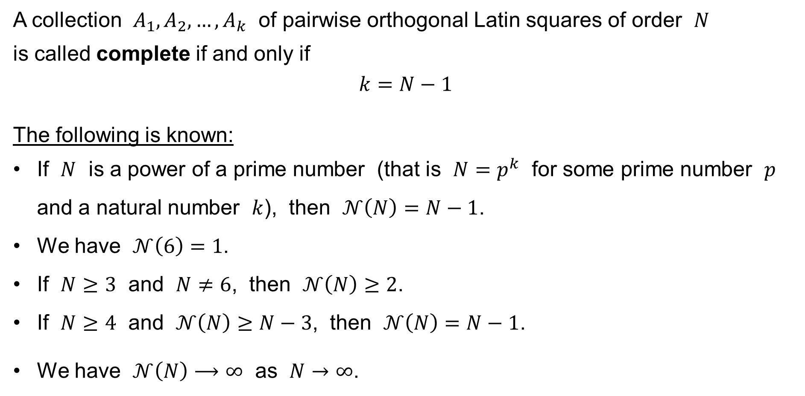
Orthogonal Latin squares
A collection $A_{1},A_{2},…,A_{k}$ of pairwise orthogonal Latin squares of order $N$
is called complete if and only if
$$k=N−1$$
The following is known:
If $N$ is a power of a prime number (that is $N=p^{k}$ for some prime number $p$ and a natural number $k$), then $𝒩\left(N\right)=N−1$.
We have $𝒩\left(6\right)=1$.
If $N≥3$ and $N≠6$, then $𝒩\left(N\right)≥2$.
If $N≥4$ and $𝒩\left(N\right)≥N−3$, then $𝒩\left(N\right)=N−1$.
We have $𝒩\left(N\right)⟶∞$ as $N→∞$.

Slide 19
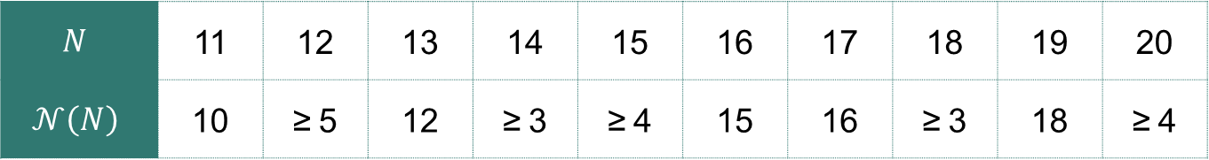
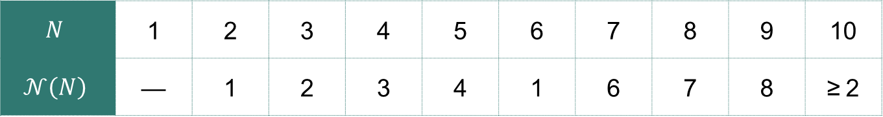
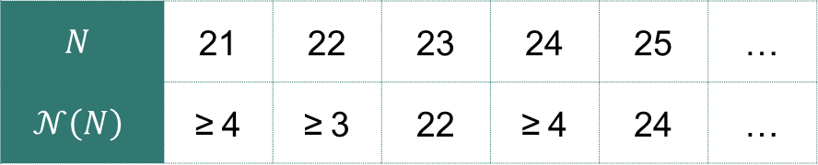
Orthogonal Latin squares: The following is known:
$$N$$ | 1 | 2 | 3 | 4 | 5 | 6 | 7 | 8 | 9 | 10
$$𝒩\left(N\right)$$ | — | 1 | 2 | 3 | 4 | 1 | 6 | 7 | 8 | ≥ 2
$$N$$ | 11 | 12 | 13 | 14 | 15 | 16 | 17 | 18 | 19 | 20
$$𝒩\left(N\right)$$ | 10 | ≥ 5 | 12 | ≥ 3 | ≥ 4 | 15 | 16 | ≥ 3 | 18 | ≥ 4
$$N$$ | 21 | 22 | 23 | 24 | 25 | …
$$𝒩\left(N\right)$$ | ≥ 4 | ≥ 3 | 22 | ≥ 4 | 24 | …

Slide 20
Græco-Latin squares
A pair of orthogonal Latin squares is also called a Græco-Latin square or
Graeco-Latin square or Greco-Latin square.
The name “Græco-Latin square” is inspired by the work of Leonhard Euler
(1707–1783), a Swiss mathematician, physicist, astronomer, geographer,
logician, and engineer who used the upper-case letters of the Latin alphabet
and the lower-case letters of the Greek alphabet as the symbols in the respective square:
A | B | C | D
B | A | D | C
C | D | A | B
D | C | B | A
α | β | γ | δ
γ | δ | α | β
δ | γ | β | α
β | α | δ | γ
Aα | Bβ | Cγ | Dδ
Bγ | Aδ | Dα | Cβ
Cδ | Dγ | Aβ | Bα
Dβ | Cα | Bδ | Aγ
&
=

Slide 21
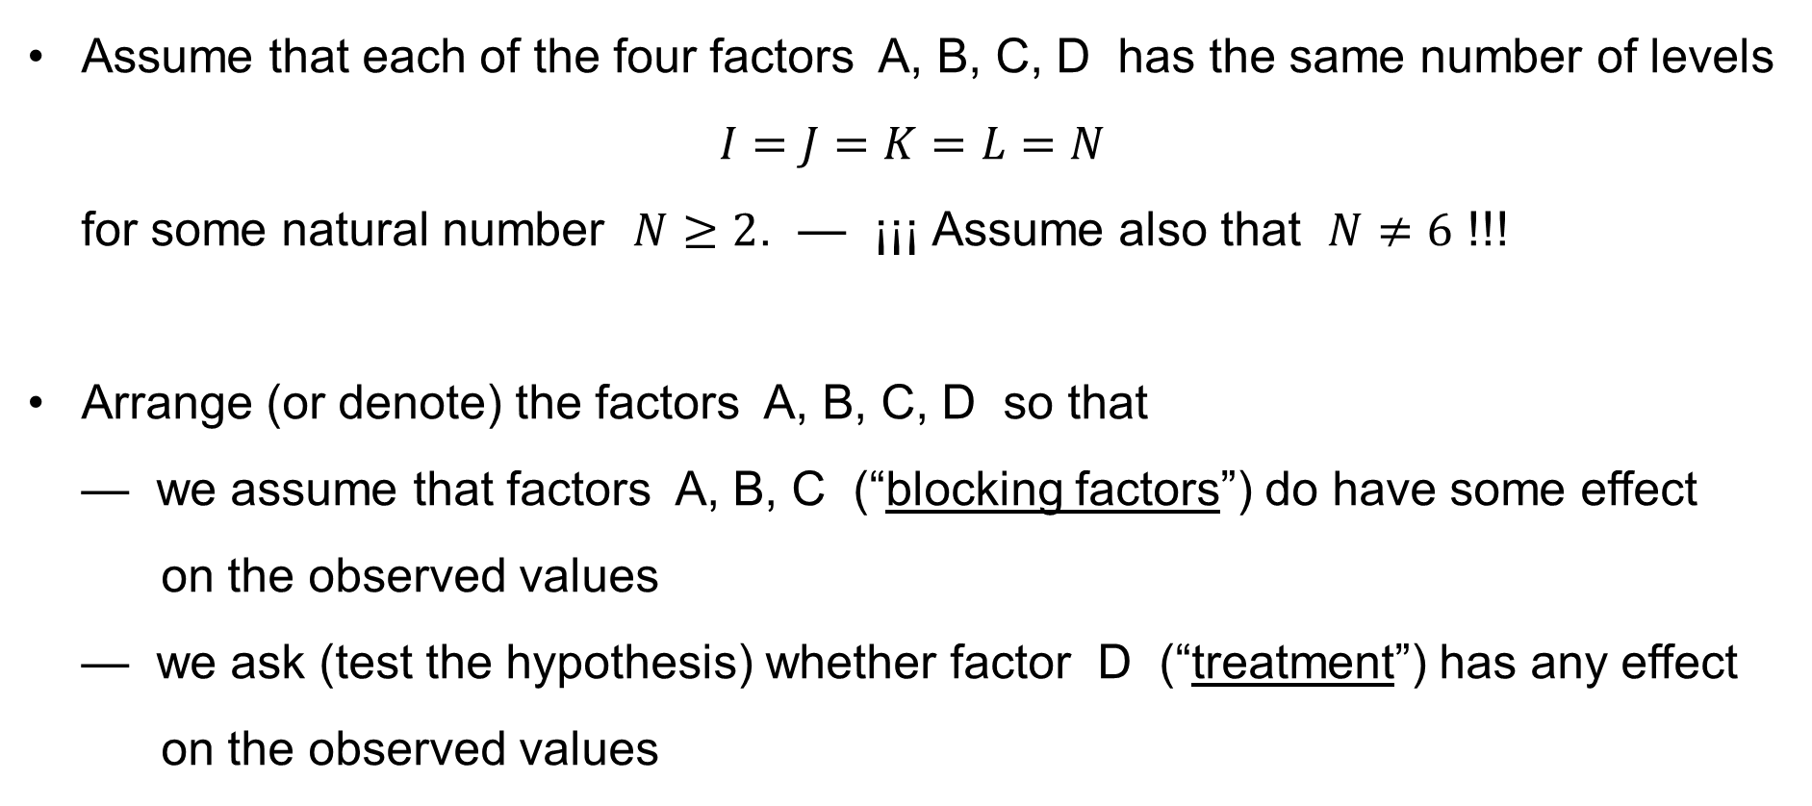
Four-factor ANOVA & Græco-Latin squares
Assume that each of the four factors A, B, C, D has the same number of levels
$I=J=K=L=N$
for some natural number $N≥2$. — ¡¡¡ Assume also that $N≠6$ !!!
Arrange (or denote) the factors A, B, C, D so that
— we assume that factors A, B, C (“blocking factors”) do have some effect
on the observed values
— we ask (test the hypothesis) whether factor D (“treatment”) has any effect
on the observed values

Slide 22

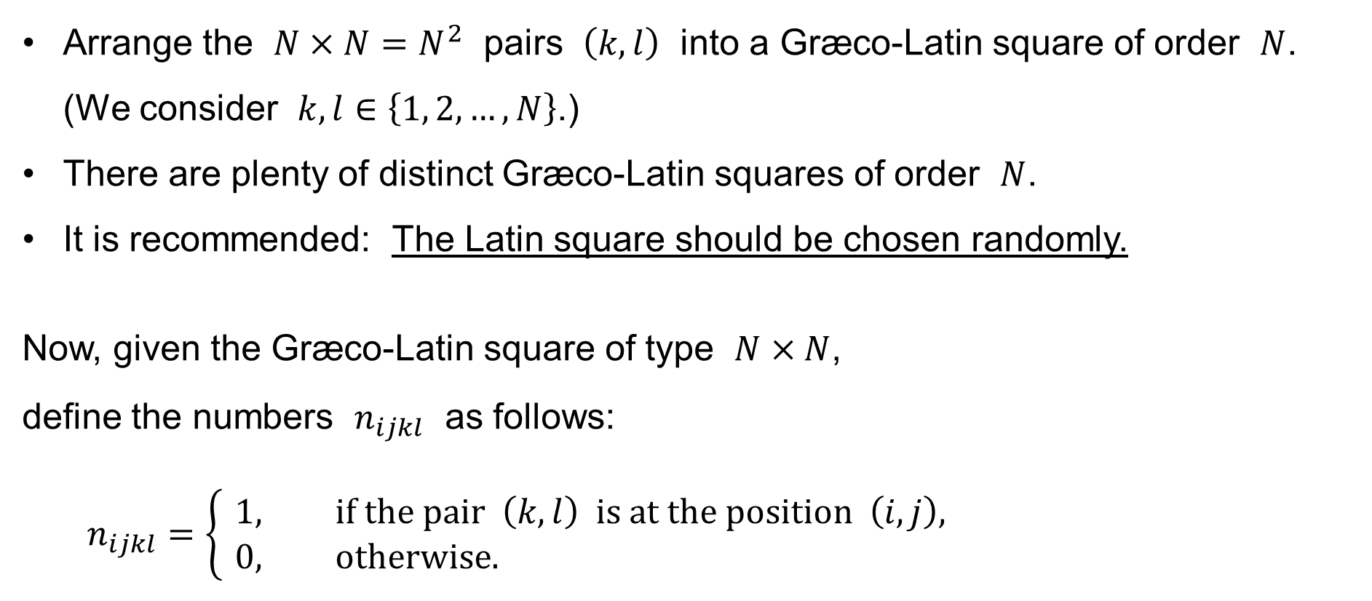
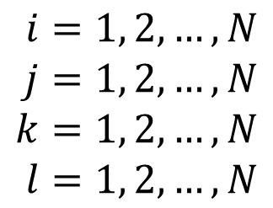
Four-factor ANOVA & Græco-Latin squares
Arrange the $N×N=N^{2}$ pairs $\left(k,l\right)$ into a Græco-Latin square of order $N$.
(We consider $k,l∈\left\{1, 2,…,N\right\}$.)
There are plenty of distinct Græco-Latin squares of order $N$.
It is recommended: The Latin square should be chosen randomly.
Now, given the Græco-Latin square of type $N×N$,
define the numbers $n_{ijkl}$ as follows:
$$n_{ijkl}=\left\{ \begin{aligned}&1, \text{if} \text{the} \text{pair} \left(k,l\right) \text{is} \text{at} \text{the} \text{position} \left(i,j\right)\text{,} \\ &0, \text{otherwise}\text{.}\end{aligned}\right.$$
$$i=1, 2,…,N \\ j=1, 2,…,N \\ k=1, 2,…,N \\ l=1, 2,…,N$$
$$\text{for}$$

Slide 23
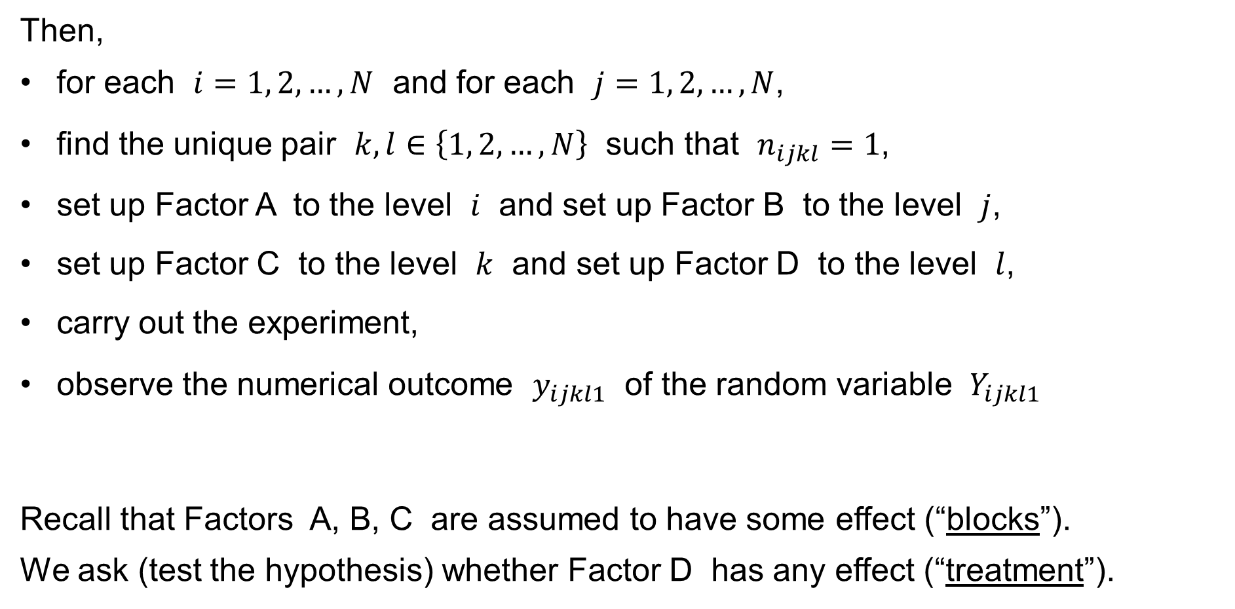
Four-factor ANOVA & Græco-Latin squares
Then,
for each $i=1, 2,…,N$ and for each $j=1, 2,…,N$,
find the unique pair $k,l∈\left\{1, 2,…,N\right\}$ such that $n_{ijkl}=1$,
set up Factor A to the level $i$ and set up Factor B to the level $j$,
set up Factor C to the level $k$ and set up Factor D to the level $l$,
carry out the experiment,
observe the numerical outcome $y_{ijkl1}$ of the random variable $Y_{ijkl1}$
Recall that Factors A, B, C are assumed to have some effect (“blocks”).
We ask (test the hypothesis) whether Factor D has any effect (“treatment”).

Slide 24
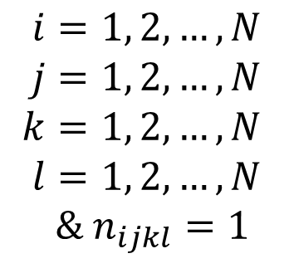
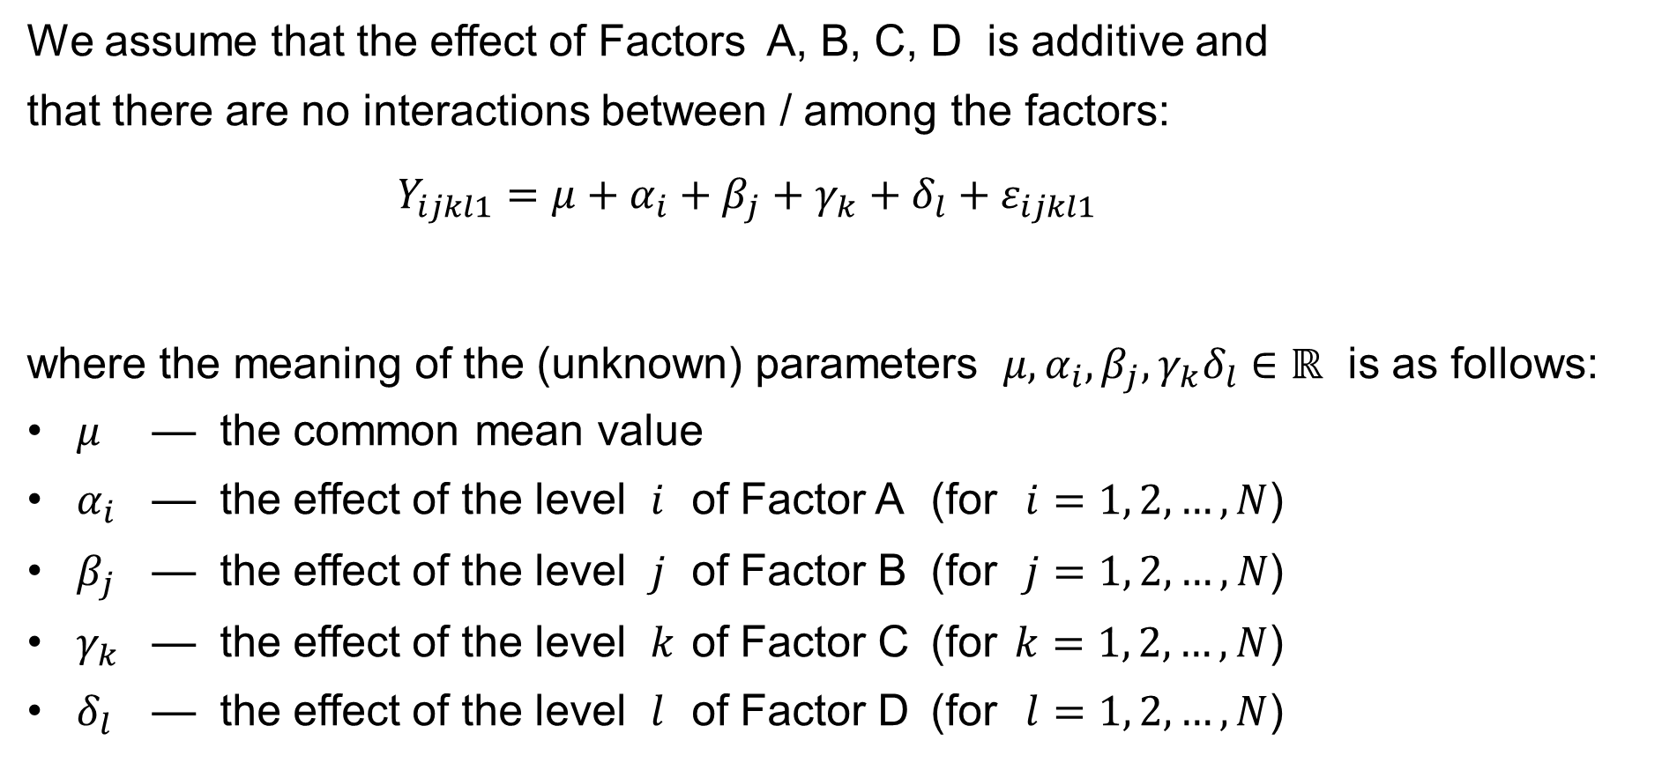

Four-factor ANOVA: Further assumptions
We assume that the effect of Factors A, B, C, D is additive and
that there are no interactions between / among the factors:
$$Y_{ijkl1}=μ+α_{i}+β_{j}+γ_{k}+δ_{l}+ε_{ijkl1}$$
where the meaning of the (unknown) parameters $μ,α_{i},β_{j},γ_{k}δ_{l}∈ℝ$ is as follows:
$μ$ — the common mean value
$α_{i}$ — the effect of the level $i$ of Factor A (for $i=1, 2,…,N$)
$β_{j}$ — the effect of the level $j$ of Factor B (for $j=1, 2,…,N$)
$γ_{k}$ — the effect of the level $k$ of Factor C (for $k=1, 2,…,N$)
$δ_{l}$ — the effect of the level $l$ of Factor D (for $l=1, 2,…,N$)
$$i=1, 2,…,N \\ j=1, 2,…,N \\ k=1, 2,…,N \\ l=1, 2,…,N$$
& $n_{ijkl}=1$
$$\text{for}$$

Slide 25
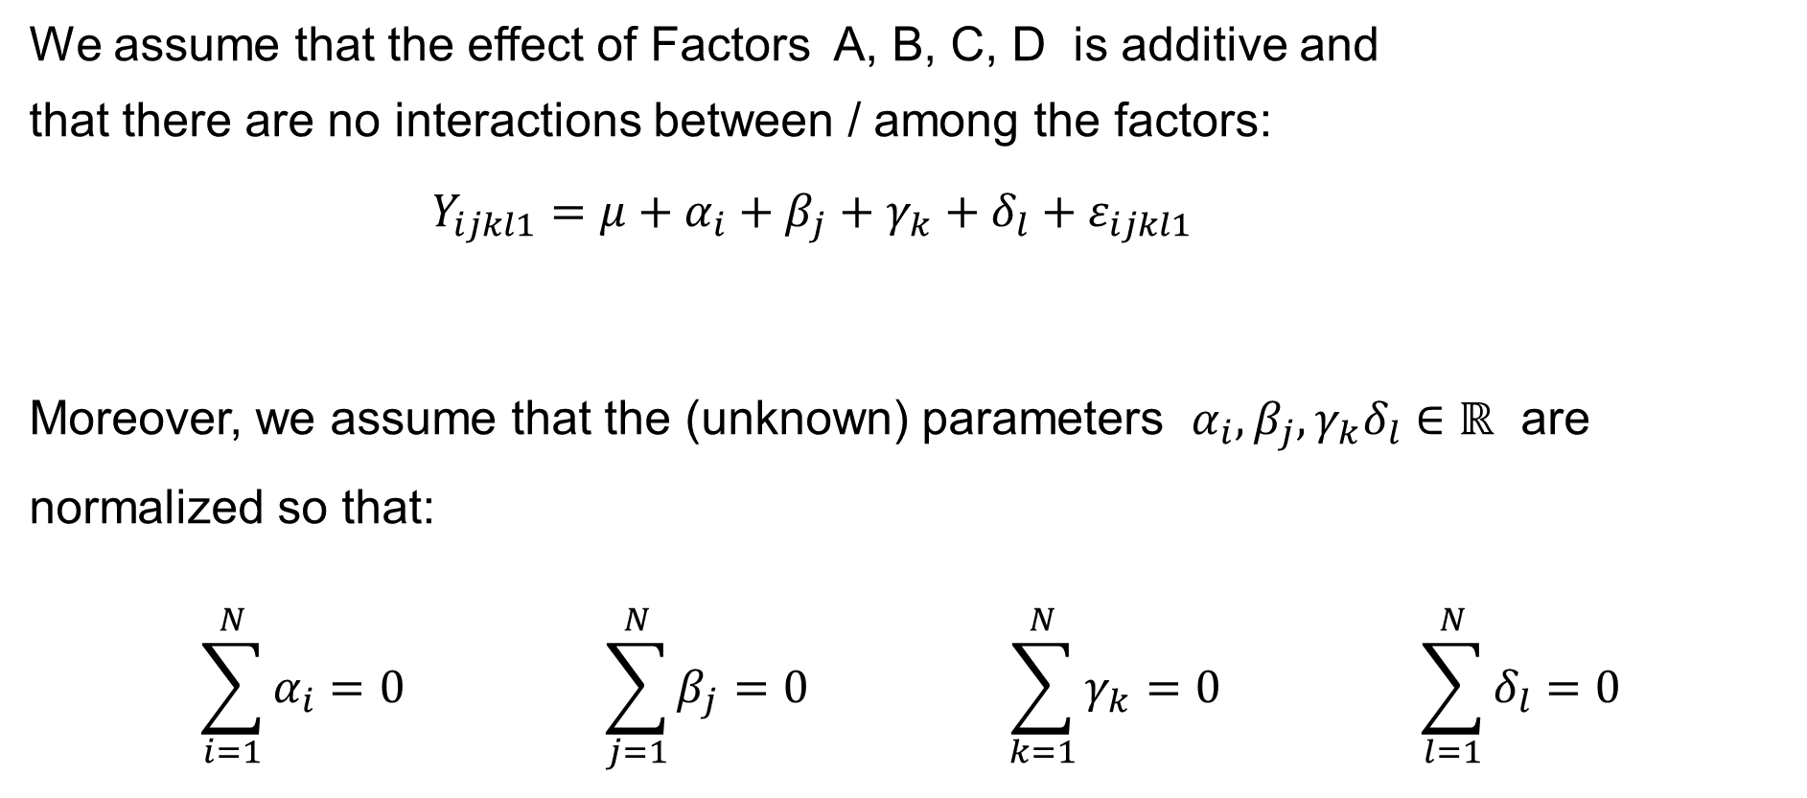
Four-factor ANOVA: Further assumptions
We assume that the effect of Factors A, B, C, D is additive and
that there are no interactions between / among the factors:
$$Y_{ijkl1}=μ+α_{i}+β_{j}+γ_{k}+δ_{l}+ε_{ijkl1}$$
Moreover, we assume that the (unknown) parameters $α_{i},β_{j},γ_{k}δ_{l}∈ℝ$ are normalized so that:
$$\sum_{i=1}^{N}{α_{i}}=0 \sum_{j=1}^{N}{β_{j}}=0 \sum_{k=1}^{N}{γ_{k}}=0 \sum_{l=1}^{N}{δ_{l}}=0$$
$$i=1, 2,…,N \\ j=1, 2,…,N \\ k=1, 2,…,N \\ l=1, 2,…,N$$
& $n_{ijkl}=1$
$$\text{for}$$

Slide 26
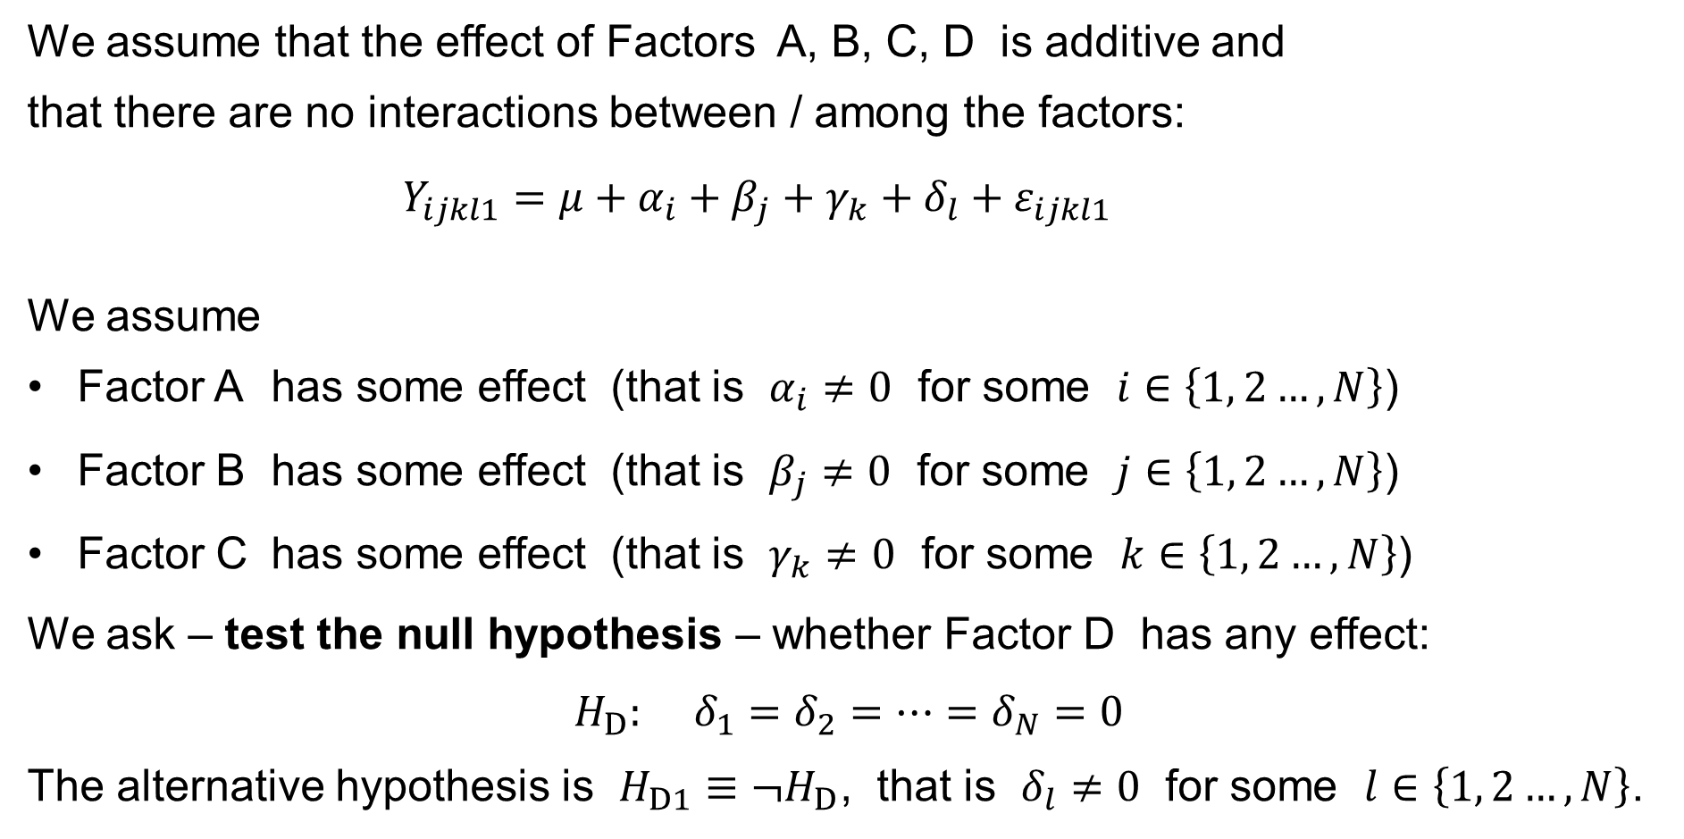
Four-factor ANOVA: Further assumptions
We assume that the effect of Factors A, B, C, D is additive and
that there are no interactions between / among the factors:
$$Y_{ijkl1}=μ+α_{i}+β_{j}+γ_{k}+δ_{l}+ε_{ijkl1}$$
We assume
Factor A has some effect (that is $α_{i}≠0$ for some $i∈\left\{1, 2…,N\right\}$)
Factor B has some effect (that is $β_{j}≠0$ for some $j∈\left\{1, 2…,N\right\}$)
Factor C has some effect (that is $γ_{k}≠0$ for some $k∈\left\{1, 2…,N\right\}$)
We ask – test the null hypothesis – whether Factor D has any effect:
$$H_{D}: δ_{1}=δ_{2}=⋯=δ_{N}=0$$
The alternative hypothesis is $H_{D1}≡¬H_{D}$, that is $δ_{l}≠0$ for some $l∈\left\{1, 2…,N\right\}$.
$$i=1, 2,…,N \\ j=1, 2,…,N \\ k=1, 2,…,N \\ l=1, 2,…,N$$
& $n_{ijkl}=1$
$$\text{for}$$

Slide 27
Four-Way ANOVA without interactions and simplified by using
Græco-Latin squares
Y_{ijkl1}=μ+
+α_{i}+β_{j}+γ_{k}+δ_{l}+ε_{ijk1}

Slide 28

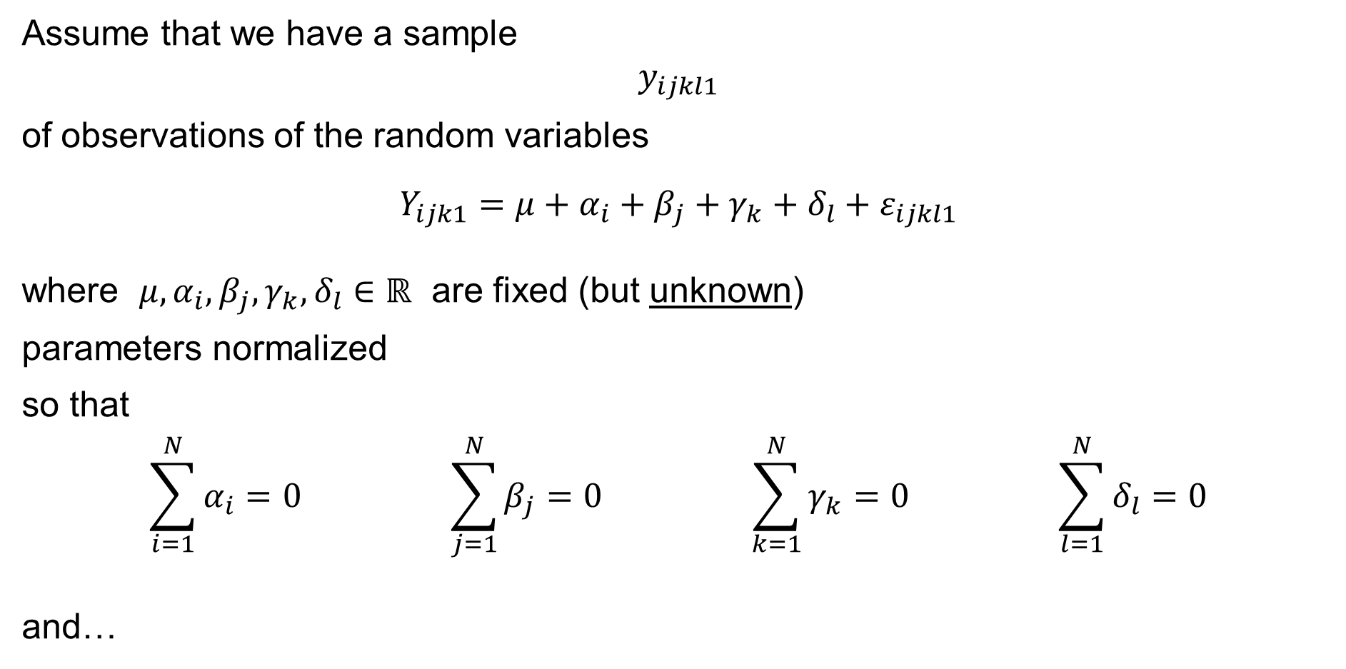
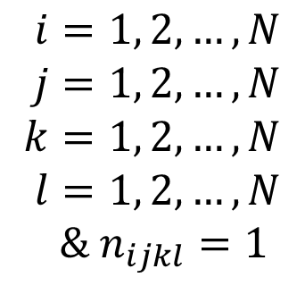
Four-way ANOVA with no interactions
Assume that we have a sample
$$y_{ijkl1}$$
of observations of the random variables
$$Y_{ijk1}=μ+α_{i}+β_{j}+γ_{k}+δ_{l}+ε_{ijkl1}$$
where $μ,α_{i},β_{j},γ_{k},δ_{l}∈ℝ$ are fixed (but unknown)
parameters normalized
so that
$$\sum_{i=1}^{N}{α_{i}}=0 \sum_{j=1}^{N}{β_{j}}=0 \sum_{k=1}^{N}{γ_{k}}=0 \sum_{l=1}^{N}{δ_{l}}=0$$
and…
$$i=1, 2,…,N \\ j=1, 2,…,N \\ k=1, 2,…,N \\ l=1, 2,…,N$$
& $n_{ijkl}=1$
$$\text{for}$$

Slide 29
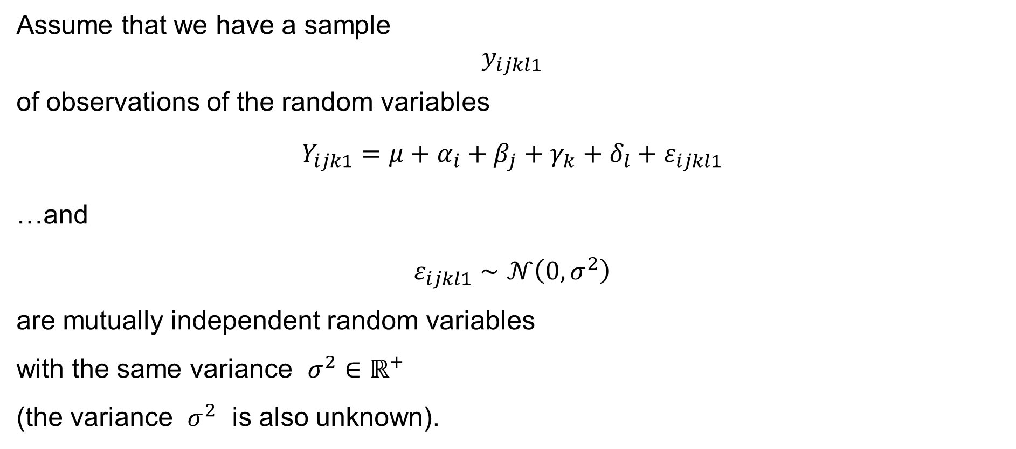
Four-way ANOVA with no interactions
Assume that we have a sample
$$y_{ijkl1}$$
of observations of the random variables
$$Y_{ijk1}=μ+α_{i}+β_{j}+γ_{k}+δ_{l}+ε_{ijkl1}$$
…and
$$ε_{ijkl1}∼𝒩\left(0,σ^{2}\right)$$
are mutually independent random variables
with the same variance $σ^{2}∈ℝ^{+}$
(the variance $σ^{2}$ is also unknown).
$$i=1, 2,…,N \\ j=1, 2,…,N \\ k=1, 2,…,N \\ l=1, 2,…,N$$
& $n_{ijkl}=1$
$$\text{for}$$

Slide 30
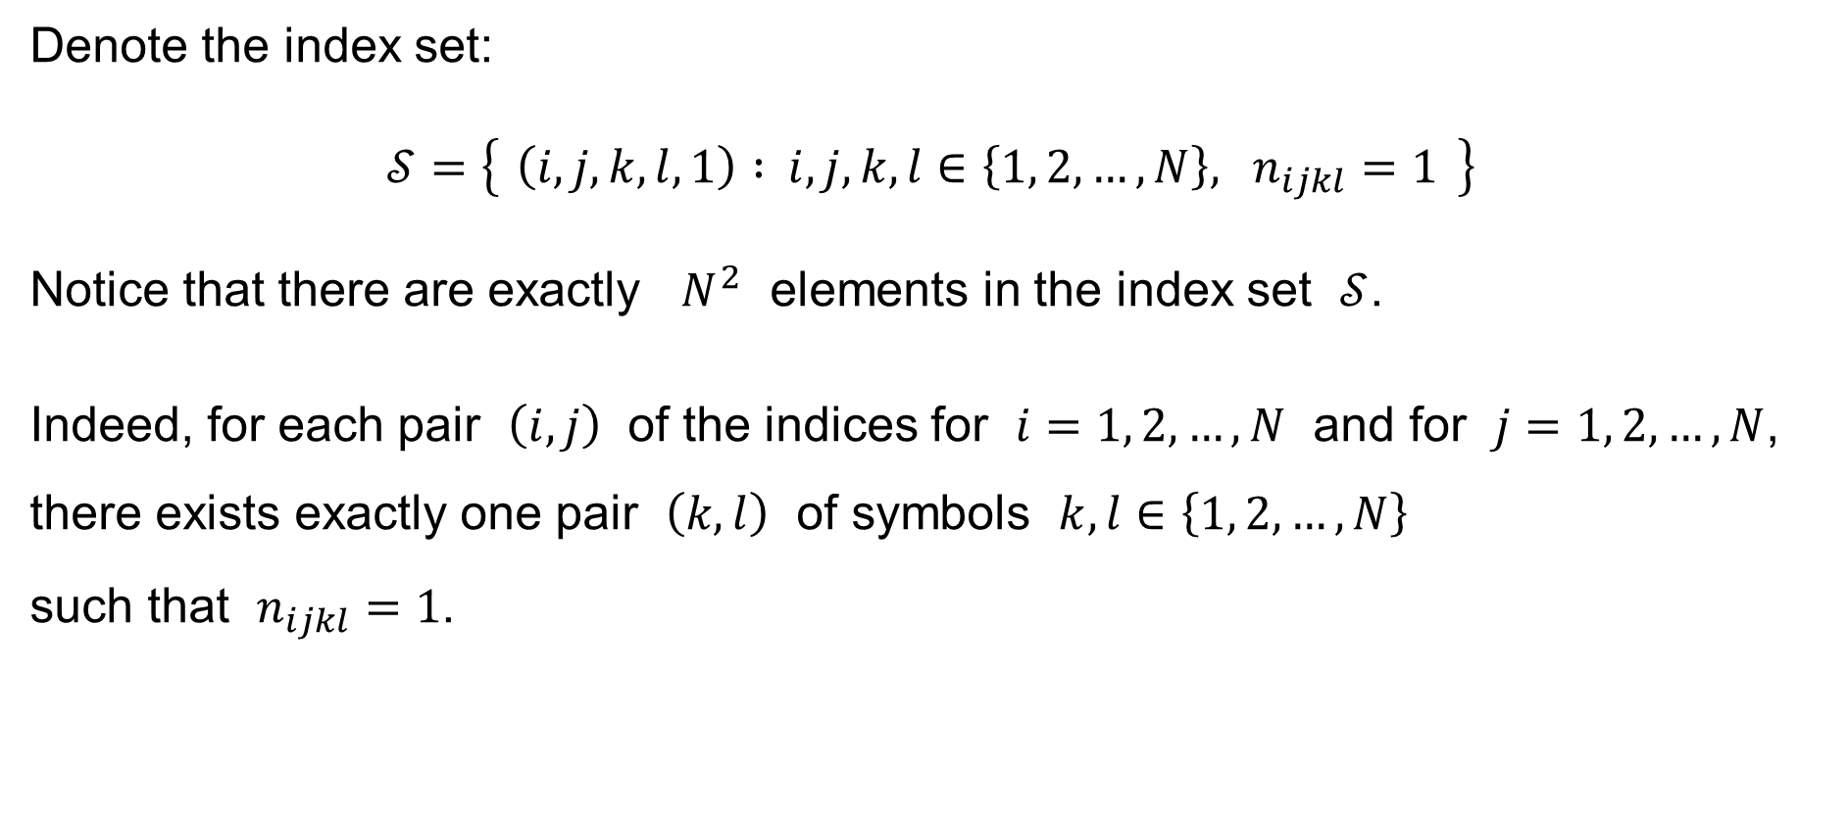
Four-way ANOVA with no interactions: Notation
Denote the index set:
$$𝒮=\left\{ \left(i,j,k,l,1\right) : i,j,k,l∈\left\{1, 2,…,N\right\}, n_{ijkl}=1 \right\}$$
Notice that there are exactly $N^{2}$ elements in the index set $𝒮$.
Indeed, for each pair $\left(i,j\right)$ of the indices for $i=1, 2,…,N$ and for $j=1, 2,…,N$, there exists exactly one pair $\left(k,l\right)$ of symbols $k,l∈\left\{1, 2,…,N\right\}$
such that $n_{ijkl}=1$.

Slide 31
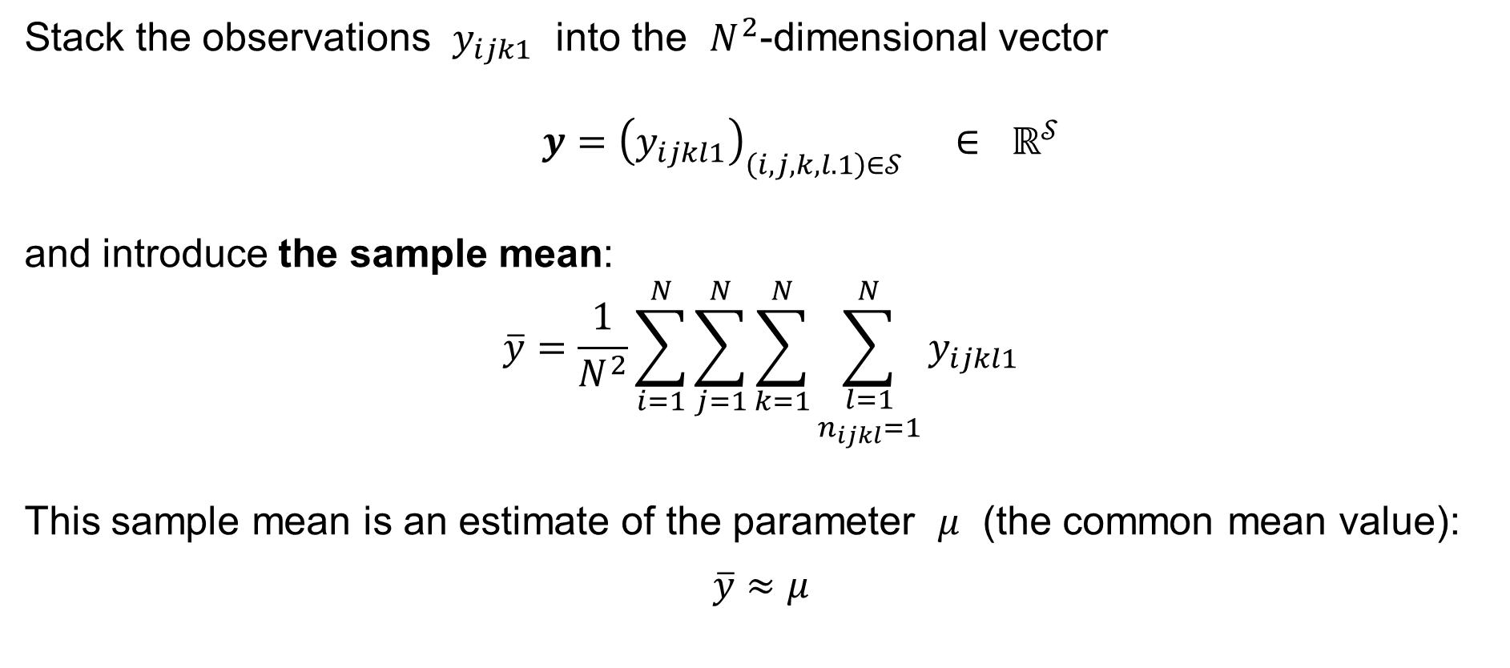
Four-way ANOVA with no interactions: Notation
Stack the observations $y_{ijk1}$ into the $N^{2}$-dimensional vector
$$y={\left(y_{ijkl1}\right)}_{\left(i,j,k,l.1\right)∈𝒮} ∈ ℝ^{𝒮}$$
and introduce the sample mean:
$$\overline{y}=\frac{1}{N^{2}}\sum_{i=1}^{N}{\sum_{j=1}^{N}{\sum_{k=1}^{N}{\sum_{\begin{aligned}l=1 \\ n_{ijkl}=1\end{aligned}}^{N}{y_{ijkl1}}}}}$$
This sample mean is an estimate of the parameter $μ$ (the common mean value):
$$\overline{y}≈μ$$

Slide 32

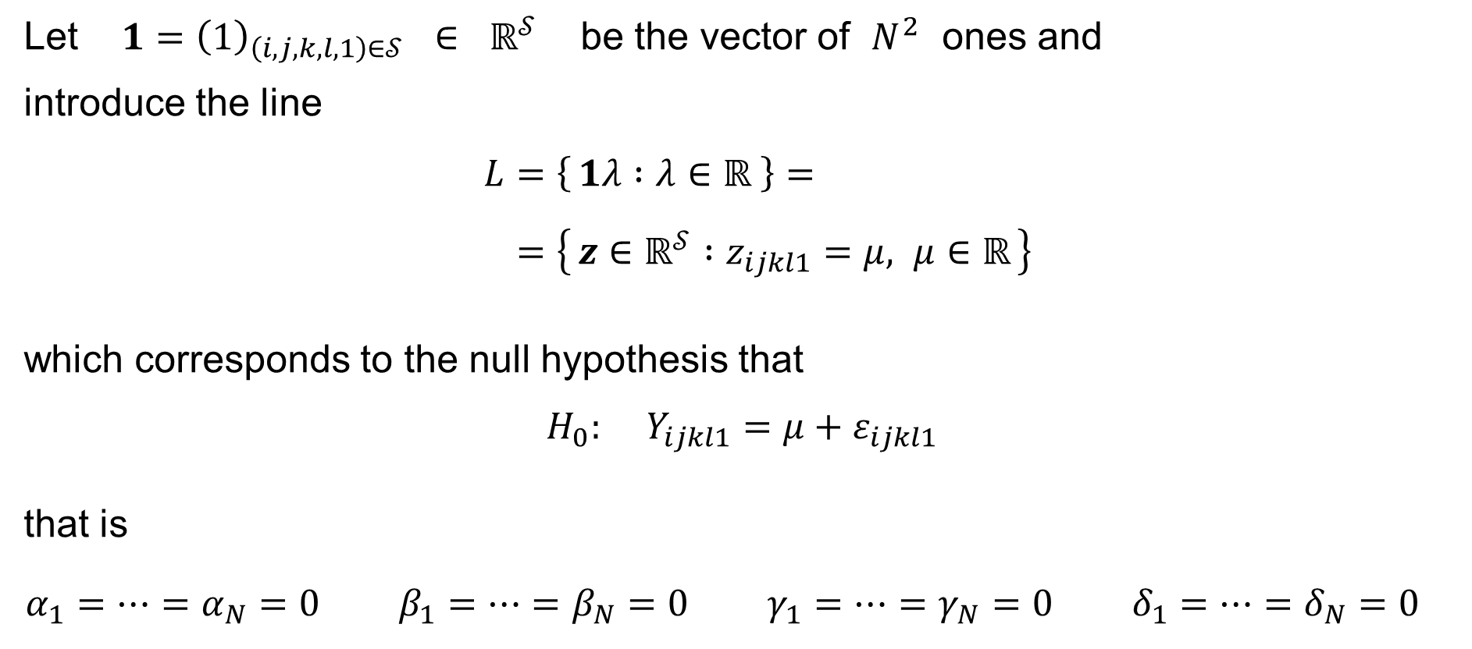
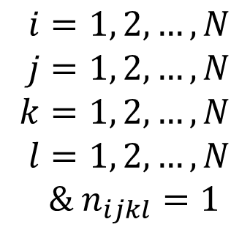
Four-way ANOVA with no interactions: Notation
Let $1={\left(1\right)}_{\left(i,j,k,l,1\right)∈𝒮} ∈ ℝ^{𝒮}$ be the vector of $N^{2}$ ones and
introduce the line
$$L=\left\{ 1λ :λ∈ℝ \right\}= \\ =\left\{ z∈ℝ^{𝒮} :z_{ijkl1}=μ, μ∈ℝ \right\}$$
which corresponds to the null hypothesis that
$$H_{0}: Y_{ijkl1}=μ+ε_{ijkl1}$$
that is
$$α_{1}=⋯=α_{N}=0 β_{1}=⋯=β_{N}=0 γ_{1}=⋯=γ_{N}=0 δ_{1}=⋯=δ_{N}=0$$
$$i=1, 2,…,N \\ j=1, 2,…,N \\ k=1, 2,…,N \\ l=1, 2,…,N$$
& $n_{ijkl}=1$
$$\text{for}$$
(cf. one-way ANOVA)

Slide 33

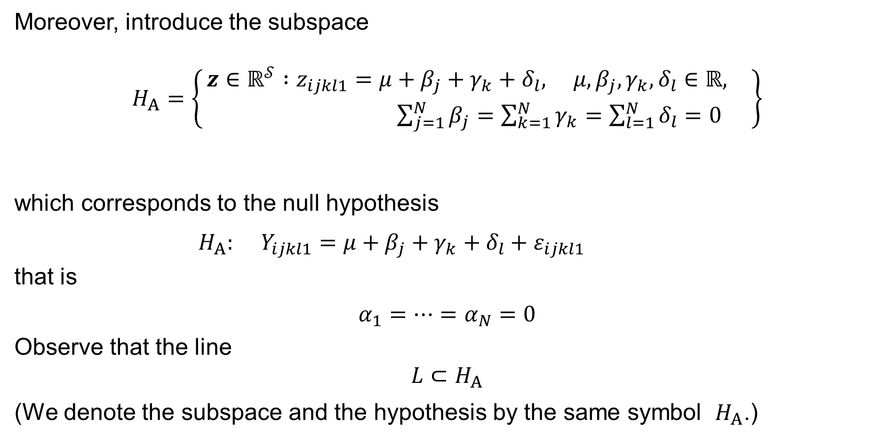
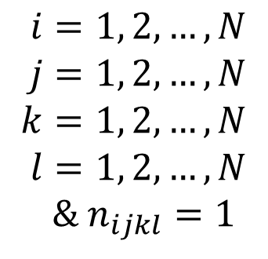
Four-way ANOVA with no interactions: Notation
Moreover, introduce the subspace
$H_{A}=\left\{\begin{aligned} z∈ℝ^{𝒮} :z_{ijkl1}=μ+β_{j}+γ_{k}+δ_{l}, μ,β_{j},γ_{k},δ_{l}∈ℝ, \\ \sum_{j=1}^{N}{β_{j}}=\sum_{k=1}^{N}{γ_{k}}=\sum_{l=1}^{N}{δ_{l}}=0\end{aligned}\right\}$
which corresponds to the null hypothesis
$$H_{A}: Y_{ijkl1}=μ+β_{j}+γ_{k}+δ_{l}+ε_{ijkl1}$$
that is
$$α_{1}=⋯=α_{N}=0$$
Observe that the line
$$L⊂H_{A}$$
(We denote the subspace and the hypothesis by the same symbol $H_{A}$.)
$$i=1, 2,…,N \\ j=1, 2,…,N \\ k=1, 2,…,N \\ l=1, 2,…,N$$
& $n_{ijkl}=1$
$$\text{for}$$

Slide 34
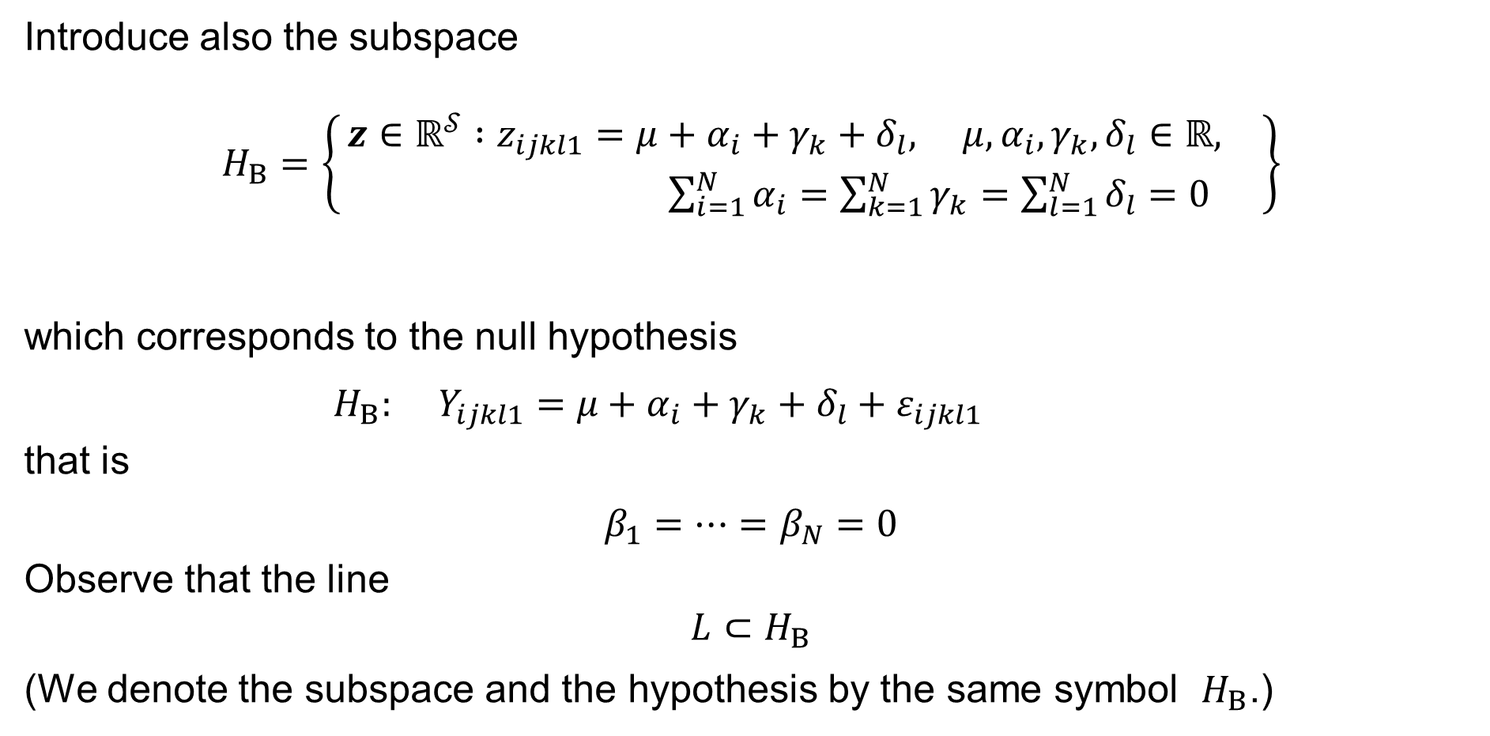
Four-way ANOVA with no interactions: Notation
Introduce also the subspace
$H_{B}=\left\{\begin{aligned} z∈ℝ^{𝒮} :z_{ijkl1}=μ+α_{i}+γ_{k}+δ_{l}, μ,α_{i},γ_{k},δ_{l}∈ℝ, \\ \sum_{i=1}^{N}{α_{i}}=\sum_{k=1}^{N}{γ_{k}}=\sum_{l=1}^{N}{δ_{l}}=0\end{aligned}\right\}$
which corresponds to the null hypothesis
$$H_{B}: Y_{ijkl1}=μ+α_{i}+γ_{k}+δ_{l}+ε_{ijkl1}$$
that is
$$β_{1}=⋯=β_{N}=0$$
Observe that the line
$$L⊂H_{B}$$
(We denote the subspace and the hypothesis by the same symbol $H_{B}$.)
$$i=1, 2,…,N \\ j=1, 2,…,N \\ k=1, 2,…,N \\ l=1, 2,…,N$$
& $n_{ijkl}=1$
$$\text{for}$$

Slide 35
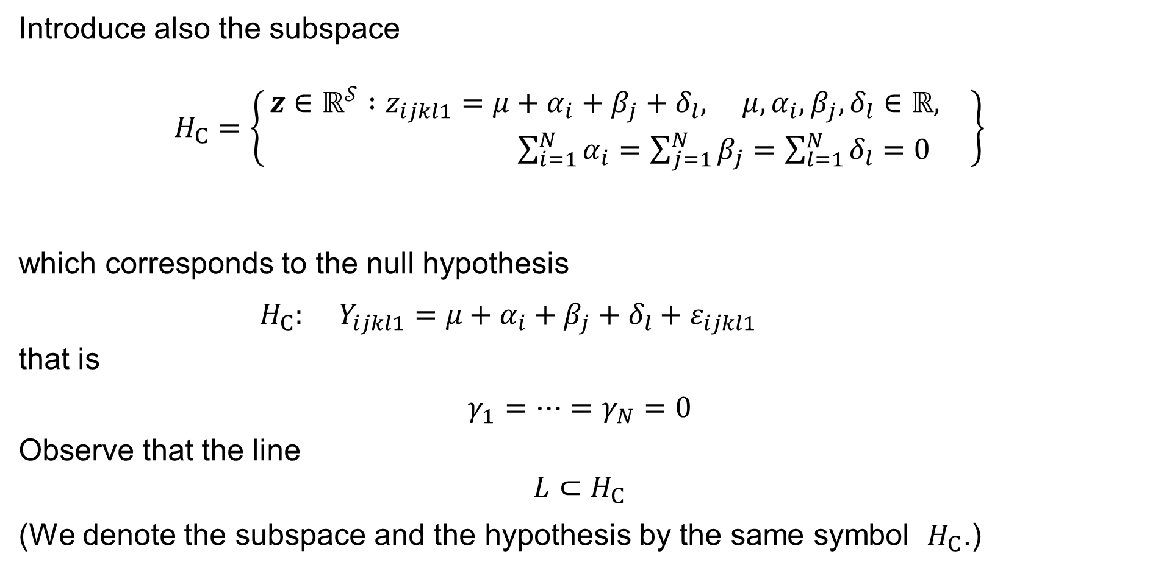
Four-way ANOVA with no interactions: Notation
Introduce also the subspace
$H_{C}=\left\{\begin{aligned} z∈ℝ^{𝒮} :z_{ijkl1}=μ+α_{i}+β_{j}+δ_{l}, μ,α_{i},β_{j},δ_{l}∈ℝ, \\ \sum_{i=1}^{N}{α_{i}}=\sum_{j=1}^{N}{β_{j}}=\sum_{l=1}^{N}{δ_{l}}=0\end{aligned}\right\}$
which corresponds to the null hypothesis
$$H_{C}: Y_{ijkl1}=μ+α_{i}+β_{j}+δ_{l}+ε_{ijkl1}$$
that is
$$γ_{1}=⋯=γ_{N}=0$$
Observe that the line
$$L⊂H_{C}$$
(We denote the subspace and the hypothesis by the same symbol $H_{C}$.)
$$i=1, 2,…,N \\ j=1, 2,…,N \\ k=1, 2,…,N \\ l=1, 2,…,N$$
& $n_{ijkl}=1$
$$\text{for}$$

Slide 36
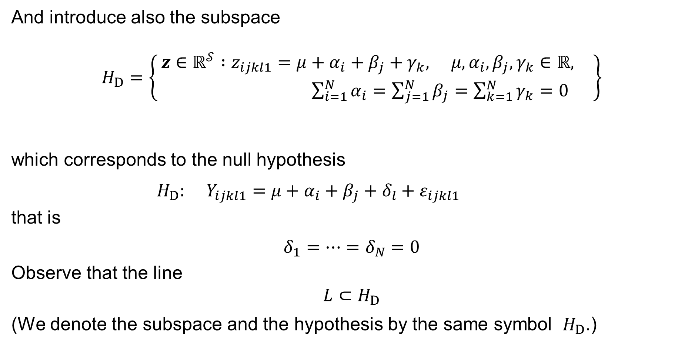
Four-way ANOVA with no interactions: Notation
And introduce also the subspace
$H_{D}=\left\{\begin{aligned} z∈ℝ^{𝒮} :z_{ijkl1}=μ+α_{i}+β_{j}+γ_{k}, μ,α_{i},β_{j},γ_{k}∈ℝ, \\ \sum_{i=1}^{N}{α_{i}}=\sum_{j=1}^{N}{β_{j}}=\sum_{k=1}^{N}{γ_{k}}=0\end{aligned}\right\}$
which corresponds to the null hypothesis
$$H_{D}: Y_{ijkl1}=μ+α_{i}+β_{j}+δ_{l}+ε_{ijkl1}$$
that is
$$δ_{1}=⋯=δ_{N}=0$$
Observe that the line
$$L⊂H_{D}$$
(We denote the subspace and the hypothesis by the same symbol $H_{D}$.)
$$i=1, 2,…,N \\ j=1, 2,…,N \\ k=1, 2,…,N \\ l=1, 2,…,N$$
& $n_{ijkl}=1$
$$\text{for}$$

Slide 37

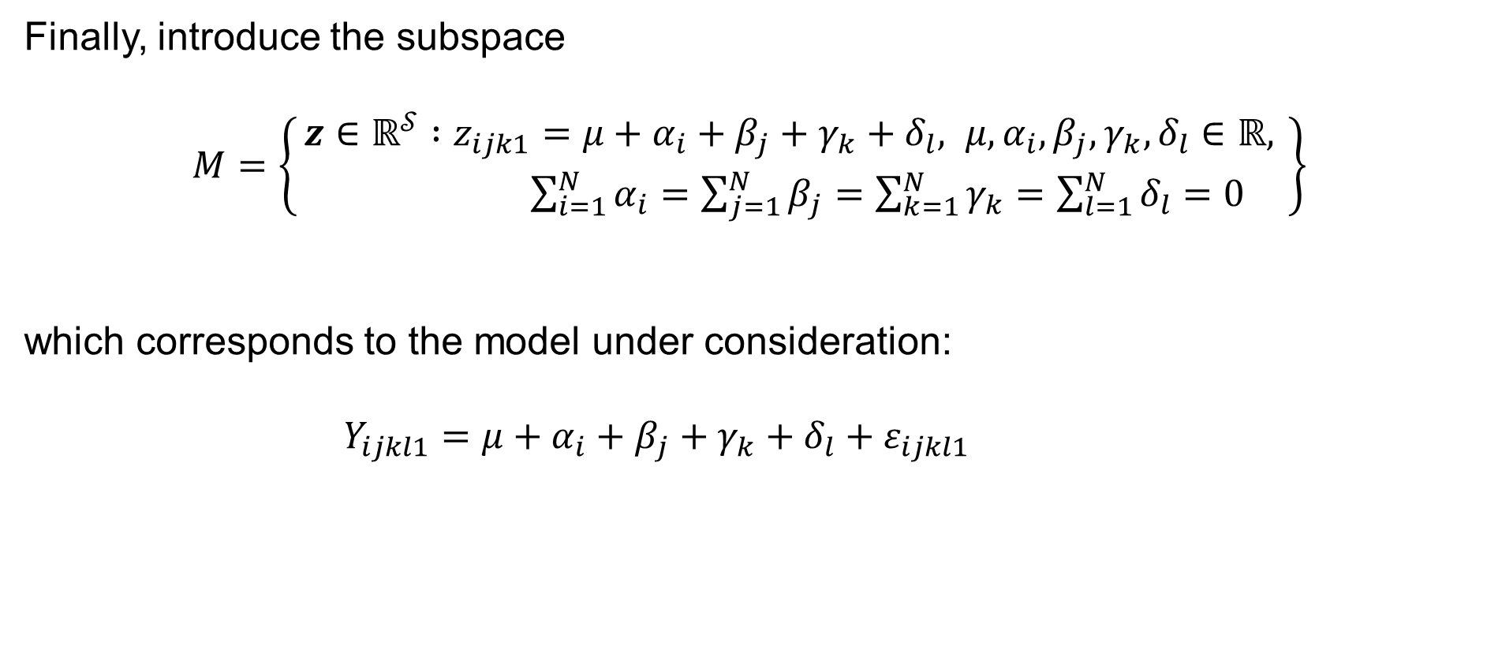
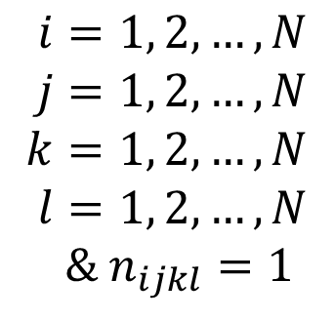
Four-way ANOVA with no interactions: Notation
Finally, introduce the subspace
$M=\left\{\begin{aligned} z∈ℝ^{𝒮} :z_{ijk1}=μ+α_{i}+β_{j}+γ_{k}+δ_{l}, μ,α_{i},β_{j},γ_{k},δ_{l}∈ℝ, \\ \sum_{i=1}^{N}{α_{i}}=\sum_{j=1}^{N}{β_{j}}=\sum_{k=1}^{N}{γ_{k}}=\sum_{l=1}^{N}{δ_{l}}=0 \end{aligned}\right\}$
which corresponds to the model under consideration:
$$Y_{ijkl1}=μ+α_{i}+β_{j}+γ_{k}+δ_{l}+ε_{ijkl1}$$
$$i=1, 2,…,N \\ j=1, 2,…,N \\ k=1, 2,…,N \\ l=1, 2,…,N$$
& $n_{ijkl}=1$
$$\text{for}$$

Slide 38

Four-way ANOVA with no interactions: Dimensions
Notice that the dimension of the line
$$L=\left\{ z∈ℝ^{𝒮} :z_{ijk1}=μ, μ∈ℝ \right\}$$
is
$$\dim{L}=1$$

Slide 39

Four-way ANOVA with no interactions: Dimensions
Notice that the dimension of the subspace
$H_{A}=\left\{\begin{aligned} z∈ℝ^{𝒮} :z_{ijkl1}=μ+β_{j}+γ_{k}+δ_{l}, μ,β_{j},γ_{k},δ_{l}∈ℝ, \\ \sum_{j=1}^{N}{β_{j}}=\sum_{k=1}^{N}{γ_{k}}=\sum_{l=1}^{N}{δ_{l}}=0\end{aligned}\right\}$
is
$$\dim{H_{A}}=\left(1+N+N+N\right)−1−1−1= 3N−2$$

Slide 40

Four-way ANOVA with no interactions: Dimensions
Notice that the dimension of the subspace
$H_{B}=\left\{\begin{aligned} z∈ℝ^{𝒮} :z_{ijkl1}=μ+α_{i}+γ_{k}+δ_{l}, μ,α_{i},γ_{k},δ_{l}∈ℝ, \\ \sum_{i=1}^{N}{α_{i}}=\sum_{k=1}^{N}{γ_{k}}=\sum_{l=1}^{N}{δ_{l}}=0\end{aligned}\right\}$
is
$$\dim{H_{B}}=\left(1+N+N+N\right)−1−1−1= 3N−2$$

Slide 41

Four-way ANOVA with no interactions: Dimensions
Notice that the dimension of the subspace
$H_{C}=\left\{\begin{aligned} z∈ℝ^{𝒮} :z_{ijkl1}=μ+α_{i}+β_{j}+δ_{l}, μ,α_{i},β_{j},δ_{l}∈ℝ, \\ \sum_{i=1}^{N}{α_{i}}=\sum_{j=1}^{N}{β_{j}}=\sum_{l=1}^{N}{δ_{l}}=0\end{aligned}\right\}$
is
$$\dim{H_{C}}=\left(1+N+N+N\right)−1−1−1= 3N−2$$

Slide 42

Four-way ANOVA with no interactions: Dimensions
Notice that the dimension of the subspace
$H_{D}=\left\{\begin{aligned} z∈ℝ^{𝒮} :z_{ijkl1}=μ+α_{i}+β_{j}+γ_{k}, μ,α_{i},β_{j},γ_{k}∈ℝ, \\ \sum_{i=1}^{N}{α_{i}}=\sum_{j=1}^{N}{β_{j}}=\sum_{k=1}^{N}{γ_{k}}=0\end{aligned}\right\}$
is
$$\dim{H_{D}}=\left(1+N+N+N\right)−1−1−1= 3N−2$$

Slide 43

Four-way ANOVA with no interactions: Dimensions
And notice that the dimension of the subspace
$M=\left\{\begin{aligned} z∈ℝ^{𝒮} :z_{ijk1}=μ+α_{i}+β_{j}+γ_{k}+δ_{l}, μ,α_{i},β_{j},γ_{k},δ_{l}∈ℝ, \\ \sum_{i=1}^{N}{α_{i}}=\sum_{j=1}^{N}{β_{j}}=\sum_{k=1}^{N}{γ_{k}}=\sum_{l=1}^{N}{δ_{l}}=0 \end{aligned}\right\}$
is
$$\dim{M}=\left(1+N+N+N+N\right)−1−1−1−1= 4N−3$$

Slide 44









Four-way ANOVA with no interactions
Letting ${\hat{y}}_{ijkl1}=μ−α_{i}−β_{j}−γ_{k}−δ_{l}$, solve the Least Squares Problem:
$$\min_{\hat{y}∈M}{\sum_{i=1}^{N}{\sum_{j=1}^{N}{\sum_{k=1}^{N}{\sum_{\begin{aligned}l=1 \\ n_{ijkl}=1\end{aligned}}^{N}{{\left(y_{ijkl1}−μ−α_{i}−β_{j}−γ_{k}−δ_{l}\right)}^{2}}}}}} = \min_{\hat{y}∈M}{{\left\|y−\hat{y}\right\|}^{2}} = RSS$$
$$M^{⊥}$$
$$y$$
$$y−\hat{y}=e$$
By the Pythagoras Theorem:
$${\left\|y\right\|}^{2}={\left\|\hat{y}\right\|}^{2}+{\left\|e\right\|}^{2} \\ y^{T}y={\hat{y}}^{T}\hat{y}+e^{T}e$$
0
$$\hat{y}$$
$$M$$
$$\dim{M^{⊥}}=N^{2}−4N+3=\left(N−1\right)\left(N−3\right)$$
$$\dim{M^{⊥}}+\dim{M}=N^{2}$$
$$\dim{M}=4N−3$$
Residual Sum of Squares: $RSS=\sum_{i=1}^{n}{{\left(y_{i}−{\hat{y}}_{i}\right)}^{2}}=\sum_{i=1}^{n}{e_{i}^{2}}=e^{T}e={\left\|e\right\|}^{2}$

Slide 45
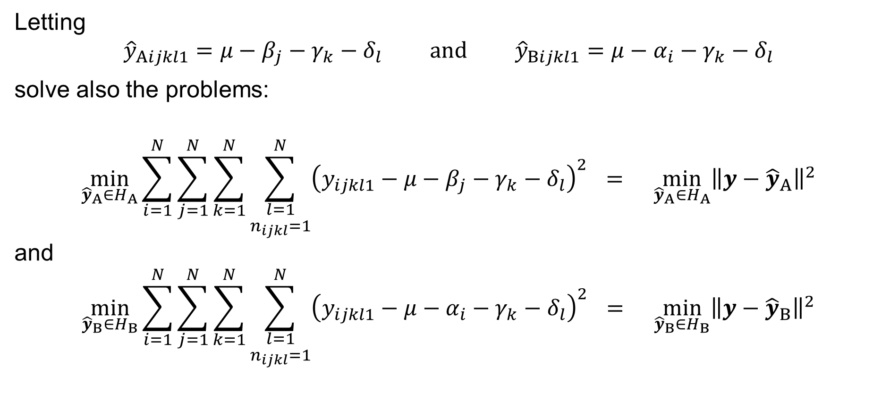
Four-way ANOVA with no interactions
Letting
$${\hat{y}}_{Aijkl1}=μ−β_{j}−γ_{k}−δ_{l} \text{and} {\hat{y}}_{Bijkl1}=μ−α_{i}−γ_{k}−δ_{l}$$
solve also the problems:
$$\min_{{\hat{y}}_{A}∈H_{A}}{\sum_{i=1}^{N}{\sum_{j=1}^{N}{\sum_{k=1}^{N}{\sum_{\begin{aligned}l=1 \\ n_{ijkl}=1\end{aligned}}^{N}{{\left(y_{ijkl1}−μ−β_{j}−γ_{k}−δ_{l}\right)}^{2}}}}}} = \min_{{\hat{y}}_{A}∈H_{A}}{{\left\|y−{\hat{y}}_{A}\right\|}^{2}}$$
and
$$\min_{{\hat{y}}_{B}∈H_{B}}{\sum_{i=1}^{N}{\sum_{j=1}^{N}{\sum_{k=1}^{N}{\sum_{\begin{aligned}l=1 \\ n_{ijkl}=1\end{aligned}}^{N}{{\left(y_{ijkl1}−μ−α_{i}−γ_{k}−δ_{l}\right)}^{2}}}}}} = \min_{{\hat{y}}_{B}∈H_{B}}{{\left\|y−{\hat{y}}_{B}\right\|}^{2}}$$

Slide 46
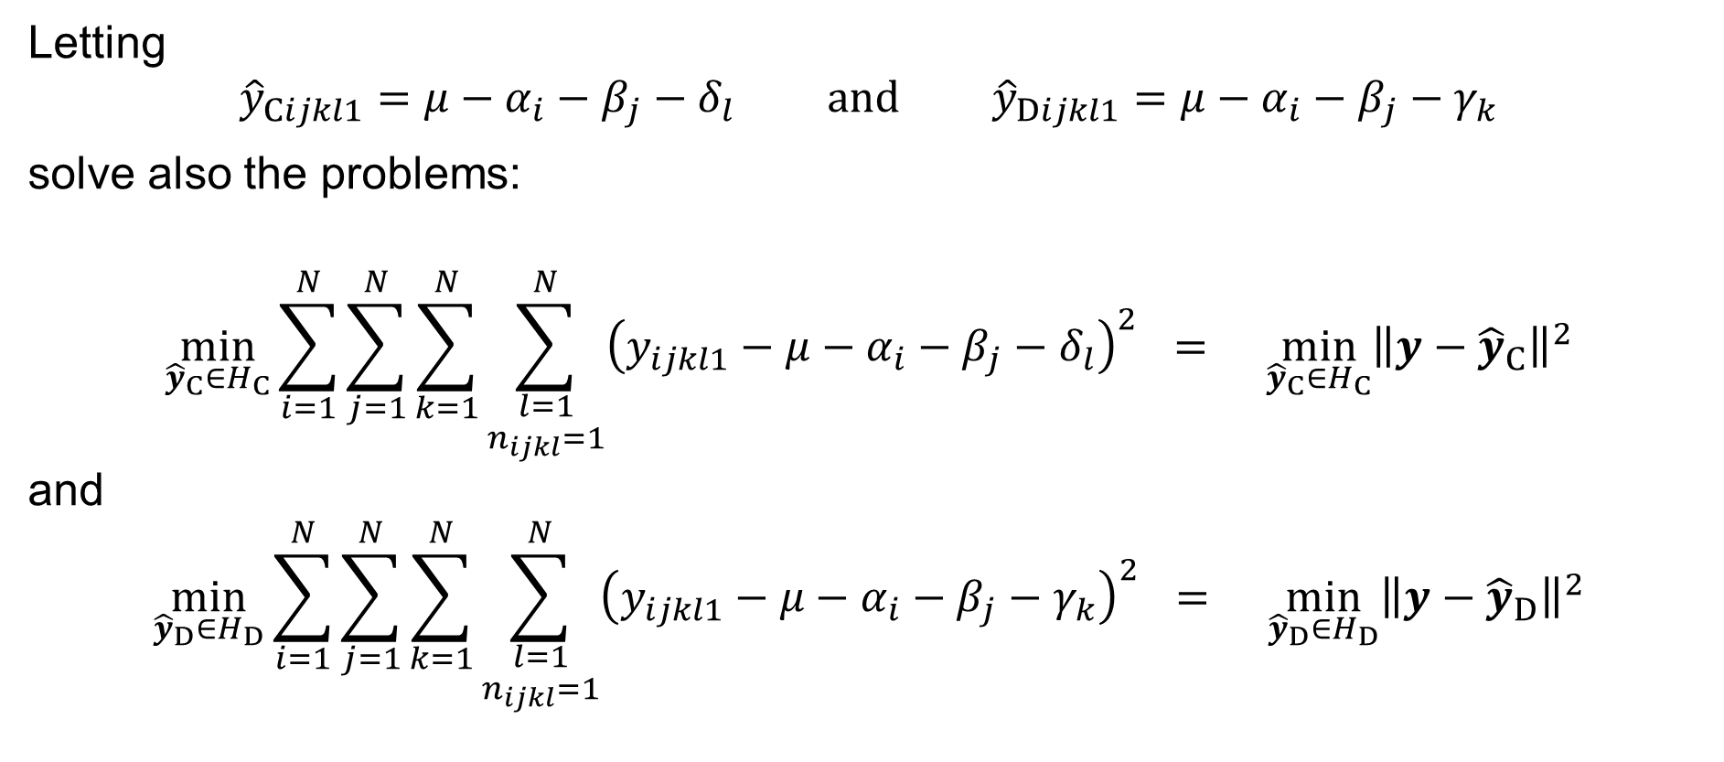
Four-way ANOVA with no interactions
Letting
$${\hat{y}}_{Cijkl1}=μ−α_{i}−β_{j}−δ_{l} \text{and} {\hat{y}}_{Dijkl1}=μ−α_{i}−β_{j}−γ_{k}$$
solve also the problems:
$$\min_{{\hat{y}}_{C}∈H_{C}}{\sum_{i=1}^{N}{\sum_{j=1}^{N}{\sum_{k=1}^{N}{\sum_{\begin{aligned}l=1 \\ n_{ijkl}=1\end{aligned}}^{N}{{\left(y_{ijkl1}−μ−α_{i}−β_{j}−δ_{l}\right)}^{2}}}}}} = \min_{{\hat{y}}_{C}∈H_{C}}{{\left\|y−{\hat{y}}_{C}\right\|}^{2}}$$
and
$$\min_{{\hat{y}}_{D}∈H_{D}}{\sum_{i=1}^{N}{\sum_{j=1}^{N}{\sum_{k=1}^{N}{\sum_{\begin{aligned}l=1 \\ n_{ijkl}=1\end{aligned}}^{N}{{\left(y_{ijkl1}−μ−α_{i}−β_{j}−γ_{k}\right)}^{2}}}}}} = \min_{{\hat{y}}_{D}∈H_{D}}{{\left\|y−{\hat{y}}_{D}\right\|}^{2}}$$

Slide 47

Four-way ANOVA with no interactions
Finally, letting
$$\overline{y}=μ$$
solve the Least Squares Problem:
$$\min_{1\overline{y}∈L}{\sum_{i=1}^{N}{\sum_{j=1}^{N}{\sum_{k=1}^{N}{\sum_{\begin{aligned}l=1 \\ n_{ijkl}=1\end{aligned}}^{N}{{\left(y_{ijkl1}−μ\right)}^{2}}}}}} = \min_{1\overline{y}∈L}{{\left\|y−1\overline{y}\right\|}^{2}}$$

Slide 48

Four-way ANOVA with no interactions
We have and denote:
$$\underset{{SS}_{TOTAL}}{\underbrace{{\left\|y−1\overline{y}\right\|}^{2}}} = \underset{{SS}_{A}}{\underbrace{{\left\|\hat{y}−{\hat{y}}_{A}\right\|}^{2}}} + \underset{{SS}_{B}}{\underbrace{{\left\|\hat{y}−{\hat{y}}_{B}\right\|}^{2}}} + \underset{{SS}_{C}}{\underbrace{{\left\|\hat{y}−{\hat{y}}_{C}\right\|}^{2}}} + \underset{{SS}_{D}}{\underbrace{{\left\|\hat{y}−{\hat{y}}_{D}\right\|}^{2}}} + \underset{RSS}{\underbrace{{\left\|e\right\|}^{2}}}$$
where, recall, we have:
$${\hat{y}}_{ijkl1}=\hat{μ}+{\hat{α}}_{i}+{\hat{β}}_{j}+{\hat{γ}}_{k}$$
$${\hat{y}}_{Aijkl1}=\hat{μ}+{\hat{β}}_{j}+{\hat{γ}}_{k}+{\hat{δ}}_{l} {\hat{y}}_{Bijkl1}=\hat{μ}+{\hat{α}}_{i}+{\hat{γ}}_{k}+{\hat{δ}}_{l}$$
$${\hat{y}}_{Cijkl1}=\hat{μ}+{\hat{α}}_{i}+{\hat{β}}_{j}+{\hat{δ}}_{l} {\hat{y}}_{Dijkl1}=\hat{μ}+{\hat{α}}_{i}+{\hat{β}}_{j}+{\hat{δ}}_{l}$$
$$\overline{y}=μ$$

Slide 49

Four-way ANOVA with no interactions
We thus have:
$${SS}_{TOTAL}={\left\|y−1\overline{y}\right\|}^{2}=\sum_{i=1}^{N}{\sum_{j=1}^{N}{\sum_{k=1}^{N}{\sum_{\begin{aligned}l=1 \\ n_{ijkl}=1\end{aligned}}^{N}{{\left(y_{ijkl1}−\overline{y}\right)}^{2}}}}}= \\ =\sum_{i=1}^{N}{\sum_{j=1}^{N}{\sum_{k=1}^{N}{\sum_{\begin{aligned}l=1 \\ n_{ijkl}=1\end{aligned}}^{N}{{\left(y_{ijkl1}−\hat{μ}\right)}^{2}}}}}$$

Slide 50

Four-way ANOVA with no interactions
We thus have:
$$RSS={\left\|e\right\|}^{2}={\left\|y−\hat{y}\right\|}^{2}=\sum_{i=1}^{N}{\sum_{j=1}^{N}{\sum_{k=1}^{N}{\sum_{\begin{aligned}l=1 \\ n_{ijkl}=1\end{aligned}}^{N}{{\left(y_{ijkl1}−{\hat{y}}_{ijkl1}\right)}^{2}}}}}= \\ =\sum_{i=1}^{N}{\sum_{j=1}^{N}{\sum_{k=1}^{N}{\sum_{\begin{aligned}l=1 \\ n_{ijkl}=1\end{aligned}}^{N}{{\left(y_{ijkl1}−\hat{μ}−{\hat{α}}_{i}−{\hat{β}}_{j}−{\hat{γ}}_{k}−{\hat{δ}}_{l}\right)}^{2}}}}}$$

Slide 51

Four-way ANOVA with no interactions
We thus have:
$${SS}_{A}={\left\|\hat{y}−{\hat{y}}_{A}\right\|}^{2}=\sum_{i=1}^{N}{\sum_{j=1}^{N}{\sum_{k=1}^{N}{\sum_{\begin{aligned}l=1 \\ n_{ijkl}=1\end{aligned}}^{N}{{\left({\hat{y}}_{ijkl1}−{\hat{y}}_{Aijkl1}\right)}^{2}}}}}= \\ =\sum_{i=1}^{N}{\sum_{j=1}^{N}{\sum_{k=1}^{N}{\sum_{\begin{aligned}l=1 \\ n_{ijkl}=1\end{aligned}}^{N}{{\left(\hat{μ}+{\hat{α}}_{i}+{\hat{β}}_{j}+{\hat{γ}}_{k}+{\hat{δ}}_{l}−\hat{μ}−{\hat{β}}_{j}−{\hat{γ}}_{k}−{\hat{δ}}_{l}\right)}^{2}}}}}= \\ =\sum_{i=1}^{N}{\sum_{j=1}^{N}{\sum_{k=1}^{N}{\sum_{\begin{aligned}l=1 \\ n_{ijkl}=1\end{aligned}}^{N}{{\hat{α}}_{i}^{2}}}}} = N\sum_{i=1}^{N}{{\hat{α}}_{i}^{2}}$$

Slide 52

Four-way ANOVA with no interactions
We thus have:
$${SS}_{B}={\left\|\hat{y}−{\hat{y}}_{B}\right\|}^{2}=\sum_{i=1}^{N}{\sum_{j=1}^{N}{\sum_{k=1}^{N}{\sum_{\begin{aligned}l=1 \\ n_{ijkl}=1\end{aligned}}^{N}{{\left({\hat{y}}_{ijkl1}−{\hat{y}}_{Bijkl1}\right)}^{2}}}}}= \\ =\sum_{i=1}^{N}{\sum_{j=1}^{N}{\sum_{k=1}^{N}{\sum_{\begin{aligned}l=1 \\ n_{ijkl}=1\end{aligned}}^{N}{{\left(\hat{μ}+{\hat{α}}_{i}+{\hat{β}}_{j}+{\hat{γ}}_{k}+{\hat{δ}}_{l}−\hat{μ}−{\hat{α}}_{i}−{\hat{γ}}_{k}−{\hat{δ}}_{l}\right)}^{2}}}}}= \\ =\sum_{i=1}^{N}{\sum_{j=1}^{N}{\sum_{k=1}^{N}{\sum_{\begin{aligned}l=1 \\ n_{ijkl}=1\end{aligned}}^{N}{{\hat{β}}_{j}^{2}}}}} = N\sum_{j=1}^{N}{{\hat{β}}_{j}^{2}}$$

Slide 53

Four-way ANOVA with no interactions
We thus have:
$${SS}_{C}={\left\|\hat{y}−{\hat{y}}_{C}\right\|}^{2}=\sum_{i=1}^{N}{\sum_{j=1}^{N}{\sum_{k=1}^{N}{\sum_{\begin{aligned}l=1 \\ n_{ijkl}=1\end{aligned}}^{N}{{\left({\hat{y}}_{ijkl1}−{\hat{y}}_{Cijkl1}\right)}^{2}}}}}= \\ =\sum_{i=1}^{N}{\sum_{j=1}^{N}{\sum_{k=1}^{N}{\sum_{\begin{aligned}l=1 \\ n_{ijkl}=1\end{aligned}}^{N}{{\left(\hat{μ}+{\hat{α}}_{i}+{\hat{β}}_{j}+{\hat{γ}}_{k}+{\hat{δ}}_{l}−\hat{μ}−{\hat{α}}_{i}−{\hat{β}}_{j}−{\hat{δ}}_{l}\right)}^{2}}}}}= \\ =\sum_{i=1}^{N}{\sum_{j=1}^{N}{\sum_{k=1}^{N}{\sum_{\begin{aligned}l=1 \\ n_{ijkl}=1\end{aligned}}^{N}{{\hat{γ}}_{k}^{2}}}}} = N\sum_{k=1}^{N}{{\hat{γ}}_{k}^{2}}$$

Slide 54

Four-way ANOVA with no interactions
We thus have:
$${SS}_{D}={\left\|\hat{y}−{\hat{y}}_{D}\right\|}^{2}=\sum_{i=1}^{N}{\sum_{j=1}^{N}{\sum_{k=1}^{N}{\sum_{\begin{aligned}l=1 \\ n_{ijkl}=1\end{aligned}}^{N}{{\left({\hat{y}}_{ijkl1}−{\hat{y}}_{Dijkl1}\right)}^{2}}}}}= \\ =\sum_{i=1}^{N}{\sum_{j=1}^{N}{\sum_{k=1}^{N}{\sum_{\begin{aligned}l=1 \\ n_{ijkl}=1\end{aligned}}^{N}{{\left(\hat{μ}+{\hat{α}}_{i}+{\hat{β}}_{j}+{\hat{γ}}_{k}+{\hat{δ}}_{l}−\hat{μ}−{\hat{α}}_{i}−{\hat{β}}_{j}−{\hat{γ}}_{k}\right)}^{2}}}}}= \\ =\sum_{i=1}^{N}{\sum_{j=1}^{N}{\sum_{k=1}^{N}{\sum_{\begin{aligned}l=1 \\ n_{ijkl}=1\end{aligned}}^{N}{{\hat{δ}}_{l}^{2}}}}} = N\sum_{l=1}^{N}{{\hat{δ}}_{l}^{2}}$$

Slide 55

Four-way ANOVA with no interactions
By solving the above Least Squares Problems
(${∂F}/{∂μ}={∂F}/{∂α_{i}}={∂F}/{∂β_{j}}={∂F}/{∂γ_{k}}={∂F}/{∂δ_{l}}=0$ etc.; do it as an exercise),
we obtain:
$$\hat{μ} = \frac{1}{N^{2}}\sum_{i=1}^{N}{\sum_{j=1}^{N}{\sum_{k=1}^{N}{\sum_{\begin{aligned}l=1 \\ n_{ijkl}=1\end{aligned}}^{N}{y_{ijkl1}}}}} = \overline{y} = {\overline{y}}_{∙∙∙∙}$$

Slide 56

Four-way ANOVA with no interactions
By solving the above Least Squares Problems
(${∂F}/{∂μ}={∂F}/{∂α_{i}}={∂F}/{∂β_{j}}={∂F}/{∂γ_{k}}={∂F}/{∂δ_{l}}=0$ etc.; do it as an exercise),
we obtain:
$${\hat{α}}_{i} = \frac{1}{N}\sum_{j=1}^{N}{\sum_{k=1}^{N}{\sum_{\begin{aligned}l=1 \\ n_{ijkl}=1\end{aligned}}^{N}{y_{ijkl1}}}}−\hat{μ} = {\overline{y}}_{i∙∙∙}−\overline{y}$$
$$\text{for} i=1, 2,…,N$$

Slide 57

Four-way ANOVA with no interactions
By solving the above Least Squares Problems
(${∂F}/{∂μ}={∂F}/{∂α_{i}}={∂F}/{∂β_{j}}={∂F}/{∂γ_{k}}={∂F}/{∂δ_{l}}=0$ etc.; do it as an exercise),
we obtain:
$${\hat{β}}_{j} = \frac{1}{N}\sum_{i=1}^{N}{\sum_{k=1}^{N}{\sum_{\begin{aligned}l=1 \\ n_{ijkl}=1\end{aligned}}^{N}{y_{ijkl1}}}}−\hat{μ} = {\overline{y}}_{∙j∙∙}−\overline{y}$$
$$\text{for} j=1, 2,…,N$$

Slide 58

Four-way ANOVA with no interactions
By solving the above Least Squares Problems
(${∂F}/{∂μ}={∂F}/{∂α_{i}}={∂F}/{∂β_{j}}={∂F}/{∂γ_{k}}={∂F}/{∂δ_{l}}=0$ etc.; do it as an exercise),
we obtain:
$${\hat{γ}}_{k} = \frac{1}{N}\sum_{i=1}^{N}{\sum_{j=1}^{N}{\sum_{\begin{aligned}l=1 \\ n_{ijkl}=1\end{aligned}}^{N}{y_{ijkl1}}}}−\hat{μ} = {\overline{y}}_{∙∙k∙}−\overline{y}$$
$$\text{for} k=1, 2,…,N$$

Slide 59

Four-way ANOVA with no interactions
By solving the above Least Squares Problems
(${∂F}/{∂μ}={∂F}/{∂α_{i}}={∂F}/{∂β_{j}}={∂F}/{∂γ_{k}}={∂F}/{∂δ_{l}}=0$ etc.; do it as an exercise),
we obtain:
$${\hat{δ}}_{l} = \frac{1}{N}\sum_{i=1}^{N}{\sum_{j=1}^{N}{\sum_{\begin{aligned}k=1 \\ n_{ijkl}=1\end{aligned}}^{N}{y_{ijkl1}}}}−\hat{μ} = {\overline{y}}_{∙∙∙l}−\overline{y}$$
$$\text{for} l=1, 2,…,N$$

Slide 60

Four-way ANOVA with no interactions
Put together, we have:
$${SS}_{TOTAL} =\sum_{i=1}^{N}{\sum_{j=1}^{N}{\sum_{k=1}^{N}{\sum_{\begin{aligned}l=1 \\ n_{ijkl}=1\end{aligned}}^{N}{{\left(y_{ijkl1}−\hat{μ}\right)}^{2}}}}} = \sum_{i=1}^{N}{\sum_{j=1}^{N}{\sum_{k=1}^{N}{\sum_{\begin{aligned}l=1 \\ n_{ijkl}=1\end{aligned}}^{N}{{\left(y_{ijkl1}−\overline{y}\right)}^{2}}}}}$$
$$RSS =\sum_{i=1}^{N}{\sum_{j=1}^{N}{\sum_{k=1}^{N}{\sum_{\begin{aligned}l=1 \\ n_{ijkl}=1\end{aligned}}^{N}{{\left(y_{ijkl1}−\hat{μ}−{\hat{α}}_{i}−{\hat{β}}_{j}−{\hat{γ}}_{k}−{\hat{δ}}_{l}\right)}^{2}}}}}= \\ =\sum_{i=1}^{N}{\sum_{j=1}^{N}{\sum_{k=1}^{N}{\sum_{\begin{aligned}l=1 \\ n_{ijkl}=1\end{aligned}}^{N}{{\left(y_{ijkl1}−{\overline{y}}_{i∙∙∙}−{\overline{y}}_{∙j∙∙}−{\overline{y}}_{∙∙k∙}−{\overline{y}}_{∙∙∙l}+3\overline{y}\right)}^{2}}}}}$$

Slide 61

Four-way ANOVA with no interactions
Remark: The quantity
$$s^{2}=\frac{RSS}{ \dim{M^{⊥}}}=\frac{RSS}{ \left(N−1\right)\left(N−3\right) }$$
is an estimate of the unknown $σ^{2}$, that is $s^{2}≈σ^{2}$.
It holds
$$E\left[s^{2}\right]=σ^{2}$$
Recall that $\dim{M^{⊥}}=N^{2}−\dim{M}=\left(N−1\right)\left(N−3\right)$ — see the figure above!

Slide 62

Four-way ANOVA with no interactions
Put together, we have:
$${SS}_{A} =N\sum_{i=1}^{N}{{\hat{α}}_{i}^{2}} = N\sum_{i=1}^{N}{{\left({\overline{y}}_{i∙∙∙}−\overline{y}\right)}^{2}}$$
$${SS}_{B} =N\sum_{j=1}^{N}{{\hat{β}}_{j}^{2}} = N\sum_{j=1}^{N}{{\left({\overline{y}}_{∙j∙∙}−\overline{y}\right)}^{2}}$$

Slide 63

Four-way ANOVA with no interactions
Put together, we have:
$${SS}_{C} =N\sum_{k=1}^{N}{{\hat{γ}}_{k}^{2}} = N\sum_{k=1}^{N}{{\left({\overline{y}}_{∙∙k∙}−\overline{y}\right)}^{2}}$$
$${SS}_{D} =N\sum_{l=1}^{N}{{\hat{δ}}_{l}^{2}} = N\sum_{l=1}^{N}{{\left({\overline{y}}_{∙∙∙l}−\overline{y}\right)}^{2}}$$

Slide 64

Four-way ANOVA with no interactions
Recall that it holds:
$${SS}_{TOTAL}={SS}_{A}+{SS}_{B}+{SS}_{C}+{SS}_{D}+RSS$$
$$\sum_{i=1}^{N}{\sum_{j=1}^{N}{\sum_{k=1}^{N}{\sum_{\begin{aligned}l=1 \\ n_{ijkl}=1\end{aligned}}^{N}{{\left(y_{ijkl1}−\overline{y}\right)}^{2}}}}}=$$
$$=N\sum_{i=1}^{N}{{\left({\overline{y}}_{i∙∙∙}−\overline{y}\right)}^{2}}+N\sum_{j=1}^{N}{{\left({\overline{y}}_{∙j∙∙}−\overline{y}\right)}^{2}}+N\sum_{k=1}^{N}{{\left({\overline{y}}_{∙∙k∙}−\overline{y}\right)}^{2}}+N\sum_{l=1}^{N}{{\left({\overline{y}}_{∙∙∙l}−\overline{y}\right)}^{2}}+$$
$$+\sum_{i=1}^{N}{\sum_{j=1}^{N}{\sum_{k=1}^{N}{\sum_{\begin{aligned}l=1 \\ n_{ijkl}=1\end{aligned}}^{N}{{\left(y_{ijkl1}−{\overline{y}}_{i∙∙∙}−{\overline{y}}_{∙j∙∙}−{\overline{y}}_{∙∙k∙}−{\overline{y}}_{∙∙∙l}+3\overline{y}\right)}^{2}}}}}$$

Slide 65

Four-way ANOVA with no interactions: Test for H_{D}
We use the theory of Linear Regression (Theorem 8) to test Hypothesis $H_{D}$:
If the null hypothesis
$$H_{D}: γ_{1}=γ_{2}=⋯=γ_{N}=0$$
holds true, then
$${\frac{{SS}_{D}}{ RSS }}/{\frac{ \dim{M}−\dim{H_{D}} }{N^{2}−\dim{M}}} = {\frac{{SS}_{D}}{ RSS }}/{\frac{N−1}{ \left(N−1\right)\left(N−2\right) }} ∼ F_{N−1, \left(N−1\right)\left(N−2\right)}$$

Slide 66















Four-way ANOVA with no interactions: Test for H_{D}
It holds:
$$M^{⊥}$$
$${cotan}^{2}{φ}=\frac{{\left(\hat{y}−{\hat{y}}_{D}\right)}^{T}\left(\hat{y}−{\hat{y}}_{D}\right)}{RSS}$$
(the orthogonal
complement =
= the space of
the residuals)
subspace
of dimension
$$y$$
$$e=y−\hat{y}$$
$${{\left(\operatorname{cotan}{φ}\right)}^{2}}/{\frac{N−1}{ N^{2}−4N+3 }}∼F_{N−1, \left(N−1\right)\left(N−3\right)}$$
$$N^{2}−4N+3$$
$${\hat{y}}_{D}$$
$$φ$$
$$\hat{y}$$
$$M$$
0
subspace of dimension
$$4N−3$$
$$H_{D}$$
subspace of dimension
the dimension of its complement within
the subspace of dimension $4N−3$ is
$$3N−2$$
$$N−1$$

Slide 67

Four-way ANOVA with no interactions: Test for H_{D}
Given the sample $y_{ijkl1}$ of the random variables
$Y_{ijkl1}=μ+α_{i}+β_{j}+γ_{k}+δ_{l}+ε_{ijkl1}$
where $μ,α_{i},β_{j},γ_{k},δ_{l}∈ℝ$ are (unknown) parameters such that
$\sum_{i=1}^{N}{α_{i}}=\sum_{j=1}^{N}{β_{j}}=\sum_{k=1}^{N}{γ_{k}}=\sum_{l=1}^{N}{δ_{l}}=0$ and $ε_{ijkl1}∼𝒩\left(0,σ^{2}\right)$
are mutually independent random variables for $i=1, 2,…,N$, $j=1, 2,…,N$,
$k=1, 2,…,N$, $l=1, 2,…,N$ such that $n_{ijkl}=1$, formulate the null hypothesis:
$H_{D}: δ_{1}=δ_{2}=⋯=δ_{N}=0$
The alternative hypothesis is $H_{D1}≡¬H_{D}$, i.e. $δ_{l}≠0$ for some $l∈\left\{1, 2,…,N\right\}$

Slide 68

Four-way ANOVA with no interactions: Test for H_{D}
Calculate the statistic
$$F={\frac{{SS}_{D}}{ RSS }}/{\frac{{DF}_{D}}{DF_{RSS}}}= \\ ={\frac{N\sum_{l=1}^{N}{{\left({\overline{y}}_{∙∙∙l}−\overline{y}\right)}^{2}}}{\sum_{i=1}^{N}{\sum_{j=1}^{N}{\sum_{k=1}^{N}{\sum_{\begin{aligned}l=1 \\ n_{ijkl}=1\end{aligned}}^{N}{{\left(y_{ijkl1}−{\overline{y}}_{i∙∙∙}−{\overline{y}}_{∙j∙∙}−{\overline{y}}_{∙∙k∙}−{\overline{y}}_{∙∙∙l}+3\overline{y}\right)}^{2}}}}}}}/{\frac{N−1}{N^{2}−4N+3}}$$
If the null hypothesis is true, then we have by the Theorem
$F∼F_{N−1, \left(N−1\right)\left(N−3\right)}$

Slide 69

Four-way ANOVA with no interactions: Test for H_{D}
Choose the level of significance, a small number $α>0$, such as $α=5 \%$
Find the critical value
$c = F_{N−1, \left(N−1\right)\left(N−3\right)} \left(1−α\right)$
so that $\int_{c}^{+∞}{f\left(x\right) dx}=α$ where $f$ is the density of the F-distribution with
$N−1$ and $\left(N−1\right)\left(N−3\right)$ degrees of freedom
If $F∈\left[c,+∞\right)$, the critical region, then reject the null hypothesis
If $F∈\left[0,c\right)$, then do not reject (or fail to reject) the null hypothesis

