Slide 1
Statistical Methods for Economists
Lecture 1
Basic Statistical Concepts and
Data Characteristics
David Bartl
Statistical Methods for Economists
INM/BASTE

Slide 2
Reading list
Measures of central tendency (arithmetic mean, mode, median)
Measures of variability (range, variance, coefficient of variation)
Measures of data concentration (skewness, kurtosis)
Moment characteristics
Two statistical variables
SUPPLEMENT: The expected values of the functions of random variables

Slide 3
Reading list
Compulsory:
TOŠENOVSKÝ, Filip: Statistical Methods for Economists.
Karviná: SU OPF, 2014. ISBN 978-80-7510-033-7
ANDERSON, David R., SWEENEY, Dennis J., WILLIAMS, Thomas A., FREEMAN, James, SHOESMITH, Eddie:
Statistics for Business and Economics. 4th Edition.
Cengage Learning, 2017. ISBN 978-1-4737-2656-7
KELLER, Gerald: Statistics for Management and Economics. 11th Edition. Cengage Learning, 2017. ISBN 978-1-337-09345-3

Slide 4
Reading list
Free Online Textbooks:
Many textbooks on statistics and other disciplines can be found at
https://freetextbook.org/
Online Statistics Education: An Interactive Multimedia Course of Study
http://onlinestatbook.com/
The Electronic Statistics Textbook by StatSoft, Inc. (2013)
www.statsoft.com/textbook
The printed version of the latter textbook:
HILL, T. & LEWICKI, P. (2007). STATISTICS: Methods and Applications. StatSoft, Tulsa, OK.

Slide 5
Reading list
Recommended I:
SIEGEL, Andrew: Practical Business Statistics. 7th Edition.
Academic Press, 2016. ISBN 978-0-12-804250-2
ÖZDEMIR, Durmuş: Applied Statistics for Economics and Business.
2nd Edition. Springer, 2016.
ISBN 978-3-319-26495-0 (hardcover). ISBN 978-3-319-79962-9 (softcover).
UBØE, Jan: Introductory Statistics for Business and Economics:
Theory, Exercises and Solutions. 1st Edition. Springer, 2017.
ISBN 978-3-319-70935-2 (hardcover). ISBN 978-3-319-89016-6 (softcover).

Slide 6
Reading list
Recommended II:
QUIRK, Thomas: Excel 2016 for Business Statistics:
A Guide to Solving Practical Problems. 1st Edition. Springer, 2016.
ISBN 978-3-319-38958-5 (softcover).
HERKENHOFF, Linda, FOGLI, John:
Applied Statistics for Business and Management using Microsoft Excel.
1st Edition. Springer, 2013. ISBN 978-1-4614-8422-6 (softcover).

Slide 7
Reading list
Optional:
DANIEL, W. W., TERREL, J.: Business Statistics for Management and Economics. Houghton Mifflin, 1995. ISBN 0-395-73717-6
WOOLDRIDGE, J. M.: Introductory Econometrics: A Modern Approach.
Mason, OH: Thomson/South-Western, 2006. ISBN 0-324-28978-2
VAN MATRE, J. G., GILBREATH, G. H.: Statistics for Business and Economics. BPI/IRWIN, Homewood, 1997. ISBN 0-256-03719-1

Slide 8
Basic Statistical Concepts
Data — Data unit —
Data item — Observation —
Dataset
Population — Sample — Data item
Population & Sample

Slide 9
Data — Data unit — Data item — Observation — Dataset
Data — (plural) — measurements and observations
Data unit — one entity (e.g. a person) in the population, under study,
about which the data are collected
Data item — a characteristics (an attribute) of a data unit
(e.g. the date of birth, gender, income, …), also called a variable
Observation — an occurrence of a specific data item recorded about a data unit,
also called a datum (singular of “data”)
Dataset — a complete collection of all observations

Slide 10
Population — Sample — Data item
Population — a collection of all data units of the same specification
Sample — a selected subset of the population
Data item — a property or an attribute of a data unit of the population
Data items – statistical variables – are:
— qualitative (categorical), such as the gender, colour, taste, satisfaction
— quantitative (numerical), such as the revenue, price, number of customers

Slide 11
Population & Sample
Assume that we have a set (i.e. a “population”) of values of some phenomenon, which we observe / measure / study / deal with. In practice, this set may be very very large (e.g. some data item, the data units being all the people living on the Earth), thus unknown to us. Another example might be the set of all results of some experiment, yet the instances which we have not done yet.
Assume however, that the set exists (in theory at least) and that the set is finite
(for simplicity).

Slide 12
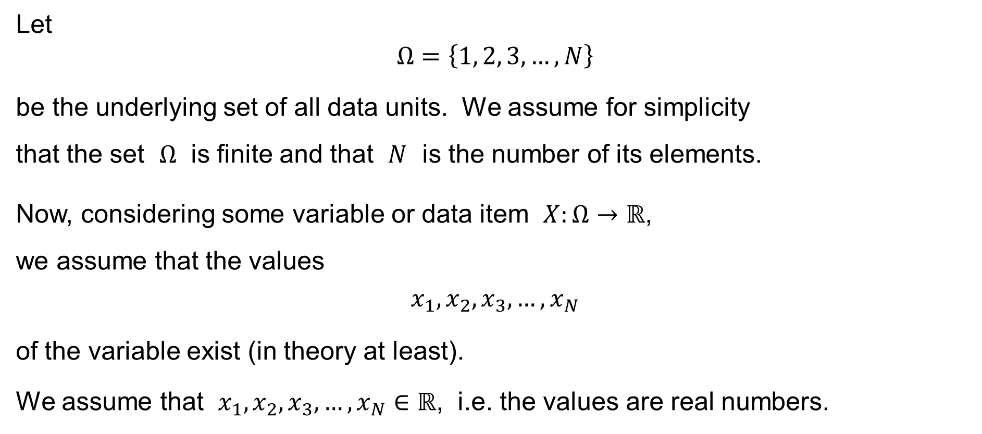
Population & Sample
Let
$$Ω=\left\{1, 2, 3,…,N\right\}$$
be the underlying set of all data units. We assume for simplicity
that the set $Ω$ is finite and that $N$ is the number of its elements.
Now, considering some variable or data item $X:Ω→ℝ$,
we assume that the values
$$x_{1},x_{2},x_{3},…,x_{N}$$
of the variable exist (in theory at least).
We assume that $x_{1},x_{2},x_{3},…,x_{N}∈ℝ$, i.e. the values are real numbers.

Slide 13
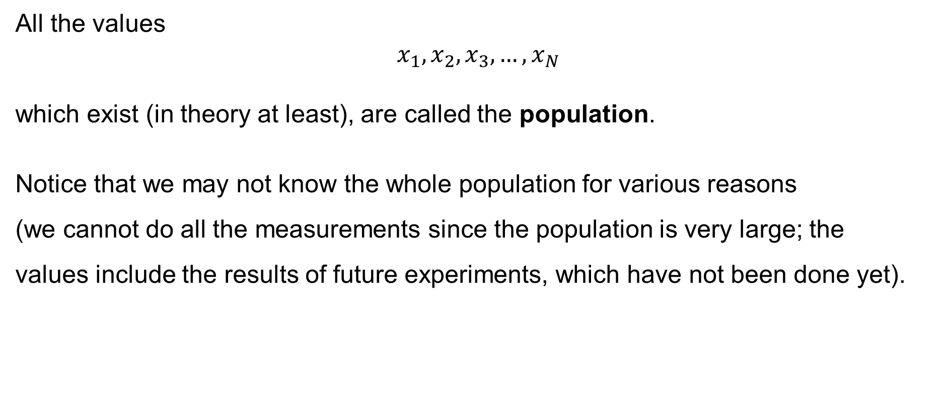
Population & Sample
All the values
$$x_{1},x_{2},x_{3},…,x_{N}$$
which exist (in theory at least), are called the population.
Notice that we may not know the whole population for various reasons
(we cannot do all the measurements since the population is very large; the
values include the results of future experiments, which have not been done yet).

Slide 14
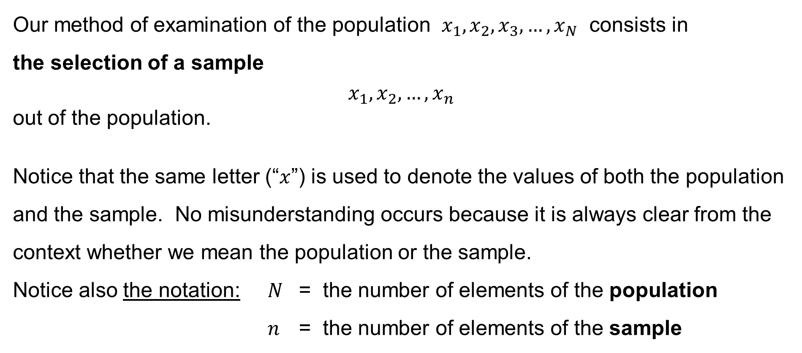
Population & Sample
Our method of examination of the population $x_{1},x_{2},x_{3},…,x_{N}$ consists in
the selection of a sample
$$x_{1},x_{2},…,x_{n}$$
out of the population.
Notice that the same letter (“$x$”) is used to denote the values of both the population and the sample. No misunderstanding occurs because it is always clear from the context whether we mean the population or the sample.
Notice also the notation: $N$ = the number of elements of the population
$n$ = the number of elements of the sample

Slide 15
Measures of central tendency
Arithmetic mean
Mode
Median
Frequencies of occurrence
Weighted arithmetic mean

Slide 16
Measures of central tendency
Assume that a variable (data item) is numerical, i.e. quantitative, discrete or continuous. We then consider several measures of central tendency of the variable:
— Arithmetic mean
— Mode
— Median

Slide 17

Arithmetic mean
Population arithmetic mean:
$$μ=\frac{1}{N}\sum_{i=1}^{N}{x_{i}}$$
Sample arithmetic mean:
$$\overline{x}=\frac{1}{n}\sum_{i=1}^{n}{x_{i}}$$

Slide 18
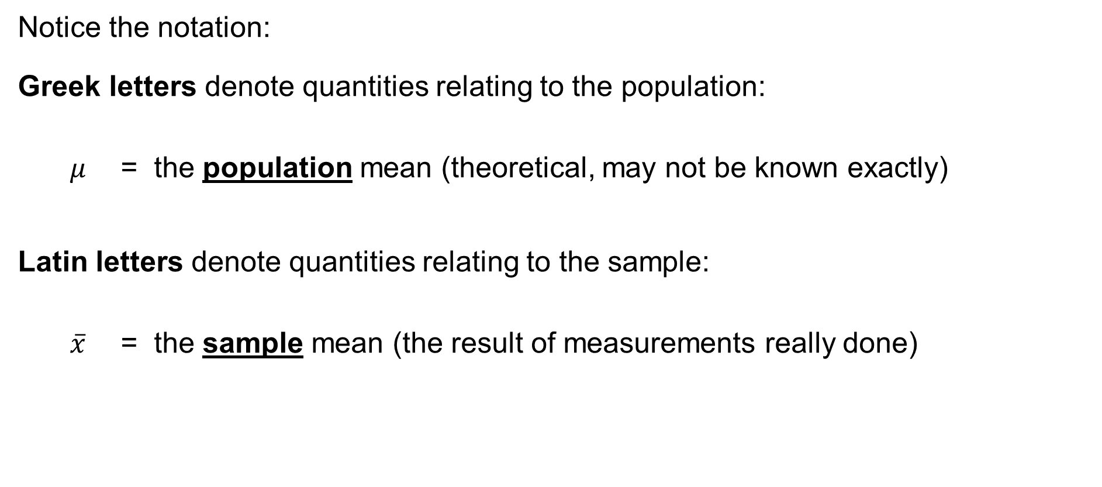
Arithmetic mean
Notice the notation:
Greek letters denote quantities relating to the population:
$μ$ = the population mean (theoretical, may not be known exactly)
Latin letters denote quantities relating to the sample:
$\overline{x}$ = the sample mean (the result of measurements really done)

Slide 19
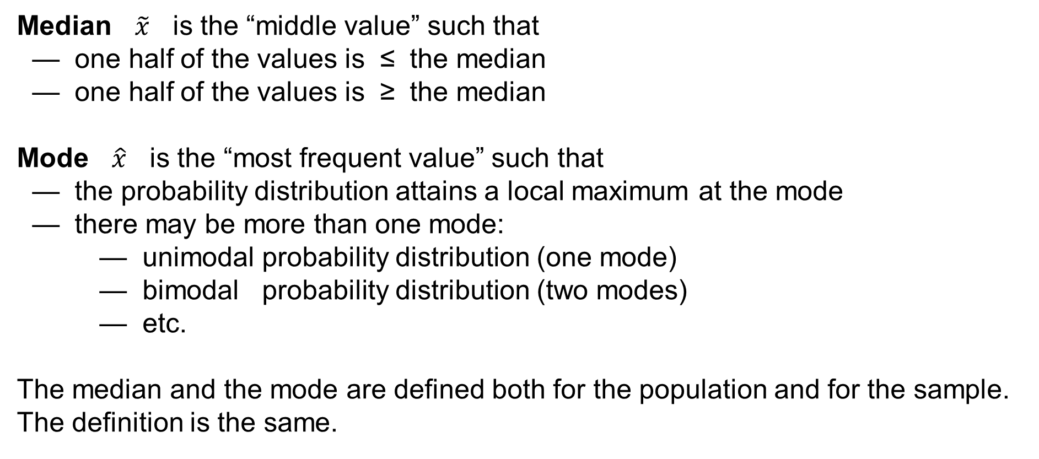
Median & Mode
Median $\tilde{x}$ is the “middle value” such that
— one half of the values is ≤ the median
— one half of the values is ≥ the median
Mode $\hat{x}$ is the “most frequent value” such that
— the probability distribution attains a local maximum at the mode
— there may be more than one mode:
— unimodal probability distribution (one mode)
— bimodal probability distribution (two modes)
— etc.
The median and the mode are defined both for the population and for the sample.
The definition is the same.

Slide 20
Sample Mean / Median / Mode in Excel
In Excel, use the functions:
=AVERAGEA() to calculate the sample arithmetic mean
=MEDIAN() to find the sample median
=MODE.SNGL() to find one of the sample modes
=MODE.MULT() to find many of the sample modes
(matrix function, press “Ctrl-Shift-Enter”)
=MODE() to find one of the sample modes
(the same as =MODE.SNGL(), deprecated)

Slide 21
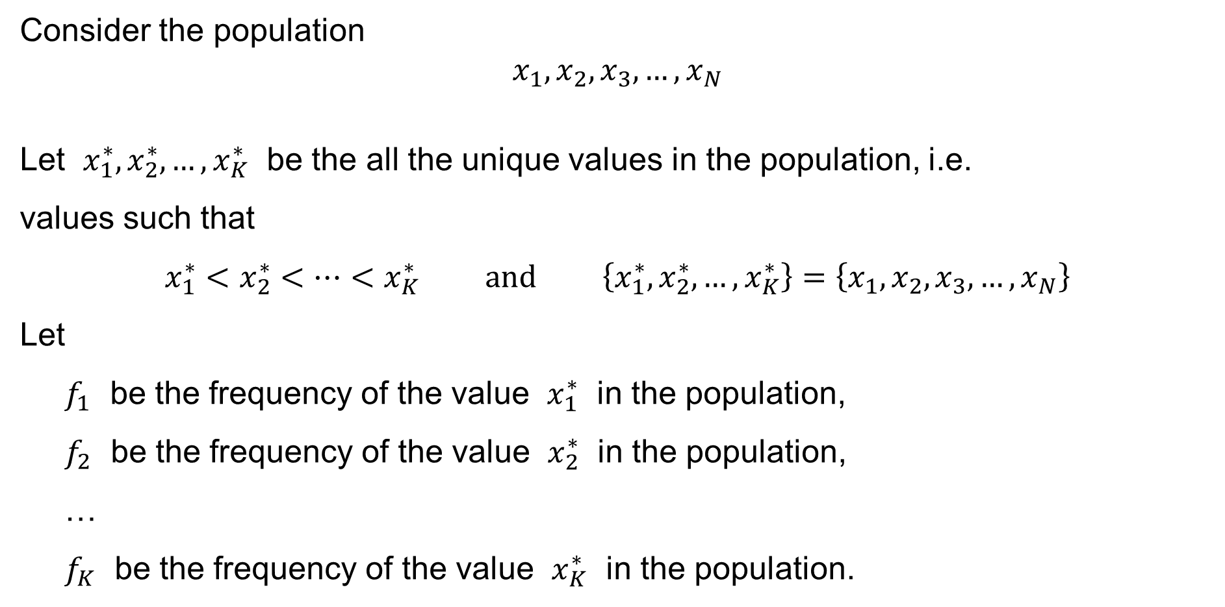
Frequencies of occurrence
Consider the population
$$x_{1},x_{2},x_{3},…,x_{N}$$
Let $x_{1}^{∗},x_{2}^{∗},…,x_{K}^{∗}$ be the all the unique values in the population, i.e.
values such that
$$x_{1}^{∗}<x_{2}^{∗}<⋯<x_{K}^{∗} \text{and} \left\{x_{1}^{∗},x_{2}^{∗},…,x_{K}^{∗}\right\}=\left\{x_{1},x_{2},x_{3},…,x_{N}\right\}$$
Let
$f_{1}$ be the frequency of the value $x_{1}^{∗}$ in the population,
$f_{2}$ be the frequency of the value $x_{2}^{∗}$ in the population,
…
$f_{K}$ be the frequency of the value $x_{K}^{∗}$ in the population.

Slide 22

Frequencies of occurrence
Mathematically written, we have:
$$f_{1}=\left|\left\{ i∈\left\{1, 2, 3,…,N\right\} :x_{1}^{∗}=x_{i} \right\}\right| \\ f_{2}=\left|\left\{ i∈\left\{1, 2, 3,…,N\right\} :x_{2}^{∗}=x_{i} \right\}\right| \\ ⋮ \\ f_{K}=\left|\left\{ i∈\left\{1, 2, 3,…,N\right\} :x_{K}^{∗}=x_{i} \right\}\right|$$
Then the population mean is
$$μ = \frac{1}{N}\sum_{i=1}^{N}{x_{i}} = \frac{1}{\sum_{k=1}^{K}{f_{k}}}\sum_{k=1}^{K}{f_{k}x_{k}^{∗}}$$

Slide 23
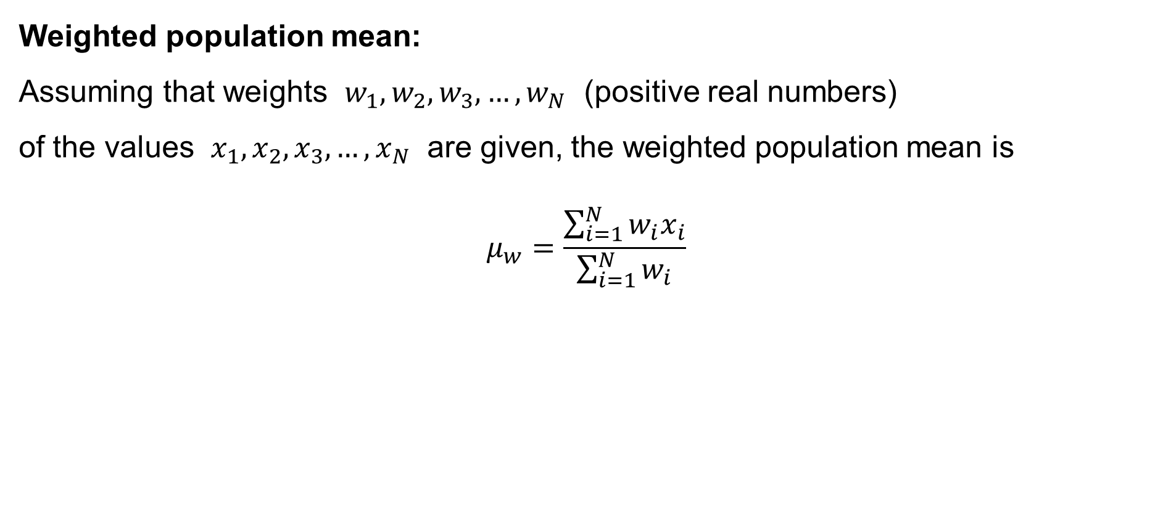
Arithmetic mean
Weighted population mean:
Assuming that weights $w_{1},w_{2},w_{3},…,w_{N}$ (positive real numbers)
of the values $x_{1},x_{2},x_{3},…,x_{N}$ are given, the weighted population mean is
$$μ_{w}=\frac{\sum_{i=1}^{N}{w_{i}x_{i}}}{\sum_{i=1}^{N}{w_{i}}}$$

Slide 24
Example: Employees (a sample of the Dataset)
ID | Gender | Age | Marital Status | Education | Position | Salary per Year | Evaluation
5060 | M | 65 | divorced | secondary | worker | 258800 | 4
1030 | M | 60 | divorced | university | manager | 630000 | 2
3049 | M | 60 | married | primary | operator | 436600 | 5
5047 | M | 60 | widowed | primary+vocational | worker | 240600 | 3
5061 | M | 60 | widowed | primary+vocational | worker | 241800 | 1
5087 | M | 60 | widowed | secondary | worker | 239500 | —
5133 | F | 60 | married | secondary | worker | 241100 | 4
5177 | F | 60 | widowed | secondary | worker | 239600 | 4
3030 | F | 58 | widowed | primary | operator | 422600 | 1
3014 | F | 56 | widowed | university | operator | 303600 | 3
5012 | F | 56 | widowed | primary+vocational | worker | 223100 | 4
5056 | M | 56 | divorced | primary | worker | 225200 | 5
5101 | M | 56 | unmarried | primary+vocational | worker | 224600 | 4
5106 | M | 56 | married | primary+vocational | worker | 226100 | 7
5146 | F | 56 | married | primary+vocational | worker | 224900 | 3
5153 | M | 56 | divorced | secondary | worker | 224500 | 4
5189 | M | 56 | married | primary+vocational | worker | 224600 | 1
5196 | M | 56 | widowed | primary+vocational | worker | 222800 | 3
1031 | M | 55 | married | university | manager | 429000 | —
5016 | M | 55 | divorced | secondary | administrative officer | 259000 | 5
5021 | F | 55 | married | primary+vocational | worker | 220200 | —
5062 | F | 55 | widowed | primary+vocational | worker | 221400 | 5
5107 | M | 55 | divorced | primary+vocational | worker | 220500 | 4
5154 | F | 55 | widowed | primary+vocational | worker | 219200 | 5
5195 | M | 55 | married | primary+vocational | worker | 219400 | 6
sample

Slide 25
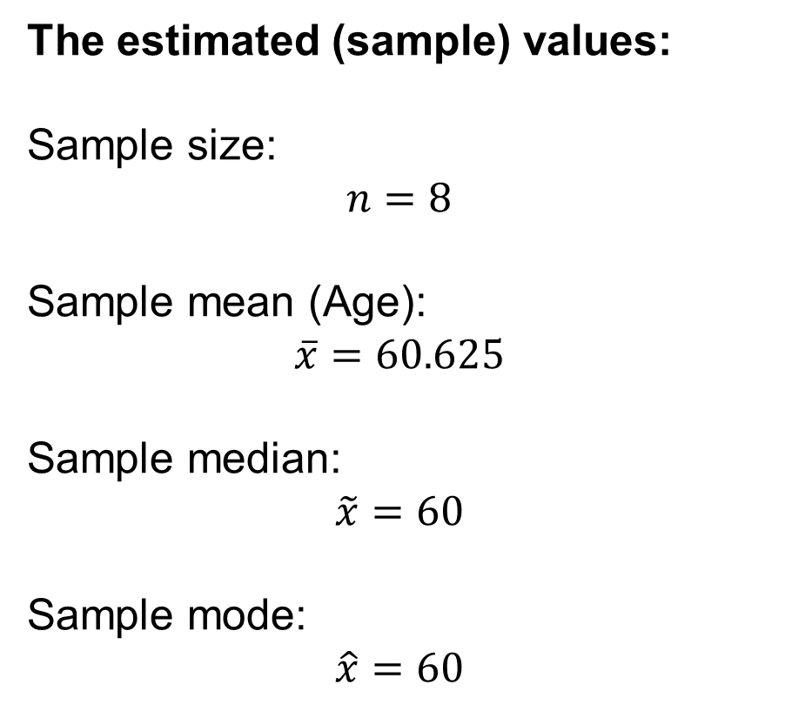
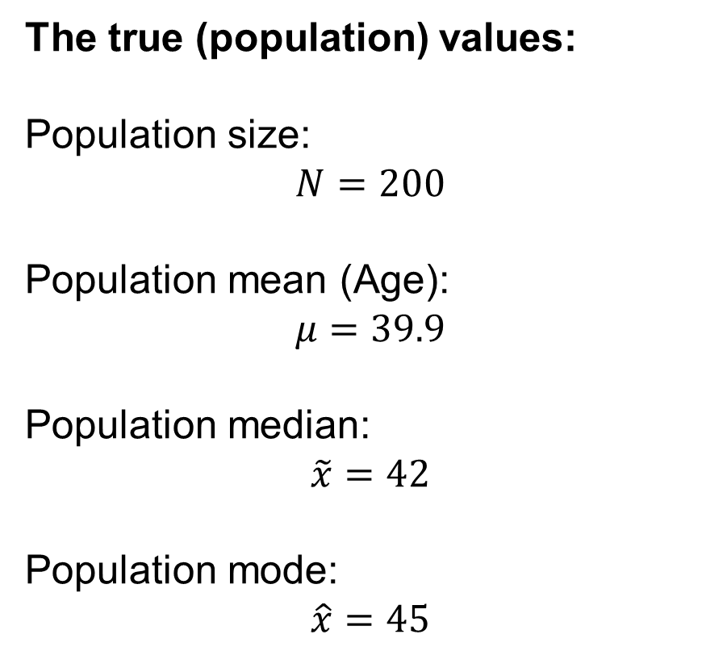
Example: Employees — data item “Age”
The true (population) values:
Population size:
$$N=200$$
Population mean (Age):
$$μ=39.9$$
Population median:
$$\tilde{x}=42$$
Population mode:
$$\hat{x}=45$$
The estimated (sample) values:
Sample size:
$$n=8$$
Sample mean (Age):
$$\overline{x}=60.625$$
Sample median:
$$\tilde{x}=60$$
Sample mode:
$$\hat{x}=60$$

Slide 26
Measures of variability
Range
Variance (dispersion)
Coefficient of variation

Slide 27
Measures of variability
Assume that a variable (data item) is numerical, i.e. quantitative, discrete or continuous. We then consider several measures of variability of the variable:
— Range
— Variance (dispersion)
— Coefficient of variation

Slide 28

Range
Population range:
$$R=\max_{i=1,…,N}{x_{i}} −\min_{i=1,…,N}{x_{i}}$$
Sample range:
$$R=\max_{i=1,…,n}{x_{i}} −\min_{i=1,…,n}{x_{i}}$$

Slide 29

Variance (dispersion)
Population variance:
$$σ^{2}=\frac{1}{N}\sum_{i=1}^{N}{{\left(x_{i}−μ\right)}^{2}}$$
Sample variance:
$$s^{2}=\frac{1}{n−1}\sum_{i=1}^{n}{{\left(x_{i}−\overline{x}\right)}^{2}}$$

Slide 30
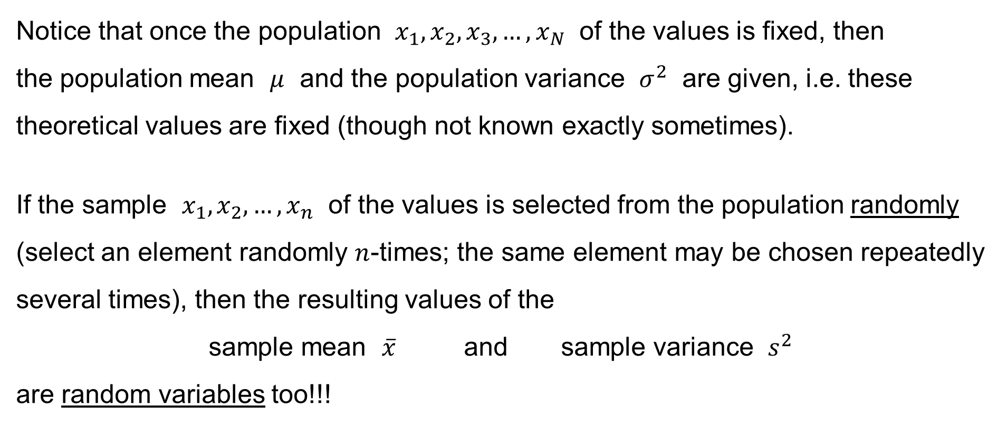
Variance (dispersion)
Notice that once the population $x_{1},x_{2},x_{3},…,x_{N}$ of the values is fixed, then
the population mean $μ$ and the population variance $σ^{2}$ are given, i.e. these theoretical values are fixed (though not known exactly sometimes).
If the sample $x_{1},x_{2},…,x_{n}$ of the values is selected from the population randomly (select an element randomly $n$-times; the same element may be chosen repeatedly several times), then the resulting values of the
sample mean $\overline{x}$ and sample variance $s^{2}$
are random variables too!!!

Slide 31

Variance (dispersion)
Calculating
— the expected value $E\overline{x}$ of the sample mean and
— the expected value $Es^{2}$ of the sample variance,
we obtain that
$$E\overline{x}=μ \text{and} Es^{2}=σ^{2}$$

Slide 32
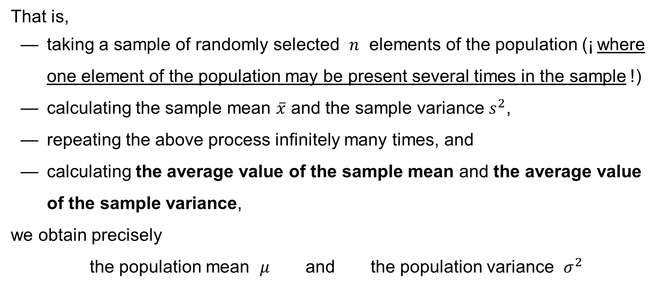
Variance (dispersion)
That is,
— taking a sample of randomly selected $n$ elements of the population (¡ where one element of the population may be present several times in the sample !)
— calculating the sample mean $\overline{x}$ and the sample variance $s^{2}$,
— repeating the above process infinitely many times, and
— calculating the average value of the sample mean and the average value of the sample variance,
we obtain precisely
the population mean $μ$ and the population variance $σ^{2}$

Slide 33
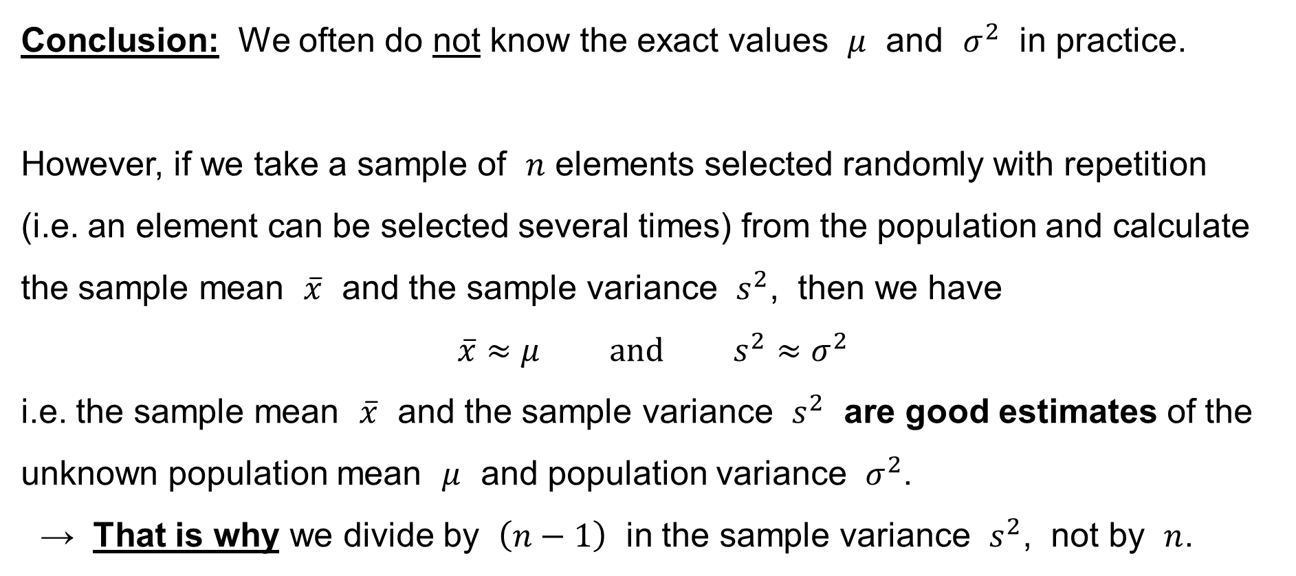
Variance (dispersion)
Conclusion: We often do not know the exact values $μ$ and $σ^{2}$ in practice.
However, if we take a sample of $n$ elements selected randomly with repetition
(i.e. an element can be selected several times) from the population and calculate
the sample mean $\overline{x}$ and the sample variance $s^{2}$, then we have
$$\overline{x}≈μ \text{and} s^{2}≈σ^{2}$$
i.e. the sample mean $\overline{x}$ and the sample variance $s^{2}$ are good estimates of the unknown population mean $μ$ and population variance $σ^{2}$.
→ That is why we divide by $\left(n−1\right)$ in the sample variance $s^{2}$, not by $n$.

Slide 34

Standard deviation
Population standard deviation:
$$σ=\sqrt{σ^{2}}=\sqrt{\frac{1}{N}\sum_{i=1}^{N}{{\left(x_{i}−μ\right)}^{2}} }$$
Sample standard deviation:
$$s=\sqrt{s^{2}}=\sqrt{\frac{1}{n−1}\sum_{i=1}^{n}{{\left(x_{i}−\overline{x}\right)}^{2}} }$$

Slide 35
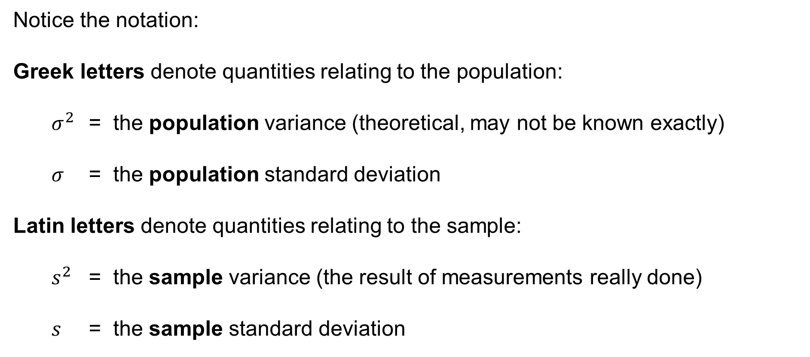
Variance (dispersion) & Standard deviation
Notice the notation:
Greek letters denote quantities relating to the population:
$σ^{2}$ = the population variance (theoretical, may not be known exactly)
$σ$ = the population standard deviation
Latin letters denote quantities relating to the sample:
$s^{2}$ = the sample variance (the result of measurements really done)
$s$ = the sample standard deviation

Slide 36
Sample Variance / Standard deviation
In Excel, use the functions:
=VARA() to calculate the sample variance
=STDEVA() to calculate the sample standard deviation
=VAR.S() to calculate the sample variance (skipping text values)
=VAR() to calculate the sample variance (skipping text values)
(the same as =VAR.S(), deprecated)

Slide 37
Population Variance / Standard deviation
In Excel, use the functions:
=VARPA() to calculate the population variance
=STDEVPA() to calculate the population standard deviation
=VAR.P() to calculate the population variance
(skipping text values)

Slide 38

Coefficient of variation
Coefficient of variation:
$$V=\frac{σ}{\left|μ\right|}$$
Sample coefficient of variation:
$$v=\frac{s}{\left|\overline{x}\right|}$$

Slide 39

Example
The prices of two stocks (ORCO and UNIPE) during a period of time:
The average price of both stocks
is the same:
${\overline{x}}_{UNIPE}={\overline{x}}_{ORCO}=135.7$
135.7

Slide 40

Example
We have
$${\overline{x}}_{UNIPE}=135.7 \text{and} s_{UNIPE}=2.09$$
hence
$$v_{UNIPE}=\frac{s_{UNIPE}}{\left|{\overline{x}}_{UNIPE}\right|}=\frac{2.09}{135.7}=0.0154$$
We have
$${\overline{x}}_{ORCO}=135.7 \text{and} s_{ORCO}=3.72$$
hence
$$v_{ORCO}=\frac{s_{ORCO}}{\left|{\overline{x}}_{ORCO}\right|}=\frac{3.72}{135.7}=0.0274$$

Slide 41
Measures of data concentration
Skewness
Kurtosis

Slide 42
Measures of data concentration
Assume that a variable (data item) is numerical, i.e. quantitative, discrete or continuous. We then consider several measures of data concentration of the variable:
— Skewness
— Kurtosis

Slide 43
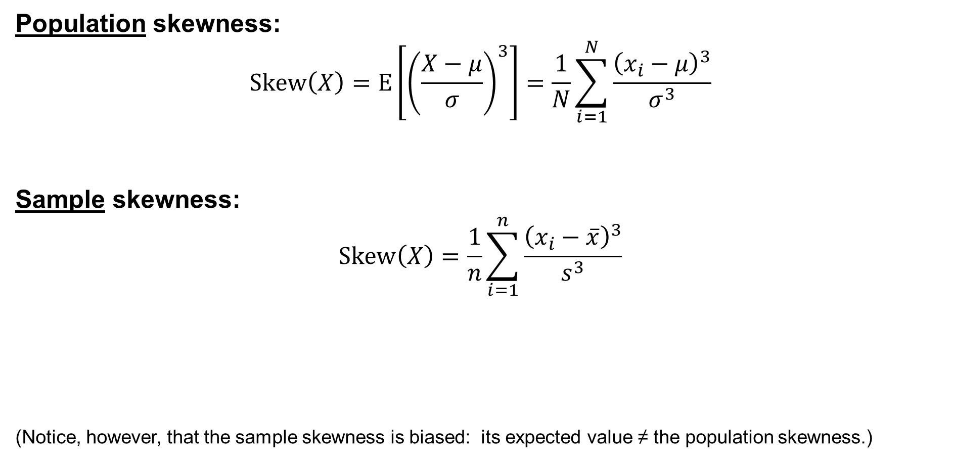
Skewness: Pearson’s moment coefficient of skewness
Population skewness:
$$\text{Skew}\left(X\right)=E\left[{\left(\frac{X−μ}{σ}\right)}^{3}\right]=\frac{1}{N}\sum_{i=1}^{N}{\frac{{\left(x_{i}−μ\right)}^{3}}{σ^{3}}}$$
Sample skewness:
$$\text{Sk}\text{e}\text{w}\left(X\right)=\frac{1}{n}\sum_{i=1}^{n}{\frac{{\left(x_{i}−\overline{x}\right)}^{3}}{s^{3}}}$$
(Notice, however, that the sample skewness is biased: its expected value ≠ the population skewness.)

Slide 44
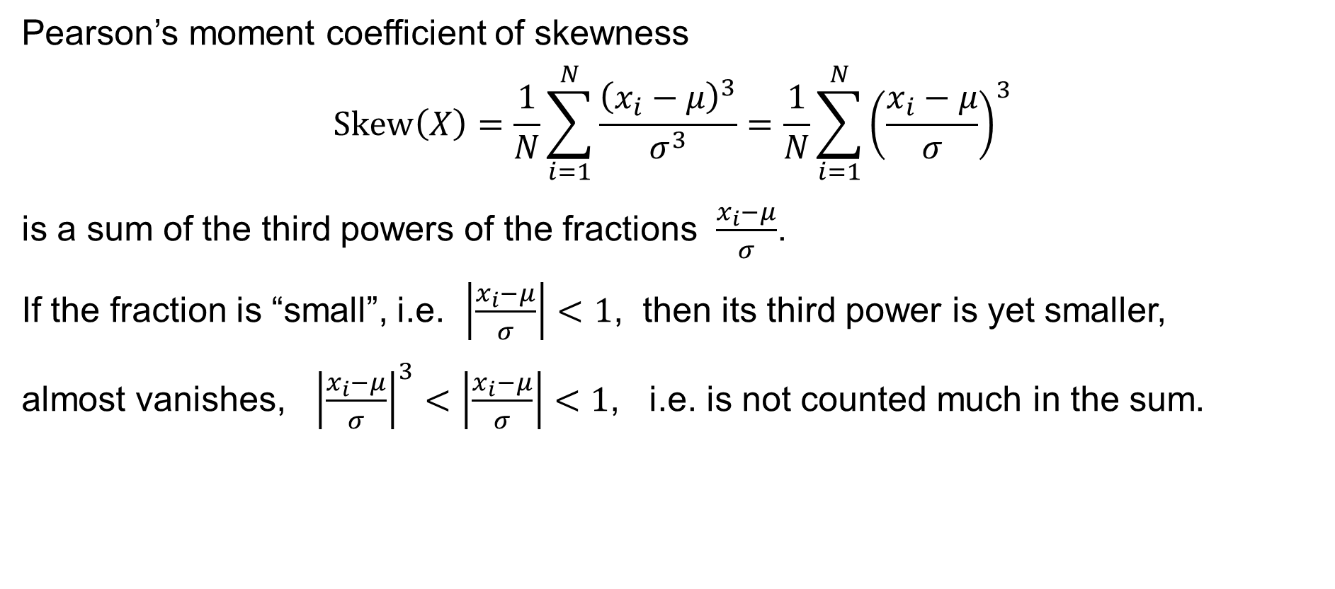
Skewness: Properties and interpretation
Pearson’s moment coefficient of skewness
$$\text{Skew}\left(X\right)=\frac{1}{N}\sum_{i=1}^{N}{\frac{{\left(x_{i}−μ\right)}^{3}}{σ^{3}}}=\frac{1}{N}\sum_{i=1}^{N}{{\left(\frac{x_{i}−μ}{σ}\right)}^{3}}$$
is a sum of the third powers of the fractions $\frac{x_{i}−μ}{σ}$.
If the fraction is “small”, i.e. $\left|\frac{x_{i}−μ}{σ}\right|<1$, then its third power is yet smaller,
almost vanishes, ${\left|\frac{x_{i}−μ}{σ}\right|}^{3}<\left|\frac{x_{i}−μ}{σ}\right|<1$, i.e. is not counted much in the sum.

Slide 45
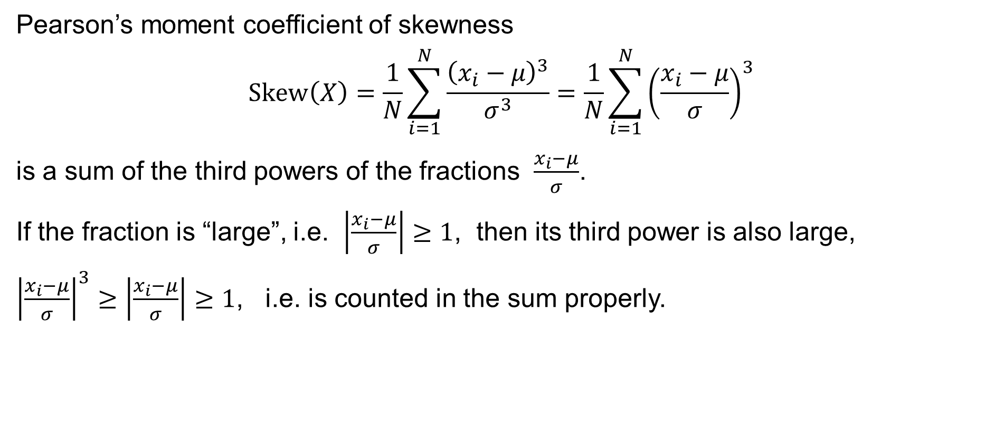
Skewness: Properties and interpretation
Pearson’s moment coefficient of skewness
$$\text{Skew}\left(X\right)=\frac{1}{N}\sum_{i=1}^{N}{\frac{{\left(x_{i}−μ\right)}^{3}}{σ^{3}}}=\frac{1}{N}\sum_{i=1}^{N}{{\left(\frac{x_{i}−μ}{σ}\right)}^{3}}$$
is a sum of the third powers of the fractions $\frac{x_{i}−μ}{σ}$.
If the fraction is “large”, i.e. $\left|\frac{x_{i}−μ}{σ}\right|≥1$, then its third power is also large,
${\left|\frac{x_{i}−μ}{σ}\right|}^{3}≥\left|\frac{x_{i}−μ}{σ}\right|≥1$, i.e. is counted in the sum properly.

Slide 46
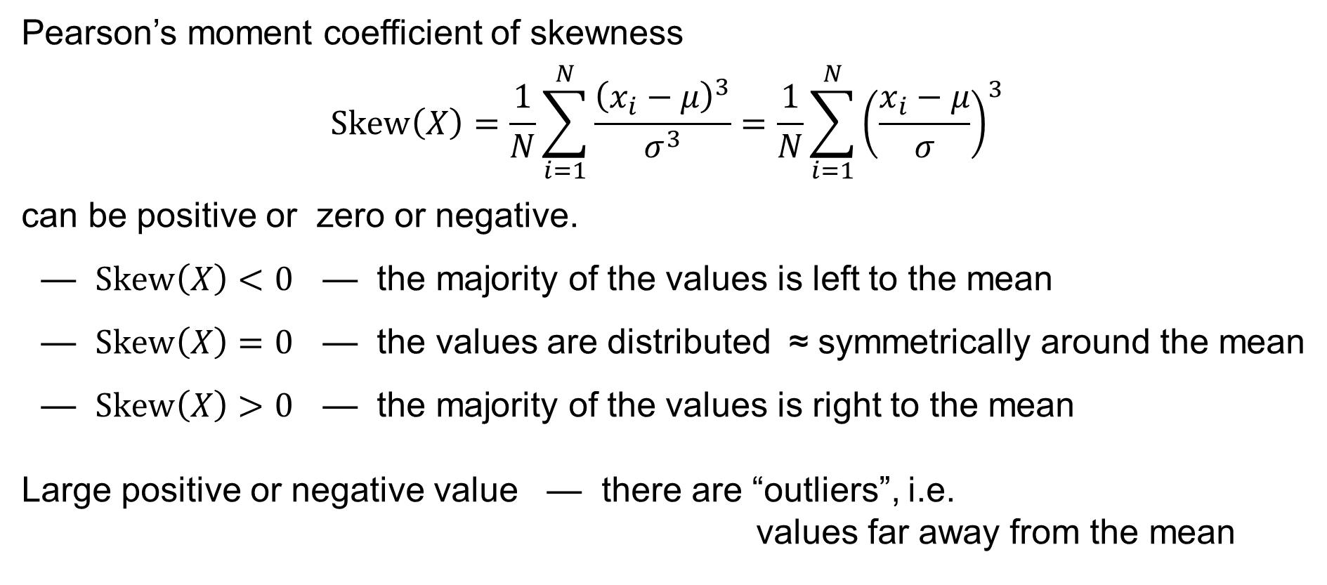
Skewness: Properties and interpretation
Pearson’s moment coefficient of skewness
$$\text{Skew}\left(X\right)=\frac{1}{N}\sum_{i=1}^{N}{\frac{{\left(x_{i}−μ\right)}^{3}}{σ^{3}}}=\frac{1}{N}\sum_{i=1}^{N}{{\left(\frac{x_{i}−μ}{σ}\right)}^{3}}$$
can be positive or zero or negative.
— $Skew\left(X\right)<0$ — the majority of the values is left to the mean
— $Skew\left(X\right)=0$ — the values are distributed ≈ symmetrically around the mean
— $Skew\left(X\right)>0$ — the majority of the values is right to the mean
Large positive or negative value — there are “outliers”, i.e.
values far away from the mean

Slide 47
Skewness in Excel
In Excel, use the functions:
=SKEW.P() to calculate the population skewness
=SKEW() to calculate the sample skewness

Slide 48
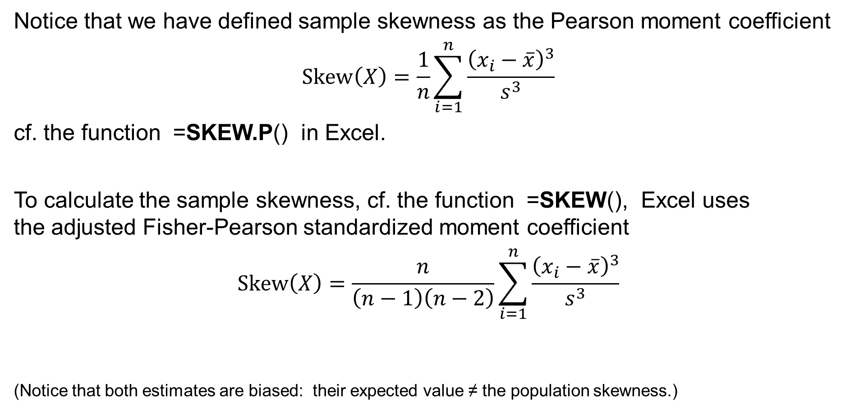
Skewness in Excel
Notice that we have defined sample skewness as the Pearson moment coefficient
$$\text{Skew}\left(X\right)=\frac{1}{n}\sum_{i=1}^{n}{\frac{{\left(x_{i}−\overline{x}\right)}^{3}}{s^{3}}}$$
cf. the function =SKEW.P() in Excel.
To calculate the sample skewness, cf. the function =SKEW(), Excel uses
the adjusted Fisher-Pearson standardized moment coefficient
$$\text{Skew}\left(X\right)=\frac{n}{\left(n−1\right)\left(n−2\right)}\sum_{i=1}^{n}{\frac{{\left(x_{i}−\overline{x}\right)}^{3}}{s^{3}}}$$
(Notice that both estimates are biased: their expected value ≠ the population skewness.)

Slide 49

Kurtosis: Pearson’s moment coefficient of kurtosis
Population kurtosis:
$$\text{Kurt}\left(X\right)=E\left[{\left(\frac{X−μ}{σ}\right)}^{4}\right]=\frac{1}{N}\sum_{i=1}^{N}{\frac{{\left(x_{i}−μ\right)}^{4}}{σ^{4}}}$$
Sample kurtosis:
$$\text{Kurt}\left(X\right)=\frac{1}{n}\sum_{i=1}^{n}{\frac{{\left(x_{i}−\overline{x}\right)}^{4}}{s^{4}}}$$

Slide 50
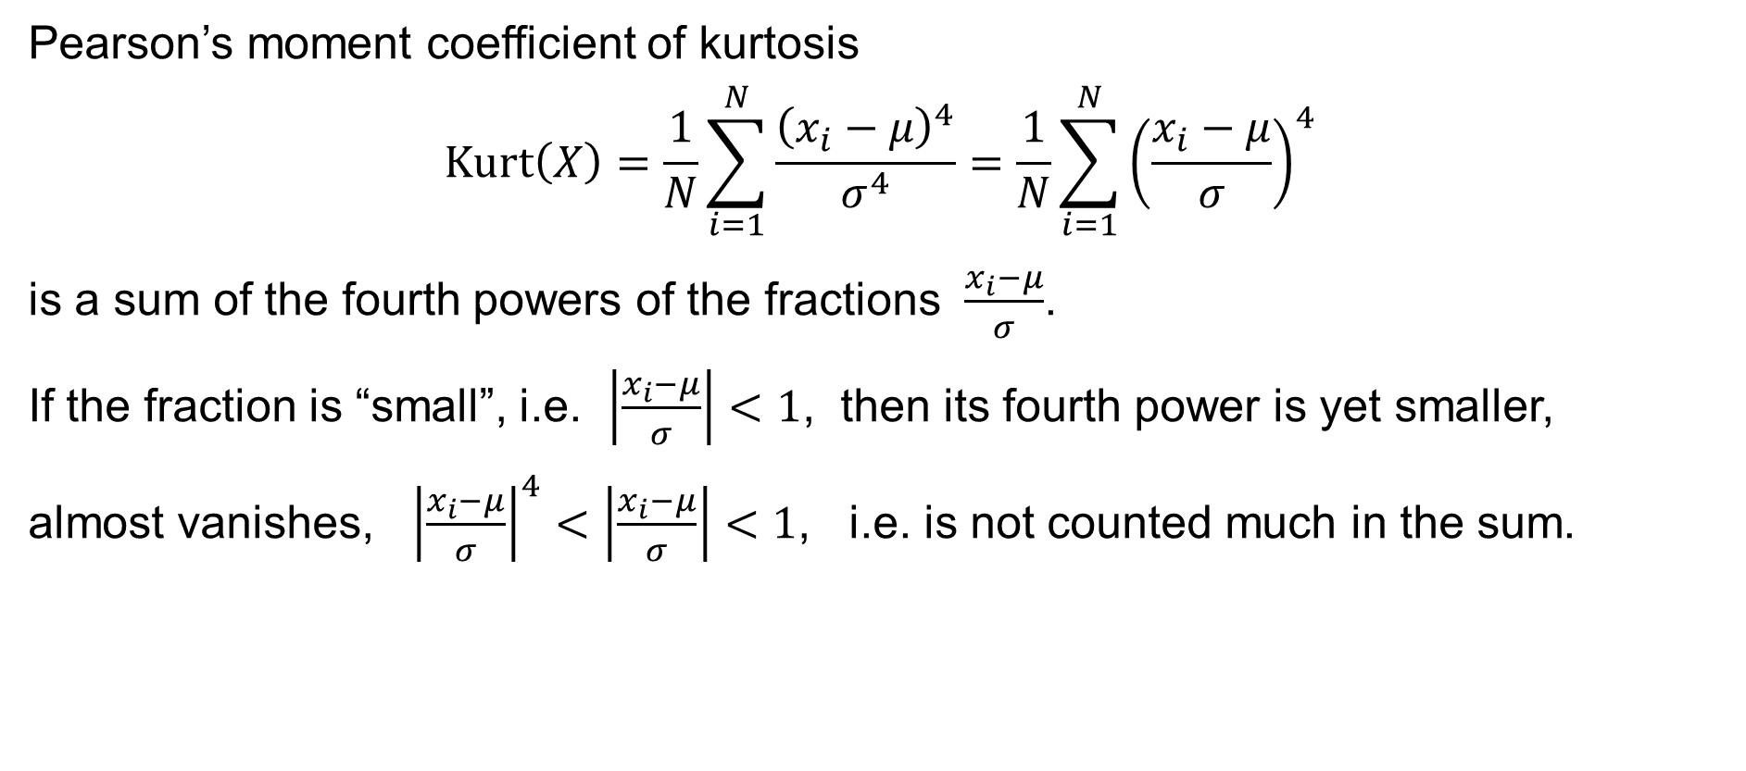
Kurtosis: Properties and interpretation
Pearson’s moment coefficient of kurtosis
$$\text{Kurt}\left(X\right)=\frac{1}{N}\sum_{i=1}^{N}{\frac{{\left(x_{i}−μ\right)}^{4}}{σ^{4}}}=\frac{1}{N}\sum_{i=1}^{N}{{\left(\frac{x_{i}−μ}{σ}\right)}^{4}}$$
is a sum of the fourth powers of the fractions $\frac{x_{i}−μ}{σ}$.
If the fraction is “small”, i.e. $\left|\frac{x_{i}−μ}{σ}\right|<1$, then its fourth power is yet smaller,
almost vanishes, ${\left|\frac{x_{i}−μ}{σ}\right|}^{4}<\left|\frac{x_{i}−μ}{σ}\right|<1$, i.e. is not counted much in the sum.

Slide 51
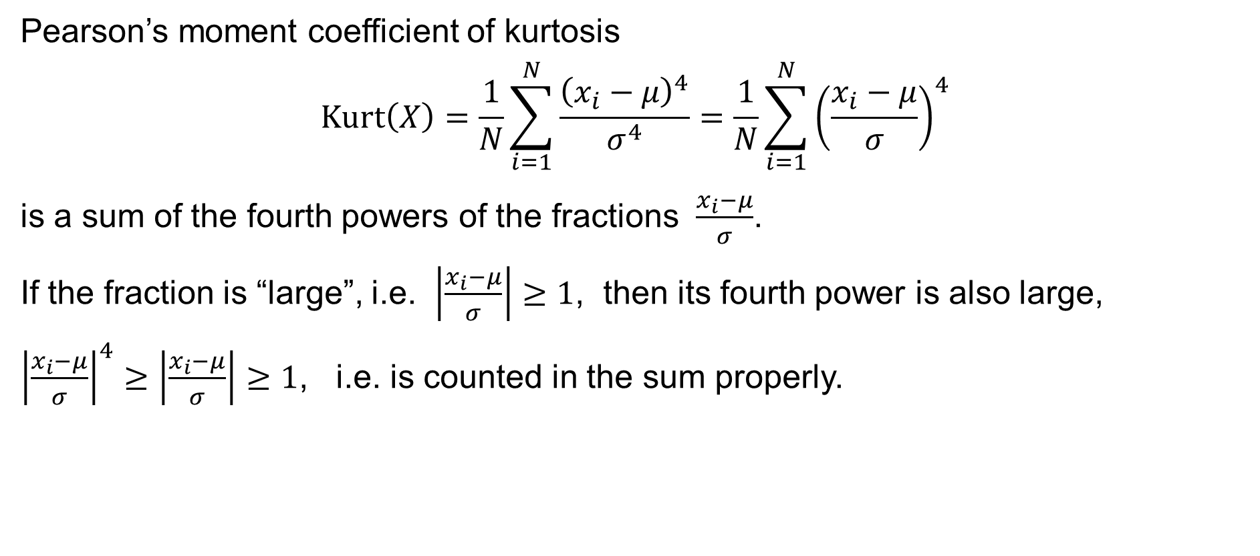
Kurtosis: Properties and interpretation
Pearson’s moment coefficient of kurtosis
$$\text{Kurt}\left(X\right)=\frac{1}{N}\sum_{i=1}^{N}{\frac{{\left(x_{i}−μ\right)}^{4}}{σ^{4}}}=\frac{1}{N}\sum_{i=1}^{N}{{\left(\frac{x_{i}−μ}{σ}\right)}^{4}}$$
is a sum of the fourth powers of the fractions $\frac{x_{i}−μ}{σ}$.
If the fraction is “large”, i.e. $\left|\frac{x_{i}−μ}{σ}\right|≥1$, then its fourth power is also large,
${\left|\frac{x_{i}−μ}{σ}\right|}^{4}≥\left|\frac{x_{i}−μ}{σ}\right|≥1$, i.e. is counted in the sum properly.

Slide 52
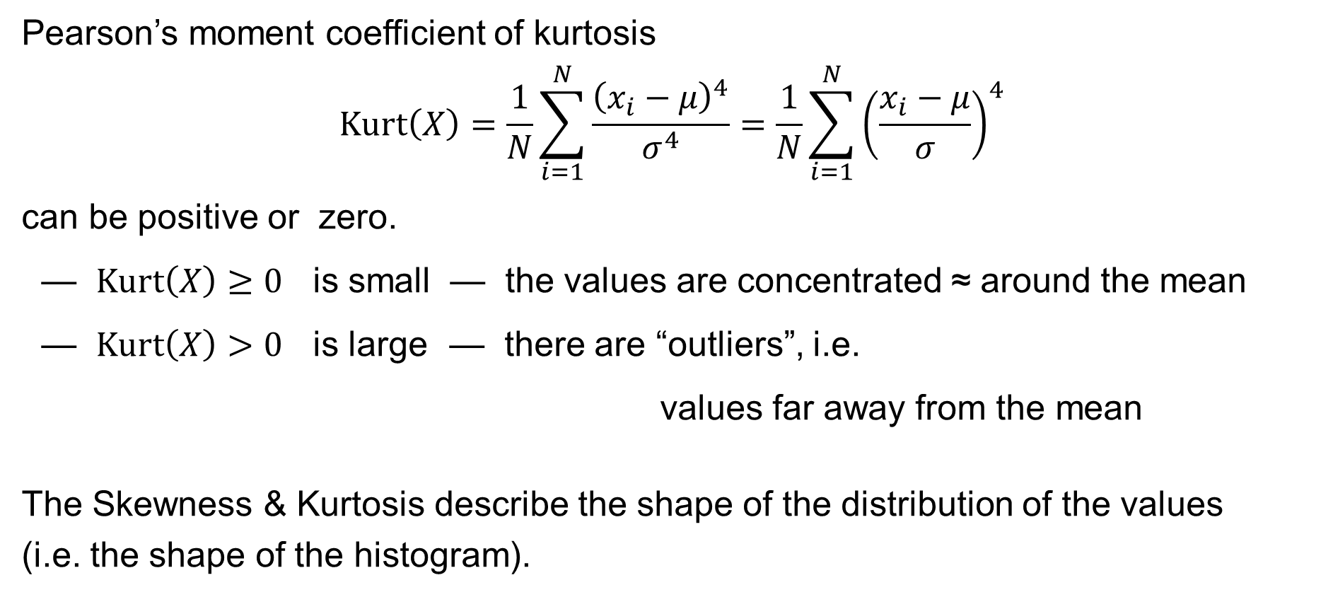
Kurtosis: Properties and interpretation
Pearson’s moment coefficient of kurtosis
$$\text{Kurt}\left(X\right)=\frac{1}{N}\sum_{i=1}^{N}{\frac{{\left(x_{i}−μ\right)}^{4}}{σ^{4}}}=\frac{1}{N}\sum_{i=1}^{N}{{\left(\frac{x_{i}−μ}{σ}\right)}^{4}}$$
can be positive or zero.
— $Kurt\left(X\right)≥0$ is small — the values are concentrated ≈ around the mean
— $Kurt\left(X\right)>0$ is large — there are “outliers”, i.e.
values far away from the mean
The Skewness & Kurtosis describe the shape of the distribution of the values
(i.e. the shape of the histogram).

Slide 53
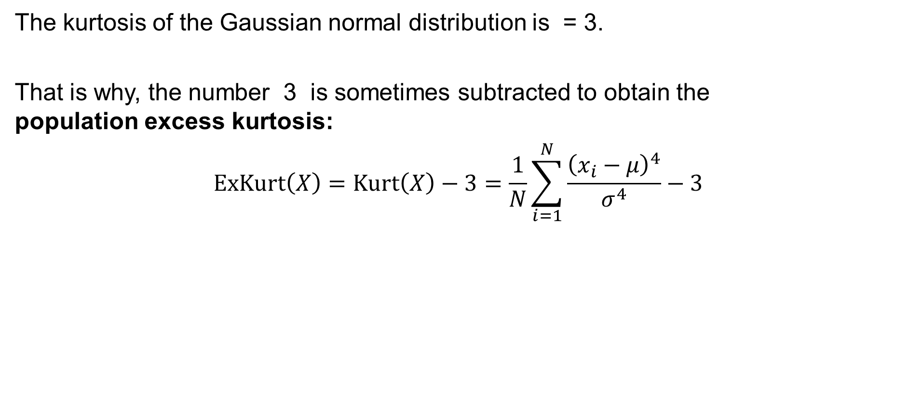
Excess kurtosis
The kurtosis of the Gaussian normal distribution is = 3.
That is why, the number 3 is sometimes subtracted to obtain the
population excess kurtosis:
$$\text{ExKurt}\left(X\right)=\text{Kurt}\left(X\right)−3=\frac{1}{N}\sum_{i=1}^{N}{\frac{{\left(x_{i}−μ\right)}^{4}}{σ^{4}}}−3$$

Slide 54
Kurtosis in Excel
In Excel, use the function:
=KURT() to calculate the sample excess kurtosis

Slide 55
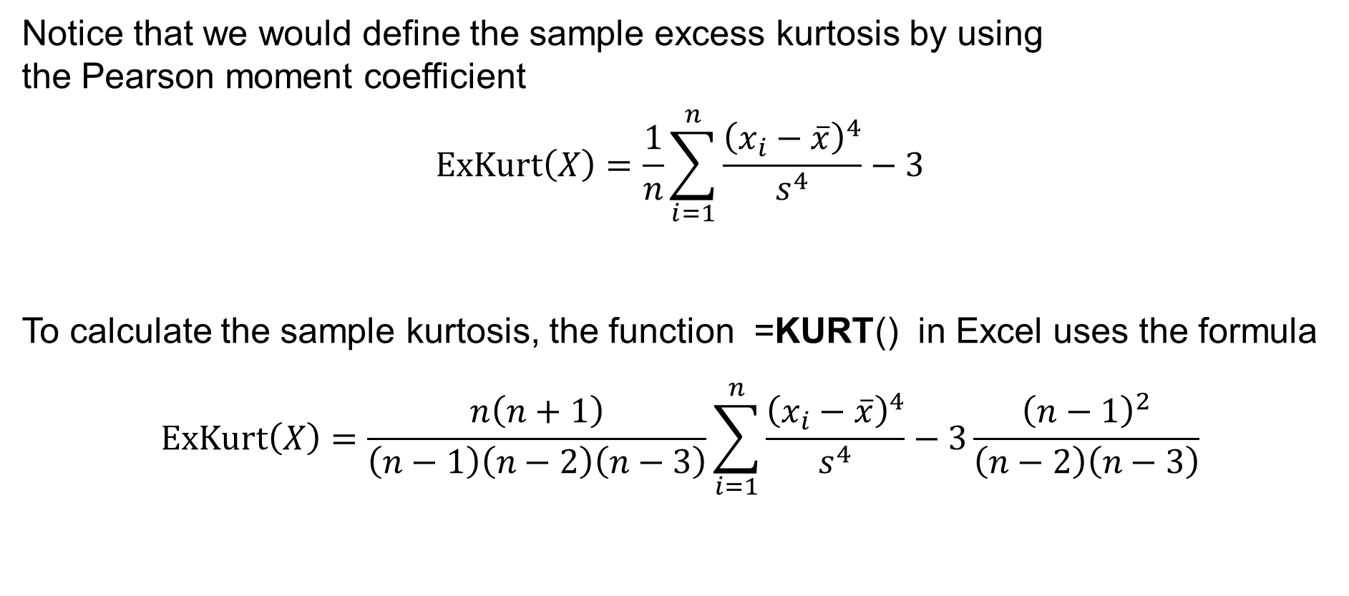
Kurtosis in Excel
Notice that we would define the sample excess kurtosis by using
the Pearson moment coefficient
$$\text{ExKurt}\left(X\right)=\frac{1}{n}\sum_{i=1}^{n}{\frac{{\left(x_{i}−\overline{x}\right)}^{4}}{s^{4}}}−3$$
To calculate the sample kurtosis, the function =KURT() in Excel uses the formula
$$\text{ExKurt}\left(X\right)=\frac{n\left(n+1\right)}{\left(n−1\right)\left(n−2\right)\left(n−3\right)}\sum_{i=1}^{n}{\frac{{\left(x_{i}−\overline{x}\right)}^{4}}{s^{4}}}−3\frac{{\left(n−1\right)}^{2}}{\left(n−2\right)\left(n−3\right)}$$

Slide 56
Moment characteristics
Raw moments
Central moments
Standardized moments

Slide 57

The moments
Given the population
$$x_{1},x_{2},…,x_{N}∈ℝ$$
we distinguish three types of moments:
— raw moment or central moment $μ_{k}^{′}$
— central moment $μ_{k}$
— standardized moment ${\tilde{μ}}_{k}$
for $k=1, 2, 3,…$

Slide 58
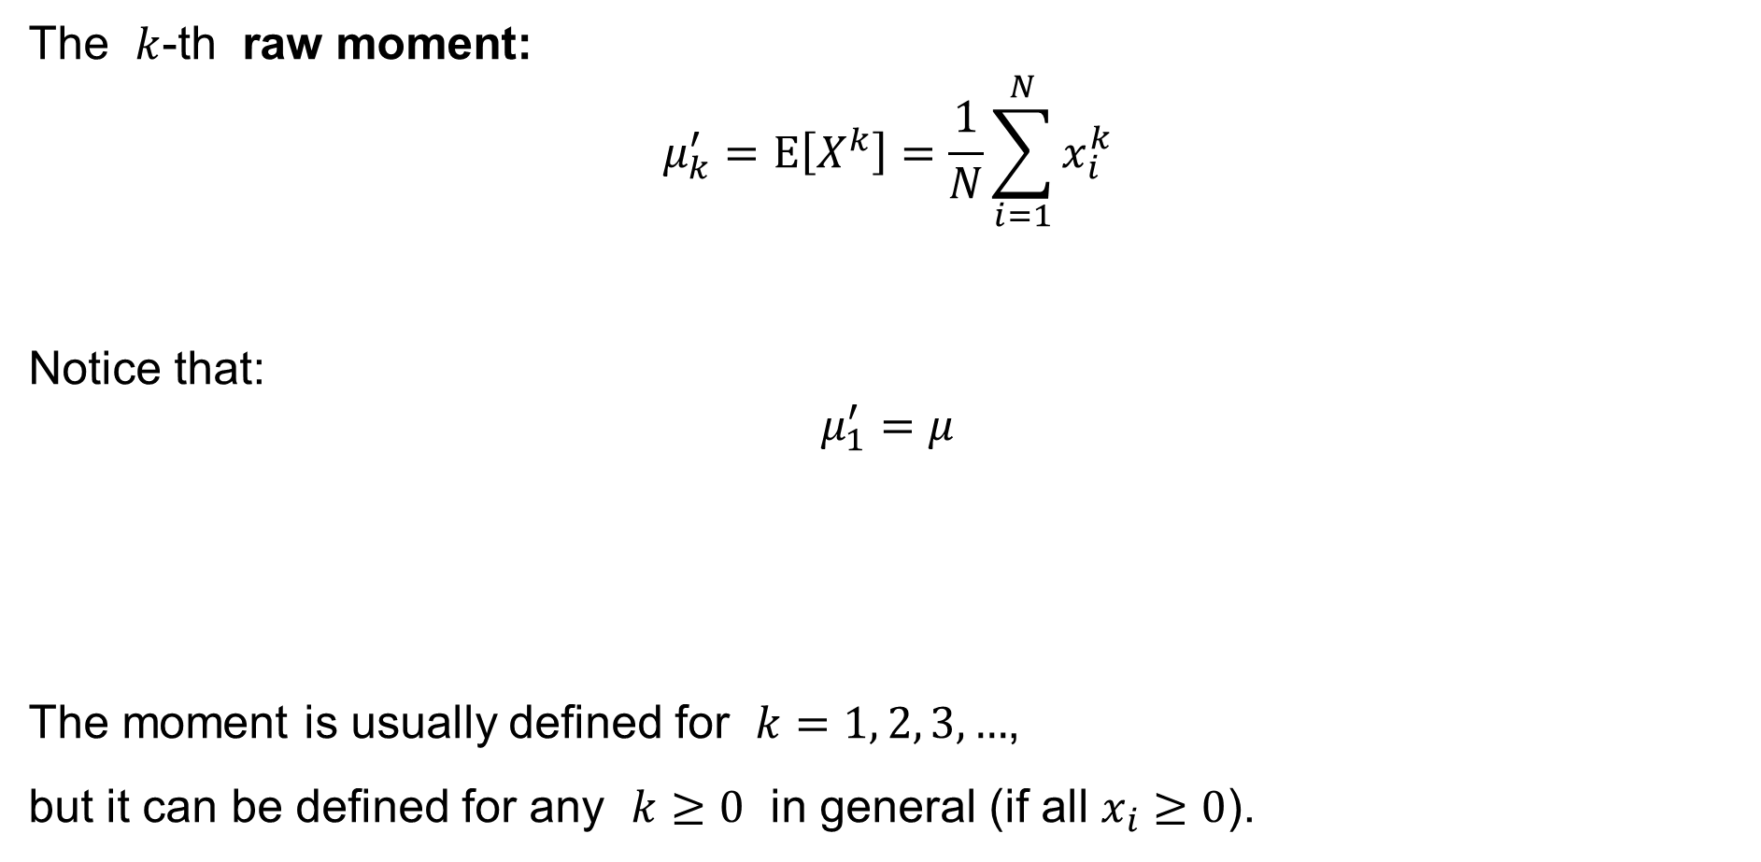
Raw moment
The $k$-th raw moment:
$$μ_{k}^{′}=E\left[X^{k}\right]=\frac{1}{N}\sum_{i=1}^{N}{x_{i}^{k}}$$
Notice that:
$$μ_{1}^{′}=μ$$
The moment is usually defined for $k=1, 2, 3,…$,
but it can be defined for any $k≥0$ in general (if all $x_{i}≥0$).

Slide 59

Central moment
The $k$-th central moment:
$$μ_{k}=E\left[{\left(X−μ\right)}^{k}\right]=\frac{1}{N}\sum_{i=1}^{N}{{\left(x_{i}−μ\right)}^{k}}$$
Notice that:
$$μ_{2}=σ^{2}$$
This moment is defined for $k=1, 2, 3,…$

Slide 60
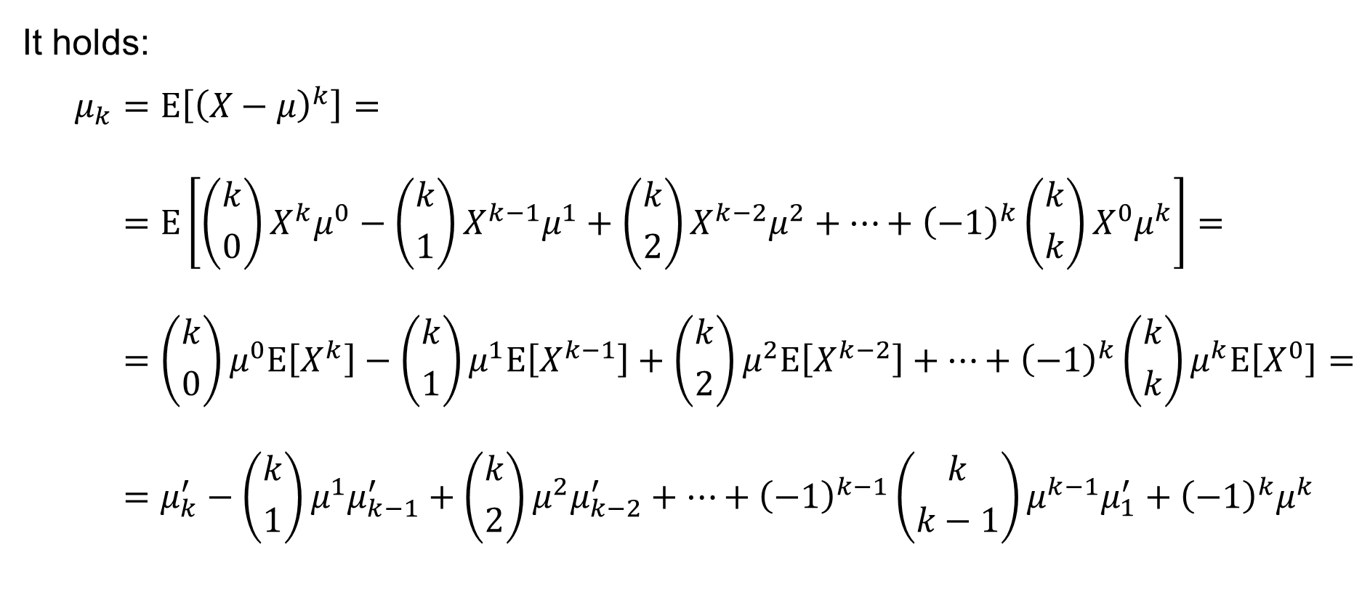
Central moment and raw moments
It holds:
$$μ_{k}=E\left[{\left(X−μ\right)}^{k}\right]= \\ =E\left[\left({k \atop 0}\right)X^{k}μ^{0}−\left({k \atop 1}\right)X^{k−1}μ^{1}+\left({k \atop 2}\right)X^{k−2}μ^{2}+⋯+{\left(−1\right)}^{k}\left({k \atop k}\right)X^{0}μ^{k}\right]= \\ =\left({k \atop 0}\right)μ^{0}E\left[X^{k}\right]−\left({k \atop 1}\right)μ^{1}E\left[X^{k−1}\right]+\left({k \atop 2}\right)μ^{2}E\left[X^{k−2}\right]+⋯+{\left(−1\right)}^{k}\left({k \atop k}\right)μ^{k}E\left[X^{0}\right]= \\ =μ_{k}^{′}−\left({k \atop 1}\right)μ^{1}μ_{k−1}^{′}+\left({k \atop 2}\right)μ^{2}μ_{k−2}^{′}+⋯+{\left(−1\right)}^{k−1}\left({k \atop k−1}\right)μ^{k−1}μ_{1}^{′}+{\left(−1\right)}^{k}μ^{k}$$

Slide 61

Central moment
The $k$-th standardized moment:
$${\tilde{μ}}_{k}=E\left[{\left(\frac{X−μ}{σ}\right)}^{k}\right]=\frac{1}{N}\sum_{i=1}^{N}{{\left(\frac{x_{i}−μ}{σ}\right)}^{k}}$$
Notice that:
$${\tilde{μ}}_{3}=Skew\left(X\right) \\ {\tilde{μ}}_{4}=Kurt\left(X\right)$$
This moment is defined for $k=1, 2, 3,…$

Slide 62
Two statistical variables
Two populations
Contingency table
Covariance
Correlation coefficient

Slide 63
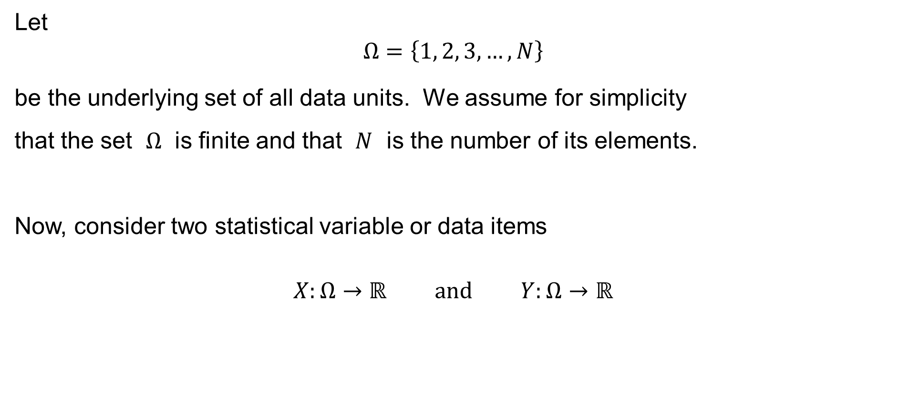
Two populations
Let
$$Ω=\left\{1, 2, 3,…,N\right\}$$
be the underlying set of all data units. We assume for simplicity
that the set $Ω$ is finite and that $N$ is the number of its elements.
Now, consider two statistical variable or data items
$$X:Ω→ℝ \text{and} Y:Ω→ℝ$$

Slide 64
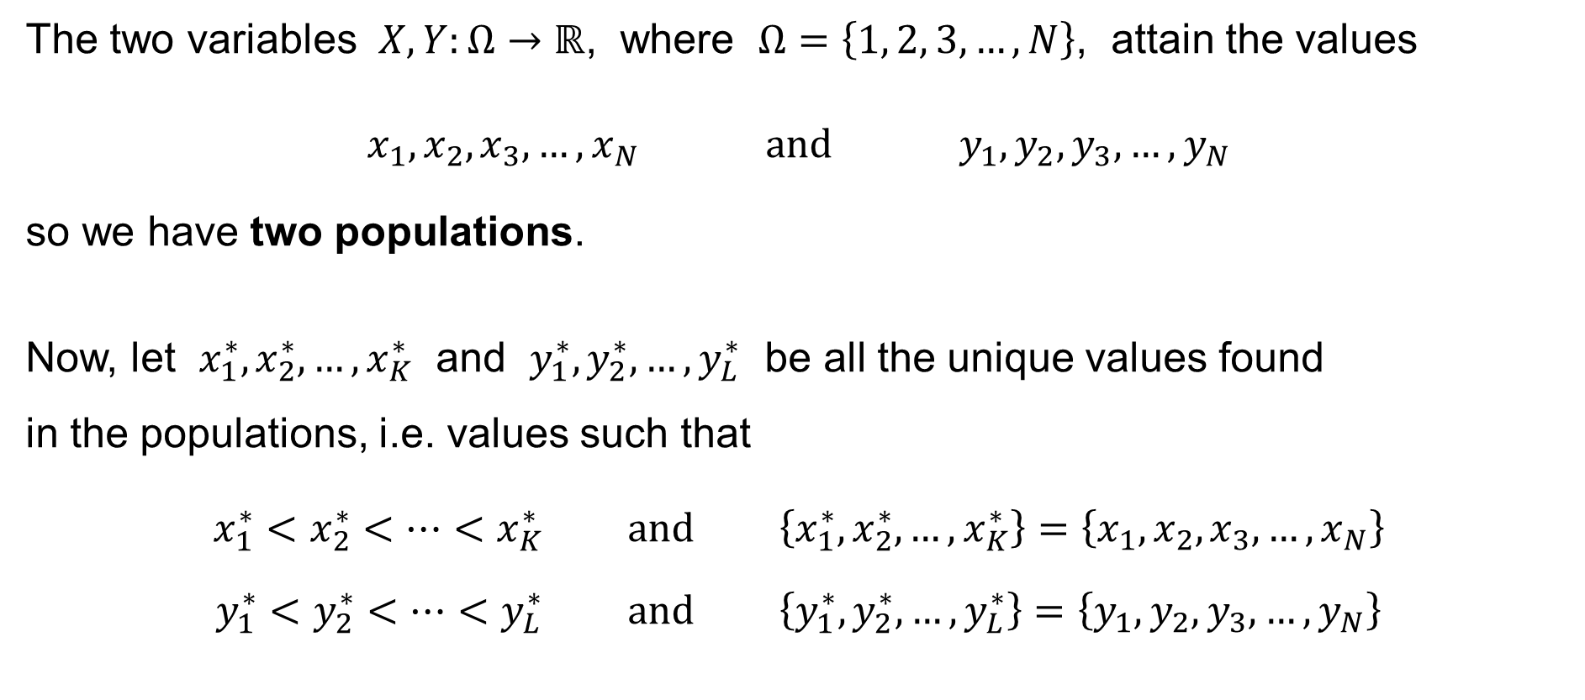
Two populations
The two variables $X,Y:Ω→ℝ$, where $Ω=\left\{1, 2, 3,…,N\right\}$, attain the values
$$x_{1},x_{2},x_{3},…,x_{N} \text{and} y_{1},y_{2},y_{3},…,y_{N}$$
so we have two populations.
Now, let $x_{1}^{∗},x_{2}^{∗},…,x_{K}^{∗}$ and $y_{1}^{∗},y_{2}^{∗},…,y_{L}^{∗}$ be all the unique values found
in the populations, i.e. values such that
$$x_{1}^{∗}<x_{2}^{∗}<⋯<x_{K}^{∗} \text{and} \left\{x_{1}^{∗},x_{2}^{∗},…,x_{K}^{∗}\right\}=\left\{x_{1},x_{2},x_{3},…,x_{N}\right\}$$
$$y_{1}^{∗}<y_{2}^{∗}<⋯<y_{L}^{∗} \text{and} \left\{y_{1}^{∗},y_{2}^{∗},…,y_{L}^{∗}\right\}=\left\{y_{1},y_{2},y_{3},…,y_{N}\right\}$$

Slide 65

Two populations: Joint frequencies
For $i=1, 2,…,K$ and for $j=1, 2,…,L$, let
$$f_{ij}=\left|\left\{ \left(ω^{′},ω^{′′}\right)∈Ω×Ω :\left(x_{ω^{′}},y_{ω^{′′}}\right)=\left(x_{i}^{∗},y_{j}^{∗}\right) \right\}\right|$$
be the joint frequency of the pair $\left(x_{i}^{∗},y_{j}^{∗}\right)$ in the population of the unique pairs.

Slide 66
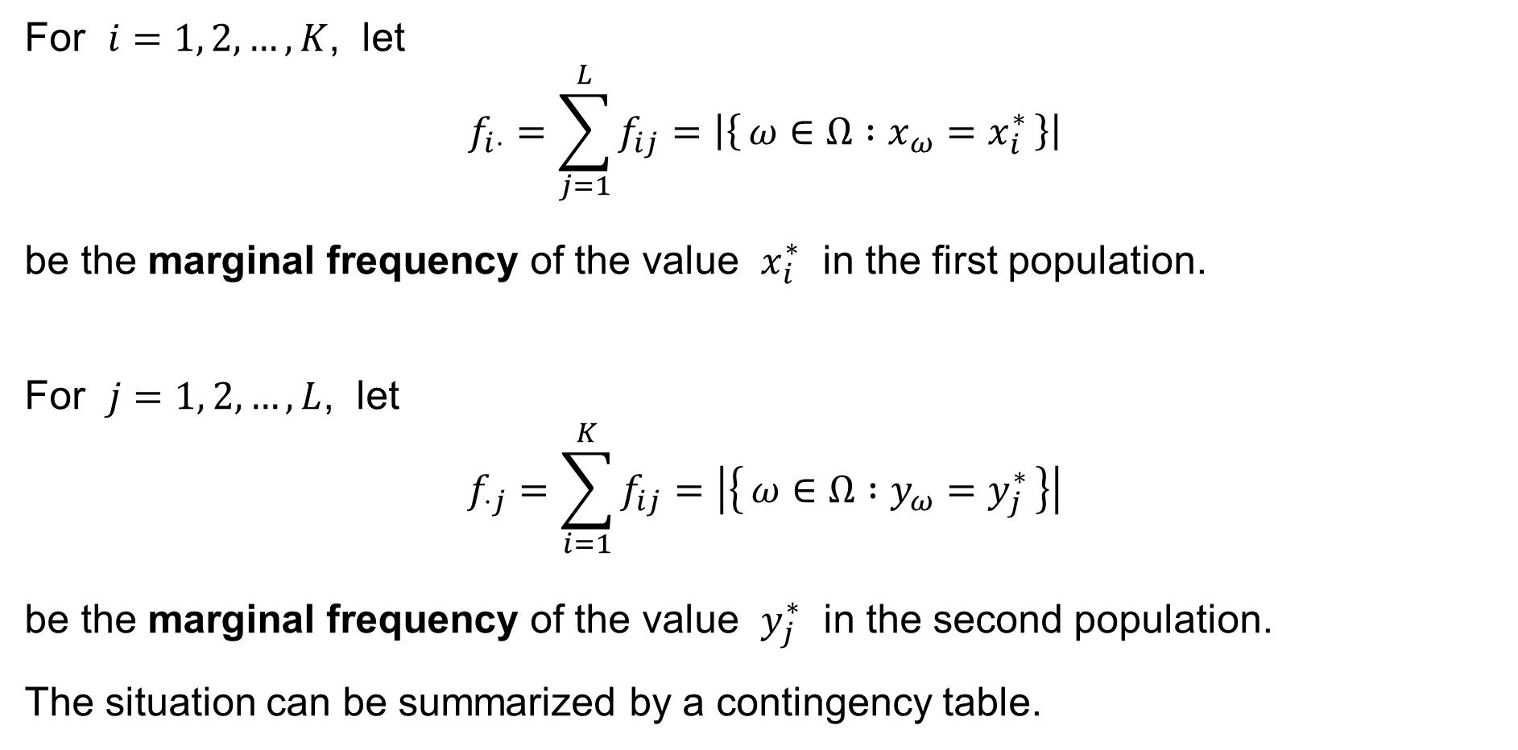
Two populations: Marginal frequencies
For $i=1, 2,…,K$, let
$$f_{i⋅}=\sum_{j=1}^{L}{f_{ij}}=\left|\left\{ ω∈Ω :x_{ω}=x_{i}^{∗} \right\}\right|$$
be the marginal frequency of the value $x_{i}^{∗}$ in the first population.
For $j=1, 2,…,L$, let
$$f_{⋅j}=\sum_{i=1}^{K}{f_{ij}}=\left|\left\{ ω∈Ω :y_{ω}=y_{j}^{∗} \right\}\right|$$
be the marginal frequency of the value $y_{j}^{∗}$ in the second population.
The situation can be summarized by a contingency table.

Slide 67
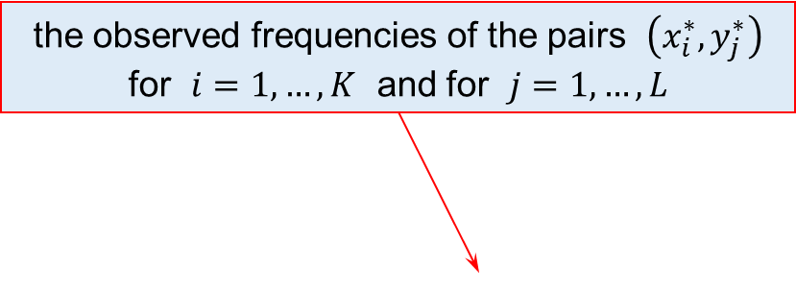
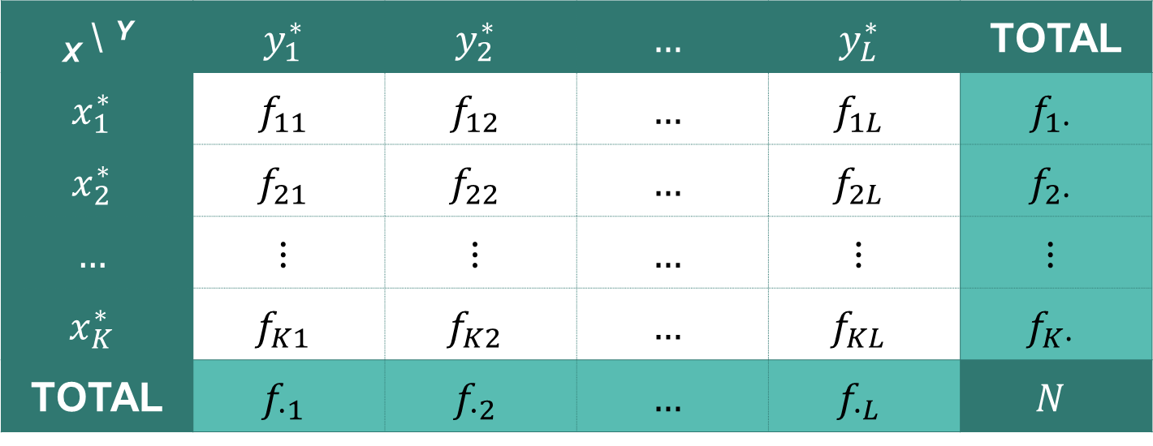
Contingency table — for the population
the observed frequencies of the pairs $\left(x_{i}^{∗},y_{j}^{∗}\right)$
for $i=1,…,K$ and for $j=1,…,L$
_{X} \ ^{Y} | $$y_{1}^{∗}$$ | $$y_{2}^{∗}$$ | $$…$$ | $$y_{L}^{∗}$$ | TOTAL
$$x_{1}^{∗}$$ | $$f_{11}$$ | $$f_{12}$$ | $$…$$ | $$f_{1L}$$ | $$f_{1∙}$$
$$x_{2}^{∗}$$ | $$f_{21}$$ | $$f_{22}$$ | $$…$$ | $$f_{2L}$$ | $$f_{2∙}$$
$$…$$ | $$⋮$$ | $$⋮$$ | $$…$$ | $$⋮$$ | $$⋮$$
$$x_{K}^{∗}$$ | $$f_{K1}$$ | $$f_{K2}$$ | $$…$$ | $$f_{KL}$$ | $$f_{K∙}$$
TOTAL | $$f_{∙1}$$ | $$f_{∙2}$$ | $$…$$ | $$f_{∙L}$$ | $$N$$
marginal
frequencies
marginal frequencies
the population size

Slide 68
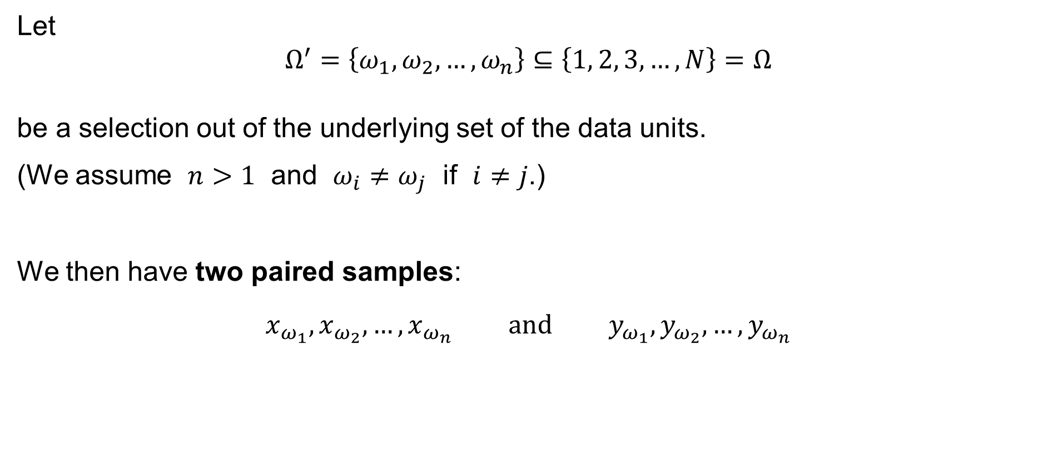
Two samples
Let
$$Ω^{′}=\left\{ω_{1},ω_{2},…,ω_{n}\right\}⊆\left\{1, 2, 3,…,N\right\}=Ω$$
be a selection out of the underlying set of the data units.
(We assume $n>1$ and $ω_{i}≠ω_{j}$ if $i≠j$.)
We then have two paired samples:
$$x_{ω_{1}},x_{ω_{2}},…,x_{ω_{n}} \text{and} y_{ω_{1}},y_{ω_{2}},…,y_{ω_{n}}$$

Slide 69
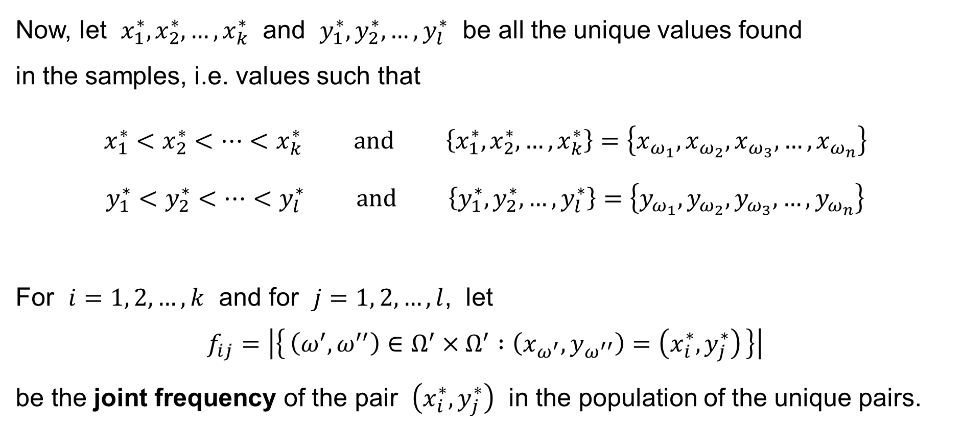
Two samples: Joint frequencies
Now, let $x_{1}^{∗},x_{2}^{∗},…,x_{k}^{∗}$ and $y_{1}^{∗},y_{2}^{∗},…,y_{l}^{∗}$ be all the unique values found
in the samples, i.e. values such that
$$x_{1}^{∗}<x_{2}^{∗}<⋯<x_{k}^{∗} \text{and} \left\{x_{1}^{∗},x_{2}^{∗},…,x_{k}^{∗}\right\}=\left\{x_{ω_{1}},x_{ω_{2}},x_{ω_{3}},…,x_{ω_{n}}\right\}$$
$$y_{1}^{∗}<y_{2}^{∗}<⋯<y_{l}^{∗} \text{and} \left\{y_{1}^{∗},y_{2}^{∗},…,y_{l}^{∗}\right\}=\left\{y_{ω_{1}},y_{ω_{2}},y_{ω_{3}},…,y_{ω_{n}}\right\}$$
For $i=1, 2,…,k$ and for $j=1, 2,…,l$, let
$$f_{ij}=\left|\left\{ \left(ω^{′},ω^{′′}\right)∈Ω^{′}×Ω^{′} :\left(x_{ω^{′}},y_{ω^{′′}}\right)=\left(x_{i}^{∗},y_{j}^{∗}\right) \right\}\right|$$
be the joint frequency of the pair $\left(x_{i}^{∗},y_{j}^{∗}\right)$ in the population of the unique pairs.

Slide 70
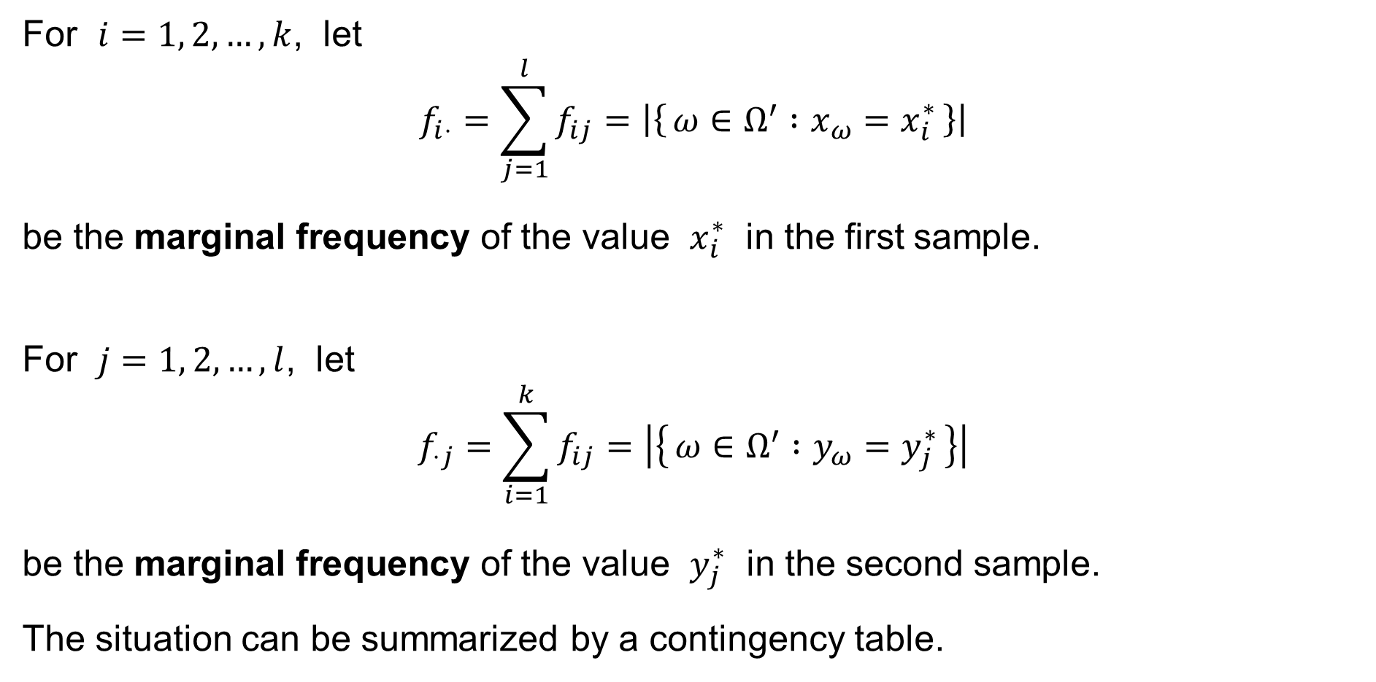
Two samples: Marginal frequencies
For $i=1, 2,…,k$, let
$$f_{i⋅}=\sum_{j=1}^{l}{f_{ij}}=\left|\left\{ ω∈Ω^{′} :x_{ω}=x_{i}^{∗} \right\}\right|$$
be the marginal frequency of the value $x_{i}^{∗}$ in the first sample.
For $j=1, 2,…,l$, let
$$f_{⋅j}=\sum_{i=1}^{k}{f_{ij}}=\left|\left\{ ω∈Ω^{′} :y_{ω}=y_{j}^{∗} \right\}\right|$$
be the marginal frequency of the value $y_{j}^{∗}$ in the second sample.
The situation can be summarized by a contingency table.

Slide 71
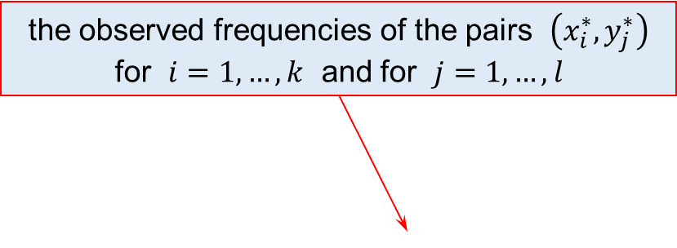

Contingency table — for the sample
the observed frequencies of the pairs $\left(x_{i}^{∗},y_{j}^{∗}\right)$
for $i=1,…,k$ and for $j=1,…,l$
_{X} \ ^{Y} | $$y_{1}^{∗}$$ | $$y_{2}^{∗}$$ | $$…$$ | $$y_{l}^{∗}$$ | TOTAL
$$x_{1}^{∗}$$ | $$f_{11}$$ | $$f_{12}$$ | $$…$$ | $$f_{1l}$$ | $$f_{1∙}$$
$$x_{2}^{∗}$$ | $$f_{21}$$ | $$f_{22}$$ | $$…$$ | $$f_{2l}$$ | $$f_{2∙}$$
$$…$$ | $$⋮$$ | $$⋮$$ | $$…$$ | $$⋮$$ | $$⋮$$
$$x_{k}^{∗}$$ | $$f_{k1}$$ | $$f_{k2}$$ | $$…$$ | $$f_{kl}$$ | $$f_{k∙}$$
TOTAL | $$f_{∙1}$$ | $$f_{∙2}$$ | $$…$$ | $$f_{∙l}$$ | $$n$$
marginal
frequencies
marginal frequencies
the sample size

Slide 72
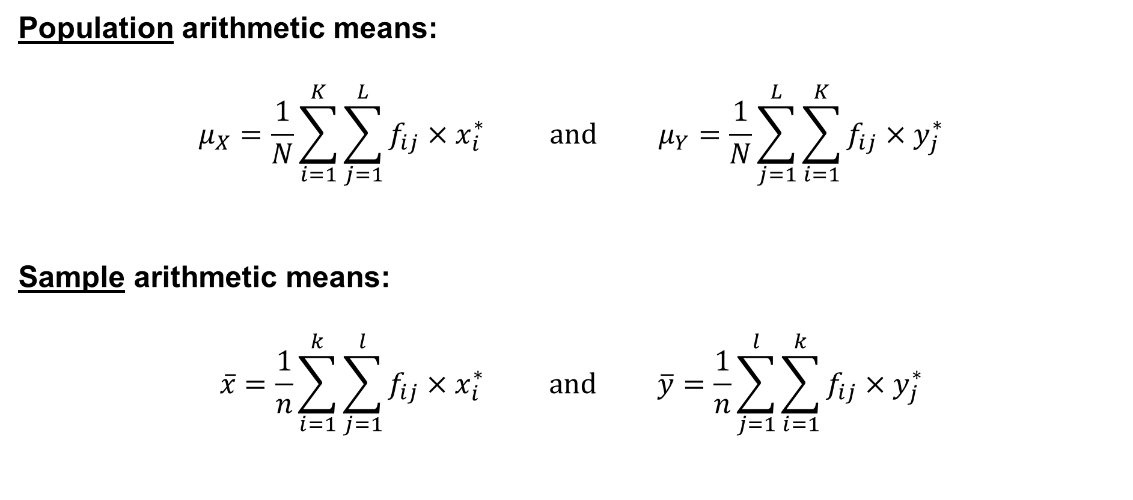
Arithmetic means
Population arithmetic means:
$$μ_{X}=\frac{1}{N}\sum_{i=1}^{K}{\sum_{j=1}^{L}{f_{ij}×x_{i}^{∗}}} \text{and} μ_{Y}=\frac{1}{N}\sum_{j=1}^{L}{\sum_{i=1}^{K}{f_{ij}×y_{j}^{∗}}}$$
Sample arithmetic means:
$$\overline{x}=\frac{1}{n}\sum_{i=1}^{k}{\sum_{j=1}^{l}{f_{ij}×x_{i}^{∗}}} \text{and} \overline{y}=\frac{1}{n}\sum_{j=1}^{l}{\sum_{i=1}^{k}{f_{ij}×y_{j}^{∗}}}$$

Slide 73
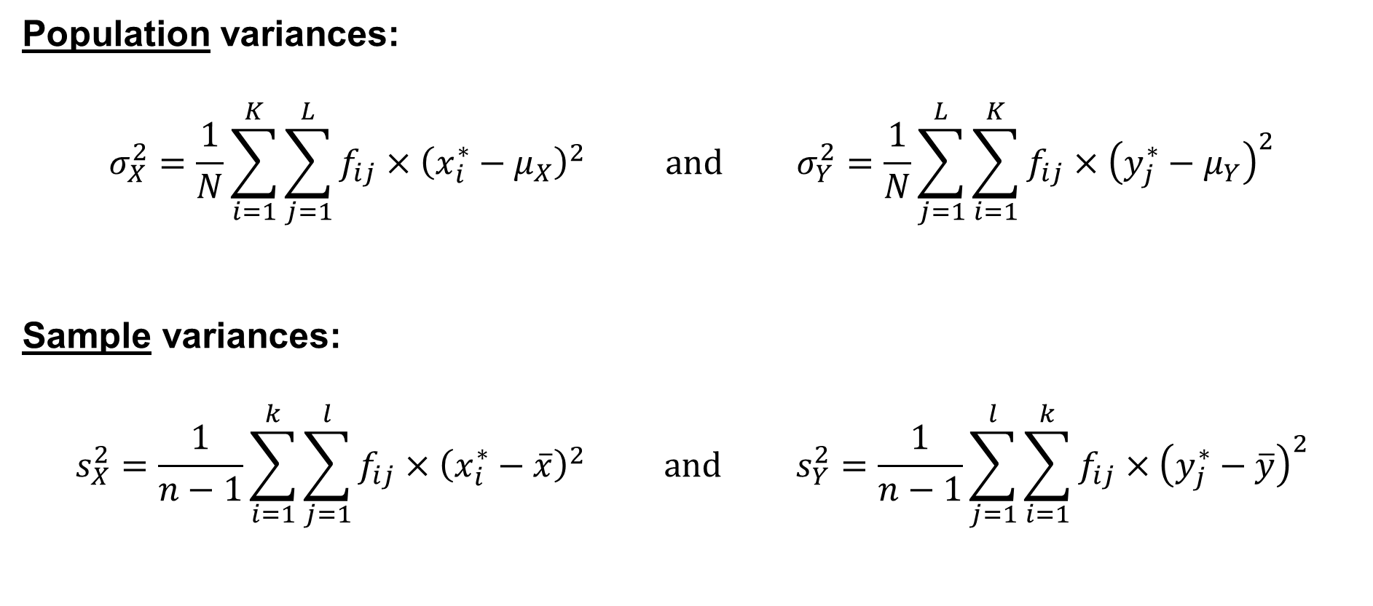
Variances
Population variances:
$$σ_{X}^{2}=\frac{1}{N}\sum_{i=1}^{K}{\sum_{j=1}^{L}{f_{ij}×{\left(x_{i}^{∗}−μ_{X}\right)}^{2}}} \text{and} σ_{Y}^{2}=\frac{1}{N}\sum_{j=1}^{L}{\sum_{i=1}^{K}{f_{ij}×{\left(y_{j}^{∗}−μ_{Y}\right)}^{2}}}$$
Sample variances:
$$s_{X}^{2}=\frac{1}{n−1}\sum_{i=1}^{k}{\sum_{j=1}^{l}{f_{ij}×{\left(x_{i}^{∗}−\overline{x}\right)}^{2}}} \text{and} s_{Y}^{2}=\frac{1}{n−1}\sum_{j=1}^{l}{\sum_{i=1}^{k}{f_{ij}×{\left(y_{j}^{∗}−\overline{y}\right)}^{2}}}$$

Slide 74

Covariance
Population co-variance:
$$cov\left(X,Y\right)=\frac{1}{N}\sum_{i=1}^{K}{\sum_{j=1}^{L}{f_{ij}×\left(x_{i}^{∗}−μ_{X}\right)\left(y_{j}^{∗}−μ_{Y}\right)}}$$
Sample co-variance:
$$c_{XY}=\frac{1}{n−1}\sum_{i=1}^{k}{\sum_{j=1}^{l}{f_{ij}×\left(x_{i}^{∗}−\overline{x}\right)\left(y_{j}^{∗}−\overline{y}\right)}}$$

Slide 75









Covariance
$$Y$$
$$\left[x_{2}^{∗},y_{2}^{∗}\right]$$
$$\left(x_{2}^{∗}−μ_{X}\right)\left(y_{2}^{∗}−μ_{Y}\right)$$
$$\left(x_{1}^{∗}−μ_{X}\right)\left(y_{1}^{∗}−μ_{Y}\right)$$
$$μ_{Y}$$
$$\left[x_{1}^{∗},y_{1}^{∗}\right]$$
$$0$$
$$μ_{X}$$
$$X$$

Slide 76

Pearson paired correlation coefficient
Population paired correlation coefficient:
$$ρ=\frac{cov\left(X,Y\right)}{σ_{X}σ_{Y}}=\frac{cov\left(X,Y\right)}{ \sqrt{Var\left(X\right)×Var\left(Y\right)} }$$
Sample paired correlation coefficient:
$$r=\frac{c_{XY}}{s_{X}s_{Y}}$$

Slide 77
The expected values of the functions of random variables
The expected value of the sample mean
Independent events
Independent random variables
The variance of the expected value
of the sample mean
The expected value
of the sample variance

Slide 78

The expected value of the sample mean
Assume that the expected values $E\left[X_{1}\right]=E\left[X_{2}\right]=…=E\left[X_{n}\right]=μ$.
Then
$$E\left[\overline{X}\right]=E\left[\frac{1}{n}\sum_{i=1}^{n}{X_{i}}\right]=\frac{1}{n}E\left[\sum_{i=1}^{n}{X_{i}}\right]=\frac{1}{n}\sum_{i=1}^{n}{E\left[X_{i}\right]}=\frac{1}{n}\sum_{i=1}^{n}{μ}=μ$$

Slide 79



Independent events
Let $\left(Ω,ℱ,P\right)$ be a probability space.
We say that events $A,B∈ℱ$ are independent if and only if
$$P\left(A∩B\right)=P\left(A\right)×P\left(B\right)$$
so that
$$P\left(A | B\right)=\frac{P\left(A∩B\right)}{P\left(B\right)}=\frac{P\left(A\right)P\left(B\right)}{P\left(B\right)}=P\left(A\right) \text{and} P\left(B | A\right)=\frac{P\left(A∩B\right)}{P\left(A\right)}=\frac{P\left(A\right)P\left(B\right)}{P\left(A\right)}=P\left(B\right)$$
$$P\left(B\right)≠0$$
$$P\left(A\right)≠0$$

Slide 80

Independent random variables
Let $\left(Ω,ℱ,P\right)$ be a probability space.
We say that random variables $X,Y:Ω→ℝ$ are independent if and only if
$$P\left(\left\{ ω∈Ω :X\left(ω\right)≤a \right\}∩\left\{ ω∈Ω :Y\left(ω\right)≤b \right\}\right)= \\ =P\left(\left\{ ω∈Ω :X\left(ω\right)≤a \right\}\right)×P\left(\left\{ ω∈Ω :Y\left(ω\right)≤b \right\}\right) \text{for} \text{every} a,b∈ℝ$$
in short:
$$P\left(\left\{X≤a\right\}∩\left\{Y≤b\right\}\right)=P\left(\left\{X≤a\right\}\right)×P\left(\left\{Y≤b\right\}\right) \text{for} \text{every} a,b∈ℝ$$

Slide 81

Independent random variables: Theorem
Let $\left(Ω,ℱ,P\right)$ be a probability space and let $X,Y:Ω→ℝ$ be independent
random variables such that the expected values $E\left[ \left|X\right| \right]$ and $E\left[ \left|Y\right| \right]$ are finite.
Then
$$E\left[X×Y\right]=E\left[X\right]×E\left[Y\right]$$
We prove this statement in the case I, when the sample space $Ω$ is finite
($Ω=\left\{1, 2,…,N\right\}$). The proof uses limiting steps and some advanced results
(Levi’s Theorem) of the theory of measures and the Lebesgue integral.

Slide 82

Independent random variables: E(XY) = E(X) E(Y)
Proof (in the case I): Let
$$\left\{x_{1},x_{2},…,x_{m}\right\}=\left\{ X\left(ω\right) :ω∈Ω \right\} \text{and} \left\{y_{1},y_{2},…,y_{n}\right\}=\left\{ Y\left(ω\right) :ω∈Ω \right\}$$
be the ranges of the random variables $X$ and $Y$, and let the ranges be finite.
(If the sample space $Ω$ is finite [the case I], then so are the ranges.) Then
$$E\left[X×Y\right]=\sum_{i=1}^{m}{\sum_{j=1}^{n}{x_{i}×y_{j}×P\left(\left\{X=x_{i}\right\}∩\left\{Y=y_{j}\right\}\right)}}$$

Slide 83

Independent random variables: E(XY) = E(X) E(Y)
$$E\left[X×Y\right]=\sum_{i=1}^{m}{\sum_{j=1}^{n}{x_{i}×y_{j}×P\left(\left\{X=x_{i}\right\}∩\left\{Y=y_{j}\right\}\right)}}= \\ =\sum_{i=1}^{m}{\sum_{j=1}^{n}{x_{i}×y_{j}×P\left(\left\{X=x_{i}\right\}\right)×P\left(\left\{Y=y_{j}\right\}\right)}}= \\ =\sum_{i=1}^{m}{x_{i}×P\left(\left\{X=x_{i}\right\}\right)}×\sum_{j=1}^{n}{y_{j}×P\left(\left\{Y=y_{j}\right\}\right)}=E\left[X\right]×E\left[Y\right]$$
(The proof is more elaborate in the general case.)

Slide 84

Independent random variables: Theorem II
Let $\left(Ω,ℱ,P\right)$ be a probability space and let $X^{′},X^{′′}:Ω→ℝ$ be independent
random variables such that the expected values $μ^{′}=E\left(\left|X^{′}\right|\right)$ and $μ^{′′}=E\left(\left|X^{′′}\right|\right)$ are finite. Then
$$E\left[\left(X^{′}−μ^{′}\right)\left(X^{′′}−μ^{′′}\right)\right]=0$$
Proof:
$$E\left[\left(X^{′}−μ^{′}\right)\left(X^{′′}−μ^{′′}\right)\right]=E\left[X^{′}X^{′′}−X^{′}μ^{′′}−μ^{′}X^{′′}+μ^{′}μ^{′′}\right]= \\ =E\left[X^{′}X^{′′}\right]−E\left[X^{′}μ^{′′}\right]−E \left[μ^{′}X^{′′}\right]+E\left[μ^{′}μ^{′′}\right]= \\ =E\left[X^{′}\right]E\left[X^{′′}\right]−E\left[X^{′}\right]μ^{′′}−μ^{′}E\left[X^{′′}\right]+μ^{′}μ^{′′}= \\ =μ^{′}μ^{′′}−μ^{′}μ^{′′}−μ^{′}μ^{′′}+μ^{′}μ^{′′}=0$$

Slide 85

The variance of the sample mean
Assume that the variances $Var\left(X_{1}\right)=Var\left(X_{2}\right)=…=Var\left(X_{n}\right)=σ^{2}$
and that the random variables $X_{1},X_{2},…,X_{n}$ are pairwise independent.
Then
$$Var\left[\overline{X}\right]=E\left[{\left(\overline{X}−E\left[\overline{X}\right]\right)}^{2}\right]=E\left[{\left(\frac{1}{n}\sum_{i=1}^{n}{X_{i}}−μ\right)}^{2}\right]=E\left[\frac{{\left(\sum_{i=1}^{n}{\left(X_{i}−μ\right)}\right)}^{2}}{n^{2}}\right] \\ =\frac{1}{n^{2}}E\left[\sum_{i=1}^{n}{{\left(X_{i}−μ\right)}^{2}}+\sum_{i=1}^{n}{\sum_{\begin{aligned}j=1 \\ i≠j\end{aligned}}^{n}{\left(X_{i}−μ\right)\left(X_{j}−μ\right)}}\right]=$$

Slide 86

The variance of the sample mean
$$Var\left[\overline{X}\right]=\frac{1}{n^{2}}E\left[\sum_{i=1}^{n}{{\left(X_{i}−μ\right)}^{2}}+\sum_{i=1}^{n}{\sum_{\begin{aligned}j=1 \\ i≠j\end{aligned}}^{n}{\left(X_{i}−μ\right)\left(X_{j}−μ\right)}}\right]= \\ =\frac{1}{n^{2}}\left(\sum_{i=1}^{n}{E\left[{\left(X_{i}−μ\right)}^{2}\right]}+\sum_{i=1}^{n}{\sum_{\begin{aligned}j=1 \\ i≠j\end{aligned}}^{n}{E\left[\left(X_{i}−μ\right)\left(X_{j}−μ\right)\right]}}\right)=$$

Slide 87

The variance of the sample mean
If $X_{i}$ and $X_{j}$ are independent, then $E\left[\left(X_{i}−μ\right)\left(X_{j}−μ\right)\right]=0$
$$Var\left[\overline{X}\right]=\frac{1}{n^{2}}\left(\sum_{i=1}^{n}{E\left[{\left(X_{i}−μ\right)}^{2}\right]}+\sum_{i=1}^{n}{\sum_{\begin{aligned}j=1 \\ i≠j\end{aligned}}^{n}{E\left[\left(X_{i}−μ\right)\left(X_{j}−μ\right)\right]}}\right)= \\ =\frac{1}{n^{2}}\left(\sum_{i=1}^{n}{E\left[{\left(X_{i}−μ\right)}^{2}\right]}\right)= \\ =\frac{1}{n^{2}}\sum_{i=1}^{n}{σ^{2}}=\frac{σ^{2}}{n}$$

Slide 88

The expected value of the sample variance
Assume that the expected values $E\left[X_{1}\right]=E\left[X_{2}\right]=…=E\left[X_{n}\right]=μ$,
that the variances $Var\left(X_{1}\right)=Var\left(X_{2}\right)=…=Var\left(X_{n}\right)=σ^{2}$,
and that the random variables $X_{1},X_{2},…,X_{n}$ are pairwise independent.
Then
$$E\left[S^{2}\right]=E\left[\frac{1}{n−1}\sum_{i=1}^{n}{{\left(X_{i}−\overline{X}\right)}^{2}}\right]=E\left[\frac{1}{n−1}\sum_{i=1}^{n}{{\left(X_{i}−\frac{1}{n}\sum_{j=1}^{n}{X_{j}}\right)}^{2}}\right]= \\ =\frac{1}{n−1}\sum_{i=1}^{n}{E\left[{\left(X_{i}−\frac{1}{n}\sum_{j=1}^{n}{X_{j}}\right)}^{2}\right]}=$$

Slide 89

The expected value of the sample variance
$$E\left[S^{2}\right]=\frac{1}{n−1}\sum_{i=1}^{n}{E\left[{\left(X_{i}−\frac{1}{n}\sum_{j=1}^{n}{X_{j}}\right)}^{2}\right]}= \\ =\frac{1}{n−1}\sum_{i=1}^{n}{E\left[X_{i}^{2}−\frac{2}{n}X_{i}\sum_{j=1}^{n}{X_{j}}+\frac{1}{n^{2}}\sum_{j=1}^{n}{X_{j}}\sum_{k=1}^{n}{X_{k}}\right]}= \\ =\frac{1}{n−1}\sum_{i=1}^{n}{E\left[X_{i}^{2}−\frac{2}{n}X_{i}^{2}−\frac{2}{n}\sum_{\begin{aligned}j=1 \\ i≠j\end{aligned}}^{n}{X_{i}X_{j}}+\frac{1}{n^{2}}\sum_{j=1}^{n}{\sum_{\begin{aligned}k=1 \\ j≠k\end{aligned}}^{n}{X_{j}X_{k}}}+\frac{1}{n^{2}}\sum_{j=1}^{n}{X_{j}^{2}}\right]}=$$

Slide 90


The expected value of the sample variance
$$=\frac{1}{n−1}\sum_{i=1}^{n}{E\left[X_{i}^{2}−\frac{2}{n}X_{i}^{2}−\frac{2}{n}\sum_{\begin{aligned}j=1 \\ i≠j\end{aligned}}^{n}{X_{i}X_{j}}+\frac{1}{n^{2}}\sum_{j=1}^{n}{\sum_{\begin{aligned}k=1 \\ j≠k\end{aligned}}^{n}{X_{j}X_{k}}}+\frac{1}{n^{2}}\sum_{j=1}^{n}{X_{j}^{2}}\right]}= \\ =\frac{1}{n−1}\sum_{i=1}^{n}{\left(\frac{n−2}{n}E\left[X_{i}^{2}\right]−\frac{2}{n}\sum_{\begin{aligned}j=1 \\ i≠j\end{aligned}}^{n}{E\left[X_{i}X_{j}\right]}+\frac{1}{n^{2}}\sum_{j=1}^{n}{\sum_{\begin{aligned}k=1 \\ j≠k\end{aligned}}^{n}{E\left[X_{j}X_{k}\right]}}+\frac{1}{n^{2}}\sum_{j=1}^{n}{E\left[X_{j}^{2}\right]}\right)}=$$
$$E\left[S^{2}\right]$$

Slide 91


The expected value of the sample variance
Recall that $E\left[X_{1}\right]=…=E\left[X_{n}\right]=μ$ and $Var\left(X_{1}\right)=…=Var\left(X_{n}\right)=σ^{2}$,
and $σ^{2}=Var\left(X_{i}\right)=E\left[X_{i}^{2}\right]−{\left(E\left[X_{i}\right]\right)}^{2}=E\left[X_{i}^{2}\right]−μ^{2}$ in general. Hence
$E\left[X_{i}^{2}\right]=μ^{2}+σ^{2}$ for every $i=1,…,n$. Since $X_{i}$ and $X_{j}$ are independent, we have $E\left[X_{i}X_{j}\right]=E\left[X_{i}\right]E\left[X_{j}\right]=μ^{2}$ for every $i,j=1,…,n$ when $i≠j$. Therefore
$$=\frac{1}{n−1}\sum_{i=1}^{n}{\left(\frac{n−2}{n}E\left[X_{i}^{2}\right]−\frac{2}{n}\sum_{\begin{aligned}j=1 \\ i≠j\end{aligned}}^{n}{E\left[X_{i}X_{j}\right]}+\frac{1}{n^{2}}\sum_{j=1}^{n}{\sum_{\begin{aligned}k=1 \\ j≠k\end{aligned}}^{n}{E\left[X_{j}X_{k}\right]}}+\frac{1}{n^{2}}\sum_{j=1}^{n}{E\left[X_{j}^{2}\right]}\right)}= \\ =\frac{1}{n−1}\sum_{i=1}^{n}{\left(\frac{n−2}{n}\left(μ^{2}+σ^{2}\right)−2\frac{n−1}{n}μ^{2}+\frac{n\left(n−1\right)}{n^{2}}μ^{2}+\frac{n^{2}}{n^{2}}\left(μ^{2}+σ^{2}\right)\right)}=$$
$$E\left[S^{2}\right]$$

Slide 92

The expected value of the sample variance
$$E\left[S^{2}\right]=\frac{1}{n−1}\sum_{i=1}^{n}{\left(\frac{n−2}{n}\left(μ^{2}+σ^{2}\right)−2\frac{n−1}{n}μ^{2}+\frac{n\left(n−1\right)}{n^{2}}μ^{2}+\frac{n^{2}}{n^{2}}\left(μ^{2}+σ^{2}\right)\right)}= \\ =\frac{1}{n−1}\sum_{i=1}^{n}{\left(\frac{n−1}{n}\left(μ^{2}+σ^{2}\right)−\frac{n−1}{n}μ^{2}\right)}= \\ =\frac{1}{n−1}\sum_{i=1}^{n}{\left(\frac{n−1}{n}σ^{2}\right)}=σ^{2}$$

Slide 93

Alternative formula for sample variance
We have noticed that the sample variance satisfies the next equation:
$$S^{2}=\frac{1}{n−1}\sum_{i=1}^{n}{{\left(X_{i}−\overline{X}\right)}^{2}} = \frac{1}{2n\left(n−1\right)}\sum_{i=1}^{n}{\sum_{j=1}^{n}{{\left(X_{i}−X_{j}\right)}^{2}}}$$
To see the equation, note that:
$$\sum_{i=1}^{n}{{\left(X_{i}−\overline{X}\right)}^{2}}=\sum_{i=1}^{n}{{\left(X_{i}−\frac{1}{n}\sum_{j=1}^{n}{X_{j}}\right)}^{2}}=\sum_{i=1}^{n}{\left(X_{i}^{2}−\frac{2}{n}X_{i}\sum_{j=1}^{n}{X_{j}}+\frac{1}{n^{2}}\sum_{j=1}^{n}{X_{j}}\sum_{k=1}^{n}{X_{k}}\right)}= \\ =\sum_{i=1}^{n}{X_{i}^{2}}−\frac{2}{n}\sum_{i=1}^{n}{\sum_{j=1}^{n}{X_{i}X_{j}}}+\frac{1}{n^{2}}\sum_{i=1}^{n}{\sum_{j=1}^{n}{\sum_{k=1}^{n}{X_{j}X_{k}}}}=$$

Slide 94

Alternative formula for sample variance
$$\sum_{i=1}^{n}{{\left(X_{i}−\overline{X}\right)}^{2}}=\sum_{i=1}^{n}{X_{i}^{2}}−\frac{2}{n}\sum_{i=1}^{n}{\sum_{j=1}^{n}{X_{i}X_{j}}}+\frac{1}{n^{2}}\sum_{i=1}^{n}{\sum_{j=1}^{n}{\sum_{k=1}^{n}{X_{j}X_{k}}}}= \\ =\sum_{i=1}^{n}{X_{i}^{2}}−\frac{2}{n}\sum_{i=1}^{n}{\sum_{j=1}^{n}{X_{i}X_{j}}}+\frac{1}{n}\sum_{j=1}^{n}{\sum_{k=1}^{n}{X_{j}X_{k}}}= \\ =\sum_{i=1}^{n}{X_{i}^{2}}−\frac{1}{n}\sum_{i=1}^{n}{\sum_{j=1}^{n}{X_{i}X_{j}}}= \\ =\frac{1}{2n}\left(\sum_{i=1}^{n}{\sum_{j=1}^{n}{X_{i}^{2}}}−2\sum_{i=1}^{n}{\sum_{j=1}^{n}{X_{i}X_{j}}}+\sum_{i=1}^{n}{\sum_{j=1}^{n}{X_{j}^{2}}}\right)=\frac{1}{2n}\sum_{i=1}^{n}{\sum_{j=1}^{n}{{\left(X_{i}−X_{j}\right)}^{2}}}$$

