Slide 1
Statistical Methods for Economists
Lecture 11 & 12
Taguchi methods
David Bartl
Statistical Methods for Economists
INM/BASTE

Slide 2
Introduction to Taguchi methods
Taguchi Loss Function
The expected loss
Total Quality Costs
Capability indices

Slide 3
Taguchi methods
Taguchi’s methods – statistical methods developed by
Dr. Genichi Taguchi (*1st January 1924 †2nd June 2012)
to improve the quality of manufactured goods.
There are two classes of Taguchi’s methods:
online methods used in the production process
offline methods used in the pre-production phases
The fundamental concept used of the online methods is the Loss Function.

Slide 4
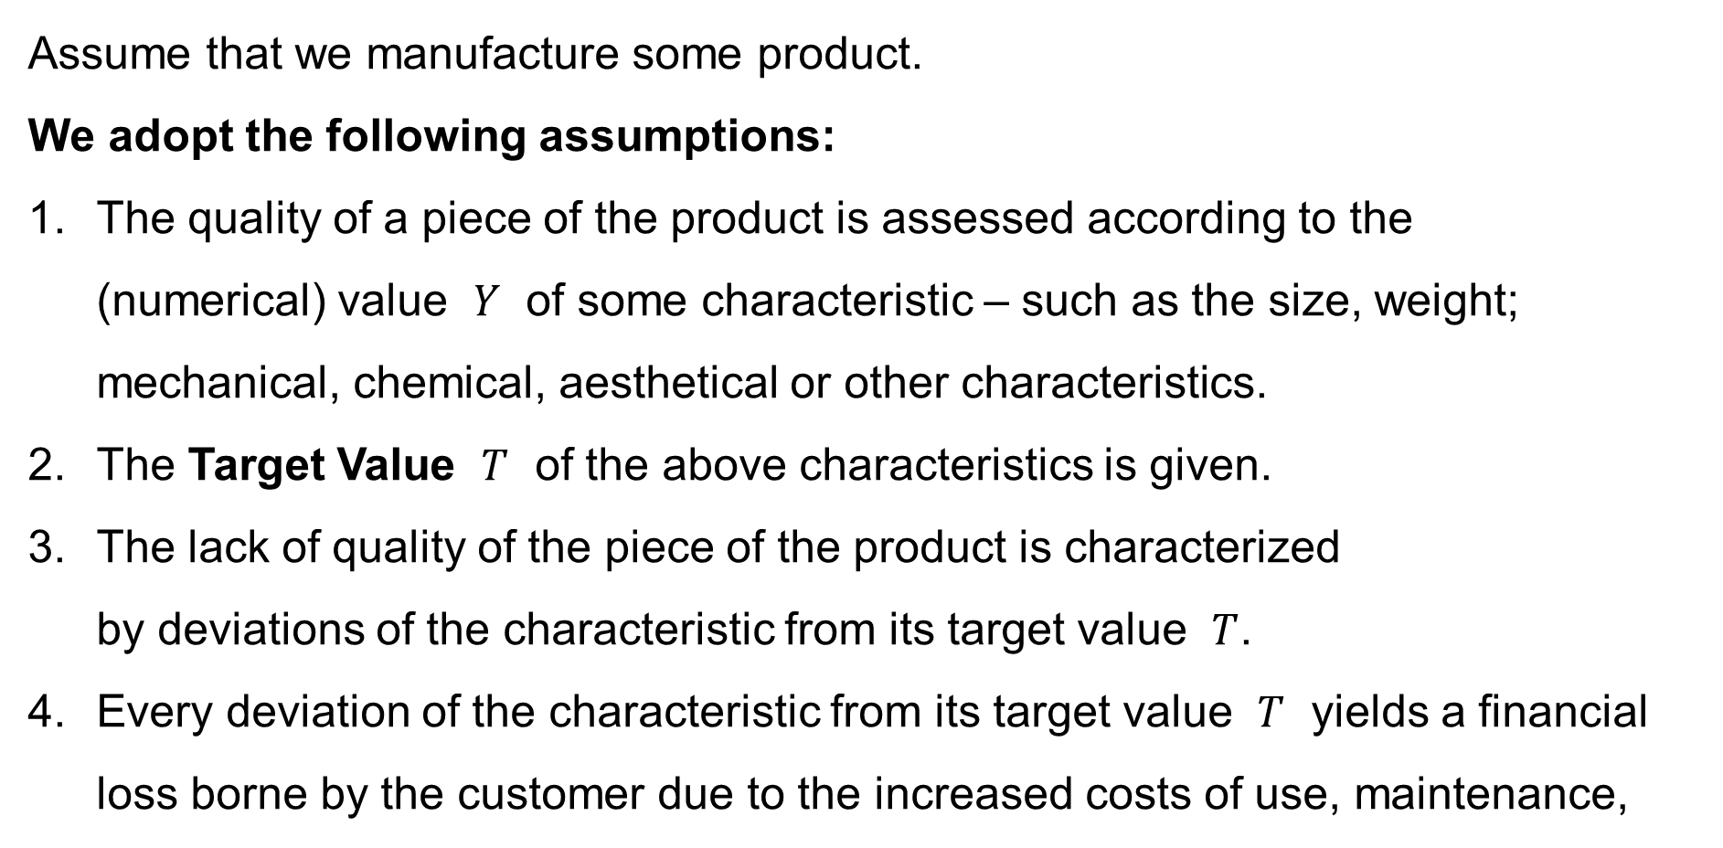
Taguchi methods: Taguchi Loss Function
Assume that we manufacture some product.
We adopt the following assumptions:
The quality of a piece of the product is assessed according to the
(numerical) value $Y$ of some characteristic – such as the size, weight;
mechanical, chemical, aesthetical or other characteristics.
The Target Value $T$ of the above characteristics is given.
The lack of quality of the piece of the product is characterized
by deviations of the characteristic from its target value $T$.
Every deviation of the characteristic from its target value $T$ yields a financial loss borne by the customer due to the increased costs of use, maintenance,
etc.

Slide 5
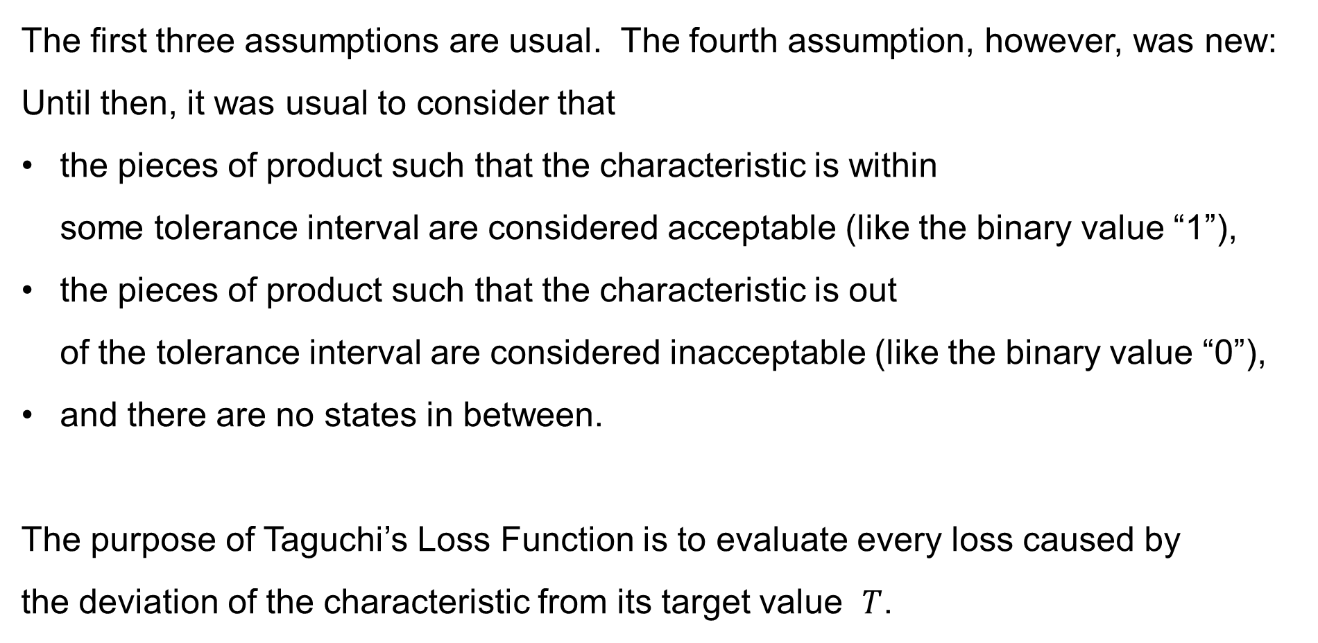
Taguchi methods: Taguchi Loss Function
The first three assumptions are usual. The fourth assumption, however, was new:
Until then, it was usual to consider that
the pieces of product such that the characteristic is within
some tolerance interval are considered acceptable (like the binary value “1”),
the pieces of product such that the characteristic is out
of the tolerance interval are considered inacceptable (like the binary value “0”),
and there are no states in between.
The purpose of Taguchi’s Loss Function is to evaluate every loss caused by
the deviation of the characteristic from its target value $T$.

Slide 6
Taguchi methods: Taguchi Loss Function: Remarks
Taguchi’s Loss Function evaluates every loss caused to the customer
by the supplier due to the (physical) impossibility to keep the absolute precision.
The link between the quality and the Loss Function
is the main contribution to the Quality Engineering;
it also allows to plan the costs.
The Loss Function measures the decreased quality within the tolerance interval.

Slide 7
The Loss Function
Symmetric N-tolerance
Non-symmetric N-tolerance
S-type tolerance (small)
L-type tolerance (large)

Slide 8
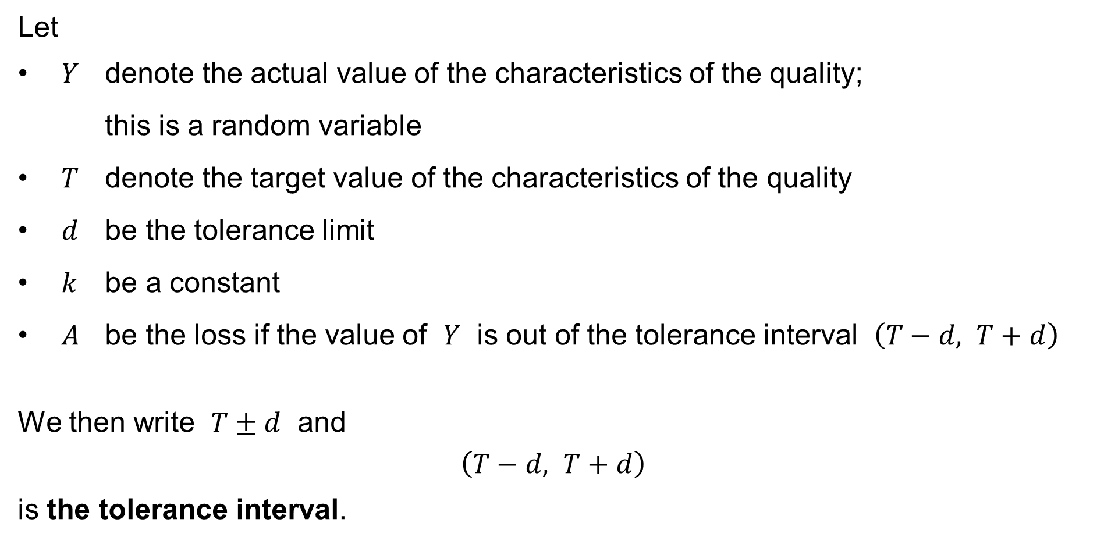
Taguchi Loss Function: Symmetric N-tolerance
Let
$Y$ denote the actual value of the characteristics of the quality;
this is a random variable
$T$ denote the target value of the characteristics of the quality
$d$ be the tolerance limit
$k$ be a constant
$A$ be the loss if the value of $Y$ is out of the tolerance interval $\left(T−d, T+d\right)$
We then write $T±d$ and
$$\left(T−d, T+d\right)$$
is the tolerance interval.

Slide 9
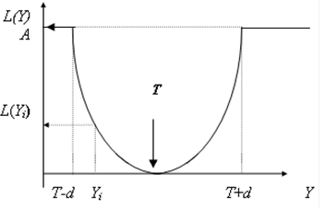

Taguchi Loss Function: Symmetric N-tolerance
We then postulate that the Loss Function is continuous and of the form:
$$L\left(Y\right)=\left\{\begin{matrix} k{\left(Y−T\right)}^{2} & \text{if} & T−d≤ Y ≤T+d \\ A & \text{if} & Y ≤T−d \text{or} T+d≤ Y\end{matrix}\right.$$

Slide 10

Taguchi Loss Function: Symmetric N-tolerance
We then postulate that the Loss Function is continuous and of the form:
$$L\left(Y\right)=\left\{\begin{matrix} k{\left(Y−T\right)}^{2} & \text{if} & T−d≤ Y ≤T+d \\ A & \text{if} & Y ≤T−d \text{or} T+d≤ Y\end{matrix}\right.$$
It follows:
$$A=k{\left(\left(T−d\right)−T\right)}^{2} \\ A=kd^{2} \\ k=\frac{A}{d^{2}}$$

Slide 11
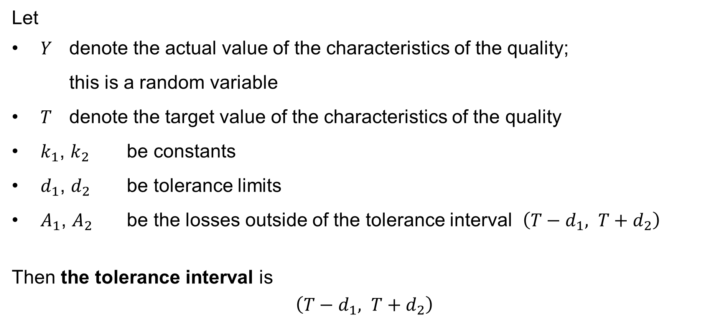
Taguchi Loss Function: Non-symmetric N-tolerance
Let
$Y$ denote the actual value of the characteristics of the quality;
this is a random variable
$T$ denote the target value of the characteristics of the quality
$k_{1}$, $k_{2}$ be constants
$d_{1}$, $d_{2}$ be tolerance limits
$A_{1}$, $A_{2}$ be the losses outside of the tolerance interval $\left(T−d_{1}, T+d_{2}\right)$
Then the tolerance interval is
$$\left(T−d_{1}, T+d_{2}\right)$$

Slide 12
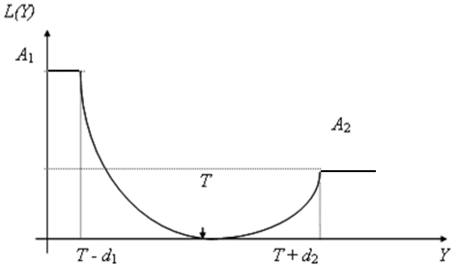

Taguchi Loss Function: Symmetric N-tolerance
We then postulate that the Loss Function is continuous and of the form:
$$L\left(Y\right)=\left\{\begin{matrix}A_{1} & \text{if} & Y≤T−d_{1} \\ k_{1}{\left(Y−T\right)}^{2} & \text{if} & T−d_{1}≤ Y ≤T \\ k_{2}{\left(Y−T\right)}^{2} & \text{if} & T≤ Y ≤T+d_{2} \\ A_{2} & \text{if} & T+d_{2}≤ Y\end{matrix}\right.$$

Slide 13



Taguchi Loss Function: Symmetric N-tolerance
We then postulate that the Loss Function is continuous and of the form:
$$L\left(Y\right)=\left\{\begin{matrix}A_{1} & \text{if} & Y≤T−d_{1} \\ k_{1}{\left(Y−T\right)}^{2} & \text{if} & T−d_{1}≤ Y ≤T \\ k_{2}{\left(Y−T\right)}^{2} & \text{if} & T≤ Y ≤T+d_{2} \\ A_{2} & \text{if} & T+d_{2}≤ Y\end{matrix}\right.$$
It follows:
$$A_{1}=k_{1}{\left(\left(T−d_{1}\right)−T\right)}^{2} \\ A_{1}=k_{1}d_{1}^{2} \\ k_{1}=\frac{A_{1}}{d_{1}^{2}}$$
$$A_{2}=k_{2}{\left(\left(T−d_{2}\right)−T\right)}^{2} \\ A_{2}=k_{2}d_{2}^{2} \\ k_{2}=\frac{A_{2}}{d_{2}^{2}}$$

Slide 14
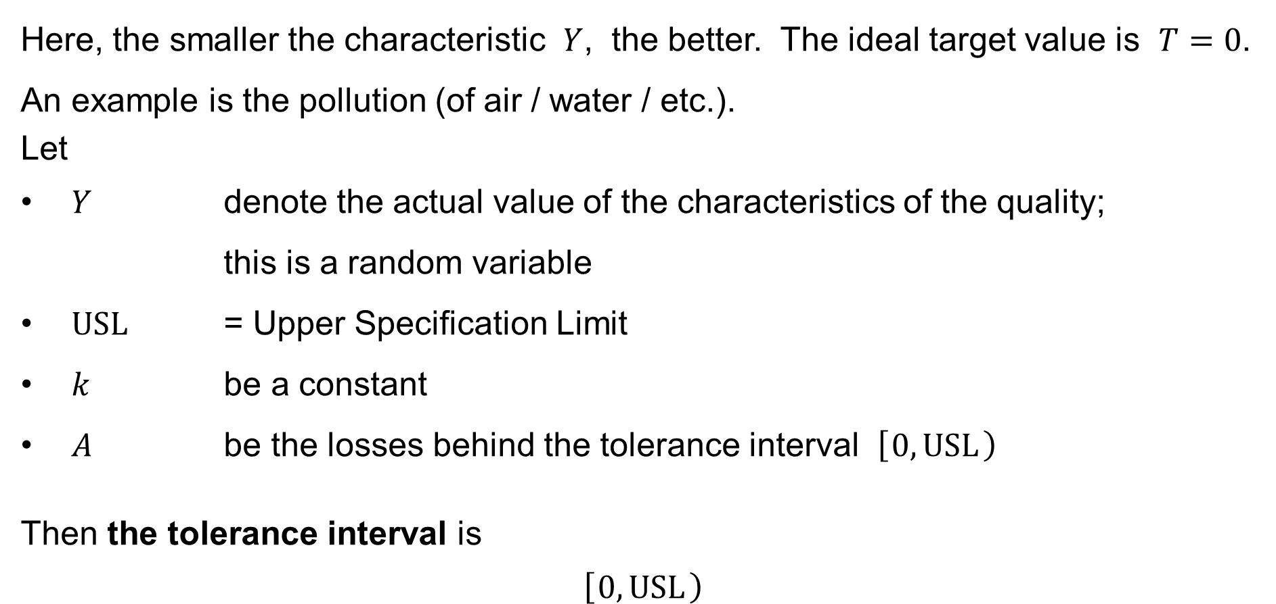
Taguchi Loss Function: S-type tolerance (small)
Here, the smaller the characteristic $Y$, the better. The ideal target value is $T=0$.
An example is the pollution (of air / water / etc.).
Let
$Y$ denote the actual value of the characteristics of the quality;
this is a random variable
$USL$ = Upper Specification Limit
$k$ be a constant
$A$ be the losses behind the tolerance interval $\left[ 0,USL \right)$
Then the tolerance interval is
$$\left[ 0,USL \right)$$

Slide 15
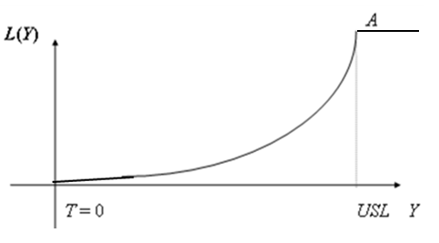

Taguchi Loss Function: S-type tolerance (small)
We then postulate that the Loss Function is continuous and of the form:
$$L\left(Y\right)=\left\{\begin{matrix}0 & \text{if} & Y≤0 \\ kY^{2} & \text{if} & 0≤Y≤USL \\ A & \text{if} & USL≤Y\end{matrix}\right.$$

Slide 16

Taguchi Loss Function: S-type tolerance (small)
We then postulate that the Loss Function is continuous and of the form:
$$L\left(Y\right)=\left\{\begin{matrix}0 & \text{if} & Y≤0 \\ kY^{2} & \text{if} & 0≤Y≤USL \\ A & \text{if} & USL≤Y\end{matrix}\right.$$
It follows:
$$A=k×{USL}^{2} \\ k=\frac{A}{{USL}^{2}}$$

Slide 17
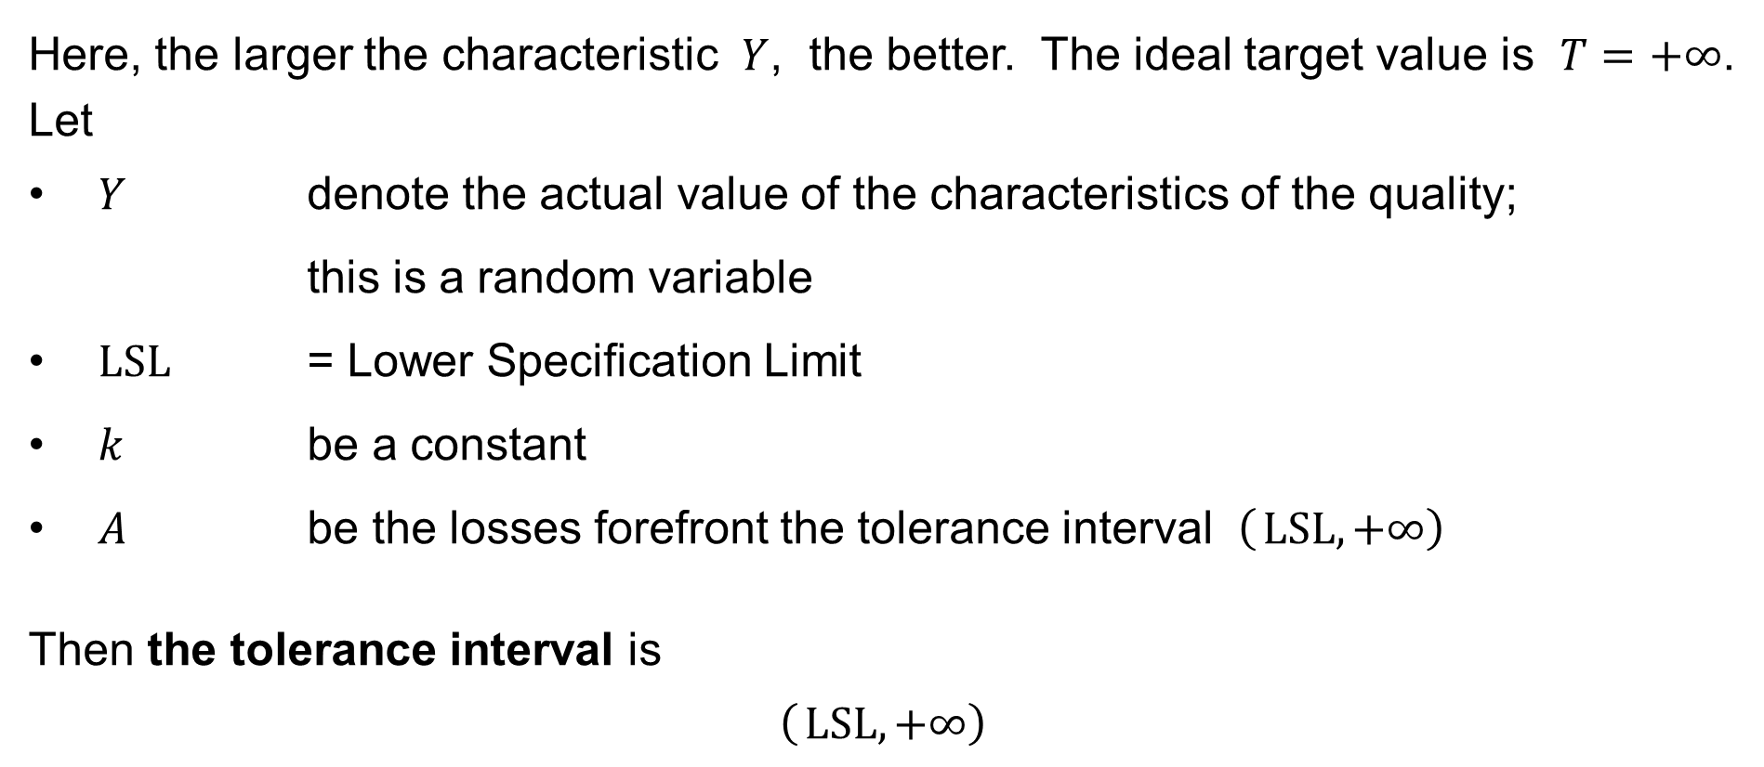
Taguchi Loss Function: L-type tolerance (large)
Here, the larger the characteristic $Y$, the better. The ideal target value is $T=+∞$.
Let
$Y$ denote the actual value of the characteristics of the quality;
this is a random variable
$LSL$ = Lower Specification Limit
$k$ be a constant
$A$ be the losses forefront the tolerance interval $\left( LSL,+∞\right)$
Then the tolerance interval is
$$\left( LSL,+∞\right)$$

Slide 18

Taguchi Loss Function: L-type tolerance (large)
We then postulate that the Loss Function is continuous and of the form:
$$L\left(Y\right)=\left\{\begin{matrix}A & \text{if} & Y≤LSL \\ k{\left(\frac{1}{Y}\right)}^{2} & \text{if} & LSL≤Y\end{matrix}\right.$$

Slide 19

Taguchi Loss Function: L-type tolerance (large)
We then postulate that the Loss Function is continuous and of the form:
$$L\left(Y\right)=\left\{\begin{matrix}A & \text{if} & Y≤LSL \\ k{\left(\frac{1}{Y}\right)}^{2} & \text{if} & LSL≤Y\end{matrix}\right.$$
It follows:
$$A=k{\left(\frac{1}{LSL}\right)}^{2} \\ k=A×{LSL}^{2}$$

Slide 20
The expected loss
Symmetric N-tolerance
Non-symmetric N-tolerance
S-type tolerance (small)
L-type tolerance (large)

Slide 21
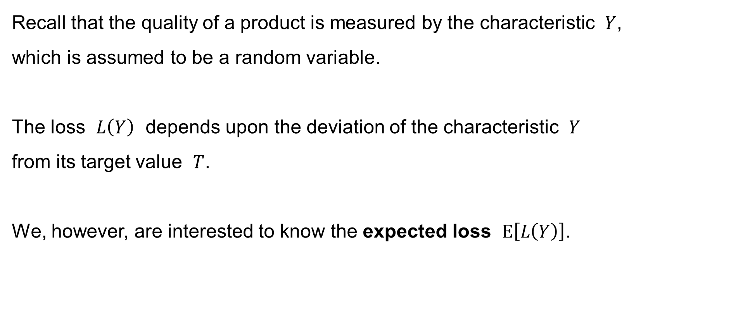
The expected loss
Recall that the quality of a product is measured by the characteristic $Y$,
which is assumed to be a random variable.
The loss $L\left(Y\right)$ depends upon the deviation of the characteristic $Y$
from its target value $T$.
We, however, are interested to know the expected loss $E\left[L\left(Y\right)\right]$.

Slide 22

The expected loss: Symmetric N-tolerance
Assume that the Loss Function is of the form
$$L\left(Y\right)=\left\{\begin{matrix} k{\left(Y−T\right)}^{2} & \text{if} & T−d≤ Y ≤T+d \\ A & \text{if} & Y ≤T−d \text{or} T+d≤ Y\end{matrix}\right.$$
where
$$k=\frac{A}{d^{2}}$$

Slide 23

The expected loss: Symmetric N-tolerance
Assume for simplicity that the random variable
$$Y∈\left(T−d, t+d\right) \text{always}$$
Then:
$$E\left[L\left(Y\right)\right]=E\left[k{\left(Y−T\right)}^{2}\right]=k×E\left[{\left(Y−T\right)}^{2}\right]$$
If $E\left[Y\right]=T$, then
$$E\left[L\left(Y\right)\right]=k×Var\left(Y\right)=kσ^{2}$$

Slide 24
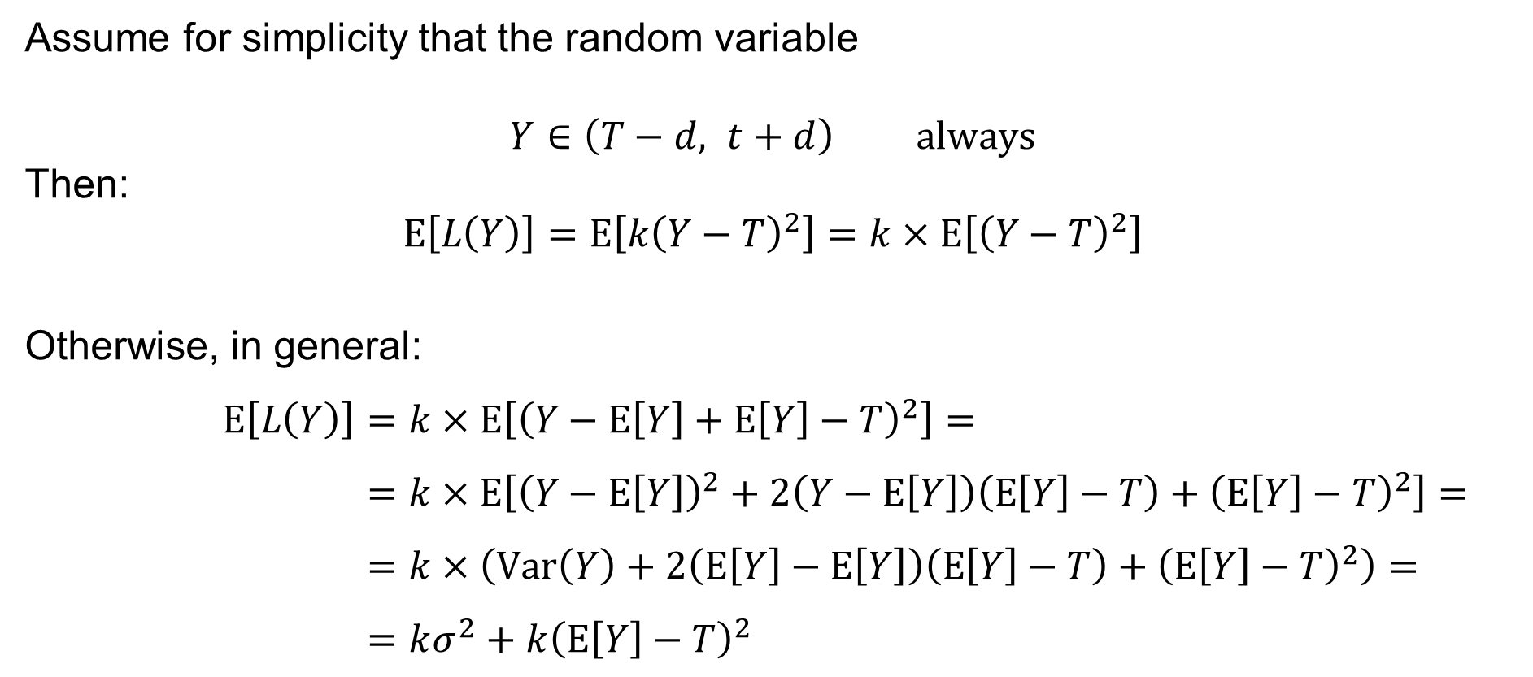
The expected loss: Symmetric N-tolerance
Assume for simplicity that the random variable
$$Y∈\left(T−d, t+d\right) \text{always}$$
Then:
$$E\left[L\left(Y\right)\right]=E\left[k{\left(Y−T\right)}^{2}\right]=k×E\left[{\left(Y−T\right)}^{2}\right]$$
Otherwise, in general:
$$E\left[L\left(Y\right)\right]=k×E\left[{\left(Y−E\left[Y\right]+E\left[Y\right]−T\right)}^{2}\right]= \\ =k×E\left[{\left(Y−E\left[Y\right]\right)}^{2}+2\left(Y−E\left[Y\right]\right)\left(E\left[Y\right]−T\right)+{\left(E\left[Y\right]−T\right)}^{2}\right]= \\ =k×\left(Var\left(Y\right)+2\left(E\left[Y\right]−E\left[Y\right]\right)\left(E\left[Y\right]−T\right)+{\left(E\left[Y\right]−T\right)}^{2}\right)= \\ =kσ^{2}+k{\left(E\left[Y\right]−T\right)}^{2}$$

Slide 25
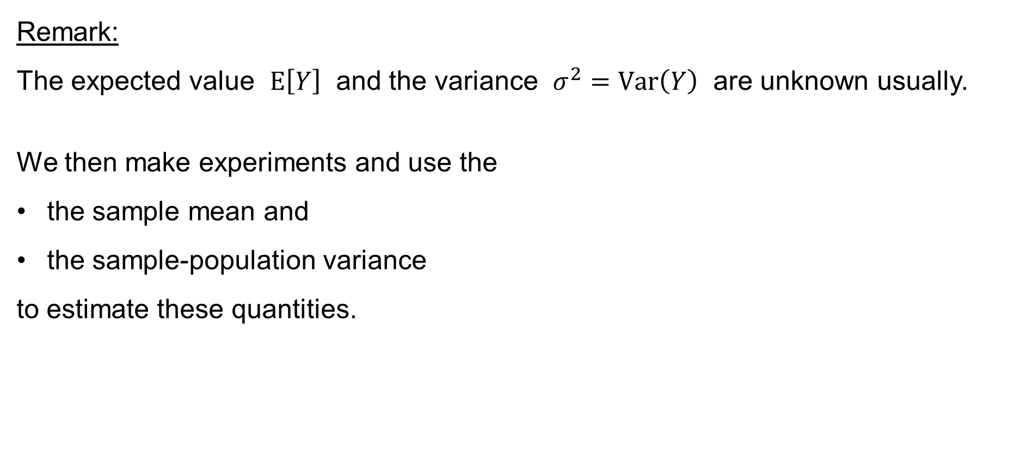
The expected loss: The estimates of E[Y] and Var(Y)
Remark:
The expected value $E\left[Y\right]$ and the variance $σ^{2}=Var\left(Y\right)$ are unknown usually.
We then make experiments and use the
the sample mean and
the sample-population variance
to estimate these quantities.

Slide 26
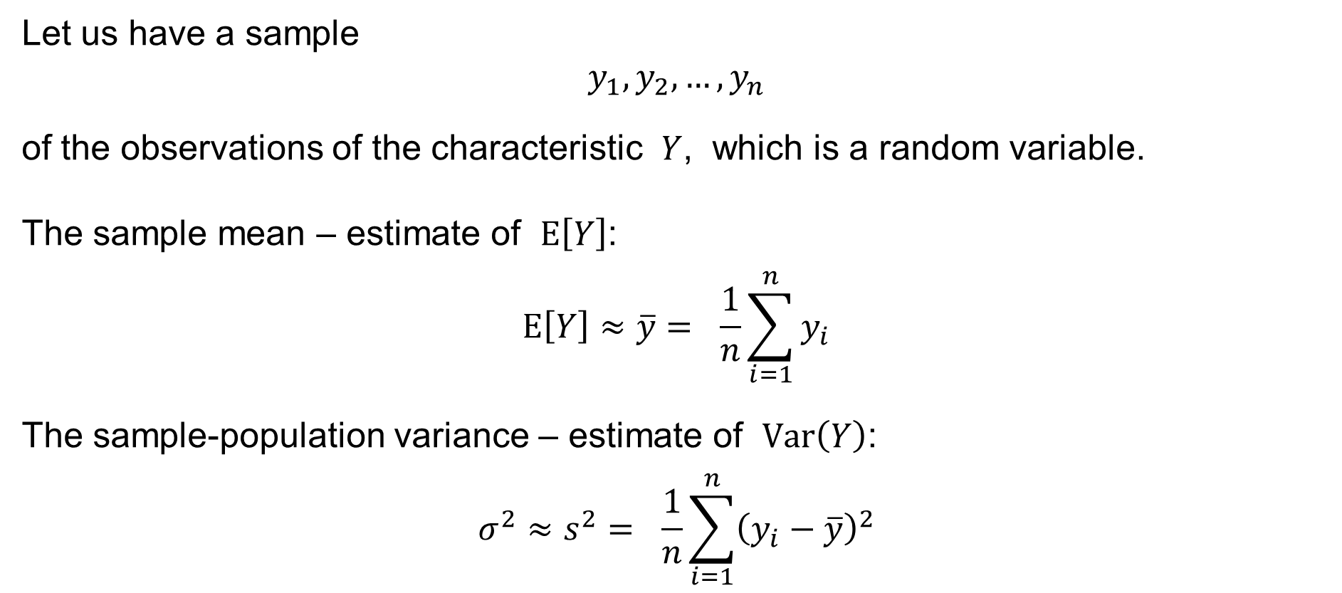
The expected loss: The estimates of E[Y] and Var(Y)
Let us have a sample
$$y_{1},y_{2},…,y_{n}$$
of the observations of the characteristic $Y$, which is a random variable.
The sample mean – estimate of $E\left[Y\right]$:
$$E\left[Y\right]≈\overline{y}= \frac{1}{n}\sum_{i=1}^{n}{y_{i}}$$
The sample-population variance – estimate of $Var\left(Y\right)$:
$$σ^{2}≈s^{2}= \frac{1}{n}\sum_{i=1}^{n}{{\left(y_{i}−\overline{y}\right)}^{2}}$$

Slide 27

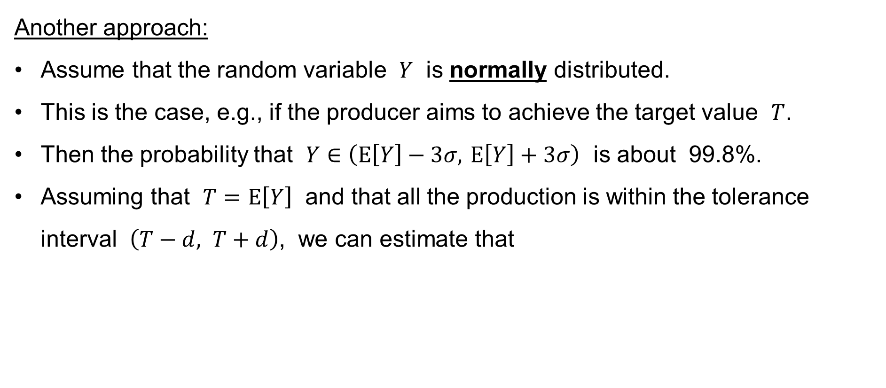
The expected loss: The estimates of E[Y] and Var(Y)
Another approach:
Assume that the random variable $Y$ is normally distributed.
This is the case, e.g., if the producer aims to achieve the target value $T$.
Then the probability that $Y∈\left(E\left[Y\right]−3σ, E\left[Y\right]+3σ\right)$ is about 99.8%.
Assuming that $T=E\left[Y\right]$ and that all the production is within the tolerance interval $\left(T−d, T+d\right)$, we can estimate that
$$d≈3σ \\ σ≈\frac{d}{3}$$

Slide 28

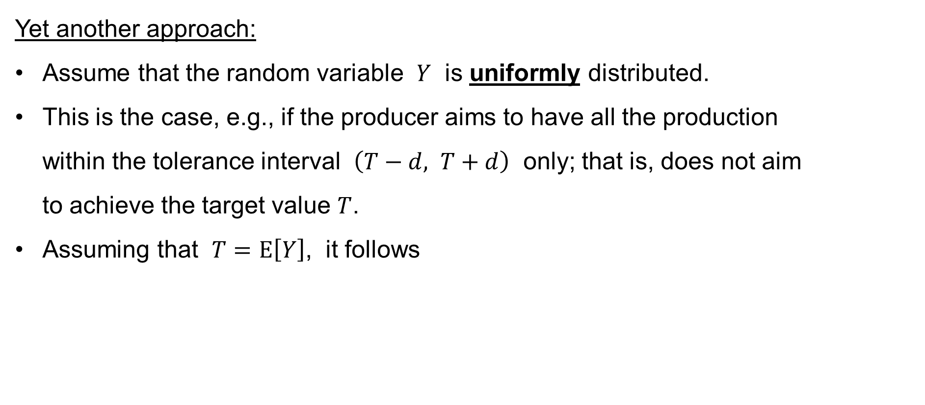
The expected loss: The estimates of E[Y] and Var(Y)
Yet another approach:
Assume that the random variable $Y$ is uniformly distributed.
This is the case, e.g., if the producer aims to have all the production
within the tolerance interval $\left(T−d, T+d\right)$ only; that is, does not aim
to achieve the target value $T$.
Assuming that $T=E\left[Y\right]$, it follows
$$σ^{2}≈\frac{{\left(2d\right)}^{2}}{12}=\frac{4d^{2}}{12}=\frac{d^{2}}{3} \\ σ≈\frac{d}{\sqrt{3} }$$

Slide 29
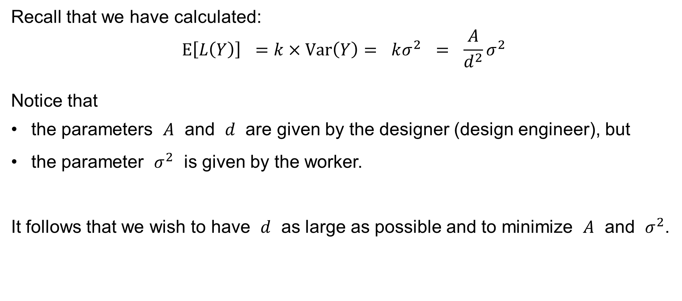
The expected loss: The cost of the quality
Recall that we have calculated:
$$E\left[L\left(Y\right)\right] =k×Var\left(Y\right)= kσ^{2} = \frac{A}{d^{2}}σ^{2}$$
Notice that
the parameters $A$ and $d$ are given by the designer (design engineer), but
the parameter $σ^{2}$ is given by the worker.
It follows that we wish to have $d$ as large as possible and to minimize $A$ and $σ^{2}$.

Slide 30

The expected loss: The cost of the quality
Example: Assume that
$$A=40 \\ d=4 \\ σ=1.33$$
Then the expected loss is
$$E\left[L\left(Y\right)\right]=\frac{A}{d^{2}}σ^{2}=\frac{40}{4^{2}}×{1.33}^{2}=4.42225$$
monetary units per a piece of production.

Slide 31
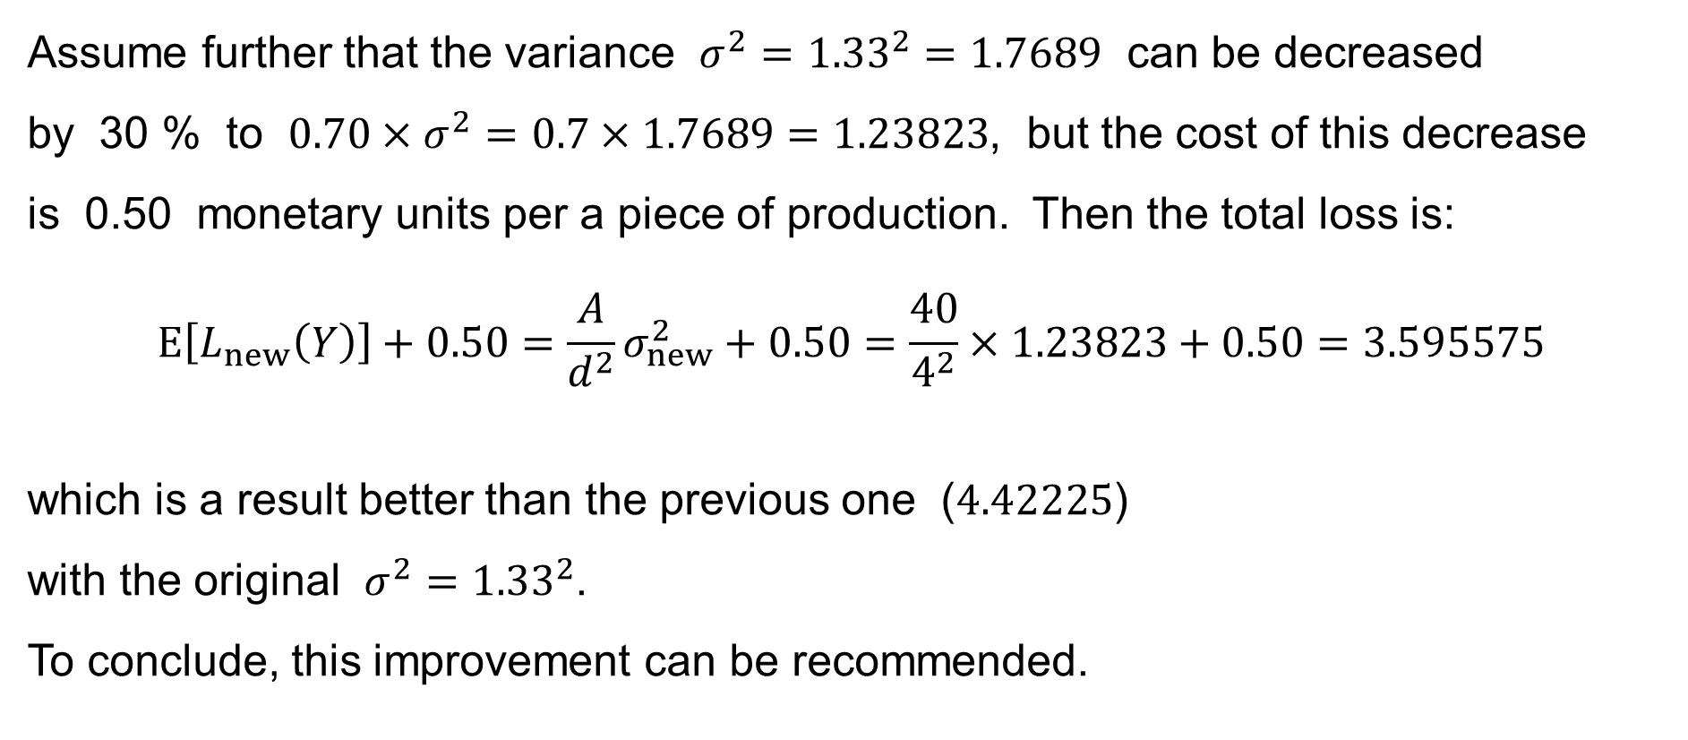
The expected loss: The cost of the quality
Assume further that the variance $σ^{2}={1.33}^{2}=1.7689$ can be decreased
by 30 % to $0.70×σ^{2}=0.7×1.7689=1.23823$, but the cost of this decrease
is 0.50 monetary units per a piece of production. Then the total loss is:
$$E\left[L_{new}\left(Y\right)\right]+0.50=\frac{A}{d^{2}}σ_{new}^{2}+0.50=\frac{40}{4^{2}}×1.23823+0.50=3.595575$$
which is a result better than the previous one ($4.42225$)
with the original $σ^{2}={1.33}^{2}$.
To conclude, this improvement can be recommended.

Slide 32
Total
Quality Costs
Quality Cost Monitoring
Taguchi’s approach
to Quality Cost Monitoring

Slide 33
Quality Cost Monitoring
We concentrate on Quality Cost Monitoring on the side of the manufacturer.
There are several approaches to Quality Cost Monitoring, including:
monitoring based on PAF (Prevention, Appraisal, Failure) models
monitoring based on process models
monitoring based on Taguchi’s approach
We here concentrate in Taguchi’s approach.

Slide 34

Taguchi’s approach to Quality Cost Monitoring
There are two main cases in Taguchi’s approach to Quality Cost Monitoring:
checking all (100%) pieces of production
checking one out of every $n$ pieces of production;
— checking qualitative (non-measurable) characteristics of quality – attributes

Slide 35
Checking all (100%) pieces of production

Slide 36
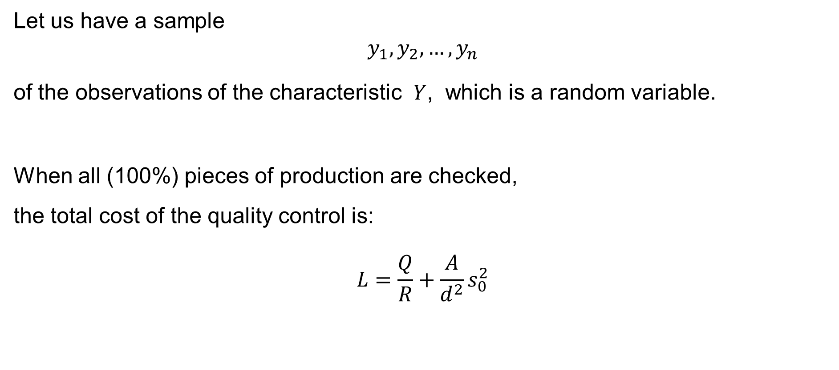
Checking all (100%) pieces of production
Let us have a sample
$$y_{1},y_{2},…,y_{n}$$
of the observations of the characteristic $Y$, which is a random variable.
When all (100%) pieces of production are checked,
the total cost of the quality control is:
$$L=\frac{Q}{R}+\frac{A}{d^{2}}s_{0}^{2}$$

Slide 37
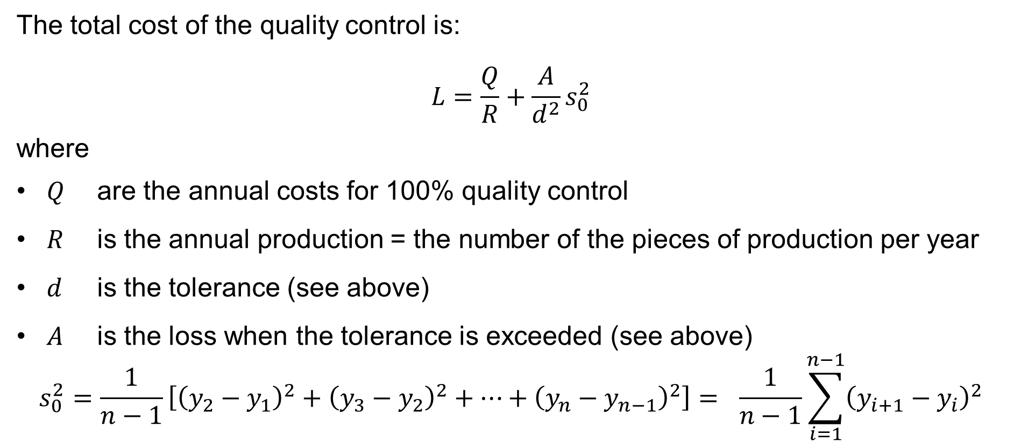
Checking all (100%) pieces of production
The total cost of the quality control is:
$$L=\frac{Q}{R}+\frac{A}{d^{2}}s_{0}^{2}$$
where
$Q$ are the annual costs for 100% quality control
$R$ is the annual production = the number of the pieces of production per year
$d$ is the tolerance (see above)
$A$ is the loss when the tolerance is exceeded (see above)
$$s_{0}^{2}=\frac{1}{n−1}\left[{\left(y_{2}−y_{1}\right)}^{2}+{\left(y_{3}−y_{2}\right)}^{2}+⋯+{\left(y_{n}−y_{n−1}\right)}^{2}\right]= \frac{1}{n−1}\sum_{i=1}^{n−1}{{\left(y_{i+1}−y_{i}\right)}^{2}}$$

Slide 38

Checking all (100%) pieces of production
Remark: The total variance
$$s_{0}^{2}=\frac{1}{n−1}\sum_{i=1}^{n−1}{{\left(y_{i+1}−y_{i}\right)}^{2}}$$
consists of:
$s_{p}^{2}$ = the production variance
$s_{m}^{2}$ = the measurement variance
and it holds:
$$s_{0}^{2}=s_{p}^{2}+s_{m}^{2}$$

Slide 39
Checking one out of every n pieces of production

Slide 40
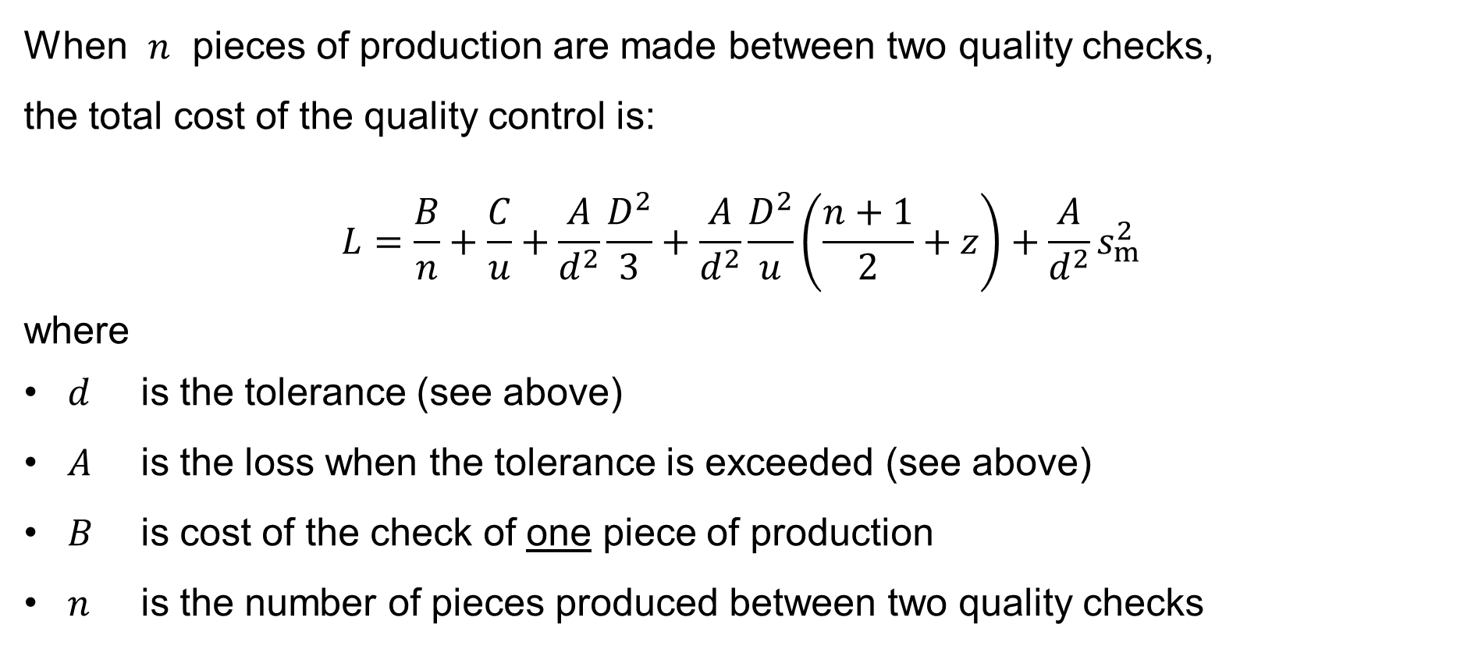
Checking one out of every n pieces of production
When $n$ pieces of production are made between two quality checks,
the total cost of the quality control is:
$$L=\frac{B}{n}+\frac{C}{u}+\frac{A}{d^{2}}\frac{D^{2}}{3}+\frac{A}{d^{2}}\frac{D^{2}}{u}\left(\frac{n+1}{2}+z\right)+\frac{A}{d^{2}}s_{m}^{2}$$
where
$d$ is the tolerance (see above)
$A$ is the loss when the tolerance is exceeded (see above)
$B$ is cost of the check of one piece of production
$n$ is the number of pieces produced between two quality checks

Slide 41
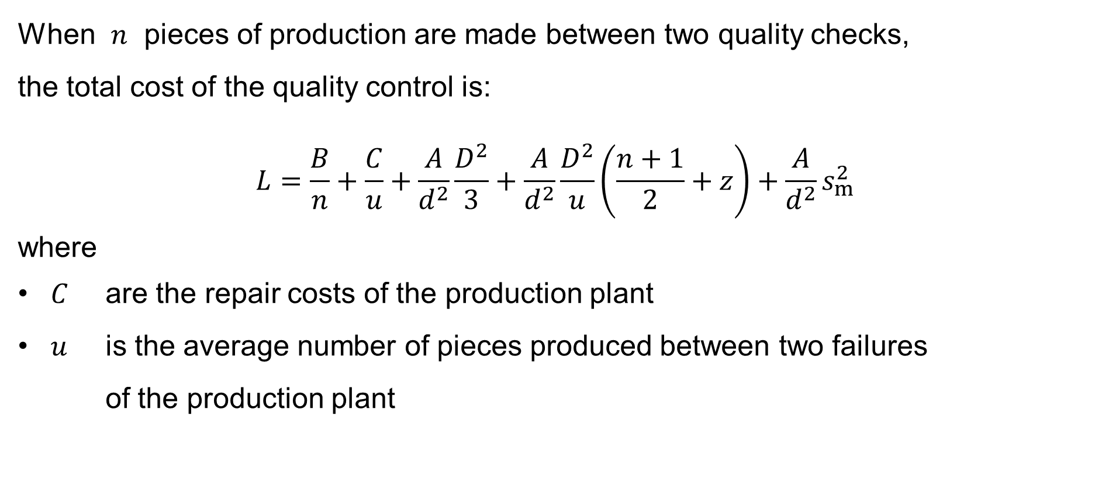
Checking one out of every n pieces of production
When $n$ pieces of production are made between two quality checks,
the total cost of the quality control is:
$$L=\frac{B}{n}+\frac{C}{u}+\frac{A}{d^{2}}\frac{D^{2}}{3}+\frac{A}{d^{2}}\frac{D^{2}}{u}\left(\frac{n+1}{2}+z\right)+\frac{A}{d^{2}}s_{m}^{2}$$
where
$C$ are the repair costs of the production plant
$u$ is the average number of pieces produced between two failures
of the production plant

Slide 42
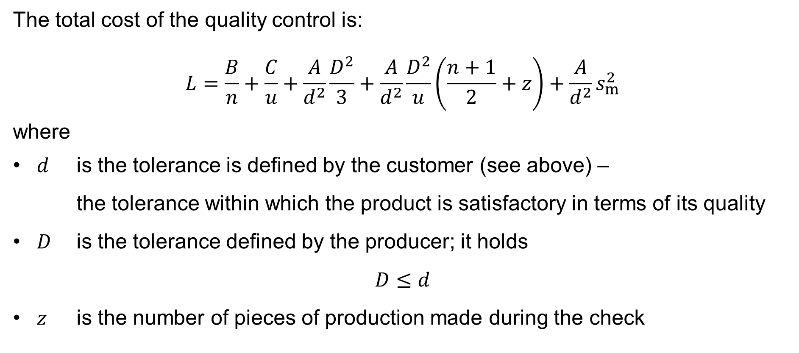
Checking one out of every n pieces of production
The total cost of the quality control is:
$$L=\frac{B}{n}+\frac{C}{u}+\frac{A}{d^{2}}\frac{D^{2}}{3}+\frac{A}{d^{2}}\frac{D^{2}}{u}\left(\frac{n+1}{2}+z\right)+\frac{A}{d^{2}}s_{m}^{2}$$
where
$d$ is the tolerance is defined by the customer (see above) –
the tolerance within which the product is satisfactory in terms of its quality
$D$ is the tolerance defined by the producer; it holds
$D≤d$
$z$ is the number of pieces of production made during the check

Slide 43
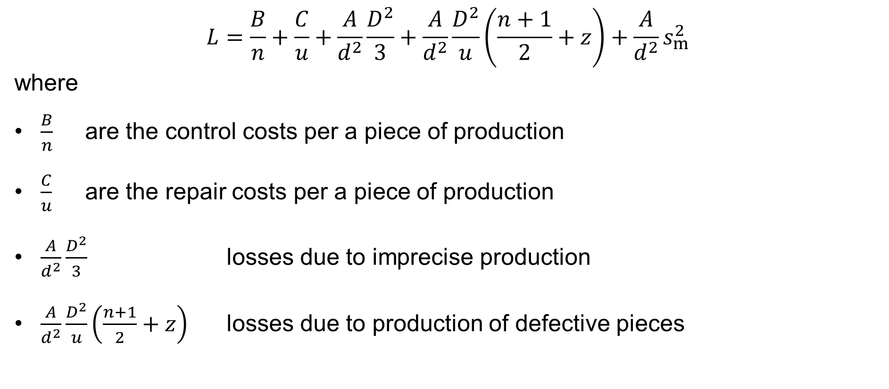
Checking one out of every n pieces of production
$$L=\frac{B}{n}+\frac{C}{u}+\frac{A}{d^{2}}\frac{D^{2}}{3}+\frac{A}{d^{2}}\frac{D^{2}}{u}\left(\frac{n+1}{2}+z\right)+\frac{A}{d^{2}}s_{m}^{2}$$
where
$\frac{B}{n}$ are the control costs per a piece of production
$\frac{C}{u}$ are the repair costs per a piece of production
$\frac{A}{d^{2}}\frac{D^{2}}{3}$ losses due to imprecise production
$\frac{A}{d^{2}}\frac{D^{2}}{u}\left(\frac{n+1}{2}+z\right)$ losses due to production of defective pieces

Slide 44
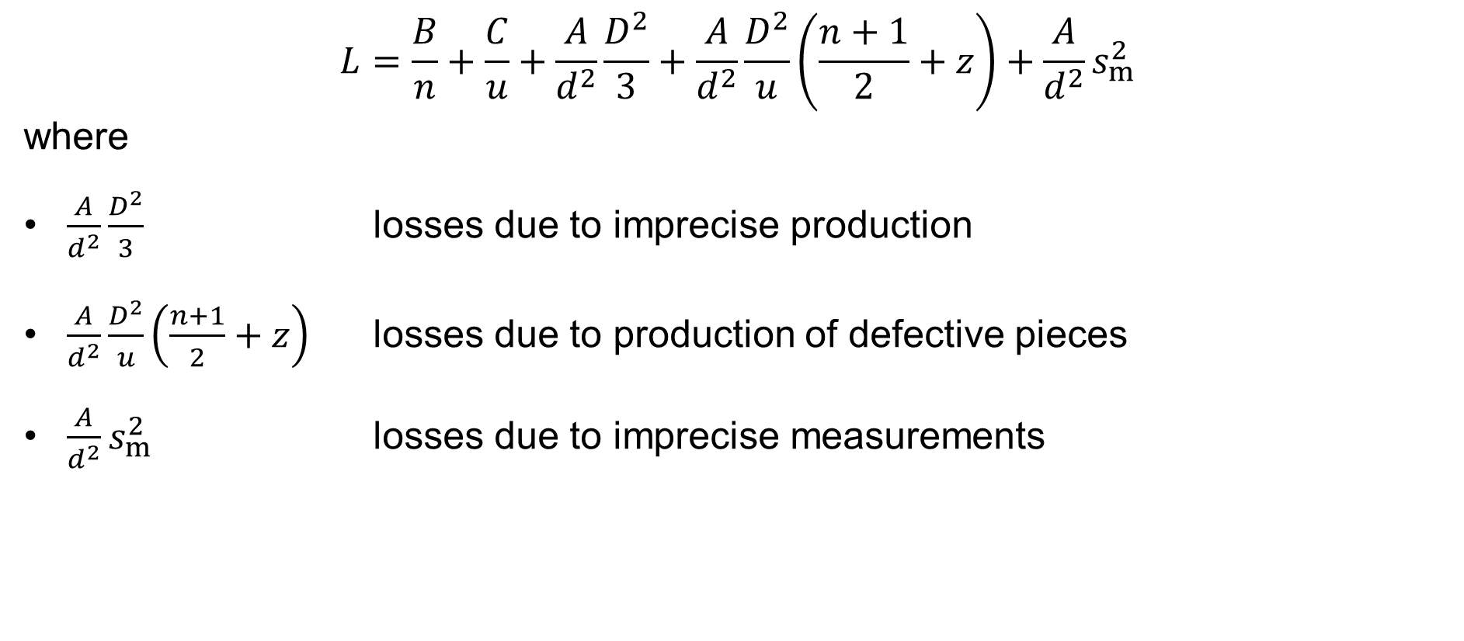
Checking one out of every n pieces of production
$$L=\frac{B}{n}+\frac{C}{u}+\frac{A}{d^{2}}\frac{D^{2}}{3}+\frac{A}{d^{2}}\frac{D^{2}}{u}\left(\frac{n+1}{2}+z\right)+\frac{A}{d^{2}}s_{m}^{2}$$
where
$\frac{A}{d^{2}}\frac{D^{2}}{3}$ losses due to imprecise production
$\frac{A}{d^{2}}\frac{D^{2}}{u}\left(\frac{n+1}{2}+z\right)$ losses due to production of defective pieces
$\frac{A}{d^{2}}s_{m}^{2}$ losses due to imprecise measurements

Slide 45
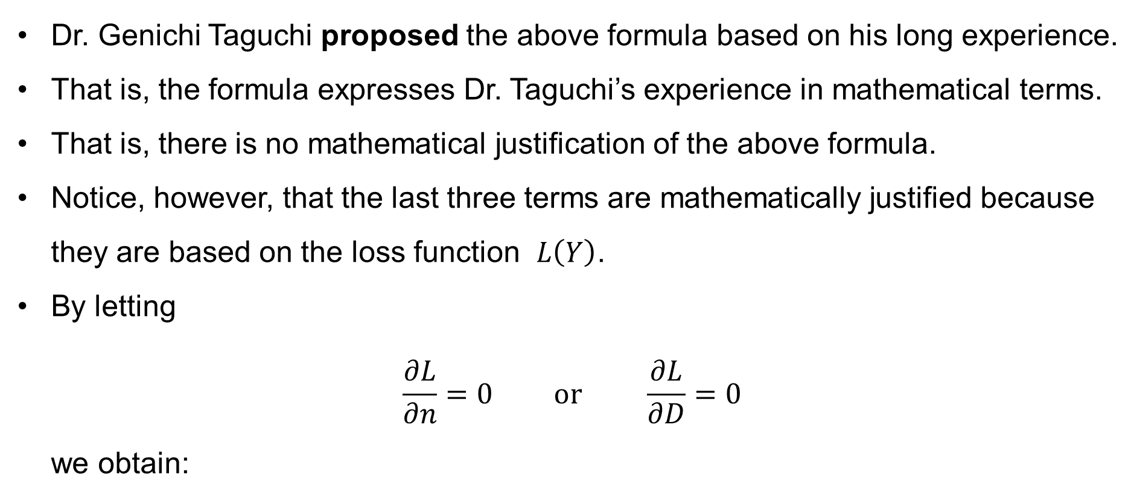
Remarks
Dr. Genichi Taguchi proposed the above formula based on his long experience.
That is, the formula expresses Dr. Taguchi’s experience in mathematical terms.
That is, there is no mathematical justification of the above formula.
Notice, however, that the last three terms are mathematically justified because they are based on the loss function $L\left(Y\right)$.
By letting
$\frac{∂L}{∂n}=0 \text{or} \frac{∂L}{∂D}=0$
we obtain:

Slide 46
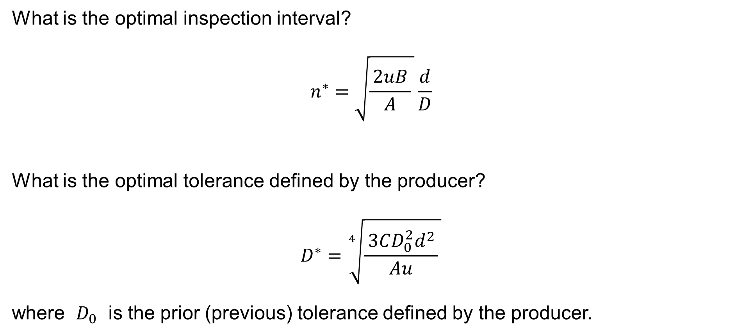
Remarks
What is the optimal inspection interval?
$$n^{∗}=\sqrt{\frac{ 2uB }{A} }\frac{d}{D}$$
What is the optimal tolerance defined by the producer?
$$D^{∗}=\sqrt[4]{\frac{ 3CD_{0}^{2}d^{2} }{Au} }$$
where $D_{0}$ is the prior (previous) tolerance defined by the producer.
(?)

Slide 47
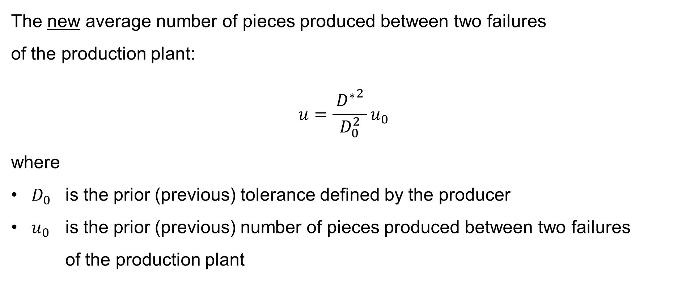
Remarks
The new average number of pieces produced between two failures
of the production plant:
$$u=\frac{ {D^{∗}}^{2} }{D_{0}^{2}}u_{0}$$
where
$D_{0}$ is the prior (previous) tolerance defined by the producer
$u_{0}$ is the prior (previous) number of pieces produced between two failures
of the production plant
(?)

Slide 48
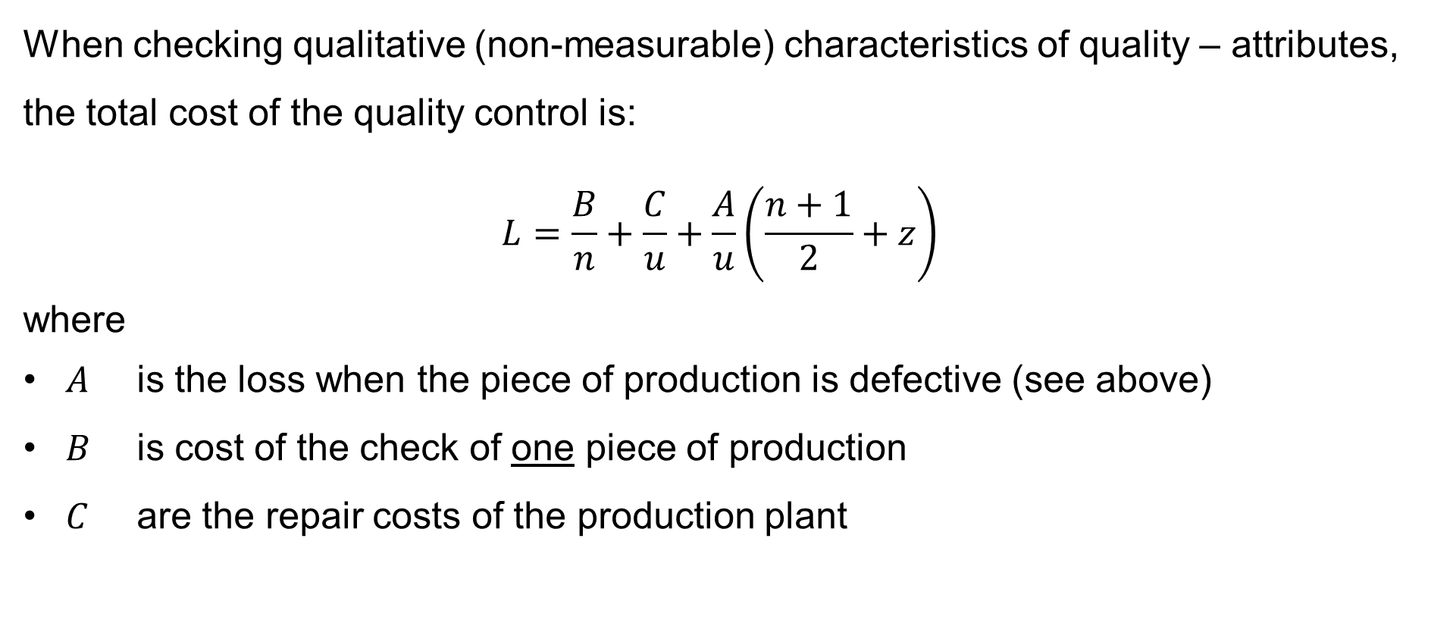
Checking attributes
When checking qualitative (non-measurable) characteristics of quality – attributes, the total cost of the quality control is:
$$L=\frac{B}{n}+\frac{C}{u}+\frac{A}{u}\left(\frac{n+1}{2}+z\right)$$
where
$A$ is the loss when the piece of production is defective (see above)
$B$ is cost of the check of one piece of production
$C$ are the repair costs of the production plant

Slide 49
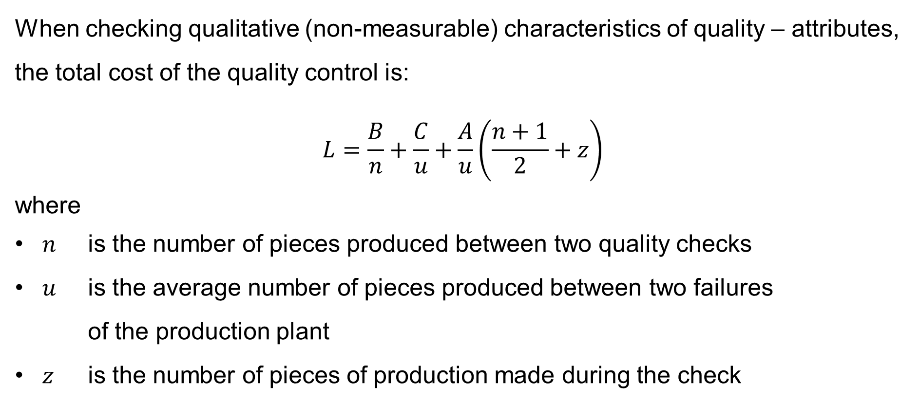
Checking attributes
When checking qualitative (non-measurable) characteristics of quality – attributes, the total cost of the quality control is:
$$L=\frac{B}{n}+\frac{C}{u}+\frac{A}{u}\left(\frac{n+1}{2}+z\right)$$
where
$n$ is the number of pieces produced between two quality checks
$u$ is the average number of pieces produced between two failures
of the production plant
$z$ is the number of pieces of production made during the check

Slide 50
Capability indices
Capability index C_{p}
Capability index C_{pK}

Slide 51
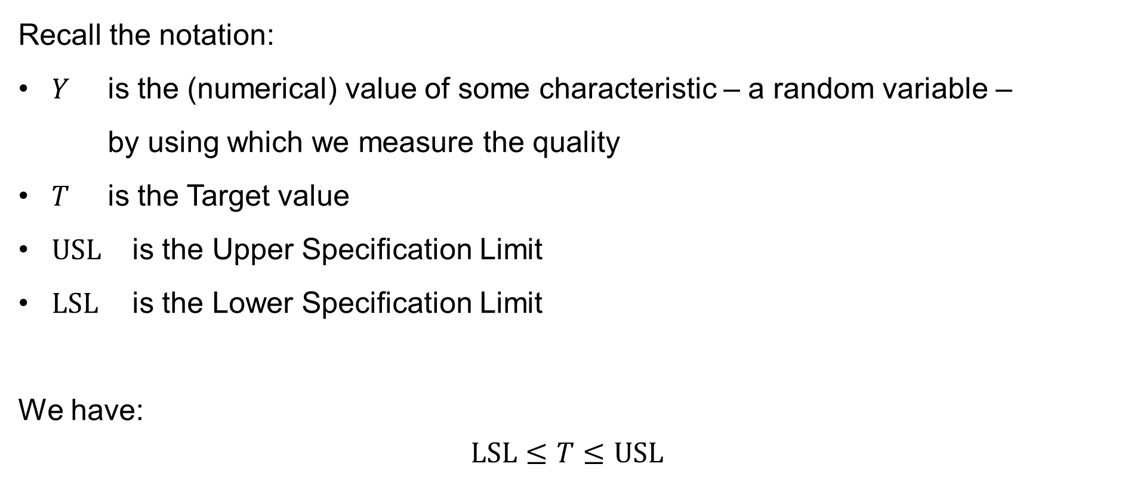
Capability indices
Recall the notation:
$Y$ is the (numerical) value of some characteristic – a random variable –
by using which we measure the quality
$T$ is the Target value
$USL$ is the Upper Specification Limit
$LSL$ is the Lower Specification Limit
We have:
$$LSL≤T≤USL$$

Slide 52
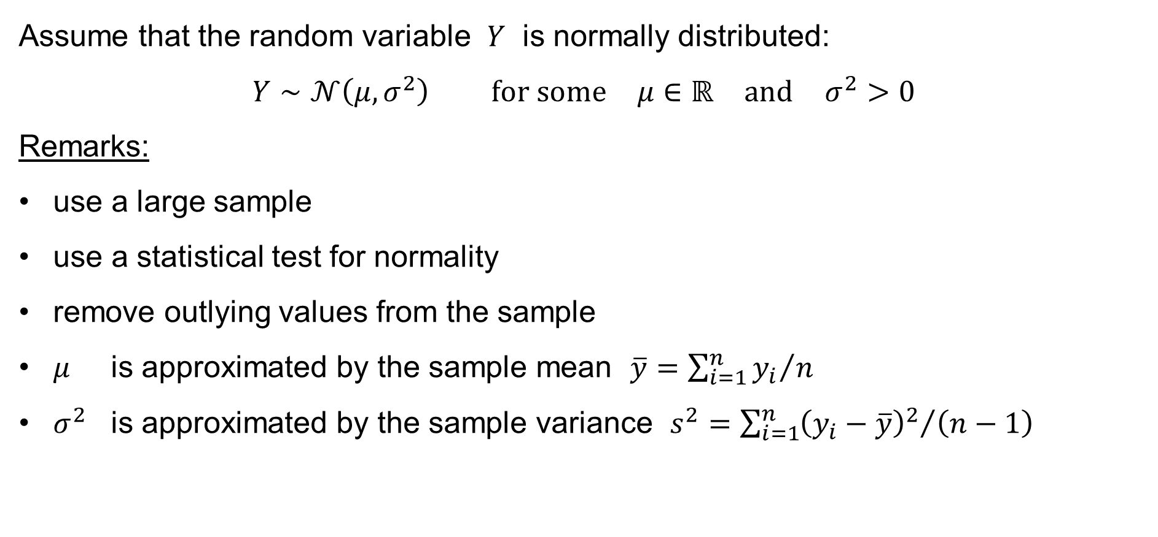
Capability indices
Assume that the random variable $Y$ is normally distributed:
$$Y∼𝒩\left(μ,σ^{2}\right) \text{for} \text{some} μ∈ℝ \text{and} σ^{2}>0$$
Remarks:
use a large sample
use a statistical test for normality
remove outlying values from the sample
$μ$ is approximated by the sample mean $\overline{y}={\sum_{i=1}^{n}{y_{i}}}/n$
$σ^{2}$ is approximated by the sample variance $s^{2}={\sum_{i=1}^{n}{{\left(y_{i}−\overline{y}\right)}^{2}}}/{\left(n−1\right)}$

Slide 53
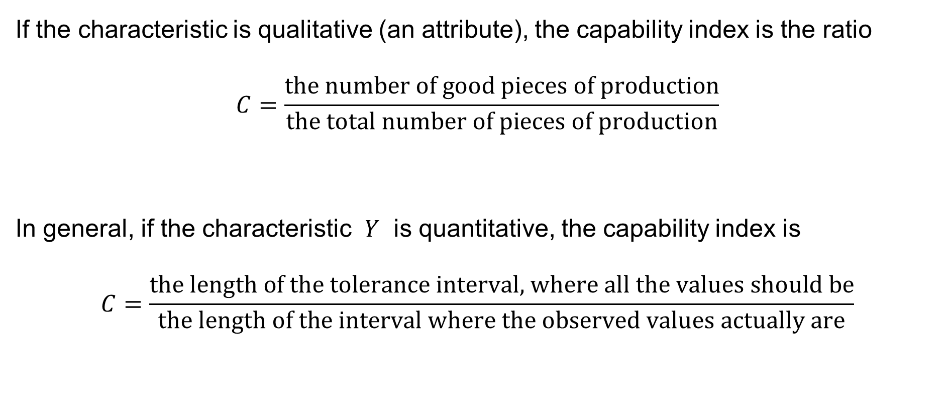
Capability indices
If the characteristic is qualitative (an attribute), the capability index is the ratio
$$C=\frac{\text{the} \text{number} \text{of} \text{good} \text{pieces} \text{of} \text{production}}{\text{the} \text{total} \text{number} \text{of} \text{pieces} \text{of} \text{production}}$$
In general, if the characteristic $Y$ is quantitative, the capability index is
$$C=\frac{\text{the} \text{length} \text{of} \text{the} \text{tolerance} \text{interval}\text{, }\text{where} \text{all} \text{the} \text{values} \text{should} \text{be}}{\text{the} \text{length} \text{of} \text{the} \text{interval} \text{where} \text{the} \text{observed} \text{values} \text{actually} \text{are}}$$

Slide 54
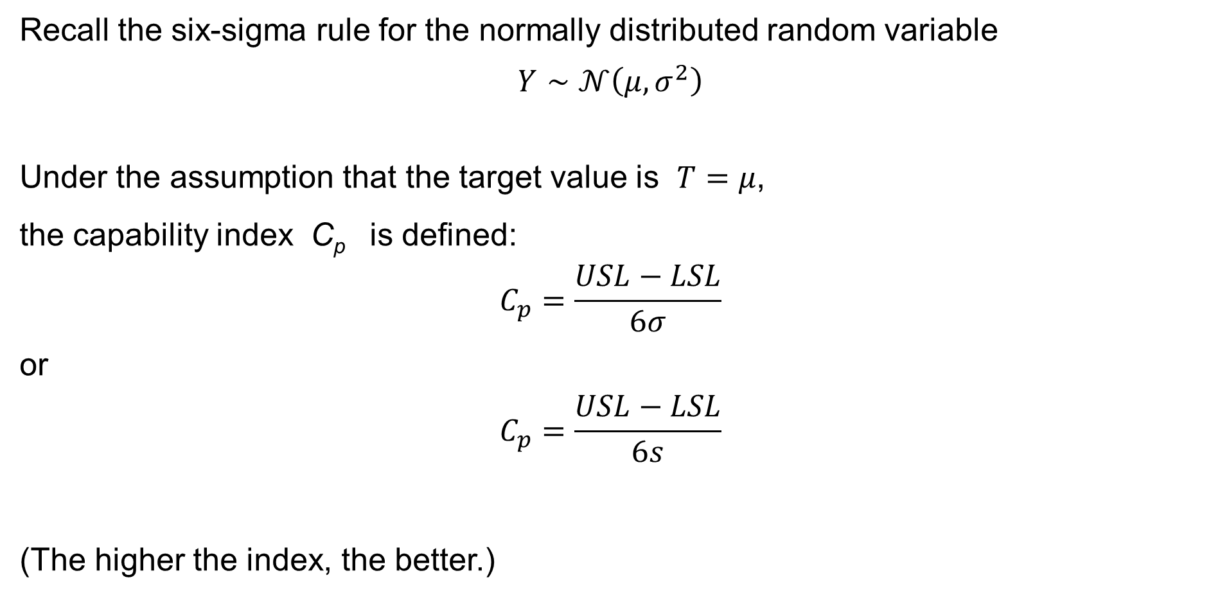
Capability index C_{p}
Recall the six-sigma rule for the normally distributed random variable
$$Y∼𝒩\left(μ,σ^{2}\right)$$
Under the assumption that the target value is $T=μ$,
the capability index C_{p} is defined:
$$C_{p}=\frac{USL−LSL}{6σ}$$
or
$$C_{p}=\frac{USL−LSL}{6s}$$
(The higher the index, the better.)

Slide 55

Capability index C_{pK}
Assuming that $Y∼𝒩\left(μ,σ^{2}\right)$, the capability index C_{pK} is defined:
$$C_{pK}=\min\left\{ \frac{ USL−μ }{3σ}, \frac{ μ−LSL }{3σ} \right\}$$
(The higher the index, the better.)

