Slide 1
Statistical Methods for Economists
Lecture 2 & 3
Hypothesis testing:
Parametric and Non-parametric tests
(in marketing and elsewhere)
David Bartl
Statistical Methods for Economists
INM/BASTE

Slide 2
About statistical hypothesis testing
PARAMETRIC TESTS
t-tests for the means
Two sample F-test for the equality of variances
NON-PARAMETRIC TESTS
Sign test for the median
Pearson’s χ²-test for the goodness of fit
χ²-test of independence of qualitative data items

Slide 3
About statistical hypothesis testing
The general outline
of a statistical hypothesis test
The p-value of a test
Parametric and Non-parametric tests

Slide 4
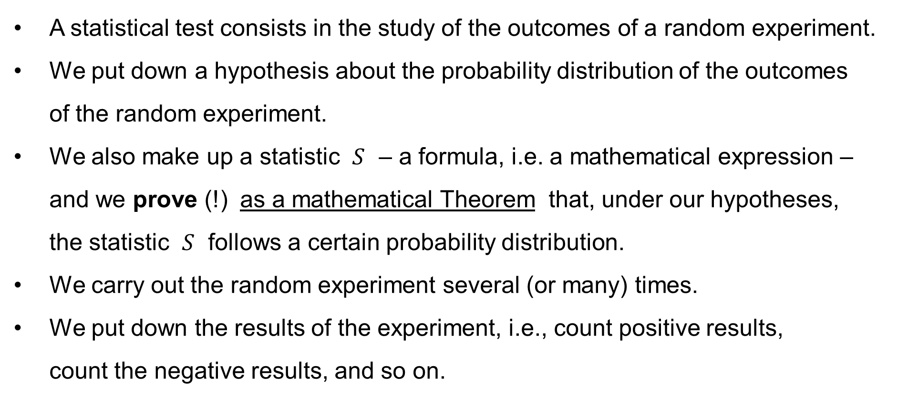
The general outline of a statistical hypothesis test
A statistical test consists in the study of the outcomes of a random experiment.
We put down a hypothesis about the probability distribution of the outcomes
of the random experiment.
We also make up a statistic $S$ – a formula, i.e. a mathematical expression –
and we prove (!) as a mathematical Theorem that, under our hypotheses,
the statistic $S$ follows a certain probability distribution.
We carry out the random experiment several (or many) times.
We put down the results of the experiment, i.e., count positive results,
count the negative results, and so on.

Slide 5
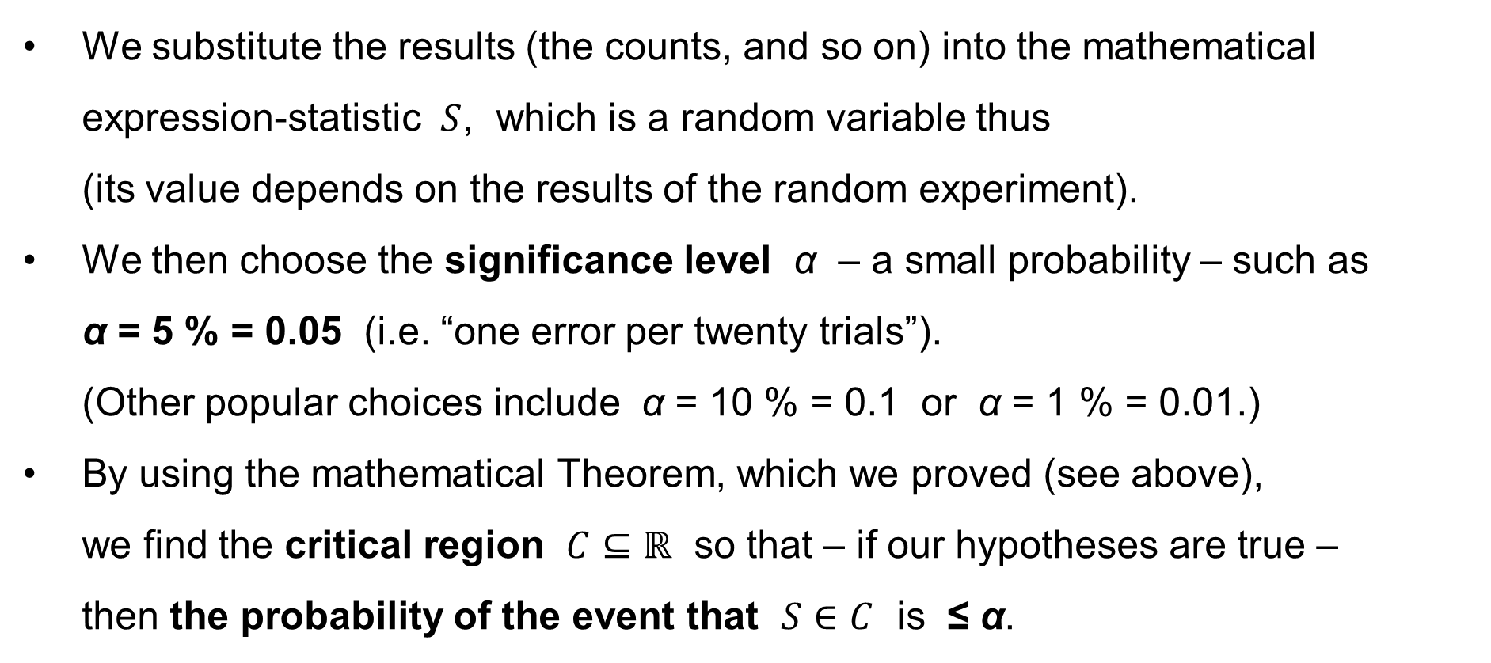
The general outline of a statistical hypothesis test
We substitute the results (the counts, and so on) into the mathematical expression-statistic $S$, which is a random variable thus
(its value depends on the results of the random experiment).
We then choose the significance level α – a small probability – such as
α = 5 % = 0.05 (i.e. “one error per twenty trials”).
(Other popular choices include α = 10 % = 0.1 or α = 1 % = 0.01.)
By using the mathematical Theorem, which we proved (see above),
we find the critical region $C⊆ℝ$ so that – if our hypotheses are true –
then the probability of the event that $S∈C$ is ≤ α.

Slide 6
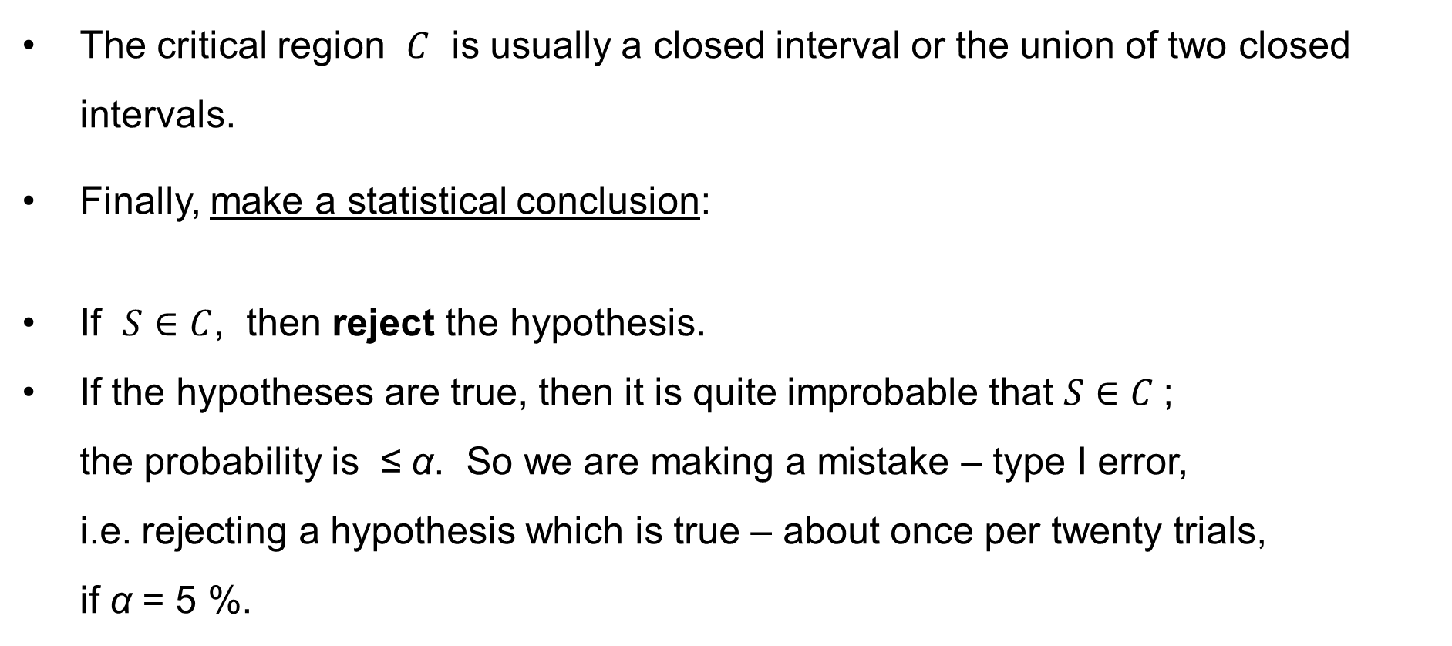
The general outline of a statistical hypothesis test
The critical region $C$ is usually a closed interval or the union of two closed intervals.
Finally, make a statistical conclusion:
If $S∈C$, then reject the hypothesis.
If the hypotheses are true, then it is quite improbable that $S∈C$ ;
the probability is ≤ α. So we are making a mistake – type I error,
i.e. rejecting a hypothesis which is true – about once per twenty trials,
if α = 5 %.

Slide 7
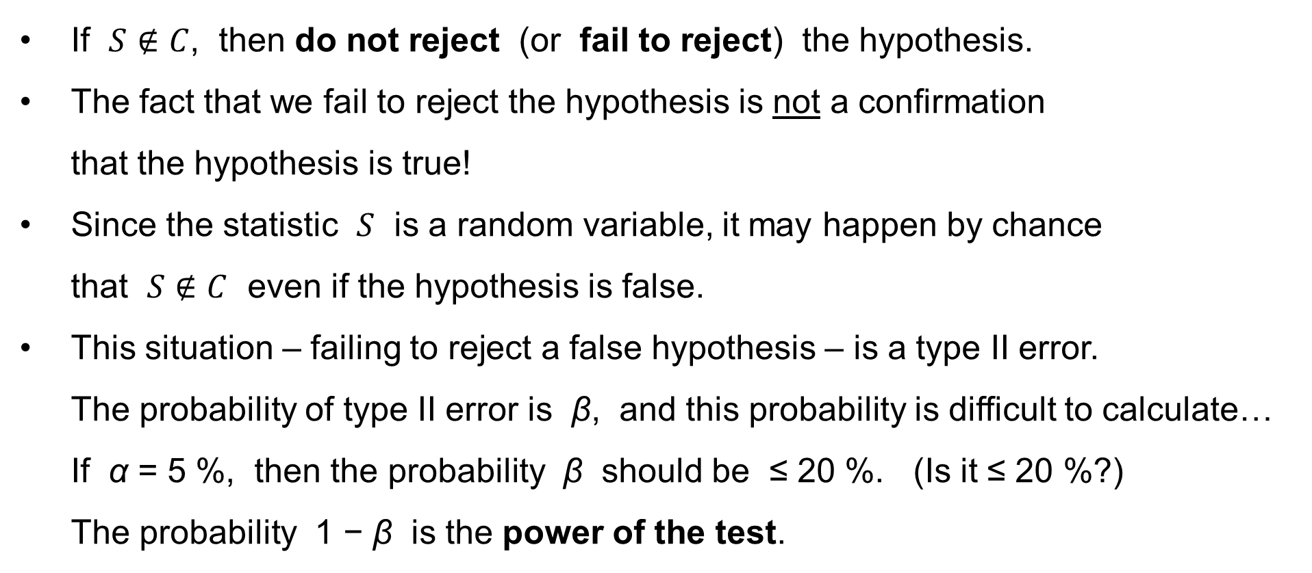
The general outline of a statistical hypothesis test
If $S∉C$, then do not reject (or fail to reject) the hypothesis.
The fact that we fail to reject the hypothesis is not a confirmation
that the hypothesis is true!
Since the statistic $S$ is a random variable, it may happen by chance
that $S∉C$ even if the hypothesis is false.
This situation – failing to reject a false hypothesis – is a type II error.
The probability of type II error is β, and this probability is difficult to calculate…
If α = 5 %, then the probability β should be ≤ 20 %. (Is it ≤ 20 %?)
The probability 1 − β is the power of the test.

Slide 8
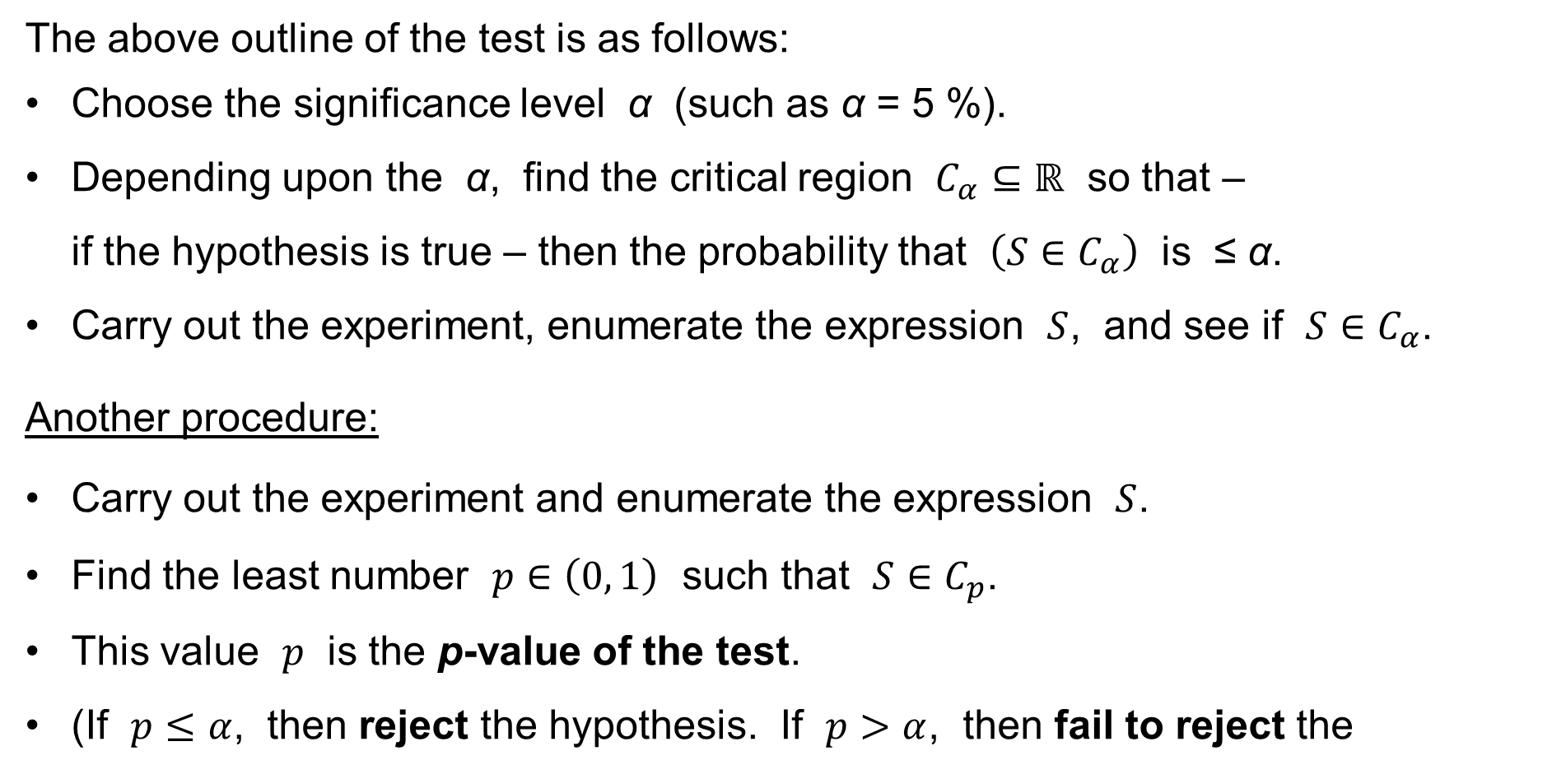
The p-value of the test
The above outline of the test is as follows:
Choose the significance level α (such as α = 5 %).
Depending upon the α, find the critical region $C_{α}⊆ℝ$ so that –
if the hypothesis is true – then the probability that $\left(S∈C_{α}\right)$ is ≤ α.
Carry out the experiment, enumerate the expression $S$, and see if $S∈C_{α}$.
Another procedure:
Carry out the experiment and enumerate the expression $S$.
Find the least number $p∈\left(0, 1\right)$ such that $S∈C_{p}$.
This value $p$ is the p-value of the test.
(If $p≤α$, then reject the hypothesis. If $p>α$, then fail to reject the
hypothesis.)

Slide 9
Parametric and Non-parametric tests
There are two large classes of statistical tests: parametric and non-parametric.
The parametric tests make assumptions about the probability distributions
of the random variables that are subject to the test. It is often assumed that
the underlying distribution is normal (Gaussian).
The non-parametric tests do not make such assumptions. The non-parametric tests can be used if the random variables are not normally distributed.

Slide 10
PARAMETRIC TESTS
t-tests for the means
Two sample F-test
for the equality of variances

Slide 11
t-tests for the means
One-sample t-test for
the population mean
Paired-sample t-test for
the difference of the population means
Two-sample t-test for
the difference of the population means

Slide 12
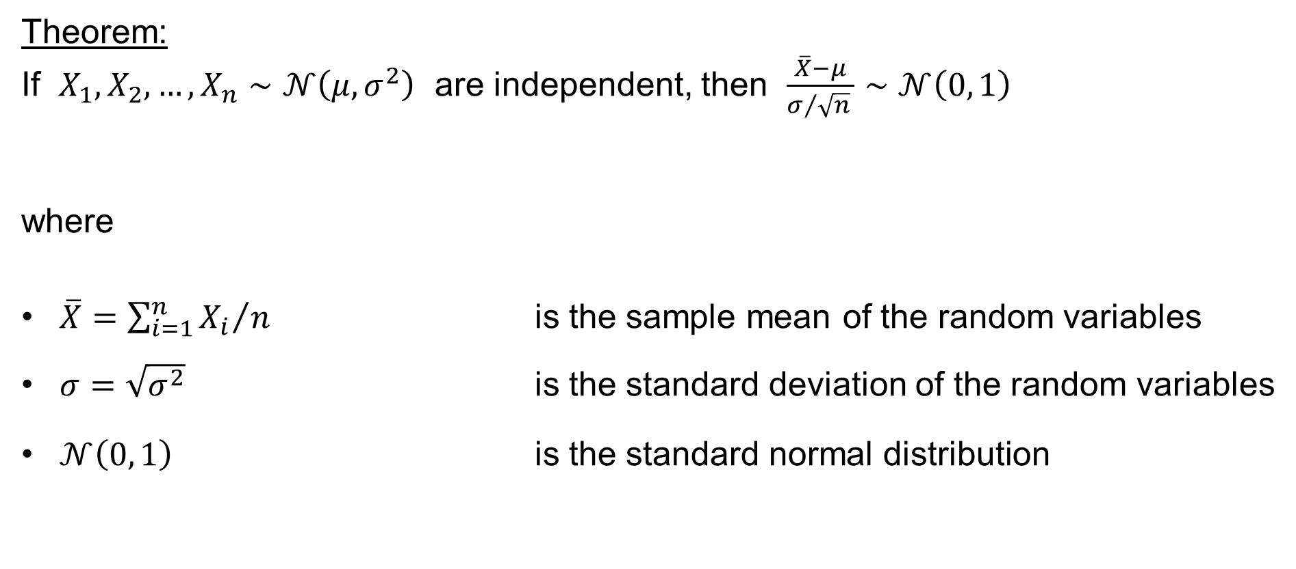
One-sample t-test for the population mean
Theorem:
If $X_{1},X_{2},…,X_{n}∼𝒩\left(μ,σ^{2}\right)$ are independent, then $\frac{\overline{X}−μ}{σ/{\sqrt{n}} }∼𝒩\left(0, 1\right)$
where
$\overline{X}={\left.\sum_{i=1}^{n}{X_{i}}\right.}/n$ is the sample mean of the random variables
$σ=\sqrt{σ^{2}}$ is the standard deviation of the random variables
$𝒩\left(0, 1\right)$ is the standard normal distribution

Slide 13
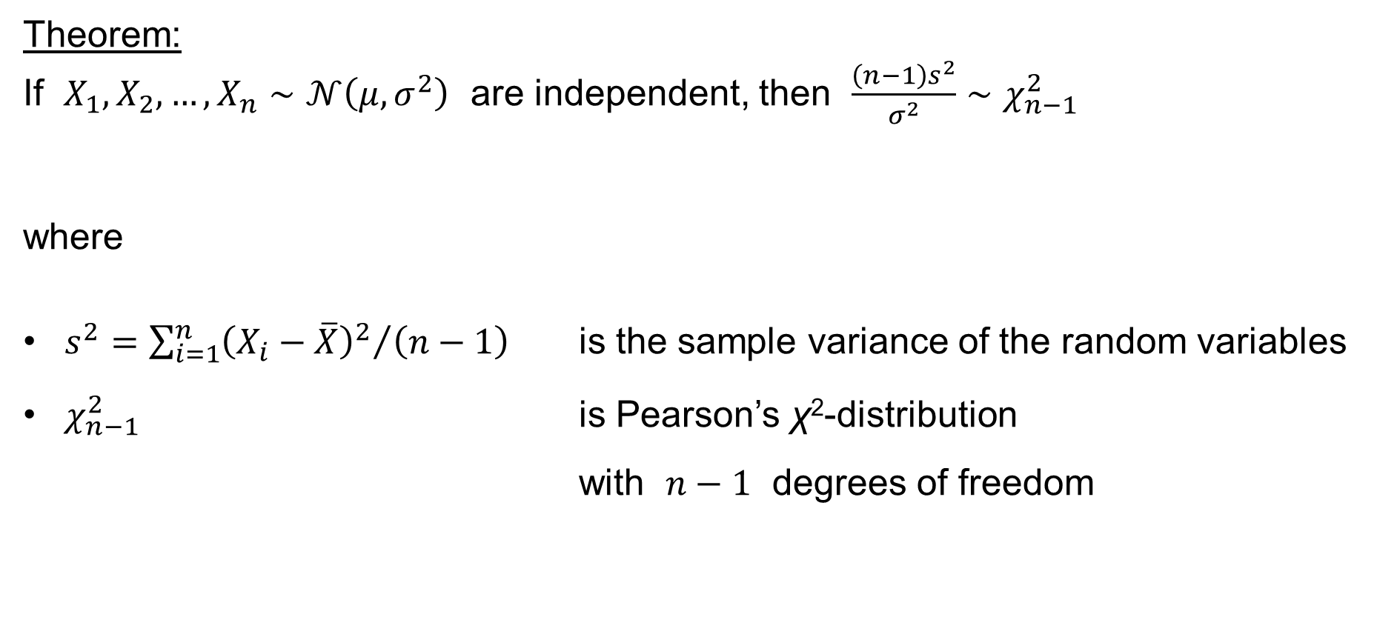
One-sample t-test for the population mean
Theorem:
If $X_{1},X_{2},…,X_{n}∼𝒩\left(μ,σ^{2}\right)$ are independent, then $\frac{\left(n−1\right)s^{2}}{σ^{2}}∼χ_{n−1}^{2}$
where
$s^{2}={\left.\sum_{i=1}^{n}{{\left(X_{i}−\overline{X}\right)}^{2}}\right.}/{\left(n−1\right)}$ is the sample variance of the random variables
$χ_{n−1}^{2}$ is Pearson’s χ²-distribution
with $n−1$ degrees of freedom

Slide 14
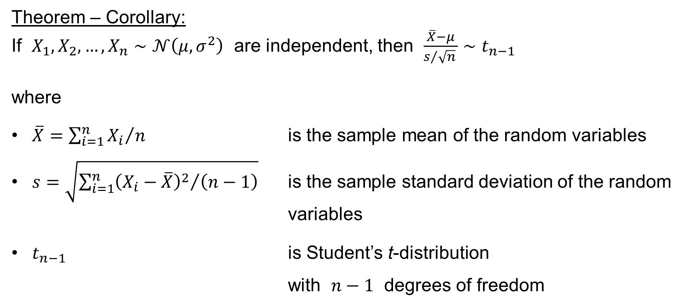
One-sample t-test for the population mean
Theorem – Corollary:
If $X_{1},X_{2},…,X_{n}∼𝒩\left(μ,σ^{2}\right)$ are independent, then $\frac{\overline{X}−μ}{s/{\sqrt{n}} }∼t_{n−1}$
where
$\overline{X}={\left.\sum_{i=1}^{n}{X_{i}}\right.}/n$ is the sample mean of the random variables
$s=\sqrt{{\left.\sum_{i=1}^{n}{{\left(X_{i}−\overline{X}\right)}^{2}}\right.}/{\left(n−1\right)}}$ is the sample standard deviation of the random
variables
$t_{n−1}$ is Student’s t-distribution
with $n−1$ degrees of freedom

Slide 15
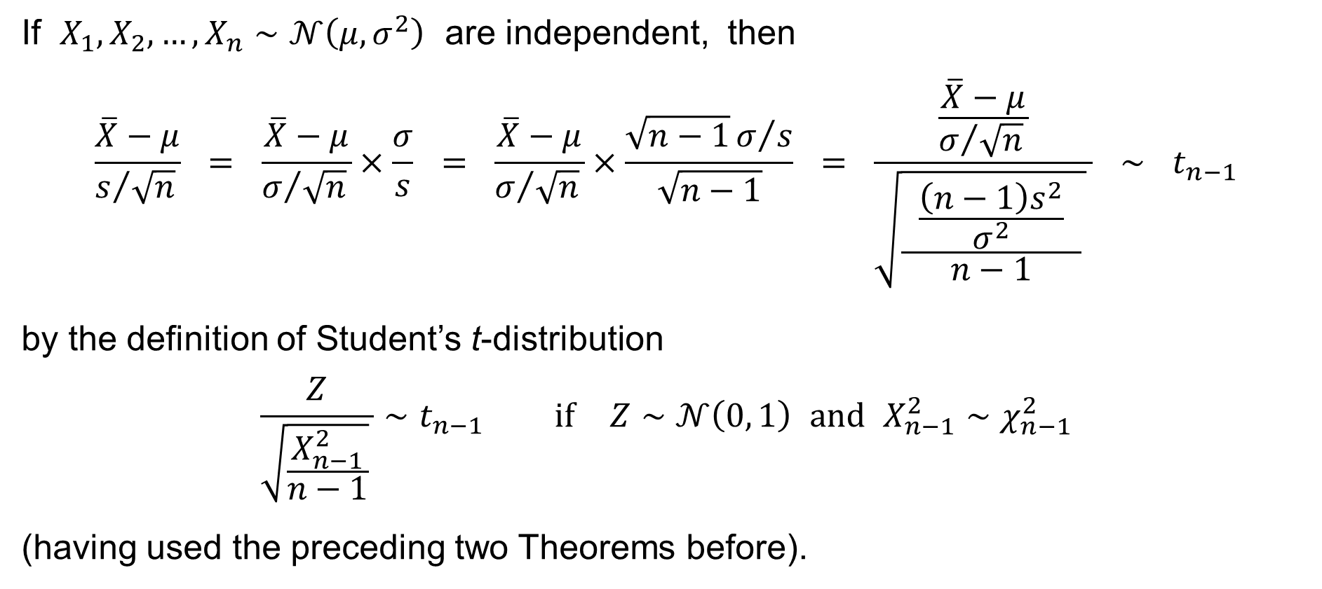
Theorem – Corollary – Proof:
If $X_{1},X_{2},…,X_{n}∼𝒩\left(μ,σ^{2}\right)$ are independent, then
$$\frac{\overline{X}−μ}{s/{\sqrt{n}} } = \frac{\overline{X}−μ}{σ/{\sqrt{n}} }×\frac{σ}{s} = \frac{\overline{X}−μ}{σ/{\sqrt{n}} }×\frac{\sqrt{n−1}σ/s}{\sqrt{n−1}} = \frac{\frac{\overline{X}−μ}{σ/{\sqrt{n}} }}{\sqrt{\frac{ \frac{\left(n−1\right)s^{2}}{σ^{2}} }{n−1} } } ∼ t_{n−1}$$
by the definition of Student’s t-distribution
$$\frac{Z}{\sqrt{\frac{X_{n−1}^{2}}{n−1}} }∼t_{n−1} \text{if} Z∼𝒩\left(0, 1\right) \text{and} X_{n−1}^{2}∼χ_{n−1}^{2}$$
(having used the preceding two Theorems before).

Slide 16
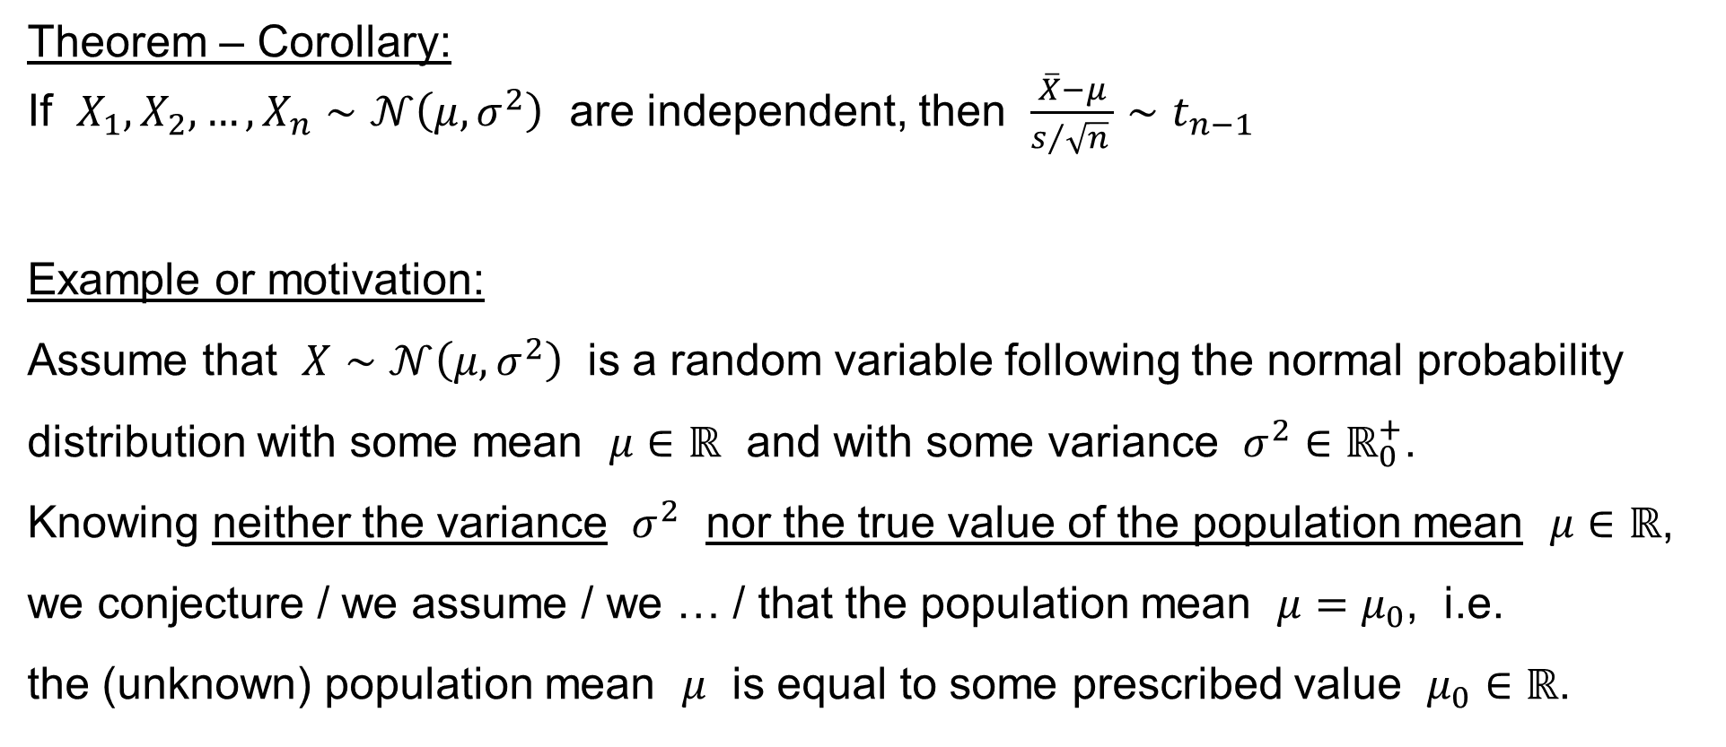
One-sample t-test for the population mean
Theorem – Corollary:
If $X_{1},X_{2},…,X_{n}∼𝒩\left(μ,σ^{2}\right)$ are independent, then $\frac{\overline{X}−μ}{s/{\sqrt{n}} }∼t_{n−1}$
Example or motivation:
Assume that $X∼𝒩\left(μ,σ^{2}\right)$ is a random variable following the normal probability distribution with some mean $μ∈ℝ$ and with some variance $σ^{2}∈ℝ_{0}^{+}$.
Knowing neither the variance $σ^{2}$ nor the true value of the population mean $μ∈ℝ$, we conjecture / we assume / we … / that the population mean $μ=μ_{0}$, i.e.
the (unknown) population mean $μ$ is equal to some prescribed value $μ_{0}∈ℝ$.

Slide 17
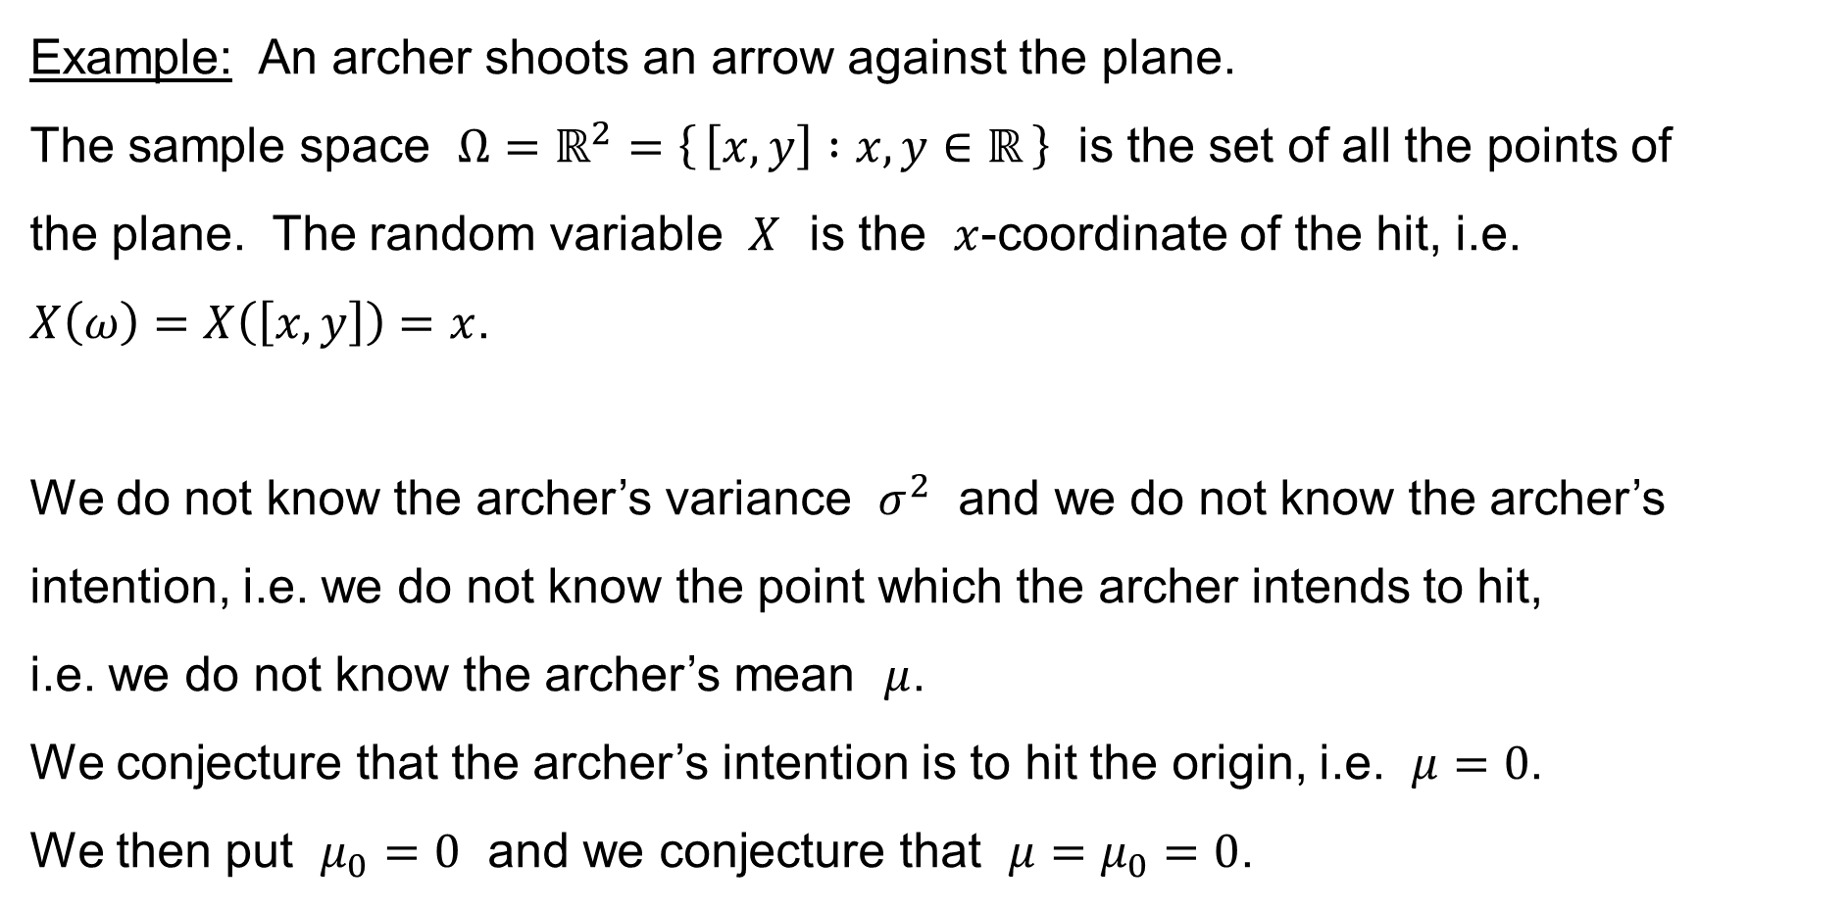
One-sample t-test for the population mean
Example: An archer shoots an arrow against the plane.
The sample space $Ω=ℝ^{2}=\left\{ \left[x,y\right] :x,y∈ℝ \right\}$ is the set of all the points of
the plane. The random variable $X$ is the $x$-coordinate of the hit, i.e.
$X\left(ω\right)=X\left(\left[x,y\right]\right)=x$.
We do not know the archer’s variance $σ^{2}$ and we do not know the archer’s intention, i.e. we do not know the point which the archer intends to hit,
i.e. we do not know the archer’s mean $μ$.
We conjecture that the archer’s intention is to hit the origin, i.e. $μ=0$.
We then put $μ_{0}=0$ and we conjecture that $μ=μ_{0}=0$.

Slide 18
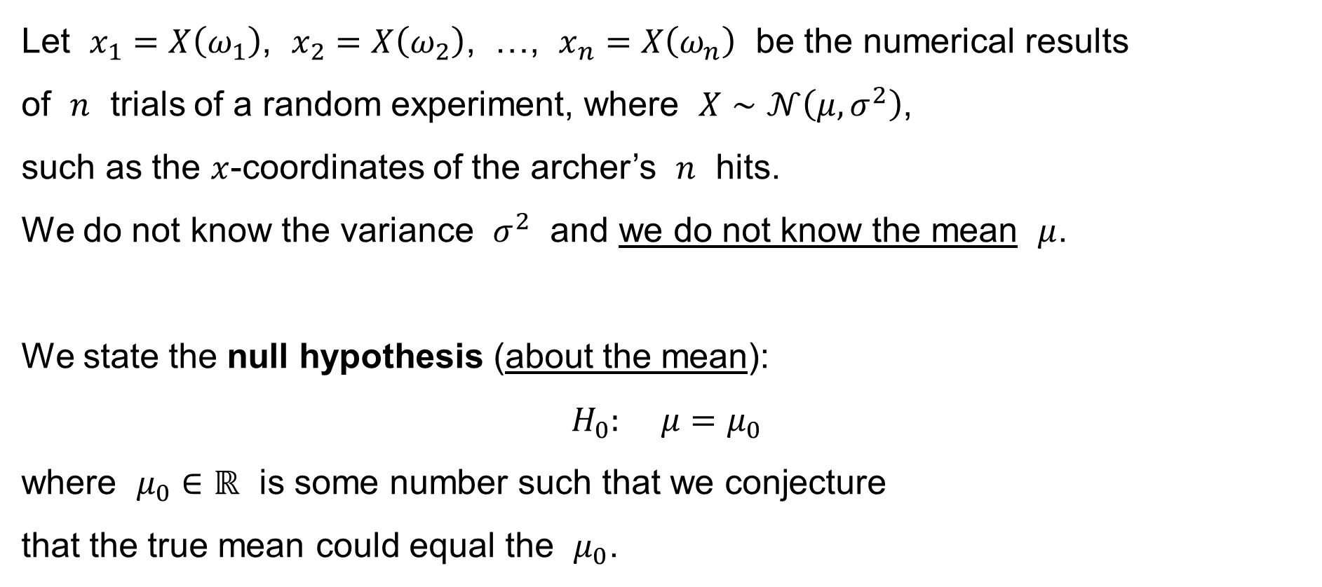
One-sample t-test for the population mean
Let $x_{1}=X\left(ω_{1}\right)$, $x_{2}=X\left(ω_{2}\right)$, …, $x_{n}=X\left(ω_{n}\right)$ be the numerical results
of $n$ trials of a random experiment, where $X∼𝒩\left(μ,σ^{2}\right)$,
such as the $x$-coordinates of the archer’s $n$ hits.
We do not know the variance $σ^{2}$ and we do not know the mean $μ$.
We state the null hypothesis (about the mean):
$$H_{0}: μ=μ_{0}$$
where $μ_{0}∈ℝ$ is some number such that we conjecture
that the true mean could equal the $μ_{0}$.

Slide 19
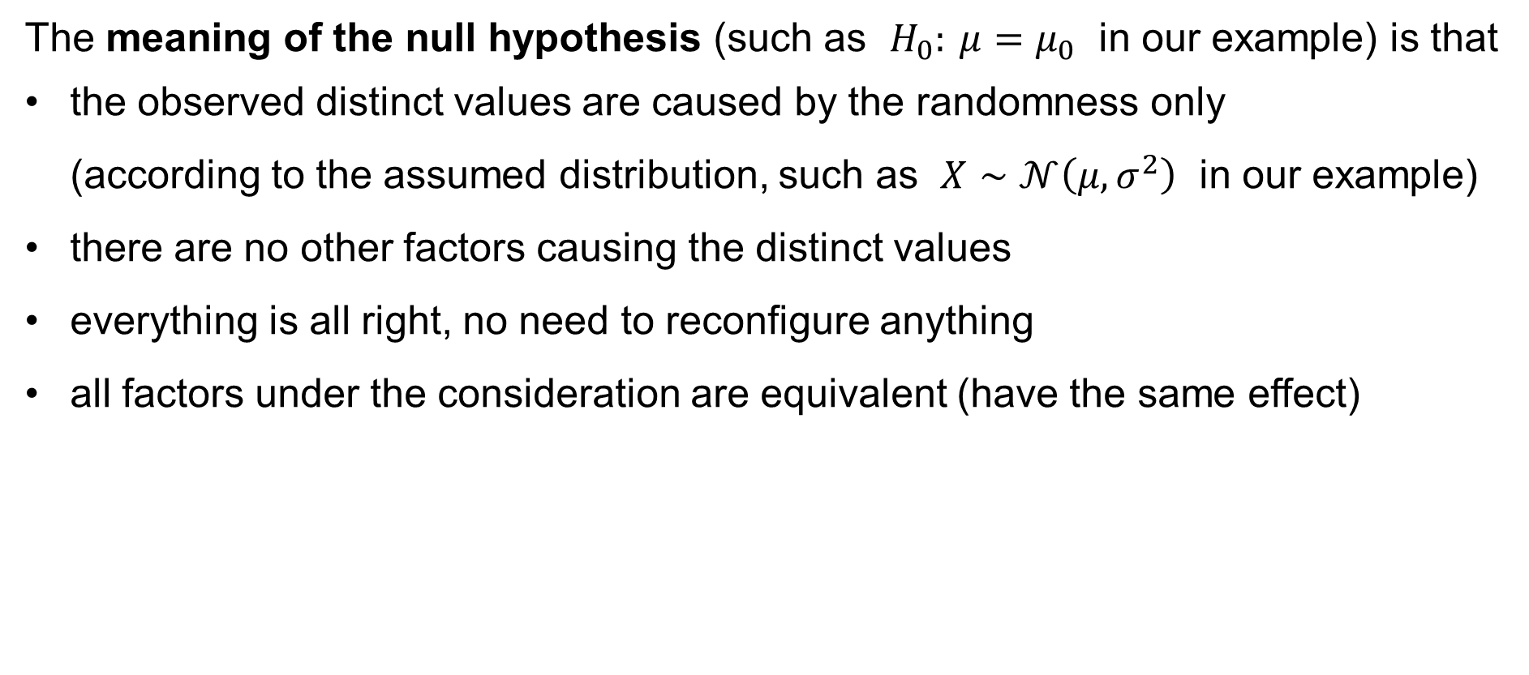
One-sample t-test for the population mean
The meaning of the null hypothesis (such as $H_{0}: μ=μ_{0}$ in our example) is that
the observed distinct values are caused by the randomness only
(according to the assumed distribution, such as $X∼𝒩\left(μ,σ^{2}\right)$ in our example)
there are no other factors causing the distinct values
everything is all right, no need to reconfigure anything
all factors under the consideration are equivalent (have the same effect)

Slide 20

One-sample t-test for the population mean
Having stated the null hypothesis
$$H_{0}: μ=μ_{0}$$
we also state the alternative hypothesis:
two-sided: $H_{1}: μ≠μ_{0}$
one-sided: $H_{1}: μ<μ_{0}$
one-sided: $H_{1}: μ>μ_{0}$

Slide 21
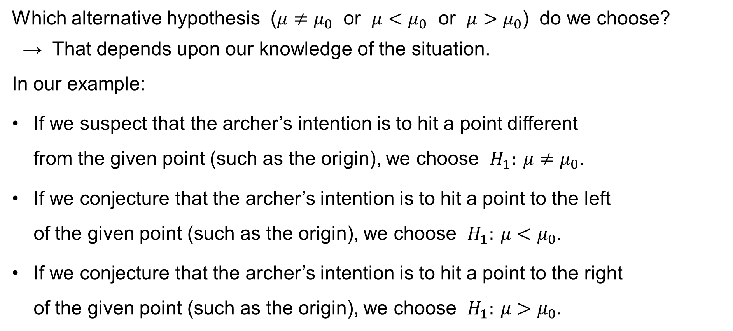
One-sample t-test for the population mean
Which alternative hypothesis ($μ≠μ_{0}$ or $μ<μ_{0}$ or $μ>μ_{0}$) do we choose?
→ That depends upon our knowledge of the situation.
In our example:
If we suspect that the archer’s intention is to hit a point different
from the given point (such as the origin), we choose $H_{1}: μ≠μ_{0}$.
If we conjecture that the archer’s intention is to hit a point to the left
of the given point (such as the origin), we choose $H_{1}: μ<μ_{0}$.
If we conjecture that the archer’s intention is to hit a point to the right
of the given point (such as the origin), we choose $H_{1}: μ>μ_{0}$.

Slide 22
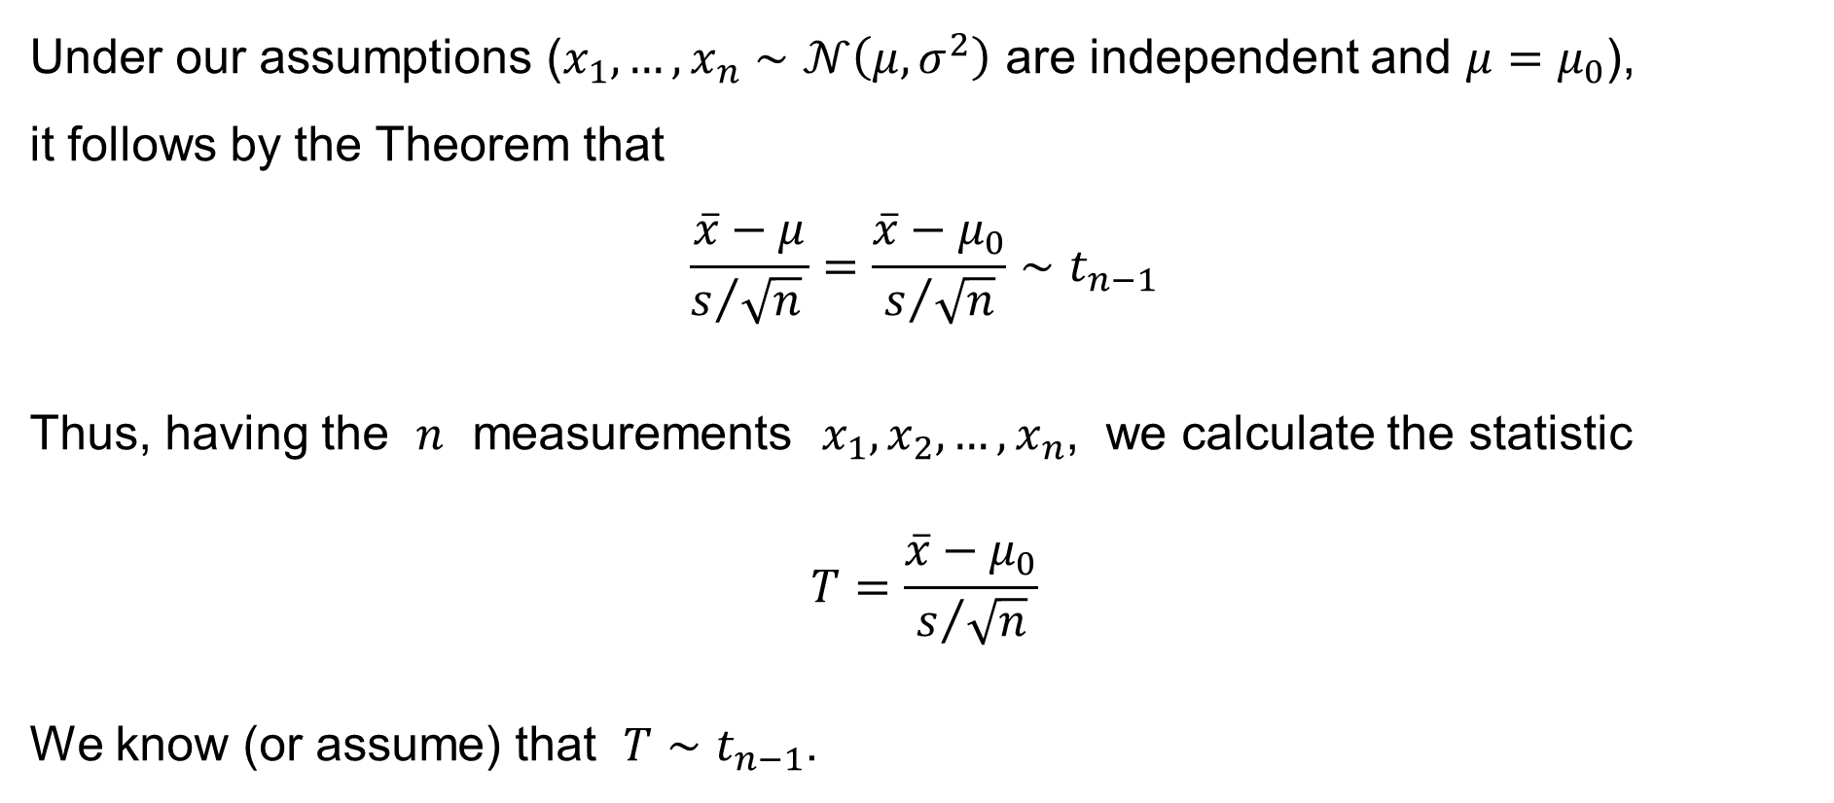
One-sample t-test for the population mean
Under our assumptions ($x_{1},…,x_{n}∼𝒩\left(μ,σ^{2}\right)$ are independent and $μ=μ_{0}$),
it follows by the Theorem that
$$\frac{\overline{x}−μ}{s/{\sqrt{n}} }=\frac{\overline{x}−μ_{0}}{s/{\sqrt{n}}}∼t_{n−1}$$
Thus, having the $n$ measurements $x_{1},x_{2},…,x_{n}$, we calculate the statistic
$$T=\frac{\overline{x}−μ_{0}}{s/{\sqrt{n}}}$$
We know (or assume) that $T∼t_{n−1}$.

Slide 23
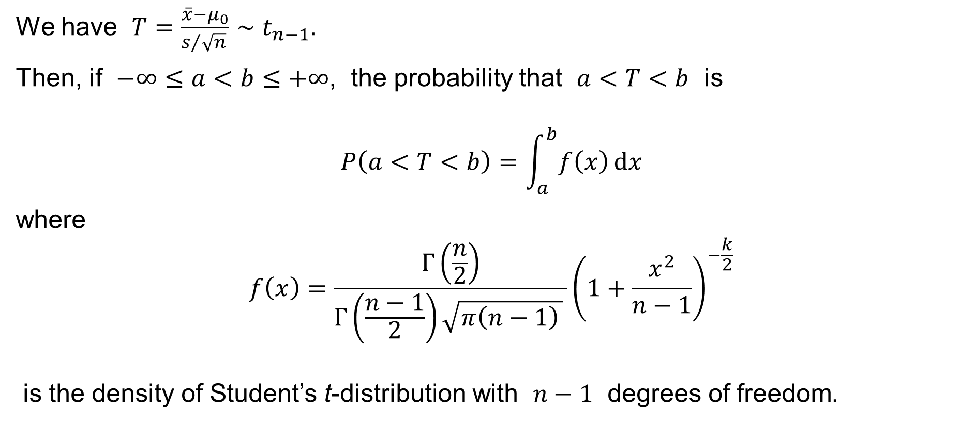
One-sample t-test for the population mean
We have $T=\frac{\overline{x}−μ_{0}}{s/{\sqrt{n}} }∼t_{n−1}$.
Then, if $−∞≤a<b≤+∞$, the probability that $a<T<b$ is
$$P\left(a<T<b\right)=\int_{a}^{b}{f\left(x\right) dx}$$
where
$$f\left(x\right)=\frac{Γ\left(\frac{n}{2}\right)}{Γ\left(\frac{n−1}{2}\right)\sqrt{π\left(n−1\right) } }{\left(1+\frac{x^{2}}{n−1}\right)}^{−\frac{k}{2}}$$
is the density of Student’s t-distribution with $n−1$ degrees of freedom.

Slide 24

The gamma function
$$Γ\left(z\right)=\int_{0}^{+∞}{x^{z}e^{−x} dx} \text{for} z∈ℂ \text{such} \text{that} \operatorname{Re}\left(z\right)>0$$
It is easy to calculate:
$$Γ\left(1\right)=1 \\ Γ\left(z+1\right)=zΓ\left(z\right)$$
Therefore:
$$Γ\left(n+1\right)=n! \text{for} n=0, 1, 2, 3,…$$

Slide 25

The gamma function – another definition (due to Euler)
$$Γ\left(z\right) = \frac{1}{z}\prod_{n=1}^{∞}{\frac{{\left(1+\frac{1}{n}\right)}^{z}}{1+\frac{z}{n}}} \text{for} z∈ℂ∖\left\{0,−1,−2,−3,…\right\}$$

Slide 26
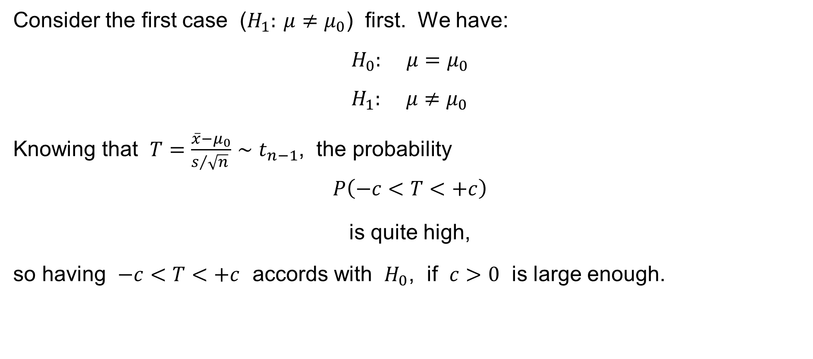
One-sample t-test for the population mean
Consider the first case ($H_{1}: μ≠μ_{0}$) first. We have:
$$H_{0}: μ=μ_{0} \\ H_{1}: μ≠μ_{0}$$
Knowing that $T=\frac{\overline{x}−μ_{0}}{s/{\sqrt{n}} }∼t_{n−1}$, the probability
$$P\left(−c<T<+c\right)$$
is quite high,
so having $−c<T<+c$ accords with $H_{0}$, if $c>0$ is large enough.

Slide 27
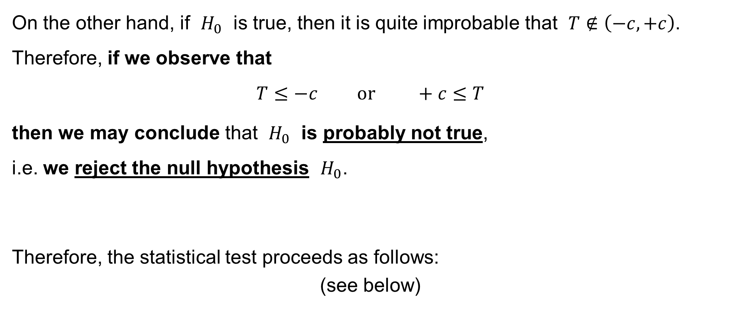
One-sample t-test for the population mean
On the other hand, if $H_{0}$ is true, then it is quite improbable that $T∉\left(−c,+c\right)$. Therefore, if we observe that
$$T≤−c \text{or} +c≤T$$
then we may conclude that $H_{0}$ is probably not true,
i.e. we reject the null hypothesis $H_{0}$.
Therefore, the statistical test proceeds as follows:
(see below)

Slide 28
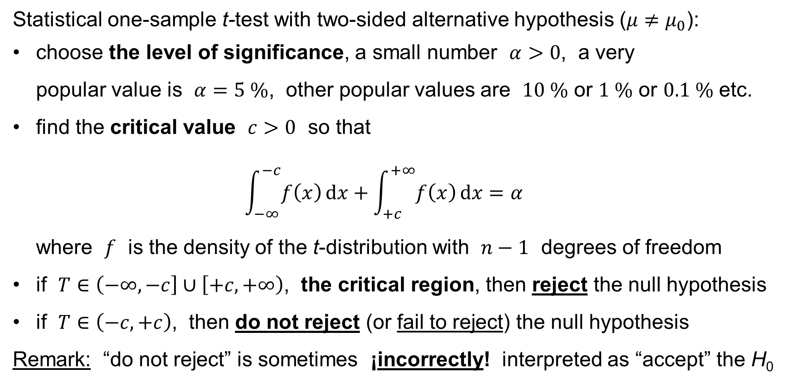
One-sample t-test for the population mean
Statistical one-sample t-test with two-sided alternative hypothesis ($μ≠μ_{0}$):
choose the level of significance, a small number $α>0$, a very
popular value is $α=5 \%$, other popular values are $10 \%$ or $1 \%$ or $0.1 \%$ etc.
find the critical value $c>0$ so that
$\int_{−∞}^{−c}{f\left(x\right) dx}+\int_{+c}^{+∞}{f\left(x\right) dx}=α$
where $f$ is the density of the t-distribution with $n−1$ degrees of freedom
if $T∈\left(−∞,−c\right]∪\left[+c,+∞\right)$, the critical region, then reject the null hypothesis
if $T∈\left(−c,+c\right)$, then do not reject (or fail to reject) the null hypothesis
Remark: “do not reject” is sometimes ¡incorrectly! interpreted as “accept” the H₀

Slide 29
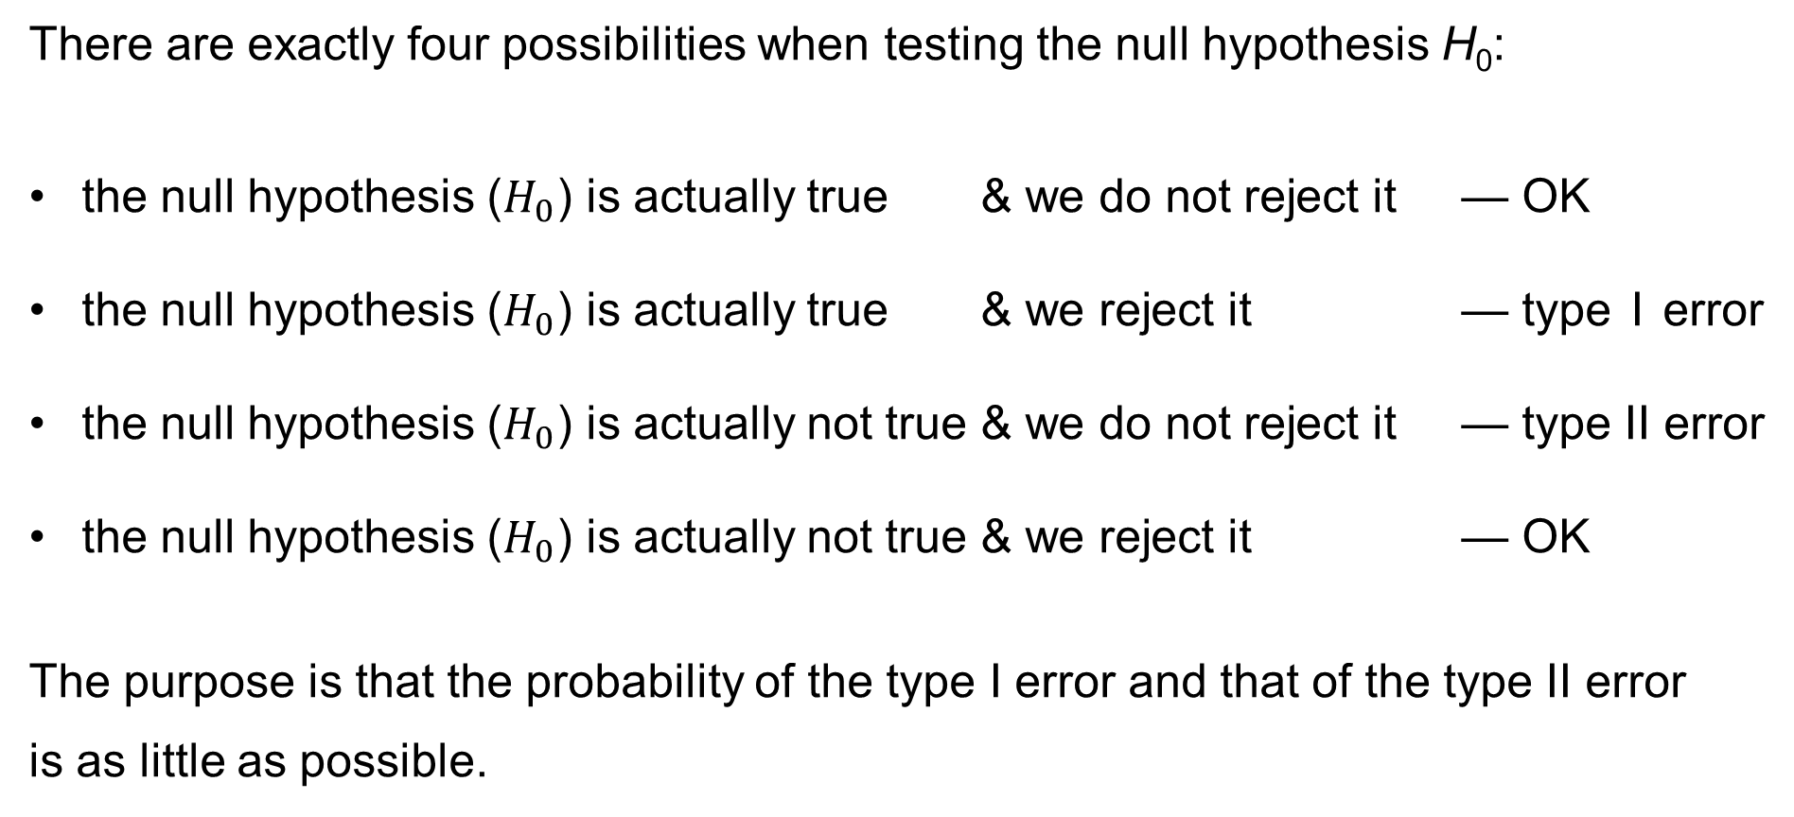
Type I and Type II error
There are exactly four possibilities when testing the null hypothesis H₀:
the null hypothesis ($H_{0}$) is actually true & we do not reject it — OK
the null hypothesis ($H_{0}$) is actually true & we reject it — type I error
the null hypothesis ($H_{0}$) is actually not true & we do not reject it — type II error
the null hypothesis ($H_{0}$) is actually not true & we reject it — OK
The purpose is that the probability of the type I error and that of the type II error
is as little as possible.

Slide 30
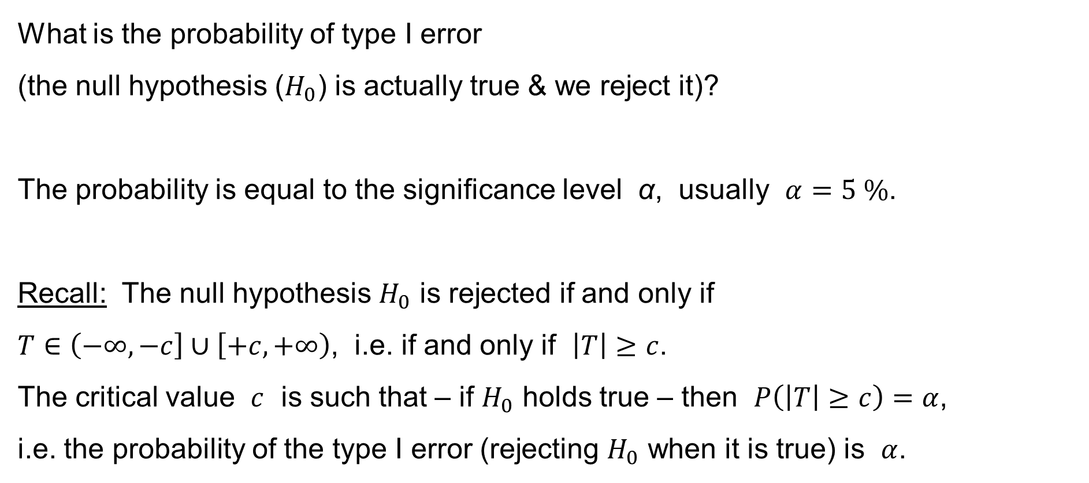
Type I and Type II error
What is the probability of type I error
(the null hypothesis ($H_{0}$) is actually true & we reject it)?
The probability is equal to the significance level α, usually $α=5 \%$.
Recall: The null hypothesis $H_{0}$ is rejected if and only if
$T∈\left(−∞,−c\right]∪\left[+c,+∞\right)$, i.e. if and only if $\left|T\right|≥c$.
The critical value $c$ is such that – if $H_{0}$ holds true – then $P\left(\left|T\right|≥c\right)=α$,
i.e. the probability of the type I error (rejecting $H_{0}$ when it is true) is $α$.

Slide 31
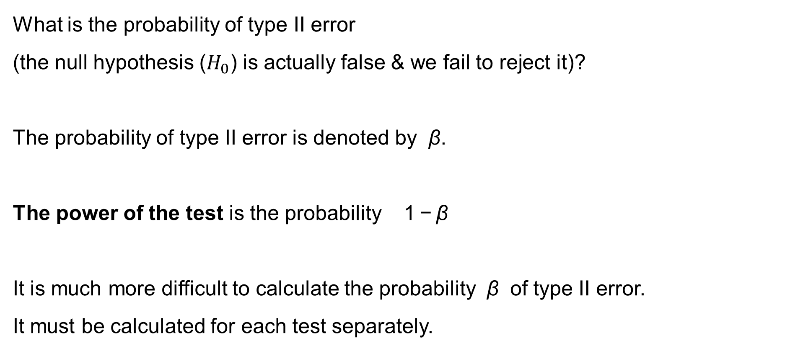
Type I and Type II error
What is the probability of type II error
(the null hypothesis ($H_{0}$) is actually false & we fail to reject it)?
The probability of type II error is denoted by β.
The power of the test is the probability 1 − β
It is much more difficult to calculate the probability β of type II error.
It must be calculated for each test separately.

Slide 32
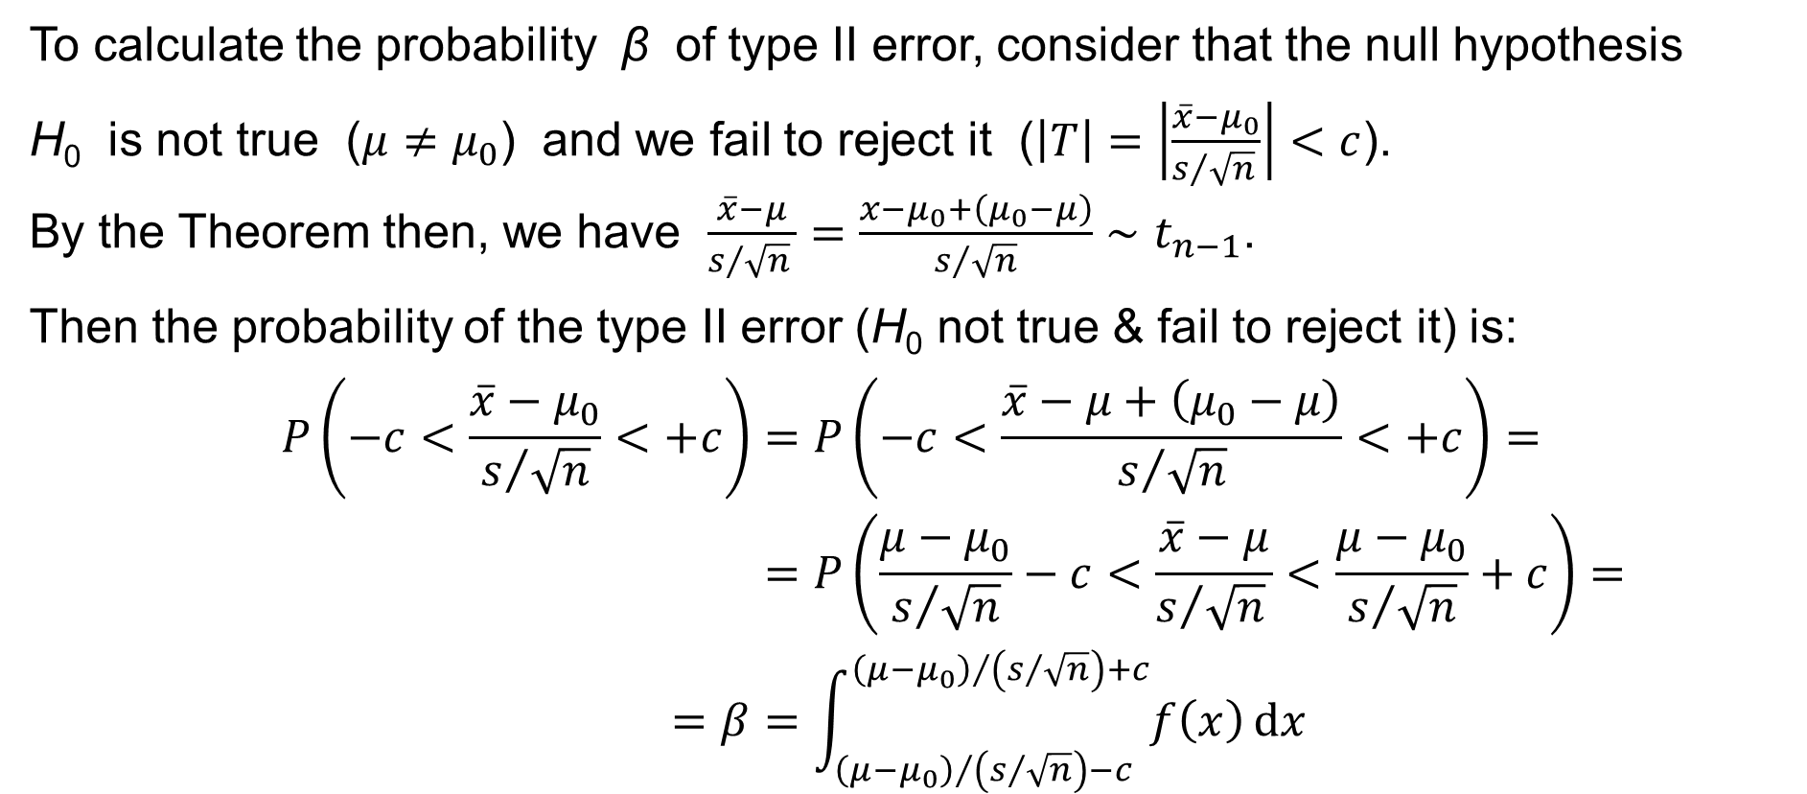
Type I and Type II error
To calculate the probability β of type II error, consider that the null hypothesis
H₀ is not true ($μ≠μ_{0}$) and we fail to reject it ($\left|T\right|=\left|\frac{\overline{x}−μ_{0}}{s/{\sqrt{n}} }\right|<c$).
By the Theorem then, we have $\frac{\overline{x}−μ}{s/{\sqrt{n}} }=\frac{x−μ_{0}+\left(μ_{0}−μ\right)}{s/{\sqrt{n}}}∼t_{n−1}$.
Then the probability of the type II error (H₀ not true & fail to reject it) is:
$$P\left(−c<\frac{\overline{x}−μ_{0}}{s/{\sqrt{n}}}<+c\right)=P\left(−c<\frac{\overline{x}−μ+\left(μ_{0}−μ\right)}{s/{\sqrt{n}}}<+c\right)= \\ =P\left(\frac{μ−μ_{0}}{s/{\sqrt{n}}}−c<\frac{\overline{x}−μ}{s/{\sqrt{n}} }<\frac{μ−μ_{0}}{s/{\sqrt{n}}}+c\right)= \\ =β=\int_{{\left(μ−μ_{0}\right)}/{\left(s/{\sqrt{n}}\right)}−c}^{{\left(μ−μ_{0}\right)}/{\left(s/{\sqrt{n}}\right)}+c}{f\left(x\right) dx}$$

Slide 33
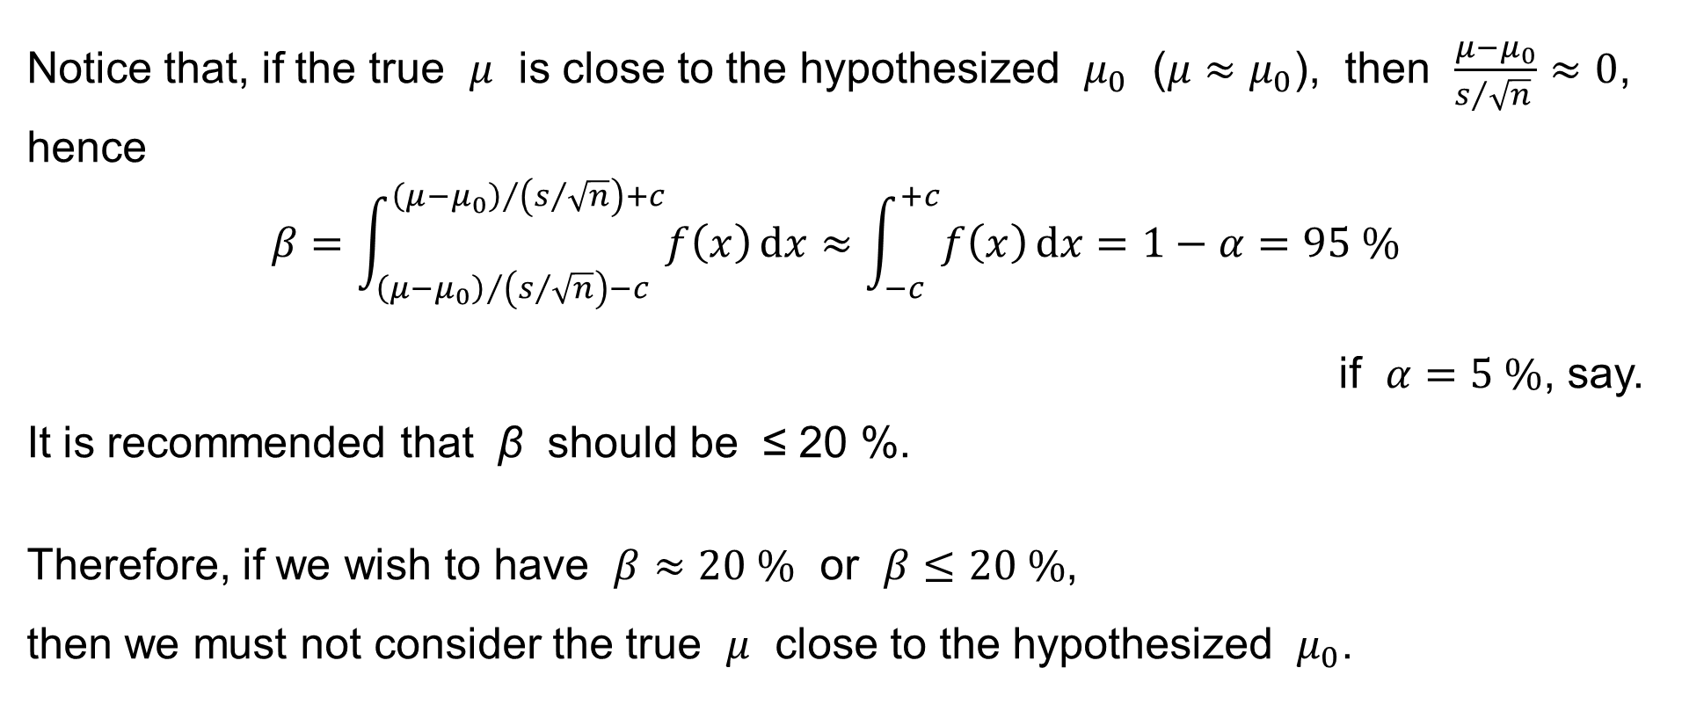
Type I and Type II error
Notice that, if the true $μ$ is close to the hypothesized $μ_{0}$ ($μ≈μ_{0}$), then $\frac{μ−μ_{0}}{s/{\sqrt{n}} }≈0$,
hence
$$β=\int_{{\left(μ−μ_{0}\right)}/{\left(s/{\sqrt{n}}\right)}−c}^{{\left(μ−μ_{0}\right)}/{\left(s/{\sqrt{n}}\right)}+c}{f\left(x\right) dx}≈\int_{−c}^{+c}{f\left(x\right) dx}=1−α=95 \%$$
if $α=5 \%$, say.
It is recommended that β should be ≤ 20 %.
Therefore, if we wish to have $β≈20 \%$ or $β≤20 \%$,
then we must not consider the true $μ$ close to the hypothesized $μ_{0}$.

Slide 34
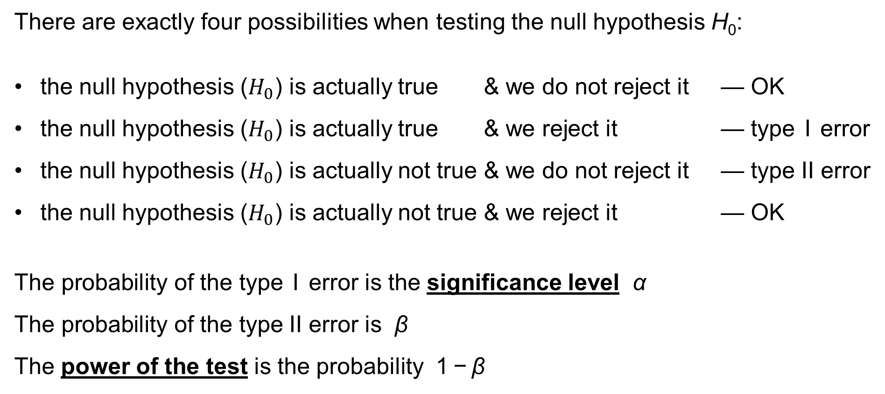
Type I and Type II error: Summary
There are exactly four possibilities when testing the null hypothesis H₀:
the null hypothesis ($H_{0}$) is actually true & we do not reject it — OK
the null hypothesis ($H_{0}$) is actually true & we reject it — type I error
the null hypothesis ($H_{0}$) is actually not true & we do not reject it — type II error
the null hypothesis ($H_{0}$) is actually not true & we reject it — OK
The probability of the type I error is the significance level α
The probability of the type II error is β
The power of the test is the probability 1 − β

Slide 35
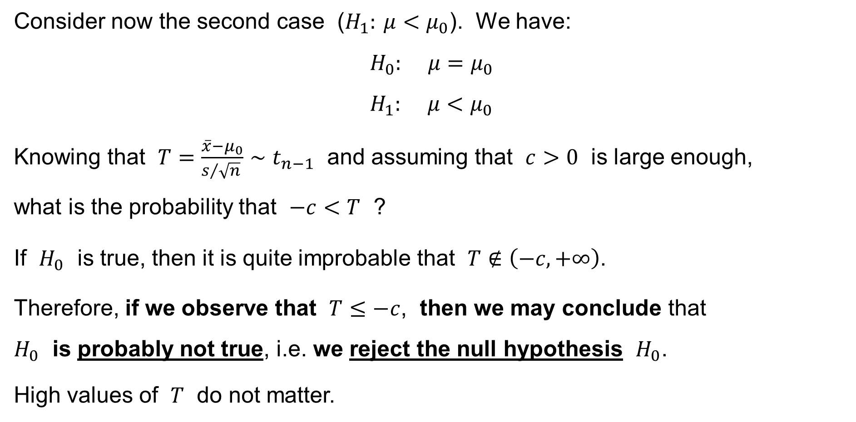
One-sample t-test for the population mean
Consider now the second case ($H_{1}: μ<μ_{0}$). We have:
$$H_{0}: μ=μ_{0} \\ H_{1}: μ<μ_{0}$$
Knowing that $T=\frac{\overline{x}−μ_{0}}{s/{\sqrt{n}} }∼t_{n−1}$ and assuming that $c>0$ is large enough,
what is the probability that $−c<T$ ?
If $H_{0}$ is true, then it is quite improbable that $T∉\left(−c,+∞\right)$.
Therefore, if we observe that $T≤−c$, then we may conclude that
$H_{0}$ is probably not true, i.e. we reject the null hypothesis $H_{0}$.
High values of $T$ do not matter.

Slide 36
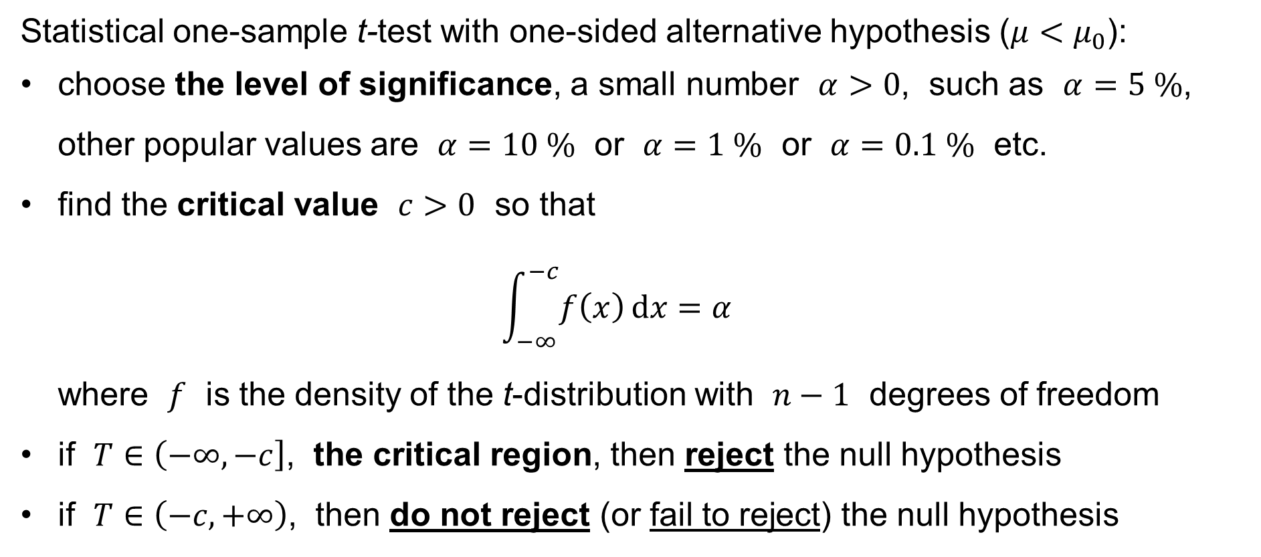
One-sample t-test for the population mean
Statistical one-sample t-test with one-sided alternative hypothesis ($μ<μ_{0}$):
choose the level of significance, a small number $α>0$, such as $α=5 \%$, other popular values are $α=10 \%$ or $α=1 \%$ or $α=0.1 \%$ etc.
find the critical value $c>0$ so that
$\int_{−∞}^{−c}{f\left(x\right) dx}=α$
where $f$ is the density of the t-distribution with $n−1$ degrees of freedom
if $T∈\left(−∞,−c\right]$, the critical region, then reject the null hypothesis
if $T∈\left(−c,+∞\right)$, then do not reject (or fail to reject) the null hypothesis

Slide 37
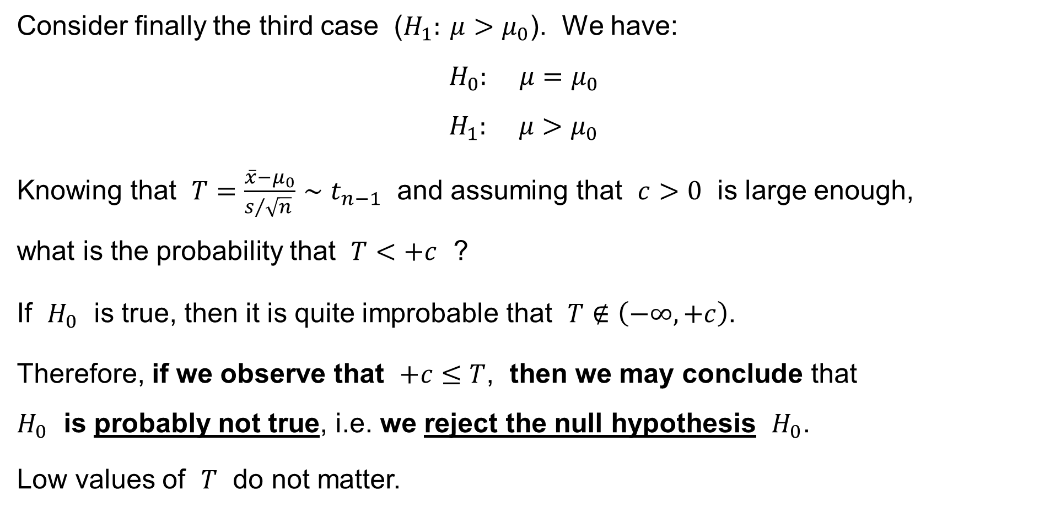
One-sample t-test for the population mean
Consider finally the third case ($H_{1}: μ>μ_{0}$). We have:
$$H_{0}: μ=μ_{0} \\ H_{1}: μ>μ_{0}$$
Knowing that $T=\frac{\overline{x}−μ_{0}}{s/{\sqrt{n}} }∼t_{n−1}$ and assuming that $c>0$ is large enough,
what is the probability that $T<+c$ ?
If $H_{0}$ is true, then it is quite improbable that $T∉\left(−∞,+c\right)$.
Therefore, if we observe that $+c≤T$, then we may conclude that
$H_{0}$ is probably not true, i.e. we reject the null hypothesis $H_{0}$.
Low values of $T$ do not matter.

Slide 38
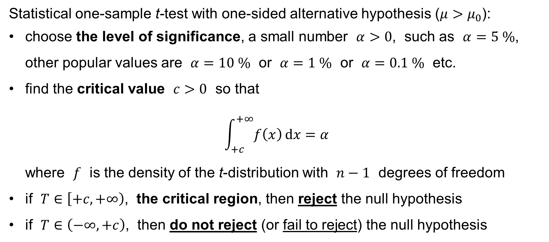
One-sample t-test for the population mean
Statistical one-sample t-test with one-sided alternative hypothesis ($μ>μ_{0}$):
choose the level of significance, a small number $α>0$, such as $α=5 \%$, other popular values are $α=10 \%$ or $α=1 \%$ or $α=0.1 \%$ etc.
find the critical value $c>0$ so that
$\int_{+c}^{+∞}{f\left(x\right) dx}=α$
where $f$ is the density of the t-distribution with $n−1$ degrees of freedom
if $T∈\left[+c,+∞\right)$, the critical region, then reject the null hypothesis
if $T∈\left(−∞,+c\right)$, then do not reject (or fail to reject) the null hypothesis

Slide 39
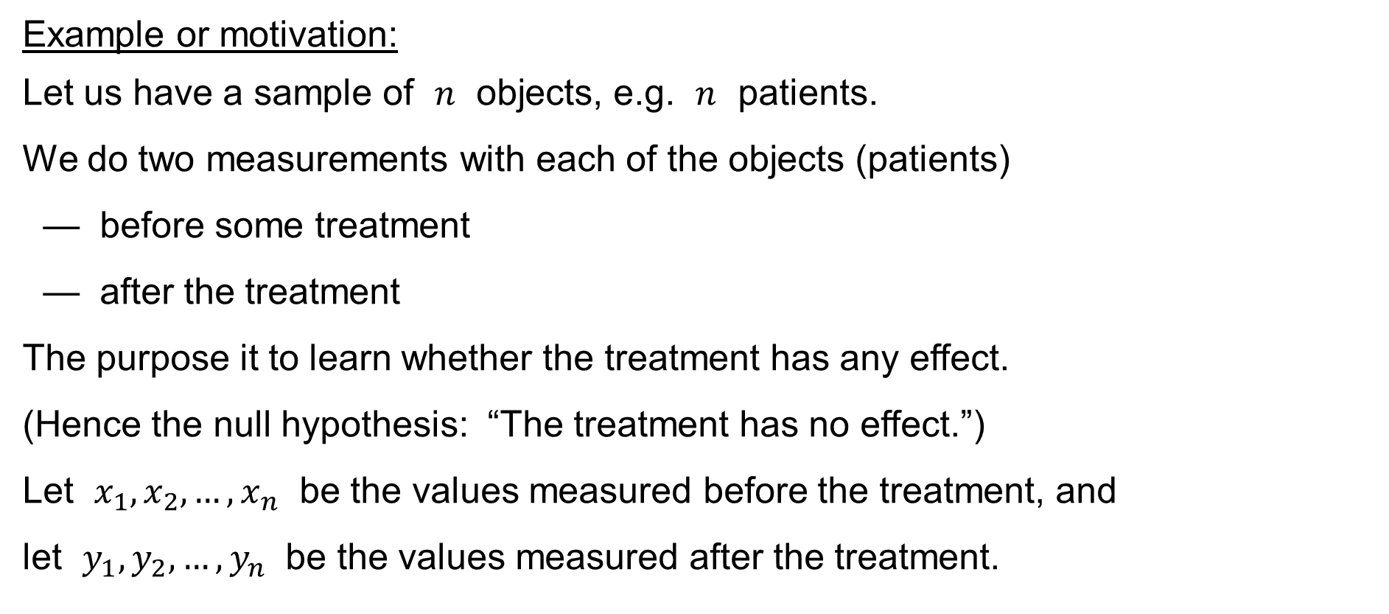
Paired-sample t-test for the difference of the pop.means
Example or motivation:
Let us have a sample of $n$ objects, e.g. $n$ patients.
We do two measurements with each of the objects (patients)
— before some treatment
— after the treatment
The purpose it to learn whether the treatment has any effect.
(Hence the null hypothesis: “The treatment has no effect.”)
Let $x_{1},x_{2},…,x_{n}$ be the values measured before the treatment, and
let $y_{1},y_{2},…,y_{n}$ be the values measured after the treatment.

Slide 40
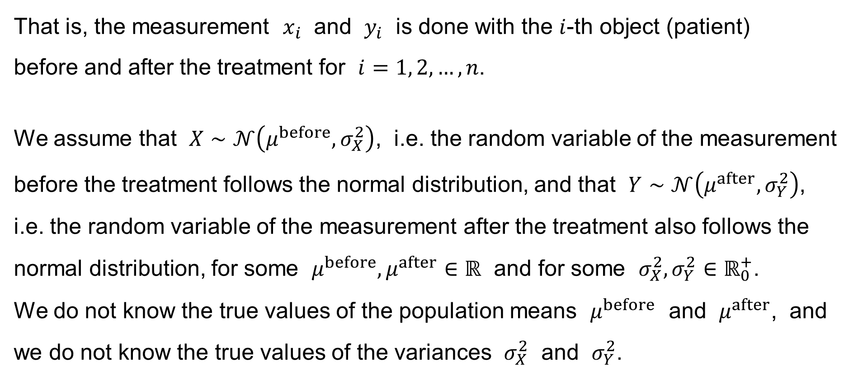
Paired-sample t-test for the difference of the pop.means
That is, the measurement $x_{i}$ and $y_{i}$ is done with the $i$-th object (patient)
before and after the treatment for $i=1, 2,…,n$.
We assume that $X∼𝒩\left(μ^{before},σ_{X}^{2}\right)$, i.e. the random variable of the measurement before the treatment follows the normal distribution, and that $Y∼𝒩\left(μ^{after},σ_{Y}^{2}\right)$, i.e. the random variable of the measurement after the treatment also follows the normal distribution, for some $μ^{before},μ^{after}∈ℝ$ and for some $σ_{X}^{2},σ_{Y}^{2}∈ℝ_{0}^{+}$.
We do not know the true values of the population means $μ^{before}$ and $μ^{after}$, and we do not know the true values of the variances $σ_{X}^{2}$ and $σ_{Y}^{2}$.

Slide 41
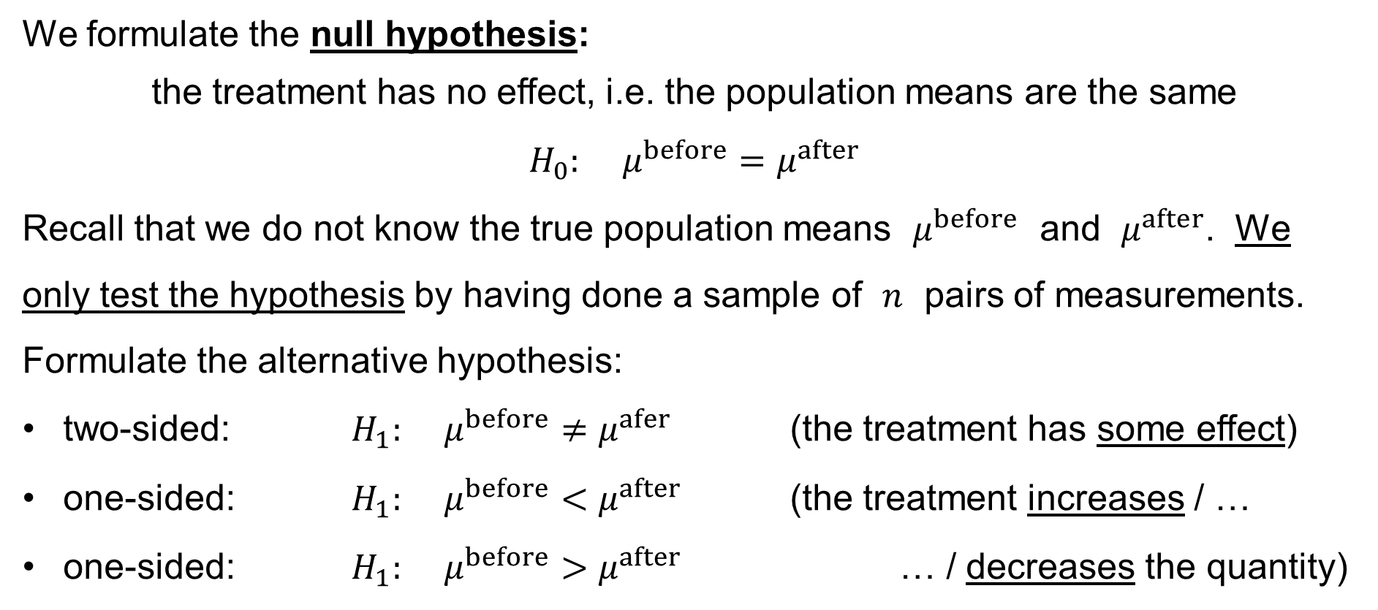
Paired-sample t-test for the difference of the pop.means
We formulate the null hypothesis:
the treatment has no effect, i.e. the population means are the same
$$H_{0}: μ^{before}=μ^{after}$$
Recall that we do not know the true population means $μ^{before}$ and $μ^{after}$. We
only test the hypothesis by having done a sample of $n$ pairs of measurements.
Formulate the alternative hypothesis:
two-sided: $H_{1}: μ^{before}≠μ^{afer}$ (the treatment has some effect)
one-sided: $H_{1}: μ^{before}<μ^{after}$ (the treatment increases / …
one-sided: $H_{1}: μ^{before}>μ^{after}$ … / decreases the quantity)

Slide 42
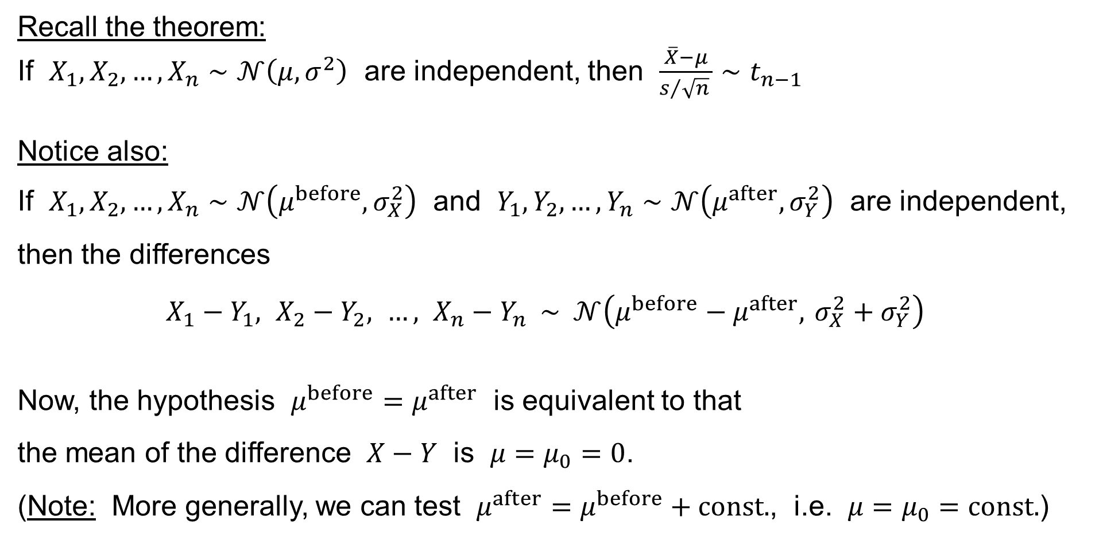
Paired-sample t-test for the difference of the pop.means
Recall the theorem:
If $X_{1},X_{2},…,X_{n}∼𝒩\left(μ,σ^{2}\right)$ are independent, then $\frac{\overline{X}−μ}{s/{\sqrt{n}} }∼t_{n−1}$
Notice also:
If $X_{1},X_{2},…,X_{n}∼𝒩\left(μ^{before},σ_{X}^{2}\right)$ and $Y_{1},Y_{2},…,Y_{n}∼𝒩\left(μ^{after},σ_{Y}^{2}\right)$ are independent, then the differences
$$X_{1}−Y_{1}, X_{2}−Y_{2}, …, X_{n}−Y_{n} ∼ 𝒩\left(μ^{before}−μ^{after}, σ_{X}^{2}+σ_{Y}^{2}\right)$$
Now, the hypothesis $μ^{before}=μ^{after}$ is equivalent to that
the mean of the difference $X−Y$ is $μ=μ_{0}=0$.
(Note: More generally, we can test $μ^{after}=μ^{before}+const.$, i.e. $μ=μ_{0}=const.$)

Slide 43
Paired-sample t-test for the difference of the pop.means
We have thus
reduced
the paired-sample t-test for the difference of the population means
to
the one-sample t-test for the population mean,
which we already know.

Slide 44
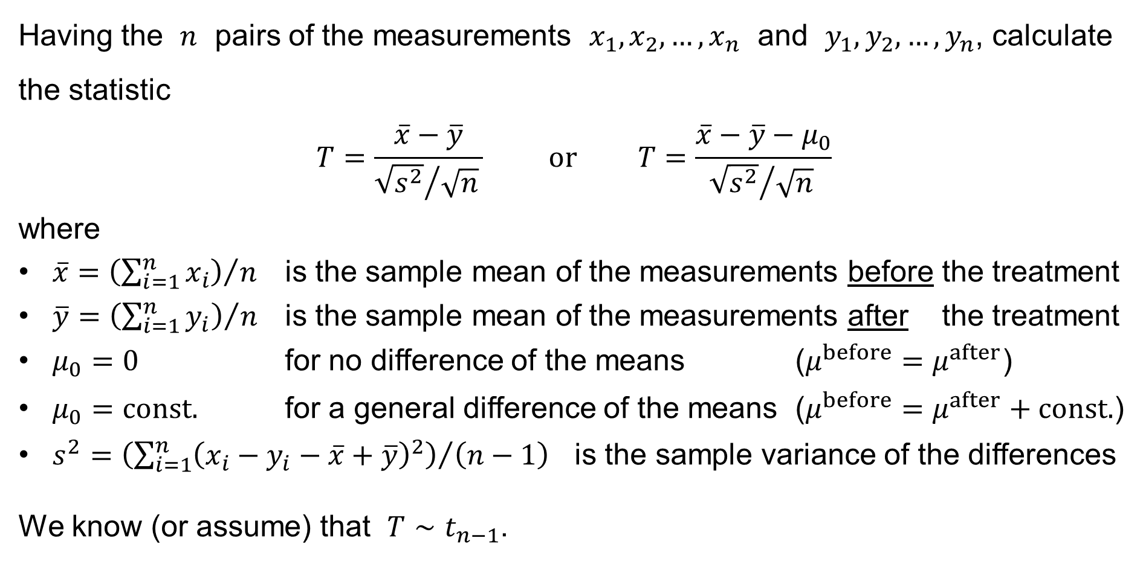
Paired-sample t-test for the difference of the pop.means
Having the $n$ pairs of the measurements $x_{1},x_{2},…,x_{n}$ and $y_{1},y_{2},…,y_{n}$, calculate the statistic
$$T=\frac{\overline{x}−\overline{y}}{{\sqrt{s^{2}}}/{\sqrt{n}} } \text{or} T=\frac{\overline{x}−\overline{y}−μ_{0}}{{\sqrt{s^{2}}}/{\sqrt{n}} }$$
where
$\overline{x}={\left(\sum_{i=1}^{n}{x_{i}}\right)}/n$ is the sample mean of the measurements before the treatment
$\overline{y}={\left(\sum_{i=1}^{n}{y_{i}}\right)}/n$ is the sample mean of the measurements after the treatment
$μ_{0}=0$ for no difference of the means ($μ^{before}=μ^{after}$)
$μ_{0}=const.$ for a general difference of the means ($μ^{before}=μ^{after}+const.$)
$s^{2}={\left(\sum_{i=1}^{n}{{\left(x_{i}−y_{i}−\overline{x}+\overline{y}\right)}^{2}}\right)}/{\left(n−1\right)}$ is the sample variance of the differences
We know (or assume) that $T∼t_{n−1}$.

Slide 45
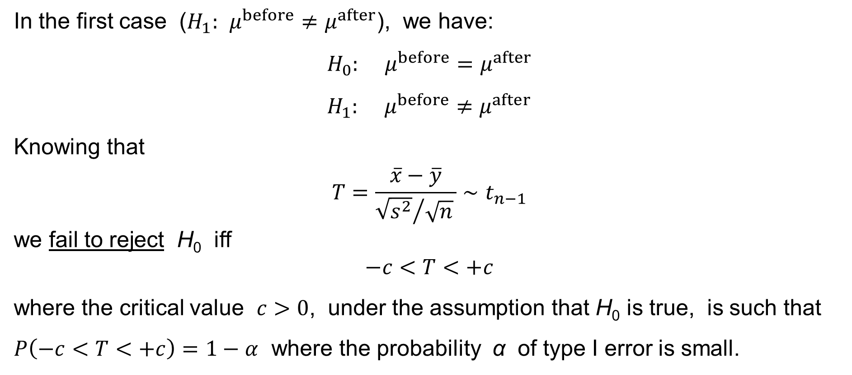
Paired-sample t-test for the difference of the pop.means
In the first case ($H_{1}: μ^{before}≠μ^{after}$), we have:
$$H_{0}: μ^{before}=μ^{after} \\ H_{1}: μ^{before}≠μ^{after}$$
Knowing that
$$T=\frac{\overline{x}−\overline{y}}{{\sqrt{s^{2}}}/{\sqrt{n}} }∼t_{n−1}$$
we fail to reject H₀ iff
$$−c<T<+c$$
where the critical value $c>0$, under the assumption that H₀ is true, is such that $P\left(−c<T<+c\right)=1−α$ where the probability α of type I error is small.

Slide 46
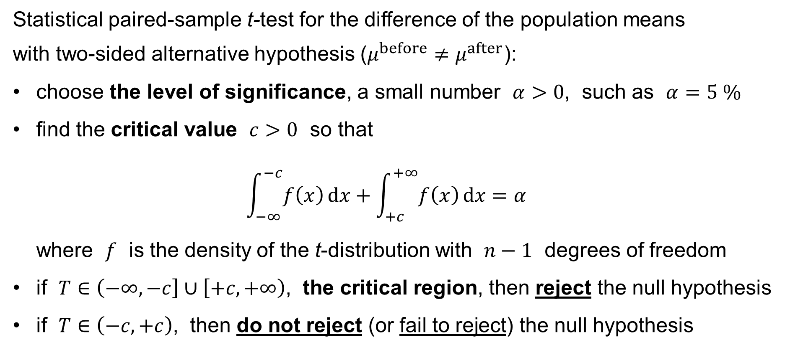
Paired-sample t-test for the difference of the pop.means
Statistical paired-sample t-test for the difference of the population means
with two-sided alternative hypothesis ($μ^{before}≠μ^{after}$):
choose the level of significance, a small number $α>0$, such as $α=5 \%$
find the critical value $c>0$ so that
$\int_{−∞}^{−c}{f\left(x\right) dx}+\int_{+c}^{+∞}{f\left(x\right) dx}=α$
where $f$ is the density of the t-distribution with $n−1$ degrees of freedom
if $T∈\left(−∞,−c\right]∪\left[+c,+∞\right)$, the critical region, then reject the null hypothesis
if $T∈\left(−c,+c\right)$, then do not reject (or fail to reject) the null hypothesis

Slide 47
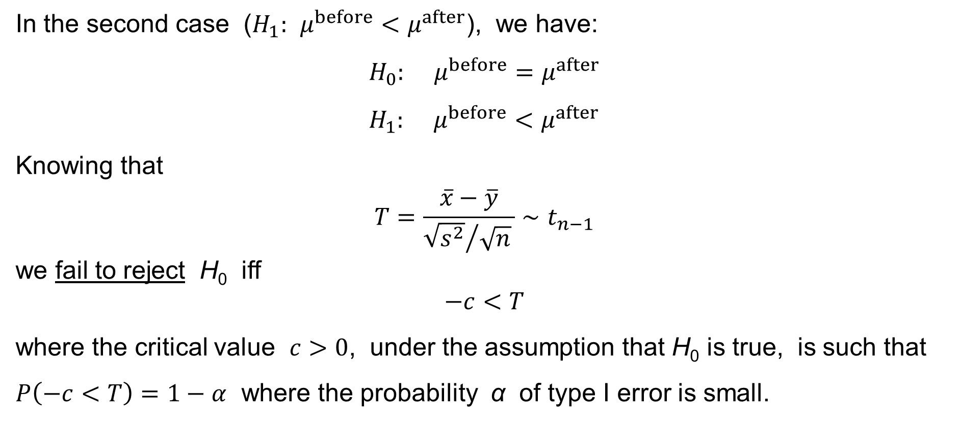
Paired-sample t-test for the difference of the pop.means
In the second case ($H_{1}: μ^{before}<μ^{after}$), we have:
$$H_{0}: μ^{before}=μ^{after} \\ H_{1}: μ^{before}<μ^{after}$$
Knowing that
$$T=\frac{\overline{x}−\overline{y}}{{\sqrt{s^{2}}}/{\sqrt{n}} }∼t_{n−1}$$
we fail to reject H₀ iff
$$−c<T$$
where the critical value $c>0$, under the assumption that H₀ is true, is such that $P\left(−c<T\right)=1−α$ where the probability α of type I error is small.

Slide 48
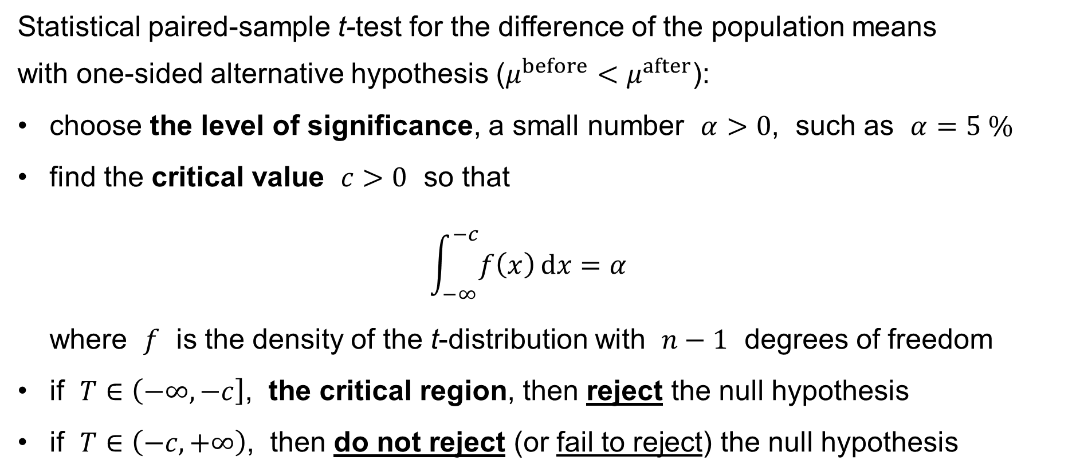
Paired-sample t-test for the difference of the pop.means
Statistical paired-sample t-test for the difference of the population means
with one-sided alternative hypothesis ($μ^{before}<μ^{after}$):
choose the level of significance, a small number $α>0$, such as $α=5 \%$
find the critical value $c>0$ so that
$\int_{−∞}^{−c}{f\left(x\right) dx}=α$
where $f$ is the density of the t-distribution with $n−1$ degrees of freedom
if $T∈\left(−∞,−c\right]$, the critical region, then reject the null hypothesis
if $T∈\left(−c,+∞\right)$, then do not reject (or fail to reject) the null hypothesis

Slide 49
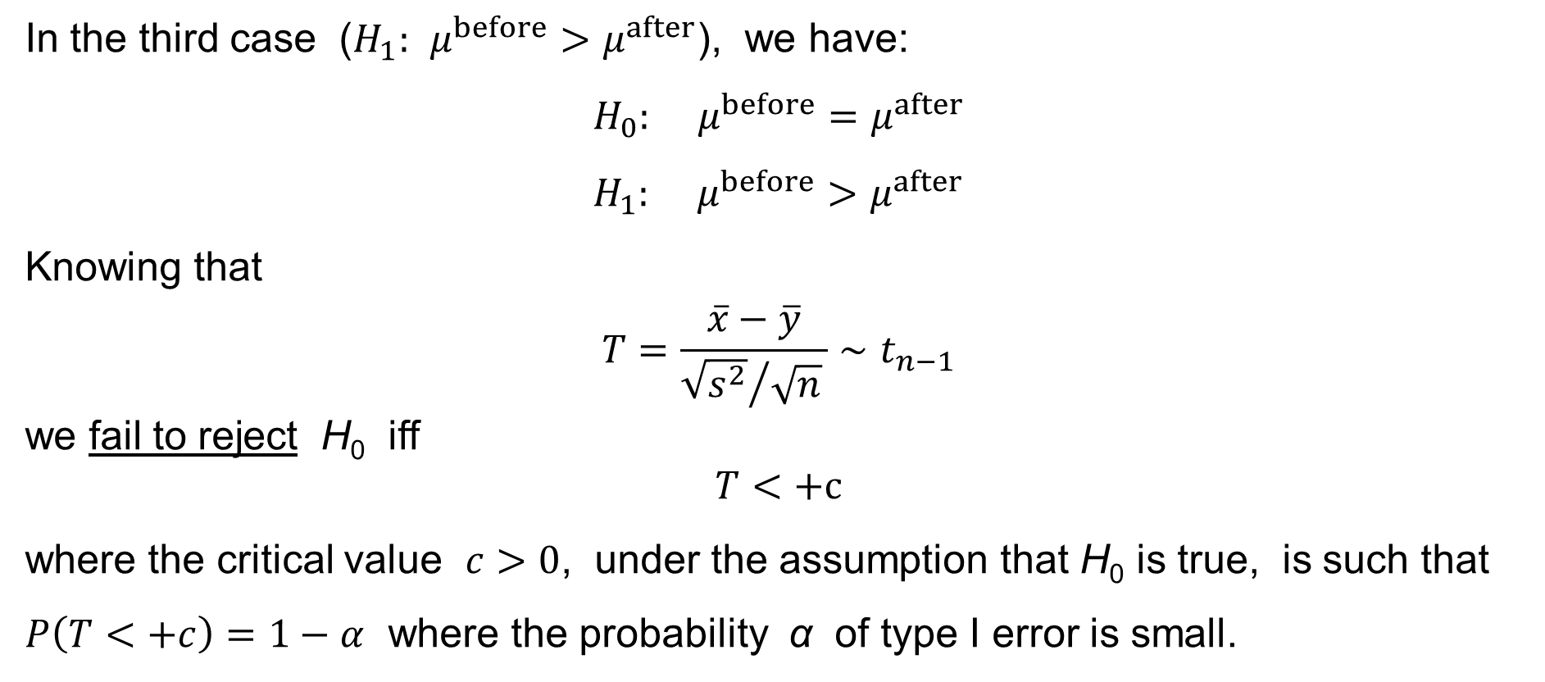
Paired-sample t-test for the difference of the pop.means
In the third case ($H_{1}: μ^{before}>μ^{after}$), we have:
$$H_{0}: μ^{before}=μ^{after} \\ H_{1}: μ^{before}>μ^{after}$$
Knowing that
$$T=\frac{\overline{x}−\overline{y}}{{\sqrt{s^{2}}}/{\sqrt{n}} }∼t_{n−1}$$
we fail to reject H₀ iff
$$T<+c$$
where the critical value $c>0$, under the assumption that H₀ is true, is such that $P\left(T<+c\right)=1−α$ where the probability α of type I error is small.

Slide 50
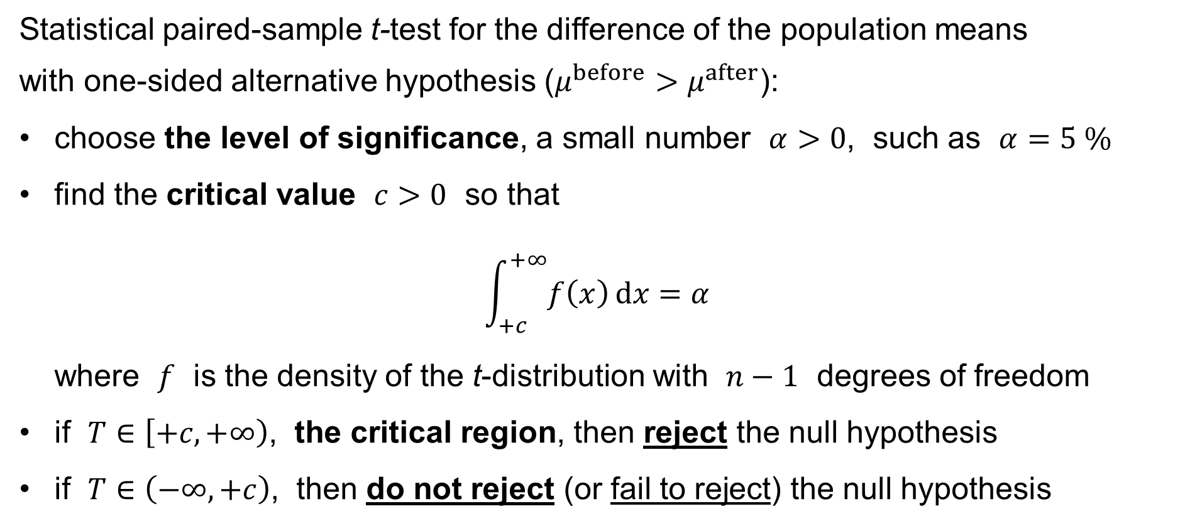
Paired-sample t-test for the difference of the pop.means
Statistical paired-sample t-test for the difference of the population means
with one-sided alternative hypothesis ($μ^{before}>μ^{after}$):
choose the level of significance, a small number $α>0$, such as $α=5 \%$
find the critical value $c>0$ so that
$\int_{+c}^{+∞}{f\left(x\right) dx}=α$
where $f$ is the density of the t-distribution with $n−1$ degrees of freedom
if $T∈\left[+c,+∞\right)$, the critical region, then reject the null hypothesis
if $T∈\left(−∞,+c\right)$, then do not reject (or fail to reject) the null hypothesis

Slide 51
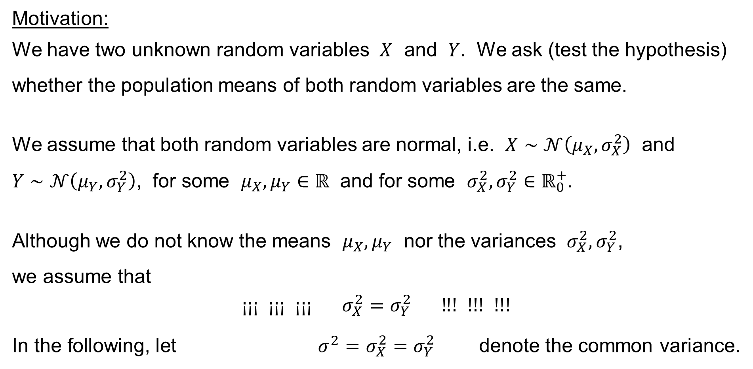
Two-sample t-test for the diff. of the pop. means // σ_{X}=σ_{Y}
Motivation:
We have two unknown random variables $X$ and $Y$. We ask (test the hypothesis) whether the population means of both random variables are the same.
We assume that both random variables are normal, i.e. $X∼𝒩\left(μ_{X},σ_{X}^{2}\right)$ and
$Y∼𝒩\left(μ_{Y},σ_{Y}^{2}\right)$, for some $μ_{X},μ_{Y}∈ℝ$ and for some $σ_{X}^{2},σ_{Y}^{2}∈ℝ_{0}^{+}$.
Although we do not know the means $μ_{X},μ_{Y}$ nor the variances $σ_{X}^{2},σ_{Y}^{2}$,
we assume that
$$\text{¡}\text{¡¡} \text{¡¡¡} \text{¡¡}\text{¡} σ_{X}^{2}=σ_{Y}^{2} \text{‼! !!! !!!}$$
In the following, let $σ^{2}=σ_{X}^{2}=σ_{Y}^{2}$ denote the common variance.

Slide 52
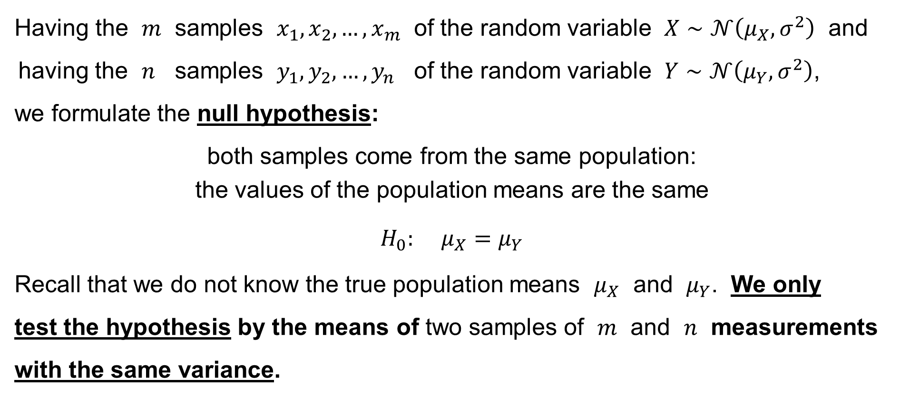
Two-sample t-test for the diff. of the pop. means // σ_{X}=σ_{Y}
Having the $m$ samples $x_{1},x_{2},…,x_{m}$ of the random variable $X∼𝒩\left(μ_{X},σ^{2}\right)$ and
having the $n$ samples $y_{1},y_{2},…,y_{n}$ of the random variable $Y∼𝒩\left(μ_{Y},σ^{2}\right)$,
we formulate the null hypothesis:
both samples come from the same population:
the values of the population means are the same
$$H_{0}: μ_{X}=μ_{Y}$$
Recall that we do not know the true population means $μ_{X}$ and $μ_{Y}$. We only
test the hypothesis by the means of two samples of $m$ and $n$ measurements
with the same variance.

Slide 53
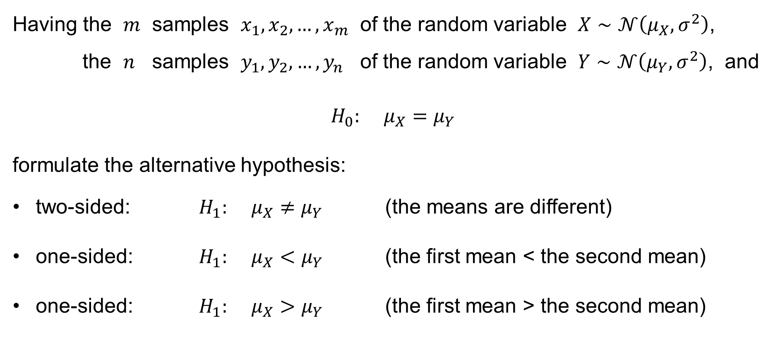
Two-sample t-test for the diff. of the pop. means // σ_{X}=σ_{Y}
Having the $m$ samples $x_{1},x_{2},…,x_{m}$ of the random variable $X∼𝒩\left(μ_{X},σ^{2}\right)$,
the $n$ samples $y_{1},y_{2},…,y_{n}$ of the random variable $Y∼𝒩\left(μ_{Y},σ^{2}\right)$, and
$$H_{0}: μ_{X}=μ_{Y}$$
formulate the alternative hypothesis:
two-sided: $H_{1}: μ_{X}≠μ_{Y}$ (the means are different)
one-sided: $H_{1}: μ_{X}<μ_{Y}$ (the first mean < the second mean)
one-sided: $H_{1}: μ_{X}>μ_{Y}$ (the first mean > the second mean)

Slide 54
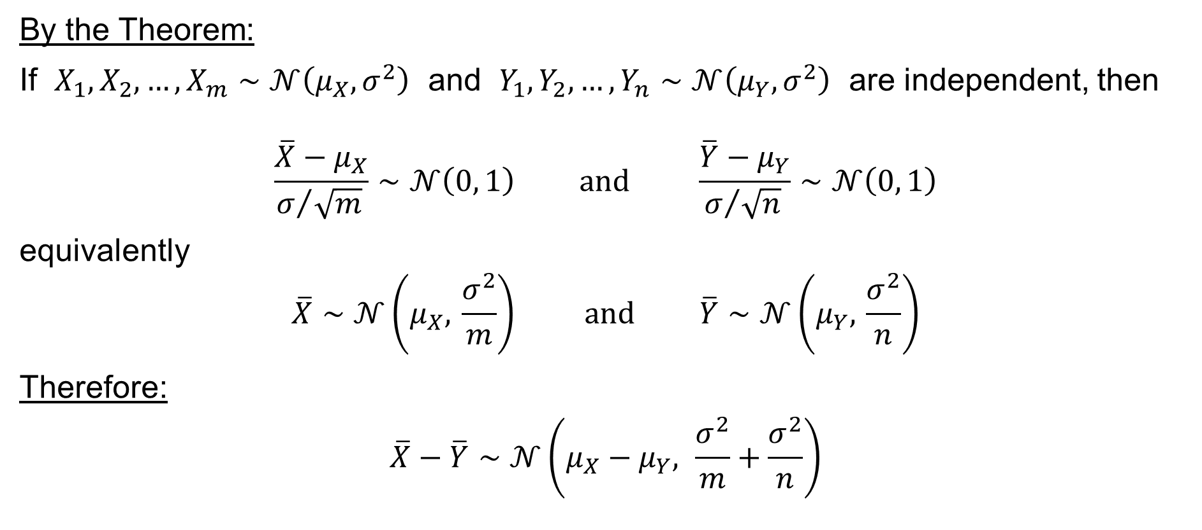
Two-sample t-test for the diff. of the pop. means // σ_{X}=σ_{Y}
By the Theorem:
If $X_{1},X_{2},…,X_{m}∼𝒩\left(μ_{X},σ^{2}\right)$ and $Y_{1},Y_{2},…,Y_{n}∼𝒩\left(μ_{Y},σ^{2}\right)$ are independent, then
$$\frac{\overline{X}−μ_{X}}{σ/{\sqrt{m}} }∼𝒩\left(0, 1\right) \text{and} \frac{\overline{Y}−μ_{Y}}{σ/{\sqrt{n}} }∼𝒩\left(0, 1\right)$$
equivalently
$$\overline{X}∼𝒩\left(μ_{X}, \frac{σ^{2}}{m}\right) \text{and} \overline{Y}∼𝒩\left(μ_{Y}, \frac{σ^{2}}{n}\right)$$
Therefore:
$$\overline{X}−\overline{Y}∼𝒩\left(μ_{X}−μ_{Y}, \frac{σ^{2}}{m}+\frac{σ^{2}}{n}\right)$$

Slide 55

Two-sample t-test for the diff. of the pop. means // σ_{X}=σ_{Y}
We have shown:
If $X_{1},X_{2},…,X_{m}∼𝒩\left(μ_{X},σ^{2}\right)$ and $Y_{1},Y_{2},…,Y_{n}∼𝒩\left(μ_{Y},σ^{2}\right)$ are independent, then
$$\overline{X}−\overline{Y}∼𝒩\left(μ_{X}−μ_{Y}, \frac{σ^{2}}{m}+\frac{σ^{2}}{n}\right)$$
equivalently
$$\frac{\left(\overline{X}−\overline{Y}\right)−\left(μ_{X}−μ_{Y}\right)}{σ\sqrt{ \frac{1}{m}+\frac{1}{n} }}∼𝒩\left(0, 1\right)$$

Slide 56

Two-sample t-test for the diff. of the pop. means // σ_{X}=σ_{Y}
The above Theorem says:
If $X_{1},X_{2},…,X_{m}∼𝒩\left(μ_{X},σ^{2}\right)$ and $Y_{1},Y_{2},…,Y_{n}∼𝒩\left(μ_{Y},σ^{2}\right)$ are independent, then
$$\frac{\left(m−1\right)s_{X}^{2}}{σ^{2}}∼χ_{m−1}^{2} \text{and} \frac{\left(n−1\right)s_{Y}^{2}}{σ^{2}}∼χ_{n−1}^{2}$$
Therefore:
$$\frac{\left(m−1\right)s_{X}^{2}+\left(n−1\right)s_{Y}^{2}}{σ^{2}}∼χ_{m+n−2}^{2}$$

Slide 57
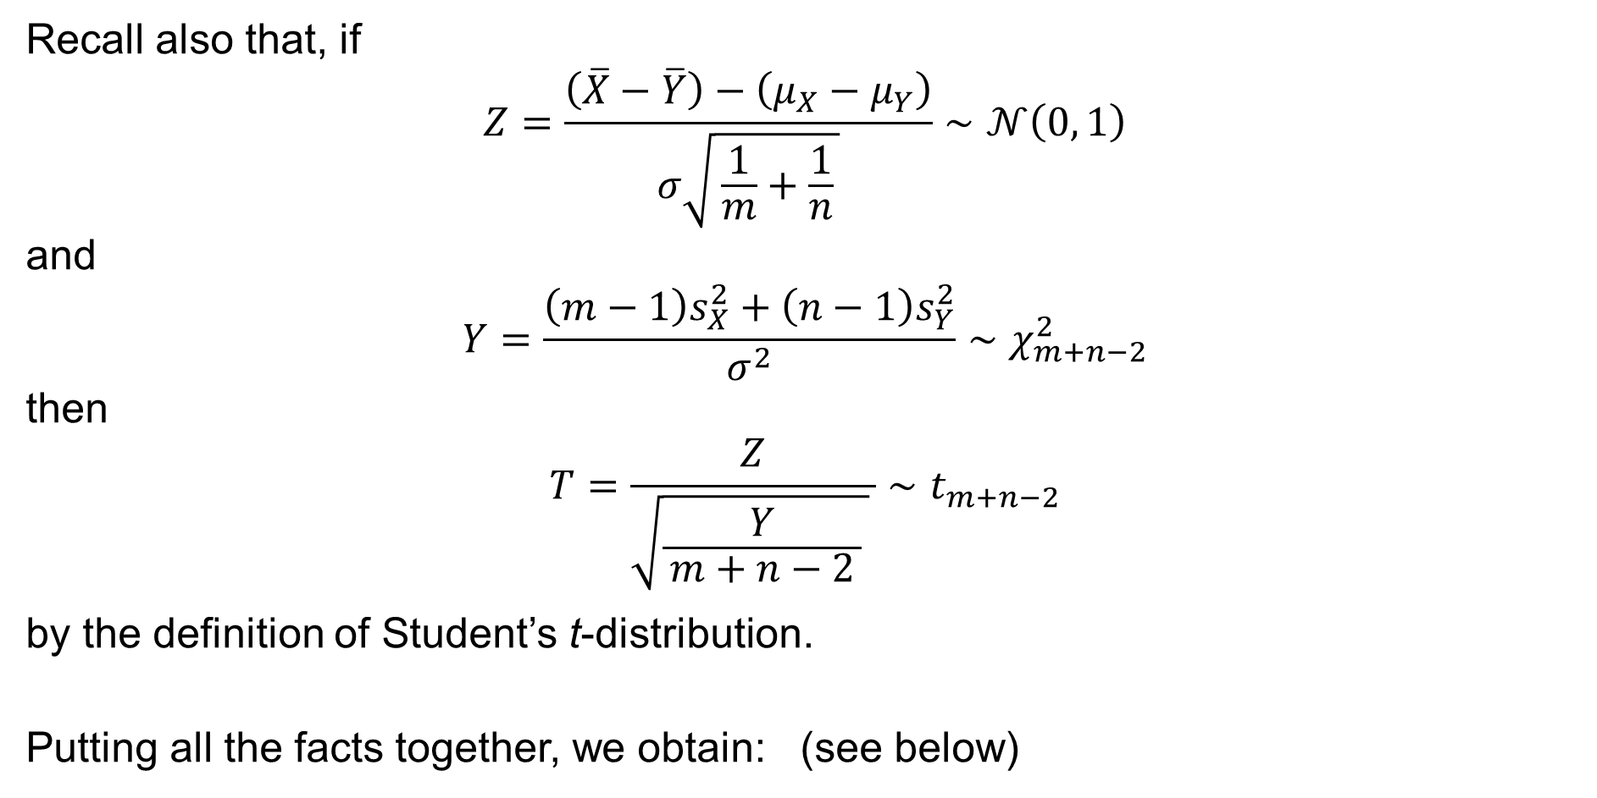
Two-sample t-test for the diff. of the pop. means // σ_{X}=σ_{Y}
Recall also that, if
$$Z=\frac{\left(\overline{X}−\overline{Y}\right)−\left(μ_{X}−μ_{Y}\right)}{σ\sqrt{ \frac{1}{m}+\frac{1}{n} }}∼𝒩\left(0, 1\right)$$
and
$$Y=\frac{\left(m−1\right)s_{X}^{2}+\left(n−1\right)s_{Y}^{2}}{σ^{2}}∼χ_{m+n−2}^{2}$$
then
$$T=\frac{Z}{\sqrt{\frac{Y}{ m+n−2 } } }∼t_{m+n−2}$$
by the definition of Student’s t-distribution.
Putting all the facts together, we obtain: (see below)

Slide 58

Two-sample t-test for the diff. of the pop. means // σ_{X}=σ_{Y}
Therefore:
$$\frac{\left(\overline{X}−\overline{Y}\right)−\left(μ_{X}−μ_{Y}\right)}{\sqrt{\frac{\left(m−1\right)s_{X}^{2}+\left(n−1\right)s_{Y}^{2}}{m+n−2} }\sqrt{ \frac{1}{m}+\frac{1}{n} } } = \frac{\frac{\left(\overline{X}−\overline{Y}\right)−\left(μ_{X}−μ_{Y}\right)}{σ\sqrt{ \frac{1}{m}+\frac{1}{n} }}}{\sqrt{\frac{ \frac{\left(m−1\right)s_{X}^{2}+\left(n−1\right)s_{Y}^{2}}{σ^{2}} }{m+n−2} } } ∼ t_{m+n−2}$$
where
$$s_{X}^{2}=\frac{\sum_{i=1}^{m}{{\left(X_{i}−\overline{X}\right)}^{2}}}{m−1} \text{and} s_{Y}^{2}=\frac{\sum_{j=1}^{n}{{\left(Y_{i}−\overline{Y}\right)}^{2}}}{n−1}$$
are the sample variances.

Slide 59

Two-sample t-test for the diff. of the pop. means // σ_{X}=σ_{Y}
Having the $m$ measurements $x_{1},x_{2},…,x_{m}$ and $n$ measurements $y_{1},y_{2},…,y_{n}$, recall that
$\overline{x}={\left.\sum_{i=1}^{m}{x_{i}}\right.}/m$ is the sample mean of the first sample
$\overline{y}={\left.\sum_{j=1}^{n}{y_{j}}\right.}/n$ is the sample mean of the second sample
$s_{x}^{2}={\sum_{i=1}^{m}{{\left(x_{i}−\overline{x}\right)}^{2}}}/{\left(m−1\right)}$ is the sample variance of the first sample
$s_{y}^{2}={\sum_{j=1}^{n}{{\left(y_{j}−\overline{y}\right)}^{2}}}/{\left(n−1\right)}$ is the sample variance of the second sample
$m$ is the size of the first sample
$n$ is the size of the second sample

Slide 60

Two-sample t-test for the diff. of the pop. means // σ_{X}=σ_{Y}
Having the $m$ measurements $x_{1},x_{2},…,x_{m}$ and $n$ measurements $y_{1},y_{2},…,y_{n}$, calculate the statistic
$$T=\frac{\left.\overline{x}−\overline{y}\right.}{\sqrt{\frac{\left(m−1\right)s_{x}^{2}+\left(n−1\right)s_{y}^{2}}{m+n−2} }\sqrt{ \frac{1}{m}+\frac{1}{n} } }$$
for no difference of the means ($μ_{X}=μ_{Y}$)
We know (or assume) that $T∼t_{m+n−2}$

Slide 61

Two-sample t-test for the diff. of the pop. means // σ_{X}=σ_{Y}
Or, having the $m$ measurements $x_{1},x_{2},…,x_{m}$ and $n$ measurements $y_{1},y_{2},…,y_{n}$, calculate the statistic
$$T=\frac{\left.\overline{x}−\overline{y}\right.−μ_{0}}{\sqrt{\frac{\left(m−1\right)s_{x}^{2}+\left(n−1\right)s_{y}^{2}}{m+n−2} }\sqrt{ \frac{1}{m}+\frac{1}{n} } }$$
for a general difference of the means ($μ_{X}=μ_{Y}+μ_{0}$)
We know (or assume) that $T∼t_{m+n−2}$

Slide 62

Two-sample t-test for the diff. of the pop. means // σ_{X}=σ_{Y}
In the first case ($H_{1}: μ_{X}≠μ_{Y}$), we have:
$$H_{0}: μ_{X}=μ_{Y} \\ H_{1}: μ_{X}≠μ_{Y}$$
Knowing that
$$T∼t_{m+n−2}$$
we fail to reject H₀ iff
$$−c<T<+c$$
where the critical value $c>0$, under the assumption that H₀ is true, is such that $P\left(−c<T<+c\right)=1−α$ where the probability α of type I error is small.

Slide 63

Two-sample t-test for the diff. of the pop. means // σ_{X}=σ_{Y}
Statistical two-sample t-test for the difference of the population means
with two-sided alternative hypothesis ($μ_{X}≠μ_{Y}$) and with the same variances:
choose the level of significance, a small number $α>0$, such as $α=5 \%$
find the critical value $c>0$ so that
$\int_{−∞}^{−c}{f\left(x\right) dx}+\int_{+c}^{+∞}{f\left(x\right) dx}=α$
where $f$ is the density of the t-distribution with $m+n−2$ degrees of freedom
if $T∈\left(−∞,−c\right]∪\left[+c,+∞\right)$, the critical region, then reject the null hypothesis
if $T∈\left(−c,+c\right)$, then do not reject (or fail to reject) the null hypothesis

Slide 64

Two-sample t-test for the diff. of the pop. means // σ_{X}=σ_{Y}
In the second case ($H_{1}: μ_{X}<μ_{Y}$), we have:
$$H_{0}: μ_{X}=μ_{Y} \\ H_{1}: μ_{X}<μ_{Y}$$
Knowing that
$$T∼t_{m+n−2}$$
we fail to reject H₀ iff
$$−c<T$$
where the critical value $c>0$, under the assumption that H₀ is true, is such that $P\left(−c<T\right)=1−α$ where the probability α of type I error is small.

Slide 65

Two-sample t-test for the diff. of the pop. means // σ_{X}=σ_{Y}
Statistical two-sample t-test for the difference of the population means
with one-sided alternative hypothesis ($μ_{X}<μ_{Y}$) and with the same variances :
choose the level of significance, a small number $α>0$, such as $α=5 \%$
find the critical value $c>0$ so that
$\int_{−∞}^{−c}{f\left(x\right) dx}=α$
where $f$ is the density of the t-distribution with $m+n−2$ degrees of freedom
if $T∈\left(−∞,−c\right]$, the critical region, then reject the null hypothesis
if $T∈\left(−c,+∞\right)$, then do not reject (or fail to reject) the null hypothesis

Slide 66

Two-sample t-test for the diff. of the pop. means // σ_{X}=σ_{Y}
In the third case ($H_{1}: μ_{X}>μ_{Y}$), we have:
$$H_{0}: μ_{X}=μ_{Y} \\ H_{1}: μ_{X}>μ_{Y}$$
Knowing that
$$T∼t_{m+n−2}$$
we fail to reject H₀ iff
$$T<+c$$
where the critical value $c>0$, under the assumption that H₀ is true, is such that $P\left(T<+c\right)=1−α$ where the probability α of type I error is small.

Slide 67

Two-sample t-test for the diff. of the pop. means // σ_{X}=σ_{Y}
Statistical two-sample t-test for the difference of the population means
with one-sided alternative hypothesis ($μ_{X}>μ_{Y}$):
choose the level of significance, a small number $α>0$, such as $α=5 \%$
find the critical value $c>0$ so that
$\int_{+c}^{+∞}{f\left(x\right) dx}=α$
where $f$ is the density of the t-distribution with $m+n−2$ degrees of freedom
if $T∈\left[+c,+∞\right)$, the critical region, then reject the null hypothesis
if $T∈\left(−∞,+c\right)$, then do not reject (or fail to reject) the null hypothesis

Slide 68

Two-sample t-test for the diff. of the pop. means // σ_{X}≠σ_{Y}
Consider two normal random variables $X∼𝒩\left(μ_{X},σ_{X}^{2}\right)$ and $Y∼𝒩\left(μ_{Y},σ_{Y}^{2}\right)$,
for some $μ_{X},μ_{Y}∈ℝ$ and for some $σ_{X}^{2},σ_{Y}^{2}∈ℝ_{0}^{+}$.
We ask (test the hypothesis) whether the population means of both random variables are the same.
Once $σ_{X}^{2}=σ_{Y}^{2}$ is not assumed, the things get complicated.
We have an approximate result only.

Slide 69

Theorem (Satterthwaite’s approximation):
If the random variables $X_{1},X_{2},…,X_{m}∼𝒩\left(μ_{X},σ_{X}^{2}\right)$ and $Y_{1},Y_{2},…,Y_{n}∼𝒩\left(μ_{Y},σ_{Y}^{2}\right)$ are independent, then the statistic
$$T=\frac{\left(\overline{X}−\overline{Y}\right)−\left(μ_{X}−μ_{Y}\right)}{\sqrt{ \frac{s_{X}^{2}}{m}+\frac{s_{Y}^{2}}{n} }}∼t_{ν} \text{approximately}$$
where
$$ν=\frac{{\left(\frac{s_{X}^{2}}{m}+\frac{s_{Y}^{2}}{n}\right)}^{2}}{ \frac{s_{X}^{4}}{m^{2}\left(m−1\right)}+\frac{s_{Y}^{4}}{n^{2}\left(n−1\right)} }$$

Slide 70
Two-sample t-test for the diff. of the pop. means // σ_{X}≠σ_{Y}
Exercise:
Use the last Theorem (Satterthwaite’s approximation) to formulate
a statistical two-sample t-test for the difference of the population means
with two-sided / one-sided alternative hypothesis
(not assuming the same variance).

Slide 71
Two sample F-test for the equality of variances

Slide 72

Motivation
We have two unknown random variables $X$ and $Y$. We ask (test the hypothesis) whether the population variances of both random variables are the same.
We assume that both random variables are normal, i.e. $X∼𝒩\left(μ_{X},σ_{X}^{2}\right)$ and
$Y∼𝒩\left(μ_{Y},σ_{Y}^{2}\right)$, for some $μ_{X},μ_{Y}∈ℝ$ and for some $σ_{X}^{2},σ_{Y}^{2}∈ℝ_{0}^{+}$.
We ask (test the hypothesis) whether
¿ $σ_{X}^{2}=σ_{Y}^{2}$ ?

Slide 73

Two sample F-test for the equality of variances
Having the $m$ samples $x_{1},x_{2},…,x_{m}$ of the random variable $X∼𝒩\left(μ_{X},σ_{X}^{2}\right)$ and
having the $n$ samples $y_{1},y_{2},…,y_{n}$ of the random variable $Y∼𝒩\left(μ_{Y},σ_{Y}^{2}\right)$,
we formulate the null hypothesis:
both samples come from populations with the same variances:
$$H_{0}: σ_{X}^{2}=σ_{Y}^{2}$$
Recall that we do not know the true population variances $σ_{X}^{2}$ and $σ_{Y}^{2}$.
We only test the hypothesis by the means of the two samples
of $m$ and $n$ independent measurements.

Slide 74

Two sample F-test for the equality of variances
The meaning of the null hypothesis (such as $H_{0}: σ_{X}^{2}=σ_{Y}^{2}$ in our example)
is that
the observed distinct values are caused by the randomness only
(according to the assumed distribution, such as
$X∼𝒩\left(μ,σ^{2}\right)$ and $Y∼𝒩\left(μ,σ^{2}\right)$, where $σ^{2}=σ_{X}^{2}=σ_{Y}^{2}$, in our example)
there are no other factors causing the distinct values
everything is all right, no need to reconfigure anything
all factors under the consideration are equivalent (have the same effect)

Slide 75

Two sample F-test for the equality of variances
Having stated the null hypothesis
$$H_{0}: σ_{X}^{2}=σ_{Y}^{2}$$
we also state the alternative hypothesis:
two-sided: $H_{1}: σ_{X}^{2}≠σ_{Y}^{2}$
one-sided: $H_{1}: σ_{X}^{2}<σ_{Y}^{2}$
one-sided: $H_{1}: σ_{X}^{2}>σ_{Y}^{2}$

Slide 76

Theorem
If the random variables $X_{1},X_{2},…,X_{m}∼𝒩\left(μ_{X},σ_{X}^{2}\right)$ and $Y_{1},Y_{2},…,Y_{n}∼𝒩\left(μ_{Y},σ_{Y}^{2}\right)$ are independent and
$$σ_{X}^{2}=σ_{Y}^{2}$$
then
$$\frac{s_{X}^{2}}{s_{Y}^{2}}∼F_{m−1,n−1}$$
where
$F_{m−1,n−1}$ is Fisher’s F-distribution with $m−1$ and $n−1$ degrees of freedom
$s_{X}^{2}={\left.\sum_{i=1}^{m}{{\left(X_{i}−\overline{X}\right)}^{2}}\right.}/{\left(m−1\right)}$ is the sample variance of the first sample
$s_{Y}^{2}={\left.\sum_{j=1}^{n}{{\left(Y_{j}−\overline{Y}\right)}^{2}}\right.}/{\left(n−1\right)}$ is the sample variance of the second sample
$\overline{X}={\left(\sum_{i=1}^{m}{X_{i}}\right)}/m$ and $\overline{Y}={\left(\sum_{j=1}^{n}{Y_{j}}\right)}/n$ are the sample means

Slide 77

Two-sample F-test for the equality of variances
Having the $m$ measurements $x_{1},x_{2},…,x_{m}$ and $n$ measurements $y_{1},y_{2},…,y_{n}$, calculate the statistic
$$F=\frac{s_{x}^{2}}{s_{y}^{2}}$$
where
$s_{x}^{2}={\left.\sum_{i=1}^{m}{{\left(x_{i}−\overline{x}\right)}^{2}}\right.}/{\left(m−1\right)}$ is the sample variance of the first sample
$s_{y}^{2}={\left.\sum_{j=1}^{n}{{\left(y_{j}−\overline{y}\right)}^{2}}\right.}/{\left(n−1\right)}$ is the sample variance of the second sample
$\overline{x}={\left.\sum_{i=1}^{m}{x_{i}}\right.}/m$ is the sample mean of the first sample
$\overline{y}={\left.\sum_{j=1}^{n}{y_{j}}\right.}/n$ is the sample mean of the second sample
$m$ and $n$ is the size of the first and second, respectively, sample
We know (or assume) that $F∼F_{m−1,n−1}$.

Slide 78

Two-sample F-test for the equality of variances
In the first case ($H_{1}: σ_{X}^{2}≠σ_{Y}^{2}$), we have:
$$H_{0}: σ_{X}^{2}=σ_{Y}^{2} \\ H_{1}: σ_{X}^{2}≠σ_{Y}^{2}$$
Knowing that
$$F=\frac{s_{x}^{2}}{s_{y}^{2}}∼F_{m−1,n−1}$$
we fail to reject H₀ iff
$$c<F<d$$
where the critical value $d>c>0$, under the assumption that H₀ is true, are such that $P\left(c<F<d\right)=1−α$ where the probability α of type I error is small.

Slide 79

Two-sample F-test for the equality of variances
Statistical two-sample F-test for the equality of the population variances
with two-sided alternative hypothesis ($σ_{X}^{2}≠σ_{Y}^{2}$):
choose the level of significance, a small number $α>0$, such as $α=5 \%$
find the critical values $0<c<d$ so that
$\int_{0}^{c}{f\left(x\right) dx}=\frac{α}{2} \text{and} \int_{d}^{+∞}{f\left(x\right) dx}=\frac{α}{2}$
where $f$ is the density of the F-distribution with $m−1$ and $n−1$ d.f.
if $F∈\left[0,c\right]∪\left[d,+∞\right)$, the critical region, then reject the null hypothesis
if $F∈\left(c,d\right)$, then do not reject (or fail to reject) the null hypothesis

Slide 80

Two-sample F-test for the equality of variances
In the second case ($H_{1}: σ_{X}^{2}<σ_{Y}^{2}$), we have:
$$H_{0}: σ_{X}^{2}=σ_{Y}^{2} \\ H_{1}: σ_{X}^{2}<σ_{Y}^{2}$$
Knowing that
$$F=\frac{s_{x}^{2}}{s_{y}^{2}}∼F_{m−1,n−1}$$
we fail to reject H₀ iff
$$c<F$$
where the critical value $c>0$, under the assumption that H₀ is true, is such that $P\left(c<F<+∞\right)=1−α$ where the probability α of type I error is small.

Slide 81

Two-sample F-test for the equality of variances
Statistical two-sample F-test for the equality of the population variances
with one-sided alternative hypothesis ($σ_{X}^{2}<σ_{Y}^{2}$):
choose the level of significance, a small number $α>0$, such as $α=5 \%$
find the critical value $c>0$ so that
$\int_{0}^{c}{f\left(x\right) dx}=α$
where $f$ is the density of the F-distribution with $m−1$ and $n−1$ d.f.
if $F∈\left[0,c\right]$, the critical region, then reject the null hypothesis
if $F∈\left(c,+∞\right)$, then do not reject (or fail to reject) the null hypothesis

Slide 82

Two-sample F-test for the equality of variances
In the third case ($H_{1}: σ_{X}^{2}>σ_{Y}^{2}$), we have:
$$H_{0}: σ_{X}^{2}=σ_{Y}^{2} \\ H_{1}: σ_{X}^{2}>σ_{Y}^{2}$$
Knowing that
$$F=\frac{s_{x}^{2}}{s_{y}^{2}}∼F_{m−1,n−1}$$
we fail to reject H₀ iff
$$F<d$$
where the critical value $d>0$, under the assumption that H₀ is true, is such that $P\left(0≤F<d\right)=1−α$ where the probability α of type I error is small.

Slide 83

Two-sample F-test for the equality of variances
Statistical two-sample F-test for the difference of the population variances
with one-sided alternative hypothesis ($σ_{X}^{2}>σ_{Y}^{2}$):
choose the level of significance, a small number $α>0$, such as $α=5 \%$
find the critical value $d>0$ so that
$\int_{d}^{+∞}{f\left(x\right) dx}=α$
where $f$ is the density of the F-distribution with $m−1$ and $n−1$ d.f.
if $F∈\left[d,+∞\right)$, the critical region, then reject the null hypothesis
if $Z∈\left[0,d\right)$, then do not reject (or fail to reject) the null hypothesis

Slide 84
NON-PARAMETRIC TESTS
Sign test for the median
Pearson’s χ²-test for the goodness of fit
χ²-test of independence of qualitative data items

Slide 85
Sign test for the median
Sign test for the median
Paired sign test for
the difference of the medians

Slide 86

Sign test for the median
Motivation:
Let $X$ be a random variable (of any distribution), but assume that
its cumulative distribution function $F$ is continuous.
Recall that the median $\tilde{x}$ of the random variable $X$ is the value such that
$$P\left(X<\tilde{x}\right)=\frac{1}{2}=P(\tilde{x}<X)$$
We conjecture / we assume / we speculate / we … / that the mean $\tilde{x}$ of the random variable $X$ is equal to some given value ${\tilde{x}}_{0}∈ℝ$.
We thus formulate the null hypothesis: $H_{0}: \tilde{x}={\tilde{x}}_{0}$

Slide 87

Sign test for the median
The sign test proceeds as follows:
Let us have $n$ samples $x_{1},x_{2},…,x_{n}$ of the random variable $X$,
whose cumulative distribution function $F$ is continuous.
Considering the null hypothesis ($H_{0}: \tilde{x}={\tilde{x}}_{0}$) about the median,
calculate the $n$ differences
$x_{1}−{\tilde{x}}_{0}, x_{2}−{\tilde{x}}_{0}, …, x_{n}−{\tilde{x}}_{0}$
Drop any zero differences (i.e., if $x_{i}−{\tilde{x}}_{0}=0$, then drop $x_{i}$ from the sample).
We have a sample of $m$ non-zero differences
$x_{j_{1}}−{\tilde{x}}_{0}, x_{j_{2}}−{\tilde{x}}_{0}, …, x_{j_{m}}−{\tilde{x}}_{0}$
thus ($m≤n$).

Slide 88

Sign test for the median
Let
$Z=\left|\left\{ i :x_{j_{i}}−{\tilde{x}}_{0}<0 \right\}\right|$
be the number of the negative differences.
Theorem:
Under the null hypothesis ($H_{0}: \tilde{x}={\tilde{x}}_{0}$) that the median $\tilde{x}$ of the random variable $X$ is ${\tilde{x}}_{0}$
$$Z∼Bi\left(m, \frac{1}{2} \right)$$
i.e. the random variable $Z$ follows the binomial probability distribution.

Slide 89

Sign test for the median
Remark: We actually test the hypothesis that the probability
$$P\left(X<{\tilde{x}}_{0}\right)=P\left(X≤{\tilde{x}}_{0}\right)=\frac{1}{2}$$
(We have $P\left(X<{\tilde{x}}_{0}\right)=P\left(X≤{\tilde{x}}_{0}\right)$ because we assume that the cumulative distribution function $F$ is continuous at ${\tilde{x}}_{0}$.)
Therefore, we could test in the same manner the null hypothesis that
${\tilde{x}}_{0}$ is the first quartile ($P\left(X<{\tilde{x}}_{0}\right)=P\left(X≤{\tilde{x}}_{0}\right)=\frac{1}{4}$, whence $Z∼Bi\left(m, \frac{1}{4}\right)$), or that
${\tilde{x}}_{0}$ is the third decile ($P\left(X<{\tilde{x}}_{0}\right)=P\left(X≤{\tilde{x}}_{0}\right)=\frac{3}{10}$, whence $Z∼Bi\left(m, \frac{3}{10}\right)$), etc.
Let us keep considering the case of the median, say, in the following.

Slide 90

Sign test for the median
Having stated the null hypothesis about the median
$$H_{0}: \tilde{x}={\tilde{x}}_{0} \text{or} H_{0}: P\left(X<{\tilde{x}}_{0}\right)=p_{0}=\frac{1}{2}$$
we also state the alternative hypothesis:
two-sided: $H_{1}: \tilde{x}≠{\tilde{x}}_{0}$ or $H_{1}: P\left(X<{\tilde{x}}_{0}\right)≠p_{0}$
one-sided: $H_{1}: \tilde{x}>{\tilde{x}}_{0}$ or $H_{1}: P\left(X<{\tilde{x}}_{0}\right)<p_{0}$
one-sided: $H_{1}: \tilde{x}<{\tilde{x}}_{0}$ or $H_{1}: P\left(X<{\tilde{x}}_{0}\right)>p_{0}$
The test then proceeds as the binomial test (or z-test approximately) for the population proportion, see the end of the last lecture.

Slide 91

Sign (binomial) test for the median
Consider the first case ($H_{1}: \tilde{x}≠{\tilde{x}}_{0}$) first. We have: $H_{0}: P\left(X<{\tilde{x}}_{0}\right)=p_{0}=1/2$
$H_{1}: P\left(X<{\tilde{x}}_{0}\right)≠p_{0}$
choose the level of significance, a small number $α>0$, such as $α=5 \%$
find the critical values $K,L∈\left\{0, 1,…,m\right\}$ so that
$K$ is the largest number and $L$ is the least number such that
$$\sum_{k=0}^{K}{\left({m \atop k}\right)p_{0}^{k}q_{0}^{m−k}}=\sum_{k=0}^{K}{\left({m \atop k}\right)\frac{1}{2^{m}}}≤\frac{α}{2} \text{and} \sum_{k=L}^{m}{\left({m \atop k}\right)p_{0}^{k}q_{0}^{n−k}}=\sum_{k=L}^{m}{\left({m \atop k}\right)\frac{1}{2^{m}}}≤\frac{α}{2}$$
if $Z∈\left\{0,…,K\right\}∪\left\{L,…,n\right\}$, the critical region, then reject the null hypothesis
if $Z∈\left\{K+1,…,L−1\right\}$, then do not reject (or fail to reject) the null hypothesis
where $q_{0}=1−p_{0}=1/2$

Slide 92

Sign (binomial) test for the median
Consider now the second case ($H_{1}: \tilde{x}>{\tilde{x}}_{0}$). We have: $H_{0}: P\left(X<{\tilde{x}}_{0}\right)=p_{0}=1/2$
$H_{1}: P\left(X<{\tilde{x}}_{0}\right)<p_{0}$
choose the level of significance, a small number $α>0$, such as $α=5 \%$
find the critical value $K∈\left\{0,1,…,m\right\}$ so that $K$ is the largest number such
$$\sum_{k=0}^{K}{\left({m \atop k}\right)p_{0}^{k}q_{0}^{m−k}}=\sum_{k=0}^{K}{\left({m \atop k}\right)\frac{1}{2^{m}}}≤α$$
if $Z∈\left\{0,…,K\right\}$, the critical region, then reject the null hypothesis
if $Z∈\left\{K+1,…,m\right\}$, then do not reject (or fail to reject) the null hypothesis
where $q_{0}=1−p_{0}=1/2$
that

Slide 93

Sign (binomial) test for the median
Consider finally the third case ($H_{1}: \tilde{x}<{\tilde{x}}_{0}$). We have: $H_{0}: P\left(X<{\tilde{x}}_{0}\right)=p_{0}=1/2$
$H_{1}: P\left(X<{\tilde{x}}_{0}\right)>p_{0}$
choose the level of significance, a small number $α>0$, such as $α=5 \%$
find the critical value $L∈\left\{0, 1,…,m\right\}$ so that $L$ is the least number such that
$$\sum_{k=L}^{m}{\left({m \atop k}\right)p_{0}^{k}q_{0}^{m−k}}=\sum_{k=L}^{m}{\left({m \atop k}\right)\frac{1}{2^{m}}}≤α$$
if $Z∈\left\{L,…,m\right\}$, the critical region, then reject the null hypothesis
if $Z∈\left\{0,…,L−1\right\}$, then do not reject (or fail to reject) the null hypothesis
where $q_{0}=1−p_{0}=1/2$

Slide 94

Sign (z-) test for the median
It is inconvenient to calculate the sums $\sum_{k=0}^{K}{\left({m \atop k}\right)\frac{1}{2^{m}}}$ and $\sum_{k=L}^{m}{\left({m \atop k}\right)\frac{1}{2^{m}}}$
if $m$ is large. It is more convenient then to approximate the sums by using
the de Moivre-Laplace Central Limit Theorem (for $p=q=1/2$):
It holds, whenever $−∞≤a<b≤+∞$, that
$$\frac{ \sum_{\begin{aligned}k=A_{m}\end{aligned}}^{B_{m}}{\left({m \atop k}\right)\frac{2}{2^{m}}}−n }{\sqrt{m}}⟶\underset{Φ\left(b\right)−Φ\left(a\right)}{\underbrace{\int_{a}^{b}{\frac{1}{\sqrt{2π} }e^{−\frac{t^{2}}{2}} dt}}} \text{as} m→∞$$
where $A_{m}=\left\lceil {\left.\left(m+a\sqrt{m}\right)\right.}/2\right\rceil ≥0$ and $B_{m}=\left\lfloor {\left.\left(m+b\sqrt{m}\right)\right.}/2\right\rfloor ≤m$ if $m≥\max\left(a^{2},b^{2}\right)$.
Moreover, the convergence is uniform with respect to $a$ and $b$.

Slide 95

Sign (z-) test for the median
De Moivre-Laplace Central Limit Theorem (reformulated):
If $X∼Bi\left(m,1/2\right)$, whenever $−∞≤a<b≤+∞$, it then holds
$$P\left(a<\frac{2X−m}{\sqrt{m}}<b\right)⟶\underset{Φ\left(b\right)−Φ\left(a\right)}{\underbrace{\int_{a}^{b}{\frac{1}{\sqrt{2π} }e^{−\frac{t^{2}}{2}} dt}}} \text{as} m→∞$$
and the convergence is uniform with respect to $a$ and $b$.

Slide 96

Sign (z-) test for the median
Consider the first case ($H_{1}: \tilde{x}≠{\tilde{x}}_{0}$) first. We have: $H_{0}: P\left(X<{\tilde{x}}_{0}\right)=p_{0}=1/2$
$H_{1}: P\left(X<{\tilde{x}}_{0}\right)≠p_{0}$
choose the level of significance, a small number $α>0$, such as $α=5 \%$
find $c>0$ so that
$$\int_{−∞}^{−c}{\frac{1}{\sqrt{2π} }e^{−\frac{t^{2}}{2}} dt}=\frac{α}{2} \text{and} \int_{+c}^{+∞}{\frac{1}{\sqrt{2π} }e^{−\frac{t^{2}}{2}} dt}=\frac{α}{2}$$
if $Z≤{\left(m−c\sqrt{m}\right)}/2$ or ${\left(m+c\sqrt{m}\right)}/2≤Z$, the critical region, then reject
the null hypothesis
if ${\left(m−c\sqrt{m}\right)}/2<Z<{\left(m+c\sqrt{m}\right)}/2$, then do not reject (or fail to reject)
the null hypothesis
where the sample is sufficiently large, i.e. $mp_{0}≥10$ and $mq_{0}≥10$

Slide 97

Sign (z-) test for the median
Consider now the second case ($H_{1}: \tilde{x}>{\tilde{x}}_{0}$). We have: $H_{0}: P\left(X<{\tilde{x}}_{0}\right)=p_{0}=1/2$
$H_{1}: P\left(X<{\tilde{x}}_{0}\right)<p_{0}$
choose the level of significance, a small number $α>0$, such as $α=5 \%$
find $c>0$ so that
$$\int_{−∞}^{−c}{\frac{1}{\sqrt{2π} }e^{−\frac{t^{2}}{2}} dt}=α$$
if $Z≤{\left(m−c\sqrt{m}\right)}/2$, the critical region, then reject the null hypothesis
if ${\left(m−c\sqrt{m}\right)}/2<Z$, then do not reject (or fail to reject) the null hypothesis
where the sample is sufficiently large, i.e. $mp_{0}≥10$ and $mq_{0}≥10$

Slide 98

Sign (z-) test for the median
Consider finally the third case ($H_{1}: \tilde{x}<{\tilde{x}}_{0}$). We have: $H_{0}: P\left(X<{\tilde{x}}_{0}\right)=p_{0}=1/2$
$H_{1}: P\left(X<{\tilde{x}}_{0}\right)>p_{0}$
choose the level of significance, a small number $α>0$, such as $α=5 \%$
find $c>0$ so that
$$\int_{+c}^{+∞}{\frac{1}{\sqrt{2π} }e^{−\frac{t^{2}}{2}} dt}=α$$
if ${\left(m+c\sqrt{m}\right)}/2≤Z$, the critical region, then reject the null hypothesis
if $Z<{\left(m+c\sqrt{m}\right)}/2$, then do not reject (or fail to reject) the null hypothesis
where the sample is sufficiently large, i.e. $mp_{0}≥10$ and $mq_{0}≥10$

Slide 99

Sign test for the median
Remarks:
• By using another probability (such as $p_{0}=0.25$, $p_{0}=0.3$, etc.) we can test
the null hypothesis that ${\tilde{x}}_{0}$ is, e.g., the first quartile, the third decile, etc.
• If we know that the distribution of $X$ is symmetric ($F\left(x\right)=1−F\left(−x\right)$), then the mean $μ=E\left[X\right]$ and the median $\tilde{x}$ of the random variable $X$ coincide ($\tilde{x}=μ$). Then the sign test for the median can also be used as another test for the mean ($H_{0}: μ={\tilde{x}}_{0}$).

Slide 100

Sign test for the median
Remarks:
• More generally, if we know that the mean $μ=E\left[X\right]$ is the $p_{0}$-quantile
($0<p_{0}<1$) of the distribution of the random variable $X$ with a continuous cumulative distribution function, then the sign test can also be used as another test for the mean ($H_{0}: μ={\tilde{x}}_{0}$ with $Z=\left|\left\{ i :x_{j_{i}}<{\tilde{x}}_{0} \right\}\right|∼Bi\left(m,p_{0}\right)$).
• Exercise: Apply the procedure of the sign test to determine the confidence interval for the median, i.e. the interval of values ${\tilde{x}}_{0}$ such that the null hypothesis is not rejected for them.

Slide 101

Paired sign test for the difference of the medians
Motivation:
Let us have a sample of $n$ objects, e.g. $n$ patients.
We do two measurements with each of the objects (patients)
— before some treatment
— after the treatment
The purpose it to learn whether the treatment has any effect.
(Hence the null hypothesis: “The treatment has no effect.”)
Let $x_{1},x_{2},…,x_{n}$ be the values measured before the treatment, and
let $y_{1},y_{2},…,y_{n}$ be the values measured after the treatment.

Slide 102

Paired sign test for the difference of the medians
That is, the measurement $x_{i}$ and $y_{i}$ is done with the $i$-th object (patient)
before and after the treatment for $i=1, 2,…,n$.
FIRST, assume that only two outcomes are possible:
$x_{i}<y_{i}$ (improvement)
$x_{i}>y_{i}$ (worsening)
Objects with $x_{i}=y_{i}$ are dropped from the sample.
We then can test the null hypothesis that the treatment has no effect, i.e.
$$Z=\left|\left\{ i :x_{i}<y_{i} \right\}\right|∼Bi\left(m, \frac{1}{2} \right)$$
etc. (Finish the details of the test analogously as above as an exercise.)

Slide 103

Paired sign test for the difference of the medians
That is, the measurement $x_{i}$ and $y_{i}$ is done with the $i$-th object (patient)
before and after the treatment for $i=1, 2,…,n$.
SECOND, assume that $x_{1},x_{2},…,x_{n}$ and $y_{1},y_{2},…,y_{n}$ are the numerical outcomes of the random variable $X$ and $Y$, respectively, with a continuous cumulative distribution function $F_{X}$ and $F_{Y}$, respectively.
Theorem: The median ${\tilde{x}}_{0}$ of the difference $X−Y$ of the random variables is
$${\tilde{x}}_{0}=\tilde{x}−\tilde{y}$$
i.e. the difference of the medians $\tilde{x}$ and $\tilde{y}$ of the random variables.

Slide 104

Paired sign test for the difference of the medians
Thus, we can test the null hypothesis that the median $\tilde{x}$ of the random variable $X$ (before the treatment) is the same as the median $\tilde{y}$ of the random variable $Y$ (after the treatment), i.e. their difference is ${\tilde{x}}_{0}=\tilde{x}−\tilde{y}=0$.
(More generally, we can test that the difference $\tilde{x}−\tilde{y}$ is equal to some prescribed value ${\tilde{x}}_{0}∈ℝ$.)
(Complete the details of the test analogously as above as an exercise.)

Slide 105
χ²-test for goodness of fit
Pearson’s χ²-test for the goodness of fit

Slide 106

Pearson’s χ²-test for the goodness of fit
Let $X$ be a random variable (discrete or continuous) and
let $F$ be the cumulative distribution function of the random variable $X$.
We do not know the cumulative distribution function $F$.
We have the numerical results $x_{1}=X\left(ω_{1}\right)$, $x_{2}=X\left(ω_{2}\right)$, …, $x_{N}=X\left(ω_{N}\right)$
of $N$ trials of the corresponding random experiment.
Let $F_{0}$ be some cumulative distribution function. We conjecture / we assume /
we speculate / we … / that $F=F_{0}$, i.e. the random variable $X$ follows the probability distribution with the cumulative distribution function $F=F_{0}$.

Slide 107

Pearson’s χ²-test for the goodness of fit
More generally, let $ℱ_{0}$ be a class of cumulative distribution functions (c.d.f.’s)
of a certain type, such as
the collection of all c.d.f.’s of $𝒰\left(a,b\right)$ for various $a,b∈ℝ$, $a<b$
the collection of all c.d.f.’s of $𝒩\left(μ,σ^{2}\right)$ for various $μ∈ℝ$ and $σ^{2}∈ℝ_{0}^{+}$
the collection of all c.d.f.’s of $Exp\left(λ\right)$ for various $λ∈ℝ^{+}$
etc.
Having the numerical results $x_{1}=X\left(ω_{1}\right)$, $x_{2}=X\left(ω_{2}\right)$, …, $x_{N}=X\left(ω_{N}\right)$
of $N$ trials of a random experiment, we conjecture / we assume / we speculate / we … / that $F∈ℱ_{0}$, i.e. the random variable $X$ follows the probability distribution with the cumulative distribution function from the class $ℱ_{0}$.

Slide 108

Pearson’s χ²-test for the goodness of fit
Having the numerical results $x_{1}=X\left(ω_{1}\right)$, $x_{2}=X\left(ω_{2}\right)$, …, $x_{N}=X\left(ω_{N}\right)$
of the $N$ trials of the random experiment and having the class $ℱ_{0}$ of the cumulative distribution functions – first of all – find the cumulative distribution function $F_{0}∈ℱ_{0}$ that best fits the experimental data:
if $ℱ_{0}=\left\{F_{0}\right\}$, then the c.d.f. $F_{0}$ is given; the number of parameters is $ν=0$
if $ℱ_{0}$ is the collection of all c.d.f.’s of $𝒩\left(μ,σ^{2}\right)$, then put
$μ=\overline{x} \text{and} σ^{2}=s^{2}$
(the sample mean and the sample variance); the number of parameters is $ν=2$

Slide 109

Pearson’s χ²-test for the goodness of fit
if $ℱ_{0}$ is the collection of all c.d.f.’s of $Exp\left(λ\right)$, then put
$\text{either} λ=\frac{1}{\overline{x}} \text{or} λ=\sqrt{\frac{1}{s^{2}} }$
the number of parameters is $ν=1$
(recall: if $X∼Exp(λ)$, then $E\left[X\right]=1/λ$ and $Var\left(X\right)=1/{λ^{2}}$)
if $ℱ_{0}$ is the collection of all c.d.f.’s of $𝒰\left(a,b\right)$, then consider the German
Tank Problem (see previous lectures); the number of parameters is $ν=2$
etc.

Slide 110

Pearson’s χ²-test for the goodness of fit
Having the sample data $x_{1},x_{2},…,x_{N}$ of the random variable $X$ and
the cumulative distribution function $F_{0}∈ℱ_{0}$ that best fits the sample.
Now – as the second step – choose $n$ intervals
$$\left(\left.t_{0},t_{1}\right.\right], \left(t_{1},t_{2}\right], \left(t_{2},t_{3}\right], …, \left(t_{n−2},t_{n−1}\right], \left(t_{n−1},t_{n}\right]$$
with
$$t_{0}<t_{1}<t_{2}<t_{3}<⋯<t_{n−2}<t_{n−1}<t_{n}$$
as well as
$$t_{0}<\min\left\{x_{1},…,x_{N}\right\} \text{and} \max\left\{x_{1},…,x_{N}\right\}≤t_{n}$$
so that
— there are at least 5 outcomes in each of the intervals
— we should also have $N≥50$ and $n≥4$ intervals

Slide 111

Pearson’s χ²-test for the goodness of fit
Formulate the null hypothesis: The random variable $X$ follows the probability distribution with the cumulative distribution function $F=F_{0}$:
$$H_{0}: F=F_{0}$$
Next – as the third step – assume the null hypothesis $H_{0}$ and calculate the theoretical probability that $t_{i−1}<X≤t_{i}$, i.e.
$$p_{i}=P\left(t_{i−1}<X≤t_{i}\right)= \\ =F_{0}\left(t_{i}\right)−F_{0}\left(t_{i−1}\right) \text{for} i=1, 2,…,n$$

Slide 112

Pearson’s χ²-test for the goodness of fit
Since $p_{i}$ is the expected probability (under the null hypothesis H₀) that
$X∈\left(t_{i−1},t_{i}\right]$ and we have a sample $x_{1},x_{2},…,x_{N}$ of $N$ observations,
we should find about
$$E_{i}=N×p_{i}$$
observations in the interval $\left(t_{i−1},t_{i}\right]$ for $i=1, 2,…,n$.
Let
$$O_{i}=\left|\left\{ j :x_{j}∈\left(t_{i−1},t_{i}\right] \right\}\right|$$
be the true number of the observations found in the interval $\left(t_{i−1},t_{i}\right]$
for $i=1, 2,…,n$.

Slide 113

Pearson’s χ²-test for the goodness of fit
Theorem: If the null hypothesis $H_{0}: F=F_{0}$ is true, then the statistic
$$X^{2}=\sum_{i=1}^{n}{\frac{{\left(O_{i}−E_{i}\right)}^{2}}{E_{i}}} ∼ χ_{n−ν−1}^{2} \text{approximately} \text{as} N→∞$$
where
$n$ is the number of the intervals $\left(t_{i−1},t_{i}\right]$
$ν$ is the number of the parameters that have been determined when
finding the cumulative distribution function $F_{0}$ ($ν=0, 1, 2,…$)
$O_{i}$ is the number of the results found (observed) in the $i$-th interval $\left(t_{i−1},t_{i}\right]$
$E_{i}$ is the number of the results expected (if H₀ is true) in the interval $\left(t_{i−1},t_{i}\right]$
$χ_{n−ν−1}^{2}$ is the χ²-distribution with $n−ν−1$ degrees of freedom

Slide 114

Pearson’s χ²-test for the goodness of fit
Now, finish Pearson’s χ²-test for the goodness of fit ($H_{0}: F=F_{0}$) as follows:
choose the level of significance, a small number $α>0$, such as $α=5 \%$, other popular values are $α=10 \%$ or $α=1 \%$ or $α=0.1 \%$ etc.
find the critical value $c>0$ so that
$\int_{c}^{+∞}{f\left(x\right) dx}=α$
where $f$ is the density of the χ²-distribution with $n−ν−1$ degrees of freedom
if $X^{2}≥c$, the critical region, then reject the null hypothesis
if $X^{2}<c$, then do not reject (or fail to reject) the null hypothesis

Slide 115

Example: Tests for population proportion
Tossing a coin repeatedly, we ask whether the coin is fair.
More generally, we consider a Bernoulli trial, with the probability of the success being $p∈\left(0, 1\right)$, and with the probability of the failure being $q=1−p$.
We do not know the true probability $p$.
We conjecture / We assume / We … / that the probability $p=p_{0}$, i.e.
the (unknown) probability $p$ is equal to some prescribed value $p_{0}∈\left(0, 1\right)$,
e.g., in the case of the coin, conjecture that $p_{0}=50 \%$ (meaning the coin is fair).

Slide 116

Example: Tests for population proportion
We now know three statistical tests to test the null hypothesis that $p=p_{0}$:
the binomial test for the population proportion
the z-test for the population proportion
Pearson’s χ²-test for the goodness of fit
The binomial test is exact and the z-test is an approximation of it.
Both binomial test and z-test allow one-sided or two-sided alternative hypothesis.
Pearson’s χ²-test for the goodness of fit allows two-sided alternative hypothesis ($H_{1}: F≠F_{0}$) only.

Slide 117

Example: Tests for population proportion
Pearson’s χ²-test for the goodness of fit proceeds as follows:
there are two intervals (1 = “success” and 0 = “failure”)
having $N$ observations of the random variable $X$, we expect (under the null hypothesis that $p=p_{0}$) that $E_{1}=N×p_{0}$ and $E_{0}=N×\left(1−p_{0}\right)$
let $O_{1}$ and $O_{0}$ be the observed number of successes and failures, respectively
the statistic
$$X^{2}=\frac{{\left(O_{1}−E_{1}\right)}^{2}}{E_{1}}+\frac{{\left(O_{0}−E_{0}\right)}^{2}}{E_{0}} ∼ χ_{1}^{2} \text{approximately} \text{as} N→∞$$
(we have $n=2$ and $ν=0$, therefore $n−ν−1=1$)
etc., to finish the test (as above)

Slide 118

Pearson’s χ²-test for the goodness of fit
Remark: In Pearson’s χ²-test for the goodness of fit, we have
$$X^{2}∼χ_{n−ν−1}^{2}$$
where
$n$ is the number of the intervals $\left(t_{i−1},t_{i}\right]$
$ν$ is the number of the parameters that have been determined when
finding the cumulative distribution function $F_{0}$ ($ν=0, 1, 2,…$)
Notice that one degree of freedom (“−1”) must always be subtracted
because the observed counts $O_{1},O_{2},…,O_{n}$ are bound by the equation
$$O_{1}+O_{2}+⋯+O_{n}=N$$
therefore only $n−1$ of the counts (such as $O_{1},O_{2},…,O_{n−1}$, say) are free,
but the $n$-th one (such as $O_{n}$, say) is determined by the equation.

Slide 119
χ²-test of independence of qualitative data items
χ²-test of independence of
qualitative data items

Slide 120

χ²-test of independence of qualitative data items
Consider a dataset where each data unit has two qualitative data items
(i.e. two qualitative variables).
Let the qualitative variables under the consideration be denoted by A and B.
Let the variable A can attain up to $r$ (“rows”) distinct categories
A₁, A₂, …, A_{r}
Let the variable B can attain up to $s$ (“columns”) distinct categories
B₁, B₂, …, B_{s}
The counts of the occurrences of all the $r×s$ combinations of the categories
are easily summarized by a contingency table.

Slide 121

Contingency table
the observed counts of the combinations
of the categories A_{i}&B_{j} for i=1,…,r & j=1,…,s
_{A} \ ^{B} | B₁ | B₂ | … | B_{s} | TOTAL
A₁ | $$n_{11}$$ | $$n_{12}$$ | $$…$$ | $$n_{1s}$$ | $$n_{1∙}$$
A₂ | $$n_{21}$$ | $$n_{22}$$ | $$…$$ | $$n_{2s}$$ | $$n_{2∙}$$
… | $$⋮$$ | $$⋮$$ | $$…$$ | $$⋮$$ | $$⋮$$
A_{r} | $$n_{r1}$$ | $$n_{r2}$$ | $$…$$ | $$n_{rs}$$ | $$n_{r∙}$$
TOTAL | $$n_{∙1}$$ | $$n_{∙2}$$ | $$…$$ | $$n_{∙s}$$ | $$n$$
marginal totals
marginal totals
the grand total

Slide 122

2 × 2 contingency table
The 2 × 2 contingency table is popular.
It is a contingency table with r=2 rows and s=2 columns.
the observed counts of the combinations
of the categories A_{i}&B_{j} for i=1,2 & j=1,2
_{A} \ ^{B} | B₁ | B₂ | TOTAL
A₁ | $$n_{11}$$ | $$n_{12}$$ | $$n_{1∙}$$
A₂ | $$n_{21}$$ | $$n_{22}$$ | $$n_{2∙}$$
TOTAL | $$n_{∙1}$$ | $$n_{∙2}$$ | $$n$$
marginal totals
marginal totals
the grand total

Slide 123
χ²-test of independence of qualitative data items
Having all the observed counts of the combinations of the categories A_{i} & B_{j} summarized in the contingency table for i=1,…,r and for j=1,…,s,
we ask whether the category of the data item (variable) B depends upon
the category of the data item (variable) A, or whether the categories of both data items (variables) A and B are independent of each other.
Assume therefore the null hypothesis H₀:
the categories of both data items (variables) A and B are independent
of each other

Slide 124
χ²-test of independence of qualitative data items
Having all the observed counts of the combinations of the categories A_{i} & B_{j} summarized in the contingency table for i=1,…,r and for j=1,…,s, assume
the null hypothesis H₀ that the categories of both data items (variables) A and B are independent of each other.
Now – if we choose a data unit randomly:
What is the probability that the data item A of the chosen data unit is of category A_{i} for some i=1,…,r ?
What is the probability that the data item B of the chosen data unit is of category B_{j} for some j=1,…,s ?

Slide 125

χ²-test of independence of qualitative data items
The total number of all data units is $n$.
The count of the data units of category A_{i} is $n_{i∙}$
Therefore, the probability that a randomly selected data unit is of category A_{i} is
$$p_{i∙}=\frac{n_{i∙}}{n}$$
The count of the data units of category B_{j} is $n_{∙j}$
Therefore, the probability that a randomly selected data unit is of category B_{j} is
$$p_{∙j}=\frac{n_{∙j}}{n}$$

Slide 126

χ²-test of independence of qualitative data items
Recall that the probability that a randomly selected data unit is of category
A_{i} and B_{j} is
$$p_{i∙}=\frac{n_{i∙}}{n} \text{and} p_{∙j}=\frac{n_{∙j}}{n}$$
respectively. If the null hypothesis H₀ (that the categories of A and B
are independent of each other) is true, then the (cumulative) probability
that a randomly selected data unit is of category A_{i} and B_{j} should be
$$p_{ij}=p_{i∙}×p_{∙j}=\frac{n_{i∙}n_{∙j}}{n^{2}}$$
for $i=1, 2,…,r$ and for $j=1, 2,…,s$.

Slide 127

χ²-test of independence of qualitative data items
Once the probability that a randomly selected data unit is of category A_{i} and B_{j} is
$$p_{ij}=p_{i∙}×p_{∙j}=\frac{n_{i∙}n_{∙j}}{n^{2}}$$
then we should expect
$$E_{ij}=p_{ij}×n=\frac{n_{i∙n}×n_{∙j}}{n}$$
data units of category A_{i} and B_{j} for $i=1, 2,…,r$ and for $j=1, 2,…,s$
if the null hypothesis H₀ (that the categories of A and B are independent
of each other) is true.

Slide 128

χ²-test of independence of qualitative data items
Expecting
$$E_{ij}=p_{ij}×n=\frac{n_{i∙n}×n_{∙j}}{n}$$
and observing
$$O_{ij}=n_{ij}$$
data units of category A_{i} and B_{j} for $i=1, 2,…,r$ and for $j=1, 2,…,s$,
we apply Pearson’s χ²-test for the goodness of fit to see if the observed counts agree with the expected counts, i.e. if the null hypothesis H₀ (that the categories
of A and B are independent of each other) is true.

Slide 129

χ²-test of independence of qualitative data items
Calculate
$$X^{2}=\sum_{i=1}^{r}{\sum_{j=1}^{s}{\frac{{\left(O_{ij}−E_{ij}\right)}^{2}}{E_{ij}}}}=\sum_{i=1}^{r}{\sum_{j=1}^{s}{\frac{{\left(n×n_{ij}−n_{i∙}×n_{∙j}\right)}^{2}}{n_{i∙}×n_{∙j}}}}$$
Theorem:
If the null hypothesis is true, then
$$X^{2}∼χ_{\left(r−1\right)\left(s−1\right)}^{2} \text{approximately} \text{as} n→∞$$
Notice the number of the degrees of freedom
(see below)

Slide 130

χ²-test of independence of qualitative data items
The number of the degrees of freedom:
The observed counts $O_{ij}$ for $i=1,…,r$ and for $j=1,…,s$
are bound by the system of $r+s$ equations:
$$\sum_{j=1}^{s}{O_{ij}}=\sum_{j=1}^{s}{n_{ij}}=n_{i∙} \text{for} i=1, 2,…,r \\ \sum_{i=1}^{r}{O_{ij}}=\sum_{i=1}^{r}{n_{ij}}=n_{∙j} \text{for} j=1, 2,…,s$$
of which only $r+s−1$ are linearly independent, i.e. one of the equations depends on the others.

Slide 131

χ²-test of independence of qualitative data items
The number of the degrees of freedom:
We thus have $r×s$ observed counts $O_{ij}$ for $i=1,…,r$ and for $j=1,…,s$
bound by $r+s−1$ linearly independent equations, i.e. only
$$r×s−r−s+1 = \left(r−1\right)×\left(s−1\right)$$
of the observed counts are free.
Therefore, the number of the degrees of freedom is
$$\left(r−1\right)\left(s−1\right)$$

Slide 132

χ²-test of independence of qualitative data items
Now, finish the χ²-test of independence of qualitative data items
(H₀: the categories of A and B are independent of each other) as follows:
choose the level of significance, a small number $α>0$, such as $α=5 \%$
find the critical value $c>0$ so that
$\int_{c}^{+∞}{f\left(x\right) dx}=α$
where $f$ is the density of the χ²-distribution with $\left(r−1\right)\left(s−1\right)$ d.f.
if $X^{2}≥c$, the critical region, then reject the null hypothesis
if $X^{2}<c$, then do not reject (or fail to reject) the null hypothesis

