Slide 1
Statistical Methods for Economists
Lecture 5
Correlation Analysis
David Bartl
Statistical Methods for Economists
INM/BASTE

Slide 2
Revision: Scalar product, Expected value, Covariance
Pearson’s Correlation Coefficient
Regression Coefficient
Multiple Correlation Coefficient
Coefficient of Partial Correlation
Hypothesis Testing
Non-parametric and robust methods:
Spearman’s Rank Correlation Coefficient

Slide 3
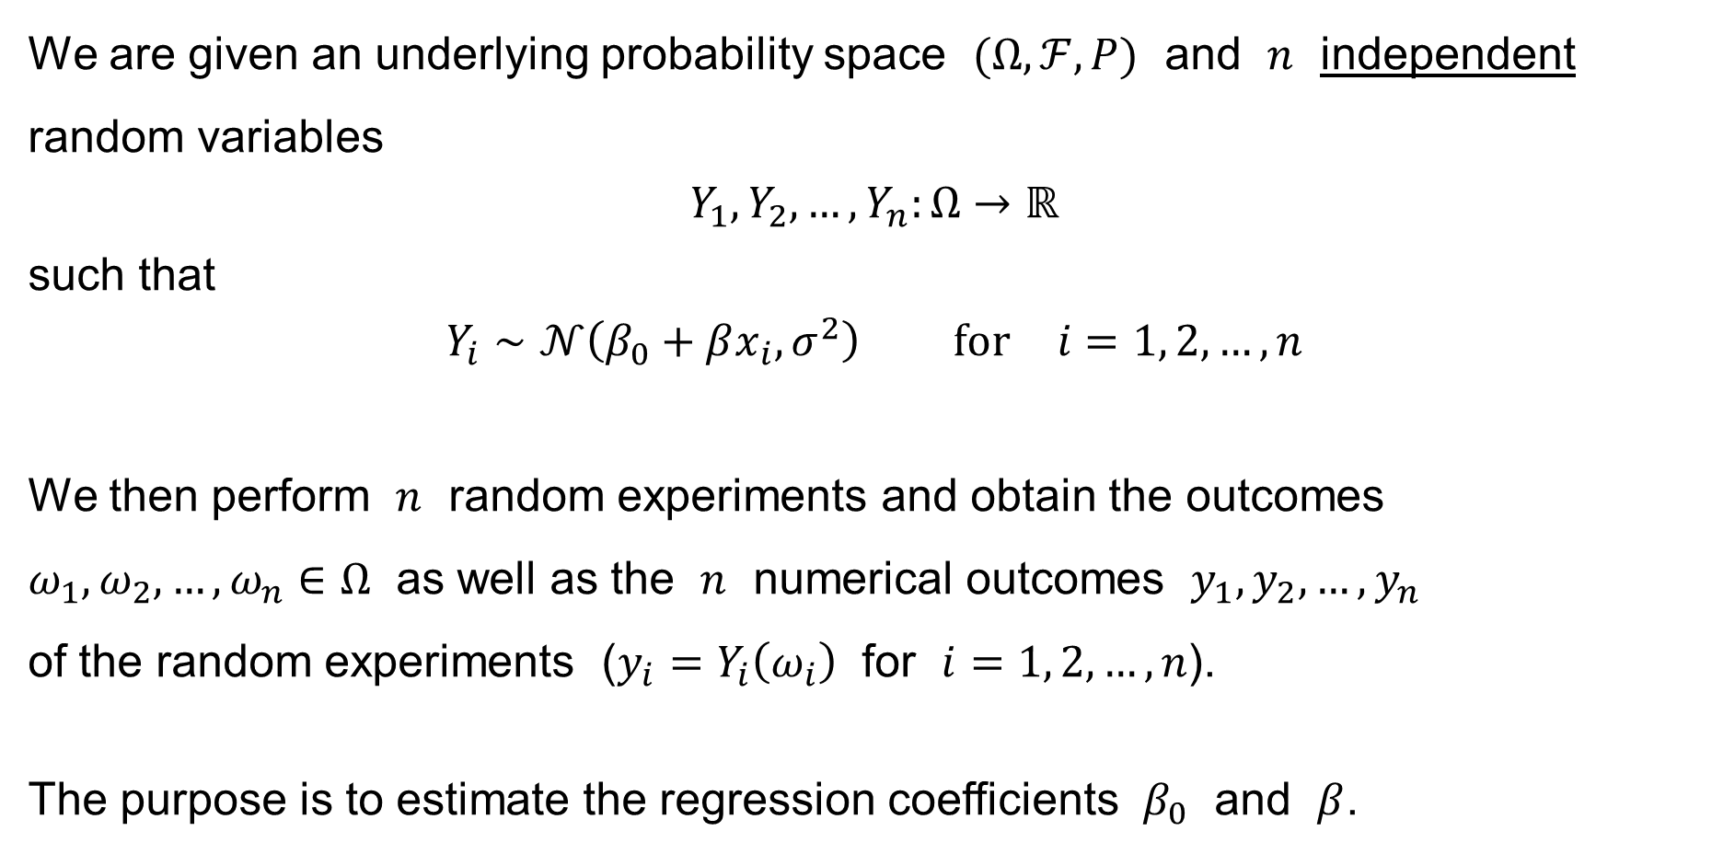
Simple Linear Regression: Summary
We are given an underlying probability space $(Ω,ℱ,P)$ and $n$ independent random variables
$$Y_{1},Y_{2},…,Y_{n}:Ω→ℝ$$
such that
$$Y_{i}∼𝒩\left(β_{0}+βx_{i},σ^{2}\right) \text{for} i=1, 2,…,n$$
We then perform $n$ random experiments and obtain the outcomes
$ω_{1},ω_{2},…,ω_{n}∈Ω$ as well as the $n$ numerical outcomes $y_{1},y_{2},…,y_{n}$
of the random experiments ($y_{i}=Y_{i}\left(ω_{i}\right)$ for $i=1, 2,…,n$).
The purpose is to estimate the regression coefficients $β_{0}$ and $β$.

Slide 4
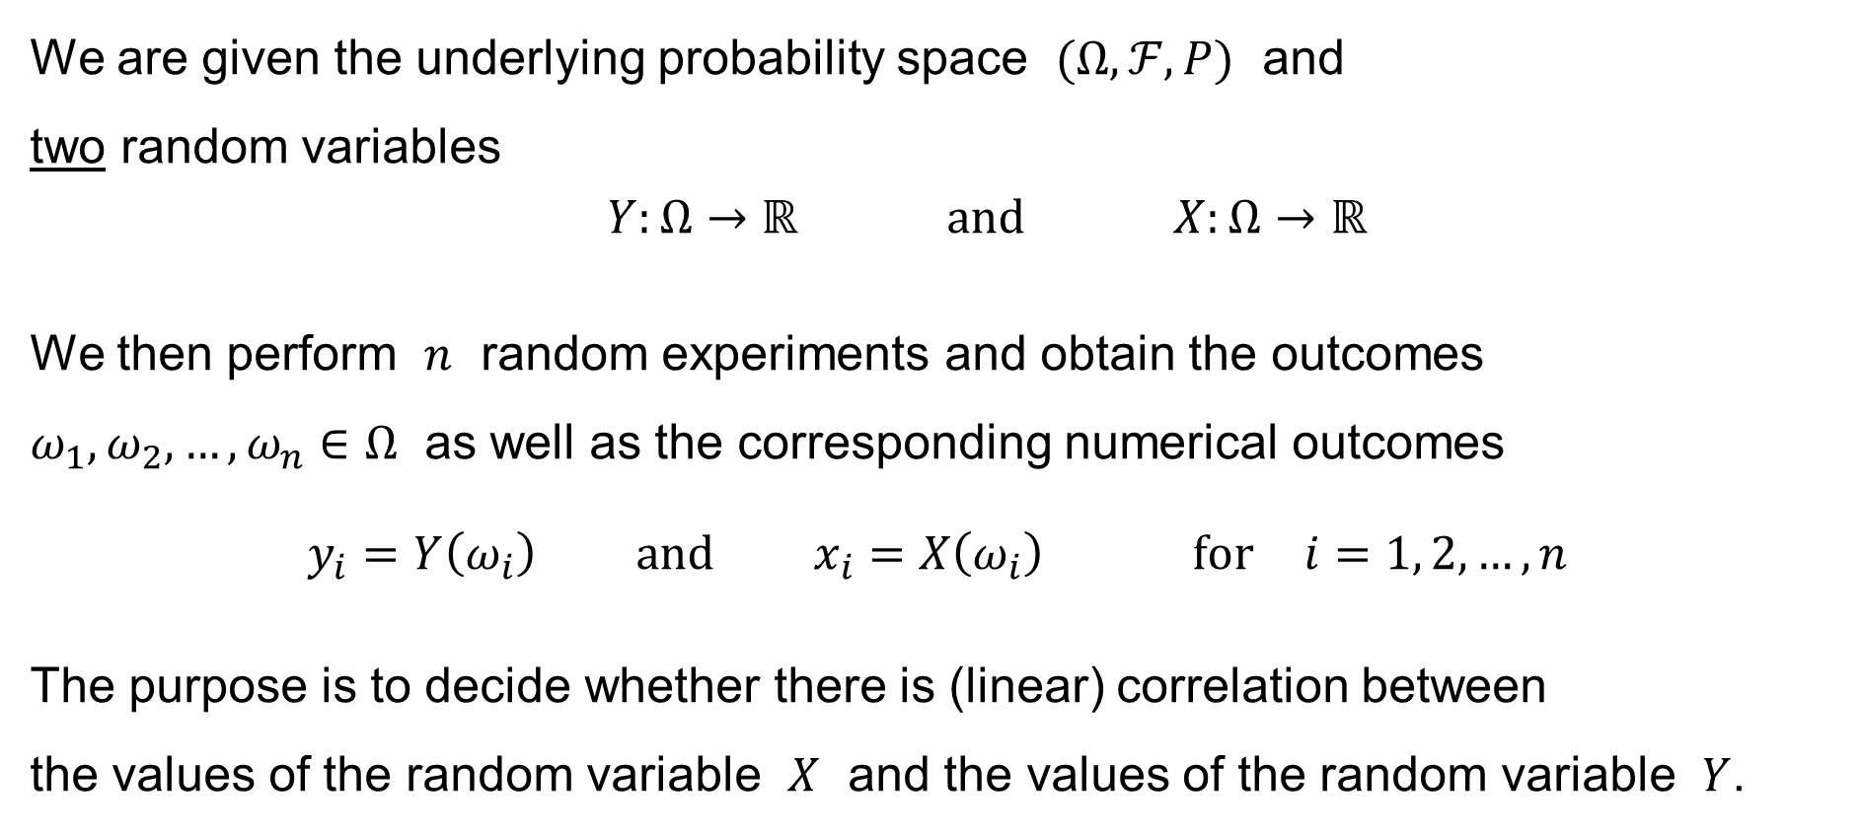
Simple Linear Correlation: Motivation
We are given the underlying probability space $(Ω,ℱ,P)$ and
two random variables
$$Y:Ω→ℝ \text{and} X:Ω→ℝ$$
We then perform $n$ random experiments and obtain the outcomes
$ω_{1},ω_{2},…,ω_{n}∈Ω$ as well as the corresponding numerical outcomes
$$y_{i}=Y\left(ω_{i}\right) \text{and} x_{i}=X\left(ω_{i}\right) \text{for} i=1, 2,…,n$$
The purpose is to decide whether there is (linear) correlation between
the values of the random variable $X$ and the values of the random variable $Y$.

Slide 5
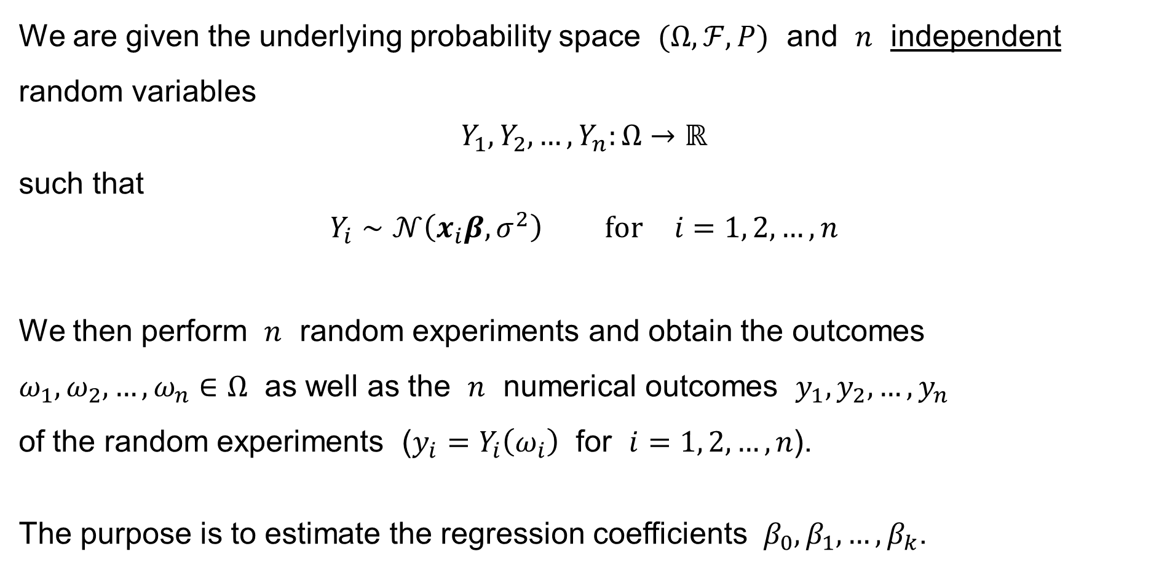
Multiple Linear Regression: Summary
We are given the underlying probability space $(Ω,ℱ,P)$ and $n$ independent random variables
$$Y_{1},Y_{2},…,Y_{n}:Ω→ℝ$$
such that
$$Y_{i}∼𝒩\left(x_{i}β,σ^{2}\right) \text{for} i=1, 2,…,n$$
We then perform $n$ random experiments and obtain the outcomes
$ω_{1},ω_{2},…,ω_{n}∈Ω$ as well as the $n$ numerical outcomes $y_{1},y_{2},…,y_{n}$
of the random experiments ($y_{i}=Y_{i}\left(ω_{i}\right)$ for $i=1, 2,…,n$).
The purpose is to estimate the regression coefficients $β_{0},β_{1},…,β_{k}$.

Slide 6
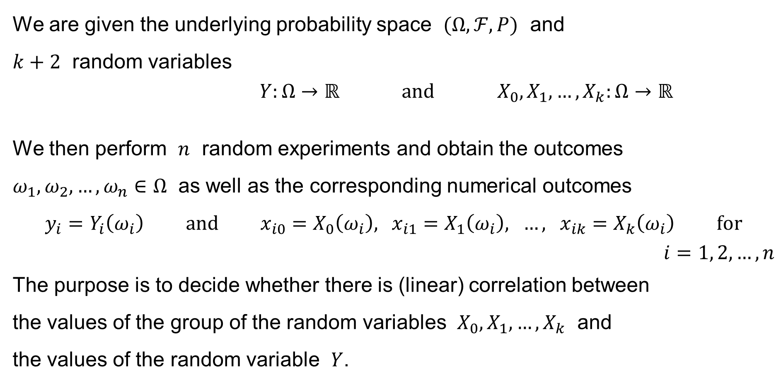
Multiple Linear Correlation: Motivation
We are given the underlying probability space $(Ω,ℱ,P)$ and
$k+2$ random variables
$$Y:Ω→ℝ \text{and} X_{0},X_{1},…,X_{k}:Ω→ℝ$$
We then perform $n$ random experiments and obtain the outcomes
$ω_{1},ω_{2},…,ω_{n}∈Ω$ as well as the corresponding numerical outcomes
$$y_{i}=Y_{i}\left(ω_{i}\right) \text{and} x_{i0}=X_{0}\left(ω_{i}\right), x_{i1}=X_{1}\left(ω_{i}\right), …, x_{ik}=X_{k}\left(ω_{i}\right) \text{for}$$
$$i=1, 2,…,n$$
The purpose is to decide whether there is (linear) correlation between
the values of the group of the random variables $X_{0},X_{1},…,X_{k}$ and
the values of the random variable $Y$.

Slide 7
Revision:
Scalar Product
Scalar Product & the Length of a vector
Geometrical interpretation
Useful conclusions

Slide 8



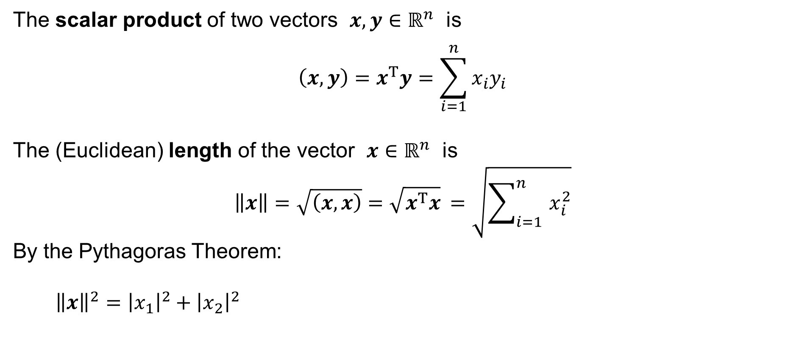




Revision: Scalar Product & the Length of a vector
The scalar product of two vectors $x,y∈ℝ^{n}$ is
$$\left(x,y\right)=x^{T}y=\sum_{i=1}^{n}{x_{i}y_{i}}$$
The (Euclidean) length of the vector $x∈ℝ^{n}$ is
$$\left\|x\right\|=\sqrt{\left(x,x\right)}=\sqrt{x^{T}x} =\sqrt{\sum_{i=1}^{n}{ x_{i}^{2}}}$$
By the Pythagoras Theorem:
${\left\|x\right\|}^{2}={\left|x_{1}\right|}^{2}+{\left|x_{2}\right|}^{2}$
$$x=\left[x_{1},x_{2}\right]$$
$$x_{2}$$
$$\left\|x\right\|$$
$$\left|x_{2}\right|$$
$$0$$
$$\left|x_{1}\right|$$
$$x_{1}$$

Slide 9










Revision: Scalar Product & the Length of a vector
The (Euclidean) length of the vector $x∈ℝ^{n}$ is
$$\left\|x\right\|=\sqrt{\left(x,x\right)}=\sqrt{x^{T}x} =\sqrt{\sum_{i=1}^{n}{ x_{i}^{2}}}$$
By the Pythagoras Theorem:
$${\left\|x\right\|}^{2}= {\left\|d\right\|}^{2} +{\left|x_{3}\right|}^{2}= \\ ={\left|x_{1}\right|}^{2}+{\left|x_{2}\right|}^{2}+{\left|x_{3}\right|}^{2}$$
$$x=\left[x_{1},x_{2},x_{3}\right]$$
$$\left|x_{3}\right|$$
$$\left\|x\right\|$$
$$d$$
$$\left\|d\right\|$$
$$\left|x_{2}\right|$$
$$0$$
$$\left|x_{1}\right|$$
$$\left[x_{1},0,0\right]$$

Slide 10



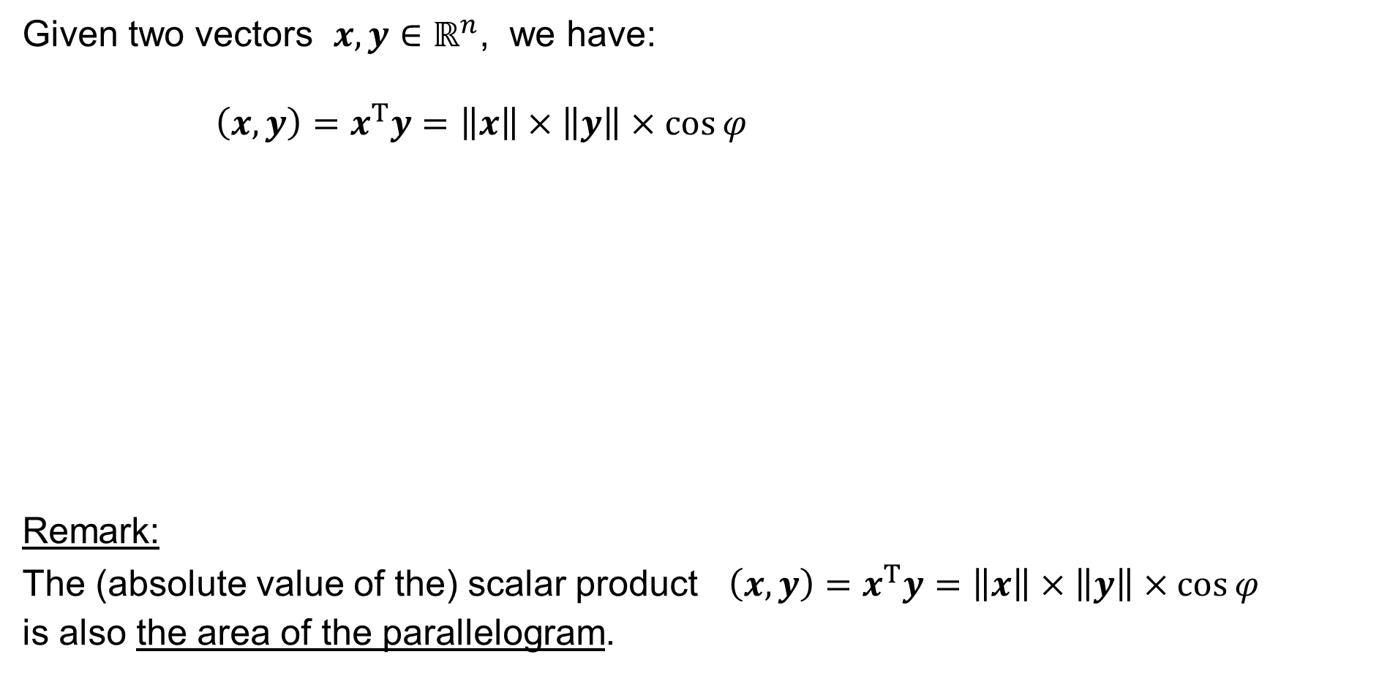



Revision: Scalar Product: Geometrical interpretation
Given two vectors $x,y∈ℝ^{n}$, we have:
$$\left(x,y\right)=x^{T}y=\left\|x\right\|×\left\|y\right\|×\cos{φ}$$
Remark:
The (absolute value of the) scalar product $\left(x,y\right)=x^{T}y=\left\|x\right\|×\left\|y\right\|×\cos{φ}$
is also the area of the parallelogram.
$$y$$
$$\left\|y\right\|$$
$$φ$$
$$0$$
$$\left\|x\right\|$$
$$x$$

Slide 11














Revision: Scalar Product: Why cos φ ?
Let $x,y∈ℝ^{n}$
be such that
$\left\|x\right\|=\left\|y\right\|=1$.
$$\cos{φ}=\cos\left(α−β\right)= \\ =\cos{α}\cos{β}+\sin{α}\sin{β}= \\ =x_{1}y_{1}+x_{2}y_{2}$$
axis 2
$$x_{2}=\sin{α}$$
$$x$$
$$y$$
$$y_{2}=\sin{β}$$
$$φ$$
$$α$$
$$β$$
$$0$$
$$x_{1}$$
$$y_{1}$$
axis 1
$$\cos{α}$$
$$\cos{β}$$

Slide 12
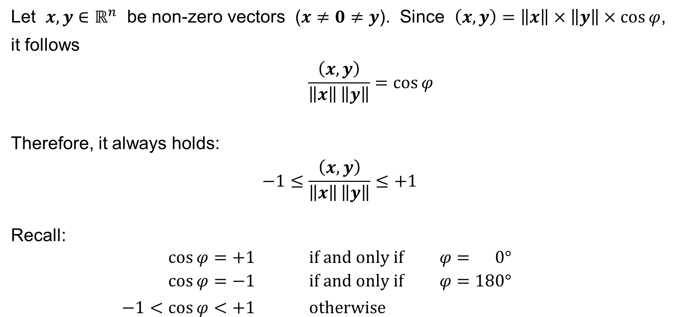
Revision: Scalar Product
Let $x,y∈ℝ^{n}$ be non-zero vectors ($x≠0≠y$). Since $\left(x,y\right)=\left\|x\right\|×\left\|y\right\|×\cos{φ}$,
it follows
$$\frac{\left(x,y\right)}{\left\|x\right\| \left\|y\right\|}=\cos{φ}$$
Therefore, it always holds:
$$−1≤\frac{\left(x,y\right)}{\left\|x\right\| \left\|y\right\|}≤+1$$
Recall:
$$\cos{φ}=+1 \text{if} \text{and} \text{only} \text{if} φ= 0°$$
$$\cos{φ}=−1 \text{if} \text{and} \text{only} \text{if} φ=180°$$
$$−1<\cos{φ}<+1 \text{otherwise}$$

Slide 13







Revision: Scalar Product
Let $x,y∈ℝ^{n}$ be non-zero vectors ($x≠0≠y$).
It then holds:
$$\frac{\left(x,y\right)}{\left\|x\right\| \left\|y\right\|}=+1 \text{if} \text{and} \text{only} \text{if} y=λx \text{for} \text{some} λ>0$$
$$\frac{\left(x,y\right)}{\left\|x\right\| \left\|y\right\|}=−1 \text{if} \text{and} \text{only} \text{if} y=λx \text{for} \text{some} λ<0$$
$$\text{otherwise} −1<\frac{\left(x,y\right)}{\left\|x\right\| \left\|y\right\|}<−1$$
$$y$$
$$x$$
$$0$$
$$y$$
$$0$$
$$x$$

Slide 14
Revision:
Expected value, Covariance
Expected value
Covariance
Variance
Standard deviation
Geometrical interpretation
Uncorrelated random variables

Slide 15
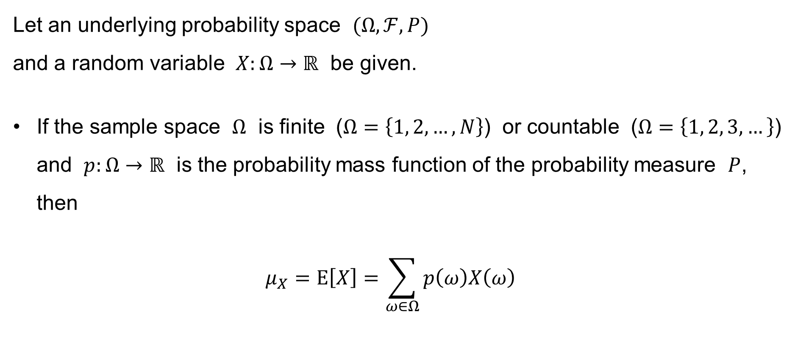
Revision: Expected value
Let an underlying probability space $(Ω,ℱ,P)$
and a random variable $X:Ω→ℝ$ be given.
If the sample space $Ω$ is finite ($Ω=\left\{1, 2,…,N\right\}$) or countable ($Ω=\left\{1, 2, 3,…\right\}$) and $p:Ω→ℝ$ is the probability mass function of the probability measure $P$, then
$μ_{X}=E\left[X\right]=\sum_{ω∈Ω}{p\left(ω\right)X\left(ω\right)}$

Slide 16
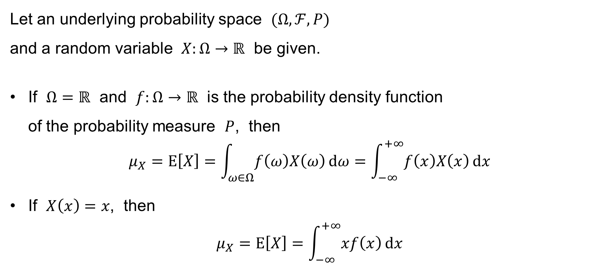
Revision: Expected value
Let an underlying probability space $(Ω,ℱ,P)$
and a random variable $X:Ω→ℝ$ be given.
If $Ω=ℝ$ and $f:Ω→ℝ$ is the probability density function
of the probability measure $P$, then
$$μ_{X}=E\left[X\right]=\int_{ω∈Ω}{f\left(ω\right)X\left(ω\right) dω}=\int_{−∞}^{+∞}{f\left(x\right)X\left(x\right) dx}$$
If $X\left(x\right)=x$, then
$$μ_{X}=E\left[X\right]=\int_{−∞}^{+∞}{xf\left(x\right) dx}$$

Slide 17
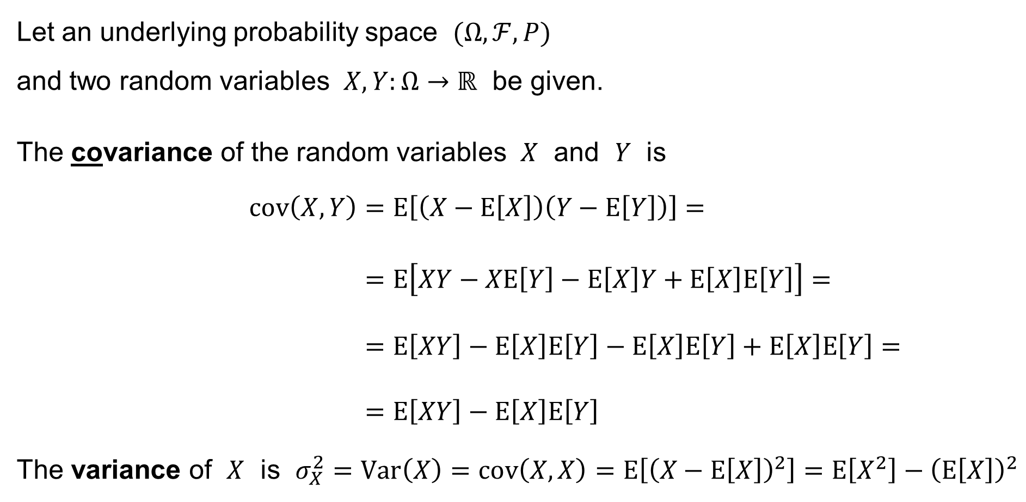
Revision: Covariance & Variance
Let an underlying probability space $(Ω,ℱ,P)$
and two random variables $X,Y:Ω→ℝ$ be given.
The covariance of the random variables $X$ and $Y$ is
$$cov\left(X,Y\right)=E\left[\left(X−E\left[X\right]\right)\left(Y−E\left[Y\right]\right)\right]= \\ =E\left[XY−XE\left[Y\right]−E\left[X\right]Y+E\left[X\right]E\left[Y\right]\right]= \\ =E\left[XY\right]−E\left[X\right]E\left[Y\right]−E\left[X\right]E\left[Y\right]+E\left[X\right]E\left[Y\right]= \\ =E\left[XY\right]−E\left[X\right]E\left[Y\right]$$
The variance of $X$ is $σ_{X}^{2}=Var\left(X\right)=cov\left(X,X\right)=E\left[{\left(X−E\left[X\right]\right)}^{2}\right]=E\left[X^{2}\right]−{\left(E\left[X\right]\right)}^{2}$

Slide 18
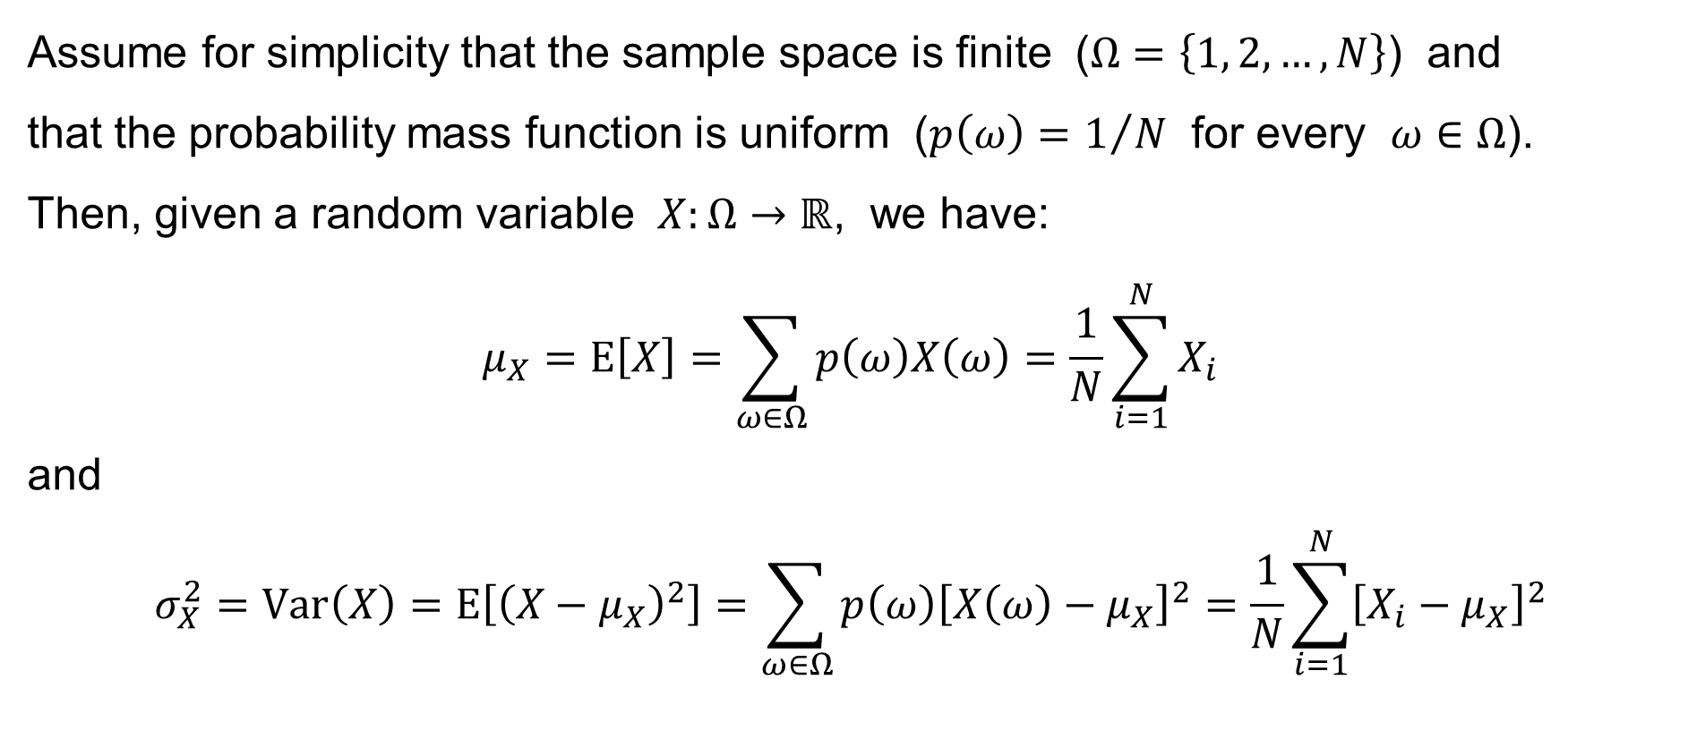
Variance: Geometrical interpretation
Assume for simplicity that the sample space is finite ($Ω=\left\{1, 2,…,N\right\}$) and
that the probability mass function is uniform ($p\left(ω\right)=1/N$ for every $ω∈Ω$).
Then, given a random variable $X:Ω→ℝ$, we have:
$$μ_{X}=E\left[X\right]=\sum_{ω∈Ω}{p\left(ω\right)X\left(ω\right)}=\frac{1}{N}\sum_{i=1}^{N}{X_{i}}$$
and
$$σ_{X}^{2}=Var\left(X\right)=E\left[{\left(X−μ_{X}\right)}^{2}\right]=\sum_{ω∈Ω}{p\left(ω\right){\left[X\left(ω\right)−μ_{X}\right]}^{2}}=\frac{1}{N}\sum_{i=1}^{N}{{\left[X_{i}−μ_{X}\right]}^{2}}$$

Slide 19
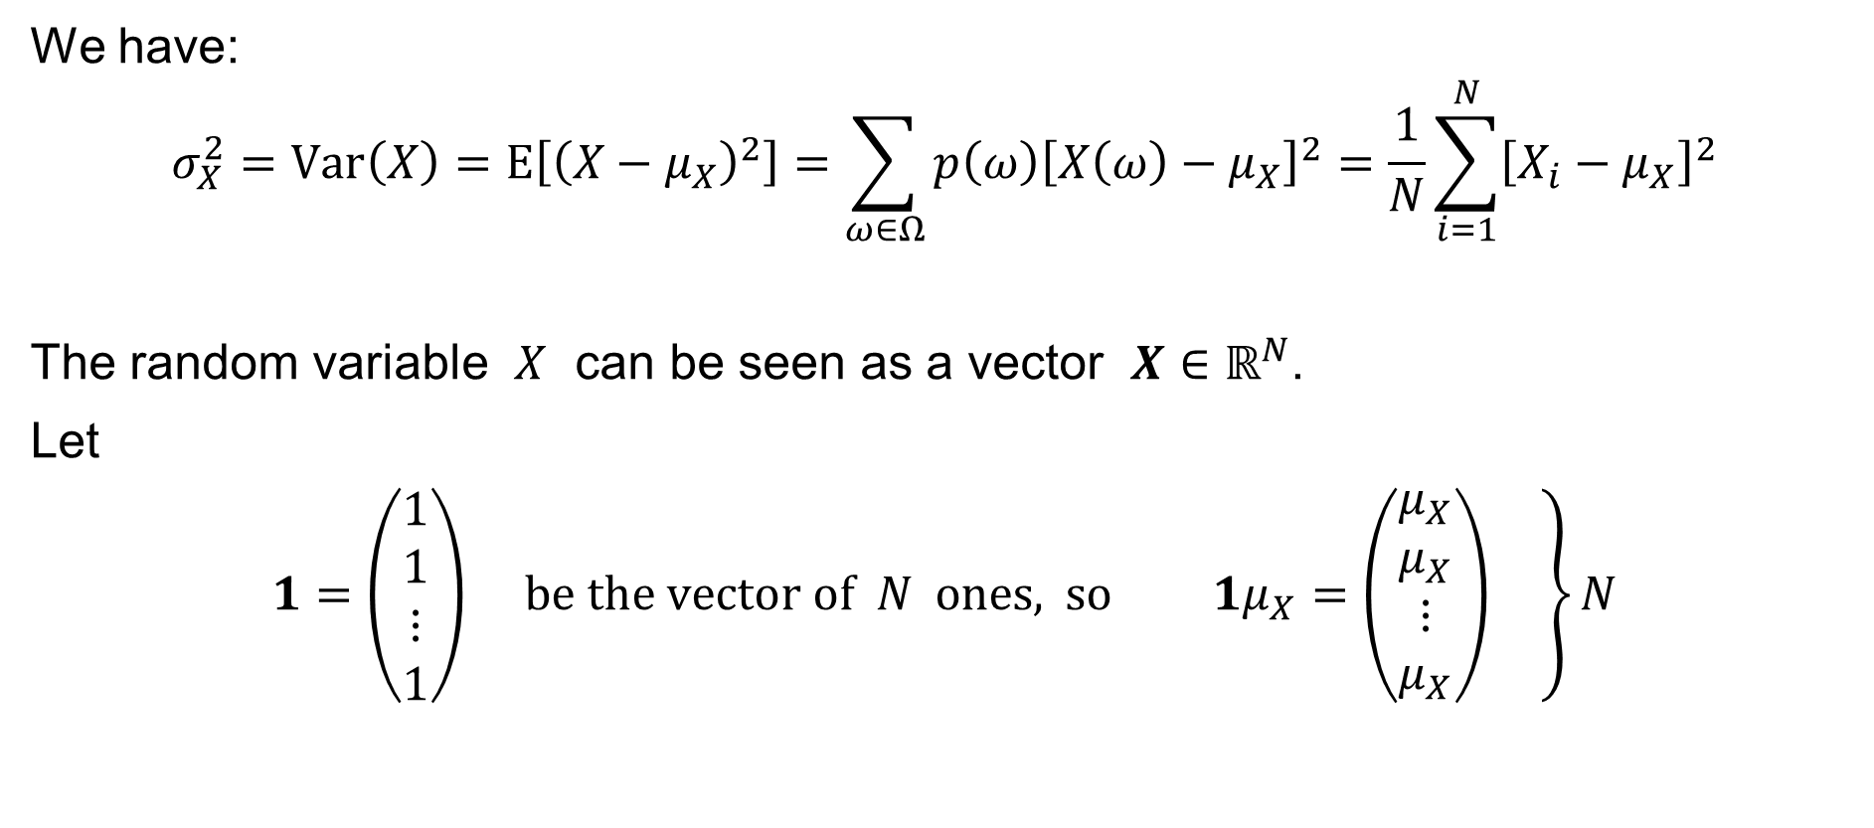
Variance: Geometrical interpretation
We have:
$$σ_{X}^{2}=Var\left(X\right)=E\left[{\left(X−μ_{X}\right)}^{2}\right]=\sum_{ω∈Ω}{p\left(ω\right){\left[X\left(ω\right)−μ_{X}\right]}^{2}}=\frac{1}{N}\sum_{i=1}^{N}{{\left[X_{i}−μ_{X}\right]}^{2}}$$
The random variable $X$ can be seen as a vector $X∈ℝ^{N}$.
Let
$$1=\left(\begin{matrix}1 \\ 1 \\ ⋮ \\ 1\end{matrix}\right) \text{be} \text{the} \text{vector} \text{of} N \text{ones}\text{, }\text{so} 1μ_{X}=\left.\left(\begin{matrix}μ_{X} \\ μ_{X} \\ ⋮ \\ μ_{X}\end{matrix}\right) \right\}N$$

Slide 20
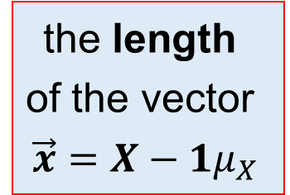
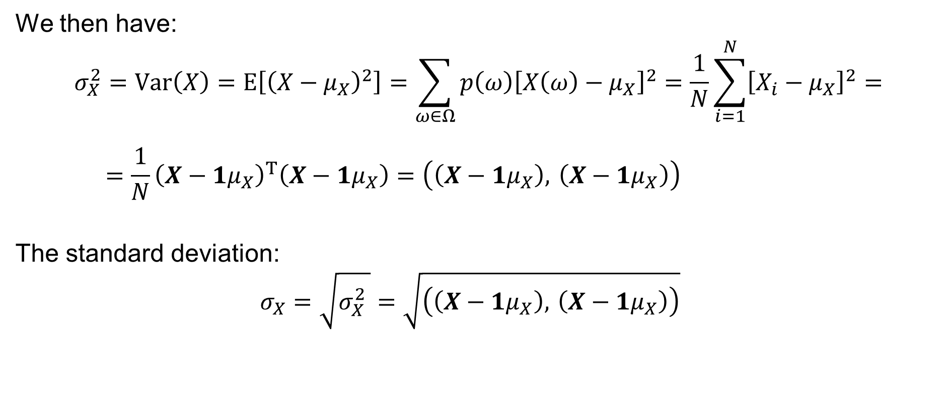
Variance: Geometrical interpretation
We then have:
$$σ_{X}^{2}=Var\left(X\right)=E\left[{\left(X−μ_{X}\right)}^{2}\right]=\sum_{ω∈Ω}{p\left(ω\right){\left[X\left(ω\right)−μ_{X}\right]}^{2}}=\frac{1}{N}\sum_{i=1}^{N}{{\left[X_{i}−μ_{X}\right]}^{2}}=$$
$$=\frac{1}{N}{\left(X−1μ_{X}\right)}^{T}\left(X−1μ_{X}\right)=\left(\left(X−1μ_{X}\right), \left(X−1μ_{X}\right)\right)$$
The standard deviation:
$$σ_{X}=\sqrt{σ_{X}^{2} }=\sqrt{\left(\left(X−1μ_{X}\right), \left(X−1μ_{X}\right)\right)}$$
scalar product
the length
of the vector
$$\vec{x}=X−1μ_{X}$$

Slide 21
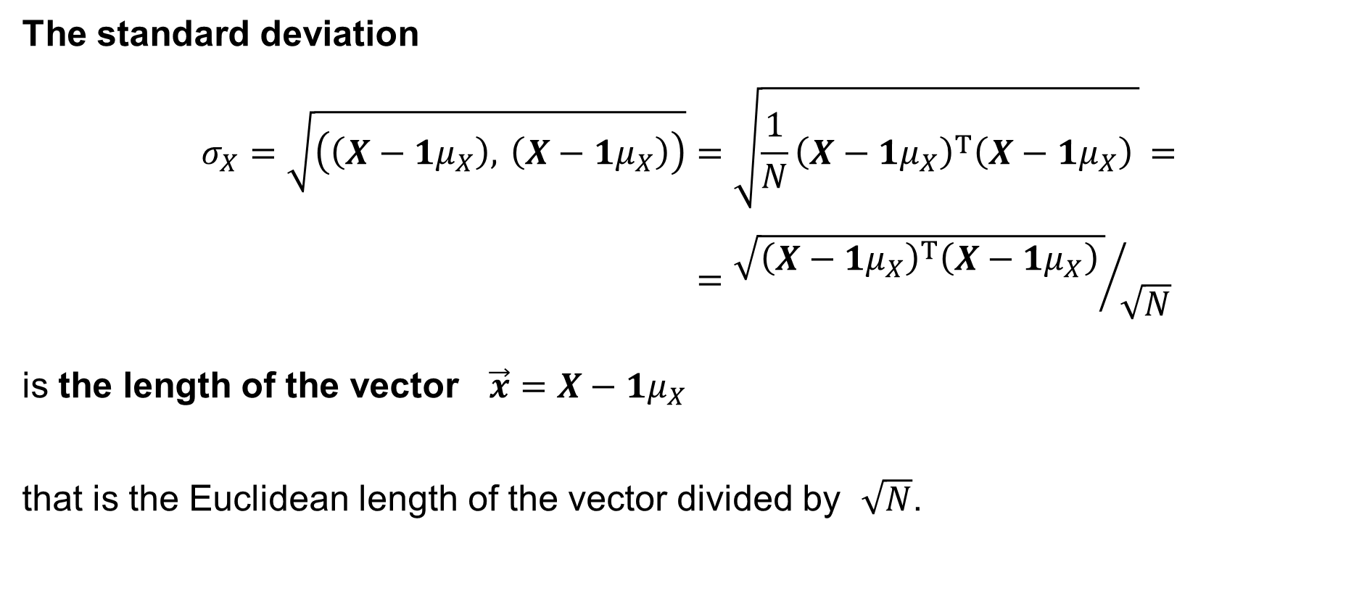
Standard deviation: Geometrical interpretation
The standard deviation
$$σ_{X}=\sqrt{\left(\left(X−1μ_{X}\right), \left(X−1μ_{X}\right)\right)}=\sqrt{\frac{1}{N}{\left(X−1μ_{X}\right)}^{T}\left(X−1μ_{X}\right) }= \\ ={\sqrt{{\left(X−1μ_{X}\right)}^{T}\left(X−1μ_{X}\right) }}/{\sqrt{N}}$$
is the length of the vector $\vec{x}=X−1μ_{X}$
that is the Euclidean length of the vector divided by $\sqrt{N}$.

Slide 22
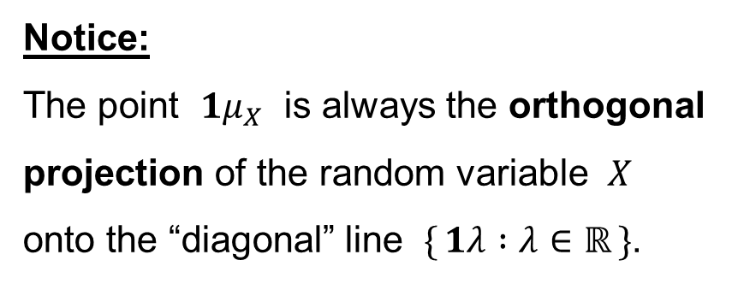




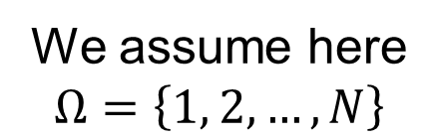

Standard deviation: Geometrical interpretation
We assume here
$$Ω=\left\{1, 2,…,N\right\}$$
$\{ 1λ :λ∈ℝ \}$ — the “diagonal” line
axis 2
Notice:
The point $1μ_{X}$ is always the orthogonal
projection of the random variable $X$
onto the “diagonal” line $\{ 1λ :λ∈ℝ \}$.
$$1μ_{X}$$
$$\left\|\vec{x}\right\|$$
$$X$$
$$0$$
axis 1

Slide 23
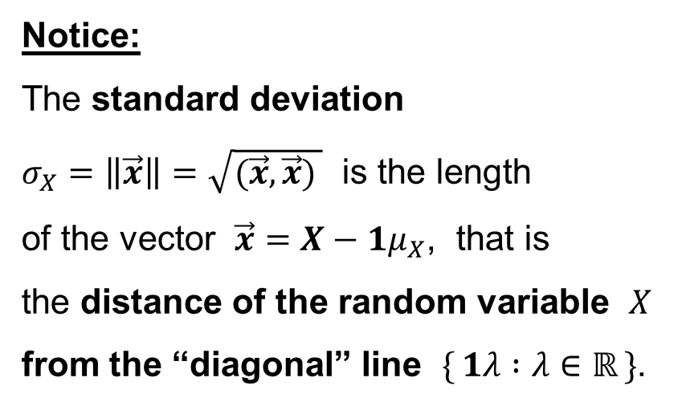
Standard deviation: Geometrical interpretation
We assume here
$$Ω=\left\{1, 2,…,N\right\}$$
$\{ 1λ :λ∈ℝ \}$ — the “diagonal” line
axis 2
Notice:
The standard deviation
$σ_{X}=\left\|\vec{x}\right\|=\sqrt{(\vec{x},\vec{x}) }$ is the length
of the vector $\vec{x}=X−1μ_{X}$, that is
the distance of the random variable $X$
from the “diagonal” line $\{ 1λ :λ∈ℝ \}$.
$$1μ_{X}$$
$$\left\|\vec{x}\right\|$$
$$X$$
$$0$$
axis 1

Slide 24
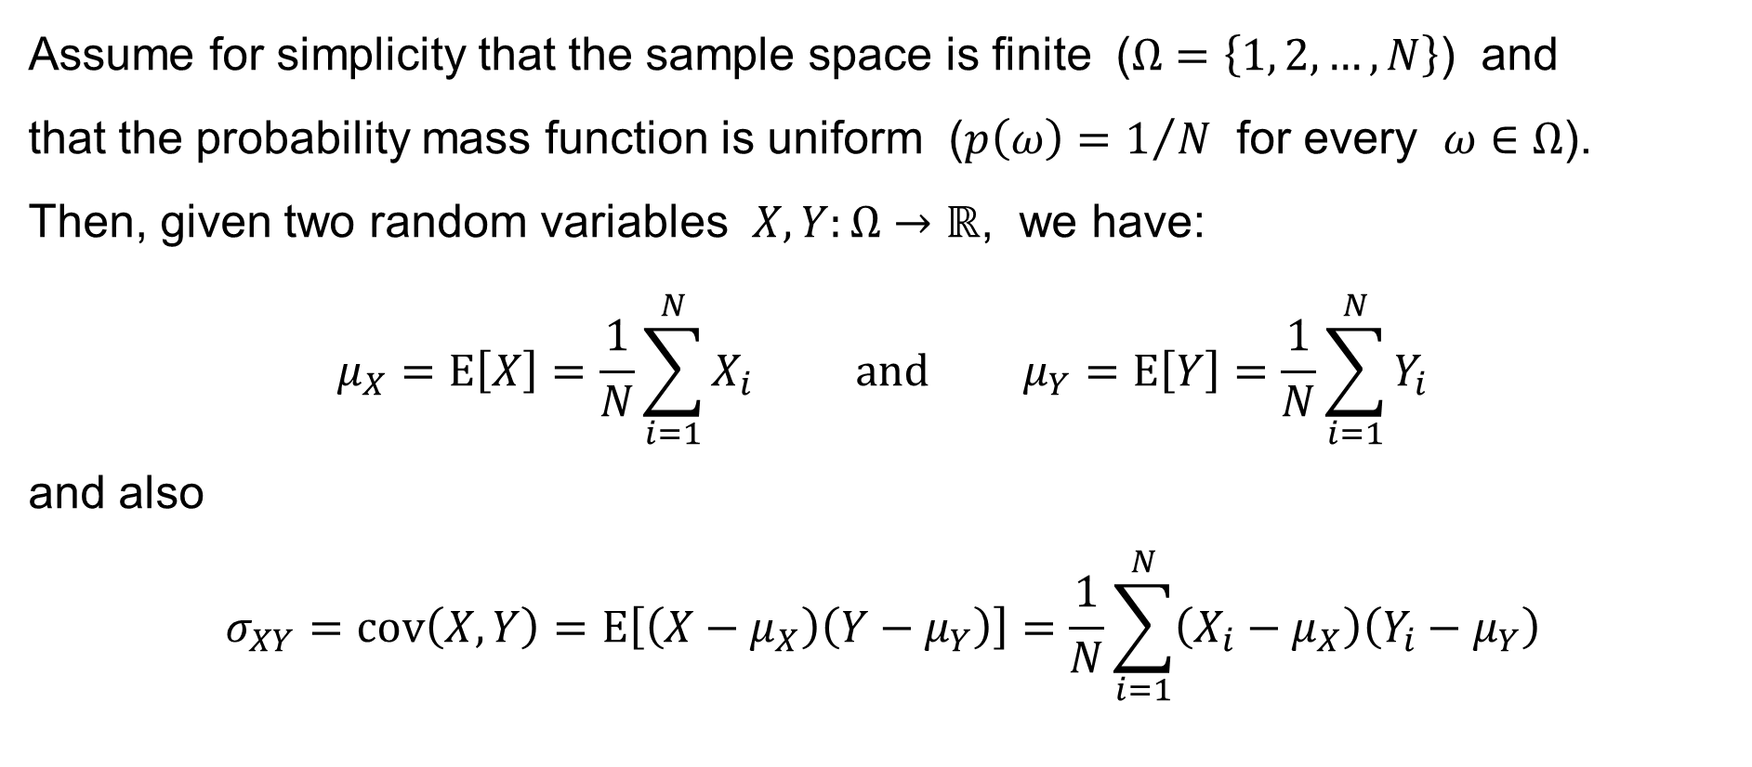
Covariance: Geometrical interpretation
Assume for simplicity that the sample space is finite ($Ω=\left\{1, 2,…,N\right\}$) and
that the probability mass function is uniform ($p\left(ω\right)=1/N$ for every $ω∈Ω$).
Then, given two random variables $X,Y:Ω→ℝ$, we have:
$$μ_{X}=E\left[X\right]=\frac{1}{N}\sum_{i=1}^{N}{X_{i}} \text{and} μ_{Y}=E\left[Y\right]=\frac{1}{N}\sum_{i=1}^{N}{Y_{i}}$$
and also
$$σ_{XY}=cov\left(X,Y\right)=E\left[\left(X−μ_{X}\right)\left(Y−μ_{Y}\right)\right]=\frac{1}{N}\sum_{i=1}^{N}{\left(X_{i}−μ_{X}\right)\left(Y_{i}−μ_{Y}\right)}$$

Slide 25
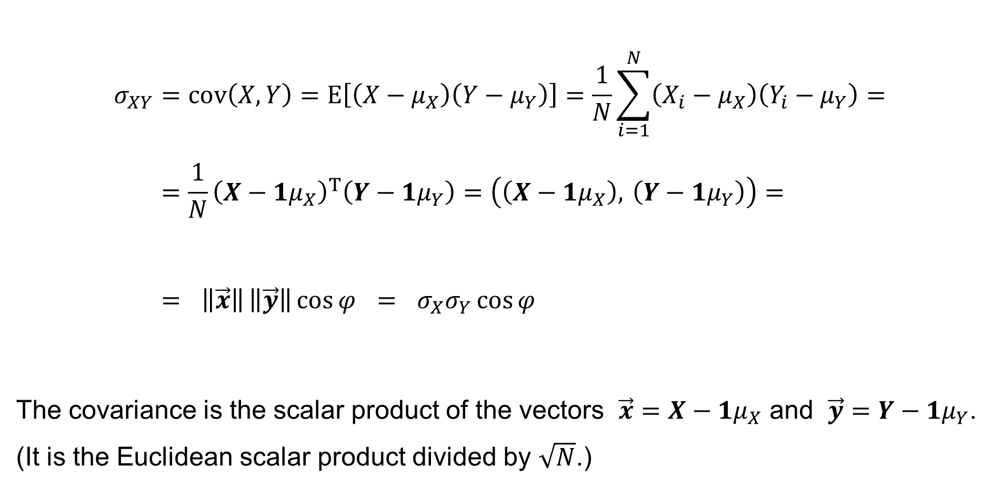
Covariance: Geometrical interpretation
$$σ_{XY}=cov\left(X,Y\right)=E\left[\left(X−μ_{X}\right)\left(Y−μ_{Y}\right)\right]=\frac{1}{N}\sum_{i=1}^{N}{\left(X_{i}−μ_{X}\right)\left(Y_{i}−μ_{Y}\right)}= \\ =\frac{1}{N}{\left(X−1μ_{X}\right)}^{T}\left(Y−1μ_{Y}\right)=\left(\left(X−1μ_{X}\right), \left(Y−1μ_{Y}\right)\right)= \\ = \left\|\vec{x}\right\| \left\|\vec{y}\right\|\cos{φ} = σ_{X}σ_{Y}\cos{φ}$$
The covariance is the scalar product of the vectors $\vec{x}=X−1μ_{X}$ and $\vec{y}=Y−1μ_{Y}$.
(It is the Euclidean scalar product divided by $\sqrt{N}$.)
We then have:

Slide 26







Covariance: Geometrical interpretation
We assume here
$$Ω=\left\{1, 2,…,N\right\}$$
$\{ 1λ :λ∈ℝ \}$ — the “diagonal” line
axis 3
$$1μ_{X}$$
$$\left\|\vec{x}\right\|$$
$$1μ_{Y}$$
axis 2
$$\left\|\vec{y}\right\|$$
$$X$$
$$Y$$
$$0$$
axis 1

Slide 27
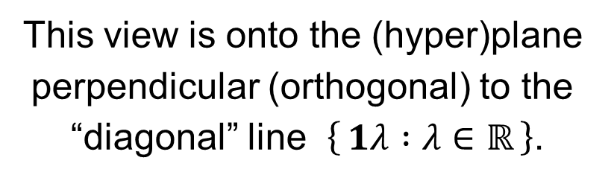
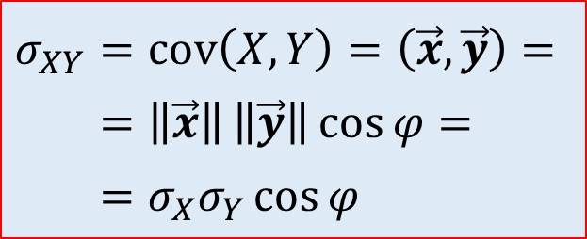
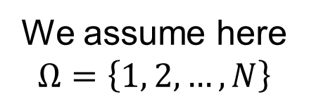








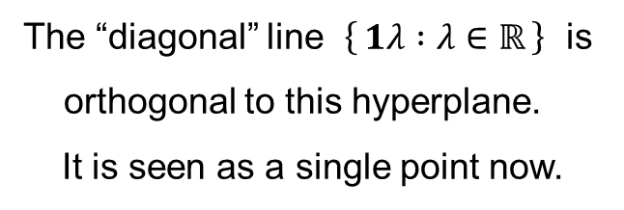
Covariance: Geometrical interpretation
We assume here
$$Ω=\left\{1, 2,…,N\right\}$$
axis 2
This view is onto the (hyper)plane
perpendicular (orthogonal) to the
“diagonal” line $\left\{ 1λ :λ∈ℝ \right\}$.
$$\vec{y}=Y−1μ_{Y}$$
$$\vec{x}=X−1μ_{X}$$
$$\left\|\vec{y}\right\|$$
$$\left\|\vec{x}\right\|$$
The “diagonal” line $\left\{ 1λ :λ∈ℝ \right\}$ is
orthogonal to this hyperplane.
It is seen as a single point now.
$$φ$$
$$σ_{XY}=cov\left(X,Y\right)=\left(\vec{x},\vec{y}\right)= \\ =\left\|\vec{x}\right\| \left\|\vec{y}\right\|\cos{φ}= \\ =σ_{X}σ_{Y}\cos{φ}$$
$$1μ_{Y}$$
$$0$$
$$1μ_{X}$$
axis 3
axis 1

Slide 28
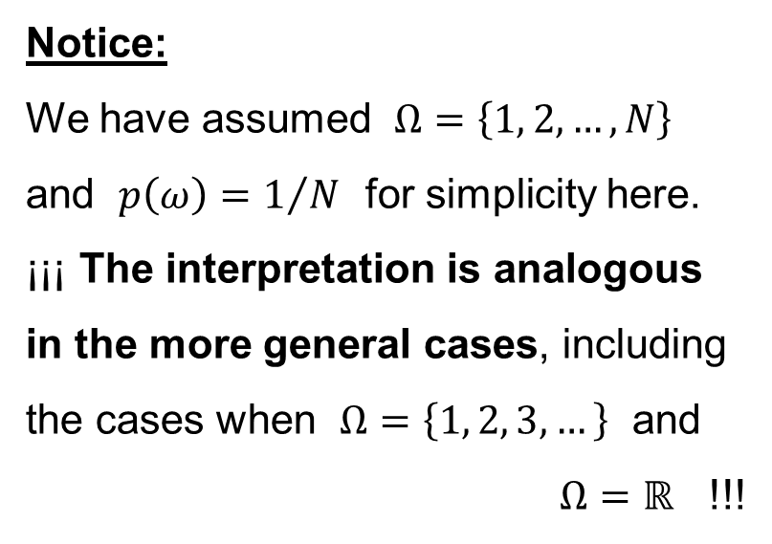
¡¡¡ Notice !!!
We assume here
$$Ω=\left\{1, 2,…,N\right\}$$
$\{ 1λ :λ∈ℝ \}$ — the “diagonal” line
axis 2
Notice:
We have assumed $Ω=\left\{1, 2,…,N\right\}$
and $p\left(ω\right)=1/N$ for simplicity here.
¡¡¡ The interpretation is analogous
in the more general cases, including
the cases when $Ω=\left\{1, 2, 3,…\right\}$ and
$Ω=ℝ$ !!!
$$1μ_{X}$$
$$\left\|\vec{x}\right\|$$
$$X$$
$$0$$
axis 1

Slide 29
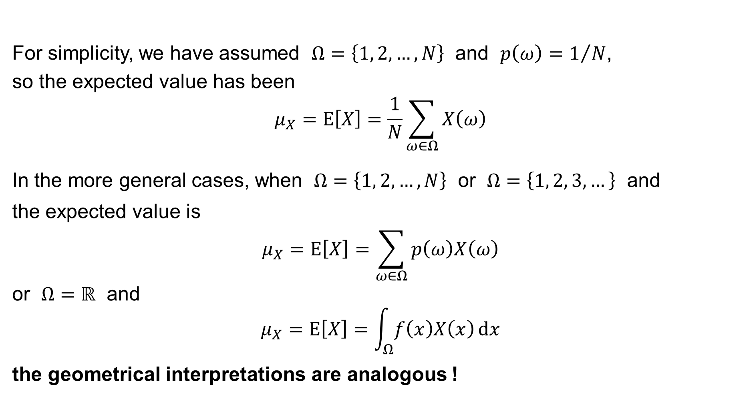
The geometrical interpretations: ¡¡¡ Notice !!!
For simplicity, we have assumed $Ω=\left\{1, 2,…,N\right\}$ and $p\left(ω\right)=1/N$,
so the expected value has been
$$μ_{X}=E\left[X\right]=\frac{1}{N}\sum_{ω∈Ω}{X\left(ω\right)}$$
In the more general cases, when $Ω=\left\{1, 2,…,N\right\}$ or $Ω=\left\{1, 2, 3,…\right\}$ and
the expected value is
$$μ_{X}=E\left[X\right]=\sum_{ω∈Ω}{p\left(ω\right)X\left(ω\right)}$$
or $Ω=ℝ$ and
$$μ_{X}=E\left[X\right]=\int_{Ω}{f\left(x\right)X\left(x\right) dx}$$
the geometrical interpretations are analogous !

Slide 30
Pearson’s Correlation Coefficient
Covariance
Independent random variables
Uncorrelated random variables
Pearson’s Correlation Coefficient

Slide 31

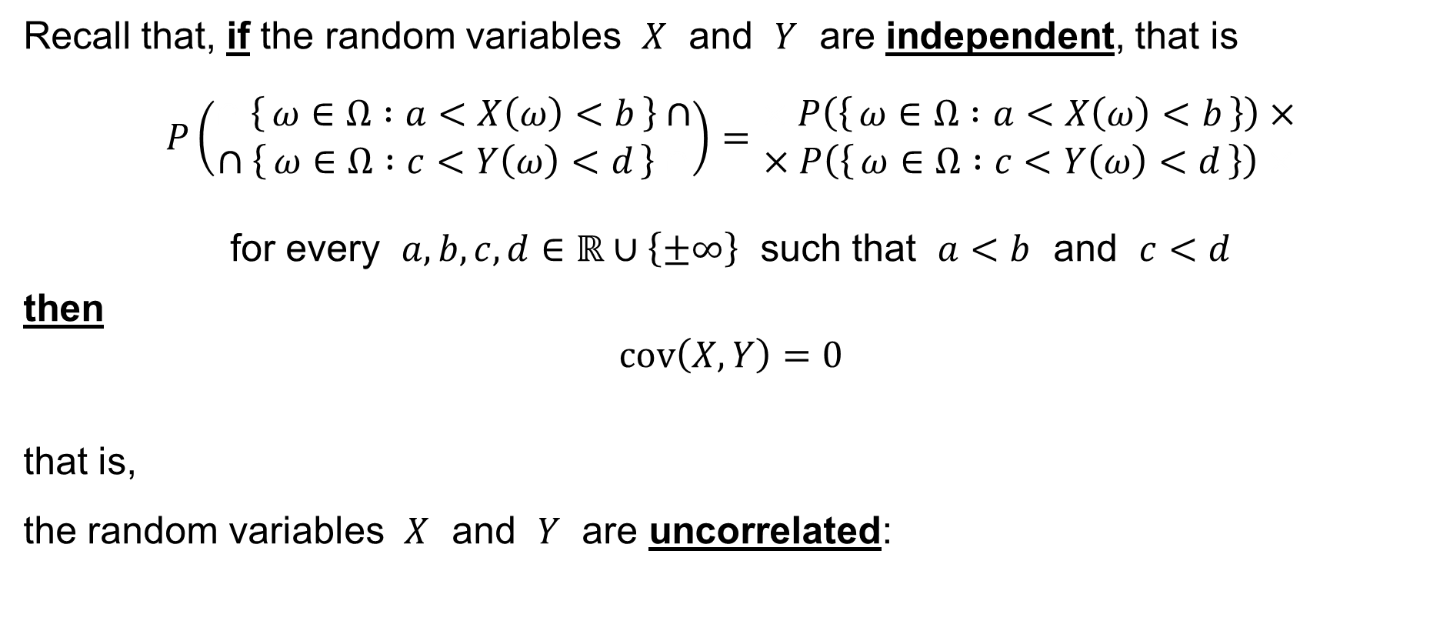


Revision: Covariance
Recall that, if the random variables $X$ and $Y$ are independent, that is
$$P\left(\begin{aligned}∩\left\{ ω∈Ω :a<X\left(ω\right)<b \right\}∩ \\ ∩\left\{ ω∈Ω :c<Y\left(ω\right)<d \right\}∩\end{aligned}\right)=\begin{aligned}×P\left(\left\{ ω∈Ω :a<X\left(ω\right)<b \right\}\right)× \\ ×P\left(\left\{ ω∈Ω :c<Y\left(ω\right)<d \right\}\right)×\end{aligned}$$
for every $a,b,c,d∈ℝ∪\left\{±∞\right\}$ such that $a<b$ and $c<d$
then
$$cov\left(X,Y\right)=0$$
that is,
the random variables $X$ and $Y$ are uncorrelated:
$$\vec{x}=X−1μ_{X}$$
$$\vec{y}=Y−1μ_{Y}$$
$$0$$

Slide 32


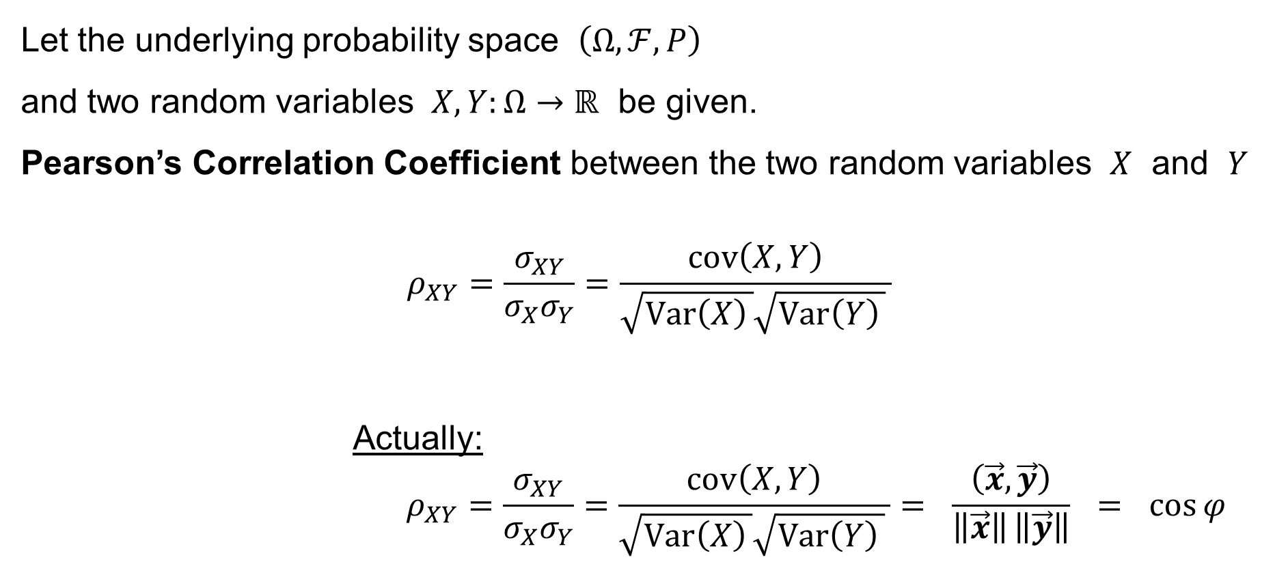



Pearson’s Correlation Coefficient
Let the underlying probability space $\left(Ω,ℱ,P\right)$
and two random variables $X,Y:Ω→ℝ$ be given.
Pearson’s Correlation Coefficient between the two random variables $X$ and $Y$
$$ρ_{XY}=\frac{σ_{XY}}{σ_{X}σ_{Y}}=\frac{cov\left(X,Y\right)}{\sqrt{Var\left(X\right) }\sqrt{Var\left(Y\right) } }$$
Actually:
$$ρ_{XY}=\frac{σ_{XY}}{σ_{X}σ_{Y}}=\frac{cov\left(X,Y\right)}{\sqrt{Var\left(X\right) }\sqrt{Var\left(Y\right) } }= \frac{\left(\vec{x},\vec{y}\right)}{\left\|\vec{x}\right\| \left\|\vec{y}\right\|} = \cos{φ}$$
is
$$\text{if} Var\left(X\right)≠0≠Var\left(Y\right)$$
$$\vec{x}=X−1μ_{X}$$
$$\vec{y}=Y−1μ_{Y}$$
$$φ$$
$$0$$

Slide 33





Pearson’s Correlation Coefficient
We have:
$$ρ_{XY}=\frac{σ_{XY}}{σ_{X}σ_{Y}}=\frac{cov\left(X,Y\right)}{\sqrt{Var\left(X\right) }\sqrt{Var\left(Y\right) } }= \frac{\left(\vec{x},\vec{y}\right)}{\left\|\vec{x}\right\| \left\|\vec{y}\right\|} = \cos{φ}$$
Notice:
It holds $ρ_{XY}=ρ_{YX}$
It holds $−1≤ρ_{XY}≤+1$
It holds $ρ_{a+bX, c+dY}=\operatorname{sgn}\left(bd\right)×ρ_{XY}$ if $b≠0≠d$
for every $a,b,c,d∈ℝ$
$$0$$
$$φ$$
$$\vec{x}=X−1μ_{X}$$
$$\vec{y}=Y−1μ_{Y}$$

Slide 34




Pearson’s Correlation Coefficient
We have:
$$ρ_{XY}=\frac{σ_{XY}}{σ_{X}σ_{Y}}=\frac{cov\left(X,Y\right)}{\sqrt{Var\left(X\right) }\sqrt{Var\left(Y\right) } }= \frac{\left(\vec{x},\vec{y}\right)}{\left\|\vec{x}\right\| \left\|\vec{y}\right\|} = \cos{φ}$$
It holds
$$ρ_{XY}=+1 \text{if} \text{and} \text{only} \text{if} \vec{y}=b\vec{x} \text{for} \text{some} b>0$$
that is
$$Y−1μ_{Y}=b\left(X−1μ_{X}\right) \\ Y−μ_{Y}=b\left(X−μ_{X}\right) \\ Y=bX+(μ_{Y}−μ_{X})$$
$$\vec{y}$$
$$\vec{x}$$
$$0$$

Slide 35



Pearson’s Correlation Coefficient
We have:
$$ρ_{XY}=\frac{σ_{XY}}{σ_{X}σ_{Y}}=\frac{cov\left(X,Y\right)}{\sqrt{Var\left(X\right) }\sqrt{Var\left(Y\right) } }= \frac{\left(\vec{x},\vec{y}\right)}{\left\|\vec{x}\right\| \left\|\vec{y}\right\|} = \cos{φ}$$
It holds
$$ρ_{XY}=−1 \text{if} \text{and} \text{only} \text{if} \vec{y}=b\vec{x} \text{for} \text{some} b<0$$
that is
$$Y−1μ_{Y}=b\left(X−1μ_{X}\right) \\ Y−μ_{Y}=b\left(X−μ_{X}\right) \\ Y=bX+(μ_{Y}−μ_{X})$$
$$\vec{y}$$
$$0$$
$$\vec{x}$$

Slide 36





Pearson’s Correlation Coefficient
We have:
$$ρ_{XY}=\frac{σ_{XY}}{σ_{X}σ_{Y}}=\frac{cov\left(X,Y\right)}{\sqrt{Var\left(X\right) }\sqrt{Var\left(Y\right) } }= \frac{\left(\vec{x},\vec{y}\right)}{\left\|\vec{x}\right\| \left\|\vec{y}\right\|} = \cos{φ}$$
It holds
$$−1<ρ_{XY}<+1 \text{otherwise}$$
$$\vec{x}=X−1μ_{X}$$
$$\vec{y}=Y−1μ_{Y}$$
$$φ$$
$$0$$

Slide 37
Regression Coefficient
Regression Coefficient
Regression Lines
Coefficients of Regression

Slide 38


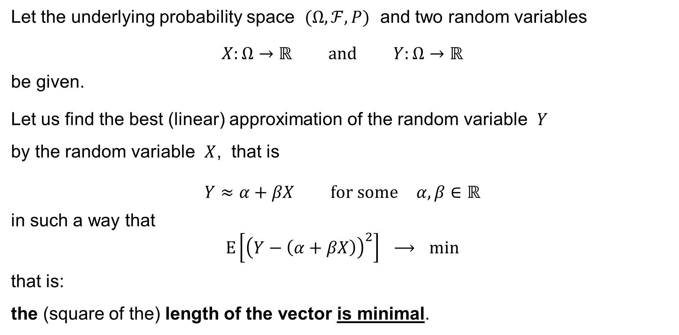



Regression Coefficient
Let the underlying probability space $(Ω,ℱ,P)$ and two random variables
$$X:Ω→ℝ \text{and} Y:Ω→ℝ$$
be given.
Let us find the best (linear) approximation of the random variable $Y$
by the random variable $X$, that is
$$Y≈α+βX \text{for} \text{some} α,β∈ℝ$$
in such a way that
$$E\left[{\left(Y−\left(α+βX\right)\right)}^{2}\right] ⟶ min$$
that is:
the (square of the) length of the vector is minimal.
$$Y$$
$$\left\|Y−\left(α1+βX\right)\right\|⟶min$$
$$1$$
$$X$$
the linear subspace $\left\{ α1+βX :α,β∈ℝ \right\}$

Slide 39
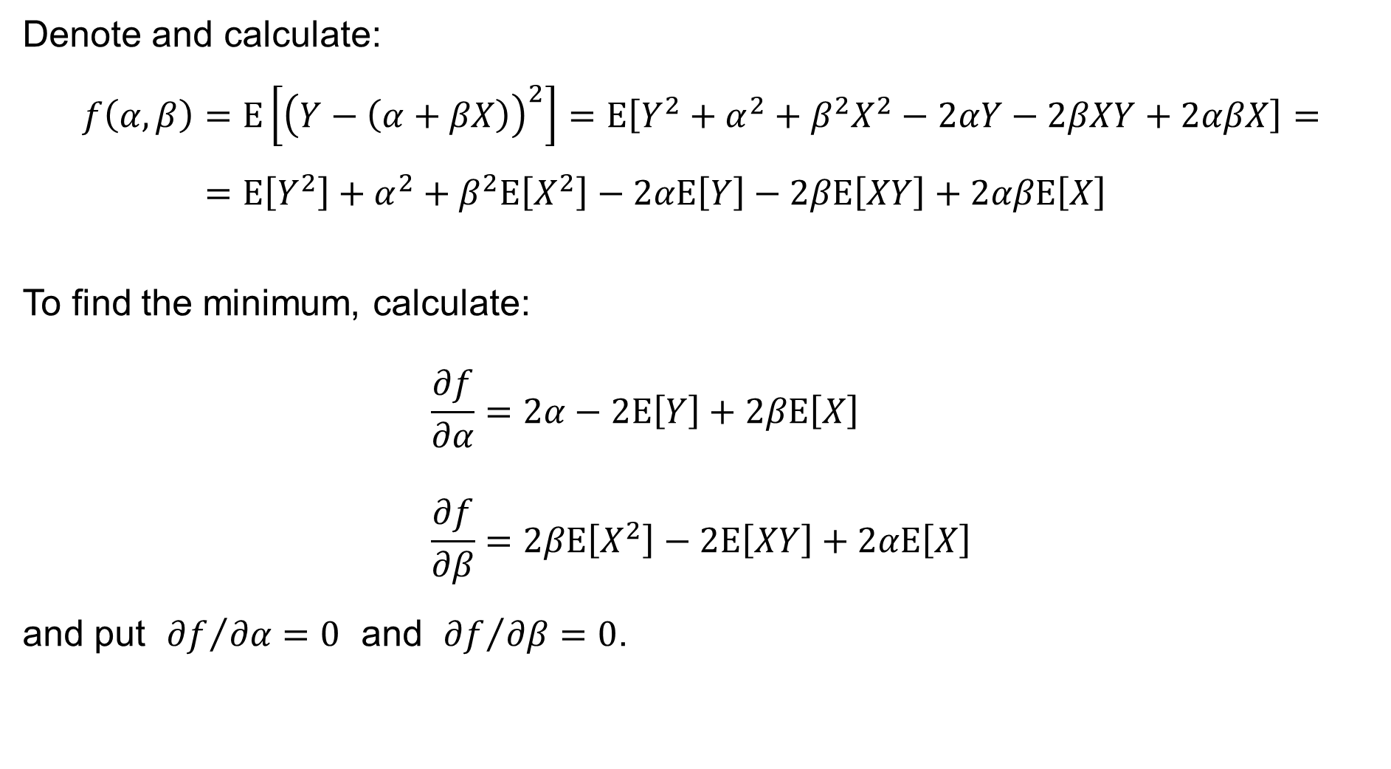
Regression Coefficient
Denote and calculate:
$$f\left(α,β\right)=E\left[{\left(Y−\left(α+βX\right)\right)}^{2}\right]=E\left[Y^{2}+α^{2}+β^{2}X^{2}−2αY−2βXY+2αβX\right]= \\ =E\left[Y^{2}\right]+α^{2}+β^{2}E\left[X^{2}\right]−2αE\left[Y\right]−2βE\left[XY\right]+2αβE\left[X\right]$$
To find the minimum, calculate:
$$\frac{∂f}{∂α}=2α−2E\left[Y\right]+2βE\left[X\right] \\ \frac{∂f}{∂β}=2βE\left[X^{2}\right]−2E\left[XY\right]+2αE\left[X\right]$$
and put ${∂f}/{∂α}=0$ and ${∂f}/{∂β}=0$.

Slide 40
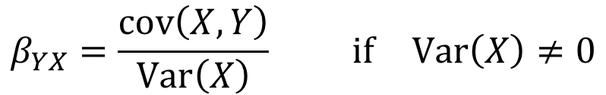

Regression Coefficient
We thus have:
$$2α−2E\left[Y\right]+2βE\left[X\right]=0 \\ 2βE\left[X^{2}\right]−2E\left[XY\right]+2αE\left[X\right]=0$$
Hence
$$α=E\left[Y\right]−βE\left[X\right]$$
and
$$βE\left[X^{2}\right]−E\left[XY\right]+\left(E\left[Y\right]−βE\left[X\right]\right)E\left[X\right]=0 \\ β\left(E\left[X^{2}\right]−E^{2}\left[X\right]\right)=E\left[XY\right]−E\left[Y\right]E\left[X\right] \\ βVar\left(X\right)=cov\left(X,Y\right)$$
$$β_{YX}=\frac{cov\left(X,Y\right)}{Var\left(X\right)} \text{if} Var\left(X\right)≠0$$
the regression coefficient of the random variable $Y$ on $X$

Slide 41
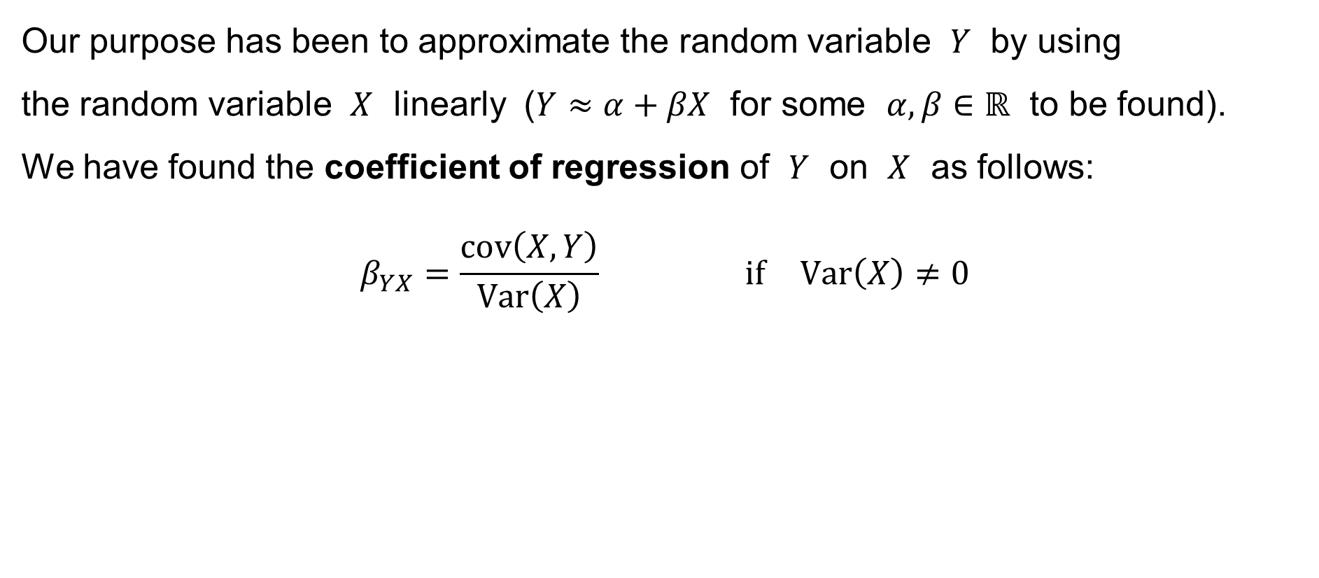
Regression Coefficient
Our purpose has been to approximate the random variable $Y$ by using
the random variable $X$ linearly ($Y≈α+βX$ for some $α,β∈ℝ$ to be found).
We have found the coefficient of regression of $Y$ on $X$ as follows:
$$β_{YX}=\frac{cov\left(X,Y\right)}{Var\left(X\right)} \text{if} Var\left(X\right)≠0$$

Slide 42
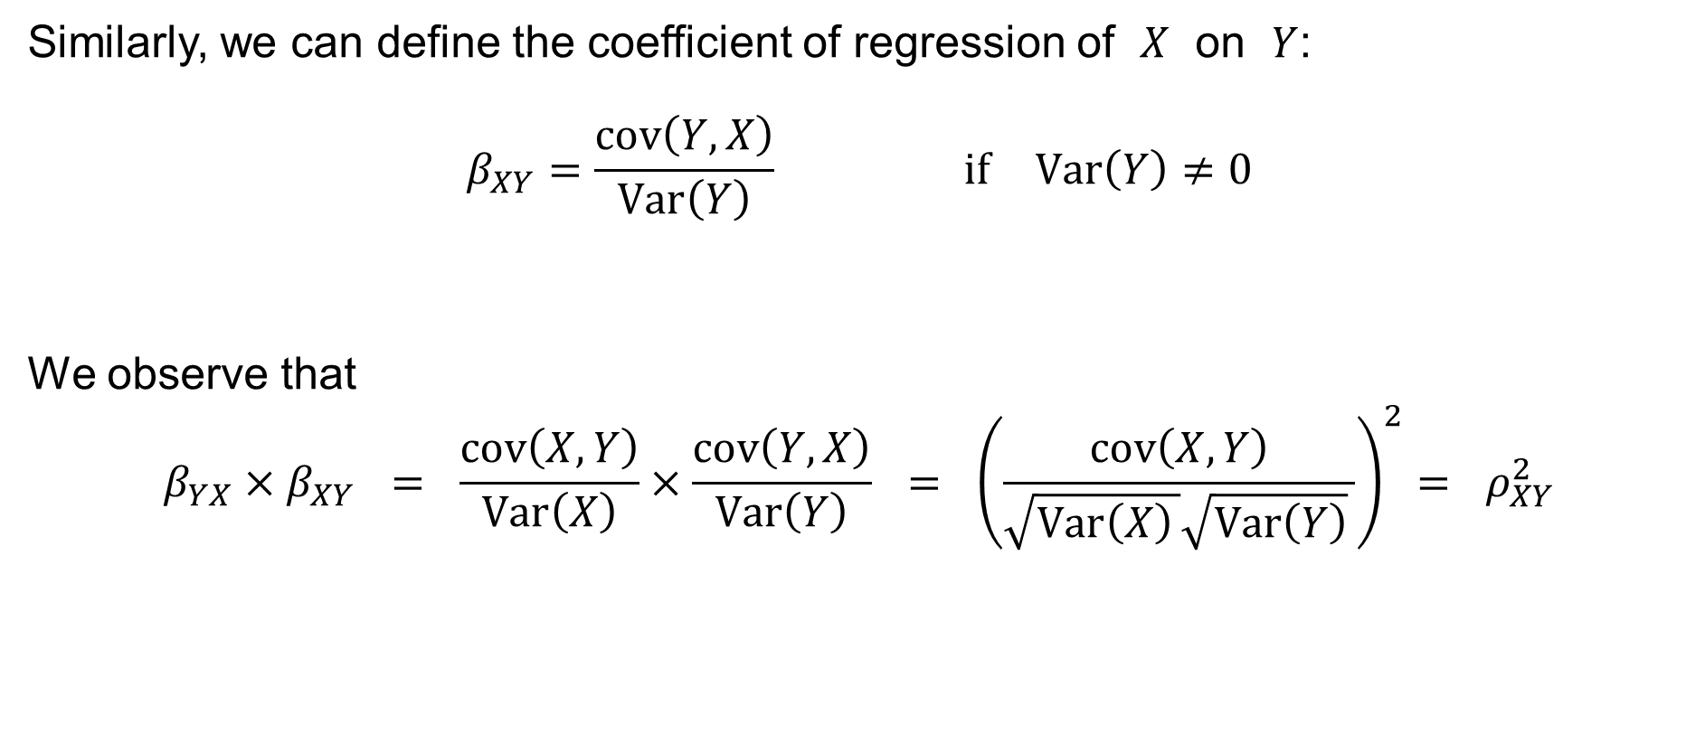
Regression Coefficient
Similarly, we can define the coefficient of regression of $X$ on $Y$:
$$β_{XY}=\frac{cov\left(Y,X\right)}{Var\left(Y\right)} \text{if} Var\left(Y\right)≠0$$
We observe that
$$β_{YX}×β_{XY} = \frac{cov\left(X,Y\right)}{Var\left(X\right)}×\frac{cov\left(Y,X\right)}{Var\left(Y\right)} = {\left(\frac{cov\left(X,Y\right)}{\sqrt{Var\left(X\right) }\sqrt{Var\left(Y\right)} }\right)}^{2}= ρ_{XY}^{2}$$

Slide 43





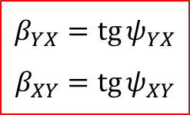




The Regression Lines
$$\operatorname{tg}{ψ}=\operatorname{tg}\left(\frac{π}{2}−ψ_{XY}−ψ_{YX}\right)=\operatorname{cotg}\left(ψ_{XY}+ψ_{YX}\right)=\frac{1}{\operatorname{tg}\left(ψ_{XY}+ψ_{YX}\right)}=\frac{1−\operatorname{tg}{ψ_{XY}}\operatorname{tg}{ψ_{YX}}}{\operatorname{tg}{ψ_{XY}}+\operatorname{tg}{ψ_{YX}}}=\frac{1−ρ_{XY}^{2}}{β_{XY}+β_{YX}}$$
$$y$$
$$ψ_{XY}$$
$$\hat{x}=μ_{X}+β_{XY}\left(y−μ_{Y}\right)$$
$$\hat{y}=μ_{Y}+β_{YX}\left(x−μ_{X}\right)$$
$$ψ$$
$$ψ_{YX}$$
$$μ_{Y}$$
$$β_{YX}=\operatorname{tg}{ψ_{YX}} \\ β_{XY}=\operatorname{tg}{ψ_{XY}}$$
$$μ_{X}$$
$$x$$

Slide 44
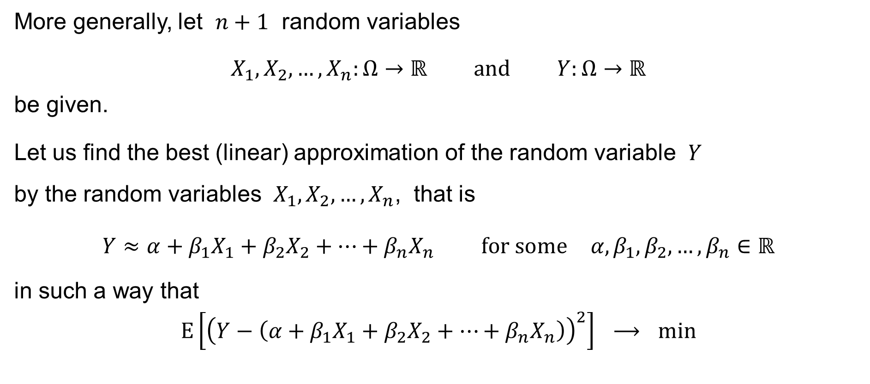
Coefficients of Regression
More generally, let $n+1$ random variables
$$X_{1},X_{2},…,X_{n}:Ω→ℝ \text{and} Y:Ω→ℝ$$
be given.
Let us find the best (linear) approximation of the random variable $Y$
by the random variables $X_{1},X_{2},…,X_{n}$, that is
$$Y≈α+β_{1}X_{1}+β_{2}X_{2}+⋯+β_{n}X_{n} \text{for} \text{some} α,β_{1},β_{2},…,β_{n}∈ℝ$$
in such a way that
$$E\left[{\left(Y−\left(α+β_{1}X_{1}+β_{2}X_{2}+⋯+β_{n}X_{n}\right)\right)}^{2}\right] ⟶ min$$

Slide 45







Coefficients of Regression
We stack the random variables $X_{1},X_{2},…,X_{n}$ into a random vector:
$$X=\left(\begin{matrix}X_{1} \\ X_{2} \\ ⋮ \\ X_{n}\end{matrix}\right)$$
And we rewrite the problem: find $α∈ℝ$ and $β∈ℝ^{n}$ so that
$$E\left[{\left(Y−\left(α+β^{T}X\right)\right)}^{2}\right] ⟶ min$$
$$Y$$
$$\left\|Y−\left(α1+β_{1}X_{1}+β_{2}X_{2}+⋯+β_{n}X_{n}\right)\right\| ⟶ min$$
$$1$$
$$X_{1}$$
$$X_{2}$$
$$…$$
$$X_{n}$$
`
the linear subspace $\left\{ α1+β_{1}X_{1}+β_{2}X_{2}+⋯+β_{n}X_{n} :α,β_{1},β_{2},…,β_{n}∈ℝ \right\}$

Slide 46
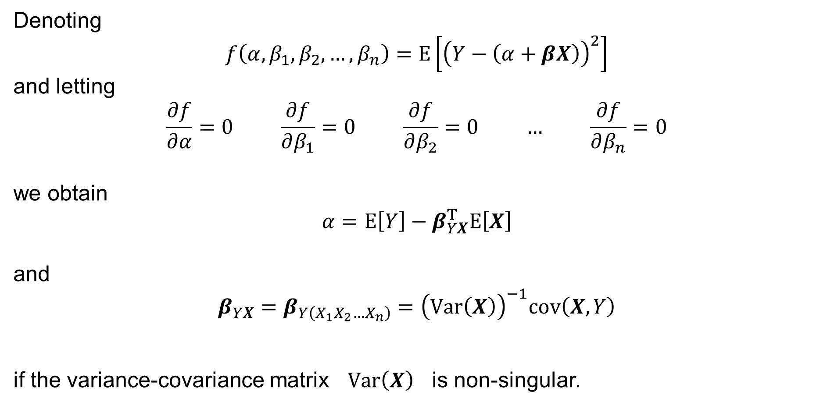
Coefficients of Regression
Denoting
$$f\left(α,β_{1},β_{2},…,β_{n}\right)=E\left[{\left(Y−\left(α+βX\right)\right)}^{2}\right]$$
and letting
$$\frac{∂f}{∂α}=0 \frac{∂f}{∂β_{1}}=0 \frac{∂f}{∂β_{2}}=0 … \frac{∂f}{∂β_{n}}=0$$
we obtain
$$α=E\left[Y\right]−β_{YX}^{T}E\left[X\right]$$
and
$$β_{YX}=β_{Y\left(X_{1}X_{2}…X_{n}\right)}={\left(Var\left(X\right)\right)}^{−1}cov\left(X,Y\right)$$
if the variance-covariance matrix $Var\left(X\right)$ is non-singular.

Slide 47
Multiple Correlation Coefficient
&
Coefficient of Partial Correlation
Multiple Correlation Coefficient
Coefficient of Partial Correlation

Slide 48
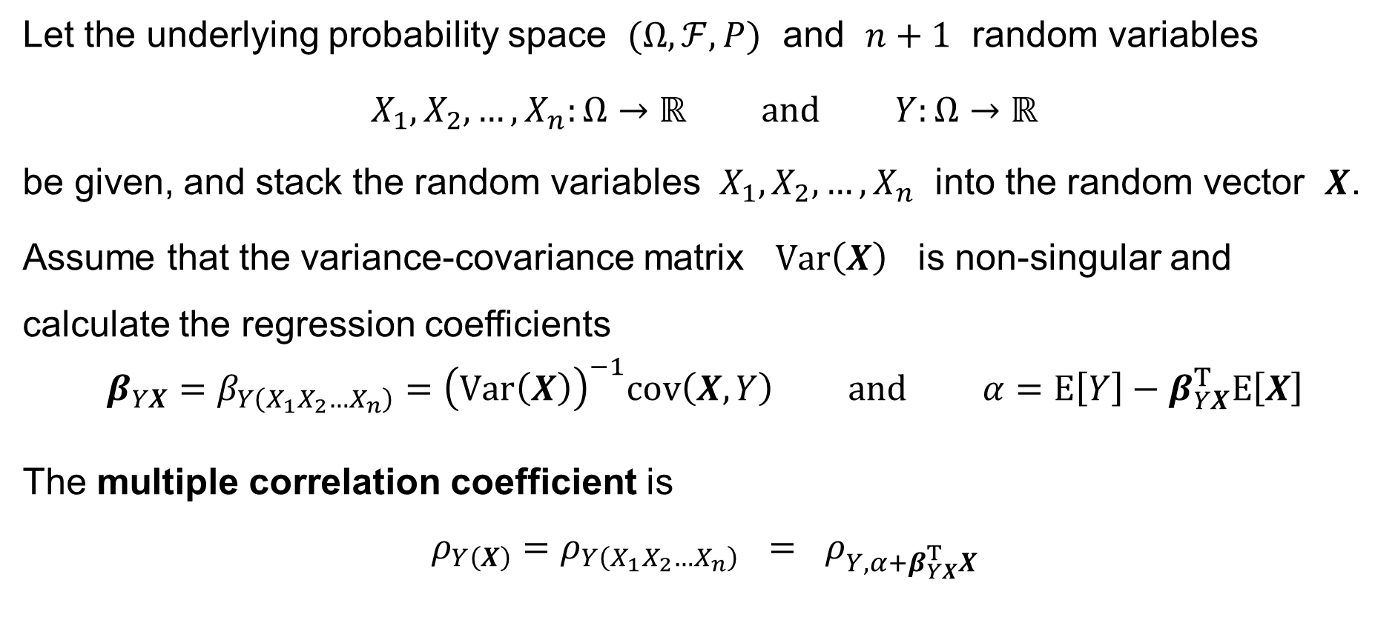
Multiple Correlation Coefficient
Let the underlying probability space $(Ω,ℱ,P)$ and $n+1$ random variables
$$X_{1},X_{2},…,X_{n}:Ω→ℝ \text{and} Y:Ω→ℝ$$
be given, and stack the random variables $X_{1},X_{2},…,X_{n}$ into the random vector $X$.
Assume that the variance-covariance matrix $Var\left(X\right)$ is non-singular and calculate the regression coefficients
$$β_{YX}=β_{Y\left(X_{1}X_{2}…X_{n}\right)}={\left(Var\left(X\right)\right)}^{−1}cov\left(X,Y\right) \text{and} α=E\left[Y\right]−β_{YX}^{T}E\left[X\right]$$
The multiple correlation coefficient is
$$ρ_{Y\left(X\right)}=ρ_{Y\left(X_{1}X_{2}…X_{n}\right)} = ρ_{Y,α+β_{YX}^{T}X}$$

Slide 49
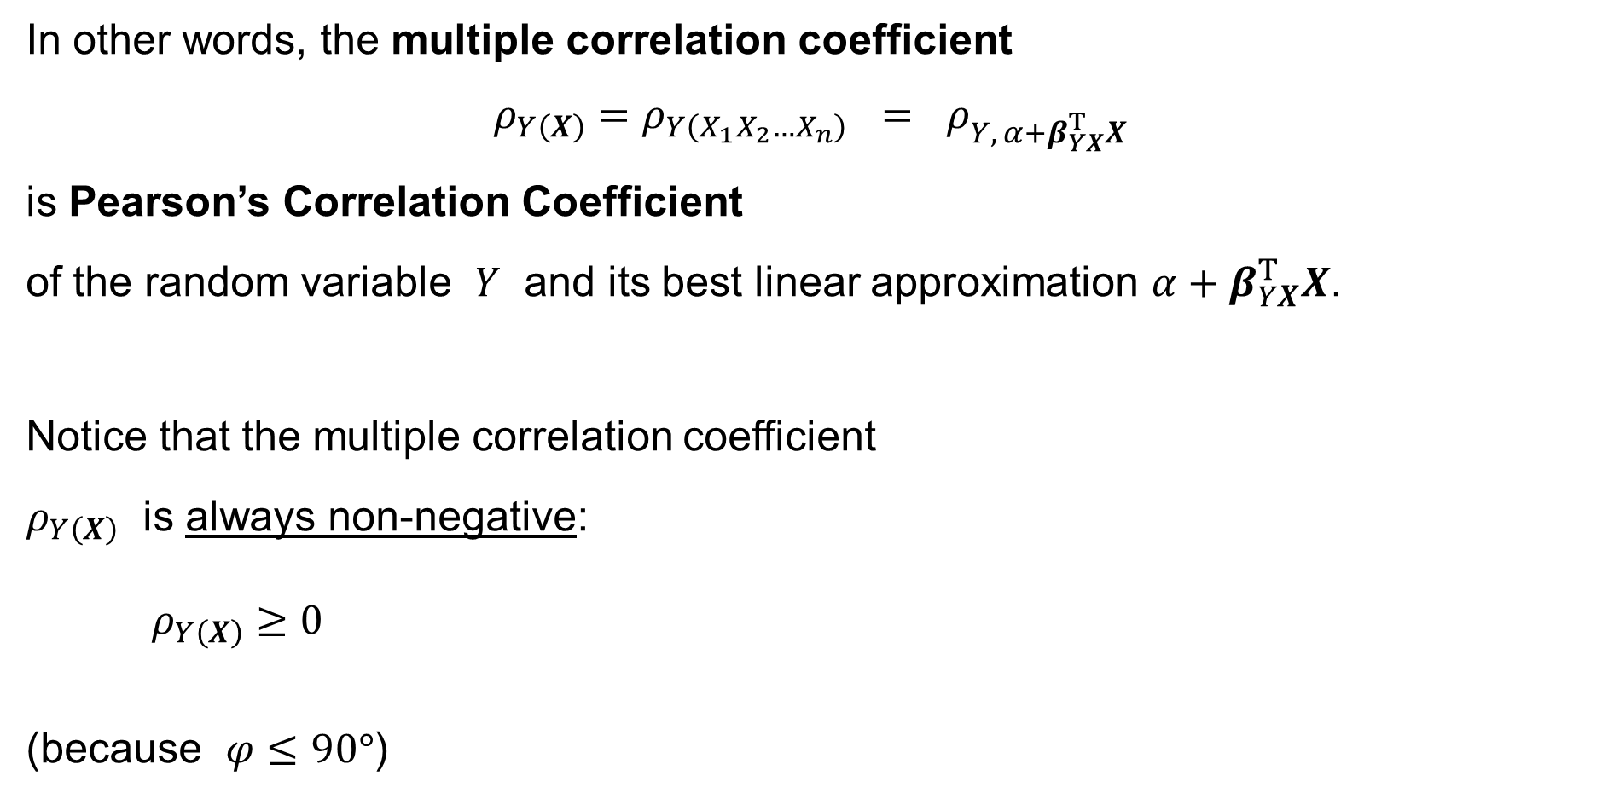


Multiple Correlation Coefficient
In other words, the multiple correlation coefficient
$$ρ_{Y\left(X\right)}=ρ_{Y\left(X_{1}X_{2}…X_{n}\right)} = ρ_{Y, α+β_{YX}^{T}X}$$
is Pearson’s Correlation Coefficient
of the random variable $Y$ and its best linear approximation $α+β_{YX}^{T}X$.
Notice that the multiple correlation coefficient
$ρ_{Y\left(X\right)}$ is always non-negative:
$$ρ_{Y\left(X\right)}≥0$$
(because $φ≤90°$)
$$Y$$
$$\left\|Y−\left(α1+β_{1}X_{1}+β_{2}X_{2}+⋯+β_{n}X_{n}\right)\right\| ⟶ min$$
$$φ$$
$$1$$
$$X_{1}$$
$$X_{2}$$
$$…$$
$$X_{n}$$
`
the linear subspace $\left\{ α1+β_{1}X_{1}+β_{2}X_{2}+⋯+β_{n}X_{n} :α,β_{1},β_{2},…,β_{n}∈ℝ \right\}$

Slide 50
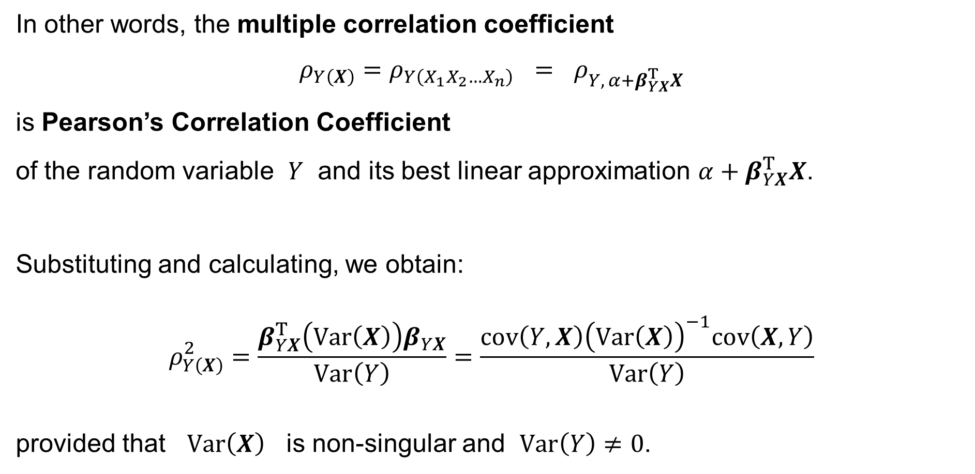
Multiple Correlation Coefficient
In other words, the multiple correlation coefficient
$$ρ_{Y\left(X\right)}=ρ_{Y\left(X_{1}X_{2}…X_{n}\right)} = ρ_{Y, α+β_{YX}^{T}X}$$
is Pearson’s Correlation Coefficient
of the random variable $Y$ and its best linear approximation $α+β_{YX}^{T}X$.
Substituting and calculating, we obtain:
$$ρ_{Y\left(X\right)}^{2}=\frac{β_{YX}^{T}\left(Var\left(X\right)\right)β_{YX}}{Var\left(Y\right)}=\frac{cov\left(Y,X\right){\left(Var\left(X\right)\right)}^{−1}cov\left(X,Y\right)}{Var\left(Y\right)}$$
provided that $Var\left(X\right)$ is non-singular and $Var\left(Y\right)≠0$.

Slide 51
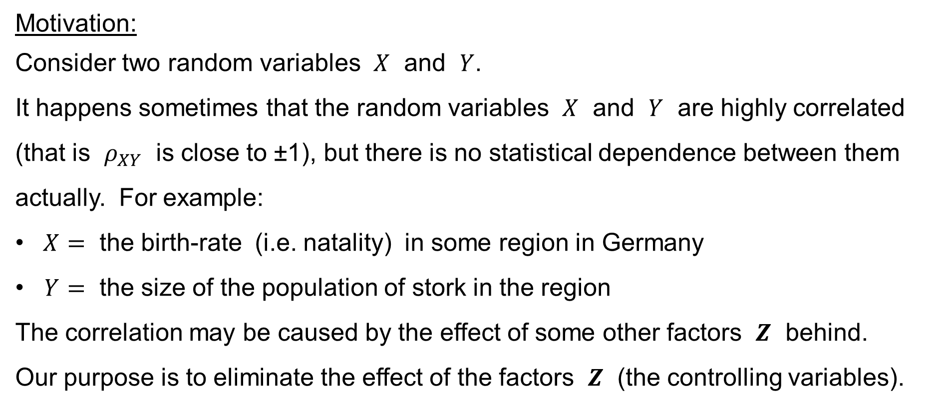
Coefficient of Partial Correlation
Motivation:
Consider two random variables $X$ and $Y$.
It happens sometimes that the random variables $X$ and $Y$ are highly correlated (that is $ρ_{XY}$ is close to ±1), but there is no statistical dependence between them actually. For example:
$X=$ the birth-rate (i.e. natality) in some region in Germany
$Y=$ the size of the population of stork in the region
The correlation may be caused by the effect of some other factors $Z$ behind.
Our purpose is to eliminate the effect of the factors $Z$ (the controlling variables).

Slide 52

Coefficient of Partial Correlation
Let the underlying probability space $(Ω,ℱ,P)$, the two random variables
$$X:Ω→ℝ \text{and} Y:Ω→ℝ$$
and a random vector
$$Z:Ω→ℝ^{n}$$
be given.
Assuming that the variance-covariance matrix $Var\left(Z\right)$ is non-singular,
find the best linear approximations of $X$ and $Y$ based on $Z$. That is,
calculate
$$α_{XZ}=E\left[X\right]−β_{XZ}^{T}E\left[Z\right] \text{and} β_{XZ}^{T}={\left(Var\left(Z\right)\right)}^{−1}cov\left(Z,X\right)$$
and
$$α_{YZ}=E\left[Y\right]−β_{YZ}^{T}E\left[Z\right] \text{and} β_{YZ}^{T}={\left(Var\left(Z\right)\right)}^{−1}cov\left(Z,Y\right)$$

Slide 53

Coefficient of Partial Correlation
Then
$$α_{XZ}+β_{XZ}^{T}Z \text{and} α_{YZ}+β_{YZ}^{T}Z$$
is the best linear approximation of $X$ and $Y$ based on $Z$, respectively.
The Coefficient of Partial Correlation between the random variables $X$ and $Y$ with the effect of the controlling random variables $Z$ removed is
$$ρ_{XY∙Z} = ρ_{{X−α}_{XZ}−β_{XZ}^{T}Z, Y−α_{YZ}−β_{YZ}^{T}Z}$$
In words, it is Pearson’s Correlation Coefficient between the residuals
$$X−\left(α_{XZ}+β_{XZ}^{T}Z\right) \text{and} Y−\left(α_{YZ}+β_{YZ}^{T}Z\right)$$

Slide 54

Coefficient of Partial Correlation
If $n=1$, that is $Z=Z_{1}=Z$, then the Coefficient of Partial Correlation between the random variables $X$ and $Y$ subject to a fixed value of $Z$ takes the form
$$ρ_{XY∙Z}=\frac{ρ_{XY}−ρ_{XZ}ρ_{YZ}}{\sqrt{1−ρ_{XZ}^{2} }\sqrt{1−ρ_{YZ}^{2} } }$$

Slide 55
Hypothesis Testing
Motivation
Pearson’s sample correlation coefficient
Sample multiple correlation coefficient
Sample coefficient of partial correlation

Slide 56

Hypothesis Testing: Motivation
Until now, we have presented the theoretical correlation coefficients:
Pearson’s correlation coefficient $ρ_{XY}$
Multiple correlation coefficient $ρ_{Y\left(X\right)}$
Partial correlation coefficient $ρ_{XY∙Z}$
Notice that these coefficients are defined by the intrinsic properties of the random variables $X$ and $Y$ (or $X$ or $Z$) themselves.
That is, no random experiments were necessary to define their values.

Slide 57

Hypothesis Testing: Motivation
The true values of the coefficients $ρ_{XY}$, $ρ_{Y\left(X\right)}$, $ρ_{XY∙Z}$ do exist in theory,
but are often unknown to us in practice. This is because we do not know
the true functions (random variables) $X,Y:Ω→ℝ$, perhaps not even the underlying probability space $\left(Ω,ℱ,P\right)$, very well.
This is the reason why we explore the properties of the random variables
by the means of doing random experiments.
We wish to test the null hypotheses that
$$H_{0}: ρ_{XY}=0 \text{or} H_{0}: ρ_{Y\left(X\right)}=0 \text{or} H_{0}: ρ_{XY∙Z}=0$$
respectively.

Slide 58

Pearson’s sample correlation coefficient
Consider the underlying probability space $(Ω,ℱ,P)$ and the two random variables
$$X:Ω→ℝ \text{and} Y:Ω→ℝ$$
Perform the underlying random experiment $n$-times, where $n≥3$.
Let $ω_{1},ω_{2},…,ω_{n}∈Ω$ be the outcomes of the trials.
(It is assumed that each trial is independent of the others.)
Then, let
$$x_{1}=X\left(ω_{1}\right) x_{2}=X\left(ω_{2}\right) … x_{n}=X\left(ω_{n}\right)$$
$$y_{1}=Y\left(ω_{1}\right) y_{2}=Y\left(ω_{2}\right) … y_{n}=Y\left(ω_{n}\right)$$
be the numerical outcomes of the trials; that is, we have $n$ pairs
of the observations of the random variables: $\left(x_{1},y_{1}\right)$, $\left(x_{2},y_{2}\right)$, …, $\left(x_{n},y_{n}\right)$.

Slide 59

Pearson’s sample correlation coefficient
Having the sample $\left(x_{1},y_{1}\right)$, $\left(x_{2},y_{2}\right)$, …, $\left(x_{n},y_{n}\right)$ of the observations
of the random variables $X,Y$, we define Pearson’s sample correlation coefficient like Pearson’s correlation coefficient, but the sample variance and the sample covariance is used instead of the variance and the covariance, respectively.
Pearson’s sample correlation coefficient is:
$$r_{XY}=\frac{\frac{1}{n−1}\sum_{i=1}^{n}{\left(x_{i}−\overline{x}\right)\left(y_{i}−\overline{y}\right)}}{\sqrt{\frac{1}{n−1}\sum_{i=1}^{n}{{\left(x_{i}−\overline{x}\right)}^{2}} }\sqrt{\frac{1}{n−1}\sum_{i=1}^{n}{{\left(y_{i}−\overline{y}\right)}^{2}} } }$$
where
$\overline{x}={\sum_{i=1}^{n}{x_{i}}}/n$ and $\overline{y}={\sum_{i=1}^{n}{y_{i}}}/n$

Slide 60

Pearson’s sample correlation coefficient
Equivalently, Pearson’s sample correlation coefficient is:
$$r_{XY}=\frac{\sum_{i=1}^{n}{\left(x_{i}−\overline{x}\right)\left(y_{i}−\overline{y}\right)}}{\sqrt{\sum_{i=1}^{n}{{\left(x_{i}−\overline{x}\right)}^{2}} }\sqrt{\sum_{i=1}^{n}{{\left(y_{i}−\overline{y}\right)}^{2}} } }= \\ =\frac{n\sum_{i=1}^{n}{x_{i}y_{i}}−\sum_{i=1}^{n}{x_{i}}\sum_{i=1}^{n}{y_{i}}}{\sqrt{n\sum_{i=1}^{n}{{\left(x_{i}\right)}^{2}}−{\left(\sum_{i=1}^{n}{x_{i}}\right)}^{2} }\sqrt{n\sum_{i=1}^{n}{{\left(y_{i}\right)}^{2}}−{\left(\sum_{i=1}^{n}{y_{i}}\right)}^{2} } }$$
where
$$\overline{x}=\frac{1}{n}\sum_{i=1}^{n}{x_{i}} \text{and} \overline{y}=\frac{1}{n}\sum_{i=1}^{n}{y_{i}}$$

Slide 61

Pearson’s sample correlation coefficient: Theorem
Let the random vector $\left({X \atop Y}\right)$ follow a bivariate normal (Gaussian) distribution,
that is
$$\left(\begin{matrix}X \\ Y\end{matrix}\right) ∼ 𝒩\left(\left(\begin{matrix}μ_{X} \\ μ_{Y}\end{matrix}\right), \left(\begin{matrix}σ_{X}^{2} & ρ_{XY}σ_{X}σ_{Y} \\ ρ_{XY}σ_{X}σ_{Y} & σ_{Y}^{2}\end{matrix}\right)\right) \text{with} σ_{X}^{2}>0 \text{and} σ_{Y}^{2}>0$$
and let $\left(x_{1},y_{1}\right)$, $\left(x_{2},y_{2}\right)$, …, $\left(x_{n},y_{n}\right)$ be a sample of $n$ observations of the random vector. If the null hypothesis
$$H_{0}: ρ_{XY}=0$$
holds true, then
$$\frac{r_{XY}}{\sqrt{1−r_{XY}^{2} } }\sqrt{n−2 } ∼ t_{n−2}$$
where $t_{n−2}$ is Student’s t-distribution with $n−2$ degrees of freedom.

Slide 62

Pearson’s sample correlation coefficient: Hyp. Test
The null hypothesis is $H_{0}: ρ_{XY}=0$ and the alternative hypothesis is $H_{1}: ρ_{XY}≠0$.
Choose the level of significance, a small number $α>0$, such as $α=5 \%$.
Calculate the statistic
$$T=\frac{r_{XY}}{\sqrt{1−r_{XY}^{2} } }\sqrt{n−2 }$$
The critical value is
$$c=t_{n−2}\left(1−\frac{α}{2}\right)$$
where $t_{n−2}\left(q\right)$ is the quantile function of Student’s t-distribution with $n−2$ d.f.
If $T∈\left(−∞,−c\right]∪\left[+c,+∞\right)$, the critical region, then reject the null hypothesis.
If $T∈\left(−c,+c\right)$, then do not reject (or fail to reject) the null hypothesis.

Slide 63


Sample Multiple Correlation Coefficient
Consider the underlying probability space $(Ω,ℱ,P)$, the random vector
$$X:Ω→ℝ^{k}$$
$$Y:Ω→ℝ$$
Perform the underlying random experiment $n$-times. Let $ω_{1},ω_{2},…,ω_{n}∈Ω$ be
the outcomes of the trials. Assume that each trial is independent of the others.
Then, let
$$x_{1}=X\left(ω_{1}\right) x_{2}=X\left(ω_{2}\right) … x_{n}=X\left(ω_{n}\right)$$
$$y_{1}=Y\left(ω_{1}\right) y_{2}=Y\left(ω_{2}\right) … y_{n}=Y\left(ω_{n}\right)$$
be the numerical outcomes of the trials; that is, we have $n$ pairs
of the observations of the random variables: $\left(x_{1},y_{1}\right)$, $\left(x_{2},y_{2}\right)$, …, $\left(x_{n},y_{n}\right)$.
and the random variable
where $n≥k+2$

Slide 64

Sample Multiple Correlation Coefficient
Having the sample $\left(x_{1},y_{1}\right)$, $\left(x_{2},y_{2}\right)$, …, $\left(x_{n},y_{n}\right)$ of the observations
of the random vector $X:Ω→ℝ^{k}$ and of the random variable $Y:Ω→ℝ$,
calculate the sample correlation vectors
$$r_{YX}=\left(\begin{matrix}r_{YX_{1}} & r_{YX_{2}} & … & r_{YX_{k}}\end{matrix}\right) \text{and} r_{XY}=\left(\begin{matrix}r_{X_{1}Y} \\ r_{X_{2}Y} \\ ⋮ \\ r_{X_{k}Y}\end{matrix}\right)$$
where
$$r_{YX_{κ}}=r_{X_{κ}Y}=\frac{\sum_{i=1}^{n}{\left(x_{κi}−{\overline{x}}_{κ}\right)\left(y_{i}−\overline{y}\right)}}{\sqrt{\sum_{i=1}^{n}{{\left(x_{κi}−{\overline{x}}_{κ}\right)}^{2}} }\sqrt{\sum_{i=1}^{n}{{\left(y_{i}−\overline{y}\right)}^{2}} } } \text{for} κ=1, 2,…,k$$
is Pearson’s sample correlation coefficient
with ${\overline{x}}_{κ}={\sum_{i=1}^{n}{x_{κi}}}/n \text{and} \overline{y}={\sum_{i=1}^{n}{y_{i}}}/n$

Slide 65

Sample Multiple Correlation Coefficient
Having the sample $x_{1}$, $x_{2}$, …, $x_{n}$ of the observations of the random
vector $X:Ω→ℝ^{k}$, calculate also the sample correlation matrix
$$R_{XX}=\left(\begin{matrix}r_{X_{1}X_{1}} & r_{X_{1}X_{2}} & … & r_{X_{1}X_{k}} \\ r_{X_{2}X_{1}} & r_{X_{2}X_{2}} & … & r_{X_{2}X_{k}} \\ ⋮ & ⋮ & ⋱ & ⋮ \\ r_{X_{k}X_{1}} & r_{X_{k}X_{2}} & … & r_{X_{k}X_{k}}\end{matrix}\right)$$
where
$$r_{X_{p}X_{q}}=\frac{\sum_{i=1}^{n}{\left(x_{pi}−{\overline{x}}_{p}\right)\left(x_{qi}−{\overline{x}}_{q}\right)}}{\sqrt{\sum_{i=1}^{n}{{\left(x_{pi}−{\overline{x}}_{p}\right)}^{2}} }\sqrt{\sum_{i=1}^{n}{{\left(x_{qi}−{\overline{x}}_{q}\right)}^{2}} } } \text{for} p,q=1, 2,…,k$$
is Pearson’s sample correlation coefficient
with ${\overline{x}}_{p}={\sum_{i=1}^{n}{x_{pi}}}/n \text{and} {\overline{x}}_{q}={\sum_{i=1}^{n}{x_{qi}}}/n$

Slide 66

Sample Multiple Correlation Coefficient
If the sample correlation matrix $R_{XX}$ is non-singular,
the sample multiple correlation coefficient squared is
$$r_{Y\left(X\right)}^{2} = r_{YX}×R_{XX}^{−1}×r_{XY}$$
Remark: We know that the multiple correlation coefficient is always non-negative. So we can define the sample multiple correlation coefficient as
$$r_{Y\left(X\right)}=\sqrt{r_{Y\left(X\right)}^{2}}$$

Slide 67

Sample Multiple Correlation Coefficient: Theorem
Let the random vector $\left({X \atop Y}\right)$ follow a $\left(k+1\right)$-dimensional normal (Gaussian) distribution, that is
$$\left(\begin{matrix}X \\ Y\end{matrix}\right) ∼ 𝒩\left(\left(\begin{matrix}μ_{X} \\ μ_{Y}\end{matrix}\right), \left(\begin{matrix}Var\left(X\right) & cov\left(X,Y\right) \\ cov\left(Y,X\right) & Var\left(Y\right)\end{matrix}\right)\right) \text{with} \left(\begin{matrix}Var\left(X\right) & cov\left(X,Y\right) \\ cov\left(Y,X\right) & Var\left(Y\right)\end{matrix}\right)$$
non-singular.
Let $\left(x_{1},y_{1}\right)$, $\left(x_{2},y_{2}\right)$, …, $\left(x_{n},y_{n}\right)$ be a sample of $n$ observations
of the random vector. If the null hypothesis
$$H_{0}: ρ_{X\left(Y\right)}=0$$
holds true, then
$${\frac{r_{Y\left(X\right)}^{2}}{ 1−r_{Y\left(X\right)}^{2} }}/{\frac{k}{n−k−1}} ∼ F_{k, n−k−1}$$
where $F_{k, n−k−1}$ is Fisher’s F-distribution with $k$ and $n−k−1$ d.f.

Slide 68


Sample Multiple Correlation Coefficient: Hyp. Test
The null hypothesis is $H_{0}: ρ_{X(Y)}=0$ and the alternative hypothesis is
$H_{1}: ρ_{X(Y)}≠0$. Choose the level of significance, a small number $α>0$,
such as $α=5 \%$. Calculate the statistic
$$F={\frac{r_{Y\left(X\right)}^{2}}{ 1−r_{Y\left(X\right)}^{2} }}/{\frac{k}{n−k−1}}$$
The critical value is
$$c=F_{k, n−k−1}\left(1−α\right)$$
where $F_{k, n−k−1}\left(q\right)$ is the quantile function of Fisher’s F-distribution
If $F∈\left(−∞,−c\right]∪\left[+c,+∞\right)$, the critical region, then reject the null hypothesis.
If $F∈\left(−c,+c\right)$, then do not reject (or fail to reject) the null hypothesis.
with $k$ and $n−k−1$ d.f.

Slide 69


Sample Coefficient of Partial Correlation
Consider the underlying probability space $(Ω,ℱ,P)$, the two random variables
$$X:Ω→ℝ \text{and} Y:Ω→ℝ$$
and the random vector
$$Z:Ω→ℝ^{k}$$
Perform the underlying random experiment $n$-times. Let $ω_{1},ω_{2},…,ω_{n}∈Ω$ be
the outcomes of the trials. Assume that each trial is independent of the others.
Then, let
$$x_{1}=X\left(ω_{1}\right) x_{2}=X\left(ω_{2}\right) … x_{n}=X\left(ω_{n}\right)$$
$$y_{1}=Y\left(ω_{1}\right) y_{2}=Y\left(ω_{2}\right) … y_{n}=Y\left(ω_{n}\right)$$
$$z_{1}=Z\left(ω_{1}\right) z_{2}=Z\left(ω_{2}\right) … z_{n}=Z\left(ω_{n}\right)$$
be the numerical outcomes of the trials.
where $n≥k+3$

Slide 70

Sample Coefficient of Partial Correlation
That is, we have $n$ triples of the observations of the random variables and vector:
$$\left(x_{1},y_{1},z_{1}\right) \left(x_{2},y_{2},z_{2}\right) … \left(x_{n},y_{n},z_{n}\right)$$
Then, calculate the sample correlation vectors
$$r_{XZ}=\left(\begin{matrix}r_{XZ_{1}} & r_{XZ_{2}} & … & r_{XZ_{k}}\end{matrix}\right) \text{and} r_{ZX}=\left(\begin{matrix}r_{Z_{1}X} \\ r_{Z_{2}X} \\ ⋮ \\ r_{Z_{k}X}\end{matrix}\right)$$
where
$$r_{XZ_{κ}}=r_{Z_{κ}X}=\frac{\sum_{i=1}^{n}{\left(x_{i}−\overline{x}\right)\left(z_{κi}−{\overline{z}}_{κ}\right)}}{\sqrt{\sum_{i=1}^{n}{{\left(x_{i}−\overline{x}\right)}^{2}} }\sqrt{\sum_{i=1}^{n}{{\left(z_{κi}−{\overline{z}}_{κ}\right)}^{2}} } } \text{for} κ=1, 2,…,k$$
is Pearson’s sample correlation coefficient
with $\overline{x}={\sum_{i=1}^{n}{x_{i}}}/n \text{and} {\overline{z}}_{κ}={\sum_{i=1}^{n}{z_{κi}}}/n$

Slide 71

Sample Coefficient of Partial Correlation
Having the $n$ triples of the observations of the random variables and vector
$$\left(x_{1},y_{1},z_{1}\right) \left(x_{2},y_{2},z_{2}\right) … \left(x_{n},y_{n},z_{n}\right)$$
calculate also the sample correlation vectors
$$r_{YZ}=\left(\begin{matrix}r_{YZ_{1}} & r_{YZ_{2}} & … & r_{YZ_{k}}\end{matrix}\right) \text{and} r_{ZY}=\left(\begin{matrix}r_{Z_{1}Y} \\ r_{Z_{2}Y} \\ ⋮ \\ r_{Z_{k}Y}\end{matrix}\right)$$
where
$$r_{YZ_{κ}}=r_{Z_{κ}Y}=\frac{\sum_{i=1}^{n}{\left(y_{i}−\overline{y}\right)\left(z_{κi}−{\overline{z}}_{κ}\right)}}{\sqrt{\sum_{i=1}^{n}{{\left(y_{i}−\overline{y}\right)}^{2}} }\sqrt{\sum_{i=1}^{n}{{\left(z_{κi}−{\overline{z}}_{κ}\right)}^{2}} } } \text{for} κ=1, 2,…,k$$
is Pearson’s sample correlation coefficient
with $\overline{y}={\sum_{i=1}^{n}{y_{i}}}/n \text{and} {\overline{z}}_{κ}={\sum_{i=1}^{n}{z_{κi}}}/n$

Slide 72

Sample Coefficient of Partial Correlation
And, having the sample $z_{1}$, $z_{2}$, …, $z_{n}$ of the observations of the random
vector $Z:Ω→ℝ^{k}$, calculate the sample correlation matrix
$$R_{ZZ}=\left(\begin{matrix}r_{Z_{1}Z_{1}} & r_{Z_{1}Z_{2}} & … & r_{Z_{1}Z_{k}} \\ r_{Z_{2}Z_{1}} & r_{Z_{2}Z_{2}} & … & r_{Z_{2}Z_{k}} \\ ⋮ & ⋮ & ⋱ & ⋮ \\ r_{Z_{k}Z_{1}} & r_{Z_{k}Z_{2}} & … & r_{Z_{k}Z_{k}}\end{matrix}\right)$$
where
$$r_{Z_{p}Z_{q}}=\frac{\sum_{i=1}^{n}{\left(z_{pi}−{\overline{z}}_{p}\right)\left(z_{qi}−{\overline{z}}_{q}\right)}}{\sqrt{\sum_{i=1}^{n}{{\left(z_{pi}−{\overline{z}}_{p}\right)}^{2}} }\sqrt{\sum_{i=1}^{n}{{\left(z_{qi}−{\overline{z}}_{q}\right)}^{2}} } } \text{for} p,q=1, 2,…,k$$
is Pearson’s sample correlation coefficient
with ${\overline{z}}_{p}={\sum_{i=1}^{n}{z_{pi}}}/n \text{and} {\overline{z}}_{q}={\sum_{i=1}^{n}{z_{qi}}}/n$

Slide 73

Sample Coefficient of Partial Correlation
If the sample correlation matrix $R_{ZZ}$ is non-singular,
the sample coefficient of partial correlation is
$$r_{XY∙Z} = \frac{r_{XY}−r_{XZ}R_{ZZ}^{−1}r_{ZY}}{\sqrt{1−r_{XZ}R_{ZZ}^{−1}r_{ZX} }\sqrt{1−r_{YZ}R_{ZZ}^{−1}r_{ZY} } }$$

Slide 74

Sample Coefficient of Partial Correlation
If $k=1$, that is $Z=Z_{1}=Z$, then the sample coefficient of partial correlation takes the form
$$r_{XY∙Z} = \frac{r_{XY}−r_{XZ}r_{YZ}}{\sqrt{1−r_{XZ}^{2} }\sqrt{1−r_{YZ}^{2} } }$$

Slide 75

Sample Coefficient of Partial Correlation: Theorem…
Let the random vector $\left(\begin{aligned}X \\ Y \\ Z\end{aligned}\right)$ follow a $\left(k+2\right)$-dimensional normal (Gaussian) distribution, that is
$$\left(\begin{aligned}X \\ Y \\ Z\end{aligned}\right) ∼ 𝒩\left(\left(\begin{matrix}μ_{X} \\ \begin{aligned}μ_{Y} \\ μ_{Z}\end{aligned}\end{matrix}\right), \left(\begin{matrix}Var\left(X\right) & cov\left(X,Y\right) & cov\left(X,Z\right) \\ cov\left(Y,X\right) & Var\left(Y\right) & cov\left(Y,Z\right) \\ cov\left(Z,X\right) & cov\left(Z,Y\right) & Var\left(Z\right)\end{matrix}\right)\right)$$
with
$$\left(\begin{matrix}Var\left(X\right) & cov\left(X,Y\right) & cov\left(X,Z\right) \\ cov\left(Y,X\right) & Var\left(Y\right) & cov\left(Y,Z\right) \\ cov\left(Z,X\right) & cov\left(Z,Y\right) & Var\left(Z\right)\end{matrix}\right) \text{being} \text{non}\text{−}\text{singular}$$

Slide 76

Sample Coefficient of Partial Correlation: …Theorem
Let the random vector $\left(\begin{aligned}X \\ Y \\ Z\end{aligned}\right)$ follow a $\left(k+2\right)$-dimensional normal (Gaussian) distribution with a non-singular variance-covariance matrix.
Let $\left(x_{1},y_{1},z_{1}\right)$, $\left(x_{2},y_{2},z_{2}\right)$, …, $\left(x_{n},y_{n},z_{n}\right)$ be a sample of $n$ observations
of the random vector. If the null hypothesis
$$H_{0}: ρ_{XY∙Z}=0$$
holds true, then
$$\frac{r_{XY∙Z}}{\sqrt{1−r_{XY∙Z}^{2} } }\sqrt{n−k−2 } ∼ t_{n−k−2}$$
where $t_{n−k−2}$ is Student’s t-distribution with $n−k−2$ degrees of freedom.

Slide 77

Sample Coefficient of Partial Correlation: Hyp. Test
The null hypothesis is $H_{0}: ρ_{XY∙Z}=0$ and the alt. hypothesis is $H_{1}: ρ_{XY∙Z}≠0$.
Choose the level of significance, a small number $α>0$, such as $α=5 \%$.
Calculate the statistic
$$T=\frac{r_{XY∙Z}}{\sqrt{1−r_{XY∙Z}^{2} } }\sqrt{n−k−2 }$$
The critical value is
$$c=t_{n−k−2}\left(1−\frac{α}{2}\right)$$
where $t_{n−k−2}\left(q\right)$ is the quantile function of Student’s t-distrib. with $n−k−2$ d.f.
If $T∈\left(−∞,−c\right]∪\left[+c,+∞\right)$, the critical region, then reject the null hypothesis.
If $T∈\left(−c,+c\right)$, then do not reject (or fail to reject) the null hypothesis.

Slide 78
Non-parametric and robust methods:
Spearman’s
Rank Correlation Coefficient
Introduction
Definition
Simplification
Theorems & Hypothesis Testing
Remarks

Slide 79

Spearman’s rank correlation coefficient: Introduction
Given the underlying probability space $(Ω,ℱ,P)$ and two random variables
$$X:Ω→ℝ \text{and} Y:Ω→ℝ$$
and asking whether there is a (linear) correlation between the variables $X$ and $Y$:
We can use Pearson’s sample correlation coefficient $r_{XY}$
under the assumption that the vector $\left({X \atop Y}\right)$ follows a bivariate
normal (Gaussian) distribution with $σ_{X}^{2}>0$ and $σ_{Y}^{2}>0$.
If we are not sure whether the distribution of the random vector $\left({X \atop Y}\right)$ is normal,
then the use of Pearson’s sample correlation coefficient is questionable,
and we should use other methods.

Slide 80

Spearman’s rank correlation coefficient: Introduction
Recall also that Pearson’s sample correlation coefficient is an estimate of the cosine of the angle between the vectors $\vec{x}=\left(X−1μ_{X}\right)$ and $\vec{y}=\left(Y−1μ_{Y}\right)$.
Therefore, Pearson’s (sample) correlation coefficient can detect
only the linear dependence between the variables $X$ and $Y$.
The idea behind Spearman’s rank correlation coefficient is different.
$$0$$
$$φ$$
$$\vec{x}=X−1μ_{X}$$
$$\vec{y}=Y−1μ_{Y}$$

Slide 81

Spearman’s rank correlation coefficient: Introduction
Spearman’s rank correlation coefficient detects whether there is any monotonic dependence between the variables $X$ and $Y$, which means:
if one variable increases, then the other variable increases too (linearly or not);
if one variable decreases, then the other variable decreases too (linearly or not).
That is, Spearman’s rank correlation coefficient is more general
than Pearson’s sample correlation coefficient (in the above sense).

Slide 82

Spearman’s rank correlation coefficient
Let the underlying probability space $\left(Ω,ℱ,P\right)$ and random variables
$$X_{1},X_{2},…,X_{n}:Ω→ℝ \text{and} Y_{1},Y_{2},…,Y_{n}:Ω→ℝ$$
be given. We test the following null hypothesis H₀:
the random variables $X_{1},X_{2},…,X_{n}$ are mutually independent and
their cumulative distribution functions are all the same $F:ℝ→ℝ$, and
the random variables $Y_{1},Y_{2},…,Y_{n}$ are mutually independent and
their cumulative distribution functions are all the same $G:ℝ→ℝ$, and
the random vectors ${\left(X_{1},X_{2},…,X_{n}\right)}^{T}$ and ${\left(Y_{1},Y_{2},…,Y_{n}\right)}^{T}$ are
mutually independent.

Slide 83


Spearman’s rank correlation coefficient
Given the random variables $X_{1},X_{2},…,X_{n}:Ω→ℝ$, define
new random variables
$$R_{1},R_{2},…,R_{n}:Ω→ℕ$$
as follows:
$$R_{i}\left(ω\right)=\left|\left\{ j∈\left\{1, 2,…,n\right\} :X_{j}\left(ω\right)≤X_{i}\left(ω\right) \right\}\right| \text{for} i=1, 2,…,n$$
The variable $R_{i}$ is the rank of the variable $X_{i}$.
It is the number of the variables $X_{j}$ that are less than or equal to $X_{i}$ (at $ω∈Ω$).
and $ω∈Ω$

Slide 84

Spearman’s rank correlation coefficient
Given the random variables $Y_{1},Y_{2},…,Y_{n}:Ω→ℝ$, define
new random variables
$$Q_{1},Q_{2},…,Q_{n}:Ω→ℕ$$
as follows:
$$Q_{i}\left(ω\right)=\left|\left\{ j∈\left\{1, 2,…,n\right\} :Y_{j}\left(ω\right)≤Y_{i}\left(ω\right) \right\}\right| \text{for} i=1, 2,…,n$$
The variable $Q_{i}$ is the rank of the variable $Y_{i}$.
It is the number of the variables $Y_{j}$ that are less than or equal to $Y_{i}$ (at $ω∈Ω$).
and $ω∈Ω$

Slide 85

Spearman’s rank correlation coefficient
Given the underlying probability space $\left(Ω,ℱ,P\right)$, the random variables
$$X_{1},X_{2},…,X_{n}:Ω→ℝ \text{and} Y_{1},Y_{2},…,Y_{n}:Ω→ℝ$$
with their ranks
$$R_{1},R_{2},…,R_{n}:Ω→ℝ \text{and} Q_{1},Q_{2},…,Q_{n}:Ω→ℝ$$
perform the underlying random experiment.
Let $ω∈Ω$ be the outcome of the random experiment.
Then the ranks $R_{1},R_{2},…,R_{n}$ and $Q_{1},Q_{2},…,Q_{n}$ can be seen as random variables on the set $Ω^{′}=\left\{1, 2,…,n\right\}$:
$$R\left(ω\right): \left\{1, 2,…,n\right\}⟶ℝ \text{and} Q\left(ω\right): \left\{1, 2,…,n\right\}⟶ℝ$$
$$R\left(ω\right): i⟼R_{i}\left(ω\right) \text{and} Q\left(ω\right): i⟼Q_{i}\left(ω\right)$$

Slide 86

Spearman’s rank correlation coefficient
Then Spearman’s rank correlation coefficient (at $ω∈Ω$) is simply
Pearson’s correlation coefficient of the new random variables
$$R\left(ω\right): \left\{1, 2,…,n\right\}⟶ℝ \text{and} Q\left(ω\right): \left\{1, 2,…,n\right\}⟶ℝ$$
Then Spearman’s rank correlation coefficient (at $ω∈Ω$) is
$$ρ\left(ω\right)=ρ_{R\left(ω\right),Q\left(ω\right)}=\frac{cov\left(R\left(ω\right),Q\left(ω\right)\right)}{\sqrt{Var\left(R\left(ω\right)\right) }\sqrt{Var\left(Q\left(ω\right)\right) } }$$
(The probability mass function is assumed uniform: $p^{′}\left(i\right)=1/n$ for $i=1, 2,…,n$.)

Slide 87

Spearman’s rank correlation coefficient
In other words, Spearman’s rank correlation coefficient (at $ω∈Ω$) is
$$ρ\left(ω\right)=ρ_{R\left(ω\right),Q\left(ω\right)}=\frac{cov\left(R\left(ω\right),Q\left(ω\right)\right)}{\sqrt{Var\left(R\left(ω\right)\right) }\sqrt{Var\left(Q\left(ω\right)\right) } }= \\ =\frac{\frac{1}{n}\sum_{i=1}^{n}{\left(R_{i}\left(ω\right)−E\left[R\left(ω\right)\right]\right)\left(Q_{i}\left(ω\right)−E\left[Q\left(ω\right)\right]\right)}}{\sqrt{\frac{1}{n}\sum_{i=1}^{n}{{\left(R_{i}\left(ω\right)−E\left[R\left(ω\right)\right]\right)}^{2}} }\sqrt{\frac{1}{n}\sum_{i=1}^{n}{{\left(Q_{i}\left(ω\right)−E\left[Q\left(ω\right)\right]\right)}^{2}} } }$$

Slide 88

Spearman’s rank correlation coefficient: Simplification
From now on, assume for simplicity that the random variables
$X_{1},X_{2},…,X_{n}$ and $Y_{1},Y_{2},…,Y_{n}$ are continuous — that is,
their cumulative distribution functions $F:ℝ→ℝ$ and $G:ℝ→ℝ$ are continuous.
Then the probability that the values of the random variables $X_{1},X_{2},…,X_{n}$ and those of the random variables $Y_{1},Y_{2},…,Y_{n}$ are pairwise distinct is equal to one:
$$P\left(\left\{ ω∈Ω :X_{i}\left(ω\right)≠X_{j}\left(ω\right) \text{if} i≠j \text{for} i,j=1, 2,…,n \right\}\right)=1 \\ P\left(\left\{ ω∈Ω : Y_{i}\left(ω\right)≠ Y_{j}\left(ω\right) \text{if} i≠j \text{for} i,j=1, 2,…,n \right\}\right)=1$$

Slide 89

Spearman’s rank correlation coefficient: Simplification
That is, we may assume (further) for simplicity that $ω∈Ω$ is such that
the values $X_{1}\left(ω\right)$, $X_{2}\left(ω\right)$, …, $X_{n}\left(ω\right)$ are pairwise distinct and
the values $Y_{1}\left(ω\right)$, $Y_{2}\left(ω\right)$, …, $Y_{n}\left(ω\right)$ are pairwise distinct.
Recall that $R_{i}\left(ω\right)$ or $Q_{i}\left(ω\right)$ is the rank of the value $X_{i}\left(ω\right)$ or $Y_{i}\left(ω\right)$, respectively, that is the number of values $X_{j}\left(ω\right)$ or $Y_{j}\left(ω\right)$ that are less than $X_{i}\left(ω\right)$ or $Y_{i}\left(ω\right)$, respectively.
Observe then that $R_{1}\left(ω\right)$, $R_{2}\left(ω\right)$, …, $R_{n}\left(ω\right)$ as well as $Q_{1}\left(ω\right)$, $Q_{2}\left(ω\right)$, …, $Q_{n}\left(ω\right)$ are permutations of $1, 2,…,n$.

Slide 90

Spearman’s rank correlation coefficient: Simplification
Then, if $R_{1}\left(ω\right)$, $R_{2}\left(ω\right)$, …, $R_{n}\left(ω\right)$ as well as $Q_{1}\left(ω\right)$, $Q_{2}\left(ω\right)$, …, $Q_{n}\left(ω\right)$ are permutations of $1, 2,…,n$, we can simplify the formula for Spearman’s rank correlation coefficient:
$$ρ\left(ω\right)=ρ_{R\left(ω\right),Q\left(ω\right)}=\frac{\frac{1}{n}\sum_{i=1}^{n}{\left(R_{i}\left(ω\right)−E\left[R\left(ω\right)\right]\right)\left(Q_{i}\left(ω\right)−E\left[Q\left(ω\right)\right]\right)}}{\sqrt{\frac{1}{n}\sum_{i=1}^{n}{{\left(R_{i}\left(ω\right)−E\left[R\left(ω\right)\right]\right)}^{2}} }\sqrt{\frac{1}{n}\sum_{i=1}^{n}{{\left(Q_{i}\left(ω\right)−E\left[Q\left(ω\right)\right]\right)}^{2}} } }$$
Firstly,
$$E\left[R\left(ω\right)\right]=\frac{1}{n}\sum_{k=1}^{n}{k}=\frac{1}{n} \frac{n^{2}+n}{2}=\frac{n+1}{2} \text{and} \text{analogously} E\left[Q\left(ω\right)\right]=\frac{n+1}{2}$$

Slide 91

Spearman’s rank correlation coefficient: Simplification
$$Var\left(R\left(ω\right)\right)=\frac{1}{n}\sum_{k=1}^{n}{{\left(k−E\left[R\left(ω\right)\right]\right)}^{2}}=\frac{1}{n}\left(\sum_{k=1}^{n}{k^{2}}−2\sum_{k=1}^{n}{k\frac{n+1}{2}}+\sum_{k=1}^{n}{{\left(\frac{n+1}{2}\right)}^{2}}\right)= \\ =\frac{1}{n}\left(\frac{2n^{3}+3n^{2}+n}{6}−2\frac{n^{2}+n}{2} \frac{n+1}{2}+n\frac{{\left(n+1\right)}^{2}}{4}\right)= \\ =\frac{1}{n}\left(\frac{2n^{3}+3n^{2}+n}{6}−n\frac{{\left(n+1\right)}^{2}}{4}\right)= \\ =\frac{1}{n} \frac{4n^{3}+6n^{2}+2n−3n^{3}−6n^{2}−3n}{12} = \frac{n^{2}−1}{12}$$
Secondly,

Slide 92

Spearman’s rank correlation coefficient: Simplification
$$ρ\left(ω\right)=\frac{\frac{1}{n}\sum_{i=1}^{n}{\left(R_{i}\left(ω\right)−E\left[R\left(ω\right)\right]\right)\left(Q_{i}\left(ω\right)−E\left[Q\left(ω\right)\right]\right)}}{\sqrt{\frac{1}{n}\sum_{i=1}^{n}{{\left(R_{i}\left(ω\right)−E\left[R\left(ω\right)\right]\right)}^{2}} }\sqrt{\frac{1}{n}\sum_{i=1}^{n}{{\left(Q_{i}\left(ω\right)−E\left[Q\left(ω\right)\right]\right)}^{2}} } }= \\ =\frac{1}{n}\sqrt{\frac{12}{n^{2}−1} }\sqrt{\frac{12}{n^{2}−1} }\sum_{i=1}^{n}{\left(R_{i}\left(ω\right)−\frac{n+1}{2}\right)\left(Q_{i}\left(ω\right)−\frac{n+1}{2}\right)}= \\ =\frac{12}{n\left(n^{2}−1\right)}\left(\sum_{i=1}^{n}{R_{i}\left(ω\right)Q_{i}\left(ω\right)}−\sum_{k=1}^{n}{k\frac{n+1}{2}}−\sum_{k=1}^{n}{\frac{n+1}{2}k}+\sum_{k=1}^{n}{{\left(\frac{n+1}{2}\right)}^{2}}\right)=$$
Finally,

Slide 93


Spearman’s rank correlation coefficient: Simplification
$$=\frac{12}{n\left(n^{2}−1\right)}\left(\sum_{i=1}^{n}{R_{i}\left(ω\right)Q_{i}\left(ω\right)}−\sum_{k=1}^{n}{k\frac{n+1}{2}}−\sum_{k=1}^{n}{\frac{n+1}{2}k}+\sum_{k=1}^{n}{{\left(\frac{n+1}{2}\right)}^{2}}\right)= \\ =\frac{12}{n\left(n^{2}−1\right)}\left(\sum_{i=1}^{n}{R_{i}\left(ω\right)Q_{i}\left(ω\right)}−2\frac{n^{2}+n}{2} \frac{n+1}{2}+n\frac{{\left(n+1\right)}^{2}}{4}\right)= \\ =\frac{12}{n\left(n^{2}−1\right)}\left(\sum_{i=1}^{n}{R_{i}\left(ω\right)Q_{i}\left(ω\right)}−\frac{n^{3}+2n^{2}+n}{4}\right)=$$
Finally, $ρ\left(ω\right)=$

Slide 94

Spearman’s rank correlation coefficient: Simplification
$$=\frac{12}{n\left(n^{2}−1\right)}\left(\sum_{i=1}^{n}{R_{i}\left(ω\right)Q_{i}\left(ω\right)}−\frac{n^{3}+2n^{2}+n}{4}\right)= \\ =\frac{6}{n^{3}−n}\left(2\sum_{i=1}^{n}{R_{i}\left(ω\right)Q_{i}\left(ω\right)}−\frac{3n^{3}+6n^{2}+3n}{6}\right)= \\ =\frac{6}{n^{3}−n}\left(−\frac{2n^{3}+3n^{2}+n}{6}+2\sum_{i=1}^{n}{R_{i}\left(ω\right)Q_{i}\left(ω\right)}−\frac{2n^{3}+3n^{2}+n}{6}+\frac{n^{3}+n}{6}\right)=$$
Finally, $ρ\left(ω\right)=$

Slide 95

Spearman’s rank correlation coefficient: Simplification
$$=\frac{6}{n^{3}−n}\left(−\frac{2n^{3}+3n^{2}+n}{6}+2\sum_{i=1}^{n}{R_{i}\left(ω\right)Q_{i}\left(ω\right)}−\frac{2n^{3}+3n^{2}+n}{6}+\frac{n^{3}+n}{6}\right)= \\ =\frac{6}{n^{3}−n}\left(−\sum_{k=1}^{n}{k^{2}}+2\sum_{i=1}^{n}{R_{i}\left(ω\right)Q_{i}\left(ω\right)}−\sum_{k=1}^{n}{k^{2}}+\frac{n^{3}+n}{6}\right)= \\ =\frac{6}{n^{3}−n}\left(−\sum_{i=1}^{n}{{\left(R_{i}\left(ω\right)\right)}^{2}}+2\sum_{i=1}^{n}{R_{i}\left(ω\right)Q_{i}\left(ω\right)}−\sum_{i=1}^{n}{{\left(Q_{i}\left(ω\right)\right)}^{2}}+\frac{n^{3}+n}{6}\right)=$$
Finally, $ρ\left(ω\right)=$

Slide 96

Spearman’s rank correlation coefficient: Simplification
$$=\frac{6}{n^{3}−n}\left(−\sum_{i=1}^{n}{{\left(R_{i}\left(ω\right)\right)}^{2}}+2\sum_{i=1}^{n}{R_{i}\left(ω\right)Q_{i}\left(ω\right)}−\sum_{i=1}^{n}{{\left(Q_{i}\left(ω\right)\right)}^{2}}+\frac{n^{3}+n}{6}\right)= \\ =1−\frac{6}{n^{3}−n}\sum_{i=1}^{n}{{\left(R_{i}\left(ω\right)−Q_{i}\left(ω\right)\right)}^{2}}$$
Finally, $ρ\left(ω\right)=$

Slide 97

Spearman’s rank correlation coefficient
In practice, we often do not know the underlying probability space $\left(Ω,ℱ,P\right)$.
This is the reason why we shall omit the symbol “$ω$” ($ω∈Ω$) from now on.
In practice, we only have the numerical outcomes
$$x_{1}=X_{1}\left(ω\right) x_{2}=X_{2}\left(ω\right) … x_{n}=X_{n}\left(ω\right)$$
$$y_{1}=Y_{1}\left(ω\right) y_{2}=Y_{2}\left(ω\right) … y_{n}=Y_{n}\left(ω\right)$$
of the random experiment.
Moreover, we do assume that the values are pairwise distinct:
$$x_{i}≠x_{j} \text{if} i≠j \text{for} i,j=1, 2,…,n$$
$$y_{i}≠y_{j} \text{if} i≠j \text{for} i,j=1, 2,…,n$$

Slide 98

Spearman’s rank correlation coefficient
We then calculate the ranks:
$$R_{i}=\left|\left\{ j∈\left\{1, 2,…,n\right\} :x_{j}<x_{i} \right\}\right| \text{for} i=1, 2,…,n$$
and
$$Q_{i}=\left|\left\{ j∈\left\{1, 2,…,n\right\} :y_{j}<y_{i} \right\}\right| \text{for} i=1, 2,…,n$$
And calculate Spearman’s rank correlation coefficient:
$$r_{s}= ρ = 1−\frac{6}{n^{3}−n}\sum_{i=1}^{n}{{\left(R_{i}−Q_{i}\right)}^{2}} = 1−\frac{6\sum_{i=1}^{n}{d_{i}^{2}}}{n\left(n^{2}−1\right)}$$
where
$$d_{i}=R_{i}−Q_{i} \text{for} i=1, 2,…,n$$

Slide 99

Spearman’s rank correlation coefficient: Hyp. testing
Assume that the null hypothesis H₀ (the random variables $X_{1},X_{2},…,X_{n}$ have the same (continuous) cumulative distributive function, the random variables $Y_{1},Y_{2},…,Y_{n}$ also have the same (continuous) cumulative distributive function,
and the variables $X_{1},X_{2},…,X_{n}$ and $Y_{1},Y_{2},…,Y_{n}$ are mutually independent)
holds true.
¿ What is the distribution of Spearman’s rank correlation coefficient $r_{s}=ρ$ ?
→ If H₀ holds true, then every permutation $Q_{1},Q_{2},…,Q_{n}$ of the numbers $1, 2,…,n$ is equally probable.

Slide 100

Spearman’s rank correlation coefficient: Hyp. testing
We may assume without loss of generality that $R_{1}=1$, $R_{2}=2$, …, $R_{n}=n$.
Then, assuming that every permutation $Q_{1},Q_{2},…,Q_{n}$ of the numbers $1, 2,…,n$
is equally probable (which is true if H₀ holds), we shall evaluate the expression
$$ρ=1−\frac{6}{n^{3}−n}\sum_{i=1}^{n}{{\left(i−Q_{i}\right)}^{2}}$$
over all the permutations $Q_{1},Q_{2},…,Q_{n}$ of the numbers $1, 2,…,n$.
We get the values $ρ$ and their probabilities. If H₀ holds true, then large values
of $\left|ρ\right|$ are improbable. That is, if $\left|ρ\right|≥c$, the critical value, we reject the null hyp.

Slide 101

Spearman’s rank correlation coefficient: Hyp. testing
The above procedure (to evaluate $ρ=1−{6\sum_{i=1}^{n}{{\left(i−Q_{i}\right)}^{2}}}/{\left(n^{3}−n\right)}$ over all the permutations) is practically hardly feasible.
Special statistical tables of the critical values (for $n≤30$) exists.
Or, we can use approximation:
Theorem: If the null hypothesis H₀ holds true and $n$ is large, then
$$Z=r_{s}\sqrt{n−1 }∼𝒩\left(0, 1\right) \text{approximately}$$
Remark: $n$ is large if $n≥30$, say.

Slide 102

Spearman’s rank correlation coefficient: Theorems
Theorem: If the null hypothesis H₀ holds true and $n$ is large, then
$$Z=r_{s}\sqrt{n−1}∼𝒩\left(0, 1\right) \text{approximately}$$
Another Theorem: If the null hypothesis H₀ holds true and $n$ is large, then
$$T=\frac{r_{s}}{\sqrt{1−r_{s}^{2} } }\sqrt{n−2 } ∼ t_{n−2} \text{approximately}$$
Remark: $n$ is large if $n≥30$, say.

Slide 103

Spearman’s rank correlation coefficient: Hyp. test
The null hypothesis is H₀ that the values in the pairs $\left(x_{1},y_{1}\right)$, $\left(x_{2},y_{2}\right)$, …, $\left(x_{n},y_{n}\right)$ of the sample are monotonically independent.
The alternative hypothesis H₁ is ¬H₀ (two-sided).
(One-sided alternative hypotheses can also be considered.)
Choose the level of significance, a small number $α>0$, such as $α=5 \%$.
Calculate the ranks
$R_{i}=\left|\left\{ j∈\left\{1, 2,…,n\right\} :x_{j}<x_{i} \right\}\right| \text{for} i=1, 2,…,n$
and
$$Q_{i}=\left|\left\{ j∈\left\{1, 2,…,n\right\} :y_{j}<y_{i} \right\}\right| \text{for} i=1, 2,…,n$$

Slide 104

Spearman’s rank correlation coefficient: Hyp. test
Calculate Spearman’s rank correlation coefficient:
$r_{s} = 1−\frac{6\sum_{i=1}^{n}{d_{i}^{2}}}{n\left(n−1\right)} = 1−\frac{6}{n\left(n−1\right)}\sum_{i=1}^{n}{{\left(R_{i}−Q_{i}\right)}^{2}}$
Calculate the statistic
$$T=\frac{r_{s}}{\sqrt{1−r_{s}^{2} } }\sqrt{n−2 } \text{or} Z=r_{s}\sqrt{n−1}$$

Slide 105

Spearman’s rank correlation coefficient: Hyp. test
The critical value is
$c=t_{n−2}\left(1−\frac{α}{2}\right) \text{or} c=Φ^{−1}\left(1−\frac{α}{2}\right)$
where $t_{n−2}\left(q\right)$ or $Φ^{−1}\left(q\right)$ is the quantile function of Student’s t-distribution with $n−2$ degrees of freedom or the quantile function of the normalized normal distribution, respectively.
If $T \text{or} Z∈\left(−∞,−c\right]∪\left[+c,+∞\right)$,
the critical region, then reject the null hypothesis.
If $T \text{or} Z∈\left(−c,+c\right)$, then do not reject (or fail to reject) the null hypothesis.

Slide 106

Spearman’s rank correlation coefficient: Remarks
The statistical test by using Spearman’s rank correlation coefficient is suitable whenever
we cannot assume the normal distribution of the observed random variables
$X$ and $Y$ ($X_{1},X_{2},…,X_{n}$ and $Y_{1},Y_{2},…,Y_{n}$);
the sample is small (the number $n$ is small)
— special statistical tables are necessary then;
the random variables $X$ and $Y$ are not numerical (quantitative), but take on qualitative values from linearly ordered scales $S_{X}$ and $S_{Y}$ (possibly $S_{X}=S_{Y}$), that is $X_{1},X_{2},…,X_{n}:Ω⟶S_{X} \text{and} Y_{1},Y_{2},…,Y_{n}:Ω⟶S_{Y}$
c.d.f.: $F:S_{X}⟶ℝ \text{and} G:S_{Y}⟶ℝ$

