Slide 1
Statistical Methods for Economists
Lecture (7 & 8)a
One-Way Analysis of Variance
(ANOVA)
David Bartl
Statistical Methods for Economists
INM/BASTE

Slide 2
One-Way ANOVA: Introduction and Motivation
One-Way ANOVA: Summary, Assumptions, and the Goal of the analysis
One-Way ANOVA as a model of Multiple Linear Regression
One-Way ANOVA: the F-test

Slide 3
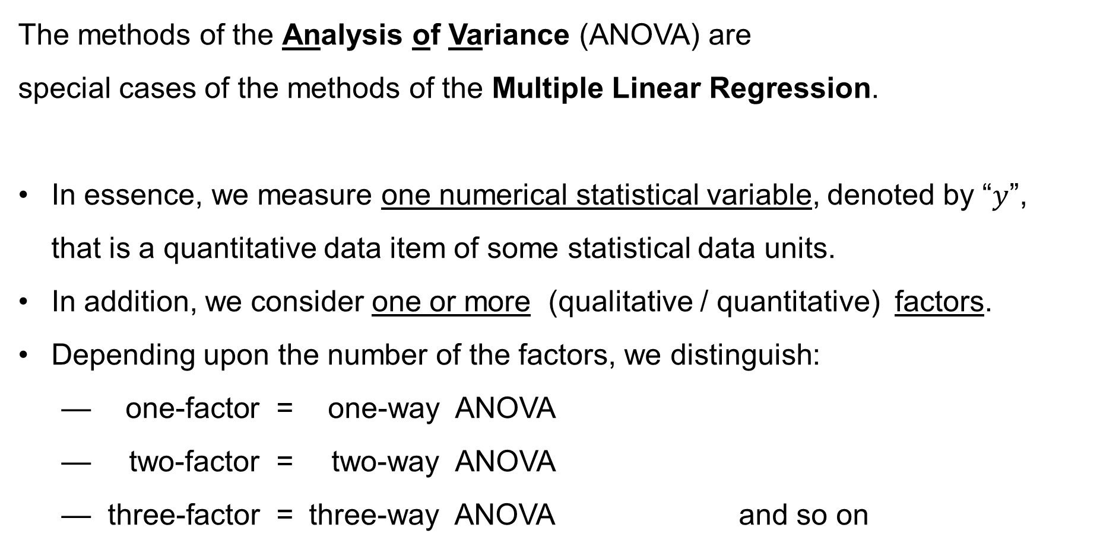
ANOVA: Introduction
The methods of the Analysis of Variance (ANOVA) are
special cases of the methods of the Multiple Linear Regression.
In essence, we measure one numerical statistical variable, denoted by “$y$”,
that is a quantitative data item of some statistical data units.
In addition, we consider one or more (qualitative / quantitative) factors.
Depending upon the number of the factors, we distinguish:
— one-factor = one-way ANOVA
— two-factor = two-way ANOVA
— three-factor = three-way ANOVA and so on

Slide 4
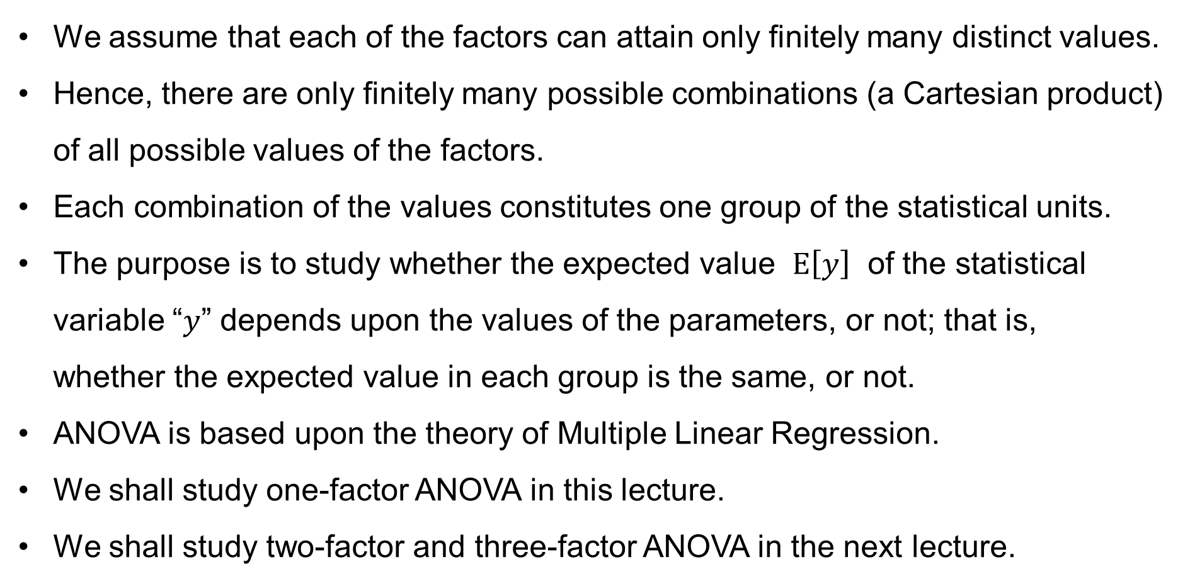
ANOVA: Introduction
We assume that each of the factors can attain only finitely many distinct values.
Hence, there are only finitely many possible combinations (a Cartesian product) of all possible values of the factors.
Each combination of the values constitutes one group of the statistical units.
The purpose is to study whether the expected value $E\left[y\right]$ of the statistical variable “$y$” depends upon the values of the parameters, or not; that is,
whether the expected value in each group is the same, or not.
ANOVA is based upon the theory of Multiple Linear Regression.
We shall study one-factor ANOVA in this lecture.
We shall study two-factor and three-factor ANOVA in the next lecture.

Slide 5
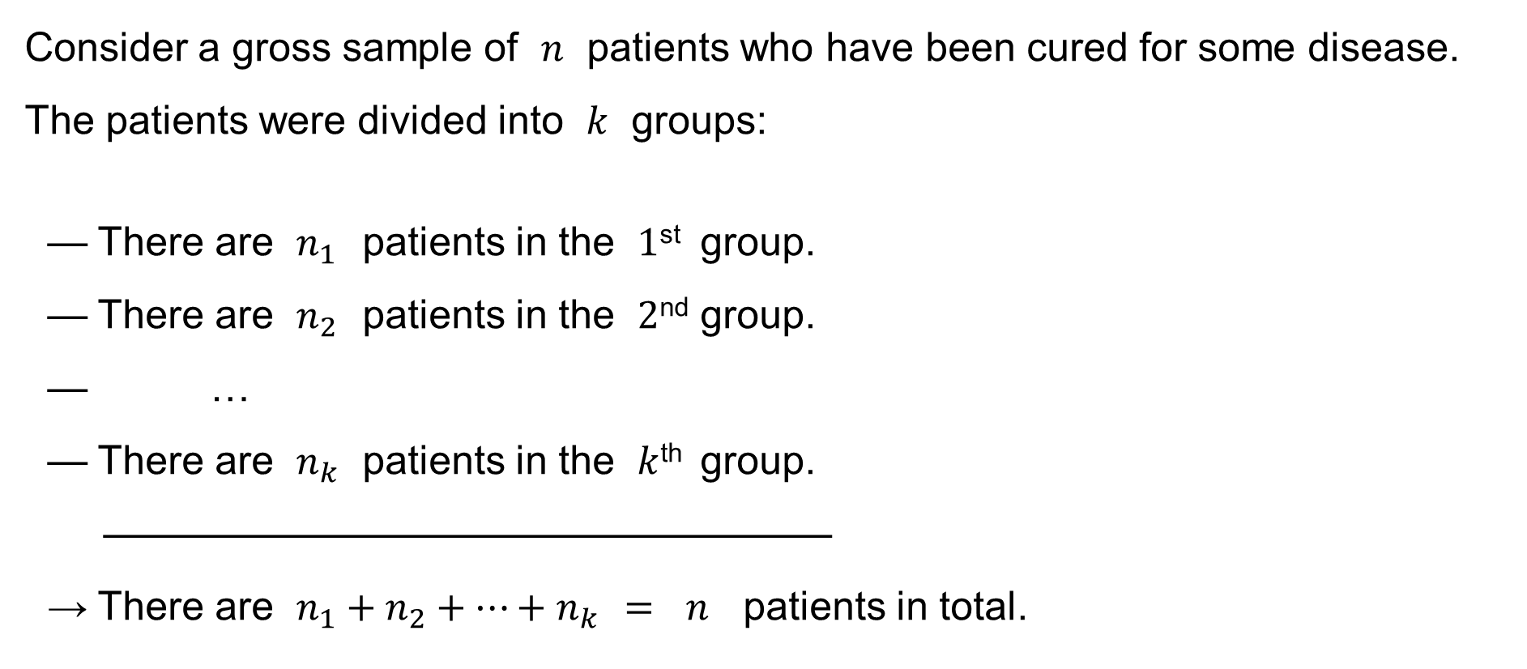
One-factor ANOVA: Motivation: Example 1
Consider a gross sample of $n$ patients who have been cured for some disease.
The patients were divided into $k$ groups:
— There are $n_{1}$ patients in the $1$^{st} group.
— There are $n_{2}$ patients in the $2$^{nd} group.
— …
— There are $n_{k}$ patients in the $k$^{th} group.
——————————————————
→ There are $n_{1}+n_{2}+⋯+n_{k} = n$ patients in total.

Slide 6
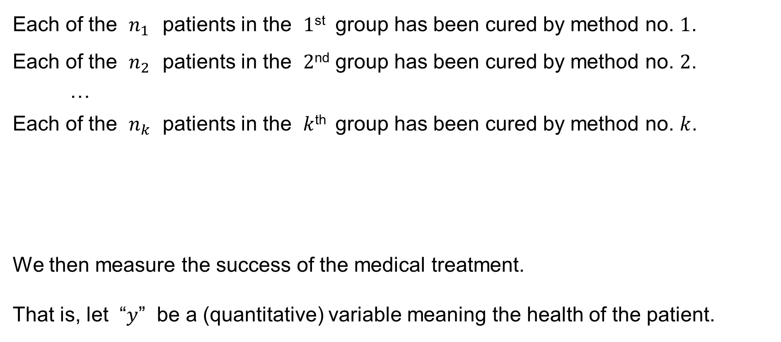
One-factor ANOVA: Motivation: Example 1
Each of the $n_{1}$ patients in the $1$^{st} group has been cured by method no. $1$.
Each of the $n_{2}$ patients in the $2$^{nd} group has been cured by method no. $2$.
…
Each of the $n_{k}$ patients in the $k$^{th} group has been cured by method no. $k$.
We then measure the success of the medical treatment.
That is, let “$y$” be a (quantitative) variable meaning the health of the patient.

Slide 7
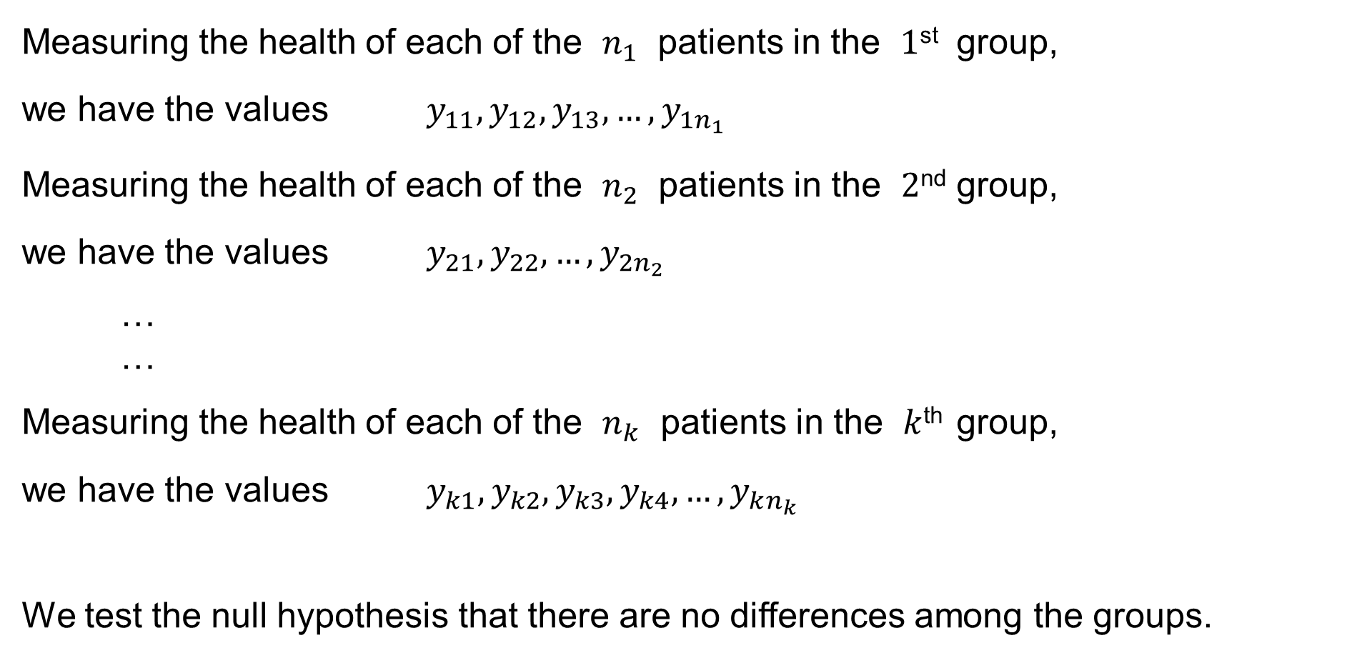
One-factor ANOVA: Motivation: Example 1
Measuring the health of each of the $n_{1}$ patients in the $1$^{st} group,
we have the values $y_{11},y_{12},y_{13},…,y_{1n_{1}}$
Measuring the health of each of the $n_{2}$ patients in the $2$^{nd} group,
we have the values $y_{21},y_{22},…,y_{2n_{2}}$
…
…
Measuring the health of each of the $n_{k}$ patients in the $k$^{th} group,
we have the values $y_{k1},y_{k2},y_{k3},y_{k4},…,y_{kn_{k}}$
We test the null hypothesis that there are no differences among the groups.

Slide 8
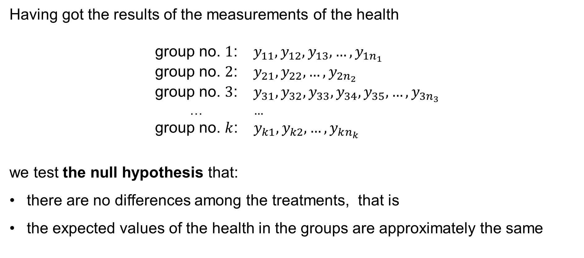
One-factor ANOVA: Motivation: Example 1
Having got the results of the measurements of the health
group no. $1$: $y_{11},y_{12},y_{13},…,y_{1n_{1}}$
group no. $2$: $y_{21},y_{22},…,y_{2n_{2}}$
group no. $3$: $y_{31},y_{32},y_{33},y_{34},y_{35},…,y_{3n_{3}}$
  … $…$
group no. $k$: $y_{k1},y_{k2},…,y_{kn_{k}}$
we test the null hypothesis that:
there are no differences among the treatments, that is
the expected values of the health in the groups are approximately the same

Slide 9
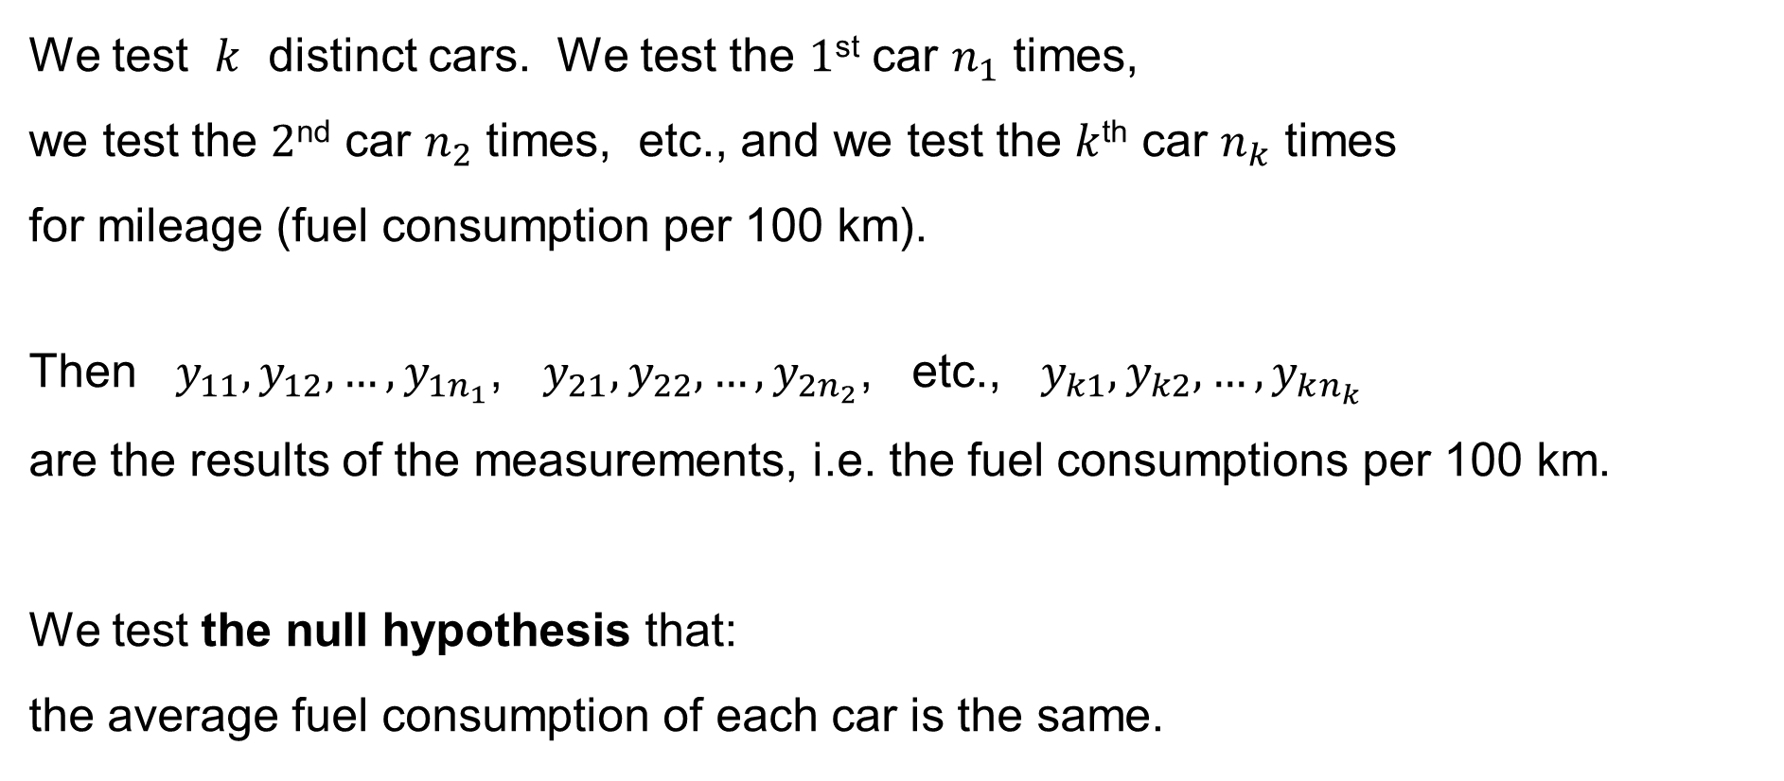
One-factor ANOVA: Motivation: Example 2
We test $k$ distinct cars. We test the $1$^{st} car $n_{1}$ times,
we test the $2$^{nd} car $n_{2}$ times, etc., and we test the $k$^{th} car $n_{k}$ times
for mileage (fuel consumption per 100 km).
Then $y_{11},y_{12},…,y_{1n_{1}}$, $y_{21},y_{22},…,y_{2n_{2}}$, etc., $y_{k1},y_{k2},…,y_{kn_{k}}$
are the results of the measurements, i.e. the fuel consumptions per 100 km.
We test the null hypothesis that:
the average fuel consumption of each car is the same.

Slide 10
One-Way ANOVA
Summary
Assumptions
The classical assumptions
The purpose of the Analysis of Variance

Slide 11
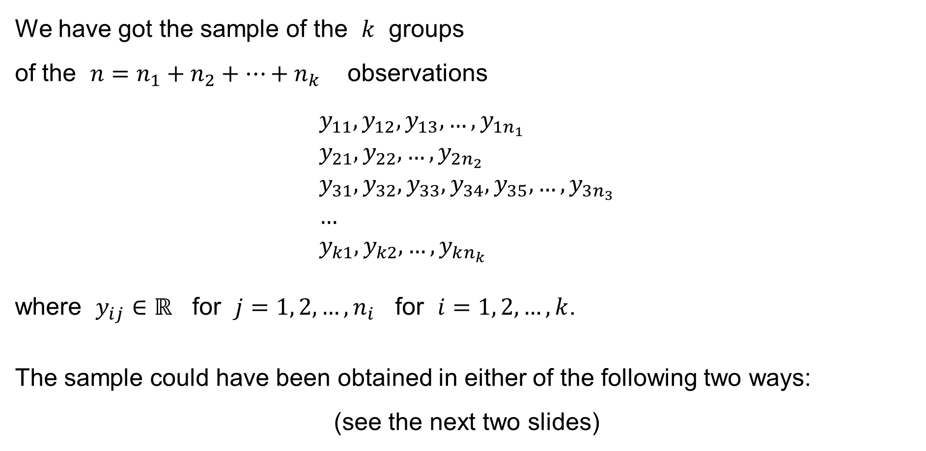
One-way ANOVA: Summary
We have got the sample of the $k$ groups
of the $n=n_{1}+n_{2}+⋯+n_{k}$ observations
$$y_{11},y_{12},y_{13},…,y_{1n_{1}} \\ y_{21},y_{22},…,y_{2n_{2}} \\ y_{31},y_{32},y_{33},y_{34},y_{35},…,y_{3n_{3}} \\ … \\ y_{k1},y_{k2},…,y_{kn_{k}}$$
where $y_{ij}∈ℝ$ for $j=1, 2,…,n_{i}$ for $i=1, 2,…,k$.
The sample could have been obtained in either of the following two ways:
(see the next two slides)

Slide 12
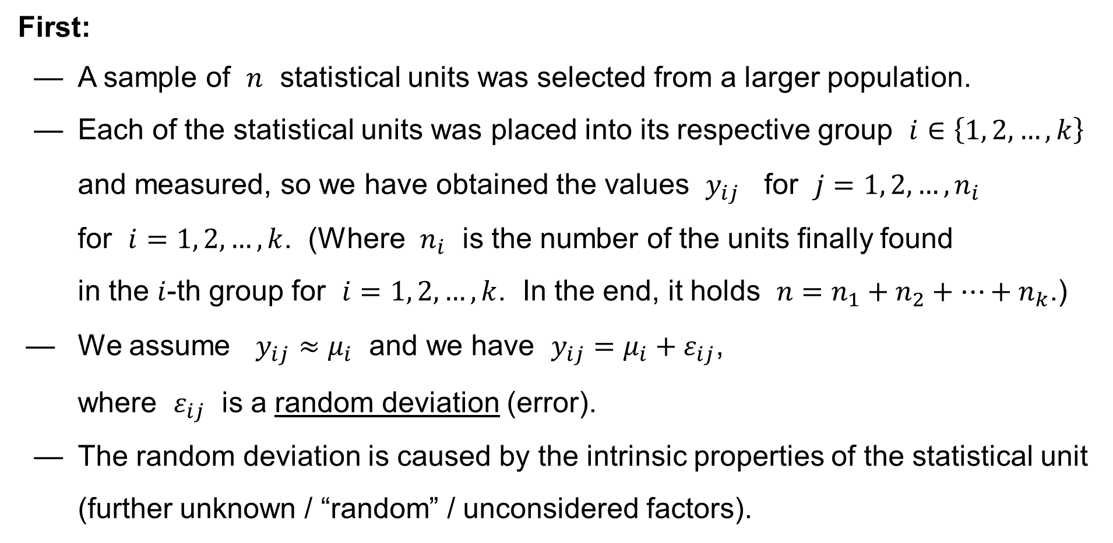
One-way ANOVA: Summary
First:
— A sample of $n$ statistical units was selected from a larger population.
— Each of the statistical units was placed into its respective group $i∈\left\{1, 2,…,k\right\}$ and measured, so we have obtained the values $y_{ij}$ for $j=1, 2,…,n_{i}$
for $i=1, 2,…,k$. (Where $n_{i}$ is the number of the units finally found
in the $i$-th group for $i=1, 2,…,k$. In the end, it holds $n=n_{1}+n_{2}+…+n_{k}$.)
— We assume $y_{ij}≈μ_{i}$ and we have $y_{ij}=μ_{i}+ε_{ij}$,
where $ε_{ij}$ is a random deviation (error).
— The random deviation is caused by the intrinsic properties of the statistical unit (further unknown / “random” / unconsidered factors).

Slide 13
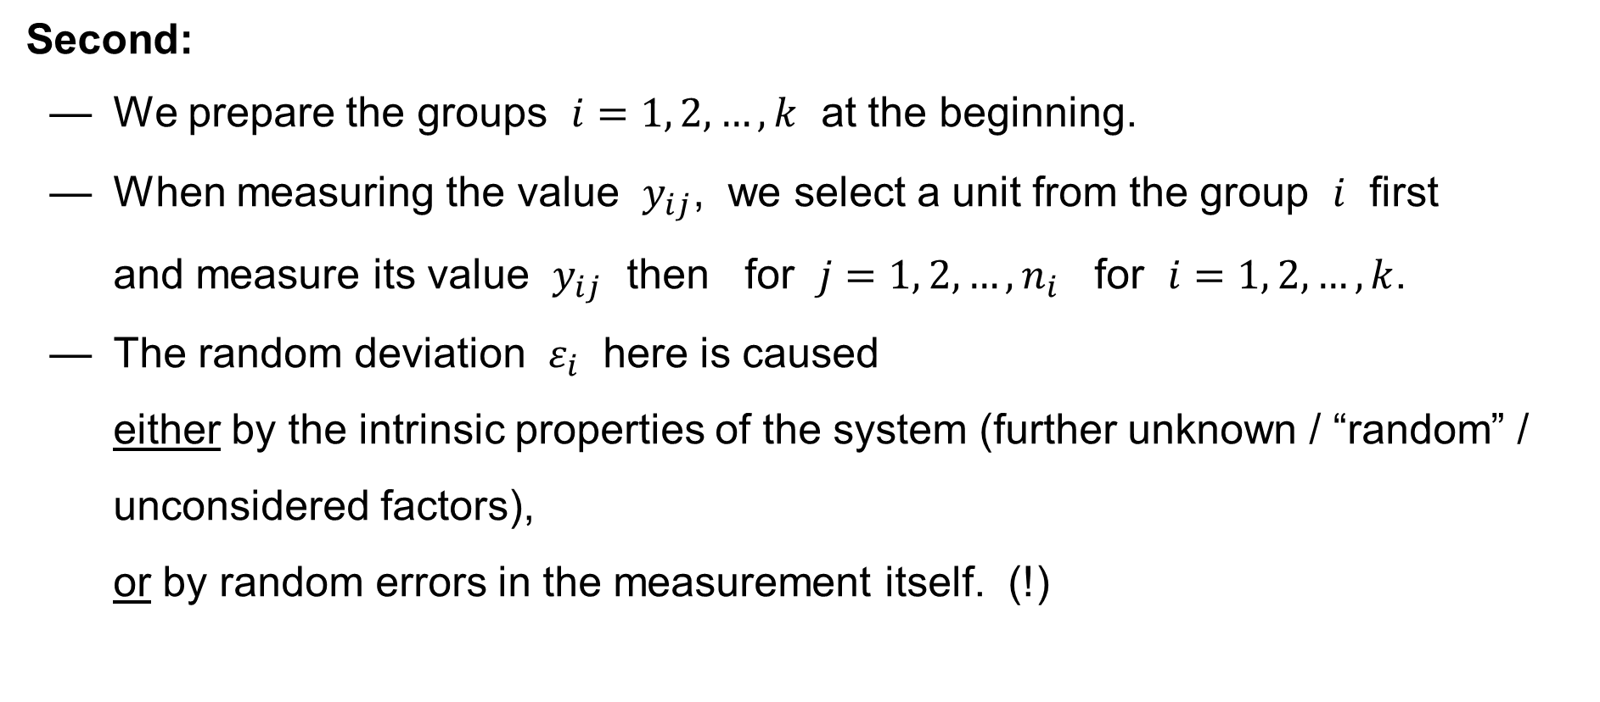
One-way ANOVA: Summary
Second:
— We prepare the groups $i=1, 2,…,k$ at the beginning.
— When measuring the value $y_{ij}$, we select a unit from the group $i$ first
and measure its value $y_{ij}$ then for $j=1, 2,…,n_{i}$ for $i=1, 2,…,k$.
— The random deviation $ε_{i}$ here is caused
either by the intrinsic properties of the system (further unknown / “random” / unconsidered factors),
or by random errors in the measurement itself. (!)

Slide 14
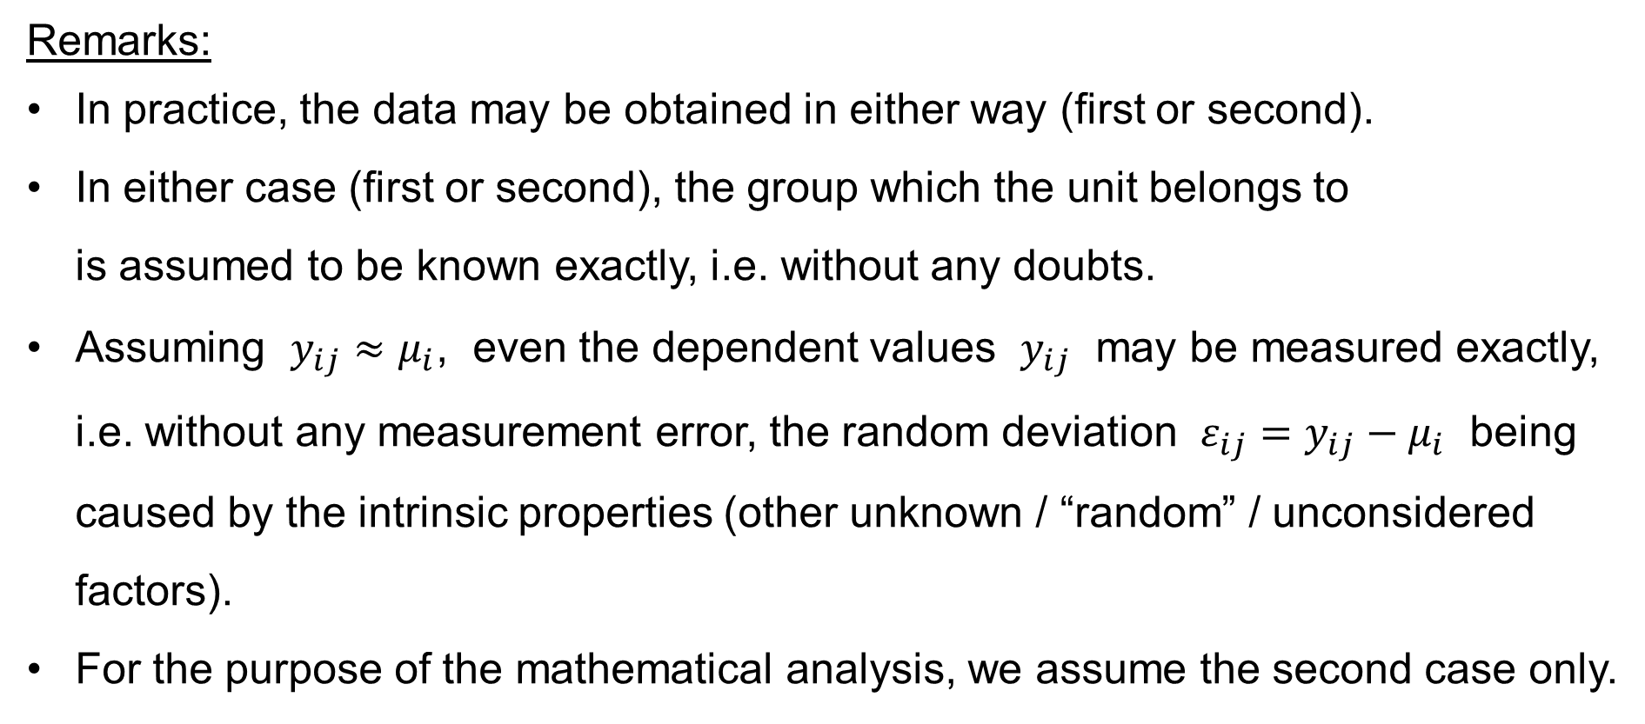
One-way ANOVA: Summary
Remarks:
In practice, the data may be obtained in either way (first or second).
In either case (first or second), the group which the unit belongs to
is assumed to be known exactly, i.e. without any doubts.
Assuming $y_{ij}≈μ_{i}$, even the dependent values $y_{ij}$ may be measured exactly, i.e. without any measurement error, the random deviation $ε_{ij}=y_{ij}−μ_{i}$ being caused by the intrinsic properties (other unknown / “random” / unconsidered factors).
For the purpose of the mathematical analysis, we assume the second case only.

Slide 15
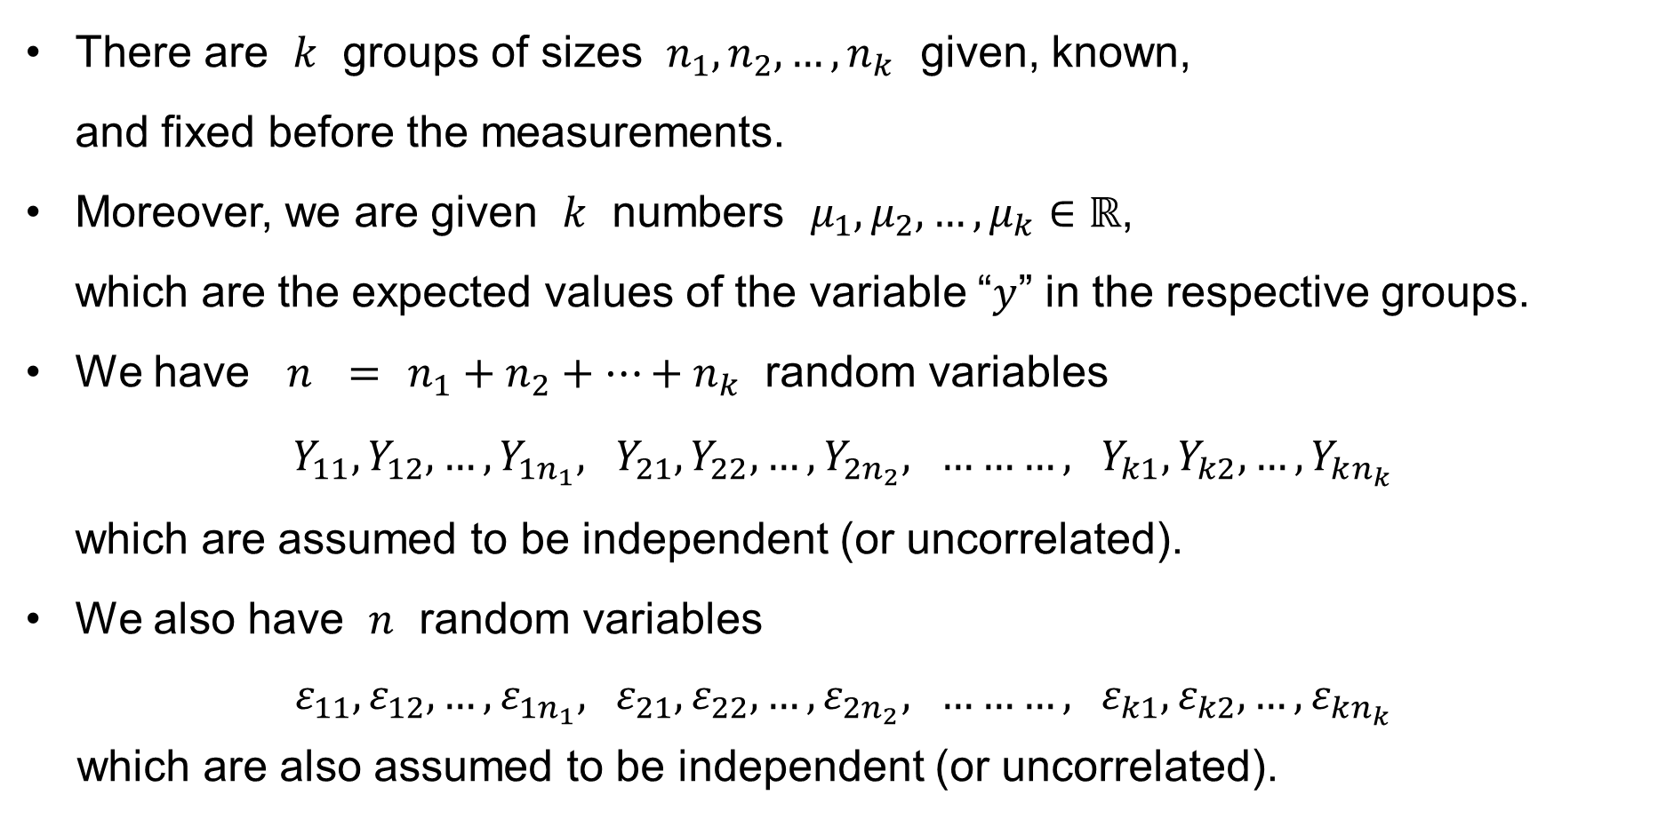
One-way ANOVA: Assumptions
There are $k$ groups of sizes $n_{1},n_{2},…,n_{k}$ given, known,
and fixed before the measurements.
Moreover, we are given $k$ numbers $μ_{1},μ_{2},…,μ_{k}∈ℝ$,
which are the expected values of the variable “$y$” in the respective groups.
We have $n = n_{1}+n_{2}+…+n_{k}$ random variables
$Y_{11},Y_{12},…,Y_{1n_{1}}, Y_{21},Y_{22},…,Y_{2n_{2}}, ………, Y_{k1},Y_{k2},…,Y_{kn_{k}}$
which are assumed to be independent (or uncorrelated).
We also have $n$ random variables
$$ε_{11},ε_{12},…,ε_{1n_{1}}, ε_{21},ε_{22},…,ε_{2n_{2}}, ………, ε_{k1},ε_{k2},…,ε_{kn_{k}}$$
which are also assumed to be independent (or uncorrelated).

Slide 16

One-way ANOVA: Assumptions
We stack the group expected values $μ_{1},μ_{2},…,μ_{k}$ into a vector:
$$μ=\left(\begin{matrix}μ_{1} \\ ⋮ \\ μ_{1} \\ μ_{2} \\ ⋮ \\ μ_{2} \\ ⋮ \\ ⋮ \\ ⋮ \\ μ_{k} \\ \begin{aligned}⋮ \\ μ_{k}\end{aligned}\end{matrix}\right)\left.\begin{aligned}\left.\begin{aligned} \\ \\ \end{aligned}\right\}n_{1}\text{−}\text{times} \\ \left.\begin{aligned} \\ \\ \end{aligned}\right\}n_{2}\text{−}\text{times} \\ \left.\begin{aligned} \\ \\ \end{aligned}\right\}…\text{−}\text{times} \\ \left.\begin{aligned} \\ \\ \end{aligned}\right\}n_{k}\text{−}\text{times}\end{aligned}\right.$$

Slide 17
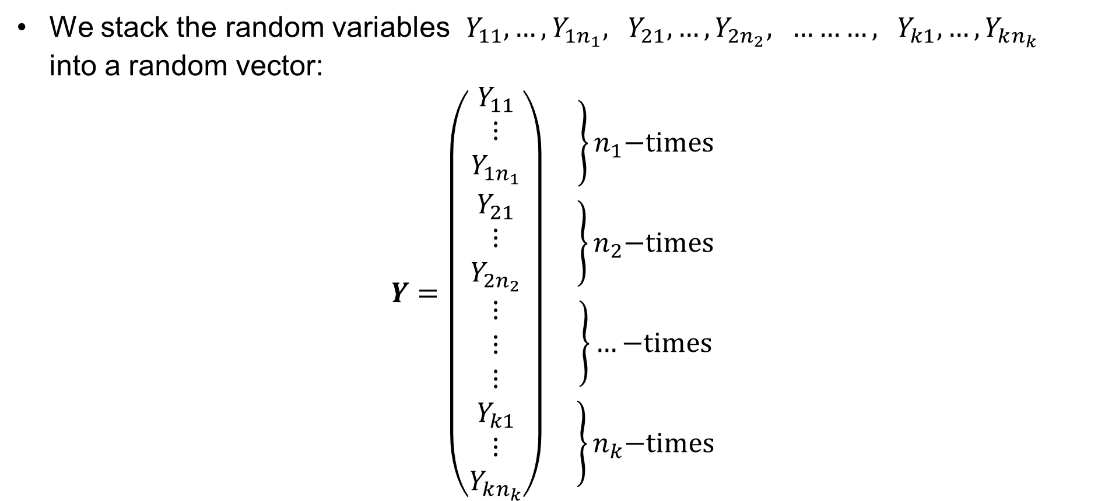
One-way ANOVA: Assumptions
We stack the random variables $Y_{11},…,Y_{1n_{1}}, Y_{21},…,Y_{2n_{2}}, ………, Y_{k1},…,Y_{kn_{k}}$ into a random vector:
$$Y=\left(\begin{matrix}Y_{11} \\ ⋮ \\ Y_{1n_{1}} \\ Y_{21} \\ ⋮ \\ Y_{2n_{2}} \\ ⋮ \\ ⋮ \\ ⋮ \\ Y_{k1} \\ \begin{aligned}⋮ \\ Y_{kn_{k}}\end{aligned}\end{matrix}\right)\left.\begin{aligned}\left.\begin{aligned} \\ \\ \end{aligned}\right\}n_{1}\text{−}\text{times} \\ \left.\begin{aligned} \\ \\ \end{aligned}\right\}n_{2}\text{−}\text{times} \\ \left.\begin{aligned} \\ \\ \end{aligned}\right\}…\text{−}\text{times} \\ \left.\begin{aligned} \\ \\ \end{aligned}\right\}n_{k}\text{−}\text{times}\end{aligned}\right.$$

Slide 18

One-way ANOVA: Assumptions
We stack the random variables $ε_{11},…,ε_{1n_{1}}, ε_{21},…,ε_{2n_{2}}, ………, ε_{k1},…,ε_{kn_{k}}$ into a random vector:
$$ε=\left(\begin{matrix}ε_{11} \\ ⋮ \\ ε_{1n_{1}} \\ ε_{21} \\ ⋮ \\ ε_{2n_{2}} \\ ⋮ \\ ⋮ \\ ⋮ \\ ε_{k1} \\ \begin{aligned}⋮ \\ ε_{kn_{k}}\end{aligned}\end{matrix}\right)\left.\begin{aligned}\left.\begin{aligned} \\ \\ \end{aligned}\right\}n_{1}\text{−}\text{times} \\ \left.\begin{aligned} \\ \\ \end{aligned}\right\}n_{2}\text{−}\text{times} \\ \left.\begin{aligned} \\ \\ \end{aligned}\right\}…\text{−}\text{times} \\ \left.\begin{aligned} \\ \\ \end{aligned}\right\}n_{k}\text{−}\text{times}\end{aligned}\right.$$

Slide 19
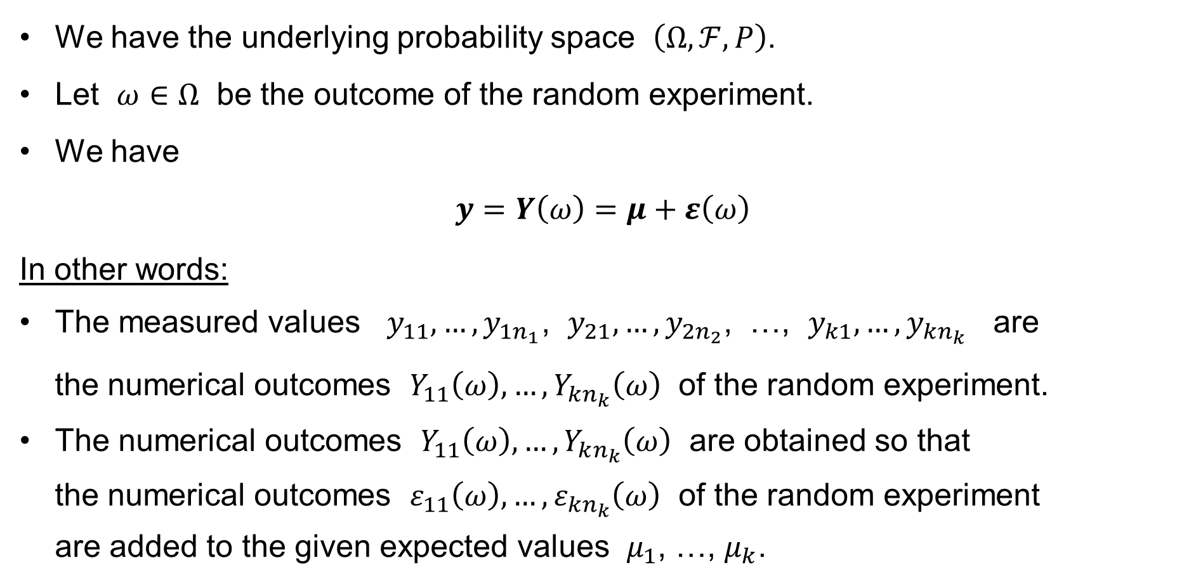
One-way ANOVA: The Classical Assumptions
We have the underlying probability space $\left(Ω,ℱ,P\right)$.
Let $ω∈Ω$ be the outcome of the random experiment.
We have
$y=Y\left(ω\right)=μ+ε\left(ω\right)$
In other words:
The measured values $y_{11},…,y_{1n_{1}}$, $y_{21},…,y_{2n_{2}}$, …, $y_{k1},…,y_{kn_{k}}$ are
the numerical outcomes $Y_{11}\left(ω\right),…,Y_{kn_{k}}\left(ω\right)$ of the random experiment.
The numerical outcomes $Y_{11}\left(ω\right),…,Y_{kn_{k}}\left(ω\right)$ are obtained so that
the numerical outcomes $ε_{11}\left(ω\right),…,ε_{kn_{k}}\left(ω\right)$ of the random experiment
are added to the given expected values $μ_{1}$, …, $μ_{k}$.

Slide 20
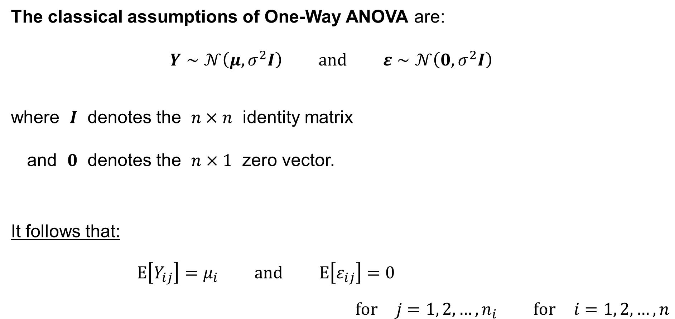
One-way ANOVA: The Classical Assumptions
The classical assumptions of One-Way ANOVA are:
$$Y∼𝒩\left(μ,σ^{2}I\right) \text{and} ε∼𝒩\left(0,σ^{2}I\right)$$
where $I$ denotes the $n×n$ identity matrix
and $0$ denotes the $n×1$ zero vector.
It follows that:
$$E\left[Y_{ij}\right]=μ_{i} \text{and} E\left[ε_{ij}\right]=0$$
$$\text{for} j=1, 2,…,n_{i} \text{for} i=1, 2,…,n$$

Slide 21
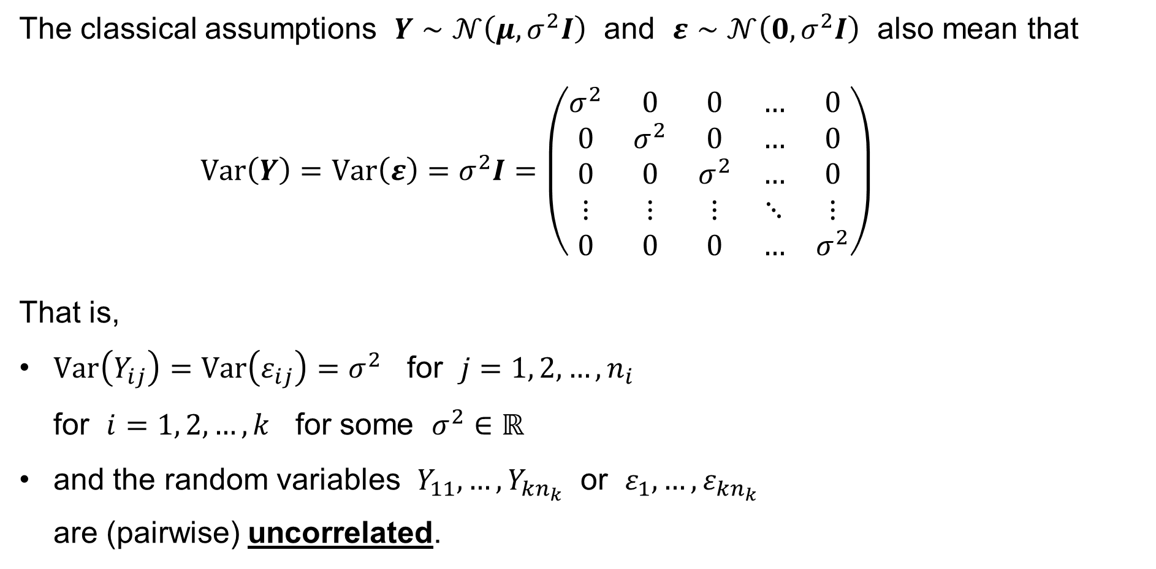
One-way ANOVA: The Classical Assumptions
The classical assumptions $Y∼𝒩\left(μ,σ^{2}I\right)$ and $ε∼𝒩\left(0,σ^{2}I\right)$ also mean that
$$Var\left(Y\right)=Var\left(ε\right)=σ^{2}I=\left(\begin{matrix}σ^{2} & 0 & 0 & … & 0 \\ 0 & σ^{2} & 0 & … & 0 \\ 0 & 0 & σ^{2} & … & 0 \\ ⋮ & ⋮ & ⋮ & ⋱ & ⋮ \\ 0 & 0 & 0 & … & σ^{2}\end{matrix}\right)$$
That is,
$Var\left(Y_{ij}\right)=Var\left(ε_{ij}\right)=σ^{2}$ for $j=1, 2,…,n_{i}$
for $i=1, 2,…,k$ for some $σ^{2}∈ℝ$
and the random variables $Y_{11},…,Y_{kn_{k}}$ or $ε_{1},…,ε_{kn_{k}}$
are (pairwise) uncorrelated.
homoscedasticity, i.e. the variance
is the same

Slide 22
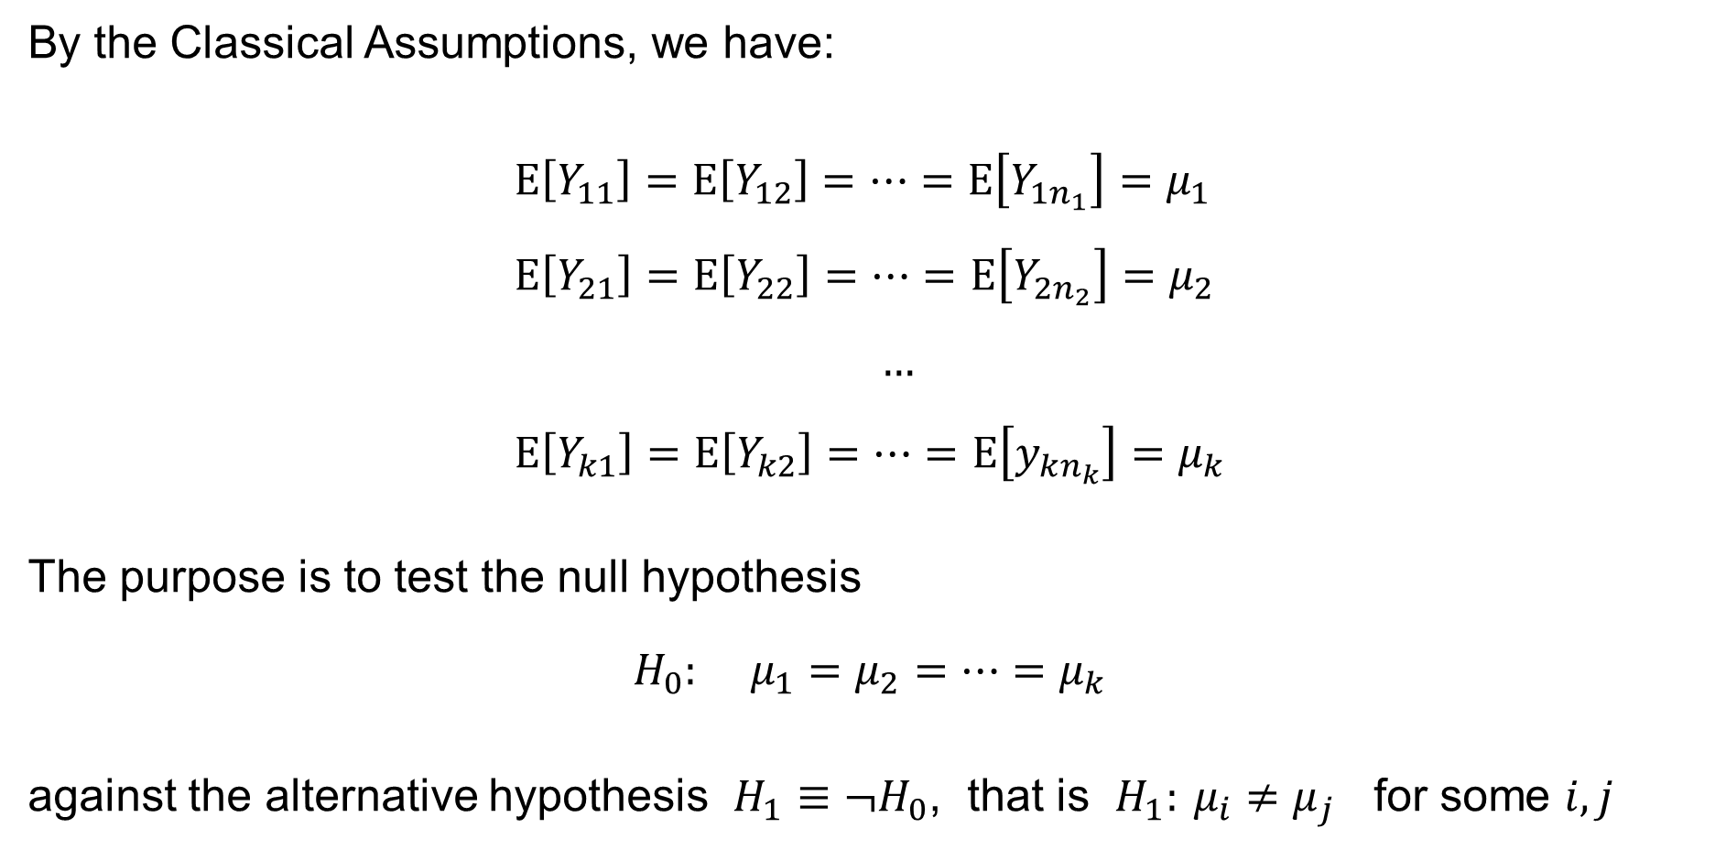
One-way ANOVA: The purpose of the analysis
By the Classical Assumptions, we have:
$$E\left[Y_{11}\right]=E\left[Y_{12}\right]=⋯=E\left[Y_{1n_{1}}\right]=μ_{1} \\ E\left[Y_{21}\right]=E\left[Y_{22}\right]=⋯=E\left[Y_{2n_{2}}\right]=μ_{2} \\ … \\ E\left[Y_{k1}\right]=E\left[Y_{k2}\right]=⋯=E\left[y_{kn_{k}}\right]=μ_{k}$$
The purpose is to test the null hypothesis
$$H_{0}: μ_{1}=μ_{2}=⋯=μ_{k}$$
against the alternative hypothesis $H_{1}≡¬H_{0}$, that is $H_{1}: μ_{i}≠μ_{j}$ for some $i,j$

Slide 23
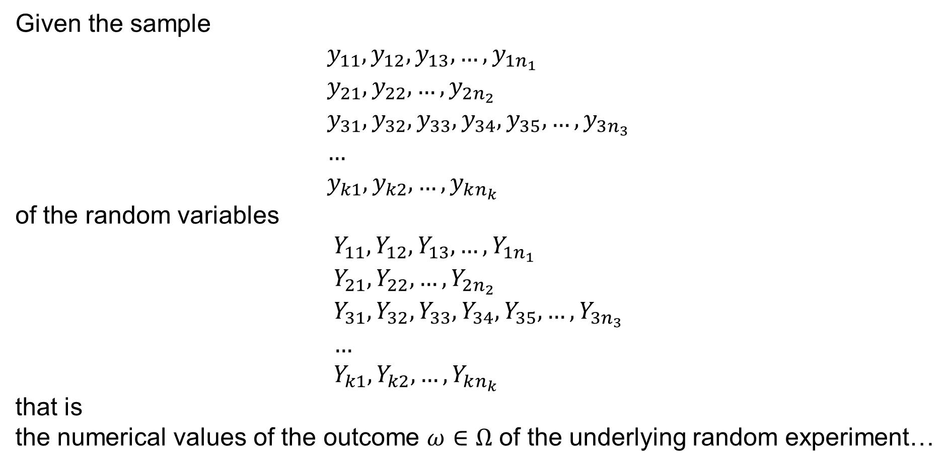
One-way ANOVA: Solution
Given the sample
$$y_{11},y_{12},y_{13},…,y_{1n_{1}} \\ y_{21},y_{22},…,y_{2n_{2}} \\ y_{31},y_{32},y_{33},y_{34},y_{35},…,y_{3n_{3}} \\ … \\ y_{k1},y_{k2},…,y_{kn_{k}}$$
of the random variables
$$Y_{11},Y_{12},Y_{13},…,Y_{1n_{1}} \\ Y_{21},Y_{22},…,Y_{2n_{2}} \\ Y_{31},Y_{32},Y_{33},Y_{34},Y_{35},…,Y_{3n_{3}} \\ … \\ Y_{k1},Y_{k2},…,Y_{kn_{k}}$$
that is
the numerical values of the outcome $ω∈Ω$ of the underlying random experiment…

Slide 24
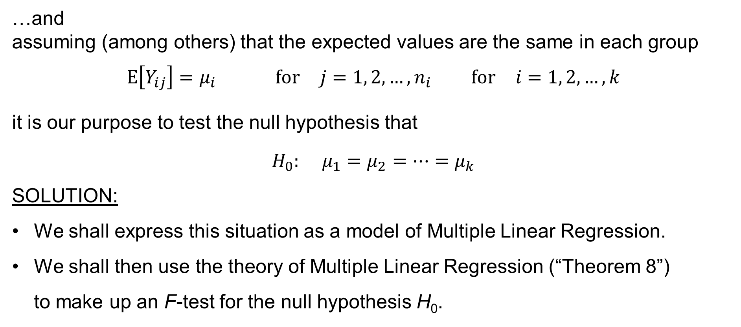
One-way ANOVA: Solution
…and
assuming (among others) that the expected values are the same in each group
$$E\left[Y_{ij}\right]=μ_{i} \text{for} j=1, 2,…,n_{i} \text{for} i=1, 2,…,k$$
it is our purpose to test the null hypothesis that
$$H_{0}: μ_{1}=μ_{2}=⋯=μ_{k}$$
SOLUTION:
We shall express this situation as a model of Multiple Linear Regression.
We shall then use the theory of Multiple Linear Regression (“Theorem 8”)
to make up an F-test for the null hypothesis H₀.

Slide 25
One-Way ANOVA as a model of Multiple Linear Regression

Slide 26
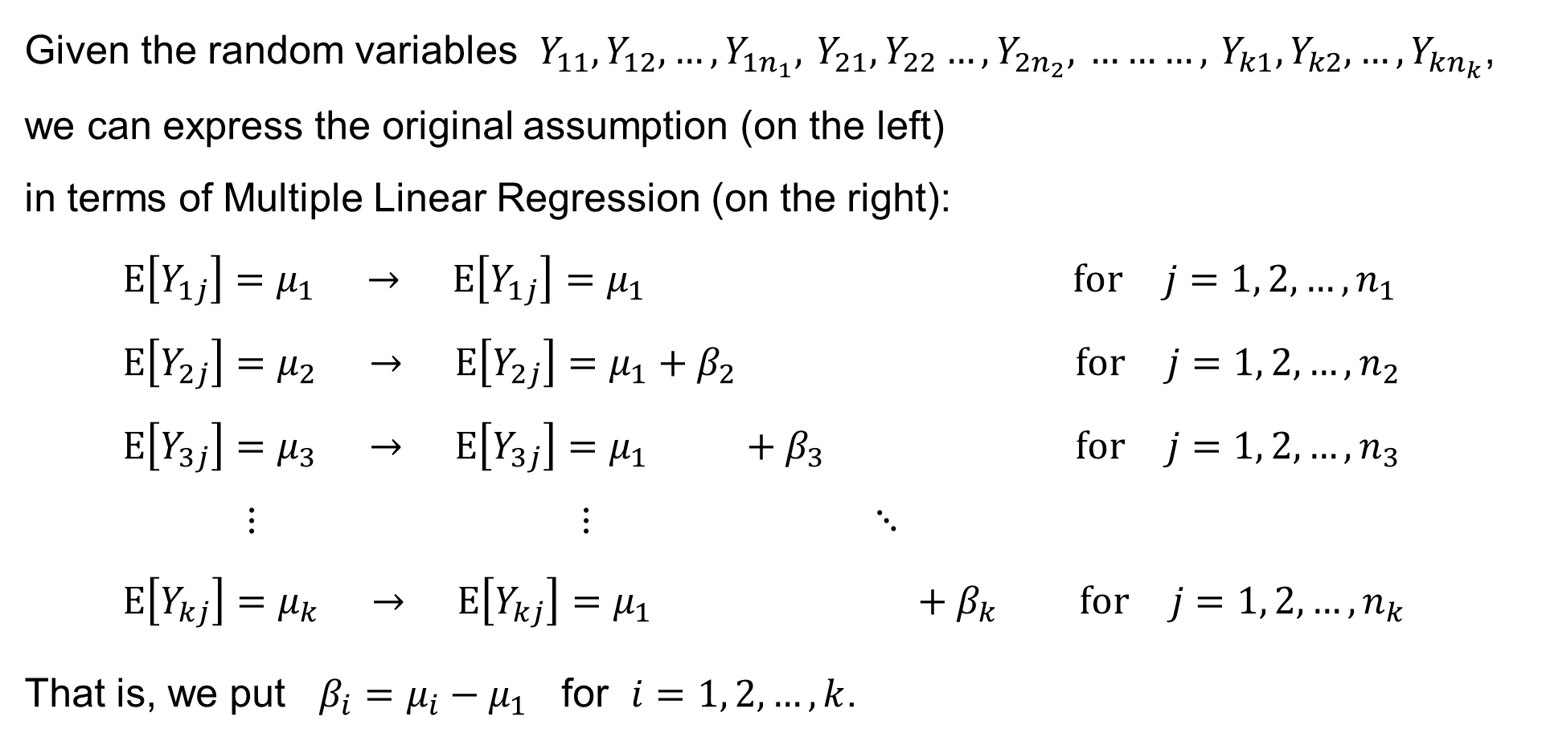
One-way ANOVA: Model of Multiple Linear Regression
Given the random variables $Y_{11},Y_{12},…,Y_{1n_{1}}, Y_{21},Y_{22}…,Y_{2n_{2}}, ………, Y_{k1},Y_{k2},…,Y_{kn_{k}}$, we can express the original assumption (on the left)
in terms of Multiple Linear Regression (on the right):
$$E\left[Y_{1j}\right]=μ_{1} → E\left[Y_{1j}\right]=μ_{1}+β_{2}+β_{3}+⋯+β_{k} \text{for} j=1, 2,…,n_{1} \\ E\left[Y_{2j}\right]=μ_{2} → E\left[Y_{2j}\right]=μ_{1}+β_{2}+β_{3}+⋯+β_{k} \text{for} j=1, 2,…,n_{2} \\ E\left[Y_{3j}\right]=μ_{3} → E\left[Y_{3j}\right]=μ_{1}+β_{2}+β_{3}+⋯+β_{k} \text{for} j=1, 2,…,n_{3} \\ ⋮ ⋮ ⋱ \\ E\left[Y_{kj}\right]=μ_{k} → E\left[Y_{kj}\right]=μ_{1}+β_{2}+β_{3}+⋯+β_{k} \text{for} j=1, 2,…,n_{k}$$
That is, we put $β_{i}=μ_{i}−μ_{1}$ for $i=1, 2,…,k$.

Slide 27

One-way ANOVA: Model of Multiple Linear Regression
Having
$$E\left[Y_{1j}\right]=μ_{1} \text{for} j=1, 2,…,n_{1} \\ E\left[Y_{ij} \right]=μ_{i}=μ_{1}+β_{j} \text{for} j=1, 2,…,n_{i} \text{for} i=2,…,k$$
the original hypothesis
$$H_{0}: μ_{1}=μ_{2}=⋯=μ_{k}$$
is equivalent with
$$H_{0}: β_{2}=⋯=β_{k}=0$$
which we can test (recall “Theorem 8”).

Slide 28
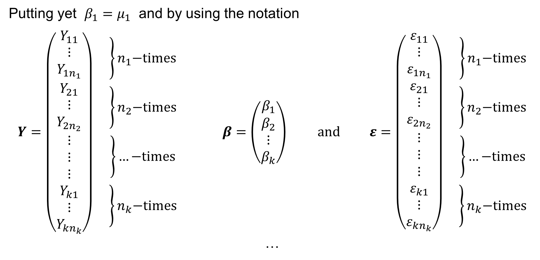
One-way ANOVA: Model of Multiple Linear Regression
Putting yet $β_{1}=μ_{1}$ and by using the notation
$$Y=\left(\begin{matrix}Y_{11} \\ ⋮ \\ Y_{1n_{1}} \\ Y_{21} \\ ⋮ \\ Y_{2n_{2}} \\ ⋮ \\ ⋮ \\ ⋮ \\ Y_{k1} \\ \begin{aligned}⋮ \\ Y_{kn_{k}}\end{aligned}\end{matrix}\right)\left.\begin{aligned}\left.\begin{aligned} \\ \\ \end{aligned}\right\}n_{1}\text{−}\text{times} \\ \left.\begin{aligned} \\ \\ \end{aligned}\right\}n_{2}\text{−}\text{times} \\ \left.\begin{aligned} \\ \\ \end{aligned}\right\}…\text{−}\text{times} \\ \left.\begin{aligned} \\ \\ \end{aligned}\right\}n_{k}\text{−}\text{times}\end{aligned}\right. β=\left(\begin{matrix}β_{1} \\ β_{2} \\ ⋮ \\ β_{k}\end{matrix}\right) \text{and} ε=\left(\begin{matrix}ε_{11} \\ ⋮ \\ ε_{1n_{1}} \\ ε_{21} \\ ⋮ \\ ε_{2n_{2}} \\ ⋮ \\ ⋮ \\ ⋮ \\ ε_{k1} \\ \begin{aligned}⋮ \\ ε_{kn_{k}}\end{aligned}\end{matrix}\right)\left.\begin{aligned}\left.\begin{aligned} \\ \\ \end{aligned}\right\}n_{1}\text{−}\text{times} \\ \left.\begin{aligned} \\ \\ \end{aligned}\right\}n_{2}\text{−}\text{times} \\ \left.\begin{aligned} \\ \\ \end{aligned}\right\}…\text{−}\text{times} \\ \left.\begin{aligned} \\ \\ \end{aligned}\right\}n_{k}\text{−}\text{times}\end{aligned}\right.$$
…

Slide 29

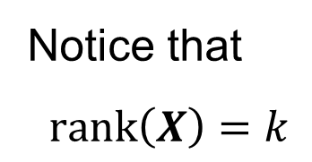
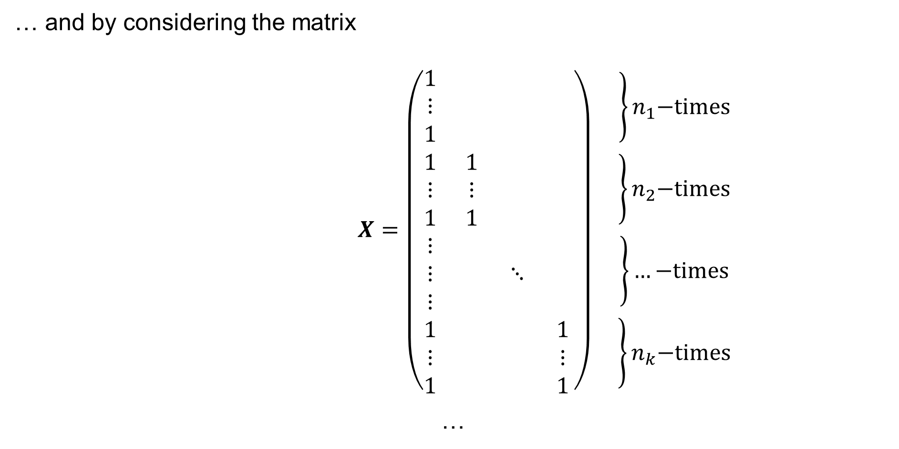



One-way ANOVA: Model of Multiple Linear Regression
… and by considering the matrix
$$X=\left(\begin{matrix}1 & & & \\ ⋮ & & & \\ 1 & & & \\ 1 & 1 & & \\ ⋮ & ⋮ & & \\ 1 & 1 & & \\ ⋮ & & & \\ ⋮ & & ⋱ & \\ ⋮ & & & \\ 1 & & & 1 \\ ⋮ & & & ⋮ \\ 1 & & & 1\end{matrix}\right)\left.\begin{aligned}\left.\begin{aligned} \\ \\ \end{aligned}\right\}n_{1}\text{−}\text{times} \\ \left.\begin{aligned} \\ \\ \end{aligned}\right\}n_{2}\text{−}\text{times} \\ \left.\begin{aligned} \\ \\ \end{aligned}\right\}…\text{−}\text{times} \\ \left.\begin{aligned} \\ \\ \end{aligned}\right\}n_{k}\text{−}\text{times}\end{aligned}\right.$$
…
$$\overset{β_{1}}{\overbrace{}}$$
$$\overset{β_{2}}{\overbrace{}}$$
$$\overset{…}{\overbrace{}}$$
$$\overset{β_{k}}{\overbrace{}}$$
Notice that
$$rank\left(X\right)=k$$

Slide 30
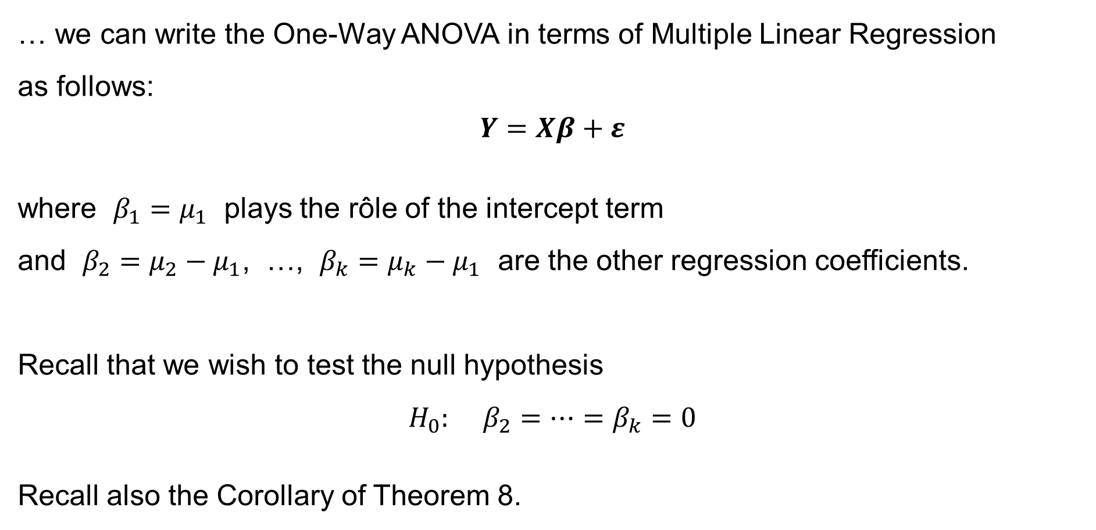
One-way ANOVA: Model of Multiple Linear Regression
… we can write the One-Way ANOVA in terms of Multiple Linear Regression
as follows:
$$Y=Xβ+ε$$
where $β_{1}=μ_{1}$ plays the rôle of the intercept term
and $β_{2}=μ_{2}−μ_{1}$, …, $β_{k}=μ_{k}−μ_{1}$ are the other regression coefficients.
Recall that we wish to test the null hypothesis
$$H_{0}: β_{2}=⋯=β_{k}=0$$
Recall also the Corollary of Theorem 8.

Slide 31












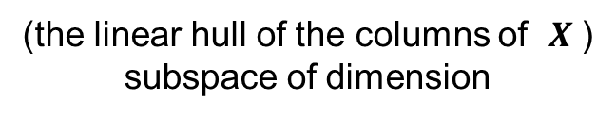
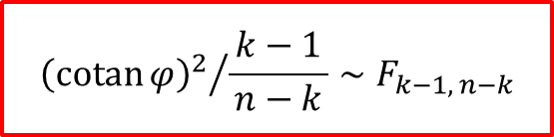
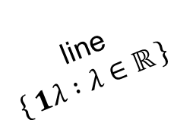
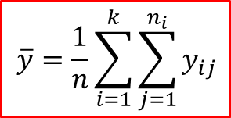


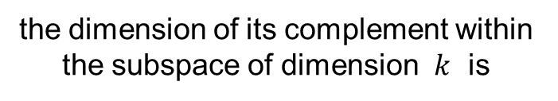
The Coefficient of Determination (R²): Th. 8: Corollary
$$\overline{y}=\frac{1}{n}\sum_{i=1}^{k}{\sum_{j=1}^{n_{i}}{y_{ij}}}$$
Let:
By Theorem 8:
$${\left\{ Xβ :β∈ℝ^{k} \right\}}^{⊥}$$
(the orthogonal
complement =
= the space of
the residuals)
subspace
of dimension
$${{\left(\operatorname{cotan}{φ}\right)}^{2}}/{\frac{ k−1 }{n−k}}∼F_{k−1, n−k}$$
$$M$$
$$y$$
$$e=\left(I−H\right)y$$
$${cotan}^{2}{φ}=\frac{{\left(\hat{y}−1\overline{y}\right)}^{T}\left(\hat{y}−1\overline{y}\right)}{RSS}=\frac{R^{2}}{1−R^{2}}$$
$$n−k$$
$$1\overline{y}$$
$$φ$$
line
$$\left\{ 1λ :λ∈ℝ \right\}$$
$$\hat{y}=Hy$$
$$\left\{ Xβ :β∈ℝ^{k} \right\}$$
0
(the linear hull of the columns of $X$ )
subspace of dimension
$$\left\{ 1λ :λ∈ℝ \right\}$$
the line is a subspace
of dimension
the dimension of its complement within
the subspace of dimension $k$ is
$$k$$
$$1$$
$$k−1$$

Slide 32
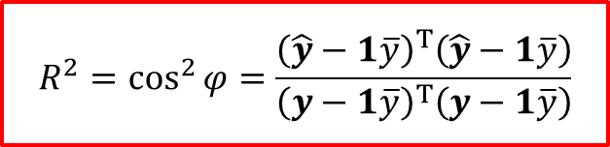
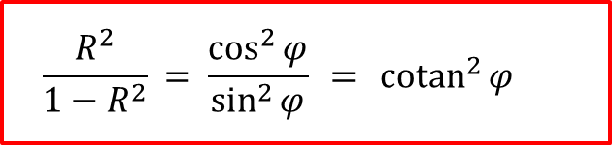
The Coefficient of Determination (R²): Th. 8: Corollary
$$\overline{y}=\frac{1}{n}\sum_{i=1}^{k}{\sum_{j=1}^{n_{i}}{y_{ij}}}$$
Let:
The Coefficient of Determination:
$${\left\{ Xβ :β∈ℝ^{k} \right\}}^{⊥}$$
(the orthogonal
complement =
= the space of
the residuals)
subspace
of dimension
$$R^{2}=\cos^{2}{φ}=\frac{{\left(\hat{y}−1\overline{y}\right)}^{T}\left(\hat{y}−1\overline{y}\right)}{{\left(y−1\overline{y}\right)}^{T}\left(y−1\overline{y}\right)}$$
$$M$$
$$y$$
$$e=\left(I−H\right)y$$
$$\frac{R^{2}}{1−R^{2}} = \frac{\cos^{2}{φ}}{\sin^{2}{φ}} = {cotan}^{2}{φ}$$
$$n−k$$
$$1\overline{y}$$
$$φ$$
line
$$\left\{ 1λ :λ∈ℝ \right\}$$
$$\hat{y}=Hy$$
$$\left\{ Xβ :β∈ℝ^{k} \right\}$$
0
(the linear hull of the columns of $X$ )
subspace of dimension
$$\left\{ 1λ :λ∈ℝ \right\}$$
the line is a subspace
of dimension
the dimension of its complement within
the subspace of dimension $k$ is
$$k$$
$$1$$
$$k−1$$

Slide 33
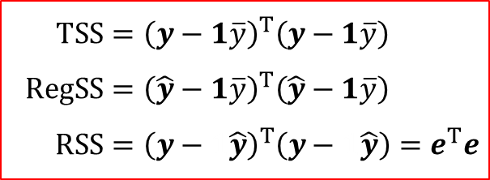

The Coefficient of Determination (R²): TSS=RSS+RegSS
$$\overline{y}=\frac{1}{n}\sum_{i=1}^{k}{\sum_{j=1}^{n_{i}}{y_{ij}}}$$
$$TSS={\left(y−1\overline{y}\right)}^{T}\left(y−1\overline{y}\right) \\ RegSS={\left(\hat{y}−1\overline{y}\right)}^{T}\left(\hat{y}−1\overline{y}\right) \\ RSS={\left(y−1\hat{y}\right)}^{T}\left(y−1\hat{y}\right)=e^{T}e$$
Let:
$${\left\{ Xβ :β∈ℝ^{k} \right\}}^{⊥}$$
(the orthogonal
complement =
= the space of
the residuals)
subspace
of dimension
$$M$$
$$y$$
$$e=\left(I−H\right)y$$
By the Pythagoras Theorem:
$$TSS=RSS+RegSS$$
$$n−k$$
$$1\overline{y}$$
$$φ$$
line
$$\left\{ 1λ :λ∈ℝ \right\}$$
$$\hat{y}=Hy$$
$$\left\{ Xβ :β∈ℝ^{k} \right\}$$
0
(the linear hull of the columns of $X$ )
subspace of dimension
$$\left\{ 1λ :λ∈ℝ \right\}$$
the line is a subspace
of dimension
the dimension of its complement within
the subspace of dimension $k$ is
$$k$$
$$1$$
$$k−1$$

Slide 34









The Coefficient of Determination (R²)
Assuming $1∈\left\{ Xβ :β∈ℝ^{k} \right\}$, define the
Coefficient of Determination:
$$R^{2}=\frac{RegSS}{TSS}=\frac{TSS−RSS}{TSS}$$
$$R^{2}=\cos^{2}{φ} = \frac{RegSS}{TSS} = 1−\frac{RSS}{TSS}$$
$${cotan}^{2}{φ}=\frac{\cos^{2}{φ}}{\sin^{2}{φ}}=\frac{R^{2}}{1−R^{2}}=\frac{RegSS}{RSS}$$
$$TSS={\left(y−1\overline{y}\right)}^{T}\left(y−1\overline{y}\right) \\ RegSS={\left(\hat{y}−1\overline{y}\right)}^{T}\left(\hat{y}−1\overline{y}\right) \\ RSS={\left(y−1\hat{y}\right)}^{T}\left(y−1\hat{y}\right)=e^{T}e$$
$$y$$
$$\sqrt{TSS }$$
$$\sqrt{RSS }$$
$$φ$$
$$1\overline{y}$$
$$\sqrt{RegSS }$$
$$\hat{y}=Hy$$

Slide 35
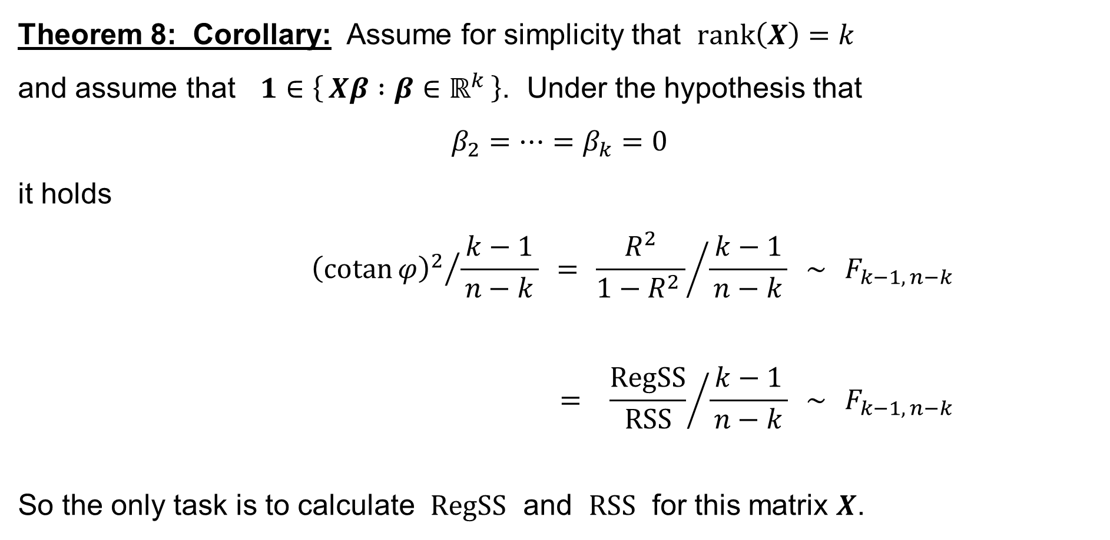
The Coefficient of Determination (R²): Th. 8: Corollary
Theorem 8: Corollary: Assume for simplicity that $rank\left(X\right)=k$
and assume that $1∈\left\{ Xβ :β∈ℝ^{k} \right\}$. Under the hypothesis that
$$β_{2}=⋯=β_{k}=0$$
it holds
$${{\left(\operatorname{cotan}{φ}\right)}^{2}}/{\frac{ k−1 }{n−k}} = {\frac{R^{2}}{1−R^{2} }}/{\frac{ k−1 }{n−k}} ∼ F_{k−1, n−k}$$
$$= {\frac{RegSS}{RSS}}/{\frac{ k−1 }{n−k}} ∼ F_{k−1, n−k}$$
So the only task is to calculate $RegSS$ and $RSS$ for this matrix $X$.

Slide 36

One-way ANOVA: Model of Multiple Linear Regression
We have
$$RegSS={\left(\hat{y}−1\overline{y}\right)}^{T}\left(\hat{y}−1\overline{y}\right)=\sum_{i=1}^{k}{\sum_{j=1}^{n_{i}}{{\left({\hat{y}}_{ij}−\overline{y}\right)}^{2}}} \text{where} \overline{y}=\frac{1}{n}\sum_{i=1}^{k}{\sum_{j=1}^{n_{i}}{y_{ij}}}$$
where
$$\hat{y}=Hy$$
where
$$H=XCX^{T}$$
where
$$C={\left(X^{T}X\right)}^{−1}$$

Slide 37

One-way ANOVA: Model of Multiple Linear Regression
Calculate:
$$X^{T}X=\left(\begin{matrix}n & n_{2} & n_{3} & n_{4} & … & n_{k} \\ n_{2} & n_{2} & & & & \\ n_{3} & & n_{3} & & & \\ n_{4} & & & n_{4} & & \\ ⋮ & & & & ⋱ & \\ n_{k} & & & & & n_{k}\end{matrix}\right)$$
where
$$n=n_{1}+n_{2}+⋯+n_{k}=\sum_{i=1}^{k}{n_{i}}$$

Slide 38
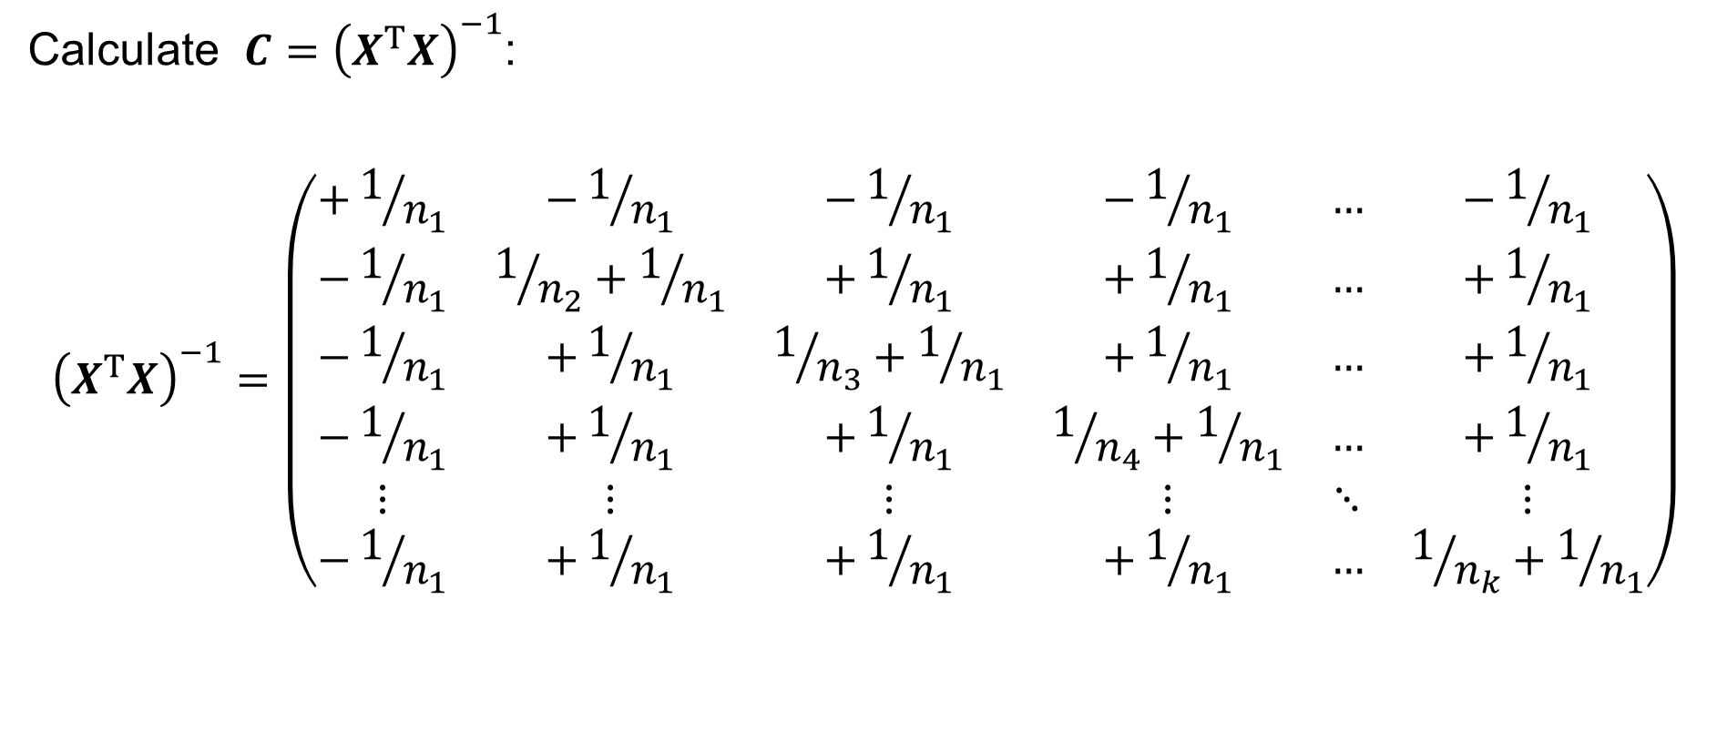
One-way ANOVA: Model of Multiple Linear Regression
Calculate $C={\left(X^{T}X\right)}^{−1}$:
$${\left(X^{T}X\right)}^{−1}=\left(\begin{matrix}+1/{n_{1}} & −1/{n_{1}} & −1/{n_{1}} & −1/{n_{1}} & … & −1/{n_{1}} \\ −1/{n_{1}} & 1/{n_{2}}+1/{n_{1}} & +1/{n_{1}} & +1/{n_{1}} & … & +1/{n_{1}} \\ −1/{n_{1}} & +1/{n_{1}} & 1/{n_{3}}+1/{n_{1}} & +1/{n_{1}} & … & +1/{n_{1}} \\ −1/{n_{1}} & +1/{n_{1}} & +1/{n_{1}} & 1/{n_{4}}+1/{n_{1}} & … & +1/{n_{1}} \\ ⋮ & ⋮ & ⋮ & ⋮ & ⋱ & ⋮ \\ −1/{n_{1}} & +1/{n_{1}} & +1/{n_{1}} & +1/{n_{1}} & … & 1/{n_{k}}+1/{n_{1}}\end{matrix}\right)$$

Slide 39





One-way ANOVA: Model of Multiple Linear Regression
Calculate $H=XCX^{T}=X{\left(X^{T}X\right)}^{−1}X^{T}$:
$$XCX^{T}=H=\left(\begin{matrix}1/{n_{1}} & … & 1/{n_{1}} & & & & & & & & & \\ ⋮ & ⋱ & ⋮ & & & & & & & & & \\ 1/{n_{1}} & … & 1/{n_{1}} & & & & & & & & & \\ & & & 1/{n_{2}} & … & 1/{n_{2}} & & & & & & \\ & & & ⋮ & ⋱ & ⋮ & & & & & & \\ & & & 1/{n_{2}} & … & 1/{n_{2}} & & & & & & \\ & & & & & & ⋱ & … & ⋱ & & & \\ & & & & & & ⋮ & ⋱ & ⋮ & & & \\ & & & & & & ⋱ & … & ⋱ & & & \\ & & & & & & & & & 1/{n_{k}} & … & 1/{n_{k}} \\ & & & & & & & & & ⋮ & ⋱ & ⋮ \\ & & & & & & & & & 1/{n_{k}} & … & 1/{n_{k}}\end{matrix}\right)\left.\begin{aligned}\left.\begin{aligned}1/{n_{1}} \\ ⋮ \\ 1/{n_{1}}\end{aligned}\right\}n_{1}\text{−}\text{times} \\ \left.\begin{aligned}1/{n_{2}} \\ ⋮ \\ 1/{n_{2}}\end{aligned}\right\}n_{2}\text{−}\text{times} \\ \left.\begin{aligned}⋱ \\ ⋮ \\ ⋱\end{aligned}\right\}…\text{−}\text{times} \\ \left.\begin{aligned}1/{n_{k}} \\ ⋮ \\ 1/{n_{k}}\end{aligned}\right\}n_{k}\text{−}\text{times}\end{aligned}\right.$$
$$\overset{n_{1}}{\overbrace{ }}$$
$$\overset{n_{2}}{\overbrace{ }}$$
$$\overset{…}{\overbrace{ }}$$
$$\overset{n_{k}}{\overbrace{ }}$$

Slide 40

One-way ANOVA: Model of Multiple Linear Regression
Calculate:
$$\hat{y}=Hy$$
That is:
$${\hat{y}}_{ij}=\frac{1}{n_{i}}\sum_{j=1}^{n_{i}}{y_{ij}} \text{for} i=1, 2,…,k$$
Denote:
$${\overline{y}}_{i}={\hat{y}}_{ij}=\frac{1}{n_{i}}\sum_{j=1}^{n_{i}}{y_{ij}} \text{for} i=1, 2,…,k$$
and call this $↗$ quantity the sample mean of the $i$-th group for $i=1,2,…,k$.

Slide 41
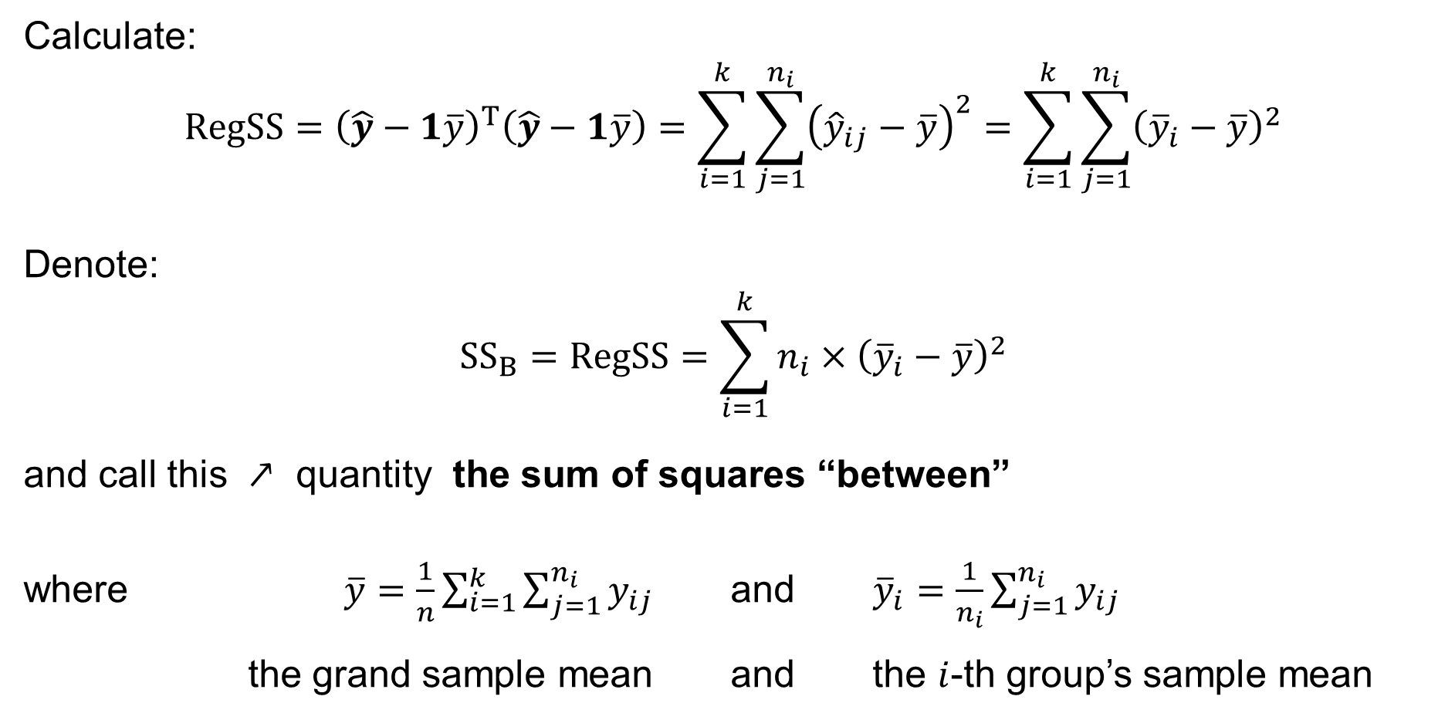
One-way ANOVA: Model of Multiple Linear Regression
Calculate:
$$RegSS={\left(\hat{y}−1\overline{y}\right)}^{T}\left(\hat{y}−1\overline{y}\right)=\sum_{i=1}^{k}{\sum_{j=1}^{n_{i}}{{\left({\hat{y}}_{ij}−\overline{y}\right)}^{2}}}=\sum_{i=1}^{k}{\sum_{j=1}^{n_{i}}{{\left({\overline{y}}_{i}−\overline{y}\right)}^{2}}}$$
Denote:
$${SS}_{B}=RegSS=\sum_{i=1}^{k}{n_{i}×{\left({\overline{y}}_{i}−\overline{y}\right)}^{2}}$$
and call this $↗$ quantity the sum of squares “between”
where $\overline{y}=\frac{1}{n}\sum_{i=1}^{k}{\sum_{j=1}^{n_{i}}{y_{ij}}}$ and ${\overline{y}}_{i}=\frac{1}{n_{i}}\sum_{j=1}^{n_{i}}{y_{ij}}$
the grand sample mean and the $i$-th group’s sample mean

Slide 42
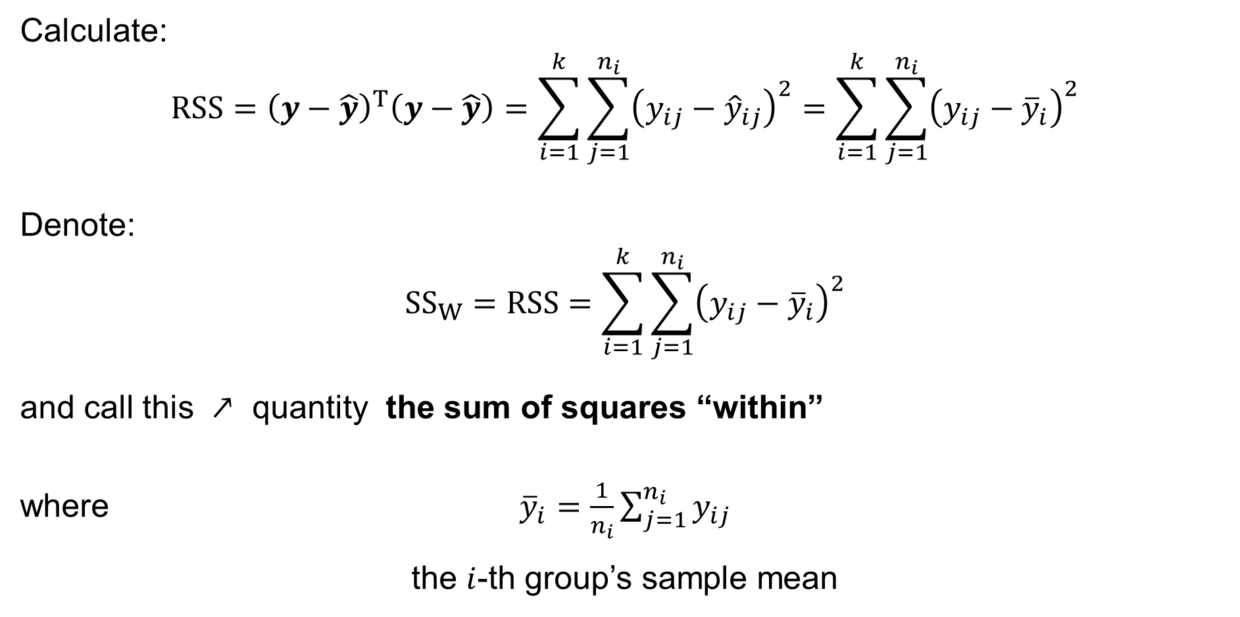
One-way ANOVA: Model of Multiple Linear Regression
Calculate:
$$RSS={\left(y−\hat{y}\right)}^{T}\left(y−\hat{y}\right)=\sum_{i=1}^{k}{\sum_{j=1}^{n_{i}}{{\left(y_{ij}−{\hat{y}}_{ij}\right)}^{2}}}=\sum_{i=1}^{k}{\sum_{j=1}^{n_{i}}{{\left(y_{ij}−{\overline{y}}_{i}\right)}^{2}}}$$
Denote:
$${SS}_{W}=RSS=\sum_{i=1}^{k}{\sum_{j=1}^{n_{i}}{{\left(y_{ij}−{\overline{y}}_{i}\right)}^{2}}}$$
and call this $↗$ quantity the sum of squares “within”
where ${\overline{y}}_{i}=\frac{1}{n_{i}}\sum_{j=1}^{n_{i}}{y_{ij}}$
the $i$-th group’s sample mean

Slide 43
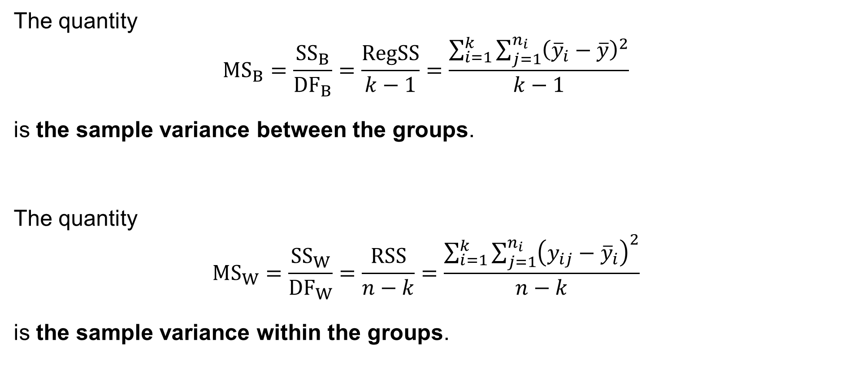
One-way ANOVA: Remarks: Sample variances
The quantity
$${MS}_{B}=\frac{{SS}_{B}}{{DF}_{B}}=\frac{RegSS}{k−1}=\frac{\sum_{i=1}^{k}{\sum_{j=1}^{n_{i}}{{\left({\overline{y}}_{i}−\overline{y}\right)}^{2}}}}{k−1}$$
is the sample variance between the groups.
The quantity
$${MS}_{W}=\frac{{SS}_{W}}{{DF}_{W}}=\frac{RSS}{n−k}=\frac{\sum_{i=1}^{k}{\sum_{j=1}^{n_{i}}{{\left(y_{ij}−{\overline{y}}_{i}\right)}^{2}}}}{n−k}$$
is the sample variance within the groups.

Slide 44
One-Way ANOVA: The F-test
The F-test

Slide 45
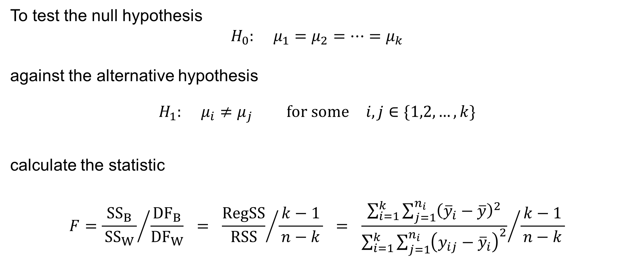
One-Way ANOVA: the F-test
To test the null hypothesis
$$H_{0}: μ_{1}=μ_{2}=⋯=μ_{k}$$
against the alternative hypothesis
$$H_{1}: μ_{i}≠μ_{j} \text{for} \text{some} i,j∈\{1,2,…,k\}$$
calculate the statistic
$$F={\frac{{SS}_{B}}{ {SS}_{W} }}/{\frac{{DF}_{B}}{{DF}_{W}}} = {\frac{RegSS}{RSS}}/{\frac{ k−1 }{n−k}} = {\frac{\sum_{i=1}^{k}{\sum_{j=1}^{n_{i}}{{\left({\overline{y}}_{i}−\overline{y}\right)}^{2}}}}{\sum_{i=1}^{k}{\sum_{j=1}^{n_{i}}{{\left(y_{ij}−{\overline{y}}_{i}\right)}^{2}}}}}/{\frac{ k−1 }{n−k}}$$

Slide 46
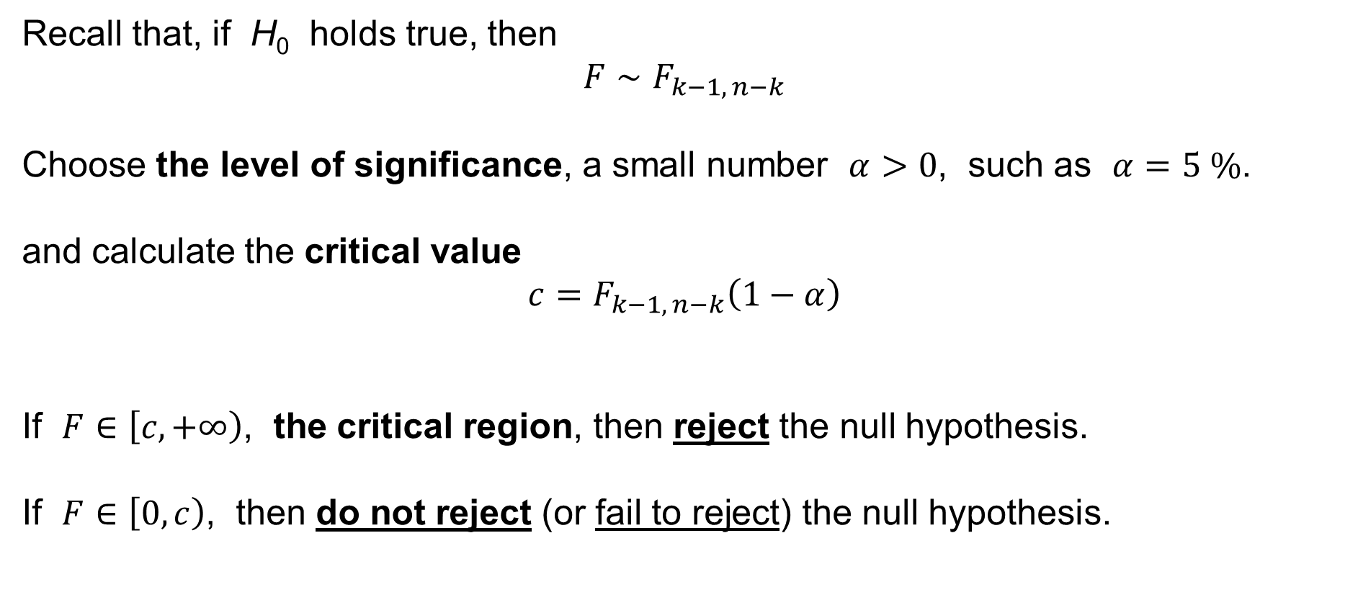
One-Way ANOVA: the F-test
Recall that, if H₀ holds true, then
$$F∼F_{k−1, n−k}$$
Choose the level of significance, a small number $α>0$, such as $α=5 \%$.
and calculate the critical value
$$c=F_{k−1, n−k}\left(1−α\right)$$
If $F∈\left[c,+∞\right)$, the critical region, then reject the null hypothesis.
If $F∈\left[0,c\right)$, then do not reject (or fail to reject) the null hypothesis.

