Slide 1
Statistical Methods for Economists
Lecture (7 & 8)c
Three-Way Analysis of Variance
(ANOVA)
— Latin Squares
David Bartl
Statistical Methods for Economists
INM/BASTE

Slide 2
Three-way ANOVA: Introduction
Latin squares
Three-way ANOVA simplified by using Latin squares

Slide 3
Three-factor ANOVA: Motivation: Example
We have:
a set of distinct cars
a set of distinct drivers
several types of car-fuel (e.g. fuel with various additives)
We wish to test whether the mileage (the fuel consumption per 100 km) of the car depends also upon the driver who drives the car and on the type of the fuel.

Slide 4
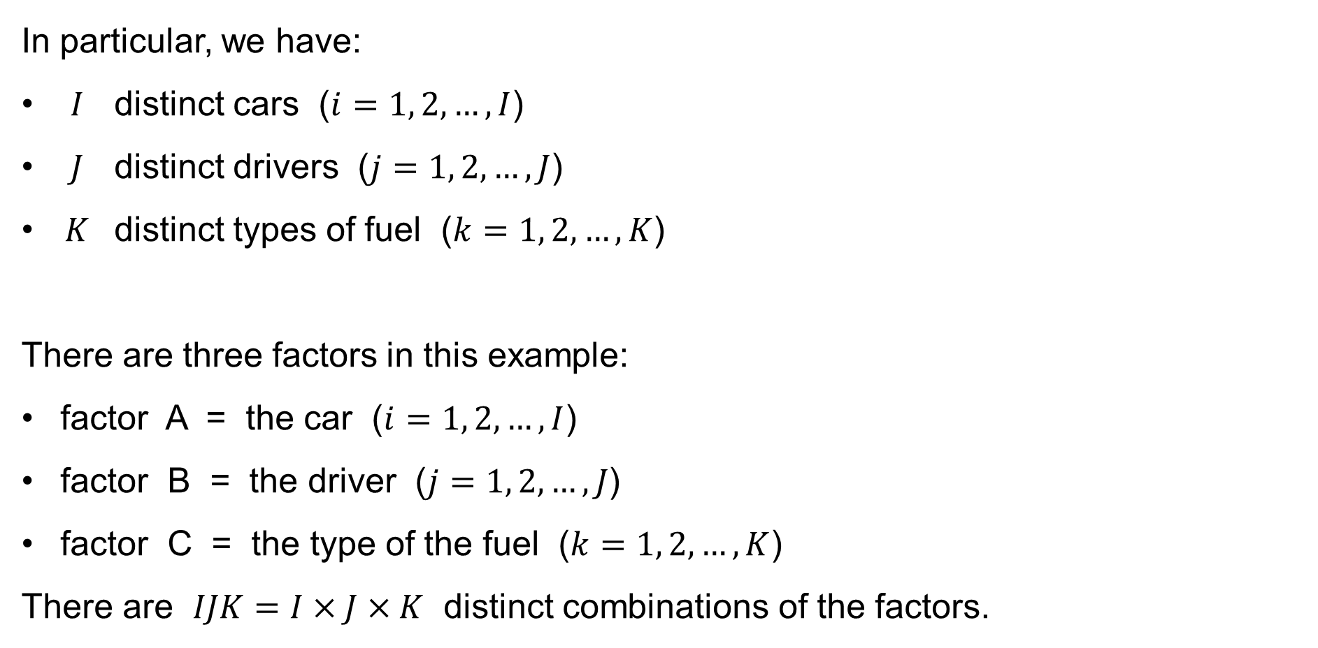
Three-factor ANOVA: Motivation: Example
In particular, we have:
$I$ distinct cars ($i=1, 2,…,I$)
$J$ distinct drivers ($j=1, 2,…,J$)
$K$ distinct types of fuel ($k=1, 2,…,K$)
There are three factors in this example:
factor A = the car ($i=1, 2,…,I$)
factor B = the driver ($j=1, 2,…,J$)
factor C = the type of the fuel ($k=1, 2,…,K$)
There are $IJK=I×J×K$ distinct combinations of the factors.

Slide 5

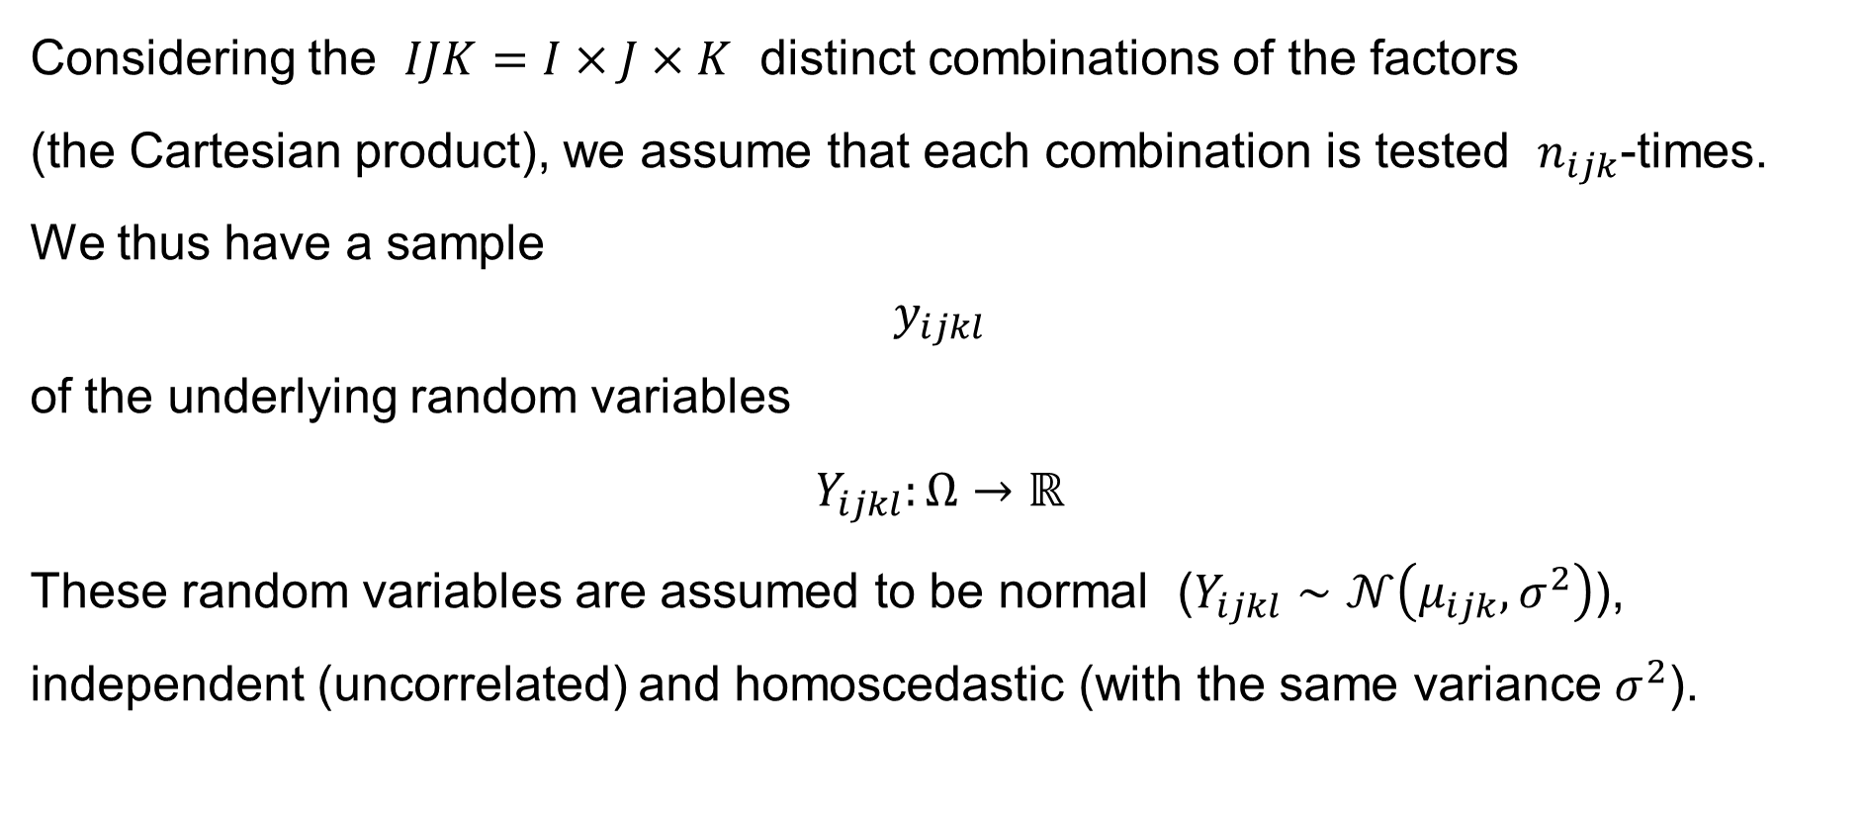

Three-factor ANOVA: Motivation & Introduction
Considering the $IJK=I×J×K$ distinct combinations of the factors
(the Cartesian product), we assume that each combination is tested $n_{ijk}$-times.
We thus have a sample
$$y_{ijkl}$$
of the underlying random variables
$$Y_{ijkl}:Ω→ℝ$$
These random variables are assumed to be normal ($Y_{ijkl}∼𝒩\left(μ_{ijk},σ^{2}\right)$), independent (uncorrelated) and homoscedastic (with the same variance $σ^{2}$).
$$i=1, 2,…,I \\ j=1, 2,…,J \\ k=1, 2,…,K \\ l=1, 2,…,n_{ijk}$$
$$\text{for}$$

Slide 6
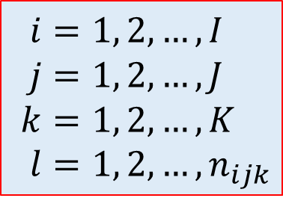
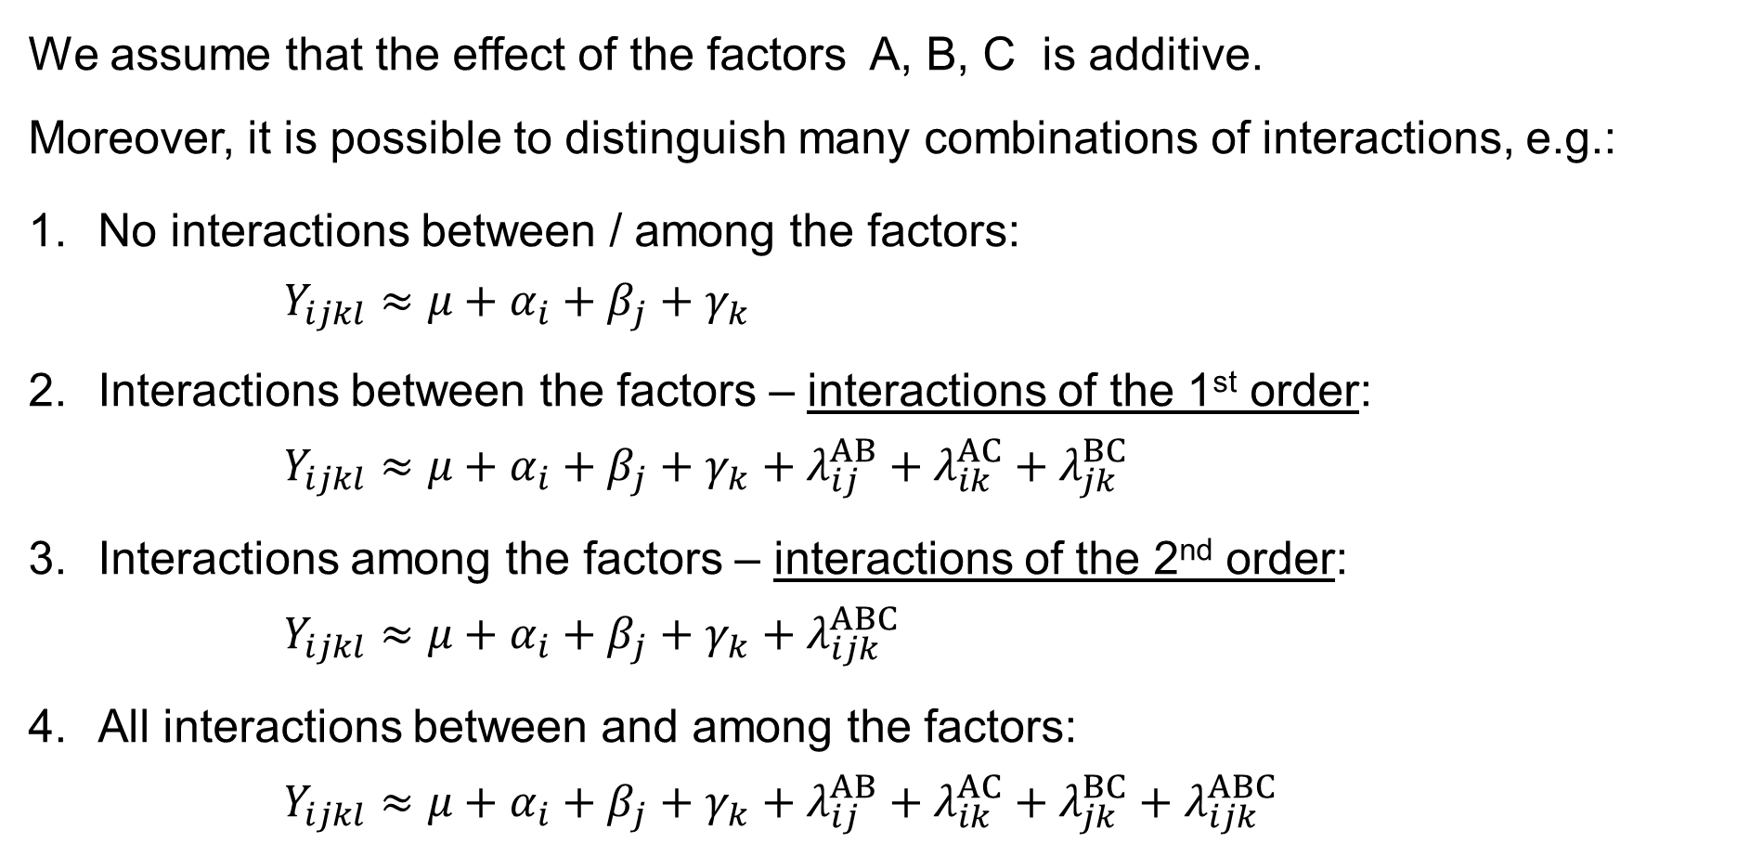
Three-factor ANOVA: Introduction: Assumptions
We assume that the effect of the factors A, B, C is additive.
Moreover, it is possible to distinguish many combinations of interactions, e.g.:
No interactions between / among the factors:
$Y_{ijkl}≈μ+α_{i}+β_{j}+γ_{k}$
Interactions between the factors – interactions of the 1st order:
$Y_{ijkl}≈μ+α_{i}+β_{j}+γ_{k}+λ_{ij}^{AB}+λ_{ik}^{AC}+λ_{jk}^{BC}$
Interactions among the factors – interactions of the 2nd order:
$Y_{ijkl}≈μ+α_{i}+β_{j}+γ_{k}+λ_{ijk}^{ABC}$
All interactions between and among the factors:
$Y_{ijkl}≈μ+α_{i}+β_{j}+γ_{k}+λ_{ij}^{AB}+λ_{ik}^{AC}+λ_{jk}^{BC}+λ_{ijk}^{ABC}$
$$i=1, 2,…,I \\ j=1, 2,…,J \\ k=1, 2,…,K \\ l=1, 2,…,n_{ijk}$$

Slide 7

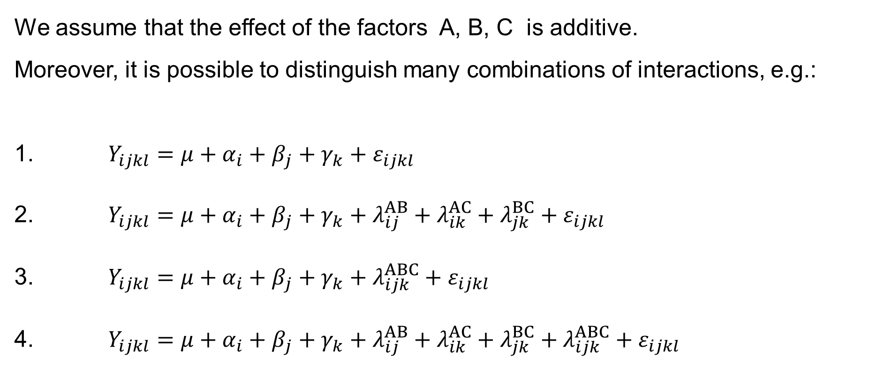
Three-factor ANOVA: Introduction: Assumptions
We assume that the effect of the factors A, B, C is additive.
Moreover, it is possible to distinguish many combinations of interactions, e.g.:
$Y_{ijkl}=μ+α_{i}+β_{j}+γ_{k}+ε_{ijkl}$
$Y_{ijkl}=μ+α_{i}+β_{j}+γ_{k}+λ_{ij}^{AB}+λ_{ik}^{AC}+λ_{jk}^{BC}+ε_{ijkl}$
$Y_{ijkl}=μ+α_{i}+β_{j}+γ_{k}+λ_{ijk}^{ABC}+ε_{ijkl}$
$Y_{ijkl}=μ+α_{i}+β_{j}+γ_{k}+λ_{ij}^{AB}+λ_{ik}^{AC}+λ_{jk}^{BC}+λ_{ijk}^{ABC}+ε_{ijkl}$
$$ε_{ijkl}∼𝒩\left(0,σ^{2}\right) \\ i=1, 2,…,I \\ j=1, 2,…,J \\ k=1, 2,…,K \\ l=1, 2,…,n_{ijk}$$

Slide 8
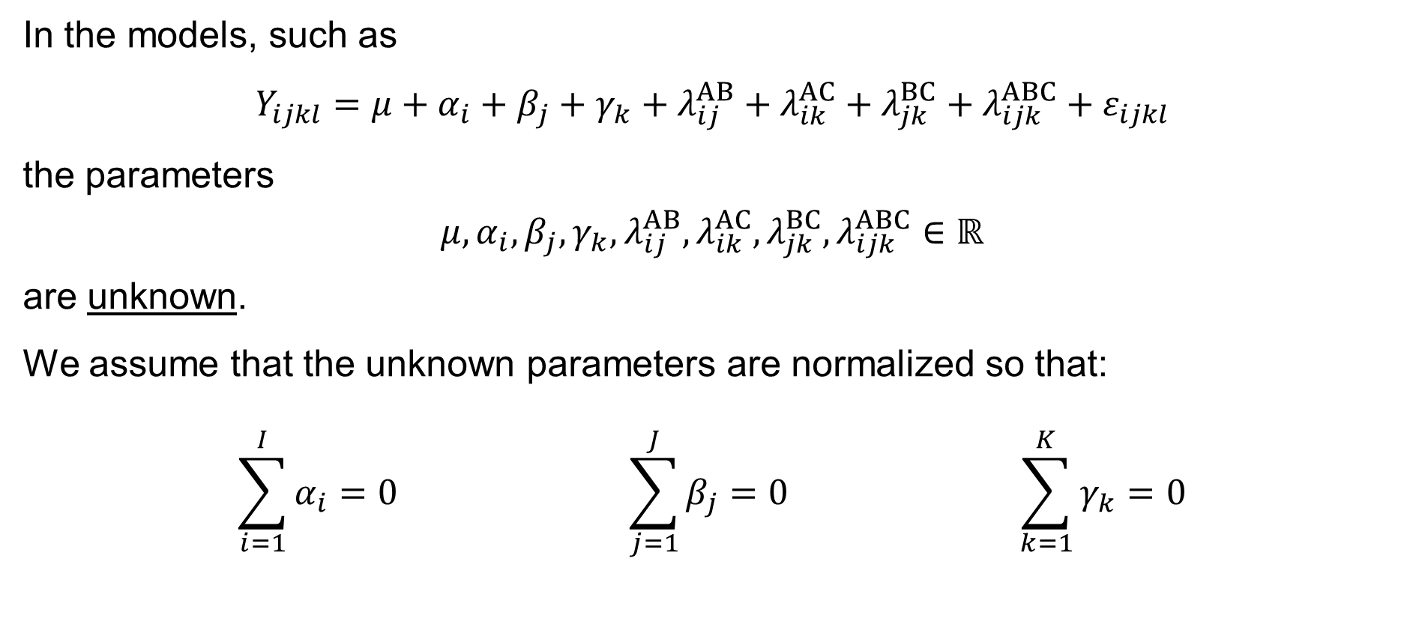
Three-factor ANOVA: Introduction: Assumptions
In the models, such as
$$Y_{ijkl}=μ+α_{i}+β_{j}+γ_{k}+λ_{ij}^{AB}+λ_{ik}^{AC}+λ_{jk}^{BC}+λ_{ijk}^{ABC}+ε_{ijkl}$$
the parameters
$$μ,α_{i},β_{j},γ_{k},λ_{ij}^{AB},λ_{ik}^{AC},λ_{jk}^{BC},λ_{ijk}^{ABC}∈ℝ$$
are unknown.
We assume that the unknown parameters are normalized so that:
$$\sum_{i=1}^{I}{α_{i}}=0 \sum_{j=1}^{J}{β_{j}}=0 \sum_{k=1}^{K}{γ_{k}}=0$$

Slide 9
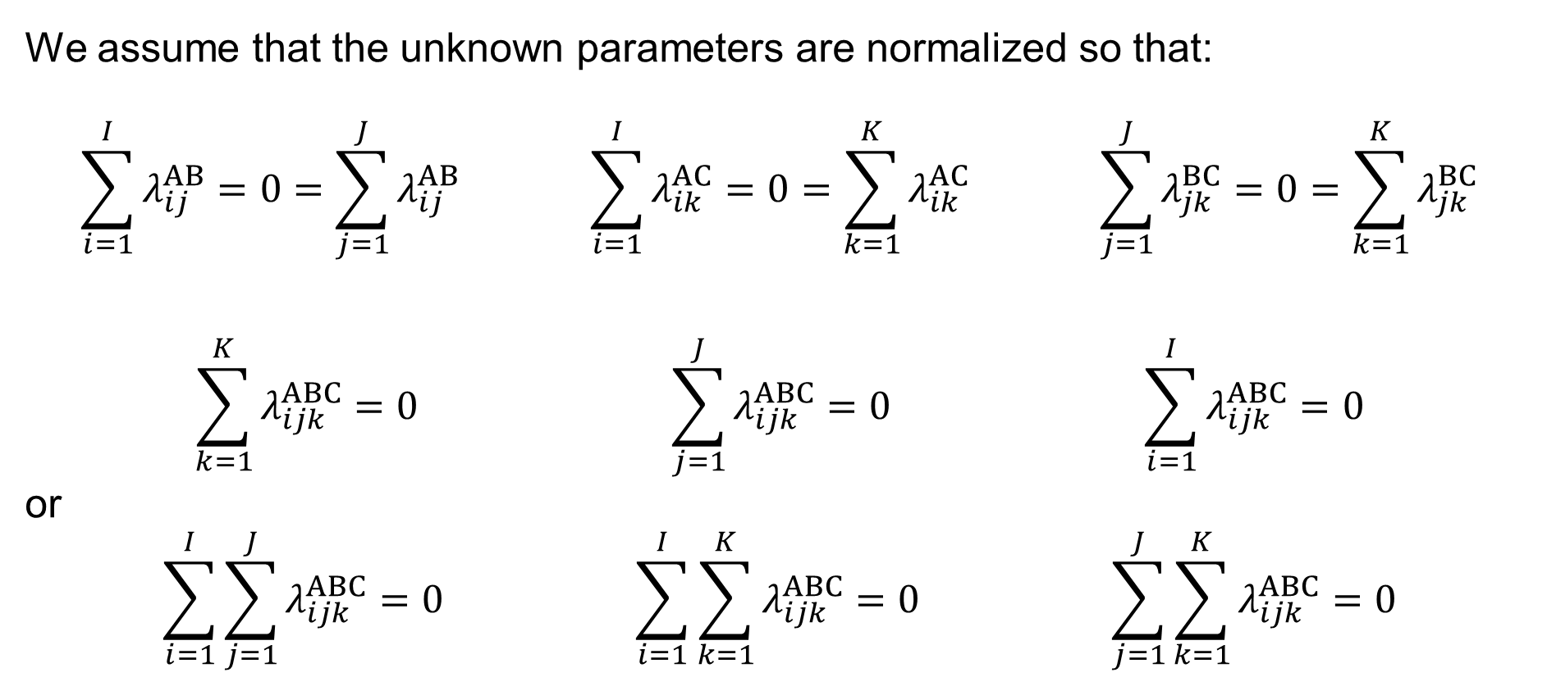
Three-factor ANOVA: Introduction: Assumptions
We assume that the unknown parameters are normalized so that:
$$\sum_{i=1}^{I}{λ_{ij}^{AB}}=0=\sum_{j=1}^{J}{λ_{ij}^{AB}} \sum_{i=1}^{I}{λ_{ik}^{AC}}=0=\sum_{k=1}^{K}{λ_{ik}^{AC}} \sum_{j=1}^{J}{λ_{jk}^{BC}}=0=\sum_{k=1}^{K}{λ_{jk}^{BC}}$$
$$\sum_{k=1}^{K}{λ_{ijk}^{ABC}}=0 \sum_{j=1}^{J}{λ_{ijk}^{ABC}}=0 \sum_{i=1}^{I}{λ_{ijk}^{ABC}}=0$$
or
$$\sum_{i=1}^{I}{\sum_{j=1}^{J}{λ_{ijk}^{ABC}}}=0 \sum_{i=1}^{I}{\sum_{k=1}^{K}{λ_{ijk}^{ABC}}}=0 \sum_{j=1}^{J}{\sum_{k=1}^{K}{λ_{ijk}^{ABC}}}=0$$
and

Slide 10
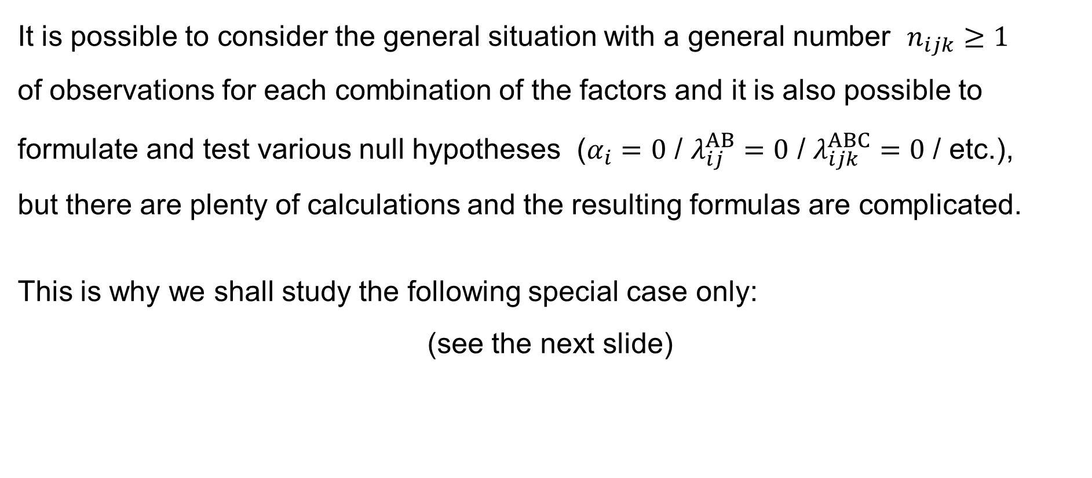
Three-factor ANOVA: Simplification
It is possible to consider the general situation with a general number $n_{ijk}≥1$
of observations for each combination of the factors and it is also possible to formulate and test various null hypotheses ($α_{i}=0$ / $λ_{ij}^{AB}=0$ / $λ_{ijk}^{ABC}=0$ / etc.),
but there are plenty of calculations and the resulting formulas are complicated.
This is why we shall study the following special case only:
(see the next slide)

Slide 11
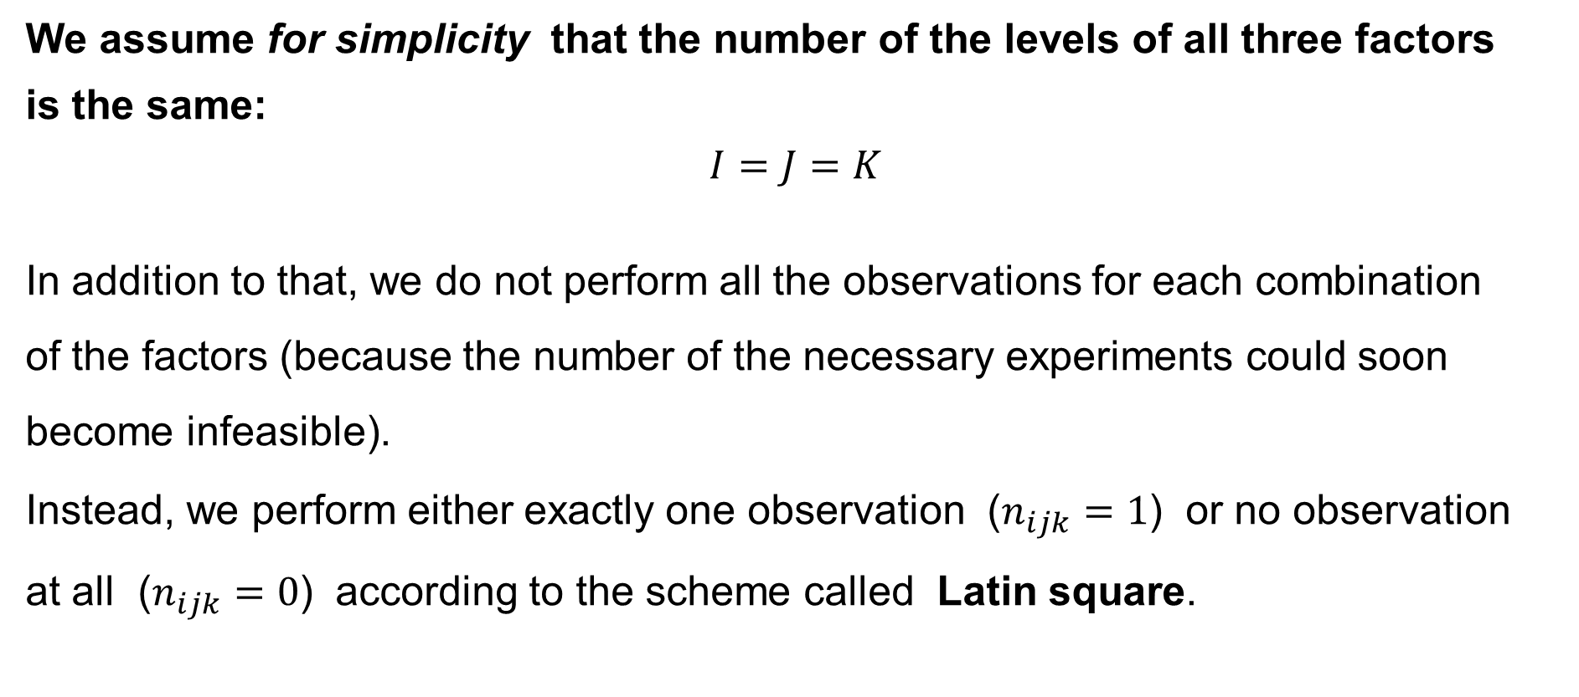
Three-factor ANOVA: Simplification
We assume for simplicity that the number of the levels of all three factors
is the same:
$$I=J=K$$
In addition to that, we do not perform all the observations for each combination
of the factors (because the number of the necessary experiments could soon become infeasible).
Instead, we perform either exactly one observation ($n_{ijk}=1$) or no observation
at all ($n_{ijk}=0$) according to the scheme called Latin square.

Slide 12
Latin squares in
Three-way ANOVA

Slide 13
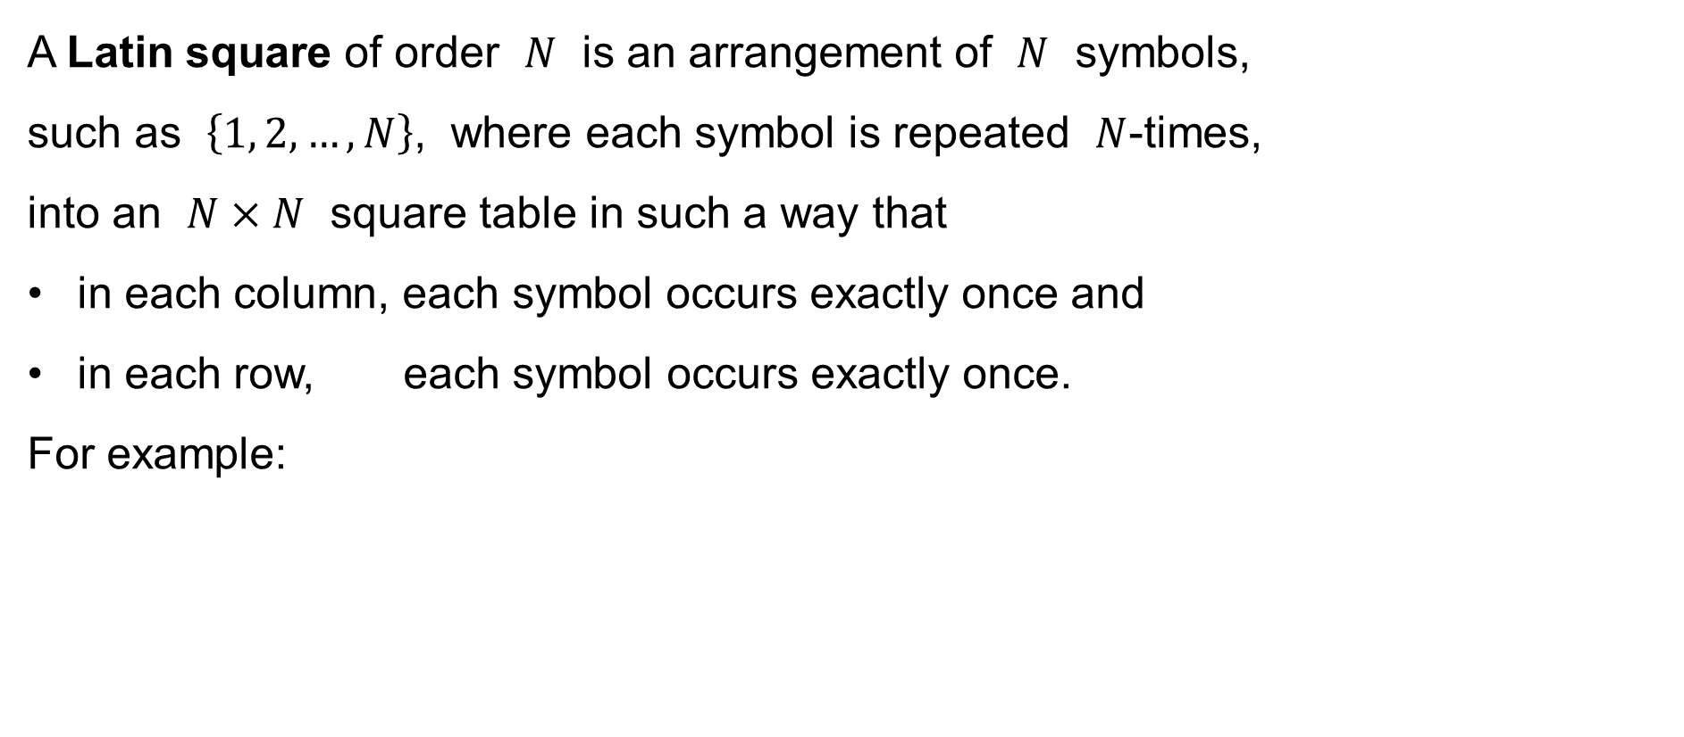
Latin square
A Latin square of order $N$ is an arrangement of $N$ symbols,
such as $\left\{1, 2,…,N\right\}$, where each symbol is repeated $N$-times,
into an $N×N$ square table in such a way that
in each column, each symbol occurs exactly once and
in each row, each symbol occurs exactly once.
For example:
1 | 2 | 3 | 4 | 5
2 | 3 | 4 | 5 | 1
3 | 4 | 5 | 1 | 2
4 | 5 | 1 | 2 | 3
5 | 1 | 2 | 3 | 4
1 | 2 | 3 | 4
2 | 3 | 4 | 1
3 | 4 | 1 | 2
4 | 1 | 2 | 3
1 | 2 | 3 | 4
3 | 4 | 1 | 2
4 | 3 | 2 | 1
2 | 1 | 4 | 3
1 | 2 | 3
2 | 3 | 1
3 | 1 | 2
1 | 2 | 3
3 | 1 | 2
2 | 3 | 1

Slide 14
Latin square: Remark
The name “Latin square” is inspired by the work of Leonhard Euler (1707–1783), a Swiss mathematician, physicist, astronomer, geographer, logician, and engineer who used the upper-case letters of the Latin alphabet as the symbols in the square:
A | B | C | D | E
B | C | D | E | A
C | D | E | A | B
D | E | A | B | C
E | A | B | C | D
A | B | C | D
B | C | D | A
C | D | A | B
D | A | B | C
A | B | C | D
C | D | A | B
D | C | B | A
B | A | D | C
A | B | C
B | C | A
C | A | B
A | B | C
C | A | B
B | C | A

Slide 15
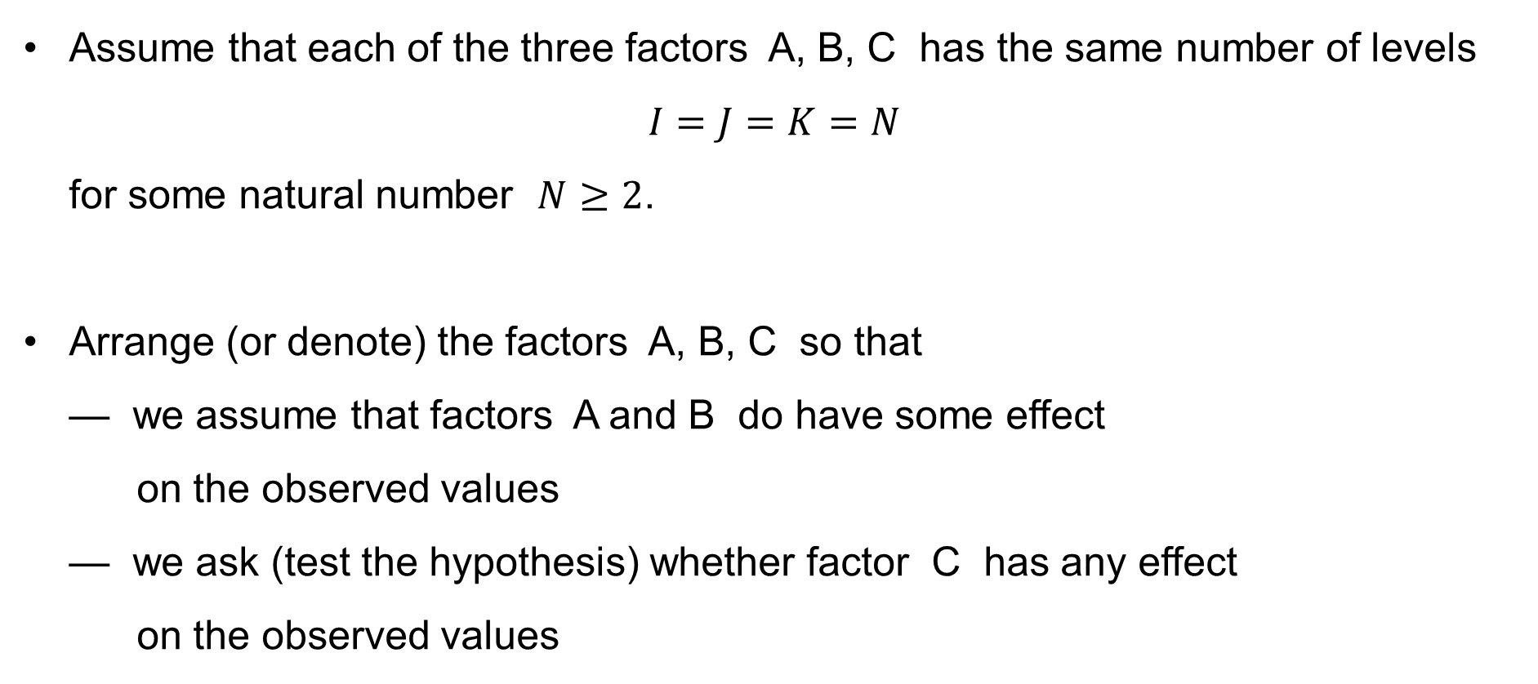
Three-factor ANOVA: Simplification by using Latin sq.
Assume that each of the three factors A, B, C has the same number of levels
$I=J=K=N$
for some natural number $N≥2$.
Arrange (or denote) the factors A, B, C so that
— we assume that factors A and B do have some effect
on the observed values
— we ask (test the hypothesis) whether factor C has any effect
on the observed values

Slide 16
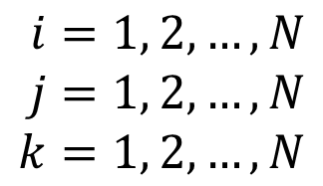
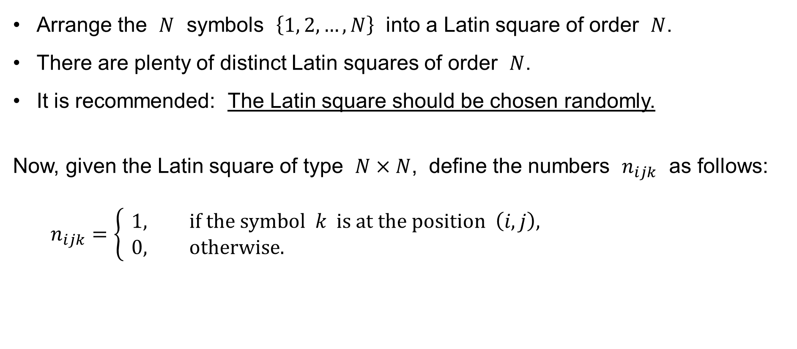

Three-factor ANOVA: Simplification by using Latin sq.
Arrange the $N$ symbols $\left\{1, 2,…,N\right\}$ into a Latin square of order $N$.
There are plenty of distinct Latin squares of order $N$.
It is recommended: The Latin square should be chosen randomly.
Now, given the Latin square of type $N×N$, define the numbers $n_{ijk}$ as follows:
$$n_{ijk}=\left\{ \begin{aligned}&1, \text{if} \text{the} \text{symbol} k \text{is} \text{at} \text{the} \text{position} \left(i,j\right)\text{,} \\ &0, \text{otherwise}\text{.}\end{aligned}\right.$$
$$i=1, 2,…,N \\ j=1, 2,…,N \\ k=1, 2,…,N$$
$$\text{for}$$

Slide 17
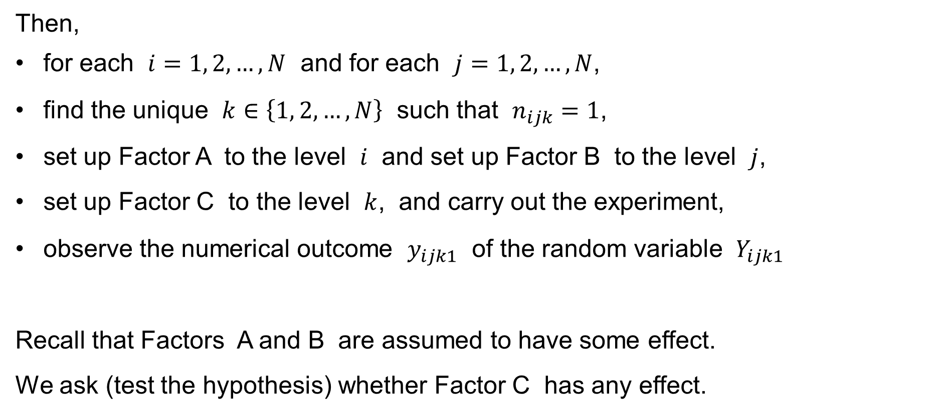
Three-factor ANOVA: Simplification by using Latin sq.
Then,
for each $i=1, 2,…,N$ and for each $j=1, 2,…,N$,
find the unique $k∈\left\{1, 2,…,N\right\}$ such that $n_{ijk}=1$,
set up Factor A to the level $i$ and set up Factor B to the level $j$,
set up Factor C to the level $k$, and carry out the experiment,
observe the numerical outcome $y_{ijk1}$ of the random variable $Y_{ijk1}$
Recall that Factors A and B are assumed to have some effect.
We ask (test the hypothesis) whether Factor C has any effect.

Slide 18
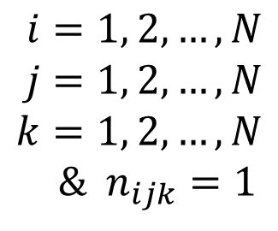
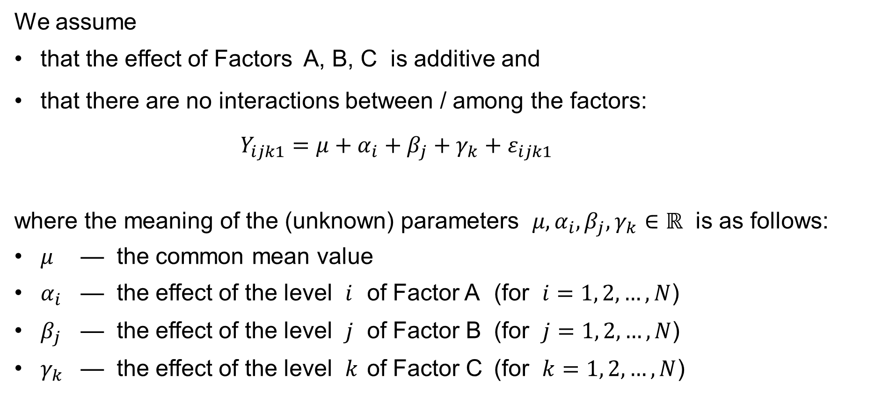

Three-factor ANOVA: Further assumptions
We assume
that the effect of Factors A, B, C is additive and
that there are no interactions between / among the factors:
$$Y_{ijk1}=μ+α_{i}+β_{j}+γ_{k}+ε_{ijk1}$$
where the meaning of the (unknown) parameters $μ,α_{i},β_{j},γ_{k}∈ℝ$ is as follows:
$μ$ — the common mean value
$α_{i}$ — the effect of the level $i$ of Factor A (for $i=1, 2,…,N$)
$β_{j}$ — the effect of the level $j$ of Factor B (for $j=1, 2,…,N$)
$γ_{k}$ — the effect of the level $k$ of Factor C (for $k=1, 2,…,N$)
$$i=1, 2,…,N \\ j=1, 2,…,N \\ k=1, 2,…,N$$
& $n_{ijk}=1$
$$\text{for}$$

Slide 19
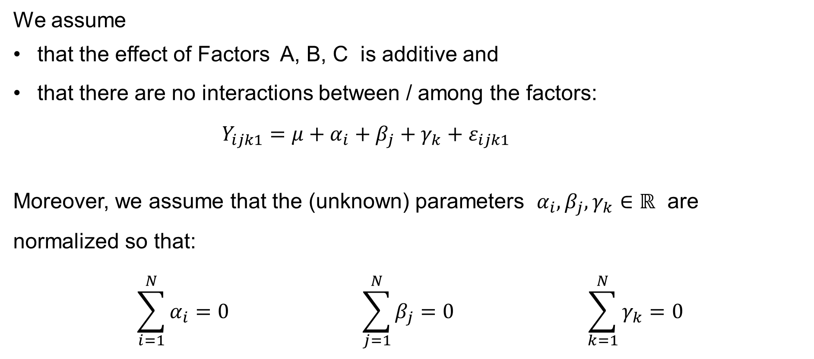
Three-factor ANOVA: Further assumptions
We assume
that the effect of Factors A, B, C is additive and
that there are no interactions between / among the factors:
$$Y_{ijk1}=μ+α_{i}+β_{j}+γ_{k}+ε_{ijk1}$$
Moreover, we assume that the (unknown) parameters $α_{i},β_{j},γ_{k}∈ℝ$ are normalized so that:
$$\sum_{i=1}^{N}{α_{i}}=0 \sum_{j=1}^{N}{β_{j}}=0 \sum_{k=1}^{N}{γ_{k}}=0$$
$$i=1, 2,…,N \\ j=1, 2,…,N \\ k=1, 2,…,N$$
& $n_{ijk}=1$
$$\text{for}$$

Slide 20
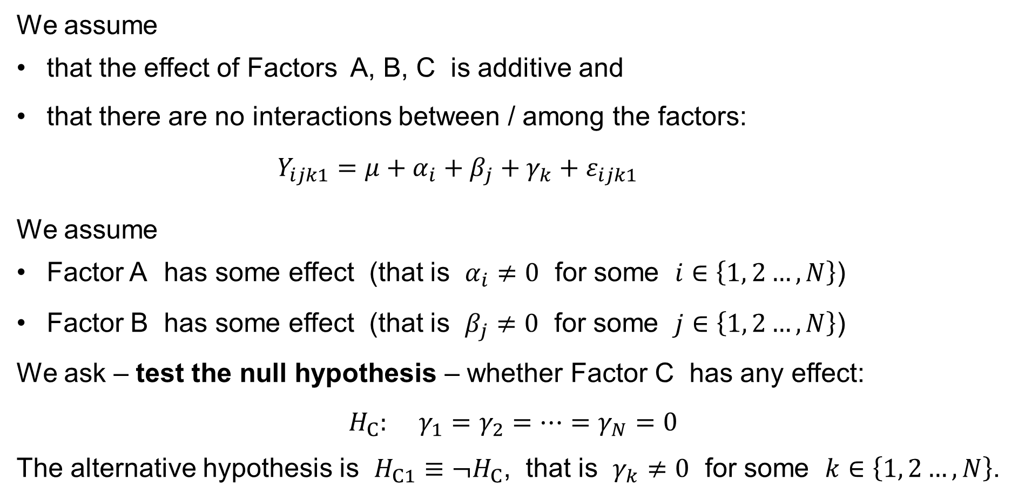
Three-factor ANOVA: Further assumptions
We assume
that the effect of Factors A, B, C is additive and
that there are no interactions between / among the factors:
$$Y_{ijk1}=μ+α_{i}+β_{j}+γ_{k}+ε_{ijk1}$$
We assume
Factor A has some effect (that is $α_{i}≠0$ for some $i∈\left\{1, 2…,N\right\}$)
Factor B has some effect (that is $β_{j}≠0$ for some $j∈\left\{1, 2…,N\right\}$)
We ask – test the null hypothesis – whether Factor C has any effect:
$$H_{C}: γ_{1}=γ_{2}=⋯=γ_{N}=0$$
The alternative hypothesis is $H_{C1}≡¬H_{C}$, that is $γ_{k}≠0$ for some $k∈\left\{1, 2…,N\right\}$.
$$i=1, 2,…,N \\ j=1, 2,…,N \\ k=1, 2,…,N$$
& $n_{ijk}=1$
$$\text{for}$$

Slide 21
Three-Way ANOVA without interactions and simplified by using
Latin squares
Y_{ijk1}=μ+α_{i}+β_{j}+γ_{k}+
+ε_{ijk1}

Slide 22

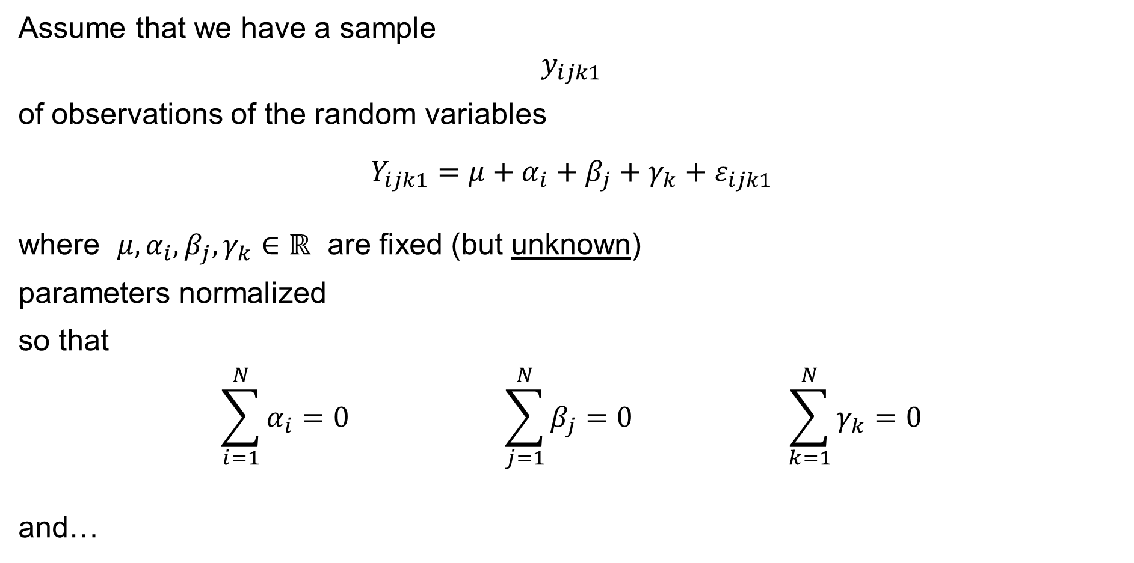
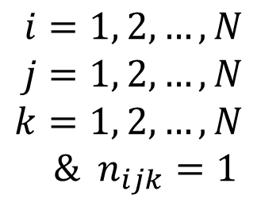
Three-way ANOVA with no interactions
Assume that we have a sample
$$y_{ijk1}$$
of observations of the random variables
$$Y_{ijk1}=μ+α_{i}+β_{j}+γ_{k}+ε_{ijk1}$$
where $μ,α_{i},β_{j},γ_{k}∈ℝ$ are fixed (but unknown)
parameters normalized
so that
$$\sum_{i=1}^{N}{α_{i}}=0 \sum_{j=1}^{N}{β_{j}}=0 \sum_{k=1}^{N}{γ_{k}}=0$$
and…
$$i=1, 2,…,N \\ j=1, 2,…,N \\ k=1, 2,…,N$$
& $n_{ijk}=1$
$$\text{for}$$

Slide 23
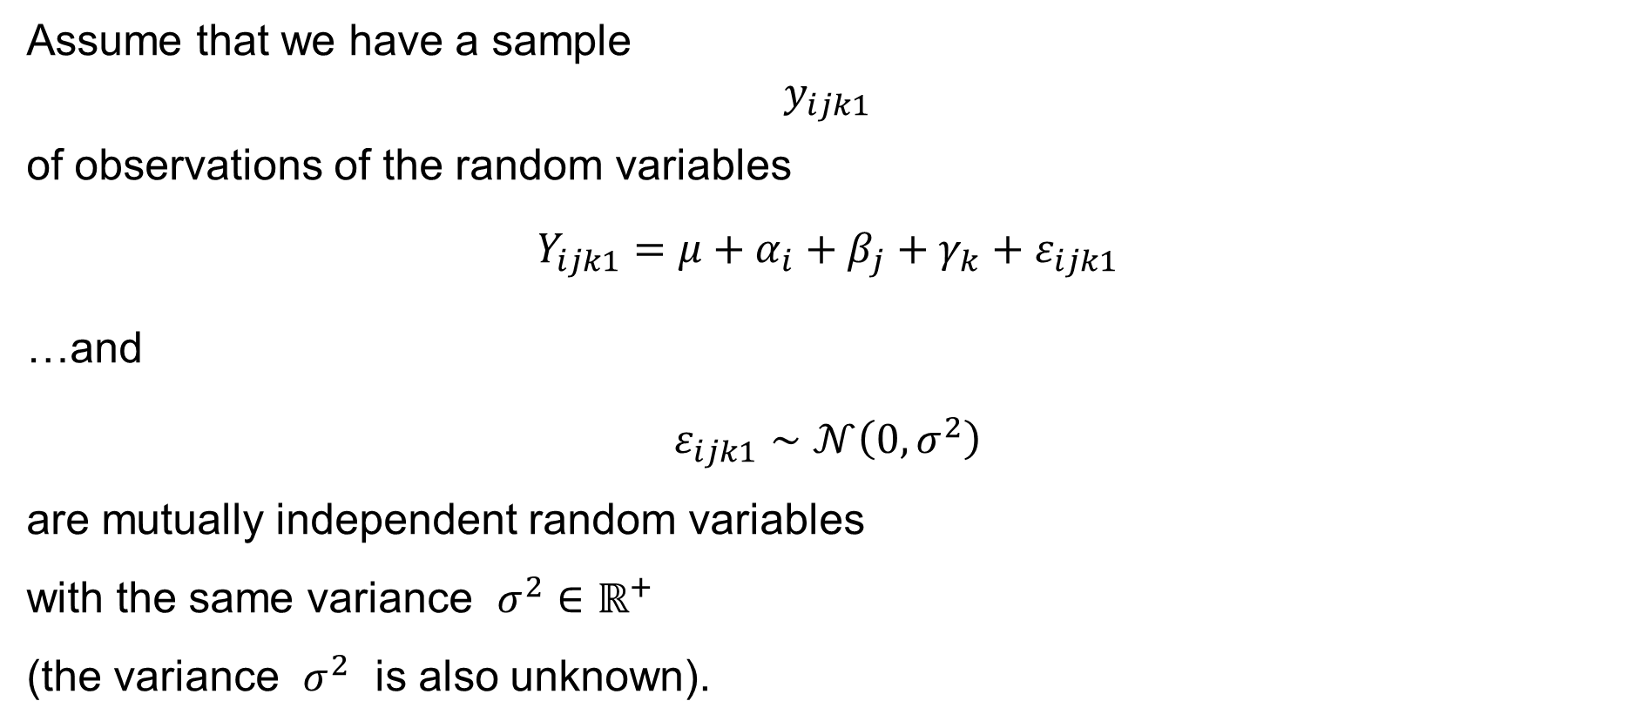
Three-way ANOVA with no interactions
Assume that we have a sample
$$y_{ijk1}$$
of observations of the random variables
$$Y_{ijk1}=μ+α_{i}+β_{j}+γ_{k}+ε_{ijk1}$$
…and
$$ε_{ijk1}∼𝒩\left(0,σ^{2}\right)$$
are mutually independent random variables
with the same variance $σ^{2}∈ℝ^{+}$
(the variance $σ^{2}$ is also unknown).
$$i=1, 2,…,N \\ j=1, 2,…,N \\ k=1, 2,…,N$$
& $n_{ijk}=1$
$$\text{for}$$

Slide 24
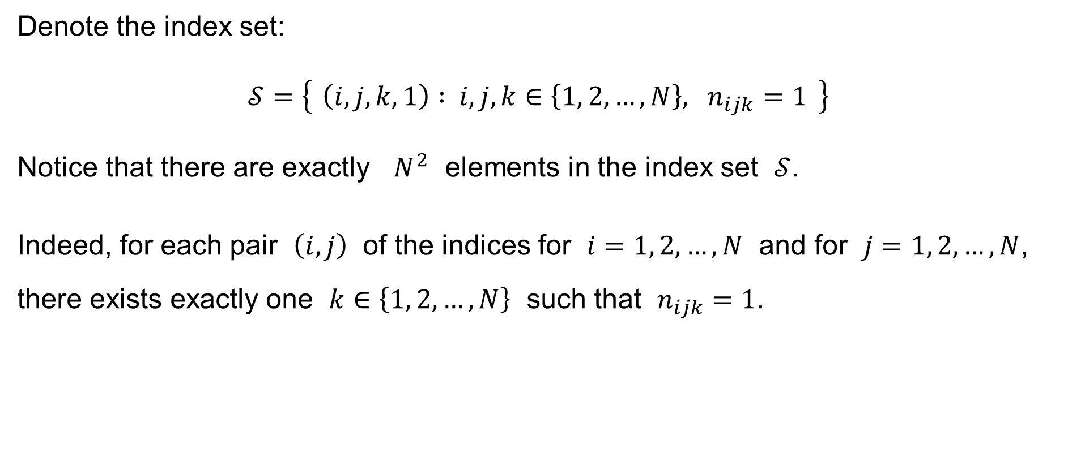
Three-way ANOVA with no interactions: Notation
Denote the index set:
$$𝒮=\left\{ \left(i,j,k,1\right) : i,j,k∈\left\{1, 2,…,N\right\}, n_{ijk}=1 \right\}$$
Notice that there are exactly $N^{2}$ elements in the index set $𝒮$.
Indeed, for each pair $\left(i,j\right)$ of the indices for $i=1, 2,…,N$ and for $j=1, 2,…,N$, there exists exactly one $k∈\left\{1, 2,…,N\right\}$ such that $n_{ijk}=1$.

Slide 25
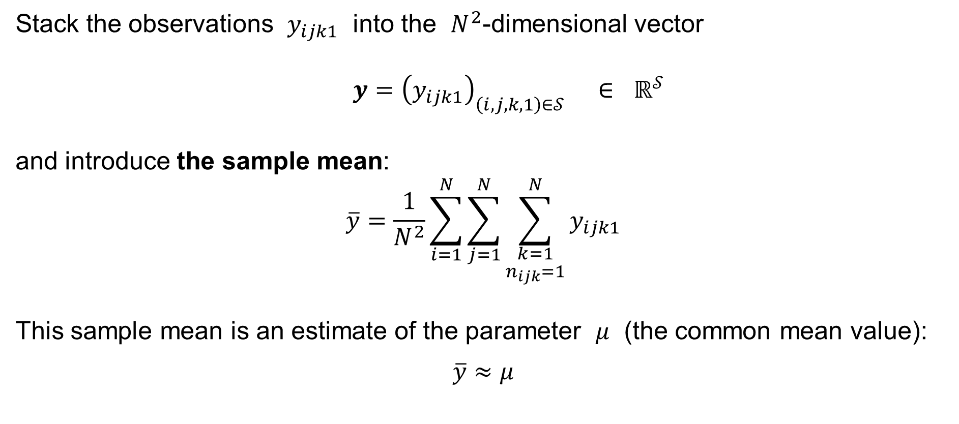
Three-way ANOVA with no interactions: Notation
Stack the observations $y_{ijk1}$ into the $N^{2}$-dimensional vector
$$y={\left(y_{ijk1}\right)}_{\left(i,j,k,1\right)∈𝒮} ∈ ℝ^{𝒮}$$
and introduce the sample mean:
$$\overline{y}=\frac{1}{N^{2}}\sum_{i=1}^{N}{\sum_{j=1}^{N}{\sum_{\begin{aligned}k=1 \\ n_{ijk}=1\end{aligned}}^{N}{y_{ijk1}}}}$$
This sample mean is an estimate of the parameter $μ$ (the common mean value):
$$\overline{y}≈μ$$

Slide 26

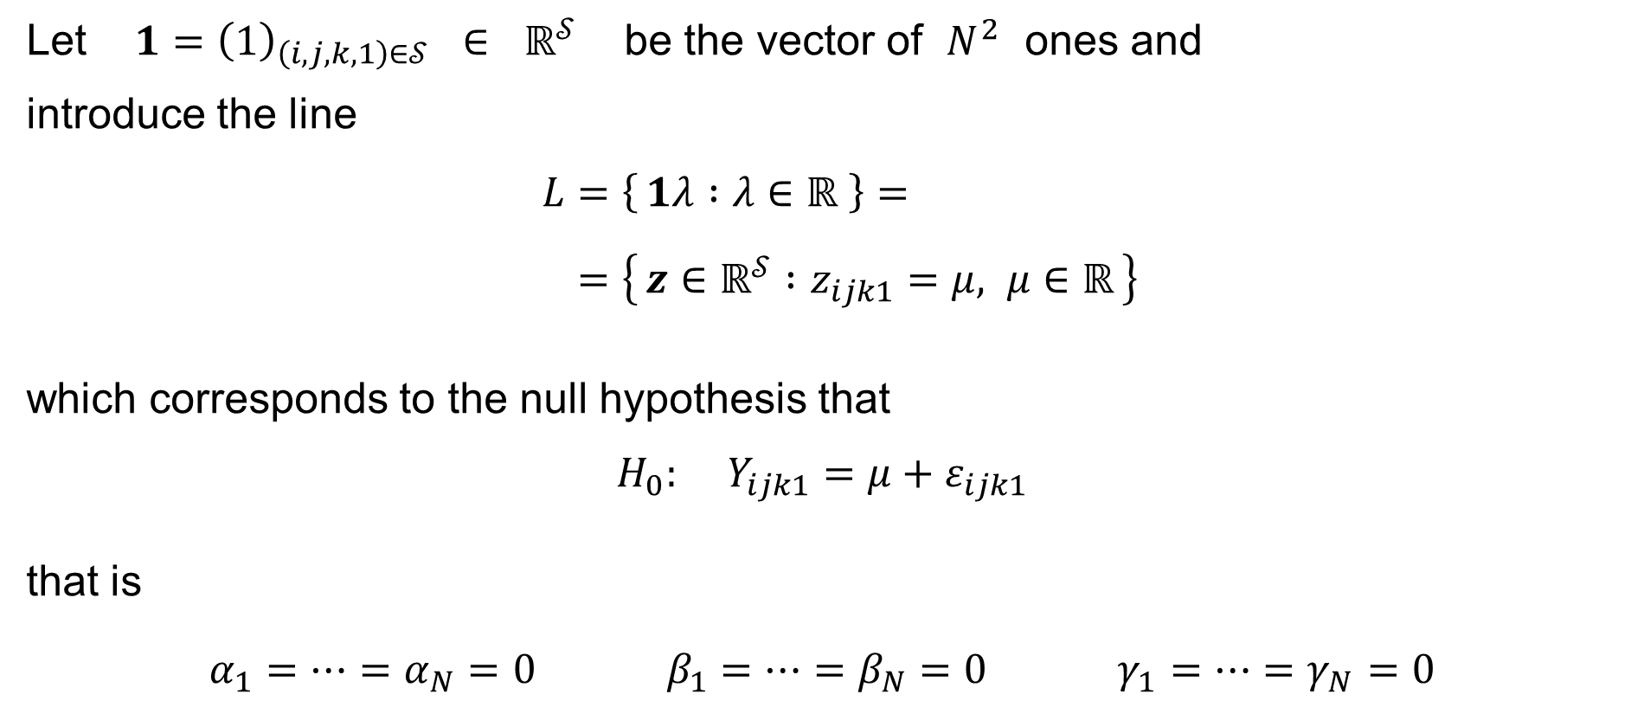
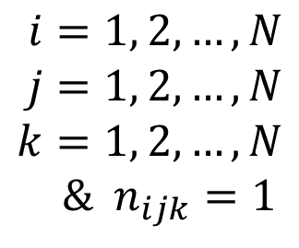
Three-way ANOVA with no interactions: Notation
Let $1={\left(1\right)}_{\left(i,j,k,1\right)∈𝒮} ∈ ℝ^{𝒮}$ be the vector of $N^{2}$ ones and
introduce the line
$$L=\left\{ 1λ :λ∈ℝ \right\}= \\ =\left\{ z∈ℝ^{𝒮} :z_{ijk1}=μ, μ∈ℝ \right\}$$
which corresponds to the null hypothesis that
$$H_{0}: Y_{ijk1}=μ+ε_{ijk1}$$
that is
$$α_{1}=⋯=α_{N}=0 β_{1}=⋯=β_{N}=0 γ_{1}=⋯=γ_{N}=0$$
$$i=1, 2,…,N \\ j=1, 2,…,N \\ k=1, 2,…,N$$
& $n_{ijk}=1$
$$\text{for}$$
(cf. one-way ANOVA)

Slide 27

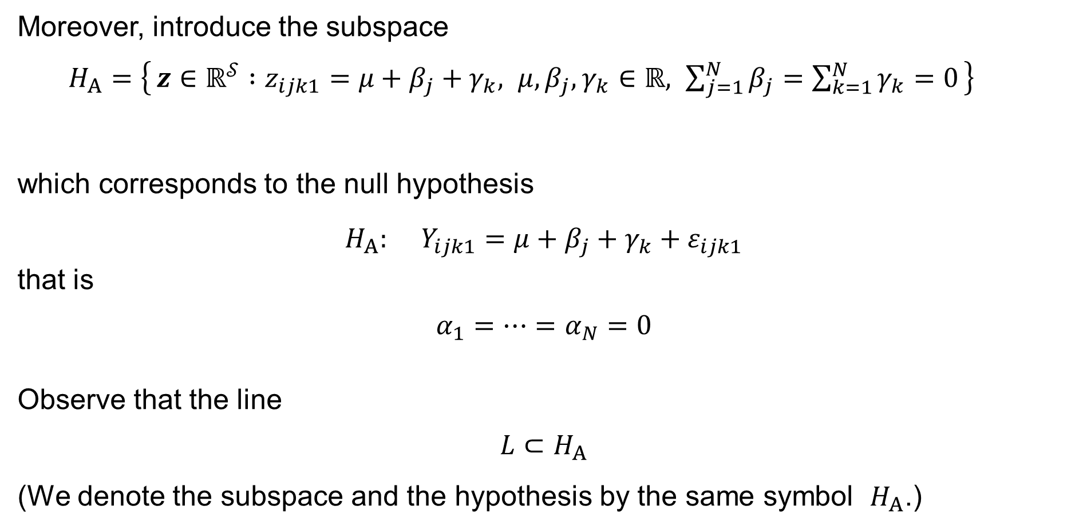
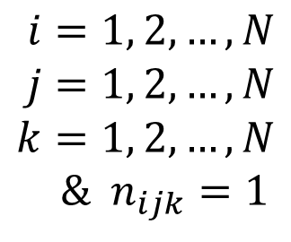
Three-way ANOVA with no interactions: Notation
Moreover, introduce the subspace
$H_{A}=\left\{ z∈ℝ^{𝒮} :z_{ijk1}=μ+β_{j}+γ_{k}, μ,β_{j},γ_{k}∈ℝ, \sum_{j=1}^{N}{β_{j}}=\sum_{k=1}^{N}{γ_{k}}=0 \right\}$
which corresponds to the null hypothesis
$$H_{A}: Y_{ijk1}=μ+β_{j}+γ_{k}+ε_{ijk1}$$
that is
$$α_{1}=⋯=α_{N}=0$$
Observe that the line
$$L⊂H_{A}$$
(We denote the subspace and the hypothesis by the same symbol $H_{A}$.)
$$i=1, 2,…,N \\ j=1, 2,…,N \\ k=1, 2,…,N$$
& $n_{ijk}=1$
$$\text{for}$$

Slide 28
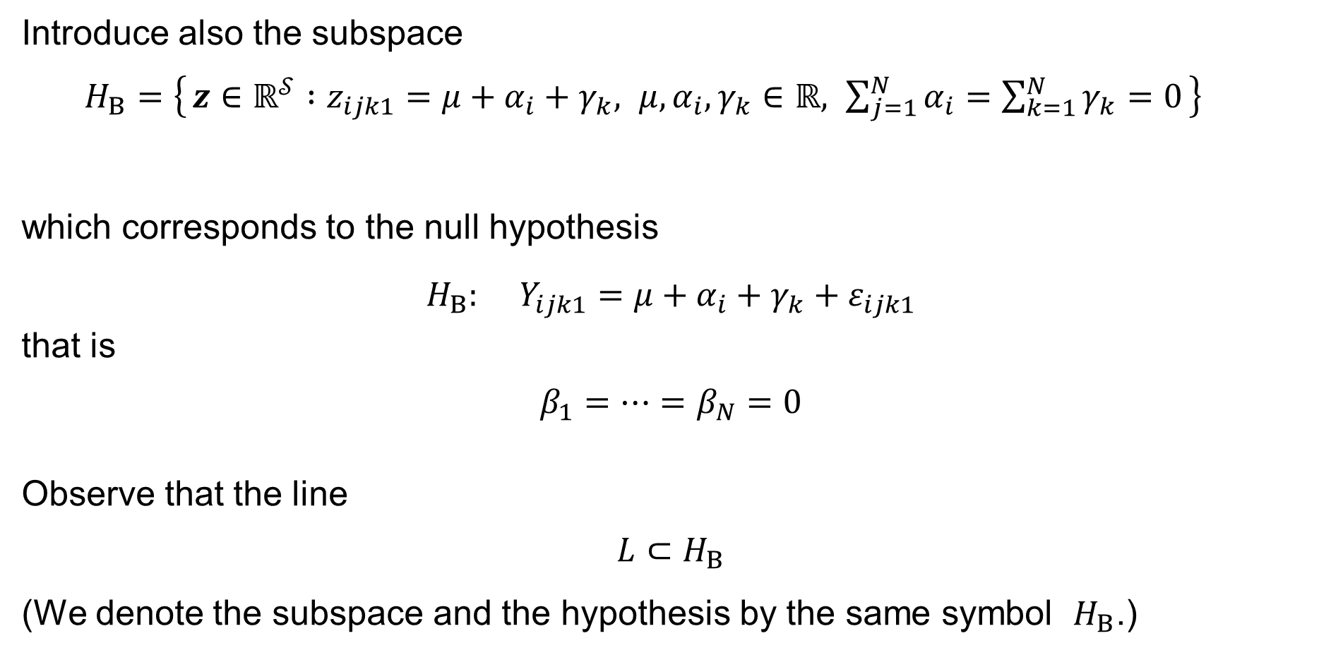
Three-way ANOVA with no interactions: Notation
Introduce also the subspace
$H_{B}=\left\{ z∈ℝ^{𝒮} :z_{ijk1}=μ+α_{i}+γ_{k}, μ,α_{i},γ_{k}∈ℝ, \sum_{j=1}^{N}{α_{i}}=\sum_{k=1}^{N}{γ_{k}}=0 \right\}$
which corresponds to the null hypothesis
$$H_{B}: Y_{ijk1}=μ+α_{i}+γ_{k}+ε_{ijk1}$$
that is
$$β_{1}=⋯=β_{N}=0$$
Observe that the line
$$L⊂H_{B}$$
(We denote the subspace and the hypothesis by the same symbol $H_{B}$.)
$$i=1, 2,…,N \\ j=1, 2,…,N \\ k=1, 2,…,N$$
& $n_{ijk}=1$
$$\text{for}$$

Slide 29
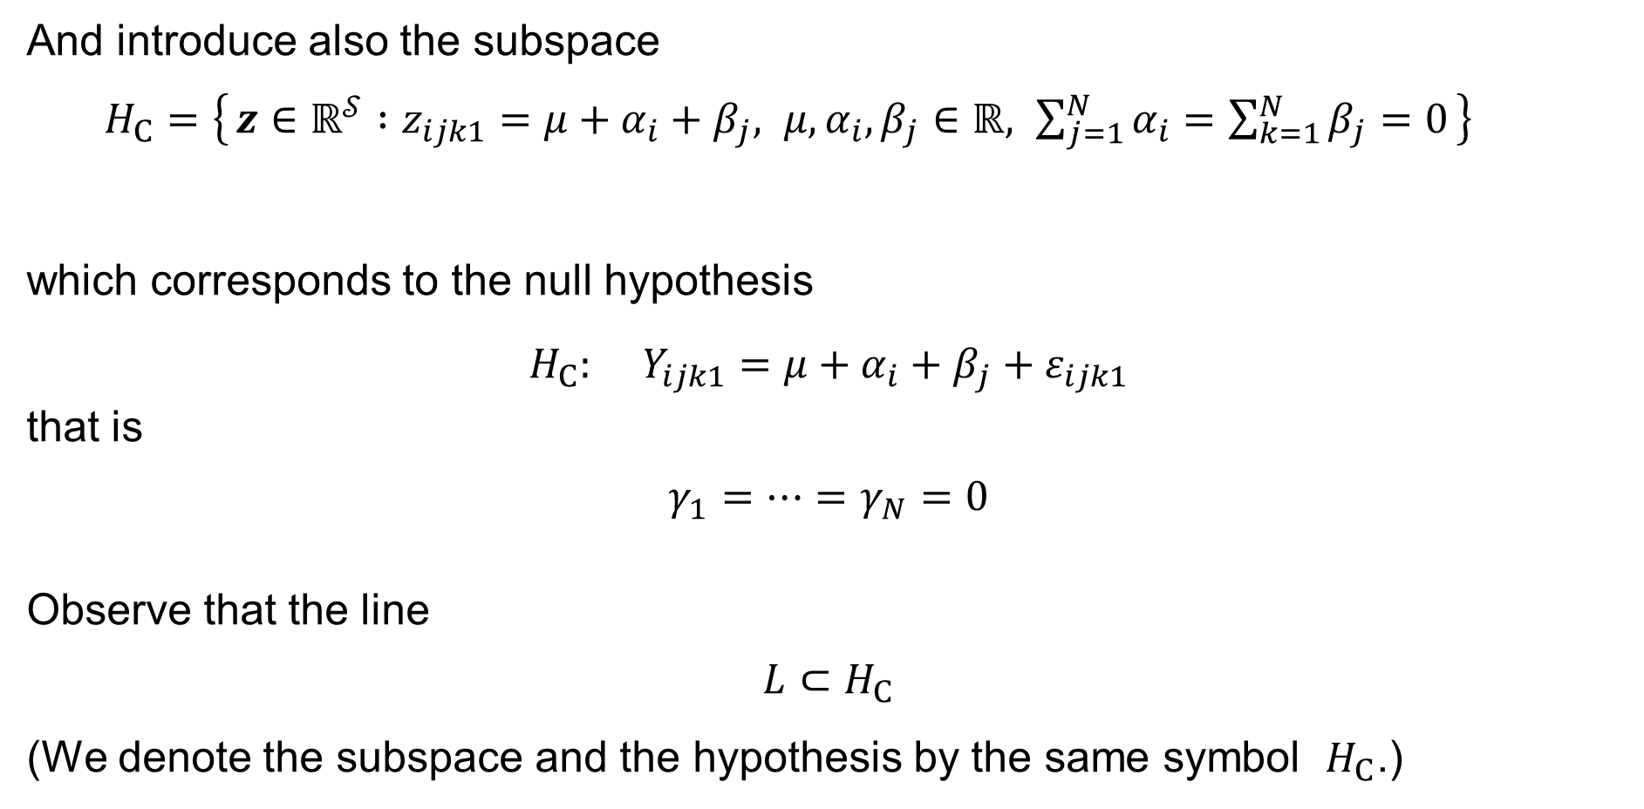
Three-way ANOVA with no interactions: Notation
And introduce also the subspace
$H_{C}=\left\{ z∈ℝ^{𝒮} :z_{ijk1}=μ+α_{i}+β_{j}, μ,α_{i},β_{j}∈ℝ, \sum_{j=1}^{N}{α_{i}}=\sum_{k=1}^{N}{β_{j}}=0 \right\}$
which corresponds to the null hypothesis
$$H_{C}: Y_{ijk1}=μ+α_{i}+β_{j}+ε_{ijk1}$$
that is
$$γ_{1}=⋯=γ_{N}=0$$
Observe that the line
$$L⊂H_{C}$$
(We denote the subspace and the hypothesis by the same symbol $H_{C}$.)
$$i=1, 2,…,N \\ j=1, 2,…,N \\ k=1, 2,…,N$$
& $n_{ijk}=1$
$$\text{for}$$

Slide 30


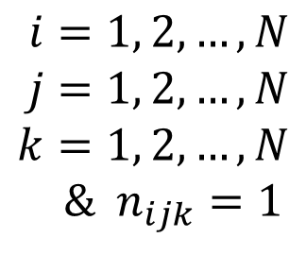
Three-way ANOVA with no interactions: Notation
Finally, introduce the subspace
$M=\left\{\begin{aligned} z∈ℝ^{𝒮} :z_{ijk1}=μ+α_{i}+β_{j}+γ_{k}, μ,α_{i},β_{j},γ_{k}∈ℝ, \\ \sum_{i=1}^{N}{α_{i}}=\sum_{j=1}^{N}{β_{j}}=\sum_{k=1}^{N}{γ_{k}}=0\end{aligned}\right\}$
which corresponds to the model under consideration:
$$Y_{ijk1}=μ+α_{i}+β_{j}+γ_{k}+ε_{ijk1}$$
$$i=1, 2,…,N \\ j=1, 2,…,N \\ k=1, 2,…,N$$
& $n_{ijk}=1$
$$\text{for}$$

Slide 31

Three-way ANOVA with no interactions: Dimensions
Notice that the dimension of
— the line
$$L=\left\{ z∈ℝ^{𝒮} :z_{ijk1}=μ, μ∈ℝ \right\}$$
is
$$1$$
— the subspace
$H_{A}=\left\{ z∈ℝ^{𝒮} :z_{ijk1}=μ+β_{j}+γ_{k}, μ,β_{j},γ_{k}∈ℝ, \sum_{j=1}^{N}{β_{j}}=\sum_{k=1}^{N}{γ_{k}}=0 \right\}$
is
$$\left(1+N+N\right)−1−1= 2N−1$$

Slide 32
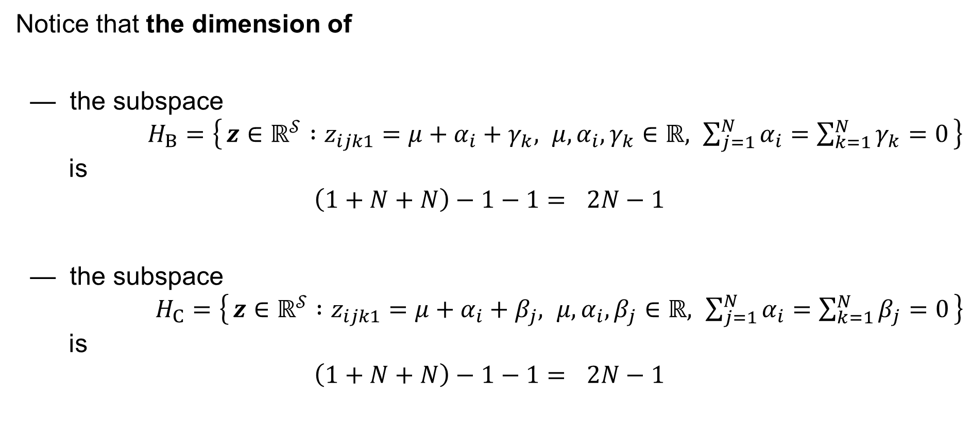
Three-way ANOVA with no interactions: Dimensions
Notice that the dimension of
— the subspace
$H_{B}=\left\{ z∈ℝ^{𝒮} :z_{ijk1}=μ+α_{i}+γ_{k}, μ,α_{i},γ_{k}∈ℝ, \sum_{j=1}^{N}{α_{i}}=\sum_{k=1}^{N}{γ_{k}}=0 \right\}$
is
$$\left(1+N+N\right)−1−1= 2N−1$$
— the subspace
$H_{C}=\left\{ z∈ℝ^{𝒮} :z_{ijk1}=μ+α_{i}+β_{j}, μ,α_{i},β_{j}∈ℝ, \sum_{j=1}^{N}{α_{i}}=\sum_{k=1}^{N}{β_{j}}=0 \right\}$
is
$$\left(1+N+N\right)−1−1= 2N−1$$

Slide 33

Three-way ANOVA with no interactions: Dimensions
Notice that the dimension of
— the subspace
$M=\left\{\begin{aligned} z∈ℝ^{𝒮} :z_{ijk1}=μ+α_{i}+β_{j}+γ_{k}, μ,α_{i},β_{j},γ_{k}∈ℝ, \\ \sum_{i=1}^{N}{α_{i}}=\sum_{j=1}^{N}{β_{j}}=\sum_{k=1}^{N}{γ_{k}}=0\end{aligned}\right\}$
is
$$\left(1+N+N+N\right)−1−1−1= 3N−2$$

Slide 34









Three-way ANOVA with no interactions
Letting ${\hat{y}}_{ijk1}=μ−α_{i}−β_{j}−γ_{k}$, solve the Least Squares Problem:
$$\min_{\hat{y}∈M}{\sum_{i=1}^{N}{\sum_{j=1}^{N}{\sum_{\begin{aligned}k=1 \\ n_{ijk}=1\end{aligned}}^{N}{{\left(y_{ijk1}−μ−α_{i}−β_{j}−γ_{k}\right)}^{2}}}}} = \min_{\hat{y}∈M}{{\left\|y−\hat{y}\right\|}^{2}} = RSS$$
$$M^{⊥}$$
$$y$$
$$y−\hat{y}=e$$
By the Pythagoras Theorem:
$${\left\|y\right\|}^{2}={\left\|\hat{y}\right\|}^{2}+{\left\|e\right\|}^{2} \\ y^{T}y={\hat{y}}^{T}\hat{y}+e^{T}e$$
0
$$\hat{y}$$
$$M$$
$$\dim{M^{⊥}}=N^{2}−3N+2=\left(N−1\right)\left(N−2\right)$$
$$\dim{M^{⊥}}+\dim{M}=N^{2}$$
$$\dim{M}=3N−2$$
Residual Sum of Squares: $RSS=\sum_{i=1}^{n}{{\left(y_{i}−{\hat{y}}_{i}\right)}^{2}}=\sum_{i=1}^{n}{e_{i}^{2}}=e^{T}e={\left\|e\right\|}^{2}$

Slide 35
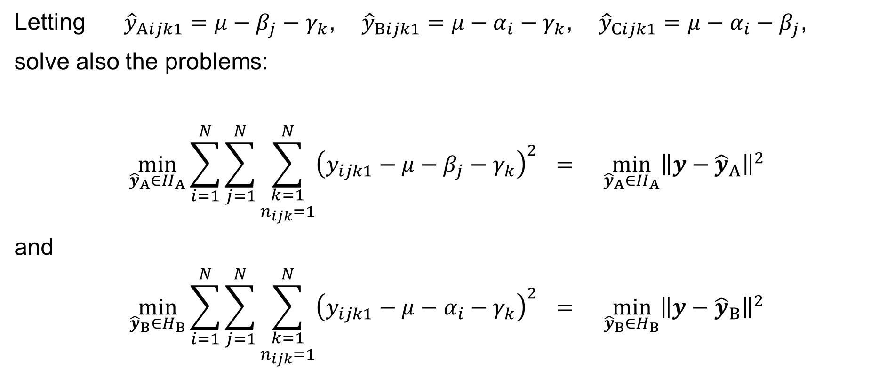
Three-way ANOVA with no interactions
Letting ${\hat{y}}_{Aijk1}=μ−β_{j}−γ_{k}$, ${\hat{y}}_{Bijk1}=μ−α_{i}−γ_{k}$, ${\hat{y}}_{Cijk1}=μ−α_{i}−β_{j}$,
solve also the problems:
$$\min_{{\hat{y}}_{A}∈H_{A}}{\sum_{i=1}^{N}{\sum_{j=1}^{N}{\sum_{\begin{aligned}k=1 \\ n_{ijk}=1\end{aligned}}^{N}{{\left(y_{ijk1}−μ−β_{j}−γ_{k}\right)}^{2}}}}} = \min_{{\hat{y}}_{A}∈H_{A}}{{\left\|y−{\hat{y}}_{A}\right\|}^{2}}$$
and
$$\min_{{\hat{y}}_{B}∈H_{B}}{\sum_{i=1}^{N}{\sum_{j=1}^{N}{\sum_{\begin{aligned}k=1 \\ n_{ijk}=1\end{aligned}}^{N}{{\left(y_{ijk1}−μ−α_{i}−γ_{k}\right)}^{2}}}}} = \min_{{\hat{y}}_{B}∈H_{B}}{{\left\|y−{\hat{y}}_{B}\right\|}^{2}}$$

Slide 36
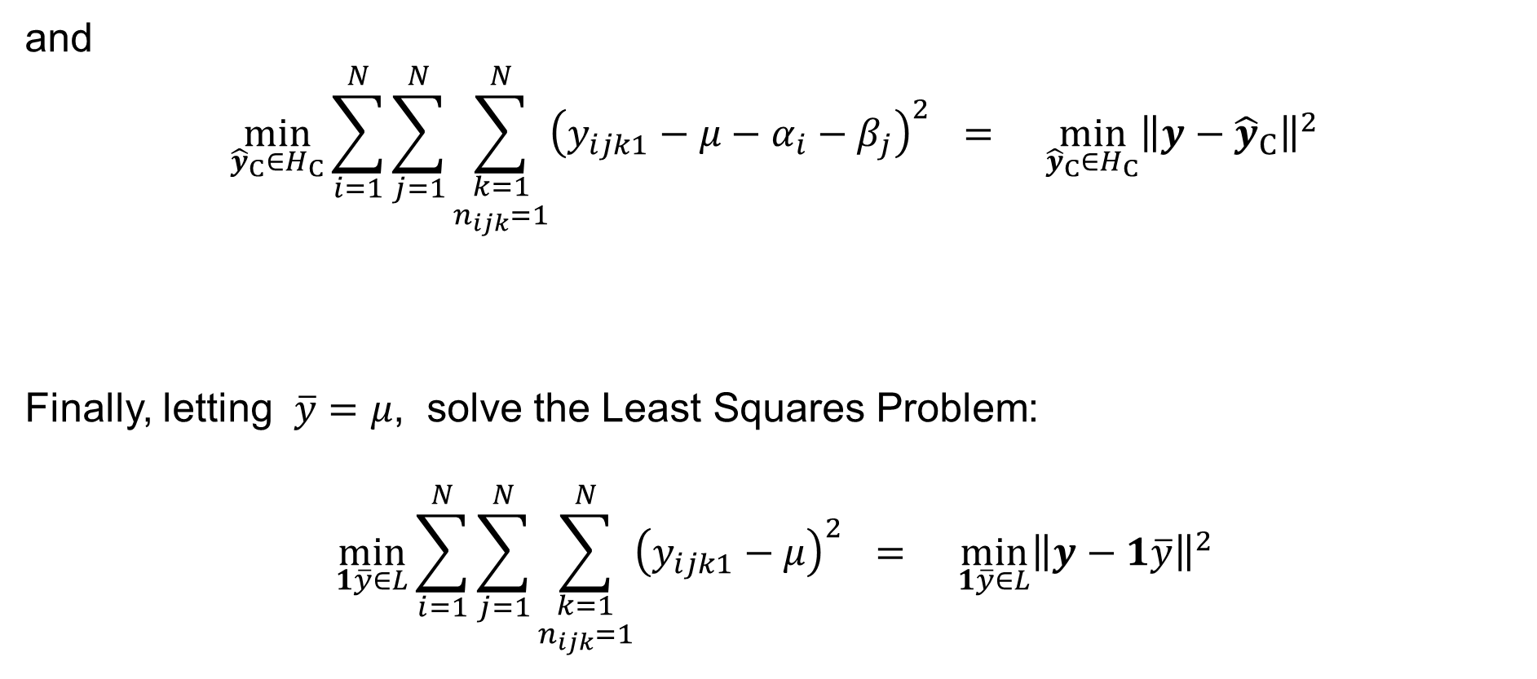
Three-way ANOVA with no interactions
and
$$\min_{{\hat{y}}_{C}∈H_{C}}{\sum_{i=1}^{N}{\sum_{j=1}^{N}{\sum_{\begin{aligned}k=1 \\ n_{ijk}=1\end{aligned}}^{N}{{\left(y_{ijk1}−μ−α_{i}−β_{j}\right)}^{2}}}}} = \min_{{\hat{y}}_{C}∈H_{C}}{{\left\|y−{\hat{y}}_{C}\right\|}^{2}}$$
Finally, letting $\overline{y}=μ$, solve the Least Squares Problem:
$$\min_{1\overline{y}∈L}{\sum_{i=1}^{N}{\sum_{j=1}^{N}{\sum_{\begin{aligned}k=1 \\ n_{ijk}=1\end{aligned}}^{N}{{\left(y_{ijk1}−μ\right)}^{2}}}}} = \min_{1\overline{y}∈L}{{\left\|y−1\overline{y}\right\|}^{2}}$$

Slide 37
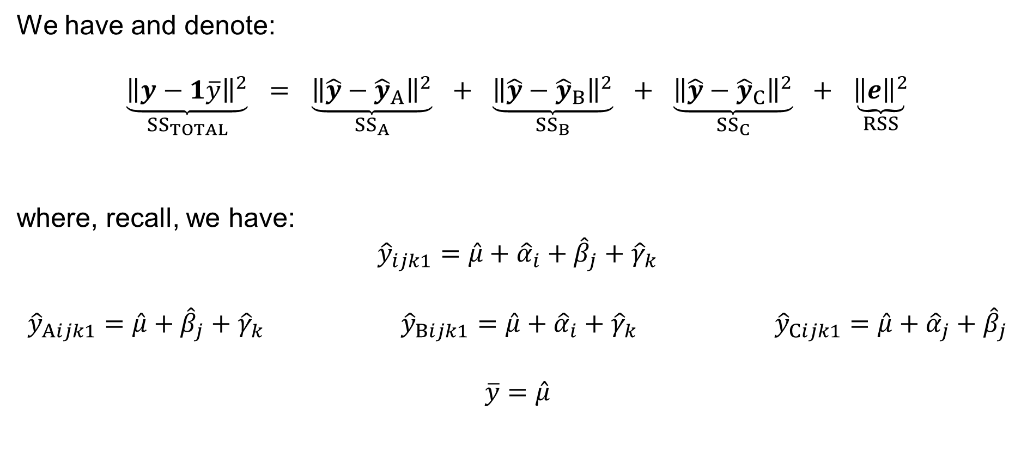
Three-way ANOVA with no interactions
We have and denote:
$$\underset{{SS}_{TOTAL}}{\underbrace{{\left\|y−1\overline{y}\right\|}^{2}}} = \underset{{SS}_{A}}{\underbrace{{\left\|\hat{y}−{\hat{y}}_{A}\right\|}^{2}}} + \underset{{SS}_{B}}{\underbrace{{\left\|\hat{y}−{\hat{y}}_{B}\right\|}^{2}}} + \underset{{SS}_{C}}{\underbrace{{\left\|\hat{y}−{\hat{y}}_{C}\right\|}^{2}}} + \underset{RSS}{\underbrace{{\left\|e\right\|}^{2}}}$$
where, recall, we have:
$${\hat{y}}_{ijk1}=\hat{μ}+{\hat{α}}_{i}+{\hat{β}}_{j}+{\hat{γ}}_{k}$$
$${\hat{y}}_{Aijk1}=\hat{μ}+{\hat{β}}_{j}+{\hat{γ}}_{k} {\hat{y}}_{Bijk1}=\hat{μ}+{\hat{α}}_{i}+{\hat{γ}}_{k} {\hat{y}}_{Cijk1}=\hat{μ}+{\hat{α}}_{j}+{\hat{β}}_{j}$$
$$\overline{y}=\hat{μ}$$

Slide 38
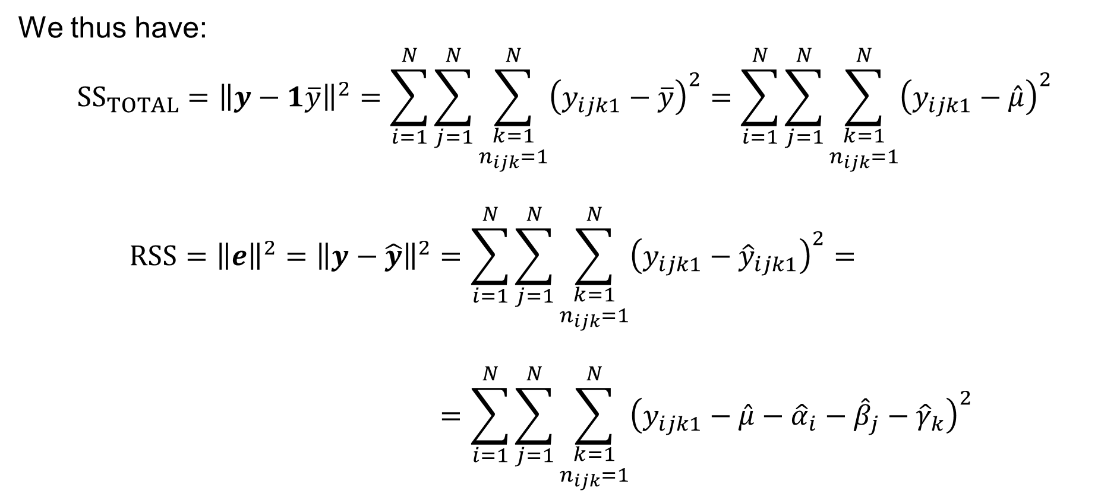
Three-way ANOVA with no interactions
We thus have:
$${SS}_{TOTAL}={\left\|y−1\overline{y}\right\|}^{2}=\sum_{i=1}^{N}{\sum_{j=1}^{N}{\sum_{\begin{aligned}k=1 \\ n_{ijk}=1\end{aligned}}^{N}{{\left(y_{ijk1}−\overline{y}\right)}^{2}}}}=\sum_{i=1}^{N}{\sum_{j=1}^{N}{\sum_{\begin{aligned}k=1 \\ n_{ijk}=1\end{aligned}}^{N}{{\left(y_{ijk1}−\hat{μ}\right)}^{2}}}}$$
$$RSS={\left\|e\right\|}^{2}={\left\|y−\hat{y}\right\|}^{2}=\sum_{i=1}^{N}{\sum_{j=1}^{N}{\sum_{\begin{aligned}k=1 \\ n_{ijk}=1\end{aligned}}^{N}{{\left(y_{ijk1}−{\hat{y}}_{ijk1}\right)}^{2}}}}= \\ =\sum_{i=1}^{N}{\sum_{j=1}^{N}{\sum_{\begin{aligned}k=1 \\ n_{ijk}=1\end{aligned}}^{N}{{\left(y_{ijk1}−\hat{μ}−{\hat{α}}_{i}−{\hat{β}}_{j}−{\hat{γ}}_{k}\right)}^{2}}}}$$

Slide 39

Three-way ANOVA with no interactions
We thus have:
$${SS}_{A}={\left\|\hat{y}−{\hat{y}}_{A}\right\|}^{2}=\sum_{i=1}^{N}{\sum_{j=1}^{N}{\sum_{\begin{aligned}k=1 \\ n_{ijk}=1\end{aligned}}^{N}{{\left({\hat{y}}_{ijk1}−{\hat{y}}_{Aijk1}\right)}^{2}}}}= \\ =\sum_{i=1}^{N}{\sum_{j=1}^{N}{\sum_{\begin{aligned}k=1 \\ n_{ijk}=1\end{aligned}}^{N}{{\left(\hat{μ}+{\hat{α}}_{i}+{\hat{β}}_{j}+{\hat{γ}}_{k}−\hat{μ}−{\hat{β}}_{j}−{\hat{γ}}_{k}\right)}^{2}}}}= \\ =\sum_{i=1}^{N}{\sum_{j=1}^{N}{\sum_{\begin{aligned}k=1 \\ n_{ijk}=1\end{aligned}}^{N}{{\hat{α}}_{i}^{2}}}} = N\sum_{i=1}^{N}{{\hat{α}}_{i}^{2}}$$

Slide 40

Three-way ANOVA with no interactions
We thus have:
$${SS}_{B}={\left\|\hat{y}−{\hat{y}}_{B}\right\|}^{2}=\sum_{i=1}^{N}{\sum_{j=1}^{N}{\sum_{\begin{aligned}k=1 \\ n_{ijk}=1\end{aligned}}^{N}{{\left({\hat{y}}_{ijk1}−{\hat{y}}_{Bijk1}\right)}^{2}}}}= \\ =\sum_{i=1}^{N}{\sum_{j=1}^{N}{\sum_{\begin{aligned}k=1 \\ n_{ijk}=1\end{aligned}}^{N}{{\left(\hat{μ}+{\hat{α}}_{i}+{\hat{β}}_{j}+{\hat{γ}}_{k}−\hat{μ}−{\hat{α}}_{i}−{\hat{γ}}_{k}\right)}^{2}}}}= \\ =\sum_{i=1}^{N}{\sum_{j=1}^{N}{\sum_{\begin{aligned}k=1 \\ n_{ijk}=1\end{aligned}}^{N}{{\hat{β}}_{j}^{2}}}} = N\sum_{j=1}^{N}{{\hat{β}}_{j}^{2}}$$

Slide 41

Three-way ANOVA with no interactions
We thus have:
$${SS}_{C}={\left\|\hat{y}−{\hat{y}}_{C}\right\|}^{2}=\sum_{i=1}^{N}{\sum_{j=1}^{N}{\sum_{\begin{aligned}k=1 \\ n_{ijk}=1\end{aligned}}^{N}{{\left({\hat{y}}_{ijk1}−{\hat{y}}_{Cijk1}\right)}^{2}}}}= \\ =\sum_{i=1}^{N}{\sum_{j=1}^{N}{\sum_{\begin{aligned}k=1 \\ n_{ijk}=1\end{aligned}}^{N}{{\left(\hat{μ}+{\hat{α}}_{i}+{\hat{β}}_{j}+{\hat{γ}}_{k}−\hat{μ}−{\hat{α}}_{i}−{\hat{β}}_{j}\right)}^{2}}}}= \\ =\sum_{i=1}^{N}{\sum_{j=1}^{N}{\sum_{\begin{aligned}k=1 \\ n_{ijk}=1\end{aligned}}^{N}{{\hat{γ}}_{k}^{2}}}} = N\sum_{k=1}^{N}{{\hat{γ}}_{k}^{2}}$$

Slide 42
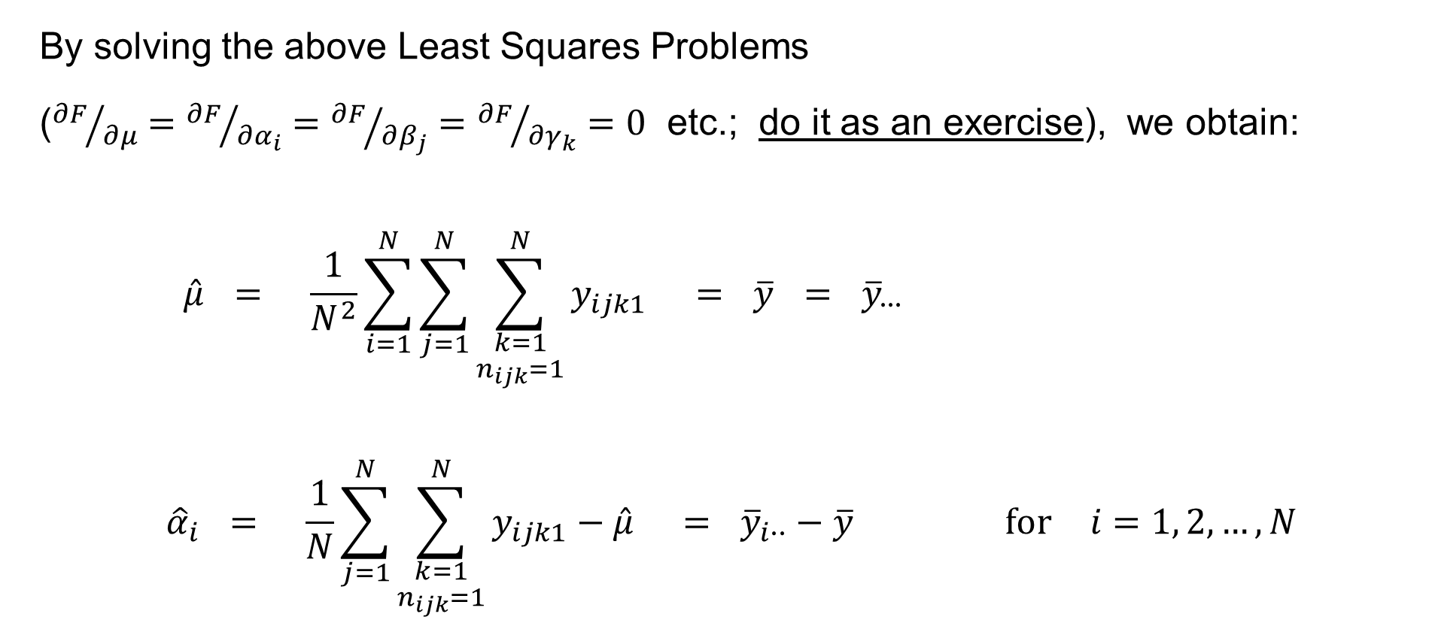
Three-way ANOVA with no interactions
By solving the above Least Squares Problems
(${∂F}/{∂μ}={∂F}/{∂α_{i}}={∂F}/{∂β_{j}}={∂F}/{∂γ_{k}}=0$ etc.; do it as an exercise), we obtain:
$$\hat{μ} = \frac{1}{N^{2}}\sum_{i=1}^{N}{\sum_{j=1}^{N}{\sum_{\begin{aligned}k=1 \\ n_{ijk}=1\end{aligned}}^{N}{y_{ijk1}}}} = \overline{y} = {\overline{y}}_{∙∙∙}$$
$${\hat{α}}_{i} = \frac{1}{N}\sum_{j=1}^{N}{\sum_{\begin{aligned}k=1 \\ n_{ijk}=1\end{aligned}}^{N}{y_{ijk1}}}−\hat{μ} = {\overline{y}}_{i∙∙}−\overline{y} \text{for} i=1, 2,…,N$$

Slide 43
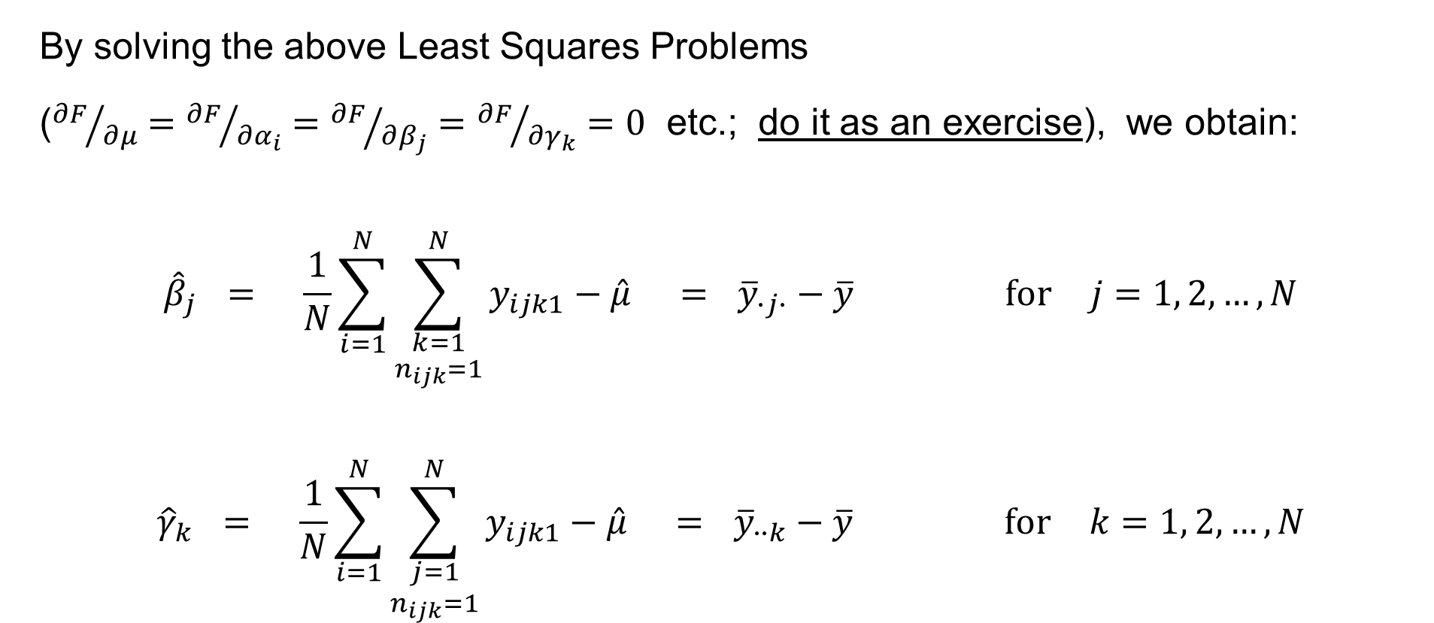
Three-way ANOVA with no interactions
By solving the above Least Squares Problems
(${∂F}/{∂μ}={∂F}/{∂α_{i}}={∂F}/{∂β_{j}}={∂F}/{∂γ_{k}}=0$ etc.; do it as an exercise), we obtain:
$${\hat{β}}_{j} = \frac{1}{N}\sum_{i=1}^{N}{\sum_{\begin{aligned}k=1 \\ n_{ijk}=1\end{aligned}}^{N}{y_{ijk1}}}−\hat{μ} = {\overline{y}}_{∙j∙}−\overline{y} \text{for} j=1, 2,…,N$$
$${\hat{γ}}_{k} = \frac{1}{N}\sum_{i=1}^{N}{\sum_{\begin{aligned}j=1 \\ n_{ijk}=1\end{aligned}}^{N}{y_{ijk1}}}−\hat{μ} = {\overline{y}}_{∙∙k}−\overline{y} \text{for} k=1, 2,…,N$$

Slide 44
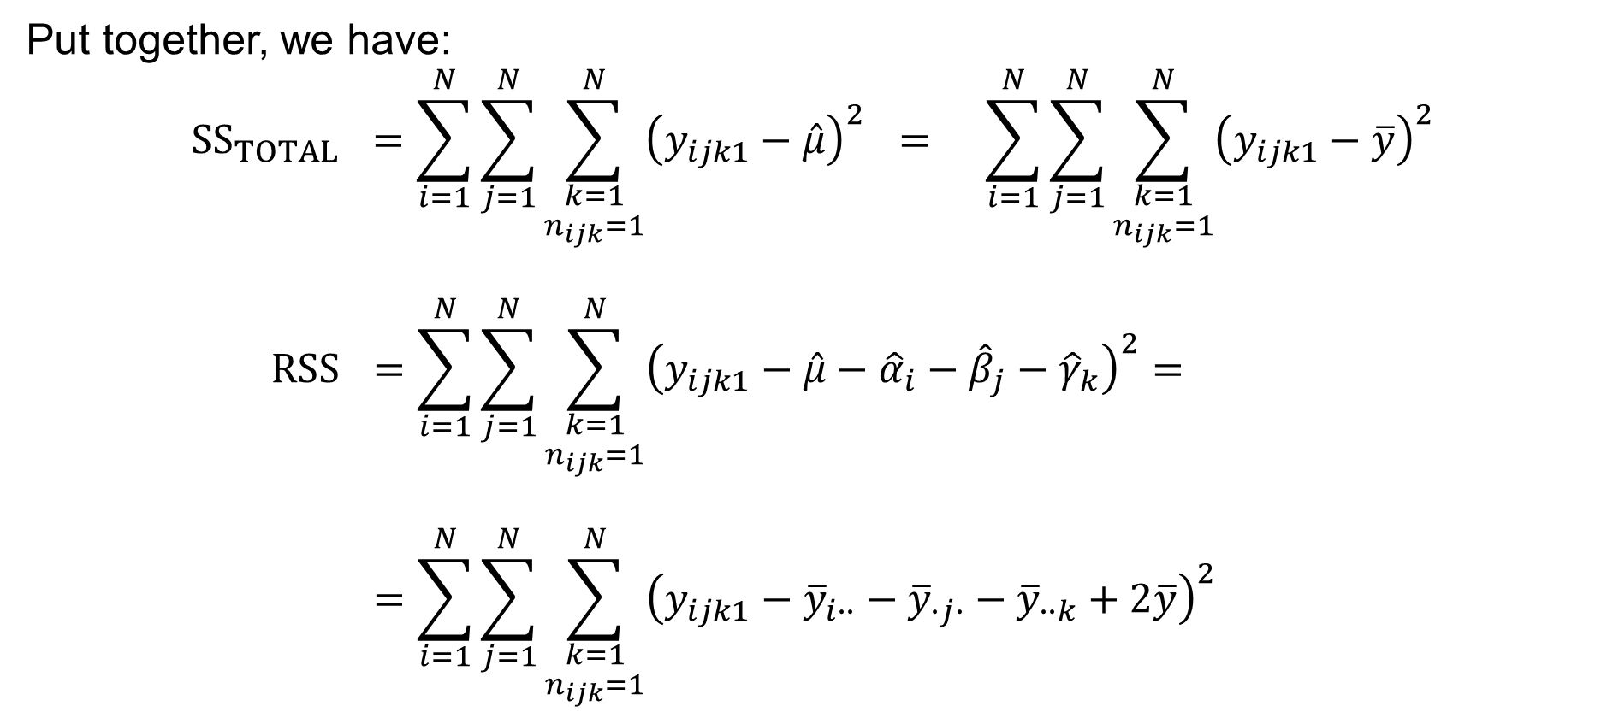
Three-way ANOVA with no interactions
Put together, we have:
$${SS}_{TOTAL} =\sum_{i=1}^{N}{\sum_{j=1}^{N}{\sum_{\begin{aligned}k=1 \\ n_{ijk}=1\end{aligned}}^{N}{{\left(y_{ijk1}−\hat{μ}\right)}^{2}}}} = \sum_{i=1}^{N}{\sum_{j=1}^{N}{\sum_{\begin{aligned}k=1 \\ n_{ijk}=1\end{aligned}}^{N}{{\left(y_{ijk1}−\overline{y}\right)}^{2}}}}$$
$$RSS =\sum_{i=1}^{N}{\sum_{j=1}^{N}{\sum_{\begin{aligned}k=1 \\ n_{ijk}=1\end{aligned}}^{N}{{\left(y_{ijk1}−\hat{μ}−{\hat{α}}_{i}−{\hat{β}}_{j}−{\hat{γ}}_{k}\right)}^{2}}}}= \\ =\sum_{i=1}^{N}{\sum_{j=1}^{N}{\sum_{\begin{aligned}k=1 \\ n_{ijk}=1\end{aligned}}^{N}{{\left(y_{ijk1}−{\overline{y}}_{i∙∙}−{\overline{y}}_{∙j∙}−{\overline{y}}_{∙∙k}+2\overline{y}\right)}^{2}}}}$$

Slide 45
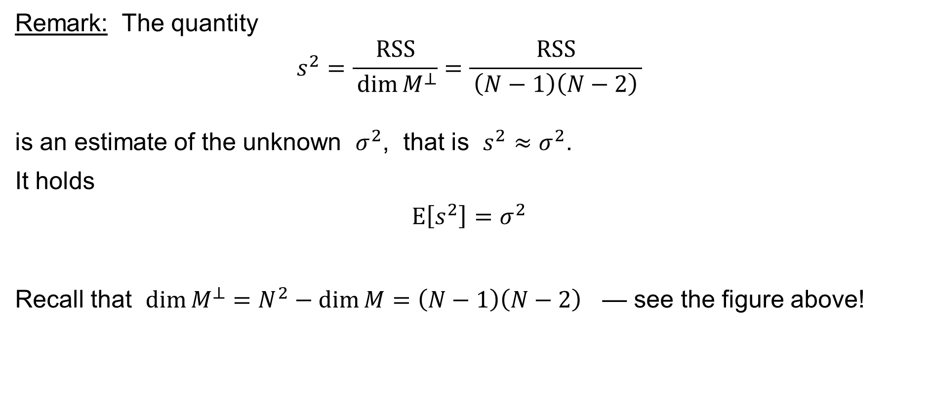
Three-way ANOVA with no interactions
Remark: The quantity
$$s^{2}=\frac{RSS}{ \dim{M^{⊥}}}=\frac{RSS}{ \left(N−1\right)\left(N−2\right) }$$
is an estimate of the unknown $σ^{2}$, that is $s^{2}≈σ^{2}$.
It holds
$$E\left[s^{2}\right]=σ^{2}$$
Recall that $\dim{M^{⊥}}=N^{2}−\dim{M}=\left(N−1\right)\left(N−2\right)$ — see the figure above!

Slide 46

Three-way ANOVA with no interactions
Put together, we have:
$${SS}_{A} =N\sum_{i=1}^{N}{{\hat{α}}_{i}^{2}} = N\sum_{i=1}^{N}{{\left({\overline{y}}_{i∙∙}−\overline{y}\right)}^{2}}$$
$${SS}_{B} =N\sum_{j=1}^{N}{{\hat{β}}_{j}^{2}} = N\sum_{j=1}^{N}{{\left({\overline{y}}_{∙j∙}−\overline{y}\right)}^{2}}$$
$${SS}_{C} =N\sum_{k=1}^{N}{{\hat{γ}}_{k}^{2}} = N\sum_{k=1}^{N}{{\left({\overline{y}}_{∙∙k}−\overline{y}\right)}^{2}}$$

Slide 47

Three-way ANOVA with no interactions
Recall that it holds:
$${SS}_{TOTAL}={SS}_{A}+{SS}_{B}+{SS}_{C}+RSS$$
$$\sum_{i=1}^{N}{\sum_{j=1}^{N}{\sum_{\begin{aligned}k=1 \\ n_{ijk}=1\end{aligned}}^{N}{{\left(y_{ijk1}−\overline{y}\right)}^{2}}}} = N\sum_{i=1}^{N}{{\left({\overline{y}}_{i∙∙}−\overline{y}\right)}^{2}}+N\sum_{j=1}^{N}{{\left({\overline{y}}_{∙j∙}−\overline{y}\right)}^{2}}+N\sum_{k=1}^{N}{{\left({\overline{y}}_{∙∙k}−\overline{y}\right)}^{2}}+$$
$$+\sum_{i=1}^{N}{\sum_{j=1}^{N}{\sum_{\begin{aligned}k=1 \\ n_{ijk}=1\end{aligned}}^{N}{{\left(y_{ijk1}−{\overline{y}}_{i∙∙}−{\overline{y}}_{∙j∙}−{\overline{y}}_{∙∙k}+2\overline{y}\right)}^{2}}}}$$

Slide 48

Three-way ANOVA with no interactions: Test for H_{C}
We use the theory of Linear Regression (Theorem 8) to test Hypothesis $H_{C}$:
If the null hypothesis
$$H_{C}: γ_{1}=γ_{2}=⋯=γ_{N}=0$$
holds true, then
$${\frac{{SS}_{C}}{ RSS }}/{\frac{ \dim{M}−\dim{H_{C}} }{N^{2}−\dim{M}}} = {\frac{{SS}_{C}}{ RSS }}/{\frac{N−1}{ \left(N−1\right)\left(N−2\right) }} ∼ F_{N−1, \left(N−1\right)\left(N−2\right)}$$

Slide 49















Three-way ANOVA with no interactions: Test for H_{C}
It holds:
$$M^{⊥}$$
$${cotan}^{2}{φ}=\frac{{\left(\hat{y}−{\hat{y}}_{C}\right)}^{T}\left(\hat{y}−{\hat{y}}_{C}\right)}{RSS}$$
(the orthogonal
complement =
= the space of
the residuals)
subspace
of dimension
$$y$$
$$e=y−\hat{y}$$
$${{\left(\operatorname{cotan}{φ}\right)}^{2}}/{\frac{N−1}{ N^{2}−3N+2 }}∼F_{N−1, \left(N−1\right)\left(N−2\right)}$$
$$N^{2}−3N+2$$
$${\hat{y}}_{C}$$
$$φ$$
$$\hat{y}$$
$$M$$
0
subspace of dimension
$$3N−2$$
$$H_{C}$$
subspace of dimension
the dimension of its complement within
the subspace of dimension $3N−2$ is
$$2N−1$$
$$N−1$$

Slide 50

Three-way ANOVA with no interactions: Test for H_{C}
Given the sample $y_{ijk1}$ of the random variables $Y_{ijk1}=μ+α_{i}+β_{j}+γ_{k}+ε_{ijk1}$ where $μ,α_{i},β_{j},γ_{k}∈ℝ$ are (unknown) parameters such that
$\sum_{i=1}^{N}{α_{i}}=\sum_{j=1}^{N}{β_{j}}=\sum_{k=1}^{N}{γ_{k}}=0$ and $ε_{ijk1}∼𝒩\left(0,σ^{2}\right)$ are
mutually independent random variables for $i=1, 2,…,N$, $j=1, 2,…,N$,
$k=1, 2,…,N$ such that $n_{ijk}=1$, formulate the null hypothesis:
$H_{C}: γ_{1}=γ_{2}=⋯=γ_{N}=0$
The alternative hypothesis is $H_{C1}≡¬H_{C}$, i.e. $γ_{k}≠0$ for some $k∈\left\{1, 2,…,N\right\}$

Slide 51

Three-way ANOVA with no interactions: Test for H_{C}
Calculate the statistic
$$F={\frac{{SS}_{C}}{ RSS }}/{\frac{{DF}_{C}}{DF_{RSS}}}={\frac{N\sum_{k=1}^{N}{{\left({\overline{y}}_{∙∙k}−\overline{y}\right)}^{2}}}{\sum_{i=1}^{N}{\sum_{j=1}^{N}{\sum_{\begin{aligned}k=1 \\ n_{ijk}=1\end{aligned}}^{N}{{\left(y_{ijk1}−{\overline{y}}_{i∙∙}−{\overline{y}}_{∙j∙}−{\overline{y}}_{∙∙k}+2\overline{y}\right)}^{2}}}}}}/{\frac{N−1}{N^{2}−3N+2}}$$
If the null hypothesis is true, then we have by the Theorem
$F∼F_{N−1, \left(N−1\right)\left(N−2\right)}$
Choose the level of significance, a small number $α>0$, such as $α=5 \%$, other popular values are $α=10 \%$ or $α=1 \%$ or $α=0.1 \%$ etc.

Slide 52

Three-way ANOVA with no interactions: Test for H_{C}
find the critical value
$c = F_{N−1, \left(N−1\right)\left(N−2\right)} \left(1−α\right)$
so that $\int_{c}^{+∞}{f\left(x\right) dx}=α$ where $f$ is the density of the F-distribution with
$N−1$ and $\left(N−1\right)\left(N−2\right)$ degrees of freedom
if $F∈\left[c,+∞\right)$, the critical region, then reject the null hypothesis
if $F∈\left[0,c\right)$, then do not reject (or fail to reject) the null hypothesis

