Slide 1
Statistical Methods for Economists
Lecture 9
Full Factorial Design
of Experiments
David Bartl
Statistical Methods for Economists
INM/BASTE

Slide 2
Motivation & Introduction
Full Factorial Experiments
Graphical assessment of factor / interaction significance
Graphs of interaction effects

Slide 3
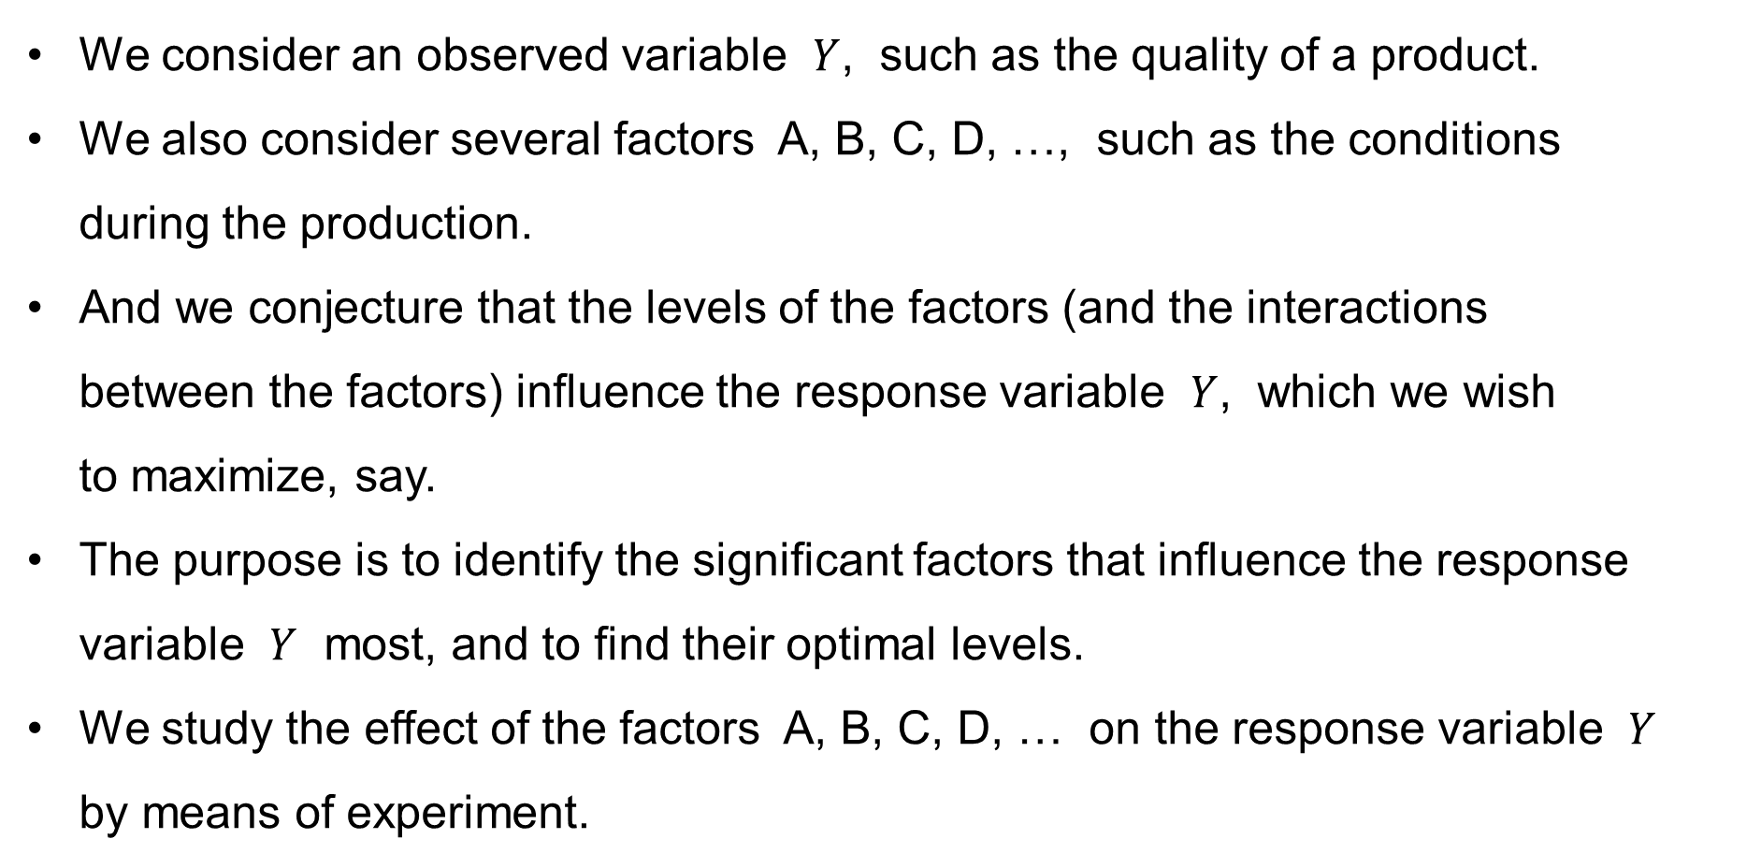
Full Factorial Experiments: Motivation
We consider an observed variable $Y$, such as the quality of a product.
We also consider several factors A, B, C, D, …, such as the conditions
during the production.
And we conjecture that the levels of the factors (and the interactions
between the factors) influence the response variable $Y$, which we wish
to maximize, say.
The purpose is to identify the significant factors that influence the response variable $Y$ most, and to find their optimal levels.
We study the effect of the factors A, B, C, D, … on the response variable $Y$
by means of experiment.

Slide 4
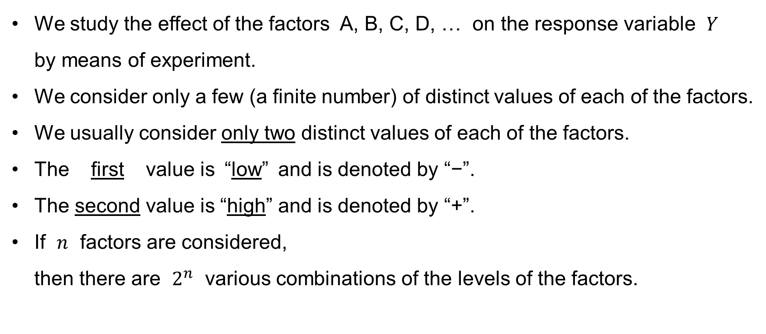
Full Factorial Experiments: Motivation & Introduction
We study the effect of the factors A, B, C, D, … on the response variable $Y$
by means of experiment.
We consider only a few (a finite number) of distinct values of each of the factors.
We usually consider only two distinct values of each of the factors.
The first value is “low” and is denoted by “−”.
The second value is “high” and is denoted by “+”.
If $n$ factors are considered,
then there are $2^{n}$ various combinations of the levels of the factors.

Slide 5

Full Factorial Experiments: Motivation & Introduction
If we consider $n=2$ factors A and B, then the arrangement of the factor levels is called a 2×2 or 2² factorial design.
There are 2×2 = 4 factorial points, which constitute a square:
Factor
A | B
− | −
+ | −
− | +
+ | +
−+
++
−−
+−

Slide 6
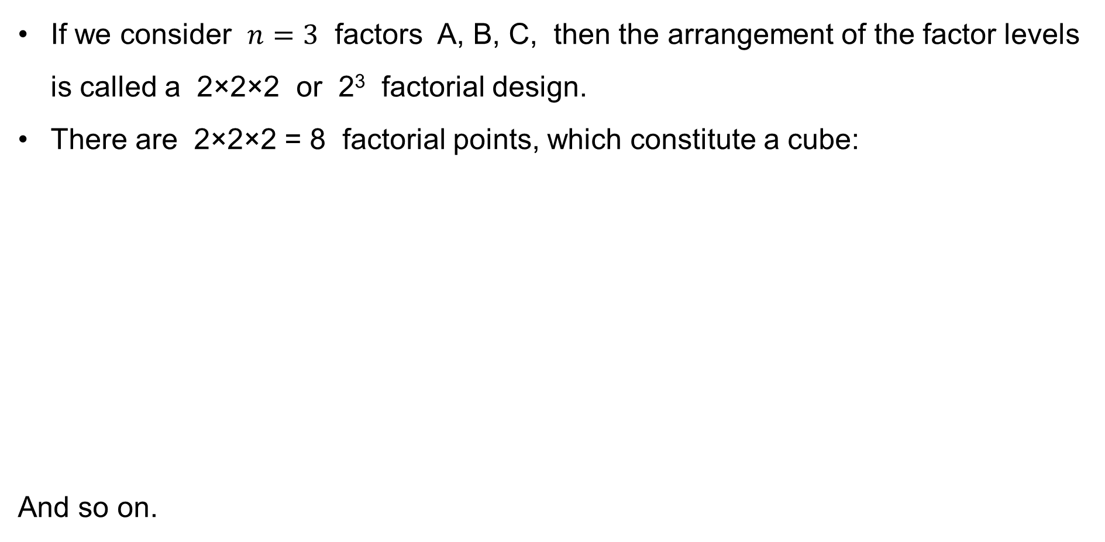
Full Factorial Experiments: Motivation & Introduction
If we consider $n=3$ factors A, B, C, then the arrangement of the factor levels is called a 2×2×2 or 2³ factorial design.
There are 2×2×2 = 8 factorial points, which constitute a cube:
And so on.
Factor
A | B | C
− | − | −
+ | − | −
− | + | −
+ | + | −
− | − | +
+ | − | +
− | + | +
+ | + | +
−++
+++
−−+
+−+
−+−
++−
−−−
+−−

Slide 7
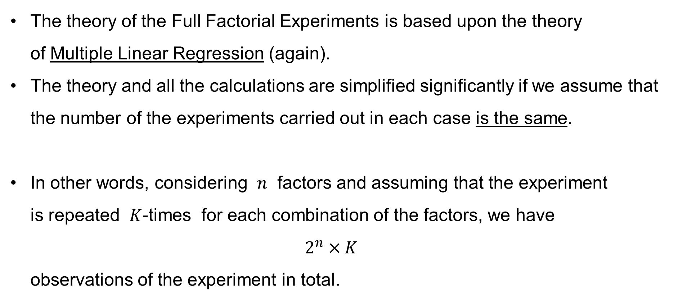
Full Factorial Experiments: Motivation & Introduction
The theory of the Full Factorial Experiments is based upon the theory
of Multiple Linear Regression (again).
The theory and all the calculations are simplified significantly if we assume that the number of the experiments carried out in each case is the same.
In other words, considering $n$ factors and assuming that the experiment
is repeated $K$-times for each combination of the factors, we have
$2^{n}×K$
observations of the experiment in total.

Slide 8
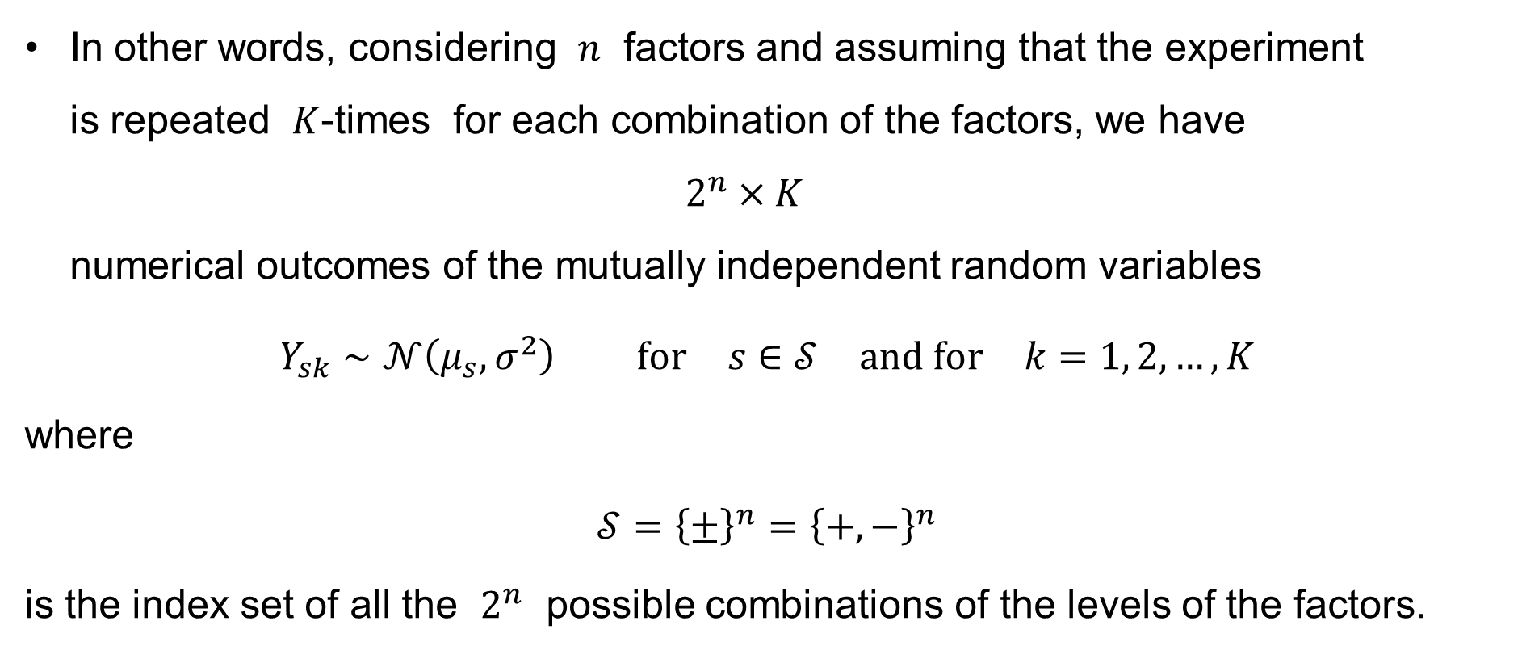
Full Factorial Experiments: Motivation & Introduction
In other words, considering $n$ factors and assuming that the experiment
is repeated $K$-times for each combination of the factors, we have
$2^{n}×K$
numerical outcomes of the mutually independent random variables
$$Y_{sk}∼𝒩\left(μ_{s},σ^{2}\right) \text{for} s∈𝒮 \text{and} \text{for} k=1, 2,…,K$$
where
$$𝒮={\left\{±\right\}}^{n}={\left\{+,−\right\}}^{n}$$
is the index set of all the $2^{n}$ possible combinations of the levels of the factors.

Slide 9
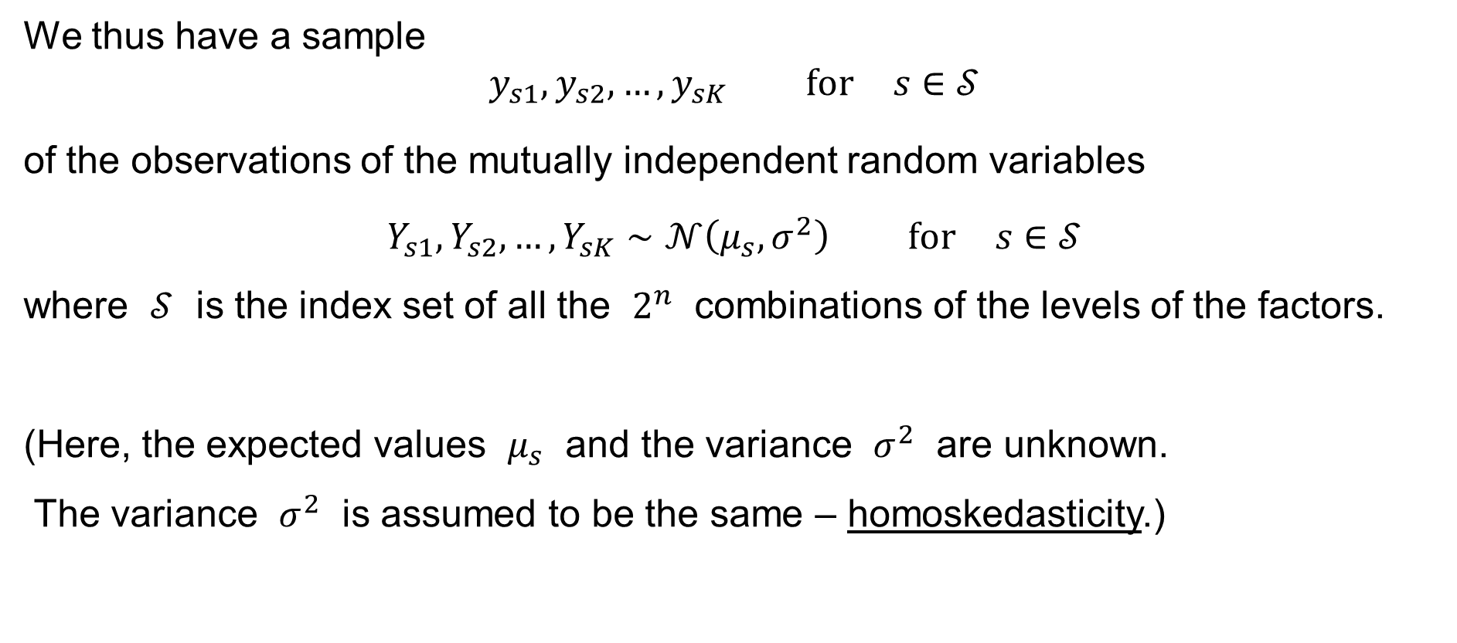
Full Factorial Experiments: Motivation & Introduction
We thus have a sample
$$y_{s1},y_{s2},…,y_{sK} \text{for} s∈𝒮$$
of the observations of the mutually independent random variables
$$Y_{s1},Y_{s2},…,Y_{sK}∼𝒩\left(μ_{s},σ^{2}\right) \text{for} s∈𝒮$$
where $𝒮$ is the index set of all the $2^{n}$ combinations of the levels of the factors.
(Here, the expected values $μ_{s}$ and the variance $σ^{2}$ are unknown.
The variance $σ^{2}$ is assumed to be the same – homoskedasticity.)

Slide 10
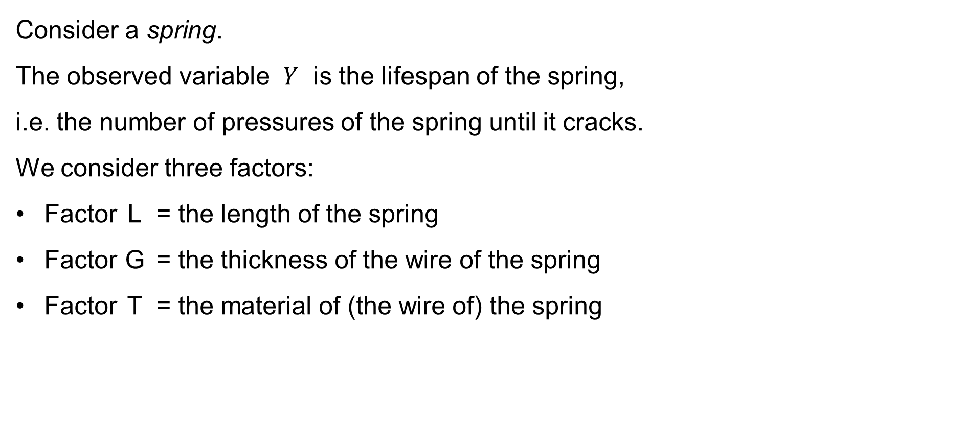
Full Factorial Experiments: Example
Consider a spring.
The observed variable $Y$ is the lifespan of the spring,
i.e. the number of pressures of the spring until it cracks.
We consider three factors:
Factor L = the length of the spring
Factor G = the thickness of the wire of the spring
Factor T = the material of (the wire of) the spring

Slide 11
Full Factorial Experiments: Example
We consider the following levels of the three factors:
Factor L = the length of the spring
“−” or “−1” = 10 cm
“+” or “+1” = 15 cm
Factor G = the thickness of the wire of the spring
“−” or “−1” = 5 mm
“+” or “+1” = 7 mm
Factor T = the material of (the wire of) the spring
“−” or “−1” = Material / alloy “A”
“+” or “+1” = Material / alloy “B”

Slide 12
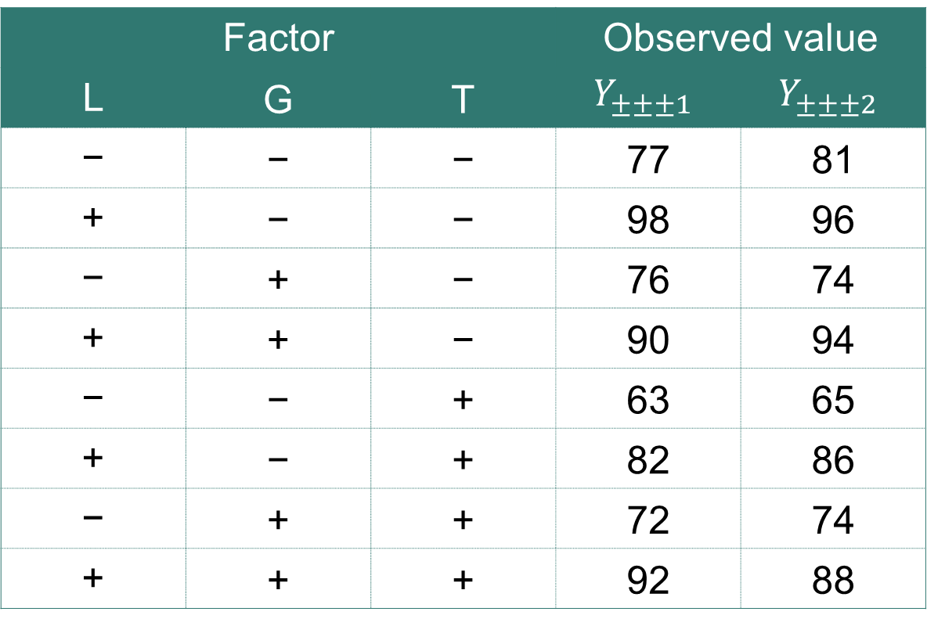
Full Factorial Experiments: Example
The experiment was carried out 2× for each combination of the factors:
Factor |  |  | Observed value
L | G | T | $$Y_{±±±1}$$ | $$Y_{±±±2}$$
− | − | − | 77 | 81
+ | − | − | 98 | 96
− | + | − | 76 | 74
+ | + | − | 90 | 94
− | − | + | 63 | 65
+ | − | + | 82 | 86
− | + | + | 72 | 74
+ | + | + | 92 | 88

Slide 13
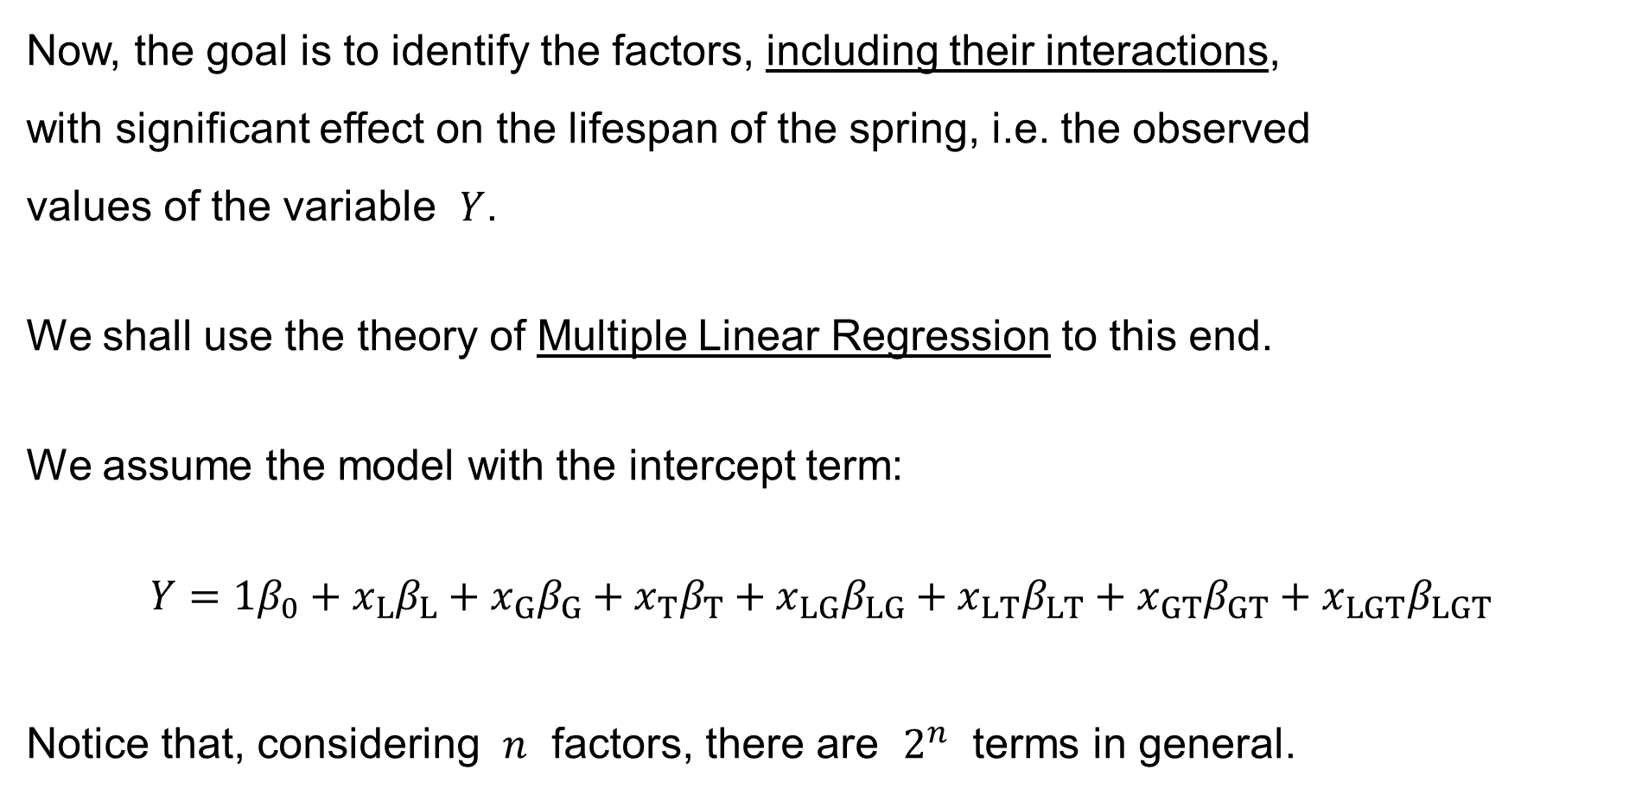
Full Factorial Experiments: Example
Now, the goal is to identify the factors, including their interactions,
with significant effect on the lifespan of the spring, i.e. the observed
values of the variable $Y$.
We shall use the theory of Multiple Linear Regression to this end.
We assume the model with the intercept term:
$$Y=1β_{0}+x_{L}β_{L}+x_{G}β_{G}+x_{T}β_{T}+x_{LG}β_{LG}+x_{LT}β_{LT}+x_{GT}β_{GT}+x_{LGT}β_{LGT}$$
Notice that, considering $n$ factors, there are $2^{n}$ terms in general.

Slide 14
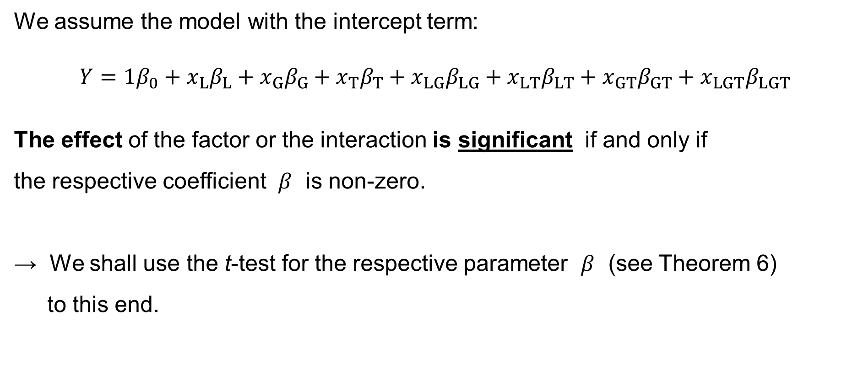
Full Factorial Experiments: Example
We assume the model with the intercept term:
$$Y=1β_{0}+x_{L}β_{L}+x_{G}β_{G}+x_{T}β_{T}+x_{LG}β_{LG}+x_{LT}β_{LT}+x_{GT}β_{GT}+x_{LGT}β_{LGT}$$
The effect of the factor or the interaction is significant if and only if
the respective coefficient $β$ is non-zero.
→ We shall use the t-test for the respective parameter $β$ (see Theorem 6)
to this end.

Slide 15


Full Factorial Experiments: Example
We set up the matrix $X$ as the first step:
“−” = “−1” & “+” = “+1”
Interaction = the product of the Factors.
Intercept | Factor |  |  | Interaction
0 | L | G | T | LG | LT | GT | LGT
1 | − | − | − | + | + | + | −
1 | + | − | − | − | − | + | +
1 | − | + | − | − | + | − | +
1 | + | + | − | + | − | − | −
1 | − | − | + | + | − | − | +
1 | + | − | + | − | + | − | −
1 | − | + | + | − | − | + | −
1 | + | + | + | + | + | + | +
This is a $2^{n}×2^{n}$ matrix in general.

Slide 16

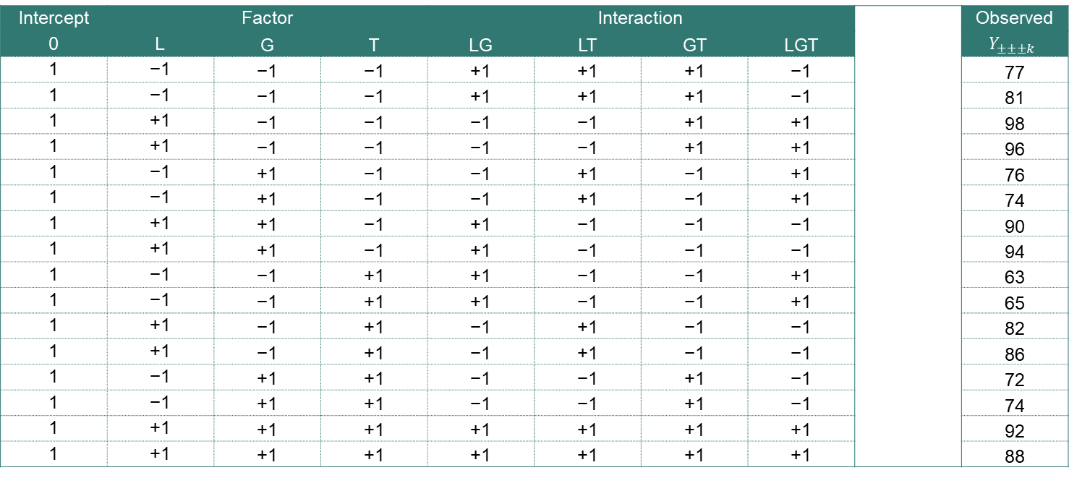


Full Factorial Experiments: Example
Since we carried out each experiment 2× for each combination
of the factors, we double each row of the table:
Interaction = the product of the Factors.
Intercept | Factor |  |  | Interaction |  |  |  |  | Observed
0 | L | G | T | LG | LT | GT | LGT |  | $$Y_{±±±k}$$
1 | −1 | −1 | −1 | +1 | +1 | +1 | −1 |  | 77
1 | −1 | −1 | −1 | +1 | +1 | +1 | −1 |  | 81
1 | +1 | −1 | −1 | −1 | −1 | +1 | +1 |  | 98
1 | +1 | −1 | −1 | −1 | −1 | +1 | +1 |  | 96
1 | −1 | +1 | −1 | −1 | +1 | −1 | +1 |  | 76
1 | −1 | +1 | −1 | −1 | +1 | −1 | +1 |  | 74
1 | +1 | +1 | −1 | +1 | −1 | −1 | −1 |  | 90
1 | +1 | +1 | −1 | +1 | −1 | −1 | −1 |  | 94
1 | −1 | −1 | +1 | +1 | −1 | −1 | +1 |  | 63
1 | −1 | −1 | +1 | +1 | −1 | −1 | +1 |  | 65
1 | +1 | −1 | +1 | −1 | +1 | −1 | −1 |  | 82
1 | +1 | −1 | +1 | −1 | +1 | −1 | −1 |  | 86
1 | −1 | +1 | +1 | −1 | −1 | +1 | −1 |  | 72
1 | −1 | +1 | +1 | −1 | −1 | +1 | −1 |  | 74
1 | +1 | +1 | +1 | +1 | +1 | +1 | +1 |  | 92
1 | +1 | +1 | +1 | +1 | +1 | +1 | +1 |  | 88
$X$:
$y$:
This is a $\left(2^{n}×K\right)×\left(2^{n}\right)$ matrix in general.

Slide 17
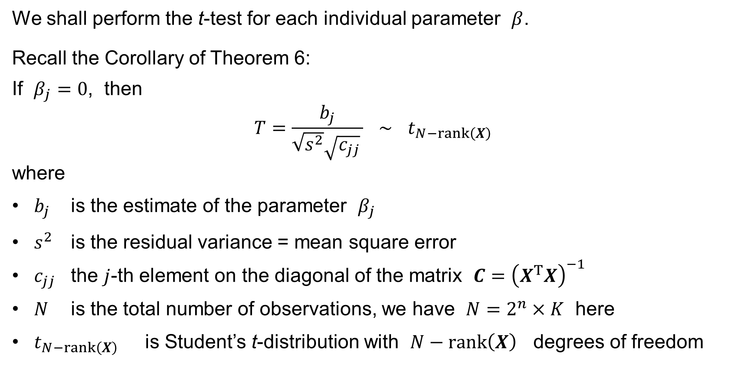
Full Factorial Experiments
We shall perform the t-test for each individual parameter $β$.
Recall the Corollary of Theorem 6:
If $β_{j}=0$, then
$$T=\frac{b_{j}}{\sqrt{s^{2}}\sqrt{c_{jj}} } ∼ t_{N−rank\left(X\right)}$$
where
$b_{j}$ is the estimate of the parameter $β_{j}$
$s^{2}$ is the residual variance = mean square error
$c_{jj}$ the $j$-th element on the diagonal of the matrix $C={\left(X^{T}X\right)}^{−1}$
$N$ is the total number of observations, we have $N=2^{n}×K$ here
$t_{N−rank\left(X\right)}$ is Student’s t-distribution with $N−rank\left(X\right)$ degrees of freedom

Slide 18
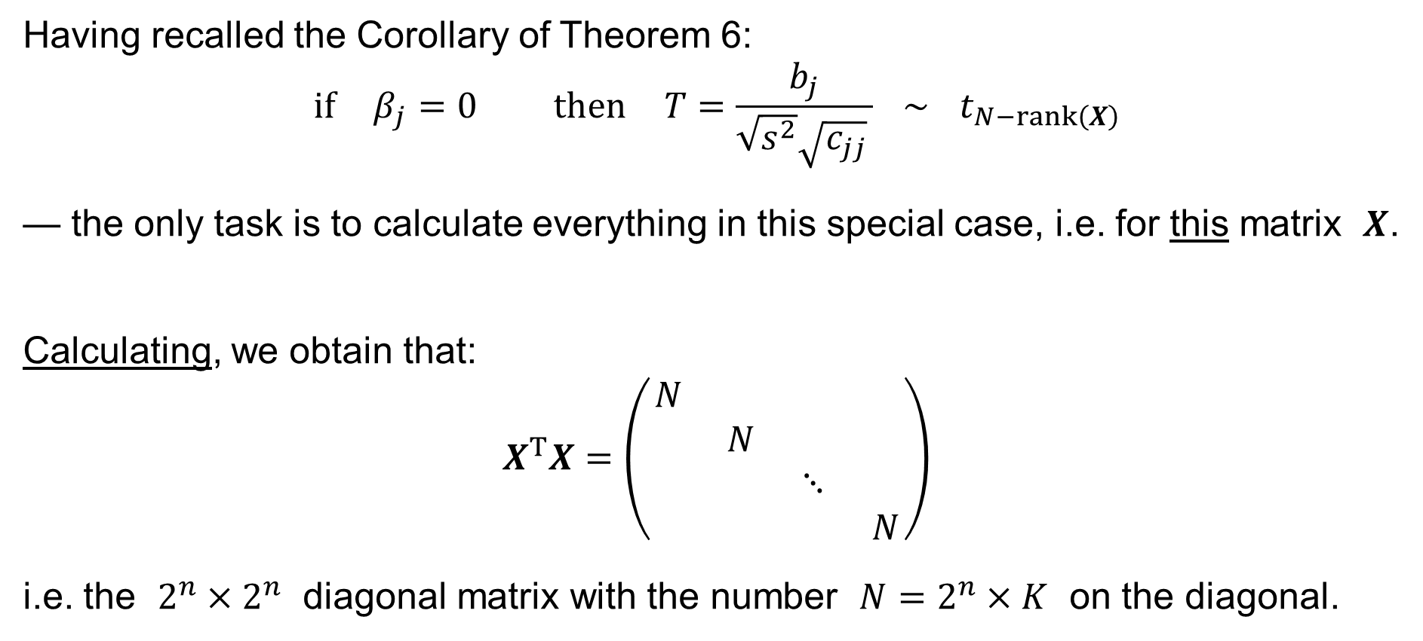
Full Factorial Experiments
Having recalled the Corollary of Theorem 6:
$$\text{if} β_{j}=0 \text{then} T=\frac{b_{j}}{\sqrt{s^{2}}\sqrt{c_{jj}} } ∼ t_{N−rank\left(X\right)}$$
— the only task is to calculate everything in this special case, i.e. for this matrix $X$.
Calculating, we obtain that:
$$X^{T}X=\left(\begin{matrix}N & & & \\ & N & & \\ & & ⋱ & \\ & & & N\end{matrix}\right)$$
i.e. the $2^{n}×2^{n}$ diagonal matrix with the number $N=2^{n}×K$ on the diagonal.

Slide 19
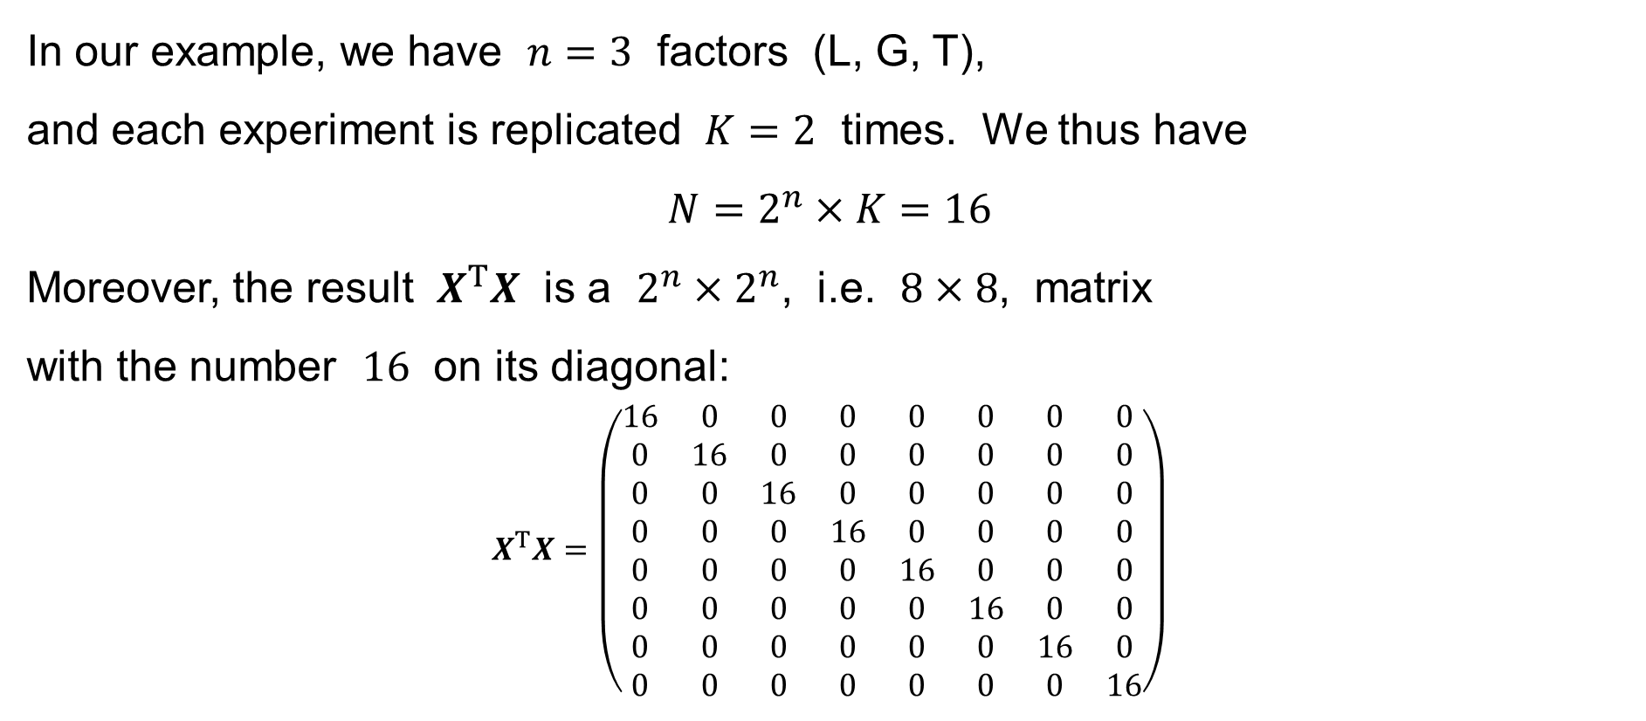
Full Factorial Experiments: Example
In our example, we have $n=3$ factors (L, G, T),
and each experiment is replicated $K=2$ times. We thus have
$$N=2^{n}×K=16$$
Moreover, the result $X^{T}X$ is a $2^{n}×2^{n}$, i.e. $8×8$, matrix
with the number $16$ on its diagonal:
$$X^{T}X=\left(\begin{matrix}16 & 0 & 0 & 0 & 0 & 0 & 0 & 0 \\ 0 & 16 & 0 & 0 & 0 & 0 & 0 & 0 \\ 0 & 0 & 16 & 0 & 0 & 0 & 0 & 0 \\ 0 & 0 & 0 & 16 & 0 & 0 & 0 & 0 \\ 0 & 0 & 0 & 0 & 16 & 0 & 0 & 0 \\ 0 & 0 & 0 & 0 & 0 & 16 & 0 & 0 \\ 0 & 0 & 0 & 0 & 0 & 0 & 16 & 0 \\ 0 & 0 & 0 & 0 & 0 & 0 & 0 & 16\end{matrix}\right)$$

Slide 20
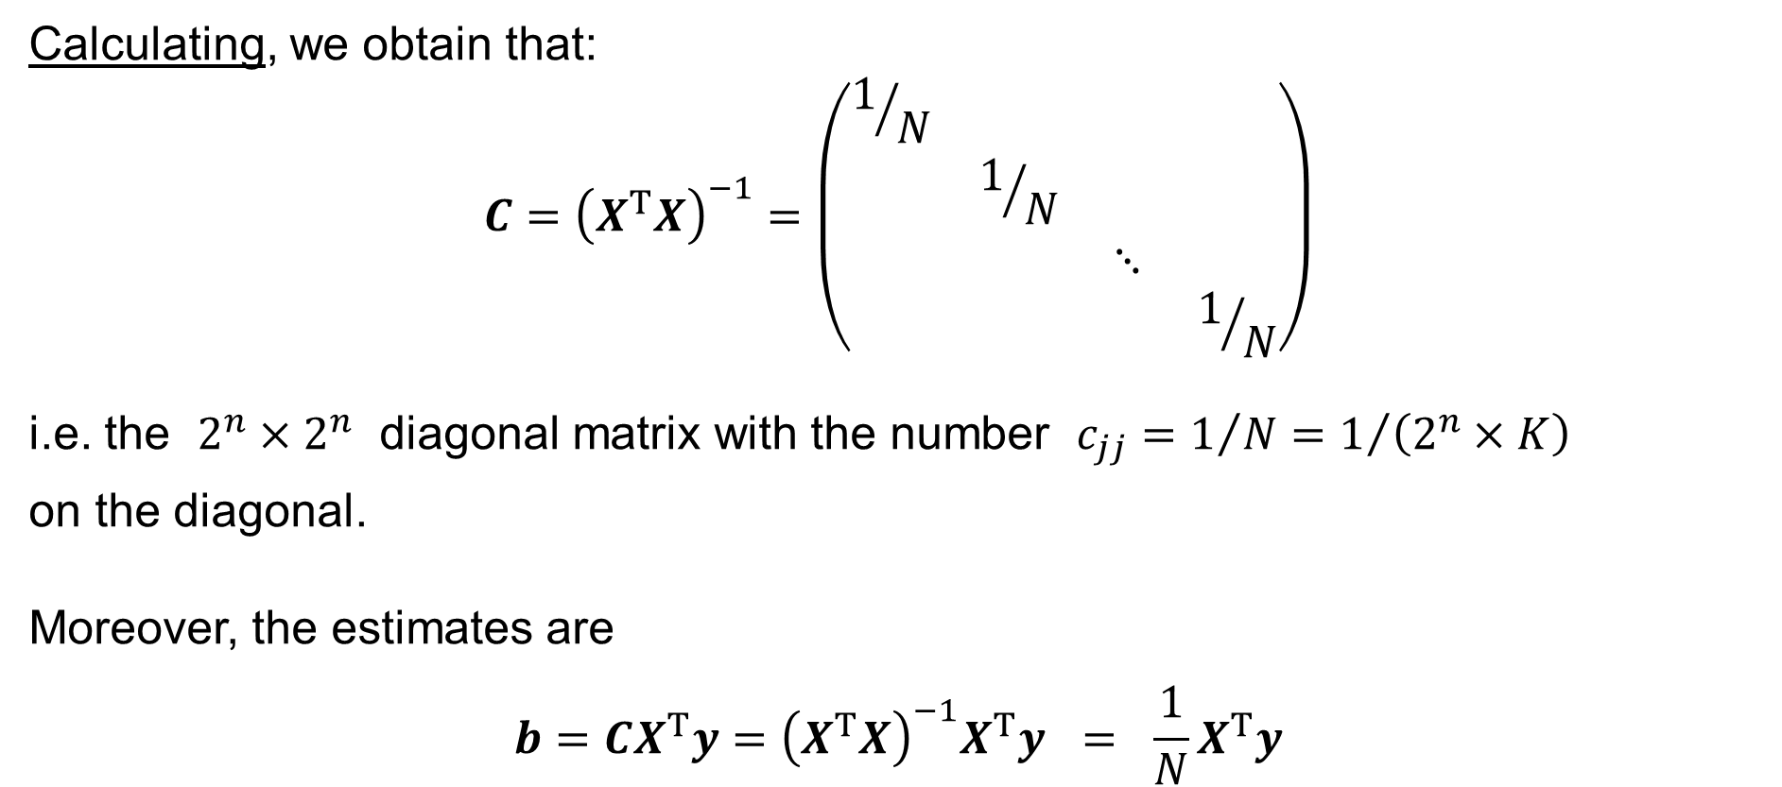
Full Factorial Experiments
Calculating, we obtain that:
$$C={\left(X^{T}X\right)}^{−1}=\left(\begin{matrix}1/N & & & \\ & 1/N & & \\ & & ⋱ & \\ & & & 1/N\end{matrix}\right)$$
i.e. the $2^{n}×2^{n}$ diagonal matrix with the number $c_{jj}=1/N=1/{\left(2^{n}×K\right)}$
on the diagonal.
Moreover, the estimates are
$$b=CX^{T}y={\left(X^{T}X\right)}^{−1}X^{T}y = \frac{1}{N}X^{T}y$$

Slide 21
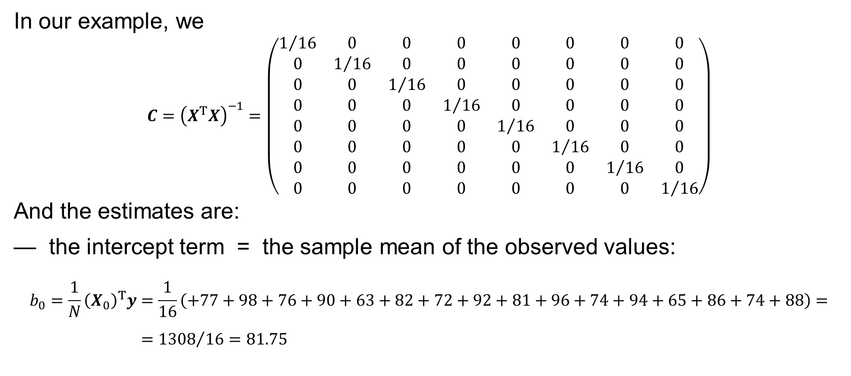
Full Factorial Experiments: Example
In our example, we
$$C={\left(X^{T}X\right)}^{−1}=\left(\begin{matrix}1/{16} & 0 & 0 & 0 & 0 & 0 & 0 & 0 \\ 0 & 1/{16} & 0 & 0 & 0 & 0 & 0 & 0 \\ 0 & 0 & 1/{16} & 0 & 0 & 0 & 0 & 0 \\ 0 & 0 & 0 & 1/{16} & 0 & 0 & 0 & 0 \\ 0 & 0 & 0 & 0 & 1/{16} & 0 & 0 & 0 \\ 0 & 0 & 0 & 0 & 0 & 1/{16} & 0 & 0 \\ 0 & 0 & 0 & 0 & 0 & 0 & 1/{16} & 0 \\ 0 & 0 & 0 & 0 & 0 & 0 & 0 & 1/{16}\end{matrix}\right)$$
And the estimates are:
— the intercept term = the sample mean of the observed values:
$$b_{0}=\frac{1}{N}{\left(X_{0}\right)}^{T}y=\frac{1}{16}\left(+77+98+76+90+63+82+72+92+81+96+74+94+65+86+74+88\right)= \\ ={1308}/{16}=81.75$$

Slide 22
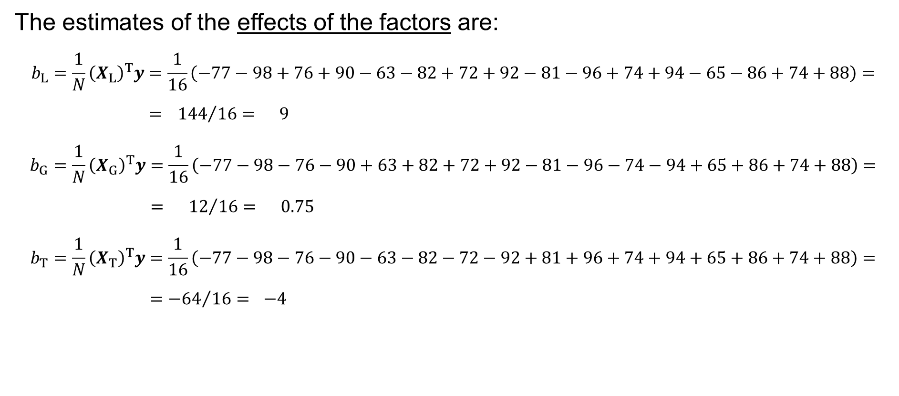
Full Factorial Experiments: Example
The estimates of the effects of the factors are:
$$b_{L}=\frac{1}{N}{\left(X_{L}\right)}^{T}y=\frac{1}{16}\left(−77−98+76+90−63−82+72+92−81−96+74+94−65−86+74+88\right)= \\ ={ 144}/{16}= 9$$
$$b_{G}=\frac{1}{N}{\left(X_{G}\right)}^{T}y=\frac{1}{16}\left(−77−98−76−90+63+82+72+92−81−96−74−94+65+86+74+88\right)= \\ ={ 12}/{16}= 0.75$$
$$b_{T}=\frac{1}{N}{\left(X_{T}\right)}^{T}y=\frac{1}{16}\left(−77−98−76−90−63−82−72−92+81+96+74+94+65+86+74+88\right)= \\ ={−64}/{16}= −4$$

Slide 23
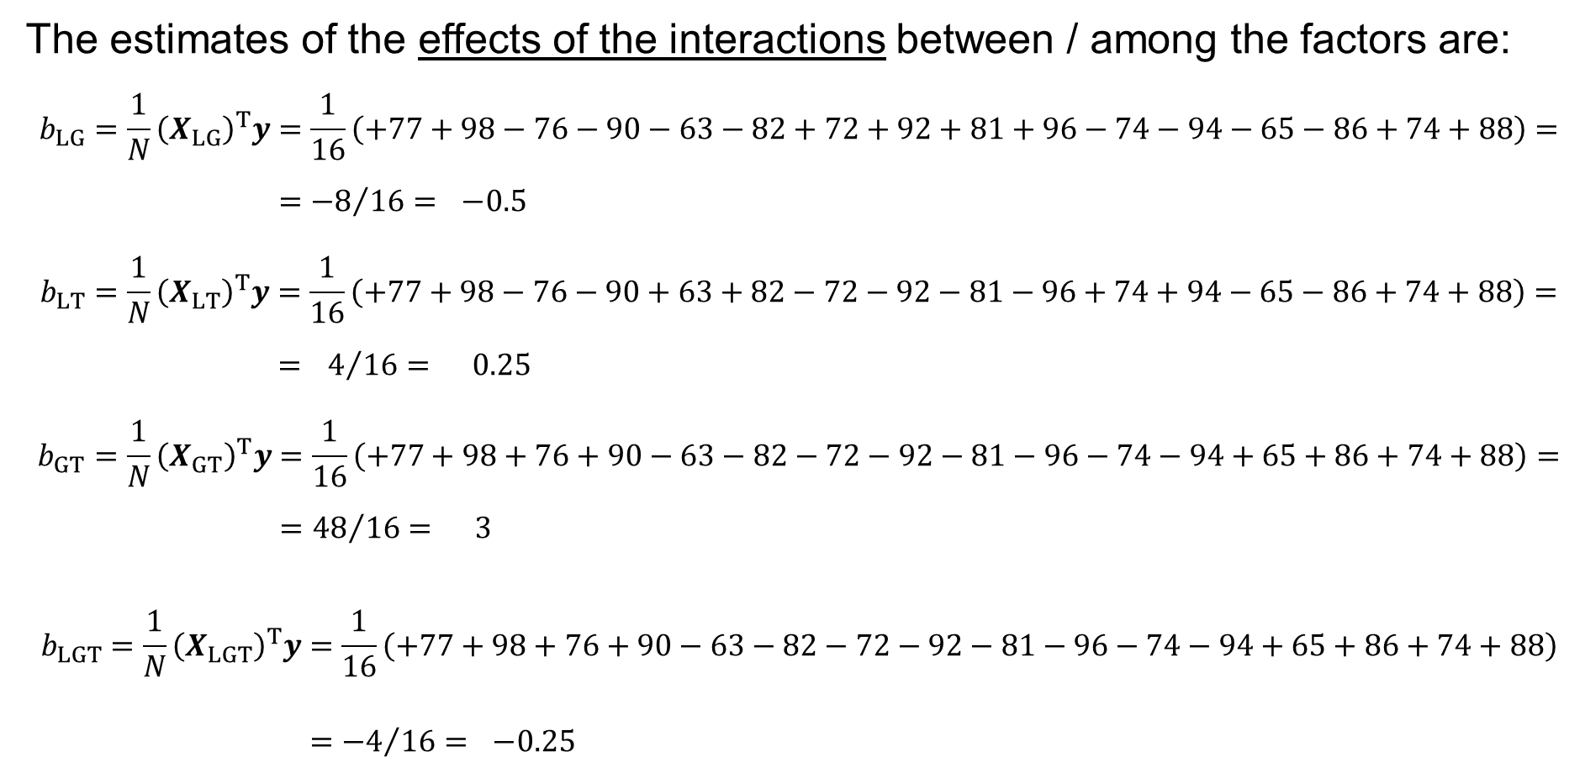
Full Factorial Experiments: Example
The estimates of the effects of the interactions between / among the factors are:
$$b_{LG}=\frac{1}{N}{\left(X_{LG}\right)}^{T}y=\frac{1}{16}\left(+77+98−76−90−63−82+72+92+81+96−74−94−65−86+74+88\right)= \\ ={−8}/{16}= −0.5$$
$$b_{LT}=\frac{1}{N}{\left(X_{LT}\right)}^{T}y=\frac{1}{16}\left(+77+98−76−90+63+82−72−92−81−96+74+94−65−86+74+88\right)= \\ ={ 4}/{16}= 0.25$$
$$b_{GT}=\frac{1}{N}{\left(X_{GT}\right)}^{T}y=\frac{1}{16}\left(+77+98+76+90−63−82−72−92−81−96−74−94+65+86+74+88\right)= \\ ={48}/{16}= 3$$
$$b_{LGT}=\frac{1}{N}{\left(X_{LGT}\right)}^{T}y=\frac{1}{16}\left(+77+98+76+90−63−82−72−92−81−96−74−94+65+86+74+88\right) \\ ={−4}/{16}= −0.25$$

Slide 24
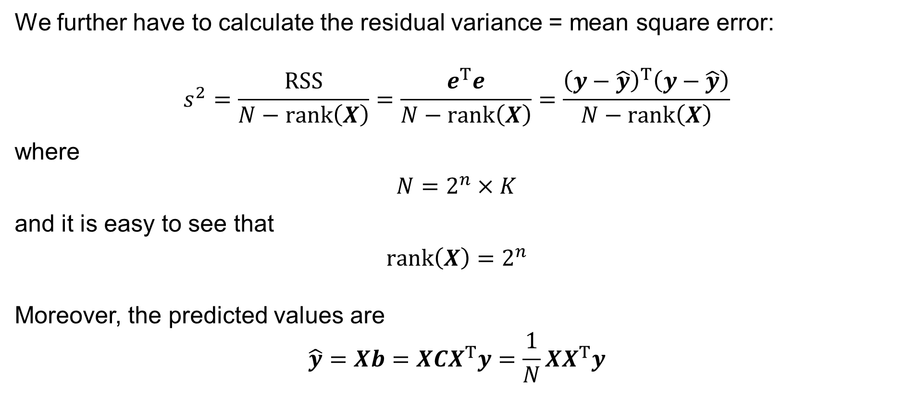
Full Factorial Experiments
We further have to calculate the residual variance = mean square error:
$$s^{2}=\frac{RSS}{N−rank\left(X\right)}=\frac{e^{T}e}{N−rank\left(X\right)}=\frac{{\left(y−\hat{y}\right)}^{T}\left(y−\hat{y}\right)}{N−rank\left(X\right)}$$
where
$$N=2^{n}×K$$
and it is easy to see that
$$rank\left(X\right)=2^{n}$$
Moreover, the predicted values are
$$\hat{y}=Xb=XCX^{T}y=\frac{1}{N}XX^{T}y$$

Slide 25
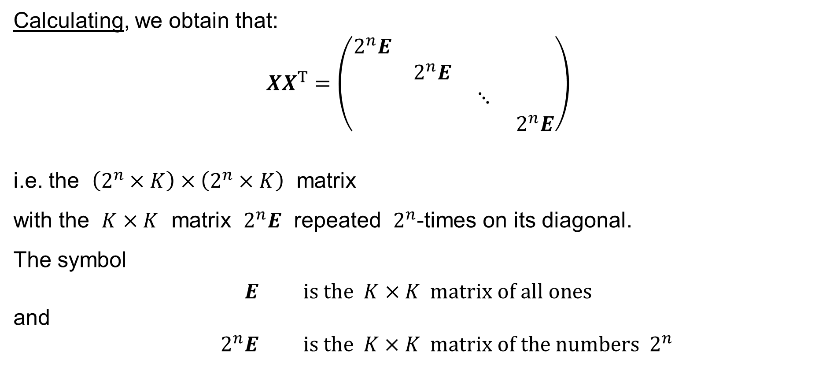
Full Factorial Experiments
Calculating, we obtain that:
$$XX^{T}=\left(\begin{matrix}2^{n}E & & & \\ & 2^{n}E & & \\ & & ⋱ & \\ & & & 2^{n}E\end{matrix}\right)$$
i.e. the $\left(2^{n}×K\right)×\left(2^{n}×K\right)$ matrix
with the $K×K$ matrix $2^{n}E$ repeated $2^{n}$-times on its diagonal.
The symbol
$$E \text{is} \text{the} K×K \text{matrix} \text{of} \text{all} \text{ones}$$
and
$$2^{n}E \text{is} \text{the} K×K \text{matrix} \text{of} \text{the} \text{numbers} 2^{n}$$

Slide 26

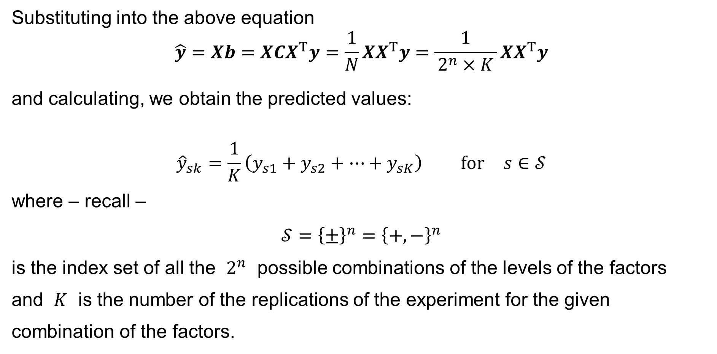
Full Factorial Experiments
Substituting into the above equation
$$\hat{y}=Xb=XCX^{T}y=\frac{1}{N}XX^{T}y=\frac{1}{ 2^{n}×K }XX^{T}y$$
and calculating, we obtain the predicted values:
$${\hat{y}}_{sk}=\frac{1}{K}\left(y_{s1}+y_{s2}+⋯+y_{sK}\right) \text{for} s∈𝒮$$
where – recall –
$$𝒮={\left\{±\right\}}^{n}={\left\{+,−\right\}}^{n}$$
is the index set of all the $2^{n}$ possible combinations of the levels of the factors
and $K$ is the number of the replications of the experiment for the given combination of the factors.
$$\text{for} k=1, 2,…,K$$

Slide 27
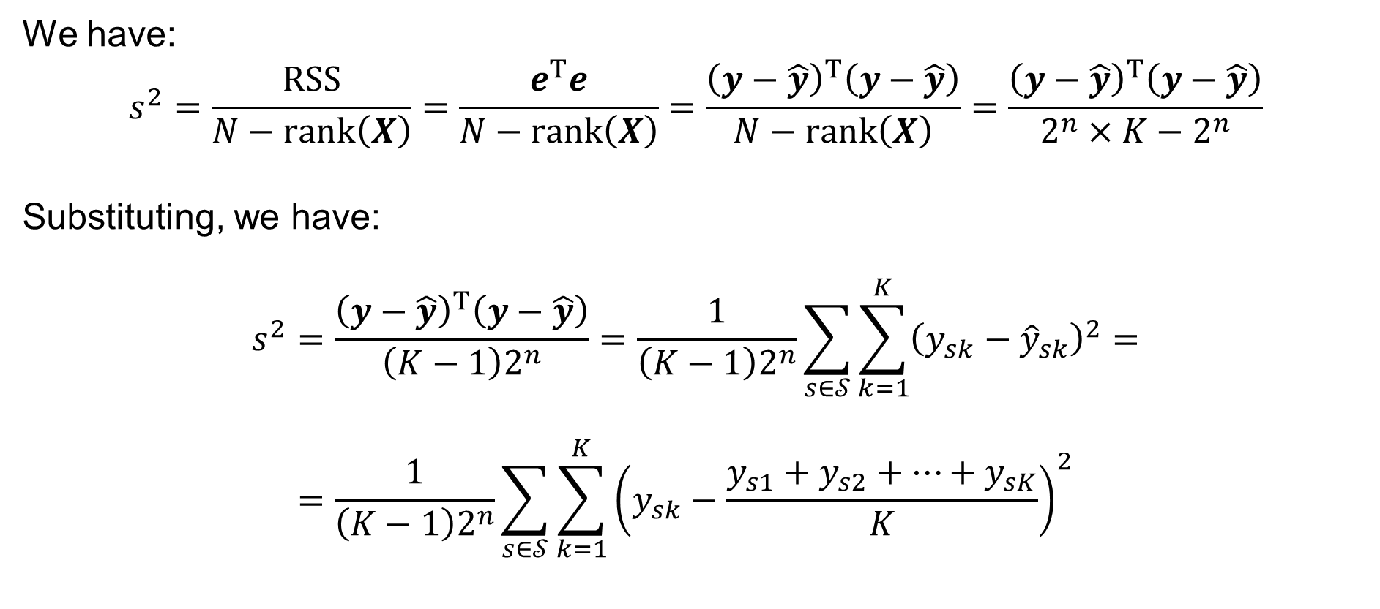
Full Factorial Experiments
We have:
$$s^{2}=\frac{RSS}{N−rank\left(X\right)}=\frac{e^{T}e}{N−rank\left(X\right)}=\frac{{\left(y−\hat{y}\right)}^{T}\left(y−\hat{y}\right)}{N−rank\left(X\right)}=\frac{{\left(y−\hat{y}\right)}^{T}\left(y−\hat{y}\right)}{2^{n}×K−2^{n}}$$
Substituting, we have:
$$s^{2}=\frac{{\left(y−\hat{y}\right)}^{T}\left(y−\hat{y}\right)}{\left(K−1\right)2^{n}}=\frac{1}{\left(K−1\right)2^{n}}\sum_{s∈𝒮}{\sum_{k=1}^{K}{{\left(y_{sk}−{\hat{y}}_{sk}\right)}^{2}}}= \\ =\frac{1}{\left(K−1\right)2^{n}}\sum_{s∈𝒮}{\sum_{k=1}^{K}{{\left(y_{sk}−\frac{y_{s1}+y_{s2}+⋯+y_{sK}}{K}\right)}^{2}}}$$

Slide 28
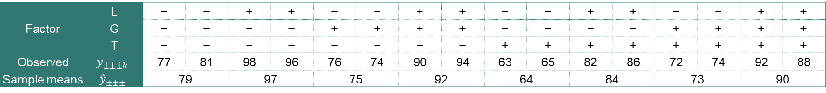
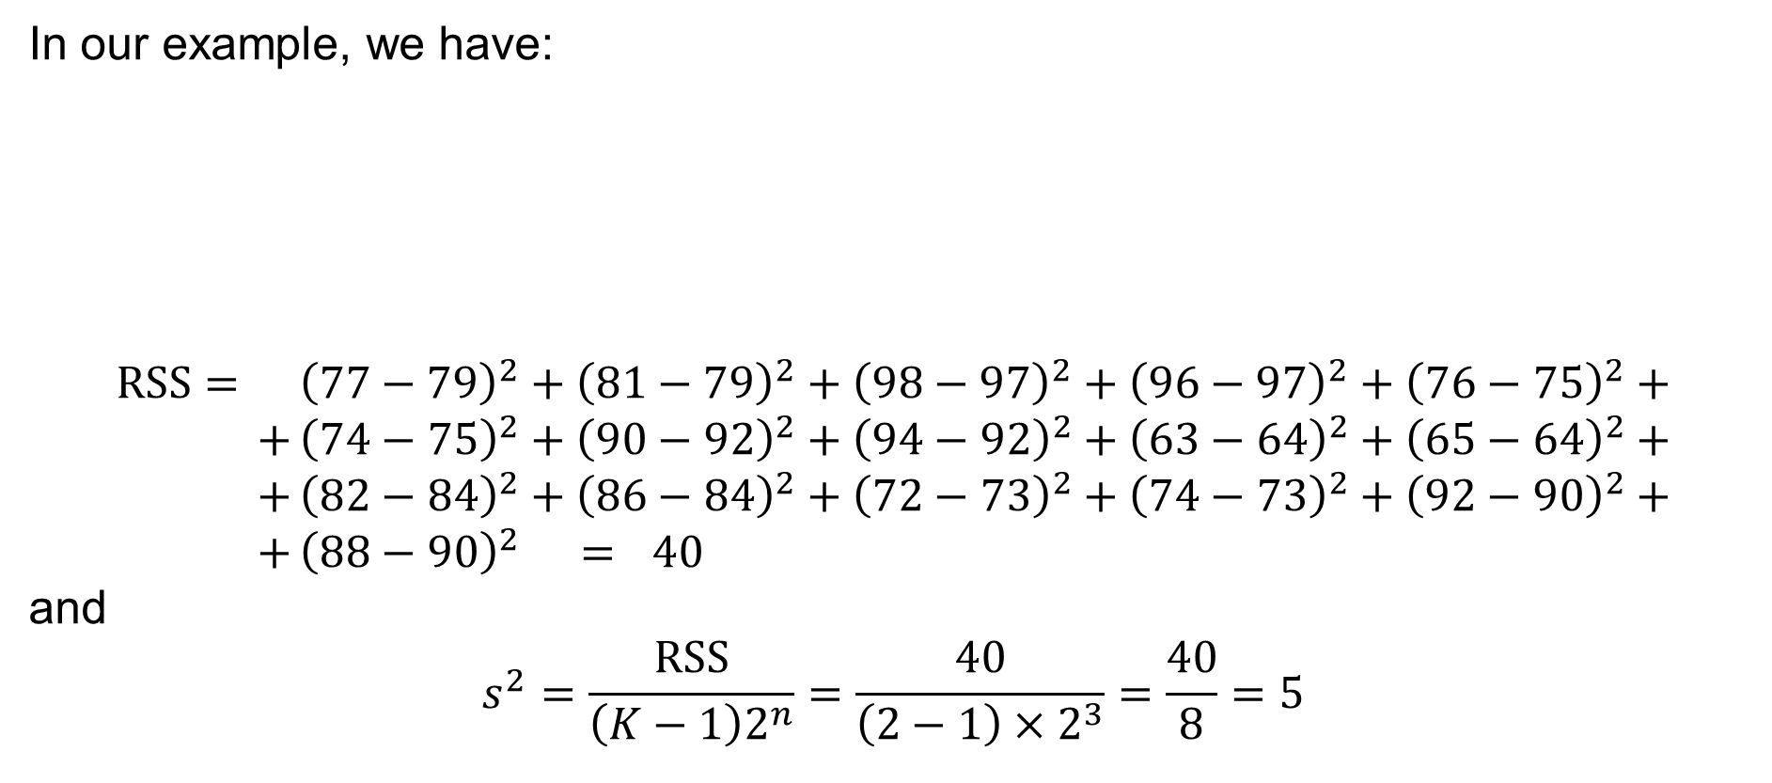
Full Factorial Experiments: Example
In our example, we have:
$$RSS= {\left(77−79\right)}^{2}+{\left(81−79\right)}^{2}+{\left(98−97\right)}^{2}+{\left(96−97\right)}^{2}+{\left(76−75\right)}^{2}+ \\ + {\left(74−75\right)}^{2}+{\left(90−92\right)}^{2}+{\left(94−92\right)}^{2}+{\left(63−64\right)}^{2}+{\left(65−64\right)}^{2}+ \\ + {\left(82−84\right)}^{2}+{\left(86−84\right)}^{2}+{\left(72−73\right)}^{2}+{\left(74−73\right)}^{2}+{\left(92−90\right)}^{2}+ \\ + {\left(88−90\right)}^{2} = 40$$
and
$$s^{2}=\frac{RSS}{\left(K−1\right)2^{n}}=\frac{40}{\left(2−1\right)×2^{3}}=\frac{40}{8}=5$$
Factor | L | − | − | + | + | − | − | + | + | − | − | + | + | − | − | + | +
 | G | − | − | − | − | + | + | + | + | − | − | − | − | + | + | + | +
 | T | − | − | − | − | − | − | − | − | + | + | + | + | + | + | + | +
Observed | $$y_{±±±k}$$ | 77 | 81 | 98 | 96 | 76 | 74 | 90 | 94 | 63 | 65 | 82 | 86 | 72 | 74 | 92 | 88
Sample means | $${\hat{y}}_{±±±}$$ | 79 |  | 97 |  | 75 |  | 92 |  | 64 |  | 84 |  | 73 |  | 90

Slide 29

Full Factorial Experiments
Finally, we calculate the statistic
$$T=\frac{b_{j}}{\sqrt{s^{2}}\sqrt{c_{jj}} }= \\ =\frac{\frac{1}{N}{\left(X_{j}\right)}^{T}y}{\sqrt{\frac{RSS}{\left(K−1\right)2^{n}} }\sqrt{\frac{1}{N} } }=\sqrt{\frac{1}{K2^{n}} }{\left(X_{j}\right)}^{T}y\sqrt{\frac{\left(K−1\right)2^{n}}{RSS} }=\sqrt{\frac{{\left(K−1\right)}/K}{RSS} } {\left(X_{j}\right)}^{T}y$$

Slide 30
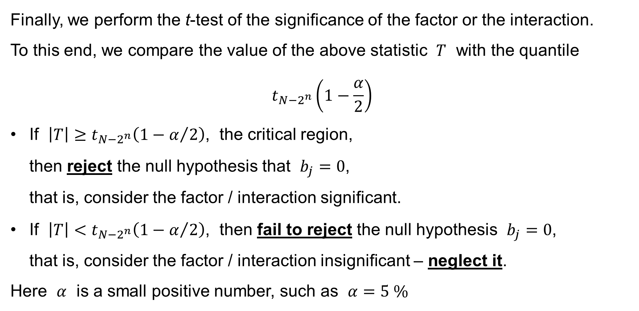
Full Factorial Experiments
Finally, we perform the t-test of the significance of the factor or the interaction.
To this end, we compare the value of the above statistic $T$ with the quantile
$$t_{N−2^{n}}\left(1−\frac{α}{2}\right)$$
If $\left|T\right|≥t_{N−2^{n}}\left(1−α/2\right)$, the critical region,
then reject the null hypothesis that $b_{j}=0$,
that is, consider the factor / interaction significant.
If $\left|T\right|<t_{N−2^{n}}\left(1−α/2\right)$, then fail to reject the null hypothesis $b_{j}=0$,
that is, consider the factor / interaction insignificant – neglect it.
Here $α$ is a small positive number, such as $α=5 \%$

Slide 31
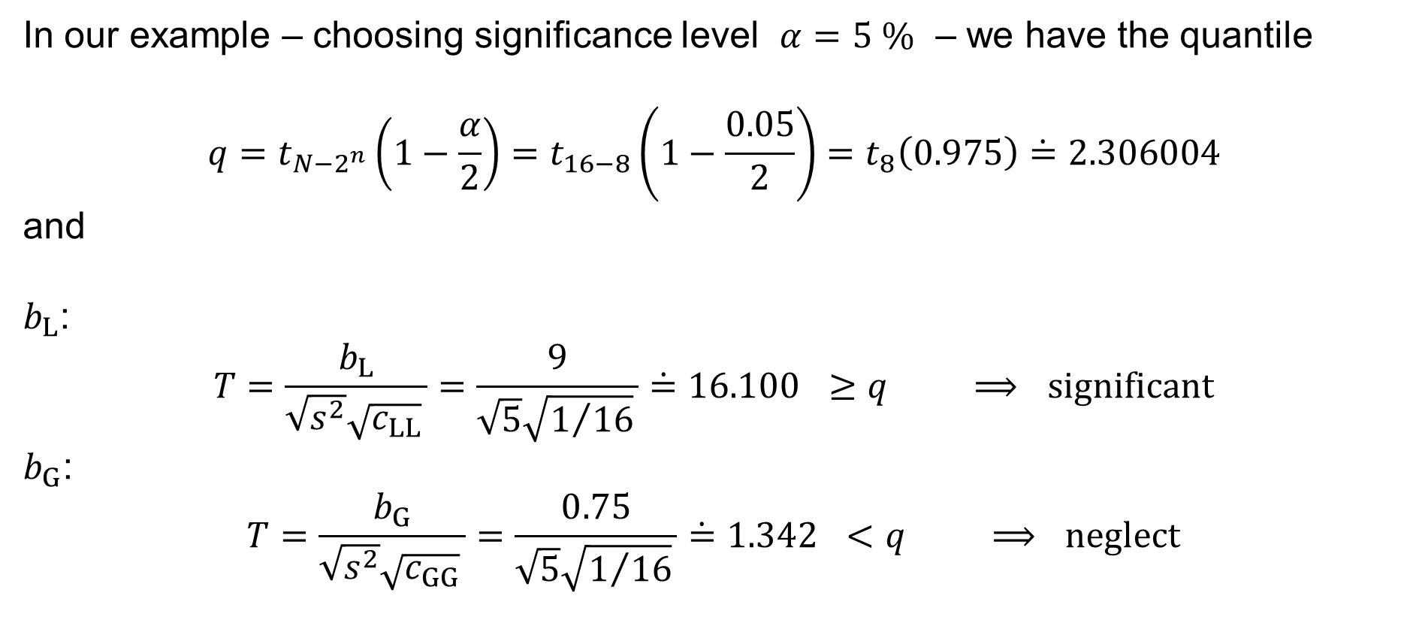
Full Factorial Experiments: Example
In our example – choosing significance level $α=5 \%$ – we have the quantile
$$q=t_{N−2^{n}}\left(1−\frac{α}{2}\right)=t_{16−8}\left(1−\frac{0.05}{2}\right)=t_{8}\left(0.975\right)\dot{=}2.306004$$
and
$b_{L}$:
$$T=\frac{b_{L}}{\sqrt{s^{2}}\sqrt{c_{LL}} }=\frac{9}{\sqrt{5}\sqrt{1/{16}} }\dot{=}16.100 ≥q ⟹ \text{significant}$$
$b_{G}$:
$$T=\frac{b_{G}}{\sqrt{s^{2}}\sqrt{c_{GG}} }=\frac{0.75}{\sqrt{5}\sqrt{1/{16}} }\dot{=}1.342 <q ⟹ \text{n}\text{eglec}\text{t}$$

Slide 32
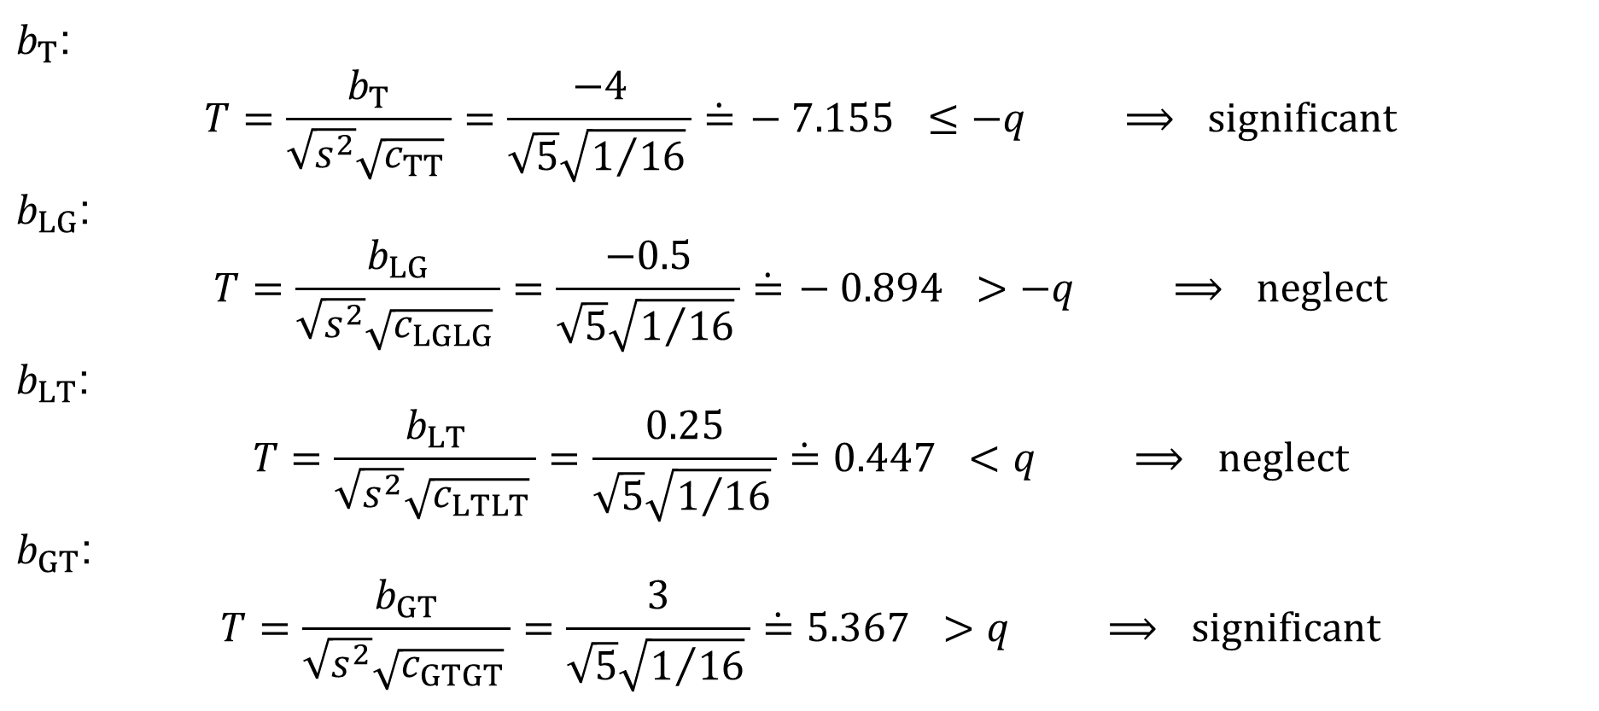
Full Factorial Experiments: Example
$b_{T}$:
$$T=\frac{b_{T}}{\sqrt{s^{2}}\sqrt{c_{TT}} }=\frac{−4}{\sqrt{5}\sqrt{1/{16}} }\dot{=} −7.155 ≤−q ⟹ \text{significant}$$
$b_{LG}$:
$$T=\frac{b_{LG}}{\sqrt{s^{2}}\sqrt{c_{LGLG}} }=\frac{−0.5}{\sqrt{5}\sqrt{1/{16}} }\dot{=} −0.894 >−q ⟹ \text{n}\text{eglec}\text{t}$$
$b_{LT}$:
$$T=\frac{b_{LT}}{\sqrt{s^{2}}\sqrt{c_{LTLT}} }=\frac{0.25}{\sqrt{5}\sqrt{1/{16}} }\dot{=}0.447 <q ⟹ \text{n}\text{eglec}\text{t}$$
$b_{GT}$:
$$T=\frac{b_{GT}}{\sqrt{s^{2}}\sqrt{c_{GTGT}} }=\frac{3}{\sqrt{5}\sqrt{1/{16}} }\dot{=}5.367 >q ⟹ \text{significan}\text{t}$$

Slide 33
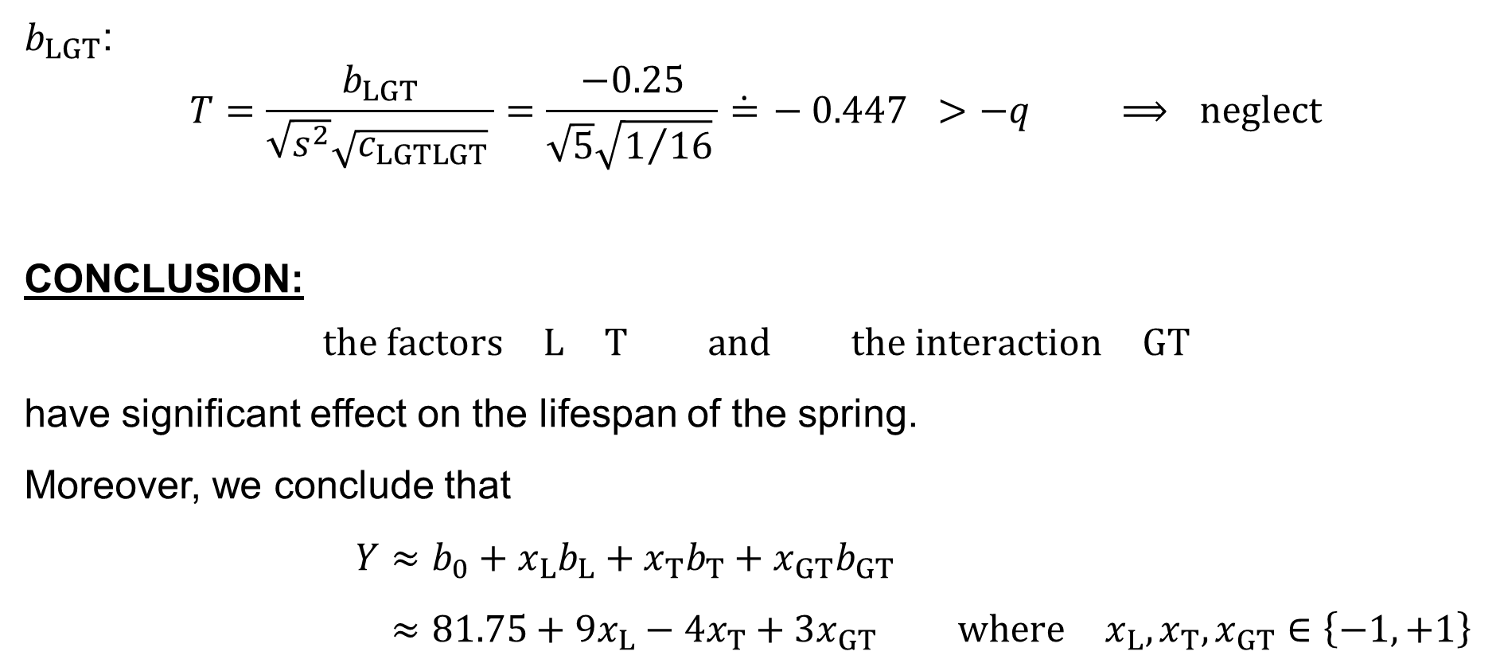
Full Factorial Experiments: Example
$b_{LGT}$:
$$T=\frac{b_{LGT}}{\sqrt{s^{2}}\sqrt{c_{LGTLGT}} }=\frac{−0.25}{\sqrt{5}\sqrt{1/{16}} }\dot{=} −0.447 >−q ⟹ \text{neglect}$$
CONCLUSION:
$$\text{the} \text{factors} L T \text{and} \text{the} \text{interaction} GT$$
have significant effect on the lifespan of the spring.
Moreover, we conclude that
$$Y≈b_{0}+x_{L}b_{L}+x_{T}b_{T}+x_{GT}b_{GT} \\ ≈81.75+9x_{L}−4x_{T}+3x_{GT} \text{where} x_{L},x_{T},x_{GT}∈\left\{−1,+1\right\}$$

Slide 34
Graphical assessment of factor / interaction significance

Slide 35
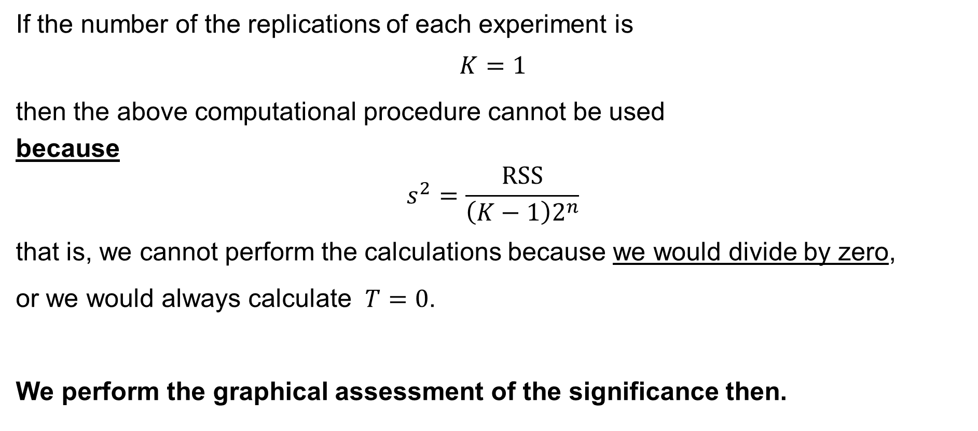
Full Factorial Experiments
If the number of the replications of each experiment is
$$K=1$$
then the above computational procedure cannot be used
because
$$s^{2}=\frac{RSS}{\left(K−1\right)2^{n}}$$
that is, we cannot perform the calculations because we would divide by zero,
or we would always calculate $T=0$.
We perform the graphical assessment of the significance then.

Slide 36
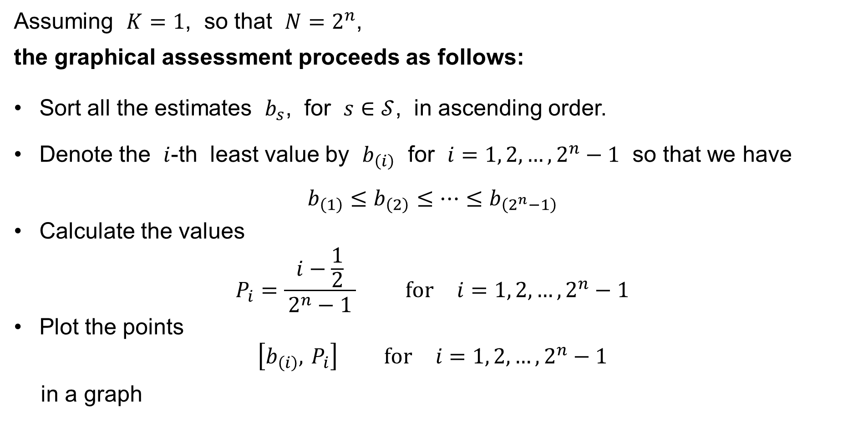
Full Factorial Experiments
Assuming $K=1$, so that $N=2^{n}$,
the graphical assessment proceeds as follows:
Sort all the estimates $b_{s}$, for $s∈𝒮$, in ascending order.
Denote the $i$-th least value by $b_{\left(i\right)}$ for $i=1, 2,…,2^{n}−1$ so that we have
$b_{\left(1\right)}≤b_{\left(2\right)}≤⋯≤b_{\left(2^{n}−1\right)}$
Calculate the values
$P_{i}=\frac{i−\frac{1}{2}}{ 2^{n}−1 } \text{for} i=1, 2,…,2^{n}−1$
Plot the points
$\left[b_{\left(i\right)}, P_{i}\right] \text{for} i=1, 2,…,2^{n}−1$
in a graph

Slide 37

Full Factorial Experiments: Example
In our example, we have:
$$b_{T}<b_{LG}<b_{LGT}<b_{LT}<b_{G}<b_{GT}<b_{L}$$
$$−4<−0.5<−0.25<0.25<0.75<3<9$$
and $P_{i}$:
$$\frac{0.5}{7}<\frac{1.5}{7}<\frac{2.5}{7}<\frac{3.5}{7}<\frac{4.5}{7}<\frac{5.5}{7}<\frac{6.5}{7}$$

Slide 38

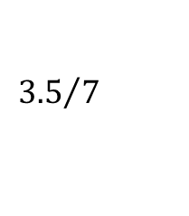




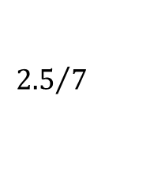


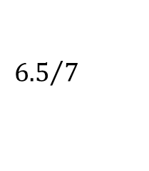


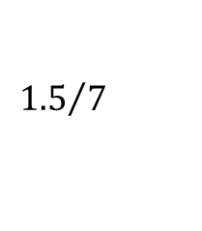


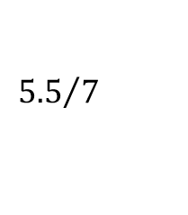

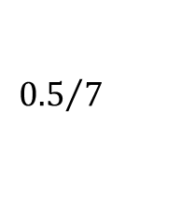



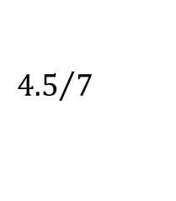

Full Factorial Experiments: Example
$$P$$
$$b_{L}$$
$${6.5}/7$$
$$b_{GT}$$
$${5.5}/7$$
$$b_{G}$$
$${4.5}/7$$
$$b_{LT}$$
$${3.5}/7$$
$$b_{LGT}$$
$${2.5}/7$$
$$b_{LG}$$
$${1.5}/7$$
$$b_{T}$$
$${0.5}/7$$
$$−4$$
$$−0.5$$
$$0.25$$
$$3$$
$$9$$
effect $b$
$$−0.25$$
$$0.75$$

Slide 39
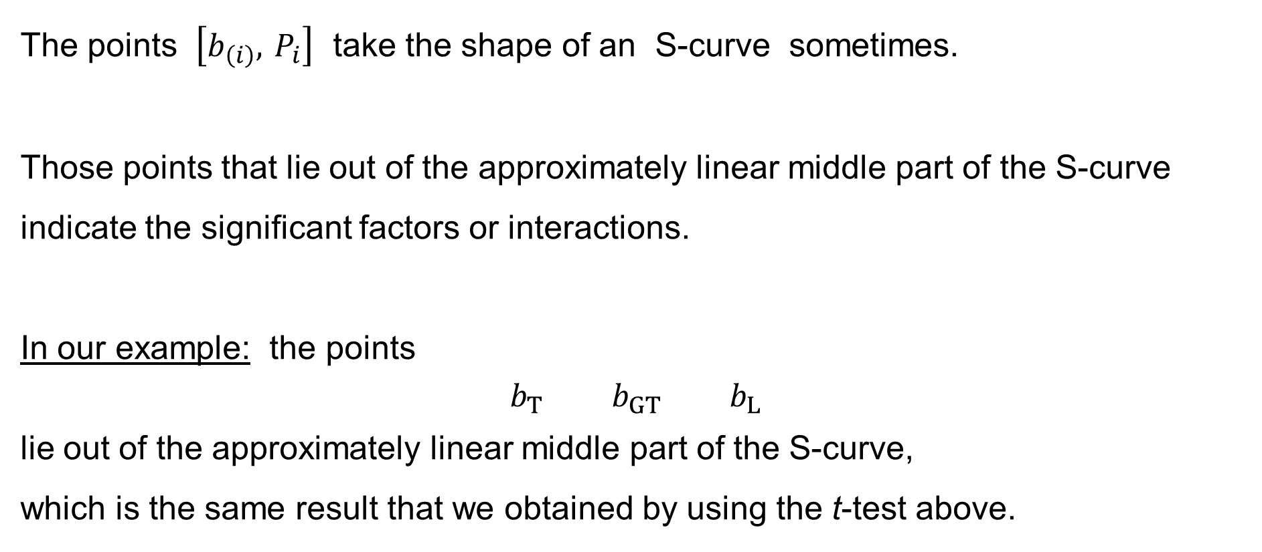
Full Factorial Experiments: Graphical assessment
The points $\left[b_{\left(i\right)}, P_{i}\right]$ take the shape of an S-curve sometimes.
Those points that lie out of the approximately linear middle part of the S-curve
indicate the significant factors or interactions.
In our example: the points
$$b_{T} b_{GT} b_{L}$$
lie out of the approximately linear middle part of the S-curve,
which is the same result that we obtained by using the t-test above.

Slide 40
Graphs of interaction effects

Slide 41
Full Factorial Experiments: Interaction effect
There is an interaction effect between two factors in a full factorial experiment
when the effect of one independent variable (factor) depends on the level
of another independent variable (factor).
Considering two factors A and B, take
all the observations when factors A and B were at the levels −−, respectively
all the observations when factors A and B were at the levels −+, respectively
all the observations when factors A and B were at the levels +−, respectively
all the observations when factors A and B were at the levels ++, respectively
and calculate the average (sample mean) for each of the four groups

Slide 42





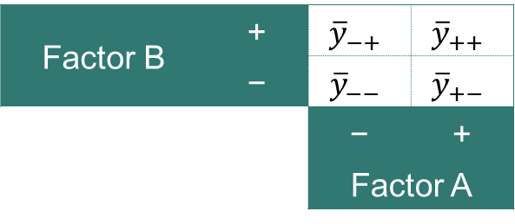






Full Factorial Experiments: Interaction effect
We then have:
We then depict the values in the form of a chart
(here as the dependence of Factor B on Factor A):
If the lines are ≈ parallel,
then the interaction is not significant.
If the lines are not parallel,
then the interaction is significant.
Factor B | + | $${\overline{y}}_{−+}$$ | $${\overline{y}}_{++}$$
 | − | $${\overline{y}}_{−−}$$ | $${\overline{y}}_{+−}$$
 |  | − | +
 |  | Factor A
$$y$$
$$y$$
$${\overline{y}}_{−−}$$
$$B_{−}$$
$${\overline{y}}_{+−}$$
$${\overline{y}}_{−+}$$
$$B_{+}$$
$${\overline{y}}_{++}$$
$$−$$
$$+$$
Factor $A$

Slide 43
Full Factorial Experiments: Example
In our example, we have:
Factor | L | − | − | + | + | − | − | + | + | − | − | + | + | − | − | + | +
 | G | − | − | − | − | + | + | + | + | − | − | − | − | + | + | + | +
 | T | − | − | − | − | − | − | − | − | + | + | + | + | + | + | + | +
Observed | $$y_{±±±k}$$ | 77 | 81 | 98 | 96 | 76 | 74 | 90 | 94 | 63 | 65 | 82 | 86 | 72 | 74 | 92 | 88
Factor G | + | 76, 74, 72, 74 | 90, 94, 92, 88
 |  | 74 | 91
 | − | 77, 81, 63, 65 | 98, 96, 82, 86
 |  | 71.5 | 90.5
 |  | − | +
 |  | Factor L
Factor T | + | 63, 65, 72, 74 | 82, 86, 92, 88
 |  | 68.5 | 87
 | − | 77, 81, 76, 74 | 98, 96, 90, 94
 |  | 77 | 94.5
 |  | − | +
 |  | Factor L

Slide 44




Full Factorial Experiments: Example
$$y$$
$$y$$
G | + | 74 | 91
 | − | 71.5 | 90.5
 |  | − | +
 |  | L
91
90.5
G₊
G₋
74
71.5
−
+
Factor L
$$y$$
$$y$$
L | + | 90.5 | 91
 | − | 71.5 | 74
 |  | − | +
 |  | G
90.5
91
L₊
L₋
74
71.5
−
+
Factor G
≈ parallel ⇨ the interaction is not significant

Slide 45
Full Factorial Experiments: Example
$$y$$
$$y$$
T | + | 68.5 | 87
 | − | 77 | 94.5
 |  | − | +
 |  | L
94.5
T₋
87
77
T₊
68.5
−
+
Factor L
$$y$$
$$y$$
L | + | 94.5 | 87
 | − | 77 | 68.5
 |  | − | +
 |  | T
94.5
L₊
87
77
L₋
68.5
−
+
Factor T
≈ parallel ⇨ the interaction is not significant

Slide 46
Full Factorial Experiments: Example
$$y$$
$$y$$
T | + | 74 | 83.5
 | − | 88 | 81.5
 |  | − | +
 |  | G
88
T₋
83.5
81.5
T₊
74
−
+
Factor G
$$y$$
$$y$$
G | + | 81.5 | 83.5
 | − | 88 | 74
 |  | − | +
 |  | T
88
G₋
83.5
81.5
G₊
74
−
+
Factor T
NOT parallel ⇨ the interaction is SIGNIFICANT

