Slide 1

ANOVA
Analysis of Variance – One Way
Ing. Elena Mielcová, Ph.D.
STATISTICAL DATA PROCESSING/NPSTZ

Slide 2
ANOVA: Analysis of Variance – One Factor
Outline of the lecture
One-way ANOVA
Sources of Variability
ANOVA Hypothesis
ANOVA Test
Statistical Software: ANOVA Tests
Correlation Ratio

Slide 3
ANOVA: Analysis of Variance – One Factor
ANOVA
ANOVA = Analysis of Variance
ANOVA
  one of the most frequently used statistical procedures in marketing as well as other areas of data analysis.
  this method enables one to assess the potential influence of a qualitative or quantitative variable on another quantitative variable.
Example of ANOVA use:
  to evaluate effects of different forms of a promotional campaign on the sales of a product. In this case, different promotional campaigns resent different categories of the observed qualitative variable = promotional campaign. The sales are then the quantitative variable in question.

Slide 4
ANOVA: Analysis of Variance – One Factor
ANOVA
Effects of factors:
  potential effect can be expressed mathematically in such a way that the expression analyses whether a change in the level of the qualitative/quantitative variable changes the population mean of the other observed quantitative variable.
  In this sense, ANOVA tests if there are any differences among the population means of the quantitative variable.
  ANOVA is based on decomposition of what is called the total variability of the observed variable.
  Depending on how many main sources or factors appear in the decomposition, we talk about one-way ANOVA, two-way ANOVA and so on.

Slide 5
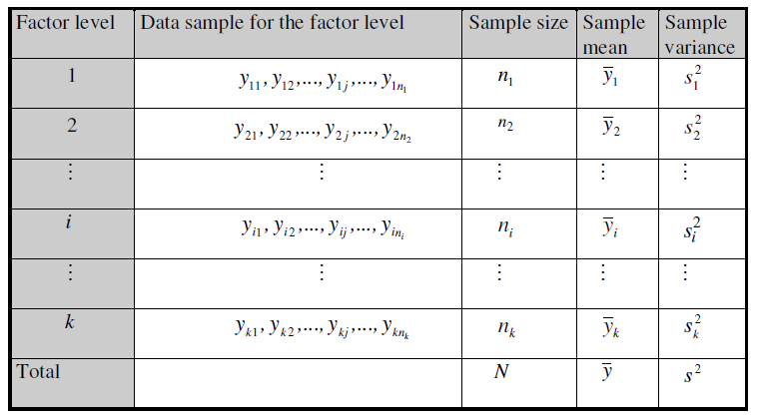
ANOVA: Analysis of Variance – One Factor
One – Way ANOVA

Slide 6
ANOVA: Analysis of Variance – One Factor
One – Way ANOVA
Statistical test
The main principle of the analysis of variance is to decompose the total variability of the observed variable.
The total variability, measured by the sum of squared deviations of the individual values of the variable from their average, is divided by the decomposition into a part that reflects a variability within the samples and a part which reflects a variability between the samples.

Slide 7

ANOVA: Analysis of Variance – One Factor
Sources of Variability
Total sum of squares (total variation):
$$S_{y}=\sum_{i=1}^{k}{\sum_{j=1}^{n_{i}}{{( y_{ij}−\overline{y} )}^{2}}}$$
Where
$$\overline{y}=\frac{\sum_{i=1}^{k}{\sum_{j=1}^{n_{i}}{y_{ij}}}}{N}$$

Slide 8

ANOVA: Analysis of Variance – One Factor
Sources of Variability
Within-group variation, also called residual variation:
$$S_{yv}=\sum_{i=1}^{k}{\sum_{j=1}^{n_{i}}{{( y_{ij}−{\overline{y}}_{i} )}^{2}}}$$
Where
$${\overline{y}}_{i}=\frac{\sum_{j=1}^{n_{i}}{y_{ij}}}{n_{i}}$$

Slide 9
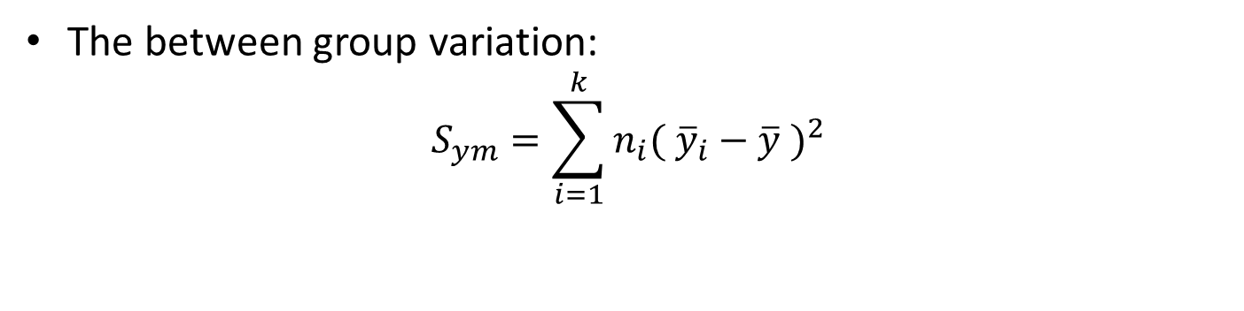
ANOVA: Analysis of Variance – One Factor
Sources of Variability
The between group variation:
$$S_{ym}=\sum_{i=1}^{k}{{n_{i}( {\overline{y}}_{i}−\overline{y} )}^{2}}$$

Slide 10
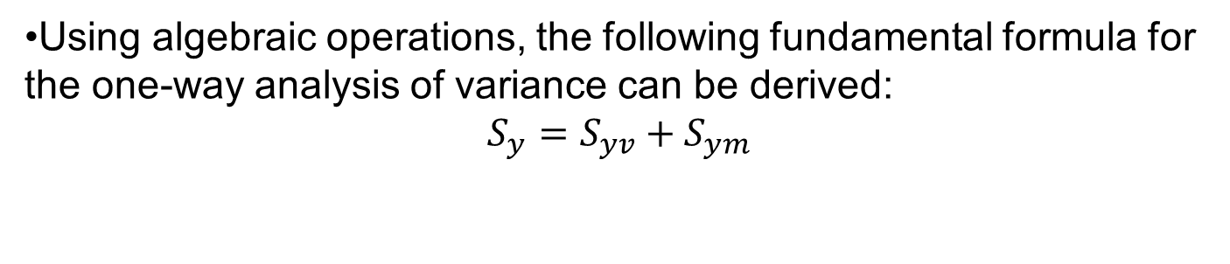
ANOVA: Analysis of Variance – One Factor
Sources of Variability
Using algebraic operations, the following fundamental formula for the one-way analysis of variance can be derived:
$$S_{y}=S_{yv}+S_{ym}$$

Slide 11
ANOVA: Analysis of Variance – One Factor
ANOVA Hypothesis
Analysis of variance is a statistical test.
  Therefore, we work with a pair of hypotheses: a null hypothesis and an alternative hypothesis.
ANOVA has its conditions under which it was derived:
  The method assumes that each of the k random samples comes from a normal distribution, and the distributions have the same variance.
  Also, the samples were drawn independently of each other. In analysis of variance, more than two samples are usually worked with, and

Slide 12
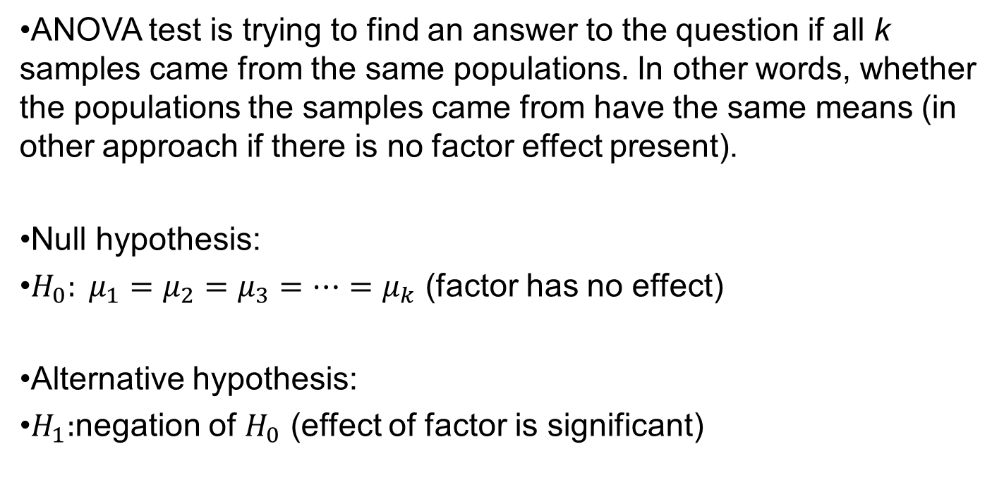
ANOVA: Analysis of Variance – One Factor
ANOVA Hypothesis
ANOVA test is trying to find an answer to the question if all k samples came from the same populations. In other words, whether the populations the samples came from have the same means (in other approach if there is no factor effect present).
Null hypothesis:
$H_{0}: μ_{1}=μ_{2}=μ_{3}=…=μ_{k}$ (factor has no effect)
Alternative hypothesis:
$H_{1}:$negation of $H_{0}$ (effect of factor is significant)

Slide 13

ANOVA: Analysis of Variance – One Factor
ANOVA – Test Criterion
Test criterion:
$T=\frac{\frac{S_{ym}}{k−1}}{\frac{S_{yv}}{N−k}}$
follows a Fisher’s distribution with k-1 and N-k degrees of freedom.

Slide 14
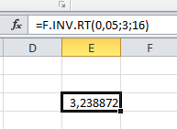
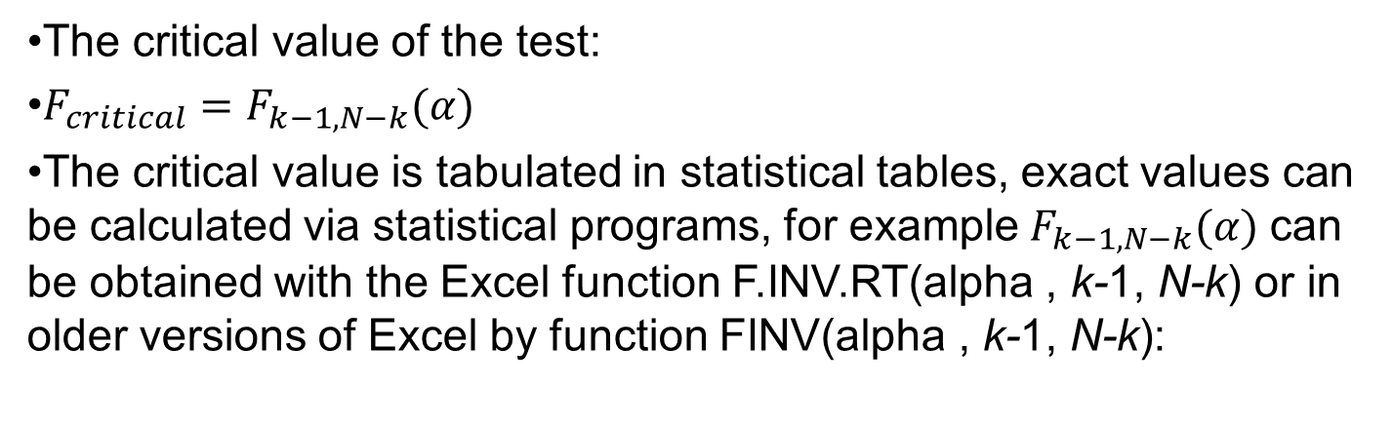
ANOVA: Analysis of Variance – One Factor
ANOVA – Critical Value
The critical value of the test:
$F_{critical}=F_{k−1, N−k}(α)$
The critical value is tabulated in statistical tables, exact values can be calculated via statistical programs, for example$F_{k−1, N−k}(α)$ can be obtained with the Excel function F.INV.RT(alpha , k-1, N-k) or in older versions of Excel by function FINV(alpha , k-1, N-k):

Slide 15
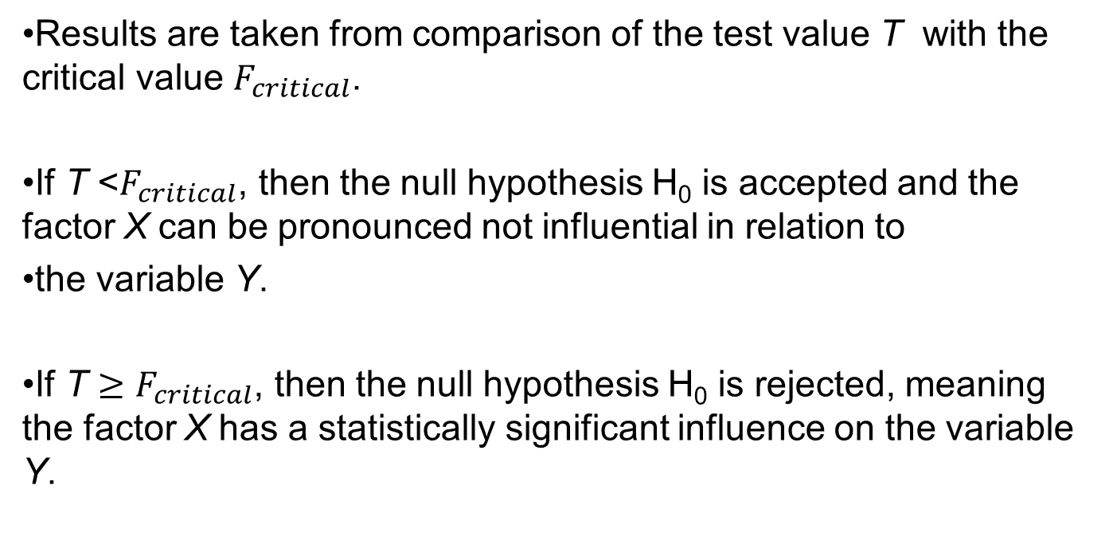
ANOVA: Analysis of Variance – One Factor
ANOVA - Results
Results are taken from comparison of the test value T with the critical value $F_{critical}$.
If T <$F_{critical}$, then the null hypothesis H₀ is accepted and the factor X can be pronounced not influential in relation to
the variable Y.
If T $≥F_{critical}$, then the null hypothesis H₀ is rejected, meaning the factor X has a statistically significant influence on the variable Y.

Slide 16
ANOVA: Analysis of Variance – One Factor
ANOVA - Results
If the test confirms that the factor X affects Y, we may ask which population means are different.
It can be the case that only population means are different, while all the other population means are the same.
There are methods that try to answer this question, one of them being devised by Scheffé and one by Tukey.

Slide 17
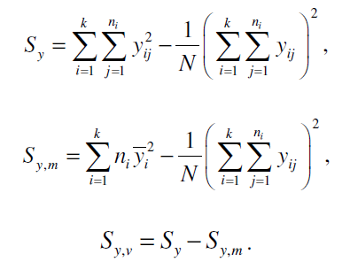
ANOVA: Analysis of Variance – One Factor
ANOVA – Alternative way of calculation of SS
These formulas are more convenient if the variabilities are to be calculated on a calculator:

Slide 18
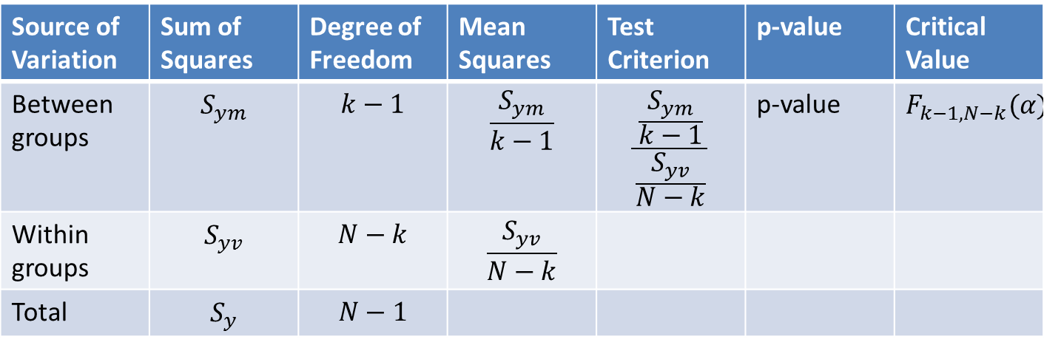
ANOVA: Analysis of Variance – One Factor
ANOVA: Typical computer outcome:
Typical computer outcome of one-way ANOVA analysis consists of an ANOVA table with these components:
Result can be seen from p-value or from comparison of calculated test criterion with provided critical value.
Source of Variation | Sum of Squares | Degree of Freedom | Mean Squares | Test Criterion | p-value | Critical Value
Between groups | $$S_{ym}$$ | $$k−1$$ | $$\frac{S_{ym}}{k−1}$$ | $$\frac{\frac{S_{ym}}{k−1}}{\frac{S_{yv}}{N−k}}$$ | p-value | $$F_{k−1,N−k}(α)$$
Within groups | $$S_{yv}$$ | $$N−k$$ | $$\frac{S_{yv}}{N−k}$$
Total | $$S_{y}$$ | $$N−1$$

Slide 19
ANOVA: Analysis of Variance – One Factor
Example
The following table contains data obtained through several independent random samplings. The observed factor is the number of octanes used to describe the quality of car fuel (90, 91, 95, 98 octanes are usually available). Thus, the factor is monitored at four possible levels. For each of the levels, five car drivers using the fuel of the corresponding quality were randomly selected. In this case, all samples have the same size, which is not required for
one-way ANOVA. We want to know whether the quality of the fuel affects fuel consumption (car mileage).

Slide 20
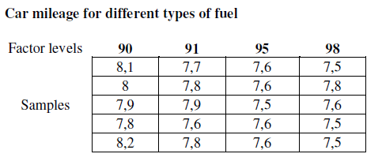
ANOVA: Analysis of Variance – One Factor
Example
Data:

Slide 21
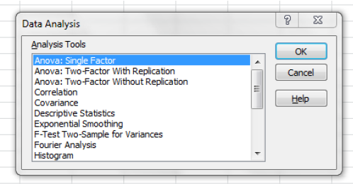
ANOVA: Analysis of Variance – One Factor
Example - Solution
Calculation via Excel – Data Analysis tool:

Slide 22
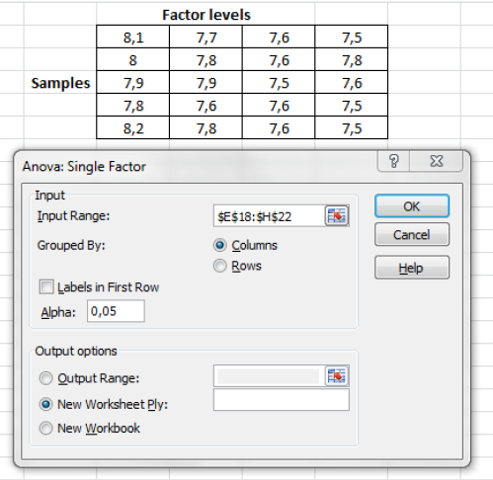
ANOVA: Analysis of Variance – One Factor
Example - Solution
In the dialogue window, it is necessary to insert as the Input Range a reference to the area of the Excel spreadsheet that contains the data samples to be worked with in ANOVA:

Slide 23
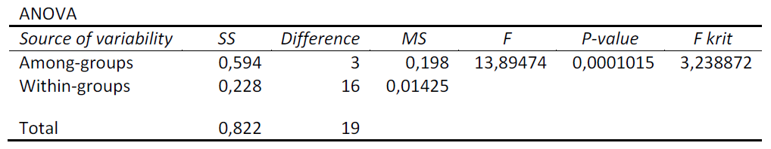
ANOVA: Analysis of Variance – One Factor
Example - Solution
Excel results are given in a form of table:
Since the test criterion is greater than critical value, we reject the null hypothesis that fuel quality has no effect on car mileage.
In other words, it seems the factor does have an influence on car mileage.

Slide 24
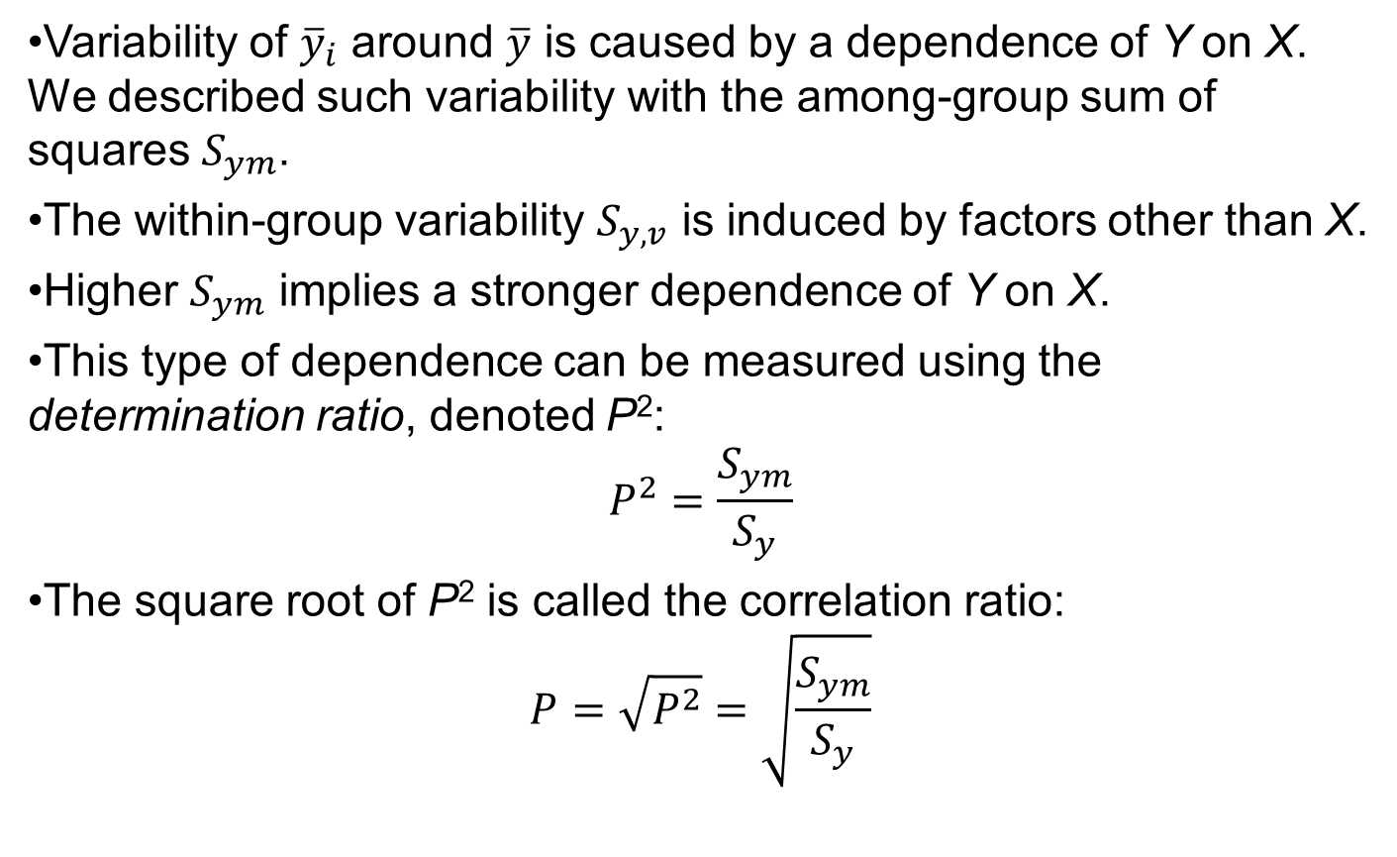
ANOVA: Analysis of Variance – One Factor
A Measure of Dependence
Variability of ${\overline{y}}_{i}$ around $\overline{y}$ is caused by a dependence of Y on X. We described such variability with the among-group sum of squares $S_{ym}$.
The within-group variability $S_{y,v}$ is induced by factors other than X.
Higher $S_{ym}$ implies a stronger dependence of Y on X.
This type of dependence can be measured using the determination ratio, denoted P²:
$$P^{2}=\frac{S_{ym}}{S_{y}}$$
The square root of P² is called the correlation ratio:
$$P=\sqrt{P^{2}}=\sqrt{\frac{S_{ym}}{S_{y}}}$$

Slide 25
ANOVA: Analysis of Variance – One Factor
A Measure of Dependence
Determination ratio P² can take on any value from interval [0,1].
The stronger the dependence of Y on X, the closer the characteristic is to one, and the closer the among-group sum of squares is to the total sum of squares (total variability). Under such condition the within-group variability approaches zero.
The closer the determination ratio is to zero, the smaller the part of the total variability which is accounted for by the among-group variability. In this case, the dependence of Y on X is weak.

Slide 26

INTRODUCTION – Estimation and Hypothesis Testing – Parametric Tests
Reading List
GUJARATI, D., 2009 . Essentials of Econometrics – Appendix C
TOŠENOVSKÝ, F., 2014. Statistical Methods for Economists – Chapter 6

Slide 27
INTRODUCTION – Estimation and Hypothesis Testing – Parametric Tests
Next Lecture:
Two-Way ANOVA and Latin Squares
THANK YOU

