Slide 1
Statistical Methods for Economists
Lecture 4
Multiple Linear Regression
David Bartl
Statistical Methods for Economists
INM/BASTE

Slide 2
Introduction: Simple Linear Regression & Least Squares Method
Multiple Linear Regression: Introduction
Multiple Linear Regression: Summary & Background
The Classical Assumptions
The Coefficient of Determination (R²)
Further Theorems, Tests of Hypotheses and Confidence Intervals
Two-sample t-test for the difference of the population means // σ_{X}=σ_{Y}
Simple linear regression without the intercept term

Slide 3
Introduction
Simple Linear Regression
Motivation
Example
Least Squares Method
Generalization
Multiple Linear Regression: Introduction
Multiple Linear Regression: Notation

Slide 4
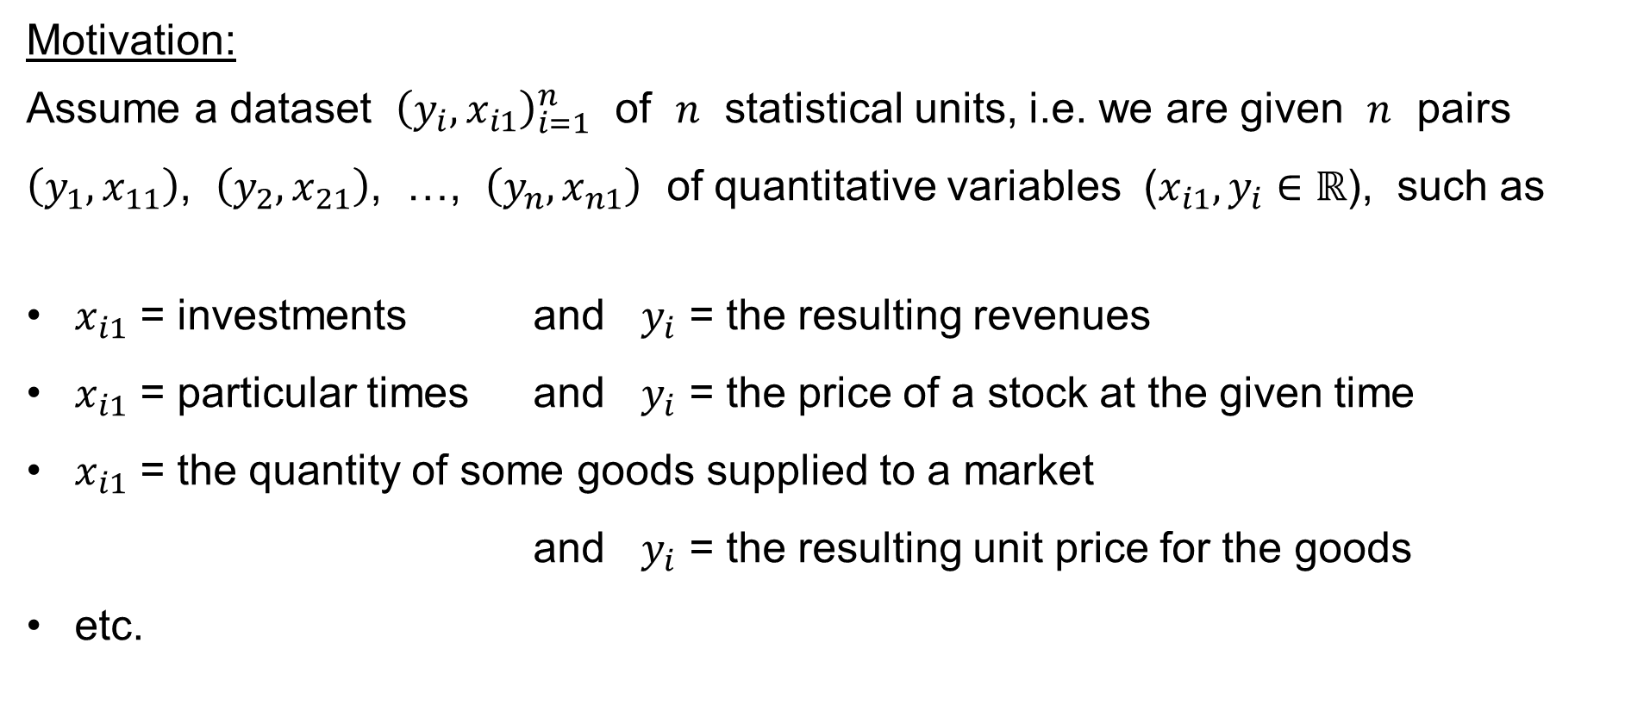
Simple Linear Regression: Motivation
Motivation:
Assume a dataset ${\left(y_{i},x_{i1}\right)}_{i=1}^{n}$ of $n$ statistical units, i.e. we are given $n$ pairs
$\left(y_{1},x_{11}\right)$, $\left(y_{2},x_{21}\right)$, …, $\left(y_{n},x_{n1}\right)$ of quantitative variables ($x_{i1},y_{i}∈ℝ$), such as
$x_{i1}$ = investments and $y_{i}$ = the resulting revenues
$x_{i1}$ = particular times and $y_{i}$ = the price of a stock at the given time
$x_{i1}$ = the quantity of some goods supplied to a market
and $y_{i}$ = the resulting unit price for the goods
etc.

Slide 5
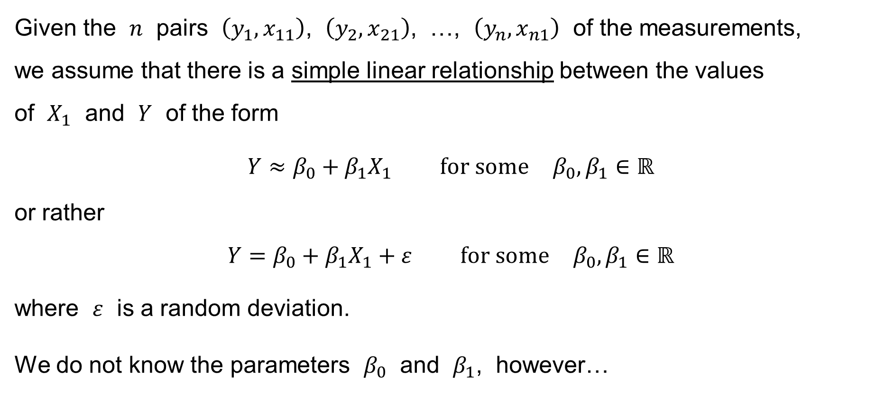
Simple Linear Regression: Motivation
Given the $n$ pairs $\left(y_{1},x_{11}\right)$, $\left(y_{2},x_{21}\right)$, …, $\left(y_{n},x_{n1}\right)$ of the measurements,
we assume that there is a simple linear relationship between the values
of $X_{1}$ and $Y$ of the form
$$Y≈β_{0}+β_{1}X_{1} \text{for} \text{some} β_{0},β_{1}∈ℝ$$
or rather
$$Y=β_{0}+β_{1}X_{1}+ε \text{for} \text{some} β_{0},β_{1}∈ℝ$$
where $ε$ is a random deviation.
We do not know the parameters $β_{0}$ and $β_{1}$, however…

Slide 6
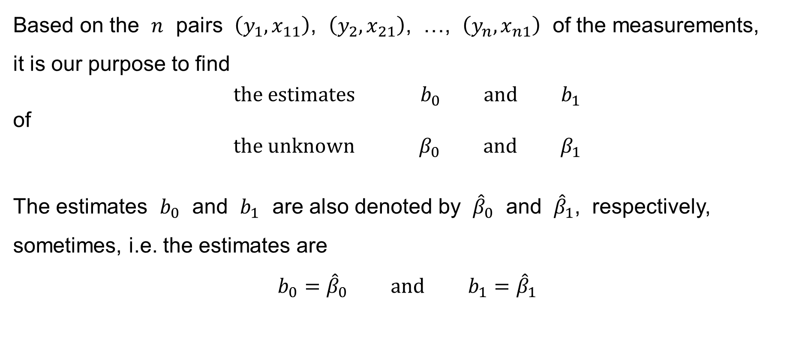
Simple Linear Regression: Motivation
Based on the $n$ pairs $\left(y_{1},x_{11}\right)$, $\left(y_{2},x_{21}\right)$, …, $\left(y_{n},x_{n1}\right)$ of the measurements,
it is our purpose to find
$$\text{the} \text{estimates} b_{0} \text{and} b_{1}$$
of
$$\text{the} \text{unknown} β_{0} \text{and} β_{1}$$
The estimates $b_{0}$ and $b_{1}$ are also denoted by ${\hat{β}}_{0}$ and ${\hat{β}}_{1}$, respectively, sometimes, i.e. the estimates are
$$b_{0}={\hat{β}}_{0} \text{and} b_{1}={\hat{β}}_{1}$$

Slide 7
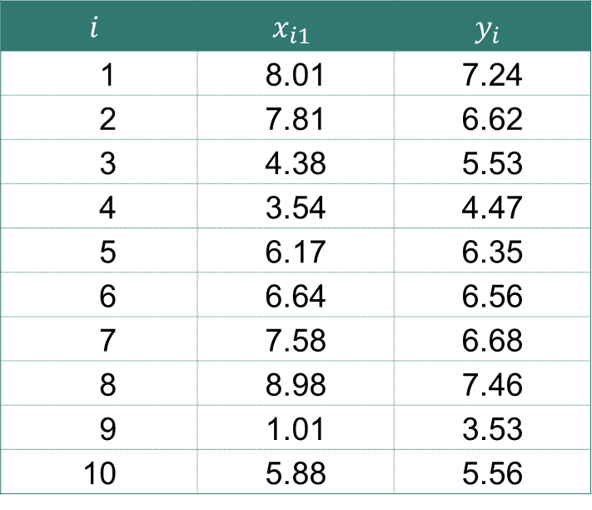

Simple Linear Regression: Example
We have got a sample of $n=10$ observations:
E.g.: $x_{i1}$ = temperature & $y_{i}$ = the length of a metal rod
$$i$$ | $$x_{i1}$$ | $$y_{i}$$
1 | 8.01 | 7.24
2 | 7.81 | 6.62
3 | 4.38 | 5.53
4 | 3.54 | 4.47
5 | 6.17 | 6.35
6 | 6.64 | 6.56
7 | 7.58 | 6.68
8 | 8.98 | 7.46
9 | 1.01 | 3.53
10 | 5.88 | 5.56

Slide 8



Simple Linear Regression: Example
$$y$$
10
9
8
$$y=3+\frac{1}{2}X_{1}$$
7
6
5
4
3
2
1
0
$$X_{1}$$
1
2
3
4
5
6
7
8
9
10

Slide 9
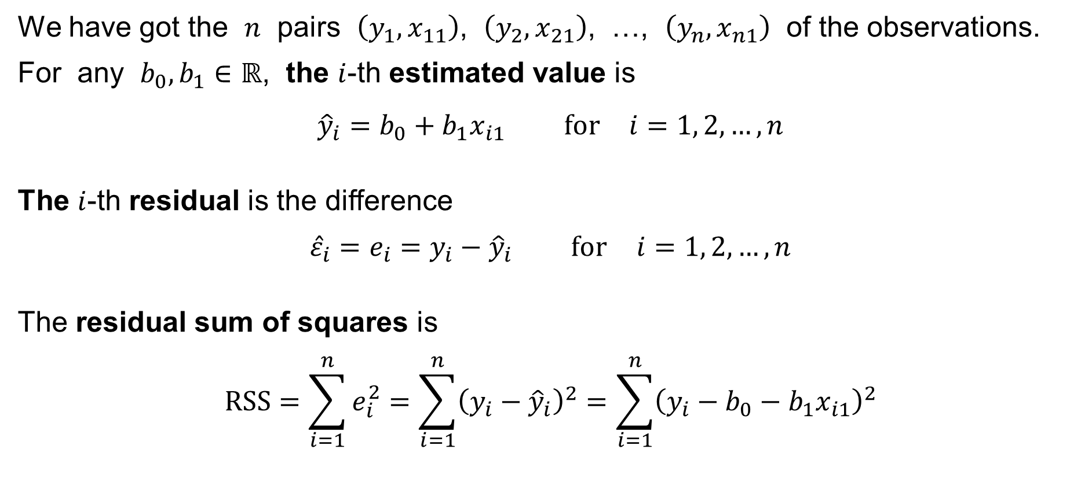
Simple Linear Regression: Least Squares Method
We have got the $n$ pairs $\left(y_{1},x_{11}\right)$, $\left(y_{2},x_{21}\right)$, …, $\left(y_{n},x_{n1}\right)$ of the observations.
For any $b_{0},b_{1}∈ℝ$, the $i$-th estimated value is
$${\hat{y}}_{i}=b_{0}+b_{1}x_{i1} \text{for} i=1, 2,…,n$$
The $i$-th residual is the difference
$${\hat{ε}}_{i}=e_{i}=y_{i}−{\hat{y}}_{i} \text{for} i=1, 2,…,n$$
The residual sum of squares is
$$RSS=\sum_{i=1}^{n}{e_{i}^{2}}=\sum_{i=1}^{n}{{\left(y_{i}−{\hat{y}}_{i}\right)}^{2}}=\sum_{i=1}^{n}{{\left(y_{i}−b_{0}−b_{1}x_{i1}\right)}^{2}}$$

Slide 10
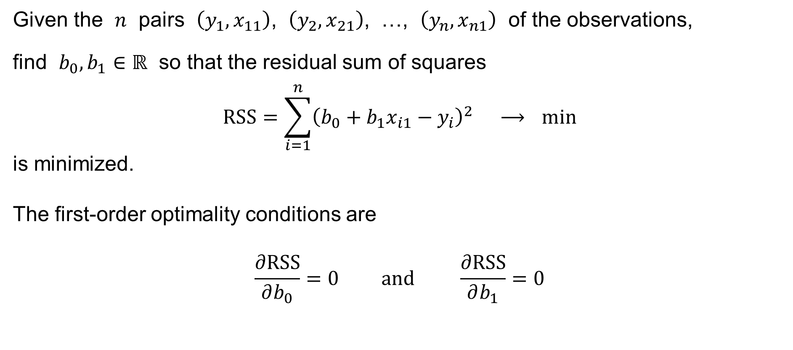
Simple Linear Regression: Least Squares Method
Given the $n$ pairs $\left(y_{1},x_{11}\right)$, $\left(y_{2},x_{21}\right)$, …, $\left(y_{n},x_{n1}\right)$ of the observations,
find $b_{0},b_{1}∈ℝ$ so that the residual sum of squares
$$RSS=\sum_{i=1}^{n}{{\left(b_{0}+b_{1}x_{i1}−y_{i}\right)}^{2}} ⟶ min$$
is minimized.
The first-order optimality conditions are
$$\frac{∂RSS}{∂b_{0}}=0 \text{and} \frac{∂RSS}{∂b_{1}}=0$$

Slide 11
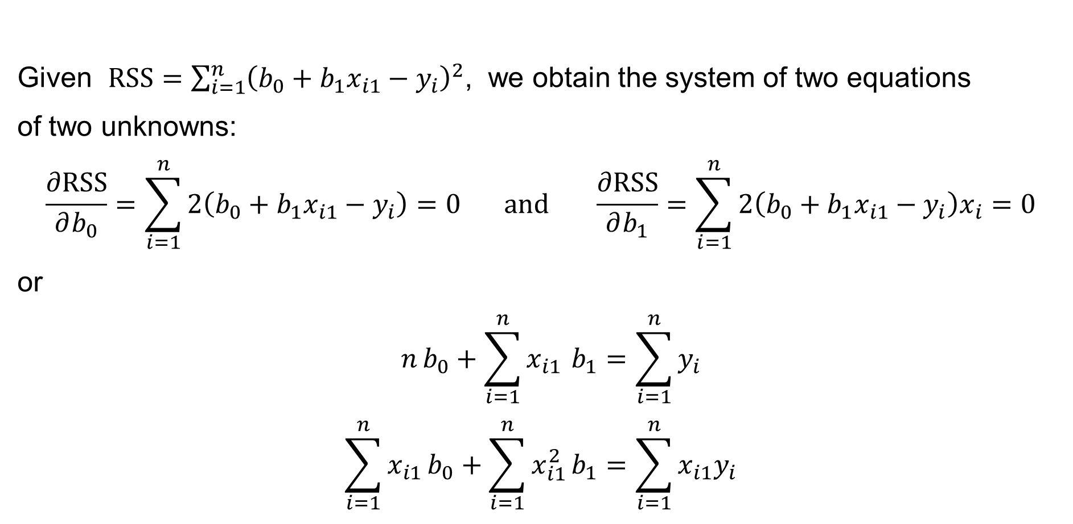
Simple Linear Regression: Least Squares Method
Given $RSS=\sum_{i=1}^{n}{{\left(b_{0}+b_{1}x_{i1}−y_{i}\right)}^{2}}$, we obtain the system of two equations
of two unknowns:
$$\frac{∂RSS}{∂b_{0}}=\sum_{i=1}^{n}{2\left(b_{0}+b_{1}x_{i1}−y_{i}\right)}=0 \text{and} \frac{∂RSS}{∂b_{1}}=\sum_{i=1}^{n}{2\left(b_{0}+b_{1}x_{i1}−y_{i}\right)x_{i}}=0$$
or
$$n b_{0}+\sum_{i=1}^{n}{x_{i1}} b_{1}=\sum_{i=1}^{n}{y_{i}} \\ \sum_{i=1}^{n}{x_{i1}}b_{0}+\sum_{i=1}^{n}{x_{i1}^{2}}b_{1}=\sum_{i=1}^{n}{x_{i1}y_{i}}$$
the normal equation

Slide 12
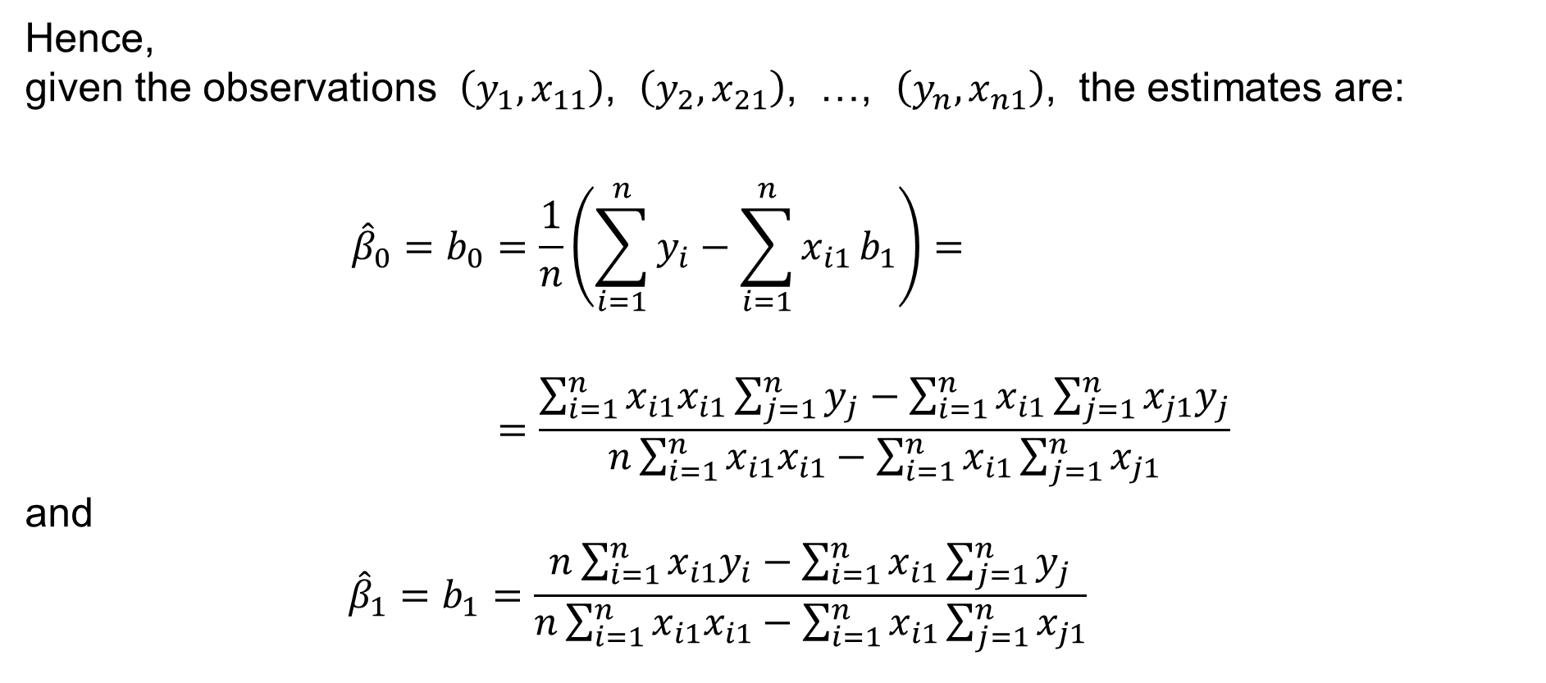
Simple Linear Regression: Least Squares Method
Hence,
given the observations $\left(y_{1},x_{11}\right)$, $\left(y_{2},x_{21}\right)$, …, $\left(y_{n},x_{n1}\right)$, the estimates are:
$${\hat{β}}_{0}=b_{0}=\frac{1}{n}\left(\sum_{i=1}^{n}{y_{i}}−\sum_{i=1}^{n}{x_{i1}}b_{1}\right)= \\ =\frac{\sum_{i=1}^{n}{x_{i1}x_{i1}}\sum_{j=1}^{n}{y_{j}}−\sum_{i=1}^{n}{x_{i1}}\sum_{j=1}^{n}{x_{j1}y_{j}}}{n\sum_{i=1}^{n}{x_{i1}x_{i1}}−\sum_{i=1}^{n}{x_{i1}}\sum_{j=1}^{n}{x_{j1}}}$$
and
$${\hat{β}}_{1}=b_{1}=\frac{n\sum_{i=1}^{n}{x_{i1}y_{i}}−\sum_{i=1}^{n}{x_{i1}}\sum_{j=1}^{n}{y_{j}}}{n\sum_{i=1}^{n}{x_{i1}x_{i1}}−\sum_{i=1}^{n}{x_{i1}}\sum_{j=1}^{n}{x_{j1}}}$$

Slide 13

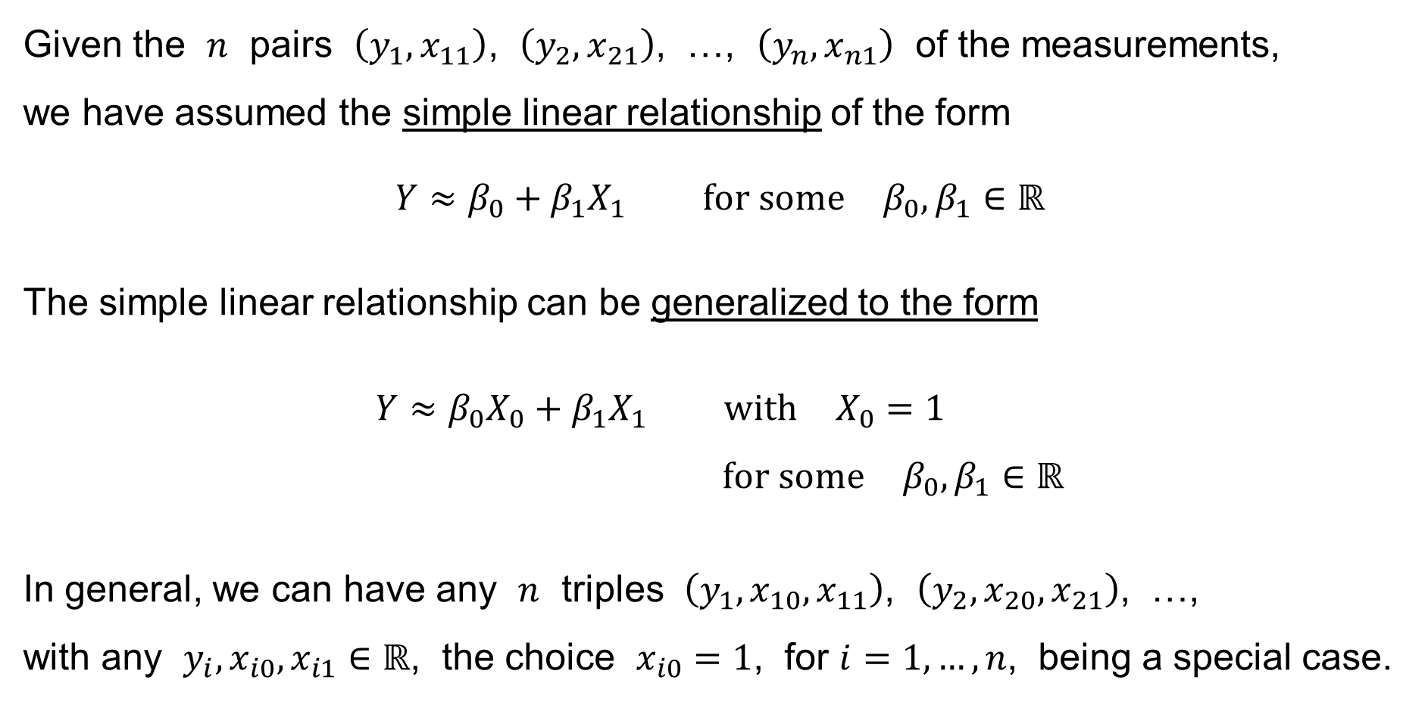
Simple Linear Regression: Generalization
Given the $n$ pairs $\left(y_{1},x_{11}\right)$, $\left(y_{2},x_{21}\right)$, …, $\left(y_{n},x_{n1}\right)$ of the measurements,
we have assumed the simple linear relationship of the form
$$Y≈β_{0}+β_{1}X_{1} \text{for} \text{some} β_{0},β_{1}∈ℝ$$
The simple linear relationship can be generalized to the form
$$Y≈β_{0}X_{0}+β_{1}X_{1} \text{with} X_{0}=1 \\ \text{for} \text{some} β_{0},β_{1}∈ℝ$$
In general, we can have any $n$ triples $\left(y_{1},x_{10},x_{11}\right)$, $\left(y_{2},x_{20},x_{21}\right)$, …,
with any $y_{i},x_{i0},x_{i1}∈ℝ$, the choice $x_{i0}=1$, for $i=1,…,n$, being a special case.
$$\left(y_{n},x_{n0},x_{n1}\right)$$

Slide 14
Simple Linear Regression: Generalization
We shall now study
Multiple Linear Regression

Slide 15

Multiple Linear Regression: Introduction
That is, we are given a dataset ${\left(y_{i},x_{i0},x_{i1},x_{i2},…,x_{ik}\right)}_{i=1}^{n}$ of $n$ statistical units ($\left(k+2\right)$-tuples):
$$\left( y_{1}, x_{10}, x_{11}, x_{12}, …, x_{1k} \right)$$
$$\left( y_{2}, x_{20}, x_{21}, x_{22}, …, x_{2k} \right)$$
$$…$$
$$\left( y_{n}, x_{n0}, x_{n1}, x_{n2}, …, x_{nk} \right)$$
where $y_{i},x_{i0},x_{i1},x_{i2},…,x_{ik}∈ℝ$ for every $i=1, 2,…,n$.

Slide 16
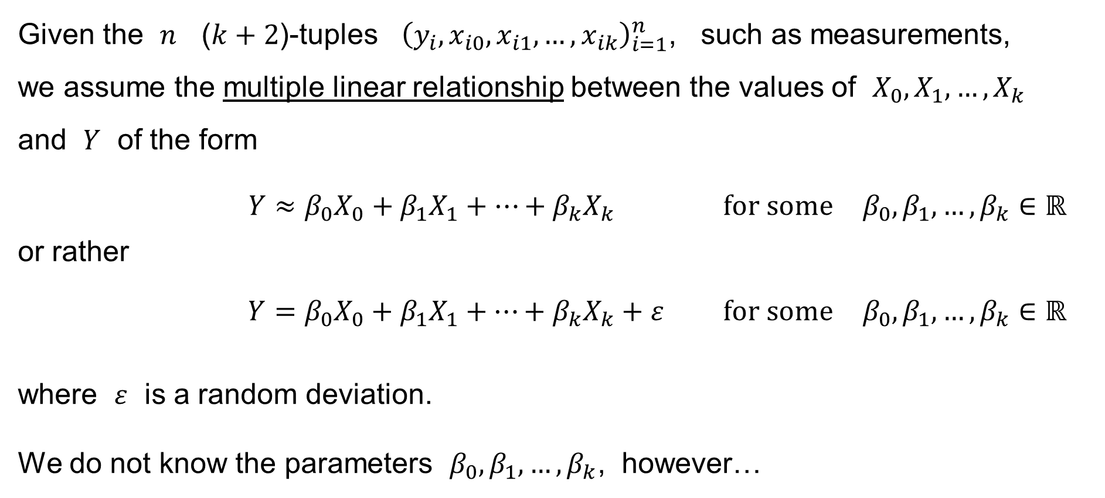
Multiple Linear Regression: Introduction
Given the $n$ ($k+2$)-tuples ${\left(y_{i},x_{i0},x_{i1},…,x_{ik}\right)}_{i=1}^{n}$, such as measurements,
we assume the multiple linear relationship between the values of $X_{0},X_{1},…,X_{k}$
and $Y$ of the form
$$Y≈β_{0}X_{0}+β_{1}X_{1}+⋯+β_{k}X_{k} \text{for} \text{some} β_{0},β_{1},…,β_{k}∈ℝ$$
or rather
$$Y=β_{0}X_{0}+β_{1}X_{1}+⋯+β_{k}X_{k}+ε \text{for} \text{some} β_{0},β_{1},…,β_{k}∈ℝ$$
where $ε$ is a random deviation.
We do not know the parameters $β_{0},β_{1},…,β_{k}$, however…

Slide 17
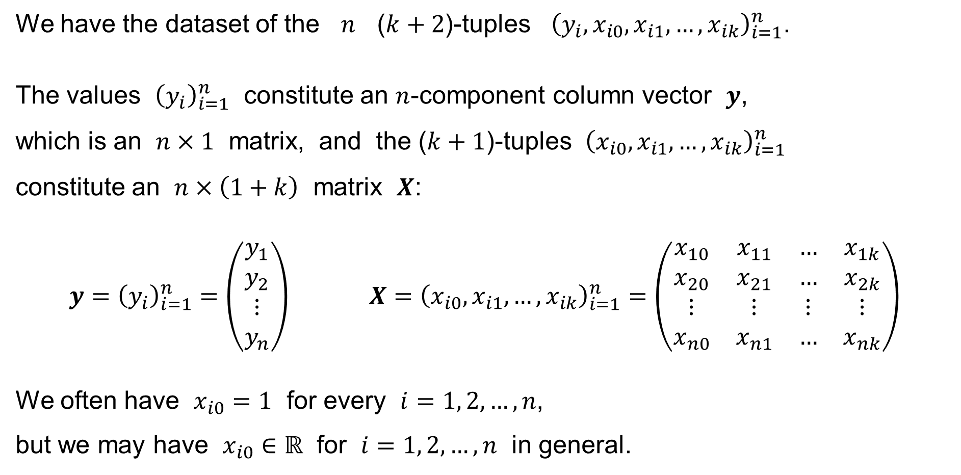
Multiple Linear Regression: Notation
We have the dataset of the $n$ ($k+2$)-tuples ${\left(y_{i},x_{i0},x_{i1},…,x_{ik}\right)}_{i=1}^{n}$.
The values ${\left(y_{i}\right)}_{i=1}^{n}$ constitute an $n$-component column vector $y$,
which is an $n×1$ matrix, and the ($k+1$)-tuples ${\left(x_{i0},x_{i1},…,x_{ik}\right)}_{i=1}^{n}$
constitute an $n×\left(1+k\right)$ matrix $X$:
$$y={\left(y_{i}\right)}_{i=1}^{n}=\left(\begin{matrix}y_{1} \\ y_{2} \\ ⋮ \\ y_{n}\end{matrix}\right) X={\left(x_{i0},x_{i1},…,x_{ik}\right)}_{i=1}^{n}=\left(\begin{matrix}x_{10} & x_{11} & … & x_{1k} \\ x_{20} & x_{21} & … & x_{2k} \\ ⋮ & ⋮ & ⋮ & ⋮ \\ x_{n0} & x_{n1} & … & x_{nk}\end{matrix}\right)$$
We often have $x_{i0}=1$ for every $i=1, 2,…,n$,
but we may have $x_{i0}∈ℝ$ for $i=1, 2,…,n$ in general.

Slide 18
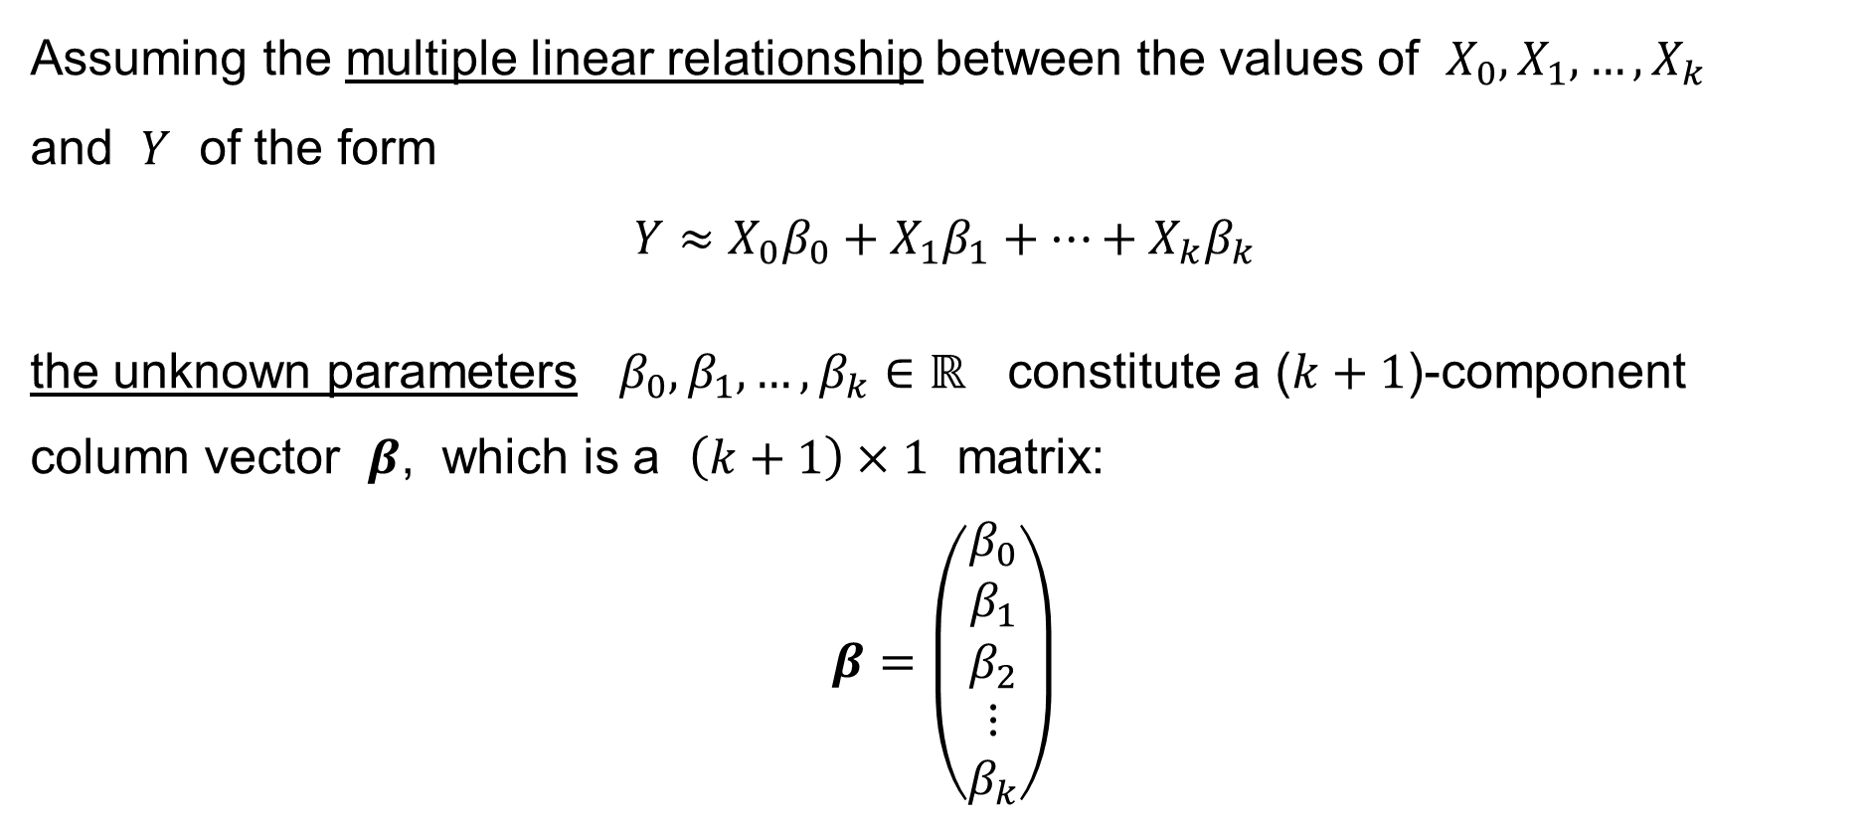
Multiple Linear Regression: Notation
Assuming the multiple linear relationship between the values of $X_{0},X_{1},…,X_{k}$
and $Y$ of the form
$$Y≈X_{0}β_{0}+X_{1}β_{1}+⋯+X_{k}β_{k}$$
the unknown parameters $β_{0},β_{1},…,β_{k}∈ℝ$ constitute a ($k+1$)-component
column vector $β$, which is a $\left(k+1\right)×1$ matrix:
$$β=\left(\begin{matrix}β_{0} \\ β_{1} \\ β_{2} \\ ⋮ \\ β_{k}\end{matrix}\right)$$

Slide 19
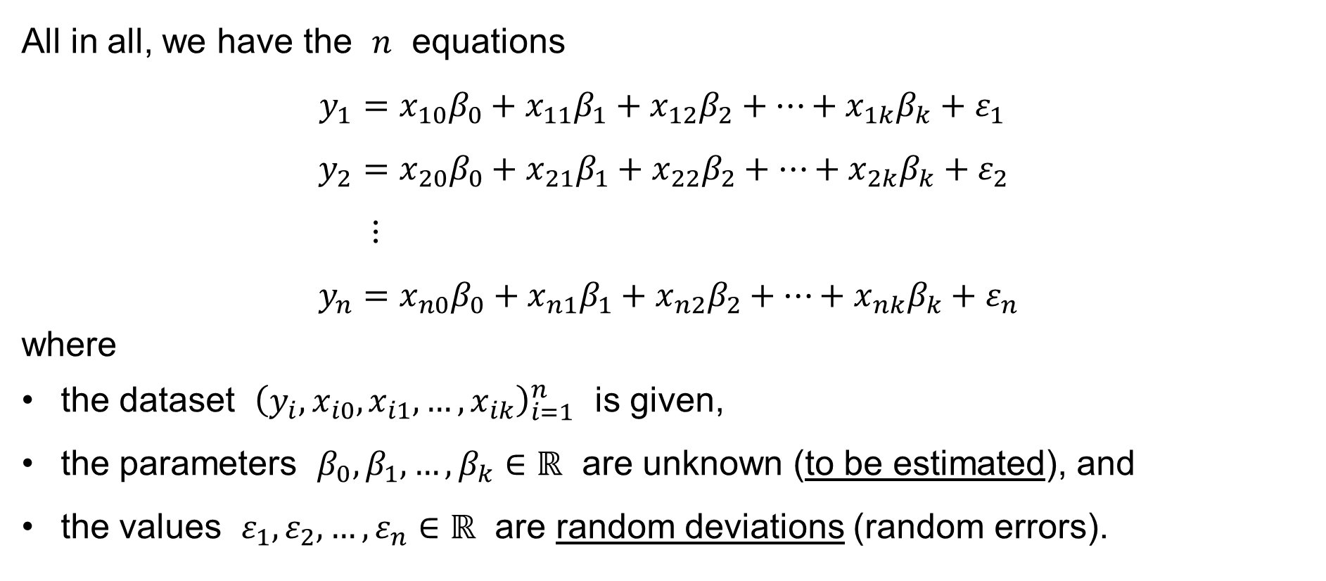
Multiple Linear Regression: Notation
All in all, we have the $n$ equations
$$y_{1}=x_{10}β_{0}+x_{11}β_{1}+x_{12}β_{2}+⋯+x_{1k}β_{k}+ε_{1} \\ y_{2}=x_{20}β_{0}+x_{21}β_{1}+x_{22}β_{2}+⋯+x_{2k}β_{k}+ε_{2} \\ ⋮ \\ y_{n}=x_{n0}β_{0}+x_{n1}β_{1}+x_{n2}β_{2}+⋯+x_{nk}β_{k}+ε_{n}$$
where
the dataset ${\left(y_{i},x_{i0},x_{i1},…,x_{ik}\right)}_{i=1}^{n}$ is given,
the parameters $β_{0},β_{1},…,β_{k}∈ℝ$ are unknown (to be estimated), and
the values $ε_{1},ε_{2},…,ε_{n}∈ℝ$ are random deviations (random errors).

Slide 20
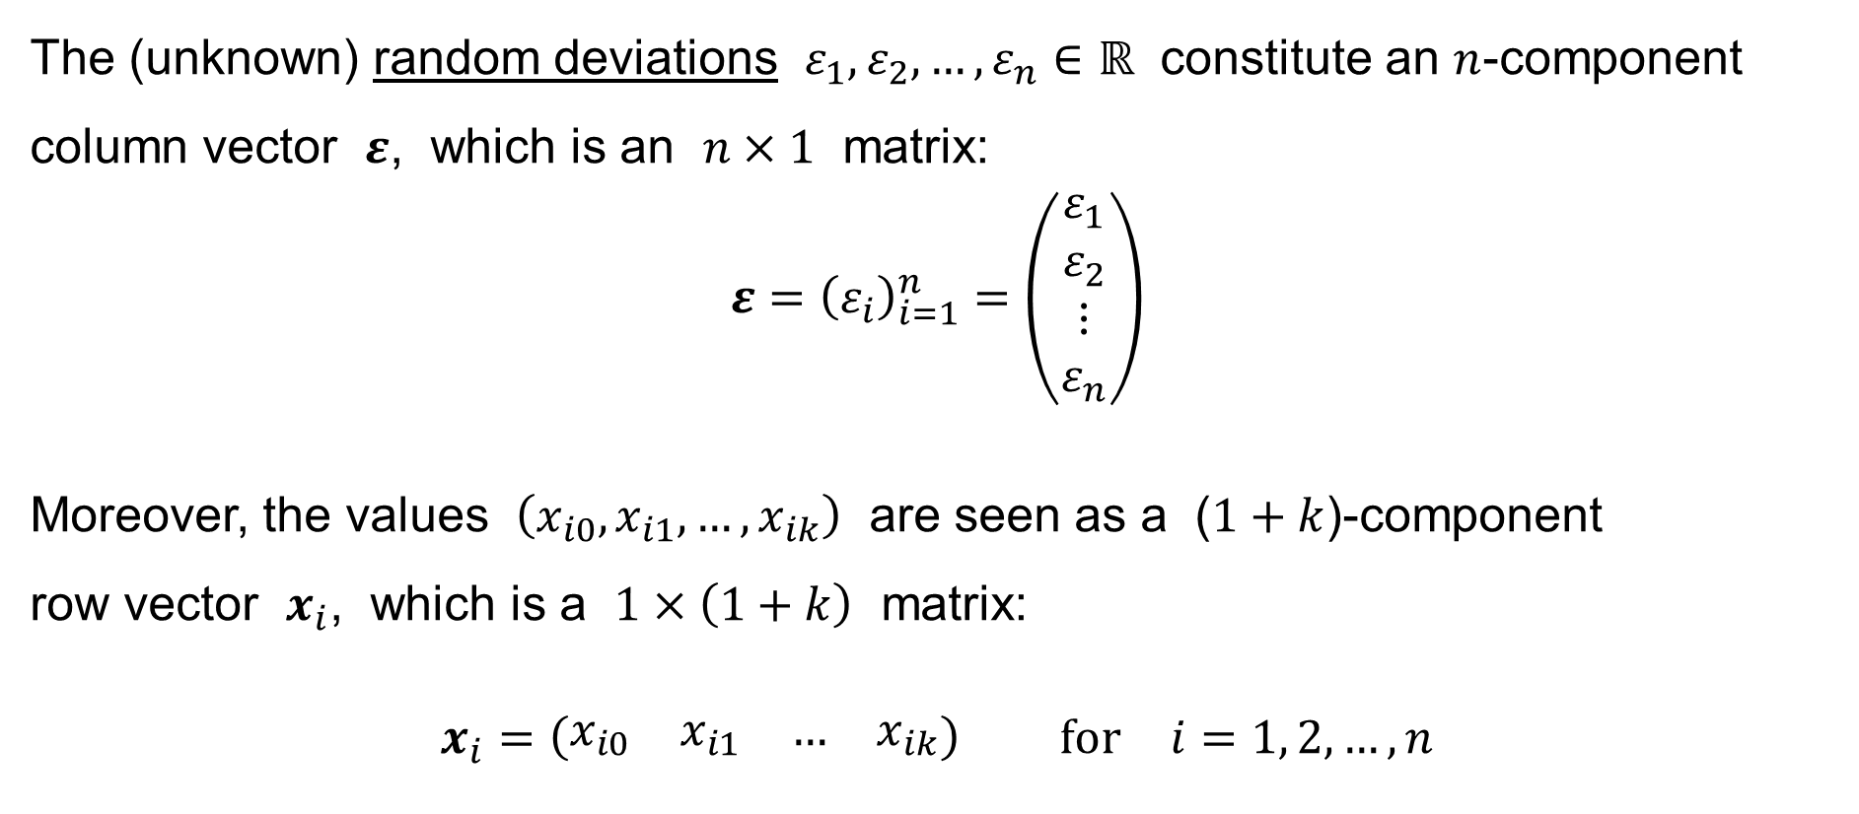
Multiple Linear Regression: Notation
The (unknown) random deviations $ε_{1},ε_{2},…,ε_{n}∈ℝ$ constitute an $n$-component column vector $ε$, which is an $n×1$ matrix:
$$ε={\left(ε_{i}\right)}_{i=1}^{n}=\left(\begin{matrix}ε_{1} \\ ε_{2} \\ ⋮ \\ ε_{n}\end{matrix}\right)$$
Moreover, the values $\left(x_{i0},x_{i1},…,x_{ik}\right)$ are seen as a ($1+k$)-component
row vector $x_{i}$, which is a $1×\left(1+k\right)$ matrix:
$$x_{i}=\left(\begin{matrix}x_{i0} & x_{i1} & … & x_{ik}\end{matrix}\right) \text{for} i=1, 2,…,n$$

Slide 21
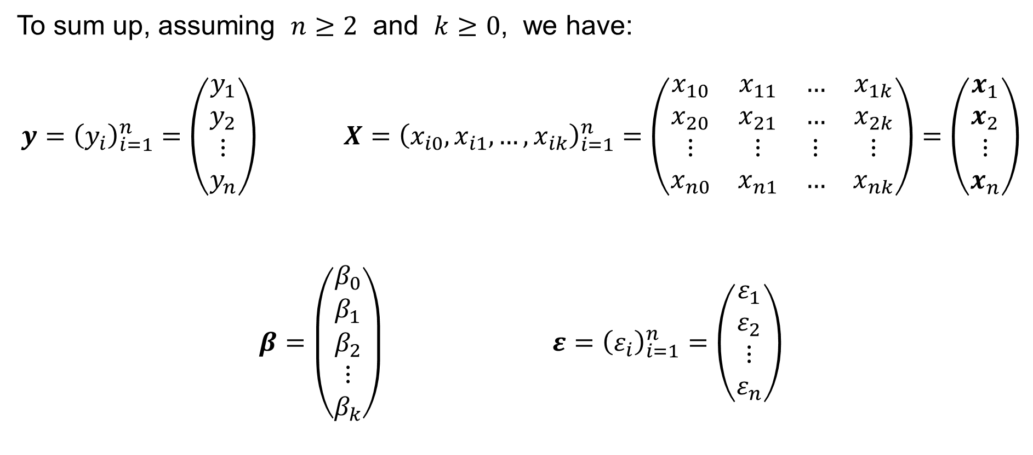
Multiple Linear Regression: Notation
To sum up, assuming $n≥2$ and $k≥0$, we have:
$$y={\left(y_{i}\right)}_{i=1}^{n}=\left(\begin{matrix}y_{1} \\ y_{2} \\ ⋮ \\ y_{n}\end{matrix}\right) X={\left(x_{i0},x_{i1},…,x_{ik}\right)}_{i=1}^{n}=\left(\begin{matrix}x_{10} & x_{11} & … & x_{1k} \\ x_{20} & x_{21} & … & x_{2k} \\ ⋮ & ⋮ & ⋮ & ⋮ \\ x_{n0} & x_{n1} & … & x_{nk}\end{matrix}\right)=\left(\begin{matrix}x_{1} \\ x_{2} \\ ⋮ \\ x_{n}\end{matrix}\right)$$
$$β=\left(\begin{matrix}β_{0} \\ β_{1} \\ β_{2} \\ ⋮ \\ β_{k}\end{matrix}\right) ε={\left(ε_{i}\right)}_{i=1}^{n}=\left(\begin{matrix}ε_{1} \\ ε_{2} \\ ⋮ \\ ε_{n}\end{matrix}\right)$$

Slide 22

Multiple Linear Regression: Notation
The $n$ equations
$$y_{1} = x_{10}β_{0}+x_{11}β_{1}+x_{12}β_{2}+⋯+x_{1k}β_{k} + ε_{1} = x_{1}β+ε_{1} \\ y_{2} = x_{20}β_{0}+x_{21}β_{1}+x_{22}β_{2}+⋯+x_{2k}β_{k} + ε_{2} = x_{2}β+ε_{2} \\ ⋮ \\ y_{n} = x_{n0}β_{0}+x_{n1}β_{1}+x_{n2}β_{2}+⋯+x_{nk}β_{k} + ε_{n} = x_{n}β+ε_{n}$$
can then be written briefly as
$$y=Xβ+ε$$

Slide 23
Random vectors
Random variable
Random vector
Mean value
Variance-covariance matrix
Uncorrelated random variables
Independent random variables

Slide 24
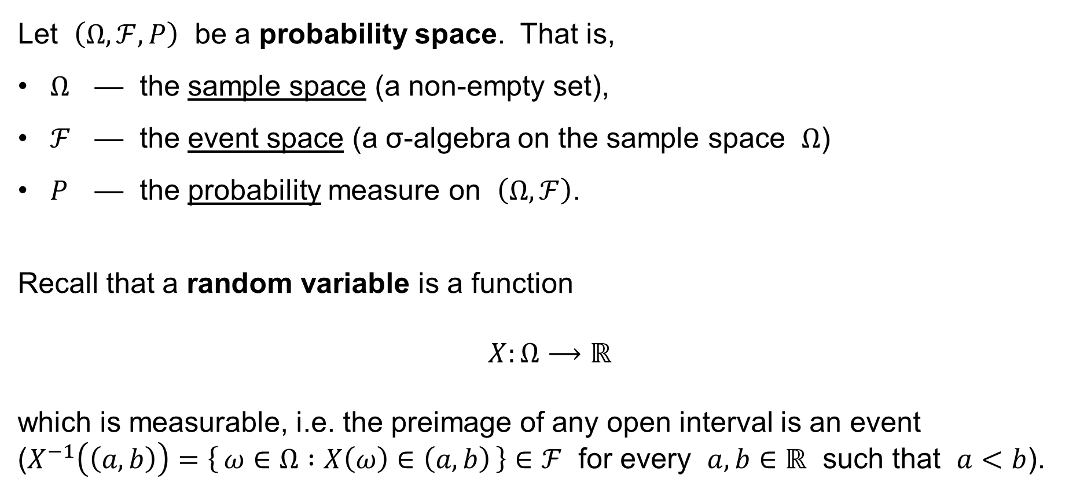
Random variable
Let $\left(Ω,ℱ,P\right)$ be a probability space. That is,
$Ω$ — the sample space (a non-empty set),
$ℱ$ — the event space (a σ-algebra on the sample space $Ω$)
$P$ — the probability measure on $\left(Ω,ℱ\right)$.
Recall that a random variable is a function
$$X:Ω⟶ℝ$$
which is measurable, i.e. the preimage of any open interval is an event
($X^{−1}\left(\left(a,b\right)\right)=\left\{ ω∈Ω :X\left(ω\right)∈\left(a,b\right) \right\}∈ℱ$ for every $a,b∈ℝ$ such that $a<b$).

Slide 25
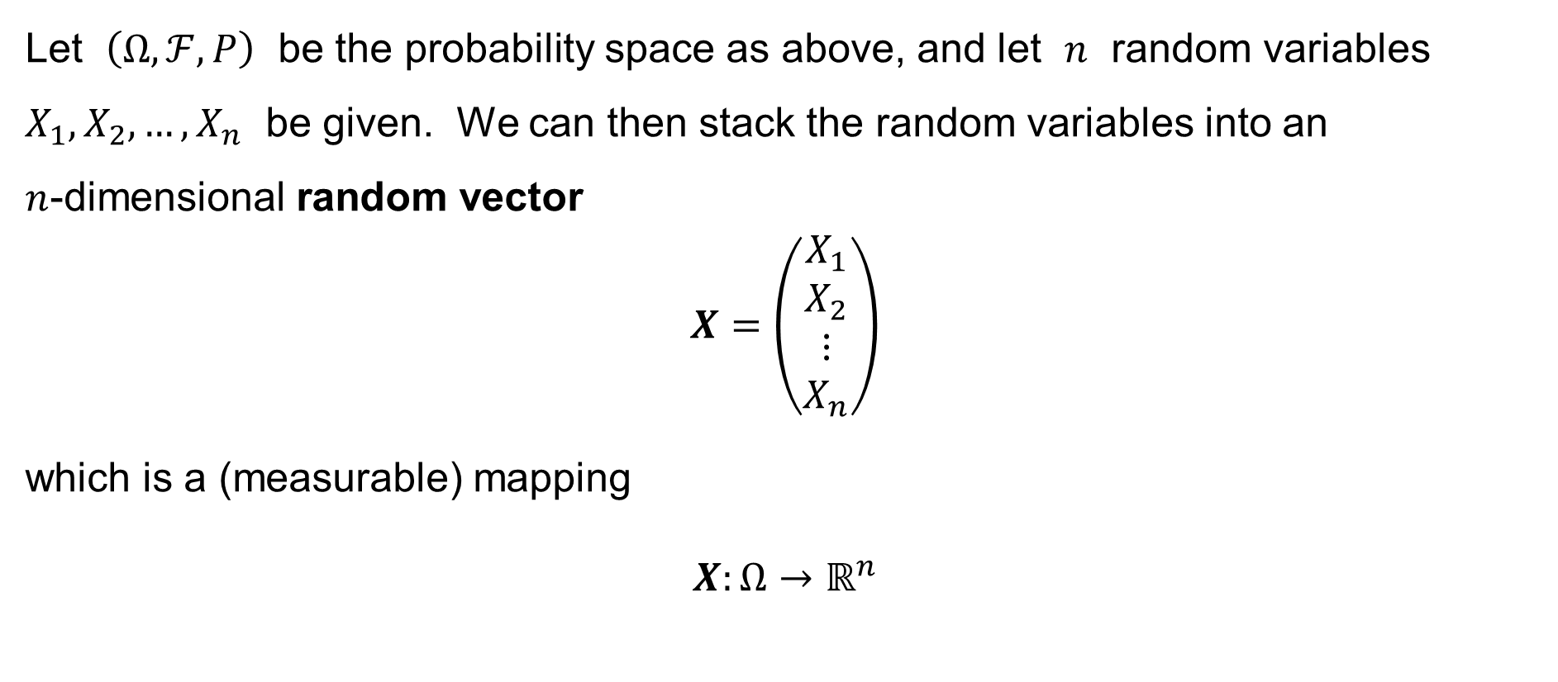
Random vector
Let $\left(Ω,ℱ,P\right)$ be the probability space as above, and let $n$ random variables $X_{1},X_{2},…,X_{n}$ be given. We can then stack the random variables into an
$n$-dimensional random vector
$$X=\left(\begin{matrix}X_{1} \\ X_{2} \\ ⋮ \\ X_{n}\end{matrix}\right)$$
which is a (measurable) mapping
$$X:Ω→ℝ^{n}$$

Slide 26
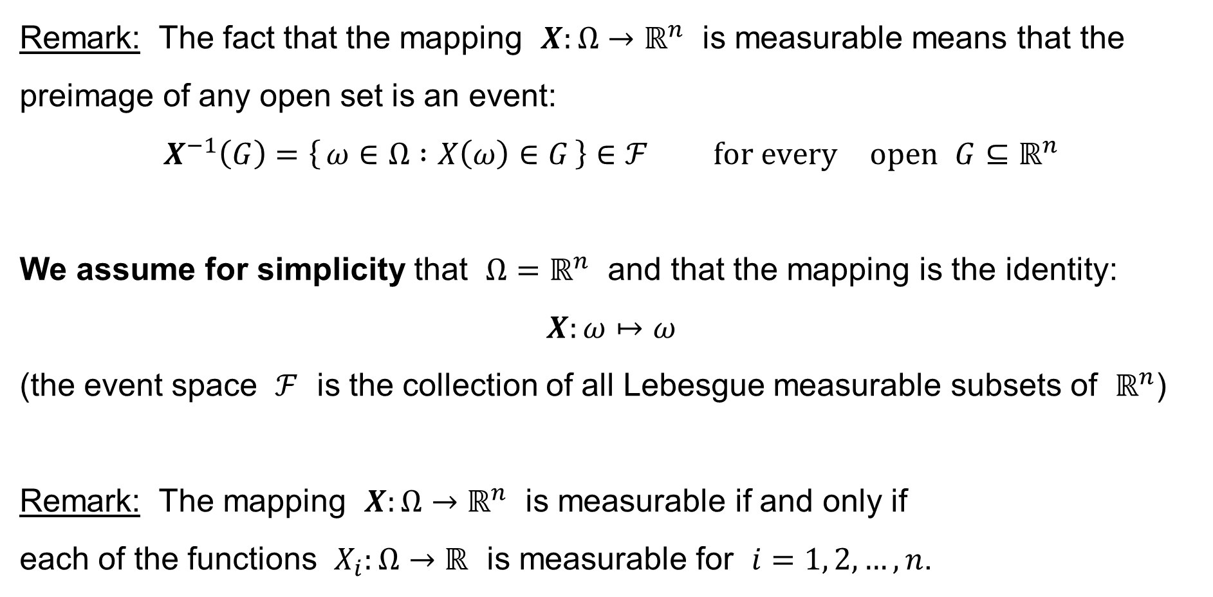
Random vector
Remark: The fact that the mapping $X:Ω→ℝ^{n}$ is measurable means that the preimage of any open set is an event:
$$X^{−1}\left(G\right)=\left\{ ω∈Ω :X\left(ω\right)∈G \right\}∈ℱ \text{for} \text{every} \text{open} G⊆ℝ^{n}$$
We assume for simplicity that $Ω=ℝ^{n}$ and that the mapping is the identity:
$$X:ω↦ω$$
(the event space $ℱ$ is the collection of all Lebesgue measurable subsets of $ℝ^{n}$)
Remark: The mapping $X:Ω→ℝ^{n}$ is measurable if and only if
each of the functions $X_{i}:Ω→ℝ$ is measurable for $i=1, 2,…,n$.

Slide 27

Random vector: Expected value
Given the random variables $X_{1},X_{2},…,X_{n}$,
the expected value of the random vector $X$ is:
$$E\left[X\right]=\left(\begin{matrix}E\left[X_{1}\right] \\ E\left[X_{2}\right] \\ ⋮ \\ E\left[X_{n}\right]\end{matrix}\right)$$

Slide 28
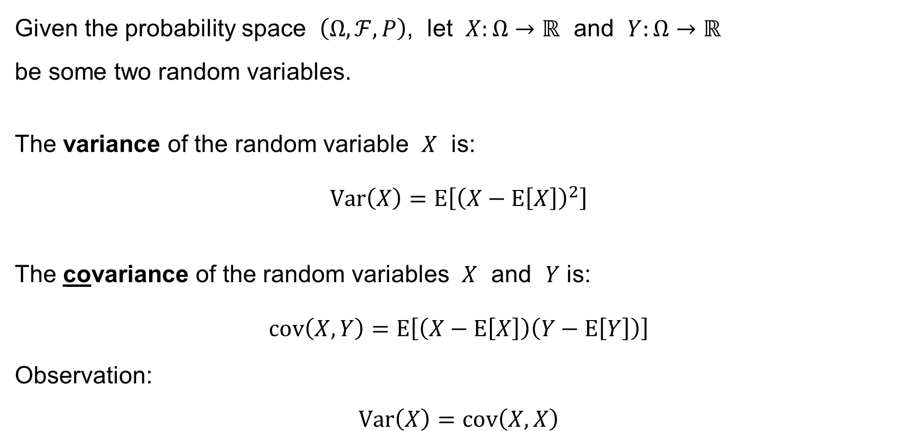
Random variables: Variance and Covariance
Given the probability space $\left(Ω,ℱ,P\right)$, let $X:Ω→ℝ$ and $Y:Ω→ℝ$
be some two random variables.
The variance of the random variable $X$ is:
$$Var\left(X\right)=E\left[{\left(X−E\left[X\right]\right)}^{2}\right]$$
The covariance of the random variables $X$ and $Y$ is:
$$cov\left(X,Y\right)=E\left[\left(X−E\left[X\right]\right)\left(Y−E\left[Y\right]\right)\right]$$
Observation:
$$Var\left(X\right)=cov\left(X,X\right)$$

Slide 29
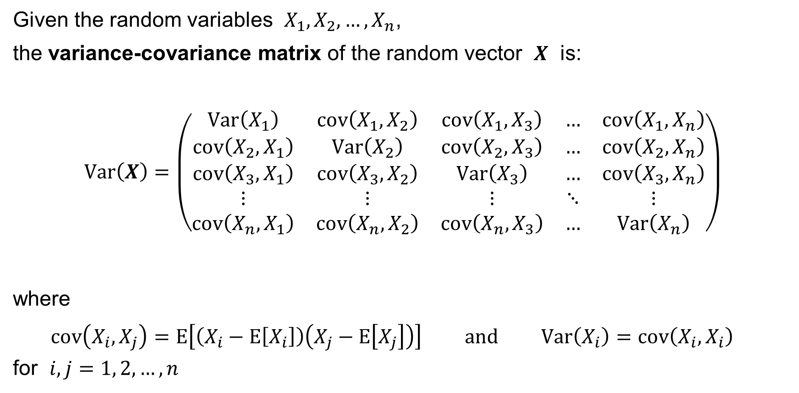
Random vector: Variance-covariance matrix
Given the random variables $X_{1},X_{2},…,X_{n}$,
the variance-covariance matrix of the random vector $X$ is:
$$Var\left(X\right)=\left(\begin{matrix}Var\left(X_{1}\right) & cov\left(X_{1},X_{2}\right) & cov\left(X_{1},X_{3}\right) & … & cov\left(X_{1},X_{n}\right) \\ cov\left(X_{2},X_{1}\right) & Var\left(X_{2}\right) & cov\left(X_{2},X_{3}\right) & … & cov\left(X_{2},X_{n}\right) \\ cov\left(X_{3},X_{1}\right) & cov\left(X_{3},X_{2}\right) & Var\left(X_{3}\right) & … & cov\left(X_{3},X_{n}\right) \\ ⋮ & ⋮ & ⋮ & ⋱ & ⋮ \\ cov\left(X_{n},X_{1}\right) & cov\left(X_{n},X_{2}\right) & cov\left(X_{n},X_{3}\right) & … & Var\left(X_{n}\right)\end{matrix}\right)$$
where
$$cov\left(X_{i},X_{j}\right)=E\left[\left(X_{i}−E\left[X_{i}\right]\right)\left(X_{j}−E\left[X_{j}\right]\right)\right] \text{and} Var\left(X_{i}\right)=cov\left(X_{i},X_{i}\right)$$
for $i,j=1, 2,…,n$

Slide 30

Random vector: Uncorrelated random variables
The random variables $X_{1},X_{2},…,X_{n}$ are (pairwise) uncorrelated if and only if
$$cov\left(X_{i},X_{j}\right)=0 \text{if} i≠j for all i,j=1, 2,…,n$$

Slide 31

Random vector: Independent events
Let $\left(Ω,ℱ,P\right)$ be a probability space and let $A_{1},A_{2},…,A_{n}∈ℱ$ be events.
Recall that the events $A_{1},A_{2},…,A_{n}$ are mutually independent if and only if
$$P\left(A_{1}∩A_{2}∩⋯∩A_{n}\right)=P\left(A_{1}\right)×P\left(A_{2}\right)×⋯×P\left(A_{n}\right)$$

Slide 32
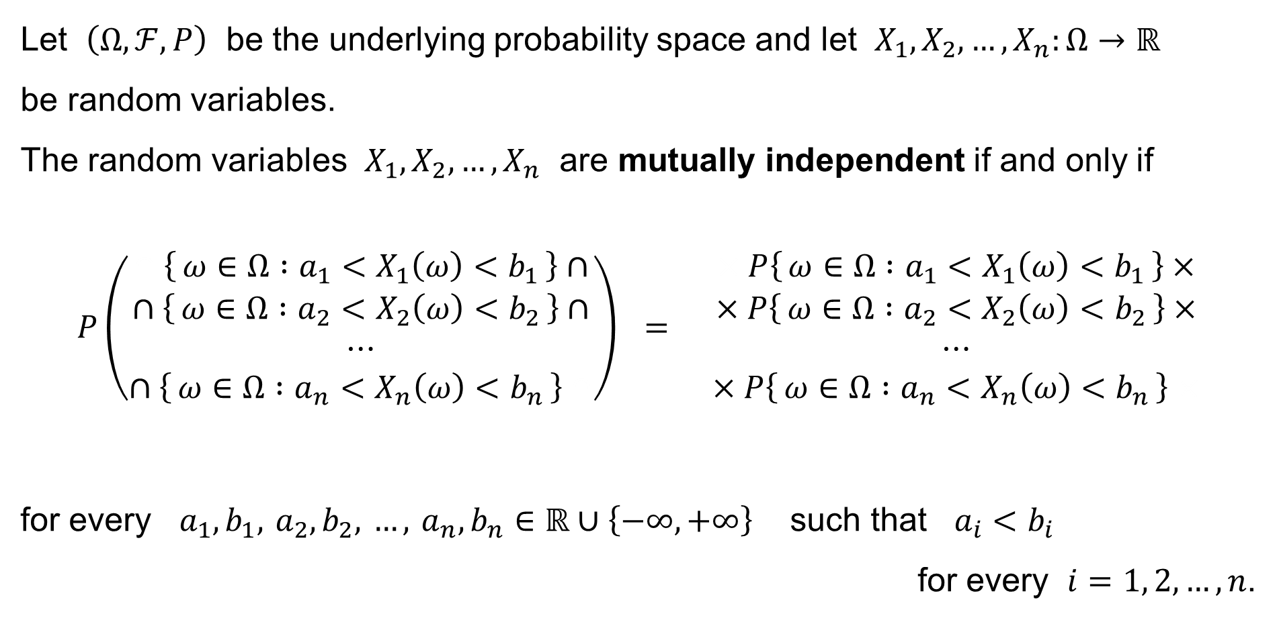
Random vector: Independent random variables
Let $\left(Ω,ℱ,P\right)$ be the underlying probability space and let $X_{1},X_{2},…,X_{n}:Ω→ℝ$
be random variables.
The random variables $X_{1},X_{2},…,X_{n}$ are mutually independent if and only if
$$P\left(\begin{aligned}∩\left\{ ω∈Ω :a_{1}<X_{1}\left(ω\right)<b_{1} \right\}∩ \\ ∩\left\{ ω∈Ω :a_{2}<X_{2}\left(ω\right)<b_{2} \right\}∩ \\ ⋯ \\ ∩\left\{ ω∈Ω :a_{n}<X_{n}\left(ω\right)<b_{n} \right\}∩\end{aligned}\right) = \begin{aligned}×P\left\{ ω∈Ω :a_{1}<X_{1}\left(ω\right)<b_{1} \right\}× \\ ×P\left\{ ω∈Ω :a_{2}<X_{2}\left(ω\right)<b_{2} \right\}× \\ ⋯ \\ ×P\left\{ ω∈Ω :a_{n}<X_{n}\left(ω\right)<b_{n} \right\}×\end{aligned}$$
for every $a_{1},b_{1}, a_{2},b_{2}, …, a_{n},b_{n}∈ℝ∪\left\{−∞,+∞\right\}$ such that $a_{i}<b_{i}$
for every $i=1, 2,…,n$.

Slide 33
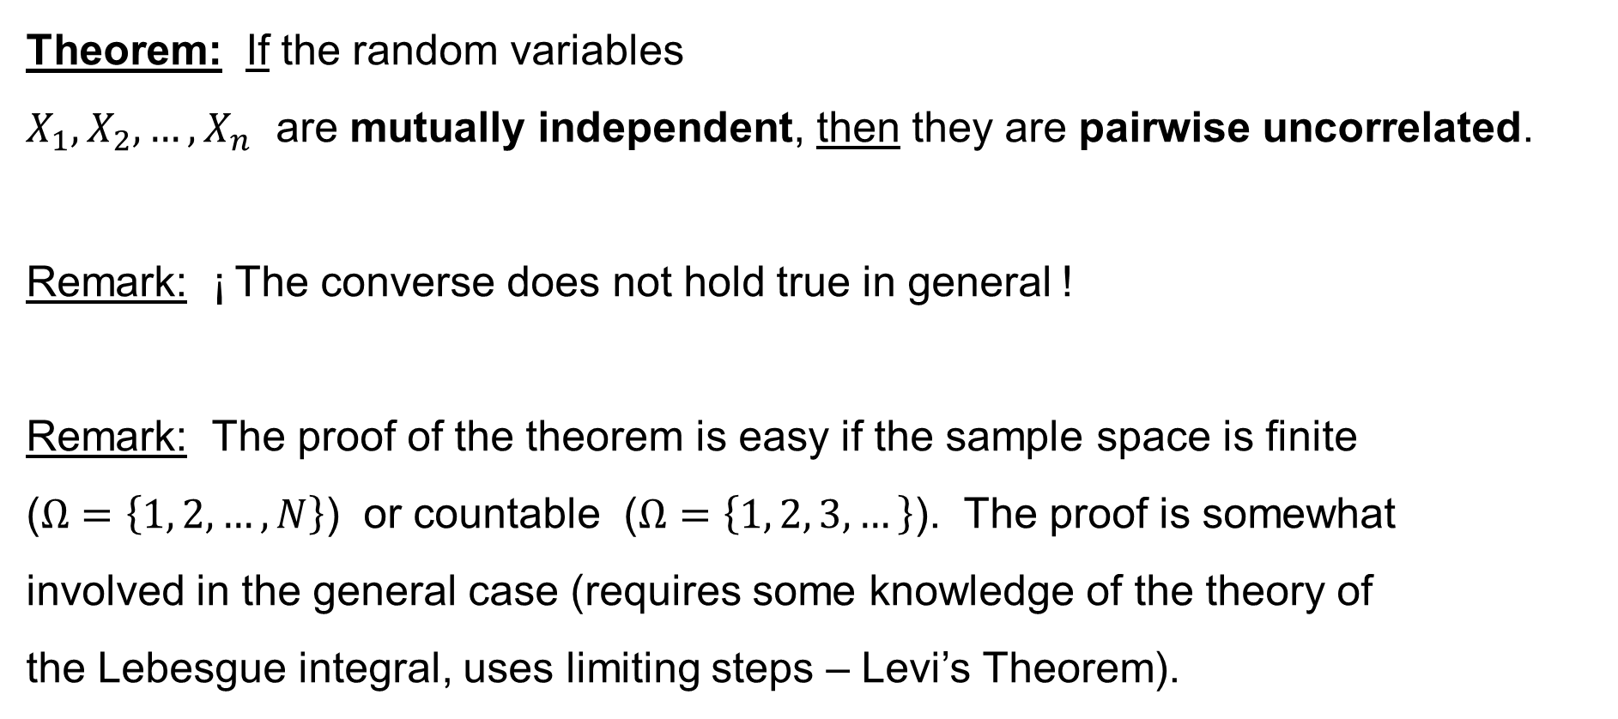
Random vector: Independent random variables
Theorem: If the random variables
$X_{1},X_{2},…,X_{n}$ are mutually independent, then they are pairwise uncorrelated.
Remark: ¡ The converse does not hold true in general !
Remark: The proof of the theorem is easy if the sample space is finite
($Ω=\left\{1, 2,…,N\right\}$) or countable ($Ω=\left\{1, 2, 3,…\right\}$). The proof is somewhat
involved in the general case (requires some knowledge of the theory of
the Lebesgue integral, uses limiting steps – Levi’s Theorem).

Slide 34
Multivariate normal distribution

Slide 35
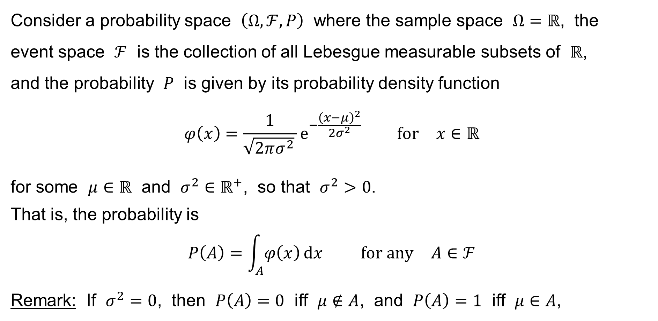
Normal distribution
Consider a probability space $\left(Ω,ℱ,P\right)$ where the sample space $Ω=ℝ$, the
event space $ℱ$ is the collection of all Lebesgue measurable subsets of $ℝ$,
and the probability $P$ is given by its probability density function
$$φ\left(x\right)=\frac{1}{\sqrt{2πσ^{2}} }e^{−\frac{{\left(x−μ\right)}^{2}}{2σ^{2}}} \text{for} x∈ℝ$$
for some $μ∈ℝ$ and $σ^{2}∈ℝ^{+}$, so that $σ^{2}>0$.
That is, the probability is
$$P\left(A\right)=\int_{A}{φ\left(x\right) dx} \text{for} \text{any} A∈ℱ$$
Remark: If $σ^{2}=0$, then $P\left(A\right)=0$ iff $μ∉A$, and $P\left(A\right)=1$ iff $μ∈A$,

Slide 36
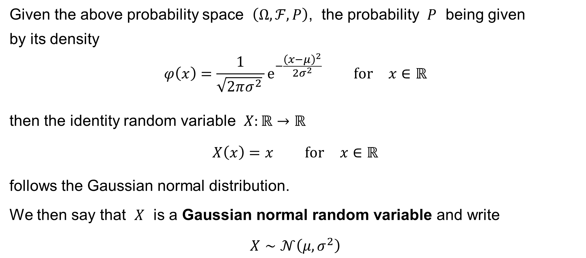
Normal distribution
Given the above probability space $\left(Ω,ℱ,P\right)$, the probability $P$ being given
by its density
$$φ\left(x\right)=\frac{1}{\sqrt{2πσ^{2}} }e^{−\frac{{\left(x−μ\right)}^{2}}{2σ^{2}}} \text{for} x∈ℝ$$
then the identity random variable $X:ℝ→ℝ$
$$X\left(x\right)=x \text{for} x∈ℝ$$
follows the Gaussian normal distribution.
We then say that $X$ is a Gaussian normal random variable and write
$$X∼𝒩\left(μ,σ^{2}\right)$$

Slide 37
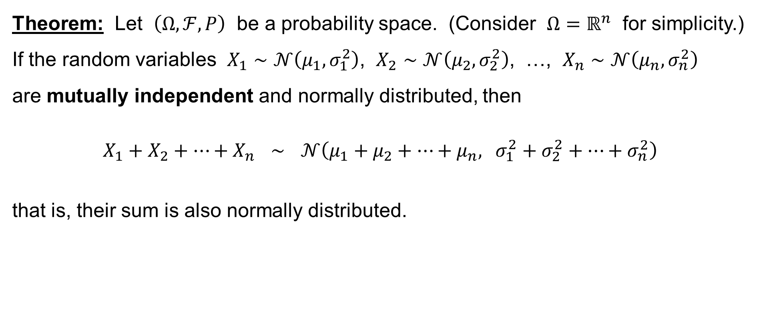
Normal distribution
Theorem: Let $\left(Ω,ℱ,P\right)$ be a probability space. (Consider $Ω=ℝ^{n}$ for simplicity.) If the random variables $X_{1}∼𝒩\left(μ_{1},σ_{1}^{2}\right)$, $X_{2}∼𝒩\left(μ_{2},σ_{2}^{2}\right)$, …, $X_{n}∼𝒩\left(μ_{n},σ_{n}^{2}\right)$
are mutually independent and normally distributed, then
$$X_{1}+X_{2}+⋯+X_{n} ∼ 𝒩\left(μ_{1}+μ_{2}+⋯+μ_{n}, σ_{1}^{2}+σ_{2}^{2}+⋯+σ_{n}^{2}\right)$$
that is, their sum is also normally distributed.

Slide 38
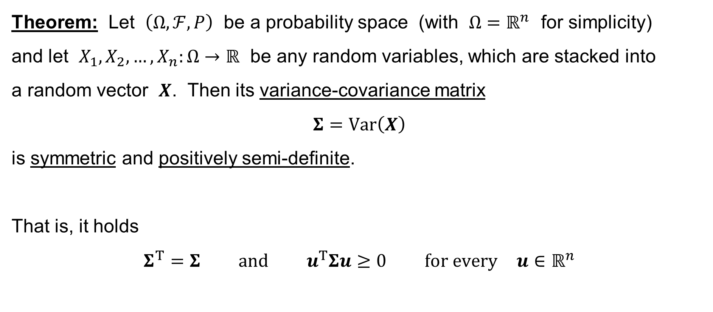
Variance-covariance matrix
Theorem: Let $\left(Ω,ℱ,P\right)$ be a probability space (with $Ω=ℝ^{n}$ for simplicity)
and let $X_{1},X_{2},…,X_{n}:Ω→ℝ$ be any random variables, which are stacked into
a random vector $X$. Then its variance-covariance matrix
$$Σ=Var\left(X\right)$$
is symmetric and positively semi-definite.
That is, it holds
$$Σ^{T}=Σ \text{and} u^{T}Σu≥0 \text{for} \text{every} u∈ℝ^{n}$$

Slide 39
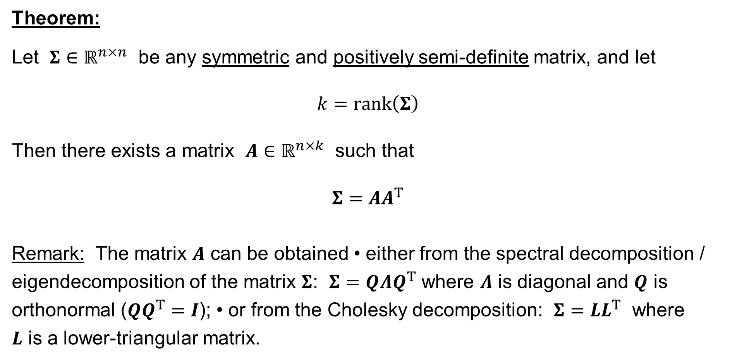
Variance-covariance matrix: A decomposition
Theorem:
Let $Σ∈ℝ^{n×n}$ be any symmetric and positively semi-definite matrix, and let
$$k=rank\left(Σ\right)$$
Then there exists a matrix $A∈ℝ^{n×k}$ such that
$$Σ=AA^{T}$$
Remark: The matrix $A$ can be obtained • either from the spectral decomposition / eigendecomposition of the matrix $Σ$: $Σ=QΛQ^{T}$ where $Λ$ is diagonal and $Q$ is orthonormal ($QQ^{T}=I$); • or from the Cholesky decomposition: $Σ=LL^{T}$ where
$L$ is a lower-triangular matrix.

Slide 40
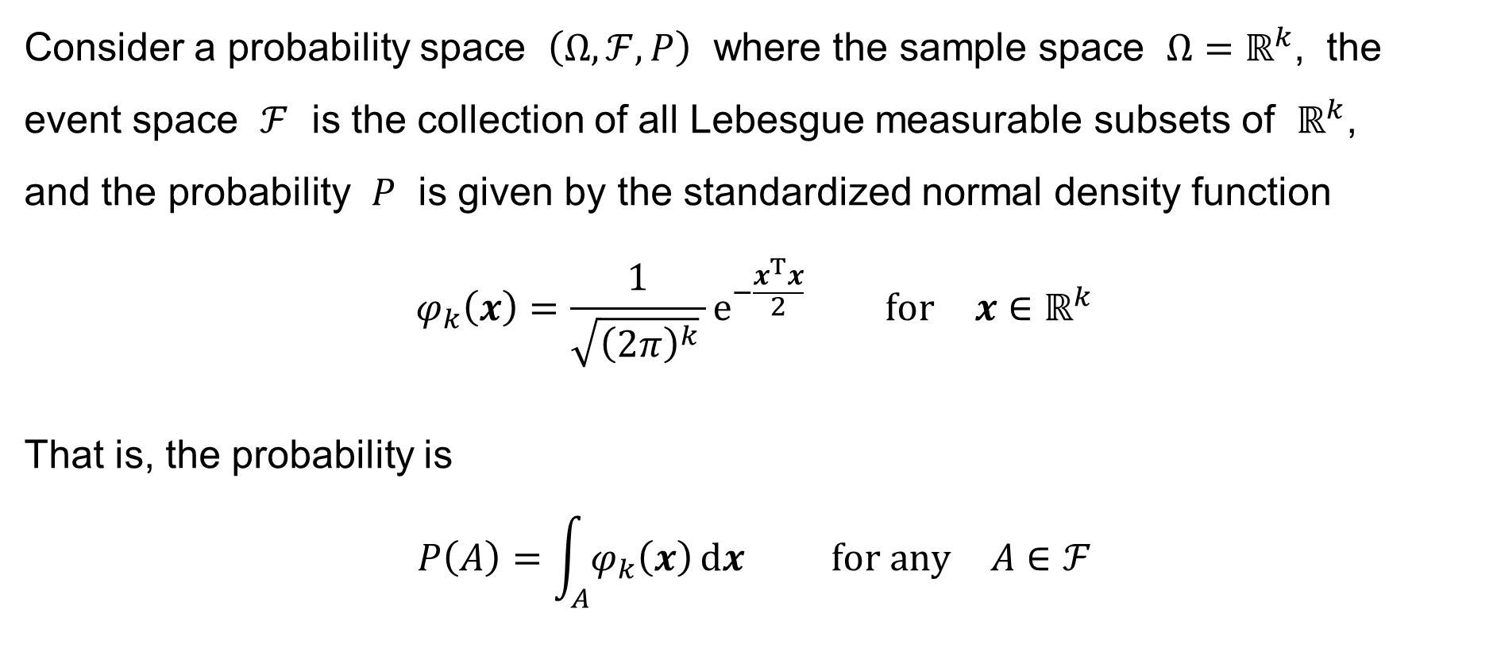
Standard multivariate normal distribution (of dim. k ≥ 1)
Consider a probability space $\left(Ω,ℱ,P\right)$ where the sample space $Ω=ℝ^{k}$, the
event space $ℱ$ is the collection of all Lebesgue measurable subsets of $ℝ^{k}$,
and the probability $P$ is given by the standardized normal density function
$$φ_{k}\left(x\right)=\frac{1}{\sqrt{{\left(2π\right)}^{k}} }e^{−\frac{x^{T}x}{2}} \text{for} x∈ℝ^{k}$$
That is, the probability is
$$P\left(A\right)=\int_{A}{φ_{k}\left(x\right) dx} \text{for} \text{any} A∈ℱ$$

Slide 41
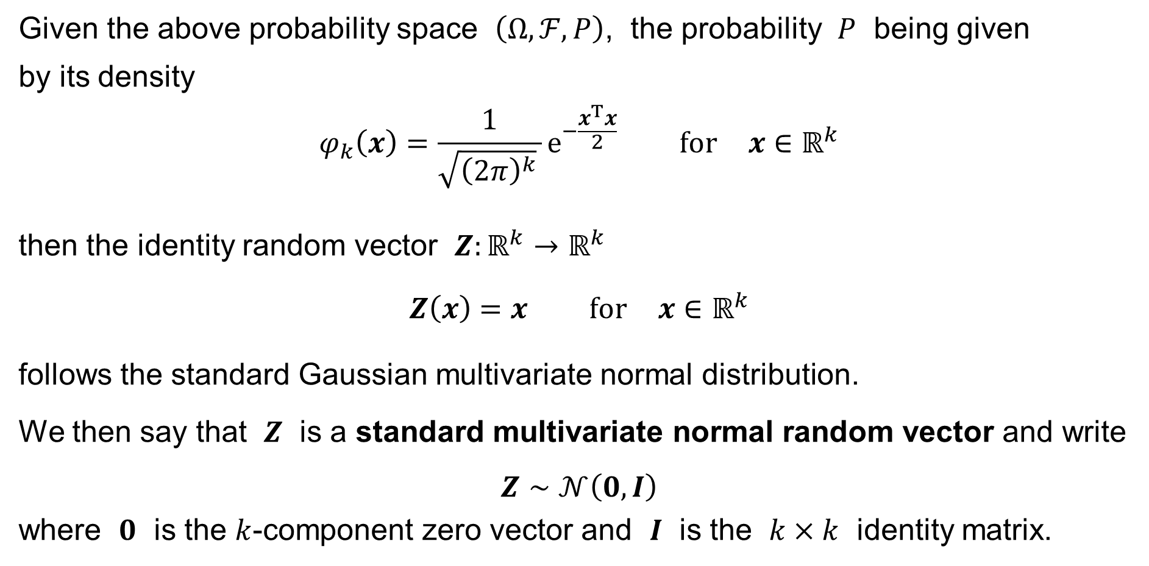
Standard multivariate normal distribution (of dim. k ≥ 1)
Given the above probability space $\left(Ω,ℱ,P\right)$, the probability $P$ being given
by its density
$$φ_{k}\left(x\right)=\frac{1}{\sqrt{{\left(2π\right)}^{k}} }e^{−\frac{x^{T}x}{2}} \text{for} x∈ℝ^{k}$$
then the identity random vector $Z:ℝ^{k}→ℝ^{k}$
$$Z\left(x\right)=x \text{for} x∈ℝ^{k}$$
follows the standard Gaussian multivariate normal distribution.
We then say that $Z$ is a standard multivariate normal random vector and write
$$Z∼𝒩\left(0,I\right)$$
where $0$ is the $k$-component zero vector and $I$ is the $k×k$ identity matrix.

Slide 42
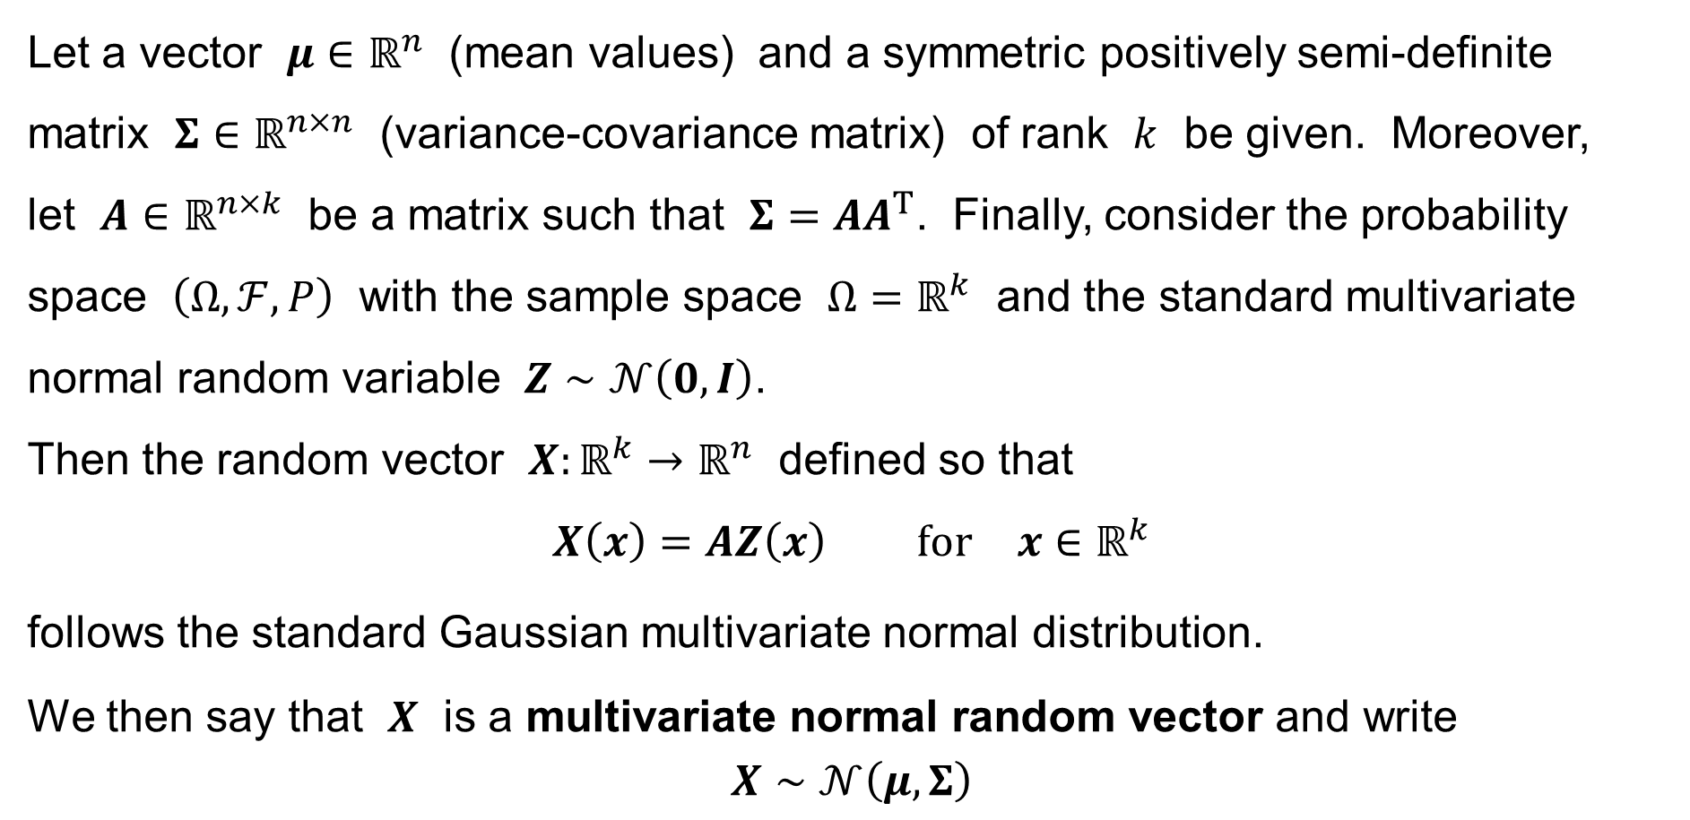
Multivariate normal distribution
Let a vector $μ∈ℝ^{n}$ (mean values) and a symmetric positively semi-definite matrix $Σ∈ℝ^{n×n}$ (variance-covariance matrix) of rank $k$ be given. Moreover,
let $A∈ℝ^{n×k}$ be a matrix such that $Σ=AA^{T}$. Finally, consider the probability space $\left(Ω,ℱ,P\right)$ with the sample space $Ω=ℝ^{k}$ and the standard multivariate normal random variable $Z∼𝒩\left(0,I\right)$.
Then the random vector $X:ℝ^{k}→ℝ^{n}$ defined so that
$$X\left(x\right)=AZ\left(x\right) \text{for} x∈ℝ^{k}$$
follows the standard Gaussian multivariate normal distribution.
We then say that $X$ is a multivariate normal random vector and write
$$X∼𝒩\left(μ,Σ\right)$$

Slide 43
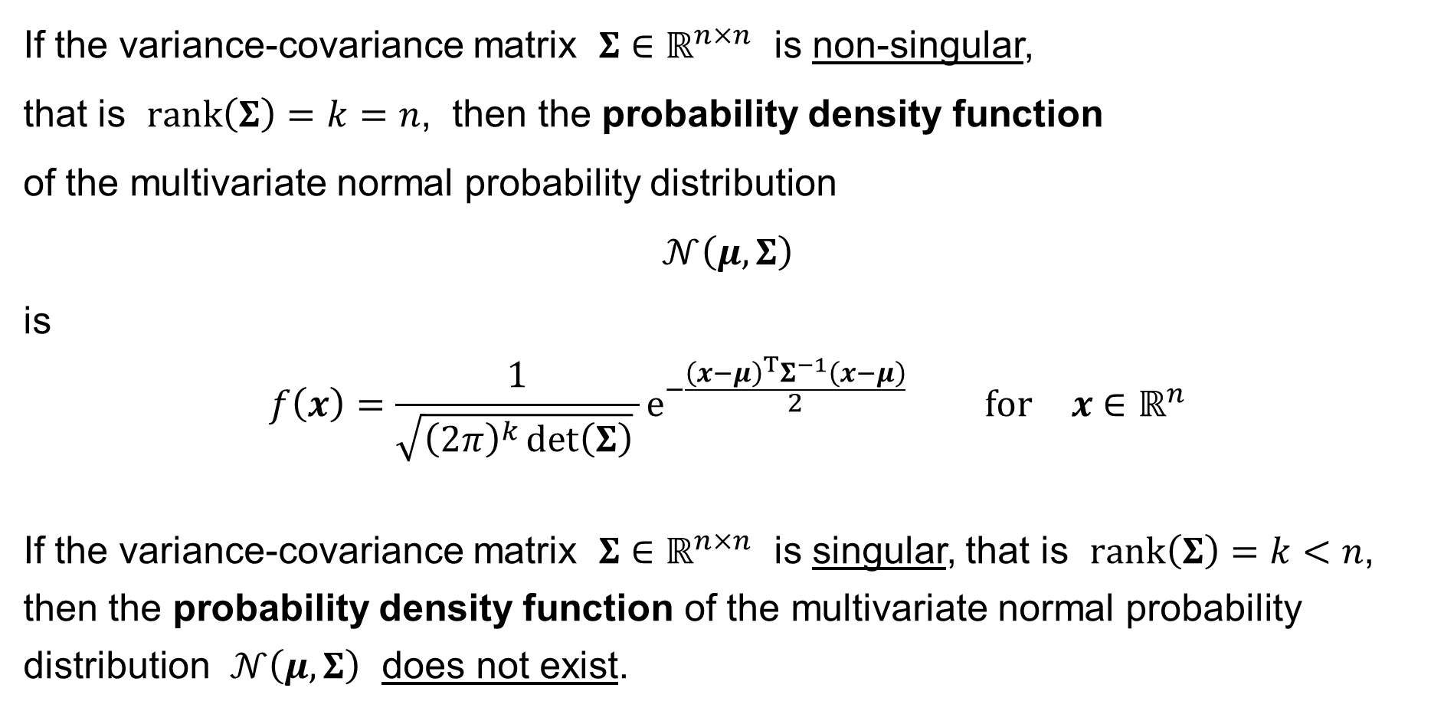
Multivariate normal distribution: Density
If the variance-covariance matrix $Σ∈ℝ^{n×n}$ is non-singular,
that is $rank\left(Σ\right)=k=n$, then the probability density function
of the multivariate normal probability distribution
$$𝒩\left(μ,Σ\right)$$
is
$$f\left(x\right)=\frac{1}{\sqrt{{\left(2π\right)}^{k}\det\left(Σ\right)} }e^{−\frac{{\left(x−μ\right)}^{T}Σ^{−1}\left(x−μ\right)}{2}} \text{for} x∈ℝ^{n}$$
If the variance-covariance matrix $Σ∈ℝ^{n×n}$ is singular, that is $rank\left(Σ\right)=k<n$, then the probability density function of the multivariate normal probability distribution $𝒩\left(μ,Σ\right)$ does not exist.

Slide 44
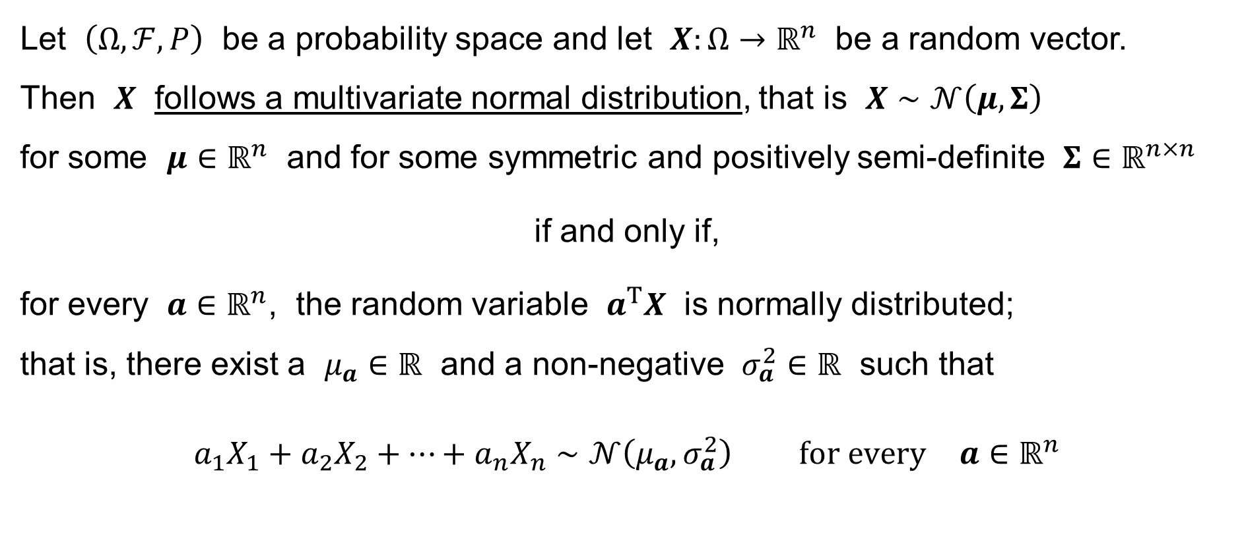
Multivariate normal distribution: Another definition
Let $\left(Ω,ℱ,P\right)$ be a probability space and let $X:Ω→ℝ^{n}$ be a random vector.
Then $X$ follows a multivariate normal distribution, that is $X∼𝒩\left(μ,Σ\right)$
for some $μ∈ℝ^{n}$ and for some symmetric and positively semi-definite $Σ∈ℝ^{n×n}$
if and only if,
for every $a∈ℝ^{n}$, the random variable $a^{T}X$ is normally distributed;
that is, there exist a $μ_{a}∈ℝ$ and a non-negative $σ_{a}^{2}∈ℝ$ such that
$$a_{1}X_{1}+a_{2}X_{2}+⋯+a_{n}X_{n}∼𝒩\left(μ_{a},σ_{a}^{2}\right) \text{for} \text{every} a∈ℝ^{n}$$

Slide 45
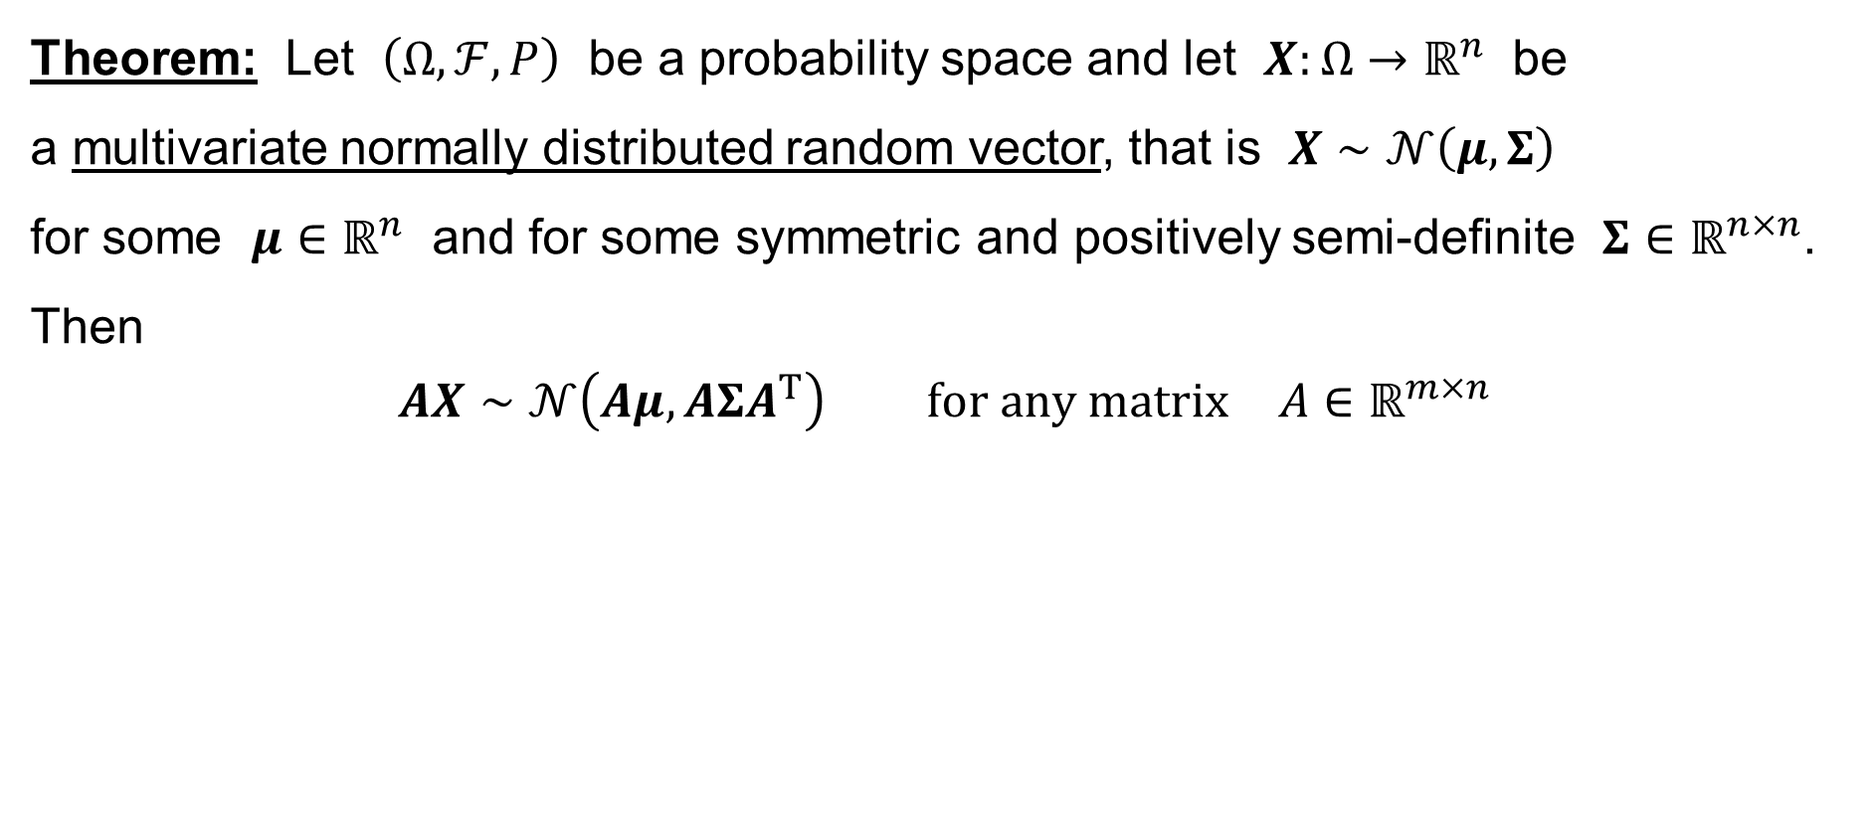
Multivariate normal distribution: Linear transformation
Theorem: Let $\left(Ω,ℱ,P\right)$ be a probability space and let $X:Ω→ℝ^{n}$ be
a multivariate normally distributed random vector, that is $X∼𝒩\left(μ,Σ\right)$
for some $μ∈ℝ^{n}$ and for some symmetric and positively semi-definite $Σ∈ℝ^{n×n}$.
Then
$$AX∼𝒩\left(Aμ,AΣA^{T}\right) \text{for} \text{any} \text{matrix} A∈ℝ^{m×n}$$

Slide 46
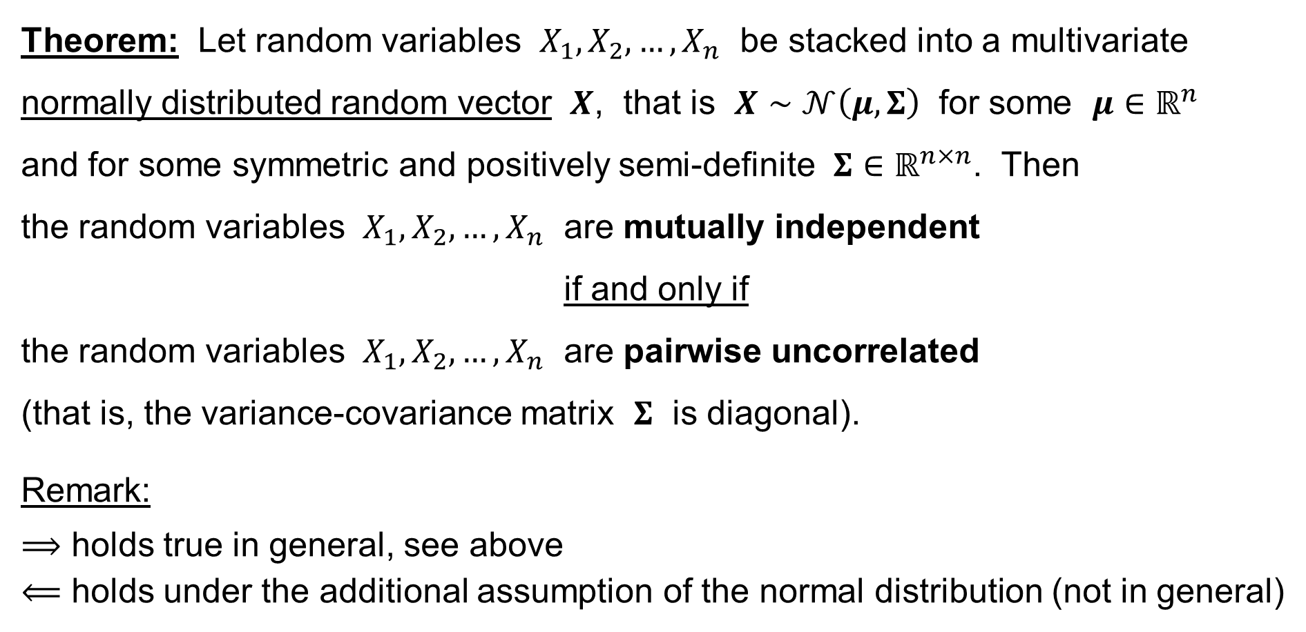
Multivariate normal distribution: Theorem
Theorem: Let random variables $X_{1},X_{2},…,X_{n}$ be stacked into a multivariate normally distributed random vector $X$, that is $X∼𝒩\left(μ,Σ\right)$ for some $μ∈ℝ^{n}$
and for some symmetric and positively semi-definite $Σ∈ℝ^{n×n}$. Then
the random variables $X_{1},X_{2},…,X_{n}$ are mutually independent
if and only if
the random variables $X_{1},X_{2},…,X_{n}$ are pairwise uncorrelated
(that is, the variance-covariance matrix $Σ$ is diagonal).
Remark:
$⟹$ holds true in general, see above
$⟸$ holds under the additional assumption of the normal distribution (not in general)

Slide 47
Multiple Linear Regression: Summary & Background
Summary
Terminology
Assumptions
Random vectors
The classical assumptions
Notation

Slide 48
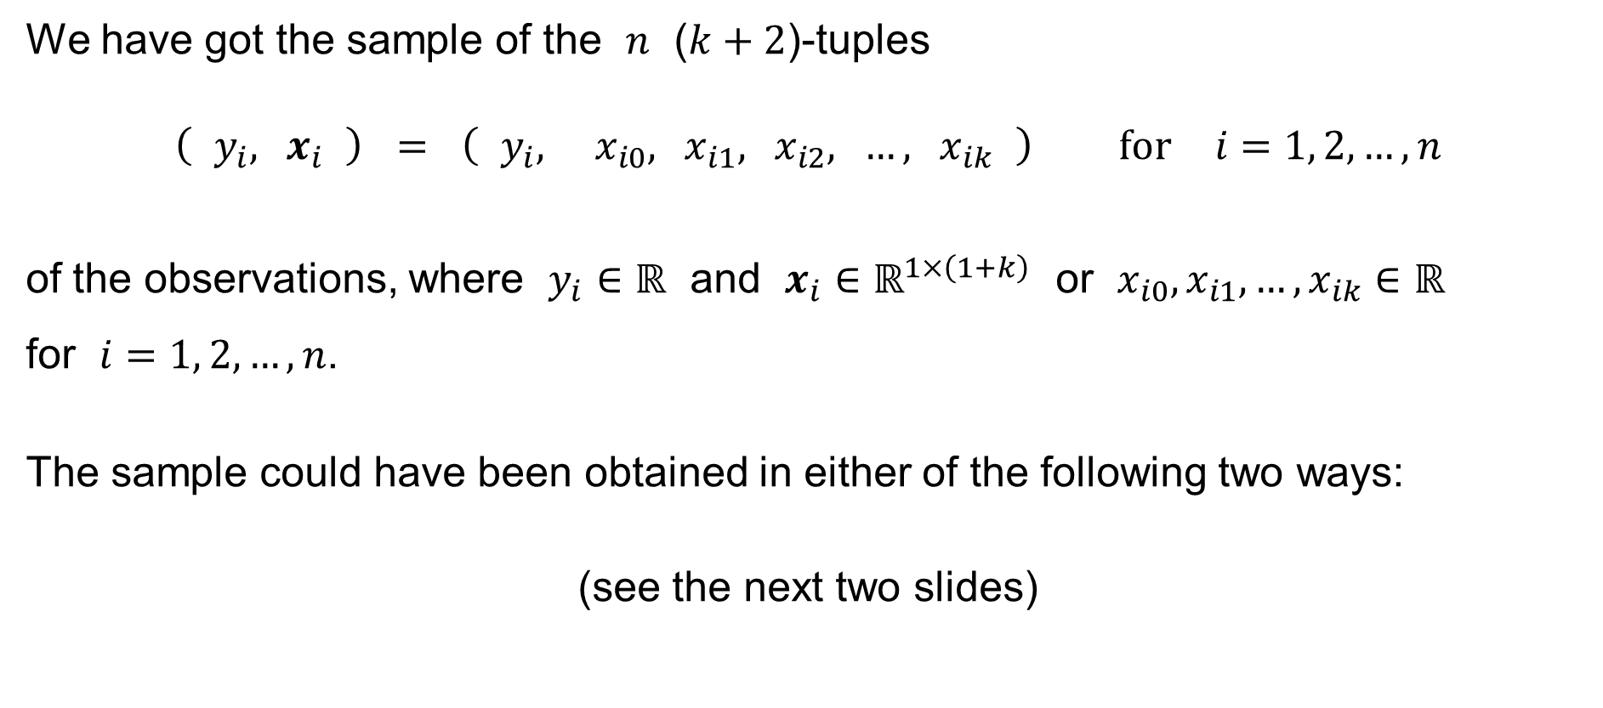
Multiple Linear Regression: Summary
We have got the sample of the $n$ ($k+2$)-tuples
$$\left( y_{i}, x_{i} \right) = \left( y_{i}, x_{i0}, x_{i1}, x_{i2}, …, x_{ik} \right) \text{for} i=1, 2,…,n$$
of the observations, where $y_{i}∈ℝ$ and $x_{i}∈ℝ^{1×\left(1+k\right)}$ or $x_{i0},x_{i1},…,x_{ik}∈ℝ$
for $i=1, 2,…,n$.
The sample could have been obtained in either of the following two ways:
(see the next two slides)

Slide 49
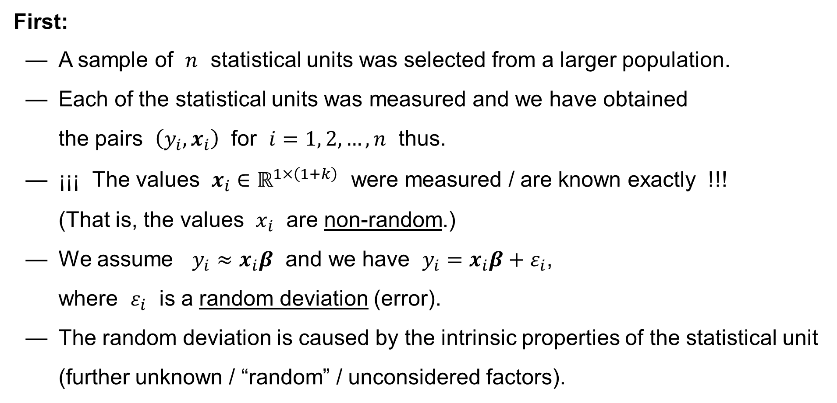
Multiple Linear Regression: Summary
First:
— A sample of $n$ statistical units was selected from a larger population.
— Each of the statistical units was measured and we have obtained
the pairs $\left(y_{i},x_{i}\right)$ for $i=1, 2,…,n$ thus.
— ¡¡¡ The values $x_{i}∈ℝ^{1×\left(1+k\right)}$ were measured / are known exactly !!!
(That is, the values $x_{i}$ are non-random.)
— We assume $y_{i}≈x_{i}β$ and we have $y_{i}=x_{i}β+ε_{i}$,
where $ε_{i}$ is a random deviation (error).
— The random deviation is caused by the intrinsic properties of the statistical unit (further unknown / “random” / unconsidered factors).

Slide 50
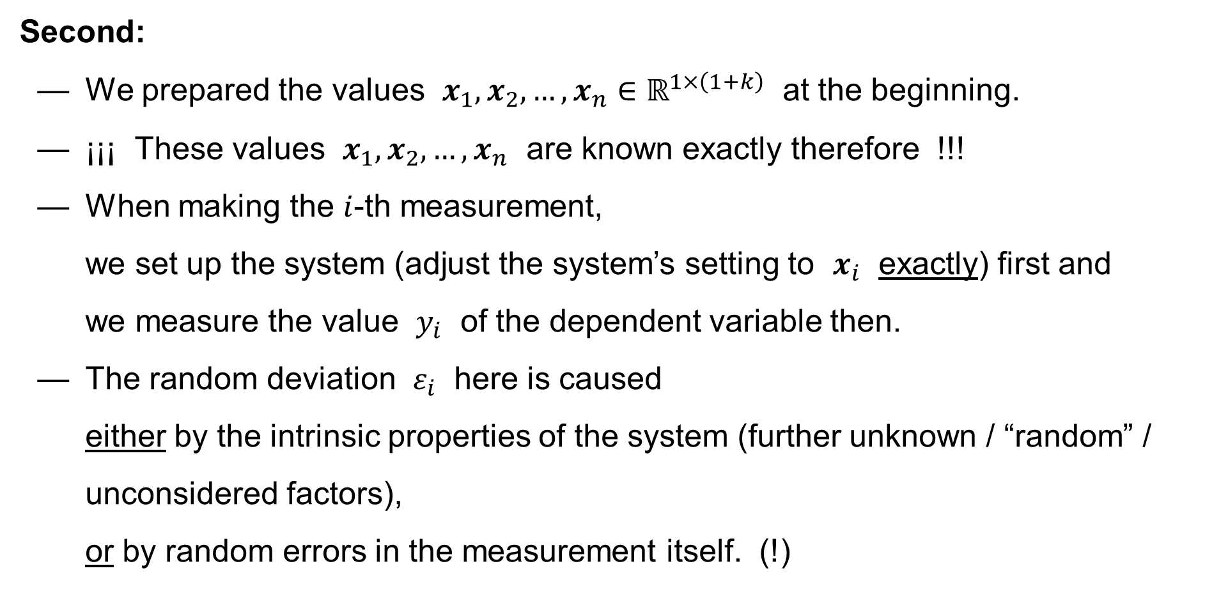
Multiple Linear Regression: Summary
Second:
— We prepared the values $x_{1},x_{2},…,x_{n}∈ℝ^{1×\left(1+k\right)}$ at the beginning.
— ¡¡¡ These values $x_{1},x_{2},…,x_{n}$ are known exactly therefore !!!
— When making the $i$-th measurement,
we set up the system (adjust the system’s setting to $x_{i}$ exactly) first and
we measure the value $y_{i}$ of the dependent variable then.
— The random deviation $ε_{i}$ here is caused
either by the intrinsic properties of the system (further unknown / “random” / unconsidered factors),
or by random errors in the measurement itself. (!)

Slide 51
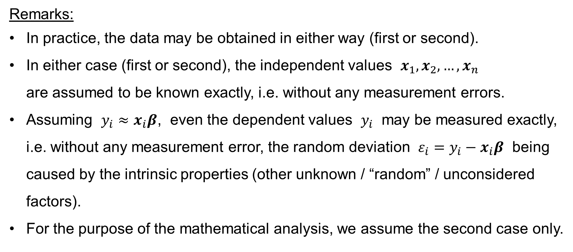
Multiple Linear Regression: Summary
Remarks:
In practice, the data may be obtained in either way (first or second).
In either case (first or second), the independent values $x_{1},x_{2},…,x_{n}$
are assumed to be known exactly, i.e. without any measurement errors.
Assuming $y_{i}≈x_{i}β$, even the dependent values $y_{i}$ may be measured exactly, i.e. without any measurement error, the random deviation $ε_{i}=y_{i}−x_{i}β$ being caused by the intrinsic properties (other unknown / “random” / unconsidered factors).
For the purpose of the mathematical analysis, we assume the second case only.

Slide 52

Multiple Linear Regression: Terminology
Parameters
Regression coefficients
$$Y=X_{0}β_{0}+X_{1}β_{1}+⋯+X_{k}β_{k}+ε$$
Regressand
Predicand
Explained variable
Dependent variable
Endogenous variable
Controlled variable
Response
Outcome
Predicted variable
Measured variable
Regressors
Predictors
Explanatory variables
Independent variables
Exogenous variables
Control variables
Stimuli
Covariates
Deviation
Error term
Disturbance
Noise

Slide 53

Multiple Linear Regression: Terminology
The intercept term
Parameters
Regression coefficients
If $X_{0}=1$ :
$$Y=β_{0}+X_{1}β_{1}+⋯+X_{k}β_{k}+ε$$
Regressand
Predicand
Explained variable
Dependent variable
Endogenous variable
Controlled variable
Response
Outcome
Predicted variable
Measured variable
Regressors
Predictors
Explanatory variables
Independent variables
Exogenous variables
Control variables
Stimuli
Covariates
Deviation
Error term
Disturbance
Noise

Slide 54
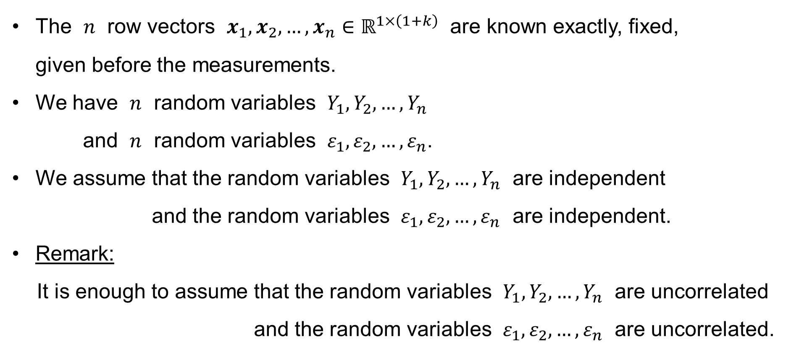
Multiple Linear Regression: Assumptions
The $n$ row vectors $x_{1},x_{2},…,x_{n}∈ℝ^{1×\left(1+k\right)}$ are known exactly, fixed,
given before the measurements.
We have $n$ random variables $Y_{1},Y_{2},…,Y_{n}$
and $n$ random variables $ε_{1},ε_{2},…,ε_{n}$.
We assume that the random variables $Y_{1},Y_{2},…,Y_{n}$ are independent
and the random variables $ε_{1},ε_{2},…,ε_{n}$ are independent.
Remark:
It is enough to assume that the random variables $Y_{1},Y_{2},…,Y_{n}$ are uncorrelated
and the random variables $ε_{1},ε_{2},…,ε_{n}$ are uncorrelated.

Slide 55
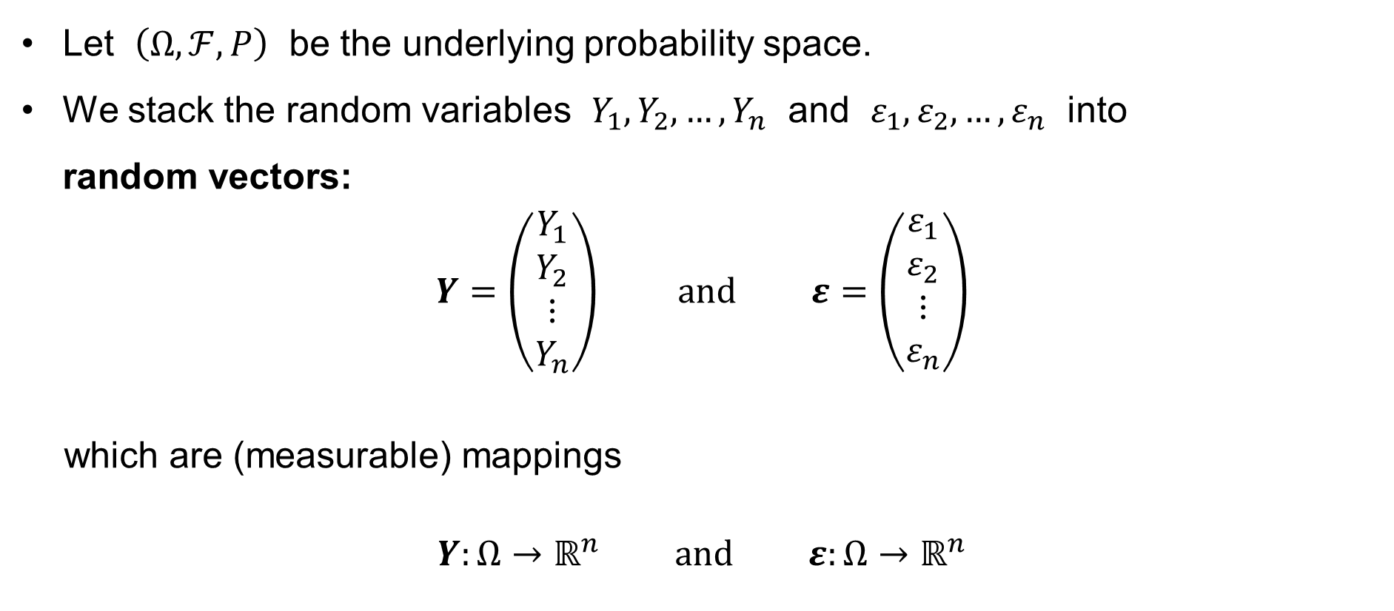
Multiple Linear Regression: Assumptions
Let $\left(Ω,ℱ,P\right)$ be the underlying probability space.
We stack the random variables $Y_{1},Y_{2},…,Y_{n}$ and $ε_{1},ε_{2},…,ε_{n}$ into
random vectors:
$$Y=\left(\begin{matrix}Y_{1} \\ Y_{2} \\ ⋮ \\ Y_{n}\end{matrix}\right) \text{and} ε=\left(\begin{matrix}ε_{1} \\ ε_{2} \\ ⋮ \\ ε_{n}\end{matrix}\right)$$
which are (measurable) mappings
$$Y:Ω→ℝ^{n} \text{and} ε:Ω→ℝ^{n}$$

Slide 56
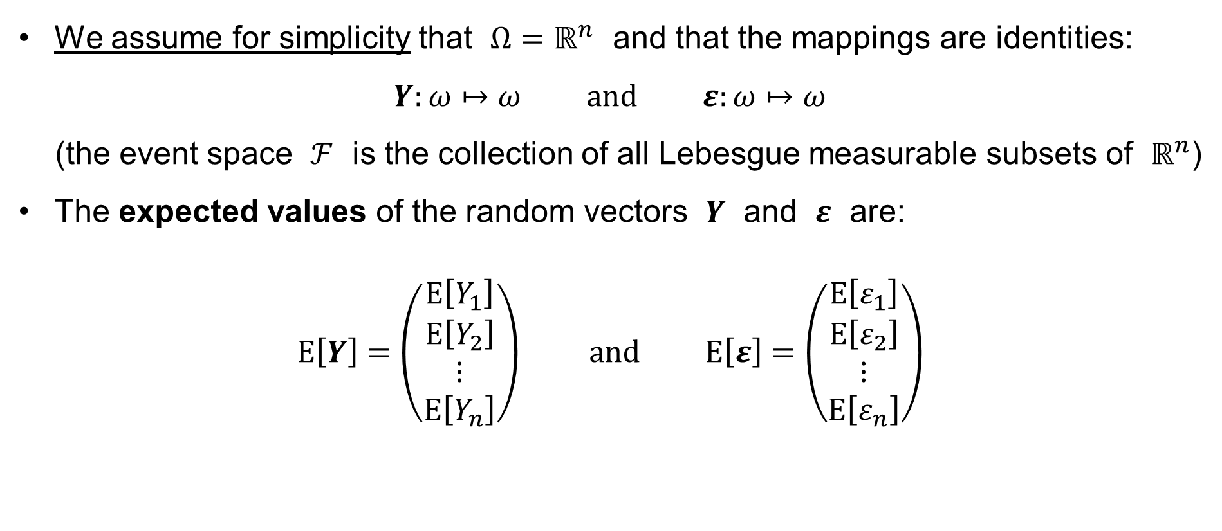
Multiple Linear Regression: Random vectors
We assume for simplicity that $Ω=ℝ^{n}$ and that the mappings are identities:
$$Y:ω↦ω \text{and} ε:ω↦ω$$
(the event space $ℱ$ is the collection of all Lebesgue measurable subsets of $ℝ^{n}$)
The expected values of the random vectors $Y$ and $ε$ are:
$$E\left[Y\right]=\left(\begin{matrix}E\left[Y_{1}\right] \\ E\left[Y_{2}\right] \\ ⋮ \\ E\left[Y_{n}\right]\end{matrix}\right) \text{and} E\left[ε\right]=\left(\begin{matrix}E\left[ε_{1}\right] \\ E\left[ε_{2}\right] \\ ⋮ \\ E\left[ε_{n}\right]\end{matrix}\right)$$

Slide 57
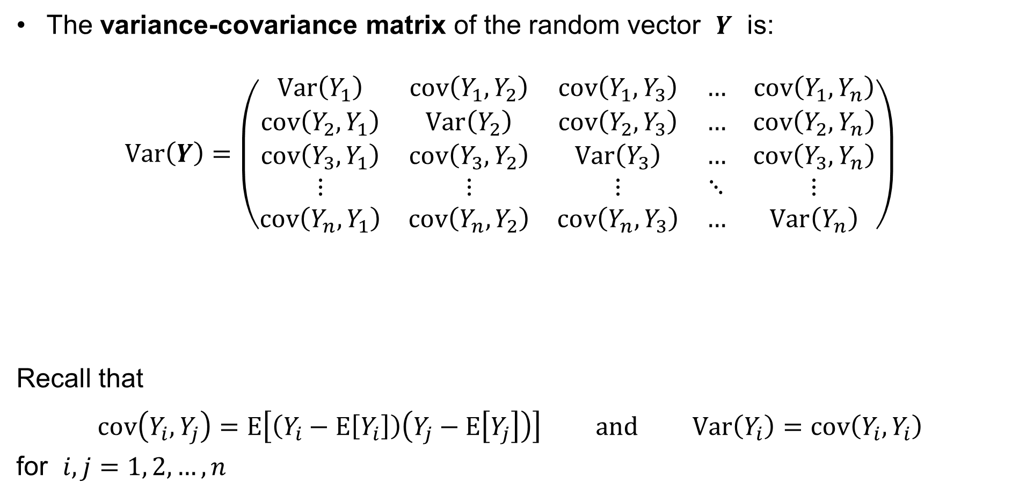
Multiple Linear Regression: Random vectors
The variance-covariance matrix of the random vector $Y$ is:
$$Var\left(Y\right)=\left(\begin{matrix}Var\left(Y_{1}\right) & cov\left(Y_{1},Y_{2}\right) & cov\left(Y_{1},Y_{3}\right) & … & cov\left(Y_{1},Y_{n}\right) \\ cov\left(Y_{2},Y_{1}\right) & Var\left(Y_{2}\right) & cov\left(Y_{2},Y_{3}\right) & … & cov\left(Y_{2},Y_{n}\right) \\ cov\left(Y_{3},Y_{1}\right) & cov\left(Y_{3},Y_{2}\right) & Var\left(Y_{3}\right) & … & cov\left(Y_{3},Y_{n}\right) \\ ⋮ & ⋮ & ⋮ & ⋱ & ⋮ \\ cov\left(Y_{n},Y_{1}\right) & cov\left(Y_{n},Y_{2}\right) & cov\left(Y_{n},Y_{3}\right) & … & Var\left(Y_{n}\right)\end{matrix}\right)$$
Recall that
$$cov\left(Y_{i},Y_{j}\right)=E\left[\left(Y_{i}−E\left[Y_{i}\right]\right)\left(Y_{j}−E\left[Y_{j}\right]\right)\right] \text{and} Var\left(Y_{i}\right)=cov\left(Y_{i},Y_{i}\right)$$
for $i,j=1, 2,…,n$

Slide 58

Multiple Linear Regression: Random vectors
The variance-covariance matrix of the random vector $ε$ is:
$$Var\left(ε\right)=\left(\begin{matrix}Var\left(ε_{1}\right) & cov\left(ε_{1},ε_{2}\right) & cov\left(ε_{1},ε_{3}\right) & … & cov\left(ε_{1},ε_{n}\right) \\ cov\left(ε_{2},ε_{1}\right) & Var\left(ε_{2}\right) & cov\left(ε_{2},ε_{3}\right) & … & cov\left(ε_{2},ε_{n}\right) \\ cov\left(ε_{3},ε_{1}\right) & cov\left(ε_{3},ε_{2}\right) & Var\left(ε_{3}\right) & … & cov\left(ε_{3},ε_{n}\right) \\ ⋮ & ⋮ & ⋮ & ⋱ & ⋮ \\ cov\left(ε_{n},ε_{1}\right) & cov\left(ε_{n},ε_{2}\right) & cov\left(ε_{n},ε_{3}\right) & … & Var\left(ε_{n}\right)\end{matrix}\right)$$
Recall that
$$cov\left(ε_{i},ε_{j}\right)=E\left[\left(ε_{i}−E\left[ε_{i}\right]\right)\left(ε_{j}−E\left[ε_{j}\right]\right)\right] \text{and} Var\left(ε_{i}\right)=cov\left(ε_{i},ε_{i}\right)$$
for $i,j=1, 2,…,n$

Slide 59

Multiple Linear Regression: The Classical Assumptions
We have the underlying probability space $\left(Ω,ℱ,P\right)$, with $Ω=ℝ^{n}$ for simplicity.
Let $ω∈Ω$ be the outcome of the random experiment.
Recalling that $X$ is the $n×\left(1+k\right)$ design matrix, we have
$y=Y\left(ω\right)=Xβ+ε\left(ω\right)$
In other words:
The measured values $y_{1},y_{2},…,y_{n}$ are the numerical outcomes $Y_{1}\left(ω\right),Y_{2}\left(ω\right),…,Y_{n}\left(ω\right)$ of the random experiment.
The numerical outcomes $Y_{1}\left(ω\right),Y_{2}\left(ω\right),…,Y_{n}\left(ω\right)$ are obtained so that the numerical outcomes $ε_{1}\left(ω\right),ε_{2}\left(ω\right),…,ε_{n}\left(ω\right)$ of the random experiment
are added to the given values $x_{1}β,x_{2}β,…,x_{n}β$.

Slide 60


Multiple Linear Regression: The Classical Assumptions
Recall:
¡¡¡ The values of the regressors $x_{1},x_{2},…,x_{n}$ are non-random and known !!!
¡¡¡ The values of the parameters $β_{0},β_{1},…,β_{k}$ are non-random but unknown !!!
We assume that
$$Y∼𝒩\left(Xβ,σ^{2}I\right) \text{and} ε∼𝒩\left(0,σ^{2}I\right)$$
where $I$ denotes the $n×n$ identity matrix
and $0$ denotes the $n×1$ zero vector.
for some $σ^{2}∈ℝ_{0}^{+}$

Slide 61

Multiple Linear Regression: The Classical Assumptions
The classical assumptions $Y∼𝒩\left(Xβ,σ^{2}I\right)$ and $ε∼𝒩\left(0,σ^{2}I\right)$ mean that
$$E\left[Y\right]=Xβ \text{and} E\left[ε\right]=0$$
that is
$$E\left[Y\right]=\left(\begin{matrix}E\left[Y_{1}\right] \\ E\left[Y_{2}\right] \\ ⋮ \\ E\left[Y_{n}\right]\end{matrix}\right)=\left(\begin{matrix}x_{1}β \\ x_{2}β \\ ⋮ \\ x_{n}β\end{matrix}\right) \text{and} E\left[ε\right]=\left(\begin{matrix}E\left[ε_{1}\right] \\ E\left[ε_{2}\right] \\ ⋮ \\ E\left[ε_{n}\right]\end{matrix}\right)=\left(\begin{matrix}0 \\ 0 \\ ⋮ \\ 0\end{matrix}\right)$$
That is
$$E\left[Y_{i}\right]=x_{i}β \text{and} E\left[ε_{i}\right]=0 \text{for} i=1, 2,…,n$$

Slide 62

Multiple Linear Regression: The Classical Assumptions
The classical assumptions $Y∼𝒩\left(Xβ,σ^{2}I\right)$ and $ε∼𝒩\left(0,σ^{2}I\right)$ also mean that
$$Var\left(Y\right)=Var\left(ε\right)=σ^{2}I=\left(\begin{matrix}σ^{2} & 0 & 0 & … & 0 \\ 0 & σ^{2} & 0 & … & 0 \\ 0 & 0 & σ^{2} & … & 0 \\ ⋮ & ⋮ & ⋮ & ⋱ & ⋮ \\ 0 & 0 & 0 & … & σ^{2}\end{matrix}\right)$$
That is,
$Var\left(Y_{i}\right)=Var\left(ε_{i}\right)=σ^{2}$ for $i=1, 2,…,n$ for some $σ^{2}∈ℝ_{0}^{+}$
and the random variables $Y_{1},Y_{2},…,Y_{n}$ or $ε_{1},ε_{2},…,ε_{n}$
are (pairwise) uncorrelated.
homoscedasticity, i.e. the variance
is the same

Slide 63

Multiple Linear Regression: The Classical Assumptions
The classical assumptions $Y∼𝒩\left(Xβ,σ^{2}I\right)$ and $ε∼𝒩\left(0,σ^{2}I\right)$ finally mean that
$$Y_{i}∼𝒩\left(x_{i}β,σ^{2}\right) \text{and} ε_{i}∼𝒩\left(0,σ^{2}\right) \text{for} i=1, 2,…,n$$
where $𝒩\left(μ,σ^{2}\right)$ denotes the normal (Gaussian) probability distribution
with mean $μ$ and variance $σ^{2}$ and that
the random variables $Y_{1},Y_{2},…,Y_{n}$ or $ε_{1},ε_{2},…,ε_{n}$ are (pairwise) uncorrelated.
Remark: It always holds: If the random variables $Y_{1},Y_{2},…,Y_{n}$ or $ε_{1},ε_{2},…,ε_{n}$
are mutually independent, then they are (pairwise) uncorrelated.
It also holds: If $Y∼𝒩\left(Xβ,σ^{2}I\right)$ and $ε∼𝒩\left(0,σ^{2}I\right)$, then the random variables $Y_{1},Y_{2},…,Y_{n}$ and $ε_{1},ε_{2},…,ε_{n}$ are mutually independent.
•

Slide 64

Multiple Linear Regression: The Classical Assumptions
The classical assumption $Y∼𝒩\left(Xβ,σ^{2}I\right)$ implies that
$$E\left[Y\right]=Xβ$$
that is
$$E\left[Y_{i}\right]=x_{i}β=x_{i0}β_{0}+x_{i1}β_{1}+⋯+x_{ik}β_{k} \text{for} i=1, 2,…,n$$
linearity

Slide 65

Multiple Linear Regression: Notation
The unknown quantities
— unknown parameters $β_{0},β_{1},…,β_{k}$
— unknown (random) deviations $ε_{1},ε_{2},…,ε_{n}$
are denoted by Greek letters
The estimates of the unknown parameters $β_{0},β_{1},…,β_{k}$
are denoted by the respective Latin letters $b_{0},b_{1},…,b_{k}$
or by the hat “^” ${\hat{β}}_{0},{\hat{β}}_{1},…,{\hat{β}}_{k}$,
so that $b_{0}={\hat{β}}_{0}$, $b_{1}={\hat{β}}_{1}$, …, $b_{k}={\hat{β}}_{k}$
We shall mainly use the Latin letters $b_{0},b_{1},…,b_{k}$ to denote the estimates.

Slide 66

Multiple Linear Regression: Notation
The predicted values of the dependent variable are denoted by the hat “^”:
${\hat{y}}_{i}=x_{i}b=x_{i0}b_{0}+x_{i1}b_{1}+⋯+x_{ik}b_{k} \text{for} i=1, 2,…,n$
The unknown (random) deviations $ε_{1},ε_{2},…,ε_{n}$ are denoted by Greek letters.
The residuals are denoted by the respective Latin letters $e_{1},e_{2},…,e_{n}$
or by the hat “^” ${\hat{ε}}_{1},{\hat{ε}}_{2},…,{\hat{ε}}_{n}$,
so that
$e_{1}={\hat{ε}}_{1}=y_{1}−{\hat{y}}_{1} e_{2}={\hat{ε}}_{2}=y_{2}−{\hat{y}}_{2} … e_{n}={\hat{ε}}_{n}=y_{n}−{\hat{y}}_{n}$
We shall mainly use the Latin letters $e_{1},e_{2},…,e_{n}$ to denote the residuals.

Slide 67


Basic Results (Theorems)
The normal equation
The predicted values
Orthogonal projections
Theorem 1: $\hat{y}$ and $e$ are independent
Theorem 2: $\hat{y}∼𝒩\left(Xβ, σ^{2}H\right)$
Theorem 3: $e∼𝒩\left(0, σ^{2}M\right)$
Theorem 4: $b∼𝒩\left(β,σ^{2}C\right)$
if $rank\left(X\right)=k+1$

Slide 68

Multiple Linear Regression: The Normal Equation
Given the $n$ pairs $\left(y_{1},x_{1}\right)$, $\left(y_{2},x_{2}\right)$, …, $\left(y_{n},x_{n}\right)$ of the observations,
the Residual Sum of Squares for the estimates $b_{0},b_{1},…,b_{k}∈ℝ$ is
$$RSS=\sum_{i=1}^{n}{e_{i}^{2}}=\sum_{i=1}^{n}{{\left(y_{i}−{\hat{y}}_{i}\right)}^{2}}=\sum_{i=1}^{n}{{\left(y_{i}−x_{i0}b_{0}−x_{i1}b_{1}−⋯−x_{ik}b_{k}\right)}^{2}} ⟶ min$$
It is our purpose to find the estimates $b_{0},b_{1},…,b_{k}∈ℝ$ so that the Residual Sum
of Squares $RSS$ is minimized. To this end, we let
$$\frac{∂RSS}{∂b_{j}}=\sum_{i=1}^{n}{−2x_{ij}\left(y_{i}−x_{i0}b_{0}−x_{i1}b_{1}−⋯−x_{ik}b_{k}\right)}=0 \text{for} j=0, 1,…,k$$

Slide 69

Multiple Linear Regression: The Normal Equation
From ${∂RSS}/{∂b_{j}}=\sum_{i=1}^{n}{−2x_{ij}\left(y_{i}−x_{i0}b_{0}−x_{i1}b_{1}−⋯−x_{ik}b_{k}\right)}=0$, we obtain
the Normal Equation:
$$\sum_{i=1}^{n}{x_{ij}\left(x_{i0}b_{0}+x_{i1}b_{1}+⋯+x_{ik}b_{k}\right)}=\sum_{i=1}^{n}{x_{ij}y_{i}} \text{for} j=0, 1,…,k$$

Slide 70

Multiple Linear Regression: The Normal Equation
Recall the notation:
$$X={\left(x_{i0},x_{i1},…,x_{ik}\right)}_{i=1}^{n}=\left(\begin{matrix}x_{10} & x_{11} & … & x_{1k} \\ x_{20} & x_{21} & … & x_{2k} \\ ⋮ & ⋮ & ⋮ & ⋮ \\ x_{n0} & x_{n1} & … & x_{nk}\end{matrix}\right)=\left(\begin{matrix}x_{1} \\ x_{2} \\ ⋮ \\ x_{n}\end{matrix}\right)$$
and
$$y={\left(y_{i}\right)}_{i=1}^{n}=\left(\begin{matrix}y_{1} \\ y_{2} \\ ⋮ \\ y_{n}\end{matrix}\right)$$

Slide 71

Multiple Linear Regression: The Normal Equation
So the normal equation
$$\sum_{i=1}^{n}{x_{ij}\left(x_{i0}b_{0}+x_{i1}b_{1}+⋯+x_{ik}b_{k}\right)}=\sum_{i=1}^{n}{x_{ij}y_{i}} \text{for} j=0, 1,…,k \\ \sum_{i=1}^{n}{x_{ij}\left(x_{i}b\right)}=\sum_{i=1}^{n}{x_{ij}y_{i}} \text{for} j=0, 1,…,k$$
can be written as
$$X^{T}Xb=X^{T}y$$
where $b∈ℝ^{1+k}$ or $b_{0},b_{1},…,b_{k}∈ℝ$ are unknown.

Slide 72

Multiple Linear Regression: The Normal Equation
Having the normal equation ($X^{T}Xb=X^{T}y$), where $X$ is an $n×\left(1+k\right)$ matrix, let
$$p=rank\left(X\right)$$
Assume for simplicity that the matrix $X$ is of full rank, that is,
$$p=rank\left(X\right)=k+1≤n$$
The matrix $X^{T}X$ is then non-singular; let:
$$C={\left(X^{T}X\right)}^{−1}$$
NO
(perfect)
multicollinearity

Slide 73

Multiple Linear Regression: The Normal Equation
We have
$$C={\left(X^{T}X\right)}^{−1}=\left(\begin{matrix}c_{00} & c_{01} & c_{02} & … & c_{0k} \\ c_{10} & c_{11} & c_{12} & … & c_{1k} \\ c_{20} & c_{21} & c_{22} & … & c_{2k} \\ ⋮ & ⋮ & ⋮ & ⋱ & ⋮ \\ c_{k0} & c_{k1} & c_{k2} & … & c_{kk}\end{matrix}\right)$$
The solution to the normal equation
$$X^{T}Xb=X^{T}y$$
is then
$$b=CX^{T}y$$

Slide 74

Multiple Linear Regression: the predicted values
Recall the $n$ equations
$$y_{1}=x_{10}β_{0}+x_{11}β_{1}+x_{12}β_{2}+⋯+x_{1k}β_{k}+ε_{1} \\ y_{2}=x_{20}β_{0}+x_{21}β_{1}+x_{22}β_{2}+⋯+x_{2k}β_{k}+ε_{2} \\ ⋮ \\ y_{n}=x_{n0}β_{0}+x_{n1}β_{1}+x_{n2}β_{2}+⋯+x_{nk}β_{k}+ε_{n}$$
where
the dataset ${\left(y_{i},x_{i0},x_{i1},…,x_{ik}\right)}_{i=1}^{n}$ is given,
the parameters $β_{0},β_{1},…,β_{k}∈ℝ$ are unknown (to be estimated), and
the values $ε_{1},ε_{2},…,ε_{n}∈ℝ$ are random deviations (random errors).

Slide 75

Multiple Linear Regression: the predicted values
Now the predicted values are:
$${\hat{y}}_{1}=x_{10}b_{0}+x_{11}b_{1}+x_{12}b_{2}+⋯+x_{1k}b_{k} \\ {\hat{y}}_{2}=x_{20}b_{0}+x_{21}b_{1}+x_{22}b_{2}+⋯+x_{2k}b_{k} \\ ⋮ \\ {\hat{y}}_{n}=x_{n0}b_{0}+x_{n1}b_{1}+x_{n2}b_{2}+⋯+x_{nk}b_{k}$$
where
$b_{0}={\hat{β}}_{0}$, $b_{1}={\hat{β}}_{1}$, …, $b_{k}={\hat{β}}_{k}$ are the estimates
of the unknown parameters $β_{0},β_{1},…,β_{k}∈ℝ$,
${\hat{y}}_{1},{\hat{y}}_{2},…,{\hat{y}}_{n}$ are the predicted values.

Slide 76

Multiple Linear Regression: the predicted values
Shortly:
— the solution to the normal equation is
$$b=CX^{T}y={\left(X^{T}X\right)}^{−1}X^{T}y$$
— the predicted values are
$$\hat{y}=Xb=XCX^{T}y$$
Introduce the notation:
$$H=XCX^{T}=X{\left(X^{T}X\right)}^{−1}X^{T}$$
The letter “H ” stands for “hat”:
$$\hat{y}=Hy$$

Slide 77

Multiple Linear Regression: some properties of H
By the construction (by the Least Squares Method: the vector $\hat{y}$ lies in the linear hull of the columns of the matrix $X$ and is as close to $y$ as possible in the Euclidean distance), the matrix
$$H=XCX^{T}=X{\left(X^{T}X\right)}^{−1}X^{T}$$
is the matrix of the orthogonal projection onto the linear subspace
$$\left\{ Xβ :β∈ℝ^{1+k} \right\}$$
(the linear hull of the columns of the matrix $X$ )
$$\left(I−H\right)$$
is the matrix of the orthogonal projection onto the orthogonal complement
$${\left\{ Xβ :β∈ℝ^{1+k} \right\}}^{⊥}$$
moreover

Slide 78

Multiple Linear Regression: some properties of H
The matrix $H=XCX^{T}=X{\left(X^{T}X\right)}^{−1}X^{T}$ therefore is:
— idempotent:
$$H=HH$$
— symmetric:
$$H=H^{T}$$
— and:
$$HX=X$$
The residuals are:
$$e=y−\hat{y}=y−Hy=\left(I−H\right)y$$
Therefore:
$$\hat{y}⊥e$$
(are orthogonal)

Slide 79










Multiple Linear Regression: some properties of H
The orthogonal decomposition
of the vector $y∈ℝ^{n}$ :
$$y=\hat{y}+e \text{and} e⊥\hat{y}$$
$${\left\{ Xβ :β∈ℝ^{1+k} \right\}}^{⊥}$$
(the orthogonal
complement =
= the space of
the residuals)
vector of the numerical outcomes
of the $n$ random experiments
$$y$$
$$\left(I−H\right)y=e$$
By the Pythagoras Theorem:
$${\left\|y\right\|}^{2}={\left\|\hat{y}\right\|}^{2}+{\left\|e\right\|}^{2} \\ y^{T}y={\hat{y}}^{T}\hat{y}+e^{T}e$$
$$M$$
0
$$\hat{y}=Hy$$
$$\left\{ Xβ :β∈ℝ^{1+k} \right\}$$
(the linear hull of the columns of $X$ )
Residual Sum of Squares: $RSS=\sum_{i=1}^{n}{{\left(y_{i}−{\hat{y}}_{i}\right)}^{2}}=\sum_{i=1}^{n}{e_{i}^{2}}=e^{T}e$

Slide 80

Multiple Linear Regression
Recalling that the regressors $x_{1},x_{2},…,x_{n}∈ℝ^{1×\left(1+k\right)}$ are given, that we assume
$$Y_{i}=x_{i}β+ε_{i} \text{for} i=1, 2,…,n$$
with
$$E\left[Y_{i}\right]=x_{i}β \text{and} Var\left(Y_{i}\right)=σ^{2} \text{for} i=1, 2,…,n$$
or
$$E\left[ε_{i}\right]=0 \text{and} Var\left(ε_{i}\right)=σ^{2} \text{for} i=1, 2,…,n$$
where the random variables $Y_{1},Y_{2},…,Y_{n}$, or $ε_{1},ε_{2},…,ε_{n}$, respectively, are independent (or uncorrelated), and that $y_{1},y_{2},…,y_{n}$ are some observations
of the random variables $Y_{1},Y_{2},…,Y_{n}$, it follows that all the estimates
$$b_{0},b_{1},…,b_{k} \text{(}{\hat{β}}_{0},{\hat{β}}_{1},…,{\hat{β}}_{k}\text{)} {\hat{y}}_{1},{\hat{y}}_{2},…,{\hat{y}}_{n} RSS \text{etc}\text{.}$$
are random variables because they depend on the random values $y_{1},y_{2},…,y_{n}$.

Slide 81

Multiple Linear Regression: Theorem 1
Theorem 1: The random vectors $\hat{y}$ and $e$ are independent.
That is,
$$P\left(\begin{aligned}∩\left\{ ω∈Ω :\hat{y}\left(ω\right)∈G_{\hat{y}} \right\}∩ \\ ∩\left\{ ω∈Ω :e\left(ω\right)∈G_{e} \right\}∩\end{aligned}\right)=\begin{aligned}×P\left\{ ω∈Ω :\hat{y}\left(ω\right)∈G_{\hat{y}} \right\}× \\ ×P\left\{ ω∈Ω :e\left(ω\right)∈G_{e} \right\}×\end{aligned}$$
for every open set $G_{\hat{y}}⊆ℝ^{n}$ and for every open set $G_{e}⊆ℝ^{n}$.

Slide 82

Multiple Linear Regression: Theorem 1: Corollary
Corollary: The random vector $\hat{y}$ and the random variable $RSS$ are independent.
Recall the Residual Sum of Squares is $RSS=\sum_{i=1}^{n}{{\left(y_{i}−{\hat{y}}_{i}\right)}^{2}}=\sum_{i=1}^{n}{e_{i}^{2}}=e^{T}e$
That is,
$$P\left(\begin{aligned}∩\left\{ ω∈Ω :\hat{y}\left(ω\right)∈G_{\hat{y}} \right\}∩ \\ ∩\left\{ ω∈Ω :RSS\left(ω\right)∈G_{RSS} \right\}∩\end{aligned}\right)=\begin{aligned}×P\left\{ ω∈Ω :\hat{y}\left(ω\right)∈G_{\hat{y}} \right\}× \\ ×P\left\{ ω∈Ω :RSS\left(ω\right)∈G_{RSS} \right\}×\end{aligned}$$
for every open set $G_{\hat{y}}⊆ℝ^{n}$ and for every open set $G_{RSS}⊆ℝ$

Slide 83

Multiple Linear Regression: Theorem 2
Theorem 2: It holds
$$\hat{y}∼𝒩\left(Xβ, σ^{2}H\right)$$
It holds in particular hence that
$$E\left[{\hat{y}}_{i}\right]=E\left[x_{i}b\right]=x_{i}β=E\left[Y_{i}\right] \text{for} i=1, 2,…,n$$
and
$$Var\left({\hat{y}}_{i}\right)=σ^{2}{\left(XCX^{T}\right)}_{ii} \text{for} i=1, 2,…,n \\ cov\left({\hat{y}}_{i},{\hat{y}}_{j}\right)=σ^{2}{\left(XCX^{T}\right)}_{ij} \text{for} i,j=1, 2,…,n$$

Slide 84

Multiple Linear Regression: Theorem 3
Theorem 3: It holds
$$e∼𝒩\left(0, σ^{2}M\right)$$
where
$$M=I−H=I−XCX^{T}=I−X{\left(X^{T}X\right)}^{−1}X^{T}$$
It holds in particular hence that
$$E\left[e_{i}\right]=0 \text{for} i=1, 2,…,n$$
and
$$Var\left(e_{i}\right)=σ^{2}m_{ii}=σ^{2}−Var\left({\hat{y}}_{i}\right) \text{for} i=1, 2,…,n \\ cov\left(e_{i},e_{j}\right)=σ^{2}m_{ij} \text{for} i,j=1, 2,…,n \\ =−cov\left({\hat{y}}_{i},{\hat{y}}_{j}\right) \text{if} i≠j$$

Slide 85

Multiple Linear Regression: Theorem 4
Theorem 4: If $rank\left(X\right)=k+1$, then
$$b∼𝒩\left(β,σ^{2}C\right)$$
It holds in particular hence that
$$E\left[b_{j}\right]=β_{j} \text{fo}\text{r} j=0, 1,…,k$$
and
$$Var\left(b_{j}\right)=σ^{2}c_{jj} \text{for} j=0, 1,…,k \\ cov\left(b_{j},b_{i}\right)=σ^{2}c_{ji} \text{for} j,i=0, 1,…,k$$

Slide 86

Residual Sum of Squares, χ²-test for the variance σ², and confidence intervals
Residual Sum of Squares ($RSS$)
Theorem 5: ${RSS}/{σ^{2}}∼χ_{n−p}^{2}$
χ²-test for the variance σ²
Confidence intervals

Slide 87

Multiple Linear Regression: Residual Sum of Squares
Recall the Residual Sum of Squares is
$$RSS=\sum_{i=1}^{n}{e_{i}^{2}}=\sum_{i=1}^{n}{{\left(y_{i}−{\hat{y}}_{i}\right)}^{2}}=\sum_{i=1}^{n}{{\left(y_{i}−x_{i}b\right)}^{2}}={\left(y−Xb\right)}^{T}\left(y−Xb\right)$$
We know that the matrix $H$ is symmetric ($H^{T}=H$) and idempotent ($HH=H$).
Moreover, we know by the Pythagoras Theorem (see above) that
$$e^{T}e=y^{T}y−{\hat{y}}^{T}\hat{y}=y^{T}y−y^{T}H^{T}Hy= \\ =y^{T}y−y^{T}Hy=y^{T}y−y^{T}\hat{y}=y^{T}\left(y−Xb\right)$$
Recall that: $Hy=\hat{y}=Xb$

Slide 88

Multiple Linear Regression: Mean Square Error
Put together, the Residual Sum of Squares is
$$RSS=\sum_{i=1}^{n}{e_{i}^{2}}=e^{T}e= {\left(y−Xb\right)}^{T}\left(y−Xb\right) = y^{T}\left(y−Xb\right)$$
Define the residual variance or the Mean Square Error as
$$s^{2}=\frac{RSS}{n−p}=\frac{\sum_{i=1}^{n}{{\left(y_{i}−x_{i}b\right)}^{2}}}{n−p}$$
where
$$p=rank\left(X\right)$$

Slide 89

Multiple Linear Regression: Theorem 5
Theorem 5: It holds
$$\frac{RSS}{σ^{2}}∼χ_{n−p}^{2}$$
where
$$p=rank\left(X\right) \text{and} RSS=e^{T}e=y^{T}y−y^{T}Xb$$
Recall that, if $X∼χ_{n−p}^{2}$, then $E\left[X\right]=n−p$.
Therefore:
$$E\left[RSS\right]=σ^{2}\left(n−p\right) \\ E\left[s^{2}\right]=E\left[\frac{RSS}{n−p}\right]=σ^{2}$$
That is, the statistic $s^{2}$ is an unbiased estimate of the variance $σ^{2}$.

Slide 90

Multiple Linear Regression: Theorem 5
Remark: Use Theorem 5 (${RSS}/{σ^{2}}∼χ_{n−p}^{2}$)
— to obtain an unbiased estimate of the variance:
$$E\left[s^{2}\right]=σ^{2} \text{that} \text{is} s^{2}≈σ^{2}$$
— for a χ²-test about the variance:
$$\frac{\left(n−p\right)s^{2}}{σ^{2}}∼χ_{n−p}^{2}$$
— or to establish the confidence intervals for the variance $σ^{2}$

Slide 91

Test of hypothesis about the variance σ²
Remark:
Theorem 5 (${RSS}/{σ^{2}}∼χ_{n−p}^{2}$) can be used to conduct the χ²-test for the variance.
Let $σ_{0}^{2}∈ℝ_{0}^{+}$ be a prescribed number.
Formulate the null hypothesis:
$H_{0}: σ^{2}=σ_{0}^{2}$
Formulate the alternative hypothesis
— two-sided: $H_{1}: σ^{2}≠σ_{0}^{2}$
— one-sided: $H_{1}: σ^{2}<σ_{0}^{2}$
— one-sided: $H_{1}: σ^{2}>σ_{0}^{2}$

Slide 92

χ²-test for the variance σ²
Notation: Let
$$χ_{n−p}^{2}\left(q\right)$$
denote the quantile function of Pearson’s χ²-distribution with $n−p$ d.f.,
where $p=rank\left(X\right)$.
The quantile function $χ_{n−p}^{2}\left(q\right)$ is the function inverse to the cumulative
distribution function $F\left(x\right)$ of Pearson’s χ²-distribution with $n−p$ degrees
of freedom, i.e.
$$χ_{n−p}^{2}\left(q\right)=F^{−1}\left(q\right) \text{for} q∈\left(0, 1\right)$$

Slide 93

χ²-test for the variance σ²
Notation: Let
$$χ_{n−p}^{2}\left(q\right)$$
denote the quantile function of Pearson’s χ²-distribution with $n−p$ d.f. ,
where $p=rank\left(X\right)$.
In other words, if $0<q<1$, then $x=χ_{n−p}^{2}\left(q\right)$ is the unique value such that
$$\int_{−∞}^{χ_{n−p}^{2}\left(q\right)}{f\left(t\right) dt}=\int_{−∞}^{x}{f\left(t\right) dt}=q$$
where $f\left(t\right)$ is the density of Pearson’s χ²-distribution with $n−p$ d.f.

Slide 94

χ²-test for the variance σ²
Having chosen the value $σ_{0}^{2}∈ℝ_{0}^{+}$ and assuming the null hypothesis $H_{0}: σ^{2}=σ_{0}^{2}$ is true, calculate the statistic
$$X^{2}=\frac{RSS}{σ^{2}}=\frac{RSS}{σ_{0}^{2}}=\frac{\sum_{i=1}^{n}{{\left(y_{i}−{\hat{y}}_{i}\right)}^{2}}}{σ_{0}^{2}}$$

Slide 95

χ²-test for the variance σ²
The χ²-test for σ² with two-sided alternative hypothesis ($σ^{2}≠σ_{0}^{2}$):
choose the level of significance, a small number $α>0$, such as $α=5 \%$, other popular values are $α=10 \%$ or $α=1 \%$ or $α=0.1 \%$ etc.
the critical values are $c=χ_{n−p}^{2}\left(\frac{α}{2}\right)$ and $d=χ_{n−p}^{2}\left(1−\frac{α}{2}\right)$
if $X^{2}∈\left[0,c\right]∪\left[d,+∞\right)$, the critical region, then reject the null hypothesis
if $X^{2}∈\left(c,d\right)$, then do not reject (or fail to reject) the null hypothesis
Remark: “do not reject” is sometimes ¡incorrectly! interpreted as “accept” the H₀

Slide 96

χ²-test for the variance σ²
The χ²-test for σ² with one-sided alternative hypothesis ($σ^{2}<σ_{0}^{2}$):
choose the level of significance, a small number $α>0$, such as $α=5 \%$, other popular values are $α=10 \%$ or $α=1 \%$ or $α=0.1 \%$ etc.
the critical value is $c=χ_{n−p}^{2}\left(α\right)$
if $X^{2}∈\left[0,c\right]$, the critical region, then reject the null hypothesis
if $X^{2}∈\left(c,+∞\right)$, then do not reject (or fail to reject) the null hypothesis
Remark: “do not reject” is sometimes ¡incorrectly! interpreted as “accept” the H₀

Slide 97

χ²-test for the variance σ²
The χ²-test for σ² with one-sided alternative hypothesis ($σ^{2}>σ_{0}^{2}$):
choose the level of significance, a small number $α>0$, such as $α=5 \%$, other popular values are $α=10 \%$ or $α=1 \%$ or $α=0.1 \%$ etc.
the critical value is $d=χ_{n−p}^{2}\left(1−α\right)$
if $X^{2}∈\left[d,+∞\right)$, the critical region, then reject the null hypothesis
if $X^{2}∈\left[0,d\right)$, then do not reject (or fail to reject) the null hypothesis
Remark: “do not reject” is sometimes ¡incorrectly! interpreted as “accept” the H₀

Slide 98

Confidence interval for the variance σ²
Let $x,y∈ℝ^{+}$ be any numbers such that $x<y$ and let $F\left(x\right)$ be the cumulative distribution function of Pearson’s χ²-distribution with $n−p$ degrees of freedom. Then, by the definition of the cumulative distribution function and by Theorem 5, the probability
$$P\left(x<\frac{RSS}{σ^{2}}≤y\right)=F\left(y\right)−F\left(x\right)$$
Therefore
$$P\left(\frac{RSS}{y}≤σ^{2}<\frac{RSS}{x}\right)=F\left(y\right)−F\left(x\right)$$

Slide 99

Confidence interval for the variance σ²
We have:
$$P\left(\frac{RSS}{y}≤σ^{2}<\frac{RSS}{x}\right)=F\left(y\right)−F\left(x\right)$$
Choose the level of significance, a small number $α>0$, such as $α=5 \%$.
Let $y=χ_{n−p}^{2}\left(1−\frac{α}{2}\right)$ and let $x=χ_{n−p}^{2}\left(\frac{α}{2}\right)$. Recall that $χ_{n−p}^{2}\left(q\right)=F^{−1}\left(q\right)$.
Then, by the continuity of the cumulative distribution function, the probability that
$$\text{the} \text{unknown} σ^{2}∈\left[\frac{RSS}{χ_{n−p}^{2}\left(1−\frac{α}{2}\right)}, \frac{RSS}{χ_{n−p}^{2}\left(1−\frac{α}{2}\right)}\right]$$
is about 1−α = 95 %.

Slide 100

Confidence interval for the variance σ²
We have:
$$P\left(\frac{RSS}{y}≤σ^{2}<\frac{RSS}{x}\right)=F\left(y\right)−F\left(x\right)$$
Choose the level of significance, a small number $α>0$, such as $α=5 \%$.
Let $y=χ_{n−p}^{2}\left(1−α\right)$ and let $x↘0$. Recall that $χ_{n−p}^{2}\left(q\right)=F^{−1}\left(q\right)$.
Then, by the continuity of the cumulative distribution function, the probability that
$$\text{the} \text{unknown} σ^{2}∈\left[\frac{RSS}{χ_{n−p}^{2}\left(1−α\right)}, +∞\right)$$
is about 1−α = 95 %.

Slide 101

Confidence interval for the variance σ²
We have:
$$P\left(\frac{RSS}{y}≤σ^{2}<\frac{RSS}{x}\right)=F\left(y\right)−F\left(x\right)$$
Choose the level of significance, a small number $α>0$, such as $α=5 \%$.
Let $y=+∞$ and let $x=χ_{n−p}^{2}\left(α\right)$. Recall that $χ_{n−p}^{2}\left(q\right)=F^{−1}\left(q\right)$.
Then, by the continuity of the cumulative distribution function, the probability that
$$\text{the} \text{unknown} σ^{2}∈\left[0, \frac{RSS}{χ_{n−p}^{2}\left(α\right)}\right]$$
is about 1−α = 95 %.

Slide 102


t-test for a single linear combination of the parameters β₀,β₁,…,β_{k} — e.g. an individual parameter β_{j} — and confidence interval
Theorem 6: $p^{T}b∼𝒩\left(p^{T}β, σ^{2}p^{T}Cp\right)$
and $\frac{p^{T}b−p^{T}β}{\sqrt{s^{2}}\sqrt{p^{T}Cp} }∼t_{n−\left(k+1\right)}$
t-test for an individual parameter β_{j}
Confidence interval for the β_{j}
if $rank\left(X\right)=k+1$

Slide 103

Multiple Linear Regression: Theorem 6
Theorem 6: Assume for simplicity that $rank\left(X\right)=k+1$
and let $p^{T}∈ℝ^{1×\left(1+k\right)}$ be a non-zero row vector ($p^{T}≠0^{T}$).
Then
$$p^{T}b∼𝒩\left(p^{T}β, σ^{2}p^{T}Cp\right)$$
and
$$\frac{p^{T}b−p^{T}β}{\sqrt{s^{2}}\sqrt{p^{T}Cp} }∼t_{n−\left(k+1\right)}$$
Remark: The matrix $X^{T}X$ is positively definite.
Therefore, its inverse $C$ is positively definite too, so we do not divide by zero.

Slide 104

Multiple Linear Regression: Prediction (Extrapolation)
Remark: Given a new row vector $x=\left(x_{0},x_{1},x_{2}…,x_{k}\right)∈ℝ^{1×\left(1+k\right)}$,
which is not included in the matrix $X$, we may wish to predict (extrapolate)
the value of the random variable $Y$ for this new statistical unit ($x$).
Assuming that the model is true, we should have
$$Y_{x}≈xβ$$
or
$$Y_{x}=xβ+ε$$
where $ε$ is the random error.
We do not know the parameters $β$, however.

Slide 105

Multiple Linear Regression: Prediction (Extrapolation)
Not knowing the parameters $β$, we have to use their estimates $b$ instead.
Then the point estimate of the value $Y_{x}$ is:
$${\tilde{Y}}_{x}=xb$$
Remark: If that $rank\left(X\right)=k+1$, then we can consider $p^{T}=x$ and Theorem 6
$$\frac{p^{T}b−p^{T}β}{\sqrt{s^{2}}\sqrt{p^{T}Cp} }∼t_{n−\left(k+1\right)}$$
to obtain a confidence interval for the true value $xβ$.

Slide 106

Multiple Linear Regression: Prediction (Extrapolation)
Choose the level of significance, a small number $α>0$, such as $α=5 \%$.
Let $c>0$ be the value such that
$$\int_{−c}^{+c}{f\left(t\right) dt}=1−α$$
where $f\left(t\right)$ is the density of Student’s t-distribution with $n−\left(k+1\right)$ d.f.
Then, by Theorem 6,
$$P\left(−c≤\frac{p^{T}b−p^{T}β}{\sqrt{s^{2}}\sqrt{p^{T}Cp} }≤+c\right) = P\left(−c≤\frac{xb−xβ}{\sqrt{s^{2}}\sqrt{p^{T}Cp} }≤+c\right) = 1−α$$

Slide 107

Multiple Linear Regression: Prediction (Extrapolation)
By Theorem 6:
$$P\left(−c≤\frac{xb−xβ}{\sqrt{s^{2}}\sqrt{p^{T}Cp} }≤+c\right)=1−α$$
$$P\left(−c\sqrt{s^{2}}\sqrt{p^{T}Cp}≤xb−xβ≤+c\sqrt{s^{2}}\sqrt{p^{T}Cp}\right)=1−α$$
$$P\left(xb−c\sqrt{s^{2}}\sqrt{p^{T}Cp}≤xβ≤xb+c\sqrt{s^{2}}\sqrt{p^{T}Cp}\right)=1−α$$

Slide 108

Multiple Linear Regression: Prediction (Extrapolation)
Having obtained
$$P\left(xb−c\sqrt{s^{2}}\sqrt{p^{T}Cp}≤xβ≤xb+c\sqrt{s^{2}}\sqrt{p^{T}Cp}\right)=1−α$$
the probability that the unknown
$$xβ∈\left[xb−t_{n−\left(k+1\right)}\left(1−\frac{α}{2}\right)\sqrt{s^{2}}\sqrt{p^{T}Cp }, xb+t_{n−\left(k+1\right)}\left(1−\frac{α}{2}\right)\sqrt{s^{2}}\sqrt{p^{T}Cp }\right]$$
is about 1−α = 95 %,
where $t_{n−\left(k+1\right)}\left(q\right)$ denotes the quantile function of Student’s t-distribution
with $n−\left(k+1\right)$ degrees of freedom. (See below.)

Slide 109

Multiple Linear Regression: Theorem 6: Corollary
Corollary: By considering
$$p^{T}=\left(\begin{matrix}0 & … & 0 & 1 & 0 & … & 0\end{matrix}\right) \text{with} \text{the} 1 \text{at} \text{the} j\text{−}\text{th} \text{position}$$
we obtain:
$$\frac{b_{j}−β_{j}}{\sqrt{s^{2}}\sqrt{c_{jj}} }∼t_{n−\left(k+1\right)} \text{for} j=0, 1,…,k$$
Remark: Use the Corollary
— for t-tests about the parameters $β_{0},β_{1},…,β_{k}$ of the model,
— to establish the confidence intervals for the parameters $β_{0},β_{1},…,β_{k}$,
— notice that any linear combination $p^{T}β$ can be considered in general.

Slide 110

Tests of hypotheses about the individual parameters β_{j}
Choose any non-zero $p^{T}∈ℝ^{1×\left(1+k\right)}$ and let $a∈ℝ$ be a prescribed number.
We can then use Theorem 5 to test the null hypothesis H₀ that $p^{T}β=a$.
By taking a particular choice of the non-zero $p^{T}∈ℝ^{1×\left(1+k\right)}$, we can use
the Corollary ($\frac{b_{j}−β_{j}}{\sqrt{s^{2}}\sqrt{c_{jj}} }∼t_{n−\left(k+1\right)}$) to test the null hypothesis H₀ that $β_{j}=a$
or $β_{j}=0$ (if we put $a=0$ in particular).

Slide 111

t-test for the parameter β_{j} // rank(X)=k+1
Notation: Let
$$t_{n−\left(k+1\right)}\left(q\right)$$
denote the quantile function of Student’s t-distribution with $n−\left(k+1\right)$ d.f.
The quantile function $t_{n−\left(k+1\right)}\left(q\right)$ is the function inverse to the cumulative
distribution function $F\left(x\right)$ of Student’s t-distribution with $n−\left(k+1\right)$ degrees
of freedom, i.e.
$$t_{n−\left(k+1\right)}\left(q\right)=F^{−1}\left(q\right) \text{for} q∈\left(0, 1\right)$$

Slide 112

t-test for the parameter β_{j} // rank(X)=k+1
Notation: Let
$$t_{n−\left(k+1\right)}\left(q\right)$$
denote the quantile function of Student’s t-distribution with $n−\left(k+1\right)$ d.f.
In other words, if $0<q<1$, then $x=t_{n−\left(k+1\right)}\left(q\right)$ is the unique value such that
$$\int_{−∞}^{t_{n−\left(k+1\right)}\left(q\right)}{f\left(t\right) dt}=\int_{−∞}^{x}{f\left(t\right) dt}=q$$
where $f\left(t\right)$ is the density of Student’s t-distribution with $n−\left(k+1\right)$ d.f.

Slide 113

t-test for the parameter β_{j} // rank(X)=k+1
Choosing the index $j∈\left\{0, 1,…,k\right\}$ and a value $b_{j0}∈ℝ$,
formulate the null hypothesis
$$H_{0}: β_{j}=b_{j0}$$
formulate the alternative hypothesis
two-sided: $H_{1}: β_{j}≠b_{j0}$
one-sided: $H_{1}: β_{j}<b_{j0}$
one-sided: $H_{1}: β_{j}>b_{j0}$
and use the aforementioned Corollary to conduct the test.

Slide 114

t-test for the parameter β_{j} // rank(X)=k+1
Having chosen the value $b_{j0}∈ℝ$, such as $b_{j0}=0$, and assuming
the null hypothesis $H_{0}: β_{j}=b_{j0}$ is true, calculate the statistic
$$T=\frac{b_{j}−β_{j}}{\sqrt{s^{2}}\sqrt{c_{jj}} }=\frac{b_{j}−b_{j0}}{\sqrt{s^{2}}\sqrt{c_{jj}} }=\frac{b_{j}}{\sqrt{s^{2}}\sqrt{c_{jj}} }$$

Slide 115

t-test for the parameter β_{j} // rank(X)=k+1
The t-test for β_{j} with two-sided alternative hypothesis ($β_{j}≠b_{j0}$):
choose the level of significance, a small number $α>0$, such as $α=5 \%$, other popular values are $α=10 \%$ or $α=1 \%$ or $α=0.1 \%$ etc.
the critical value is $c=t_{n−\left(k+1\right)}\left(1−\frac{α}{2}\right)$
if $T∈\left(−∞,−c\right]∪\left[+c,+∞\right)$, the critical region, then reject the null hypothesis
if $T∈\left(−c,+c\right)$, then do not reject (or fail to reject) the null hypothesis
Remark: “do not reject” is sometimes ¡incorrectly! interpreted as “accept” the H₀

Slide 116

t-test for the parameter β_{j} // rank(X)=k+1
The t-test for β_{j} with one-sided alternative hypothesis ($β_{j}<b_{j0}$):
choose the level of significance, a small number $α>0$, such as $α=5 \%$, other popular values are $α=10 \%$ or $α=1 \%$ or $α=0.1 \%$ etc.
the critical value is $c=t_{n−\left(k+1\right)}\left(1−α\right)$
if $T∈\left(−∞,−c\right]$, the critical region, then reject the null hypothesis
if $T∈\left(−c,+∞\right)$, then do not reject (or fail to reject) the null hypothesis
Remark: “do not reject” is sometimes ¡incorrectly! interpreted as “accept” the H₀

Slide 117

t-test for the parameter β_{j} // rank(X)=k+1
The t-test for β_{j} with one-sided alternative hypothesis ($β_{j}>b_{j0}$):
choose the level of significance, a small number $α>0$, such as $α=5 \%$, other popular values are $α=10 \%$ or $α=1 \%$ or $α=0.1 \%$ etc.
the critical value is $c=t_{n−\left(k+1\right)}\left(1−α\right)$
if $T∈\left[+c,+∞\right)$, the critical region, then reject the null hypothesis
if $T∈\left(−∞,+c\right)$, then do not reject (or fail to reject) the null hypothesis
Remark: “do not reject” is sometimes ¡incorrectly! interpreted as “accept” the H₀

Slide 118

t-test for the parameter β_{j} // rank(X)=k+1
¡¡¡WARNING!!! It usually makes no sense to test the null hypothesis $β_{0}=0$
if $X_{0}=1$, that is, if $β_{0}$ is the intercept term. Do not use the aforementioned test unless you know what and why you are doing.
It can make sense to test the null hypothesis $β_{0}=0$ if the independent values $x_{1},x_{2},…,x_{n}$ are from a neighbourhood of zero.
Otherwise (if the cluster of $x_{1},x_{2},…,x_{n}$ is far from zero) it hardly makes sense
to test the null hypothesis $β_{0}=0$ because the intercept term $β_{0}$ is just a constant
to fit the hyperplane better.

Slide 119

Confidence interval for the parameter β_{j} // rank(X)=k+1
Let $x,y∈ℝ$ be any numbers such that $x<y$ and let $F\left(x\right)$ be the cumulative distribution function of Student’s t-distribution with $n−\left(k+1\right)$ degrees of freedom. Then, by the definition of the cumulative distribution function and by the Corollary, the probability
$$P\left(x<\frac{b_{j}−β_{j}}{\sqrt{s^{2}}\sqrt{c_{jj}}}≤y\right)=F\left(y\right)−F\left(x\right)$$
Therefore
$$P\left(x\sqrt{s^{2}}\sqrt{c_{jj}}<b_{j}−β_{j}≤y\sqrt{s^{2}}\sqrt{c_{jj}}\right)=F\left(y\right)−F\left(x\right) \\ P\left(b_{j}−y\sqrt{s^{2}}\sqrt{c_{jj}}≤ β_{j} <b_{j}−x\sqrt{s^{2}}\sqrt{c_{jj}}\right)=F\left(y\right)−F\left(x\right)$$

Slide 120

Confidence interval for the parameter β_{j} // rank(X)=k+1
We have:
$$P\left(b_{j}−y\sqrt{s^{2}}\sqrt{c_{jj}}≤β_{j}<b_{j}−x\sqrt{s^{2}}\sqrt{c_{jj}}\right)=F\left(y\right)−F\left(x\right)$$
Choose the level of significance, a small number $α>0$, such as $α=5 \%$.
Let $y=t_{n−\left(k+1\right)}\left(1−\frac{α}{2}\right)$ and let $x=−y=−t_{n−\left(k+1\right)}\left(1−\frac{α}{2}\right)=t_{n−\left(k+1\right)}\left(\frac{α}{2}\right)$.
Recall that $t_{n−\left(k+1\right)}\left(q\right)=F^{−1}\left(q\right)$.
Then, by the continuity of the cumulative distribution function, the probability that
$$\text{the} \text{unknown} β_{j}∈\left[b_{j}−t_{n−\left(k+1\right)}\left(1−\frac{α}{2}\right)\sqrt{s^{2}}\sqrt{c_{jj}}, b_{j}+t_{n−\left(k+1\right)}\left(1−\frac{α}{2}\right)\sqrt{s^{2}}\sqrt{c_{jj}}\right]$$
is about 1−α = 95 %.

Slide 121

Confidence interval for the parameter β_{j} // rank(X)=k+1
We have:
$$P\left(b_{j}−y\sqrt{s^{2}}\sqrt{c_{jj}}≤β_{j}<b_{j}−x\sqrt{s^{2}}\sqrt{c_{jj}}\right)=F\left(y\right)−F\left(x\right)$$
Choose the level of significance, a small number $α>0$, such as $α=5 \%$.
Let $y=t_{n−\left(k+1\right)}\left(1−α\right)$ and let $x=−∞$. Recall that $t_{n−\left(k+1\right)}\left(q\right)=F^{−1}\left(q\right)$.
Then, by the continuity of the cumulative distribution function, the probability that
$$\text{the} \text{unknown} β_{j}∈\left[b_{j}−t_{n−\left(k+1\right)}\left(1−α\right)\sqrt{s^{2}}\sqrt{c_{jj}}, +∞\right)$$
is about 1−α = 95 %.

Slide 122

Confidence interval for the parameter β_{j} // rank(X)=k+1
We have:
$$P\left(b_{j}−y\sqrt{s^{2}}\sqrt{c_{jj}}≤β_{j}<b_{j}−x\sqrt{s^{2}}\sqrt{c_{jj}}\right)=F\left(y\right)−F\left(x\right)$$
Choose the level of significance, a small number $α>0$, such as $α=5 \%$.
Let $y=+∞$ and let $x=t_{n−\left(k+1\right)}\left(α\right)$. Recall that $t_{n−\left(k+1\right)}\left(q\right)=F^{−1}\left(q\right)$.
Then, by the continuity of the cumulative distribution function, the probability that
$$\text{the} \text{unknown} β_{j}∈\left(−∞, b_{j}+t_{n−\left(k+1\right)}\left(α\right)\sqrt{s^{2}}\sqrt{c_{jj}}\right]$$
is about 1−α = 95 %.

Slide 123


Confidence interval for the parameter β_{j} // rank(X)=k+1
¡¡¡ WARNING !!!
Never use the above t-test for the parameters β₀,β₁,…,β_{k} consecutively!
Never use the above construction of the confidence intervals consecutively!
Use the following result (Theorem 7) instead !
$$β_{1}$$
the true confidence region
the confidence interval for β₁
$$β_{0}$$
the confidence interval for β₀

Slide 124


F-test for the significance of the model and confidence region &
F-test for a system of linear combinations of the parameters β₀,β₁,…,β_{k}
Theorem 7:
F-test for the significance of the model
Confidence region
Theorem 8:
$${\frac{{\left(b−β\right)}^{T}\left(A^{T}X\right)\left(b−β\right)}{RSS}}/{\frac{k+1}{n−\left(k+1\right)}}∼F_{k+1, n−\left(k+1\right)}$$
$${\frac{{\left(Ab−a\right)}^{T}{\left(ACA^{T}\right)}^{−1}\left(Ab−a\right)}{RSS}}/{\frac{r}{n−\left(k+1\right)}}∼F_{r, n−\left(k+1\right)}$$

Slide 125

Multiple Linear Regression: Theorem 7
Theorem 7: Assume for simplicity that $rank\left(X\right)=k+1$.
It holds
$${\frac{{\left(b−β\right)}^{T}\left(X^{T}X\right)\left(b−β\right)}{RSS}}/{\frac{k+1}{n−\left(k+1\right)}} ∼ F_{k+1, n−\left(k+1\right)}$$

Slide 126

Multiple Linear Regression: Theorem 7*
Theorem 7*: Assume for simplicity that $rank\left(X\right)=k+1$.
Let $a∈ℝ^{1+k}$ be a vector.
If
$$β=a$$
then
$${\frac{{\left(b−a\right)}^{T}\left(X^{T}X\right)\left(b−a\right)}{RSS}}/{\frac{k+1}{n−\left(k+1\right)}} ∼ F_{k+1, n−\left(k+1\right)}$$

Slide 127

Multiple Linear Regression: Theorem 7*: Corollary
Corollary: By considering
$$a=0$$
that is the zero vector, we are testing the null hypothesis that
$$H_{0}: β=0$$
that is
$$H_{0}: β_{0}=β_{1}=⋯=β_{k}=0$$
that is we are testing the overall significance of the model.

Slide 128

Multiple Linear Regression: Theorem 7*: Corollary
Corollary: By considering
$$a=0$$
we obtain:
$${\frac{b^{T}X^{T}Xb}{RSS}}/{\frac{k+1}{n−\left(k+1\right)}} = {\frac{{\hat{y}}^{T}\hat{y}}{RSS} }/{\frac{k+1}{n−\left(k+1\right)}} ∼ F_{k+1, n−\left(k+1\right)}$$
Remark: Use this Corollary
— for F-test about the significance of the model,
— to establish the confidence region.

Slide 129







Multiple Linear Regression: Theorem 7*: Corollary
The orthogonal decomposition
of the vector $y∈ℝ^{n}$ :
$$y=\hat{y}+e \text{and} e⊥\hat{y}$$
$${\left\{ Xβ :β∈ℝ^{1+k} \right\}}^{⊥}$$
(the orthogonal
complement =
= the space of
the residuals)
$${{\left(\operatorname{cotan}{φ}\right)}^{2}}/{\frac{k+1}{n−\left(k+1\right)}}∼F_{k+1, n−\left(k+1\right)}$$
vector of the numerical outcomes
of the $n$ random experiments
By the Corollary
$$y$$
$$\left(I−H\right)y=e$$
By the Pythagoras Theorem:
$${\left\|y\right\|}^{2}={\left\|\hat{y}\right\|}^{2}+{\left\|e\right\|}^{2} \\ y^{T}y={\hat{y}}^{T}\hat{y}+e^{T}e$$
$${cotan}^{2}{φ}=\frac{{\hat{y}}^{T}\hat{y}}{RSS}$$
$$M$$
$$φ$$
subspace
of dimension
$$n−\left(k+1\right)$$
0
$$\hat{y}=Hy$$
$$\left\{ Xβ :β∈ℝ^{1+k} \right\}$$
(the linear hull of the columns of $X$ )
Residual Sum of Squares: $RSS=\sum_{i=1}^{n}{{\left(y_{i}−{\hat{y}}_{i}\right)}^{2}}=\sum_{i=1}^{n}{e_{i}^{2}}=e^{T}e$
subspace of dimension
$$k+1$$

Slide 130

F-test for the significance of the model // rank(X)=k+1
Notation: Let
$$F_{k+1, n−\left(k+1\right)}\left(q\right)$$
denote the quantile function of Fisher’s F-distribution
with $k+1$ and $n−\left(k+1\right)$ degrees of freedom.
The quantile function $F_{k+1, n−\left(k+1\right)}\left(q\right)$ is the function inverse to the cumulative
distribution function $F\left(x\right)$ of Fisher’s F-distribution with $k+1$ and $n−\left(k+1\right)$ degrees of freedom, i.e.
$$F_{k+1, n−\left(k+1\right)}\left(q\right)=F^{−1}\left(q\right) \text{for} q∈\left(0, 1\right)$$

Slide 131

F-test for the significance of the model // rank(X)=k+1
Notation: Let
$$F_{k+1, n−\left(k+1\right)}\left(q\right)$$
denote the quantile function of Fisher’s F-distribution
with $k+1$ and $n−\left(k+1\right)$ degrees of freedom.
In other words, if $0<q<1$, then $x=F_{k+1, n−\left(k+1\right)}\left(q\right)$ is the unique value
such that
$$\int_{−∞}^{F_{k+1, n−\left(k+1\right)}\left(q\right)}{f\left(t\right) dt}=\int_{−∞}^{x}{f\left(t\right) dt}=q$$
where $f\left(t\right)$ is the density of Fisher’s F-distribution with $k+1$ and $n−\left(k+1\right)$
d.f.

Slide 132

F-test for the significance of the model // rank(X)=k+1
Formulate the null hypothesis
$$H_{0}: β_{0}=β_{1}=⋯=β_{k}=0$$
Be cautious because it usually makes no sense to test the value
of the intercept term $β_{0}$ (see above).
See also the Coefficient of Determination (R²) below.
The alternative hypothesis is simply $H_{1}≡¬H_{0}$, the logical negation of $H_{0}$,
that is $β_{j}≠0$ for at least one $j∈\left\{0, 1,…,k\right\}$.

Slide 133

F-test for the significance of the model // rank(X)=k+1
Calculate the statistic
$$F={\frac{{\hat{y}}^{T}\hat{y}}{RSS} }/{\frac{k+1}{n−\left(k+1\right)}}$$
Choose the level of significance, a small number $α>0$, such as $α=5 \%$.
The critical value is $c=F_{k+1, n−\left(k+1\right)}\left(1−α\right)$, that is $\int_{c}^{+∞}{f\left(x\right) dx}=α$,
where $f\left(x\right)$ is the density of Fisher’s F-distribution with $k+1$ and $n−\left(k+1\right)$ degrees of freedom,
If $F∈\left[c,+∞\right)$, the critical region, then reject the null hypothesis.
If $F∈\left(0,c\right)$, then do not reject (fail to reject) the null hypothesis.

Slide 134

Confidence region for the parameters // rank(X)=k+1
Consider $\overline{β}=0$, let $x∈ℝ$ be any real number, and let $F\left(x\right)$ be the cumulative distribution function of Fisher’s F-distribution with $k+1$ and $n−\left(k+1\right)$ degrees of freedom. Then, by the definition of the cumulative distribution function and by the Corollary, the probability
$$P\left({\frac{{\left(b−β\right)}^{T}X^{T}X\left(b−β\right)}{RSS}}/{\frac{k+1}{n−\left(k+1\right)}}≤x\right)=F\left(x\right) \text{for} \text{any} β∈ℝ^{1+k}$$

Slide 135

Confidence region for the parameters // rank(X)=k+1
Choose the level of significance, a small number $α>0$, such as $α=5 \%$.
Then the probability that
$$β∈\left\{ β∈ℝ^{1+k} :{\frac{{\left(b−β\right)}^{T}X^{T}X\left(b−β\right)}{RSS}}/{\frac{k+1}{n−\left(k+1\right)}}≤F_{k+1, n−\left(k+1\right)}\left(1−α\right) \right\}$$
is about 1−α = 95 %.
Remark: This confidence region is an ellipsoid centred at $b$.
The nominator (${\left(b−β\right)}^{T}X^{T}X\left(b−β\right)$) is a quadratic expression in $β$.
To gain a geometrical insight, calculate the spectral / eigendecomposition
of the matrix $X^{T}X=QΛQ^{T}$ where $Λ$ is diagonal and $Q$ is orthonormal.
the unknown

Slide 136

Multiple Linear Regression: Theorem 8
Theorem 8: Assume for simplicity that $rank\left(X\right)=k+1$. Let $a∈ℝ^{r}$ be a vector and let $A∈ℝ^{r×\left(1+k\right)}$ be an $r×\left(1+k\right)$ matrix of full-rank where $r≤1+k$,
that is
$$r=rank\left(A\right)≤rank\left(X\right)=k+1$$
If
$$Aβ=a$$
then
$${\frac{{\left(Ab−a\right)}^{T}{\left(ACA^{T}\right)}^{−1}\left(Ab−a\right)}{RSS}}/{\frac{r}{n−\left(k+1\right)}} ∼ F_{r, n−\left(k+1\right)}$$

Slide 137

















Multiple Linear Regression: Theorem 8: Illustration
It holds:
$${\left\{ Xβ :β∈ℝ^{1+k} \right\}}^{⊥}$$
$${\left(Ab−a\right)}^{T}{\left(ACA^{T}\right)}^{−1}\left(Ab−a\right)={\left\|\hat{y}−{\hat{y}}^{′}\right\|}^{2}= \\ ={\left(\hat{y}−{\hat{y}}^{′}\right)}^{T}\left(\hat{y}−{\hat{y}}^{′}\right)$$
(the orthogonal
complement =
= the space of
the residuals)
subspace
of dimension
$$M$$
$$y$$
$${cotan}^{2}{φ}=\frac{{\left(\hat{y}−{\hat{y}}^{′}\right)}^{T}\left(\hat{y}−{\hat{y}}^{′}\right)}{RSS}$$
$$e=\left(I−H\right)y$$
$${{\left(\operatorname{cotan}{φ}\right)}^{2}}/{\frac{r}{n−\left(k+1\right)}}∼F_{r, n−\left(k+1\right)}$$
$$n−\left(k+1\right)$$
$${\hat{y}}^{′}$$
$$φ$$
$$\hat{y}=Hy$$
$$\left\{ Xβ :β∈ℝ^{1+k} \right\}$$
0
(the linear hull of the columns of $X$ )
subspace of dimension
this is
an affine subspace
of dimension
$$\left\{ Xβ :Aβ=a, β∈ℝ^{1+k} \right\}$$
the dimension of its complement within
the subspace of dimension $k+1$ is
$$k+1$$
$$k+1−r$$
$$r$$

Slide 138

Multiple Linear Regression: Theorem 8: Remark
Theorem 8
$$Aβ=a ⟹ {\frac{{\left(Ab−a\right)}^{T}{\left(ACA^{T}\right)}^{−1}\left(Ab−a\right)}{RSS}}/{\frac{r}{n−\left(k+1\right)}} ∼ F_{r, n−\left(k+1\right)}$$
is at the heart of the ANOVA method
and other results.

Slide 139

The Coefficient of Determination (R²)
Assumption: $1∈\left\{ Xβ :β∈ℝ^{1+k} \right\}$
Motivation
Some facts
Theorem 8: Corollary
F-test for the null hypothesis
H₀: β₁=…=β_{k}=0

Slide 140

The Coefficient of Determination (R²): Assumption
Assume throughout this section that
$$1∈\left\{ Xβ :β∈ℝ^{1+k} \right\}$$
where $1$ is the vector of $n$ ones:
$$1=\left(\begin{matrix}1 \\ 1 \\ ⋮ \\ 1\end{matrix}\right)$$
For example, assume that
$$X_{0}=1$$
that is $β_{0}$ is the intercept term.

Slide 141

The Coefficient of Determination (R²): Th. 8: Corollary
If $X_{0}=1$, that is $β_{0}$ is the intercept term, then it may be desirable to
test the null hypothesis
$$H_{0}: β_{1}=⋯=β_{k}=0$$
that is without the test for the parameter $β_{0}$.
To this end, apply Theorem 8 with the $k×\left(k+1\right)$ matrix and the $k$-vector
$$A=\left(\begin{matrix}0 & 1 & 0 & 0 & … & 0 \\ 0 & 0 & 1 & 0 & … & 0 \\ 0 & 0 & 0 & 1 & … & 0 \\ ⋮ & ⋮ & ⋮ & ⋮ & ⋱ & ⋮ \\ 0 & 0 & 0 & 0 & … & 1\end{matrix}\right) \text{and} a=\left(\begin{matrix}0 \\ 0 \\ 0 \\ ⋮ \\ 0\end{matrix}\right)$$

Slide 142

The Coefficient of Determination (R²): Th. 8: Corollary
Recall our assumption that
$$1∈\left\{ Xβ :β∈ℝ^{1+k} \right\}$$
Then the line
$$\left\{ 1λ :λ∈ℝ \right\}⊂\left\{ Xβ :β∈ℝ^{1+k} \right\}$$
In particular, if $X_{0}=1$, that is
$$X=\left(\begin{matrix}1 & x_{11} & … & x_{1k} \\ 1 & x_{21} & … & x_{2k} \\ 1 & x_{31} & … & x_{3k} \\ ⋮ & ⋮ & … & ⋮ \\ 1 & x_{n1} & … & x_{nk}\end{matrix}\right) A=\left(\begin{matrix}0 & 1 & 0 & 0 & … & 0 \\ 0 & 0 & 1 & 0 & … & 0 \\ 0 & 0 & 0 & 1 & … & 0 \\ ⋮ & ⋮ & ⋮ & ⋮ & ⋱ & ⋮ \\ 0 & 0 & 0 & 0 & … & 1\end{matrix}\right) \text{and} a=\left(\begin{matrix}0 \\ 0 \\ 0 \\ ⋮ \\ 0\end{matrix}\right)$$
then
$$\left\{ Xβ :Aβ=a, β∈ℝ^{1+k} \right\}=\left\{ 1β_{0} :β_{0}∈ℝ \right\}⊂\left\{ Xβ :β∈ℝ^{1+k} \right\}$$

Slide 143











The Coefficient of Determination (R²): Th. 8: Corollary
$$\overline{y}=\frac{1}{n}\sum_{i=1}^{n}{y_{i}}$$
Let:
By Theorem 8:
$${\left\{ Xβ :β∈ℝ^{1+k} \right\}}^{⊥}$$
(the orthogonal
complement =
= the space of
the residuals)
subspace
of dimension
$${{\left(\operatorname{cotan}{φ}\right)}^{2}}/{\frac{k}{n−\left(k+1\right)}}∼F_{k, n−\left(k+1\right)}$$
$$M$$
$$y$$
$$e=\left(I−H\right)y$$
$${cotan}^{2}{φ}=\frac{{\left(\hat{y}−1\overline{y}\right)}^{T}\left(\hat{y}−1\overline{y}\right)}{RSS}=\frac{R^{2}}{1−R^{2}}$$
$$n−\left(k+1\right)$$
$$1\overline{y}$$
$$φ$$
line
$$\left\{ 1λ :λ∈ℝ \right\}$$
$$\hat{y}=Hy$$
$$\left\{ Xβ :β∈ℝ^{1+k} \right\}$$
0
(the linear hull of the columns of $X$ )
subspace of dimension
$$\left\{ 1λ :λ∈ℝ \right\}$$
the line is a subspace
of dimension
the dimension of its complement within
the subspace of dimension $k+1$ is
$$k+1$$
$$1$$
$$k$$

Slide 144


The Coefficient of Determination (R²): Th. 8: Corollary
$$\overline{y}=\frac{1}{n}\sum_{i=1}^{n}{y_{i}}$$
Let:
The Coefficient of Determination:
$${\left\{ Xβ :β∈ℝ^{1+k} \right\}}^{⊥}$$
(the orthogonal
complement =
= the space of
the residuals)
subspace
of dimension
$$R^{2}=\cos^{2}{φ}=\frac{{\left(\hat{y}−1\overline{y}\right)}^{T}\left(\hat{y}−1\overline{y}\right)}{{\left(y−1\overline{y}\right)}^{T}\left(y−1\overline{y}\right)}$$
$$M$$
$$y$$
$$e=\left(I−H\right)y$$
$$\frac{R^{2}}{1−R^{2}} = \frac{\cos^{2}{φ}}{\sin^{2}{φ}} = {cotan}^{2}{φ}$$
$$n−\left(k+1\right)$$
$$1\overline{y}$$
$$φ$$
line
$$\left\{ 1λ :λ∈ℝ \right\}$$
$$\hat{y}=Hy$$
$$\left\{ Xβ :β∈ℝ^{1+k} \right\}$$
0
(the linear hull of the columns of $X$ )
subspace of dimension
$$\left\{ 1λ :λ∈ℝ \right\}$$
the line is a subspace
of dimension
the dimension of its complement within
the subspace of dimension $k+1$ is
$$k+1$$
$$1$$
$$k$$

Slide 145

The Coefficient of Determination (R²): TSS=RSS+RegSS
Introduce the Total Sum of Squares:
$$TSS={\left(y−1\overline{y}\right)}^{T}\left(y−1\overline{y}\right)=\sum_{i=1}^{n}{{\left(y_{i}−\overline{y}\right)}^{2}}$$
Introduce the Regression Sum of Squares:
$$RegSS={\left(\hat{y}−1\overline{y}\right)}^{T}\left(\hat{y}−1\overline{y}\right)=\sum_{i=1}^{n}{{\left({\hat{y}}_{i}−\overline{y}\right)}^{2}}$$
Recall the Residual Sum of Squares:
$$RSS=e^{T}e=\sum_{i=1}^{n}{e_{i}^{2}}={\left(y−\hat{y}\right)}^{T}\left(y−\hat{y}\right)=\sum_{i=1}^{n}{{\left(y_{i}−{\hat{y}}_{i}\right)}^{2}}$$
where $\overline{y}={\sum_{i=1}^{n}{y_{i}}}/n$ is the sample mean

Slide 146


The Coefficient of Determination (R²): TSS=RSS+RegSS
$$\overline{y}=\frac{1}{n}\sum_{i=1}^{n}{y_{i}}$$
$$TSS={\left(y−1\overline{y}\right)}^{T}\left(y−1\overline{y}\right) \\ RegSS={\left(\hat{y}−1\overline{y}\right)}^{T}\left(\hat{y}−1\overline{y}\right) \\ RSS={\left(y−1\hat{y}\right)}^{T}\left(y−1\hat{y}\right)=e^{T}e$$
Let:
$${\left\{ Xβ :β∈ℝ^{1+k} \right\}}^{⊥}$$
(the orthogonal
complement =
= the space of
the residuals)
subspace
of dimension
$$M$$
$$y$$
$$e=\left(I−H\right)y$$
By the Pythagoras Theorem:
$$TSS=RSS+RegSS$$
$$n−\left(k+1\right)$$
$$1\overline{y}$$
$$φ$$
line
$$\left\{ 1λ :λ∈ℝ \right\}$$
$$\hat{y}=Hy$$
$$\left\{ Xβ :β∈ℝ^{1+k} \right\}$$
0
(the linear hull of the columns of $X$ )
subspace of dimension
$$\left\{ 1λ :λ∈ℝ \right\}$$
the line is a subspace
of dimension
the dimension of its complement within
the subspace of dimension $k+1$ is
$$k+1$$
$$1$$
$$k$$

Slide 147

The Coefficient of Determination (R²): Some facts
Proposition: Under the assumption $1∈\left\{ Xβ :β∈ℝ^{1+k} \right\}$, it holds
$$1^{T}1\overline{y}=1^{T}y=1^{T}\hat{y}$$
In words:
All three points $1\overline{y}$, $y$, $\hat{y}$ lie in the hyperplane
$$\left\{ β∈ℝ^{1+k} :1^{T}β=1^{T}1\overline{y} \right\}$$
which is perpendicular to the line $\left\{ 1λ :λ∈ℝ \right\}$.

Slide 148

The Coefficient of Determination (R²): Some facts
Proposition: Under the assumption $1∈\left\{ Xβ :β∈ℝ^{1+k} \right\}$, it holds
$$1^{T}1\overline{y}=1^{T}y=1^{T}\hat{y}$$
Corollary:
$$1^{T}\left(y−\hat{y}\right)=1^{T}e= \sum_{i=1}^{n}{e_{i}}=0$$

Slide 149

The Coefficient of Determination (R²): Some facts
Proposition: Under the assumption $1∈\left\{ Xβ :β∈ℝ^{1+k} \right\}$, it holds
$$1^{T}1\overline{y}=1^{T}y=1^{T}\hat{y}$$
Proof:
The assumption equivalently says $H1=1$, where $H$ is the matrix
of the orthogonal projection onto the subspace $\left\{ Xβ :β∈ℝ^{1+k} \right\}$.
Recall the matrix $H$ is symmetric ($H^{T}=H$), therefore $1^{T}H^{T}=1^{T}H=1^{T}$. Therefore $1^{T}y=1^{T}Hy=1^{T}\hat{y}$.
The first equality is obvious:
$1^{T}1\overline{y}=\sum_{i=1}^{m}{1×1}×{\sum_{i=1}^{n}{y_{i}}}/n=n×{\sum_{i=1}^{n}{y_{i}}}/n=\sum_{i=1}^{n}{y_{i}}=1^{T}y$.
q.e.d.

Slide 150









The Coefficient of Determination (R²): TSS=RSS+RegSS
Proposition: Under the assumption $1∈\left\{ Xβ :β∈ℝ^{1+k} \right\}$,
it holds
$$TSS=RSS+RegSS$$
Proof:
The point $\hat{y}$ is the orthogonal projection of the point $y$ onto
$\left\{ Xβ :β∈ℝ^{1+k} \right\}$, therefore $\left(y−\hat{y}\right)⊥\left\{ Xβ :β∈ℝ^{1+k} \right\}$.
We have $\hat{y}∈\left\{ Xβ :β∈ℝ^{1+k} \right\}$, and we assume
$1∈\left\{ Xβ :β∈ℝ^{1+k} \right\}$, whence $1\overline{y}∈\left\{ Xβ :β∈ℝ^{1+k} \right\}$
follows, therefore $\hat{y}−1\overline{y}∈\left\{ Xβ :β∈ℝ^{1+k} \right\}$ and
$\left(y−\hat{y}\right)⊥\left(\hat{y}−1\overline{y}\right)$. By using the Pythagoras Theorem,
the equation follows. q.e.d.
$$TSS={\left(y−1\overline{y}\right)}^{T}\left(y−1\overline{y}\right) \\ RegSS={\left(\hat{y}−1\overline{y}\right)}^{T}\left(\hat{y}−1\overline{y}\right) \\ RSS={\left(y−1\hat{y}\right)}^{T}\left(y−1\hat{y}\right)=e^{T}e$$
$$y$$
$$\sqrt{TSS }$$
$$\sqrt{RSS }$$
$$φ$$
$$1\overline{y}$$
$$\sqrt{RegSS }$$
$$\hat{y}=Hy$$

Slide 151

The Coefficient of Determination (R²): Some facts
Proposition: Under the assumption $1∈\left\{ Xβ :β∈ℝ^{1+k} \right\}$,
it holds
$${\left(y−1\overline{y}\right)}^{T}\left(\hat{y}−1\overline{y}\right)={\left(\hat{y}−1\overline{y}\right)}^{T}\left(\hat{y}−1\overline{y}\right)$$
Proof:
$${\left(y−1\overline{y}\right)}^{T}\left(\hat{y}−1\overline{y}\right)={\left(\left(y−\hat{y}\right)+\left(\hat{y}−1\overline{y}\right)\right)}^{T}\left(\hat{y}−1\overline{y}\right)= \\ ={\left(y−\hat{y}\right)}^{T}\left(\hat{y}−1\overline{y}\right)+{\left(\hat{y}−1\overline{y}\right)}^{T}\left(\hat{y}−1\overline{y}\right)= \\ =0+{\left(\hat{y}−1\overline{y}\right)}^{T}\left(\hat{y}−1\overline{y}\right)= \\ ={\left(\hat{y}−1\overline{y}\right)}^{T}\left(\hat{y}−1\overline{y}\right)$$
q.e.d.
$$TSS={\left(y−1\overline{y}\right)}^{T}\left(y−1\overline{y}\right) \\ RegSS={\left(\hat{y}−1\overline{y}\right)}^{T}\left(\hat{y}−1\overline{y}\right) \\ RSS={\left(y−1\hat{y}\right)}^{T}\left(y−1\hat{y}\right)=e^{T}e$$
$$y$$
$$\sqrt{TSS }$$
$$\sqrt{RSS }$$
$$φ$$
$$1\overline{y}$$
$$\sqrt{RegSS }$$
$$\hat{y}=Hy$$

Slide 152

The Coefficient of Determination (R²)
Assuming $1∈\left\{ Xβ :β∈ℝ^{1+k} \right\}$, define the
Coefficient of Determination:
$$R^{2}=\frac{{\left[{\left(y−1\overline{y}\right)}^{T}\left(\hat{y}−1\overline{y}\right)\right]}^{2}}{{\left(y−1\overline{y}\right)}^{T}\left(y−1\overline{y}\right)×{\left(\hat{y}−1\overline{y}\right)}^{T}\left(\hat{y}−1\overline{y}\right)}= \\ =\frac{{\left[{\left(\hat{y}−1\overline{y}\right)}^{T}\left(\hat{y}−1\overline{y}\right)\right]}^{2}}{{\left(y−1\overline{y}\right)}^{T}\left(y−1\overline{y}\right)×{\left(\hat{y}−1\overline{y}\right)}^{T}\left(\hat{y}−1\overline{y}\right)}= \\ =\frac{{\left(\hat{y}−1\overline{y}\right)}^{T}\left(\hat{y}−1\overline{y}\right)}{{\left(y−1\overline{y}\right)}^{T}\left(y−1\overline{y}\right)} = \cos^{2}{φ} = \frac{RegSS}{TSS}$$
$$TSS={\left(y−1\overline{y}\right)}^{T}\left(y−1\overline{y}\right) \\ RegSS={\left(\hat{y}−1\overline{y}\right)}^{T}\left(\hat{y}−1\overline{y}\right) \\ RSS={\left(y−1\hat{y}\right)}^{T}\left(y−1\hat{y}\right)=e^{T}e$$
$$y$$
$$\sqrt{TSS }$$
$$\sqrt{RSS }$$
$$φ$$
$$1\overline{y}$$
$$\sqrt{RegSS }$$
$$\hat{y}=Hy$$

Slide 153

The Coefficient of Determination (R²)
Assuming $1∈\left\{ Xβ :β∈ℝ^{1+k} \right\}$, define the
Coefficient of Determination:
$$R^{2}=\frac{RegSS}{TSS}=\frac{TSS−RSS}{TSS}$$
$$R^{2}=\cos^{2}{φ} = \frac{RegSS}{TSS} = 1−\frac{RSS}{TSS}$$
$${cotan}^{2}{φ}=\frac{\cos^{2}{φ}}{\sin^{2}{φ}}=\frac{R^{2}}{1−R^{2}}=\frac{RegSS}{RSS}$$
$$TSS={\left(y−1\overline{y}\right)}^{T}\left(y−1\overline{y}\right) \\ RegSS={\left(\hat{y}−1\overline{y}\right)}^{T}\left(\hat{y}−1\overline{y}\right) \\ RSS={\left(y−1\hat{y}\right)}^{T}\left(y−1\hat{y}\right)=e^{T}e$$
$$y$$
$$\sqrt{TSS }$$
$$\sqrt{RSS }$$
$$φ$$
$$1\overline{y}$$
$$\sqrt{RegSS }$$
$$\hat{y}=Hy$$

Slide 154

The Coefficient of Determination (R²): Th. 8: Corollary
Theorem 8: Corollary: Assume for simplicity that $rank\left(X\right)=k+1$
and assume that $1∈\left\{ Xβ :β∈ℝ^{1+k} \right\}$. Under the hypothesis that
$$β_{1}=⋯=β_{k}=0$$
it holds
$${{\left(\operatorname{cotan}{φ}\right)}^{2}}/{\frac{k}{n−\left(k+1\right)}} = {\frac{R^{2}}{1−R^{2} }}/{\frac{k}{n−\left(k+1\right)}} ∼ F_{k, n−\left(k+1\right)}$$
$$= {\frac{RegSS}{RSS}}/{\frac{k}{n−\left(k+1\right)}} ∼ F_{k, n−\left(k+1\right)}$$

Slide 155

F-test for the null hypothesis H₀: β₁=…=β_{k}=0
Choose the level of significance, a small number $α>0$, such as $α=5 \%$.
Find the critical value $c>0$ so that $\int_{c}^{+∞}{f\left(x\right) dx}=α$, where $f$ is the density of the F-distribution with $k$ and $n−\left(k+1\right)$ degrees of freedom.
Calculate the statistic
$$F={\frac{R^{2}}{1−R^{2} }}/{\frac{k}{n−\left(k+1\right)}}={\frac{RegSS}{RSS}}/{\frac{k}{n−\left(k+1\right)}}={\frac{\sum_{i=1}^{n}{{\left({\hat{y}}_{i}−\overline{y}\right)}^{2}}}{\sum_{i=1}^{n}{{\left(y_{i}−{\hat{y}}_{i}\right)}^{2}}}}/{\frac{k}{n−\left(k+1\right)}}$$
If $F∈\left[c,+∞\right)$, the critical region, then reject the null hypothesis.
If $F∈\left[0,c\right)$, then do not reject (or fail to reject) the null hypothesis.
Remark: “do not reject” is sometimes ¡incorrectly! interpreted as “accept” the H₀

Slide 156

The Coefficient of Determination (R²)
Remark: The above F-test is one-factor ANOVA in fact.
The coefficient of determination
$$R^{2}=\cos^{2}{φ}=1−\frac{\sum_{i=1}^{n}{{\left(y_{i}−{\hat{y}}_{i}\right)}^{2}}}{\sum_{i=1}^{n}{{\left(y_{i}−\overline{y}\right)}^{2}}}=\frac{\sum_{i=1}^{n}{{\left({\hat{y}}_{i}−\overline{y}\right)}^{2}}}{\sum_{i=1}^{n}{{\left(y_{i}−\overline{y}\right)}^{2}}}=1−\frac{RSS}{TSS}=\frac{RegSS}{TSS}$$
is a “measure” (?) “how well the regression hyperplane $Y=b_{0}+b_{1}X_{1}+⋯+b_{k}X_{k}$
fits the observed data $\left(y_{1},x_{1}\right)$, $\left(y_{2},x_{2}\right)$, …, $\left(y_{n},x_{n}\right)$”.
It holds
$$0≤R^{2}≤1$$

Slide 157

The Coefficient of Determination (R²)
$$R^{2}=\cos^{2}{φ}$$
If $R^{2}↗1$
— then
$$F={\frac{R^{2}}{1−R^{2} }}/{\frac{k}{n−\left(k+1\right)}} ↗+∞$$
— then
— reject the null hypothesis that ($β_{1}=⋯=β_{k}=0$)
— then
— say “the fit is good”

Slide 158

The Coefficient of Determination (R²)
$$R^{2}=\cos^{2}{φ}$$
If $R^{2}↘0$
— then
$$F={\frac{R^{2}}{1−R^{2} }}/{\frac{k}{n−\left(k+1\right)}} ↘0$$
— then
— fail to reject the null hypothesis that ($β_{1}=⋯=β_{k}=0$)
— it may be the case that
$$E\left[y_{i}\right]=β_{0} \text{for} \text{all} i=1, 2,…,n$$
— the sample $\left(y_{1},x_{1}\right)$, $\left(y_{2},x_{2}\right)$ …, $\left(y_{n},x_{n}\right)$ may come from one
— then
— say “the fit is poor”
(cf. ANOVA)
population

