Slide 1
TOPIC
Organizational culture
Ing. Pavel Adámek, Ph.D.
adamek@opf.slu.cz

Slide 2
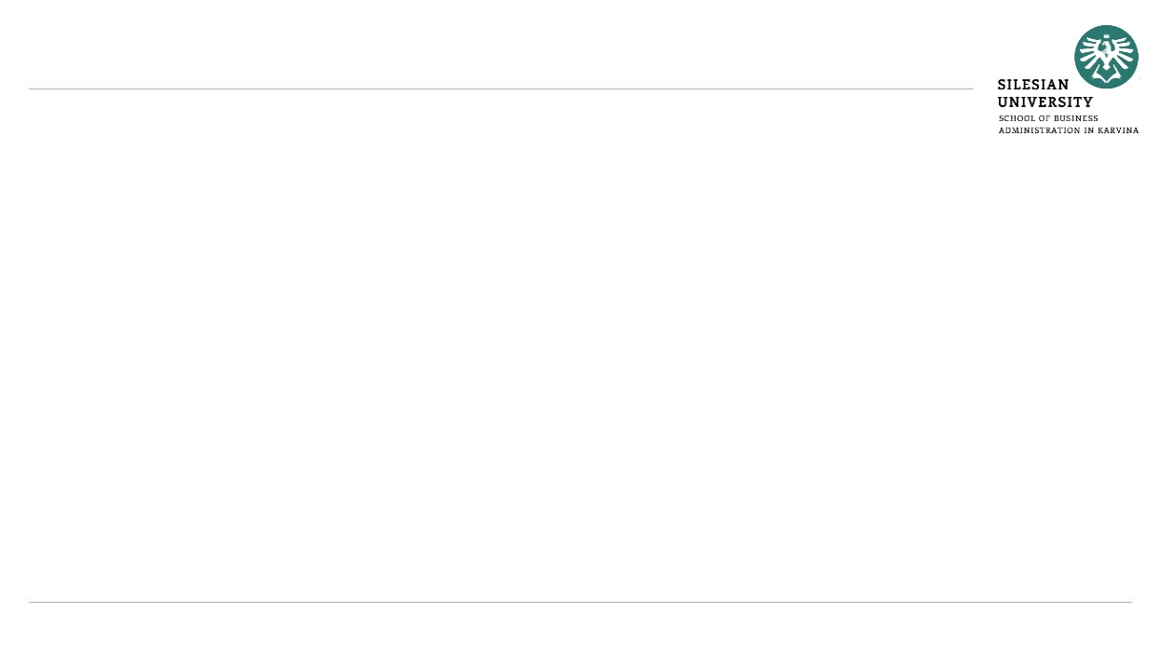
How the lecture will be conducted?
The lecture is divided into two blocks, where each block introduces an issue associated with:
  Culture: surface manifestations, values and basic assumptions
  Organizational values
  Organizational socialization
  Culture managed versus tolerated
  Types of organizational culture
We use MS Teams, a shared whiteboard for your engagement and reactions, brainstorming ideas and for sharing answers.
The lecture is completed by quizzes in Vevox, the link is always in the presentation.

Slide 3
Contents
PART (45 min.)
Culture: surface manifestations, values and basic assumptions
Organizational values
Organizational socialization
2. PART (45 min.)
Culture managed versus tolerated
Types of organizational culture

Slide 4
Learning objectives
After studying this topic, you should be able to:
Understand and explain the importance of organizational values and socialization.
Define and understand the types of organisational structures

Slide 5
Key readings
You can find support in the following sources:
Book – Huczynski, A. (2013). Organizational Behaviour. Chapter 4., p. 111

Slide 6
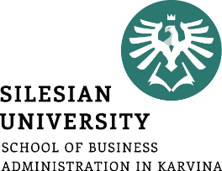
PART 1
Culture: surface manifestations, values and basic assumptions
Organizational values
Organizational socialization
Corporate culture - how things are done in a company on a daily basis.

Slide 7
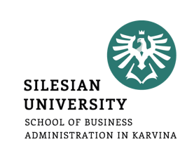
Organizational Culture
shapes the image that the public has of an organization;
influences organizational effectiveness;
provides direction for the company;
helps to attract, retain and motivate staff.

Slide 8
Organizational Culture
Corporate culture - how things are done in a company on a daily basis.
It affects how employees perform their work, and how they relate to each other, to customers, and to their managers.
Organizational culture affects not only task issues – how well or badly an organization performs – but also emotional issues – how workers feel about their work and their companies.
Organizational culture has been a popular topic since the early 1980s:
Japan’s industrial success during the 1970s and 1980s;
increasing globalization, placing organizational culture into sharp focus alongside national culture;
the contentious view that management can consciously manipulate culture to achieve organizational (change) objectives;
the belief that intangible (soft) factors such as values and beliefs impacted on financial (hard) ones and the conviction that managers were capable of changing cultures.

Slide 9
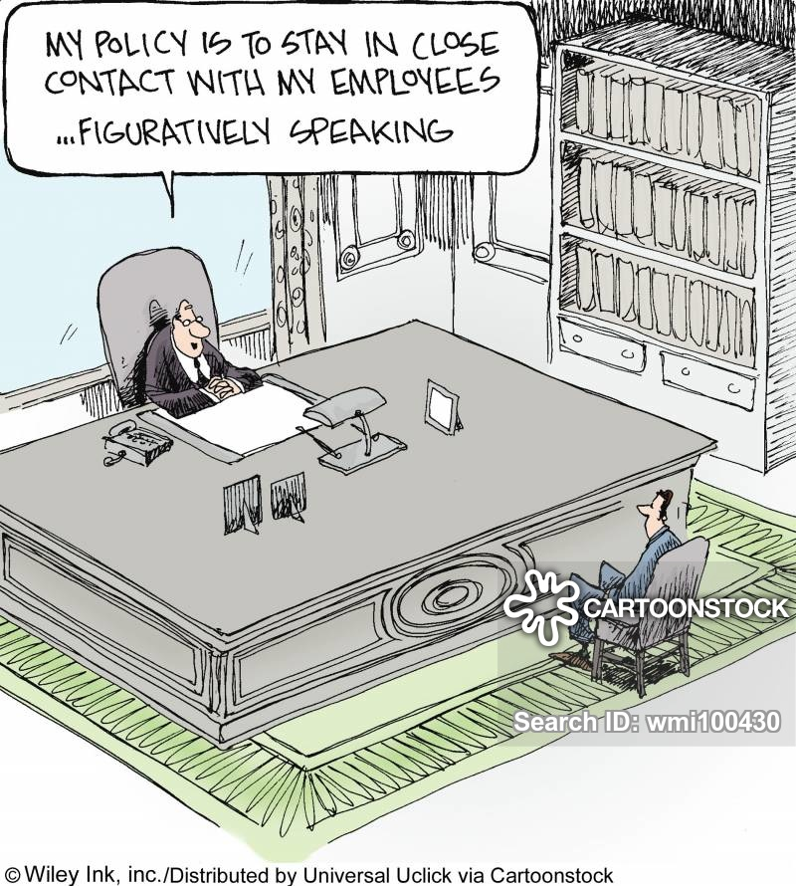
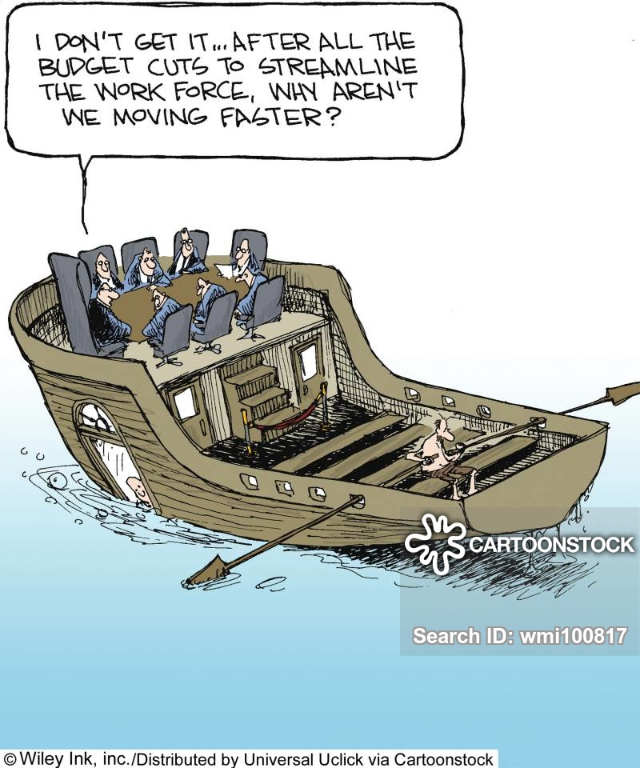
Organizational Culture

Slide 10
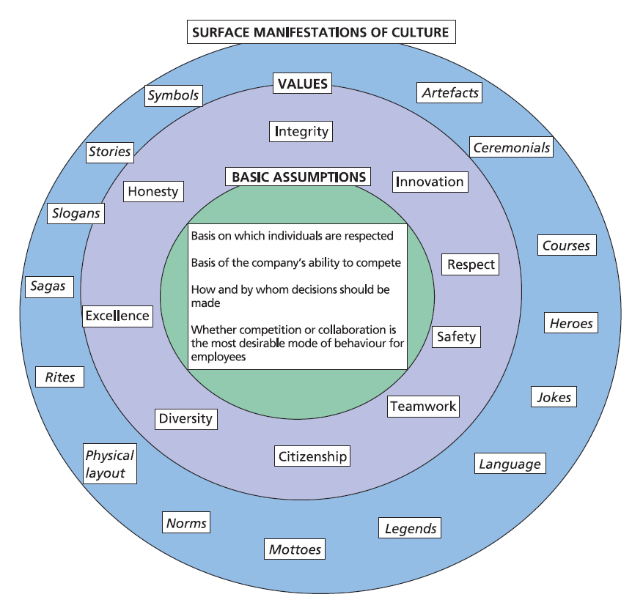
Culture: surface manifestations, values and basic assumptions
First level is the surface manifestations of Organizational culture, also called ‘observable culture’.

Slide 11
Culture: surface manifestations, values and basic assumptions
Artefacts are material objects created by human hands to facilitate culturally expressive activities. They include tools, furniture, appliances, and clothing.
Ceremonials are formally planned, elaborate, dramatic sets of activities of cultural expression, e.g. opening events, prize-givings, graduations, religious services.
Courses and workshops are used to instruct, induct, orient, and train new members in company practices.
Heroes are characters, living or dead, who personify the values and beliefs; who are referred to in company stories, legends, sagas, myths and jokes; and who represent role models that current employees should emulate.
Jokes are humorous stories intended to cause amusement.

Slide 12
Culture: surface manifestations, values and basic assumptions
Language is the particular form or manner in which members use vocal sounds and written signs to convey meaning to each other. It includes specialist technical vocabulary related to the business (jargon) as well as general naming choices.
Legends are handed-down narratives about wonderful events based on company history.These fascinate employees and invite them to admire or deplore certain activities.
Mottoes are maxims adopted as rules of conduct. Unlike slogans, mottoes are rarely, if ever, changed.
Norms are expected modes of behaviour that are accepted as the company’s way of doing things, thereby providing guidance for employee behaviour.

Slide 13
Culture: surface manifestations, values and basic assumptions
Physical layout concerns things that surround people, providing them with immediate sensory stimuli, as they carry out culturally expressive activities.
Slogans are short, catchy phrases that are regularly changed. They are used both for customer advertising and to motivate employees.
Stories are narratives describing how individuals acted and the decisions they made that affected the company’s future. Stories can include a mixture of both truth and fiction.
Symbols refer to any act, event, object, quality, or relationship that serves as a vehicle for conveying meaning.

Slide 14
Organizational Values
Organizational values are the accumulated beliefs held about how work should be done and situations dealt with.
They can be encapsulated either in phrases or in single words such as
Citizenship
Diversity
Excellence
Honesty
Integrity
Innovation
Respect
Safety
Teamwork

Slide 15
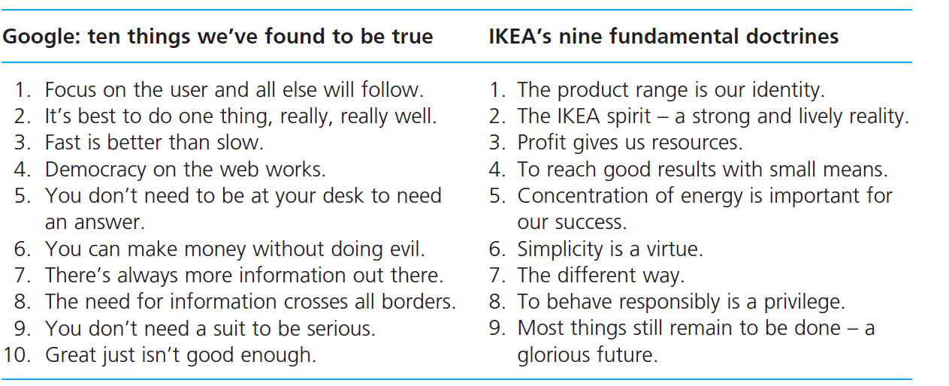
Corporate Values

Slide 16
Corporate Values
Adidas
Performance: Sport is the foundation for all we do and executional excellence is a core value of our Group.
Passion: Passion is at the heart of our company. We are continuously moving forward, innovating, and improving.
Integrity: We are honest, open, ethical, and fair. People trust us to adhere to our word.
Diversity: We know it takes people with different ideas, strengths, interests, and cultural backgrounds to make our company succeed. We encourage healthy debate and differences of opinion.

Slide 17
Corporate Values
Facebook
Focus on impact
Move fast
Be bold
Be open
Build social value

Slide 18
Corporate Values
H&M
We believe in people
We are one team
Straightforward and open-minded
Keep it simple
Entrepreneurial spirit
Constant improvement
Cost-consciousness

Slide 19
Corporate Values
Uber
At Uber, company values are called “cultural norms”:
We build globally, we live locally.
We are customer obsessed.
We celebrate differences.
We do the right thing.
We act like owners.
We persevere.
We value ideas over hierarchy.
We make big bold bets.

Slide 20
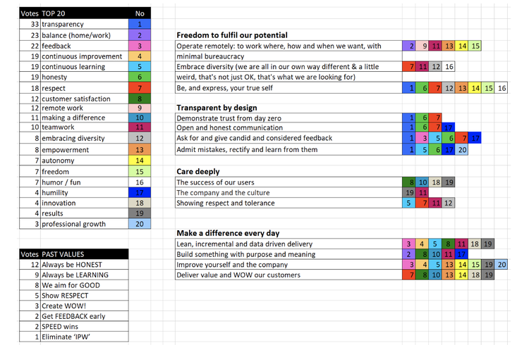
Corporate Values
Uber
At Uber, company values are called “cultural norms”:
We build globally, we live locally.
We are customer obsessed.
We celebrate differences.
We do the right thing.
We act like owners.
We persevere.
We value ideas over hierarchy.
We make big bold bets.

Slide 21
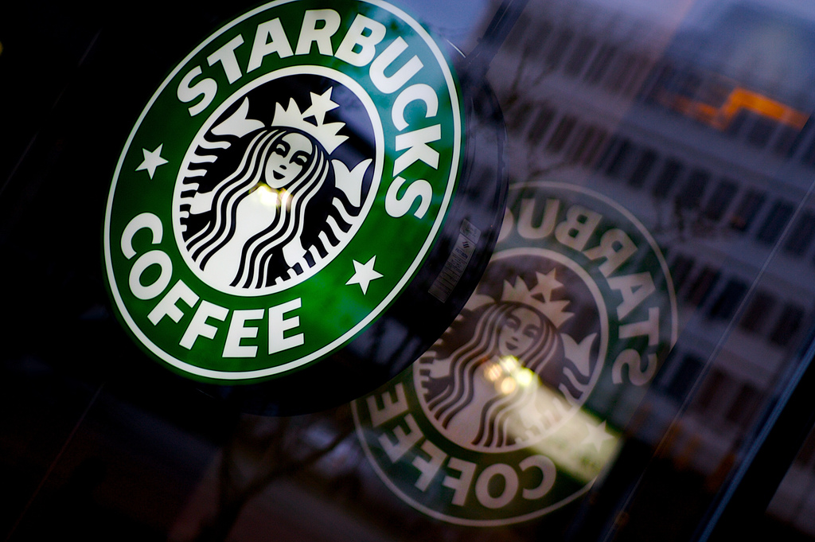
Corporate Values
Starbucks Coffee
Creating a culture of warmth and belonging, where everyone is welcome.
Acting with courage, challenging the status quo and finding new ways to grow our company and each other.
Being present, connecting with transparency, dignity and respect.
Delivering our very best in all we do, holding ourselves accountable for results.

Slide 22

Corporate Values
Netflix - https://inside.6q.io/the-nine-netflix-company-values/
Judgement
Communication
Impact
Curiosity
Innovation
Courage
Passion
Honesty
Selflessness

Slide 23
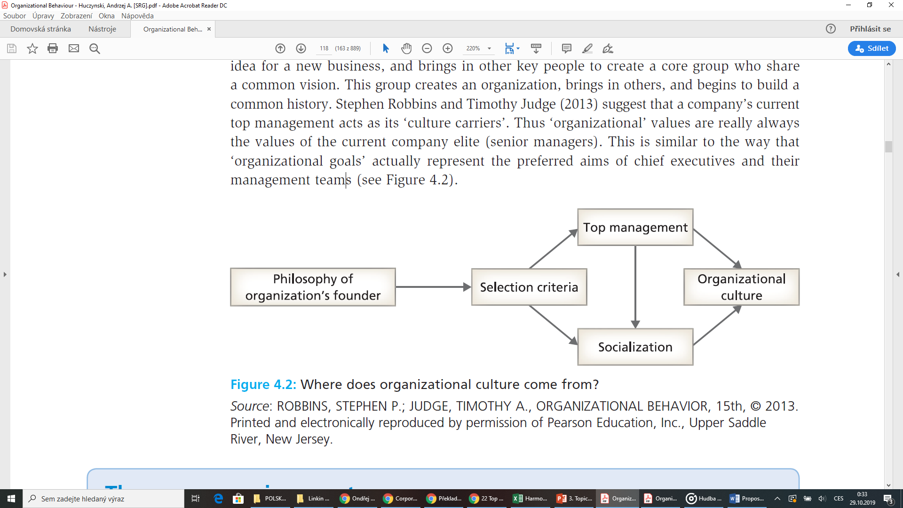
Sources of Values
Originally, a single person, or a group of people, has an idea for a new business, and brings in other key people to create a core group who share a common vision. This group creates an organization, brings in others, and begins to build a common history.
A company’s current top management acts as its ‘culture carriers’. Thus ‘organizational’ values are really always the values of the current company elite (senior managers). This is similar to the way that ‘organizational goals’ actually represent the preferred aims of chief executives and their management teams.

Slide 24
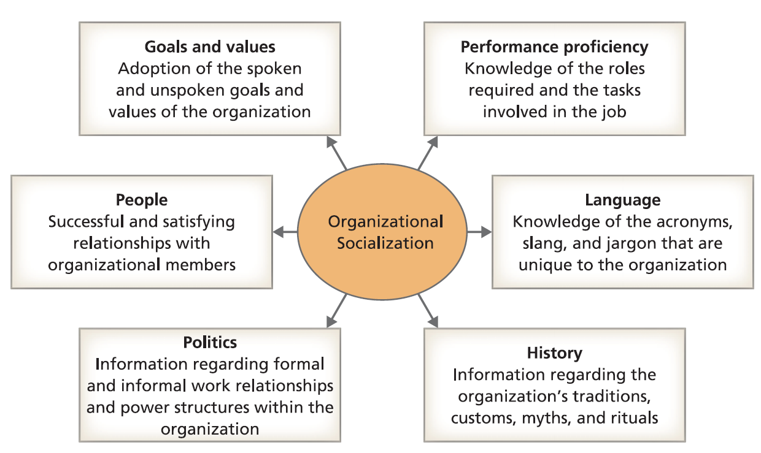
Organizational socialization
This is the process through which an employee’s pattern of behaviour, values, attitudes, and motives is influenced to conform to those of the organization.
It includes the careful selection of new company members, their instruction in appropriate ways of thinking and behaving; and the reinforcement of desired behaviours by senior managers.

Slide 25
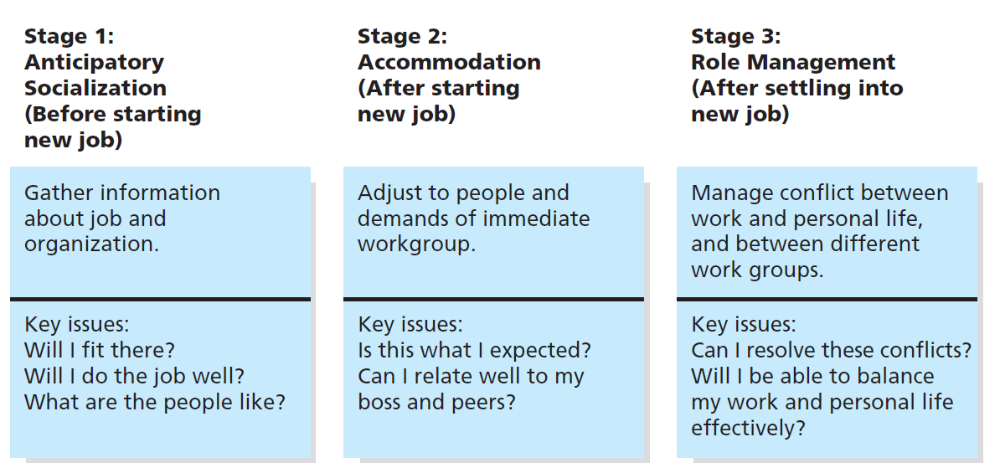
Stages of Socialization

Slide 26
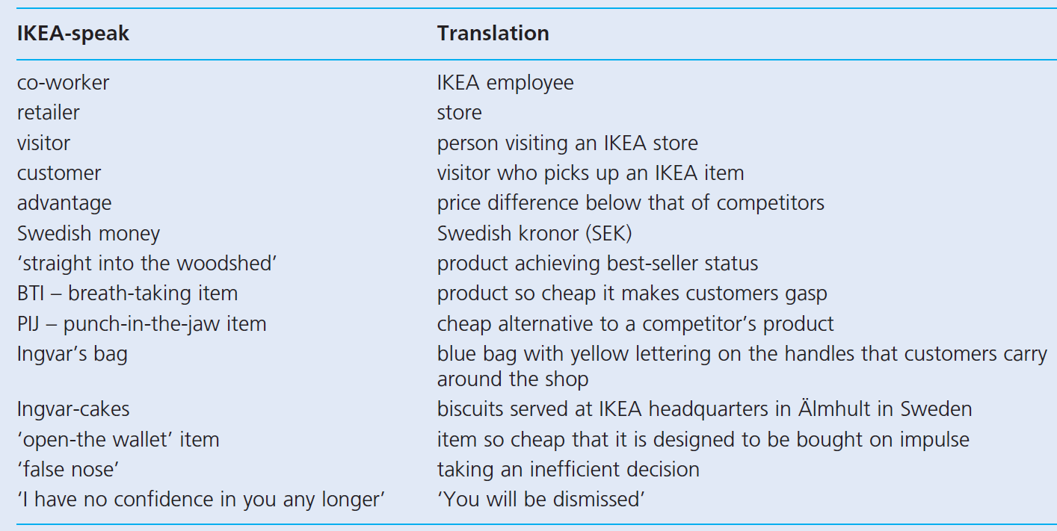
Do you speak IKEA?

Slide 27
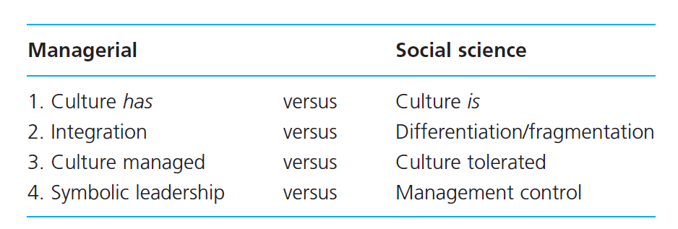
Culture „has“ versus culture „is“
The has view holds that every organization possesses a culture which, along with its strategy, structure, technology, and employees, is part of the organizational machine that can be controlled and managed. This is also known as the ‘critical variable’ view.
The culture is ‘given’ to new hires who have not participated in its formation. From this perspective, culture is acquired by employees. It is seen as capable of definition, intervention, and control, representing a ‘tool for change’ that can be used by managers.

Slide 28
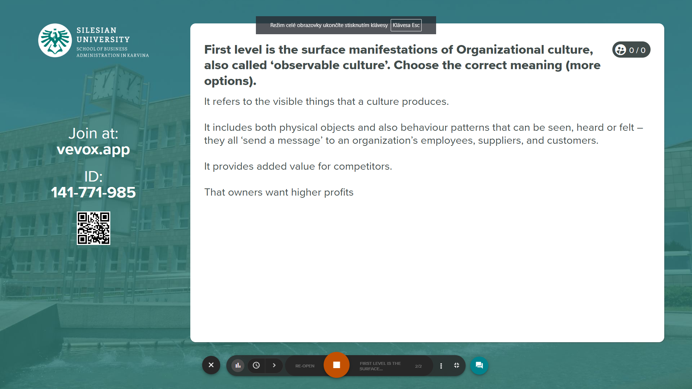
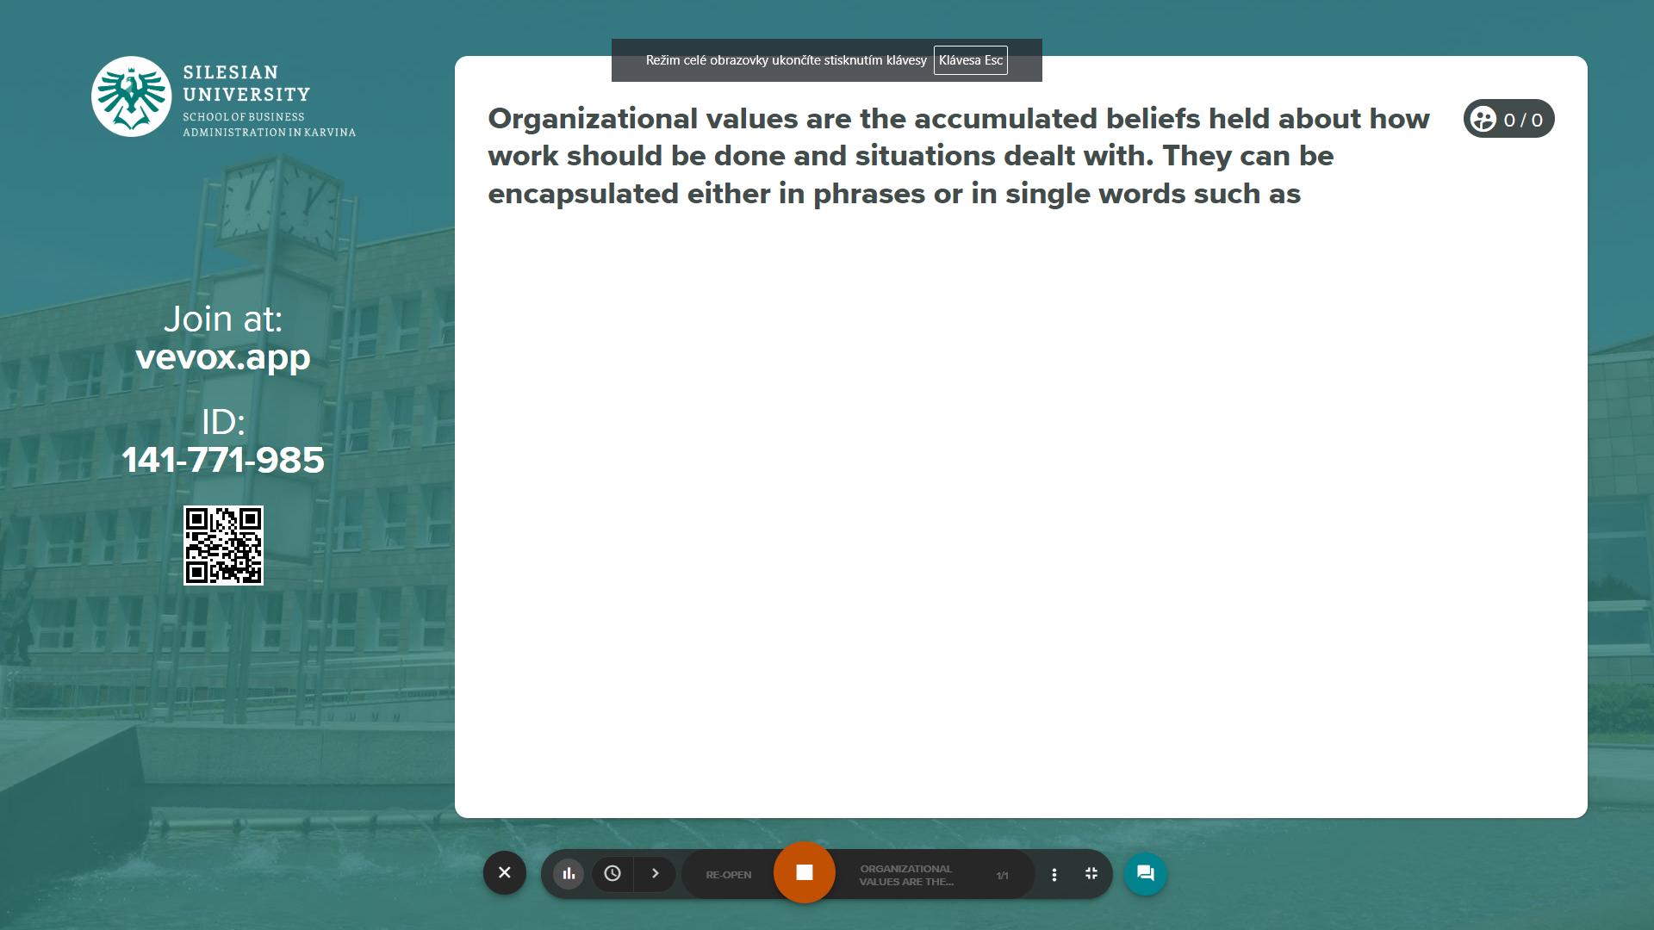
Vevox questions
https://silesianuniversity.vevox.com/#/meeting/450590/polls

Slide 29
PART 2
Culture managed versus tolerated
Types of organizational culture
How managers can change their company’s culture from ‘weak’ to ‘strong’?

Slide 30
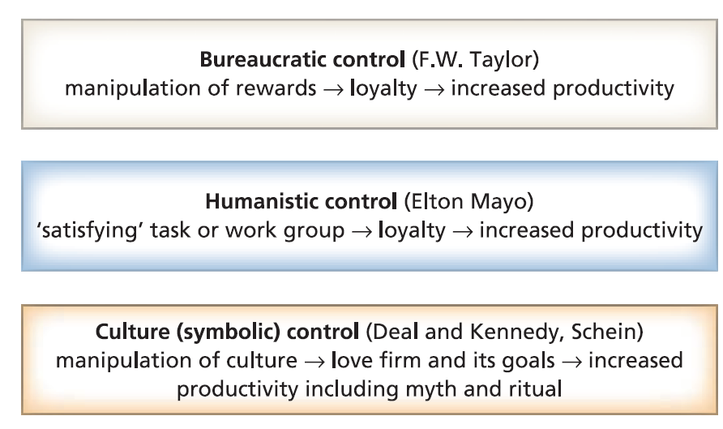
Culture managed versus tolerated
How managers can change their company’s culture from ‘weak’ to ‘strong’;
How culture can help a company innovate and adjust rapidly to environmental changes?
The part played by leaders’ visions and styles of management in managing their cultures.
Cultural leadership is seen as maintaining, promoting and developing the company’s culture.

Slide 31
Culture managed versus tolerated
For example:
Disrupted and reorganized the traditional inside/outside boundary by holding team meetings before or after work at city centre cafés or nearby parks.
The teambuilding meetings involved participants bringing personal items from home to the workshop.
It also encouraged inside-the-organization activities that normally took place outside work, e.g. wearing pyjamas, drinking alcohol, bringing home-made food to share with colleagues, decorating a work area with personal items, and dressing casually – to be ‘free to be themselves’.

Slide 32
Culture strength
There are four components to an organization’s culture: beliefs, behavioural rules, traditions, and rituals.
The degree to which these components are present or absent determine the strength or weakness of a culture.
WEAK CULTURE
A culture is weak when its beliefs, behavioural rules, traditions, and rituals are not apparent to its members or there is incongruence between stated values and behaviour.

Slide 33
Culture strength
CHARACTERISTICS OF A WEAK CULTURE
Narrow/Isolated Thinking: People in these organizations believe they have all the answers.
Resistance to Change: The organization focuses on maintaining the status quo, avoiding risk, and not making mistakes. It is the leadership in the culture that allows these factors to pervade and paralyze the organization rather than focusing on innovation and success.
Political Internal Environment: issues and problems get resolved along the lines of power. Vocal support or opposition, personal lobbying, and the formation of coalitions interested in a particular outcome stifles change.
Unhealthy Promotion Practices: This characteristic is evident when an organization promotes a dedicated or long-time employee to management who is hard-working and good at day-to-day operations, but lacks leadership skills, vision, and the ability to think strategically.

Slide 34
Culture strength
STRONG CULTURE
A culture is considered strong when there is cohesion around beliefs, behavioural rules, traditions, and rituals. Strong cultures typically feature their beliefs, behavioural rules, traditions, and rituals in public displays so that employees can use these cultural elements for decision making throughout the organization. Strong cultures include:
More than one strong leader who articulates beliefs, behavioral rules, traditions, and rituals that are aligned with customer needs, strategic direction, and competitive environments.
Organizational commitment to operating its business as directed by the culture.
Unfaltering commitment by the organization to support its key stakeholders — business partners, suppliers, employees, customers, and shareholders (if any) — and by extension the community, society, and environment.

Slide 35
Culture strength
CHARACTERISTICS OF A STRONG CULTURE
Culture-reinforcing Tools: These include things like ceremonies, symbols, language, behavioral rules, and policies. Ceremonies and symbols help recognize and celebrate high-performance employees and help create an emotional bond among all employees.
Intensely People Oriented: Organizations with strong cultures display their concern for their employees in a variety of ways. These include:
  Treating employees with dignity and respect
  Granting employees enough autonomy to excel and contribute
  Holding managers at every level accountable for the growth and development of people who report to them
  Using of a full range of rewards and consequences to reinforce high-performance behavior
  Setting clear performance standards for all employees
Results Oriented: High-performance cultures invest more time and resources to ensure that employees who excel and achieve performance targets are identified and rewarded.
Emphasis on Achievement And Excellence

Slide 36
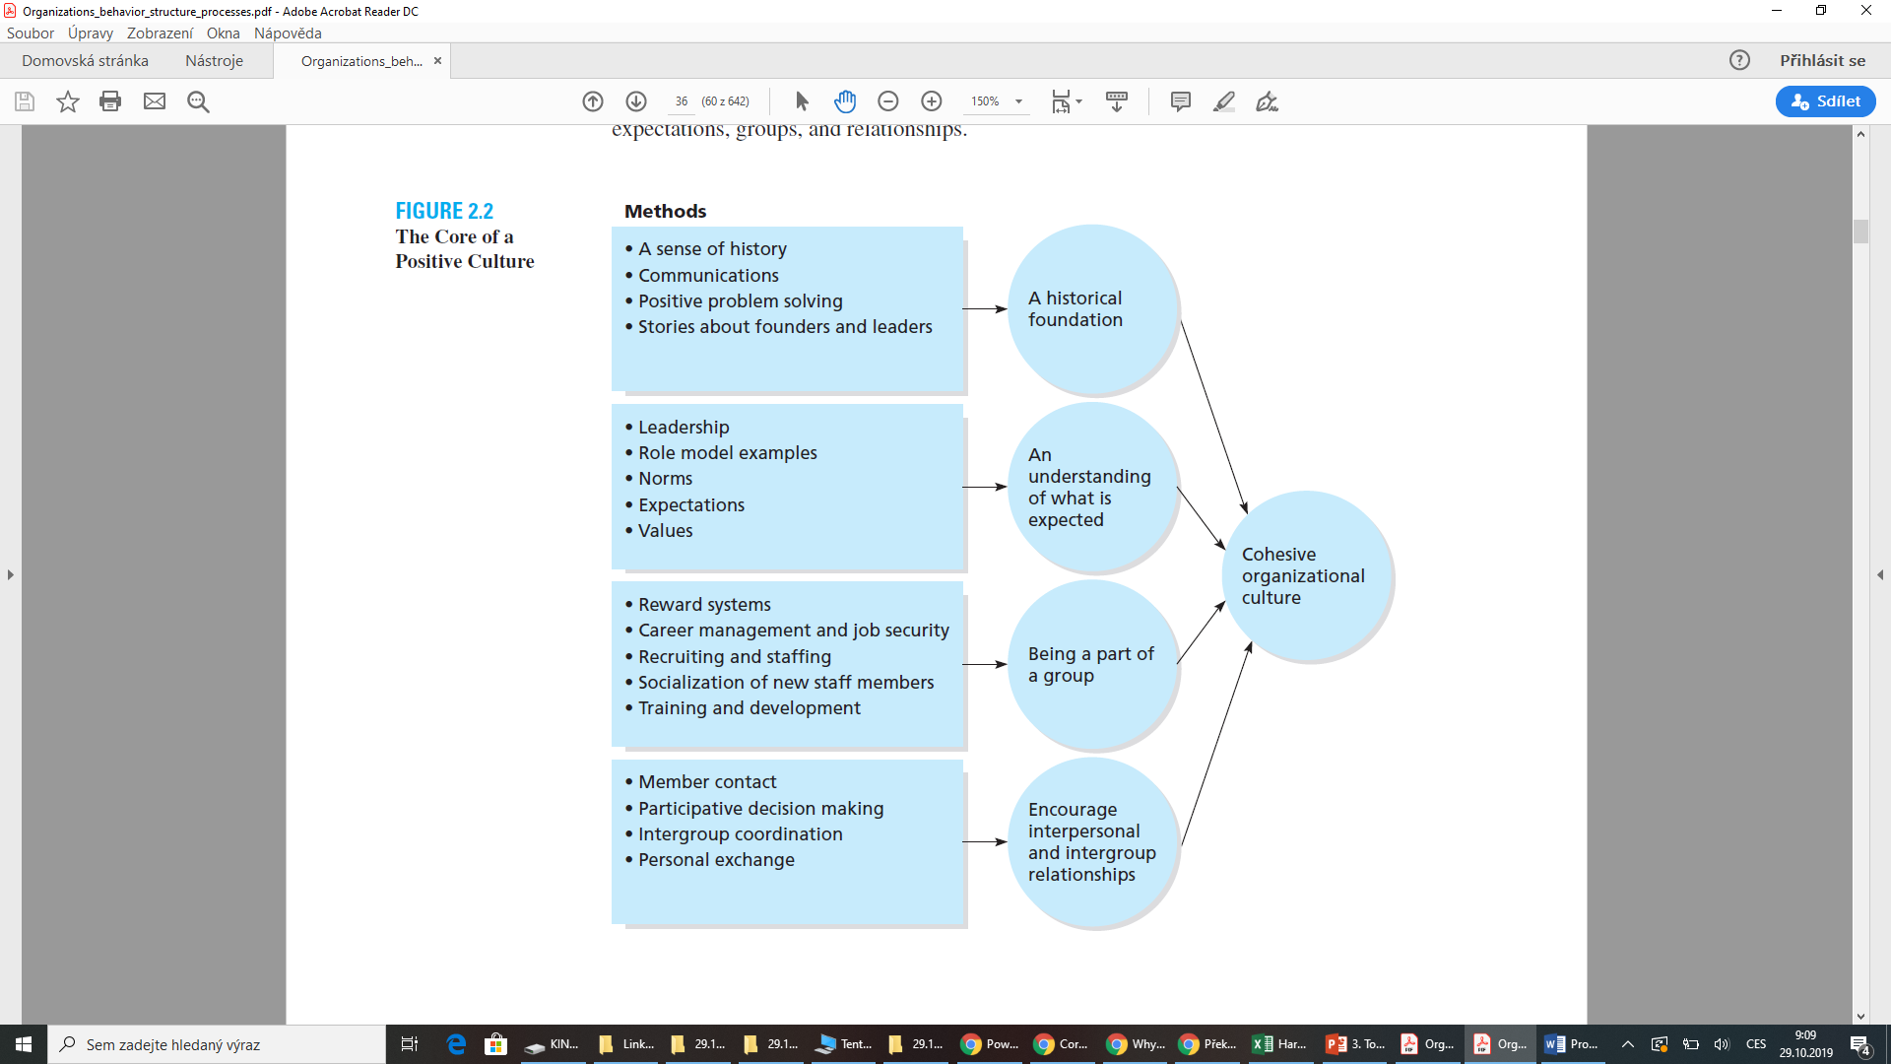
The core of a positive culture

Slide 37
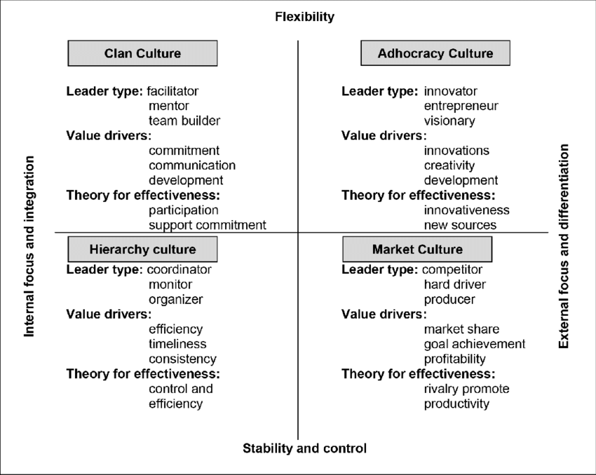
Types of organizational culture
Clan oriented cultures are family-like, with a focus on mentoring, nurturing, and “doing things together.”
Adhocracy oriented cultures are dynamic and entrepreneurial, with a focus on risk-taking, innovation, and “doing things first.”
Market oriented cultures are results oriented, with a focus on competition, achievement, and “getting the job done.”
Hierarchy oriented cultures are structured and controlled, with a focus on efficiency, stability and “doing things right.

Slide 38
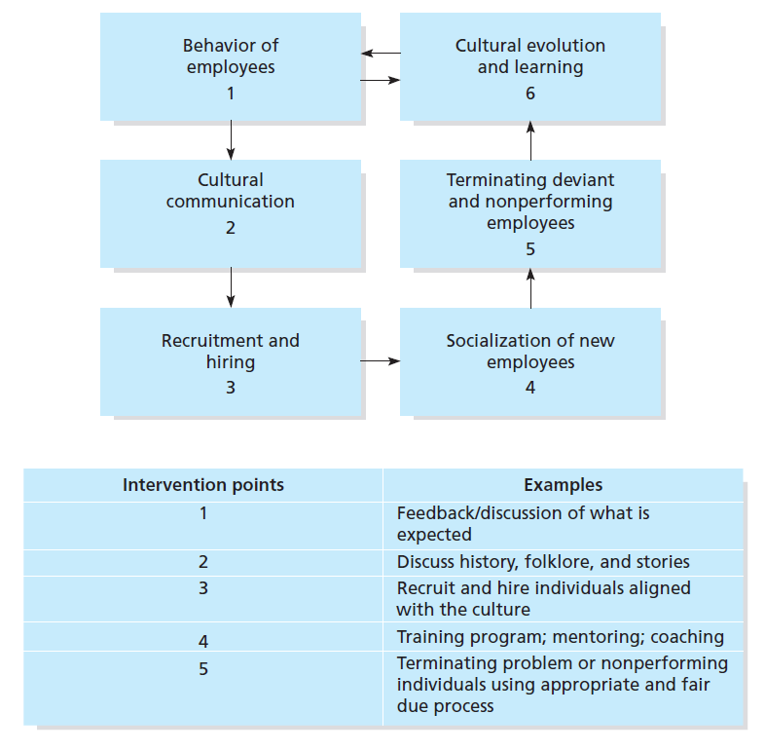
Manager-Initiated Interventions

Slide 39
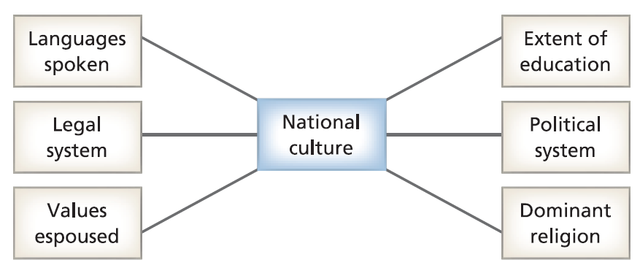
National cultures
Organizational culture being partly the outcome of societal factors.
National cultural stereotypes are well established: Scots are mean; Americans are brash; Germans are humourless; French are romantic; and Japanese are inscrutable.

Slide 40
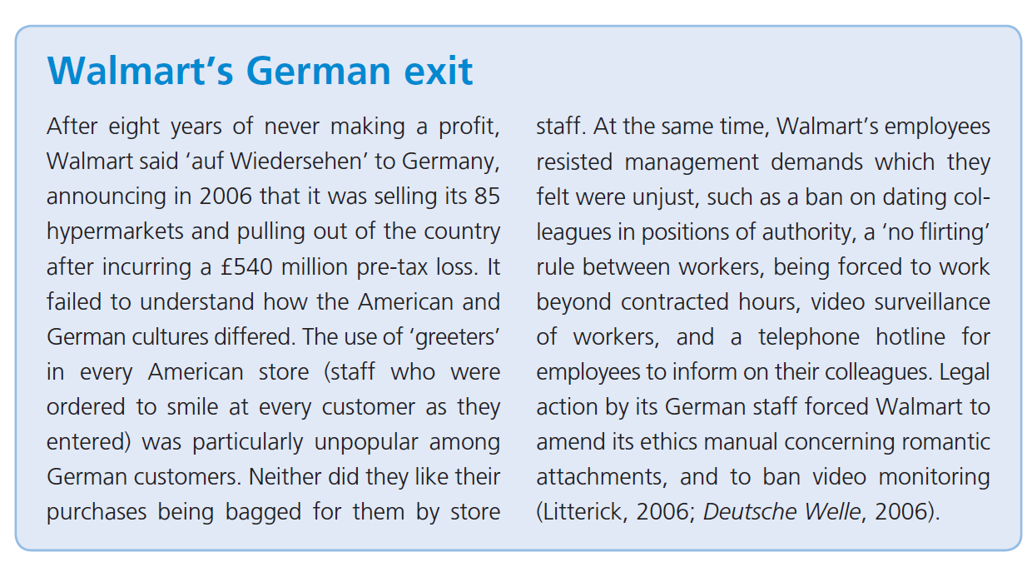
National cultures
https://www.youtube.com/watch?v=PxtXI0K4YJs
Video: https://www.dailymotion.com/video/x791mfj

Slide 41
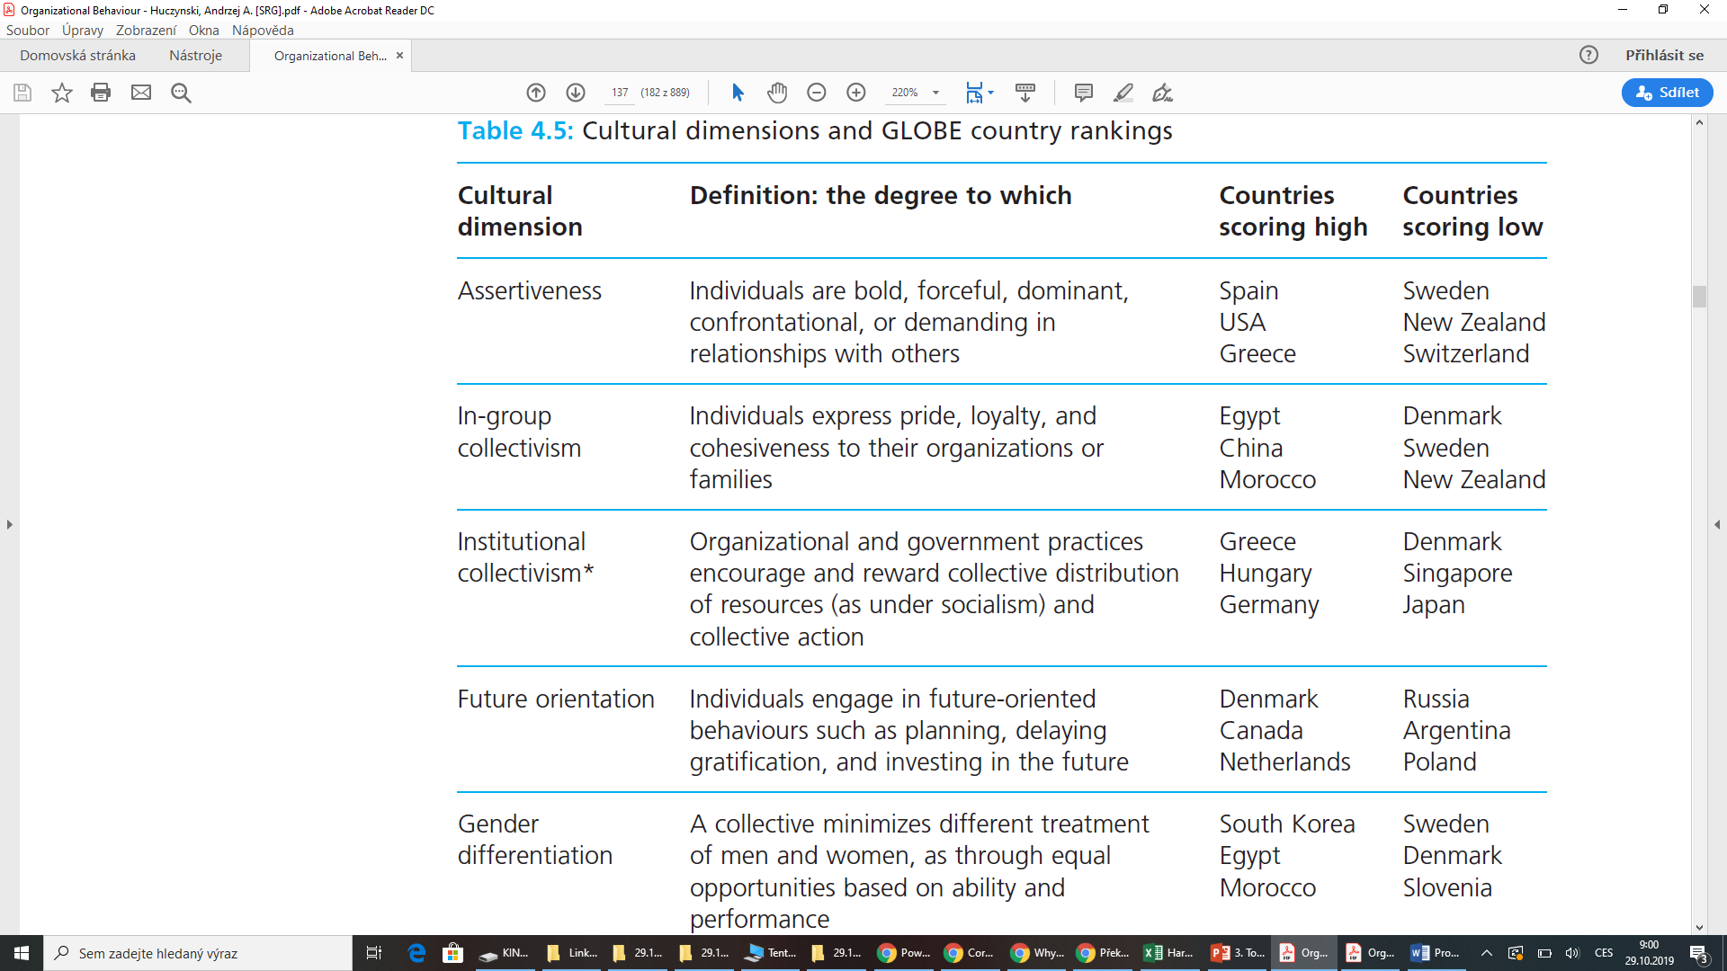
Culturam dimension and GLOBE country rankings

Slide 42
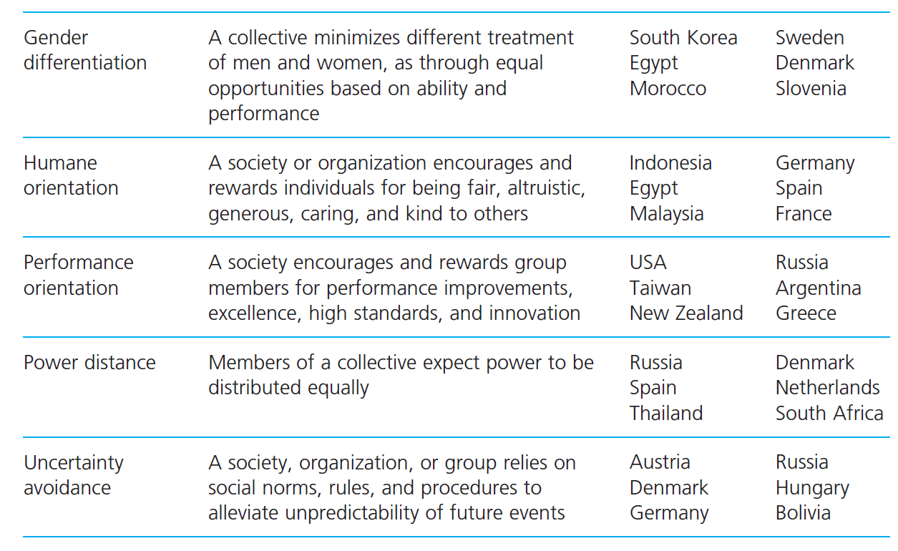
Culturam dimension and GLOBE country rankings

Slide 43
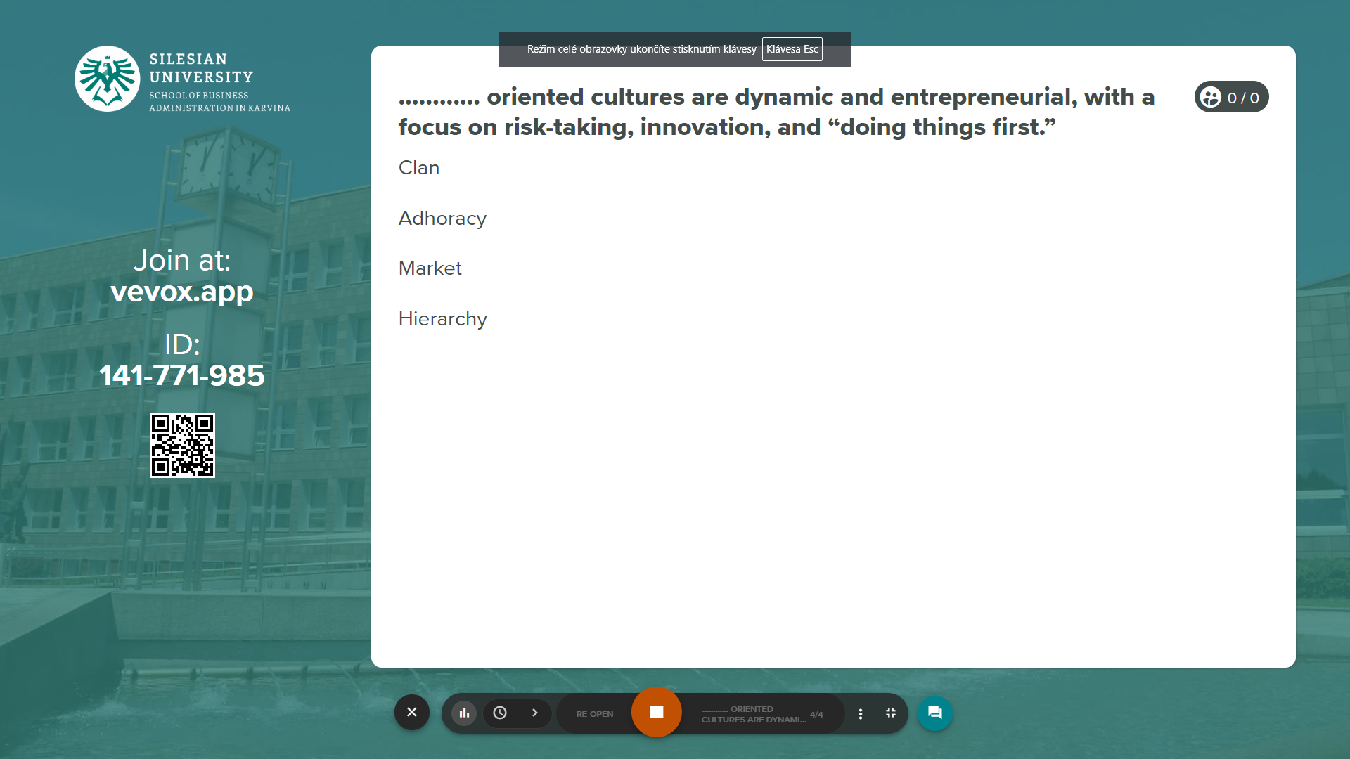
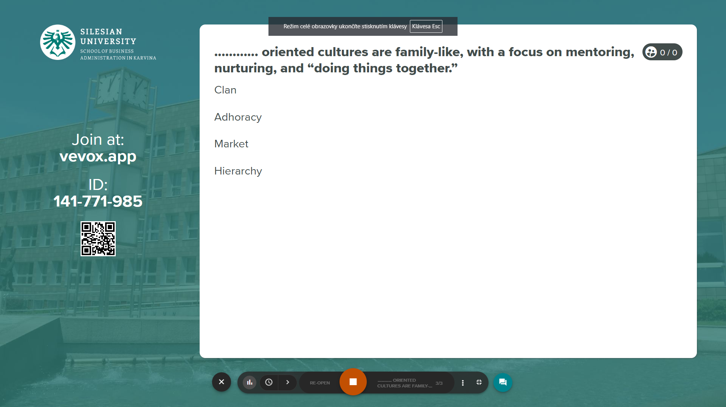
Vevox questions
https://silesianuniversity.vevox.com/#/meeting/450590/polls

Slide 44
RECAP
We can distinguished surface manifestations of culture at level one (e.g., artefacts, rites, ceremonials); organizational values at level two (e.g. Customer obsession); and basic assumptions at level three which actually was the culture (e.g. nature of reality and truth).
Organizational culture is either something that a company has, or what a company is.
Organizational culture is a single, integrated unit or a differentiated entity consisting of multiple, different subcultures, fragmented with conflicting interests.
An organization’s culture can be managed by its leaders or it is beyond their direct control and has to be tolerated by them.
We categorized the cultures of organization using a four-type framework: role, power, task, and person.
Culture could be differentiated along five dimensions: power distance; uncertainty avoidance; individualism–collectivism; masculinity–femininity; and short-term–long-term perspective.

Slide 45
We can share our thoughts and ask questions
☺
Pavel Adámek
adamek@opf.slu.cz

