Slide 1
4. TOPIC
ORGANIZATIONAL ENVIRONMENT
Ing. Pavel Adámek, Ph.D.
adamek@opf.slu.cz

Slide 2

How the lecture will be conducted?
The lecture is divided into two blocks, where each block introduces an issue associated with environment, methods of environment analysis and case studies examples.
We use MS Teams, a shared whiteboard for your engagement and reactions, brainstorming ideas and for sharing answers.
The lecture is completed by quizzes in Vevox, the link is always in the presentation.

Slide 3
Contents
PART (35 min.)
An organization must interact with the outside world, with its environment.
2. PART (55 min.)
Analysing the organization’s environment, methods, case studies

Slide 4
Learning objectives
After studying this topic, you should be able to:
Understand the mutual interdependence between the organization and its environment.
Appreciate the strengths and limitations of PESTLE analysis o organizational environments.
Explain contemporary organizational responses to environmental turbulence.

Slide 5
Key readings
You can find support in the following sources:
Book – Jones, G. R. and J. M. George (2019). Essentials of Contemporary Management, Chapter Four p. 122

Slide 6

PART 1
Environment
An organization must interact with the outside world, with its environment.
The operations of any organization – local café, city hospital, multinational car-producing company – can be described in terms of ‘import-transformation-export’ processes.

Slide 7
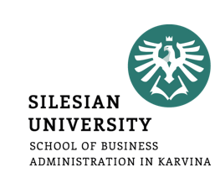
Environment
An organization must interact with the outside world, with its environment. The operations of any organization – local café, city hospital, multinational car-producing company – can be described in terms of ‘import-transformation-export’ processes.
Environment issues, trends, and events outside the boundaries of the organization, which influence internal decisions and behaviours.
Organizations are involved in a constant series of exchanges with their suppliers, consumers, regulatory agencies, and other stakeholders, including their employees.
Example – a car plant in 21st century. The development of hybrid and electric-powered vehicles is starting to erode sales of petrol-driven cars.
  The industry consolidation of the late 1990s saw many smaller manufacturers (Saab, Rover, Rolls- Royce, Jaguar, Land Rover, Volvo) bought by larger companies (General Motors, BMW, Ford, the Tata Group).
  Competition encourages manufacturers to locate plants in low-wage countries (Hungary, Brazil, Romania) generating resentment in traditional manufacturing bases (America, Britain, Europe).
  In Japan - foreign pressure, led to restructuring at Toyota, Honda, and Nissan in the late 1990s.

Slide 8
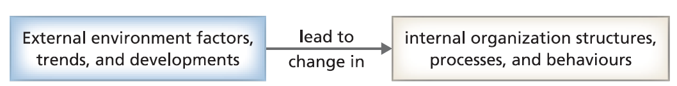
Environment
Environmental uncertainty the degree of unpredictable turbulence and change in the political, economic, social, technological, legal, and ecological context in which an organization operates.
Organizations that are able to adapt quickly to new pressures and opportunities are likely to be more successful than those which are slow to respond.
A key concern for organizational behaviour, therefore, has been the search for ‘fit’ between the internal properties of the organization, and features of the external environment.

Slide 9
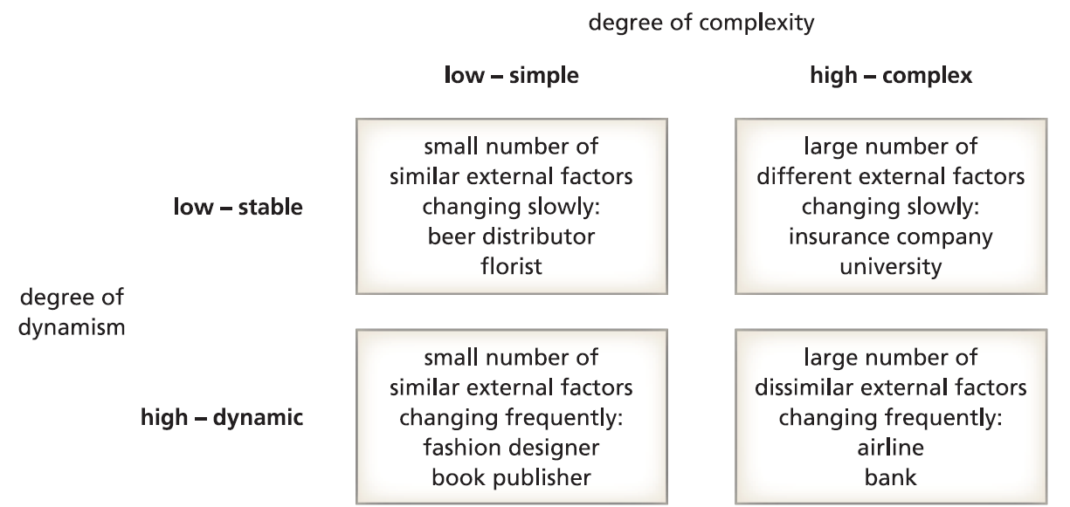
Environment
How can what happens outside an organization influence what happens inside?
Robert Duncan defined uncertainty as the lack of adequate information to reach an unambiguous decision, and argued that environmental uncertainty has two dimensions.
One of these dimensions concerns the degree of simplicity or complexity, and the other concerns the degree of stability or dynamism.
The simplicity– complexity dimension refers to issues such as the number of different issues faced, the number of different factors to consider, and the number of things to worry about.
The stability– dynamism dimension refers to the extent to which those issues are changing or stable, and if they are subject to slow movement or to abrupt shifts.

Slide 10
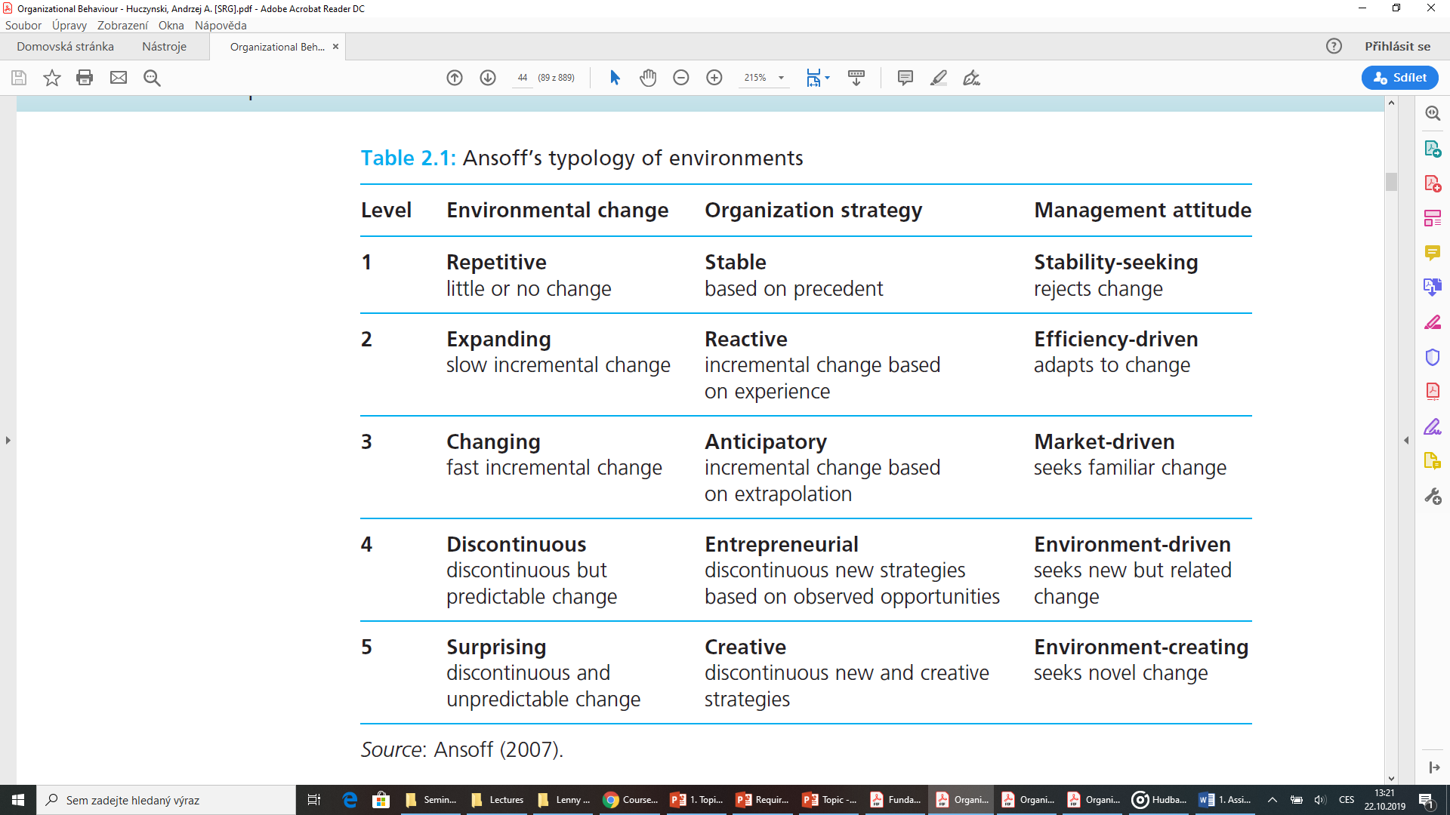
Environment
An organization must

Slide 11
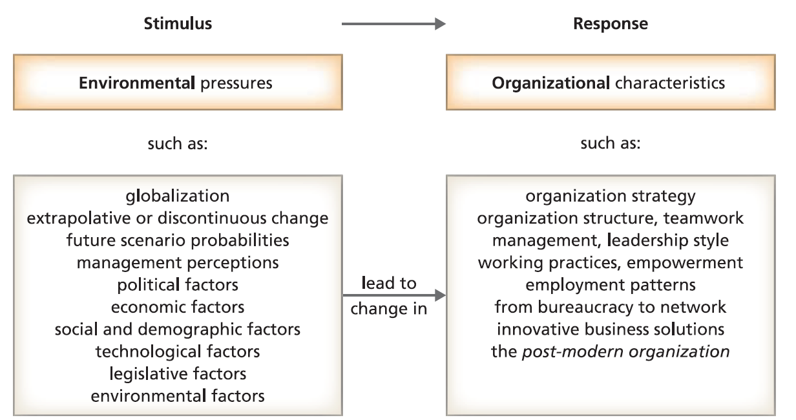
The search for environment–organization ‘fit’

Slide 12
Environment
The scale, dynamism and complexity of environmental stimuli appear to encourage a new adaptive, environmentally responsive organizational ‘paradigm’, described as the post-modern organization.
Where modernist consumption was premised on mass forms, post-modernist consumption is premised on niches.
Where modernist organization and jobs were highly differentiated, demarcated and de-skilled, post-modernist organization and jobs are highly de-differentiated, de-demarcated and multiskilled.
So, it is claimed that bureaucracy, macho managers, and boring jobs are being replaced in the post-modern world by flexible organizations with participative, supportive managers and interesting, multiskilled jobs.
Post-modern organization a networked, information-rich, de-layered, downsized,
boundaryless, high commitment organization employing highly skilled, well-paid autonomous knowledge workers.

Slide 13
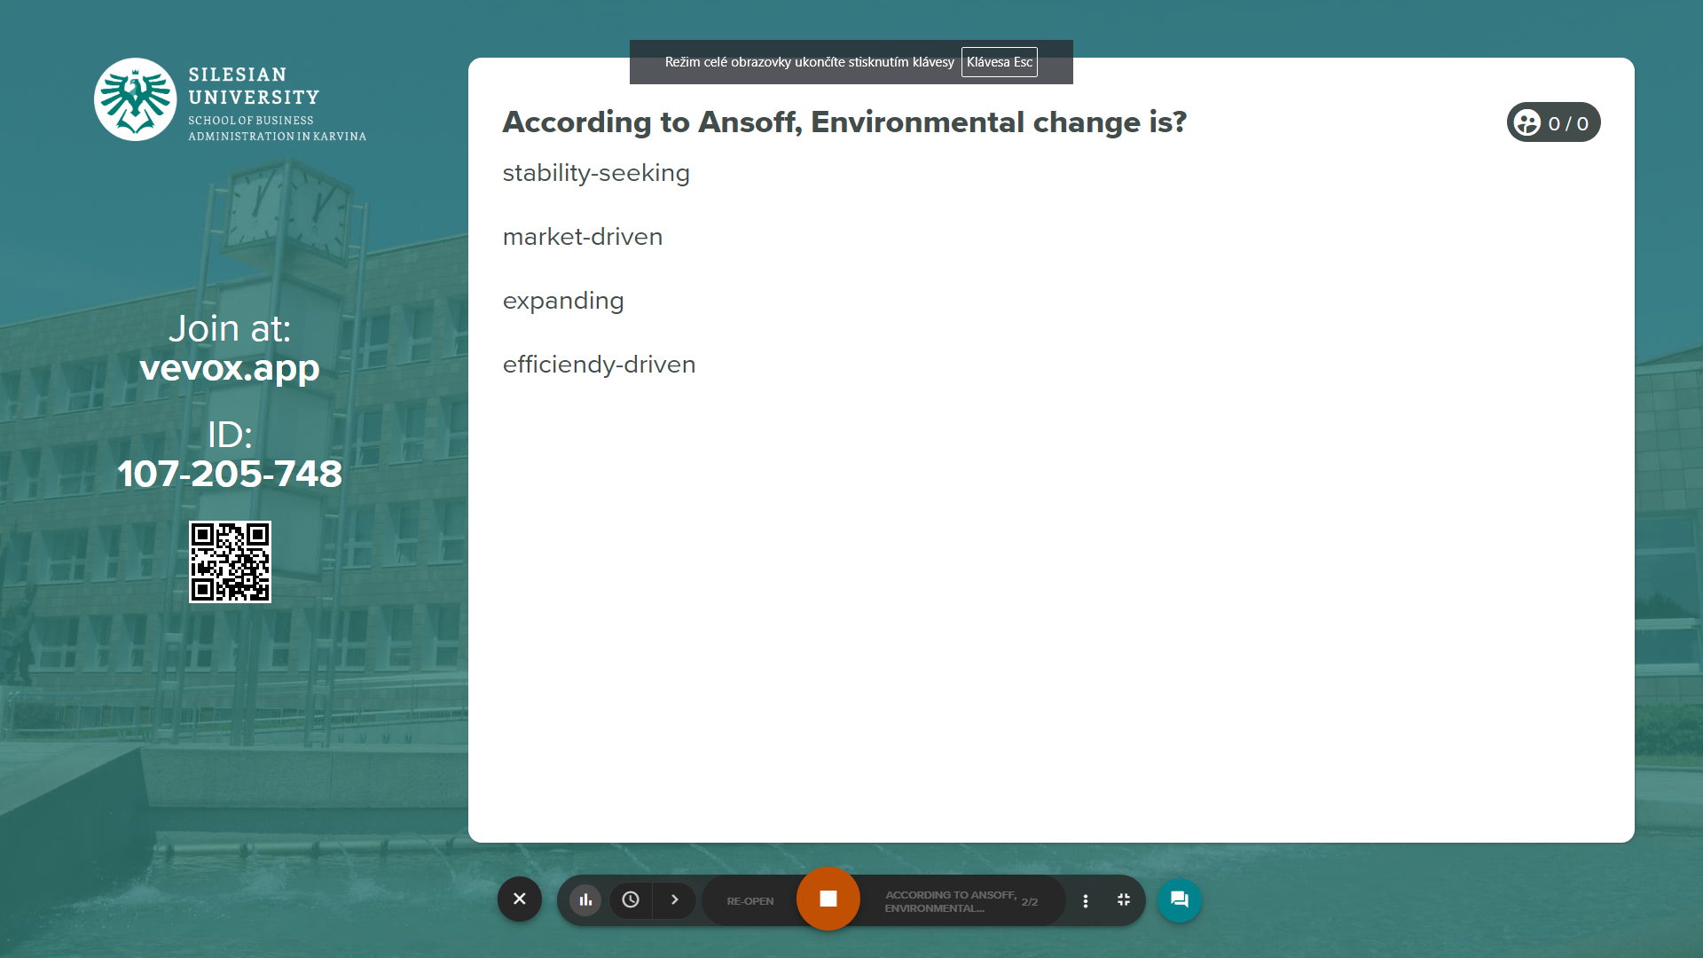
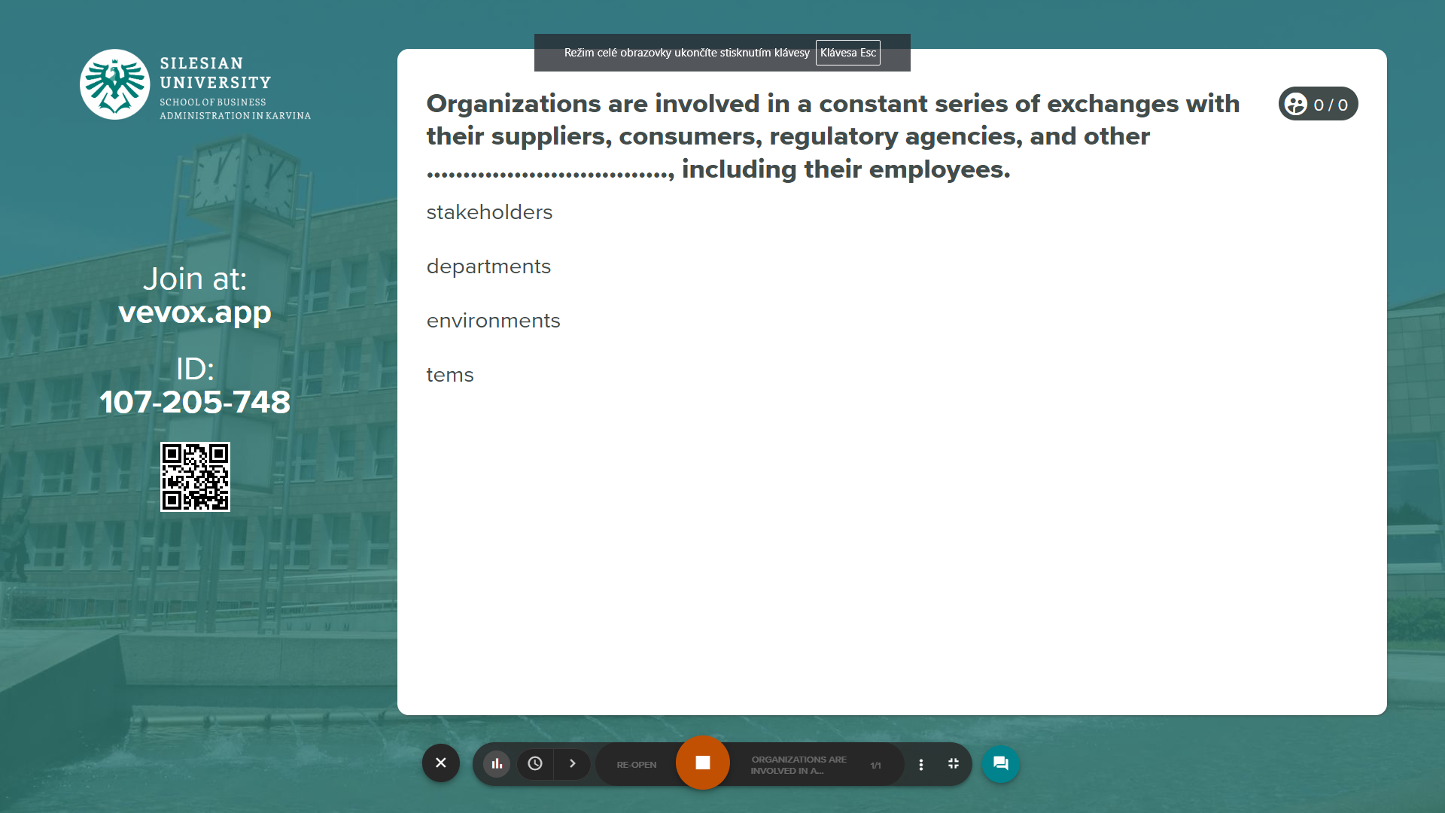
Vevox questions
https://silesianuniversity.vevox.com/#/meeting/450422/polls

Slide 14
PART 2
Analysing the organization’s environment
The methods used to analyse the environment are known as environmental scanning techniques.

Slide 15
Analysing the organization’s environment
Environmental scanning involves collecting information from a range of sources: government statistics, newspapers and magazines, internet sites, specialist research and consulting agencies, demographic analysis, market research, focus groups.
There are three major trends affecting most organizations: technology, globalization, and demographics.

Slide 16
Analysing the organization’s Environment - technology
Technology affects organizational behaviour in many ways, and on many levels. Technological developments influence the design and nature of products and services, corporate strategies, modes of communications and information exchange, and the day-to-day work of individuals.
Expertise in making technologically sophisticated products has moved to developing countries with lower labour costs, raising concerns that the developed economies which invented those products have become unnecessarily dependent on their overseas manufacturers.

Slide 17
Analysing the organization’s Environment - technology
Technological innovation is one of the key features of contemporary society. It affects:
how you communicate - email, mobile phone, smartphone, Twitter, Facebook, Skype
how you buy and use goods and services - cloud computing, smart cash cards, e-commerce, internet access to news, information, films and music
how you travel and find places - satellite navigation, iPhone location services
how you find and apply for jobs - LinkedIn; personality and skills assessment apps, online job applications through your iPhone
how you spend your leisure time - iPod, iPad, Xbox, YouTube, Kindle, surfing, blogging, interactive gaming, iPhone apps, social networking
how private you can be - CCTV (Closed Circuit TV) , the GPS in your smartphone, web history recording, transaction logging, data mining

Slide 18
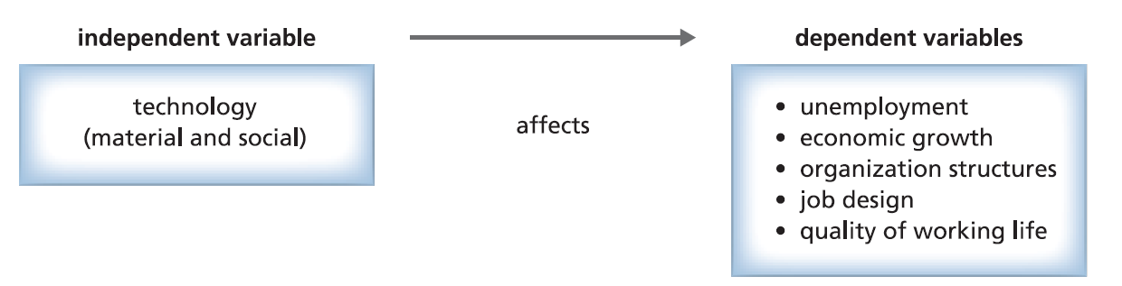
Analysing the organization’s Environment - technology
However, while new technologies promise better personal and corporate performance, productivity gains are not always achieved. Technology can liberate and empower, but it can also increase workload and stress, and intensify surveillance and control.
We have to distinguished material technology from social technology.
Material technology tools, machinery, and equipment that can be seen, touched, and heard.
Social technology the methods which order the behaviour and relationships of people in systematic, purposive ways through structures of coordination, control, motivation, and reward.

Slide 19

Analysing the organization’s Environment - technology
Remote Jobs website:
https://www.flexjobs.com/blog/post/fortune-500-companies-with-remote-jobs/

Slide 20
Analysing the organization’s Environment - technology
New technology creates unemployment through replacement effects, which substitute equipment for people, while increasing productivity.
  For example, supermarkets use selfservice checkout technology, reducing the number of checkout staff required.
Another example of how technology enables us to work in nonstandard ways, but without determining the nature of jobs, can be seen in teleworking.
There are, several disadvantages of teleworking:
high set-up costs (though hardware costs have fallen);
staff are not able to share equipment and other office facilities;
lack of face-to-face social interaction, sharing of ideas, and team spirit;
staff can lose touch with organization culture and goals;
management cannot easily monitor and control activity;
some customers expect to contact a ‘conventional’ office.

Slide 21
Analysing the organization’s Environment - technology
From a management perspective, there appear to be five main and five subsidiary reasons for introducing teleworking. The main reasons are:
1. in response to requests from employees;
2. to reduce costs;
3. to cope with maternity;
4. to help reduce office overcrowding;
5. following relocation of offices, where some staff were unable to move.
The subsidiary reasons are:
1. to cope with illness or disability;
2. to fit the kind of work being done;
3. because staff live some distance from the office;
4. because it allows more undisturbed working time;
5. database connections are faster out of main working hours.

Slide 22
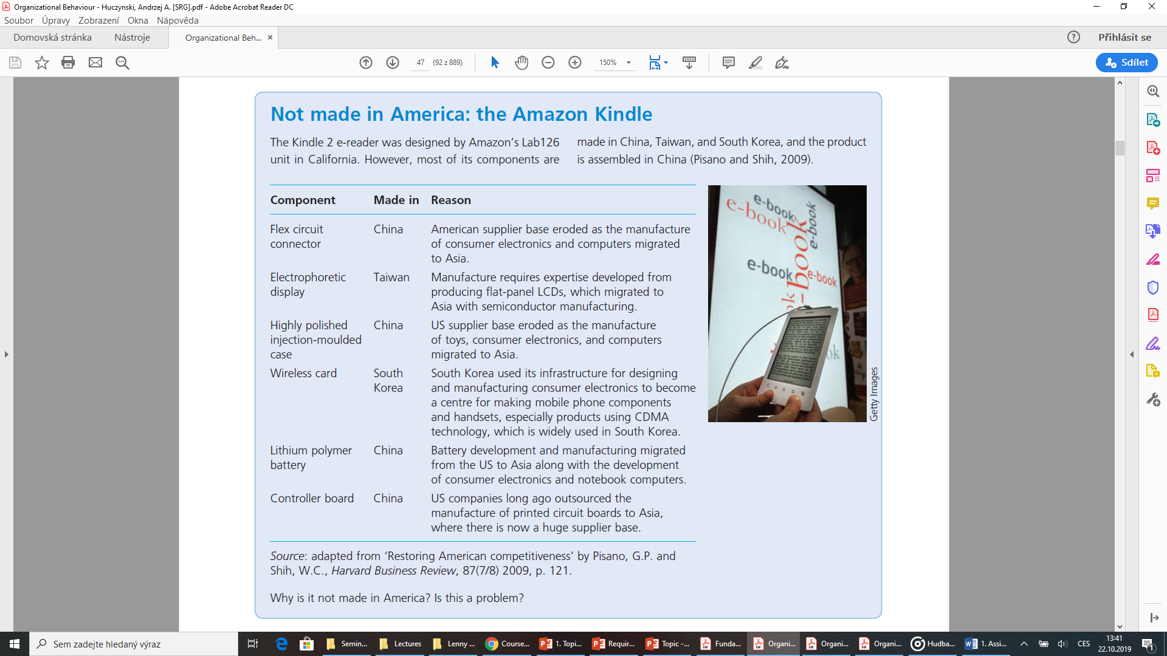
Analysing the organization’s Environment - technology
T

Slide 23
Analysing the organization’s Environment - globalization
One feature of globalization is ‘the death of distance’, a term which means that geographical separation of countries and individuals is now unimportant.
Globalization also means that the fate of a village in a developing country, dependent on export sales revenues from a single cash crop, is decided by price movements in exchanges in New York and Frankfurt.
Globalization means that decisions taken in Tokyo in Japan affect Employment in the English Midlands, where Toyota has an assembly plant.
Globalization means that the collapse of the investment bank Lehman Brothers in 2008, due to high-risk lending practices, led to a financial crisis affecting banks and economies around the world.

Slide 24
Analysing the organization’s Environment - globalization
Where Is the iPhone Made?
https://www.lifewire.com/where-is-the-iphone-made-1999503
Assembled vs. Manufactured???

Slide 25
Analysing the organization’s Environment - globalization
STOP and THINK
How does globalization affect you personally?
In what ways could globalization influence your working life and your career?
What are the personal benefits and disadvantages?
Share ideas in Whiteboard in MS Teams!!

Slide 26
Analysing the organization’s Environment - globalization
This may involve holiday plans, working abroad, the clothes that you wear, the food and drink that you consume, and the way in which you use the internet, phones, social networking sites, and different types of media technology.
You probably have many direct and indirect encounters with other cultures, daily.

Slide 27
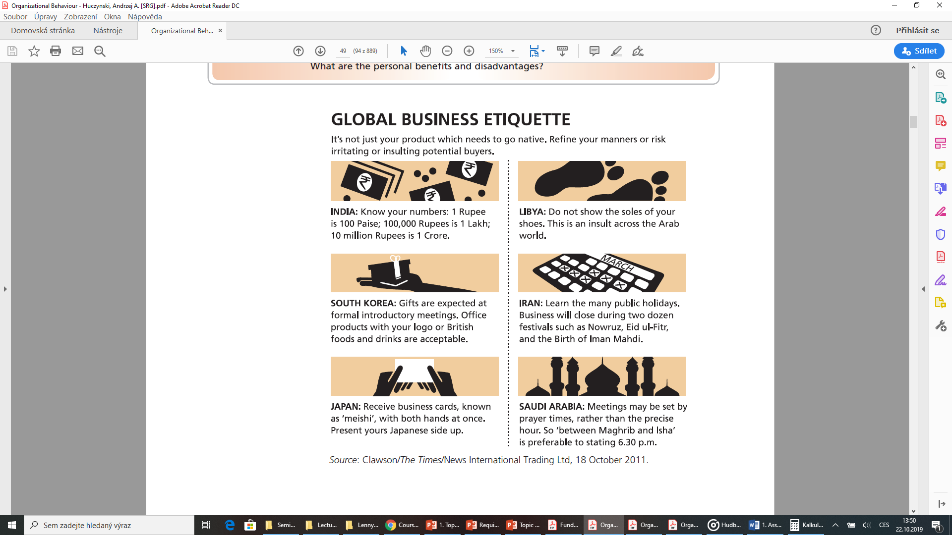

Slide 28
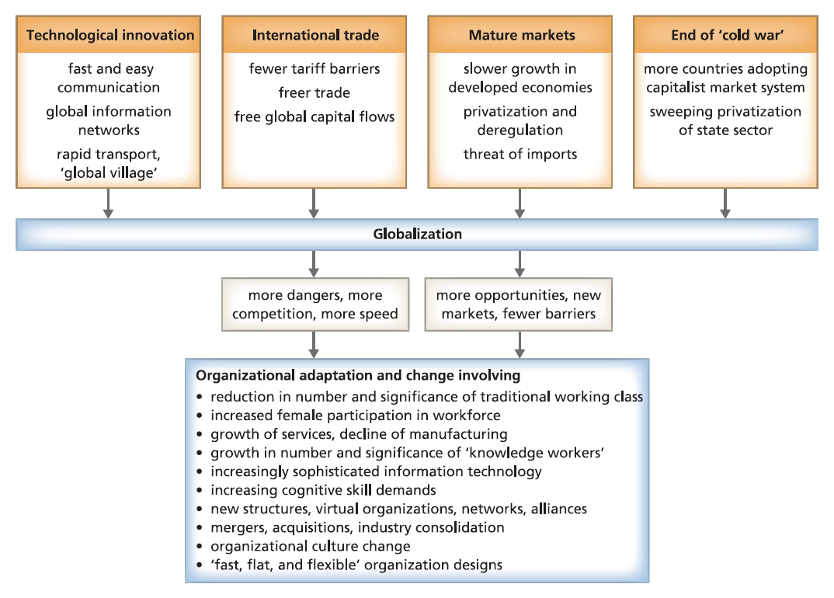
Globalization and Organizational change

Slide 29
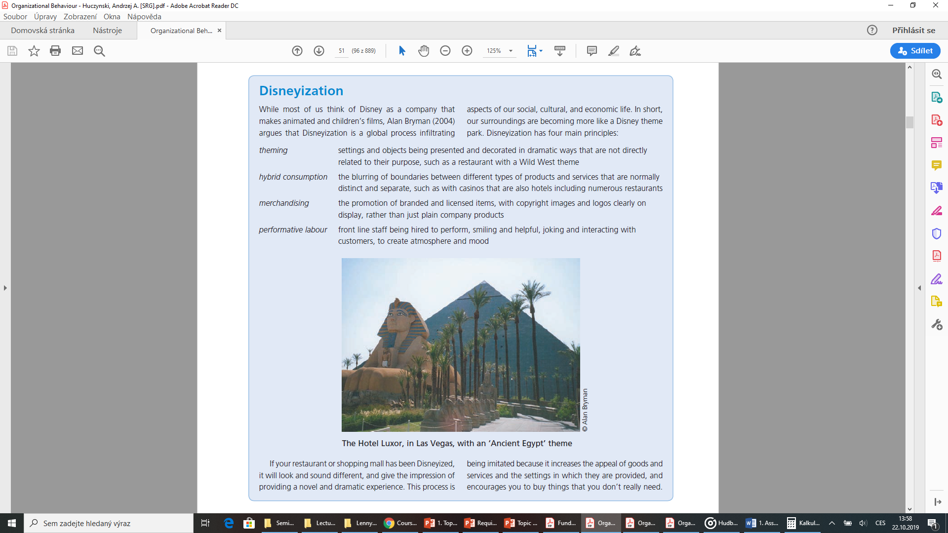
Globalization and Organizational change

Slide 30
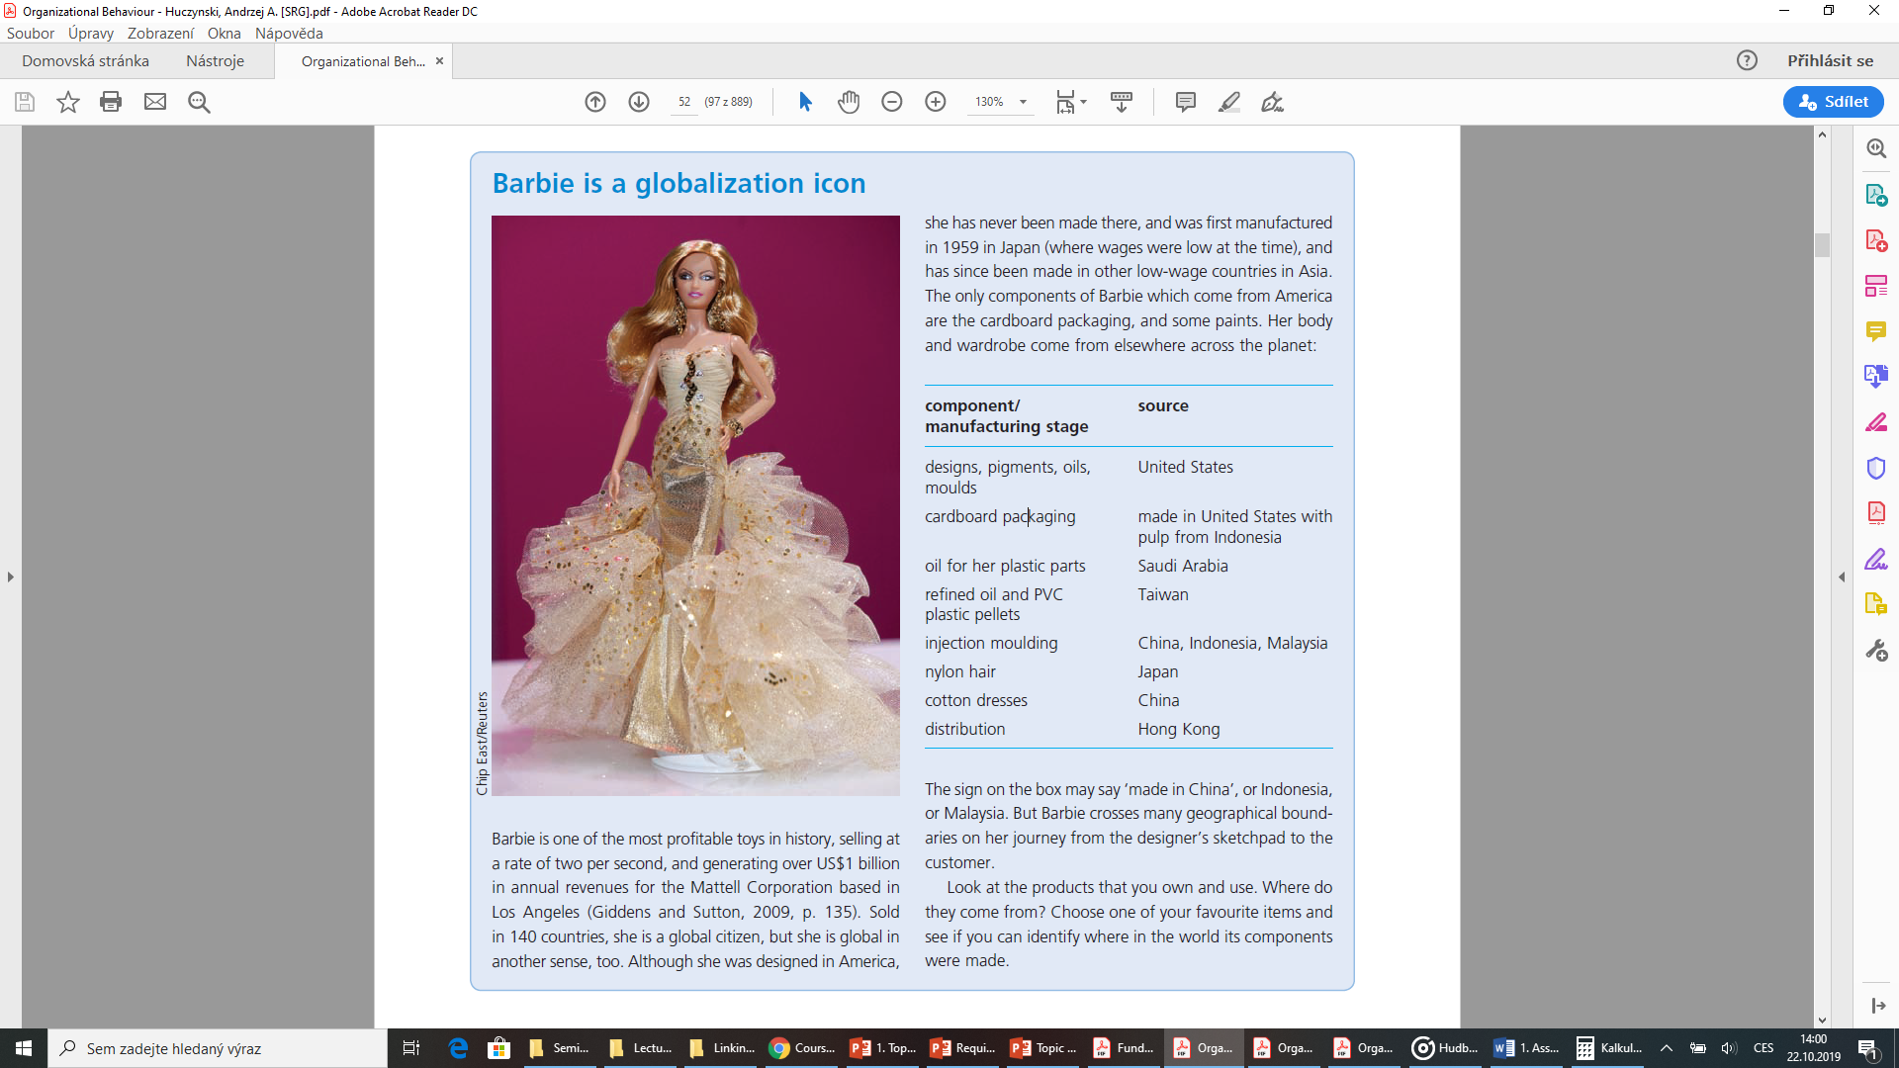
Globalization and Organizational change

Slide 31
Analysing the organization’s Environment – globalization - The Virtual Expatriate
Robert Adams, an American, has worked for a multinational company headquartered in the United States for over seven years. Perceived as a fast-track manager destined for executive-level status, Adams has performed well in a variety of domestic assignments. However, his supervisor has just Asked him to take a three-year expatriate assignment in a high-potential foreign subsidiary some 7,000 miles from headquarters.
  Although Adams recognizes the importance of developing international language, cultural, and business skills, he has several concerns regarding this long-term assignment: It could make him “out of sight, out of mind” with regard to promotions and politics back at headquarters; his children are about to enter high school and do not want to leave their peer groups.
  Adams solved this potential dilemma by suggesting to his manager that he become a virtual expatriate, meaning he would commute back and forth between the international subsidiary and headquarters.
  Even though he would be away from home for several days each month, Adams and his family would not have to sell their house and relocate overseas. This way, he would be able to protect his career interests at headquarters while not disrupting his spouse’s career or children’s social development by relocating overseas.

Slide 32
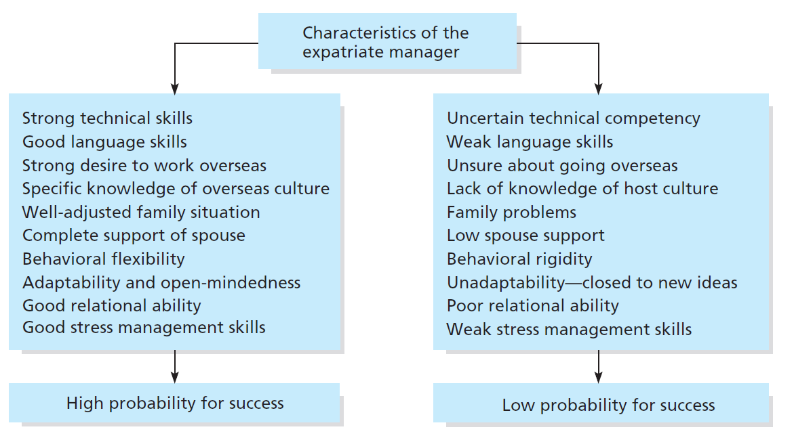
Analysing the organization’s Environment – globalization - The Virtual Expatriate
Factors in Expatriate Managers´Success and Failure

Slide 33
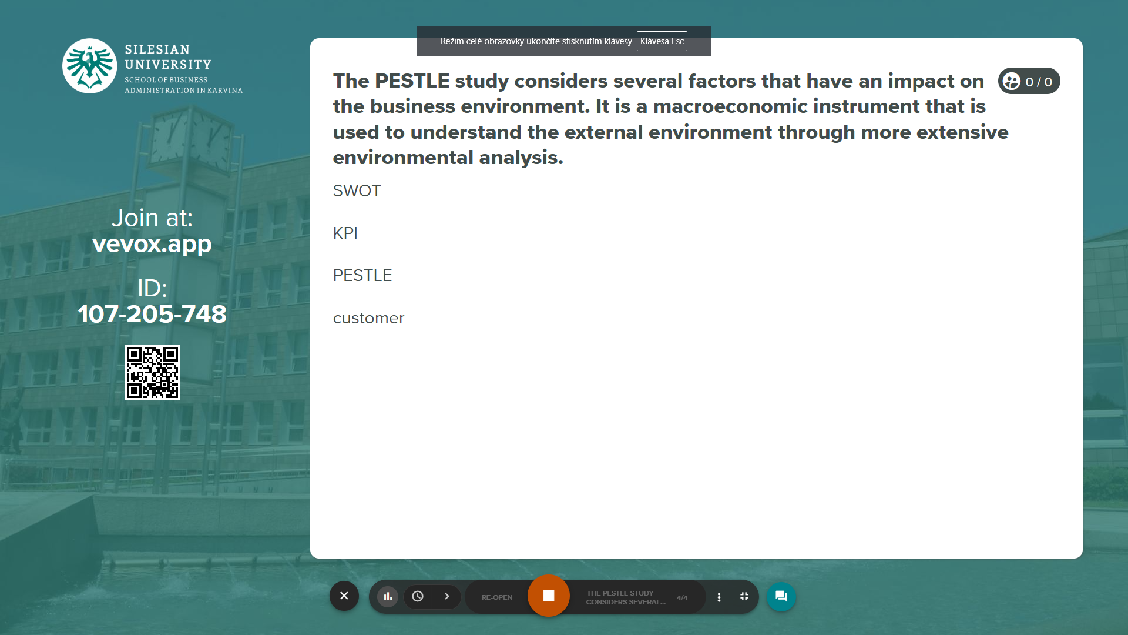
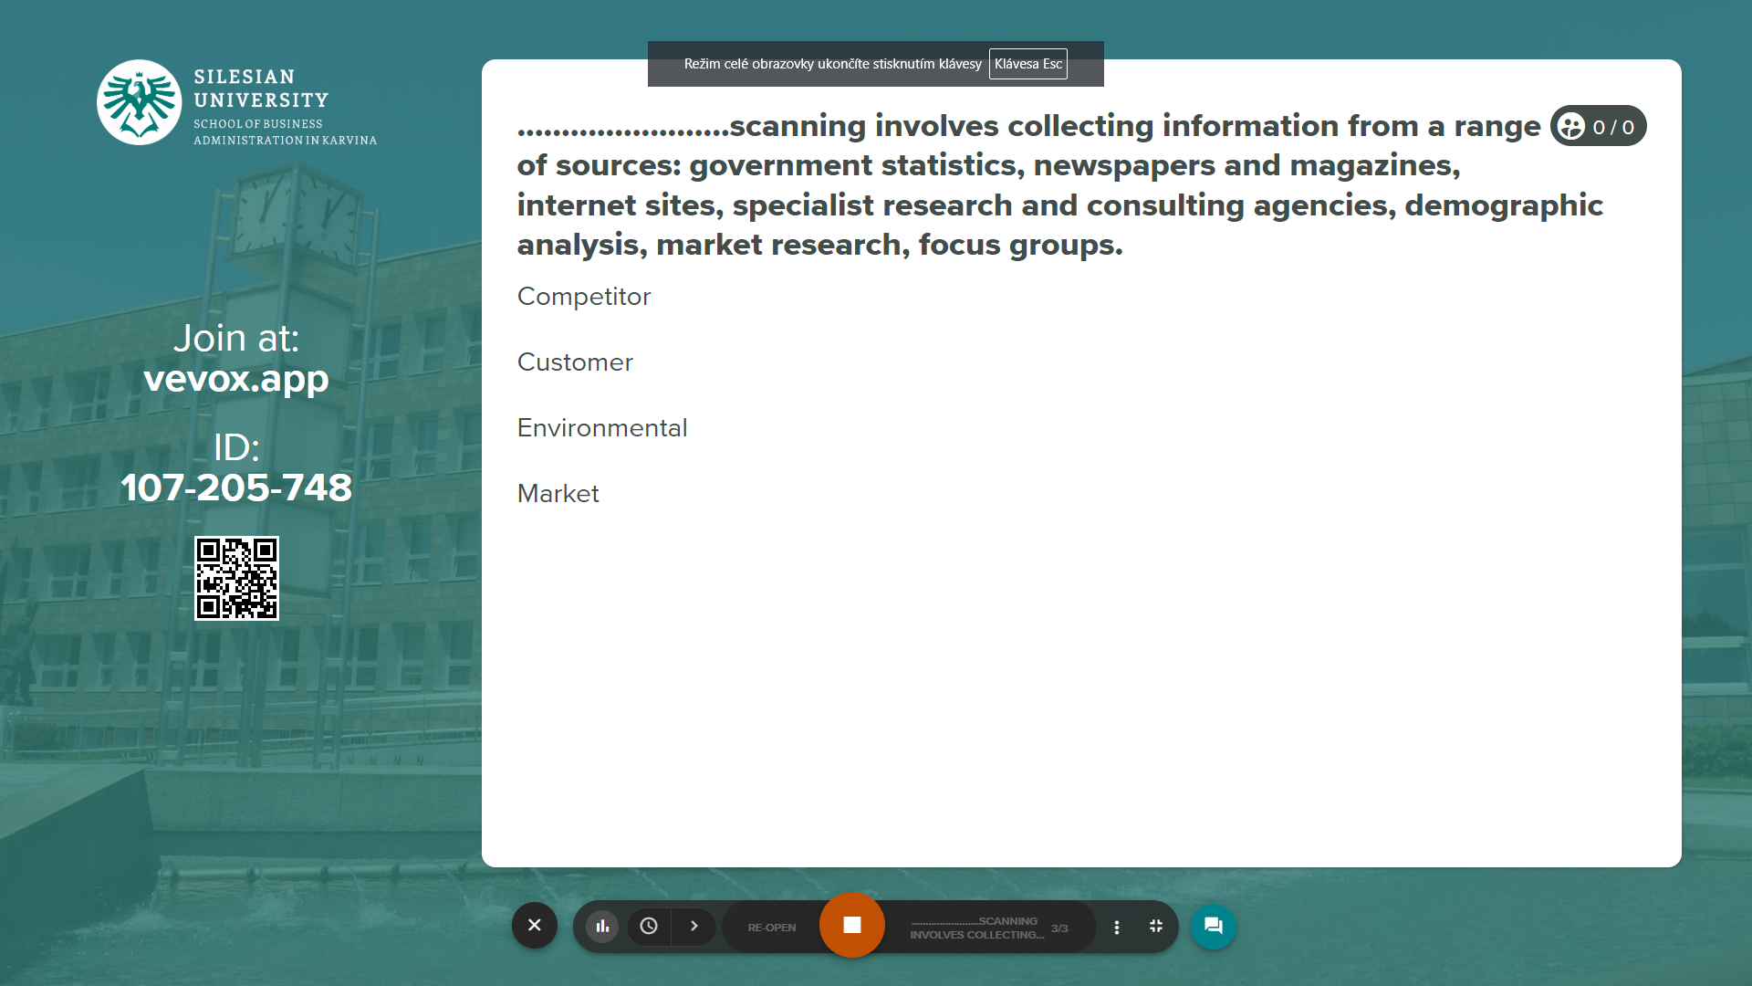
Vevox questions
https://silesianuniversity.vevox.com/#/meeting/450422/polls

Slide 34
RECAP
Understand the mutual interdependence between the organization and its environment.
To survive, organizations have to adapt their internal structures, processes and behaviours to cope with complexity and the pace of external change.
External pressures on organizations come from the globalization of business, developments in information technology, and social and demographic trends.
Appreciate the strengths and limitations of PESTLE analysis of organizational environments.
PESTLE analysis provides a comprehensive framework for identifying and planning responses to external factors that can affect an organization.
PESTLE analysis generates vast amounts of information, creating a time consuming analysis problem, and making predictions based on this analysis can be difficult.

Slide 35
RECAP
Apply utilitarianism, the theory of rights, and the theory of justice to assess whether or not management actions are ethical, and recognize the limitations of those criteria.
The utilitarian perspective argues that behaviour is ethical if it achieves the greatest good for the greatest number.
The theory of rights judges behaviour on the extent to which individual rights are respected, including the right of free consent, the right to privacy, the right to freedom of conscience, the right of free speech, and the right to due process in an impartial hearing.
The theory of justice judges behaviour on whether or not the benefits and burdens flowing from an action are fairly, equitably, and impartially distributed.
Understand the concept of corporate social responsibility, and the practical and ethical implications of this concept for organizational behaviour.
Businesses and their managers are expected to act in responsible and ethical ways, contributing to social and environmental outcomes as well as making profit.
Responsible practices include, for example, the business contribution to the community, the Sustainable use of resources, ethical behaviour in relationships with suppliers and customers, and the impact of the business on all stakeholders.
Critics argue that it is government’s job to deal with social and environmental issues, that the role of business is to maximize profits while operating within the law, and that managers who donate company funds to ‘good causes’ give away shareholders’ money.

Slide 36
We can share our thoughts and ask questions
☺
Pavel Adámek
adamek@opf.slu.cz

