Slide 1

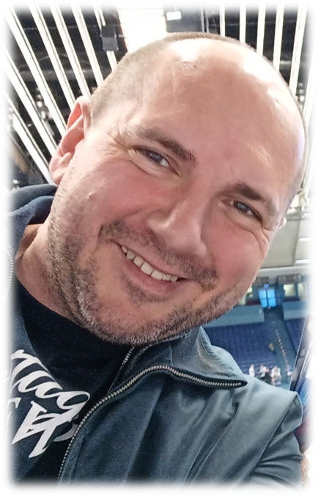
SUSTAINABLE DEVELOPMENT
Pavel Adámek, Ing., Ph.D.
adámek@opf.slu.cz
Department of Business Economics and Management
Corporate Social Responsibility Specialist
Guarantor of the master's course Corporate Social Responsibility
Business Sustainability and ESG
Blended Intensive Programme
10th April, 2025

Slide 2

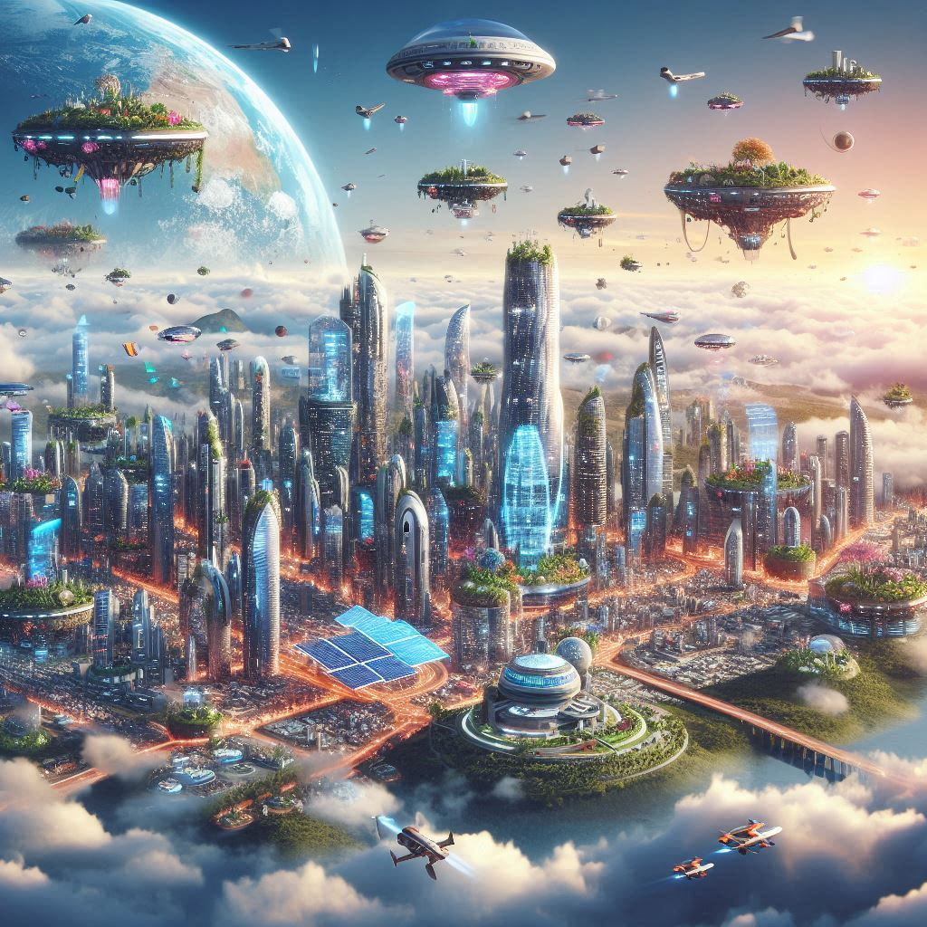
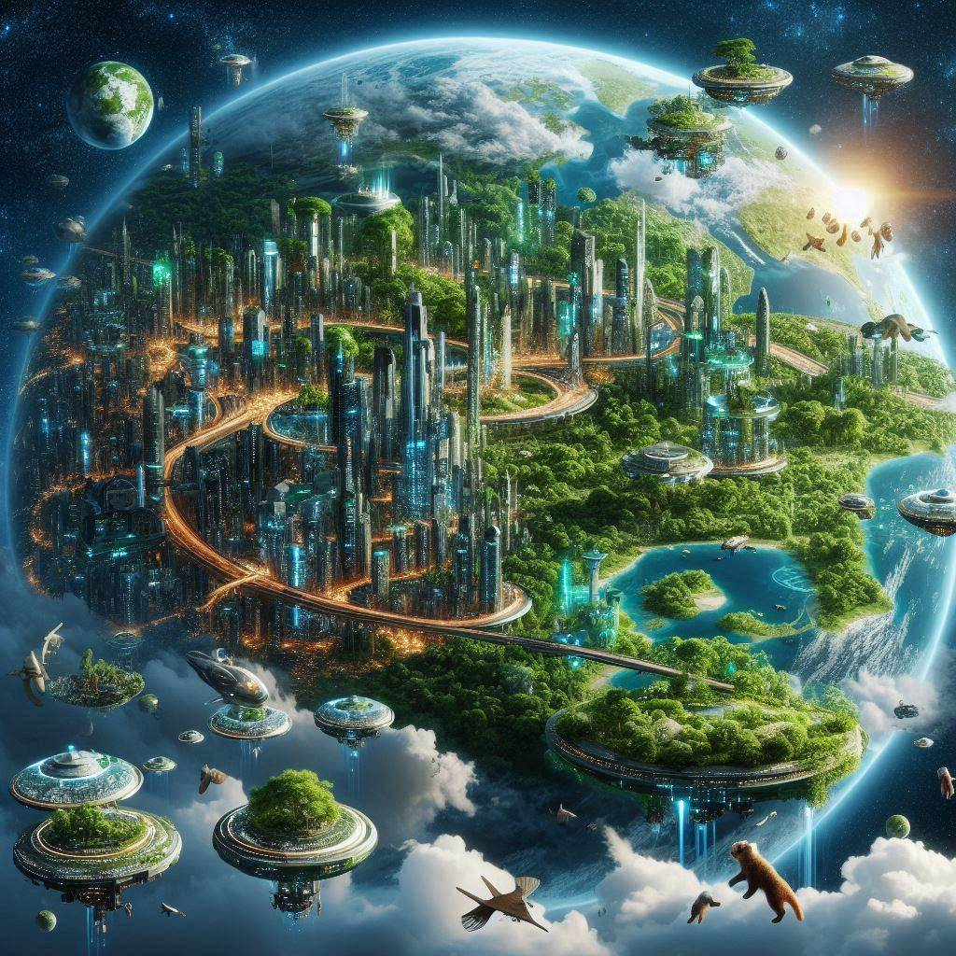

The Future of our planet…?
AI promt „Design a picture of the earth in a thousand/10 000 years“.
In 10 000 years (Copilot)
In a thousand years (Copilot)
In a thousand years (deepai.org)

Slide 3
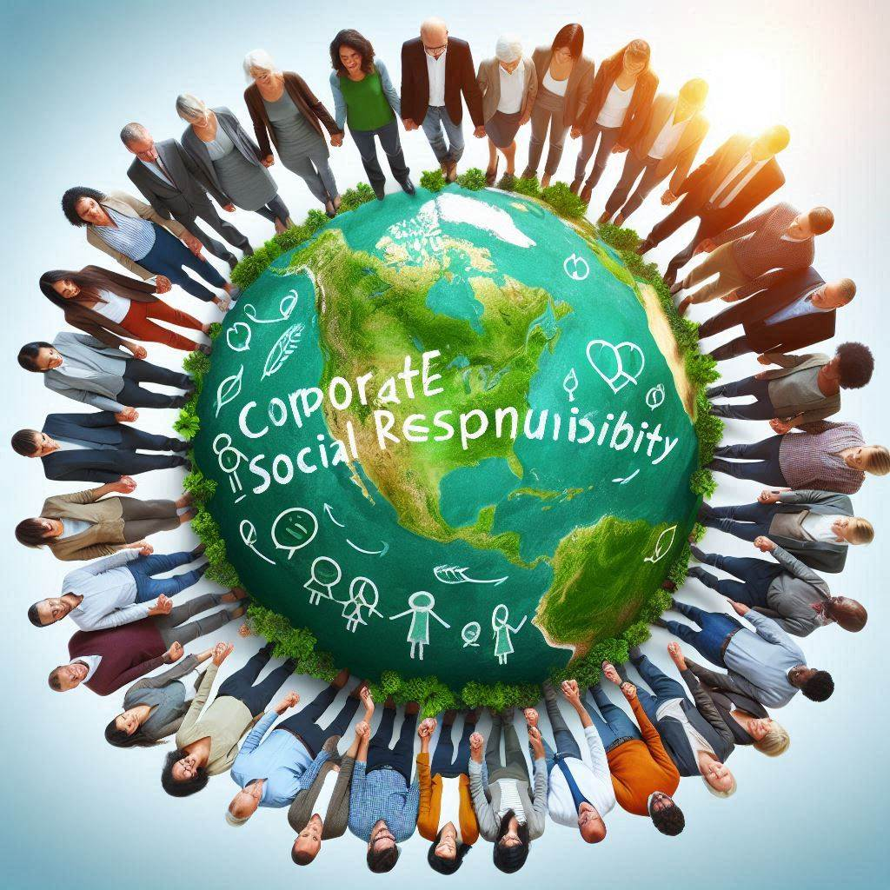
Content
1. Meaning of Sustainable Development
2. Introduction of the global risks
3. The planetary boundaries concept
4. Sustainable Development Goals (SDGs)
5. Measurability of SDGs goals
6. SDGs Good Practices
Source: Copilot (2024), AI promt "Design an image for Corporate Social Responsibility"

Slide 4
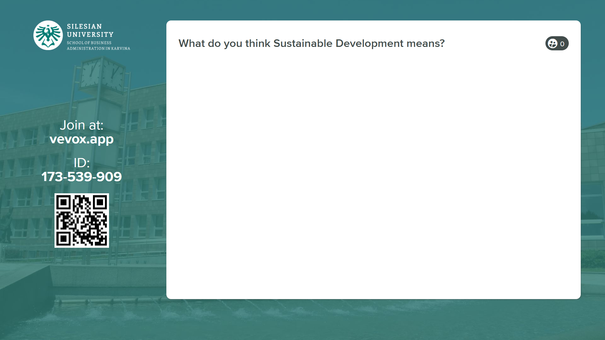

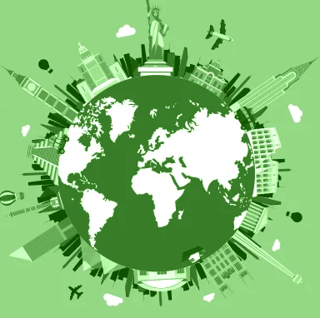
1. Introduction of the global risks
WHY?
For enterprises, CSR provide important benefits in terms of risk management, cost savings, access to capital, customer relationships, HR management, sustainability of operations, ability to innovate and be profitable.
For the economy, CSR make companies more sustainable and innovative, which contributes to a more sustainable economy.
For society, CSR offer a set of values on which we can build a more cohesive society and on which we can base the transition to a sustainable economic system.

Slide 5
The overall goal of sustainable development (SD) is the long-term stability of the economy and environment; this is only achievable through the integration and acknowledgement of economic, environmental, and social concerns throughout the decision making process.
1. Meaning of Sustainable Development
But what is sustainability? The definition of sustainability may be taken further and it is widely accepted that to achieve sustainability we must balance economic, environmental and social factors in equal harmony.
Taking these three pillars of sustainability further if we only achieve two out of three pillars then we end up with:
Social + Economic Sustainability = Equitable
Social + Environmental Sustainability = Bearable
Economic + Environmental Sustainability = Viable
Only through balancing Economic + Social + Environmental can we achieve true Sustainability.

Slide 6

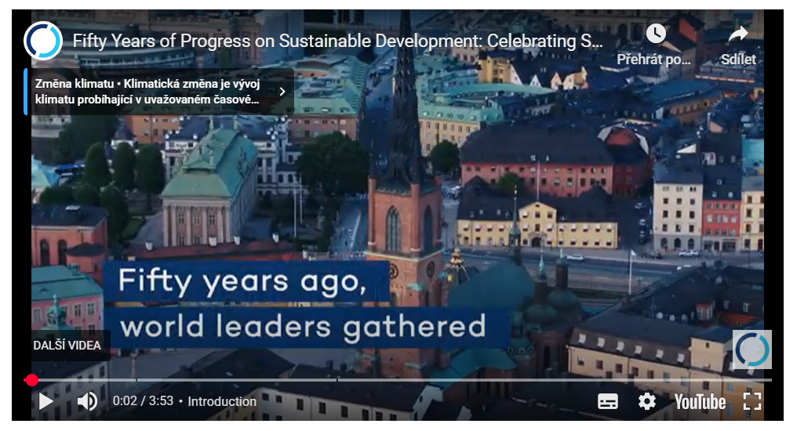
Fifty Years of Progress on Sustainable Development
Video: https://youtu.be/mlnzIwX2fjE

Slide 7
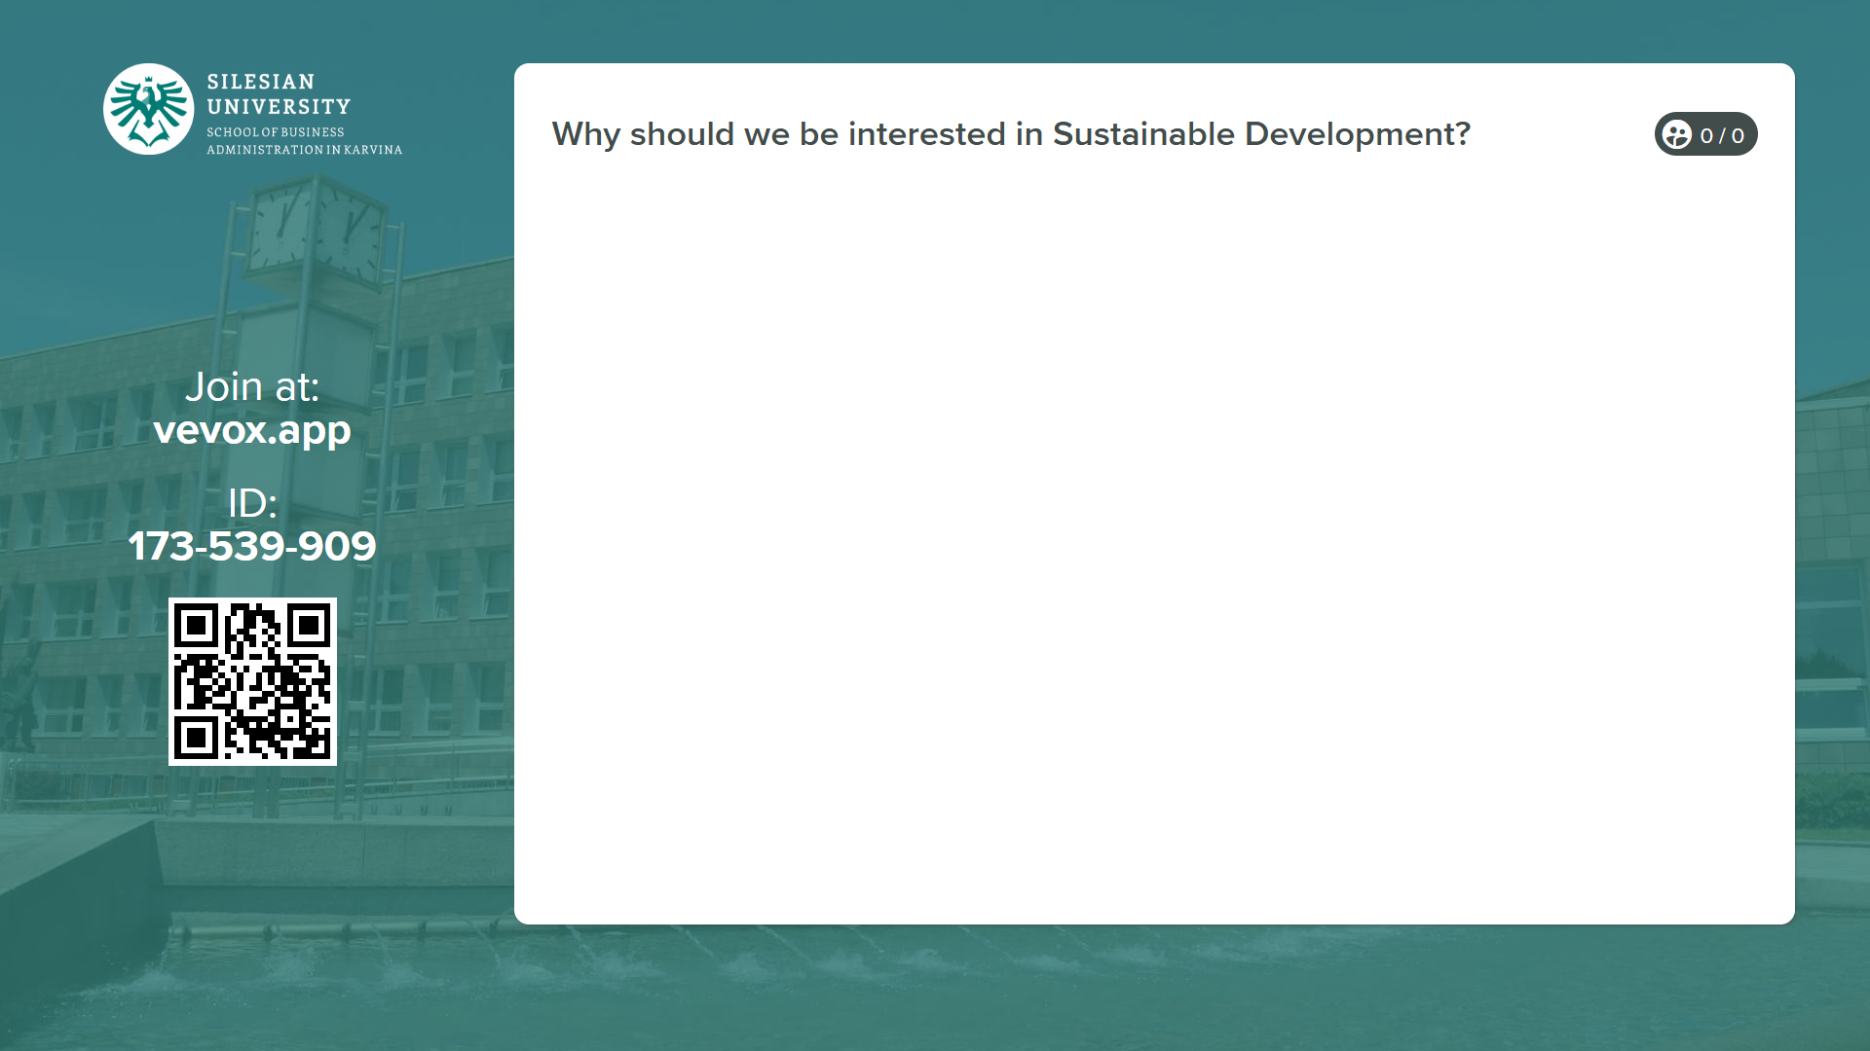

Slide 8
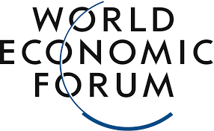
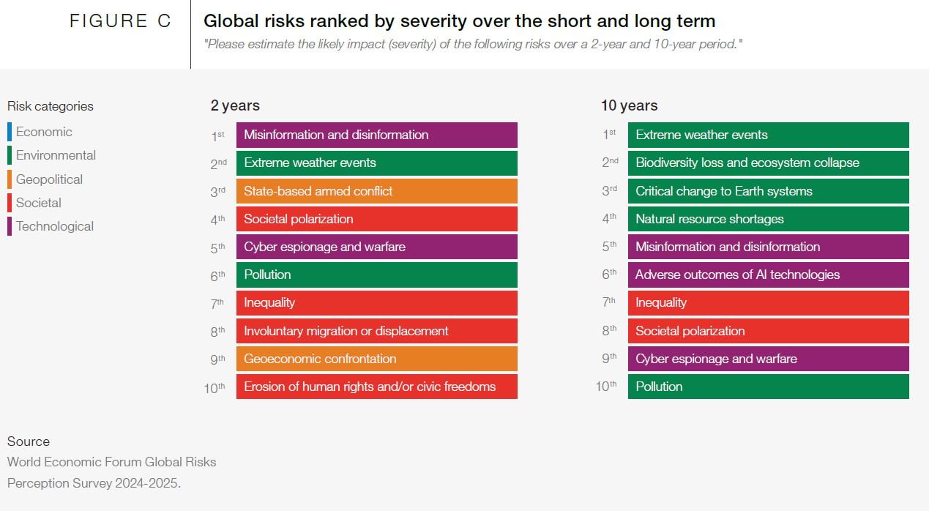
2. Introduction of the global risks
Global Risks Report 2025
https://www.weforum.org/publications/global-risks-report-2025/
The 20th edition of the Global Risks Report 2025 reveals an increasingly fractured global landscape, where escalating geopolitical, environmental, societal and technological challenges threaten stability and progress.

Slide 9
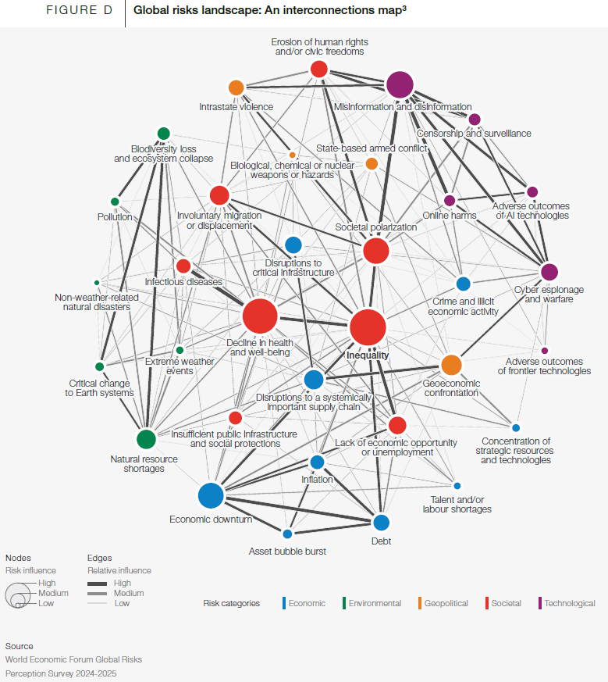
2. Introduction of the global risks

Slide 10
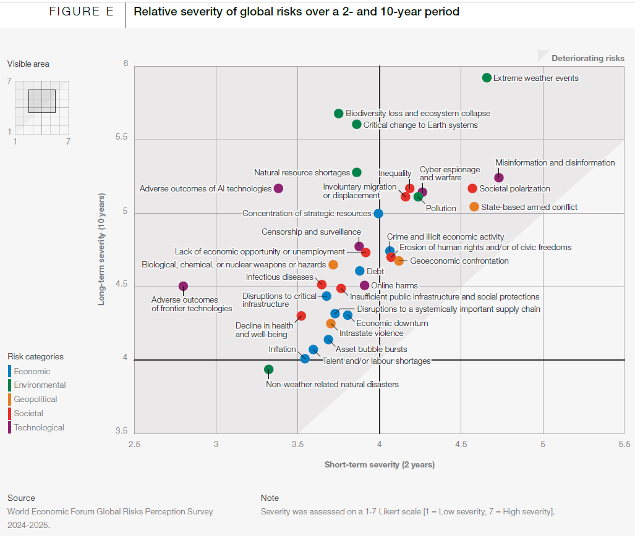
2. Introduction of the global risks

Slide 11
Why should we be interested in sustainable development?
Humanity is eroding the biological and physical resilience of Earth’s physical systems by transgressing environmental limits that endanger their functioning: the “planetary boundaries” that regulate the Earth system.
The scientific evidence points to global risks well beyond climate change, including the loss of biodiversity and ecological functions, changes in natural land use configuration, overuse of both green and blue water, overloading of nitrogen and phosphorus, and widespread chemical pollution.
Want to know more?
Climate Change
Soil Degradation
Global Warming
Overpopulation
Because…
Natural Resource Depletion
Microplastic Pollution
Ambient (outdoor) Air Pollution
Generating Unsustainable Waste (The impact of textile production and waste on the environment)
and more…

Slide 12
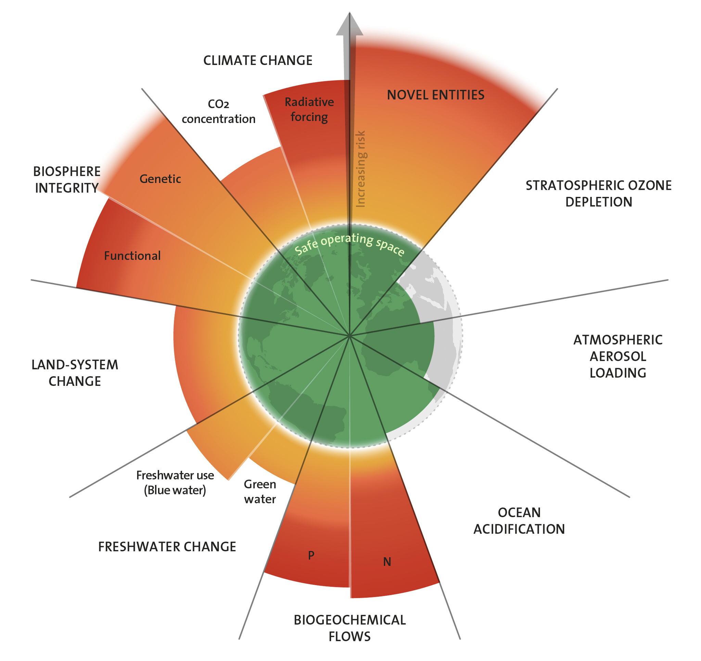
3. The planetary boundaries concept
The planetary boundaries concept presents a set of nine planetary boundaries within which humanity can continue to develop and thrive for generations to come.
In September 2023, a team of scientists quantified, for the first time, all nine processes that regulate the stability and resilience of the Earth system.
From global warming to the biosphere and deforestation, from pollutants and plastic to nitrogen cycles and freshwater: Six of nine planetary boundaries are being crossed, while simultaneously pressure in all boundary processes is increasing, new research published in the journal Science Advances shows.

Slide 13
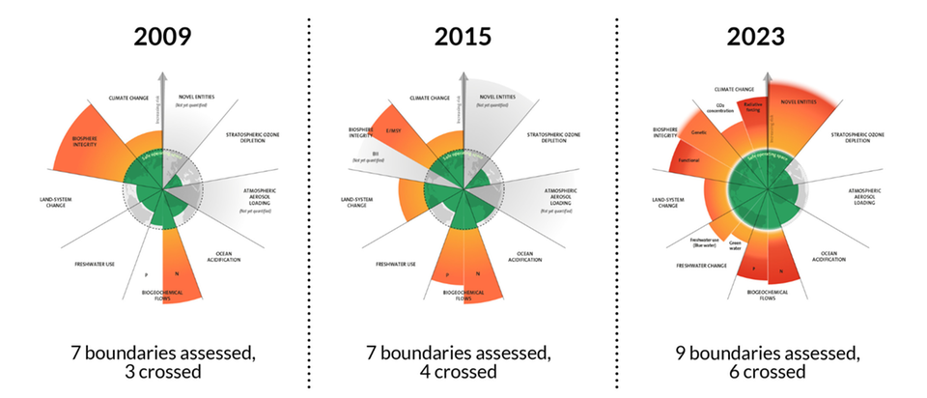
The evolution of the planetary boundaries framework
Source: Azote for Stockholm Resilience Centre, Stockholm University. Based on Richardson et al. 2023, Steffen et al. 2015, and Rockström et al. 2009)

Slide 14
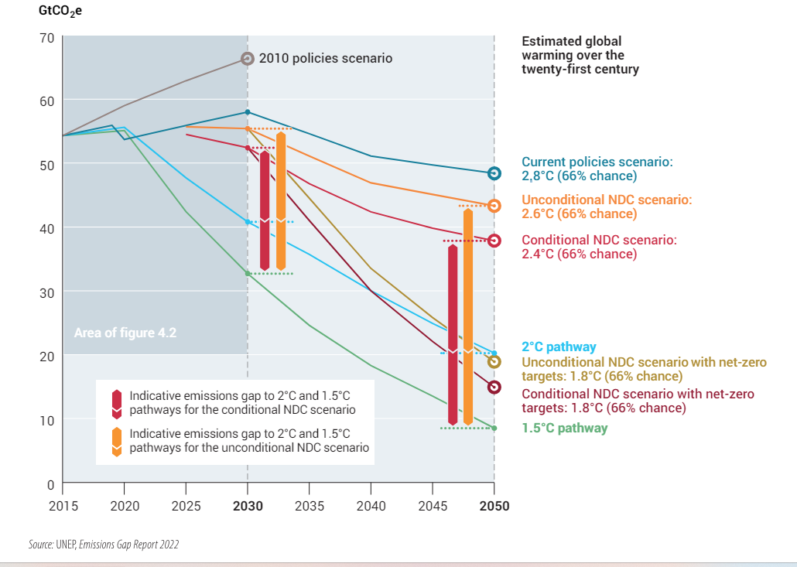
Projected global warming under alternative policy scenarios
The interconnected environmental, social, and health challenges can be characterized as a planetary health crisis, caused by human activities such as industrialization, urbanization, deforestation, and the burning of fossil fuels.
The consequences of inaction in the face of this crisis are significant and far-reaching, affecting both the natural systems that sustain life on Earth and the wellbeing of human societies.

Slide 15
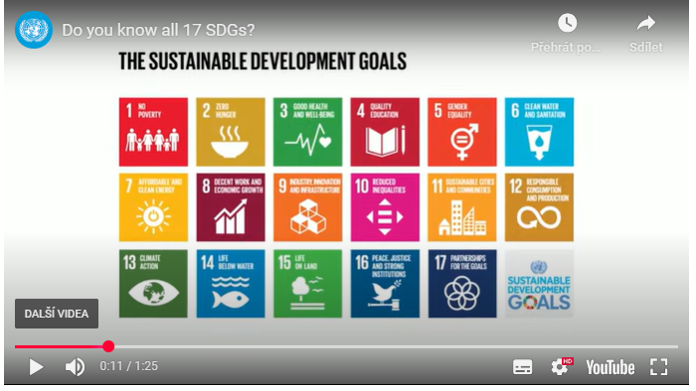
3. Sustainable Development Goals (SDGs)
The 2030 Agenda for Sustainable Development, adopted by all United Nations Member States in 2015, provides a shared blueprint for peace and prosperity for people and the planet, now and into the future.
At its heart are the 17 Sustainable Development Goals (SDGs), which are an urgent call for action by all countries - developed and developing - in a global partnership.
They recognize that ending poverty and other deprivations must go hand-in-hand with strategies that improve health and education, reduce inequality, and spur economic growth – all while tackling climate change and working to preserve our oceans and forests.
https://sdgs.un.org/goals
Do you know all 17 SDGs?

Slide 16
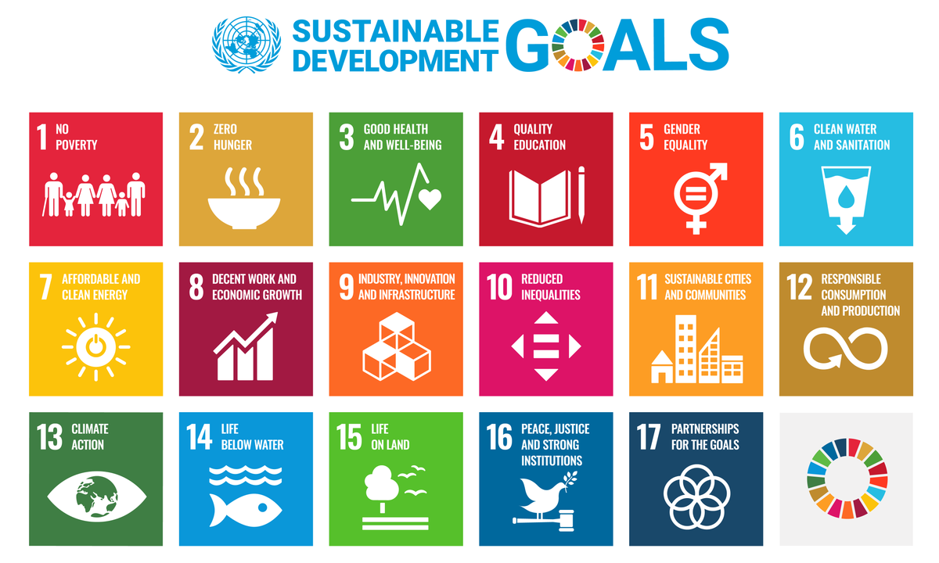

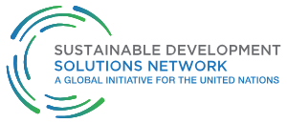
Source: https://sdgs.un.org/goals

Slide 17
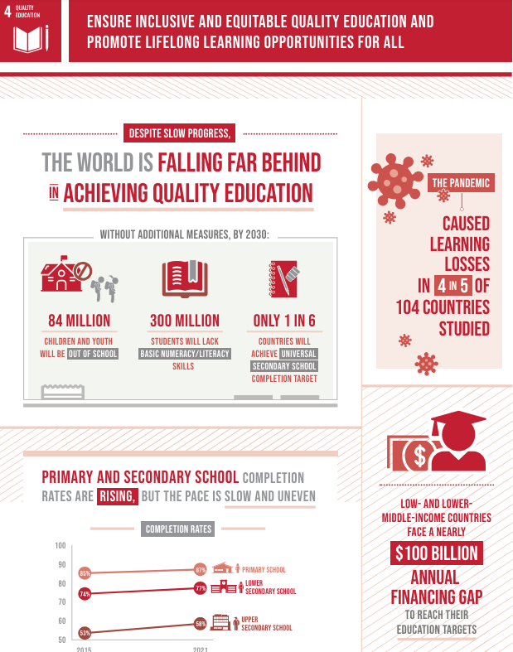
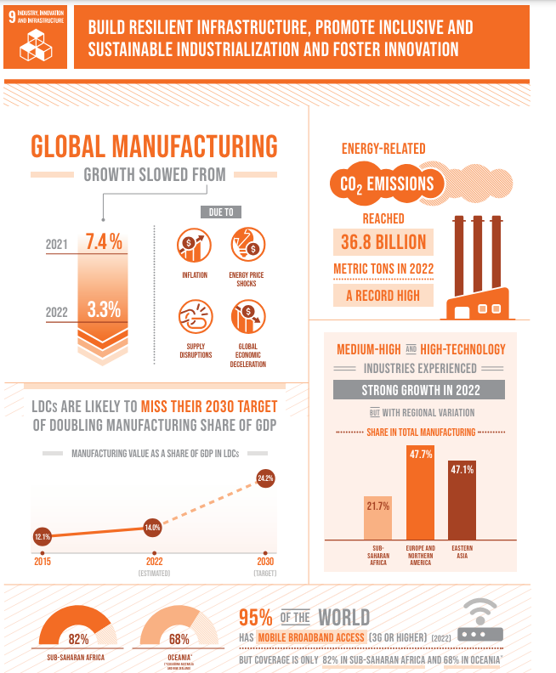
Examples of SDGs 4 and 9, Source: https://www.un.org/sustainabledevelopment/blog/2023/08/what-is-sustainable-development/

Slide 18
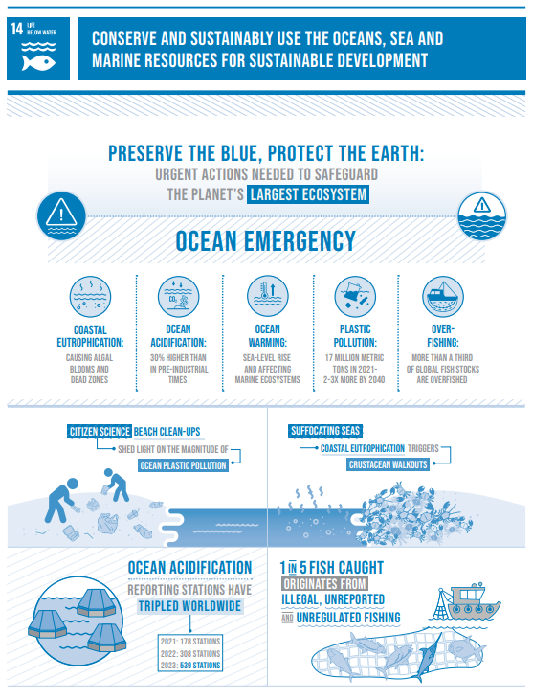
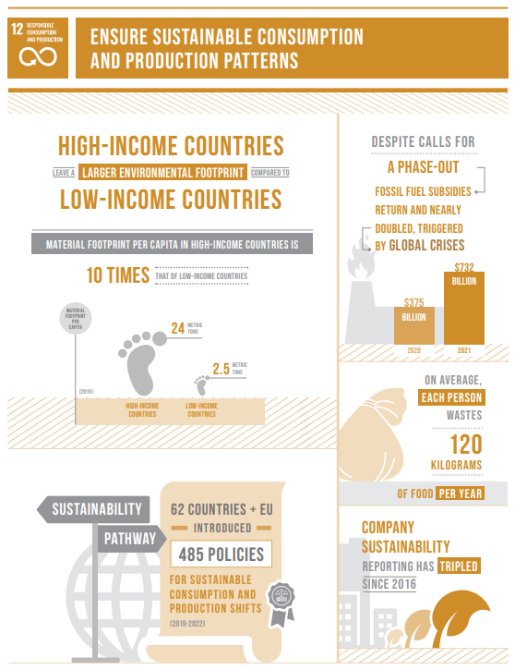
Examples of SDGs 12 and 14, Source: https://www.un.org/sustainabledevelopment/blog/2023/08/what-is-sustainable-development/

Slide 19
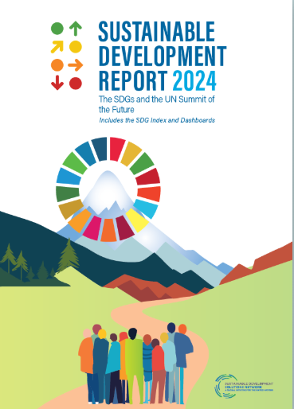
5. Measurability of SDGs goals
From this report you can:
View Rankings & Scores
Explore Interactive Maps
Analyse Country Profiles
Try the Data Explorer
Download Report and Materials
Methodology of this report https://dashboards.sdgindex.org/chapters/methodology#a-3-methodology-overview
Source: https://dashboards.sdgindex.org/
https://dashboards.sdgindex.org/map
Discover….

Slide 20
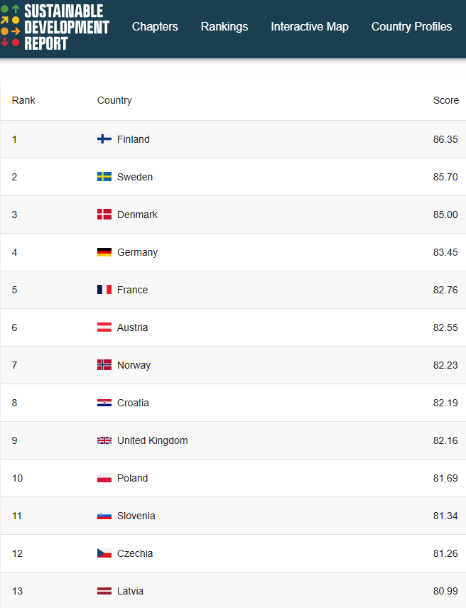
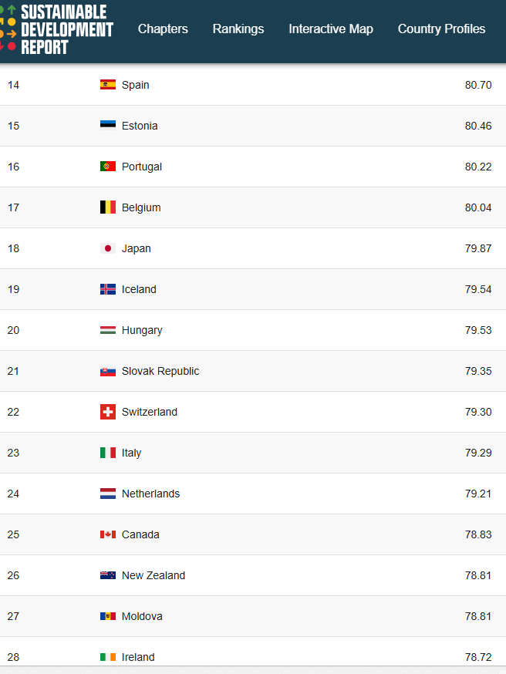
Sustainable Development – Dashboard Rankings
Countries are ranked by their overall score.
The overall score measures the total progress towards achieving all 17 SDGs.
The score can be interpreted as a percentage of SDG achievement.
A score of 100 indicates that all SDGs have been achieved.
Source: https://dashboards.sdgindex.org/rankings

Slide 21
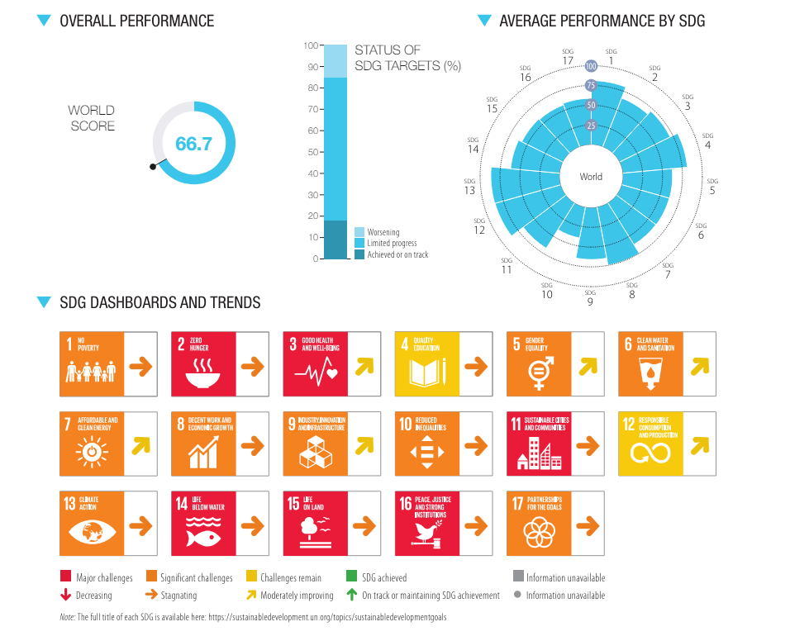
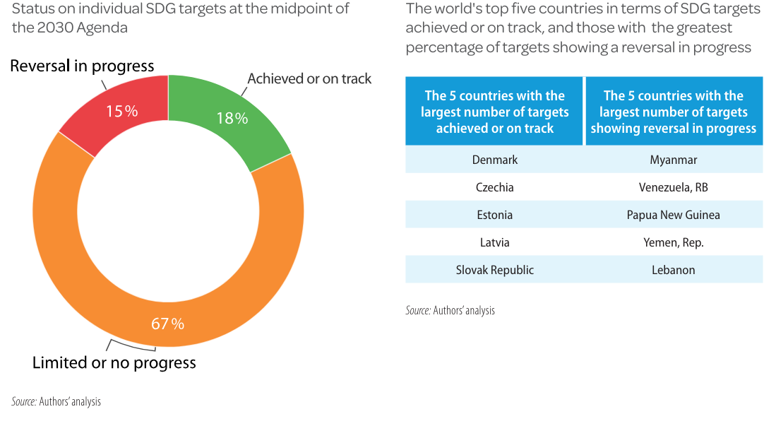
WORLD – Overall Performance SDGs
Source: SDSN,(2023) https://s3.amazonaws.com/sustainabledevelopment.report/2023/sustainable-development-report-2023.pdf

Slide 22
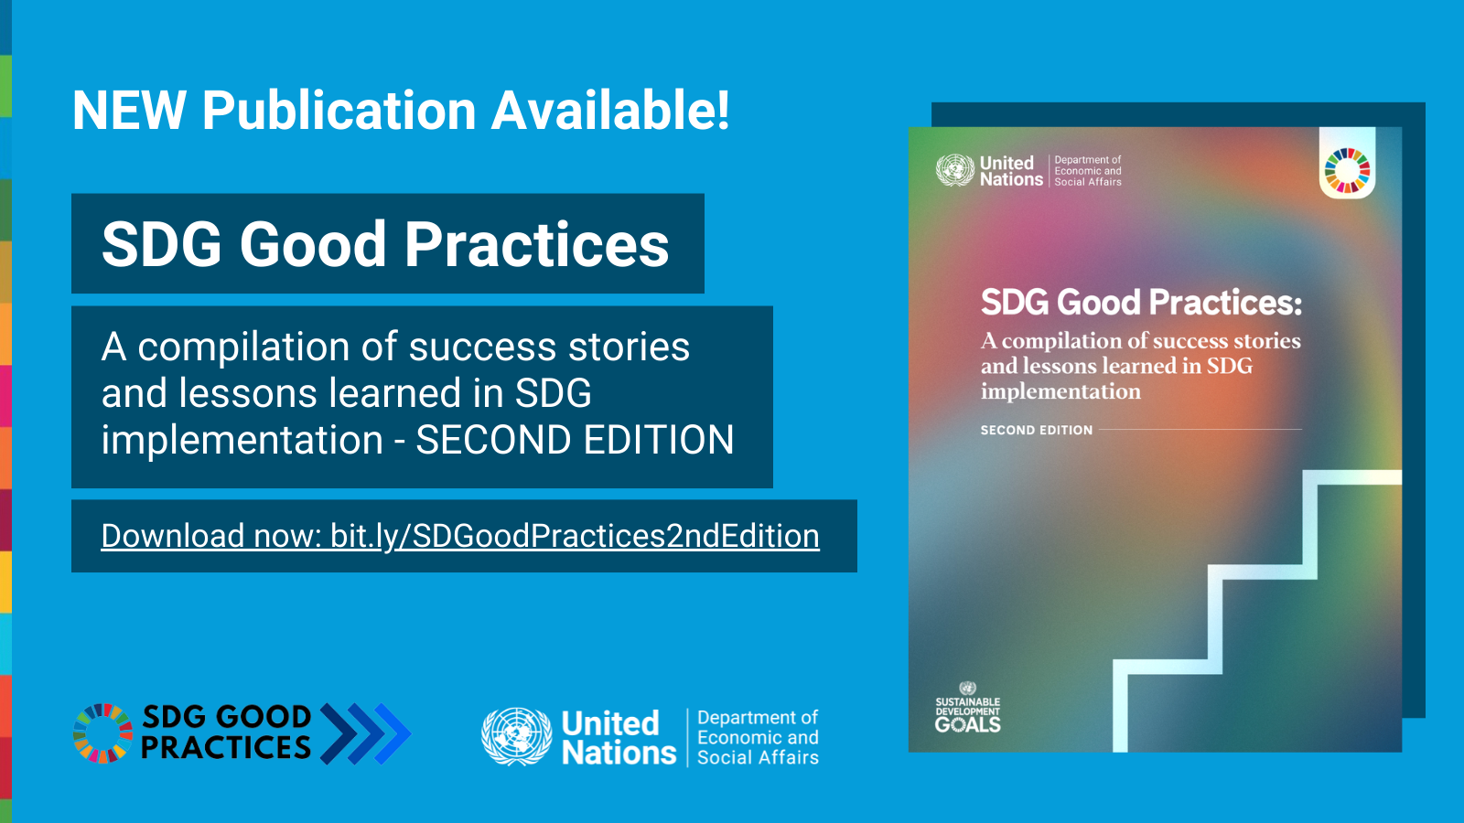

6. SDGs Good Practices
Discover….
Source: https://sdgs.un.org/sdg-good-practices

Slide 23
SDGs Good Practices
EU External Investment Plan (EIP), including the European Fund for Sustainable Development
Implemented by the European Commission to help generate jobs, growth and prosperity in countries neighbouring the EU and in Africa. This investment helps to bridge the gap between Available financing and the financing needed to create jobs, to boost growth, and to meet the other SDGs.
The European Fund for Sustainable Development has allocated €3.5 billion through the Plan for grants for blending projects, financing 181 in total. This should bring in about €32.6 billion in overall investment.
Partnership for Action on Green Economy
PAGE is a global partnership which unites five United Nations agencies, namely UNEP, the ILO, UNDP, UNIDO and UNITAR. Total contributions US $87m.
The partnership provides integrated and holistic support to countries on eradicating poverty; increasing jobs and social equity; strengthening livelihoods and environmental stewardship and sustaining growth; ensuring coherence; and avoiding duplication of efforts
…And more….visit https://sdgs.un.org/sites/default/files/2022-03/SDGs%20Good%20Practices%20-%20second%20edition%20-%20FINAL%20FEB092022.pdf
Source: SDGS UN, https://sdgs.un.org/sdg-good-practices

Slide 24
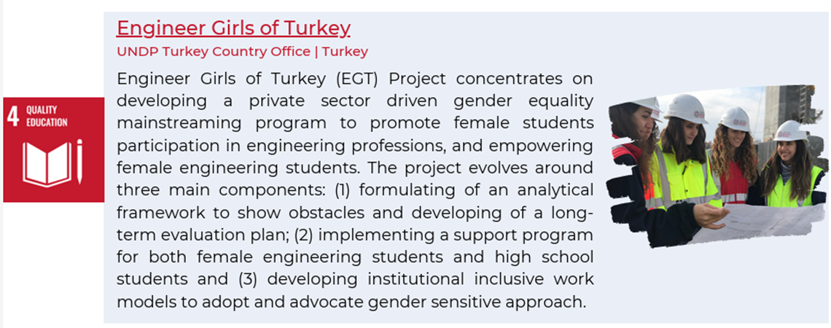
SDGs Good Practices - examplex
Source: https://sdgs.un.org/sdg-good-practices

Slide 25
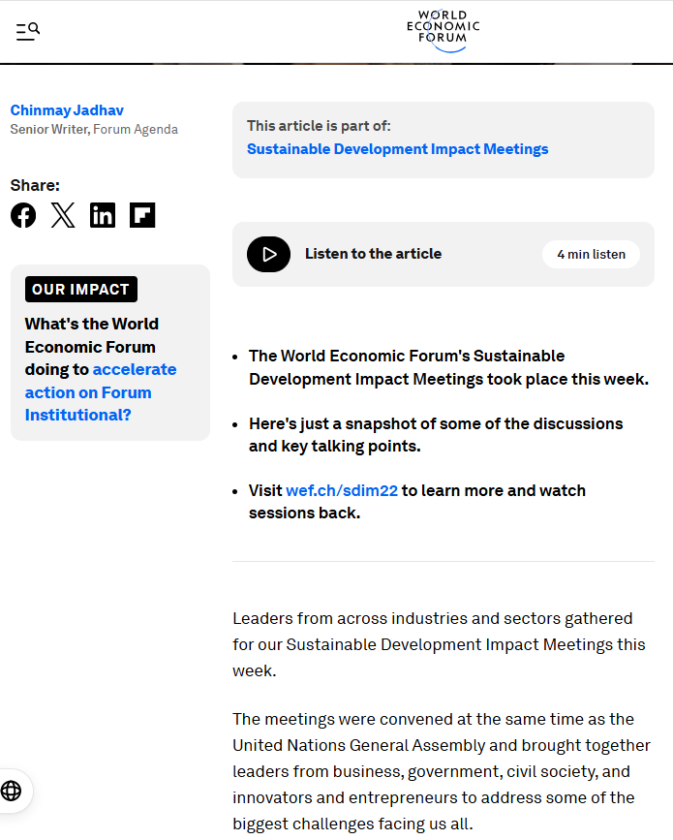
Key Takeaways
The World Economic Forum´ s Sustainable Development Impact Meetings…
Visit: https://www.weforum.org/stories/2022/09/key-takeaways-sustainable-development-impact-meetings/

Slide 26
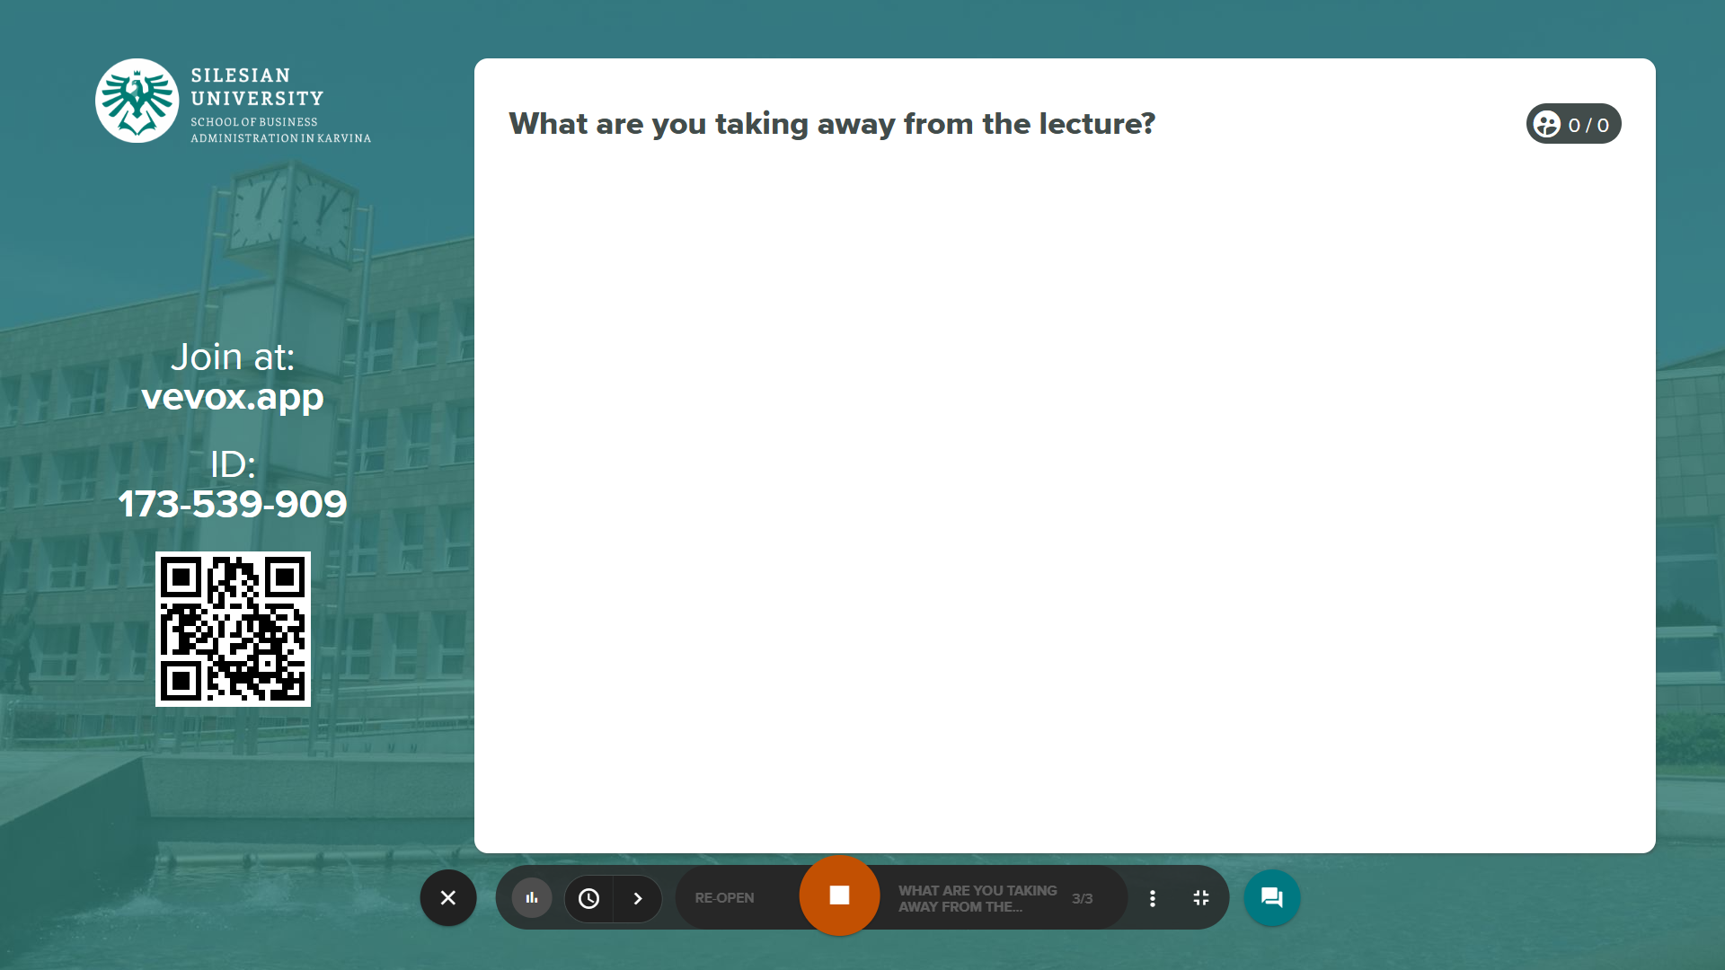
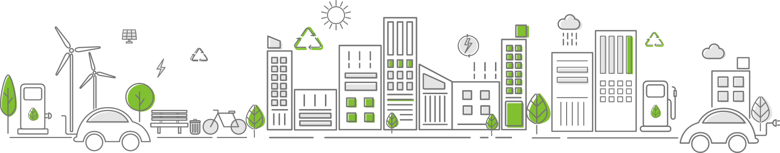
What are you taking away from the lecture?

Slide 27
Homework…
Use the infographic
and visualize today's lecture!

Slide 28
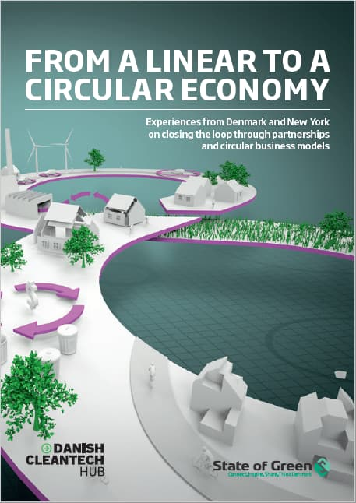
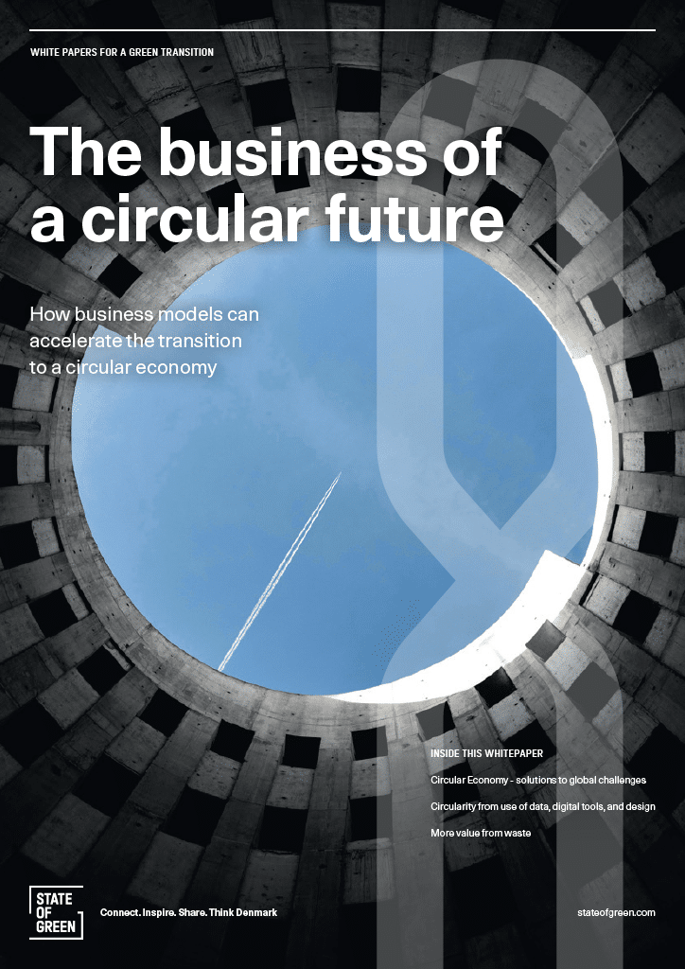
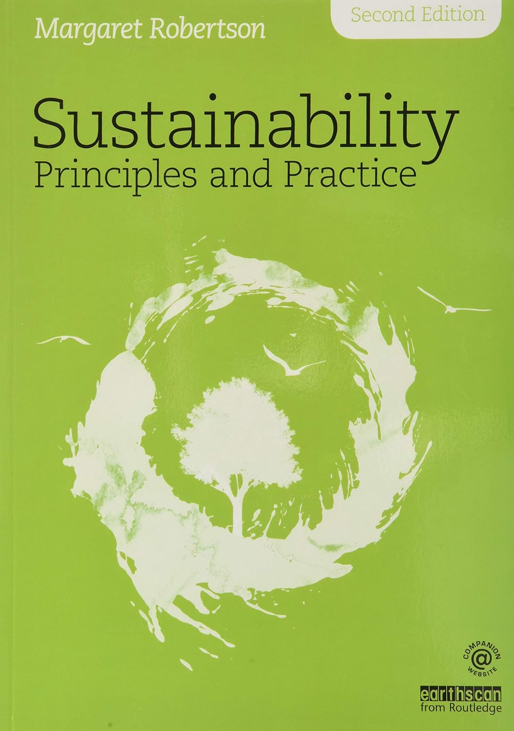
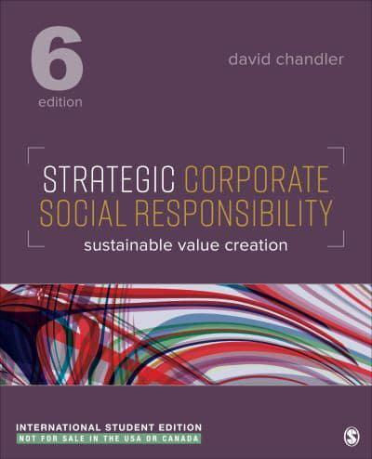
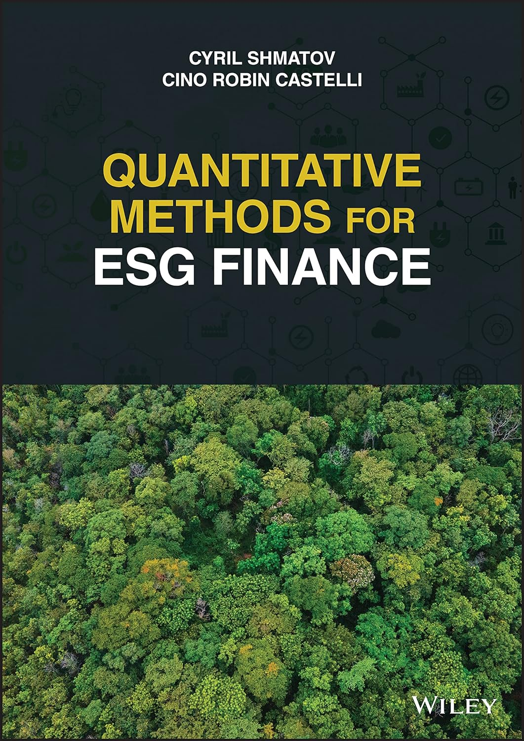
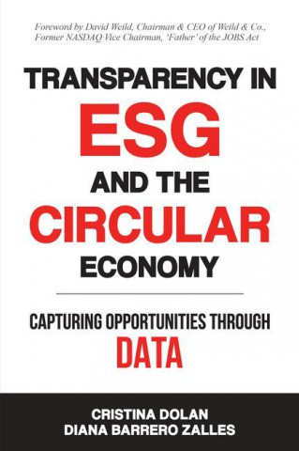
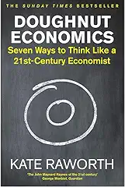
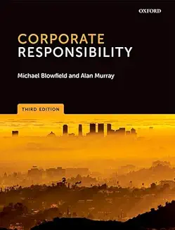
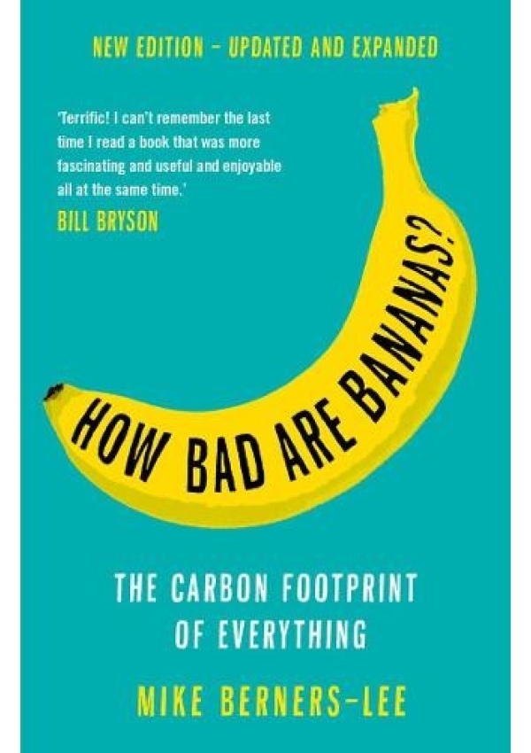
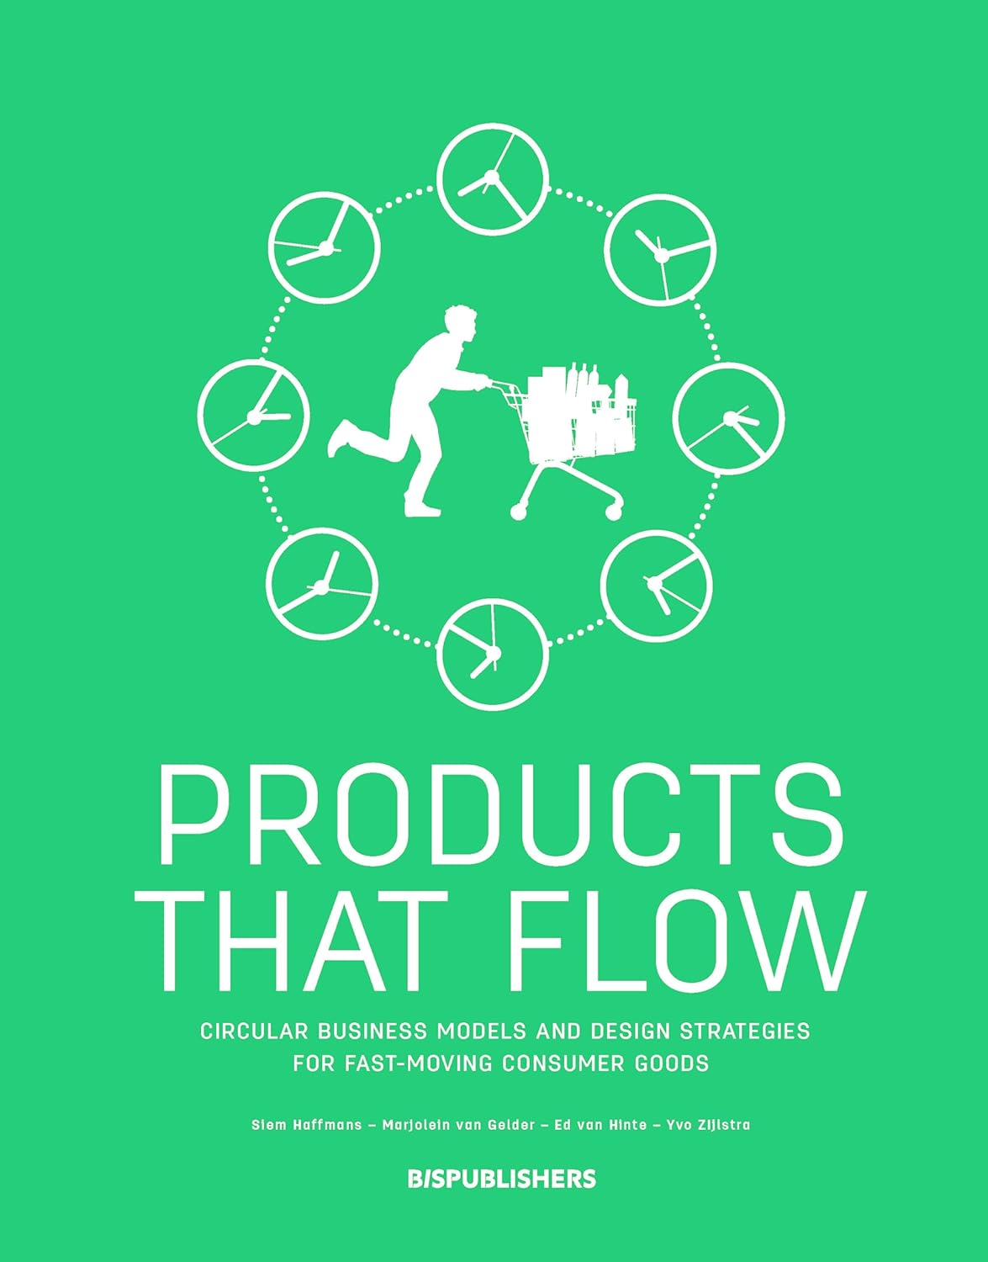
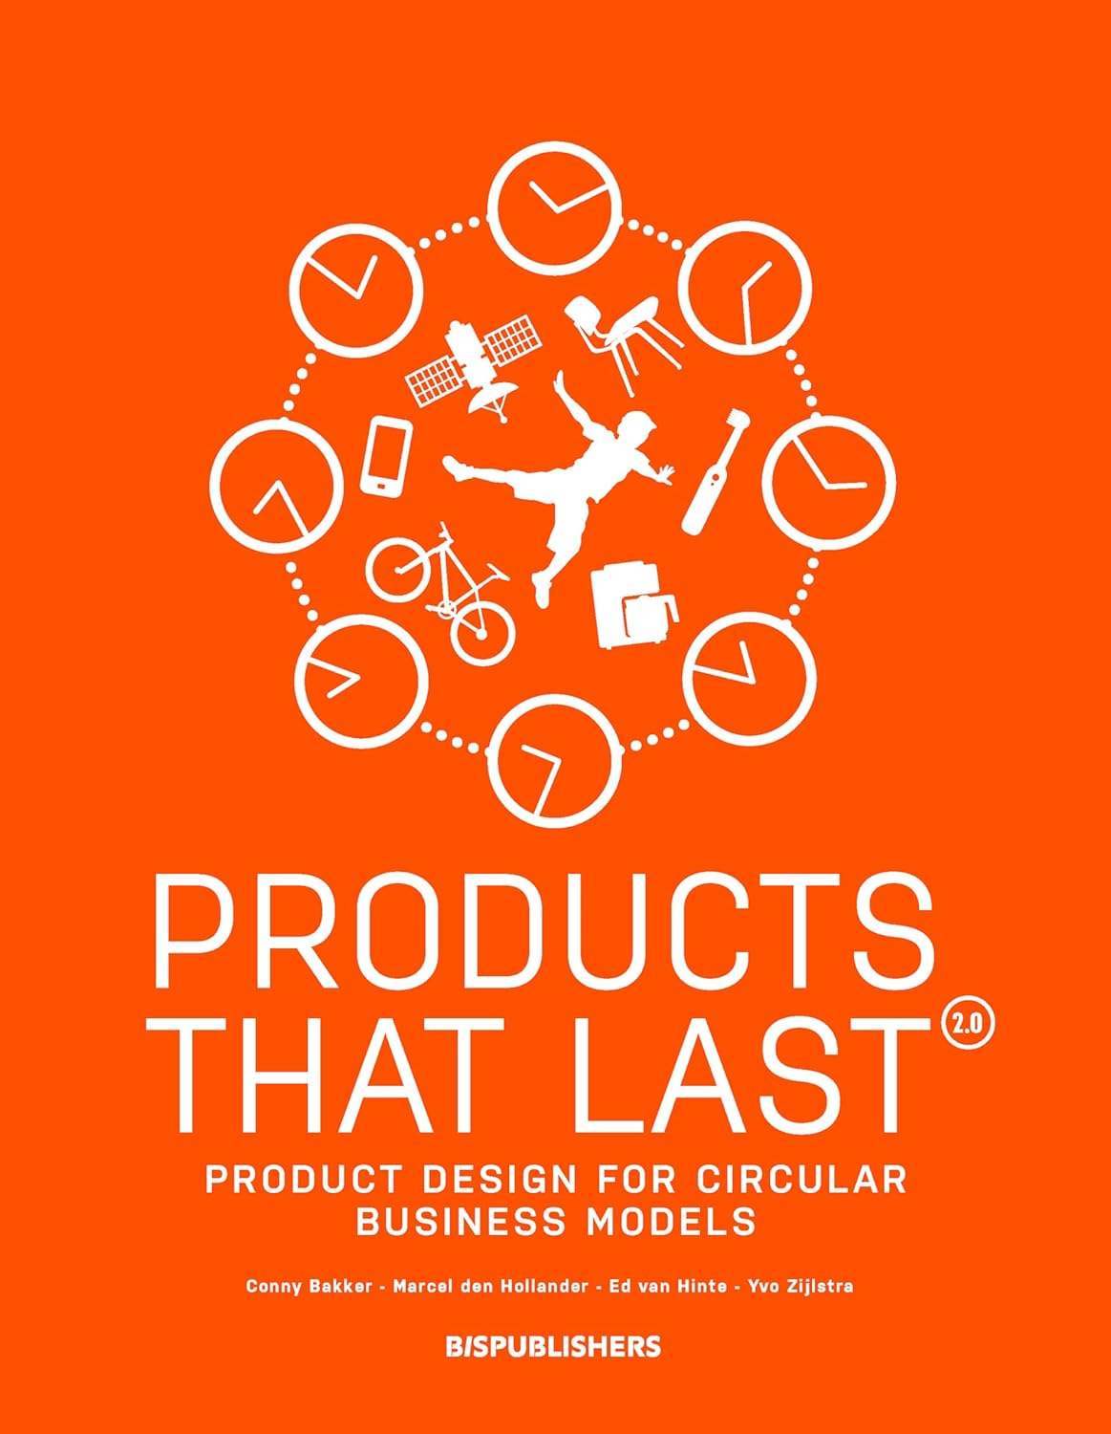
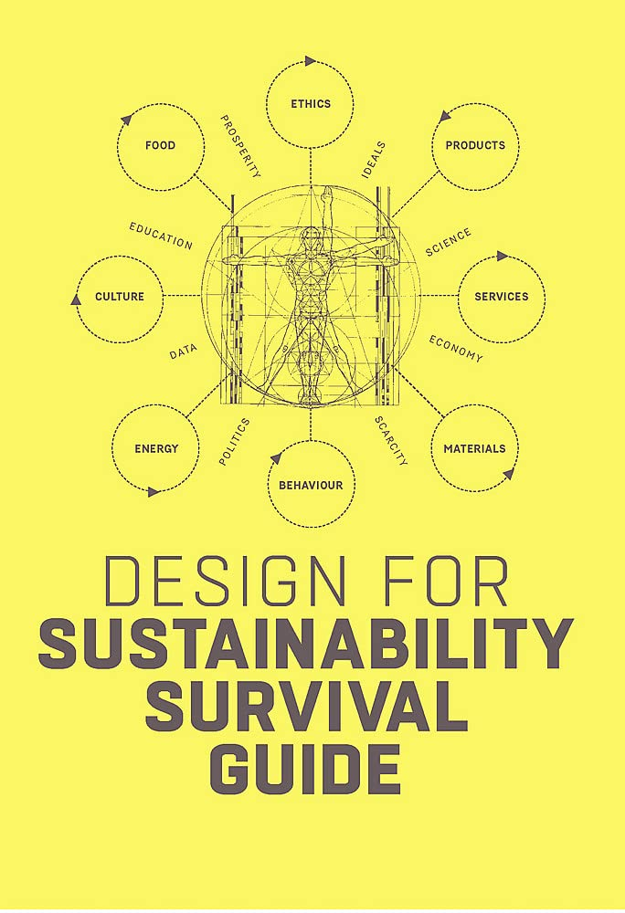
Explore publications…

Slide 29

Thank you for your attention
Pavel Adámek, Ing., Ph.D.
adamek@opf.slu.cz

