Slide 1
HUMAN RESOURCE MANAGEMENT
Lesson 10
Performance management and motivation. Rewarding system.
Ing. Helena Marková, Ph.D.

Slide 2
Content
PERSONALISTIKA PEM SU OPF
motivation
performace management
reward, rewarding system
purpose of rewarding strategies

Slide 3
motivation
Employee motivation is a process that leads to people wanting to do their jobs effectively and with commitment. It is why employees do what they do and how hard they try.
Key elements of motivation:
Needs and wants - People want to satisfy their personal needs, such as having a secure income, being recognised, or having opportunities for development.
Goals - Employees need to see the purpose of their work and know that they are achieving some goals.
Rewards - Motivation is enhanced by rewards, which can be tangible (money, bonuses, benefits) and intangible (praise, recognition, good relationships with colleagues)
Why is motivation important?
Motivated employees are more productive, more loyal and contribute to a better company atmosphere. Conversely, demotivation leads to lost performance, higher turnover and stress in the workplace. Motivation is what drives people forward. For employees, it is a combination of rewards, goals and an environment that gives them purpose. Without motivation, performance declines; with motivation, performance increases.
Slezská univerzita

Slide 4
Theory of motivation
All of these theories arose in response to specific problems:
The Industrial Revolution raised productivity issues in factories.
Economic crises forced firms to look for ways to maintain employee performance.
Technological advances and the development of new industries increased the emphasis on human creativity and self-actualization.
Slezská univerzita

Slide 5
Theory of motivation
Slezská univerzita

Slide 6
Theory of motivation
Slezská univerzita

Slide 7
Theory of motivation
Slezská univerzita

Slide 8
Theory of motivation
Slezská univerzita

Slide 9
Motivation & performance appraisal
Motivation theories show us that people have different needs and desires that drive them to perform better - some want recognition, others want security, others want growth.
How can we as managers find out what really motivates each individual employee?
One of the best tools is employee evaluations.
With it, we can not only evaluate their performance, but also discover what motivates them, what's holding them back, and how to provide feedback that will drive them forward.
So if we understand how motivational theories work, we can link them directly to the practice of employee appraisal.
How to effectively appraise employees and how the process affects their motivation.
Setting goals and performance management practices based on them is also important to getting the appraisal process right.
Slezská univerzita

Slide 10
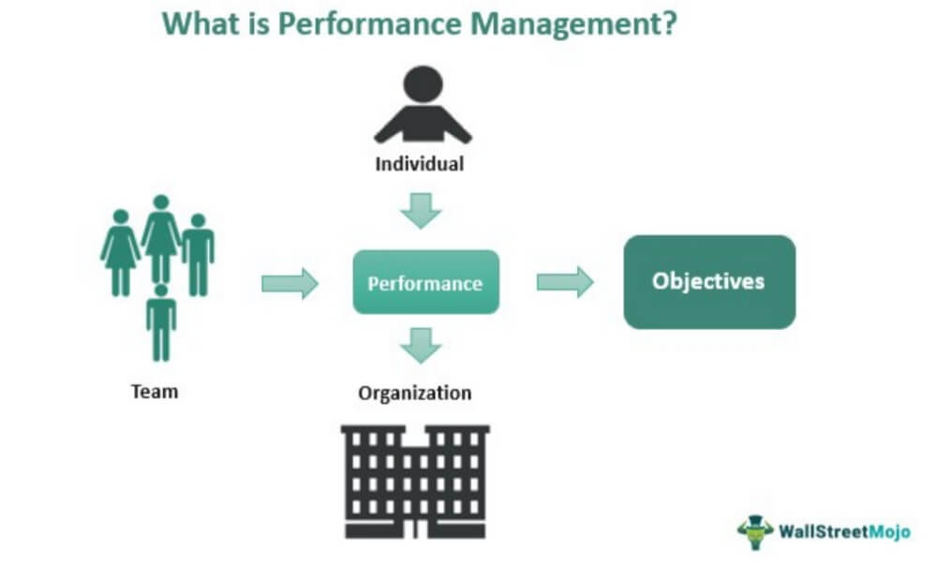
Motivation & performance appraisal
Definition of performance management: Performance management is a periodic, systematic, and objective process of developing an employee to perform their job to the best of their ability. The performance appraisal is thus part of performance management.
Stages of the cycle: Planning → Monitoring → Reviewing → Rewarding
Role in organizational strategy
Slezská univerzita

Slide 11
Why performance appraisal
Improve employee performance as well as ......
provide feedback
motivate employees
set new goals and development plans
support career development and identify talent
strengthen equity (equal access to rewards, promotions...)
improve communication between employees and management
identify training needs and development opportunities
align individual goals and organizational goals
Slezská univerzita

Slide 12
3 areas of appraisal
The concept of goal setting (individual, team) is used to evaluate performance
Ii is used the code of ethics, corporate culture values to evaluate behaviour. Usually a rating scale is used because this evaluation is quite subjective.
Work and social behavior are evaluated by interviews, psychological tests, Development Centers are used to determine potential.
potential
performance
behavior
Slezská univerzita

Slide 13
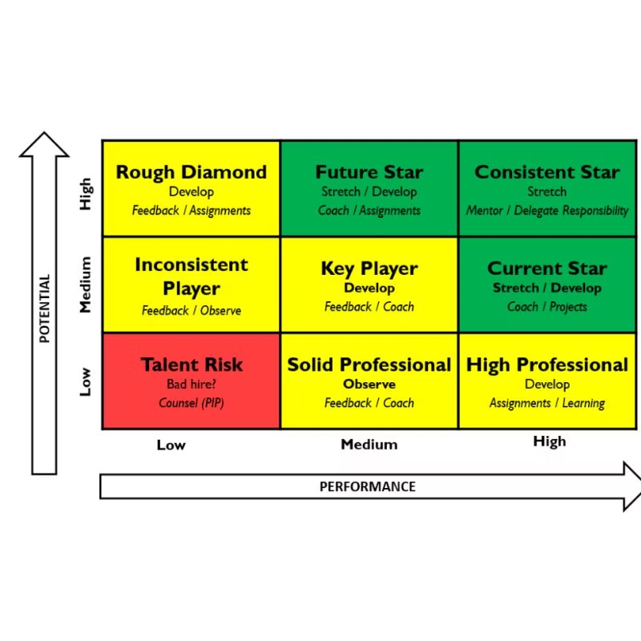
PERFORMANCE AND POTENTIAL RATING MATRIX - STARS, CENTRE AND BRAKES
Slezská univerzita

Slide 14
Main Features of Performance Appraisal
Periodic evaluation
Individual vs team focus
Goal alignment
Feedback mechanism
Slezská univerzita

Slide 15
Objectives of Performance Appraisal
🎯 Main Objectives:
Evaluate employee performance against predefined standards.
Provide feedback to guide performance improvement.
Support decision-making related to promotions, compensation, training, and development.
Align individual goals with organizational strategy.
✅ Potential Benefits:
Performance Improvement: Helps employees understand what is expected and how to improve.
Employee Development: Identifies skill gaps and training needs.
Motivation & Engagement: Recognition can boost morale and productivity.
Succession Planning: Highlights high-potential employees for leadership roles.
Legal Documentation: Maintains a record of employee performance for HR decisions.
⚠️ Potential Complications:
Bias and Subjectivity: Appraisals can be influenced by personal opinions, halo/horn effect, or favoritism.
Inconsistency: Without standardized criteria, appraisals can vary widely between managers.
Stress and Demotivation: Negative feedback, if not delivered constructively, can lead to disengagement.
Time-Consuming: Especially in large organizations, preparing and conducting evaluations requires significant time and effort.
Resistance to Feedback: Some employees may reject feedback or become defensive, undermining the appraisal's purpose.
Slezská univerzita

Slide 16
Relationship with job analysis
How job descriptions and specifications inform appraisal? Examples from your task – HR expert
Importance of clear job standards
Appraisal based on job-relevant criteria
Slezská univerzita

Slide 17
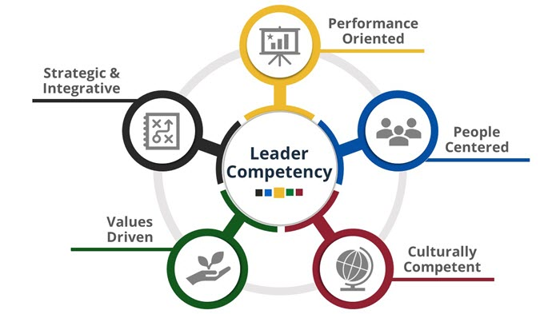
Competency framework model as a base
Slezská univerzita

Slide 18
Tools and techniques of appraisal systems
Quantitative Tools: Rating scales, checklists (Rating Scales: Employees are rated, e.g., from 1 to 5, based on specific criteria such as cooperation, accuracy, or initiative.Checklists: The manager checks whether the employee meets certain tasks or skill requirements.)
Qualitative Tools: Narrative reports, critical incidents (Narrative Reports: The manager writes a descriptive evaluation of the employee’s performance – strengths, weaknesses, and recommendations.Critical Incident Method: Records specific positive or negative events that had a significant impact on performance.)
Digital tools: Performance management software, dashboards (Performance Management Software (e.g., SAP SuccessFactors, Workday): Enables automated data collection, goal setting, 360-degree feedback, and real-time performance tracking.Online Dashboards: Visual representation of employee performance, comparisons between teams or individuals.)
Slezská univerzita

Slide 19
Methods of collecting appraisal data
Past-Oriented:
Performance records (https://hubstaff.com/blog/wp-content/uploads/2024/03/Hubstaff-monthly-template-document.png)
Behaviorally Anchored Rating Scales (BARS) (https://www.purdue.edu/hr/lod/media/docs/annualevaluationcompetencybehavioranchors.pdf )
Future-Oriented:
Management by Objectives (MBO)
Assessment centers
Development planning
Slezská univerzita

Slide 20
360 degree feedback
Slezská univerzita

Slide 21
360 degree feedback
Phase 1 - communication, identification with the method - emphasis must be placed primarily on explanation, clarification of benefits.
Phase 2 - evaluation process - participating evaluators at all levels develop the evaluation, the evaluated also performs self-assessment. The outputs are forwarded to the evaluator's supervisor.
Phase 3 - evaluation - the evaluator's supervisor processes the evaluation outputs, summarises them.
Phase 4 - feedback - the evaluator's supervisor sensitively confronts the evaluator with the findings. Together with the appraisee, updates learning needs and sets SMART g
Slezská univerzita

Slide 22
360 degree feedback
Example of attributes that can be evaluated:
Communication - timely, feedback communication to external and internal partners
Creativity - employee comes up with new ideas, innovates processes
Collaboration - employee is a team player, respects other members in the project
Leadership - uses leadership competencies in accordance with their responsibilities
Method of evaluation: - e.g. three scale numerical value, verbal evaluation
Slezská univerzita

Slide 23
Peer and self assessment (evaluation)
Peer Assessment:
Employees evaluate the performance of their colleagues—typically within teams where they closely collaborate.
It offers valuable insight into areas like teamwork, communication, helpfulness, and cooperation that managers might not fully observe.
Self-Assessment:
The employee evaluates their own performance, achievements, and areas for improvement.
It encourages reflection, self-awareness, and personal development, and helps employees prepare for performance discussions with their manager.
Principles and Criteria:
Trust and openness: The process must be built on mutual trust—employees need to feel safe giving and receiving feedback.
Objectivity: Clearly defined criteria help reduce personal bias or emotion-driven judgments.
Constructive focus: The goal is to support improvement—not to criticize or blame.
Anonymity (in peer reviews): In some systems, peer feedback is anonymous to encourage honesty and minimize tension.
Advantages:
Provides a broader view of employee performance—not just from a supervisor.
Encourages a team-oriented culture and mutual support.
Increases personal responsibility for one's own performance and development.
Disadvantages:
Risk of bias, favoritism, or rivalry between colleagues.
Reluctance to give honest feedback—especially negative.
Requires training on how to give and receive constructive feedback effectively.
Slezská univerzita

Slide 24
Legal Implications of Performance Appraisal
Performance appraisals are not just tools for development and feedback—they also have important legal consequences. When done poorly or unfairly, they can expose organizations to legal risks such as discrimination claims or wrongful termination lawsuits.
Avoiding discrimination (EEO laws) – legal compliance matters!
Appraisals are often used to make decisions about promotions, disciplinary actions, or dismissals.
Poor documentation or inconsistent evaluation can lead to legal challenges.
In many countries, employment laws require fair and non-discriminatory treatment of employees.
Slezská univerzita

Slide 25
Cross-cultural considerations
Cultural bias in performance expectations
Global performance standards vs local norms
Tips for multicultural settings (e.g., use of neutral language, diverse panels)
Hofstede cultural dimension theory
TASK 1
https://www.theculturefactor.com/country-comparison-tool?countries=france%2Cmalaysia
Slezská univerzita

Slide 26
appraisal interview common mistakes
Lack of Preparation
Focusing Only on Recent Events (Recency Bias)
Being Too Vague or General
Avoiding Difficult Conversations
Talking Too Much, Listening Too Little
Letting Personal Bias Influence Judgement
Not Linking Performance to Goals
No Action Plan or Follow-Up
Lack of Empathy or Emotional Intelligence
Inconsistent Standards
Slezská univerzita

Slide 27
Rewarding systems
HRM PEM SU OPF
Compensation X Reward
Purpose of reward
Different forms
Rewarding systems
Rewarding Strategies
Motivation

Slide 28
Significance of pay policy
HRM PEM SU OPF
In manufacturing sector
20 to 30 percent of operational costs
In service sector
50 to 70 percent of operational costs
Employers and their quality are the source of competitive advantage
Balance of fixed and variable pay based on the evaluation of performance (individual or team) – it also transfers some of the financial risk to the firm from employers onto the employees.

Slide 29
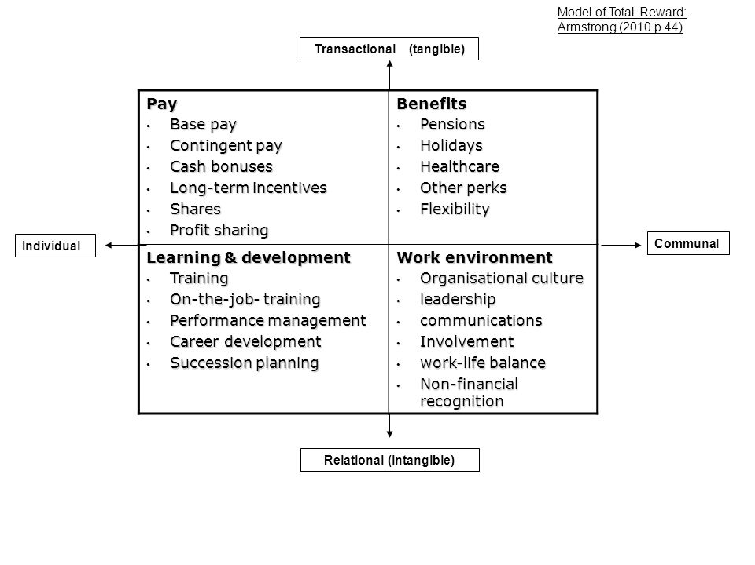
Total reward by Armstrong
HRM PEM SU OPF

Slide 30
Compensation X Reward
HRM PEM SU OPF
Compensation refers to the total package of financial and non-financial benefits that an employee receives in exchange for their work, including base salary, bonuses, benefits, and other forms of pay. Compensation is typically structured according to the job market and the value of the employee's skills and experience.
Rewards are incentives or recognition that are given to employees for their performance or contributions. Rewards can take many forms, including bonuses, promotions, recognition programs, and other non-financial incentives.

Slide 31
Compensation X Reward
HRM PEM SU OPF
Compensation is a key part of the overall employee package, but rewards are a way to motivate and appreciate employees for their contributions over and above their normal duties.
Reward programs are often used to increase employee engagement, encourage high performance, and retain top talent.
While compensation is a fixed package of pay and benefits that an employee receives as part of their job, rewards are additional encouragements that are used to motivate and recognize employees for their performance and contributions.

Slide 32
Purpose of reward
HRM PEM SU OPF
Atraction
Ŕetention
Motiovation
Fairness in reward (CEO / employees, sportstars, popstars, men x women)

Slide 33
Equality in rewarding systems
HRM PEM SU OPF
Equality in rewarding systems refers to the principle of providing equal rewards for equal contributions within an organization. This concept is based on the idea of fairness and impartiality in recognizing and compensating employees.
Features of equal rewarding systém:
1. Fairness: Reward systems are considered equal when they are fair, meaning that they are free from bias, favoritism, or discrimination. Rewards should be based on objective criteria such as performance, effort, skills, or responsibilities rather than on subjective preferences or personal characteristics.
2. Transparency: Equal rewarding systems operate transparently, with clear criteria for what is rewarded and how. Employees should understand what is expected of them and how these expectations tie to the rewards they can receive.
3. Consistency: There should be consistency in the way rewards are distributed. Employees in similar roles with similar achievements and levels of contribution should receive similar rewards.

Slide 34
Equality in rewarding systems
HRM PEM SU OPF
4. Merit-based: Rewards should be based on merit, reflecting the contributions and performance of the employees. The idea is to reward employees proportionately to the value they bring to the organization.
5. Non-Discriminatory: Equality in rewarding systems ensures that all employees, regardless of gender, race, age, disability, or any other personal characteristic, have equal access to rewards for comparable work.
6. Compliance with Laws and Standards: The system should comply with all relevant laws and ethical standards, including equal pay for equal work and other labor and anti-discrimination laws.
7. Aligned with Organizational Goals: Reward systems should align with the overall goals and values of the organization. This means that the rewards should support the organization's strategy by incentivizing behaviors and outcomes that advance its objectives.

Slide 35
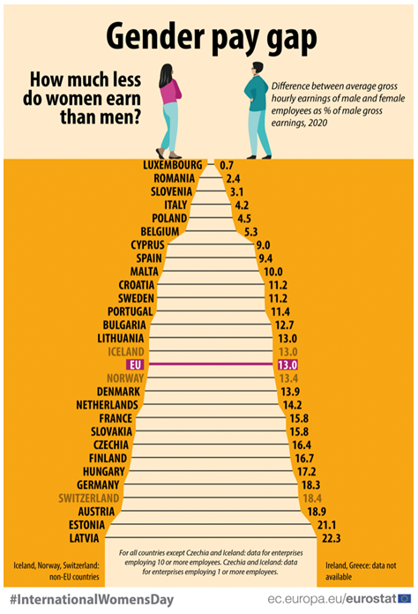
Fairness
HRM PEM SU OPF

Slide 36
Rewarding forms
HRM PEM SU OPF
Financial Rewards X Non-Financial Rewards
Extrinsic Rewards X Intrinsic Rewards
external resources - internal(sense of accomp., perso-
physical items nal satisfaction

Slide 37
Componenets of rewarding forms
HRM PEM SU OPF
Monetary Rewards:
Salary: The basic compensation an employee receives for their work.
Bonuses: Additional compensation awarded for meeting or exceeding certain goals or for exceptional performance.
Commissions: Earnings linked directly to the amount of sales or revenue an employee generates.
Profit Sharing: A system where employees receive a share of the company's profits, usually distributed annually or quarterly.

Slide 38
Componenets of rewarding forms
HRM PEM SU OPF
Benefits:
Health Insurance: Medical, dental, and vision plans.
Retirement Plans: Such as 401(k) plans in the U.S. or pension schemes.
paid Time Off: Including vacation days, personal days, and sick leave.
Life and Disability Insurance: Coverage for unforeseen life events impacting the employee’s ability to work.

Slide 39
Componenets of rewarding forms
HRM PEM SU OPF
Non-Monetary Rewards:
Recognition Programs: Employee of the month, service awards, or public acknowledgments.
Professional Development: Training, courses, workshops, and seminars that enhance an employee’s skills and value.
Career Advancement Opportunities: Promotions or internal mobility options that provide a path for growth within the company.
Work-Life Balance: Flexible working hours, remote work options, and sabbaticals.

Slide 40
Componenets of rewarding forms
HRM PEM SU OPF
Performance Management:
Appraisals: Regular reviews of employee performance to discuss achievements and areas for improvement.
Feedback Mechanisms: Ongoing communication channels for providing immediate recognition and constructive criticism.
Incentive Plans:
Short-term Incentive Plans: Rewards based on the achievement of specific short-term performance targets.
Long-term Incentive Plans: Rewards such as stock options or deferred compensation plans designed to align employees’ interests with long-term company success.

Slide 41
Componenets of rewarding forms
HRM PEM SU OPF
Perquisites (Perks):
Company Car: Often provided to high-level executives or employees in roles that require extensive travel.
Gym Memberships: To promote health and wellness among employees.
Childcare Assistance: On-site childcare facilities or assistance programs.
Employee Discounts: Special pricing on company products or services.
Social Recognition:
Peer Recognition Programs: Allowing employees to recognize each other's efforts and achievements.
Team-Building Events: Company retreats, holiday parties, or team outings that encourage bonding and morale.
Job Design:
Job Enrichment: Adding variety and more complex tasks to a role to increase job satisfaction.
Job Empowerment: Giving employees more autonomy and control over their work.

Slide 42
Strategic and total reward
HRM PEM SU OPF
There is a range of purposes thet a reward system serves and many aspects of work tha can be considered rewarding.
Priorities of reward policy coresponds with HR strategy.
Total reward
All of the tools available to teh employer that may be used to attract, motivate and retain employees perceives to be a value resulting from the employment relationship.

Slide 43
Effectiveness of a reward system
HRM PEM SU OPF
Combintion of quantitative and qualitative metrics
Aim of measure: how well the reward system is influencing job satisfaction, performance, and turnover rates, among other factors
Job satisfaction (surveys and questionnaires, exit interviews)
Performance (performance metrics, 360-degree feedback, KPI)
Turnover rates (turnover rate analysis, voluntary turnover)
Additional tools and metrics (cost-benefit analysis, engagement scores)

Slide 44
TASK 1 – REWARDS THROUGHT THE GENERATIONS
HRM PEM SU OPF
Case study
Team work
Theory + practise

Slide 45
PERSONALISTIKA PEM SU OPF
Thank you
for your attention.
Děkuji vám za pozornost, přeji příjemný den.

