Slide 1

HUMAN RESOURCE MANAGEMENT
Lesson 2
HRM – significance, developement, functions
Ing. Helena Marková, Ph.D.

Slide 2
Experts from practice - topics
PERSONALISTIKA PEM SU OPF
11.3. Leadership. Multigenerational leadership.
Presenter: Kostas Zervas, Kyndryl, IBM division
15.4. Remote & Hybrid work and its influence on company culture.
Presenter: Michal Křemen, HR manager Tieto Evry
22.4. Performance management and motivation
Presenter: Kostas Zervas, Kyndryl, IBM division

Slide 3
Content
PERSONALISTIKA PEM SU OPF
personnel management,
human resource management,
personalities of management and personnel management history
diffencies of personal and human resource management
geographical differencies of the developement ant their reasons

Slide 4
Developement of HRM
HRM PEM SU OPF
The emergence of industrial relations and personnel management
Late 19th century to 1920
Connected with the need of improvement of working condition and need of higher efficiency
Labour movements across the newly indistrualized world
Typical conditions: working hours, child labour, improved health and safety at work.

Slide 5
Developement of HRM
HRM PEM SU OPF
Key influencers:
Frederick W. Taylor (1856–1915): Father of Scientific Management. Studied workflows to increase efficiency—though often criticized for treating workers like cogs in a machine.
Max Weber (1864–1920): Proposed bureaucracy as a rational, structured approach to organizing work (clear hierarchy, defined roles).
Fun fact: Imagine a time when the 8-hour workday was considered revolutionary—this era paved the way for many labor laws we take for granted today!

Slide 6
Developement of HRM
HRM PEM SU OPF
How to achieve efficiency?
(notions of bureaucracy, division of labour, Principles of Scientific Management)
Efficiency may be attained through:
The increasing mechanisation of the workplace.
The simplification and routinisation of work.
The extrinsic, out-put related, reward-based motiovation of employees.

Slide 7
Developement of HRM
HRM PEM SU OPF
1st stage - people care (care about employees)
1920 - 30
technical aspect of hiring, evaluating, training, compensating
Taylorism, often referred to as Scientific Management, was the first theory of management to focus specifically on analyzing and optimizing workflows, but then came
conflict of managers and employees – motivation/only money
a human was a part of technological process

Slide 8
Developement of HRM
HRM PEM SU OPF
Growing interest in employee well-being beyond mere wages or efficiency.
Early forms of employee training, basic benefits, and first serious attempts at improving work conditions.
Key Influencers:
Elton Mayo (1880–1949): Led the Hawthorne Experiments, finding that social factors—like feeling valued—boost productivity.
Mary Parker Follett (1868–1933): Pioneered ideas of cooperative leadership and the importance of human interaction in organizations.

Slide 9
The Hawthorne Experiments showed that being observed can itself improve performance—so yes, your study group might work harder if everyone’s watching!
HRM PEM SU OPF
The Hawthorne Effect
1924 - 1933
Hawthorne Experiments at Western Electric originally aimed to study the impact of lighting on worker productivity. Surprisingly, social and psychological factors (feeling recognized, attention from management, group relationships) proved more influential than physical conditions. This became known as the Hawthorne Effect, where the mere awareness of being observed can boost performance.

Slide 10
Developement of HRM
HRM PEM SU OPF
The Hawthorne Effect
https://www.youtube.com/watch?v=o4XX90lqT6E
Where did the Hawthorne experiments take place, and when did they occur?
What was the original goal of the Hawthorne experiments?
Which factor turned out to be more important than physical conditions in influencing productivity?
Why are the Hawthorne experiments still relevant in management and HR today?

Slide 11
Developement of HRM
HRM PEM SU OPF
2nd stage
Personnel administration
explosion of academic research in psychology, anthropology and sociology
human realtions movement
rise of behaviourial, psychological and emotional perspective
divided into processes, technical background is still important

Slide 12
Developement of HRM
HRM PEM SU OPF
3rd stage (1940s – 50s)
Personnel management – developement
specific social needs of a person
comprehensive plans for personal and social development
personnel management (not just administration )
corporate management was both operational and tactical

Slide 13
Developement of HRM
HRM PEM SU OPF
Key Influencers:
Abraham Maslow (1908–1970): Proposed the Hierarchy of Needs, suggesting that people are motivated by a progression of needs—from basics like safety to self-actualization.
Douglas McGregor (1906–1964): Introduced Theory X and Theory Y, reshaping how managers view and motivate employees (strict oversight vs. empowerment).
Fun fact:
Maslow’s pyramid is almost a pop-culture icon now—look out for memes about “Wi-Fi” or “phone battery” sneaking onto the hierarchy of needs!s both operational and tactical

Slide 14
Developement of HRM
HRM PEM SU OPF
4th stage (1960s – 70s)
Personnel management – maturity
Companies become more aware of organizational culture, employee satisfaction, and social dynamics at work.
Expanding personnel management with formal programs for talent development, employee relations, and organizational communication.
corporate management was both operational and tactical
employees as a part of the system, increasing role of education, HR generally

Slide 15
Developement of HRM
HRM PEM SU OPF
4th stage (1960s – 70s)
Personnel management – maturity
specific social needs of a person
comprehensive plans for personal and social development
personnel management
corporate management was both operational and tactical
employees as a part of the system, increasing role of education, HR generally

Slide 16
Developement of HRM
HRM PEM SU OPF
Key Influencers:
Rensis Likert (1903–1981): Developed management systems focusing on participative groups.
Chris Argyris (1923–2013): Explored how organizational structures can either hinder or foster individual growth.
Fun fact:
This is where the idea of a “team-building retreat” starts to emerge—companies realized that social bonds among employees can enhance performance.

Slide 17
Developement of HRM
HRM PEM SU OPF
5th stage (1980s - )
Human resource managment
more strategies
learning and developing people – learning organization
man was seen as a highly individualized
organized, pro-activeand pro-social system
systems are interconnected and processes build on each other
more oriented towards the external environment of the company

Slide 18
Developement of HRM
HRM PEM SU OPF
Key Influencers:
Peter F. Drucker (1909–2005): While known for broad management theories, he strongly advocated for seeing employees as vital resources and focusing on leadership.
Dave Ulrich (born 1953): Introduced the HR Business Partner model, shifting HR from administrative tasks to a strategic advisory role.
Fun fact:
Today’s HR pros often leverage AI for tasks like recruiting and performance analysis.

Slide 19
Developement of HRM
HRM PEM SU OPF
It developed differently in the world.
It differes geographically.
Discuss:
What are the reasons of geogr. differencies of the HRM developement?
Find some examples.

Slide 20
Key differencies
HRM PEM SU OPF
Personnel Management Human Resource Manag.
employee focused business partner
operational, administrative strategic
reactive proactive
fragmental,ad hoc integrated, coordinated
policies and practises policies and practises
focus on performance focus on added value measurment

Slide 21
Hard x soft HRM
HRM PEM SU OPF
Hard HRM
emphasises on the efficient utilisation of the workforce
employees are the source to achieve organisational goals
Soft HRM
people management practises and activities to gain commitment of employees „emotionaly“ – you want to do that because you believe it…

Slide 22
Hard x soft HRM
HRM PEM SU OPF
Hard HRM Soft HRM
Employees are a resource …they are a source of
utilized competitive advantage
Deployment Developement
Control Commitment
Direction Involvement
Rigidity Flexibility
Performance measurement Performance enabling

Slide 23
Common HR activities
HRM PEM SU OPF

Slide 24
The pillars of HRM
HRM PEM SU OPF
Company culture
Philosophy
HRM Strategy
Policies and procedures

Slide 25
Company culture
HRM PEM SU OPF
Company culture is about the climate in the company, about relationships, behaviour towards employees and clients, respect to each other.
It goes throught strategies and policies.
It is based on philosophy (usually of the founder or owner).
Main values of the company.
CSR – what is it? Is it important? Is it what can company culture be built on? Name some rules…

Slide 26
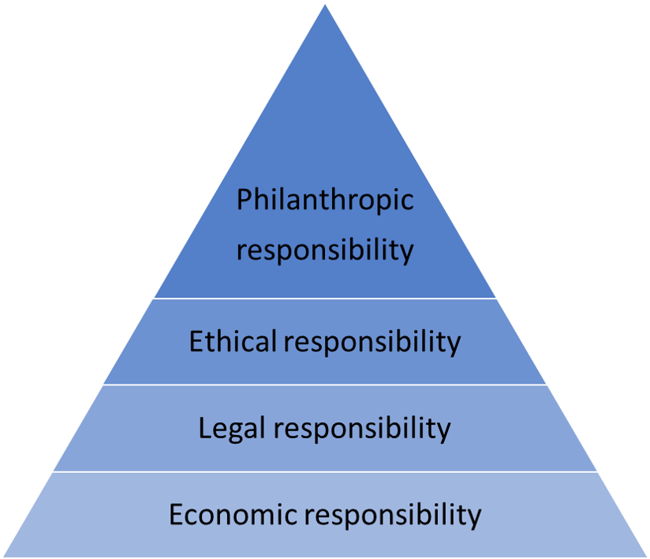
CSR pyramid
HRM PEM SU OPF

Slide 27
CSR in the social area
HRM PEM SU OPF
Social activities of a socially responsible company may include:
philanthropy
communication with stakeholders
strict respect for human rights (holidays, overtime, sick days, benefits, not trying to set a minimum wage saying there are 20 more people waiting outside)
compliance with labour standards
https://digitalmarketinginstitute.com/blog/corporate-16-brands-doing-corporate-social-responsibility-successfully

Slide 28
Sustainability
HRM PEM SU OPF
Sustainablity
enviromental pillar
social pillar
economical pillar
https://www.theguardian.com/technology/2025/feb/05/google-dei-trump

Slide 29
TASK 1
HRM PEM SU OPF
Trip to history (2-point activity)
4 group of students
Search for information about 4 historical personalities of management:
Henri Fayol Frederick W. Taylor
Peter F. Drucker Max Weber
Basic biography
What is their benefit in management, especially HRM?
What is relevant today?
Present it to your co-students.

Slide 30

PERSONALISTIKA PEM SU OPF
Thank you
for your attention.
Děkuji vám za pozornost, přeji příjemný den.

