Slide 1

HUMAN RESOURCE MANAGEMENT
Lesson 8
Strategic and operational HR activities:
Selection.
Ing. Helena Marková, Ph.D.

Slide 2
Common HR activities
HRM PEM SU OPF

Slide 3
Selection
HRM PEM SU OPF
The process of evaluating candidates and selecting the most suitable one for a particular job.

Slide 4
Evaluation methods by KSAO
HRM PEM SU OPF
To evaluate job candidates based on KSAO, you can use various assessment methods, including:
Resumes and Cover Letters: Evaluate candidates' knowledge, skills, and abilities based on their work experience, education, and other relevant qualifications mentioned in their resume and cover letter.
Interviews: Ask candidates questions that assess their knowledge, skills, and abilities. You can ask behavioral interview questions that focus on how they've applied their KSAOs in the past to solve problems or achieve goals.
Skills Assessments and Tests: Use skills assessments and tests to evaluate candidates' knowledge and skills in a particular area. For example, you can use coding tests to assess a candidate's programming skills or a writing test to evaluate their writing ability.

Slide 5
Evaluation methods by KSAO
HRM PEM SU OPF
Reference Checks: Contact a candidate's references to verify their past work experience and performance. Ask questions that assess their knowledge, skills, and abilities.
Simulation Exercises: Ask candidates to perform a simulation exercise that reflects the skills required for the job. For example, if you're hiring a customer service representative, you can ask them to role-play a customer interaction.
Overall, evaluating job candidates based on KSAO can help you identify the most qualified and best-suited candidate for the job. It's important to consider all relevant KSAOs for the job and use a variety of assessment methods to ensure you get a complete picture of the candidate's capabilities.

Slide 6
Why to construct the objective methods
HRM PEM SU OPF
Negative effects of subjective assessment
Biases: Subjective assessments can be influenced by the assessor's personal biases, including their own preferences, stereotypes, or prejudices. These biases can lead to discrimination against certain candidates and can result in less diversity in the workplace.
Inconsistency: Subjective assessments can also be inconsistent across different assessors, leading to a lack of standardization and fairness in the hiring process. Different assessors may have different interpretations of the candidate's skills, abilities, or personality traits, leading to different evaluations of the same candidate.
Legal issues: Subjective assessments that are not based on objective criteria or that are influenced by biases or discrimination can lead to legal issues for the employer. For example, if a candidate believes they were discriminated against in the hiring process, they may file a complaint or lawsuit against the employer.
Overall, subjective assessments of candidates can be unreliable and unfair, and can lead to negative consequences for both the candidates and the employer. It is important for employers to use objective, standardized measures to evaluate candidates based on their KSAOs to ensure that the hiring process is fair, reliable, and legally defensible. – REMIND EMPLOYER BRANDING

Slide 7
Negative effect of subjectivity
HRM PEM SU OPF
Halo effect: The halo effect occurs when an assessor's overall positive impression of a candidate influences their assessment of the candidate's specific qualities or abilities. For example, if an assessor is impressed by a candidate's appearance, they may rate the candidate more highly on other qualities, such as intelligence or work ethic, even if there is no evidence to support this assessment.
Similarity effect: The similarity effect occurs when an assessor favors candidates who are similar to themselves or who share similar characteristics or backgrounds. For example, an assessor may be more likely to favor a candidate who went to the same school or grew up in the same neighborhood.
Beautyism: Beautyism, also known as the "what is beautiful is good" stereotype, is the tendency to attribute positive qualities to attractive people. In the context of hiring, this can lead to biased assessments of candidates based on their appearance rather than their qualifications or KSAOs.

Slide 8
Negative effect of subjectivity
HRM PEM SU OPF
All these effect we call
IDIOSYNCRATIC RATING TENDENCIES
biases in perception of canditates
they can make around 60 percent of subjective rating of candidates
That why the main aspects of selection methods are
reliability and validity.

Slide 9
Assesment techniques
HRM PEM SU OPF
Early-stage techniques
the main goal is to reduce the number of candidates
CVs
Application forms
ATS – Applicant tracking Systems

Slide 10
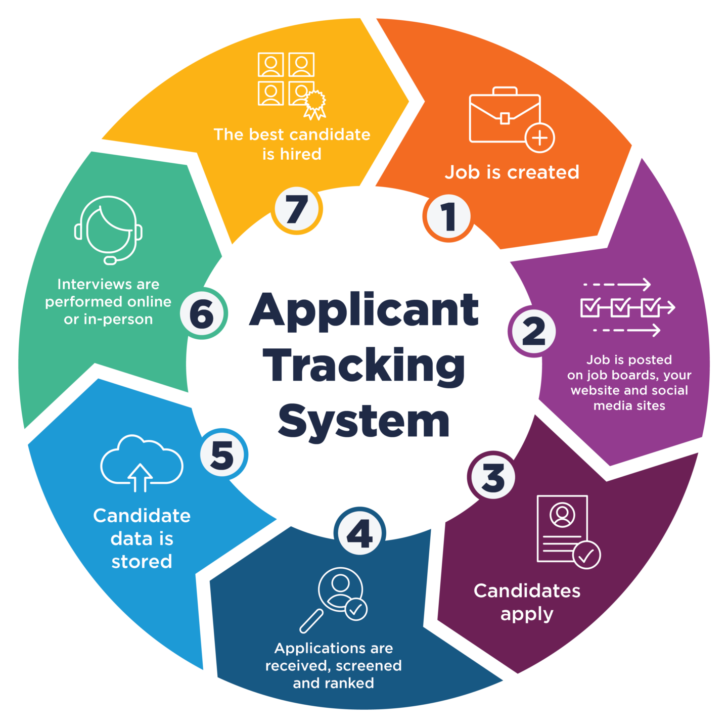
ATS – the process
HRM PEM SU OPF

Slide 11
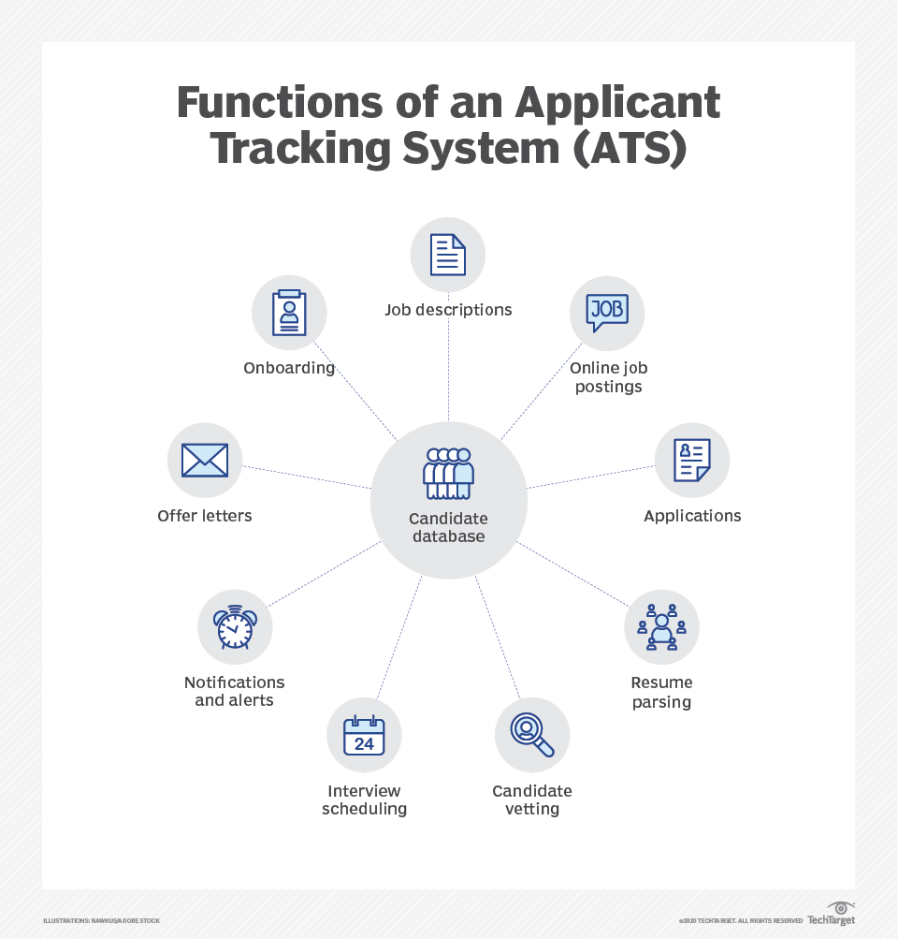
ATS
HRM PEM SU OPF

Slide 12
Assesment techniques
HRM PEM SU OPF
Mid-stage techniques
Psychometric tools are standardized assessments that measure an individual's abilities, skills, personality traits, and other psychological attributes.
There are several psychometric tools that employers can use to assess job candidates:

Slide 13
Psychometric tools
HRM PEM SU OPF
Cognitive Ability Tests: Cognitive ability tests measure a candidate's mental abilities, including their problem-solving, reasoning, and critical thinking skills. These tests can be used to assess a candidate's potential to perform well in the job.
Personality Assessments: Personality assessments measure a candidate's personality traits, such as their level of extroversion, emotional stability, and openness to experience. These assessments can help employers determine if a candidate's personality is a good fit for the job and the organizational culture.

Slide 14
Psychometric tools
HRM PEM SU OPF
Situational Judgment Tests: Situational judgment tests measure a candidate's ability to make decisions in specific job-related situations. These tests present candidates with hypothetical scenarios and ask them to choose the best course of action.
Interest Inventories: Interest inventories measure a candidate's interests and preferences related to the job. These assessments can help employers determine if a candidate is motivated and engaged in the work.

Slide 15
Psychometric tools
HRM PEM SU OPF
Behavioral Assessments: Behavioral assessments measure a candidate's behaviors and motivations in specific job-related situations. These assessments can help employers predict how a candidate will behave on the job and how well they will fit with the team and the organizational culture.

Slide 16
Psychometric tools
HRM PEM SU OPF
How to prepare behavioral interview
S.T.A.R. is a useful acronym and an effective formula for structuring your behavioral interview response. Let’s start by breaking down the formula:
Situation (20%), explain the situation so that your interviewer understands the context of your example, they do not need to know every detail!
Task (10%), talk about the task that you took responsibility for completing or the goal of your efforts.
Action (60%), describe the actions that you personally took to complete the task or reach the end goal. Highlight skills or character traits addressed in the question.
Result (10%), explain the positive outcomes or results generated by your actions or efforts. Here, it is important to highlight quantifiable results. You may also want to emphasize what you learned from the experience or your key takeaways.

Slide 17
Psychometric tools
HRM PEM SU OPF
How to prepare behavioral interview
S.T.A.R.
https://www.tiktok.com/@careervidz/video/7441170090483043617

Slide 18
Task 1 – Choose 1, use STAR, answer
HRM PEM SU OPF
Typical questions
Give me an example of a time you had a conflict with a team member. How did you handle it?
Tell me about a time you made a mistake at work. How did you resolve the problem, and what did you learn from your mistake?
Describe an occasion when you failed at a task. What did you learn from it?
Describe a time when you used your leadership skills to motivate your team or colleagues.
Share an example of a (career) goal you had. What steps did you take to achieve it?

Slide 19
Task 1 – Choose 1, use STAR, answer
HRM PEM SU OPF
Read more
https://www.indeed.com/career-advice/interviewing/behavioral-interview-questions

Slide 20
Psychometric tools
HRM PEM SU OPF
By using psychometric tools, employers can gain a more objective and comprehensive assessment of job candidates, beyond their resumes, interviews, and references.
These tools can help employers identify the most qualified and best-suited candidates for the job and reduce the influence of personal biases and subjective assessments.

Slide 21
Assesment techniques
HRM PEM SU OPF
Late-stage techniques
Late-stage techniques of assessment are used to evaluate job candidates during the final stages of the hiring process, usually after the initial screening and interviewing stages.
These techniques are designed to provide employers with a more detailed and comprehensive assessment of the candidate's abilities, skills, and potential for success on the job.

Slide 22
Assesment techniques – late-stage
HRM PEM SU OPF
Some examples of late-stage assessment techniques include:
Assessment Centers: Assessment centers are a type of group evaluation where candidates are put through a series of job-related exercises, such as role-plays, simulations, case studies, and presentations. These exercises are designed to assess a candidate's skills, abilities, and behaviors in specific job-related situations. Assessment centers are often used for managerial or leadership positions.
Job Simulations: Job simulations are simulations of the actual job that a candidate would be performing if hired. These simulations can include a range of tasks, such as responding to customer inquiries, completing technical tasks, or managing a team. Job simulations can provide a realistic and objective assessment of a candidate's abilities and potential for success on the job.

Slide 23
Assessment techniques – late-stage
HRM PEM SU OPF
Reference Checks: Reference checks involve contacting a candidate's former employers, colleagues, or other references to gather information about their past performance, work habits, and personal qualities. Reference checks can provide valuable insights into a candidate's strengths and weaknesses and can help verify their qualifications and experience.
Background Checks: Background checks involve conducting a thorough review of a candidate's criminal record, education, employment history, and other relevant information. Background checks can help ensure that a candidate is qualified and suitable for the position and can reduce the risk of legal or reputational issues for the employer.

Slide 24
Assessment techniques – late-stage
HRM PEM SU OPF
Interview
Interviews are a common technique used to assess job candidates and are typically conducted during the early to late-stages of the hiring process.
Interviews can be structured or unstructured, and can be conducted in person, over the phone, or via video conference. Interviews can provide employers with an opportunity to evaluate a candidate's communication skills, personality, and cultural fit.

Slide 25
Assessment techniques – late-stage
HRM PEM SU OPF
Interview - limitation
Interviewer Bias: Interviewers may be influenced by their own personal biases.
Candidate Bias: Candidates may present themselves in a certain way during the interview, which may not be a true representation of their actual abilities or behaviors on the job.
Lack of Standardization: Unstructured interviews can make it difficult to compare candidates and make objective hiring decisions.
Limited Information: Interviews may only provide a limited amount of information about a candidate's abilities, skills, and potential for success on the job.

Slide 26
Assessment techniques – late-stage
HRM PEM SU OPF
By using these late-stage assessment techniques, employers can gain a more comprehensive and objective assessment of job candidates and make more informed hiring decisions.
These techniques can help identify the best-suited candidates for the job and reduce the risk of hiring mistakes or turnover.

Slide 27
TASK 2 – How to prepare for an interview
HRM PEM SU OPF
as an employer (HR specialist…imagine, you are)
as an candidate (you apply for your dream job)
Discuss your ideas

Slide 28
Measure if hiring is succesful
HRM PEM SU OPF
By measuring these metrics, employers can assess the effectiveness and efficiency of the hiring process, identify areas for improvement, and make data-driven decisions to enhance the quality of their hires and the overall success of the hiring process..
Time-to-Fill: This metric measures the amount of time it takes to fill a job opening from the time it is posted to the time an offer is accepted. A shorter time-to-fill indicates a more efficient and effective hiring process.
Cost-per-Hire: This metric measures the total cost of the hiring process, including advertising, recruiting, interviewing, and other expenses, divided by the number of hires made. A lower cost-per-hire indicates a more cost-effective hiring process.

Slide 29
Measure if hiring is succesful
HRM PEM SU OPF
Quality-of-Hire: This metric measures the performance and retention of new hires over time. A higher quality-of-hire indicates that the hiring process was successful in identifying and selecting high-performing candidates who are a good fit for the job and the organization.
Diversity and Inclusion: This metric measures the diversity and inclusion of the candidate pool and hires made. A more diverse and inclusive hiring process can lead to a more diverse and inclusive workforce, which can enhance creativity, innovation, and overall performance.
Candidate Experience: This metric measures the satisfaction and engagement of candidates with the hiring process. A positive candidate experience can enhance the employer brand and attract more qualified candidates in the future.

Slide 30

PERSONALISTIKA PEM SU OPF
Thank you
for your attention.
Děkuji vám za pozornost, přeji příjemný den.

