Slide 1
Methods and techniques used in innovation management
Ing. Žaneta Rylková, Ph.D.

Slide 2
Content
Methods of creative thinking
Methods for problem analysis
Main categories of factors (causes) that affect the outcome.
Methods and techniques for identifying customer needs
Methods and techniques for assessing topics and understanding problems

Slide 3
Methods of creative thinking
Analogy
Gordon's method
Brainstorming
Brainwriting
Discussion 66

Slide 4
Methods of creative thinking
Analogy - Comparing two different things that are essentially different, but we can find common features
Gordon's method - based on analogy, the real problem is not defined but the general problem, after a number of ideas a real problem is revealed

Slide 5
Gordon´s method
Convicted experts discuss the issue;
The leader of the discussion only sets out the general theme;
Gradually, the subject narrows (specifies) the problem.

Slide 6
Brainstorming
Beginnings: 50s of the last century in the US as a way of improving the unsatisfactory course of meetings and committee meetings.
Purpose: Within a short timeframe, get the most (quantity) of ideas, thoughts, opinions, ideas, etc. from the group of people on the setted topic (problem, goal).

Slide 7
Rules for brainstorming
Criticism is ruled out (it is necessary to ensure that the evaluation does not occur immediately);
Free associations are welcome (suggest every idea that comes to mind);
Quantitation is desirable (the more ideas, the more likely that a good and useful idea will be between them);
Combination and improvement of designs are desirable.

Slide 8
THREE STEPS NEITHER FOR BRAINSTORMING
Brainstorming session preparation;
Realization of brainstorming session;
Evaluation and use of results.

Slide 9
Seating preparation
Set the topic (general - complex ideas, more specific - clear and more precise solutions);
Specify the size and composition of the group (6-12, subtopics, moderator, recorder, independent experts, without superiority and subordination);
Determine when and where it will be (pleasant environment, U, morning hours, max 50 minutes).

Slide 10
Realization of the session
Let's recall the rules first;
Specify topic and objectives of the session;
Plot logos (blackboard, flip-chart);
Structured and unstructured form;
The moderator can support and encourage activity, not actively involved.

Slide 11
Evaluation and use of results
Grouping of subjects by context;
Evaluation using the XY point allocation, multi-vote, etc .;
A great deal of ideas in a short time;
Unexpected and better ways to find solutions.

Slide 12
When to use? What is the vision of our organization? What do we have to do to achieve the vision? How can we shorten delivery dates for products? How can we improve cooperation between the financial and personnel departments? How can we reduce the number of bugs in documents? What are the reasons for ineffective negotiations? How can we improve the process?

Slide 13
Brainwriting
Modification of brainstorming;
Suggested solutions on a sheet of paper;
Proposals are being read and complementing new.

Slide 14
Brainwriting

Slide 15
Discussion 66
Generating new ideas;
6 members of the team discuss 6 minutes to solve the problem;
The analysis and synthesis of the discussion results and the final formulation of the solution;
Usable especially for dealing with nonstandard problems (in the framework of working meetings).

Slide 16
Methods for problem analysis
They use both creative and analytical thinking;
Most organizational problems have more than one cause;
The more alternatives are judged, the better the proposed solution will be;
Diagram of causes and consequences;
Six-words chart.

Slide 17
Diagram of Causes and Consequences
Beginnings: Kaoru Ishikawa; 50s of the last century; To solve problems related to quality.
Purpose: When analyzing a problem or a situation where the causes (factors) that negatively or positively affect the outcome (result, effect) are identified.

Slide 18
Diagram of Causes and Consequences
Ishikawa diagram (Cause-Effect diagram) - "fish bone" diagram;
It shows the relationships between the result and all the factors that we assume the result affects;
We are looking for all the factors - we identify the key.

Slide 19
Compile a diagram
Clearly and specifically, we define the result (result) that we will analyze;
We will identify and record in the diagram the main category of factors (causes) that affect the outcome.
We determine the factors and sub-factors in each major category of factors.
We identify key (root) causes.
We will prioritize the list of key causes.

Slide 20
We define the consequence (result) that we will analyze
Positive determination - the objective to be achieved, we are looking for factors that will enable us to achieve our goals;
Negative determination - a problem that has occurred or can occur. We are looking for causes to take preventive measures;
Set it as specific as possible!
In the diagram place the fish head on the right side.

Slide 22
The main categories of factors (causes) that affect the outcome.
4M;
4P;
Shewhart's Concept of Process;
7S according to McKinsey.

Slide 23
4M | 4P | Shewhart´s Concept | McKinsleye 7S
Methods – metody | Policies – politika | Machines | Strategy – strategie
Manpower – zaměstnanci | Procedures – postupy | Methods | Structure – struktura
Materials -materiál | People – zaměstnanci | Environment | Management system – systém řízení
Machinery - technika | Plant – výrobní závod | Material | Styl of management – styl řízení
 |  | Measurement | Staff – spolupracovníci
 |  | People | Skill – schopnosti
 |  |  | Shared values – sdílené hodnoty

Slide 24
We determine the factors and sub-factors in each major category of factors
You can use some of the ideas-making methods;
The same cause can be identified in several major categories;
It is done until all possibilities and ideas have been exhausted;
letting the suggestions on the chart before proceeding to work "to settle".

Slide 25
We identify key (root) causes
The location of the cause in the diagram is not an indication of its meaning;
The most common causes, which need not be discussed further, and specific corrective or preventive measures can be proposed for their removal.

Slide 26
We will prioritize the list of key causes
Selection of the three most important;
Factor value determination;
Each team member must justify his / her assessment.

Slide 27
Six-words diagram
"I keep six honest serving men, They taught me all I knew; Their names are What and Why and When, And How and Where and Who.."
Rudyard Kipling

Slide 28
Six Questions
One of the most generic and most effective analytical methods;
Other Names - Six Servants;
Sometimes referred to 5W + 1H (who, what, where, when, why, how).

Slide 29
Variations of questions
Who - identifying the entities concerned;
What - determination of affected subjects, objects, entities etc .;
When - determining time aspects;
Where - spatial location of the problem, spatial aspects;
How - identifying actions, processes, mechanisms, ways of functioning, etc .;
Why - Identify causes, reasons, purposes,

Slide 30
Another alternative
What is and what is not a problem?
When does the problem occur and when does not it occur?
Why does the problem occur and why does not it happen?
Where does the problem occur and where does it not happen?
Who causes the problem and who contributes to solving it?
How do we find out that the problem has occurred and how do we know it did not happen?

Slide 31
Pareto diagram
Beginnings: At the beginning of the last century, Italian economist Vilfredo Pareto found that 80% of the national income accounts for 20% of the population.
Purpose: Set priorities for improvement or problem solving.

Slide 32
Pareto diagram
It allows to identify 20% of the factors that cause 80% of the consequences;
Solutions of these causes will ensure optimal improvement;
It provides clarity and unambiguous information.

Slide 33
Pareto diagram in four steps
We will define and clearly describe the consequence (problem, consequence, disagreement) and causes of its origin (Ishikawa's diagram, brainstorming, etc.).
Example: In an organization, a large number of documents are approved late or are not issued as planned. The main causes of this condition were identified by brainstorming.

Slide 34
We will determine the criterion on which the analyzed causes (disagreements, problems) will be evaluated (eg number of occurrences, financial value - costs, losses - scoring methods, etc.)
Example: As an assessment criterion, the frequency of occurrence was determined in absolute terms. It is necessary to set a time horizon for detection of occurrence.

Slide 35
We will compile a table
On the basis of the set criterion, the causes found in the table are downwardly;
We calculate cumulative frequency and relative cumulative frequency (%)
Relative cumulative frequency = decisive minority of causes.

Slide 36
We draw a diagram
Horizontal axis - types of causes in the same order as in the table;
Left vertical axis - absolute frequencies;
Right vertical axis - relative cumulative frequencies;
At the endpoints of the intervals of the different types of causes, their relative cumulative frequency is indicated, the linkage of which is the so-called Lorenz curve.

Slide 38
Methods and techniques for identifying customer needs
An empatic map (what does he or she think about and how he or she feels in the context, what he or she does, tells and how he or she behaves, how he or she sees what he or she will get from it)

Slide 39
Methods and techniques for identifying customer needs

Slide 40
Methods and techniques for assessing topics and understanding problems
Analysis of field forces
Current state - where are we? (driving forces, braking forces)
Target status - where do we want to be?
Delphic method - questioning experts, do not communicate directly, the goal is to predict the development
Mind maps - a general tool for viewing the problem
Six thought hats

Slide 41
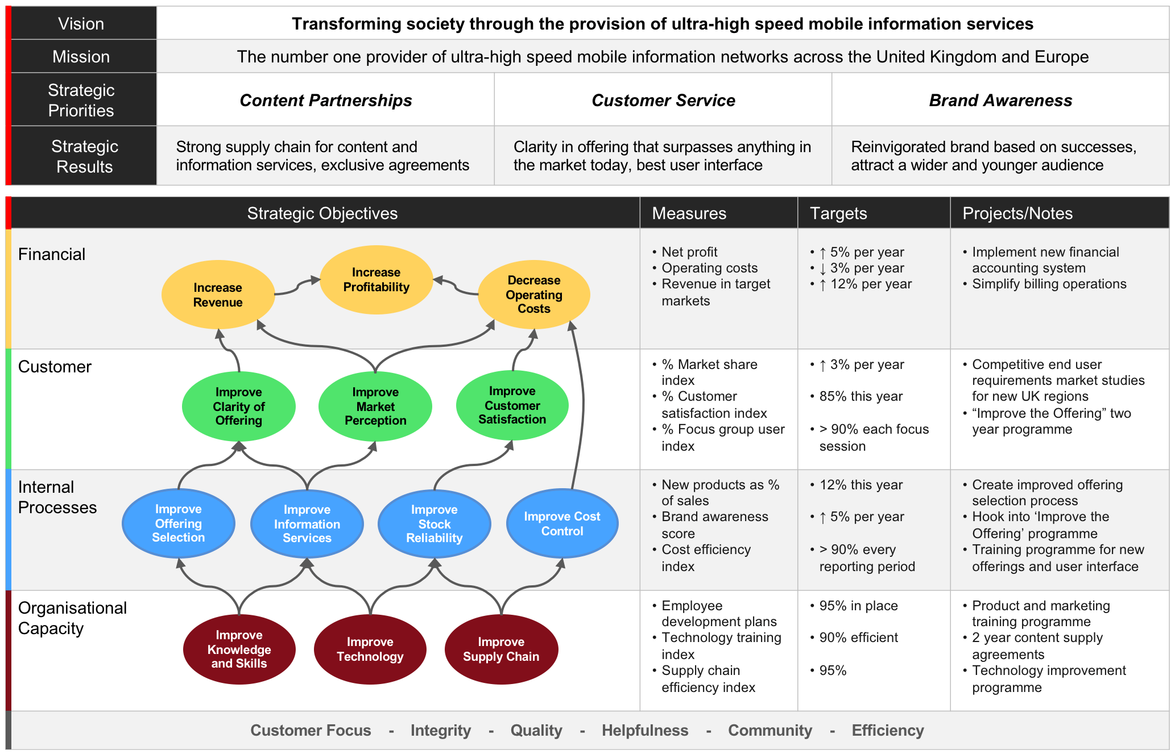
Methods and techniques for assessing topics and understanding problems

Slide 42
Methods and techniques for assessing topics and understanding problems

