Slide 1
Statistics
Lecture 10
Hypothesis testing:
Non-parametric tests
David Bartl
Statistics
INM/BASTA

Slide 2
About statistical hypothesis testing:
Parametric and Non-parametric tests
Sign test for the median
Pearson’s χ²-test for the goodness of fit
χ²-test of independence of qualitative data items

Slide 3
About statistical hypothesis testing
Parametric and Non-parametric tests

Slide 4
Parametric and Non-parametric tests
There are two large classes of statistical tests: parametric and non-parametric.
The parametric tests make assumptions about the probability distributions
of the random variables that are subject to the test. It is often assumed that
the underlying distribution is normal (Gaussian).
The non-parametric tests do not make such assumptions. The non-parametric tests can be used if the random variables are not normally distributed.

Slide 5
Sign test for the median
Sign test for the median
Paired sign test for
the difference of the medians

Slide 6
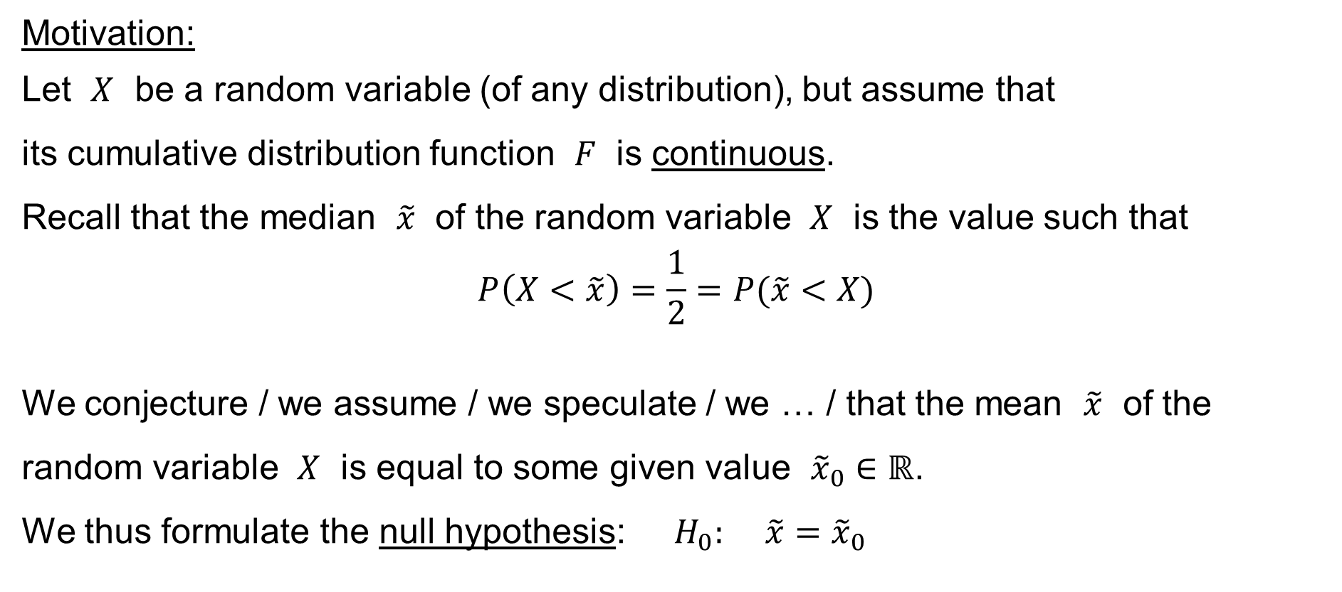
Sign test for the median
Motivation:
Let $X$ be a random variable (of any distribution), but assume that
its cumulative distribution function $F$ is continuous.
Recall that the median $\tilde{x}$ of the random variable $X$ is the value such that
$$P\left(X<\tilde{x}\right)=\frac{1}{2}=P(\tilde{x}<X)$$
We conjecture / we assume / we speculate / we … / that the mean $\tilde{x}$ of the random variable $X$ is equal to some given value ${\tilde{x}}_{0}∈ℝ$.
We thus formulate the null hypothesis: $H_{0}: \tilde{x}={\tilde{x}}_{0}$

Slide 7
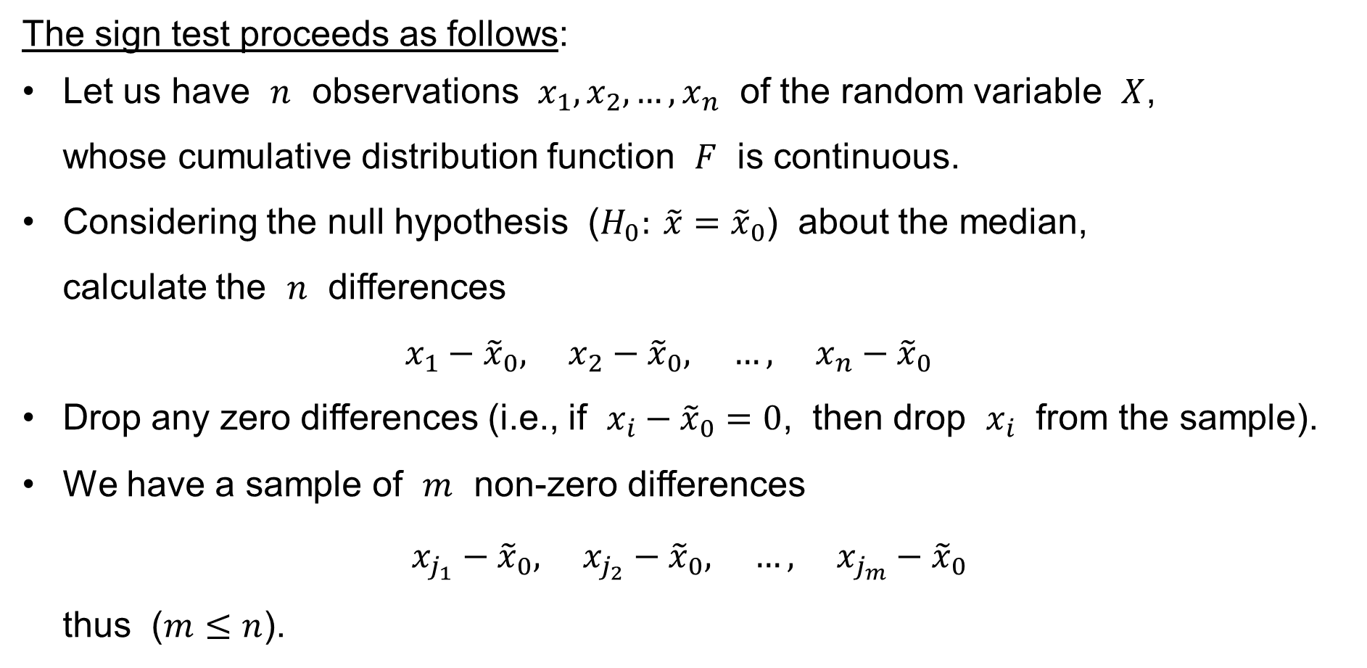
Sign test for the median
The sign test proceeds as follows:
Let us have $n$ observations $x_{1},x_{2},…,x_{n}$ of the random variable $X$,
whose cumulative distribution function $F$ is continuous.
Considering the null hypothesis ($H_{0}: \tilde{x}={\tilde{x}}_{0}$) about the median,
calculate the $n$ differences
$x_{1}−{\tilde{x}}_{0}, x_{2}−{\tilde{x}}_{0}, …, x_{n}−{\tilde{x}}_{0}$
Drop any zero differences (i.e., if $x_{i}−{\tilde{x}}_{0}=0$, then drop $x_{i}$ from the sample).
We have a sample of $m$ non-zero differences
$x_{j_{1}}−{\tilde{x}}_{0}, x_{j_{2}}−{\tilde{x}}_{0}, …, x_{j_{m}}−{\tilde{x}}_{0}$
thus ($m≤n$).

Slide 8
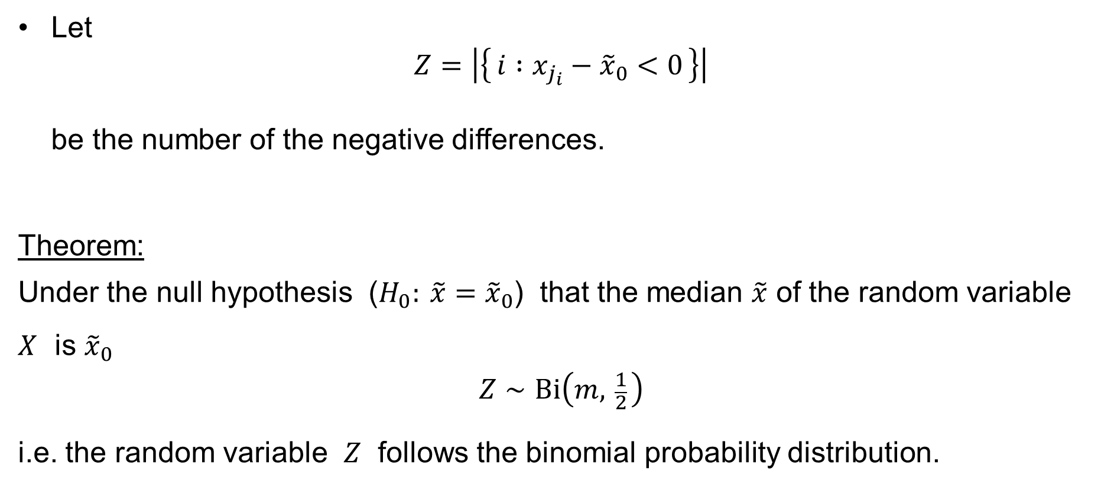
Sign test for the median
Let
$Z=\left|\left\{ i :x_{j_{i}}−{\tilde{x}}_{0}<0 \right\}\right|$
be the number of the negative differences.
Theorem:
Under the null hypothesis ($H_{0}: \tilde{x}={\tilde{x}}_{0}$) that the median $\tilde{x}$ of the random variable $X$ is ${\tilde{x}}_{0}$
$$Z∼Bi\left(m, \frac{1}{2} \right)$$
i.e. the random variable $Z$ follows the binomial probability distribution.

Slide 9
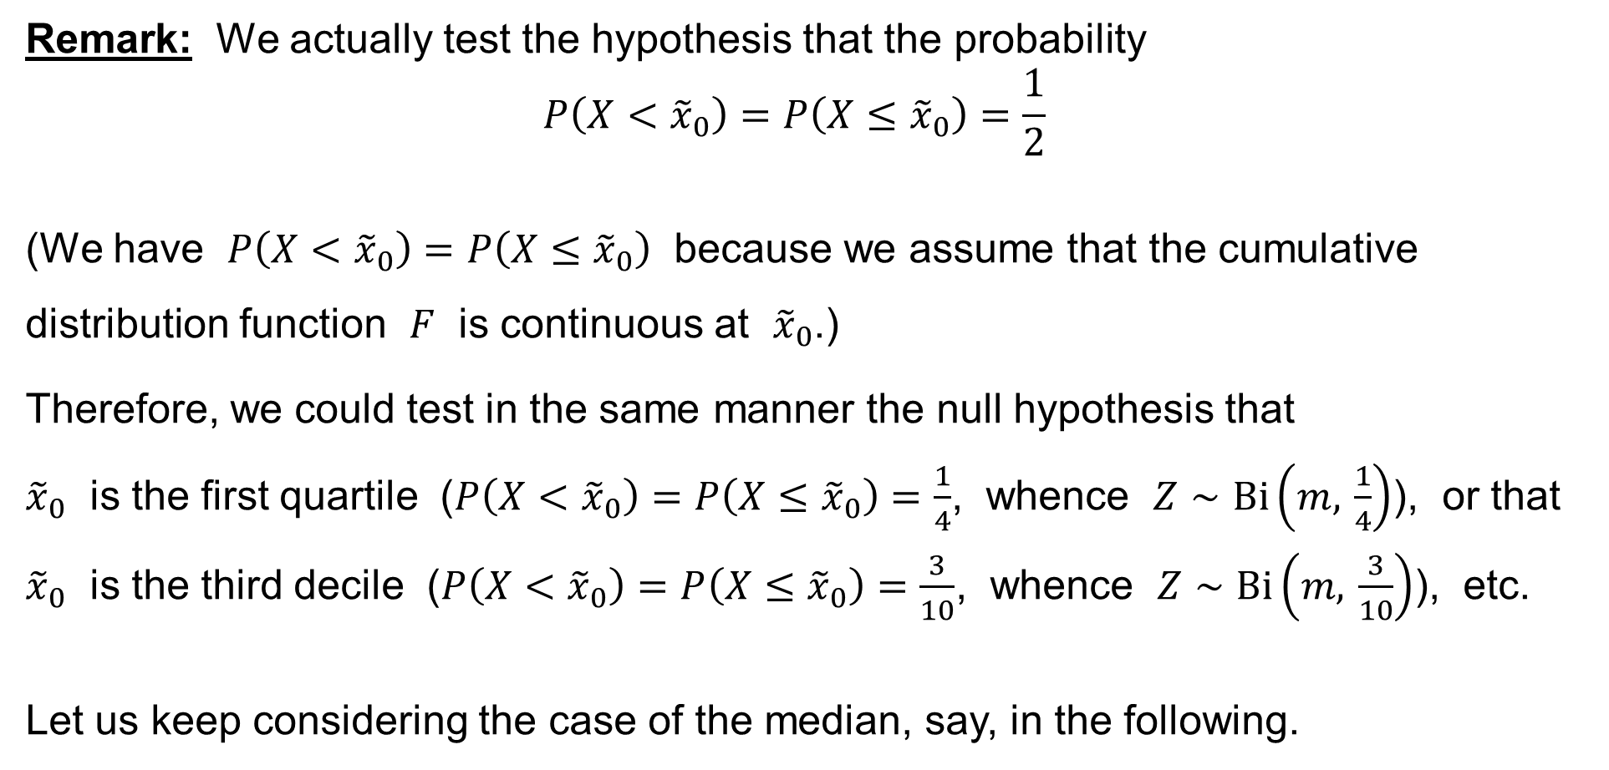
Sign test for the median
Remark: We actually test the hypothesis that the probability
$$P\left(X<{\tilde{x}}_{0}\right)=P\left(X≤{\tilde{x}}_{0}\right)=\frac{1}{2}$$
(We have $P\left(X<{\tilde{x}}_{0}\right)=P\left(X≤{\tilde{x}}_{0}\right)$ because we assume that the cumulative distribution function $F$ is continuous at ${\tilde{x}}_{0}$.)
Therefore, we could test in the same manner the null hypothesis that
${\tilde{x}}_{0}$ is the first quartile ($P\left(X<{\tilde{x}}_{0}\right)=P\left(X≤{\tilde{x}}_{0}\right)=\frac{1}{4}$, whence $Z∼Bi\left(m, \frac{1}{4}\right)$), or that
${\tilde{x}}_{0}$ is the third decile ($P\left(X<{\tilde{x}}_{0}\right)=P\left(X≤{\tilde{x}}_{0}\right)=\frac{3}{10}$, whence $Z∼Bi\left(m, \frac{3}{10}\right)$), etc.
Let us keep considering the case of the median, say, in the following.

Slide 10
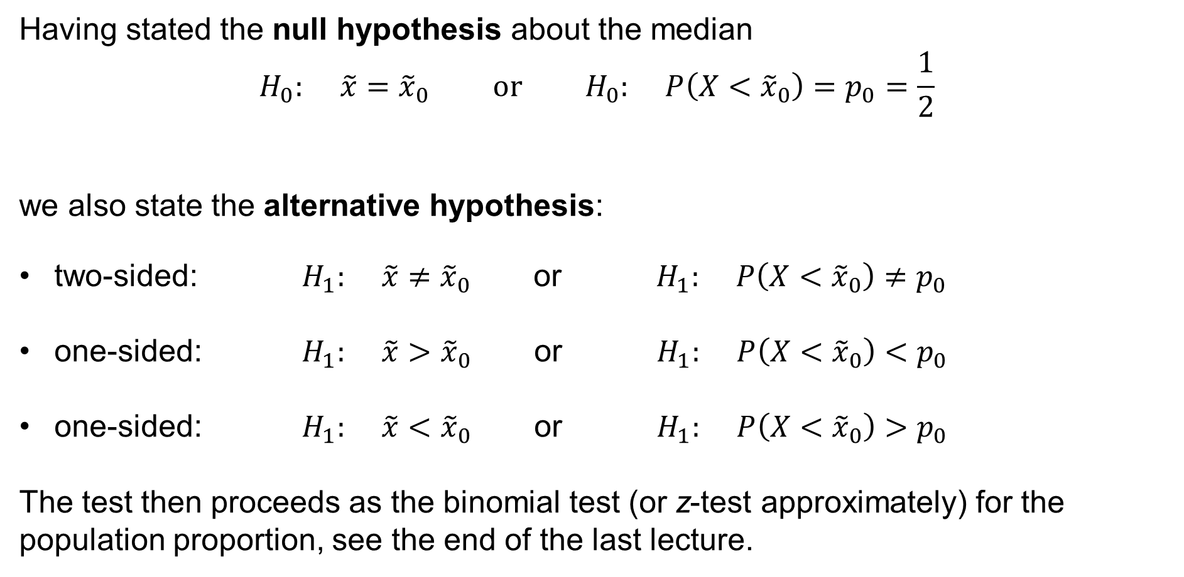
Sign test for the median
Having stated the null hypothesis about the median
$$H_{0}: \tilde{x}={\tilde{x}}_{0} \text{or} H_{0}: P\left(X<{\tilde{x}}_{0}\right)=p_{0}=\frac{1}{2}$$
we also state the alternative hypothesis:
two-sided: $H_{1}: \tilde{x}≠{\tilde{x}}_{0}$ or $H_{1}: P\left(X<{\tilde{x}}_{0}\right)≠p_{0}$
one-sided: $H_{1}: \tilde{x}>{\tilde{x}}_{0}$ or $H_{1}: P\left(X<{\tilde{x}}_{0}\right)<p_{0}$
one-sided: $H_{1}: \tilde{x}<{\tilde{x}}_{0}$ or $H_{1}: P\left(X<{\tilde{x}}_{0}\right)>p_{0}$
The test then proceeds as the binomial test (or z-test approximately) for the population proportion, see the end of the last lecture.

Slide 11
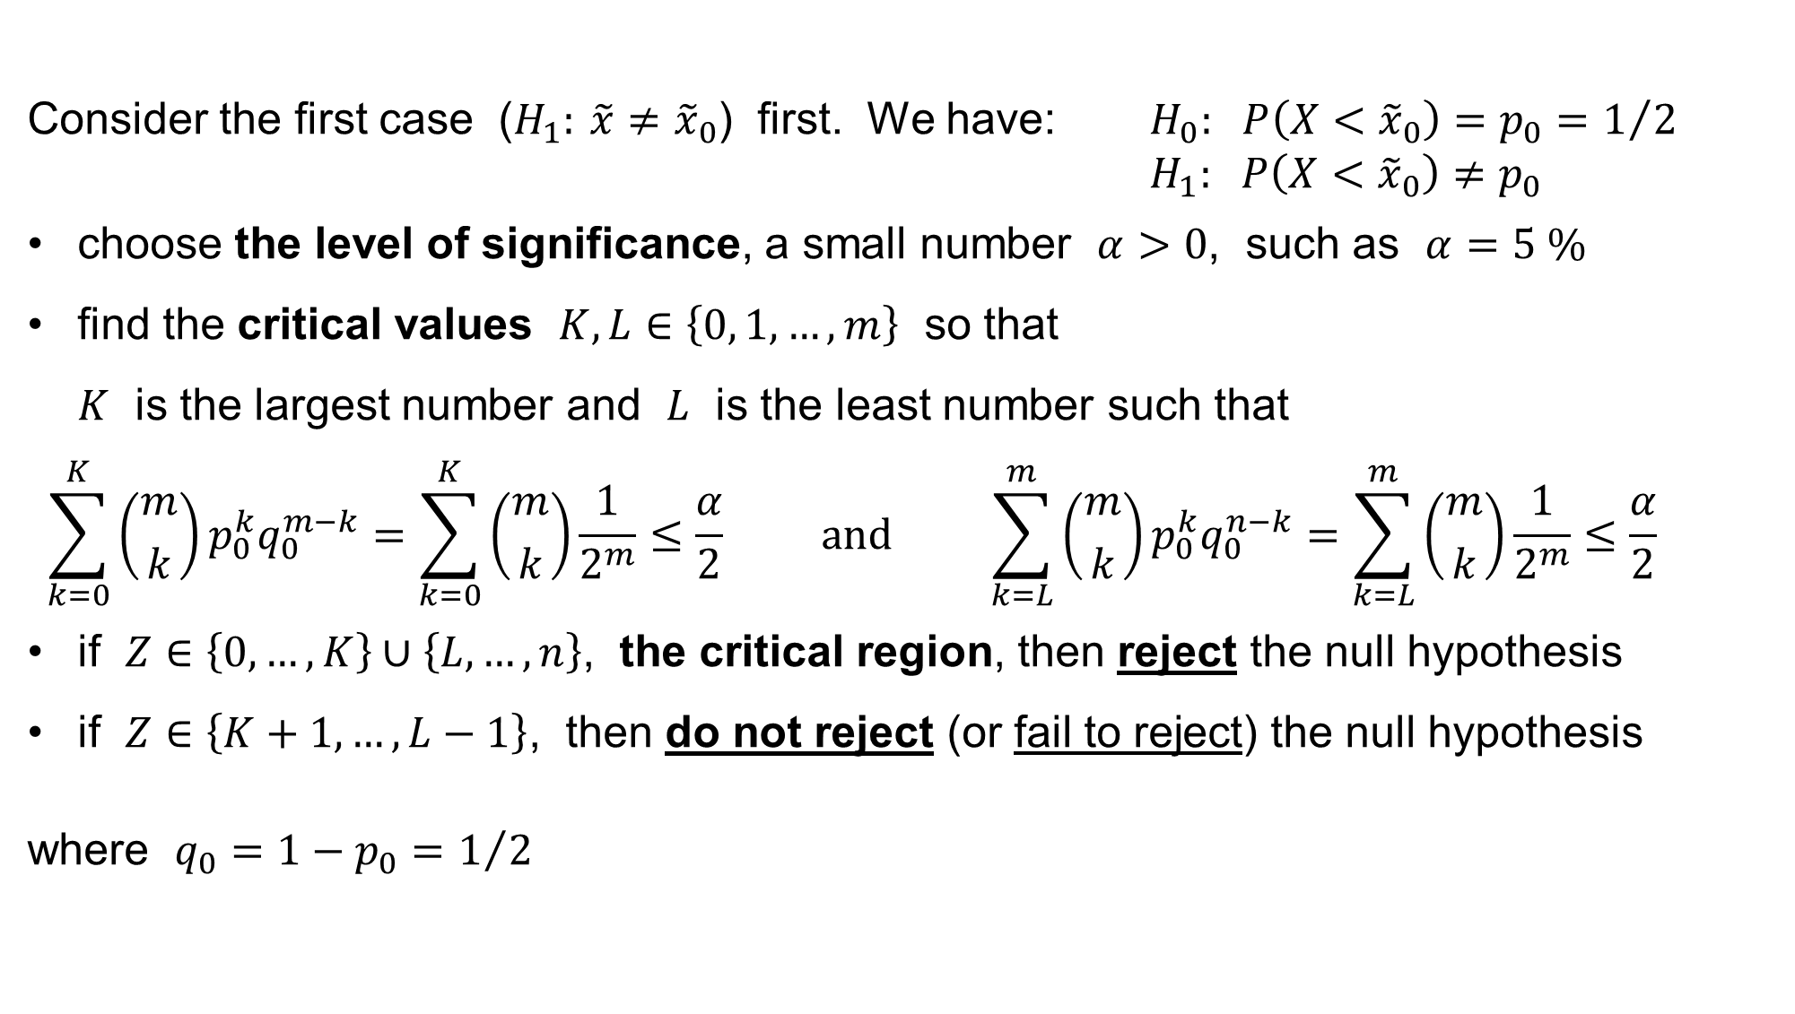
Sign (binomial) test for the median
Consider the first case ($H_{1}: \tilde{x}≠{\tilde{x}}_{0}$) first. We have: $H_{0}: P\left(X<{\tilde{x}}_{0}\right)=p_{0}=1/2$
$H_{1}: P\left(X<{\tilde{x}}_{0}\right)≠p_{0}$
choose the level of significance, a small number $α>0$, such as $α=5 \%$
find the critical values $K,L∈\left\{0, 1,…,m\right\}$ so that
$K$ is the largest number and $L$ is the least number such that
$$\sum_{k=0}^{K}{\left({m \atop k}\right)p_{0}^{k}q_{0}^{m−k}}=\sum_{k=0}^{K}{\left({m \atop k}\right)\frac{1}{2^{m}}}≤\frac{α}{2} \text{and} \sum_{k=L}^{m}{\left({m \atop k}\right)p_{0}^{k}q_{0}^{n−k}}=\sum_{k=L}^{m}{\left({m \atop k}\right)\frac{1}{2^{m}}}≤\frac{α}{2}$$
if $Z∈\left\{0,…,K\right\}∪\left\{L,…,n\right\}$, the critical region, then reject the null hypothesis
if $Z∈\left\{K+1,…,L−1\right\}$, then do not reject (or fail to reject) the null hypothesis
where $q_{0}=1−p_{0}=1/2$

Slide 12
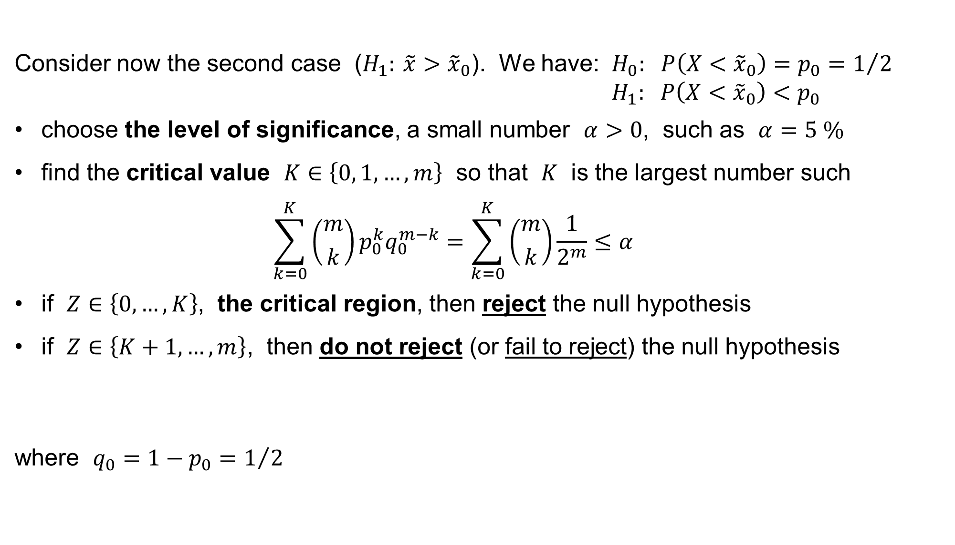
Sign (binomial) test for the median
Consider now the second case ($H_{1}: \tilde{x}>{\tilde{x}}_{0}$). We have: $H_{0}: P\left(X<{\tilde{x}}_{0}\right)=p_{0}=1/2$
$H_{1}: P\left(X<{\tilde{x}}_{0}\right)<p_{0}$
choose the level of significance, a small number $α>0$, such as $α=5 \%$
find the critical value $K∈\left\{0, 1,…,m\right\}$ so that $K$ is the largest number such
$$\sum_{k=0}^{K}{\left({m \atop k}\right)p_{0}^{k}q_{0}^{m−k}}=\sum_{k=0}^{K}{\left({m \atop k}\right)\frac{1}{2^{m}}}≤α$$
if $Z∈\left\{0,…,K\right\}$, the critical region, then reject the null hypothesis
if $Z∈\left\{K+1,…,m\right\}$, then do not reject (or fail to reject) the null hypothesis
where $q_{0}=1−p_{0}=1/2$
that

Slide 13
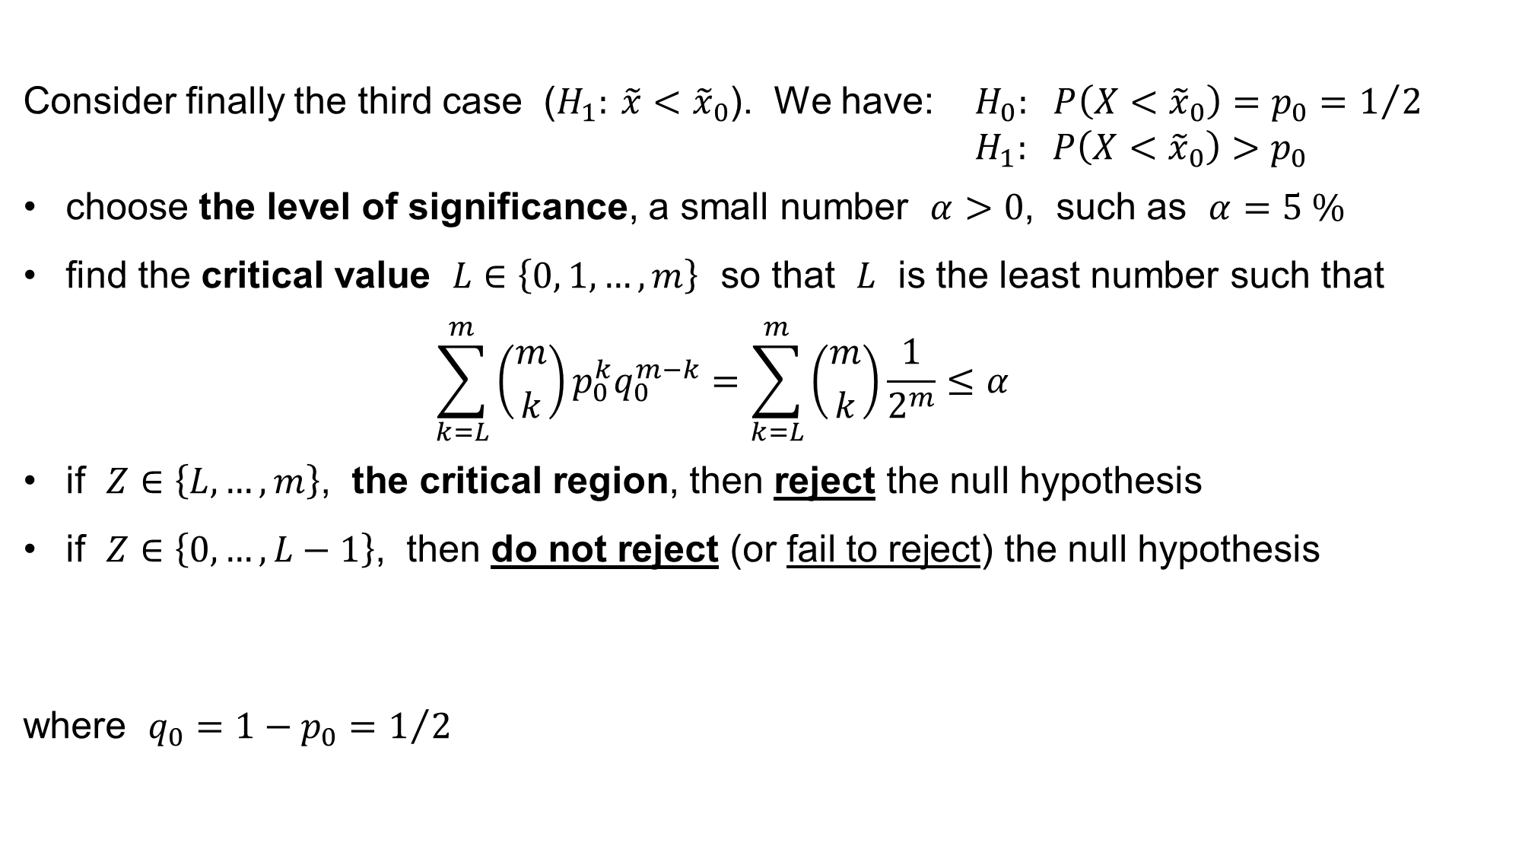
Sign (binomial) test for the median
Consider finally the third case ($H_{1}: \tilde{x}<{\tilde{x}}_{0}$). We have: $H_{0}: P\left(X<{\tilde{x}}_{0}\right)=p_{0}=1/2$
$H_{1}: P\left(X<{\tilde{x}}_{0}\right)>p_{0}$
choose the level of significance, a small number $α>0$, such as $α=5 \%$
find the critical value $L∈\left\{0, 1,…,m\right\}$ so that $L$ is the least number such that
$$\sum_{k=L}^{m}{\left({m \atop k}\right)p_{0}^{k}q_{0}^{m−k}}=\sum_{k=L}^{m}{\left({m \atop k}\right)\frac{1}{2^{m}}}≤α$$
if $Z∈\left\{L,…,m\right\}$, the critical region, then reject the null hypothesis
if $Z∈\left\{0,…,L−1\right\}$, then do not reject (or fail to reject) the null hypothesis
where $q_{0}=1−p_{0}=1/2$

Slide 14
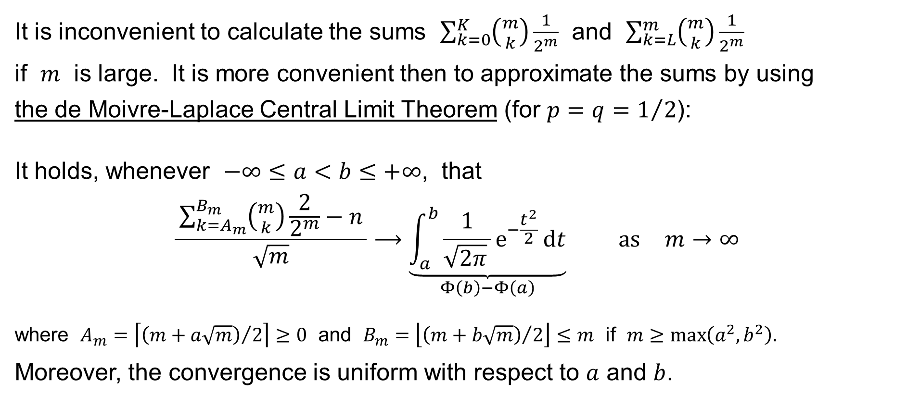
Sign (z-) test for the median
It is inconvenient to calculate the sums $\sum_{k=0}^{K}{\left({m \atop k}\right)\frac{1}{2^{m}}}$ and $\sum_{k=L}^{m}{\left({m \atop k}\right)\frac{1}{2^{m}}}$
if $m$ is large. It is more convenient then to approximate the sums by using
the de Moivre-Laplace Central Limit Theorem (for $p=q=1/2$):
It holds, whenever $−∞≤a<b≤+∞$, that
$$\frac{ \sum_{\begin{aligned}k=A_{m}\end{aligned}}^{B_{m}}{\left({m \atop k}\right)\frac{2}{2^{m}}}−n }{\sqrt{m}}⟶\underset{Φ\left(b\right)−Φ\left(a\right)}{\underbrace{\int_{a}^{b}{\frac{1}{\sqrt{2π} }e^{−\frac{t^{2}}{2}} dt}}} \text{as} m→∞$$
where $A_{m}=\left\lceil {\left.\left(m+a\sqrt{m}\right)\right.}/2\right\rceil ≥0$ and $B_{m}=\left\lfloor {\left.\left(m+b\sqrt{m}\right)\right.}/2\right\rfloor ≤m$ if $m≥\max\left(a^{2},b^{2}\right)$.
Moreover, the convergence is uniform with respect to $a$ and $b$.

Slide 15
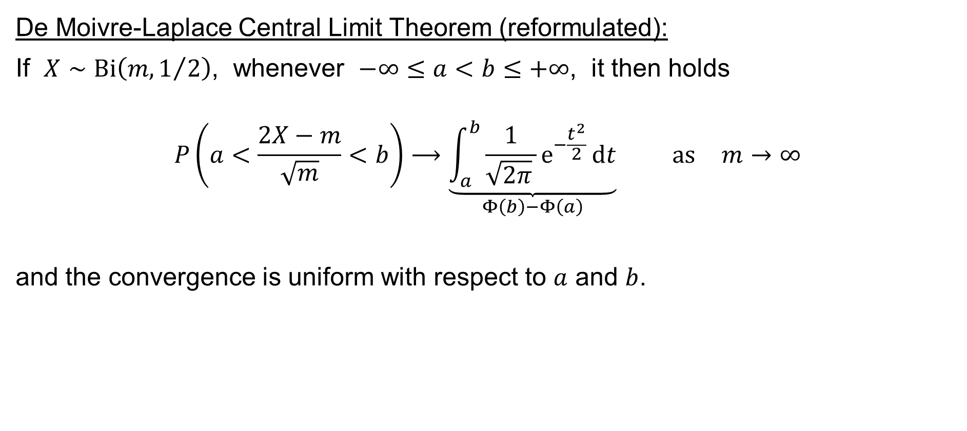
Sign (z-) test for the median
De Moivre-Laplace Central Limit Theorem (reformulated):
If $X∼Bi\left(m,1/2\right)$, whenever $−∞≤a<b≤+∞$, it then holds
$$P\left(a<\frac{2X−m}{\sqrt{m}}<b\right)⟶\underset{Φ\left(b\right)−Φ\left(a\right)}{\underbrace{\int_{a}^{b}{\frac{1}{\sqrt{2π} }e^{−\frac{t^{2}}{2}} dt}}} \text{as} m→∞$$
and the convergence is uniform with respect to $a$ and $b$.

Slide 16
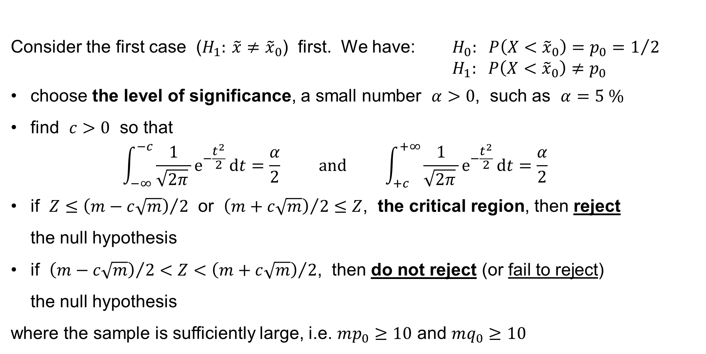
Sign (z-) test for the median
Consider the first case ($H_{1}: \tilde{x}≠{\tilde{x}}_{0}$) first. We have: $H_{0}: P\left(X<{\tilde{x}}_{0}\right)=p_{0}=1/2$
$H_{1}: P\left(X<{\tilde{x}}_{0}\right)≠p_{0}$
choose the level of significance, a small number $α>0$, such as $α=5 \%$
find $c>0$ so that
$$\int_{−∞}^{−c}{\frac{1}{\sqrt{2π} }e^{−\frac{t^{2}}{2}} dt}=\frac{α}{2} \text{and} \int_{+c}^{+∞}{\frac{1}{\sqrt{2π} }e^{−\frac{t^{2}}{2}} dt}=\frac{α}{2}$$
if $Z≤{\left(m−c\sqrt{m}\right)}/2$ or ${\left(m+c\sqrt{m}\right)}/2≤Z$, the critical region, then reject
the null hypothesis
if ${\left(m−c\sqrt{m}\right)}/2<Z<{\left(m+c\sqrt{m}\right)}/2$, then do not reject (or fail to reject)
the null hypothesis
where the sample is sufficiently large, i.e. $mp_{0}≥10$ and $mq_{0}≥10$

Slide 17
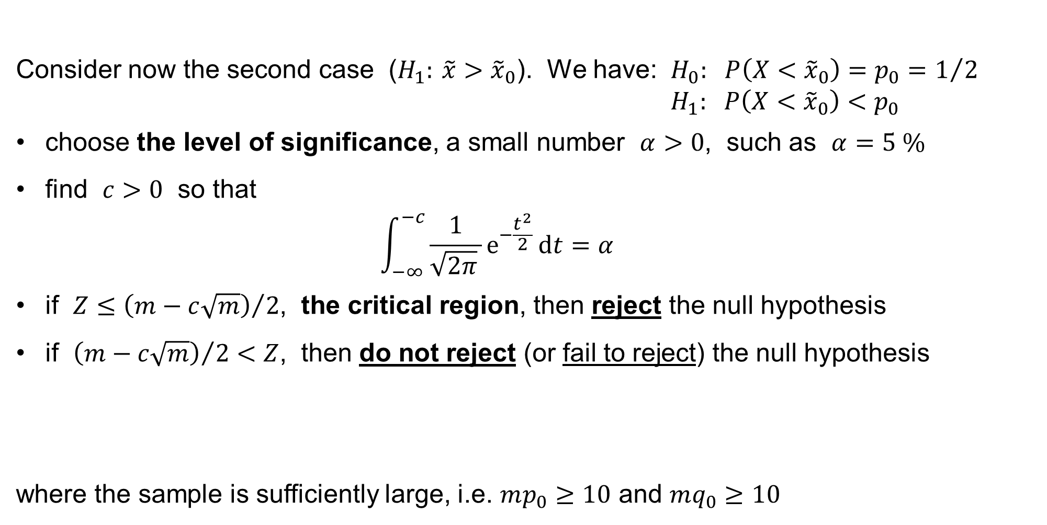
Sign (z-) test for the median
Consider now the second case ($H_{1}: \tilde{x}>{\tilde{x}}_{0}$). We have: $H_{0}: P\left(X<{\tilde{x}}_{0}\right)=p_{0}=1/2$
$H_{1}: P\left(X<{\tilde{x}}_{0}\right)<p_{0}$
choose the level of significance, a small number $α>0$, such as $α=5 \%$
find $c>0$ so that
$$\int_{−∞}^{−c}{\frac{1}{\sqrt{2π} }e^{−\frac{t^{2}}{2}} dt}=α$$
if $Z≤{\left(m−c\sqrt{m}\right)}/2$, the critical region, then reject the null hypothesis
if ${\left(m−c\sqrt{m}\right)}/2<Z$, then do not reject (or fail to reject) the null hypothesis
where the sample is sufficiently large, i.e. $mp_{0}≥10$ and $mq_{0}≥10$

Slide 18
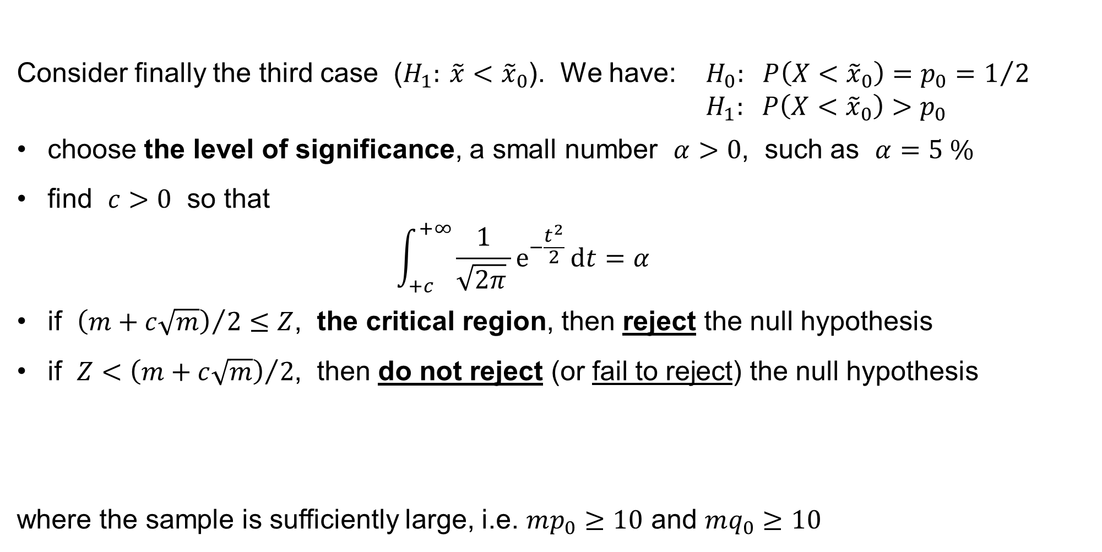
Sign (z-) test for the median
Consider finally the third case ($H_{1}: \tilde{x}<{\tilde{x}}_{0}$). We have: $H_{0}: P\left(X<{\tilde{x}}_{0}\right)=p_{0}=1/2$
$H_{1}: P\left(X<{\tilde{x}}_{0}\right)>p_{0}$
choose the level of significance, a small number $α>0$, such as $α=5 \%$
find $c>0$ so that
$$\int_{+c}^{+∞}{\frac{1}{\sqrt{2π} }e^{−\frac{t^{2}}{2}} dt}=α$$
if ${\left(m+c\sqrt{m}\right)}/2≤Z$, the critical region, then reject the null hypothesis
if $Z<{\left(m+c\sqrt{m}\right)}/2$, then do not reject (or fail to reject) the null hypothesis
where the sample is sufficiently large, i.e. $mp_{0}≥10$ and $mq_{0}≥10$

Slide 19
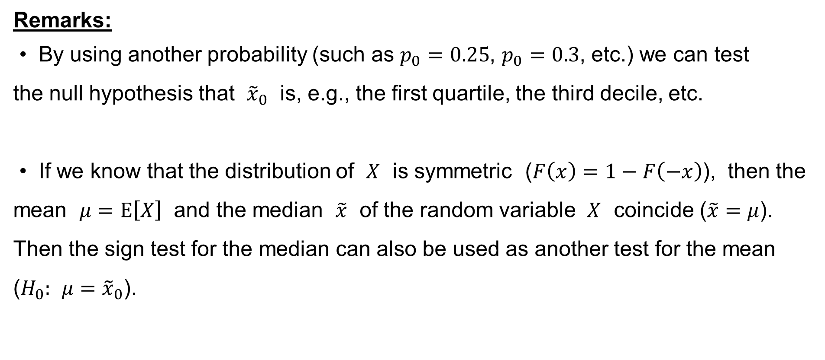
Sign test for the median
Remarks:
• By using another probability (such as $p_{0}=0.25$, $p_{0}=0.3$, etc.) we can test
the null hypothesis that ${\tilde{x}}_{0}$ is, e.g., the first quartile, the third decile, etc.
• If we know that the distribution of $X$ is symmetric ($F\left(x\right)=1−F\left(−x\right)$), then the mean $μ=E\left[X\right]$ and the median $\tilde{x}$ of the random variable $X$ coincide ($\tilde{x}=μ$). Then the sign test for the median can also be used as another test for the mean ($H_{0}: μ={\tilde{x}}_{0}$).

Slide 20
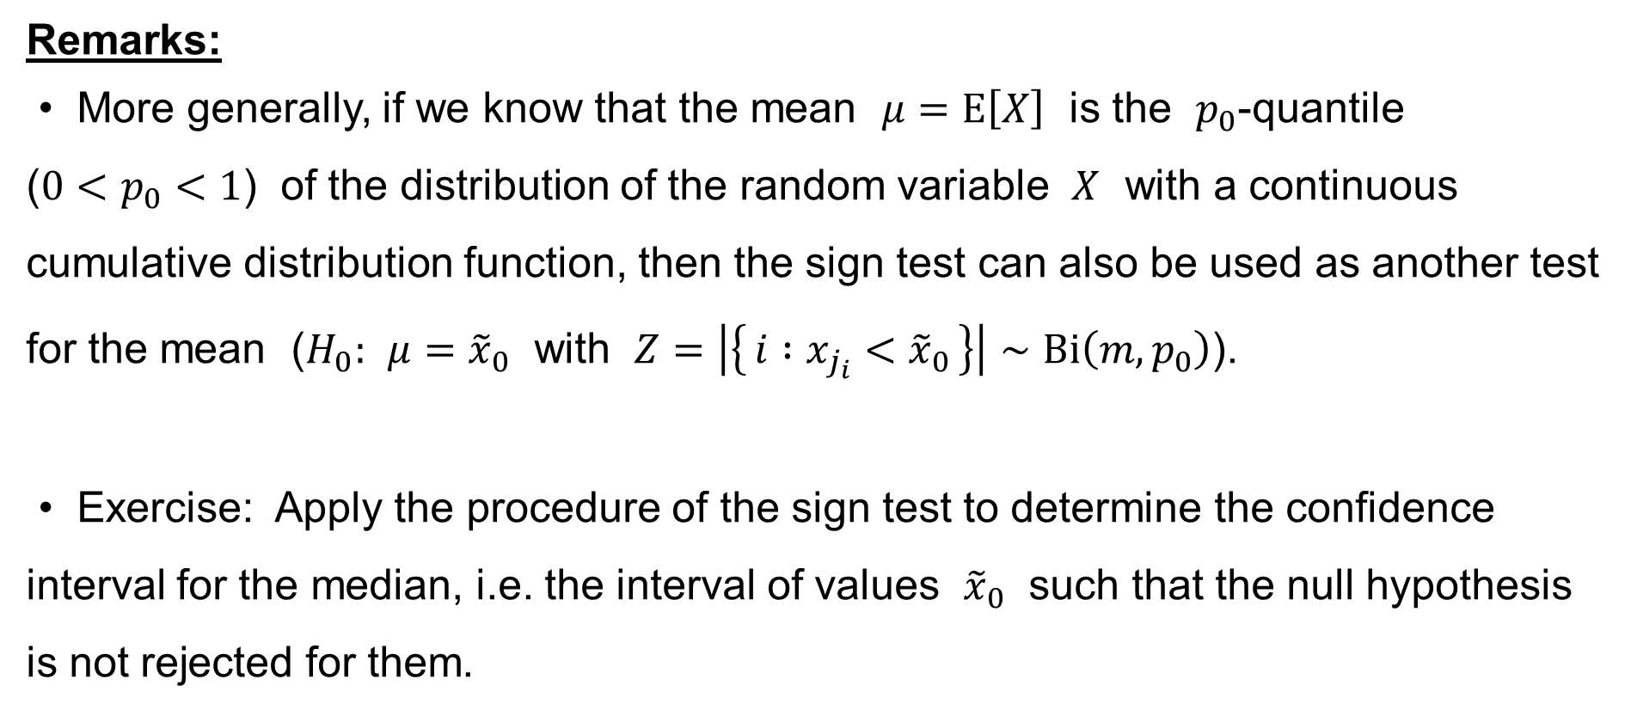
Sign test for the median
Remarks:
• More generally, if we know that the mean $μ=E\left[X\right]$ is the $p_{0}$-quantile
($0<p_{0}<1$) of the distribution of the random variable $X$ with a continuous cumulative distribution function, then the sign test can also be used as another test for the mean ($H_{0}: μ={\tilde{x}}_{0}$ with $Z=\left|\left\{ i :x_{j_{i}}<{\tilde{x}}_{0} \right\}\right|∼Bi\left(m,p_{0}\right)$).
• Exercise: Apply the procedure of the sign test to determine the confidence interval for the median, i.e. the interval of values ${\tilde{x}}_{0}$ such that the null hypothesis is not rejected for them.

Slide 21
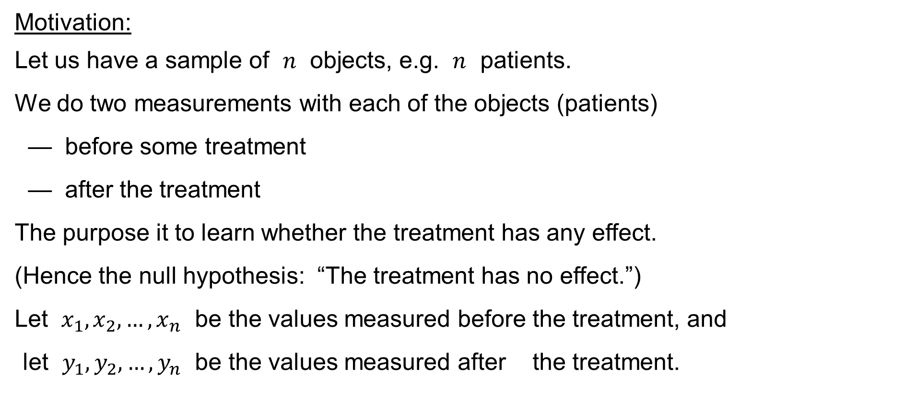
Paired sign test for the difference of the medians
Motivation:
Let us have a sample of $n$ objects, e.g. $n$ patients.
We do two measurements with each of the objects (patients)
— before some treatment
— after the treatment
The purpose it to learn whether the treatment has any effect.
(Hence the null hypothesis: “The treatment has no effect.”)
Let $x_{1},x_{2},…,x_{n}$ be the values measured before the treatment, and
let $y_{1},y_{2},…,y_{n}$ be the values measured after the treatment.

Slide 22
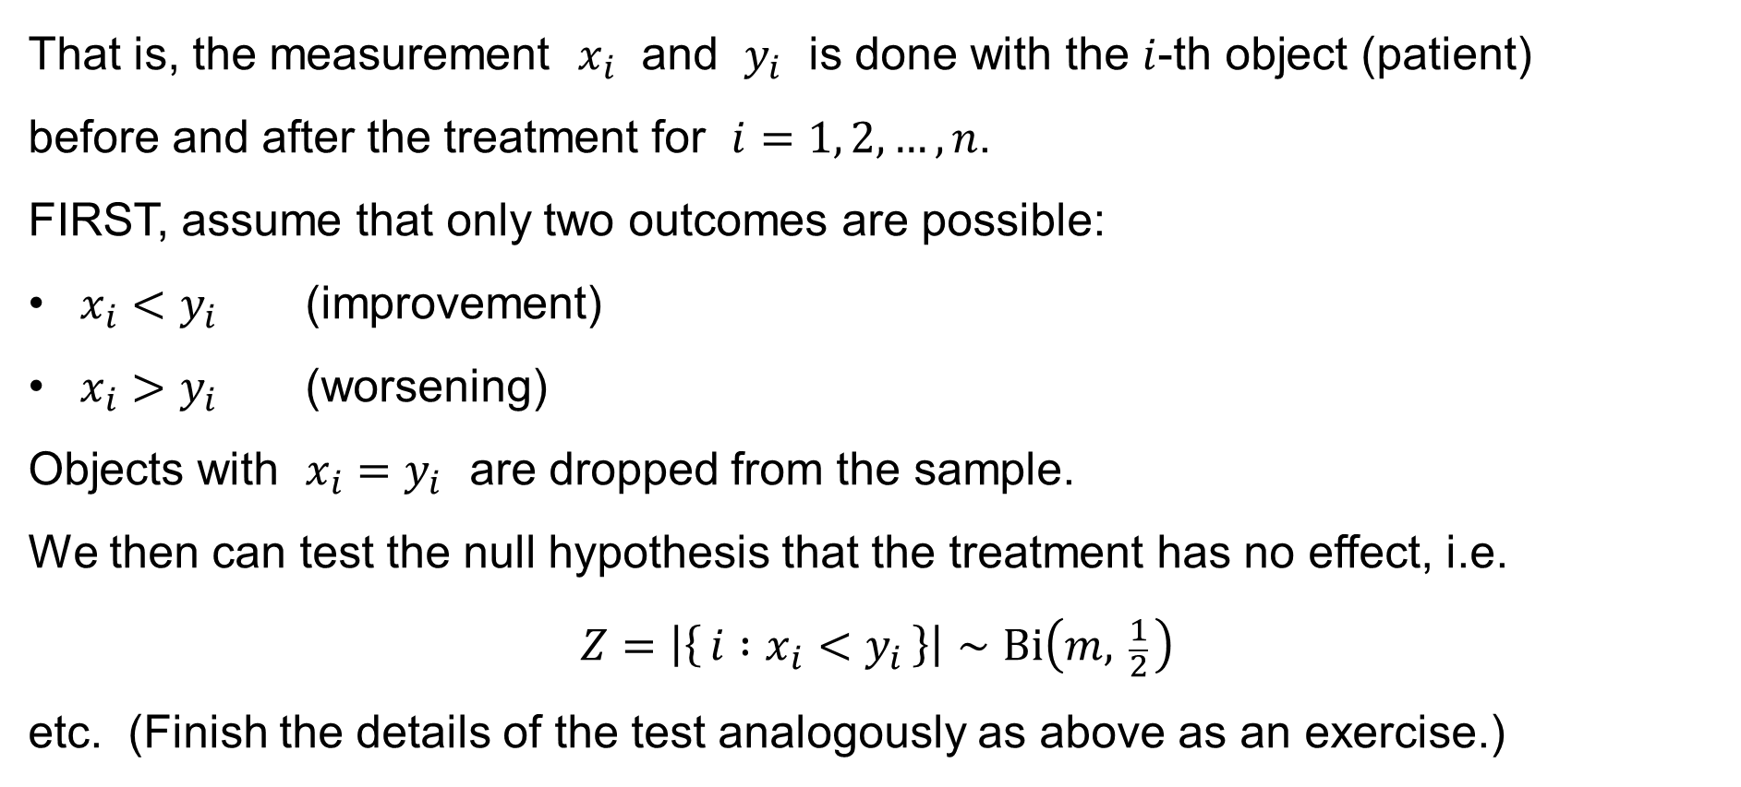
Paired sign test for the difference of the medians
That is, the measurement $x_{i}$ and $y_{i}$ is done with the $i$-th object (patient)
before and after the treatment for $i=1, 2,…,n$.
FIRST, assume that only two outcomes are possible:
$x_{i}<y_{i}$ (improvement)
$x_{i}>y_{i}$ (worsening)
Objects with $x_{i}=y_{i}$ are dropped from the sample.
We then can test the null hypothesis that the treatment has no effect, i.e.
$$Z=\left|\left\{ i :x_{i}<y_{i} \right\}\right|∼Bi\left(m, \frac{1}{2} \right)$$
etc. (Finish the details of the test analogously as above as an exercise.)

Slide 23
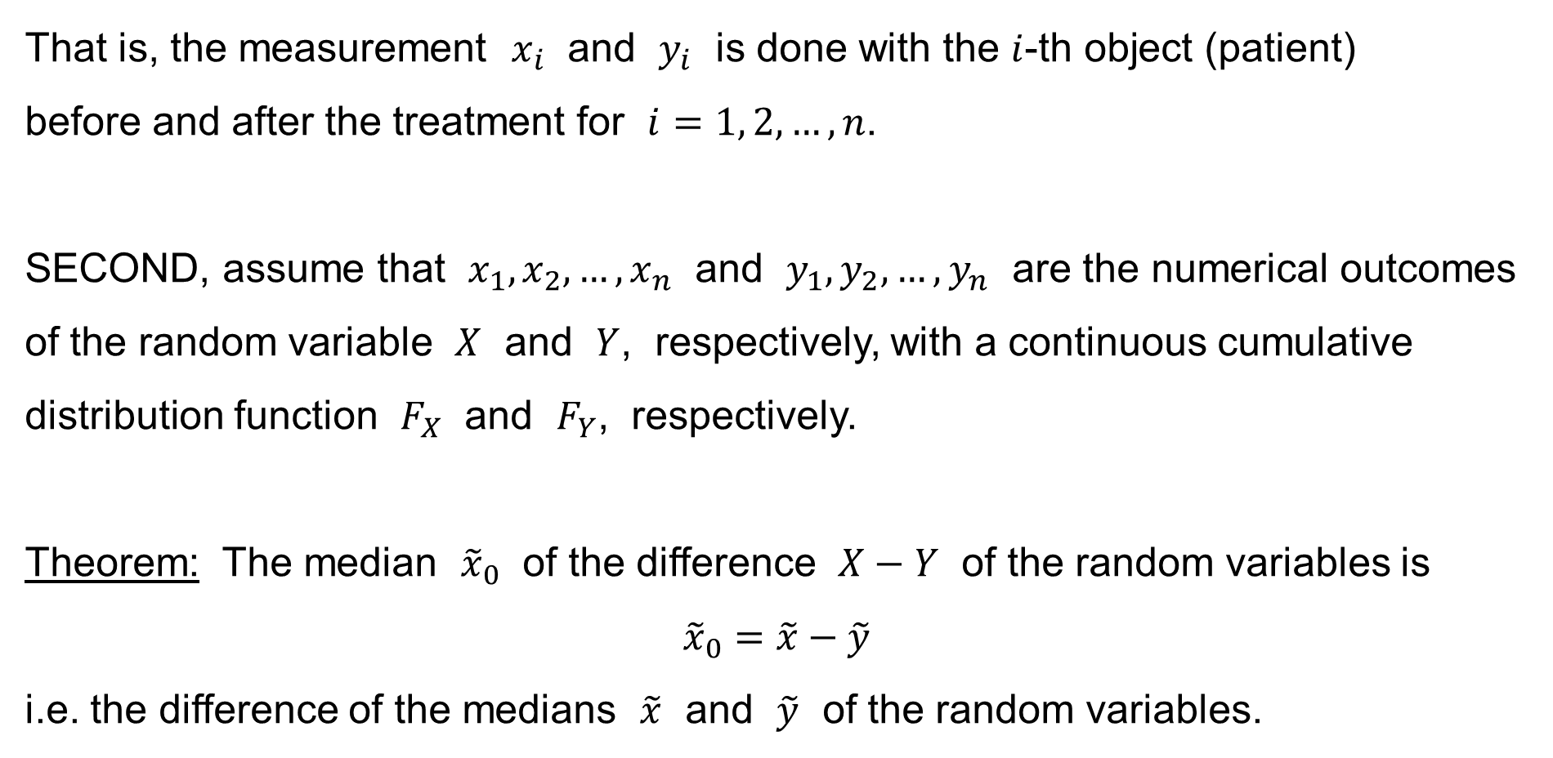
Paired sign test for the difference of the medians
That is, the measurement $x_{i}$ and $y_{i}$ is done with the $i$-th object (patient)
before and after the treatment for $i=1, 2,…,n$.
SECOND, assume that $x_{1},x_{2},…,x_{n}$ and $y_{1},y_{2},…,y_{n}$ are the numerical outcomes of the random variable $X$ and $Y$, respectively, with a continuous cumulative distribution function $F_{X}$ and $F_{Y}$, respectively.
Theorem: The median ${\tilde{x}}_{0}$ of the difference $X−Y$ of the random variables is
$${\tilde{x}}_{0}=\tilde{x}−\tilde{y}$$
i.e. the difference of the medians $\tilde{x}$ and $\tilde{y}$ of the random variables.

Slide 24
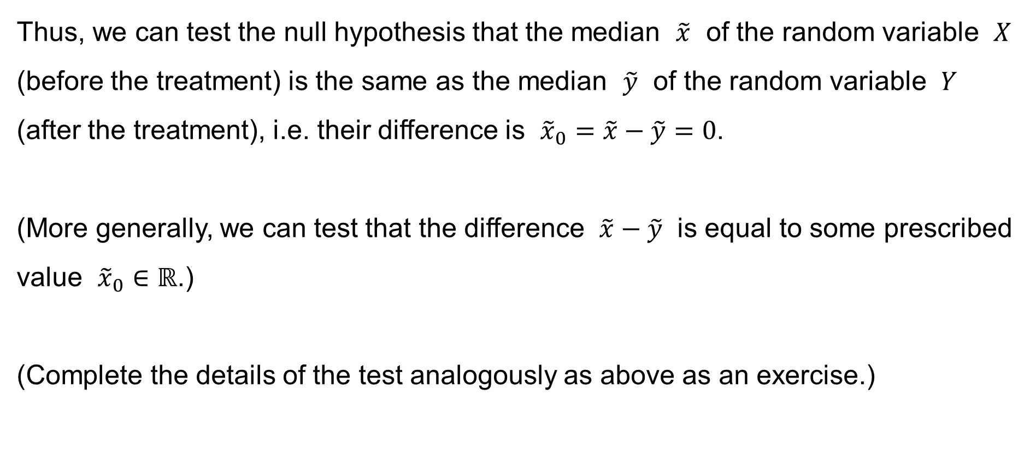
Paired sign test for the difference of the medians
Thus, we can test the null hypothesis that the median $\tilde{x}$ of the random variable $X$ (before the treatment) is the same as the median $\tilde{y}$ of the random variable $Y$ (after the treatment), i.e. their difference is ${\tilde{x}}_{0}=\tilde{x}−\tilde{y}=0$.
(More generally, we can test that the difference $\tilde{x}−\tilde{y}$ is equal to some prescribed value ${\tilde{x}}_{0}∈ℝ$.)
(Complete the details of the test analogously as above as an exercise.)

Slide 25
χ²-test for goodness of fit
Pearson’s χ²-test for the goodness of fit

Slide 26
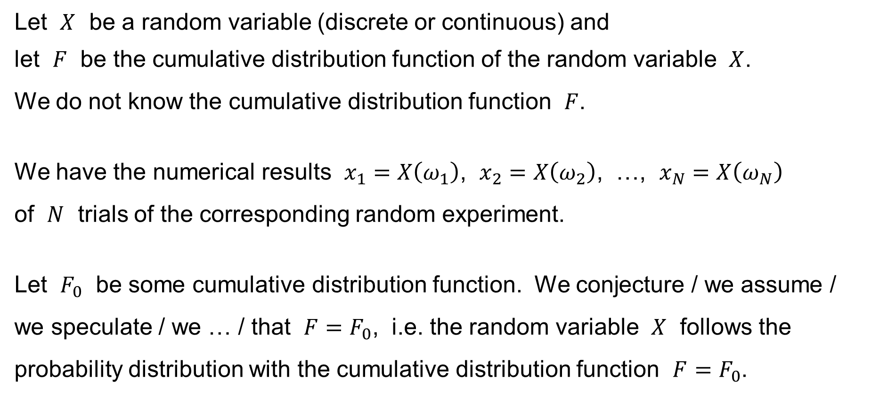
Pearson’s χ²-test for the goodness of fit
Let $X$ be a random variable (discrete or continuous) and
let $F$ be the cumulative distribution function of the random variable $X$.
We do not know the cumulative distribution function $F$.
We have the numerical results $x_{1}=X\left(ω_{1}\right)$, $x_{2}=X\left(ω_{2}\right)$, …, $x_{N}=X\left(ω_{N}\right)$
of $N$ trials of the corresponding random experiment.
Let $F_{0}$ be some cumulative distribution function. We conjecture / we assume /
we speculate / we … / that $F=F_{0}$, i.e. the random variable $X$ follows the probability distribution with the cumulative distribution function $F=F_{0}$.

Slide 27
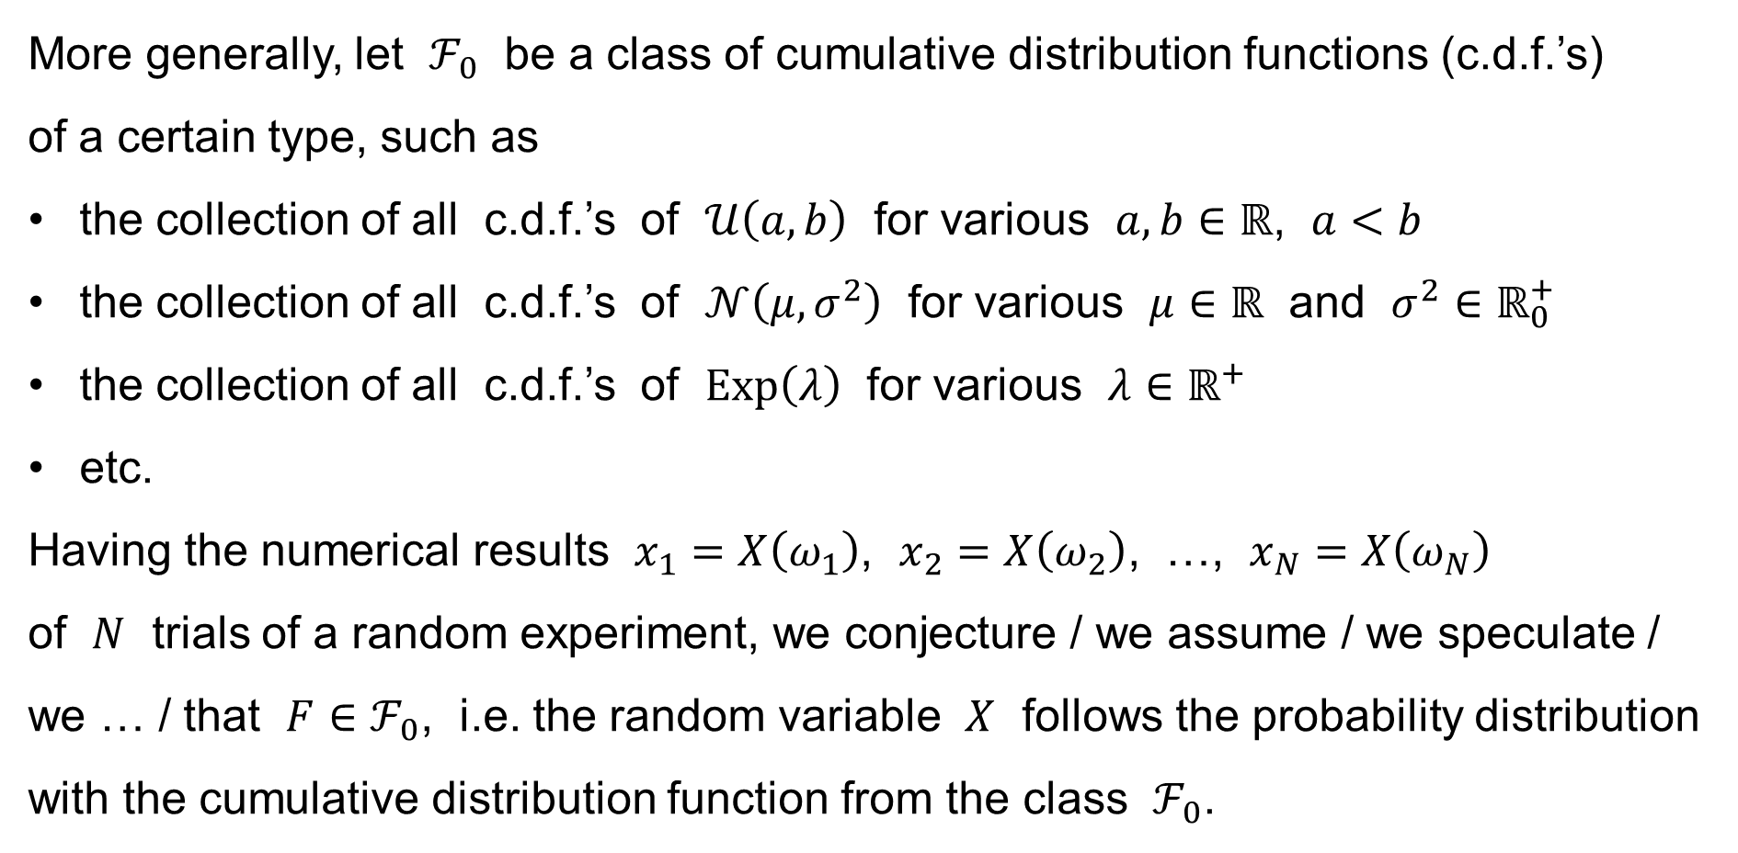
Pearson’s χ²-test for the goodness of fit
More generally, let $ℱ_{0}$ be a class of cumulative distribution functions (c.d.f.’s)
of a certain type, such as
the collection of all c.d.f.’s of $𝒰\left(a,b\right)$ for various $a,b∈ℝ$, $a<b$
the collection of all c.d.f.’s of $𝒩\left(μ,σ^{2}\right)$ for various $μ∈ℝ$ and $σ^{2}∈ℝ_{0}^{+}$
the collection of all c.d.f.’s of $Exp\left(λ\right)$ for various $λ∈ℝ^{+}$
etc.
Having the numerical results $x_{1}=X\left(ω_{1}\right)$, $x_{2}=X\left(ω_{2}\right)$, …, $x_{N}=X\left(ω_{N}\right)$
of $N$ trials of a random experiment, we conjecture / we assume / we speculate / we … / that $F∈ℱ_{0}$, i.e. the random variable $X$ follows the probability distribution with the cumulative distribution function from the class $ℱ_{0}$.

Slide 28
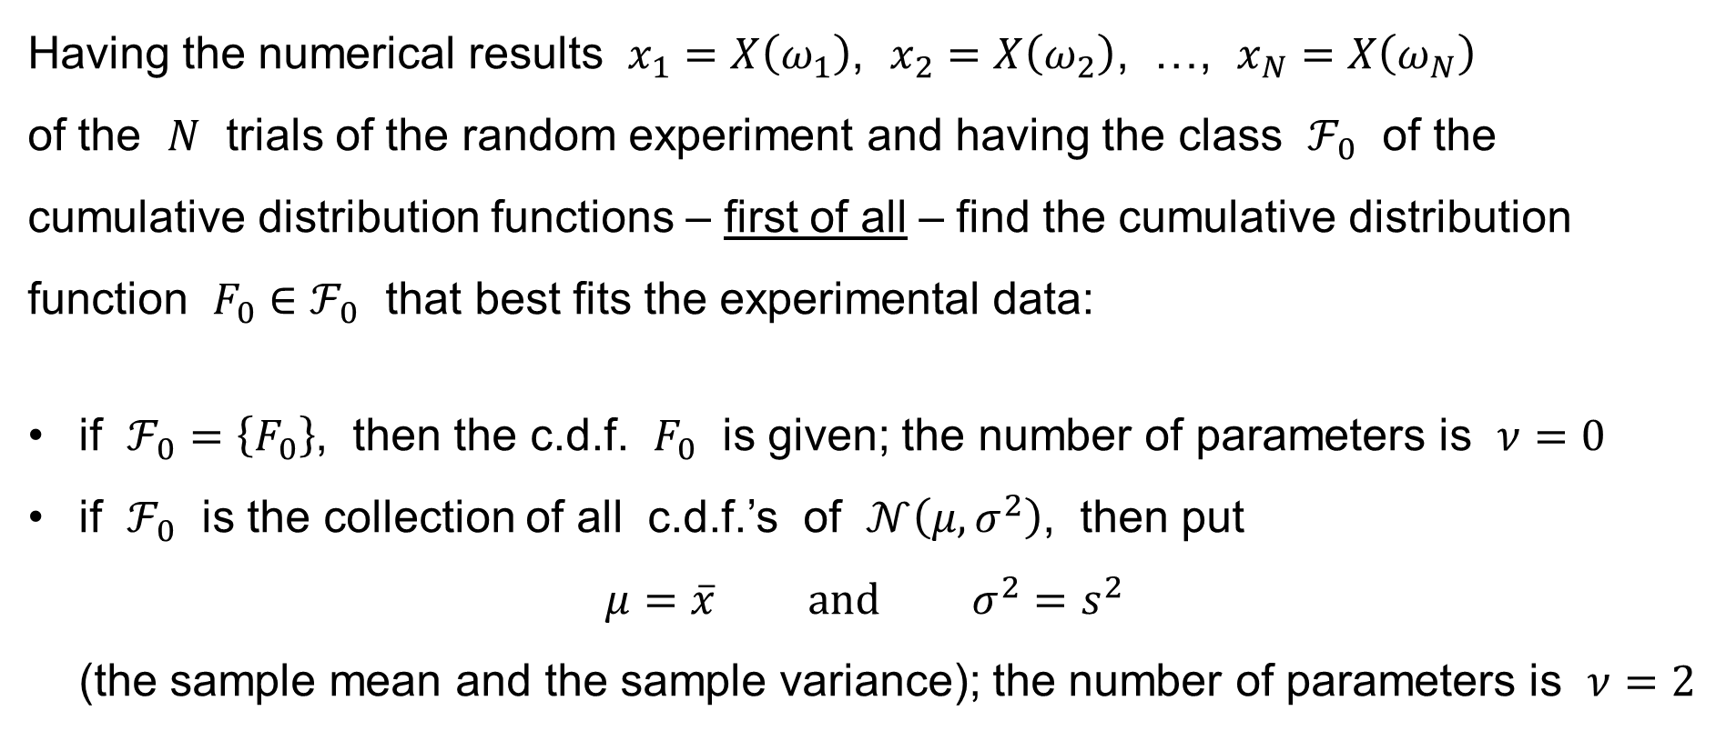
Pearson’s χ²-test for the goodness of fit
Having the numerical results $x_{1}=X\left(ω_{1}\right)$, $x_{2}=X\left(ω_{2}\right)$, …, $x_{N}=X\left(ω_{N}\right)$
of the $N$ trials of the random experiment and having the class $ℱ_{0}$ of the cumulative distribution functions – first of all – find the cumulative distribution function $F_{0}∈ℱ_{0}$ that best fits the experimental data:
if $ℱ_{0}=\left\{F_{0}\right\}$, then the c.d.f. $F_{0}$ is given; the number of parameters is $ν=0$
if $ℱ_{0}$ is the collection of all c.d.f.’s of $𝒩\left(μ,σ^{2}\right)$, then put
$μ=\overline{x} \text{and} σ^{2}=s^{2}$
(the sample mean and the sample variance); the number of parameters is $ν=2$

Slide 29
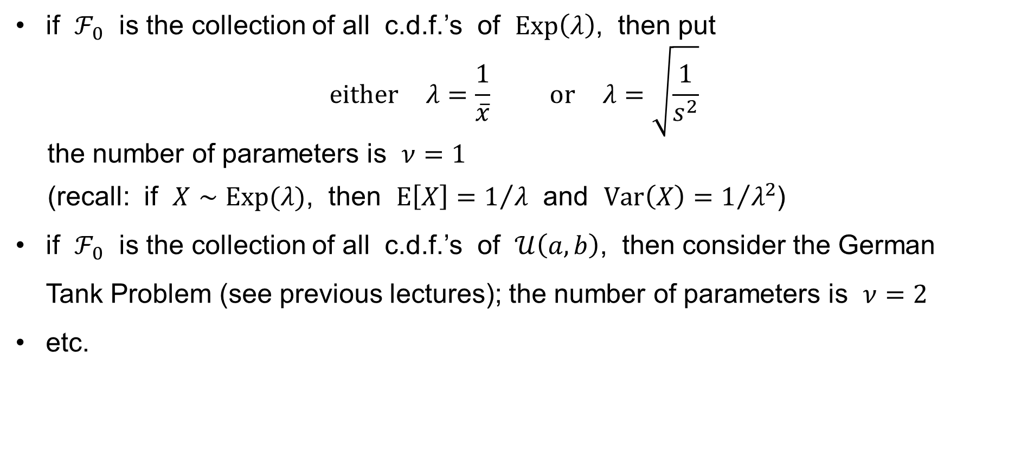
Pearson’s χ²-test for the goodness of fit
if $ℱ_{0}$ is the collection of all c.d.f.’s of $Exp\left(λ\right)$, then put
$\text{either} λ=\frac{1}{\overline{x}} \text{or} λ=\sqrt{\frac{1}{s^{2}}}$
the number of parameters is $ν=1$
(recall: if $X∼Exp(λ)$, then $E\left[X\right]=1/λ$ and $Var\left(X\right)=1/{λ^{2}}$)
if $ℱ_{0}$ is the collection of all c.d.f.’s of $𝒰\left(a,b\right)$, then consider the German
Tank Problem (see previous lectures); the number of parameters is $ν=2$
etc.

Slide 30
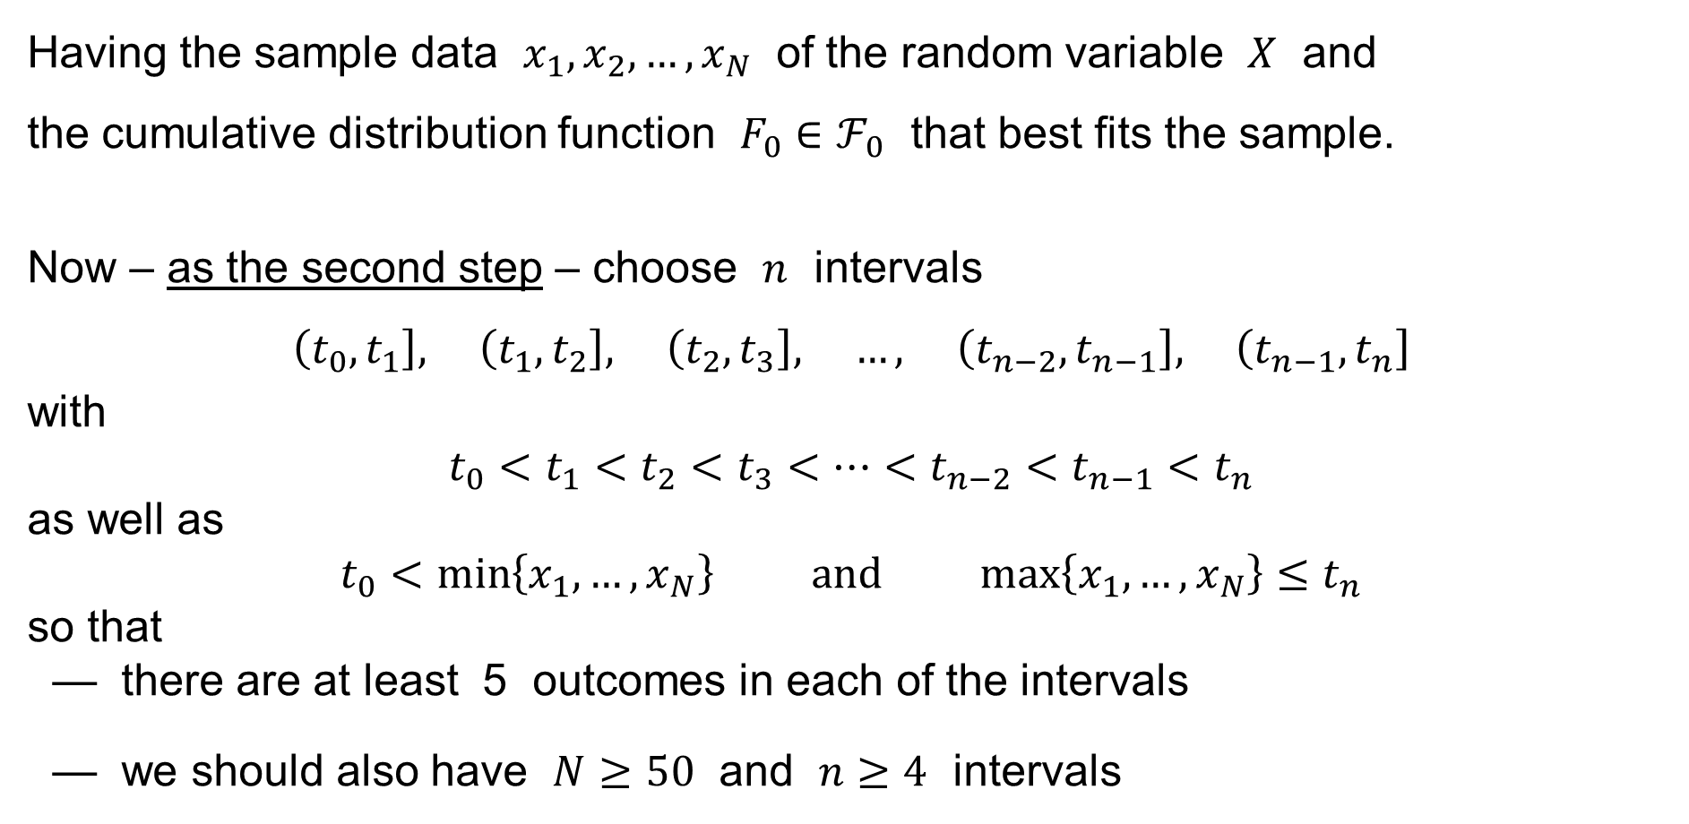
Pearson’s χ²-test for the goodness of fit
Having the sample data $x_{1},x_{2},…,x_{N}$ of the random variable $X$ and
the cumulative distribution function $F_{0}∈ℱ_{0}$ that best fits the sample.
Now – as the second step – choose $n$ intervals
$$\left(\left.t_{0},t_{1}\right.\right], \left(t_{1},t_{2}\right], \left(t_{2},t_{3}\right], …, \left(t_{n−2},t_{n−1}\right], \left(t_{n−1},t_{n}\right]$$
with
$$t_{0}<t_{1}<t_{2}<t_{3}<⋯<t_{n−2}<t_{n−1}<t_{n}$$
as well as
$$t_{0}<\min\left\{x_{1},…,x_{N}\right\} \text{and} \max\left\{x_{1},…,x_{N}\right\}≤t_{n}$$
so that
— there are at least 5 outcomes in each of the intervals
— we should also have $N≥50$ and $n≥4$ intervals

Slide 31
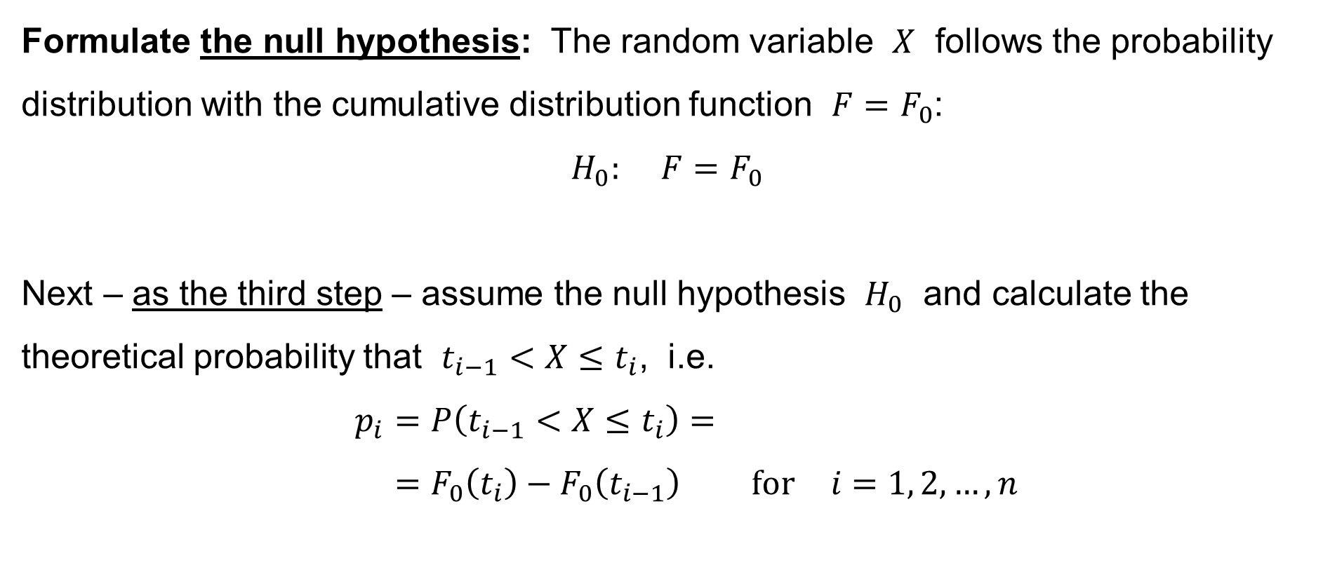
Pearson’s χ²-test for the goodness of fit
Formulate the null hypothesis: The random variable $X$ follows the probability distribution with the cumulative distribution function $F=F_{0}$:
$$H_{0}: F=F_{0}$$
Next – as the third step – assume the null hypothesis $H_{0}$ and calculate the theoretical probability that $t_{i−1}<X≤t_{i}$, i.e.
$$p_{i}=P\left(t_{i−1}<X≤t_{i}\right)= \\ =F_{0}\left(t_{i}\right)−F_{0}\left(t_{i−1}\right) \text{for} i=1, 2,…,n$$

Slide 32
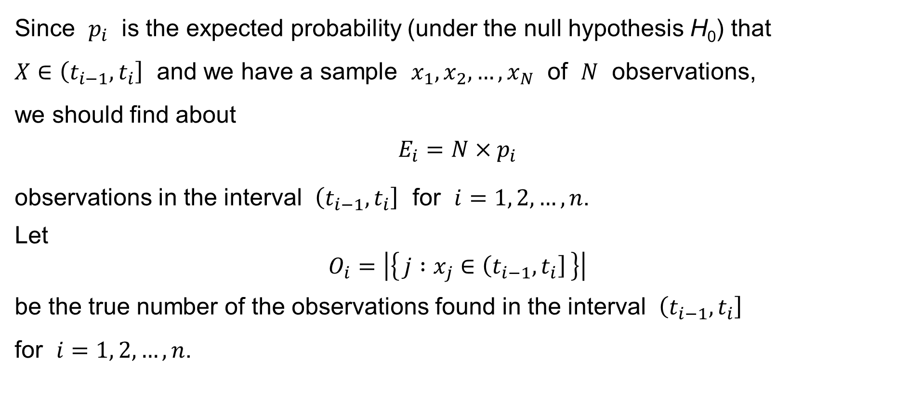
Pearson’s χ²-test for the goodness of fit
Since $p_{i}$ is the expected probability (under the null hypothesis H₀) that
$X∈\left(t_{i−1},t_{i}\right]$ and we have a sample $x_{1},x_{2},…,x_{N}$ of $N$ observations,
we should find about
$$E_{i}=N×p_{i}$$
observations in the interval $\left(t_{i−1},t_{i}\right]$ for $i=1, 2,…,n$.
Let
$$O_{i}=\left|\left\{ j :x_{j}∈\left(t_{i−1},t_{i}\right] \right\}\right|$$
be the true number of the observations found in the interval $\left(t_{i−1},t_{i}\right]$
for $i=1, 2,…,n$.

Slide 33
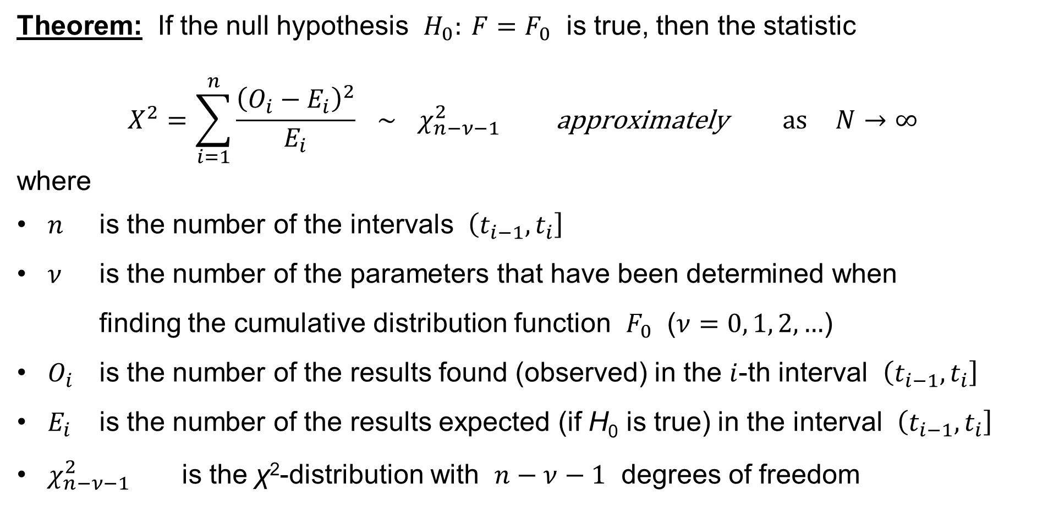
Pearson’s χ²-test for the goodness of fit
Theorem: If the null hypothesis $H_{0}: F=F_{0}$ is true, then the statistic
$$X^{2}=\sum_{i=1}^{n}{\frac{{\left(O_{i}−E_{i}\right)}^{2}}{E_{i}}} ∼ χ_{n−ν−1}^{2} \text{approximately} \text{as} N→∞$$
where
$n$ is the number of the intervals $\left(t_{i−1},t_{i}\right]$
$ν$ is the number of the parameters that have been determined when
finding the cumulative distribution function $F_{0}$ ($ν=0, 1, 2,…$)
$O_{i}$ is the number of the results found (observed) in the $i$-th interval $\left(t_{i−1},t_{i}\right]$
$E_{i}$ is the number of the results expected (if H₀ is true) in the interval $\left(t_{i−1},t_{i}\right]$
$χ_{n−ν−1}^{2}$ is the χ²-distribution with $n−ν−1$ degrees of freedom

Slide 34
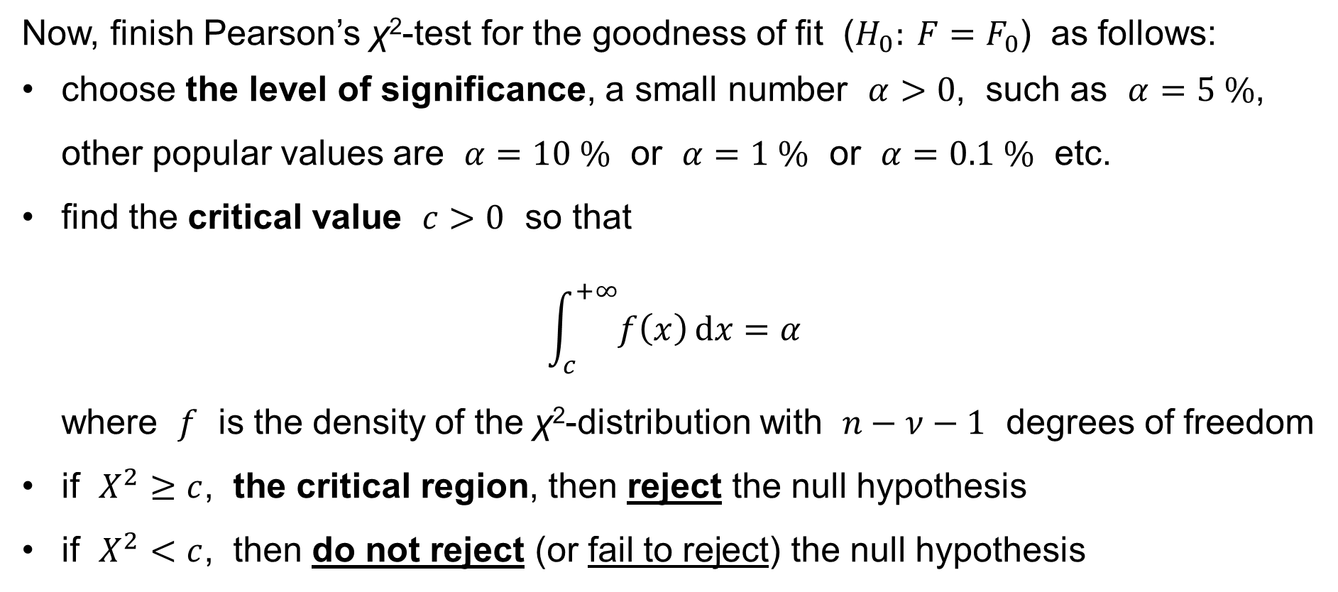
Pearson’s χ²-test for the goodness of fit
Now, finish Pearson’s χ²-test for the goodness of fit ($H_{0}: F=F_{0}$) as follows:
choose the level of significance, a small number $α>0$, such as $α=5 \%$, other popular values are $α=10 \%$ or $α=1 \%$ or $α=0.1 \%$ etc.
find the critical value $c>0$ so that
$\int_{c}^{+∞}{f\left(x\right) dx}=α$
where $f$ is the density of the χ²-distribution with $n−ν−1$ degrees of freedom
if $X^{2}≥c$, the critical region, then reject the null hypothesis
if $X^{2}<c$, then do not reject (or fail to reject) the null hypothesis

Slide 35
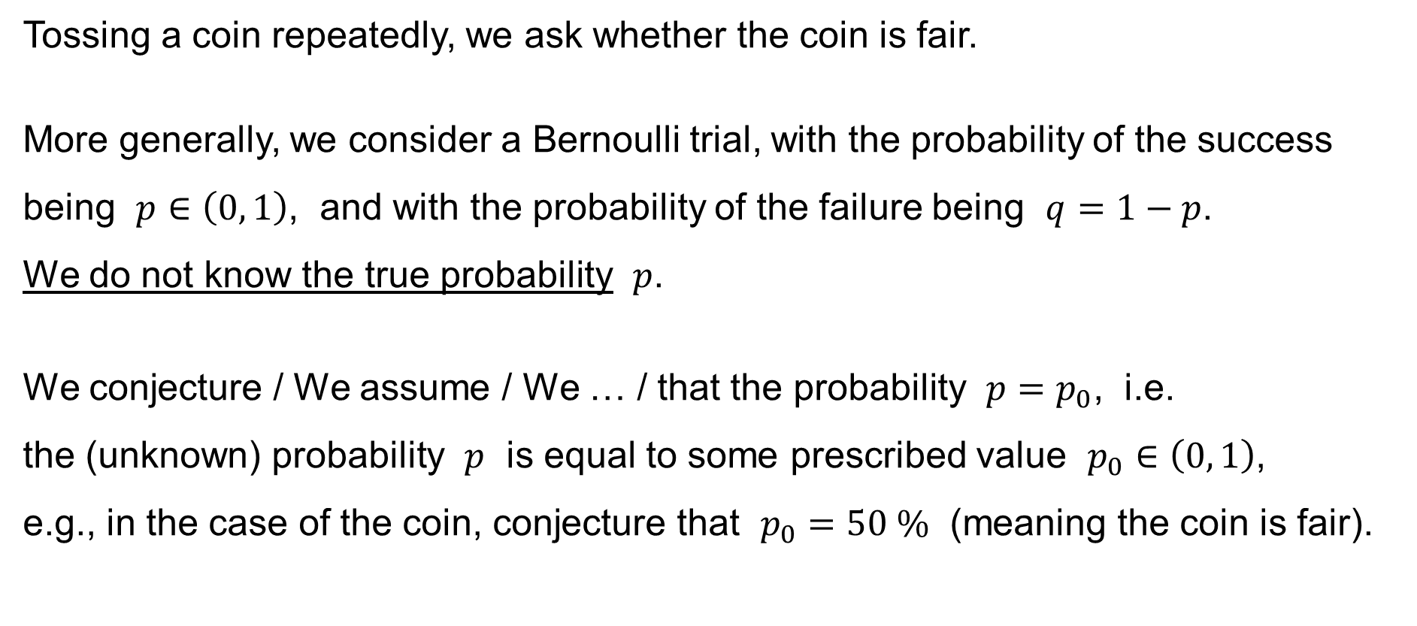
Example: Tests for population proportion
Tossing a coin repeatedly, we ask whether the coin is fair.
More generally, we consider a Bernoulli trial, with the probability of the success being $p∈\left(0, 1\right)$, and with the probability of the failure being $q=1−p$.
We do not know the true probability $p$.
We conjecture / We assume / We … / that the probability $p=p_{0}$, i.e.
the (unknown) probability $p$ is equal to some prescribed value $p_{0}∈\left(0, 1\right)$,
e.g., in the case of the coin, conjecture that $p_{0}=50 \%$ (meaning the coin is fair).

Slide 36
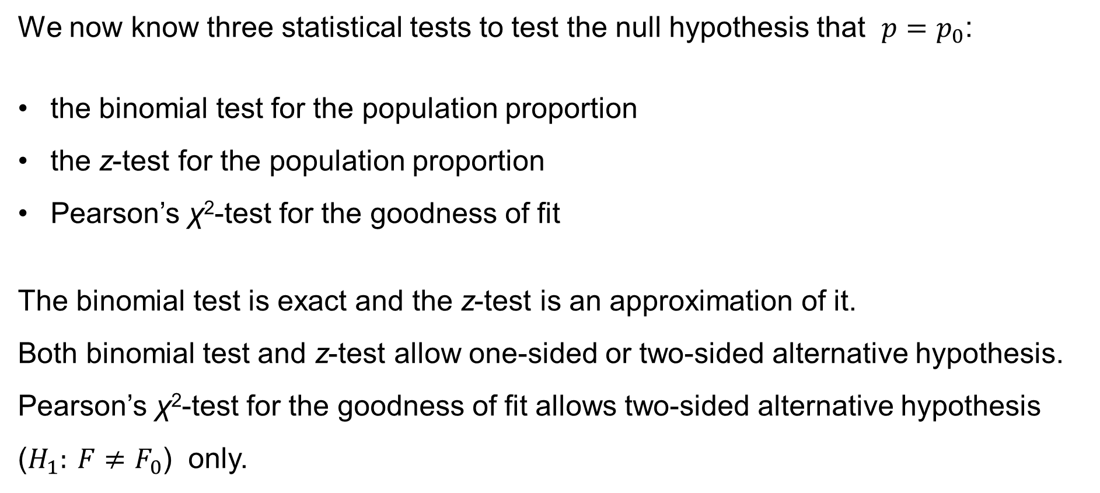
Example: Tests for population proportion
We now know three statistical tests to test the null hypothesis that $p=p_{0}$:
the binomial test for the population proportion
the z-test for the population proportion
Pearson’s χ²-test for the goodness of fit
The binomial test is exact and the z-test is an approximation of it.
Both binomial test and z-test allow one-sided or two-sided alternative hypothesis.
Pearson’s χ²-test for the goodness of fit allows two-sided alternative hypothesis ($H_{1}: F≠F_{0}$) only.

Slide 37
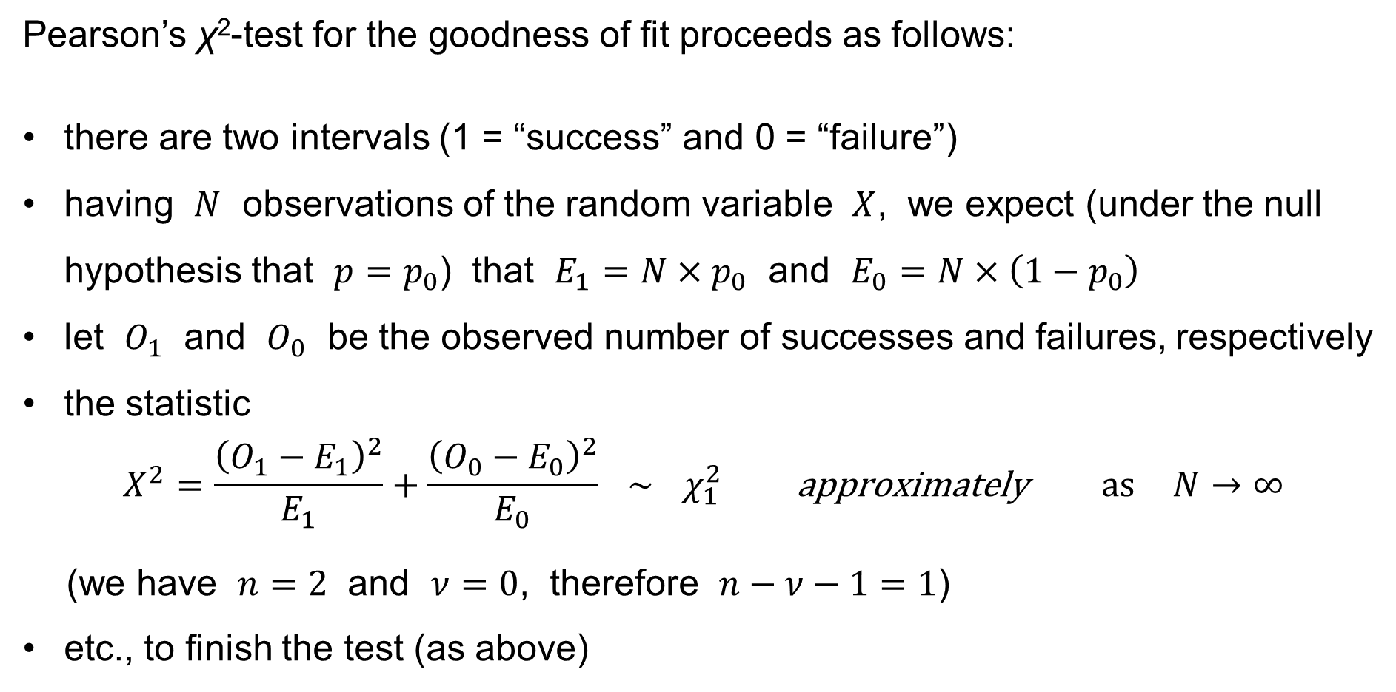
Example: Tests for population proportion
Pearson’s χ²-test for the goodness of fit proceeds as follows:
there are two intervals (1 = “success” and 0 = “failure”)
having $N$ observations of the random variable $X$, we expect (under the null hypothesis that $p=p_{0}$) that $E_{1}=N×p_{0}$ and $E_{0}=N×\left(1−p_{0}\right)$
let $O_{1}$ and $O_{0}$ be the observed number of successes and failures, respectively
the statistic
$$X^{2}=\frac{{\left(O_{1}−E_{1}\right)}^{2}}{E_{1}}+\frac{{\left(O_{0}−E_{0}\right)}^{2}}{E_{0}} ∼ χ_{1}^{2} \text{approximately} \text{as} N→∞$$
(we have $n=2$ and $ν=0$, therefore $n−ν−1=1$)
etc., to finish the test (as above)

Slide 38
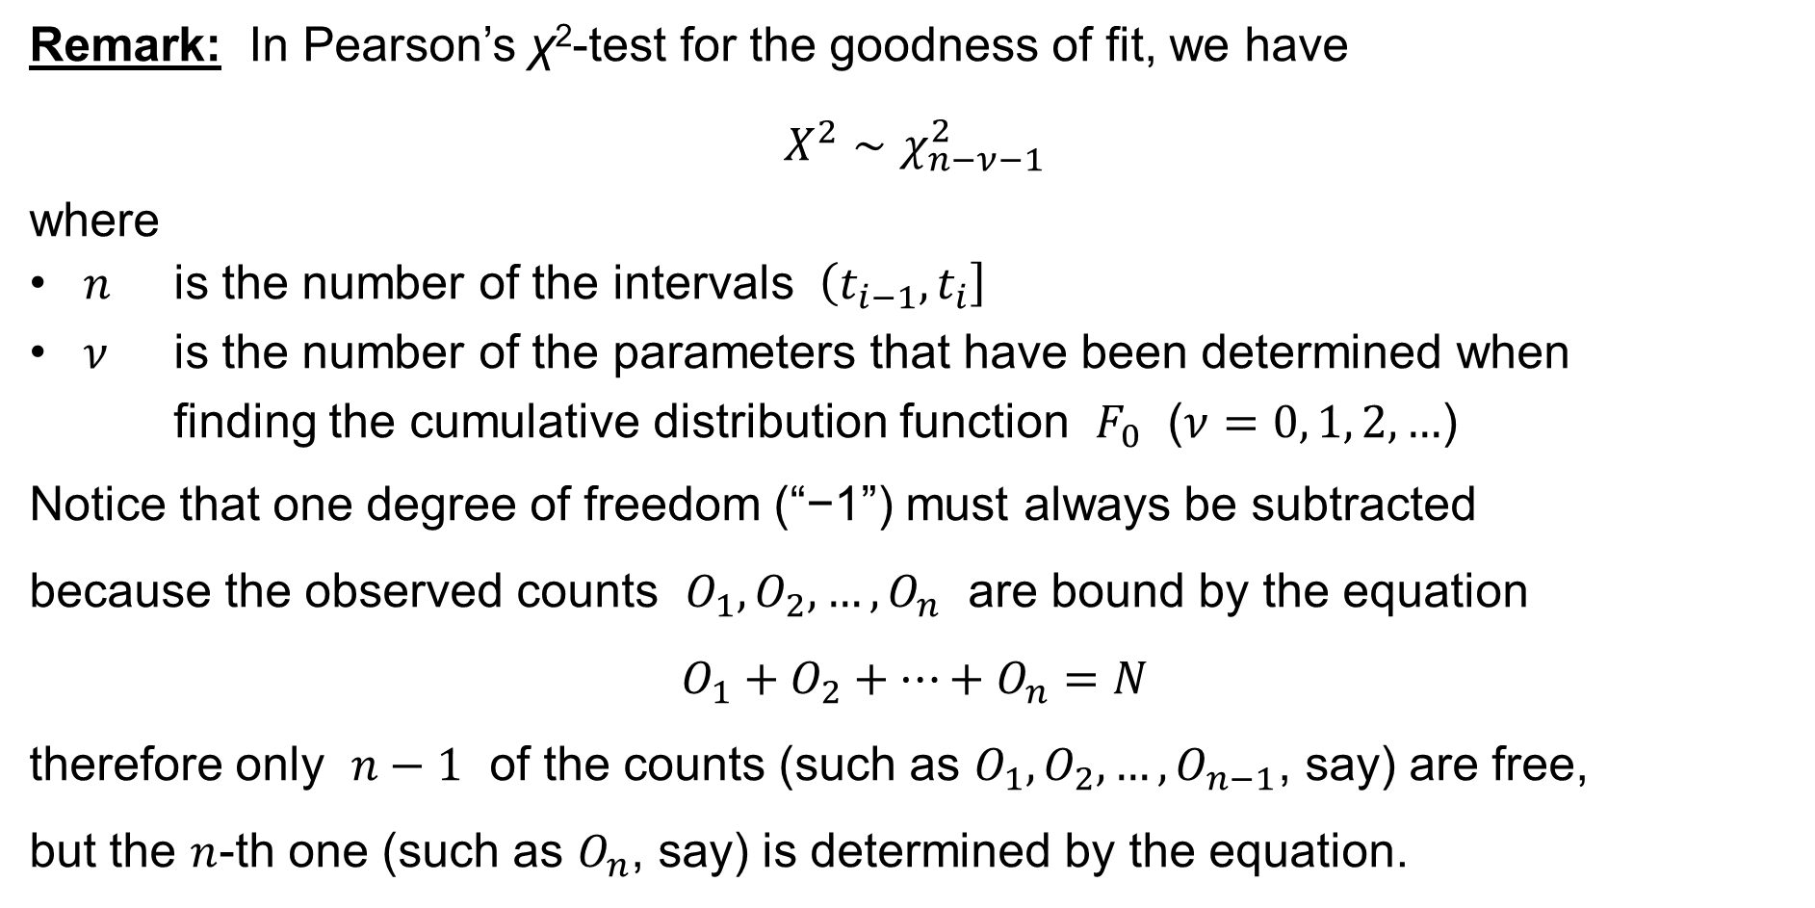
Pearson’s χ²-test for the goodness of fit
Remark: In Pearson’s χ²-test for the goodness of fit, we have
$$X^{2}∼χ_{n−ν−1}^{2}$$
where
$n$ is the number of the intervals $\left(t_{i−1},t_{i}\right]$
$ν$ is the number of the parameters that have been determined when
finding the cumulative distribution function $F_{0}$ ($ν=0, 1, 2,…$)
Notice that one degree of freedom (“−1”) must always be subtracted
because the observed counts $O_{1},O_{2},…,O_{n}$ are bound by the equation
$$O_{1}+O_{2}+⋯+O_{n}=N$$
therefore only $n−1$ of the counts (such as $O_{1},O_{2},…,O_{n−1}$, say) are free,
but the $n$-th one (such as $O_{n}$, say) is determined by the equation.

Slide 39
χ²-test of independence of qualitative data items
χ²-test of independence of
qualitative data items

Slide 40
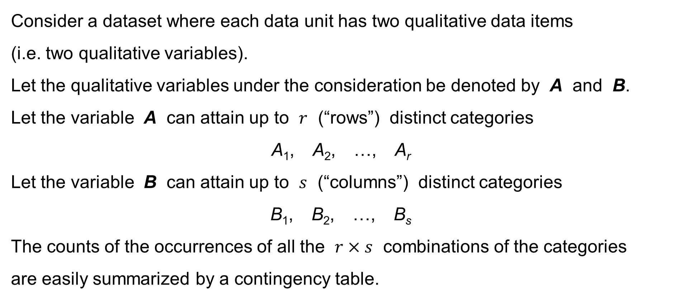
χ²-test of independence of qualitative data items
Consider a dataset where each data unit has two qualitative data items
(i.e. two qualitative variables).
Let the qualitative variables under the consideration be denoted by A and B.
Let the variable A can attain up to $r$ (“rows”) distinct categories
A₁, A₂, …, A_{r}
Let the variable B can attain up to $s$ (“columns”) distinct categories
B₁, B₂, …, B_{s}
The counts of the occurrences of all the $r×s$ combinations of the categories
are easily summarized by a contingency table.

Slide 41
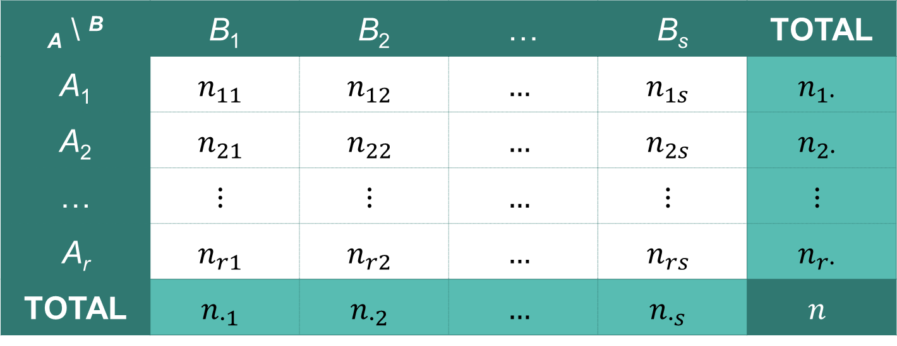
Contingency table
the observed counts of the combinations
of the categories A_{i}&B_{j} for i=1,…,r & j=1,…,s
_{A} \ ^{B} | B₁ | B₂ | … | B_{s} | TOTAL
A₁ | $$n_{11}$$ | $$n_{12}$$ | $$…$$ | $$n_{1s}$$ | $$n_{1∙}$$
A₂ | $$n_{21}$$ | $$n_{22}$$ | $$…$$ | $$n_{2s}$$ | $$n_{2∙}$$
… | $$⋮$$ | $$⋮$$ | $$…$$ | $$⋮$$ | $$⋮$$
A_{r} | $$n_{r1}$$ | $$n_{r2}$$ | $$…$$ | $$n_{rs}$$ | $$n_{r∙}$$
TOTAL | $$n_{∙1}$$ | $$n_{∙2}$$ | $$…$$ | $$n_{∙s}$$ | $$n$$
marginal totals
marginal totals
the grand total

Slide 42
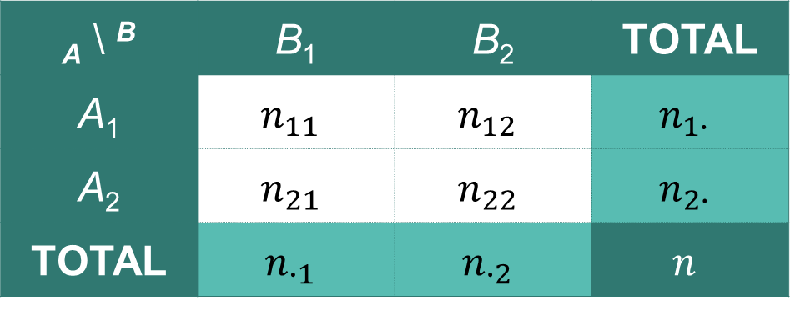
2 × 2 contingency table
The 2 × 2 contingency table is popular.
It is a contingency table with r=2 rows and s=2 columns.
the observed counts of the combinations
of the categories A_{i}&B_{j} for i=1,2 & j=1,2
_{A} \ ^{B} | B₁ | B₂ | TOTAL
A₁ | $$n_{11}$$ | $$n_{12}$$ | $$n_{1∙}$$
A₂ | $$n_{21}$$ | $$n_{22}$$ | $$n_{2∙}$$
TOTAL | $$n_{∙1}$$ | $$n_{∙2}$$ | $$n$$
marginal totals
marginal totals
the grand total

Slide 43
χ²-test of independence of qualitative data items
Having all the observed counts of the combinations of the categories A_{i} & B_{j} summarized in the contingency table for i=1,…,r and for j=1,…,s,
we ask whether the category of the data item (variable) B depends upon
the category of the data item (variable) A, or whether the categories of both data items (variables) A and B are independent of each other.
Assume therefore the null hypothesis H₀:
the categories of both data items (variables) A and B are independent
of each other

Slide 44
χ²-test of independence of qualitative data items
Having all the observed counts of the combinations of the categories A_{i} & B_{j} summarized in the contingency table for i=1,…,r and for j=1,…,s, assume
the null hypothesis H₀ that the categories of both data items (variables) A and B are independent of each other.
Now – if we choose a data unit randomly:
What is the probability that the data item A of the chosen data unit is of category A_{i} for some i=1,…,r ?
What is the probability that the data item B of the chosen data unit is of category B_{j} for some j=1,…,s ?

Slide 45
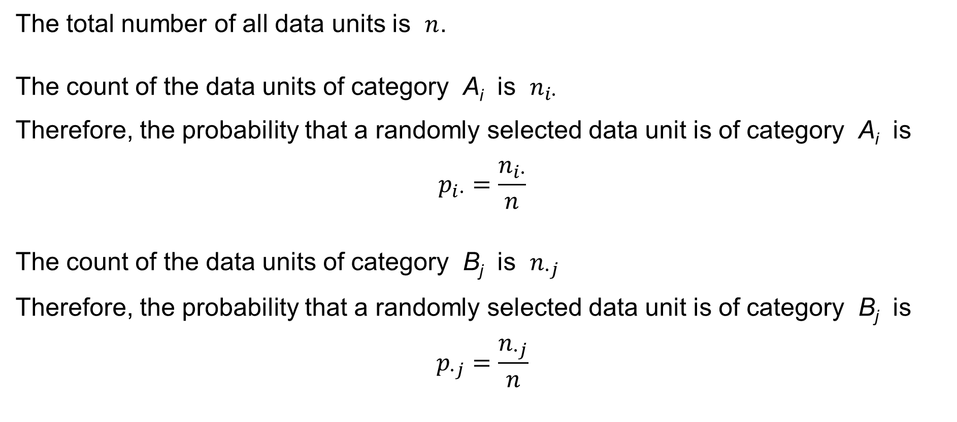
χ²-test of independence of qualitative data items
The total number of all data units is $n$.
The count of the data units of category A_{i} is $n_{i∙}$
Therefore, the probability that a randomly selected data unit is of category A_{i} is
$$p_{i∙}=\frac{n_{i∙}}{n}$$
The count of the data units of category B_{j} is $n_{∙j}$
Therefore, the probability that a randomly selected data unit is of category B_{j} is
$$p_{∙j}=\frac{n_{∙j}}{n}$$

Slide 46
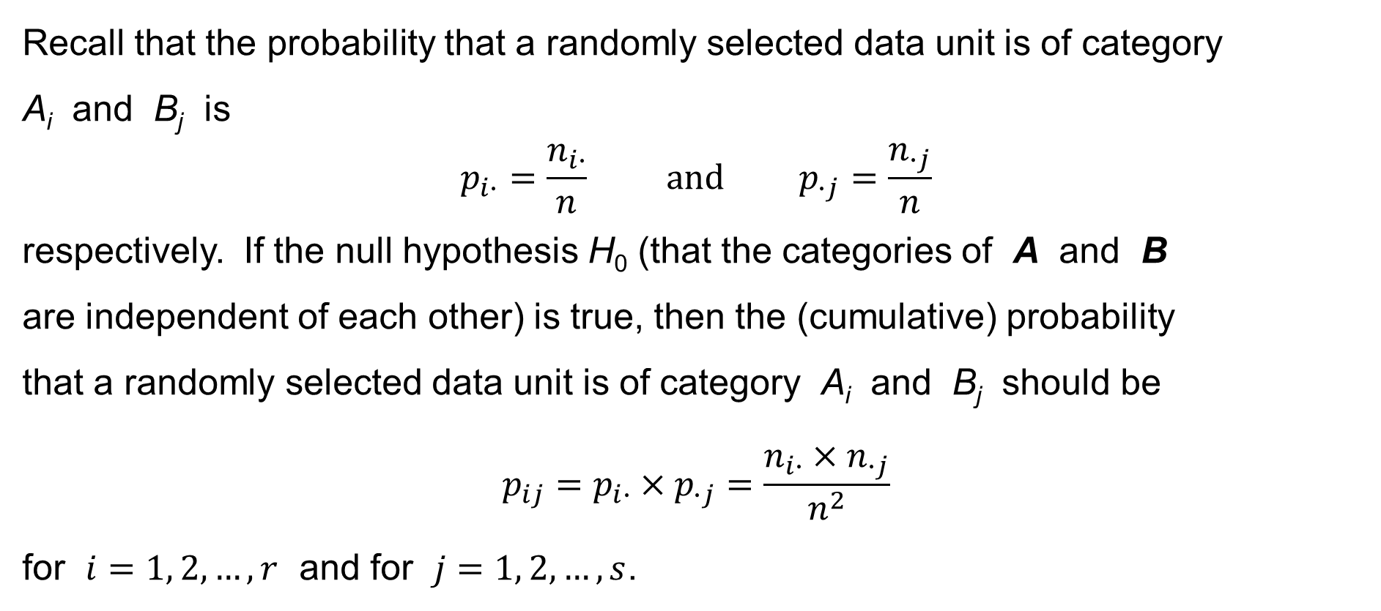
χ²-test of independence of qualitative data items
Recall that the probability that a randomly selected data unit is of category
A_{i} and B_{j} is
$$p_{i∙}=\frac{n_{i∙}}{n} \text{and} p_{∙j}=\frac{n_{∙j}}{n}$$
respectively. If the null hypothesis H₀ (that the categories of A and B
are independent of each other) is true, then the (cumulative) probability
that a randomly selected data unit is of category A_{i} and B_{j} should be
$$p_{ij}=p_{i∙}×p_{∙j}=\frac{n_{i∙}×n_{∙j}}{n^{2}}$$
for $i=1, 2,…,r$ and for $j=1, 2,…,s$.

Slide 47
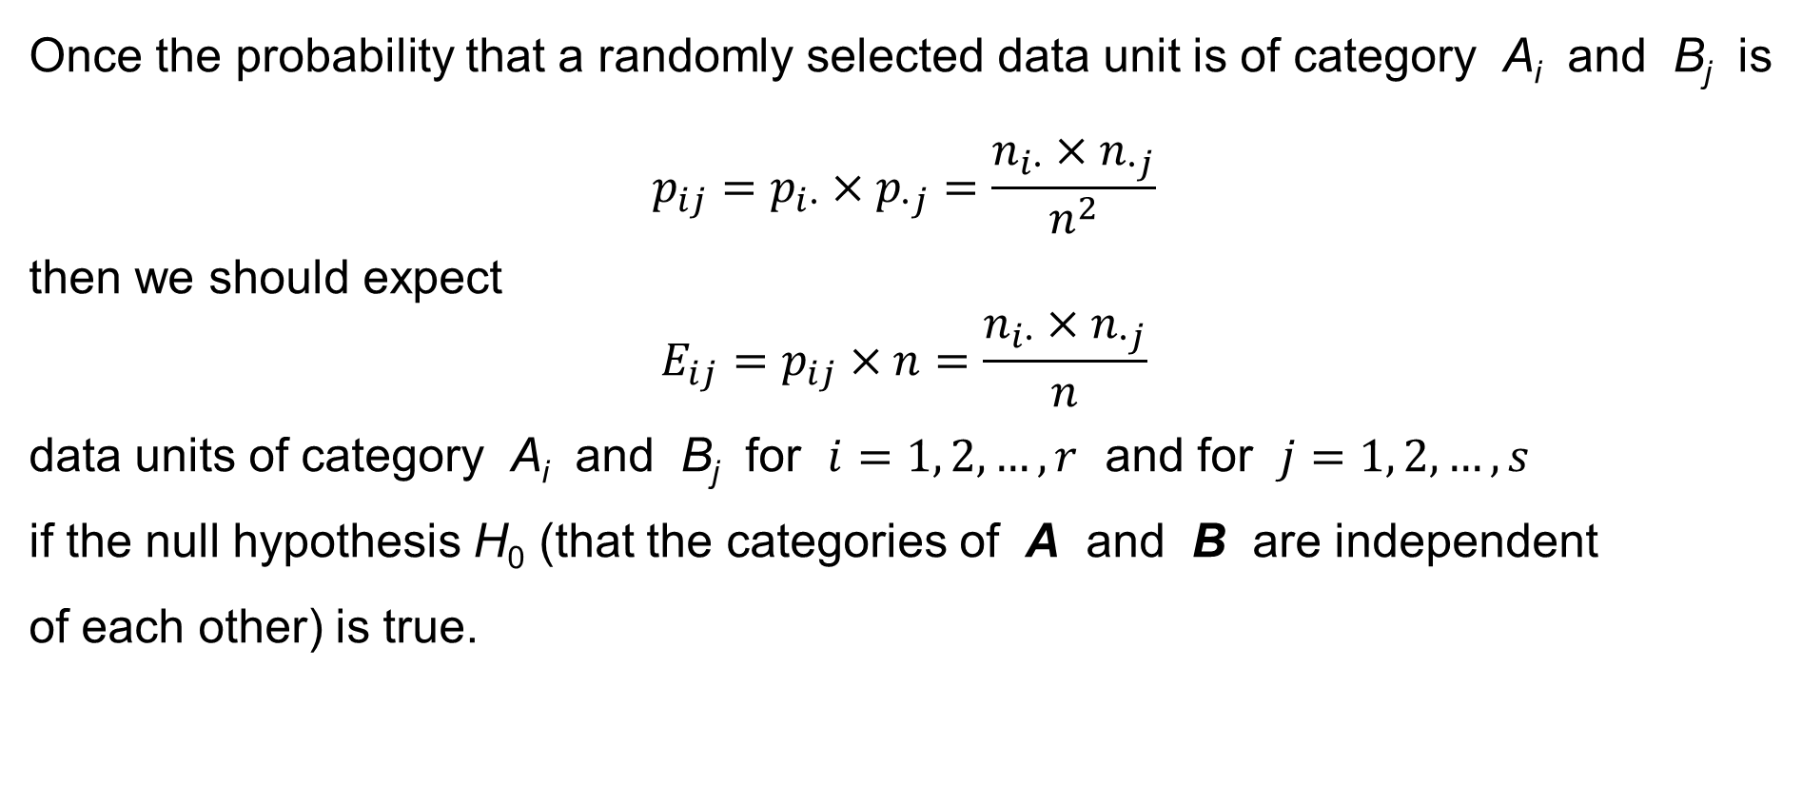
χ²-test of independence of qualitative data items
Once the probability that a randomly selected data unit is of category A_{i} and B_{j} is
$$p_{ij}=p_{i∙}×p_{∙j}=\frac{n_{i∙}×n_{∙j}}{n^{2}}$$
then we should expect
$$E_{ij}=p_{ij}×n=\frac{n_{i∙}×n_{∙j}}{n}$$
data units of category A_{i} and B_{j} for $i=1, 2,…,r$ and for $j=1, 2,…,s$
if the null hypothesis H₀ (that the categories of A and B are independent
of each other) is true.

Slide 48
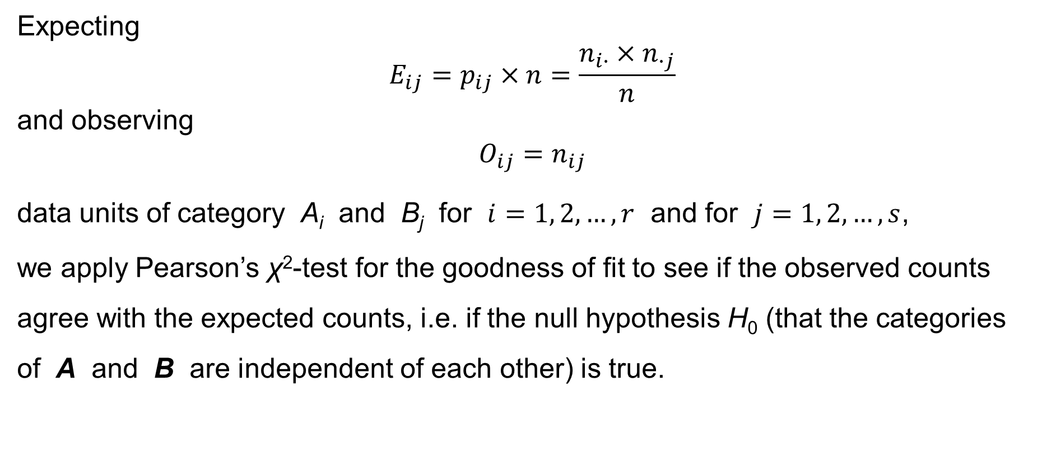
χ²-test of independence of qualitative data items
Expecting
$$E_{ij}=p_{ij}×n=\frac{n_{i∙}×n_{∙j}}{n}$$
and observing
$$O_{ij}=n_{ij}$$
data units of category A_{i} and B_{j} for $i=1, 2,…,r$ and for $j=1, 2,…,s$,
we apply Pearson’s χ²-test for the goodness of fit to see if the observed counts agree with the expected counts, i.e. if the null hypothesis H₀ (that the categories
of A and B are independent of each other) is true.

Slide 49
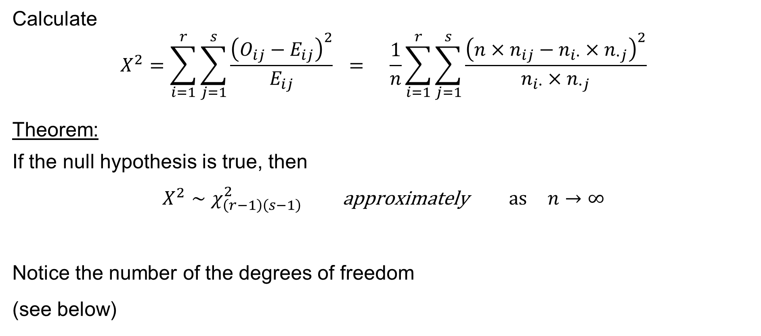
χ²-test of independence of qualitative data items
Calculate
$$X^{2}=\sum_{i=1}^{r}{\sum_{j=1}^{s}{\frac{{\left(O_{ij}−E_{ij}\right)}^{2}}{E_{ij}}}} = \frac{1}{n}\sum_{i=1}^{r}{\sum_{j=1}^{s}{\frac{{\left(n×n_{ij}−n_{i∙}×n_{∙j}\right)}^{2}}{n_{i∙}×n_{∙j}}}}$$
Theorem:
If the null hypothesis is true, then
$$X^{2}∼χ_{\left(r−1\right)\left(s−1\right)}^{2} \text{approximately} \text{as} n→∞$$
Notice the number of the degrees of freedom
(see below)

Slide 50
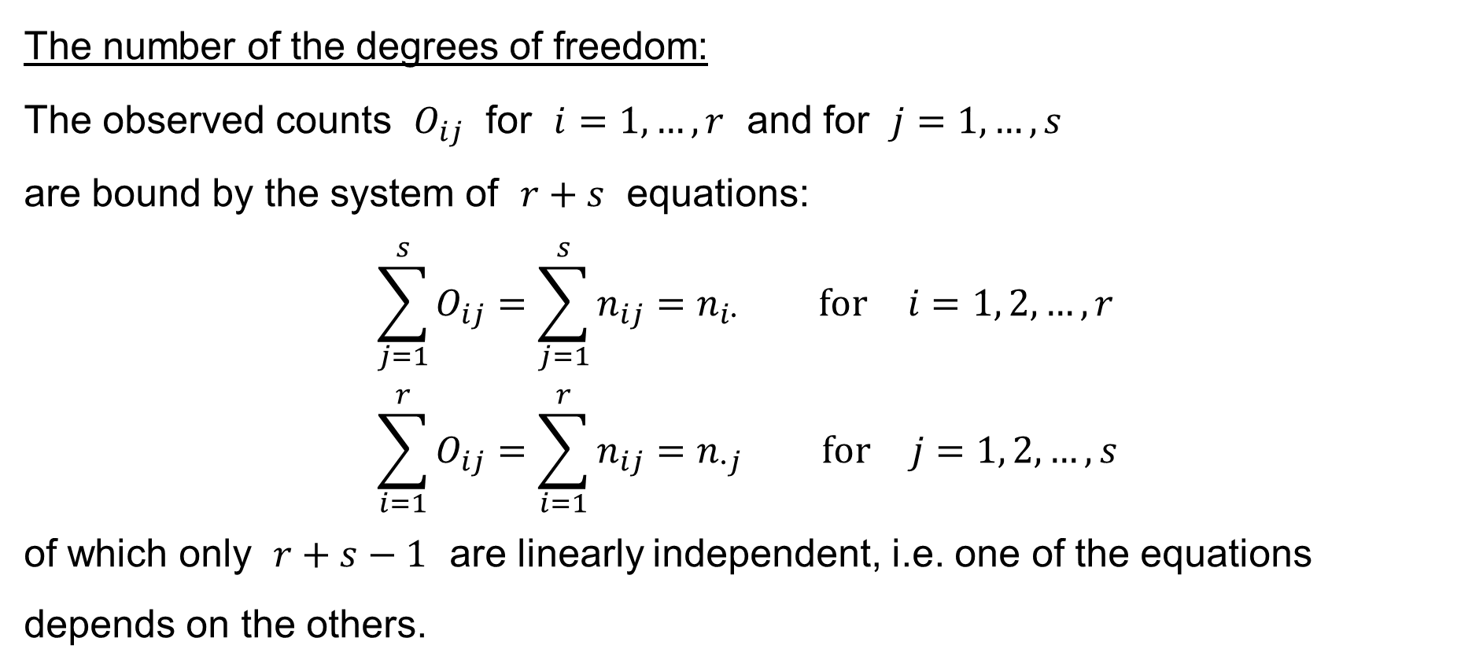
χ²-test of independence of qualitative data items
The number of the degrees of freedom:
The observed counts $O_{ij}$ for $i=1,…,r$ and for $j=1,…,s$
are bound by the system of $r+s$ equations:
$$\sum_{j=1}^{s}{O_{ij}}=\sum_{j=1}^{s}{n_{ij}}=n_{i∙} \text{for} i=1, 2,…,r \\ \sum_{i=1}^{r}{O_{ij}}=\sum_{i=1}^{r}{n_{ij}}=n_{∙j} \text{for} j=1, 2,…,s$$
of which only $r+s−1$ are linearly independent, i.e. one of the equations depends on the others.

Slide 51
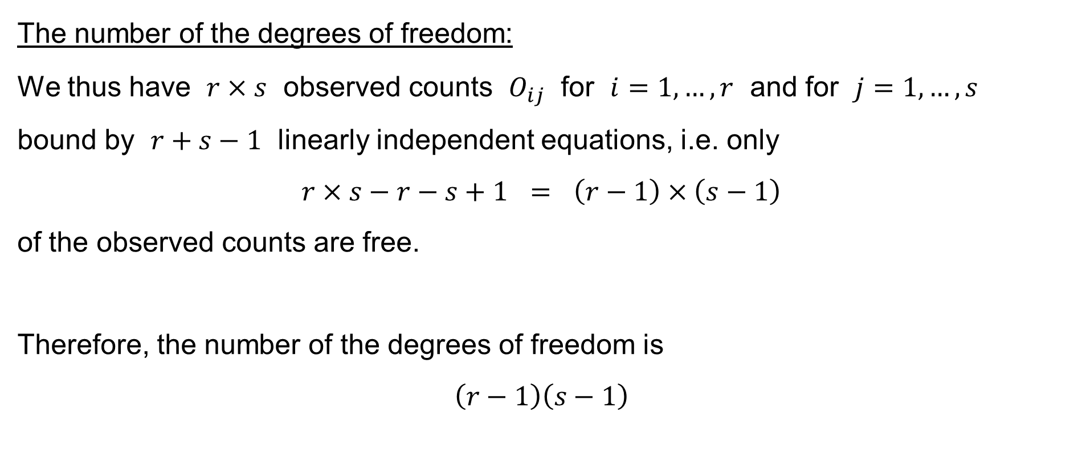
χ²-test of independence of qualitative data items
The number of the degrees of freedom:
We thus have $r×s$ observed counts $O_{ij}$ for $i=1,…,r$ and for $j=1,…,s$
bound by $r+s−1$ linearly independent equations, i.e. only
$$r×s−r−s+1 = \left(r−1\right)×\left(s−1\right)$$
of the observed counts are free.
Therefore, the number of the degrees of freedom is
$$\left(r−1\right)\left(s−1\right)$$

Slide 52
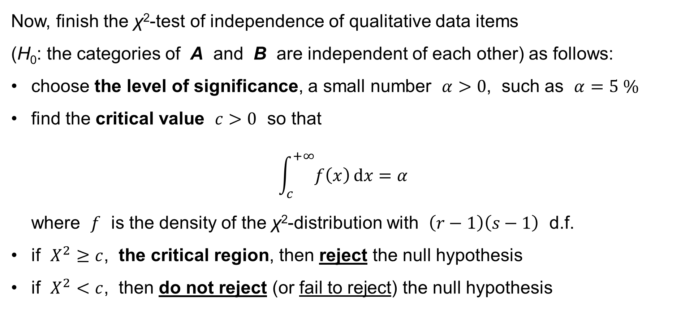
χ²-test of independence of qualitative data items
Now, finish the χ²-test of independence of qualitative data items
(H₀: the categories of A and B are independent of each other) as follows:
choose the level of significance, a small number $α>0$, such as $α=5 \%$
find the critical value $c>0$ so that
$\int_{c}^{+∞}{f\left(x\right) dx}=α$
where $f$ is the density of the χ²-distribution with $\left(r−1\right)\left(s−1\right)$ d.f.
if $X^{2}≥c$, the critical region, then reject the null hypothesis
if $X^{2}<c$, then do not reject (or fail to reject) the null hypothesis

