Slide 1
Statistics
Lecture 6
Discrete probability distributions
David Bartl
Statistics
INM/BASTA

Slide 2
Discrete probability distributions
Discrete uniform distribution
Bernoulli Trials
Binomial distribution
Poisson distribution
Some other discrete probability distributions

Slide 3
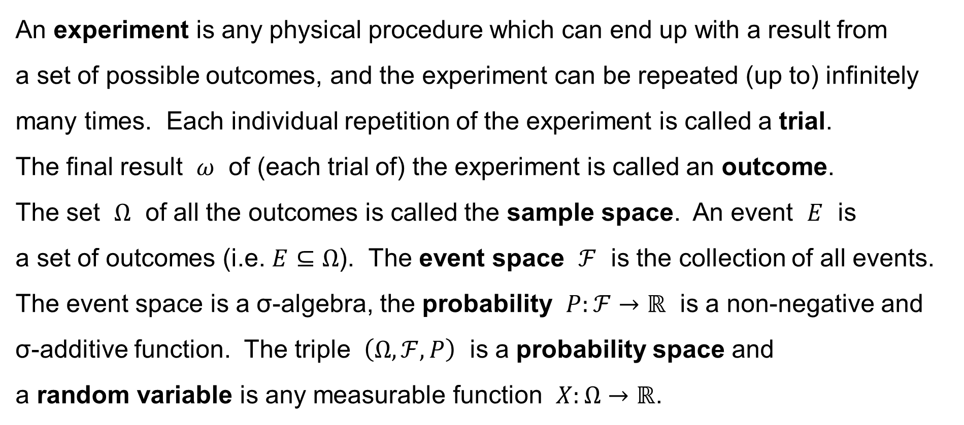
Experiment — Trial — Random variable
An experiment is any physical procedure which can end up with a result from
a set of possible outcomes, and the experiment can be repeated (up to) infinitely many times. Each individual repetition of the experiment is called a trial.
The final result $ω$ of (each trial of) the experiment is called an outcome.
The set $Ω$ of all the outcomes is called the sample space. An event $E$ is
a set of outcomes (i.e. $E⊆Ω$). The event space $ℱ$ is the collection of all events. The event space is a σ-algebra, the probability $P:ℱ→ℝ$ is a non-negative and
σ-additive function. The triple $\left(Ω,ℱ,P\right)$ is a probability space and
a random variable is any measurable function $X:Ω→ℝ$.

Slide 4
Random variable — Dataset
To conclude, the random variable assigns a numerical value to each outcome of the random experiment.
Now, a dataset is a collection of measurements and observations, i.e.
it is a collection of data. A data unit is an entity of the population under study,
and a data item or a variable is a characteristics of each data unit.
We are considering numerical (quantitative) variables now.
We assume the hypothesis that the data items in the dataset are realizations
of the random variable, i.e. the random variable (via the trials of the random experiment) generates the data.

Slide 5
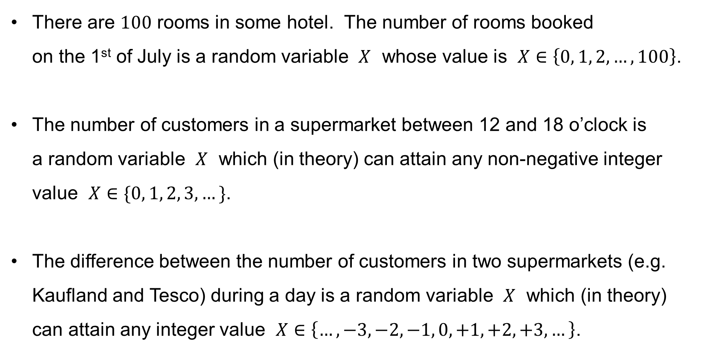
Examples of discrete random variables
There are $100$ rooms in some hotel. The number of rooms booked
on the 1st of July is a random variable $X$ whose value is $X∈\left\{0, 1, 2,…,100\right\}$.
The number of customers in a supermarket between 12 and 18 o’clock is
a random variable $X$ which (in theory) can attain any non-negative integer value $X∈\{0, 1, 2, 3,…\}$.
The difference between the number of customers in two supermarkets (e.g. Kaufland and Tesco) during a day is a random variable $X$ which (in theory)
can attain any integer value $X∈\left\{…,−3,−2,−1, 0,+1,+2,+3,…\right\}$.

Slide 6
Discrete probability distributions
The purpose of this lecture, however, is to present the most important,
yet elementary, discrete probability distributions.
We shall present:
— the uniform distribution
— Bernoulli’s experiment
— the binomial distribution
— Poisson’s distribution

Slide 7
Discrete uniform distribution

Slide 8
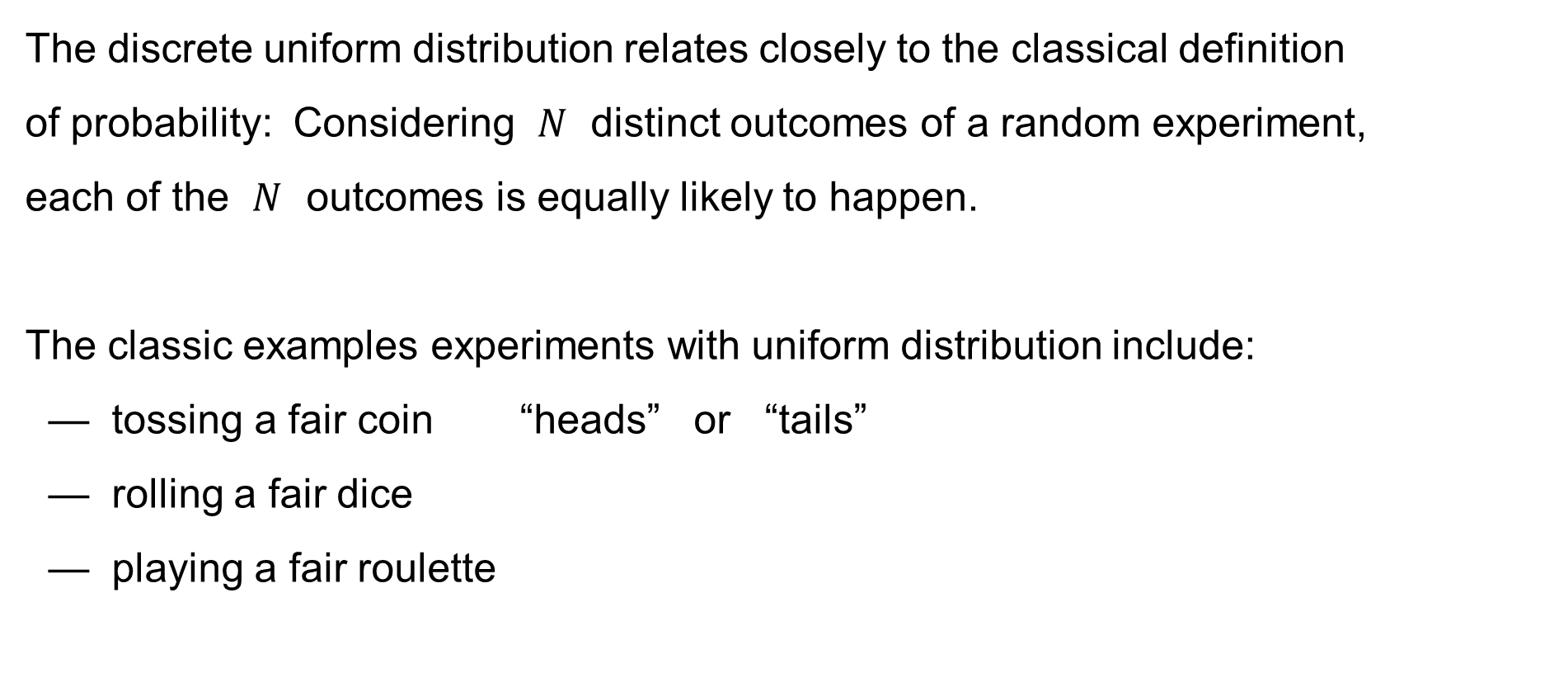
Uniform distribution (discrete)
The discrete uniform distribution relates closely to the classical definition
of probability: Considering $N$ distinct outcomes of a random experiment,
each of the $N$ outcomes is equally likely to happen.
The classic examples experiments with uniform distribution include:
— tossing a fair coin “heads” or “tails”
— rolling a fair dice
— playing a fair roulette
21
16
11
6
1
32
27
22
26
17
31
12
36
7
5
2
10
33
15
28
20
23
25
18
30
13
35
4
9
14
29
34
3
8
19
24

Slide 9
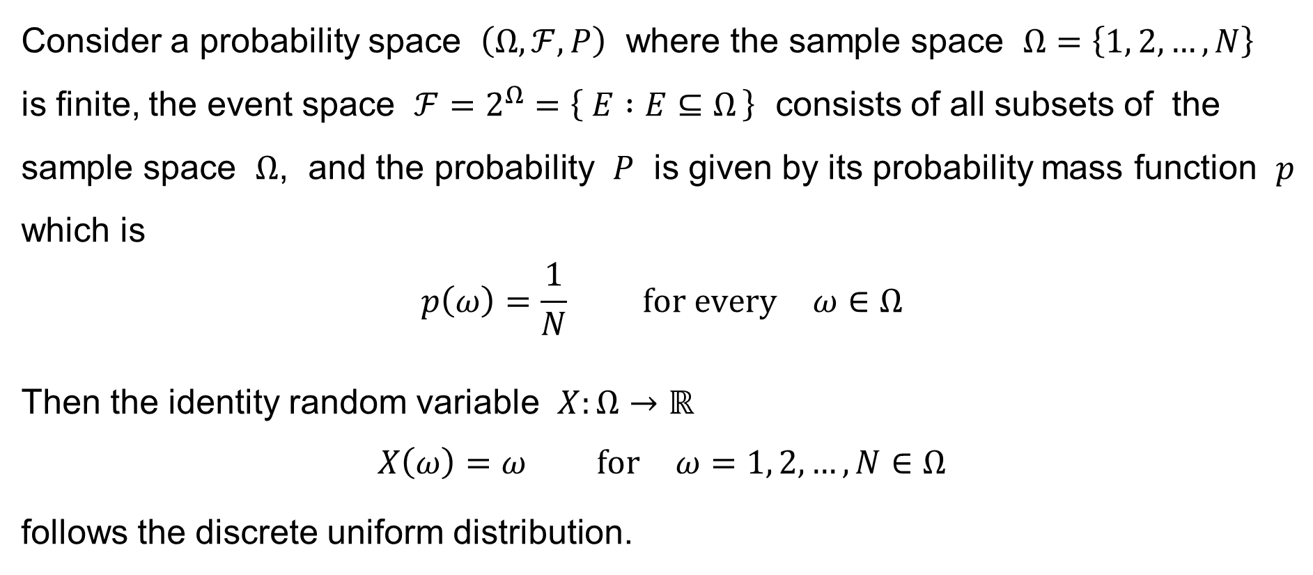
Uniform distribution (discrete)
Consider a probability space $\left(Ω,ℱ,P\right)$ where the sample space $Ω=\left\{1, 2,…,N\right\}$
is finite, the event space $ℱ=2^{Ω}=\left\{ E :E⊆Ω \right\}$ consists of all subsets of the sample space $Ω$, and the probability $P$ is given by its probability mass function $p$ which is
$$p\left(ω\right)=\frac{1}{N} \text{for} \text{every} ω∈Ω$$
Then the identity random variable $X:Ω→ℝ$
$$X\left(ω\right)=ω \text{for} ω=1, 2,…,N∈Ω$$
follows the discrete uniform distribution.

Slide 10
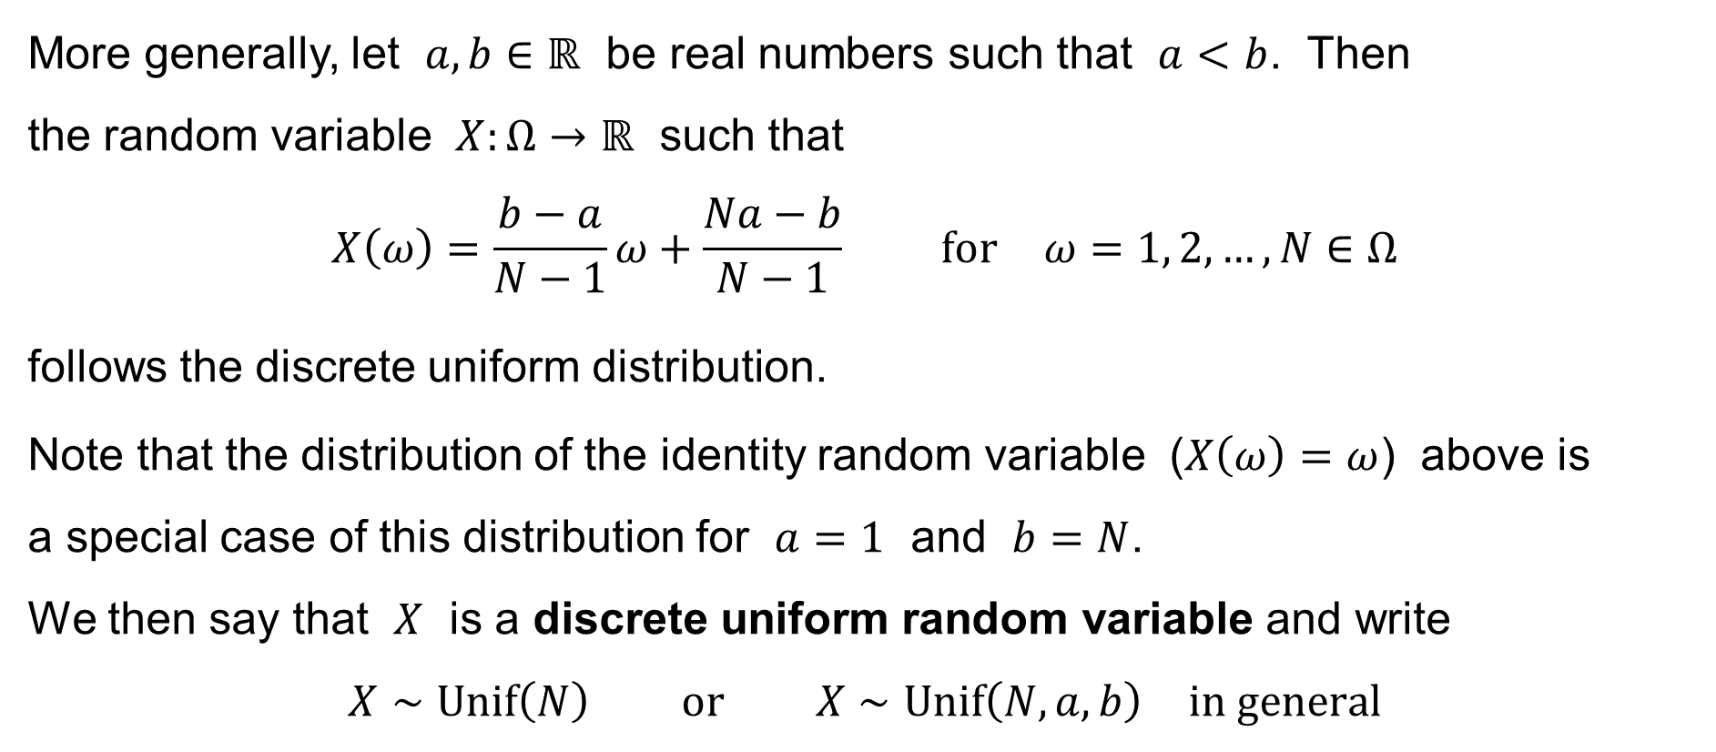
Uniform distribution (discrete)
More generally, let $a,b∈ℝ$ be real numbers such that $a<b$. Then
the random variable $X:Ω→ℝ$ such that
$$X\left(ω\right)=\frac{b−a}{N−1}ω+\frac{Na−b}{N−1} \text{for} ω=1, 2,…,N∈Ω$$
follows the discrete uniform distribution.
Note that the distribution of the identity random variable ($X\left(ω\right)=ω$) above is
a special case of this distribution for $a=1$ and $b=N$.
We then say that $X$ is a discrete uniform random variable and write
$$X∼Unif\left(N\right) \text{or} X∼Unif\left(N,a,b\right) \text{in} \text{general}$$

Slide 11














Uniform distribution (discrete)
The graph of the probability mass function
of a discrete uniform random variable $X∼Unif\left(N\right)$:
$$\frac{1}{N}$$
$$p\left(x\right)$$
$$…$$
$$0$$
$$x$$
$$0$$
$$1$$
$$2$$
$$3$$
$$4$$
$$5$$
$$…$$
$$N$$

Slide 12












Uniform distribution (discrete)
The graph of the probability mass function of the result of rolling a dice
(which is a discrete uniform random variable $X∼Unif\left(6\right)$):
$$\frac{1}{6}$$
$$p\left(x\right)$$
$$0$$
$$x$$
$$0$$
$$1$$
$$2$$
$$3$$
$$4$$
$$5$$
$$6$$

Slide 13
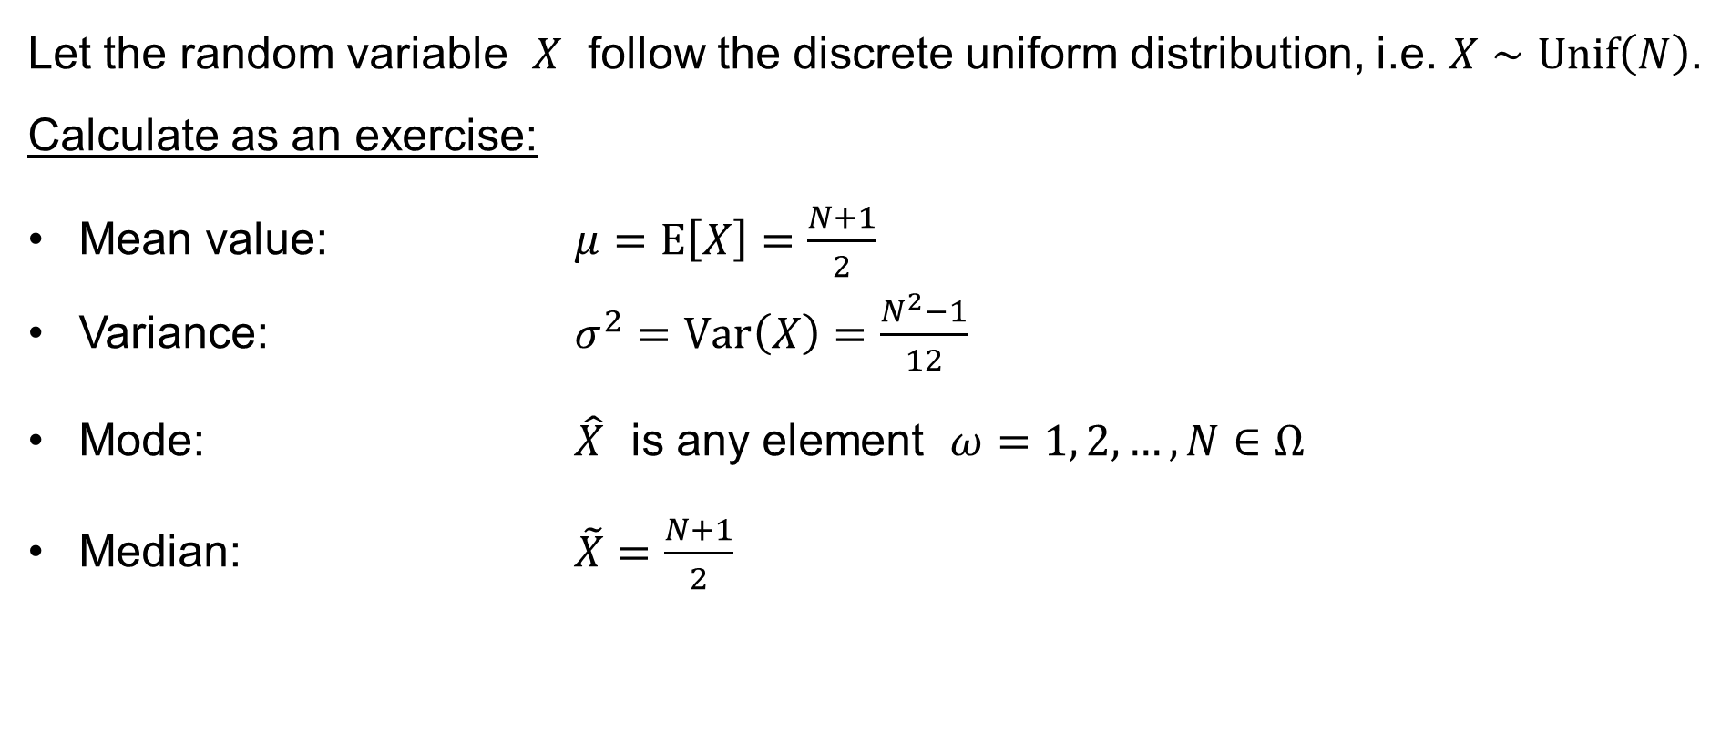
Uniform distribution (discrete)
Let the random variable $X$ follow the discrete uniform distribution, i.e. $X∼Unif\left(N\right)$.
Calculate as an exercise:
Mean value: $μ=E\left[X\right]=\frac{N+1}{2}$
Variance: $σ^{2}=Var\left(X\right)=\frac{N^{2}−1}{12}$
Mode: $\hat{X}$ is any element $ω=1, 2,…,N∈Ω$
Median: $\tilde{X}=\frac{N+1}{2}$

Slide 14
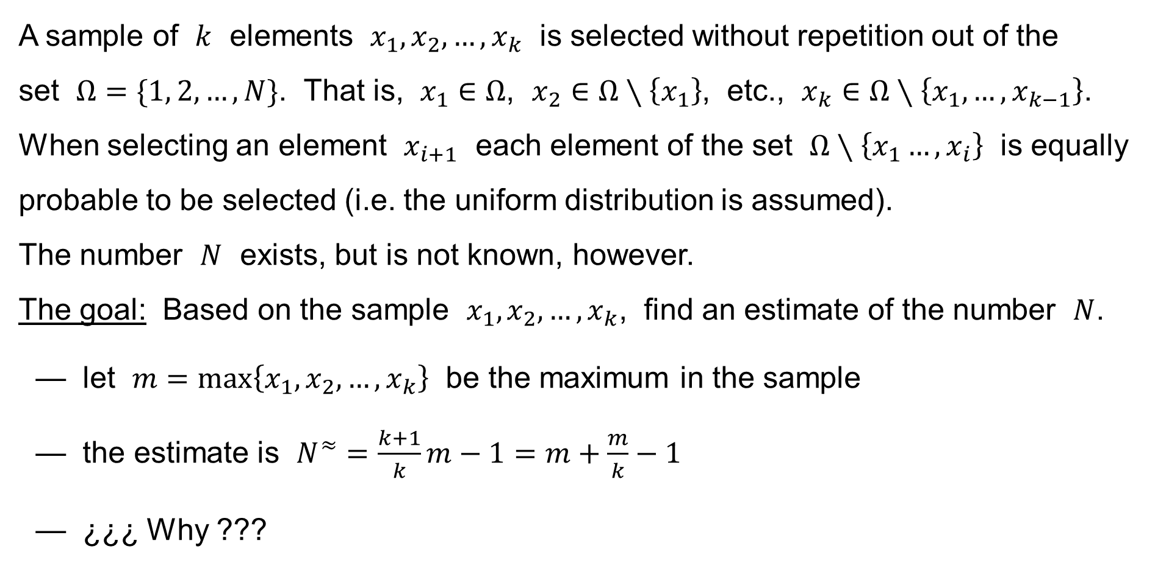
An application: the German Tank Problem
A sample of $k$ elements $x_{1},x_{2},…,x_{k}$ is selected without repetition out of the
set $Ω=\{1, 2,…,N\}$. That is, $x_{1}∈Ω$, $x_{2}∈Ω∖\left\{x_{1}\right\}$, etc., $x_{k}∈Ω∖\left\{x_{1},…,x_{k−1}\right\}$.
When selecting an element $x_{i+1}$ each element of the set $Ω∖\left\{x_{1}…,x_{i}\right\}$ is equally probable to be selected (i.e. the uniform distribution is assumed).
The number $N$ exists, but is not known, however.
The goal: Based on the sample $x_{1},x_{2},…,x_{k}$, find an estimate of the number $N$.
— let $m=\max\left\{x_{1},x_{2},…,x_{k}\right\}$ be the maximum in the sample
— the estimate is $N^{≈}=\frac{k+1}{k}m−1=m+\frac{m}{k}−1$
— ¿¿¿ Why ???

Slide 15
Binomial distribution
Bernoulli Trials
Binomial distribution

Slide 16
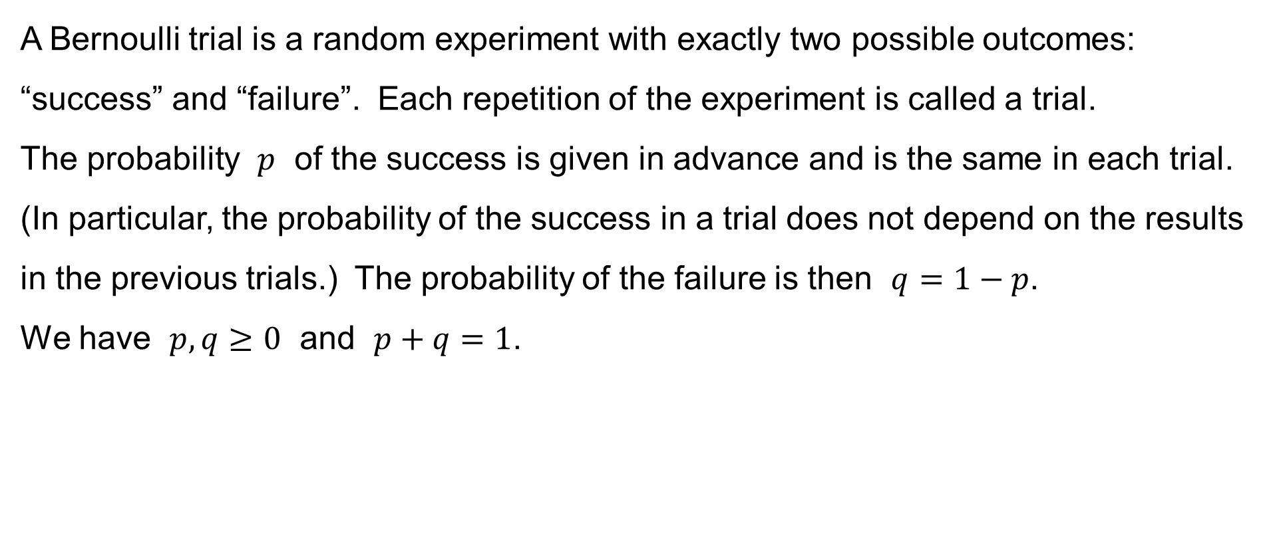
Bernoulli Trials
A Bernoulli trial is a random experiment with exactly two possible outcomes: “success” and “failure”. Each repetition of the experiment is called a trial.
The probability $p$ of the success is given in advance and is the same in each trial. (In particular, the probability of the success in a trial does not depend on the results in the previous trials.) The probability of the failure is then $q=1−p$.
We have $p,q≥0$ and $p+q=1$.

Slide 17
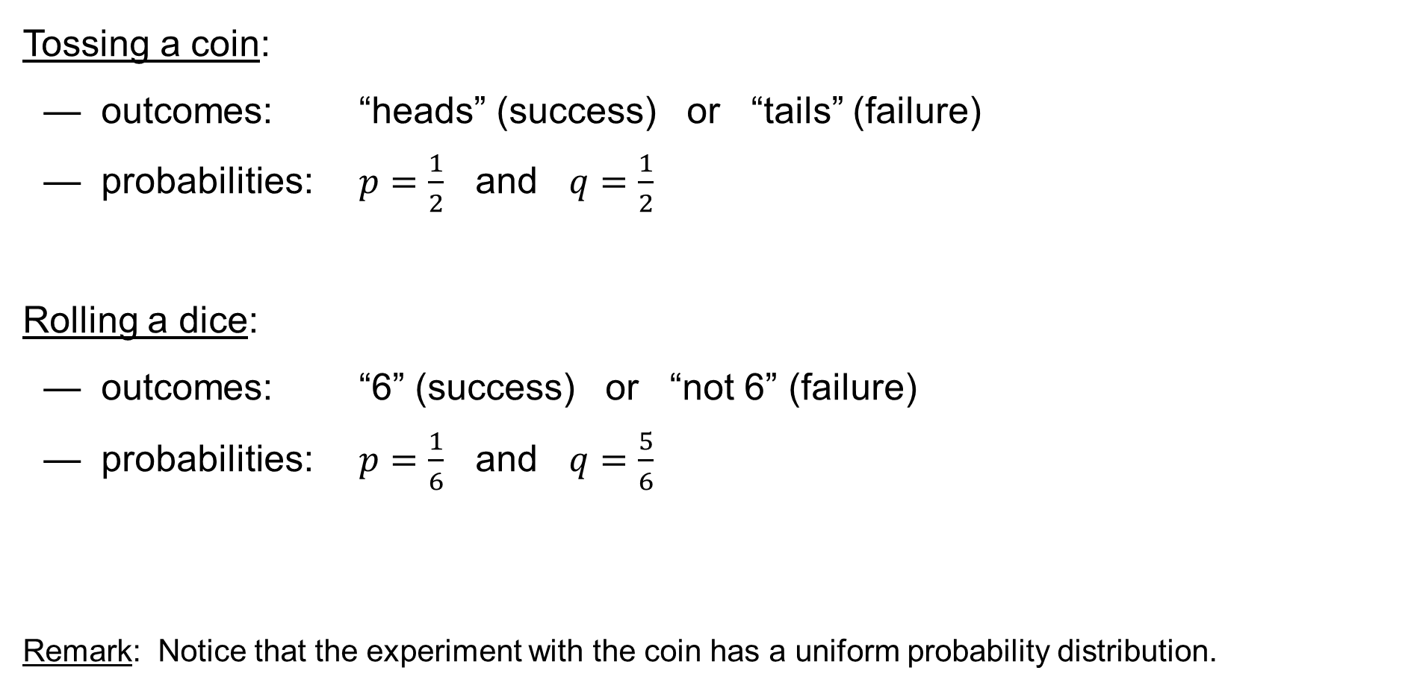
Examples of Bernoulli Trials
Tossing a coin:
— outcomes: “heads” (success) or “tails” (failure)
— probabilities: $p=\frac{1}{2}$ and $q=\frac{1}{2}$
Rolling a dice:
— outcomes: “6” (success) or “not 6” (failure)
— probabilities: $p=\frac{1}{6}$ and $q=\frac{5}{6}$
Remark: Notice that the experiment with the coin has a uniform probability distribution.

Slide 18
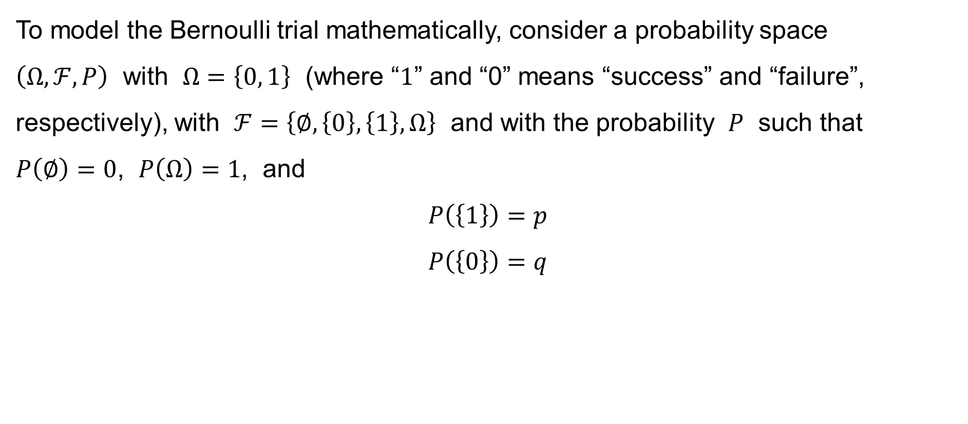
Mathematical model of the Bernoulli Trial
To model the Bernoulli trial mathematically, consider a probability space
$\left(Ω,ℱ,P\right)$ with $Ω=\left\{0, 1\right\}$ (where “$1$” and “0” means “success” and “failure”, respectively), with $ℱ=\left\{∅,\left\{0\right\},\left\{1\right\},Ω\right\}$ and with the probability $P$ such that
$P\left(∅\right)=0$, $P\left(Ω\right)=1$, and
$$P\left(\left\{1\right\}\right)=p$$
$$P\left(\left\{0\right\}\right)=q$$

Slide 19
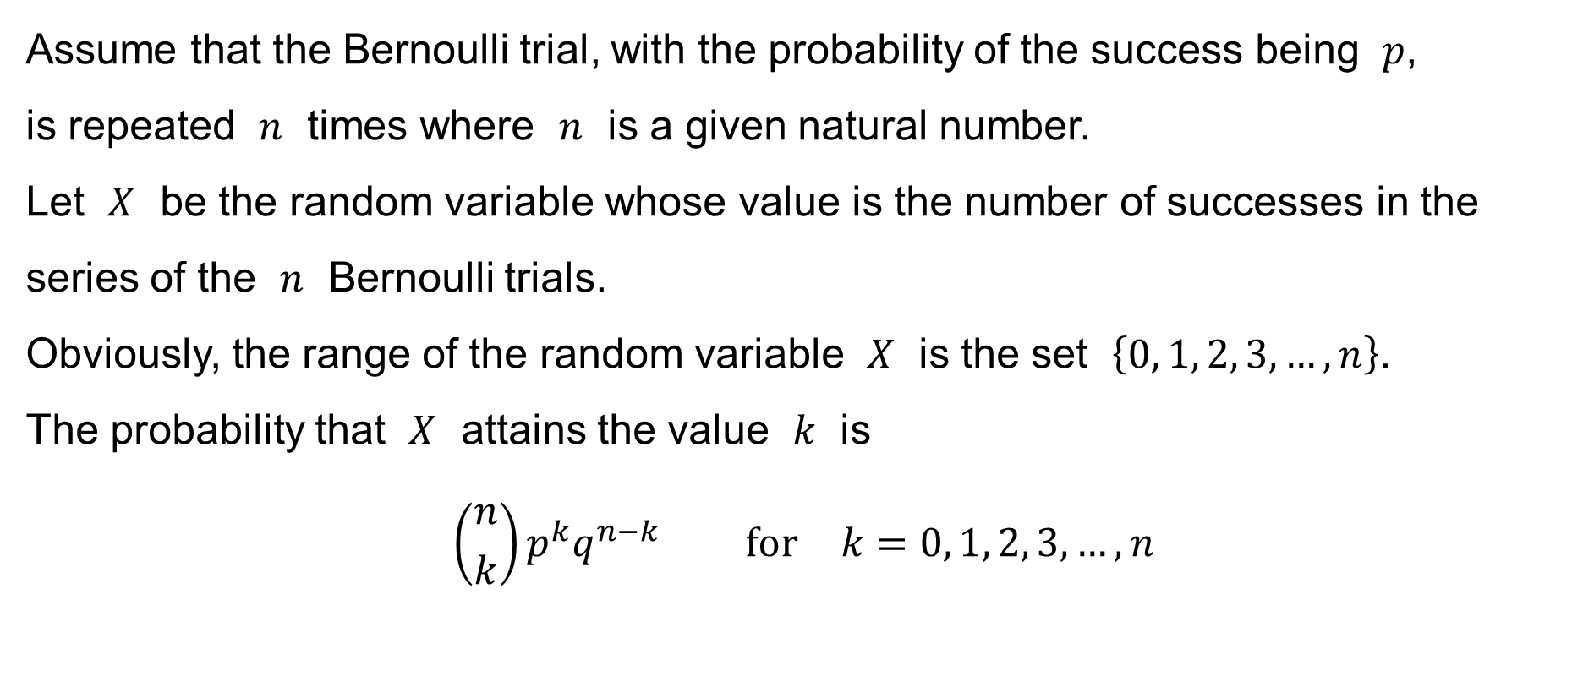
Binomial distribution
Assume that the Bernoulli trial, with the probability of the success being $p$,
is repeated $n$ times where $n$ is a given natural number.
Let $X$ be the random variable whose value is the number of successes in the series of the $n$ Bernoulli trials.
Obviously, the range of the random variable $X$ is the set $\left\{0, 1, 2, 3,…,n\right\}$.
The probability that $X$ attains the value $k$ is
$$\left({n \atop k}\right)p^{k}q^{n−k} \text{for} k=0, 1, 2, 3,…,n$$

Slide 20
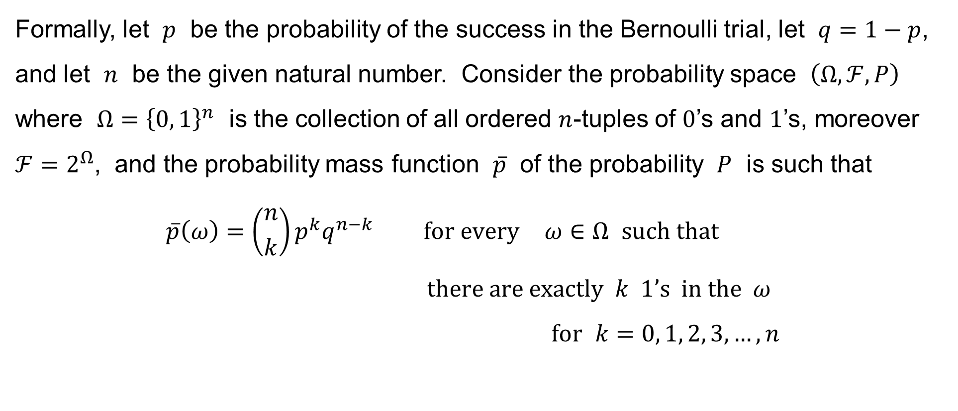
Binomial distribution
Formally, let $p$ be the probability of the success in the Bernoulli trial, let $q=1−p$, and let $n$ be the given natural number. Consider the probability space $\left(Ω,ℱ,P\right)$ where $Ω={\left\{0, 1\right\}}^{n}$ is the collection of all ordered $n$-tuples of $0$’s and $1$’s, moreover $ℱ=2^{Ω}$, and the probability mass function $\overline{p}$ of the probability $P$ is such that
$$\overline{p}\left(ω\right)=\left({n \atop k}\right)p^{k}q^{n−k} \text{for} \text{every} ω∈Ω \text{such} \text{that} \\ \text{there} \text{are} \text{exactly} k 1’\text{s} \text{in} \text{the} ω \\ \text{for} k=0, 1, 2, 3,…,n$$

Slide 21
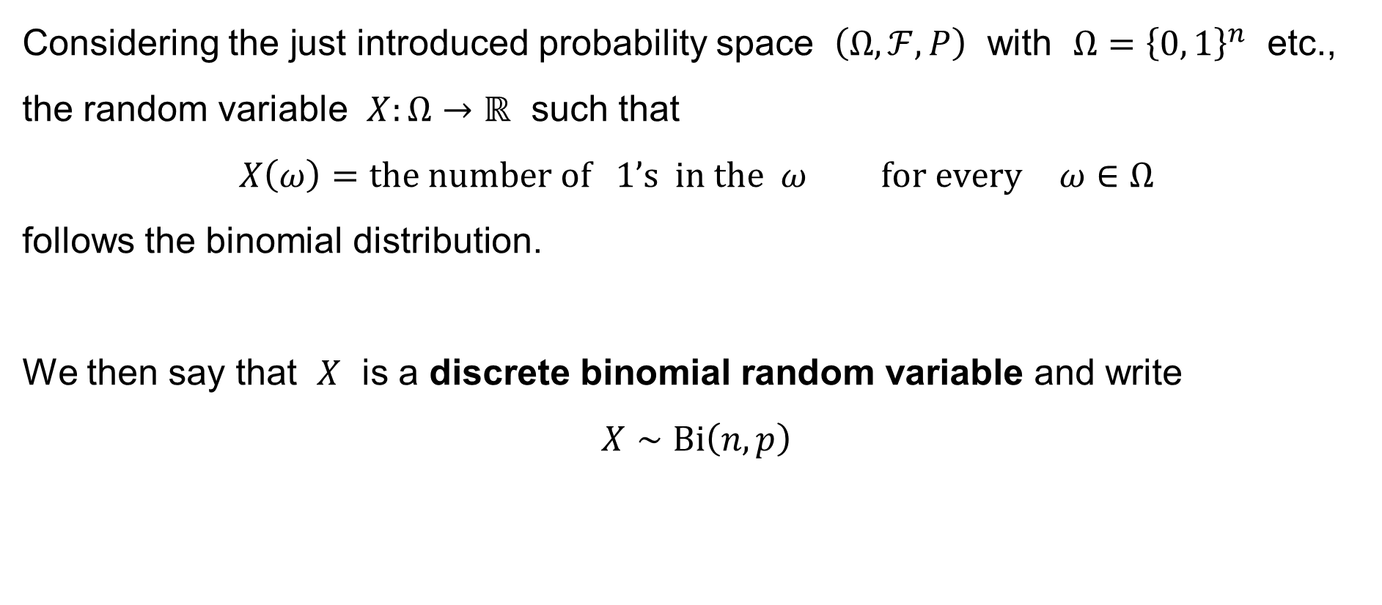
Binomial distribution
Considering the just introduced probability space $\left(Ω,ℱ,P\right)$ with $Ω={\left\{0, 1\right\}}^{n}$ etc., the random variable $X:Ω→ℝ$ such that
$$X\left(ω\right)=\text{the} \text{number} \text{of} 1\text{’}\text{s} \text{in} \text{the} ω \text{for} \text{every} ω∈Ω$$
follows the binomial distribution.
We then say that $X$ is a discrete binomial random variable and write
$$X∼Bi\left(n,p\right)$$

Slide 22














Binomial distribution
The graph of the probability mass function of an $X∼Bi\left(6, 0.5\right)$ :
$$0.312500$$
$$0.234375$$
$$0.093750$$
$$p\left(x\right)$$
$$0.015625$$
$$0$$
$$x$$
$$0$$
$$1$$
$$2$$
$$3$$
$$4$$
$$5$$
$$6$$

Slide 23






Binomial distribution
The graph of the probability mass function of an $X∼Bi\left(4, 0.2\right)$ :
$$0.4096$$
$$0.1536$$
$$0.0256$$
$$p\left(x\right)$$
$$0.0016$$
$$0$$
$$x$$
$$0$$
$$1$$
$$2$$
$$3$$
$$4$$

Slide 24

Binomial distribution
Let the random variable $X∼Bi\left(n,p\right)$.
Calculate as an exercise:
Mean value: $μ=E\left[X\right]=np$
Variance: $σ^{2}=Var\left(X\right)=np(1−p)$
Mode: $\hat{X}$

Slide 25
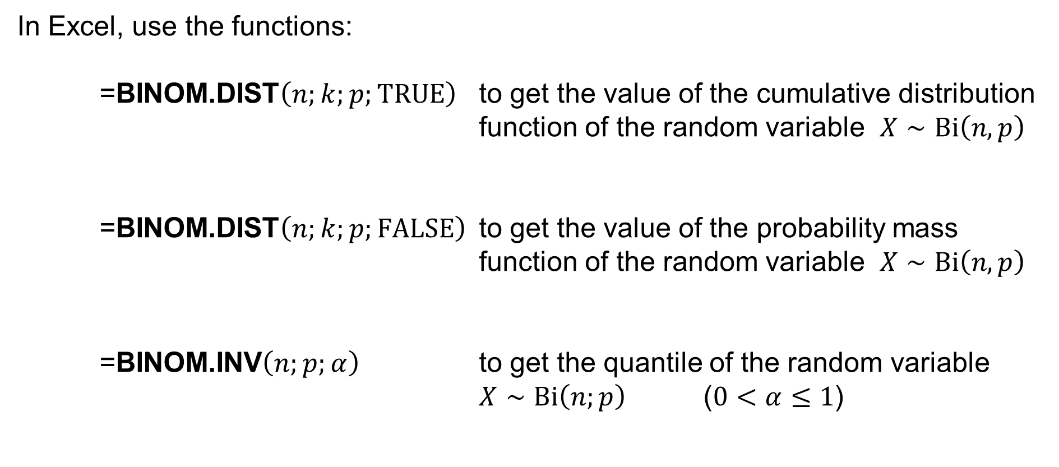
Binomial distribution in Excel
In Excel, use the functions:
=BINOM.DIST$\left(n;k;p;TRUE\right)$ to get the value of the cumulative distribution function of the random variable $X∼Bi\left(n,p\right)$
=BINOM.DIST$\left(n;k;p;FALSE\right)$ to get the value of the probability mass function of the random variable $X∼Bi\left(n,p\right)$
=BINOM.INV$\left(n;p;α\right)$ to get the quantile of the random variable $X∼Bi\left(n;p\right)$ ($0<α≤1$)

Slide 26
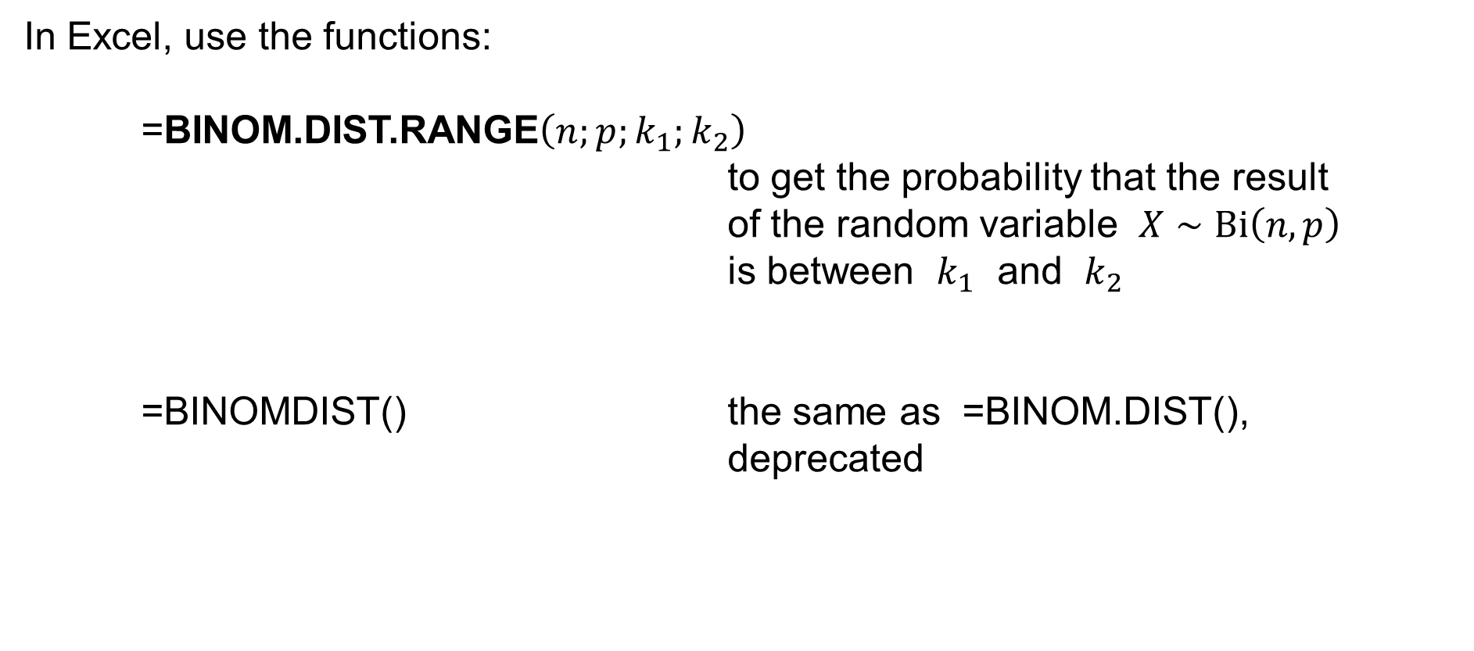
Binomial distribution in Excel
In Excel, use the functions:
=BINOM.DIST.RANGE$\left(n;p;k_{1};k_{2}\right)$
to get the probability that the result of the random variable $X∼Bi\left(n,p\right)$
is between $k_{1}$ and $k_{2}$
=BINOMDIST() the same as =BINOM.DIST(),
deprecated

Slide 27
Poisson distribution

Slide 28
Poisson distribution
There are some events, such as
— customers coming to a shop during one hour (between 10:00 and 11:00, say)
— telephone calls incoming during one hour (between 10:00 and 11:00, say)
— requests incoming to a server during one minute (between 10:00 and 10:01)
— meteorites of diameter ≥ 1 meter hitting the Earth during a year
— decay events from a radioactive source
that (as we suppose) have some properties in common.

Slide 29
Poisson distribution
Suppose that a random event occurs repeatedly and satisfies
the following assumptions:
the event can occur at any time
the average number of occurrences of the event during an interval of time
of a fixed length is constant; the number does not depend on the beginning
of the interval, and does not depend on the number of occurrences of the event before the beginning of the time interval
the average number of occurrences of the event during an interval of time is proportional to the length of the interval
…

Slide 30
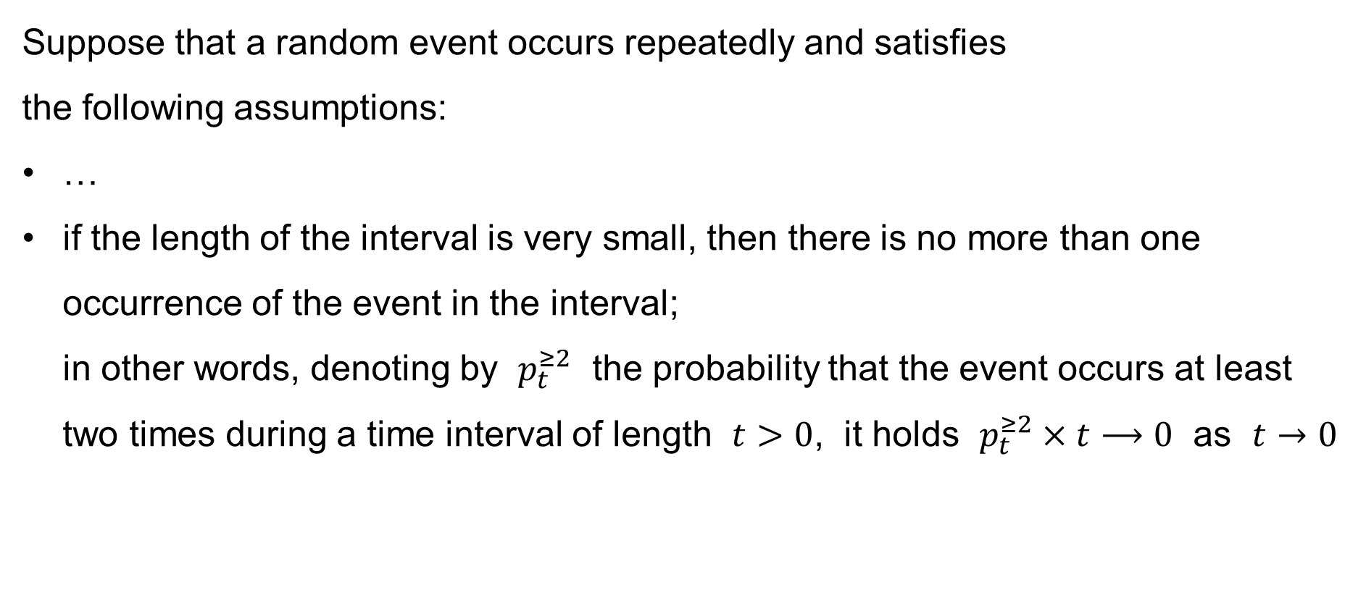
Poisson distribution
Suppose that a random event occurs repeatedly and satisfies
the following assumptions:
…
if the length of the interval is very small, then there is no more than one occurrence of the event in the interval;
in other words, denoting by $p_{t}^{≥2}$ the probability that the event occurs at least two times during a time interval of length $t>0$, it holds $p_{t}^{≥2}×t⟶0$ as $t→0$

Slide 31
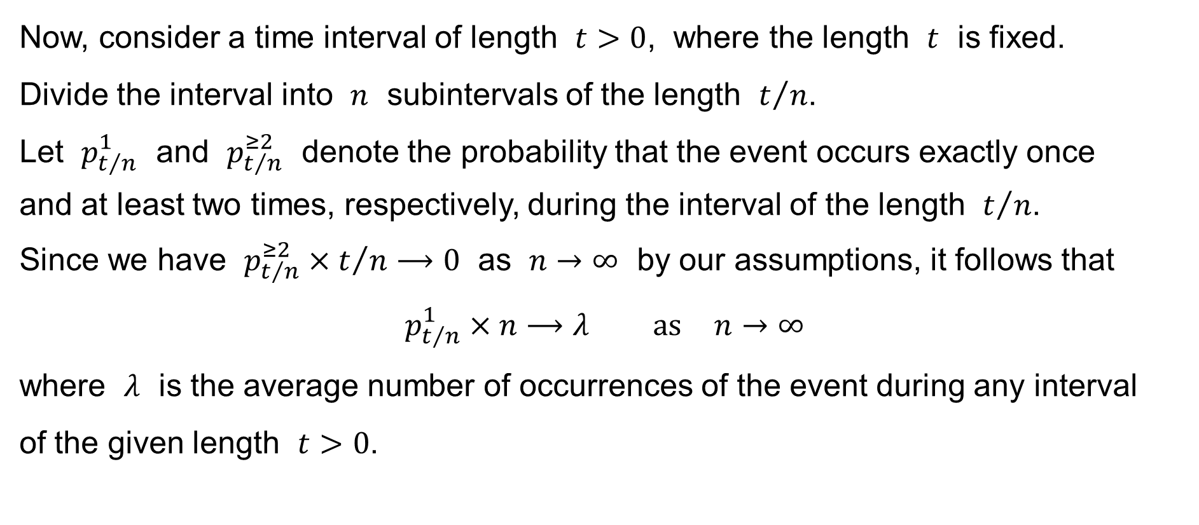
Poisson distribution
Now, consider a time interval of length $t>0$, where the length $t$ is fixed.
Divide the interval into $n$ subintervals of the length $t/n$.
Let $p_{t/n}^{1}$ and $p_{t/n}^{≥2}$ denote the probability that the event occurs exactly once
and at least two times, respectively, during the interval of the length $t/n$.
Since we have $p_{t/n}^{≥2}×t/n⟶0$ as $n→∞$ by our assumptions, it follows that
$$p_{t/n}^{1}×n⟶λ \text{as} n→∞$$
where $λ$ is the average number of occurrences of the event during any interval
of the given length $t>0$.

Slide 32
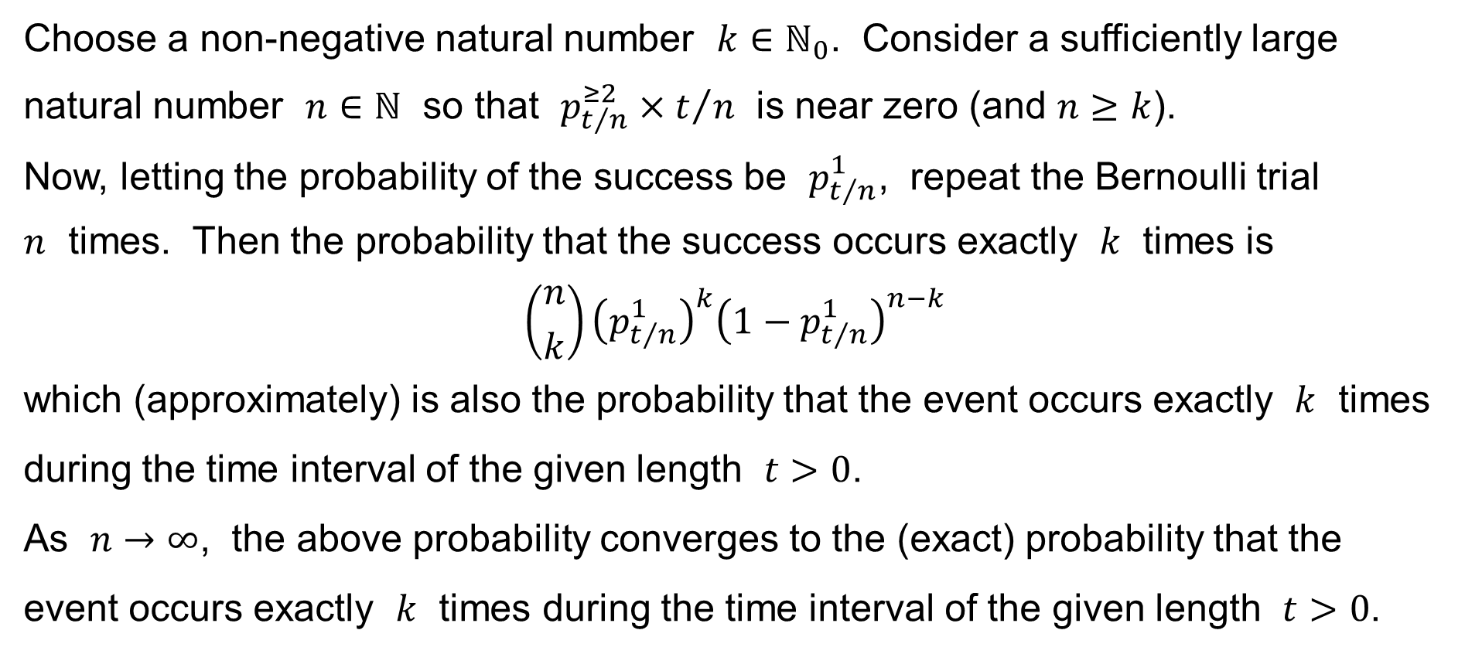
Poisson distribution
Choose a non-negative natural number $k∈ℕ_{0}$. Consider a sufficiently large natural number $n∈ℕ$ so that $p_{t/n}^{≥2}×t/n$ is near zero (and $n≥k$).
Now, letting the probability of the success be $p_{t/n}^{1}$, repeat the Bernoulli trial
$n$ times. Then the probability that the success occurs exactly $k$ times is
$$\left({n \atop k}\right){\left(p_{t/n}^{1}\right)}^{k}{\left(1−p_{t/n}^{1}\right)}^{n−k}$$
which (approximately) is also the probability that the event occurs exactly $k$ times during the time interval of the given length $t>0$.
As $n→∞$, the above probability converges to the (exact) probability that the event occurs exactly $k$ times during the time interval of the given length $t>0$.

Slide 33
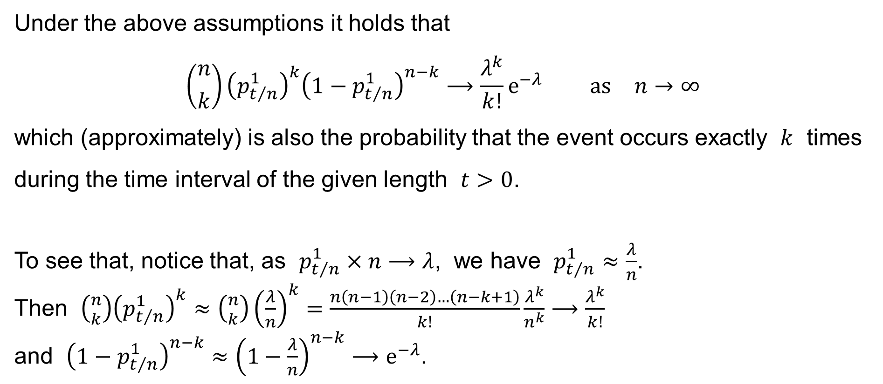
Poisson’s Theorem
Under the above assumptions it holds that
$$\left({n \atop k}\right){\left(p_{t/n}^{1}\right)}^{k}{\left(1−p_{t/n}^{1}\right)}^{n−k}⟶\frac{λ^{k}}{k!}e^{−λ} \text{as} n→∞$$
which (approximately) is also the probability that the event occurs exactly $k$ times during the time interval of the given length $t>0$.
To see that, notice that, as $p_{t/n}^{1}×n⟶λ$, we have $p_{t/n}^{1}≈\frac{λ}{n}$.
Then $\left({n \atop k}\right){\left(p_{t/n}^{1}\right)}^{k}≈\left({n \atop k}\right){\left(\frac{λ}{n}\right)}^{k}=\frac{n\left(n−1\right)\left(n−2\right)…\left(n−k+1\right)}{k!}\frac{λ^{k}}{n^{k}}⟶\frac{λ^{k}}{k!}$
and ${\left(1−p_{t/n}^{1}\right)}^{n−k}≈{\left(1−\frac{λ}{n}\right)}^{n−k}⟶e^{−λ}$.

Slide 34
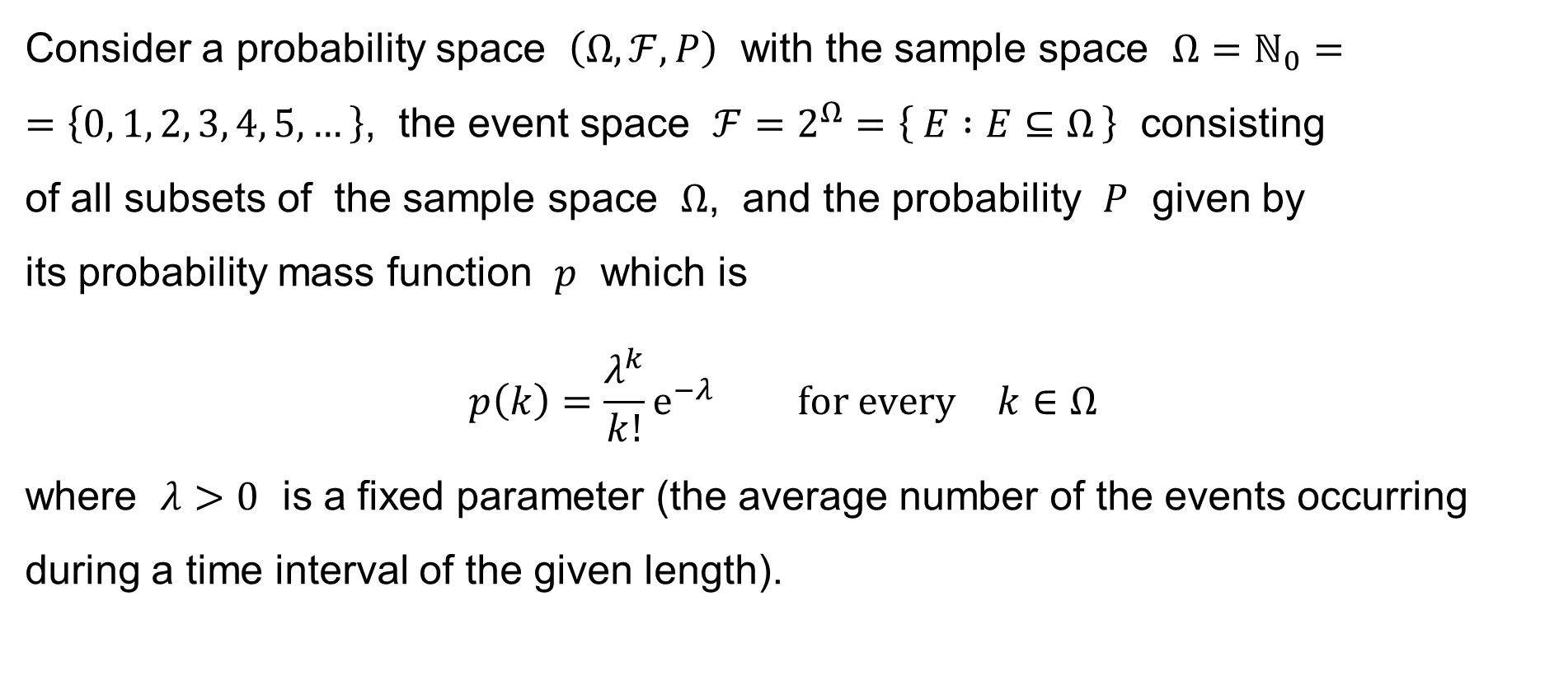
Poisson distribution
Consider a probability space $\left(Ω,ℱ,P\right)$ with the sample space $Ω=ℕ_{0}=$
$=\left\{0, 1, 2, 3, 4, 5,…\right\}$, the event space $ℱ=2^{Ω}=\left\{ E :E⊆Ω \right\}$ consisting
of all subsets of the sample space $Ω$, and the probability $P$ given by
its probability mass function $p$ which is
$$p\left(k\right)=\frac{λ^{k}}{k!}e^{−λ} \text{for} \text{every} k∈Ω$$
where $λ>0$ is a fixed parameter (the average number of the events occurring during a time interval of the given length).

Slide 35
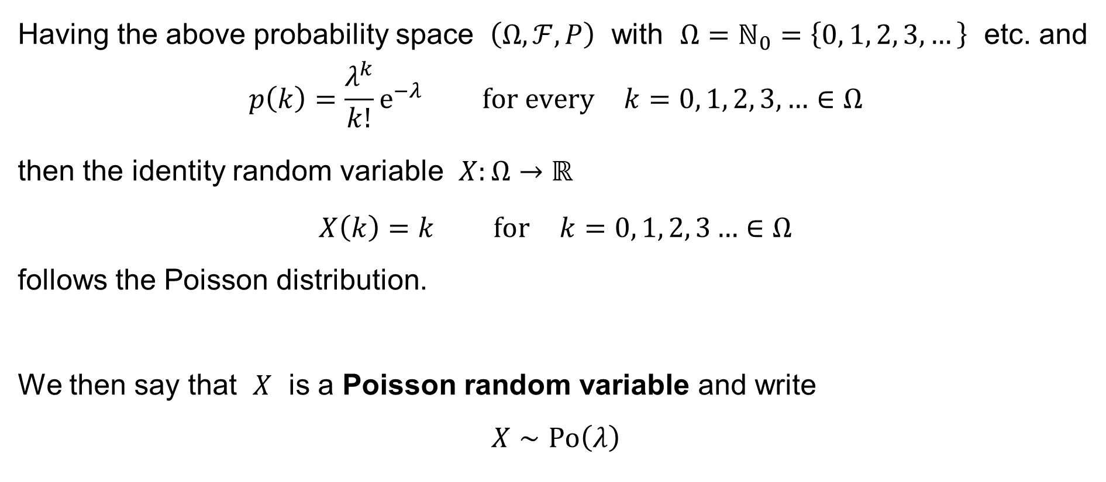
Poisson distribution
Having the above probability space $\left(Ω,ℱ,P\right)$ with $Ω=ℕ_{0}=\left\{0, 1, 2, 3,…\right\}$ etc. and
$$p\left(k\right)=\frac{λ^{k}}{k!}e^{−λ} \text{for} \text{every} k=0, 1, 2, 3,…∈Ω$$
then the identity random variable $X:Ω→ℝ$
$$X\left(k\right)=k \text{for} k=0, 1, 2, 3…∈Ω$$
follows the Poisson distribution.
We then say that $X$ is a Poisson random variable and write
$$X∼Po\left(λ\right)$$

Slide 36














Poisson distribution
The graph of the probability mass function of an $X∼Po\left(0.5\right)$:
$$\dot{=}0.606531$$
$$\dot{=}0.303265$$
$$\dot{=}0.075816$$
$$p\left(x\right)$$
$$\dot{=}0.012636$$
$$0$$
$$x$$
$$0$$
$$1$$
$$2$$
$$3$$
$$4$$
$$5$$
$$6$$
$$7$$
$$8$$
$$9$$
$$10$$
$$11$$
$$12$$
$$…$$

Slide 37







Poisson distribution
The graph of the probability mass function of an $X∼Po\left(1\right)$:
$$\dot{=}0.367879$$
$$\dot{=}0.183940$$
$$\dot{=}0.061313$$
$$\dot{=}0.015328$$
$$p\left(x\right)$$
$$\dot{=}0.003066$$
$$0$$
$$x$$
$$0$$
$$1$$
$$2$$
$$3$$
$$4$$
$$5$$
$$6$$
$$7$$
$$8$$
$$9$$
$$10$$
$$11$$
$$12$$
$$…$$

Slide 38













Poisson distribution
The graph of the probability mass function of an $X∼Po\left(5\right)$:
$$\dot{=}0.175467$$
$$\dot{=}0.146223$$
$$\dot{=}0.140374$$
$$\dot{=}0.104445$$
$$\dot{=}0.084224$$
$$\dot{=}0.065278$$
$$\dot{=}0.033690$$
$$\dot{=}0.036266$$
$$\dot{=}0.018133$$
$$\dot{=}0.006738$$
$$\dot{=}0.008242$$
$$p\left(x\right)$$
$$0$$
$$x$$
$$0$$
$$1$$
$$2$$
$$3$$
$$4$$
$$5$$
$$6$$
$$7$$
$$8$$
$$9$$
$$10$$
$$11$$
$$12$$
$$…$$

Slide 39

Poisson distribution
Let the random variable $X∼Po\left(λ\right)$.
Calculate as an exercise:
Mean value: $μ=E\left[X\right]=λ$
Variance: $σ^{2}=Var\left(X\right)=λ$
Mode: $\hat{X}$

Slide 40
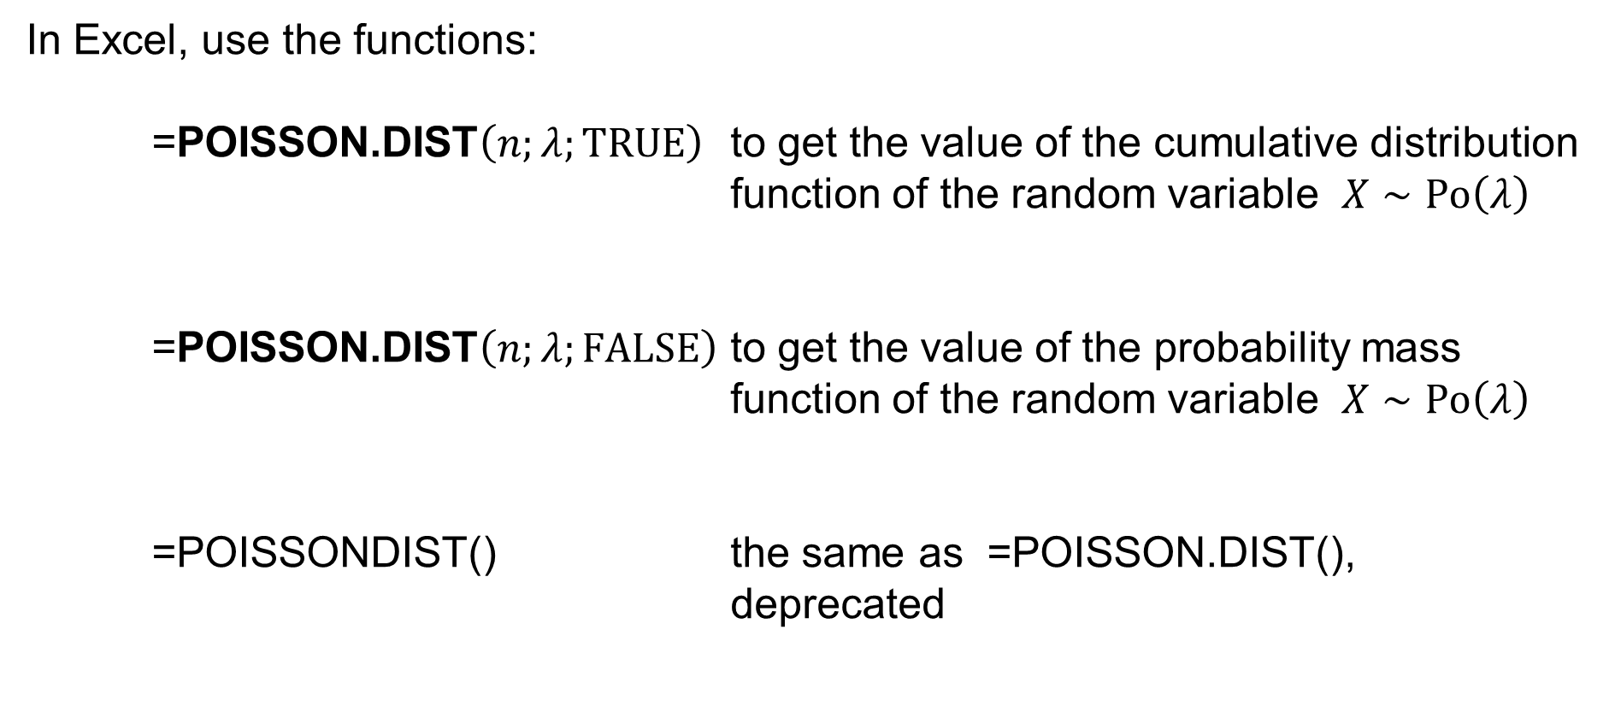
Poisson distribution in Excel
In Excel, use the functions:
=POISSON.DIST$\left(n;λ;TRUE\right)$ to get the value of the cumulative distribution function of the random variable $X∼Po\left(λ\right)$
=POISSON.DIST$\left(n;λ;FALSE\right)$ to get the value of the probability mass function of the random variable $X∼Po\left(λ\right)$
=POISSONDIST() the same as =POISSON.DIST(),
deprecated

Slide 41
Poisson distribution: Examples
The number of telephone calls received by a call centre per hour.
The number of customers coming to the shop per hour.
The number of radioactive decay events per second from a radioactive source.
The number of clicks per second of a Geiger-Müller counter.
The number of defaults per year in risk modelling.
The number of some failures / accidents / … per year.

Slide 42
Some other discrete probability distributions
Negative binomial distribution
Lady tasting the tea
Hypergeometric distribution

Slide 43
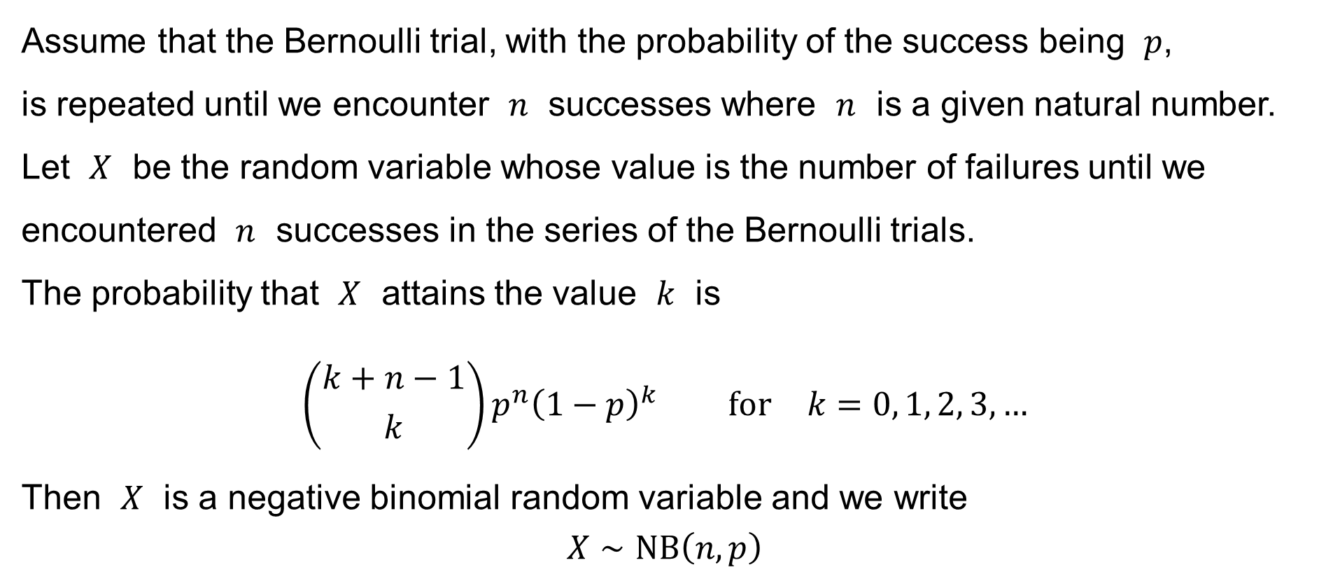
Negative binomial distribution
Assume that the Bernoulli trial, with the probability of the success being $p$,
is repeated until we encounter $n$ successes where $n$ is a given natural number.
Let $X$ be the random variable whose value is the number of failures until we encountered $n$ successes in the series of the Bernoulli trials.
The probability that $X$ attains the value $k$ is
$$\left({k+n−1 \atop k}\right)p^{n}{\left(1−p\right)}^{k} \text{for} k=0, 1, 2, 3,…$$
Then $X$ is a negative binomial random variable and we write
$$X∼NB\left(n,p\right)$$

Slide 44

Negative binomial distribution
Let the random variable $X∼NB\left(n,p\right)$.
Calculate as an exercise:
Mean value: $μ=E\left[X\right]=\frac{n\left(1−p\right)}{p}$
Variance: $σ^{2}=Var\left(X\right)=\frac{n\left(1−p\right)}{p^{2}}$
Mode: $\hat{X}=\left\{\begin{aligned}\left\lfloor \frac{\left(n−1\right)\left(1−p\right)}{p}\right\rfloor &, n=2, 3, 4,… \\ 0&, n=1\end{aligned}\right.$

Slide 45
Hypergeometric distribution
A Lady Tasting the Tea: We prepare a cup of tea with milk.
There are two ways to prepare the cup:
pour the tea into the cup first and then add the milk,
pour the milk into the cup first and then add the tea.
A lady says that she can recognize by the taste of the tea
how the cup was prepared.

Slide 46
Hypergeometric distribution
A Lady Tasting the Tea: We prepare 8 cups of tea with milk.
We prepare:
4 cups so that we pour the tea first and then add the milk,
4 cups so that we pour the milk first and then add the tea.
We are to choose 4 cups out of the 8 cups. What is the probability – if one selects the cups randomly – that we choose the 4 cups where the tea was first correctly? (I.e., we correctly recognize whether the tea was first in the cup?)
— By the way, the Lady recognized the cups correctly.

Slide 47
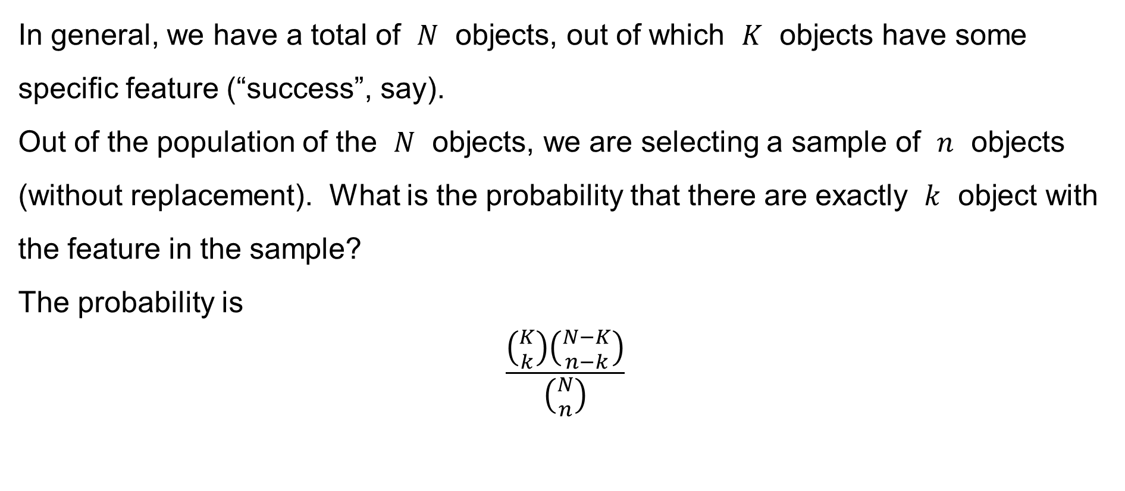
Hypergeometric distribution
In general, we have a total of $N$ objects, out of which $K$ objects have some specific feature (“success”, say).
Out of the population of the $N$ objects, we are selecting a sample of $n$ objects (without replacement). What is the probability that there are exactly $k$ object with the feature in the sample?
The probability is
$$\frac{\left({K \atop k}\right)\left({N−K \atop n−k}\right)}{\left({N \atop n}\right)}$$

Slide 48
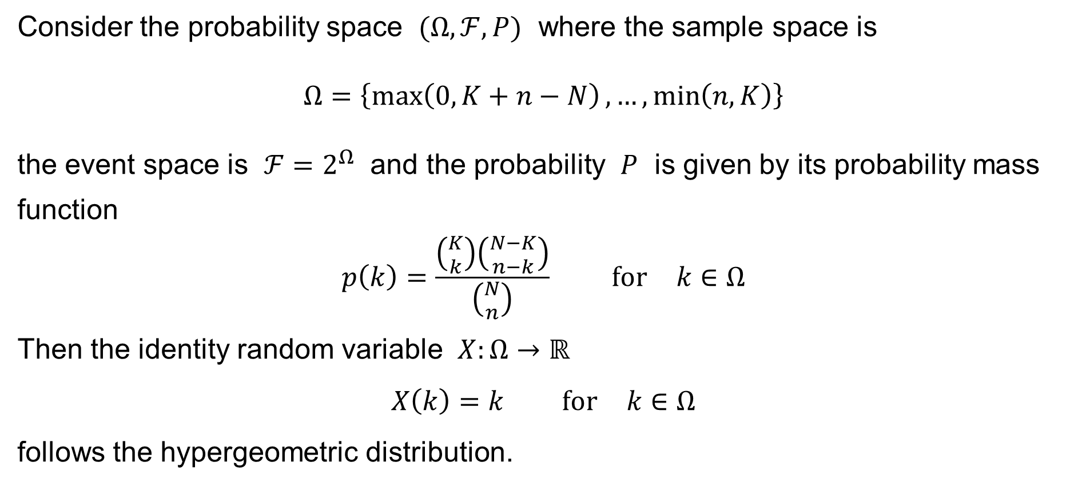
Hypergeometric distribution
Consider the probability space $(Ω,ℱ,P)$ where the sample space is
$$Ω=\left\{\max\left(0,K+n−N\right),…,\min\left(n,K\right)\right\}$$
the event space is $ℱ=2^{Ω}$ and the probability $P$ is given by its probability mass
function
$$p\left(k\right)=\frac{\left({K \atop k}\right)\left({N−K \atop n−k}\right)}{\left({N \atop n}\right)} \text{for} k∈Ω$$
Then the identity random variable $X:Ω→ℝ$
$$X\left(k\right)=k \text{for} k∈Ω$$
follows the hypergeometric distribution.

Slide 49

Hypergeometric distribution
Let the random variable $X$ follow the hypergeometric distribution with $N,K,n$.
Calculate as an exercise:
Mean value: $μ=E\left[X\right]=n\frac{K}{N}$
Variance: $σ^{2}=Var\left(X\right)=n\frac{K}{N}\left(1−\frac{K}{N}\right)\frac{N−n}{N−1}$

Slide 50

The binomial coefficient in Excel
In Excel, use the function:
=COMBIN$\left(n;k\right)$ to get the value of the binomial coefficient
$$\left({n \atop k}\right)$$

