Slide 1
TOPIC Organization structure WORK DESIGN, ELEMENTS OF STRUCTURE
Ing. Pavel Adámek, Ph.D.
adamek@opf.slu.cz

Slide 2
Content
Fordism and Taylorism
Organization structuring
Line, staff, and functional relationships
Informal and formal organization
Centralization versus decentralization

Slide 3
Learning outcomes
Knowledge
Students explain the principles of scientific management (Taylorism and Fordism) and describe the main elements of organizational structure, including line and staff relationships, formal and informal organization, and centralization versus decentralization.
Skills
Students analyse a basic organizational structure, identify key structural elements, and interpret line and staff roles within an organization.
Competences
Students evaluate how organizational structure influences employee behaviour, coordination, and decision-making in organizations.

Slide 4
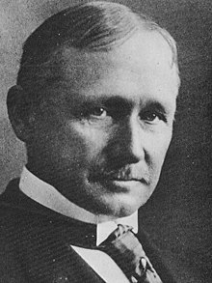
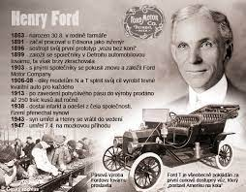
Why study work desing?
The roots of the design of jobs that we see in today’s organizations.
Only a handful of theories can claim to be truly revolutionary, and to have had an enduring and worldwide impact on organizational thought and management practice. Those of Frederick Winslow Taylor (1856 –1915) and Henry Ford (1863 –1947) are two of them.
Developments in information technology have increased rather than reduced their relevance. For example, one current debate focuses on whether the virtual organization is a new organizational arrangement or a refinement of scientific management thinking.
Taylorism and Fordism are alive and well, still thriving at the start of the twenty-first century.

Slide 5
Taylorism
Scientific management a form of job design which stresses short, repetitive work cycles; detailed, prescribed task sequences; a separation of task conception from task execution; and motivation based on economic rewards.
Taylor attributed systematic soldiering to a number of factors:
the view among the workers that an increase in output would result in redundancies;
poor management controls which enabled them to work slowly, in order to protect their own best interests;
the choice of methods of work which were left entirely to the discretion of the workers who wasted a large part of their efforts using inefficient and untested rules-of-thumb.

Slide 6
Taylorism
He set out to show how management and workforce could both benefit from adopting his more efficient work arrangements. His objectives were to achieve:
efficiency, by increasing the output per worker and reducing deliberate ‘underworking’ by employees,
predictability, of job performance by standardizing tasks by dividing up tasks into small, standardized, closely specified sub-tasks,
control, by establishing discipline through hierarchical authority and introducing a system whereby all management’s policy decisions could be implemented.

Slide 7
Taylorism
Taylor’s scientific management was a powerful and largely successful attempt to wrest the organization of production from the workers, and place it under the control of management.
Before Taylor, the use of the initiative and incentive system within the company involved management specifying production requirements, providing workers with incentives in the form of a piece-rate bonus, and leaving them to use their own initiative in deciding how best to organize their work.

Slide 8
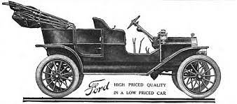
Fordism
Fordism is distinguishable from Taylorism in that it represents a form of work organization designed for efficient mass production.
Fordism a form of work design that applies scientific management principles to workers’ jobs; the installation of single-purpose machine tools to manufacture standardized parts; and the introduction of the mechanized assembly line.
Analysing jobs: Ford applied the principles of scientific management to remove waste and inefficiency.
Installation of single-purpose machine tools to produce standardized parts: Ford used rigid and heavy machine tools, carbon alloy tool steels, and universal grinding machines.
Creation of the mechanized assembly line: Despite the aforementioned innovations, employees could still work at their own speed.

Slide 9
Fordism
Ford’s legacy was twofold. First, he created what came to be defined as the characteristics of mass production work:
mechanical pacing of work;
choice of tools or methods;
repetitiveness;
minute subdivision of product;
minimum skill requirements;
surface mental attention.

Slide 10
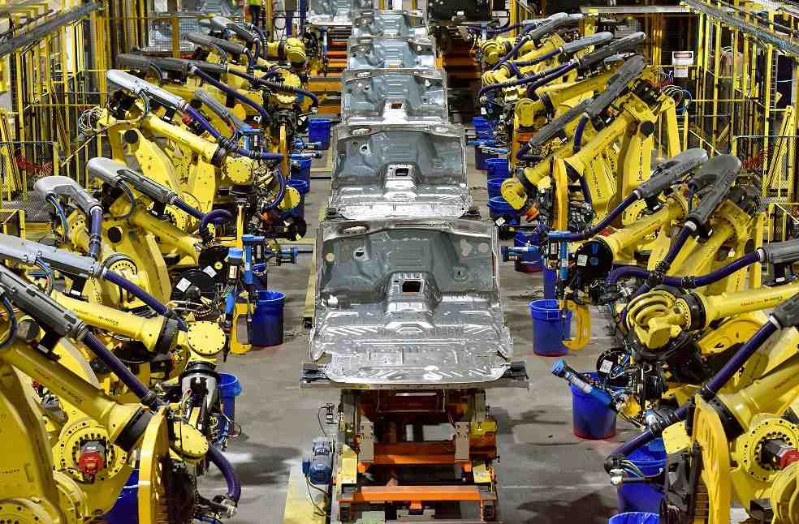
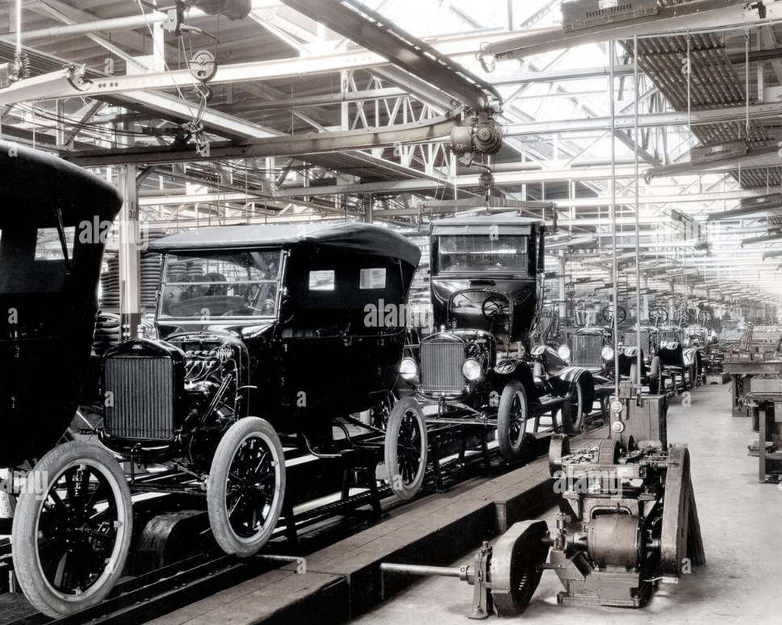
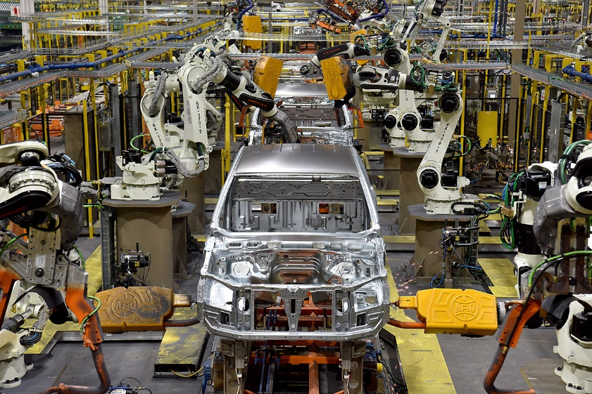
Fordism

Slide 11
Back to the future?
Just how alienating and demotivating is Taylorism? Paul Adler (1999) offers an interesting counter-argument to this established view, claiming that Taylorism actually represents a fundamental emancipatory philosophy of job design.
He reports that at the New United Motors Manufacturing, Inc. (NUMMI) auto plant in Fremont, California, which uses a classical Taylorist approach, workers show relatively high levels of motivation and job commitment.
Instrumental orientation an attitude that sees work as an instrument to the fulfilment of other life goals.
Introjection a formerly external regulation or value that has been ‘taken in’ and is now enforced through internal pressures such as guilt, anxiety, or related self-esteem dynamics.
Concertive control control exercised by the workers themselves who collaborate to develop the means of their own control by negotiating a consensus which shapes their own behaviour according to a set of core values such as those of the corporate vision statement.

Slide 12
Why study elements of structure?
People’s attitudes and behaviour can be shaped as much by the structure of the organization within which they work as by the personalities that they possess and the groups and teams of which they are a part.
The constraints and demands of the job, imposed through the roles that they play, can dictate their behaviour and even change their personalities.
Jay Lorsch described organization structure as management’s formal and explicit attempts to indicate to organizational members what is expected of them.
This involved the definition of individual jobs and their expected relationship to each other as indicated in organizational charts and in job descriptions

Slide 13
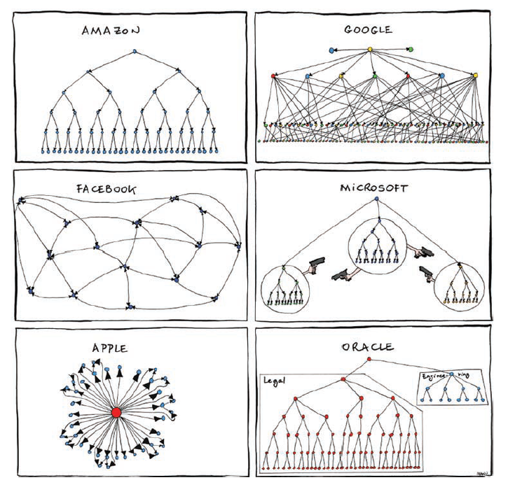
Alan Fox argued that explanations of human behaviour in organizations must consider
structural factors.

Slide 14
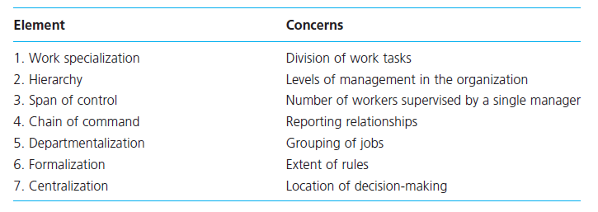
Organization structuring
The purpose of organization structure is, first, to divide up organizational activities and allocate them to sub-units; and second, to coordinate and control these activities so that they achieve the aims of the organization.

Slide 15
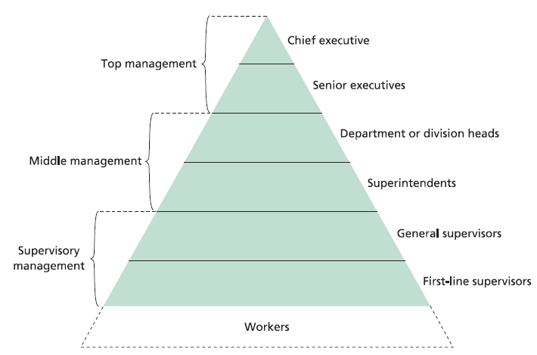
Organization structuring
A popular way of depicting the structure of any large organizations is as a pyramid or triangle. This is only one of many possible shapes for an organization’s structure.

Slide 16
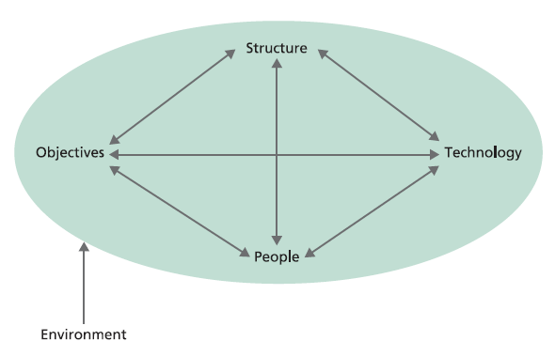
Organization structuring
Harold Leavitt (1965) has suggested that organizations can be viewed as complex systems which consist of four mutually interacting, independent classes of variables: organizational objectives, company structure, technology used, and people employed.
All of these were affected by aspects of the firm’s environment such as the economic, political, or social situation.
The differences in organization structure can be partly accounted for by the interactions of these elements.

Slide 17
Line, staff, and functional relationships
Within an organization, one can distinguish two classes of workers. First, there are the line employees, who contribute directly to the provision of goods or services to the customer.
The second class of workers are called staff employees. They contribute indirectly to the provision of goods or services to the customer.
These individuals occupy advisory positions and use their specialized expertise to support the efforts of line employees.
Staff employees work in departments such as purchasing, human resources, information technology, and legal. These are considered to be secondary organizational functions.
A firm may provide line managers with advice by establishing a separate department headed by staff specialists.
This is a modification of the basic line structure, and is referred to as a line-and-staff structure.

Slide 18
Line, staff, and functional relationships
To explain the differences between these types of relationships, it is first necessary to introduce and define the concepts of authority, responsibility, and accountability.
You cannot be held accountable for an action unless you are first given the authority to do it. In a situation where your manager delegates authority to you, they remain responsible for your actions to senior management.
Authority is vested in organizational positions, not in the individuals who occupy them.
A line relationship is one in which a manager has the authority to direct the activities of those in positions below them on the same line on an organization chart. Line managers can ‘tell’ their subordinates on their own line what to do. Such relationships are depicted with vertical lines on the chart, and these connect positions at each hierarchical level with those above and below them.

Slide 19
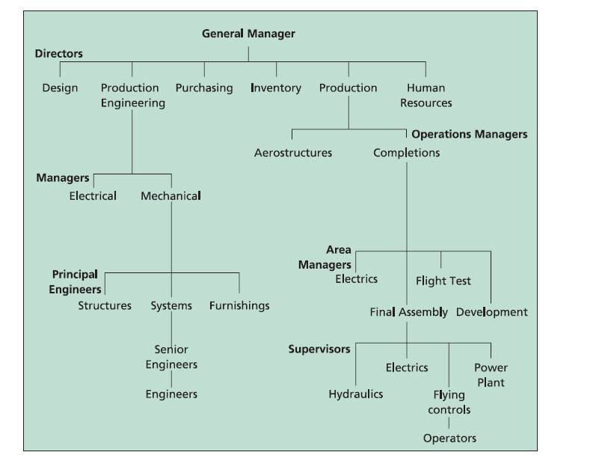
Line, staff, and functional relationships
The line relationships in a company are found within departments and functions.
Line managers are responsible for everything that happens within their particular department.

Slide 20
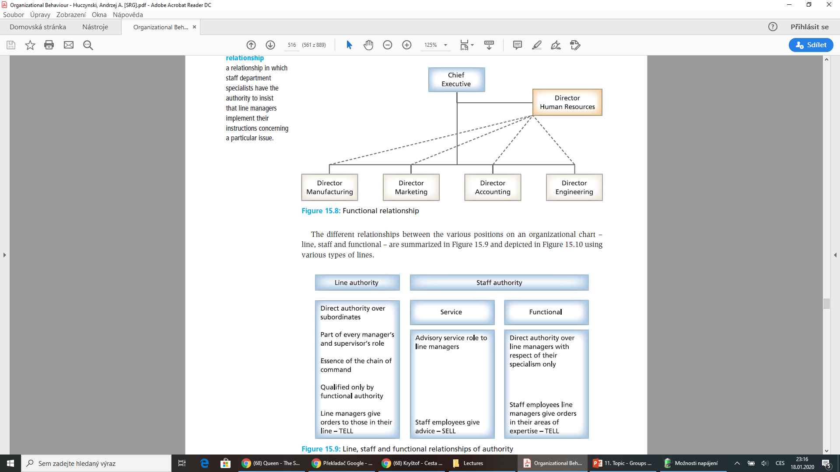
Line, staff, and functional relationships
A staff relationship is one in which staff department specialists provide a service to line managers.
They can recommend, advise, or assist line managers to implement their instructions concerning a particular issue, but have no authority to insist that they do so.
Thus they have to ‘sell’ their recommendations to line managers.

Slide 21
Formal organization
Decisions about job descriptions, organization charts, types of authority, and so on all relate to designing the formal organization.
This refers to the documented, planned relationships established by management to coordinate the activities of different employees towards the achievement of a common goal, using the division of labour and the creation of a hierarchy of authority.
These relationships between employees are all written down, and can be checked and modified, as required. However, to understand and explain the behaviour of people in organizations, it is also necessary to become familiar with the informal organization.

Slide 22
Informal organization
The informal organization refers to the undocumented relationships that arise spontaneously between individuals in the workplace as they interact with one another, not only to do their jobs, but also to meet their psychological and physical needs.
These interactions lead to the creation of relationships between individual employees and to the development of informal groups, each with their own values and norms of behaviour, which allow people to meet their social needs.
These groups are separate from those specified by the formal organization. Compared to the formal organization, the informal organization has a more transient membership, making it looser and more flexible, with interactions between individuals being more spontaneous and more emotional, resulting in their relationships being less clearly defined, and their involvement being more variable.

Slide 23
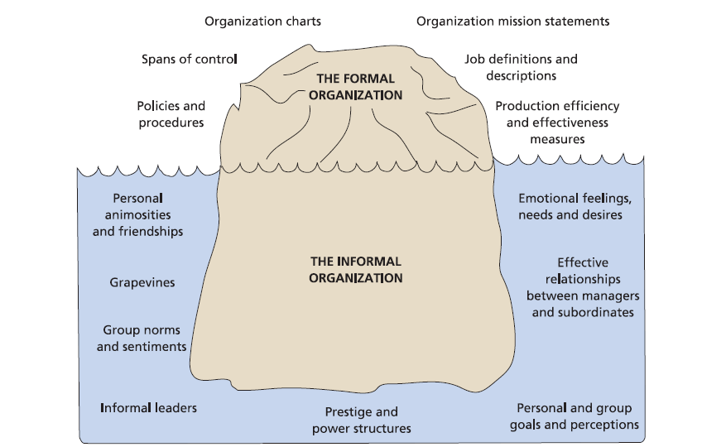
Informal and formal organization

Slide 24
Centralization versus decentralization
A fundamental question faced by every chief executive is what kinds of decisions are to be made and by whom.
Centralization refers to the concentration of authority and responsibility for decision-making power in the hands of managers at the top of an organization’s hierarchy.
Others choose to delegate their power, giving junior managers more individual autonomy and self-directed teams greater freedom, and introducing job enrichment for shop-floor workers.
Thus, their organizations are much more decentralized in their structure.
Decentralization refers to the downward dispersion of authority and responsibility for decision-making to operating units, branches and lower-level managers. New technology has facilitated this by making information easily available to all levels of employees, right down to the shop floor.
The question of whether and how much to centralize or decentralize has been one of the major topics discussed in organization structuring

Slide 25
RECAP
The objectives are efficiency, by increasing the output per worker and reducing deliberate ‘underworking’; predictability of job performance – standardizing tasks by dividing them up into small and closely specified sub-tasks; and control by establishing discipline through hierarchical authority and introducing a system whereby all management’s policy decisions can be implemented.
Ford developed the analysis of jobs; installed single purpose machine tools to produce standardized parts; and established the mechanically paced assembly line.
The procedures employees are required to follow, and the rules by which they are required to abide, all control and direct their behaviour in specified directions.
The main elements include chain of command; hierarchical levels; line employees; rules; staff employees; role expectations; span of control; departmentalization; authority; and job description.
Line relationships are depicted vertically on a organization chart, indicating that those above possess the authority to direct the behaviours of those below.

Slide 26
RECAP
The seniors have responsibility for the work of the juniors, while the juniors ar accountable for their work to their seniors.
Staff relationships are depicted horizontally on a organization chart, indicating that those who possess specific expertise (e.g. in personnel, or in computing matters) advise those in line positions.
The formal organization refers to the collection o work groups that have been consciously designed by senior management to maximize efficiency and achieve organizational goals, while the informal organization refers to the network of relationships that spontaneously establish themselves between members of the organization on the basis of their common interests and friendships.

Slide 27
We can share our thoughts and ask questions ☺
Pavel Adámek
adamek@opf.slu.cz

