Slide 1
TOPIC Introducing Organizational behaviour
Ing. Pavel Adámek, Ph.D.
adamek@opf.slu.cz

Slide 2
Content
Definitions and Importance
A field map of the organizational behaviour terrain
Human resource management: OB in action
Discretionary behaviour

Slide 3
Organizational behaviour – Definitions and Importance
What´s Organizational behaviour?
Organizational behaviour the study of the structure and
management of organizations, their environments, and the actions and interactions of their individual members and groups.

Slide 4
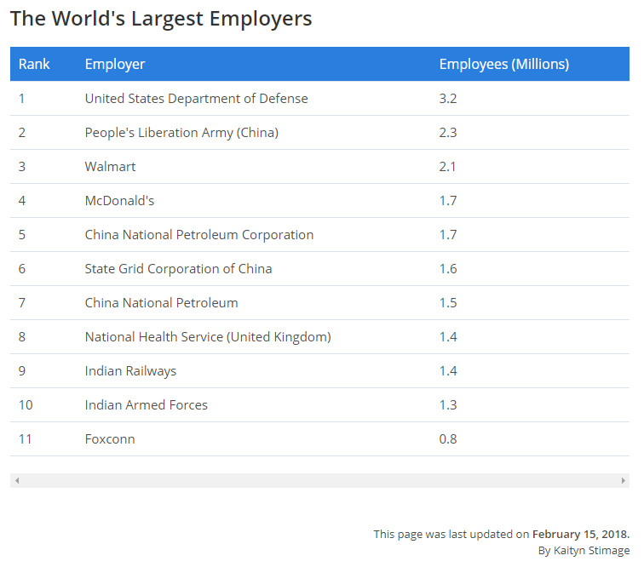
Organizational Behaviour – Definitions and Importance
Organizations affect everything that you do – sleeping, eating, travelling, working, relaxing, studying – everything.
Organizational behaviour covers environmental (macro) issues and group and individual (micro) factors. We live in an organized world.
Take a look at your clothes, food, computer – we are affected in many ways by organizations of different kinds.

Slide 5
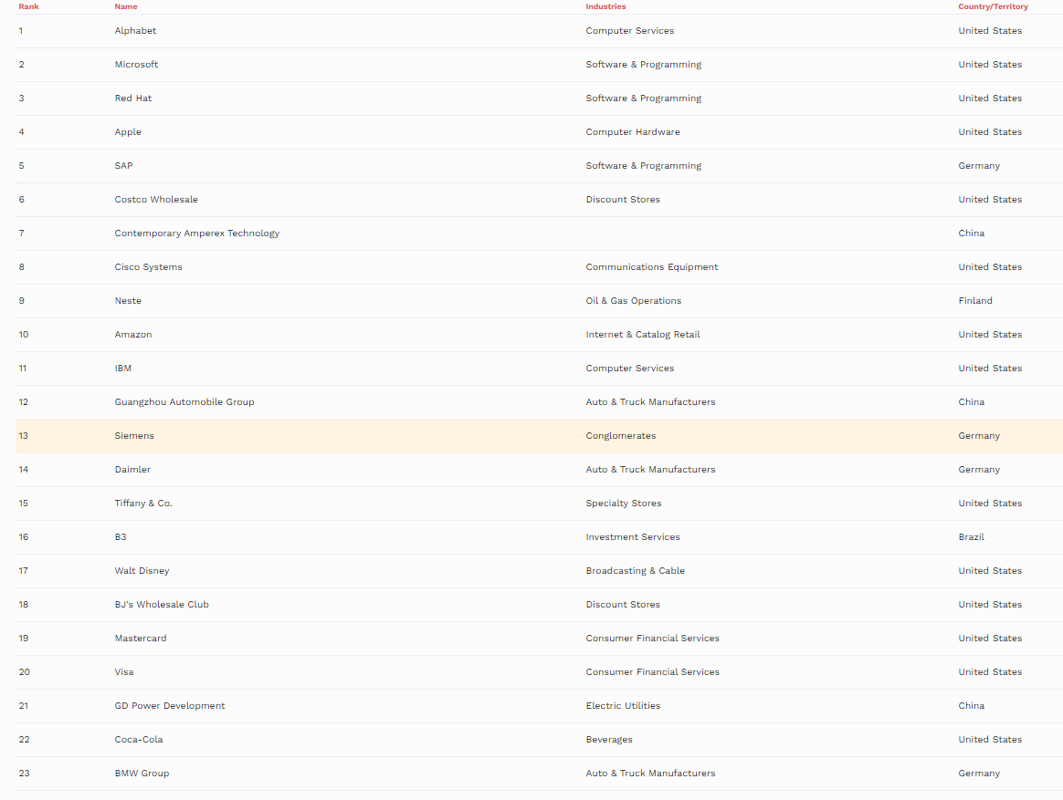
FORBES
THE WORLD'S BEST EMPLOYERS 2019 LIST
Source: https://www.forbes.com/lists/worlds-best-employers/#628ddc1a1e0c

Slide 6
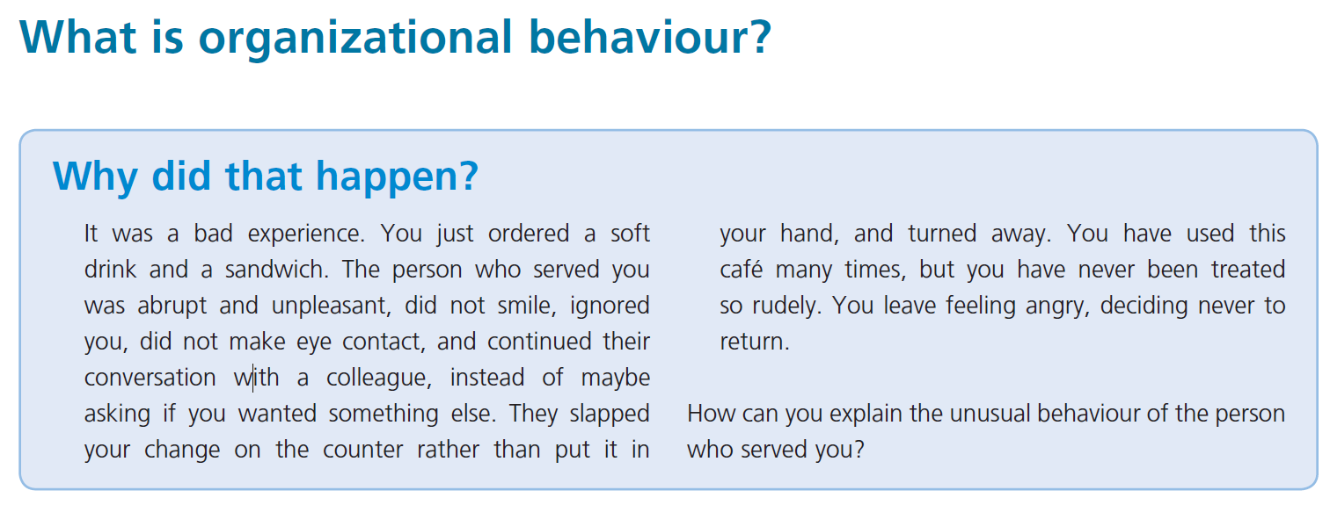
Organizational Behaviour – Definitions and Importance

Slide 7
Organizational Behaviour – Definitions and Importance
How can we explain your experience in the café?
We can blame the personality and skills of the individual who served you. However, there are many other possible explanations such as:
inadequate staff training;
staff absences increasing working pressure;
long hours, fatigue, poor work-life balance;
equipment not working properly;
anxiety about anticipated organizational changes;
domestic difficulties – family feuds, ill-health;
low motivation due to low pay;
an autocratic supervisor;
a dispute with colleagues creating an uncomfortable working atmosphere;
timing – you came in at the wrong moment.

Slide 8
Organizational Behaviour – Definitions and Importance
Your experience could be explained by contextual, individual, group, structural, and managerial process factors, in and beyond the workplace. The explanation could come from any one of those factors.
In many cases, a combination of factors will explain the behaviour in question.
The customer walks away.
As a member of that organization, you have to live with these issues.
As a manager, you may be responsible for solving the problem.

Slide 9
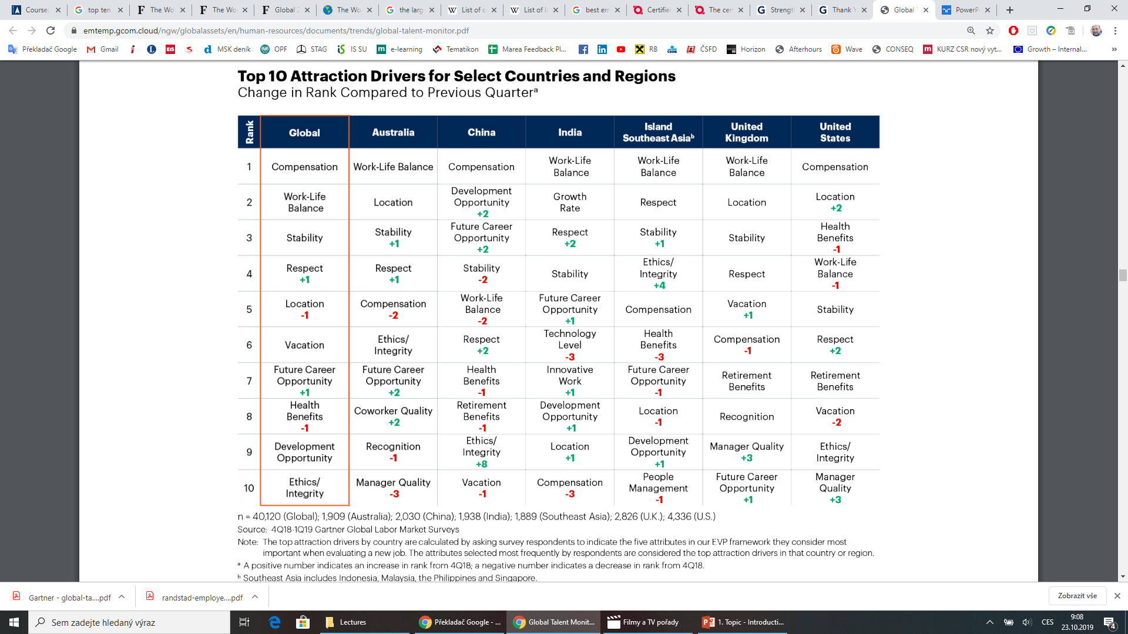

Slide 10
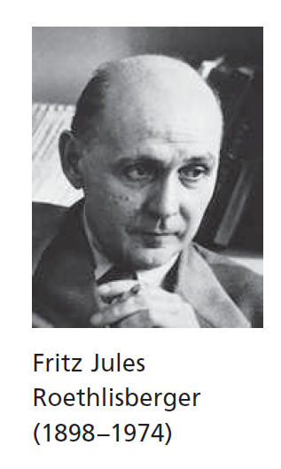
Organizational Behaviour – Definitions and Importance
The study of organizational behaviour has direct practical implications for those who work in, manage, seek to subvert, or interact in other ways with organizations, whether they are small and local, or large and international.
A ‘multiple-stakeholders-inclusive-agenda’ view of Organizational behaviour, developing a broad social science perspective.
The term organizational behaviour was first used by Fritz Roethlisberger in the late 1950s, because it suggested a wider scope than human relations.
The term behavioural sciences was first used to describe a Ford Foundation research programme at Harvard in 1950, and in 1957 the Human Relations Group at Harvard (previously the Mayo Group) became the Organizational Behavior Group.

Slide 11
Organizational Behaviour – Definitions and Importance
Organizations do not ‘behave’. Only people can be said to behave. Organizational behaviour is shorthand for the activities and interactions of people in organizations.
Organizations populate our physical, social, cultural, political and economic environment, offering jobs, providing goods and services, creating our built environment, and contributing to the existence and fabric of communities.
The products and services of McDonald’s, Google, Apple, Microsoft, Ford, and Sony shape our existence and our daily experience.

Slide 12
Think!
Consider: Total the number of organizations with which you have had contact during 3 days?
‘Contact’ includes, for example, a radio programme that you listen to at breakfast, a television station that you watch, the shops that you visit, the bank with whose card you make payments, the companies who run the buses, trains and taxis that you use.
Also, which cinemas, bars, nightclubs, sports and social clubs did you visit? Religious and educational establishments? Medical facilities or emergency services that you have used (you never know)? Check your mail; which organizations have written to you?
Do you have any utility or council tax bills to pay, and from which organizations do you get these services? Have you dealt with any charity requests? Have you checked your internet service provider and social networking organizations? What companies made your computer and mobile phone? Which companies designed the browser and other software that you are using? Whose advertisements have you watched?
Number of organizations??? private/public, profit/charitable, goods/services, etc.
Consider what this list of organizations reveals about you and your lifestyle?

Slide 13
Organizational Behaviour – Definitions and Importance
What is an organization?
Organization a social arrangement for achieving controlled performance in pursuit of collective goals.
Social arrangements
To say that organizations are social arrangements is simply to observe that they are groups of people who interact with each other as a consequence of their membership.
Collective goals
Common membership implies shared objectives. Organizations are more likely to exist where individuals acting alone cannot achieve goals that are considered worthwhile pursuing.
Controlled performance
The performance of an organization as a whole determines its survival. The performance of a department determines the resources allocated to it. The performance of individuals determines pay and promotion prospects.

Slide 14
Organizational Behaviour – Definitions and Importance
Controlled performance
Admission to membership of organizations is controlled, usually with reference to standards of performance – will the person be able to do the job?
The price of failure to perform to standard is loss of membership.
The need for controlled performance leads to the establishment of authority relationships.
The controls only work where members comply with the orders of those responsible for performing the control functions.
Summary, controlled performance setting standards, measuring performance, comparing actual with standard, and taking corrective action if necessary.

Slide 15
Organizational Behaviour – Definitions and Importance
Groups can achieve more than individuals acting alone.
We achieve psychological satisfaction and material gain from organized activity.
Senior managers may decide on objectives and try to get others to agree by calling them the ‘organization’s mission’ or ‘corporate strategy’; but they are still the goals of the people who determined them in the first place.
Organizations can mean different things to those who use them and who work in them, because they are significant personal and social sources of
money, physical resources, other rewards;
meaning, relevance, purpose, identity;
order and stability;
security, support, protection;
status, prestige, self-esteem, self-confidence;
power, authority, and control.

Slide 16
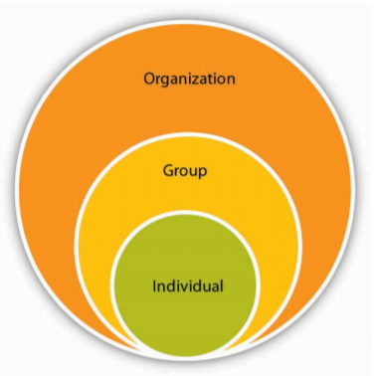
Organizational Behaviour – Definitions and Importance
The goals pursued by individual members of an organization can be quite different from the collective purpose of their organized activity.
This creates an organizational dilemma – how to design organizations that are effective in achieving overall objectives, while also meeting the needs of those who work for them.

Slide 17
A field map of the organizational behaviour terrain
How can behaviour in organizations be explained?
To answer this question systematically we - develop a ‘field map’ of the organizational behaviour terrain.
The map shows that we want to explain two sets of outcomes: organizational effectiveness, and quality of working life.
Organizations and their members have plans for the future which influence actions today.

Slide 18
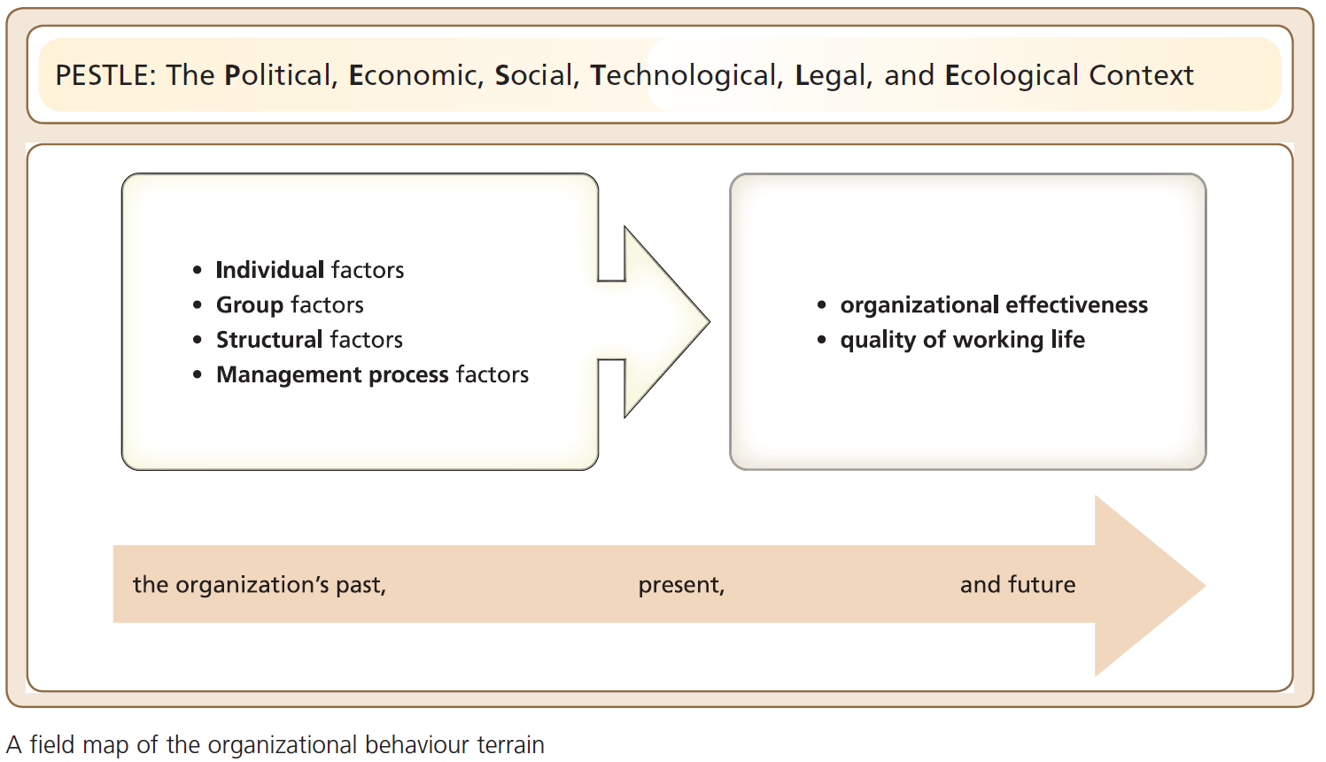
Organizational Behaviour – Definitions and Importance

Slide 19
A field map of the organizational behaviour terrain
Remember the rude and unhelpful person serving in your café?
Consequences with a field map of the Organizational behaviour…
Context factors (PESTLE): Maybe the store is facing competition, sales have collapsed, the store is closing next month, and the loyal shop assistant is bitter about being made redundant (economic factors). Perhaps closure is threatened because the local population is falling, and reducing sales (social issues).
Individual factors: Maybe the shop assistant is not coping with the demands of the job because training has not been provided (learning deficit). Maybe this assistant is not suited to work that involves interaction with a demanding public (personality traits). Or perhaps the shop assistant finds the job boring and lacks challenge (motivation problem).

Slide 20
A field map of the organizational behaviour terrain
Remember the rude and unhelpful person serving in your café?
Consequences with a field map of the Organizational behaviour…
Group factors: Maybe the employees in this part of the organization have not formed a cohesive team (group formation issues). Maybe this shop assistant is excluded from the group for some reason (a newcomer, perhaps) and is unhappy (group structure problems). The informal norm for dealing with awkward customers like you is to be awkward in return, and this assistant is just ‘playing by the rules’ (group norms).
Structural factors: Perhaps the organization is bureaucratic and slow, and our assistant is anxiously waiting for a long-standing issue to be resolved (hierarchy problems). Maybe there is concern about the way in which work is allocated (work design problems). Perhaps the unit manager cannot deal with problems without referring them to a regional manager who doesn’t understand local issues (decision-making issues).
Management process factors: Maybe the shop assistant is annoyed at the autocratic behaviour of the unit manager (inappropriate leadership style), or is suffering ‘initiative fatigue’ following organizational changes (change problems). Perhaps the assistant feels that management has made decisions without consulting employees who have useful information and ideas (management decision-making problems).

Slide 21
A field map of the organizational behaviour terrain
The term organizational effectiveness is controversial, because different stakeholders have different ideas about what counts as ‘effective’. A stakeholder is anyone with an interest, or stake, in the organization.
For commercial companies, effectiveness usually means ‘profit’, but this raises other issues.
Some organizations forgo profit temporarily, in order to increase market share, which contributes to corporate survival and growth.
Shareholders want a return on investment; customers want quality products or services at reasonable prices; managers want high-flying careers; most employees want decent pay, good working conditions, development and promotion opportunities, and job security.
Environmental groups want organizations to protect wildlife, reduce carbon dioxide emissions and other forms of pollution, reduce traffic and noise levels, and so on.

Slide 22
A field map of the organizational behaviour terrain
Quality of working life is linked to organizational effectiveness, and also to most of the other factors on the left-hand side of our map.
It is difficult to talk about quality of working life without considering an
individual’s overall assessment of satisfaction with their job,
working conditions,
pay,
colleagues,
management style,
organization culture,
work-life balance,
and training, development, and career opportunities.

Slide 23
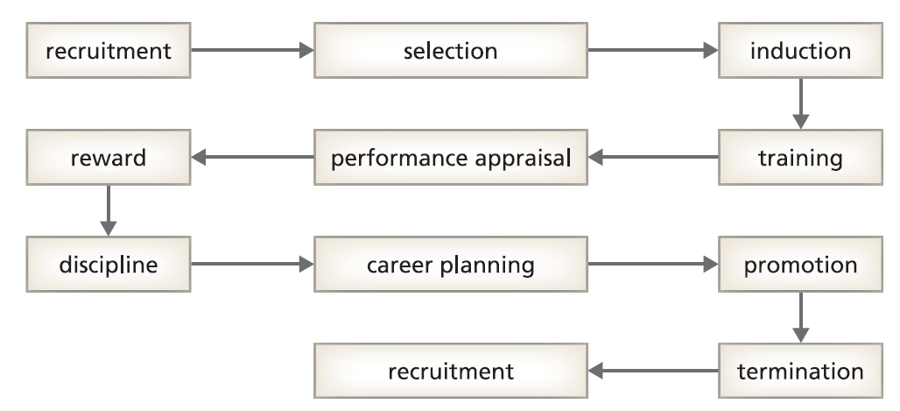
Human resource management: OB in action
One area where organizational behaviour (OB) contributes to evidence-based practice is human resource management (HRM – or personnel management).
OB is concerned with understanding micro- and macro-organizational issues, at individual, group, corporate, and contextual levels of analysis.
HRM develops and implements policies which enhance the quality of working life and encourage commitment, engagement, flexibility, and high performance from employees in the context of corporate strategy.
HRM can be seen as ‘organizational behaviour in practice’, and this applies to all stages of the employment cycle.
The employment cycle

Slide 24
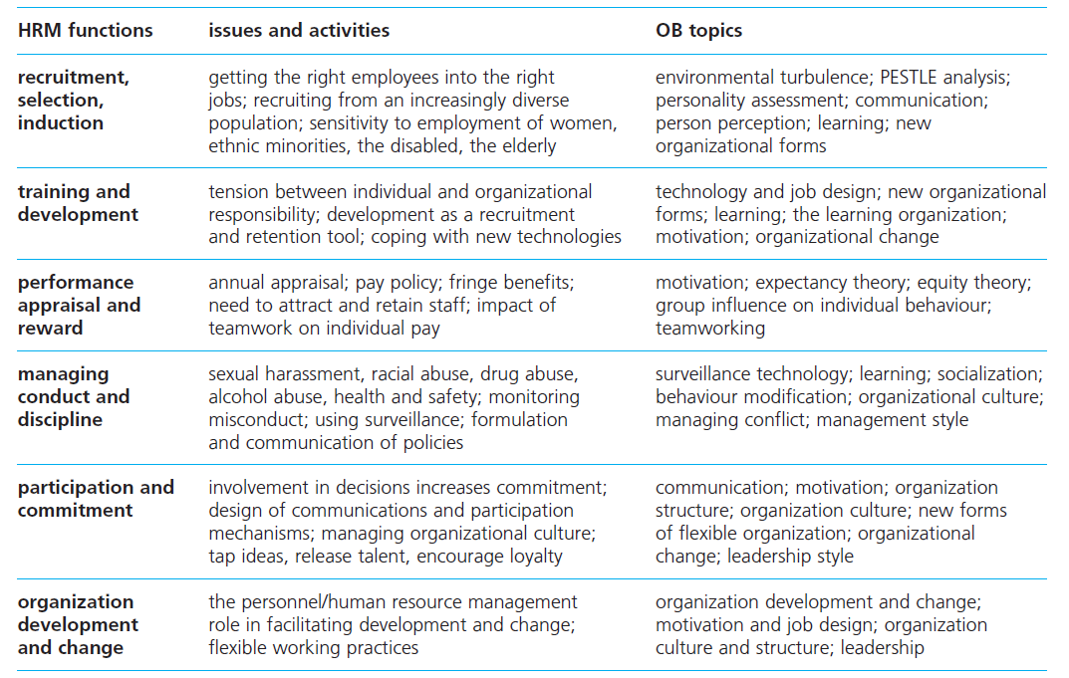
Human resource management and organizational behaviour

Slide 25
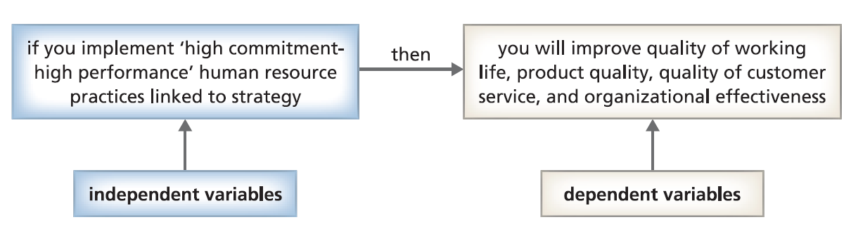
The basic model of HRM

Slide 26
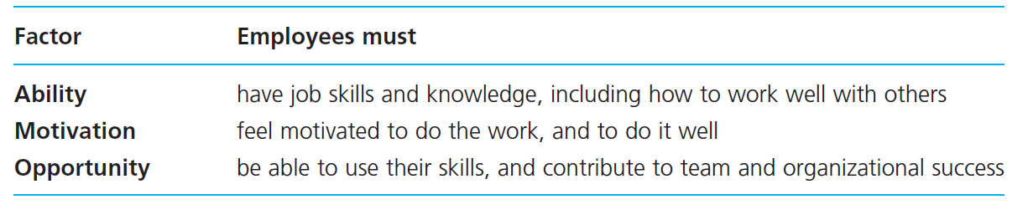
The Bath model of HRM
This approach focuses on the processes through which HR policies influence employee behaviour and performance.
This model argues that, for people to perform beyond the minimum requirements of a job, three factors, Ability, Motivation and Opportunity (AMO) are necessary:

Slide 27
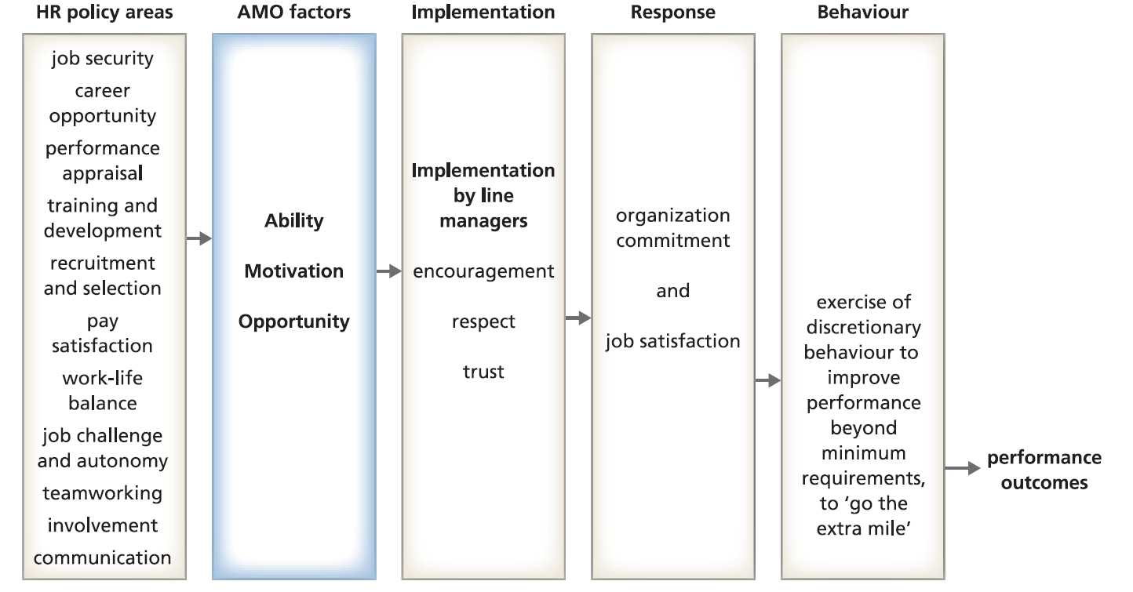
The Bath model of HRM

Slide 28
The Bath model of HRM
The policies central to this model are:
recruitment and selection that is careful and sophisticated;
training and development that equips employees for their job roles;
career opportunities provided;
communication that is two-way, and information-sharing;
involvement of employees in management decision-making;
teamworking;
performance appraisal and development for individuals;
pay that is regarded as equitable and motivating;
job security;
challenge and autonomy in jobs;
work-life balance.

Slide 29
Discretionary behaviour
Most employees have some choice over how, and how well, they perform their jobs. This is known as discretionary behaviour.
Sales assistants, for example, can decide to adopt a casual and unsympathetic tone, or they can make customers feel that their concerns have been handled in a competent and friendly way.
Negative, uncaring behaviours are often a response to an employee’s perception that the organization no longer cares about them. When one member of staff annoys a customer, and management finds out, then that employee has a problem.

Slide 30
Discretionary behaviour
What encourages employees to ‘go the extra mile’?
The answer lies in the model’s process theory, which explains performance outcomes in terms of a combination of factors:
Basic HR policies are required to produce the Ability, Motivation and Opportunity central to any level of performance.
The line managers who ‘bring these policies to life’ have to communicate trust, respect and encouragement. This is achieved through the way that they give directions, and respond to suggestions.
The combination of HR policies with line management behaviours must lead to feelings of job satisfaction and employee commitment. Otherwise, the policies themselves will have little impact on behaviour and performance.
People tend to use positive discretionary behaviours when they experience pride in their organization, and want to stay there. Commitment and job satisfaction thus encourage employees to use discretionary behaviour to perform better.

Slide 31
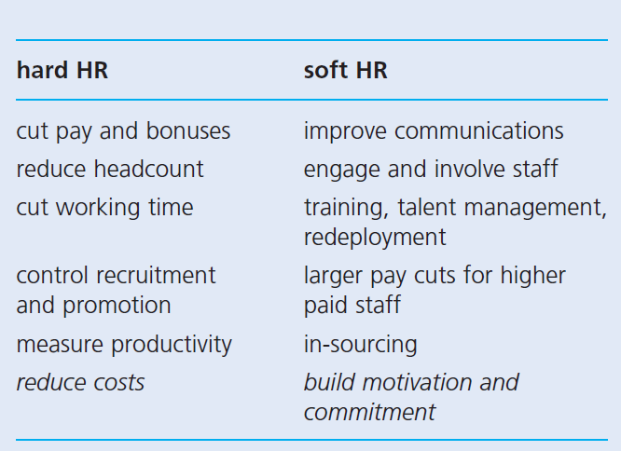


The ‘hard’ and ‘soft’ HR practices
How does HR work in this situation?
The human resource (HR) function is traditionally the ‘employees’ champion’, but it is also responsible for ensuring that employment practices fit the company’s commercial strategy. These roles involve the use of ‘hard’ and ‘soft’ HR practices.
Hard HR aims to control or reduce costs.
Soft HR aims to maintain motivation and commitment.
In a recession, a company’s need to control costs can conflict with its employees’ desire for job security.

Slide 32
RECAP
Explain the importance of an understanding of organizational behaviour.
Organizations influence almost every aspect of our daily lives in a multitude of ways.
If we eventually destroy this planet, the cause will not lie with technology or weaponry, but with ineffective organizations and management practices.
Explain and illustrate the central dilemma of organizational design.
The organizational dilemma concerns how to reconcile the inconsistency between individual needs and aspirations, and the collective purpose of the organization.
Understand the need for explanations of behaviour in organizations that take account of relationships between factors at different levels of analysis.
The study of organizational behaviour is multidisciplinary, drawing in particular from psychology, social psychology, sociology, economics and political science.
Organizational behaviour involves a multi-level study of the external environment, the internal structure, functioning, and performance of organizations, and the behaviour of groups and individuals.
Organizational effectiveness and quality of working life are explained by a combination of contextual, individual, group, structural, process, and managerial factors.
In considering explanations of Organizational behaviour, systemic thinking is required, avoiding explanations based on single causes, and considering a range of interrelated factors

Slide 33
We can share our thoughts and ask questions ☺
Pavel Adámek
adamek@opf.slu.cz

