Slide 1

DEVELOPMENT OF THE WORLD ECONOMY
LESSON II
Ingrid Majerova
World Economy
EVS/XXX

Slide 2

Outline of the lecture
Indicators of the World Economy
Phases of the Development
Peaks of the Development
Stages of the Development

Slide 3
INDICATORS OF THE WORLD ECONOMY
For carrying out the analysis of an economic situation of the world economy the system of the indicators characterizing a state and dynamics of the modern world economy is used. The most important of them are:
  National wealth of the country in general and per capita. National wealth – set of the saved-up resources of the country, reduced by the cost of its financial obligations.
    In world practice it is accepted to include in national wealth such elements as production assets, non-productive assets (the earth, houses and the used natural resources), the capital intangible assets (intellectual property) and financial assets (money, gold, securities, etc.).
  The gross internal product (GIP) – the market value of the final goods and services made in the territory of this country in a year – one of the most often applied indicators of world economy. GDP per capita – the most important indicator of world economy, pays off usually in US dollars. Growth rate of GDP is also estimated as the most important indicator of economic growth of the country, most often on average in a year. An indicator of 3-4% – normal rate of economic growth of the country. Growth rate of GDP at the level of 6–10% a year is high;
  Indicators of participation of the country in the international economic relations. They are diverse. Distinguish such often applied indicator as the foreign trade quota from them – percentage of the sum of export and import to GDP. Other indicator – the foreign trade turnover per capita counted as the average cost volume of export of the country falling on the citizen of this country.

Slide 4
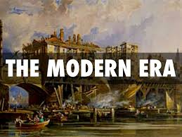
PHASES OF DEVELOPMENT OF THE WORLD ECONOMY
Process based on changes on the modes of accumulation (how growth is generated) and their functional relations (how growth is structured).
The capacity to produce (manufacturing) and to distribute (transport) remain fundamental as vectors of economic development.
Since the beginning of the Modern Era in the 16th century, four major phases leading to the development of the world economy can be identified, with the fifth speculative about how globalization of the world economy may unfold in the future.

Slide 5
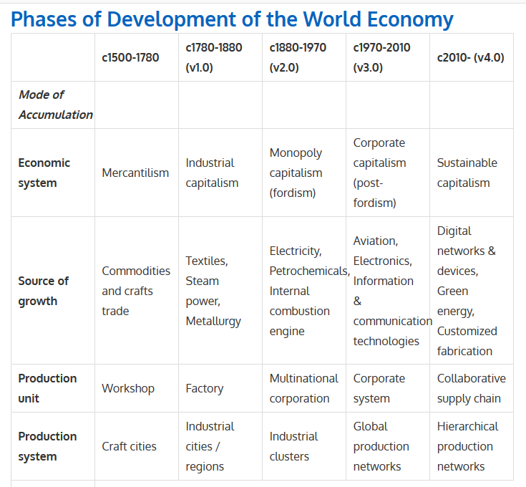
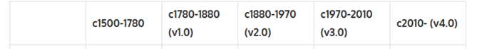
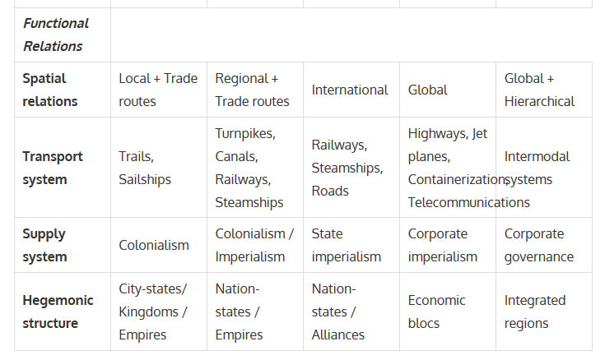
PHASES OF DEVELOPMENT OF THE WORLD ECONOMY

Slide 6
PHASES OF THE WORLD ECONOMY
The age of mercantilism (1500-1780) and the setting of the first transoceanic trade routes led to a remarkable expansion of the hegemony of Europe through the setting of colonial empires (such as the Spanish and Portuguese empires) and their underlying mercantilist system where trade relations were monopolized and controlled.
Although Empires such as China and India (Mughal) were significant economic entities, they were not proactive at setting long distance trade relations but transacted with foreign merchants. Still, for the majority of economic activities the spatial scale of relations remained local in scope as economies of scale for inland transportation remained illusive.
Production stayed relatively unchanged since the Middle Ages with a system based on the workshop where crafts were learned, developed and diffused to apprentices. In many cases this led to the emergence of specialized craft cities where specific production expertise were mastered and guarded by guild organizations.
Yet this system of monopolistic and did not permit mass production.

Slide 7
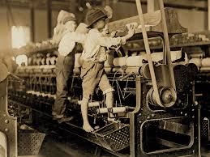
PHASES OF THE WORLD ECONOMY
The industrial revolution (1780-1880) saw to setting of mechanized production and distribution systems and the emergence of industrial capitalism where mass production and consumption became a possibility.
This required the usage of a larger production unit; the factory. Additional demand for labor incited higher levels of urbanization and the emergence of industrial cities having a wide scale of trade relations, mostly with areas supplying raw materials and energy. This was made possible by the setting of canals and then by the first regional rail networks, permitting for the first time economies of scale for inland transportation.
The introduction of the steamship strengthened long distance trade and colonialism.

Slide 8
PHASES OF THE WORLD ECONOMY
The emergence of fordism (1880-1970) resulted in a capitalist system dominated by large multinational corporations or corporations operating under a quasi-monopolistic status over their respective economies.
The growing complexity of manufacturing benefited from the setting of industrial clusters (manufacturing belts) where related industries agglomerated. The setting of the assembly line model relied on a network of suppliers in relative close proximity and the advent of production management.
International and regional relations were serviced by well-established steamship and rail networks. During the later part of this period, colonial empires collapsed with state imperialism replaced by corporate imperialism.
The economic role of developing countries (many of which being former colonies) started to become more prevalent in a world that until then was dominantly assumed by Europe and its offshoots (e.g. USA). Yet, for entities such as China and India, this period marked a remarkable decline in their economic importance.

Slide 9
PHASES OF THE WORLD ECONOMY
Post-fordism (1970-2010) saw an acceleration of globalization, particularly with the emergence of export-oriented economies (e.g. Japan, Korea, China) that gained from the offshoring of several manufacturing tasks and the setting of global production networks managed by corporate systems.
This was made possible by a convergence of key transportation technologies, particularly containerization, jet planes services and telecommunications. While the level of manufacturing output increased, its relative share declined in relation to the growth of service activities.
Knowledge became a form of capital, particularly since innovation played an important role in the quantitative and qualitative improvement of goods and services.
Information technologies became increasingly embedded in products and services.
Multilateral trade agreements and economic blocs provided a transactional environment favorable to take advantage of the comparative advantages of locations in terms of labor, land or resources.

Slide 10
PHASES OF THE WORLD ECONOMY
The challenges standing at the beginning of the 21st century bring the question about how globalization and its underlying production and distribution processes will evolve.
Emerging environmental and resource scarcity concerns are indicative of a sustainable capitalism paradigm where economic activities a bound to minimize their externalities (e.g. waste, pollution, congestion) both because of regulatory and competitive pressures.
Like the previous post-fordist phase, the setting of efficient supply chains will be fundamental, particularly in the context where each element collaborate to add value.
While globalization will remain a dominant paradigm, energy and recycling will incite a more regionally focused manufacturing system. Production systems are likely to take a more hierarchical structure, shifting to global sourcing when necessary, but preferring regional suppliers.
The level of intermodal integration of transport systems, for both passengers and freight, will lead to additional efficiency improvements, even if modal speeds do not very significantly. Nation-states will remain the basic functional unit, but economic integration will continue to blur the distinctiveness between the nation and the economic region.

Slide 11
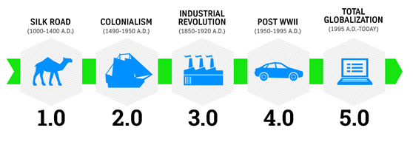
PEAKS OF THE WORLD ECONOMY
Three peaks of development of the world economy:
I. the last third of the 19th century: all countries of the world connected by networks of global communications and involved into one system
II. 60th of 20th century: completed the process of decolonization
III. information coup in the last half of the 20th century: process of globalization of the world economy
the world economy is divided into six stages defined by layout events from the perspective of the development of the world economy
definition: the elements of the world economy, economic relations and the development of scientific and technological progress

Slide 12
BEFORE….
Silk roads (1st century BC-5th century AD, and 13th-14th centuries AD)
People have been trading goods for almost as long as they’ve been around. But as of the 1st century BC, a remarkable phenomenon occurred. For the first time in history, luxury products from China started to appear on the other edge of the Eurasian continent – in Rome. They got there after being hauled for thousands of miles along the Silk Road. Trade had stopped being a local or regional affair and started to become global.
Silk was mostly a luxury good, and so were the spices that were added to the intercontinental trade between Asia and Europe. As a percentage of the total economy, the value of these exports was tiny, and many middlemen were involved to get the goods to their destination. But global trade links were established, and for those involved, it was a goldmine. From purchase price to final sales price, the multiple went in the dozens.
The Silk Road could prosper in part because two great empires dominated much of the route. If trade was interrupted, it was most often because of blockades by local enemies of Rome or China. If the Silk Road eventually closed, as it did after several centuries, the fall of the empires had everything to do with it. And when it reopened in Marco Polo’s late medieval time, it was because the rise of a new hegemonic empire: the Mongols. It is a pattern we’ll see throughout the history of trade: it thrives when nations protect it, it falls when they don’t.

Slide 13
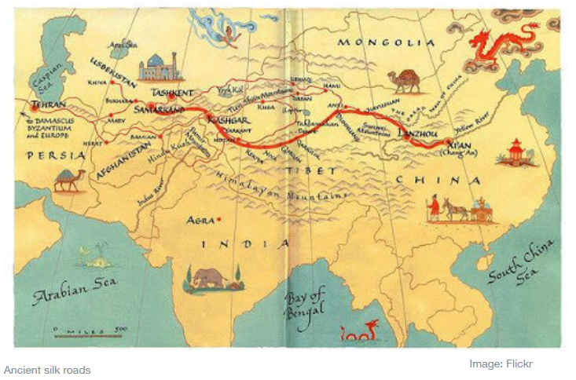
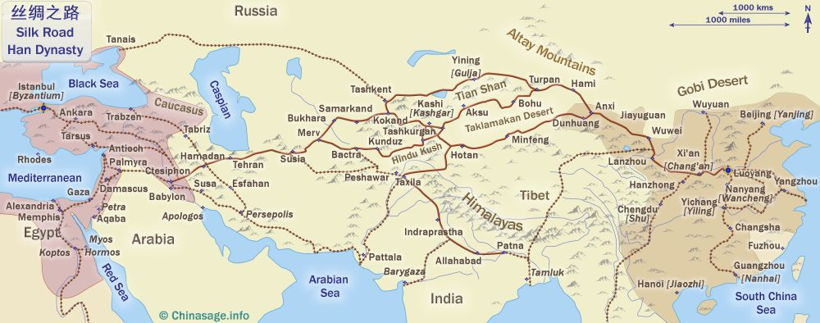
BEFORE…

Slide 14
BEFORE…
Spice routes (7th-15th centuries)
The next chapter in trade happened thanks to Islamic merchants. As the new religion spread in all directions from its Arabian heartland in the 7th century, so did trade. The founder of Islam, the prophet Mohammed, was famously a merchant, as was his wife Khadija. Trade was thus in the DNA of the new religion and its followers, and that showed. By the early 9th century, Muslim traders already dominated Mediterranean and Indian Ocean trade; afterwards, they could be found as far east as Indonesia, which over time became a Muslim-majority country, and as far west as Moorish Spain.
The main focus of Islamic trade in those Middle Ages were spices. Unlike silk, spices were traded mainly by sea since ancient times. But by the medieval era they had become the true focus of international trade. Chief among them were the cloves, nutmeg and mace from the fabled Spice islands – the Maluku islands in Indonesia. They were extremely expensive and in high demand, also in Europe. But as with silk, they remained a luxury product, and trade remained relatively low volume. Globalization still didn’t take off, but the original Belt (sea route) and Road (Silk Road) of trade between East and West did now exist.

Slide 15
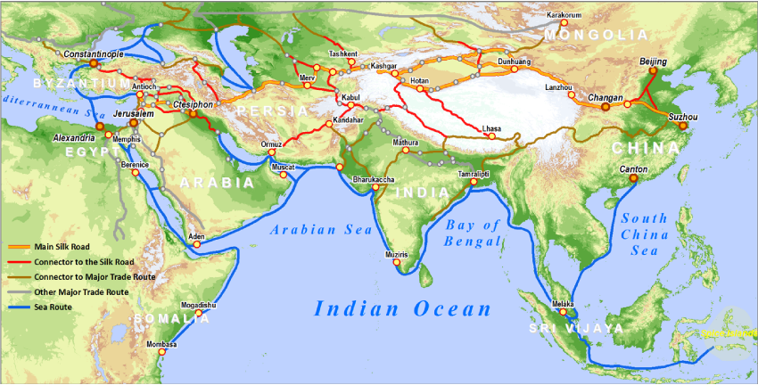
BEFORE…

Slide 16
DEVELOPMENT OF THE WORLD ECONOMY
First stage: since the establishment of feudal states (10th century) to 1492 (Discovery of America)
  Leading force: China, islamic states and Europa (Genoa a Venice)
  Characteristics:
    long-distance trade
    emergence of the banking system - money and bills of exchange
  Innovations: compass, rudder, gunpowder, silk and china
  Production: Hand-made character, manufacturers were organized in guilds, which monitored the quality of products, set prices and other terms of production

Slide 17
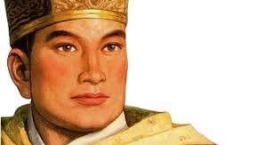
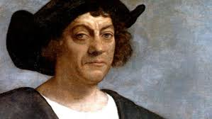
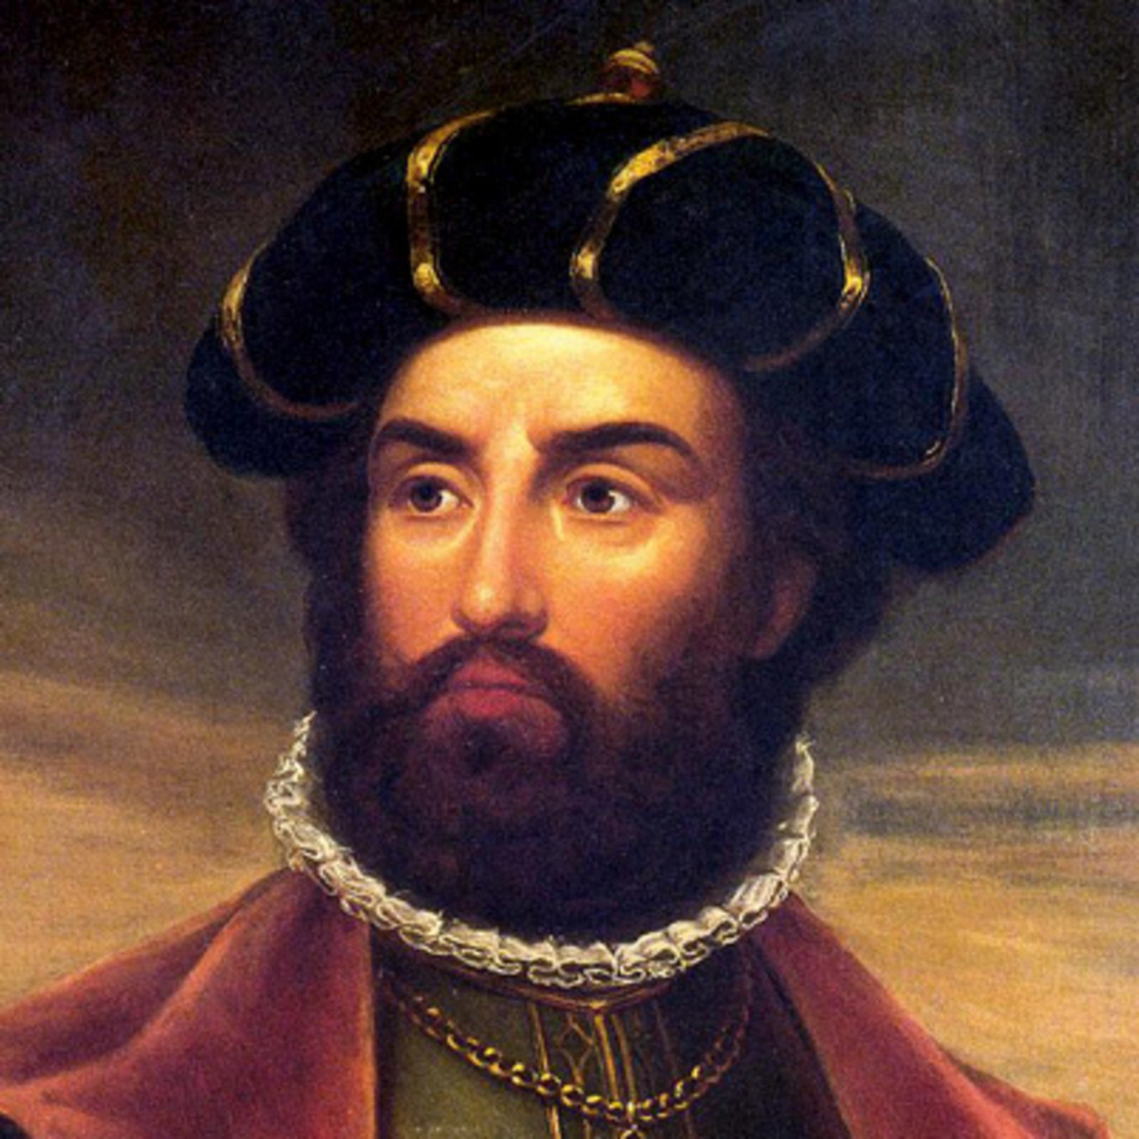
DEVELOPMENT OF THE WORLD ECONOMY
Discovery paths: the way to the creation of a real world economy
Maritime expansion of China: Zheng He (1371-1435) in the years 1405-1433
Bartolemeo Diaz (1450-1500): sailed around the Cape of Good Hope in 1488
Christopher Columbus (1451-1506): discovered America in 1492
Vasco da Gama (1460/1469-1524): arrived in India in 1497
Chinese ships : circumnavigated America and Australia - maps

Slide 18
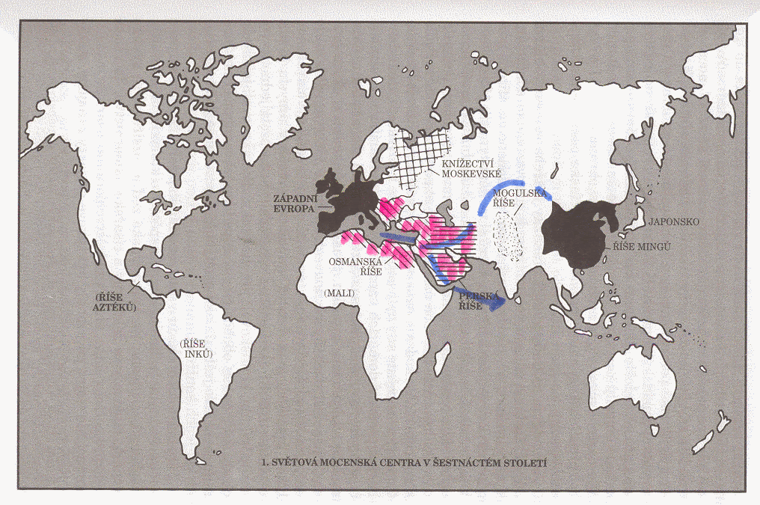
DEVELOPMENT OF THE WORLD ECONOMY

Slide 19
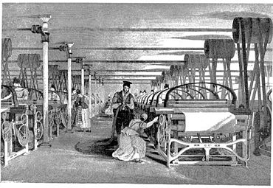
DEVELOPMENT OF THE WORLD ECONOMY
Second stage: 1492-1865 (end of the U.S. civil war)
Colonization with changing of the main hegemon (Spain and England)
The first great migration of the population - slavery
First Industrial Revolution (1760-1847): the industrialization of the countries and the transfer of labor from agriculture to industry
Leading force: Great Britain

Slide 20
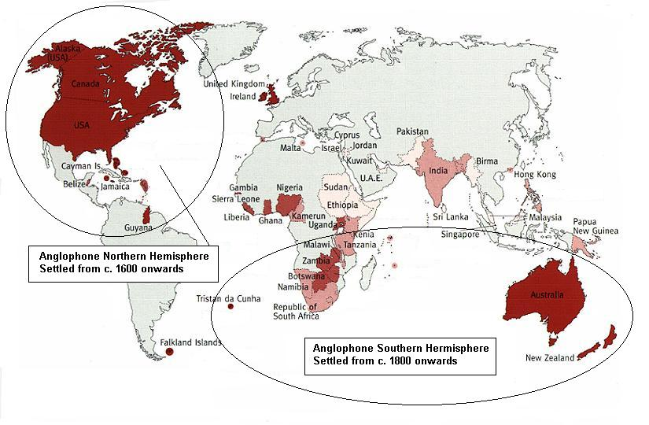
DEVELOPMENT OF THE WORLD ECONOMY

Slide 21
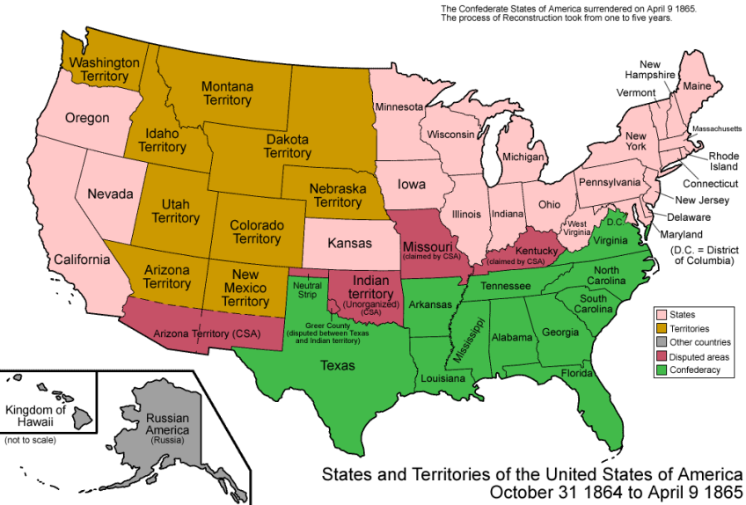
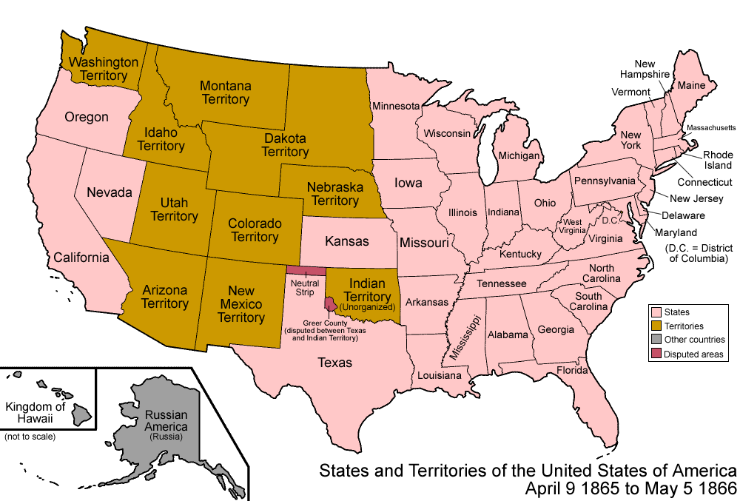
DEVELOPMENT OF THE WORLD ECONOMY
Third stage: 1865-1918 (end of the First World War)
Creation of the world economy (as we know now)
Leading force: Great Britain
Economic nationalism: the increased tariff protection should support and build competitive industry
Free trade and the gold coin standard

Slide 22
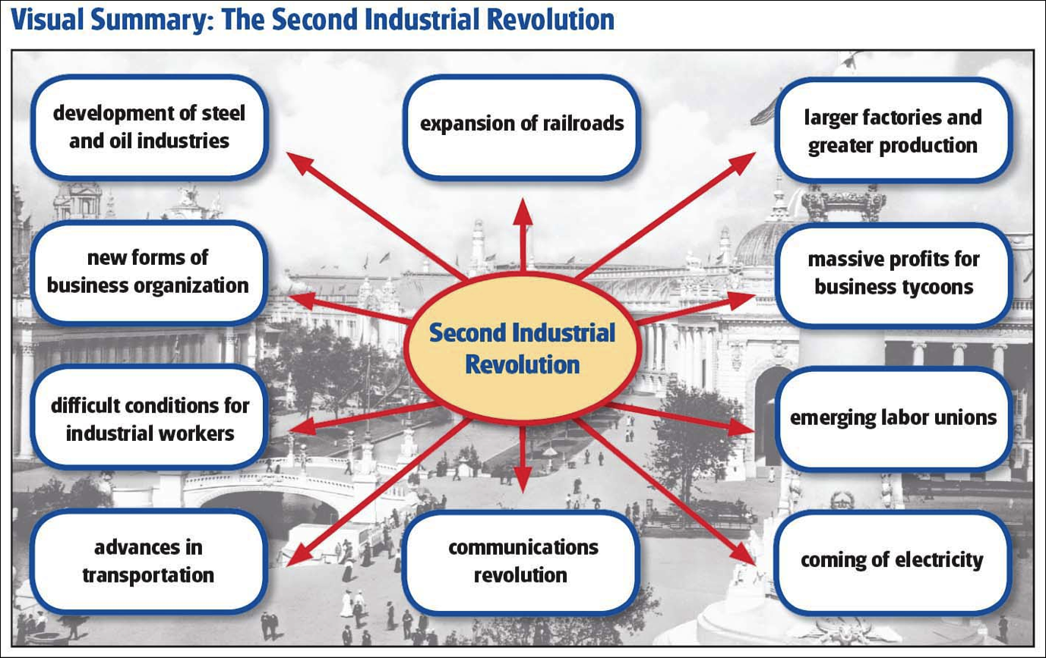
DEVELOPMENT OF THE WORLD ECONOMY
Second Industrial Revolution: the turn of the 19th and 20th century (technical-scientific revolution - electricity, internal combustion engines, the development of chemistry)
Countries that own colonies x newly emerging leaders
General war conflict: the World War I
Emergence of new world leader: the United States

Slide 23
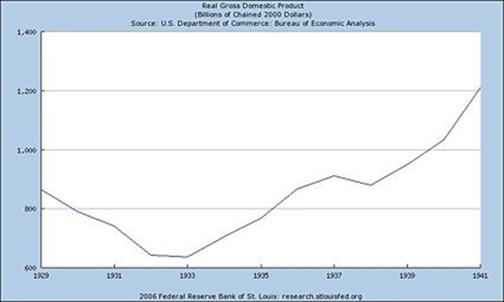
DEVELOPMENT OF THE WORLD ECONOMY
Fourth stage: 1918-1945
Growing influence of large national and early multinational corporations
Economic nationalism: a general increase in tariffs, which further limited the opportunities for economic growth

Slide 24
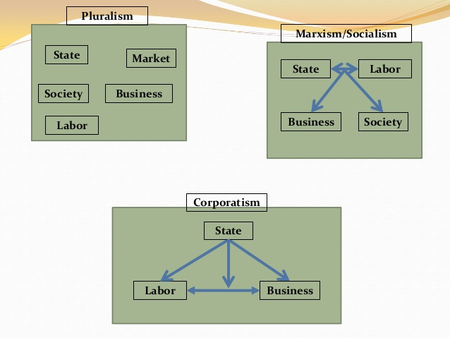
DEVELOPMENT OF THE WORLD ECONOMY
The emergence of other international organizations:
  IMF (1944) and World Bank (1945)
Corporatist states: state control of public private ownership (Italy of Mussolini, now HongKong)
World War II (1939-1945)
Mechanism of central planning

Slide 25
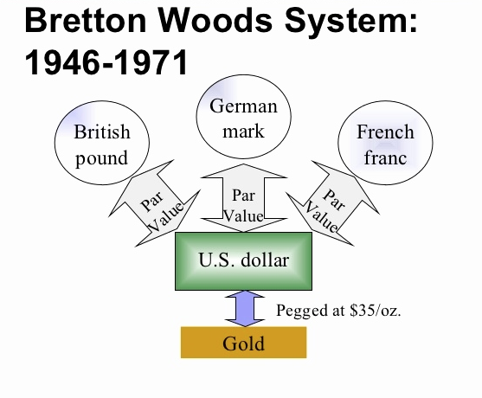
DEVELOPMENT OF THE WORLD ECONOMY
Fifth stage: the second half of the 40th to 60 years 20th century
Emancipatory process of colonies
Two economic systems: market economy x centrally planned economy
Foundations for regional economic integration were laid
Signed the General Agreement on Tariffs and Trade (GATT)
Gold exchange standard: Bretton-Woods monetary system

Slide 26
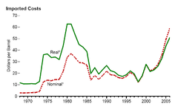
DEVELOPMENT OF THE WORLD ECONOMY
Sixth stage: 70th-90th of the 20th century ….
Structural crisis: characterized by energetic (mainly oil in 1973), raw materials and food crisis (1972)
Oil prices rose in one year from $ 3 to $ 12 per barrel
Leaving the gold exchange parity (1971) and the associated reconstruction of the international monetary system
Jamaican monetary system of floating exchange rates
The second oil crisis (1978) - panic and price regulation of gasoline

Slide 27
DEVELOPMENT OF THE WORLD ECONOMY
Innovations:
  the advent of miniaturization in electronics, which then enabled the mass advent of computer technology in information processes and the advent of automated manufacturing and robotics
  information technology has penetrated into all manufacturing and service sectors
Structural consequences of the crisis: the deterioration of the situation of developing countries
Emergence of newly industrialized countries
Termination of centrally planned economies: the cause was the weakening economic performance

Slide 28
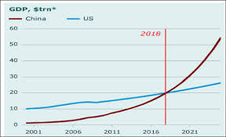
DEVELOPMENT OF THE WORLD ECONOMY
The process of globalization of the world economy starts
Establishment of the postindustrial world
1980 - 1990 – European Union, United States and Japan lead expansion
1990 - 2000 – United States dominates expansion
2000 - 2010 – Rise of Developing and Emerging Economies
2010 - 2018 – China leads economic growth

Slide 29
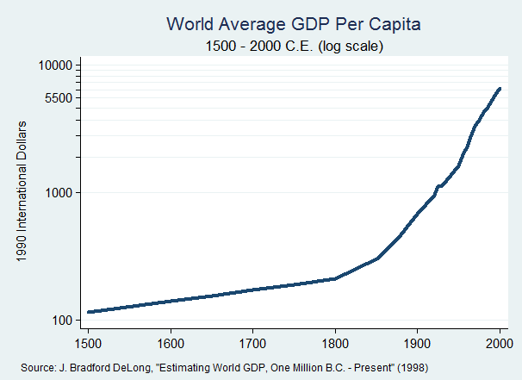
DEVELOPMENT OF THE WORLD ECONOMY

Slide 30
DEVELOPMENT OF THE WORLD ECONOMY
The challenges at the beginning of the 21st century bring the question about how globalization and its underlying production and distribution processes will evolve
Sustainable capitalism paradigm - economic activities minimize their externalities (waste, pollution, congestion) both because of regulatory and competitive pressures
Globalization - a dominant paradigm
Production systems - more hierarchical structure, shifting to global sourcing when necessary, but preferring regional suppliers
Level of integration of transport systems, for both passengers and freight, will lead to additional efficiency improvements
Nation-states - the basic functional unit, but economic integration will continue to blur the distinctiveness between the nation and the economic region

Slide 31
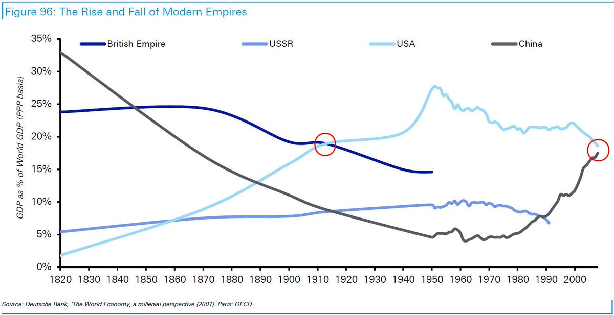
DEVELOPMENT OF THE WORLD ECONOMY

Slide 32
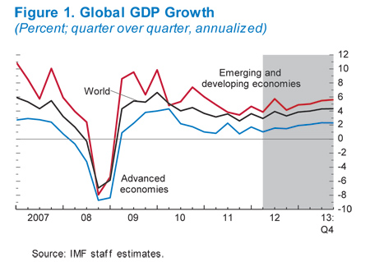
DEVELOPMENT OF THE WORLD ECONOMY

Slide 33
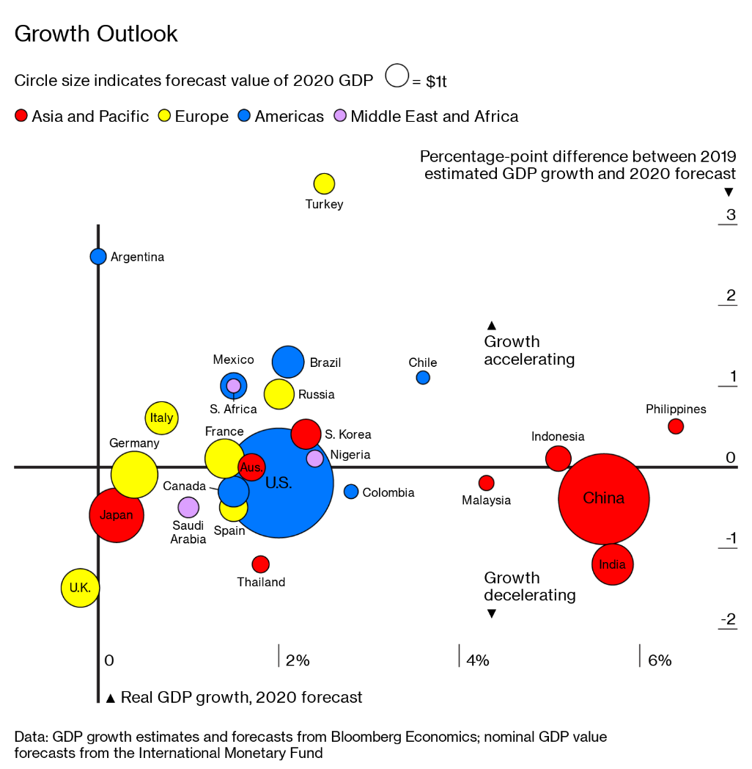
DEVELOPMENT OF THE WORLD ECONOMY

Slide 34
WORLD ECONOMY
Thank you for your Attention!

