Slide 1

GLOBALIZATION AND ITS ASPECTS
Ingrid Majerova
World Economy
EVS/XXX
LESSON IV

Slide 2

Outline of the lecture
Principle of Globalization
Waves of Globalization
Importance of Globalization
Microeconomic Aspects of Globalizaion

Slide 3
PRINCIPLE OF GLOBALIZATION
Globalization: one of the dominant features of the world economy in the last millennium
Essential importance for the development of globalization:
  Diversity of economic and social forms, which are implemented by processes of globalization
  Changes in the production and development of information and communication technologies to make material assumptions and tools of globalization
Globalization: the development of international economic relations, which leads to a deepening of the interconnectedness and interdependence of national economies

Slide 4
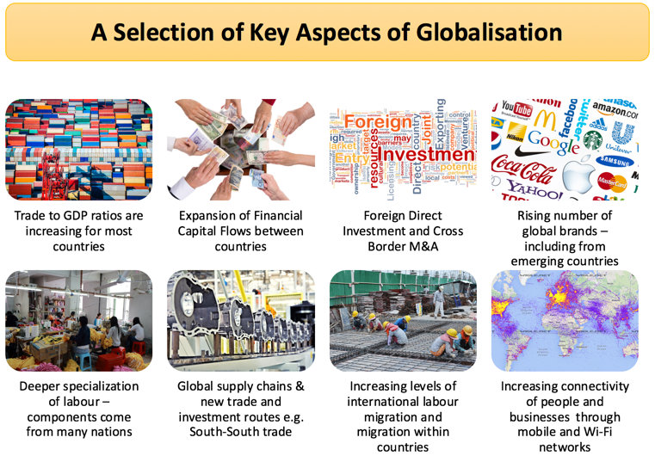
PRINCIPLE OF GLOBALIZATION

Slide 5
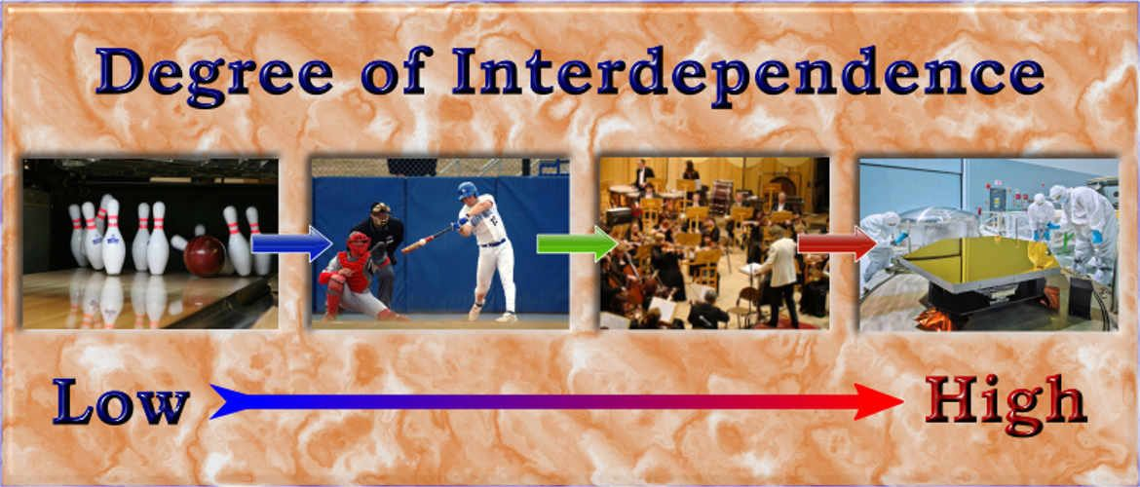
PRINCIPLE OF GLOBALIZATION
High degree of economic interdependence
No nation exists in economic isolation
All aspects of a nation’s economy are linked to the economies of its trading partners
Reflects the historical evolution of the world’s economic and political order
Complex and its effects uneven

Slide 6
PRINCIPLE OF GLOBALIZATION
High degree of economic interdependence
Steps toward international cooperation
Mutually advantageous for trading nations
Specialization, efficiencies of large scale production
Wider variety of products at lower cost
Protectionist pressures
Developing nations
Liberalized trading system - serves to keep the developing nations in poverty

Slide 7
PRINCIPLE OF GLOBALIZATION
Globalization
Greater interdependence
Countries and their citizens
International flows
Goods and services
People
Investments in equipment, factories, stocks, bonds
Non-economic elements
Culture and the environment

Slide 8
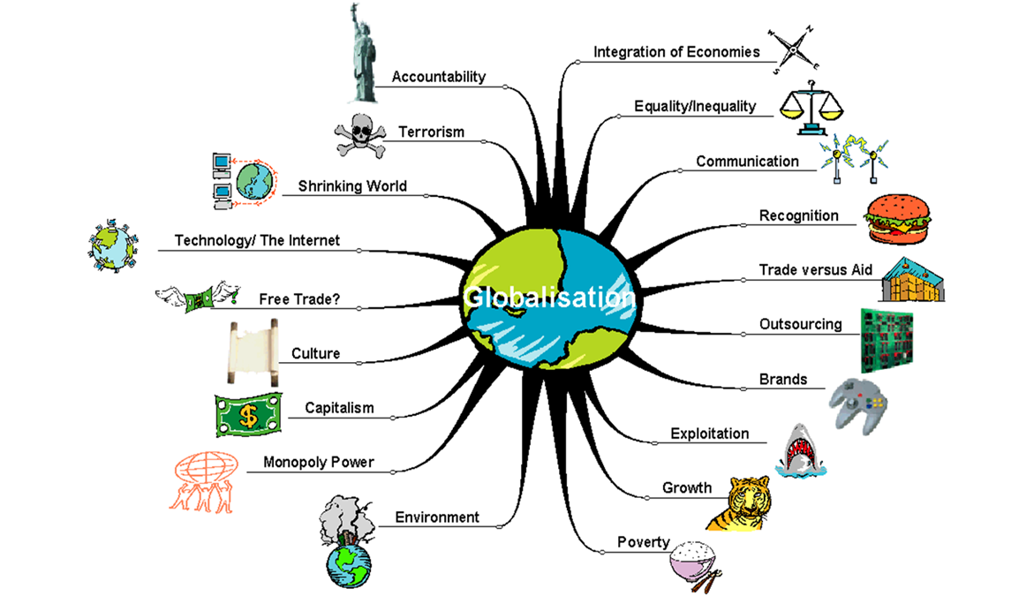
PRINCIPLE OF GLOBALIZATION

Slide 9

PRINCIPLE OF GLOBALIZATION
What forces are driving globalization?
Technological change
Multilateral trade negotiations
Continuing liberalization of trade and investment
Widespread liberalization of investment transactions
Development of international financial markets

Slide 10
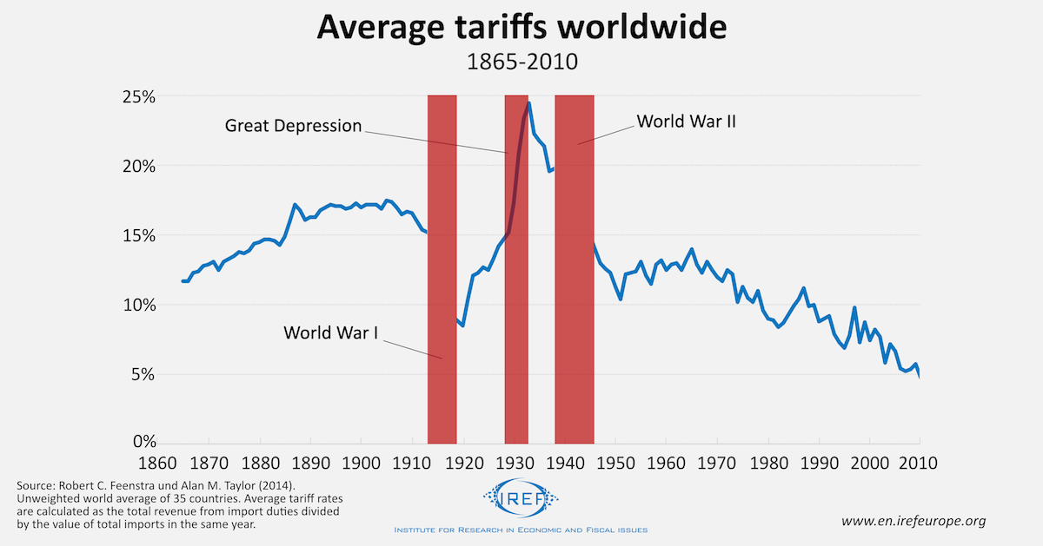
WAVES OF GLOBALIZATION
First Wave of Globalization: 1870–1914
Decreases in tariff barriers & new technologies
Declining transportation costs
Shift from sail to steamships; Railways
Driven by European and American businesses and individuals

Slide 11
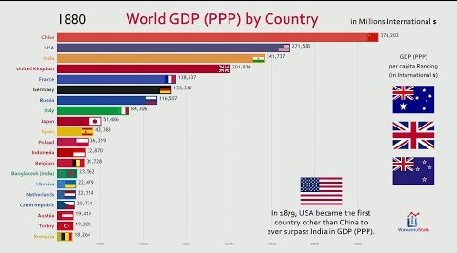
WAVES OF GLOBALIZATION
First Wave of Globalization: 1870–1914
Exports as a share of world income
  Nearly doubled to 8%
Per capita incomes increased 1.3% per year
  Previous 50 years: 0.5% per year
Countries that actively participated in globalization
  Became the richest countries in the world
Brought to an end by World War I

Slide 12
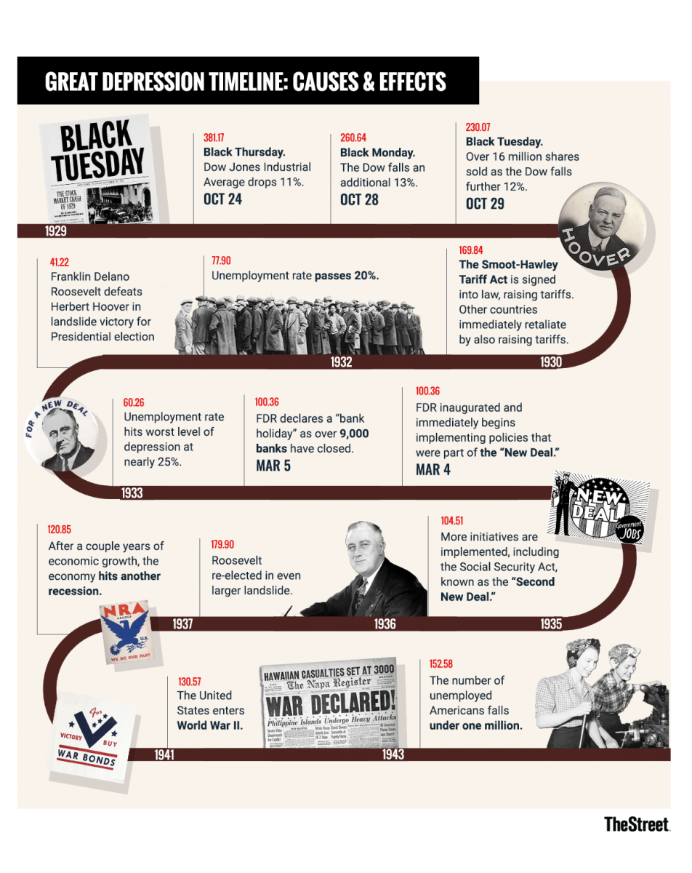
WAVES OF GLOBALIZATION
Great Depression of the 1930s
Governments – protectionism
Tariffs on imports
  Try to shift demand into domestic markets
  Promote sales for domestic companies
  Promote jobs for domestic workers
Exports as a share of national income
  Falls to 5%

Slide 13
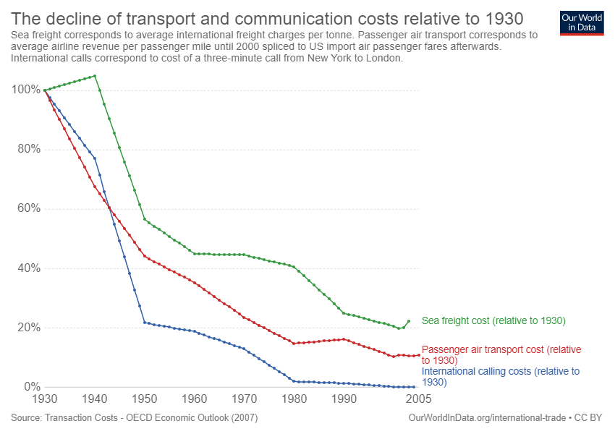
WAVES OF GLOBALIZATION
Second Wave of Globalization: 1945–1980
Horrors of the retreat into nationalism
Falling transportation costs
Decrease previously established trade barriers
Trade liberalization – discrimination
  Which countries participated
  Which products were included

Slide 14
WAVES OF GLOBALIZATION
Trade liberalization – discrimination
Developed countries, manufactured goods
  Largely freed of barriers
  Greatly increased the exchange of manufactured goods
  Raise the incomes of developed countries
Developing countries
  Eliminate barriers only for those agricultural products that did not compete with agriculture in developed countries
  Manufactured goods - sizable barriers

Slide 15

WAVES OF GLOBALIZATION
Second Wave of Globalization: 1945–1980
New kind of trade
Rich country specialization in manufacturing niches
  Gained productivity through agglomeration economies
Firms clustered together
  Some clusters produced the same product
  Others were connected by vertical linkages
Agglomeration economies
  Benefit those in the clusters
  Bad news for those who are left out

Slide 16
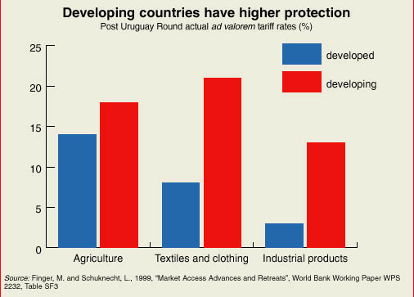
WAVES OF GLOBALIZATION
Second Wave of Globalization: 1945–1980
Most developing countries
  Did not participate in the growth of global trade in manufacturing and services
  Continuing trade barriers in developed countries
  Unfavorable investment climates
  Antitrade policies in developing countries
  Dependence on agricultural and natural-resource products

Slide 17
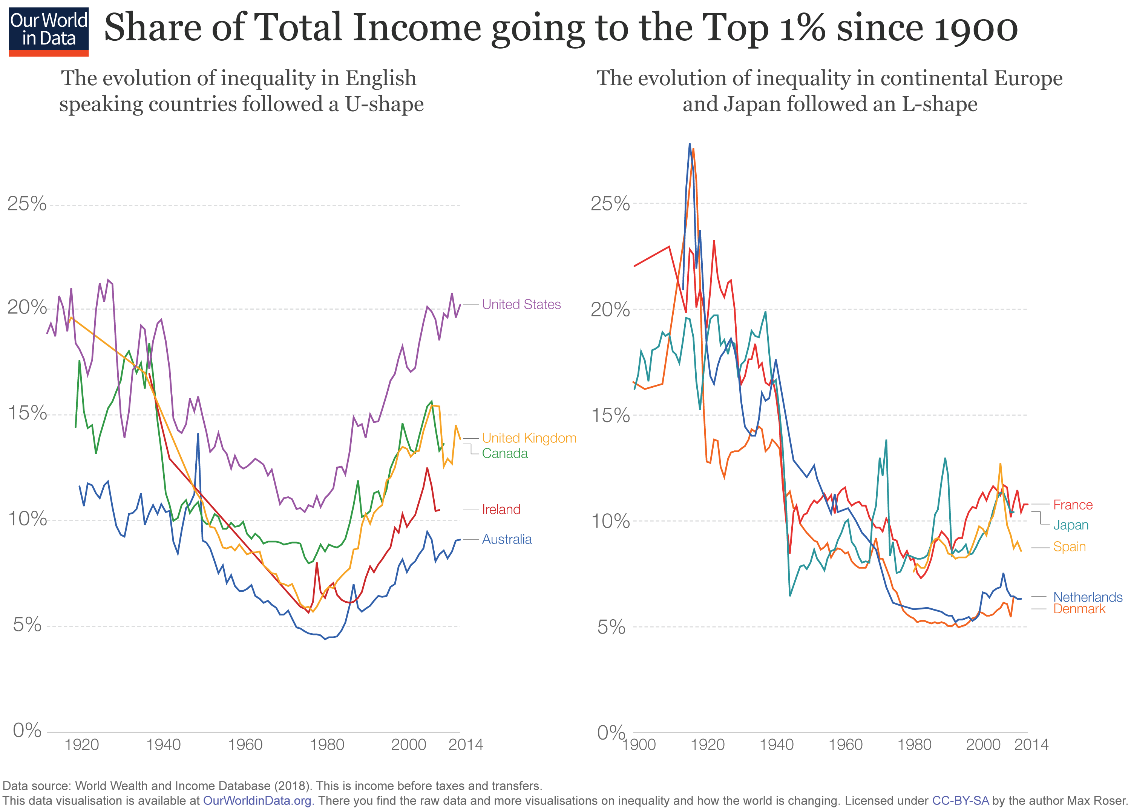
WAVES OF GLOBALIZATION
Second Wave of Globalization: 1945–1980
Increased per capita incomes within the developed countries
Developing countries as a group were being left behind
World inequality

Slide 18
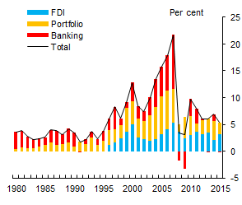
WAVES OF GLOBALIZATION
Latest Wave of Globalization, began in 1980
A large number of developing countries
  China, India, and Brazil
  Broke into the world markets for manufacturers
Other developing countries
  Increasingly marginalized in the world economy
  Decreasing incomes
  Increasing poverty
  Significant international capital movements

Slide 19

WAVES OF GLOBALIZATION
Latest Wave of Globalization, began in 1980
Some developing countries
  Competitive advantage in labor-intensive manufacturing
  Bangladesh, Malaysia, Turkey, Mexico, Hungary, Indonesia, Sri Lanka, Thailand, and the Philippines
Tariff cuts
Lower barriers to foreign investment
Technological progress in transportation and communications
Protectionist policies in developed countries

Slide 20
WAVES OF GLOBALIZATION
Latest Wave of Globalization, began in 1980
World
  More globalized - international trade, capital flows
Less globalization - labor flows
Foreign outsourcing
Certain aspects of a product’s manufacture are performed in more than one country
Manufacturing - moved to wherever costs were the lowest
Job losses for blue-collar workers
Cries for the passage of laws to restrict outsourcing

Slide 21
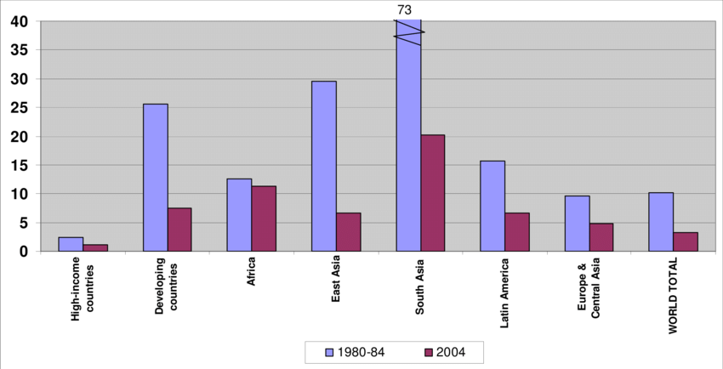
WAVES OF GLOBALIZATION - Tarrifs

Slide 22

WAVES OF GLOBALIZATION
Latest Wave of Globalization, began in 1980
By the 2000s, foreign outsourcing of white-collar work
Information Age
Digitization, Internet, and high-speed data networks around the world
Sending upscale jobs offshore
Accounting, chip design, engineering, basic research, and financial analysis
Foreign outsourcing
  Reduce costs of a given service: 30 to 50%

Slide 23
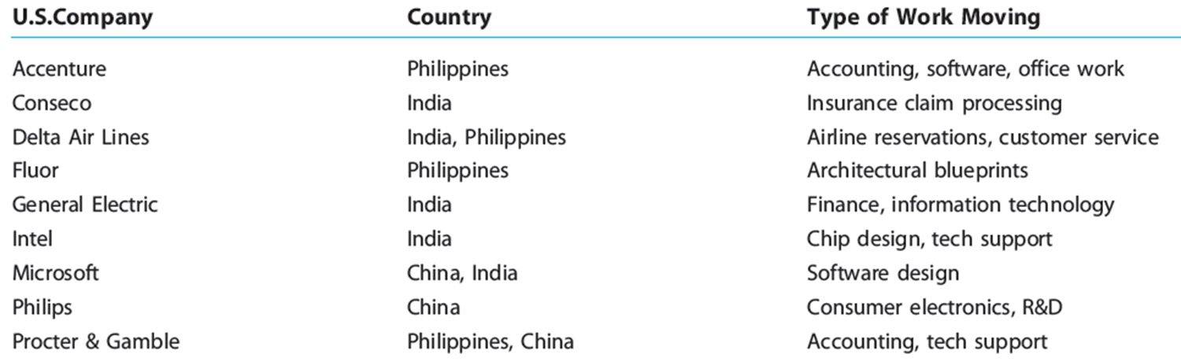
WAVES OF GLOBALIZATION

Slide 24
WHY IS GLOBALIZATION IMPORTANT?
Law of comparative advantage
Citizens of each nation can gain
Spend more of their time and resources doing those things in which they have a relative advantage
If a good or service can be obtained more economically through trade
Trade for it instead of producing it domestically
How the available resources can be used to obtain each good at the lowest possible cost

Slide 25

WHY IS GLOBALIZATION IMPORTANT?
Open economies
  Produce a larger joint output
Competition - essential to both innovation and efficient production
International competition
Domestic producers - strong incentive to improve the quality of their products
Weakens monopolies

Slide 26

WHY IS GLOBALIZATION IMPORTANT?
Globalization
Rapid growth in some countries
Increased demand for commodities
  Crude oil, cooper, steel - higher prices
Increased supply of substitutes
  Biodiesel, ethanol
Domestic economy
  Vulnerable to disturbances initiated overseas
Increased competition from abroad

Slide 27
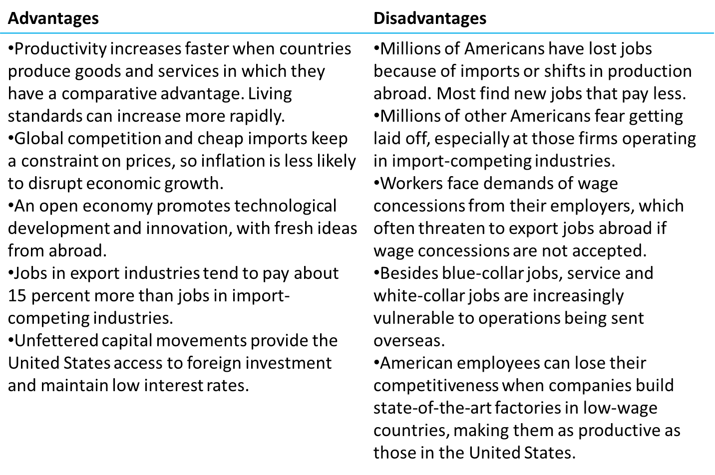
WHY IS GLOBALIZATION IMPORTANT?
Advantages and disadvantages of globalization

Slide 28
MICROECONOMIC ASPECTS OF GLOBALIZATION
The impact of globalization on the business sector:
The emergence of various forms of international companies and multinational corporations that become the ground of the whole structure of the globalized economy
Globalization significantly reduces the success-chances of small and medium-sized enterprises that are not able, from a cost perspective, compete these large transnational corporations
Transnational corporation: person or entity without legal personality, which is made up of parent companies and their foreign affiliates
Multinational corporation: a company that is composed of companies that operate in at least two countries

Slide 29

MICROECONOMIC ASPECTS OF GLOBALIZATION
There are two types of transnational corporations in the world economy:
Multinational corporations: fusion of two or more firms from different countries
Transnational companies: allocation of a company's capital to other countries
Ways through which a company, allocated in one country obtain ownership interests in other states:
  build a business in the host country from the ground up (Hyundai)
  buy an existing company, or part of it (Mittal Steel)

Slide 30
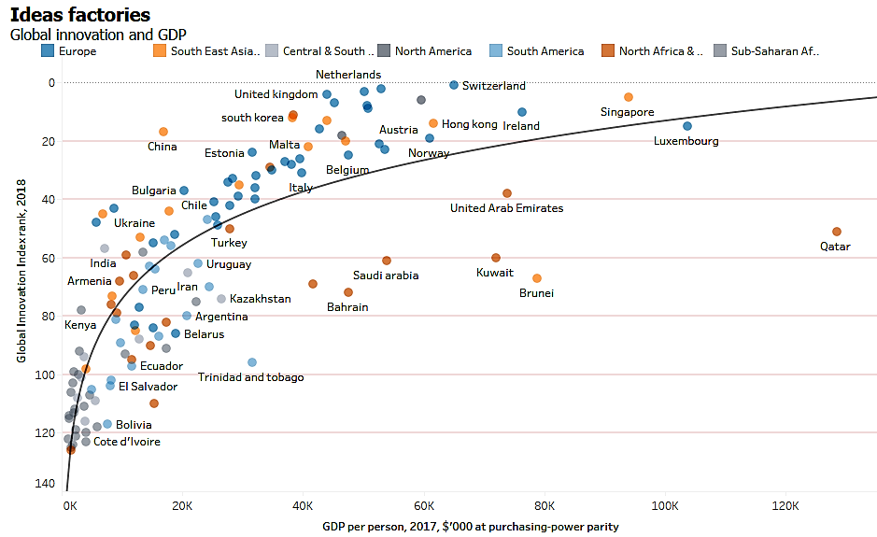
MICROECONOMIC ASPECTS OF GLOBALIZATION
Positive aspects of multinational companies:
The ability to fund the research and development at an appropriate level
Ability to rapidly and widely spread the innovations across the world,
Risk: the possibility of limiting the current form of political and economic sovereignty of the state
The size and growth of multinational companies can be measured by the volume of turnover, its profits or number of employees

Slide 31
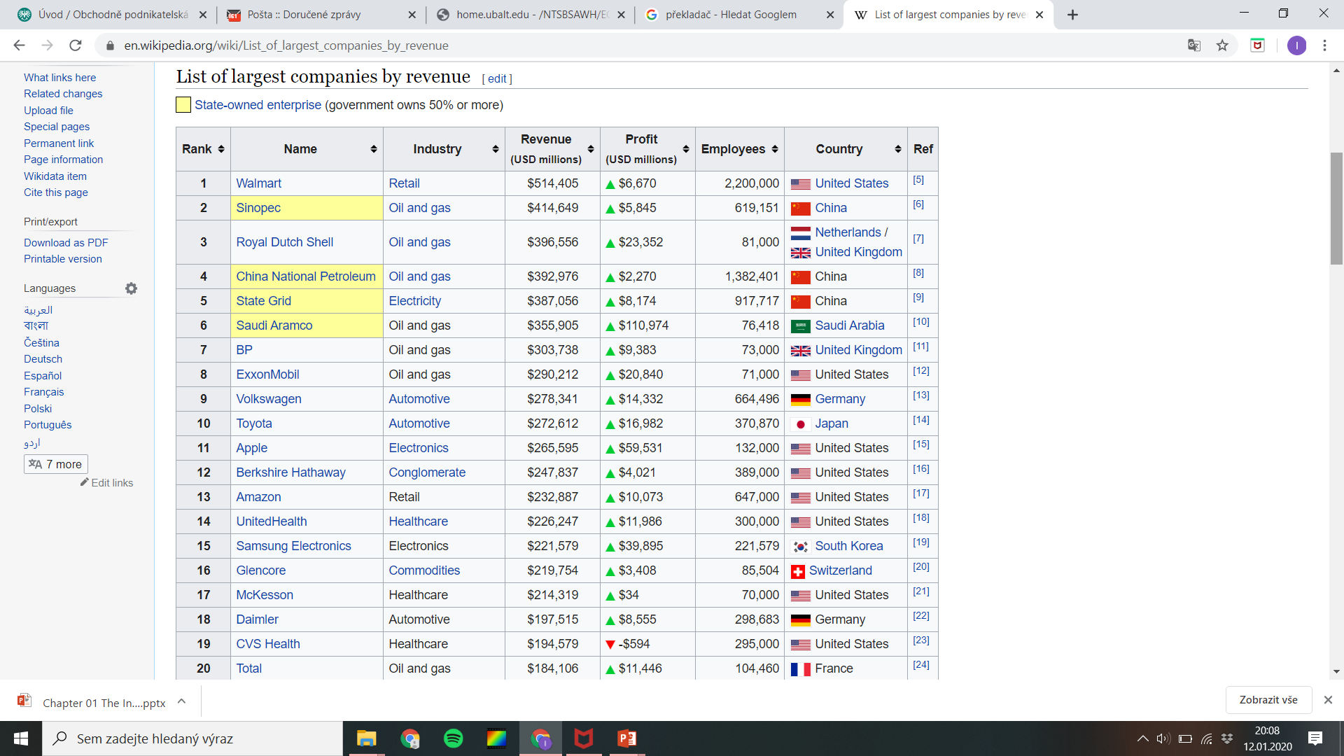
MICROECONOMIC ASPECTS OF GLOBALIZATION

Slide 32
WORLD ECONOMY
Thank you for your Attention!

