Slide 1

INTERNATIONAL TRADE THEORIES
Ingrid Majerova
World Economy
EVS/XXX
LESSON V

Slide 2

Outline of the lecture
Historical Development of Trade Theories
Comparative Advantages
Modern Trade Theories
Constant and Increasing Opportunity Costs

Slide 3
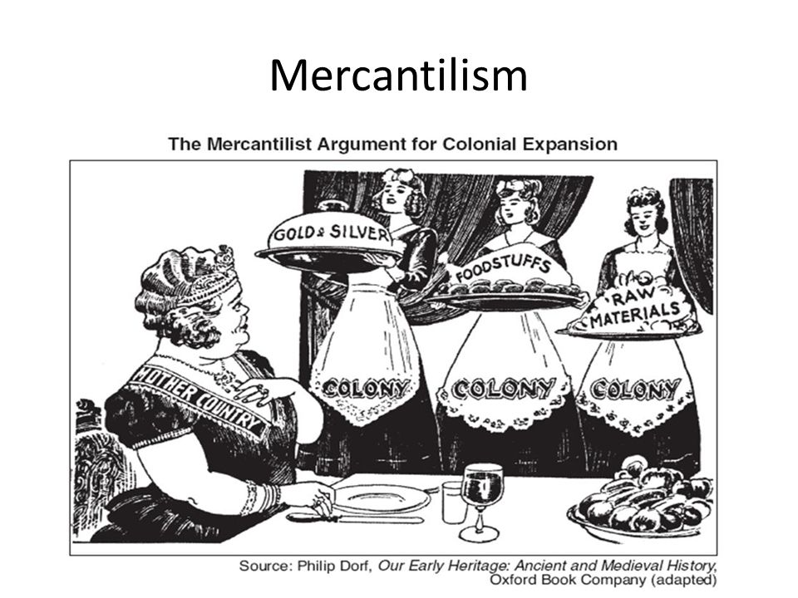
HISTORICAL DEVELOPMENT OF TRADE THEORIES
The Mercantilists, 1500–1800
A strong foreign-trade sector
Favorable trade balance
Net payments - gold and silver
Increased spending
  Rise in domestic output and employment
Promote a favorable trade balance
Government regulation of trade
  Tariffs, quotas, other commercial policies
Static view of the world economy

Slide 4
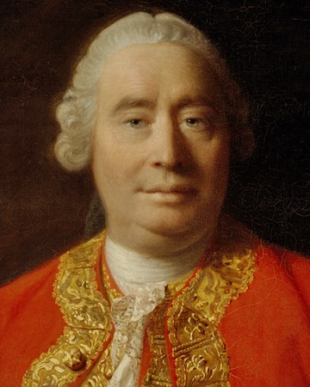
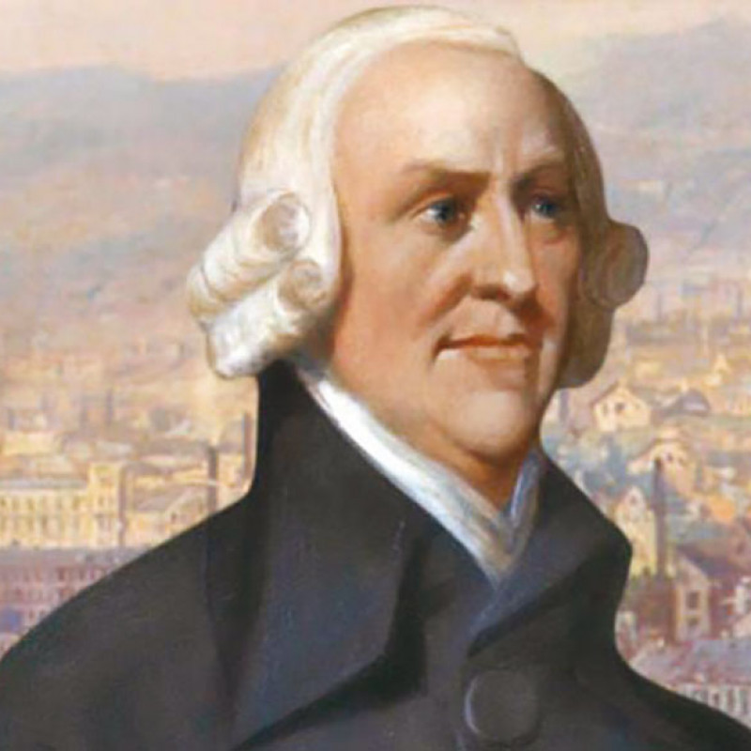
HISTORICAL DEVELOPMENT OF TRADE THEORIES
The Mercantilists under attack
David Hume’s price-specie-flow doctrine
  A favorable trade balance is possible only in the short run
1776, Adam Smith - The Wealth of Nations
  World’s wealth is not a fixed quantity
International trade
  Increase the general level of productivity within a country
Increase world output (wealth)

Slide 5
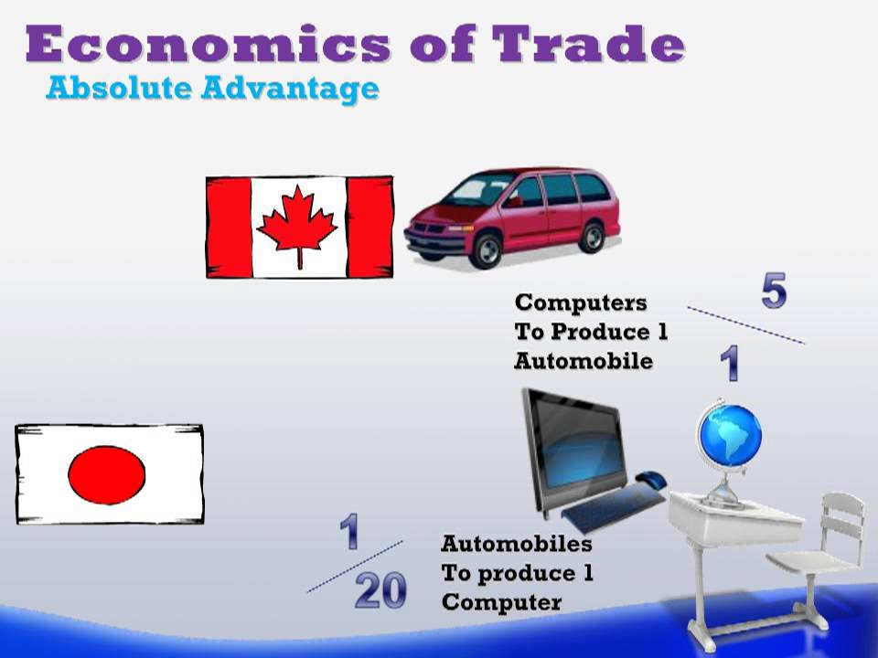
HISTORICAL DEVELOPMENT OF TRADE THEORIES
Why Nations Trade: Absolute Advantage
Adam Smith – free trade advocate
Production costs differ among nations
Different productivities of factor inputs
Labor – homogenous
Absolute cost advantage
Uses less labor to produce one unit of output

Slide 6
HISTORICAL DEVELOPMENT OF TRADE THEORIES
Principle of absolute advantage
A two-nation, two-product world
International specialization and trade
One nation - absolute cost advantage in one good
The other nation - absolute cost advantage in the other good
Each nation must have a good that it is absolutely more efficient in producing than its trading partner
Import goods – if absolute cost disadvantage
Export goods – if absolute cost advantage

Slide 7
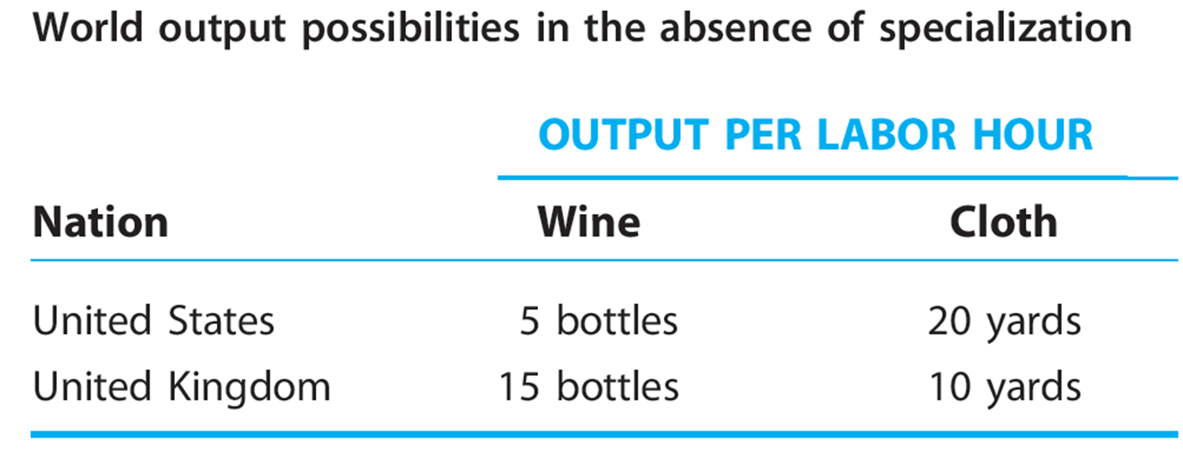
HISTORICAL DEVELOPMENT OF TRADE THEORIES

Slide 8
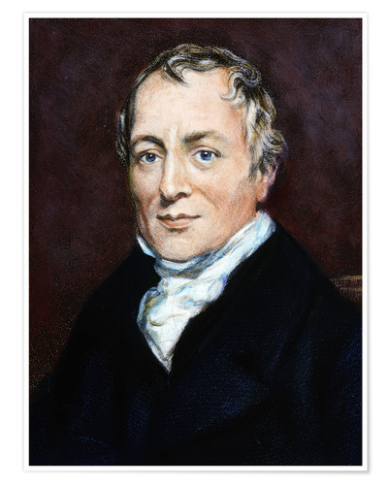
COMPARATIVE ADVANTAGES
Why Nations Trade: Comparative Advantage
1800, David Ricardo (1772–1823)
Free trade
Mutually beneficial trade can occur whether or not countries have any absolute advantage
Principle of comparative advantage
Emphasized comparative (relative) cost differences

Slide 9
COMPARATIVE ADVANTAGES
Principle of comparative advantage
Even if a nation has an absolute cost disadvantage in the production of both goods
The less efficient nation
Specialize in and export the good in which it is relatively less inefficient
Where its absolute disadvantage is least
The more efficient nation
Specialize in and export that good in which it is relatively more efficient
Where its absolute advantage is greatest

Slide 10
COMPARATIVE ADVANTAGES
Principle of comparative advantage, simplified model - assumptions:
1. The world consists of two nations
  Each – use a single input, produce two commodities
2. In each nation, labor is the only input
  Fixed endowment of labor
  Labor is fully employed and homogeneous
3. Labor can move freely among industries
  Within a nation
  But is incapable of moving between nations

Slide 11
COMPARATIVE ADVANTAGES
Principle of comparative advantage, simplified model - assumptions:
4. Technology - fixed for both nations
  Different nations may use different technologies
  All firms within each nation - a common production method for each commodity
5. Costs do not vary with the level of production
  Proportional to the amount of labor used
6. Perfect competition prevails in all markets
  All are price takers
  Identical products
  Free entry to and exit from an industry
  Price of each product = product’s marginal cost of production
7. Free trade occurs between nations
  No government barriers to trade

Slide 12

COMPARATIVE ADVANTAGES
Principle of comparative advantage, simplified model - assumptions:
8. Transportation costs are zero
  Consumers - indifferent between domestically produced and imported versions of a product if the domestic prices of the two products are identical
9. Firms make production decisions in an attempt to maximize profits
  Consumers maximize satisfaction through their consumption decisions
10. There is no money illusion
  When consumers make their consumption choices and firms make their production decisions, they take into account the behavior of all prices
11. Trade is balanced
  Exports must pay for imports
  Ruling out flows of money between nations

Slide 13
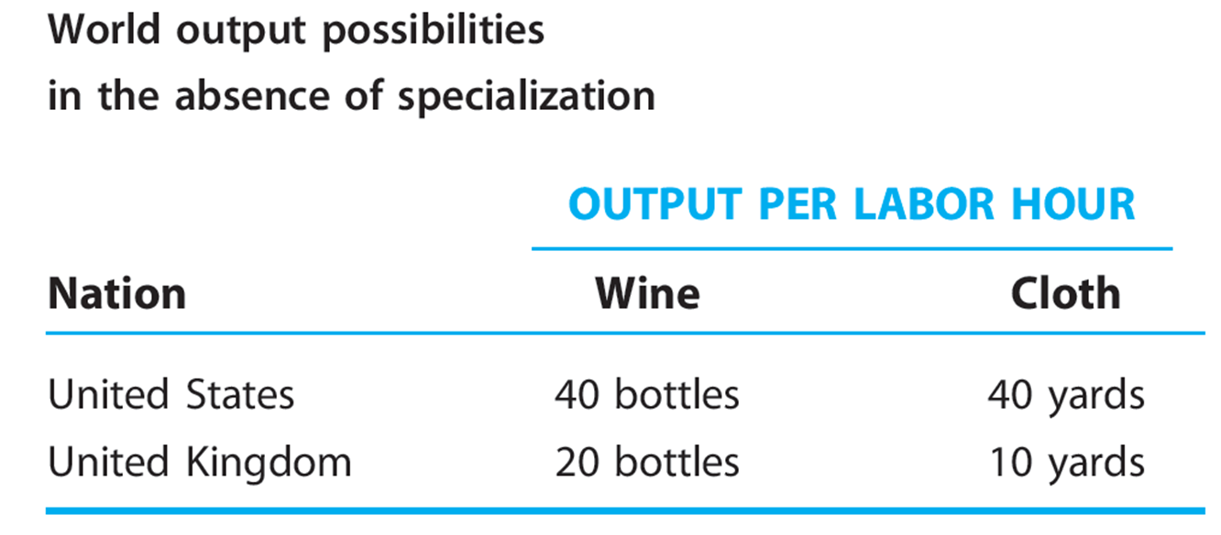
COMPARATIVE ADVANTAGES

Slide 14
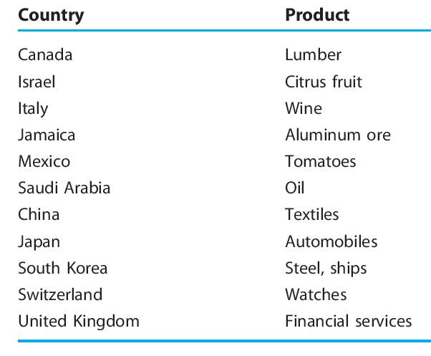
COMPARATIVE ADVANTAGES
Examples of comparative advantages in international trade

Slide 15

MODERN TRADE THEORIES
Modern trade theory
More generalized theory of comparative advantage
Use a production possibilities schedule
Transformation schedule

Slide 16

MODERN TRADE THEORIES
Production possibilities schedule
Various alternative combinations of two goods
A nation can produce
  When all of its factor inputs
Land, labor, capital, entrepreneurship
  Are used in their most efficient manner
Maximum output possibilities of a nation

Slide 17
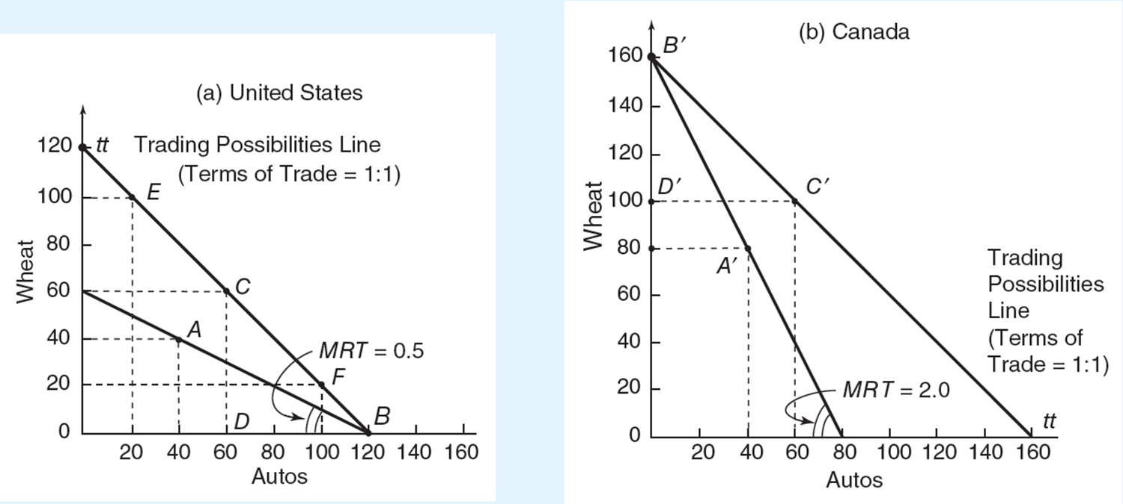
MODERN TRADE THEORIES
Figure 1: Trading under constant opportunity costs
With constant opportunity costs, a nation will specialize in the product of its comparative advantage. The principle of comparative advantage implies that with specialization and free trade, a nation enjoys production gains and consumption gains. A nation’s trade triangle denotes its exports, imports, and terms of trade. In a two nation, two product world, the trade triangle of one nation equals that of the other nation; one nation’s exports equal the other nation’s imports, and there is one equilibrium terms of trade.

Slide 18
MODERN TRADE THEORIES
Marginal rate of transformation, MRT
The amount of one product a nation must sacrifice to get one additional unit of the other product
Rate of sacrifice = opportunity cost of a product
Absolute value of the slope of production possibilities schedule
For Figure 1:

Slide 19
MODERN TRADE THEORIES
Constant opportunity costs
Straight line production possibilities schedules
Factors of production
  Perfect substitutes for each other
  All units of a given factor are of the same quality
Autarky
  Absence of trade
Basis for Trade
  Principle of comparative advantage
Direction of Trade
  Specialize and export the good with the lowest opportunity cost
  Production Gains from Specialization
  Production gains for both countries
  Arise from the reallocation of existing resources
  Static gains from specialization

Slide 20
MODERN TRADE THEORIES
Consumption Gains from Trade
Trade = consumption gains for both countries
Consumption points
Outside domestic production possibilities schedules
Consume more of both goods
Terms of trade
Rate at which a country’s export product is traded for the other country’s export product
Define the relative prices of the two products

Slide 21
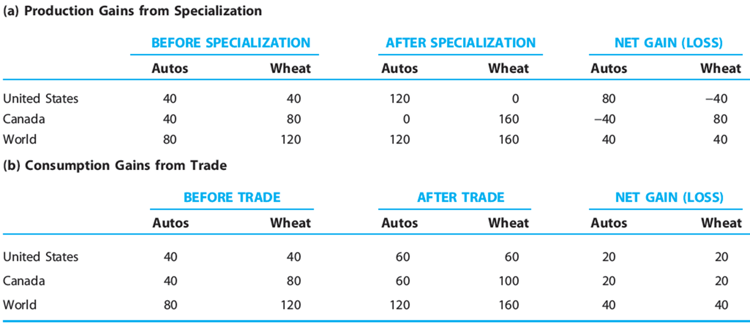
MODERN TRADE THEORIES
Gains from specialization and trade by constant opportunity costs

Slide 22
MODERN TRADE THEORIES
Domestic cost ratio
Negatively sloped production possibilities schedule
Transform into a positively sloped cost-ratio line
Outer limits for the equilibrium terms of trade
Becomes no-trade boundary
Region of mutually beneficial trade
Bounded by the cost ratios of the two countries

Slide 23
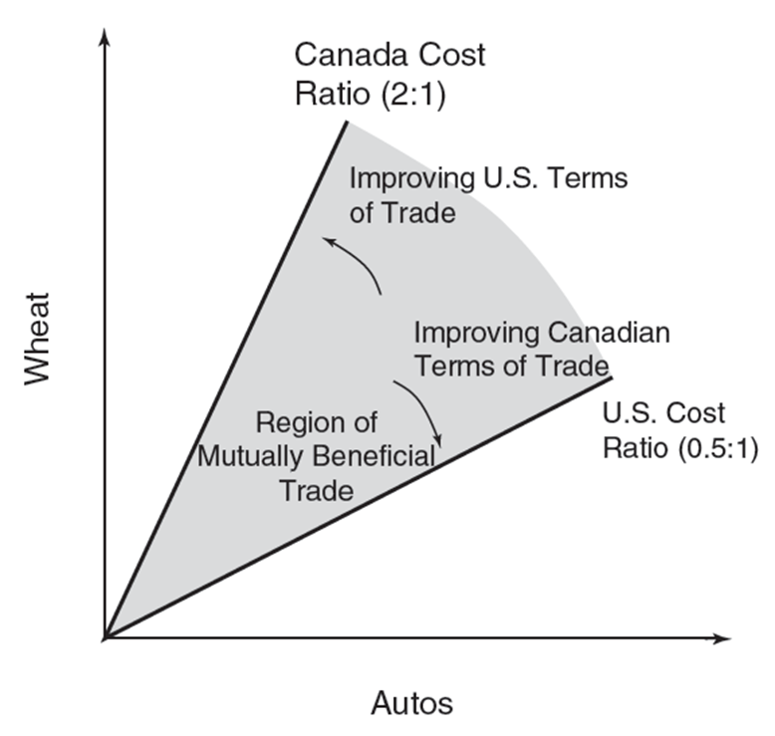
MODERN TRADE THEORIES
Figure 2: Equilibrium terms-of-trade limits
The supply-side analysis of Ricardo describes the outer limits within which the equilibrium terms of trade must fall. The domestic cost ratios set the outer limits for the equilibrium terms of trade. Mutually beneficial trade for both nations occurs if the equilibrium terms of trade lies between the two nations’ domestic cost ratios. According to the theory of reciprocal demand, the actual exchange ratio at which trade occurs depends on the trading partners’ interacting demands.

Slide 24
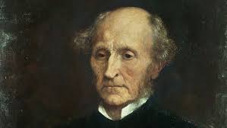
MODERN TRADE THEORIES
Equilibrium Terms of Trade, John Stuart Mill (1806–1873)
Add the intensity of the trading partners’ demands
Determine the actual terms of trade
The theory of reciprocal demand

Slide 25
MODERN TRADE THEORIES
Theory of reciprocal demand
Within the outer limits of the terms of trade
Actual terms of trade are determined by the relative strength of each country’s demand for the other country’s product
Production costs determine the outer limits of the terms of trade
Reciprocal demand determines what the actual terms of trade will be within those limits

Slide 26
MODERN TRADE THEORIES
Theory of reciprocal demand
Best applies when both nations are of equal economic size
The demand of each nation - noticeable effect on market price
If two nations are of unequal economic size
The relative demand strength of the smaller nation will be dwarfed by that of the larger nation
Domestic exchange ratio of the larger nation will prevail
The small nation can export as much of the commodity as it desires

Slide 27
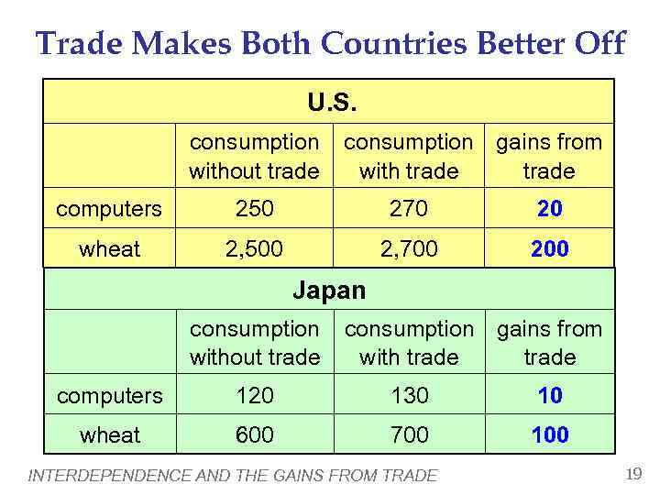
MODERN TRADE THEORIES
The importance of being unimportant
For two nations engaged in international trade
Same size, similar taste patterns
Gains from trade – shared equally between them
  One nation is significantly larger than the other
  Larger nation - fewer gains from trade
  Smaller nation - most of the gains from trade

Slide 28
MODERN TRADE THEORIES
Improvement in a nation’s terms of trade
Rise in its export prices
Relative to its import prices
A smaller quantity of export goods sold abroad
Required to obtain a given quantity of imports
Deterioration in a nation’s terms of trade
  Rise in its import prices
  Relative to its export prices
  Purchase of a given quantity of imports
  Sacrifice of a greater quantity of export

Slide 29
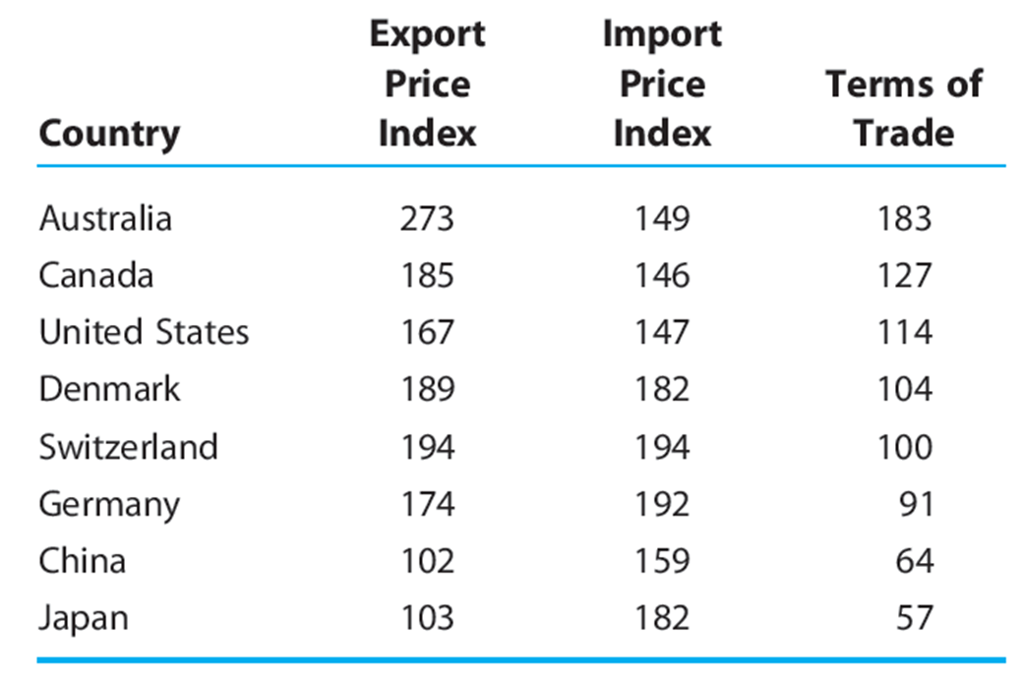
MODERN TRADE THEORIES
Comodity terms of trade in 2008 (2000=100)

Slide 30
MODERN TRADE THEORIES
Patterns of comparative advantage change over time
Productivity increases
Production possibilities schedule changes
More output can be produced - with the same amount of resources
Producers - need to hone their skills to compete in more profitable areas
Increasing opportunity costs
  Concave production possibilities schedule
  Bowed outward from the diagram’s origin
  Inputs are imperfect substitutes for each other
MRT rises
  Absolute slope of the production possibilities schedule

Slide 31
MODERN TRADE THEORIES
Increasing-Cost Trading Case
One country specializes in producing one good
The other country specializes in producing the other good
Specialization continues in both nations until
  Relative cost of one good is identical in both nations
  One country’s exports of one good are precisely equal to the other country’s imports of the good
  Same domestic rates of transformation

Slide 32
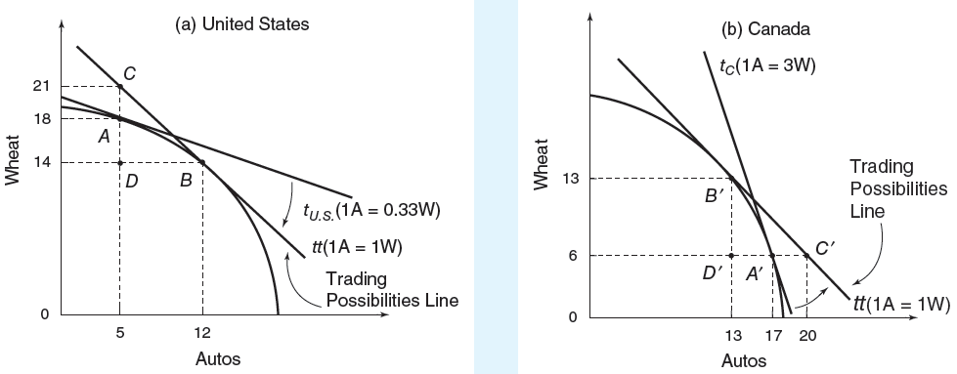
MODERN TRADE THEORIES
Figure 3: Trading under increasing opportunity costs
With increasing opportunity costs, comparative product prices in each country are determined by both supply and demand factors. A country tends to partially specialize in the product of its comparative advantage under increasing cost conditions.

Slide 33

MODERN TRADE THEORIES
Production gains
More of each good is being produced
Consumption gains
Both countries consume more of at least one good
The trade triangle
Exports, imports, and terms of trade
Same for both countries

Slide 34
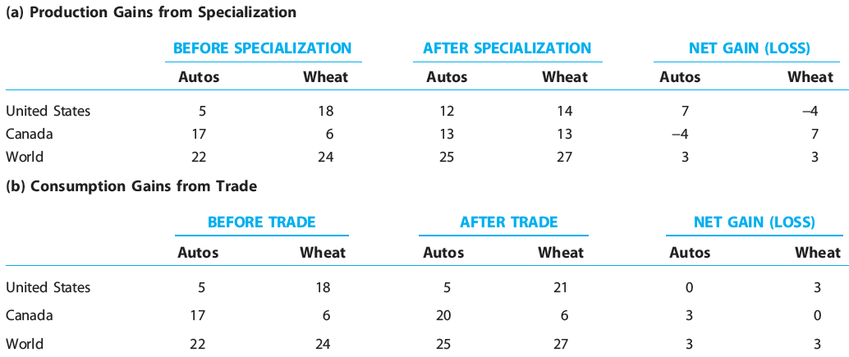
MODERN TRADE THEORIES
Gains from specialization and trade – increasing oppportunity costs

Slide 35
WORLD ECONOMY
Thank you for your Attention!

