Slide 1
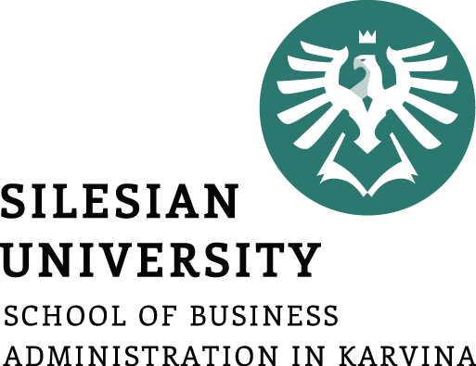
INTERNATIONAL MONETARY SYSTEM AND RELATIONS
Ingrid Majerova
World Economy
EVS/XXX
LESSON VII

Slide 2

Outline of the lecture
Evolution of the International Monetary System
Bretton Wood System
Flexible Exchange Rate Regime
Financial Crisis
International Monetary Relations (IMF, WB)

Slide 3
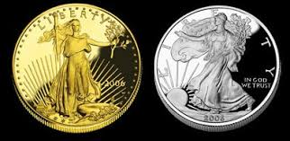
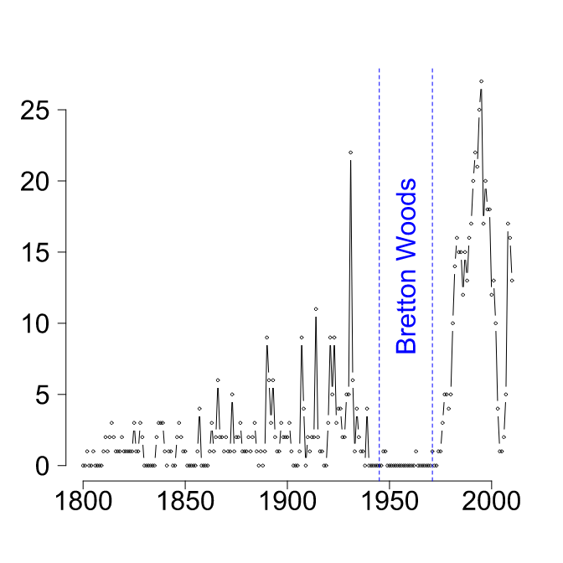

EVOLUTION OF THE INTERNATIONAL MONETARY SYSTEM
Bimetallism: Before 1875
Classical Gold Standard: 1875-1914
Interwar Period: 1915-1944
Bretton Woods System: 1945-1972
The Flexible Exchange Rate Regime: 1973-Present

Slide 4
EVOLUTION OF THE INTERNATIONAL MONETARY SYSTEM
Bimetallism: Before 1875
A “double standard” in the sense that both gold and silver were used as money.
Both gold and silver were used as international means of payment and the exchange rates among currencies were determined by either their gold or silver contents.
A major problem in the international use of bimetallism was that, with each nation independently setting its own rate of exchange between the two metals, the resulting rates often differed widely from country to country.
  during the period from 1792 to 1834 the United States maintained an exchange ratio between silver and gold of 15:1, while ratios in Europe ranged from 15.5:1 to 16.06:1. This made it profitable for owners of gold to sell their gold in the European market and take their silver to the United States mint. The effect was that gold was withdrawn from domestic American circulation; the “inferior” money had driven it out.

Slide 5
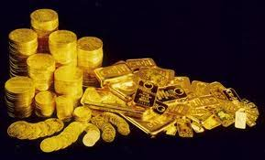
EVOLUTION OF THE INTERNATIONAL MONETARY SYSTEM
Classical Gold Standard: 1875-1914
During this period in most major countries:
  Gold alone was assured of unrestricted coinage
  There was two-way convertibility between gold and national currencies at a stable ratio.
  Gold could be freely exported or imported.
The exchange rate between two country’s currencies would be determined by their relative gold contents.

Slide 6
EVOLUTION OF THE INTERNATIONAL MONETARY SYSTEM
Classical Gold Standard: 1875-1914
Highly stable exchange rates under the classical gold standard provided an environment that was favorable to international trade and investment.
Misalignment of exchange rates and international imbalances of payment were automatically corrected by the price-specie-flow mechanism.
  Suppose Great Britain exported more to France than France imported from Great Britain.
  This cannot persist under a gold standard.
  Net export of goods from Great Britain to France will be accompanied by a net flow of gold from France to Great Britain.
  This flow of gold will lead to a lower price level in France and, at the same time, a higher price level in Britain.
  The resultant change in relative price levels will slow exports from Great Britain and encourage exports from France.

Slide 7

EVOLUTION OF THE INTERNATIONAL MONETARY SYSTEM
Classical Gold Standard: 1875-1914
There are shortcomings:
The supply of newly minted gold is so restricted that the growth of world trade and investment can be hampered for the lack of sufficient monetary reserves.
Even if the world returned to a gold standard, any national government could abandon the standard.

Slide 8

EVOLUTION OF THE INTERNATIONAL MONETARY SYSTEM
Interwar Period: 1915-1944
Exchange rates fluctuated as countries widely used “predatory” depreciations of their currencies as a means of gaining advantage in the world export market.
Attempts were made to restore the gold standard, but participants lacked the political will to “follow the rules of the game”.
The result for international trade and investment was profoundly detrimental.

Slide 9
EVOLUTION OF THE INTERNATIONAL MONETARY SYSTEM
Bretton Woods System: 1945-1972
Named for a 1944 meeting of 44 nations at Bretton Woods, New Hampshire.
The purpose was to design a postwar international monetary system.
The goal was exchange rate stability without the gold standard.
The result was the creation of the IMF and the World Bank.
Under the Bretton Woods system, the U.S. dollar was pegged to gold at $35 per ounce and other currencies were pegged to the U.S. dollar.
Each country was responsible for maintaining its exchange rate within ±1% of the adopted par value by buying or selling foreign reserves as necessary.
The Bretton Woods system was a dollar-based gold exchange standard.

Slide 10
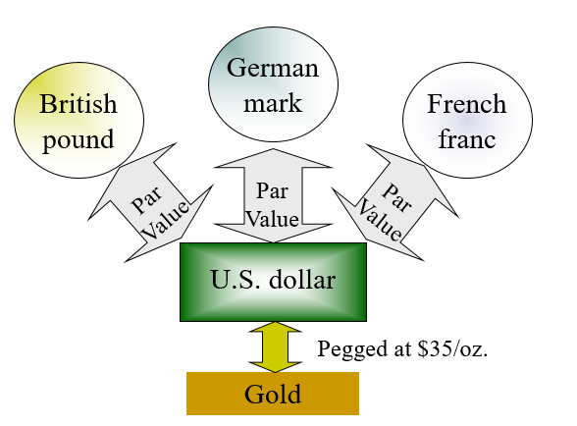
EVOLUTION OF THE INTERNATIONAL MONETARY SYSTEM
Bretton Woods System: 1945-1972

Slide 11
EVOLUTION OF THE INTERNATIONAL MONETARY SYSTEM
The Flexible Exchange Rate Regime: 1973-Present
Current Exchange Rate Arrangements
Free Float
  The largest number of countries, about 48, allow market forces to determine their currency’s value.
Managed Float
  About 25 countries combine government intervention with market forces to set exchange rates.
Pegged to another currency
  Such as the U.S. dollar or euro (through franc or mark).
No national currency
  Some countries do not bother printing their own currency. For example, Ecuador, Panama, and El Salvador have dollarized. Montenegro and San Marino use the euro.

Slide 12
FINANCIAL CRISIS
The Mexican Peso Crisis
On 20 December, 1994, the Mexican government announced a plan to devalue the peso against the dollar by 14 percent.
This decision changed currency trader’s expectations about the future value of the peso.
They stampeded for the exits.
In their rush to get out the peso fell by as much as 40 percent.
The Mexican Peso crisis is unique in that it represents the first serious international financial crisis touched off by cross-border flight of portfolio capital.

Slide 13
FINANCIAL CRISIS
The Mexican Peso Crisis
Two lessons emerge:
  It is essential to have a multinational safety net in place to safeguard the world financial system from such crises.
  An influx of foreign capital can lead to an overvaluation in the first place.
2004
TEN years ago Mexico suffered its “tequila crisis”. Its current-account deficit was a dangerous 7% of GDP and its foreign-exchange reserves dwindled: as a result, the peso's fixed exchange rate against the dollar snapped. The currency plunged by around 50% within six months.

Slide 14
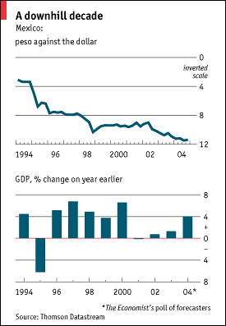
FINANCIAL CRISIS

Slide 15
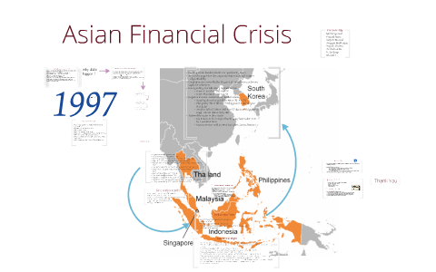
FINANCIAL CRISIS
The Asian Currency Crisis
1997-1998
The Asian currency crisis turned out to be far more serious than the Mexican peso crisis in terms of the extent of the contagion and the severity of the resultant economic and social costs.
Many firms with foreign currency bonds were forced into bankruptcy.
The region experienced a deep, widespread recession.

Slide 16
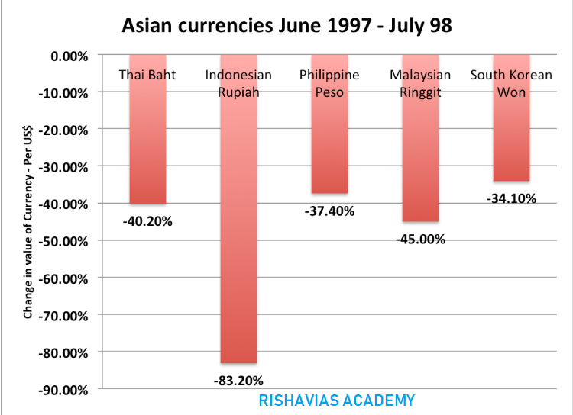
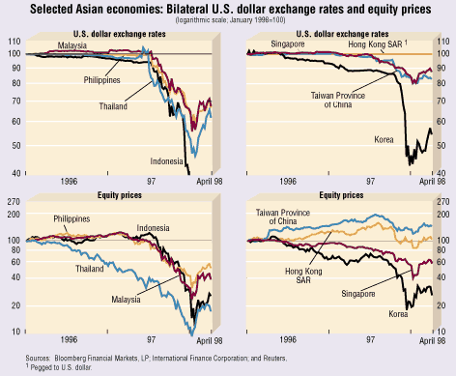
FINANCIAL CRISIS

Slide 17
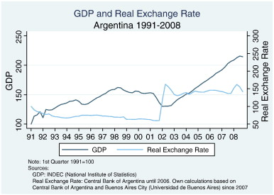
FINANCIAL CRISIS
The Argentinean Peso Crisis
In 1991 the Argentine government passed a convertibility law that linked the peso to the U.S. dollar at parity.
The initial economic effects were positive:
  Argentina’s chronic inflation was curtailed
  Foreign investment poured in
As the U.S. dollar appreciated on the world market
the Argentine peso became stronger as well.

Slide 18
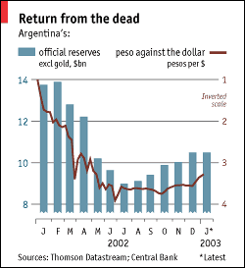
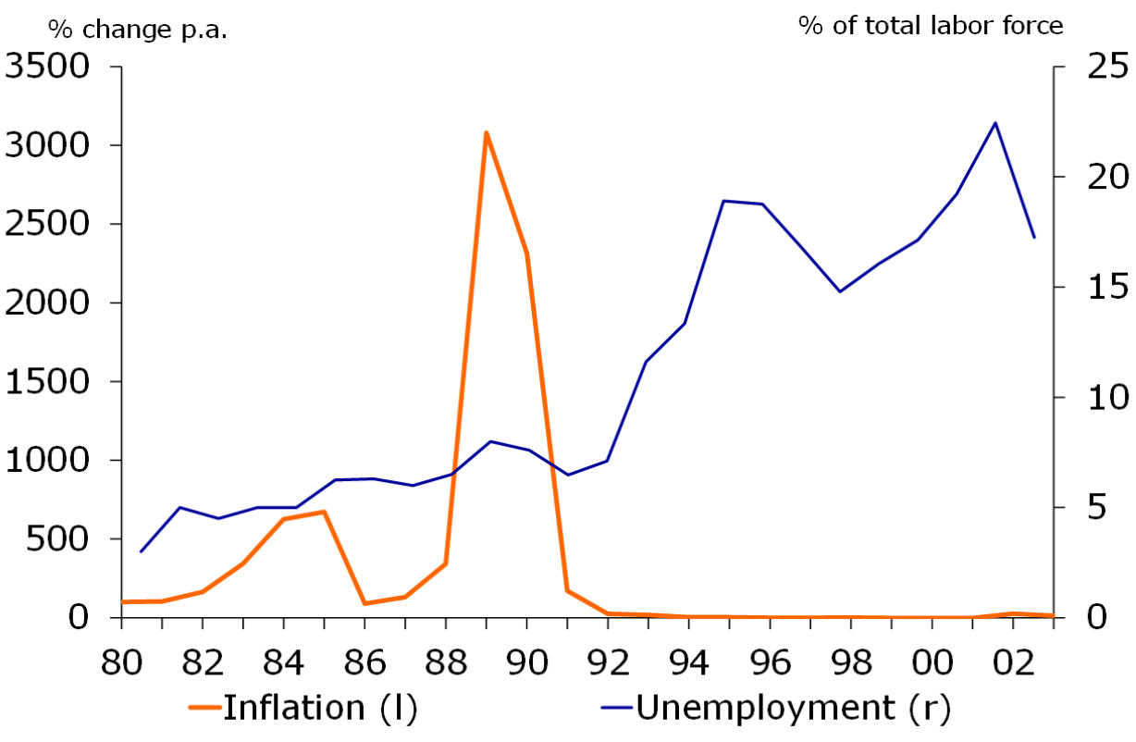
FINANCIAL CRISIS
The Argentinean Peso Crisis
The strong peso hurt exports from Argentina and caused a protracted economic downturn that led to the abandonment of peso–dollar parity in January 2002.
  The unemployment rate rose above 20 percent
  The inflation rate reached a monthly rate of 20 percent

Slide 19
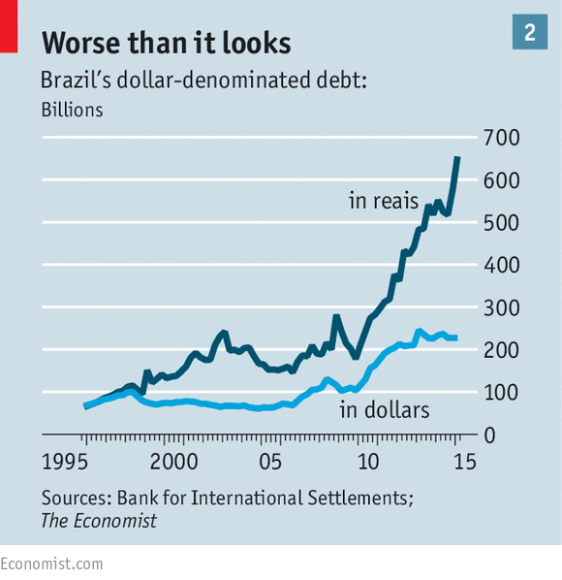
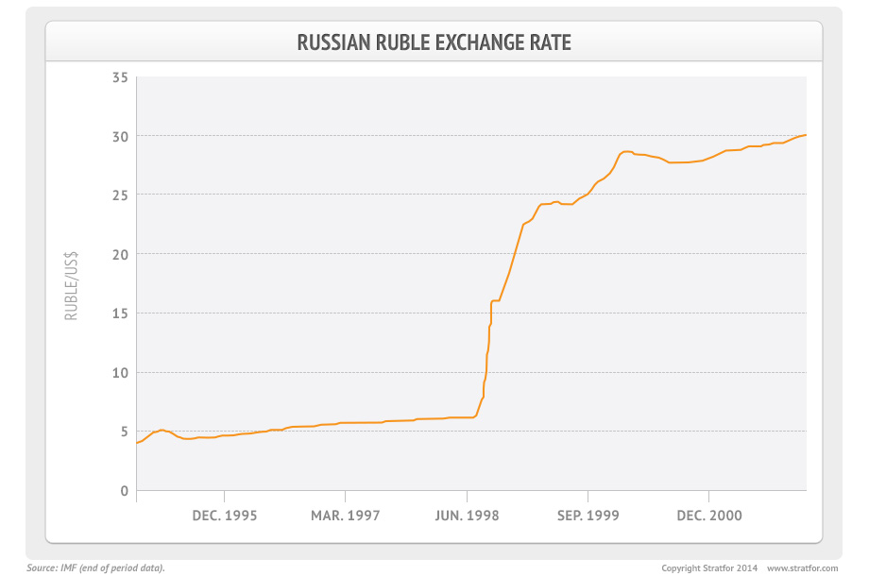
FINANCIAL CRISIS
The Argentinean Peso Crisis
There are at least three factors that are related to the collapse of the currency board arrangement and the ensuing economic crisis:
  Lack of fiscal discipline
  Labor market inflexibility
  Contagion from the financial crises in Brazil and Russia

Slide 20
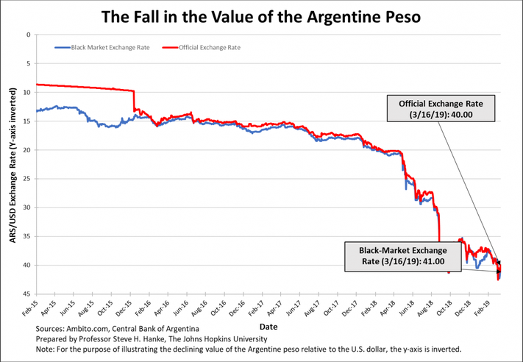
FINANCIAL CRISIS
The Argentinean Peso Crisis – to be continued?

Slide 21
INTERNATIONAL MONETARY RELATIONS
International Monetary Fund
The IMF was conceived in July 1944 at the United Nations Bretton Woods Conference in New Hampshire, United States.
The 44 countries in attendance sought to build a framework for international economic cooperation and avoid repeating the competitive currency devaluations that contributed to the Great Depression of the 1930s.
The IMF's primary mission is to ensure the stability of the international monetary system—the system of exchange rates and international payments that enables countries and their citizens to transact with each other.

Slide 22
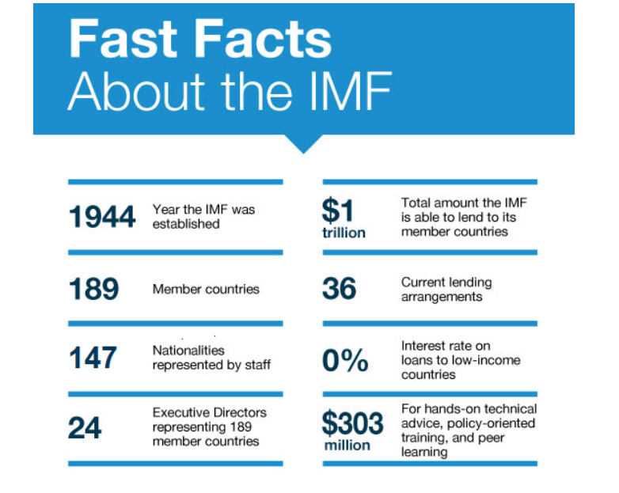
INTERNATIONAL MONETARY RELATIONS
International Monetary Fund

Slide 23
INTERNATIONAL MONETARY RELATIONS
International Monetary Fund
Surveillance - the IMF monitors member country policies as well as national, regional, and global economic and financial developments through a formal system.
Financial assistance - Providing loans to member countries that are experiencing actual or potential balance-of-payments problems is a core responsibility of the IMF.
Capacity development - The IMF provides technical assistance and training to help member countries build better economic institutions and strengthen related human capacities.

Slide 24
INTERNATIONAL MONETARY RELATIONS
International Monetary Fund
SDRs - The IMF issues an international reserve asset known as Special Drawing Rights, or SDRs, that can supplement the official reserves of member countries. Total global allocations are currently about SDR 204 billion (some $283 billion).
Resources - Member quotas are the primary source of IMF financial resources. A member’s quota broadly reflects its size and position in the world economy.
Governance and organization - at the top of its organizational structure is the Board of Governors, consisting of one governor and one alternate governor from each member country, usually the top officials from the central bank or finance ministry. The Board of Governors meets once a year at the IMF–World Bank Annual Meetings. Twenty-four of the governors serve on the International Monetary and Financial Committee, or IMFC, which advises the IMF's Executive Board on the supervision and management of the international monetary and financial system.

Slide 25
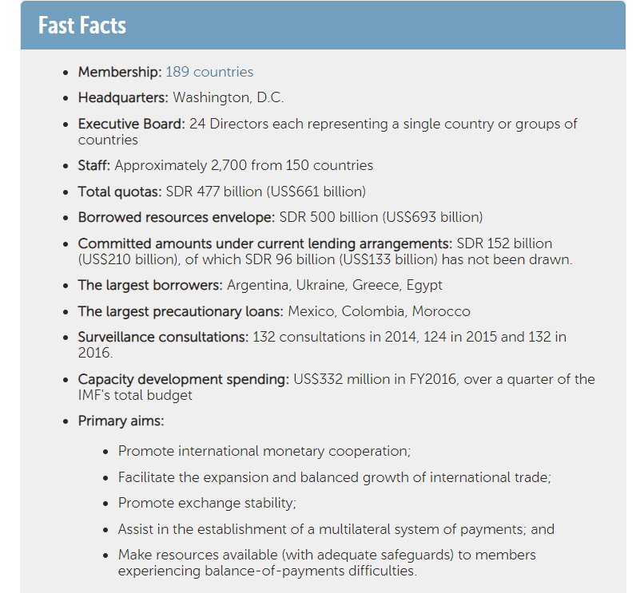
INTERNATIONAL MONETARY RELATIONS
International Monetary Fund

Slide 26
INTERNATIONAL MONETARY RELATIONS
World Bank
The World Bank is like a cooperative, made up of 189 member countries. These member countries, or shareholders, are represented by a Board of Governors, who are the ultimate policymakers at the World Bank. Generally, the governors are member countries' ministers of finance or ministers of development. They meet once a year at the Annual Meetings of the Boards of Governors of the World Bank Group and the International Monetary Fund.
The governors delegate specific duties to 25 Executive Directors, who work on-site at the Bank. The five largest shareholders appoint an executive director, while other member countries are represented by elected executive directors.

Slide 27
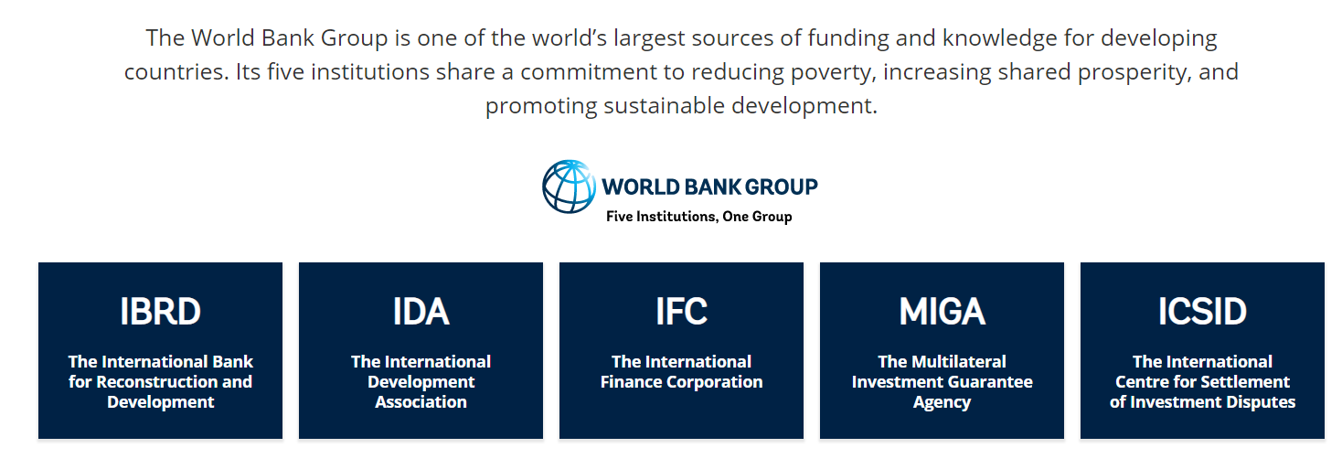
INTERNATIONAL MONETARY RELATIONS
World Bank

Slide 28
INTERNATIONAL MONETARY RELATIONS
World Bank - IBRD
The International Bank for Reconstruction and Development (IBRD) is a global development cooperative owned by 189 member countries. As the largest development bank in the world, it supports the World Bank Group’s mission by providing loans, guarantees, risk management products, and advisory services to middle-income and creditworthy low-income countries, as well as by coordinating responses to regional and global challenges.
International Development Association (IDA) helps countries create strong institutions that facilitate private sector growth, reduce poverty, deliver valuable services and earn the confidence of their citizens.

Slide 29
INTERNATIONAL MONETARY RELATIONS
World Bank - IBRD
The International Finance Corporation (IFC) is the largest global development institution focused on the private sector in developing countries. The Bank Group has set two goals for the world to achieve by 2030: end extreme poverty and promote shared prosperity in every country.
The Multilateral Investment Guarantee Agency (MIGA) - its goal is to promote foreign direct investment into developing countries to support economic growth and more.
The International Centre for Settlement of Investment Disputes (ISCID) was established in 1966 and is the world’s leading institution devoted to international investment dispute settlement. It has extensive experience in this field, having administered the majority of all international investment cases.

Slide 30
WORLD ECONOMY
Thank you for your Attention!

